Slide 1
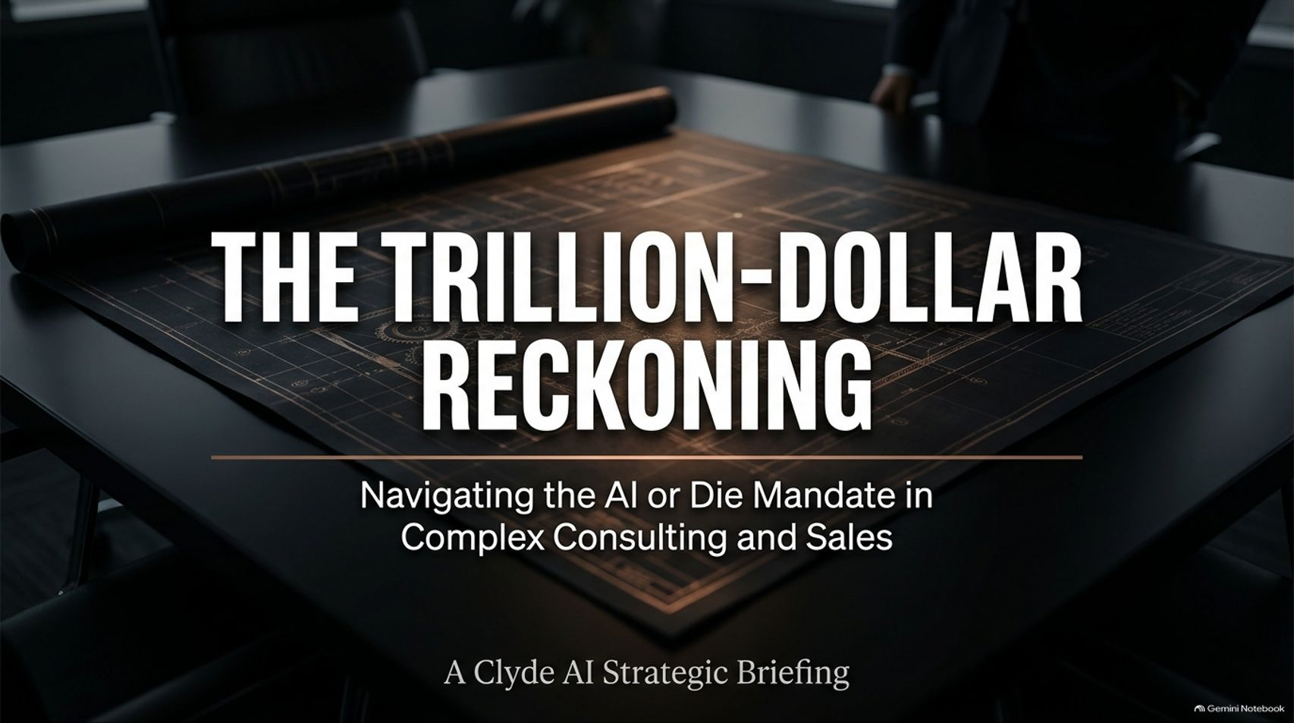
Notes:
Visual Theme: A moody executive boardroom table featuring a detailed architectural blueprint under warm overhead lighting.
Subtitle: Navigating the AI or Die Mandate in Complex Consulting and Sales.
Speaker Notes:
Introduction (Minute 1): Welcome, everyone. Today we are addressing the trillion-dollar reckoning facing complex consulting and enterprise sales. Across professional services, executive leadership teams have issued a blunt, non-negotiable directive: adapt to AI or become obsolete.
The High-Stakes Environment (Minute 2–3): As Timothy Lidman, CEO of Clyde AI, discussed on The AI for Sales Podcast, traditional professional services and enterprise bidding processes are buckling under the weight of astronomical customer acquisition costs. Firms are spending tens of millions of dollars just to win contracts, leaving razor-thin margins.
Setting the Stage (Minute 4–5): Today, we will explore why cobbled-together tech stacks are failing to hit their 10x targets, how modern trust gaps are destroying client relationships, and how platforms like Clyde AI are pioneering a human-centric collaborative workspace that bridges the gap between raw AI speed and authentic human judgment.
AI Or Die: Inside Consulting's Trillion-Dollar Reckoning | Timothy Lidman
https://www.youtube.com/watch?v=IJyAcpMxzN4

Slide 2
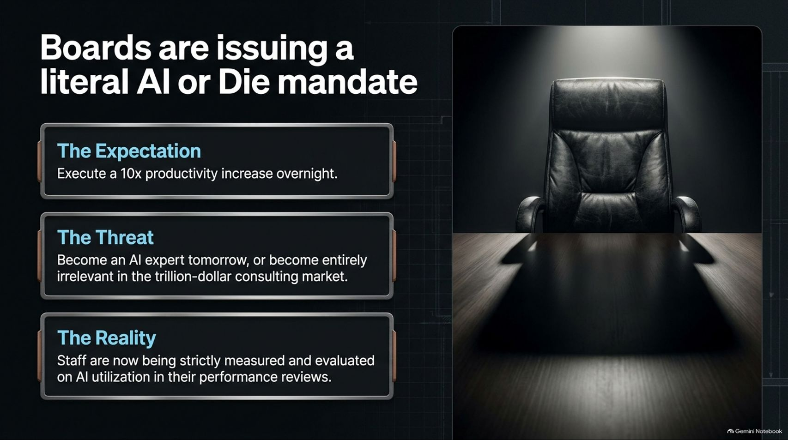
Notes:
Visual Theme: A dramatic, high-contrast leather executive chair casting a long shadow across a polished dark wood conference table.
Key Bullet Points:
The Expectation: Execute a 10x productivity increase overnight.
The Threat: Become an AI expert tomorrow, or become entirely irrelevant in the trillion-dollar consulting market.
The Reality: Staff are now being strictly measured and evaluated on AI utilization in their performance reviews.
Speaker Notes:
The Top-Down Pressure (Minutes 1–2): The mandate from corporate boards is unequivocal. As Timothy Lidman noted during his interview, leadership teams have told their consultants: "AI or die—if you don't become an expert on AI tomorrow, you're irrelevant."
Performance Reviews and Metrics (Minutes 3–4): This isn't just loose corporate chatter. Major firms are actively incorporating AI utilization metrics directly into staff performance reviews.
The Catch (Minutes 5–6): While the expectation is a 10x leap in productivity overnight, organizations have largely failed to provide the right specialized tooling, leaving employees scrambling to figure it out on their own.

Slide 3
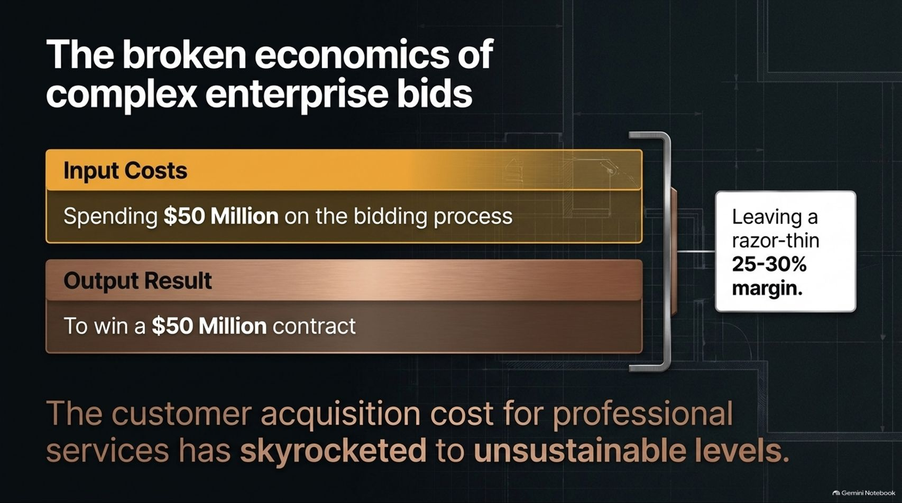
Notes:
Visual Theme: A data contrast graphic comparing massive input bidding costs against final contract values and razor-thin profit margins.
Subtitle: The customer acquisition cost for professional services has skyrocketed to unsustainable levels.
Speaker Notes:
Unsustainable Input Costs (Minutes 1–2): Look at the underlying economics of high-end enterprise sales. Firms routinely spend $50 million on the bidding and proposal process just to win a $50 million contract.
Margin Compression (Minutes 3–4): When your customer acquisition cost matches your gross contract value, your business model is broken. Leaving a razor-thin 25% to 30% margin after months of exhaustive labor leaves zero room for error.
The Need for Systemic Efficiency (Minutes 5–6): Traditional bidding models are structurally heavy. To survive, firms must dramatically compress the cost and time required to capture complex enterprise business.

Slide 4
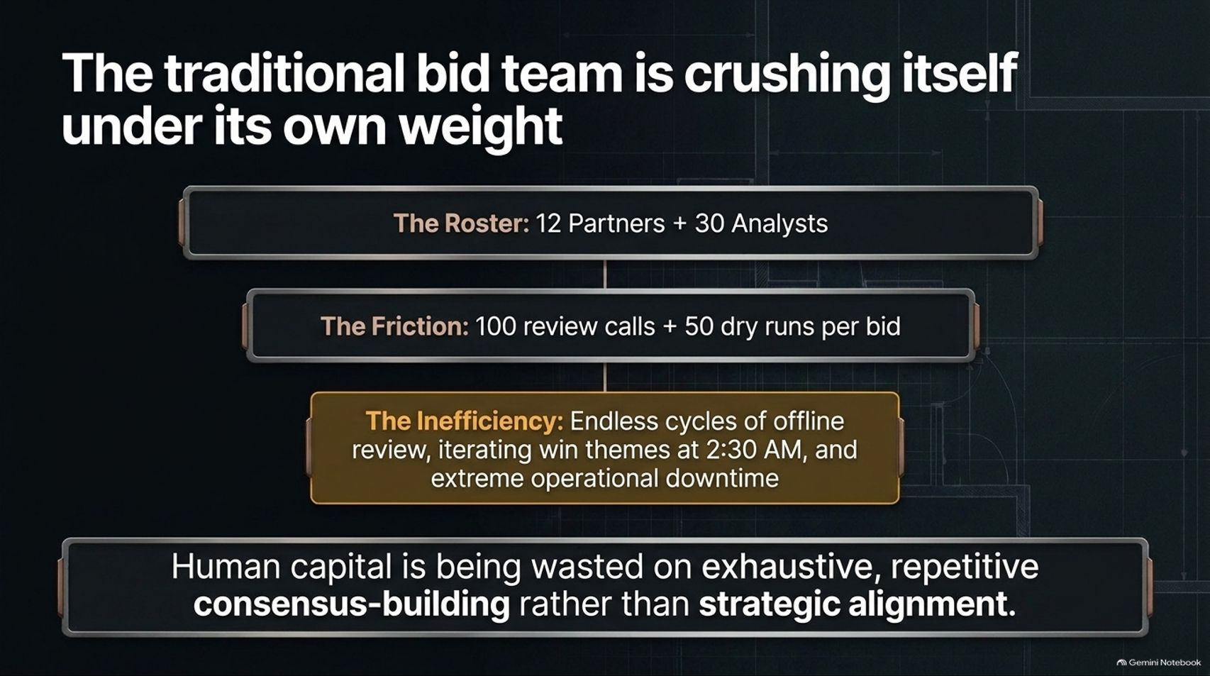
Notes:
Visual Theme: A descending hierarchy diagram mapping bloated rosters, review friction, and operational downtime.
Key Bullet Points:
The Roster: 12 Partners + 30 Analysts.
The Friction: 100 review calls + 50 dry runs per bid.
The Inefficiency: Endless cycles of offline review, iterating win themes at 2:30 AM, and extreme operational downtime.
Speaker Notes:
The Bloated Roster (Minutes 1–2): Why do bids cost so much? Look at a typical enterprise proposal team: 12 partners and 30 analysts locked in an endless marathon of meetings.
The Friction of Consensus (Minutes 3–4): Lidman highlights the brutal reality of traditional bids: 100 review calls, 50 dry runs per bid, and exhausted analysts iterating on win themes at 2:30 in the morning.
Wasted Human Capital (Minutes 5–6): Highly paid human capital is being squandered on repetitive, exhaustive consensus-building and formatting busywork rather than true strategic alignment.

Slide 5
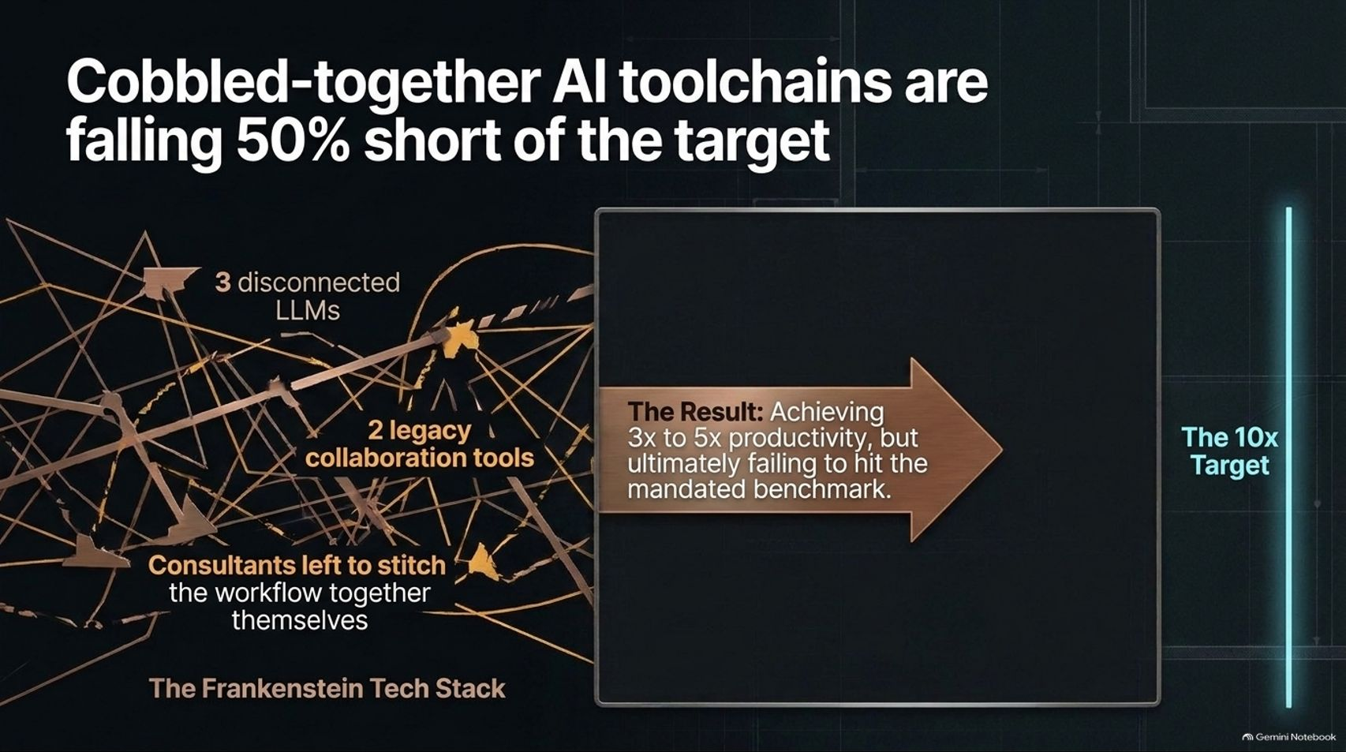
Notes:
Visual Theme: A chaotic spiderweb of fragmented tech icons contrasting against a bronze productivity arrow.
Callout Box: The Frankenstein Tech Stack: 3 disconnected LLMs, 2 legacy collaboration tools, consultants left to stitch the workflow together themselves.
Speaker Notes:
The Frankenstein Trap (Minutes 1–2): In their desperation to meet the 10x mandate, consultants are cobbling together makeshift toolchains—stitching together three disconnected LLMs and two legacy collaboration tools.
Falling Short (Minutes 3–4): While this DIY approach helps consultants achieve a 3x to 5x productivity bump, it ultimately falls 50% short of the board's 10x target.
The Integration Gap (Minutes 5–6): Forcing humans to manually bridge the gaps between disparate AI chat interfaces and static document repositories creates cognitive fatigue rather than true workflow liberation.

Slide 6
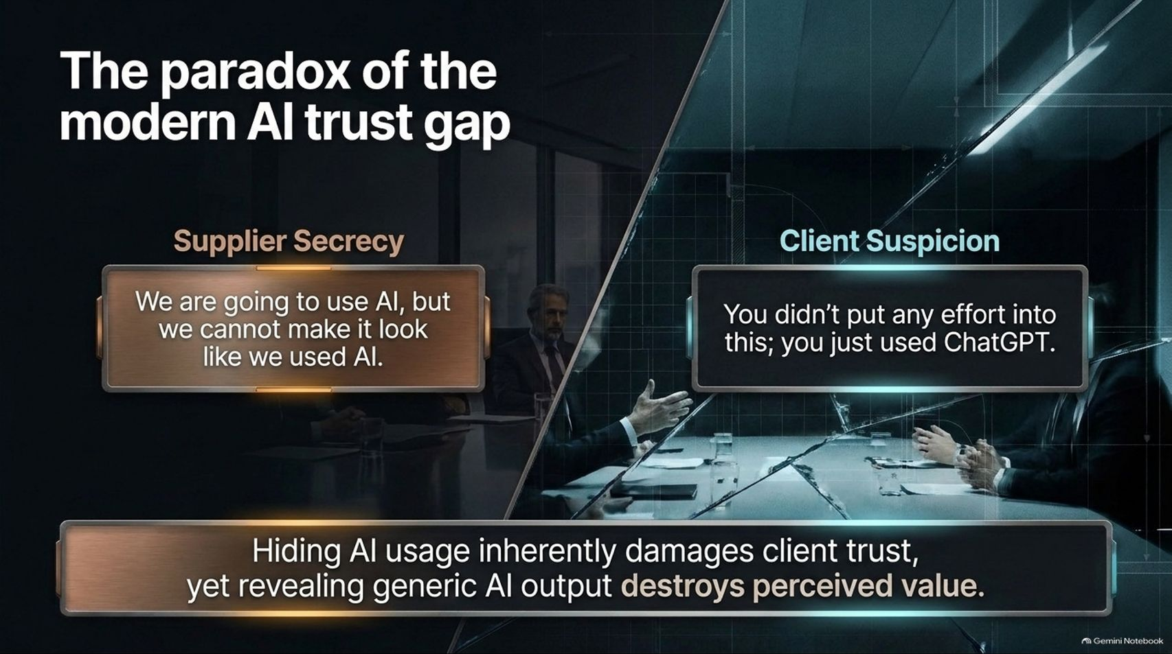
Notes:
Visual Theme: A split glass panel contrasting corporate supplier secrecy against suspicious client reactions.
Callout Box: Hiding AI usage inherently damages client trust, yet revealing generic AI output destroys perceived value.
Speaker Notes:
The Supplier Dilemma (Minutes 1–2): There is a profound psychological paradox in modern B2B sales. Suppliers adopt a stance of secrecy: "We are going to use AI, but we cannot make it look like we used AI."
Client Suspicion (Minutes 3–4): Conversely, clients are hyper-suspicious. If a proposal looks too generic, the client immediately assumes: "You didn't put any effort into this; you just used ChatGPT."
The Trust Deficit (Minutes 5–6): Hiding AI usage destroys trust when discovered, but vomiting raw, unrefined AI text destroys perceived value. To win in this environment, firms need a completely new mechanism for transparency and collaboration.

Slide 7
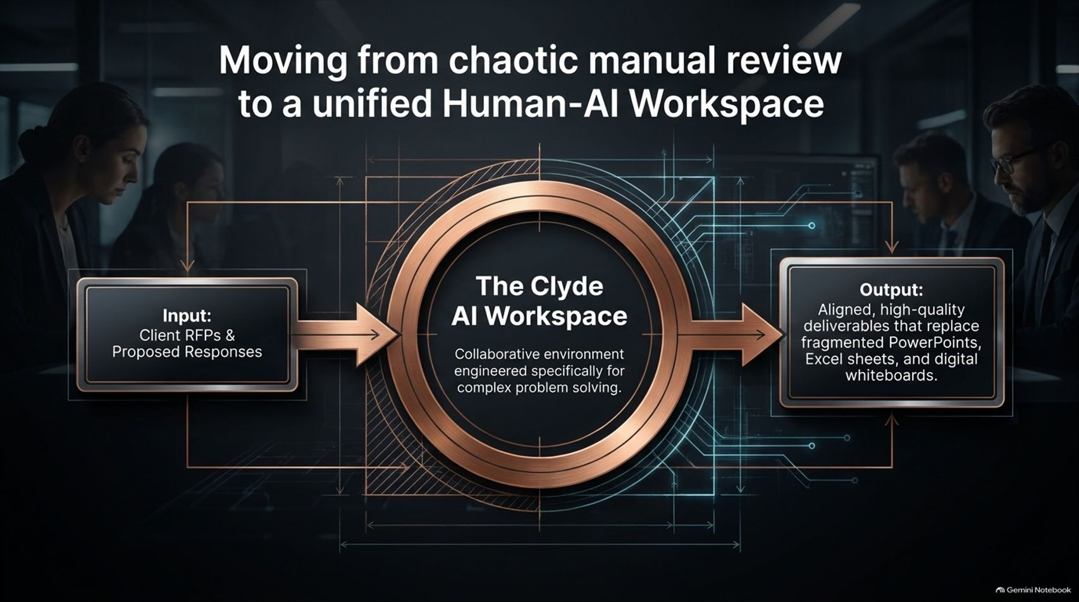
Notes:
Visual Theme: A glowing, precision-engineered golden-bronze concentric gear hub ("The Clyde AI Workspace") bridging client RFPs to polished enterprise outputs.
Speaker Notes:
The Unified Hub (Minutes 1–2): Enter the Clyde AI Workspace. Moving away from fragmented PowerPoints, isolated spreadsheets, and digital whiteboards, Clyde provides a single, unified environment engineered specifically for complex problem-solving.
Streamlined Inputs (Minutes 3–4): The platform ingests complex client RFPs and proposed responses seamlessly.
High-Quality Outputs (Minutes 5–6): Instead of chaotic manual review loops, the workspace produces aligned, high-grade strategic deliverables that satisfy both internal leadership and external clients.

Slide 8
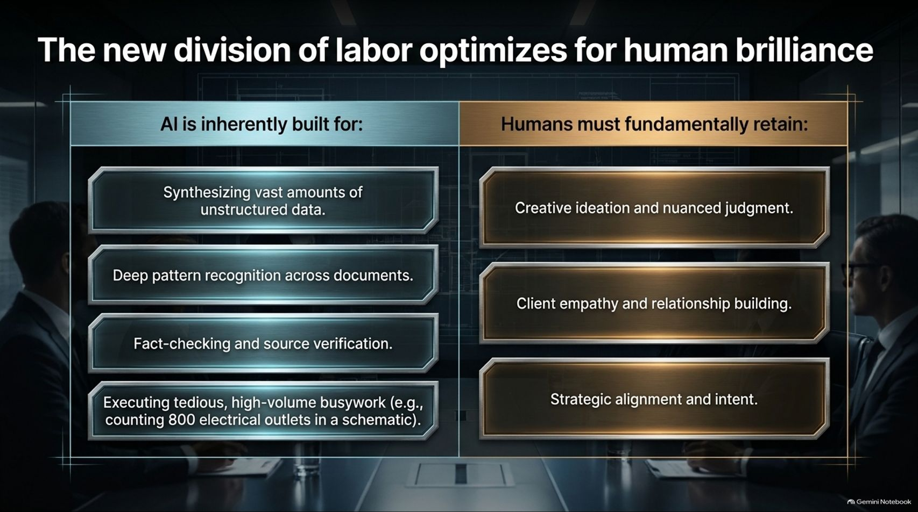
Notes:
Visual Theme: A structured comparison matrix dividing automated machine capabilities from core human strengths.
Speaker Notes:
AI Strengths (Minutes 1–2): What should AI handle? AI is inherently built for synthesizing vast amounts of unstructured data, performing deep pattern recognition across thousands of pages, fact-checking sources, and executing tedious busywork—such as counting 800 electrical outlets in a complex engineering schematic.
Human Strengths (Minutes 3–4): What must humans retain? Creative ideation, nuanced professional judgment, client empathy, relationship building, and high-level strategic intent.
Amplification, Not Replacement (Minutes 5–6): The goal is not to remove the human, but to liberate humans from administrative drudgery so they can focus entirely on where human brilliance matters most.

Slide 9
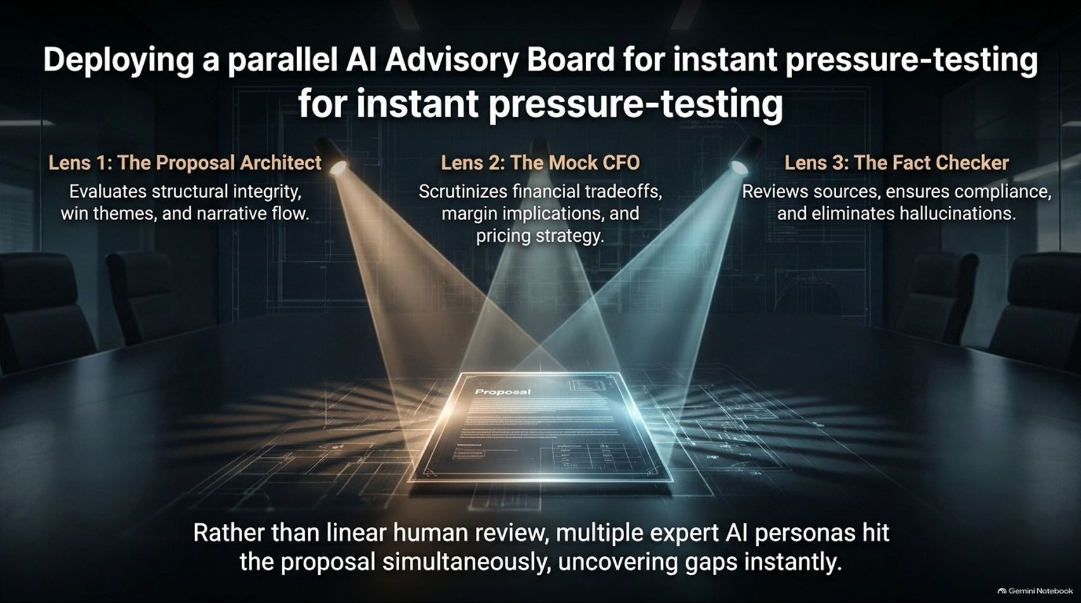
Notes:
Visual Theme: A dark intelligence briefing room illuminated by overhead spotlights focusing on a glowing digital dossier, surrounded by three distinct AI lenses.
Lenses: Proposal Architect | Mock CFO | Fact Checker.
Speaker Notes:
Beyond Linear Review (Minutes 1–2): Traditional proposal reviews happen sequentially and slowly. Clyde deploys a parallel AI Advisory Board featuring specialized expert personas that hit the proposal simultaneously.
The Three Advisory Lenses (Minutes 3–4):
The Proposal Architect: Evaluates structural integrity, win themes, and narrative flow.
The Mock CFO: Scrutinizes financial tradeoffs, margin implications, and pricing strategy.
The Fact Checker: Reviews underlying sources, ensures compliance, and eliminates hallucinations.
Instant Gap Analysis (Minutes 5–6): Multiple expert AI personas stress-test the document at once, uncovering blind spots in minutes rather than weeks.

Slide 10
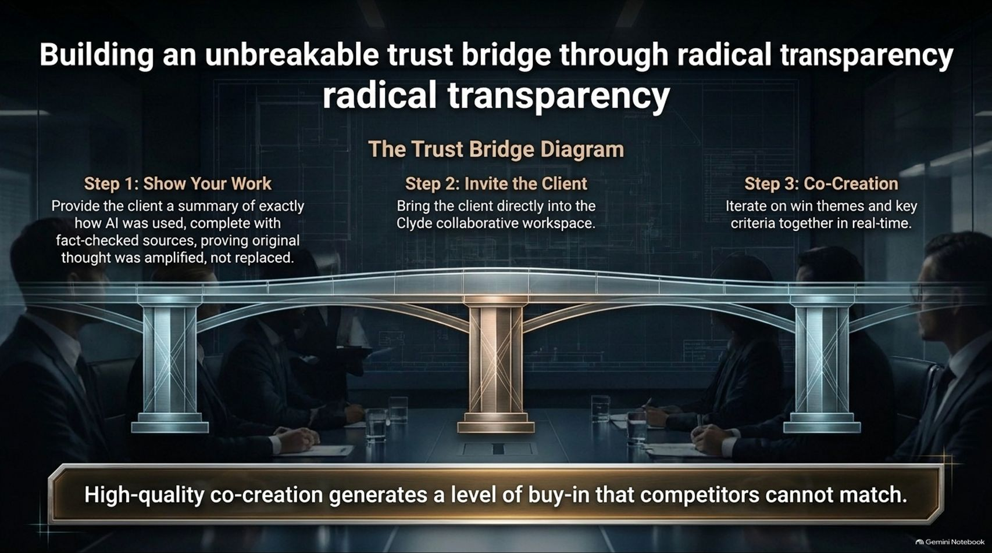
Notes:
Visual Theme: A sturdy architectural suspension bridge connecting corporate suppliers and clients over a deep chasm, supported by pillars representing co-creation steps.
Steps: 1. Show Your Work | 2. Invite the Client | 3. Co-Creation.
Speaker Notes:
Step 1: Show Your Work (Minutes 1–2): Provide the client with a summary detailing exactly how AI was utilized, complete with fact-checked sources, proving that original human thought was amplified, not replaced.
Step 2: Invite the Client (Minutes 3–4): Bring the client directly into the secure Clyde collaborative workspace.
Step 3: Co-Creation (Minutes 5–6): Iterate on win themes and key criteria together in real-time. As Lidman emphasized, high-quality co-creation generates a level of client buy-in and trust that traditional competitors simply cannot match.

Slide 11
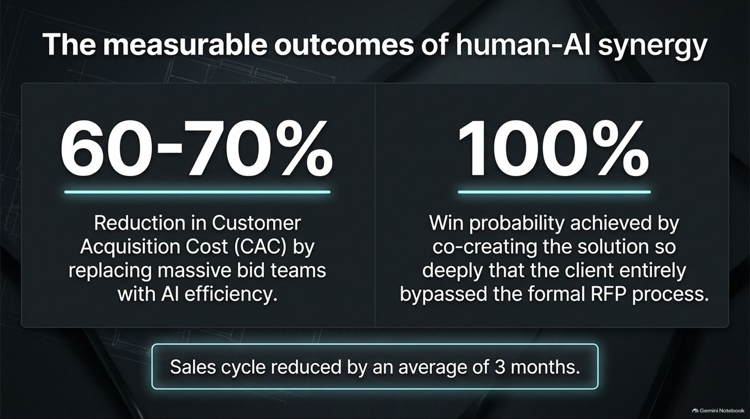
Notes:
Visual Theme: Two massive metric data callout cards set against a dark brushed metallic backdrop.
Key Metrics: 60-70% CAC Reduction | 100% Win Probability (RFP Bypassed).
Speaker Notes:
Crushing Acquisition Costs (Minutes 1–2): By replacing massive, bloated bid teams and endless review cycles with streamlined AI efficiency, early enterprise users are seeing a 60% to 70% reduction in Customer Acquisition Cost (CAC).
Bypassing the RFP (Minutes 3–4): Lidman shared a remarkable success story where deep co-creation with a client during scoping so thoroughly refined the solution that the formal RFP became entirely irrelevant—allowing the client to bypass the RFP process and award the business directly.
Velocity (Minutes 5–6): Overall sales cycles are reduced by an average of 3 months.

Slide 12
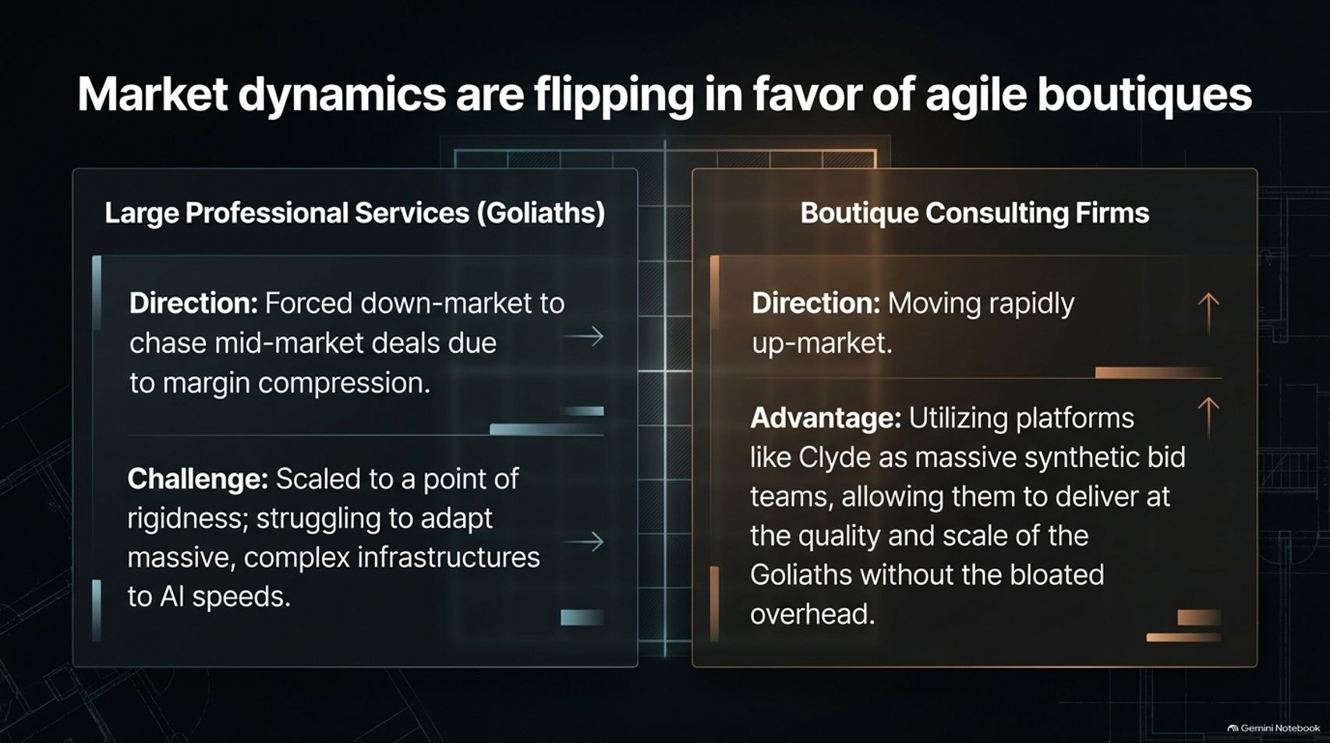
Notes:
Visual Theme: A comparative matrix contrasting the rigid downward movement of enterprise Goliaths against the upward market ascent of boutique consulting firms.
Speaker Notes:
The Dilemma of the Goliaths (Minutes 1–2): Large professional services "Goliaths" are facing severe margin compression, forcing them down-market to chase mid-tier deals. However, their massive scale makes them too rigid to adapt quickly to AI speeds.
The Rise of the Boutique (Minutes 3–4): Conversely, nimble boutique consulting firms are moving rapidly up-market.
Synthetic Scale (Minutes 5–6): By utilizing platforms like Clyde as a massive "synthetic bid team," boutique firms can deliver at the quality and scale of the Goliaths without carrying bloated overhead.

Slide 13
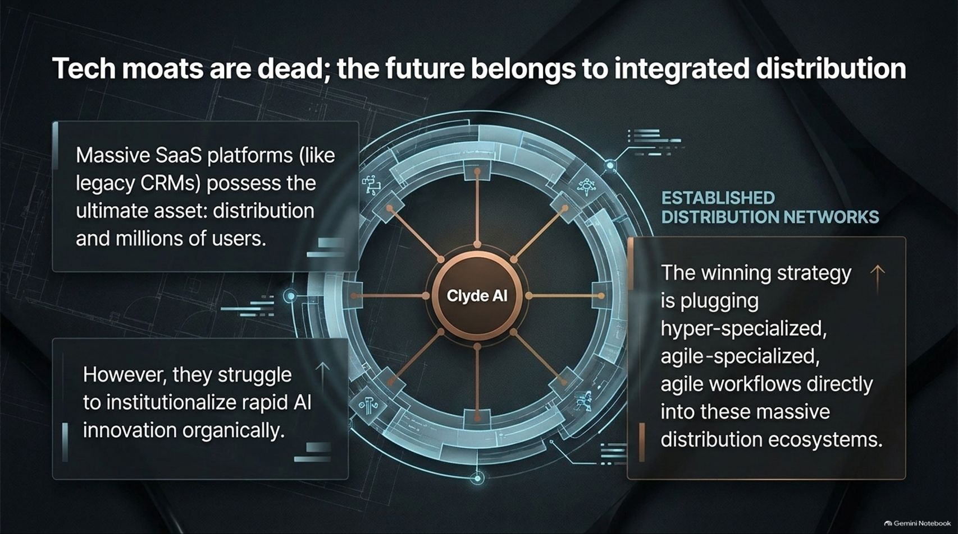
Notes:
Visual Theme: A complex circular network diagram centering on Clyde AI interacting with massive external SaaS distribution rings.
Speaker Notes:
The Limits of Pure Tech Moats (Minutes 1–2): In the modern AI landscape, proprietary software moats erode quickly. Massive SaaS platforms—such as legacy CRMs—hold the ultimate strategic asset: established distribution networks and millions of active users.
The Innovation Challenge (Minutes 3–4): While these giant SaaS platforms possess unmatched distribution, they often struggle to institutionalize rapid AI innovation organically inside their core legacy codebases.
The Winning Playbook (Minutes 5–6): The ultimate winning strategy is plugging hyper-specialized, agile AI workflows directly into these massive distribution ecosystems.

Slide 14
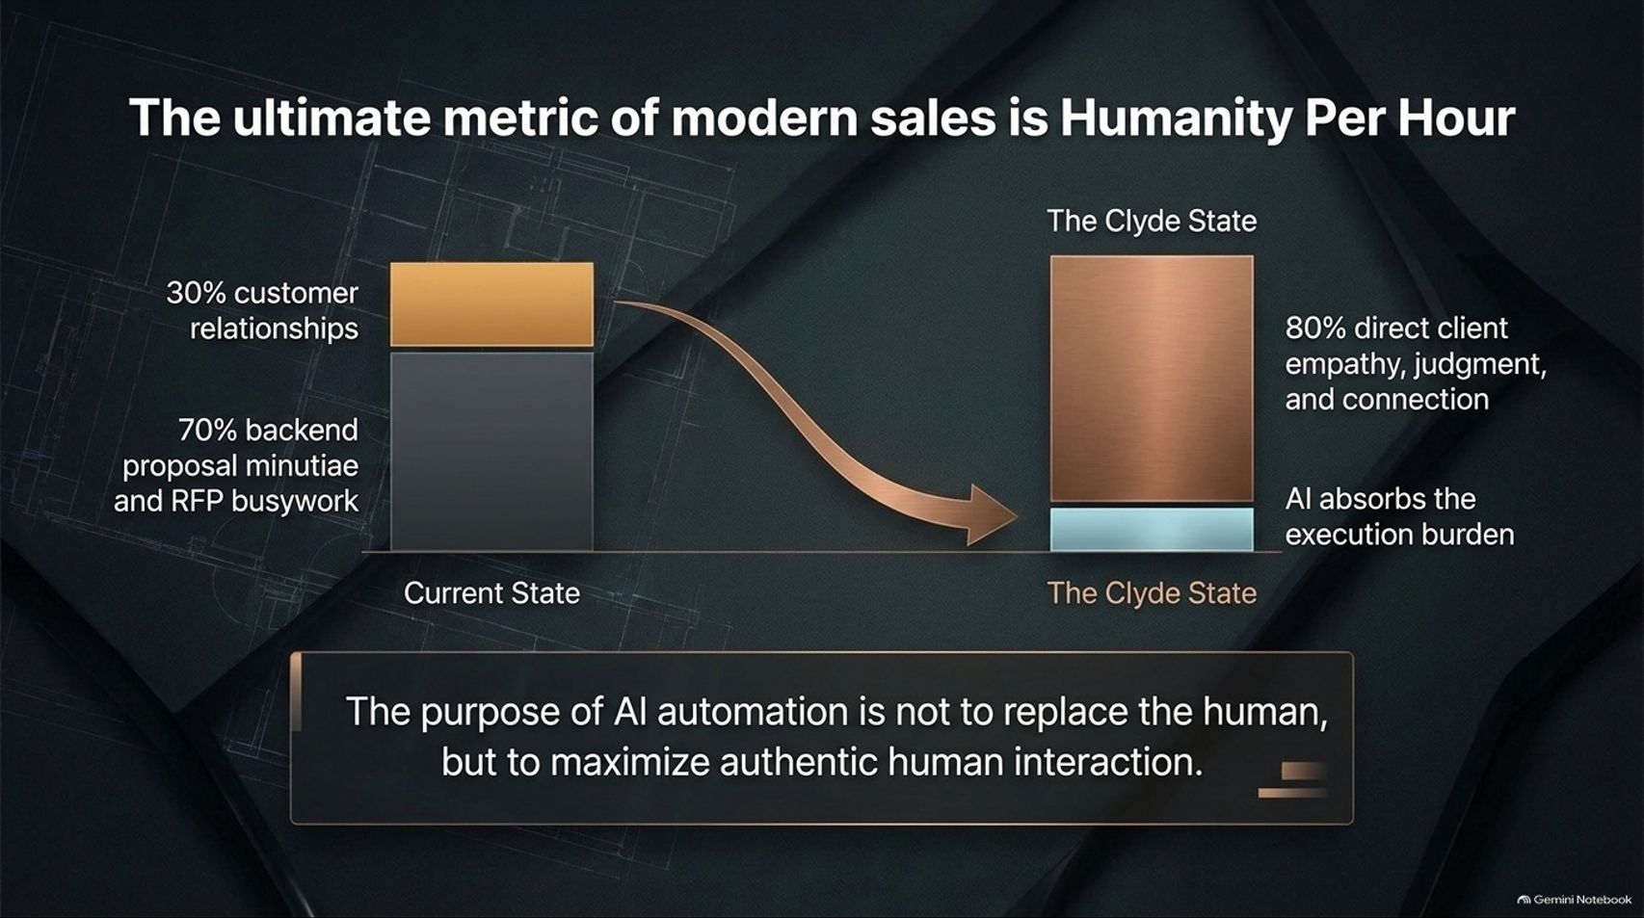
Notes:
Visual Theme: A comparative bar chart contrasting current state inefficiencies against the optimized "Clyde State."
Speaker Notes:
The Current State Imbalance (Minutes 1–2): In typical sales and consulting organizations, reps spend upwards of 70% of their time trapped in backend proposal minutiae and RFP busywork, leaving a paltry 30% for actual customer relationships.
The Clyde State (Minutes 3–4): We must invert this entirely. By allowing AI to absorb 80% of the execution and drafting burden, human professionals can dedicate 80% of their time to direct client empathy, strategic judgment, and authentic connection.
Core Philosophy (Minutes 5–6): As Timothy Lidman notes, the true purpose of AI automation is not to replace the human, but to maximize authentic human interaction.

Slide 15
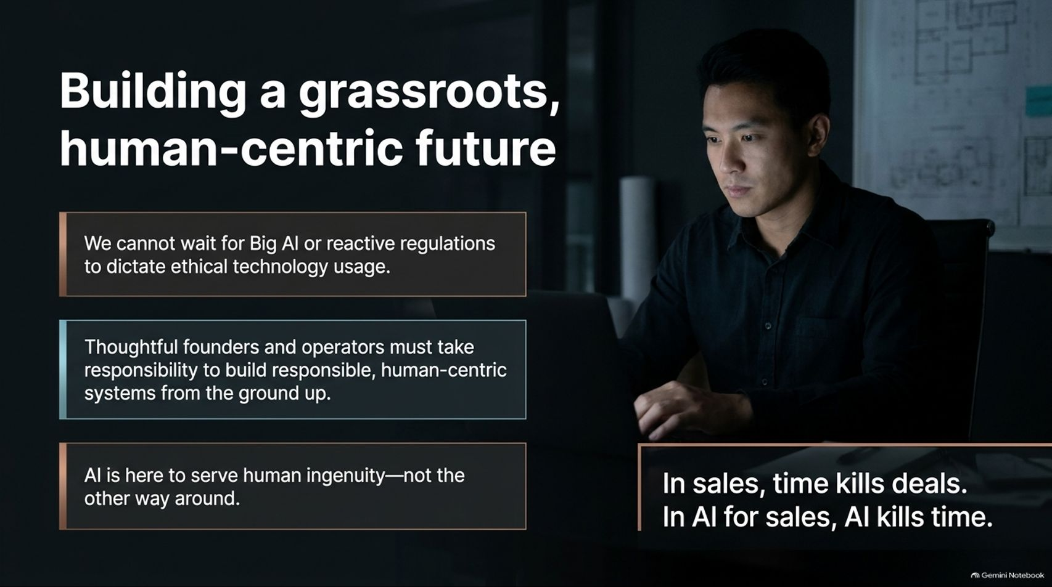

Slide 16
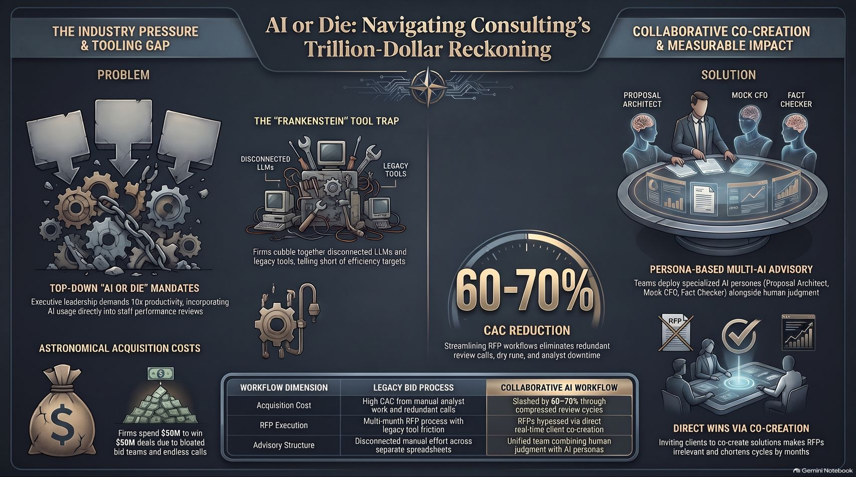
Notes:
Visual Theme: An executive master synthesis dashboard integrating industry pressures, the Frankenstein tool trap, persona-based AI advisory boards, and measurable impact metrics.
Speaker Notes:
Synthesizing the Journey (Minutes 1–2): Let's review the core pillars of our strategic blueprint:
The Problem: Top-down "AI or die" mandates demand 10x efficiency, but cobbled-together tools leave firms trapped with high acquisition costs and broken workflows.
The Solution: Deploying persona-based multi-AI advisory teams (Proposal Architect, Mock CFO, Fact Checker) inside a unified human-AI workspace.
The Payoff (Minutes 3–4): By shifting from isolated document drafting to radical transparency and client co-creation, firms slash customer acquisition costs by 60% to 70%, compress sales cycles by months, and secure unbreakable client trust.
Conclusion (Minutes 5–6): The future belongs not to the biggest, most rigid Goliaths, but to agile teams that leverage AI to elevate human relationships. Thank you.

