Slide 1
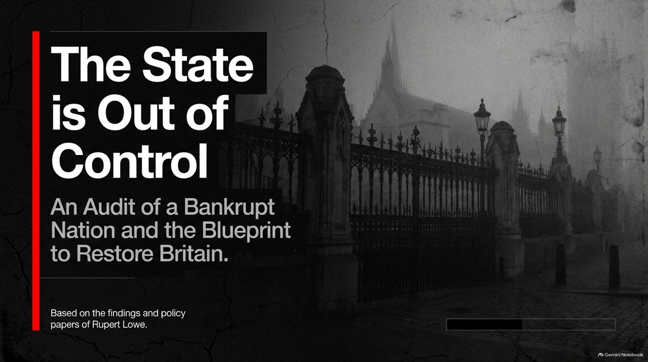
Notes:
The State is Out of Control and Bankrupting Britain | Rupert Lowe
https://www.youtube.com/watch?v=C0kGaA4Brrk

Slide 2
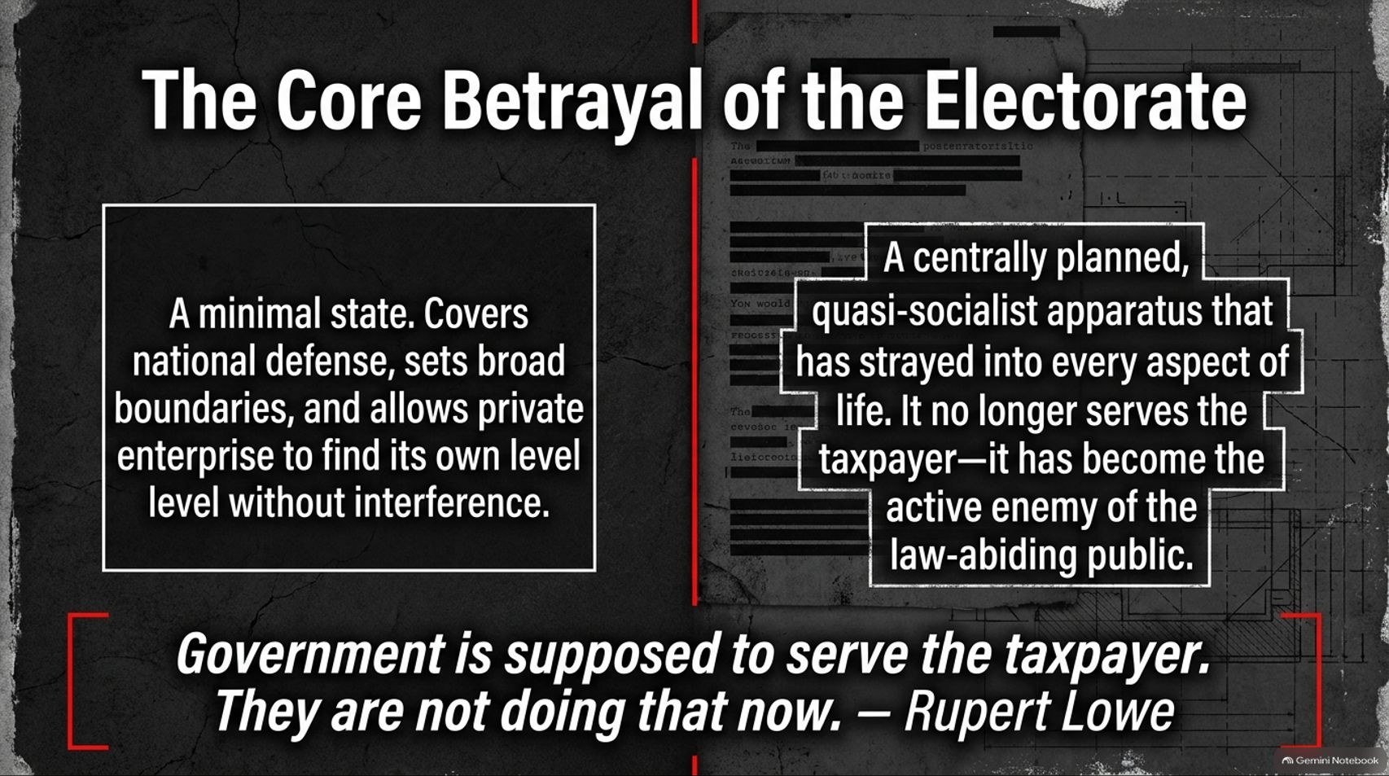

Slide 3
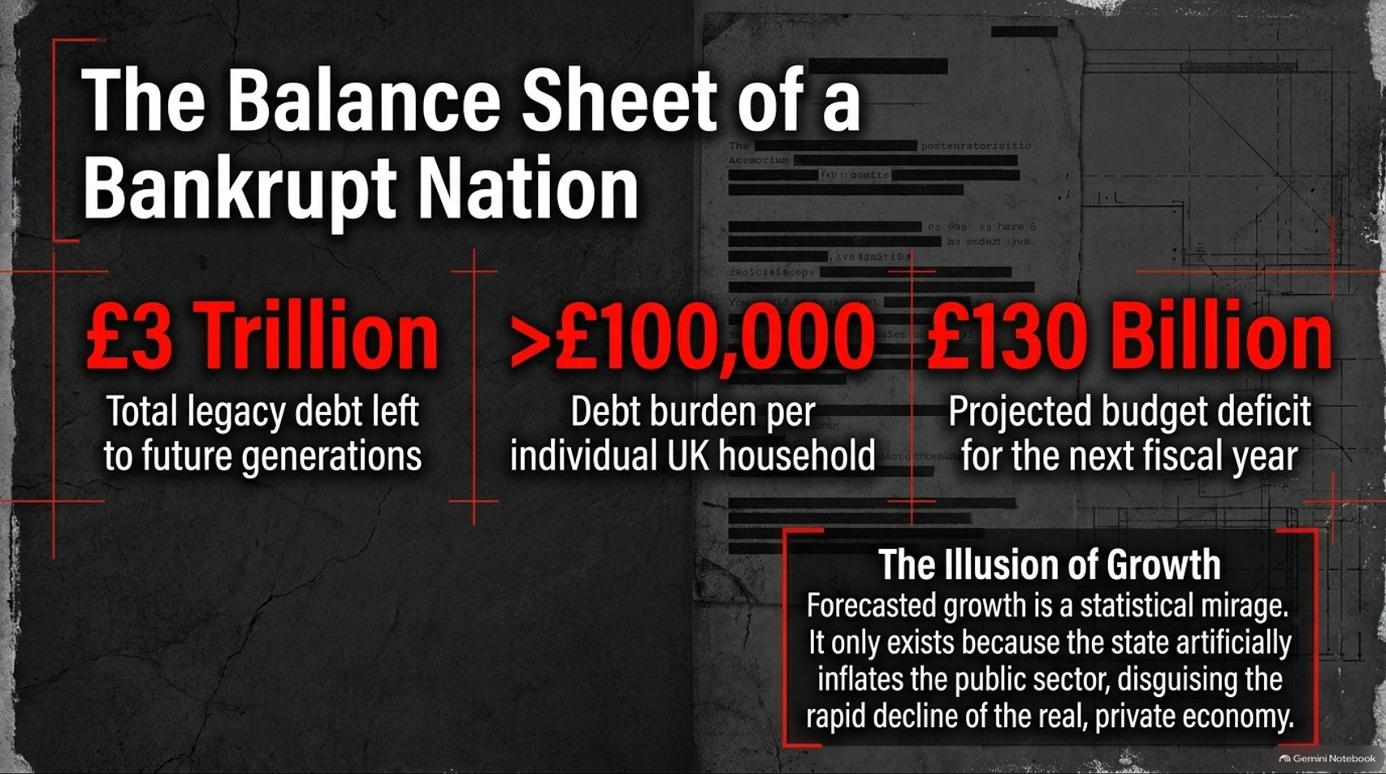
Notes:
Visual Theme: Heavy red data callouts displaying national debt, household burden, and projected deficits against a backdrop of heavily redacted official documents.
Key Metrics: £3 Trillion legacy debt | >£100,000 debt burden per household | £130 Billion projected budget deficit.
Speaker Notes:
Weighing the Legacy Debt (Minutes 1–2): Let's look at the cold, hard numbers. Britain carries over £3 trillion in legacy debt passed down to future generations. That translates to a staggering debt burden exceeding £100,000 for every single individual UK household.
The Deficit Spiral (Minutes 3–4): With a projected budget deficit of £130 billion for the upcoming fiscal year, the math is no longer sustainable.
The Illusion of Growth (Minutes 5–6): Official reports often boast about economic growth, but it is a statistical mirage. That growth exists purely because the state is artificially inflating the public sector, masking the rapid, dangerous decline of the real, productive private economy.

Slide 4
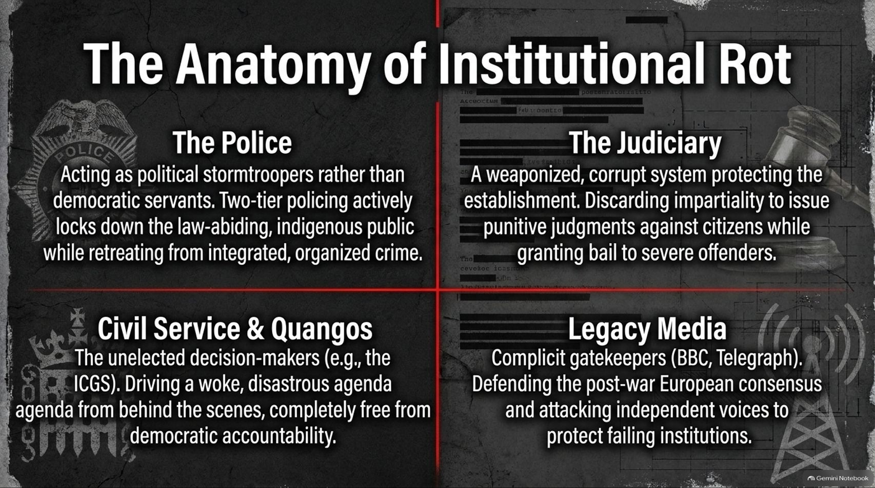

Slide 5
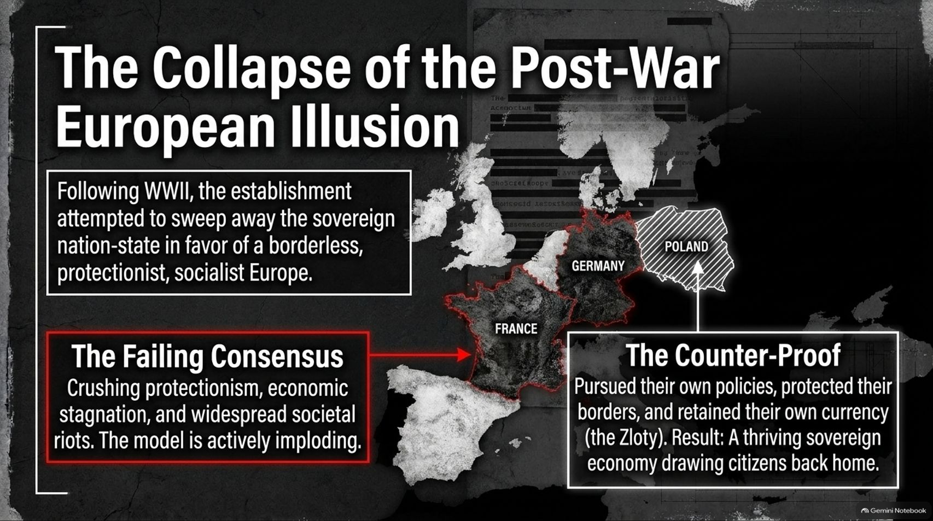
Notes:
Visual Theme: A stylized map of Western Europe highlighting the fading consensus in France and Germany alongside the sovereign success of Poland.
Speaker Notes:
The Post-War Project (Minutes 1–2): Since World War II, the European establishment has tried to abolish the sovereign nation-state in favor of a borderless, protectionist, bureaucratic superstate.
The Failing Consensus (Minutes 3–4): Look at the results across Western Europe: crushing protectionism, permanent economic stagnation, and widespread societal unrest. The model is actively imploding under its own weight.
The Polish Counter-Proof (Minutes 5–6): In stark contrast, nations like Poland that pursued independent policies, protected their borders, and retained their own currency (the Zloty) have built thriving sovereign economies that are actively drawing their citizens back home. Sovereignty works.

Slide 6
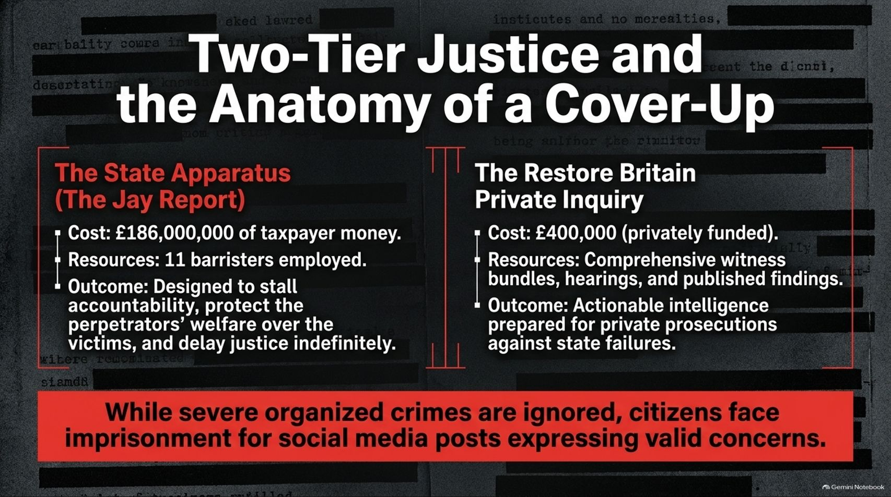
Notes:
Visual Theme: A comparison panel contrasting the costly, delayed state-backed Jay Report against a swift, privately funded Citizen Inquiry.
Speaker Notes:
The State Apparatus (Minutes 1–2): When institutional failures occur, the state protects itself. Consider the Jay Report: costing £186 million of taxpayer money and employing 11 barristers, its primary outcome was to stall accountability, protect institutional perpetrators, and delay justice indefinitely.
The Restore Britain Private Inquiry (Minutes 3–4): Contrast that with a privately funded inquiry costing a fraction of the price (£400,000), delivering comprehensive witness bundles and actionable intelligence designed for private prosecutions against state negligence.
The Two-Tier Reality (Minutes 5–6): While severe organized crime and grooming gangs are frequently ignored or mishandled by authorities, ordinary citizens face harsh imprisonment for posting valid concerns on social media. This two-tier injustice must end.

Slide 7
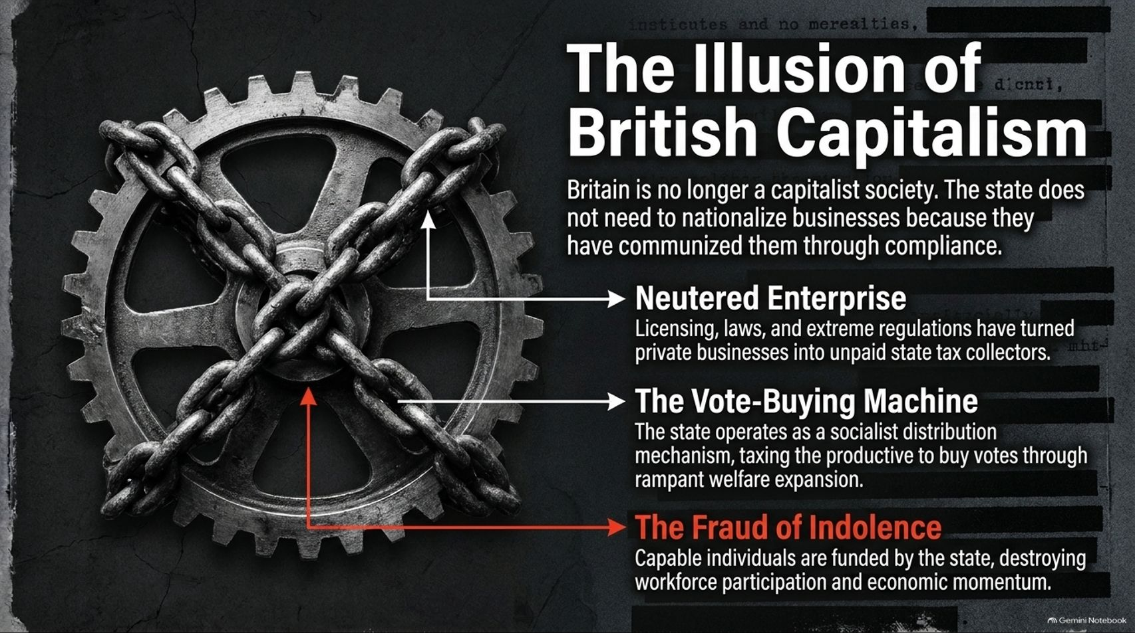
Notes:
Visual Theme: A heavy industrial gear tightly bound and locked down by thick iron chains.
Key Concepts: Neutered Enterprise | The Vote-Buying Machine | The Fraud of Indolence.
Speaker Notes:
Compulsory Compliance (Minutes 1–2): Britain is no longer a free-market capitalist society. The state hasn't needed to formally nationalize businesses because it has effectively communized them through regulatory compliance.
Neutered Enterprise (Minutes 3–4): Overbearing licensing laws and suffocating regulations have turned private businesses into unpaid tax collectors and compliance officers for Whitehall.
The Welfare Trap (Minutes 5–6): Furthermore, the state operates a massive vote-buying machine—taxing productive workers to fund rampant welfare expansion. Subsidizing indolence while penalizing work destroys workforce participation and economic momentum.

Slide 8
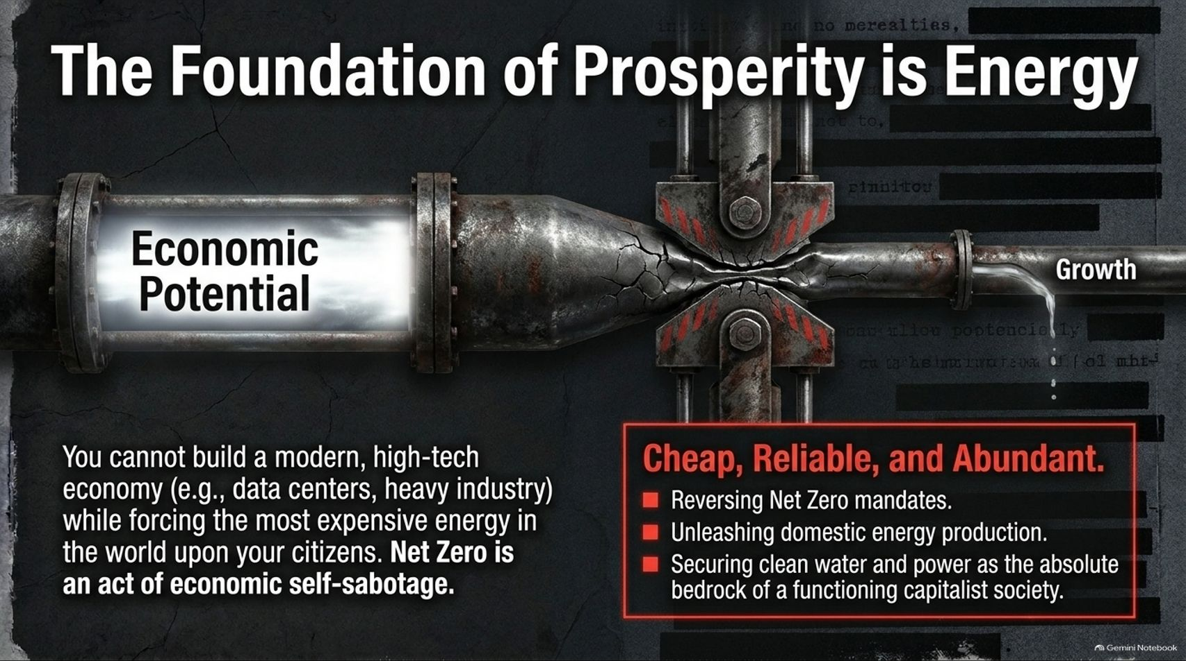
Notes:
Visual Theme: An industrial pipeline compressed by a mechanical vice, leaking precious fluid as output.
Callout Box: Net Zero is an act of economic self-sabotage.
Speaker Notes:
The Energy Chokepoint (Minutes 1–2): You cannot build a modern, high-tech industrial economy—supporting data centers, manufacturing, and heavy industry—while forcing the most expensive energy prices in the world onto your citizens.
The Folly of Net Zero (Minutes 3–4): Net Zero mandates as currently enforced represent pure economic self-sabotage. They squeeze the lifeblood out of our industrial base under the guise of climate compliance.
The Restoration (Minutes 5–6): Prosperity requires energy that is cheap, reliable, and abundant. We must reverse Net Zero mandates, unleash domestic oil, gas, and nuclear production, and secure affordable power as the absolute bedrock of a capitalist society.

Slide 9

Notes:
Visual Theme: A heavy industrial sliding mechanism shifting the Overton Window from the "Mainstream Consensus" toward the "Fringe/Unthinkable."
Three Milestones: 1. The Economic Reality | 2. The Energy Reality | 3. The Border Reality.
Speaker Notes:
Shifting the Overton Window (Minutes 1–2): True political leadership is about forcing the national conversation where the establishment fears to tread. Movements like Restore Britain are actively shifting the Overton Window from the unthinkable into the mainstream.
Challenging the Consensus (Minutes 3–4):
The Economic Reality: Demanding an end to reckless spending and unsustainable tax burdens before financial collapse hits.
The Energy Reality: Exposing the lunacy of unyielding green mandates and forcing legacy parties to quietly scale back their pledges.
The Border Reality: Breaking the taboo on mass migration, Indefinite Leave to Remain (ILR), and demanding immediate deportations.

Slide 10
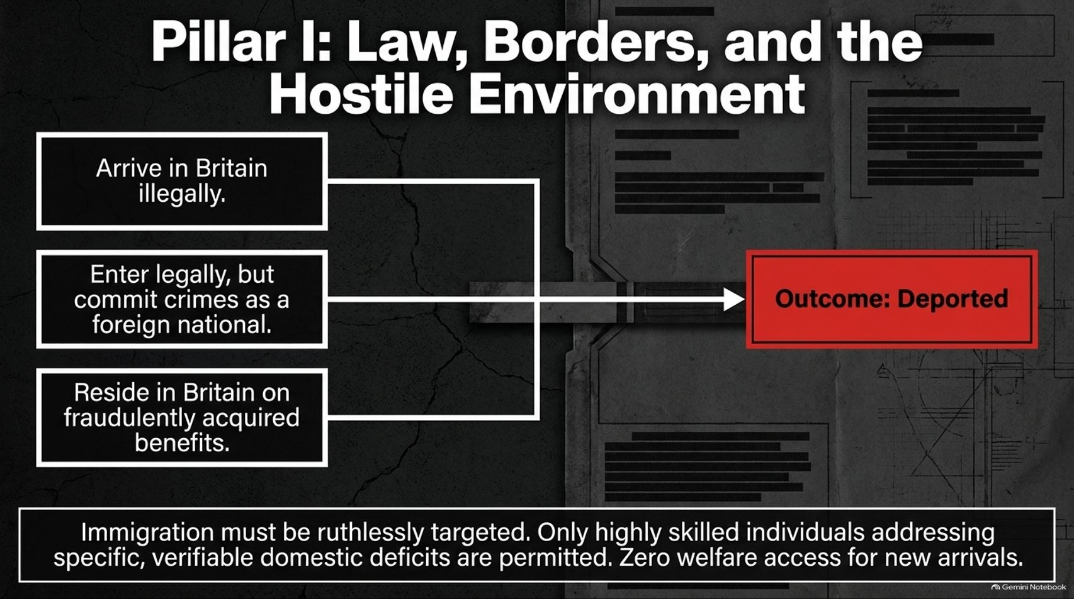
Notes:
Visual Theme: A decisive flowchart routing illegal arrivals, foreign criminals, and benefit fraudsters directly to a red deportation box.
Speaker Notes:
Restoring National Borders (Minutes 1–2): Pillar One of our blueprint is unequivocal: Law, borders, and a genuinely hostile environment for those who break our laws.
The Triad of Enforcement (Minutes 3–4):
Arrive in Britain illegally? Deported.
Enter legally, but commit crimes as a foreign national? Deported.
Reside in Britain on fraudulently acquired benefits? Deported.
Protecting the Taxpayer (Minutes 5–6): Immigration must be ruthlessly targeted to serve national interests. Only highly skilled individuals addressing verifiable domestic deficits should be permitted, paired with zero initial welfare access for new arrivals.

Slide 11
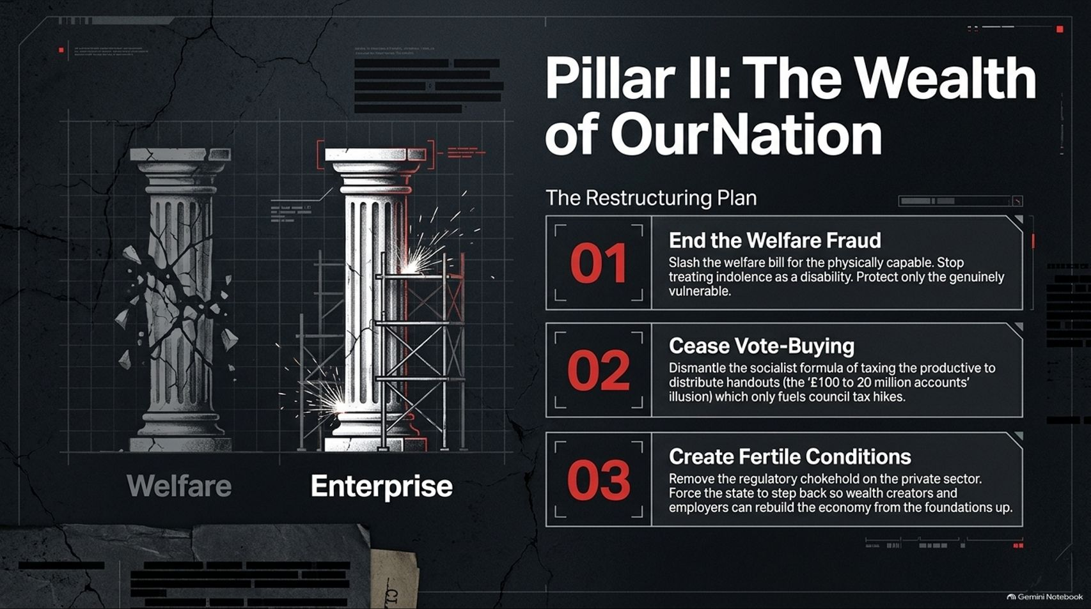
Notes:
Visual Theme: Two architectural pillars—one crumbling and cracked, the other robust and supported by scaffolding, paired with a 3-step restructuring plan.
Speaker Notes:
Rebuilding the Economic Bedrock (Minutes 1–2): Pillar Two focuses on restoring the wealth of our nation by unshackling enterprise and ending the culture of managed decline.
The Three-Step Plan (Minutes 3–4):
End Welfare Fraud: Slash the bloated welfare bill for the physically capable. Stop treating lifestyle indolence as a disability and protect only the genuinely vulnerable.
Cease Vote-Buying: Dismantle the socialist formula of taxing the productive to distribute hollow handouts.
Create Fertile Conditions: Remove the regulatory chokepoint on the private sector so wealth creators can rebuild the economy from the foundations up.

Slide 12
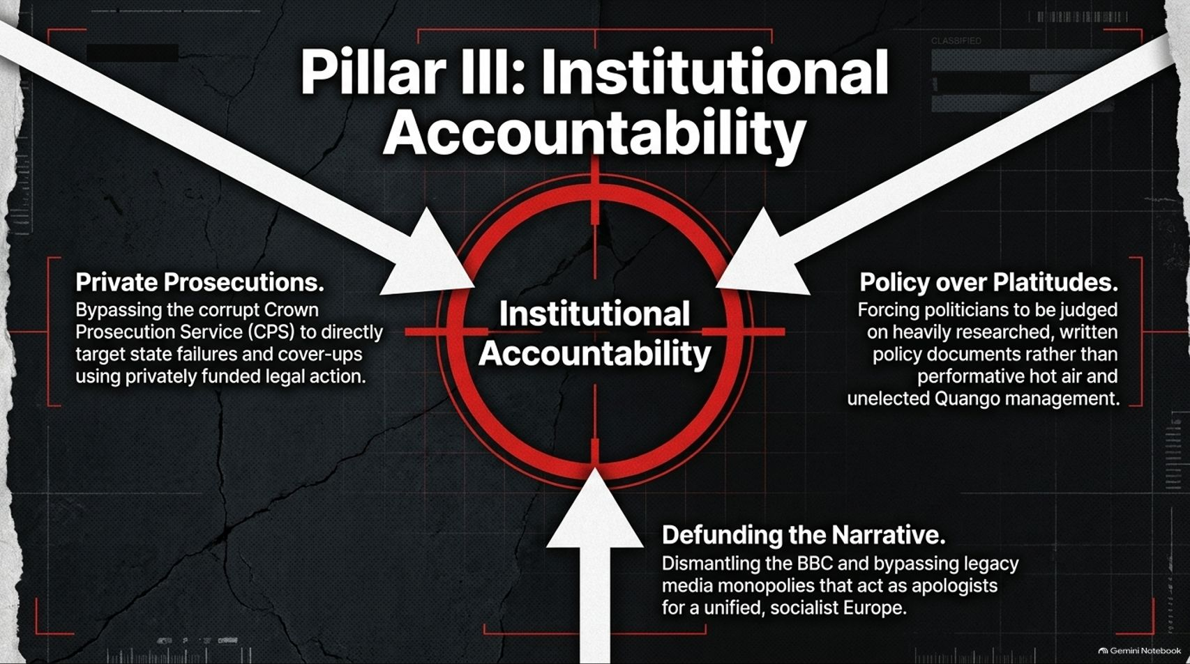
Notes:
Visual Theme: A high-contrast targeting reticle anchored by converging white arrows representing strategic institutional reform.
Speaker Notes:
Shattering Impunity (Minutes 1–2): Pillar Three establishes absolute institutional accountability. Public servants and political class members must no longer be above the law.
Core Mechanisms (Minutes 3–4):
Private Prosecutions: Bypassing a captured Crown Prosecution Service (CPS) to directly target state failures using privately funded legal action.
Policy over Platitudes: Forcing politicians to be judged on heavily researched written policy documents rather than performative hot air.
Defunding the Narrative: Dismantling state-backed broadcasting monopolies that act as apologists for globalist overreach.

Slide 13

Notes:
Visual Theme: A split graphic contrasting blurred, sensationalized legacy newspaper headlines against clean digital truth distribution.
Speaker Notes:
The Legacy Gatekeepers (Minutes 1–2): The legacy media thrives on the managed decline of Britain. They routinely refuse to cover critical policy papers on mass deportations, energy realism, or sovereign wealth creation because independent nationhood threatens their globalist worldview.
Bypassing the Narrative (Minutes 3–4): Relying on traditional media gatekeepers guarantees misinformation. True accountability requires reading primary source documents and utilizing independent digital distribution.
The Availability of Truth (Minutes 5–6): The facts are readily available to anyone willing to look past the smoke and mirrors of establishment journalism.

Slide 14

Notes:
Visual Theme: A sharp fork in the road dividing Path A (The Hard Truth/Austerity) from Path B (The Weimar Trajectory/Hyperinflation & Bankruptcy).
Speaker Notes:
Running Out of Time (Minutes 1–2): Quantitative easing and endless borrowing allowed the political establishment to disguise structural failure ever since the 2008 financial crisis. But the bill has finally arrived. We are completely out of time.
Path A: The Hard Truth (Minutes 3–4): We must voluntarily put on the 'hair shirt.' We must accept a necessary period of rigorous fiscal discipline, dismantle bloated state agencies, rebuild the private sector from the ground up, and lay fresh foundations for a sovereign republic.
Path B: The Weimar Trajectory (Minutes 5–6): If we choose cowardice—continuing to print money, expanding the public sector to fake economic growth, and buying votes with borrowed welfare—we face total, catastrophic national bankruptcy.

Slide 15

Notes:
Visual Theme: A gritty, realistic grayscale image of a strong, calloused working hand gripping a heavy steel tool against a concrete floor.
Quote Box: [ Read the research. Read the policy papers. Judge us by our policies, and take your country back. ]
Speaker Notes:
Rejecting Easy Lies (Minutes 1–2): Real democracy requires absolute honesty. We are not offering an immediate political nirvana or easy government handouts. We are offering the raw, unvarnished truth and the blueprint required to survive it.
Ignoring the Noise (Minutes 3–4): Do not judge this movement by the hysterical noise of the legacy media or the panic of a cornered political establishment.
Call to Action (Minutes 5–6): Read our research. Read our comprehensive policy papers. Judge us by the substance of our plans, and join us in taking our country back.

Slide 16
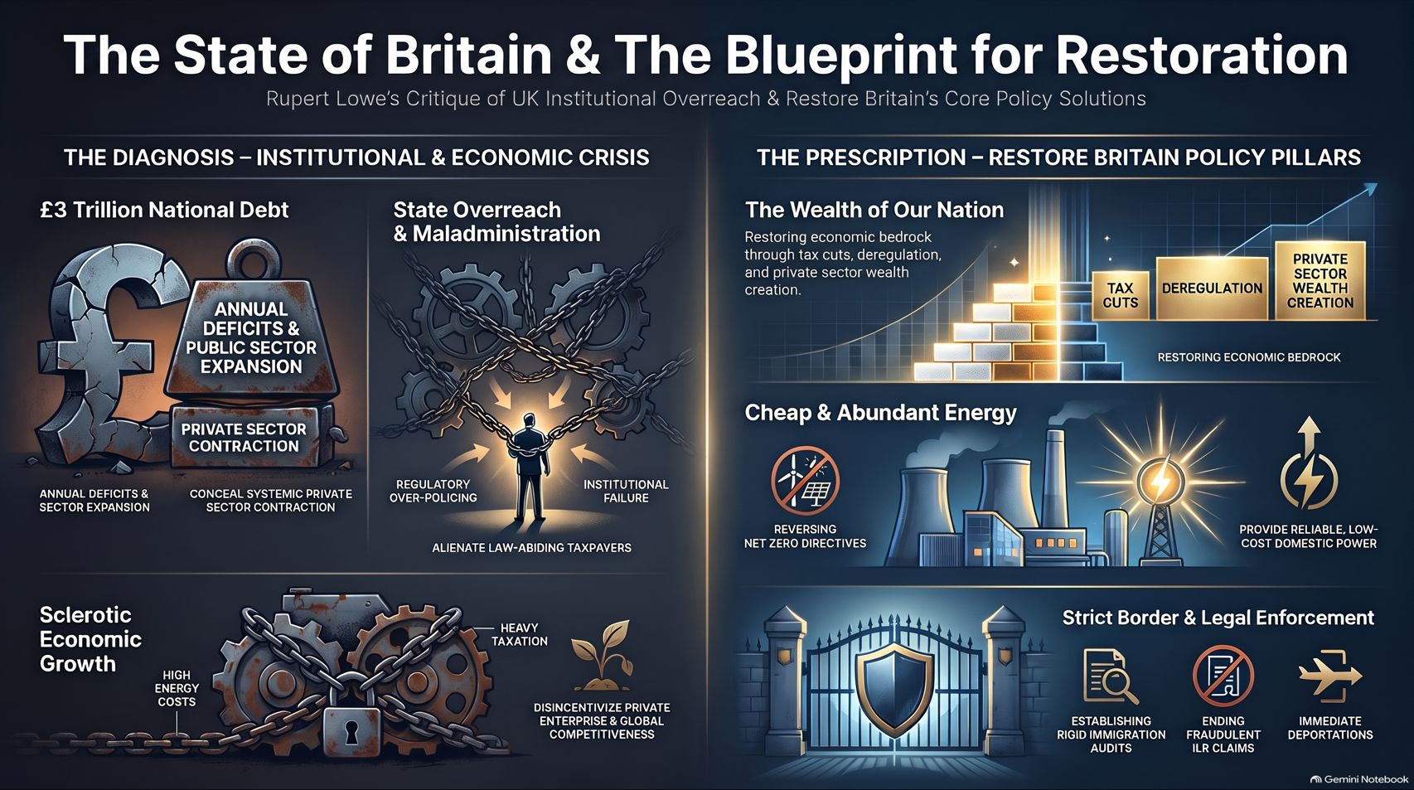
Notes:
Visual Theme: A comprehensive master dashboard uniting economic diagnoses, institutional audits, and the three pillars of national restoration.
Speaker Notes:
Synthesizing the Audit (Minutes 1–2): As we conclude this presentation, let's review our starting premise: Britain is burdened by £3 trillion in debt, crippled by institutional rot, and trapped by net-zero energy self-sabotage.
The Three Pillars in Action (Minutes 3–4): Restoration requires absolute clarity: ruthlessly securing our borders and enforcing the law; unleashing the wealth of our nation through deregulation, tax cuts, and welfare reform; and holding public institutions legally and morally accountable.
Final Takeaway (Minutes 5–6): The path forward demands courage, discipline, and uncompromising realism. The blueprint exists. Now is the time to execute it and restore Great Britain. Thank you.
The Blueprint to Restore Britain provides an in-depth look into the systemic institutional challenges and policy frameworks proposed for national renewal.

