Slide 1
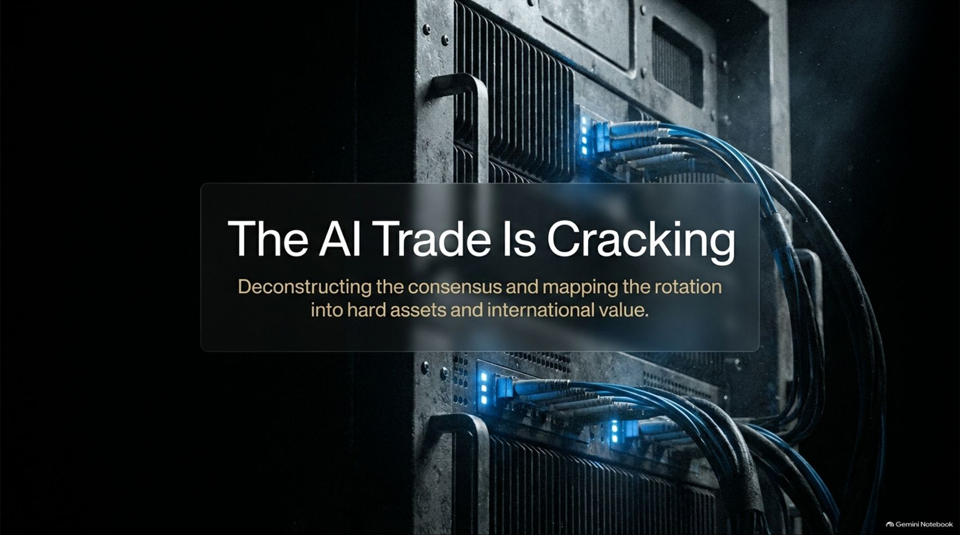
Notes:
Visual Theme: A moody, industrial close-up of high-performance server racks with glowing blue fiber-optic connection cables.
Subtitle: Deconstructing the consensus and mapping the rotation into hard assets and international value.
Speaker Notes:
Introduction (Minute 1): Welcome everyone. Today we are looking at a major inflection point in global financial markets: the cracking of the AI trade. For years, the market consensus has been straightforward—stay long US tech, ignore traditional valuations, and assume infinite AI growth.
The Shifting Narrative (Minutes 2–3): As Peter Boockvar noted in his recent conversation on Excess Returns, every silver lining has a touch of gray. Over the past few weeks, the cracks in the "all-in" AI economic buildout have begun to show.
Setting the Objective (Minutes 4–5): Today, we will deconstruct why this consensus trade is rolling over, examine the underlying financing risks in data center infrastructure, and map out the exact rotation into defensive staples, international value, and hard assets.
The AI Trade Is Cracking | Peter Boockvar on What to Own Instead
https://www.youtube.com/watch?v=cs3OyqbIMYo

Slide 2
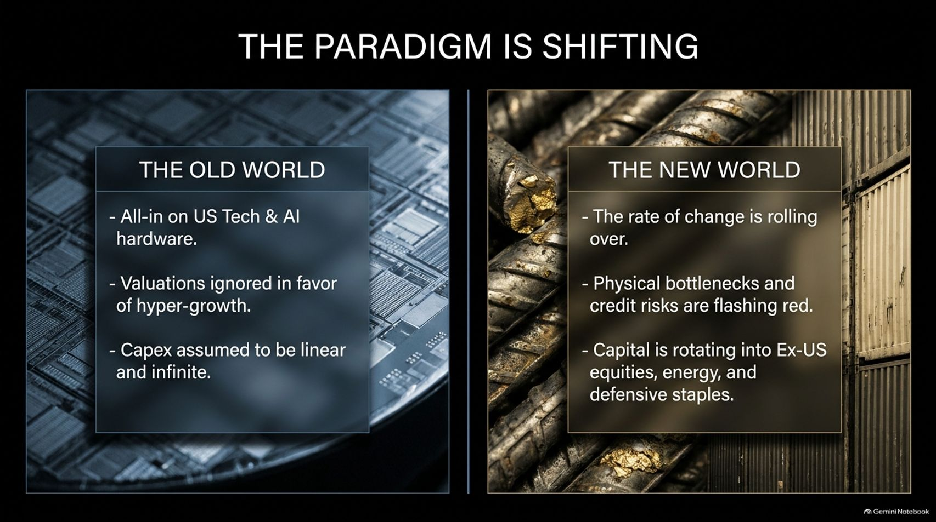

Slide 3
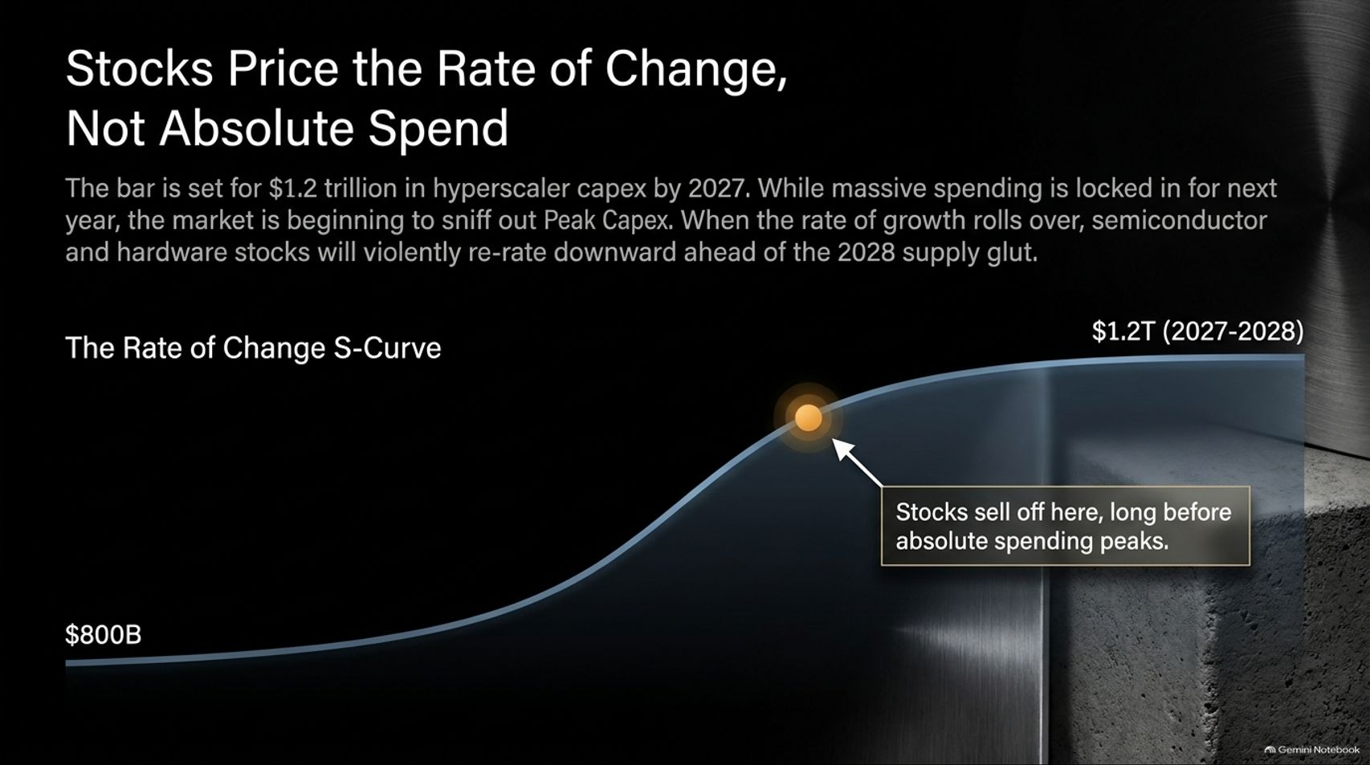
Notes:
Visual Theme: An S-curve chart illustrating capital expenditure acceleration, highlighting a crucial inflection point where stock prices peak well before absolute spending does.
Speaker Notes:
The $1.2 Trillion Bar (Minutes 1–2): The market consensus has baked in roughly $1.2 trillion in hyperscaler capex by 2027. While massive spending is completely locked in for next year, the market is beginning to sniff out "Peak Capex".
Rate of Change vs. Absolute Spend (Minutes 3–4): As Peter Boockvar emphasizes, investors must understand that stocks price in the rate of change, not absolute spend. Even if companies spend heavily next year, if the growth rate rolls over, hardware and semiconductor stocks will violently re-rate downward.
The 2028 Supply Glut (Minutes 5–6): Markets look forward. Stocks sell off at the flattening of the S-curve, long before absolute spending actually peaks, anticipating the looming 2028 supply glut.

Slide 4
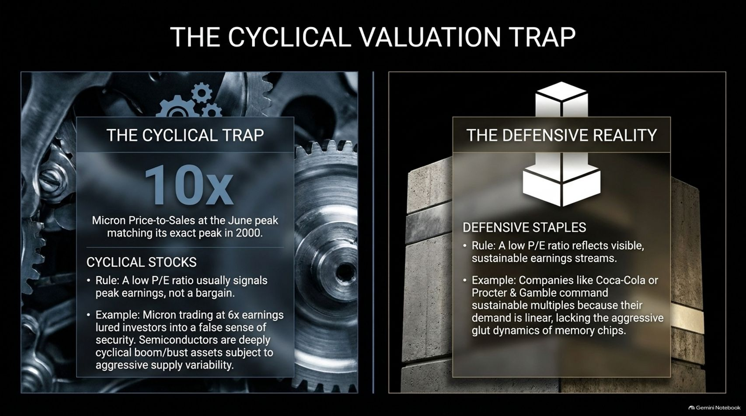
Notes:
Visual Theme: A split-screen comparison showing interlocking factory gears on the left ("The Cyclical Trap") against a solid concrete architectural block on the right ("The Defensive Reality").
Speaker Notes:
The Micron Valuation Trap (Minutes 1–2): Over the last few months, market commentators kept pointing out how "cheap" semiconductor stocks like Micron looked because they were trading at 6x earnings. As Boockvar remarked, that kind of analysis makes your head explode.
Price-to-Sales Parity with 2000 (Minutes 3–4): At the June peak, Micron’s price-to-sales ratio hit 10x—matching its exact peak in the year 2000. A low P/E ratio on a cyclical stock usually signals peak earnings, not a bargain.
Cyclicals vs. Defensives (Minutes 5–6): Semiconductors are deeply cyclical boom-and-bust assets subject to aggressive supply variability. Compare that to defensive staples like Coca-Cola or Procter & Gamble, where low P/E reflects sustainable, linear cash flows rather than temporary cyclical windfalls.

Slide 5
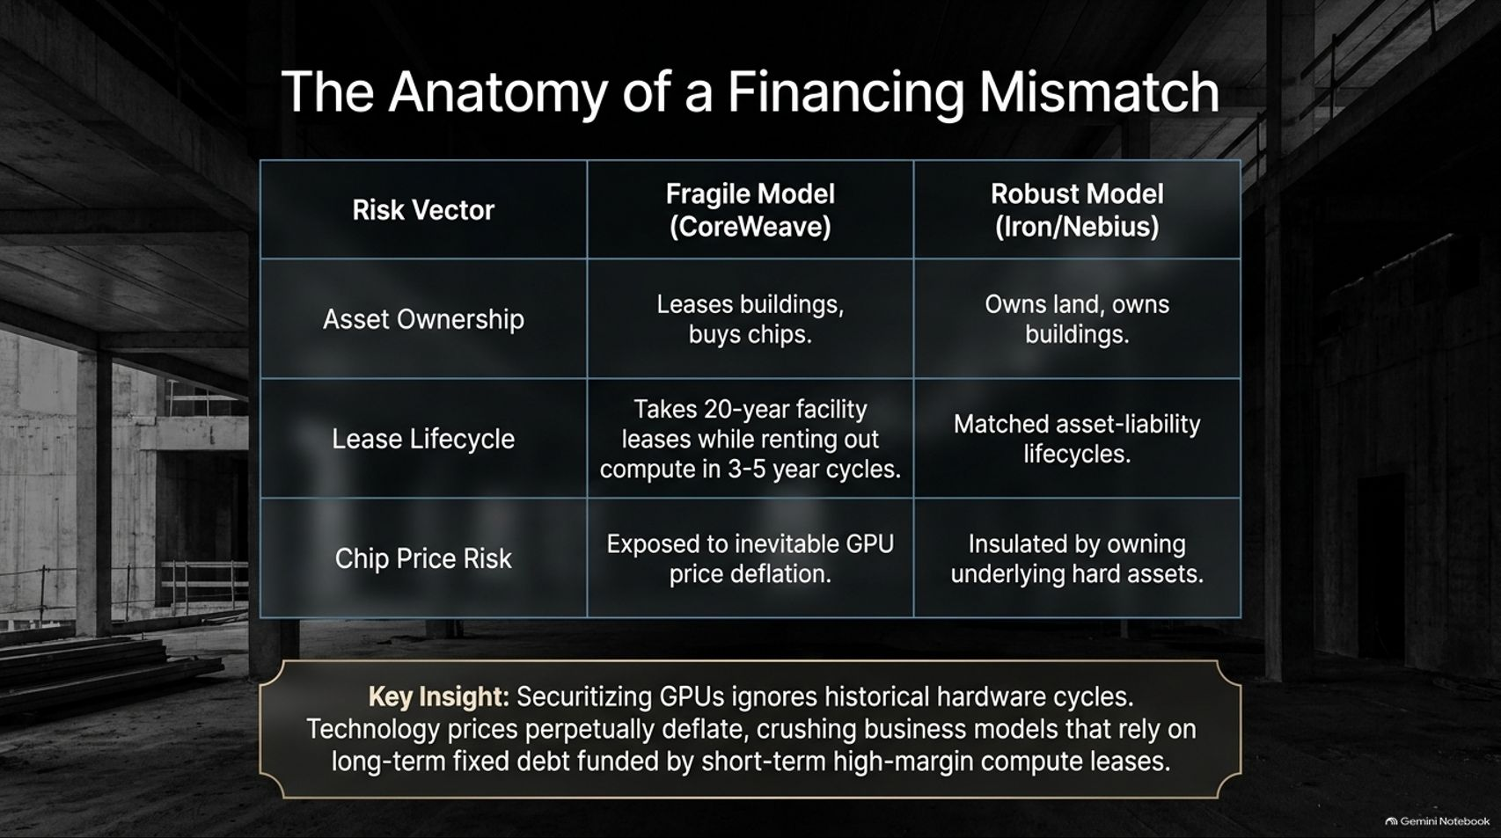
Notes:
Visual Theme: A comparative matrix contrasting a fragile financing model (Coreweave) against a robust asset-backed model (Iron/Nebius).
Speaker Notes:
Leasing Buildings vs. Owning Hard Assets (Minutes 1–2): Let's look under the hood at infrastructure providers. Fragile models—typified by CoreWeave—lease buildings and buy chips using long-term debt while renting out compute on short 3-to-5-year cycles.
The Asset-Liability Mismatch (Minutes 3–4): Robust operators like Nebius or Iron own their land and buildings, matching asset and liability lifecycles.
The Danger of GPU Deflation (Minutes 5–6): Securitizing GPUs ignores historical hardware cycles. Technology prices perpetually deflate; business models relying on long-term fixed debt funded by short-term high-margin compute leases are highly vulnerable to inevitable price deflation.

Slide 6
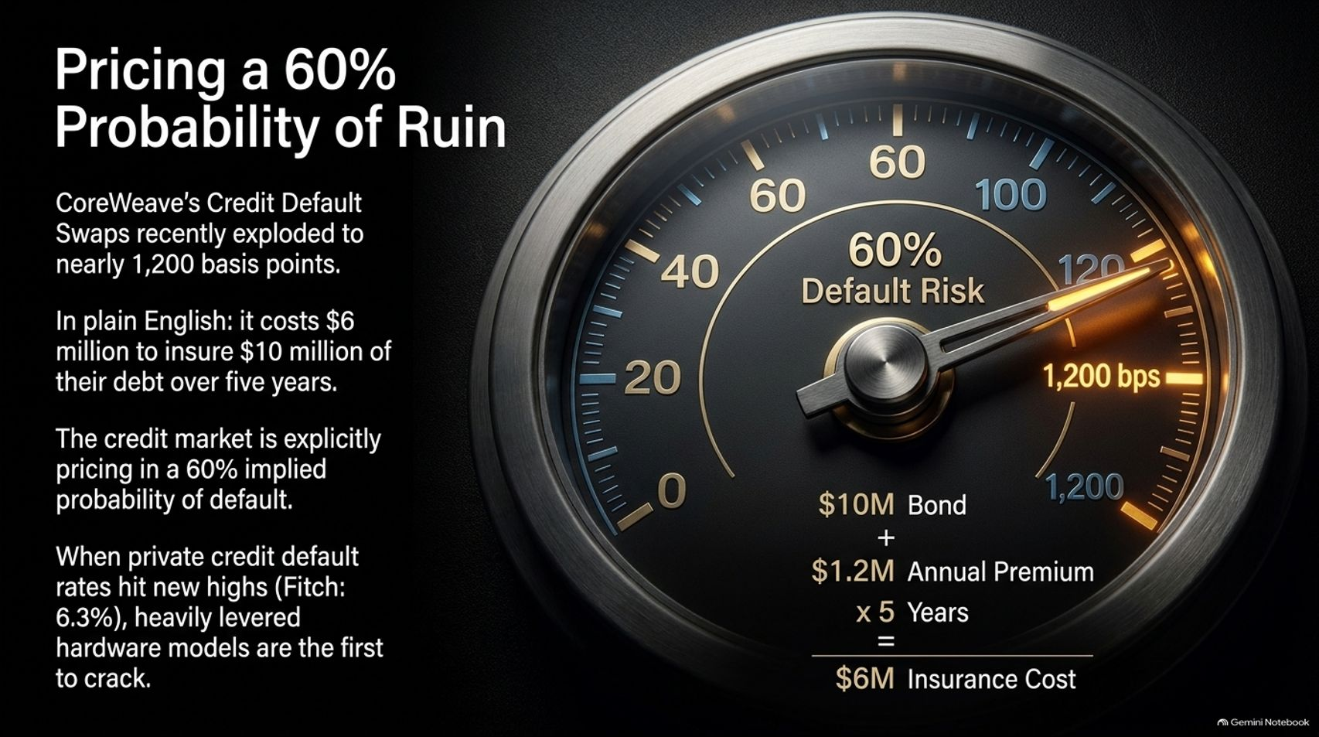
Notes:
Visual Theme: A heavy industrial pressure gauge reading 1,200 basis points of credit default risk, accompanied by bond insurance math.
Speaker Notes:
Credit Default Swaps Blowing Out (Minutes 1–2): Financial stress in the AI infrastructure space is showing up clearly in the credit markets. CoreWeave's Credit Default Swaps (CDS) recently exploded to nearly 1,200 basis points.
Translating the Math (Minutes 3–4): What does that mean in plain English? To insure $10 million of their debt over five years, it costs $1.2 million annually—totaling $6 million in insurance premiums.
The Market Pricing Default (Minutes 5–6): The credit market is explicitly pricing in a 60% implied probability of default. When private credit default rates hit new highs across the financial sector, heavily levered hardware models are always the first to crack.

Slide 7
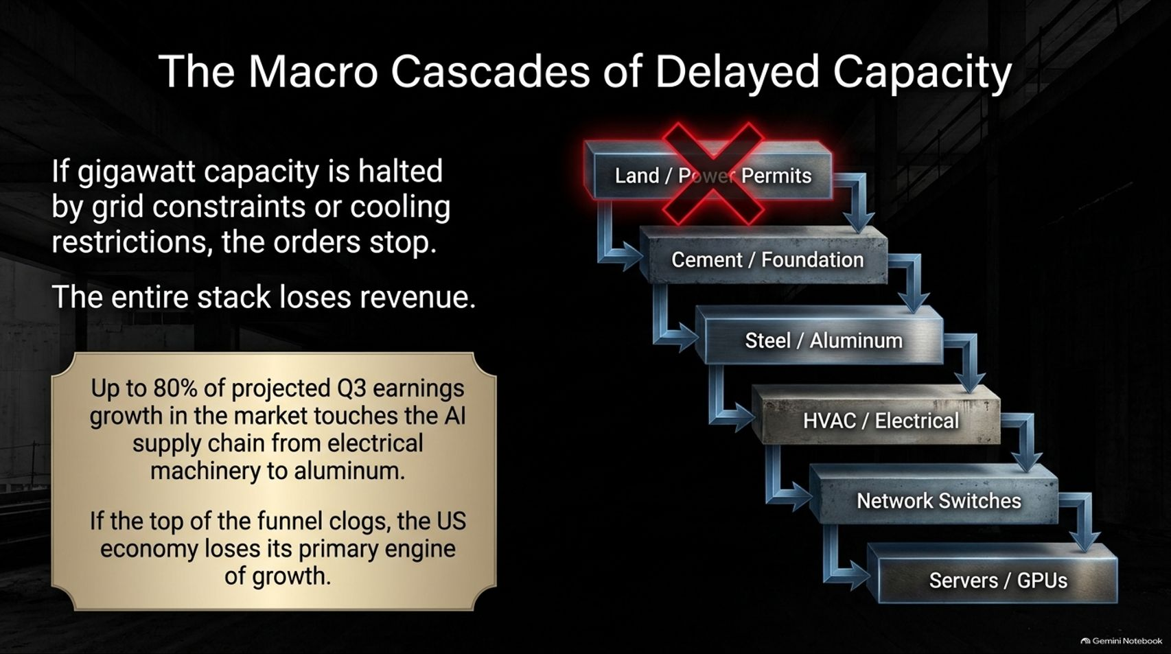
Notes:
Visual Theme: A stepped industrial supply chain flowchart showing how a single permit halt at the top cascades down through cement, steel, HVAC, switches, and servers.
Speaker Notes:
The Top of the Funnel (Minutes 1–2): If gigawatt capacity is halted by state grid constraints, local governance, or cooling restrictions, the orders stop.
Upstream and Downstream Impact (Minutes 3–4): Up to 80% of projected Q3 corporate earnings growth in the market touches the AI supply chain—ranging from electrical machinery and switches to structural steel and aluminum.
The Wider Economic Ripple (Minutes 5–6): If the top of the funnel clogs, the entire stack loses revenue. Because the AI buildout has been the primary engine of US economic growth, any slowdown here ripples across the entire macroeconomic landscape.

Slide 8
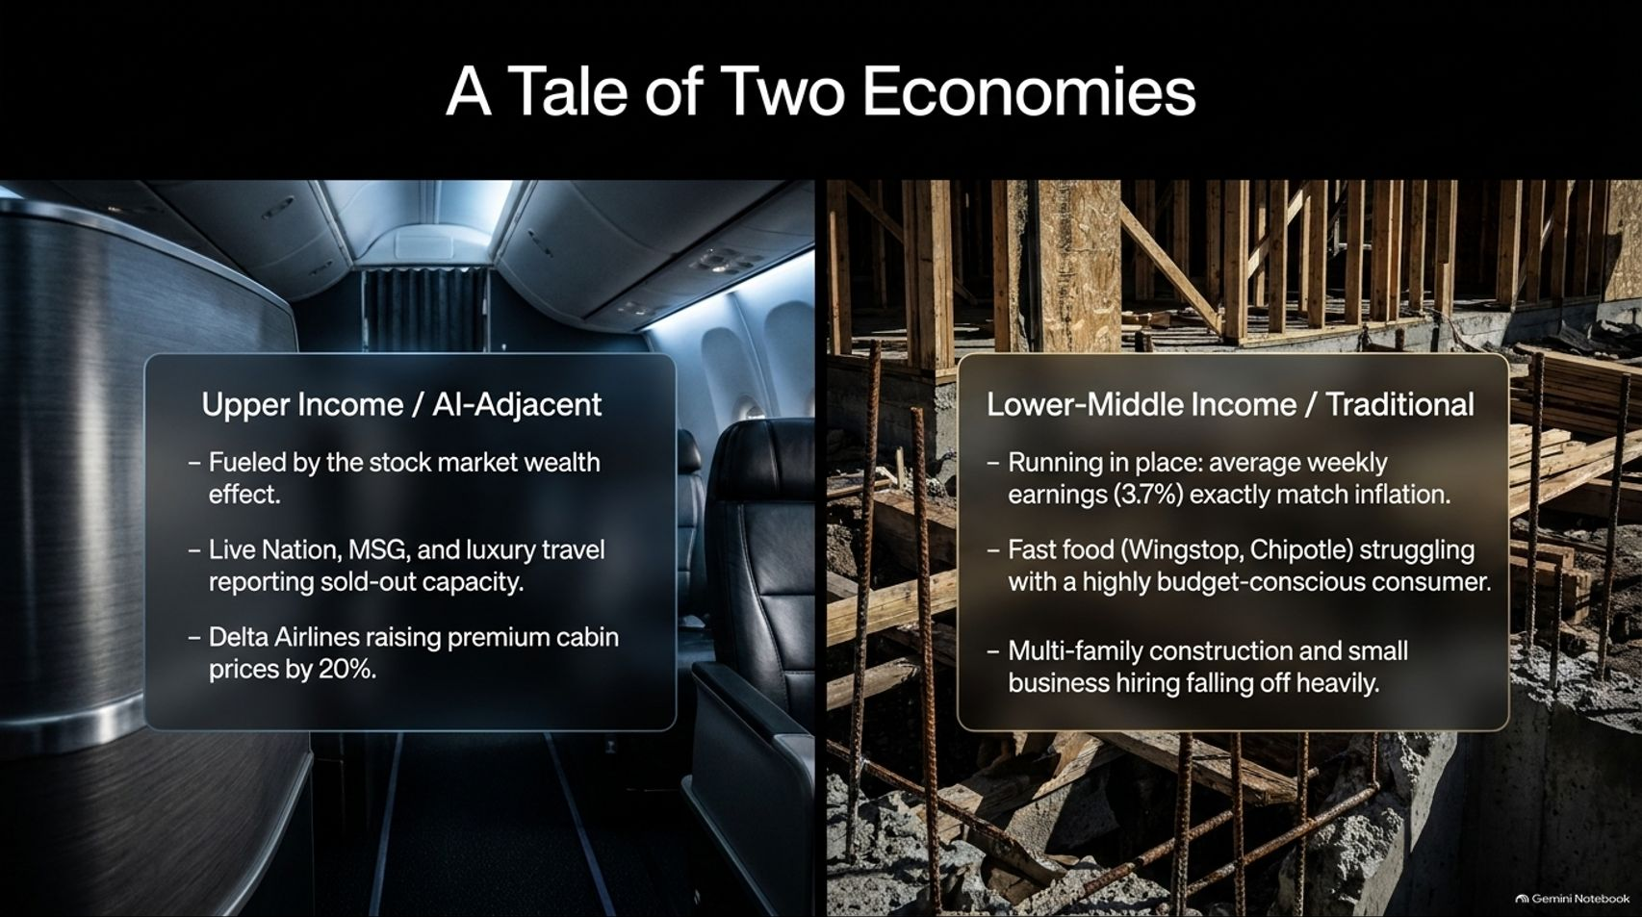

Slide 9
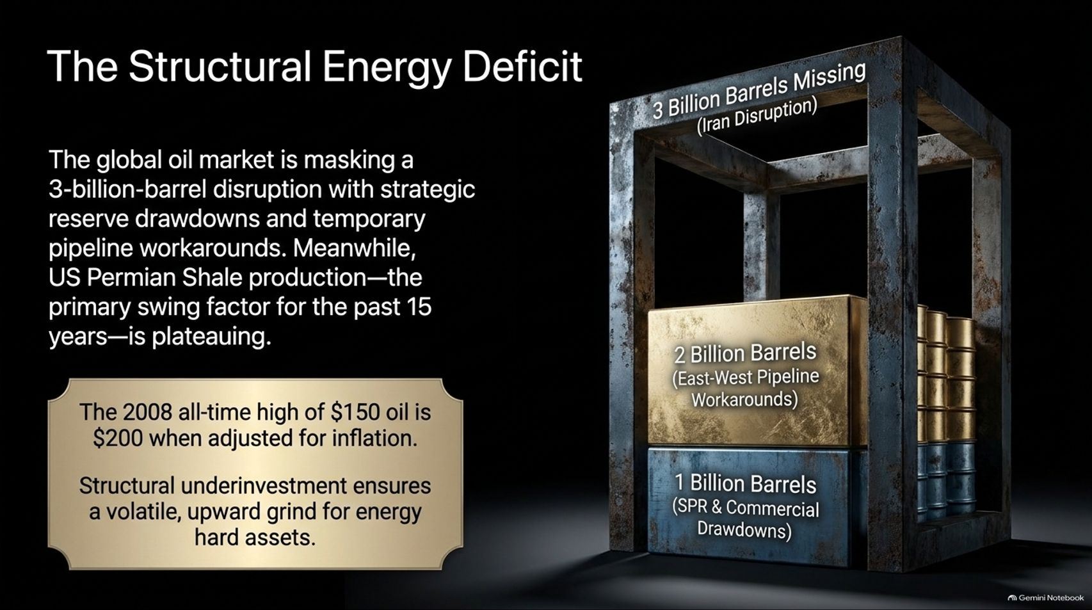
Notes:
Visual Theme: An industrial storage container graphic illustrating a 3-billion-barrel global oil deficit masked by reserve drawdowns.
Speaker Notes:
The 3-Billion-Barrel Disruption (Minutes 1–2): Turning to energy, the global oil market is currently masking a 3-billion-barrel supply disruption—stemming from Middle East conflicts—through strategic reserve drawdowns and temporary pipeline workarounds.
Plateauing US Shale (Minutes 3–4): At the same time, US Permian Shale production, which served as the primary non-OPEC swing factor for the past 15 years, is plateauing.
Inflation-Adjusted Oil Prices (Minutes 5–6): Remember that the 2008 all-time high of $150 oil equals $200 when adjusted for inflation. Structural underinvestment ensures a volatile, upward grind for energy hard assets going forward.

Slide 10
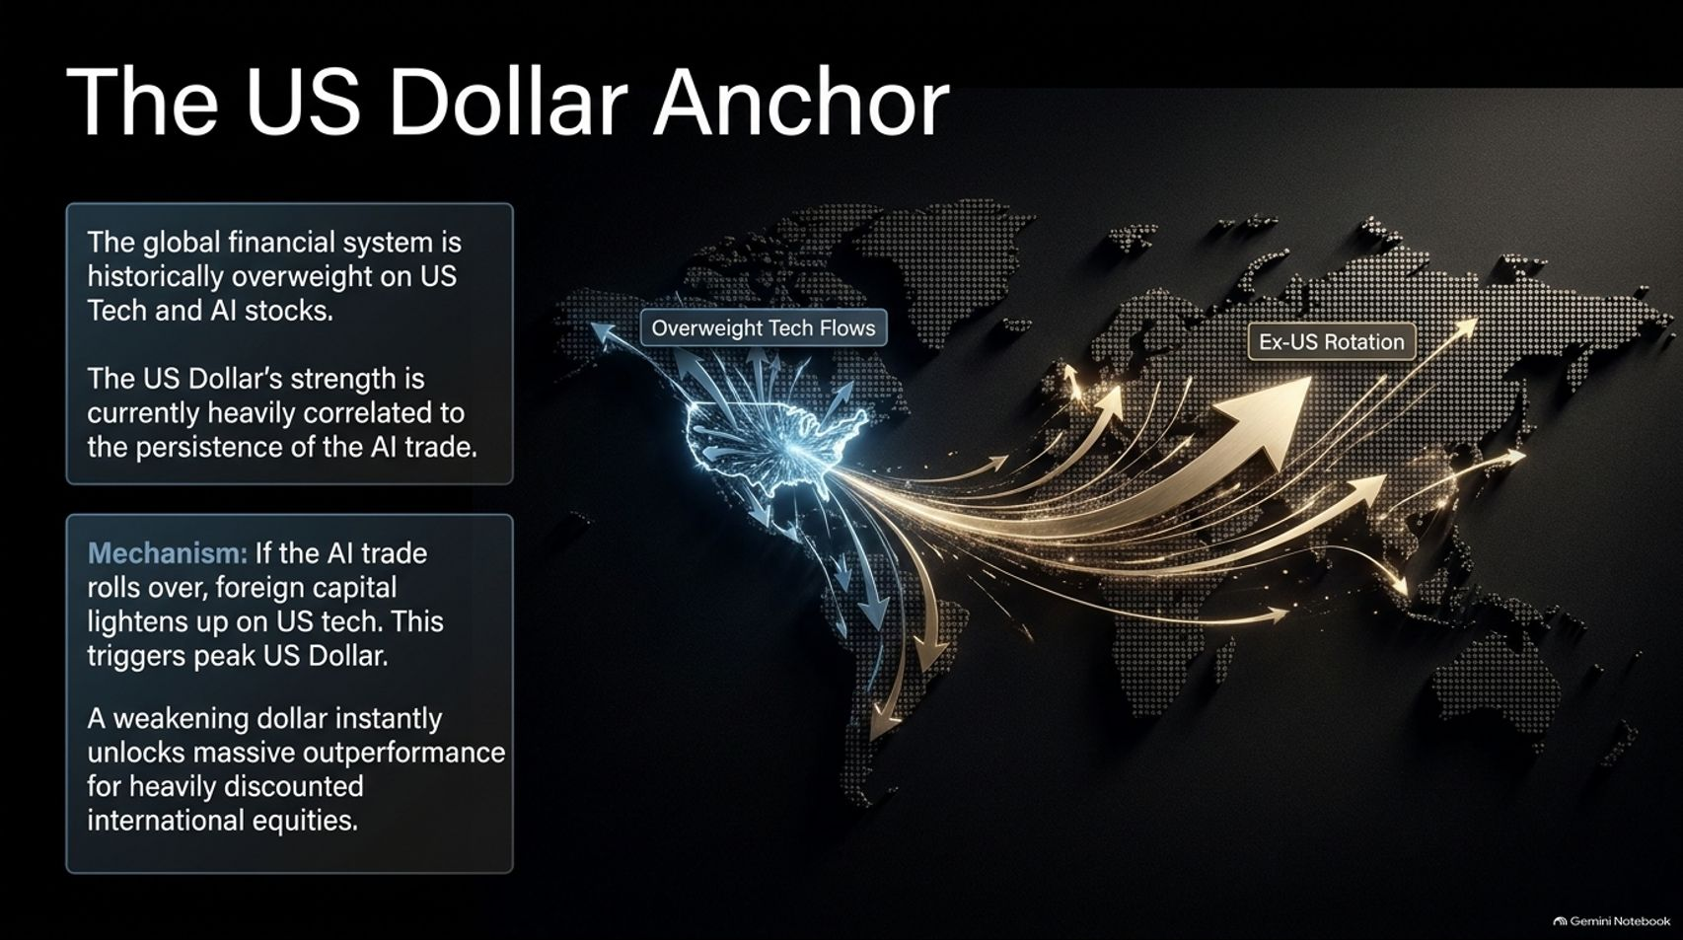
Notes:
Visual Theme: A dark global map highlighting massive capital flows originating from North America and rotating outward toward international markets.
Speaker Notes:
Overweight US Tech Flows (Minutes 1–2): The entire global financial system is historically overweight on US technology and AI stocks. Consequently, the strength of the US Dollar has been heavily correlated to the persistence of the AI trade.
The Unwinding Mechanism (Minutes 3–4): If the AI trade rolls over, foreign capital will inevitably lighten up on US tech, triggering a definitive peak in the US Dollar.
Unlocking International Value (Minutes 5–6): A weakening dollar instantly unlocks massive outperformance and tailwinds for heavily discounted international equities that have languished for years.

Slide 11
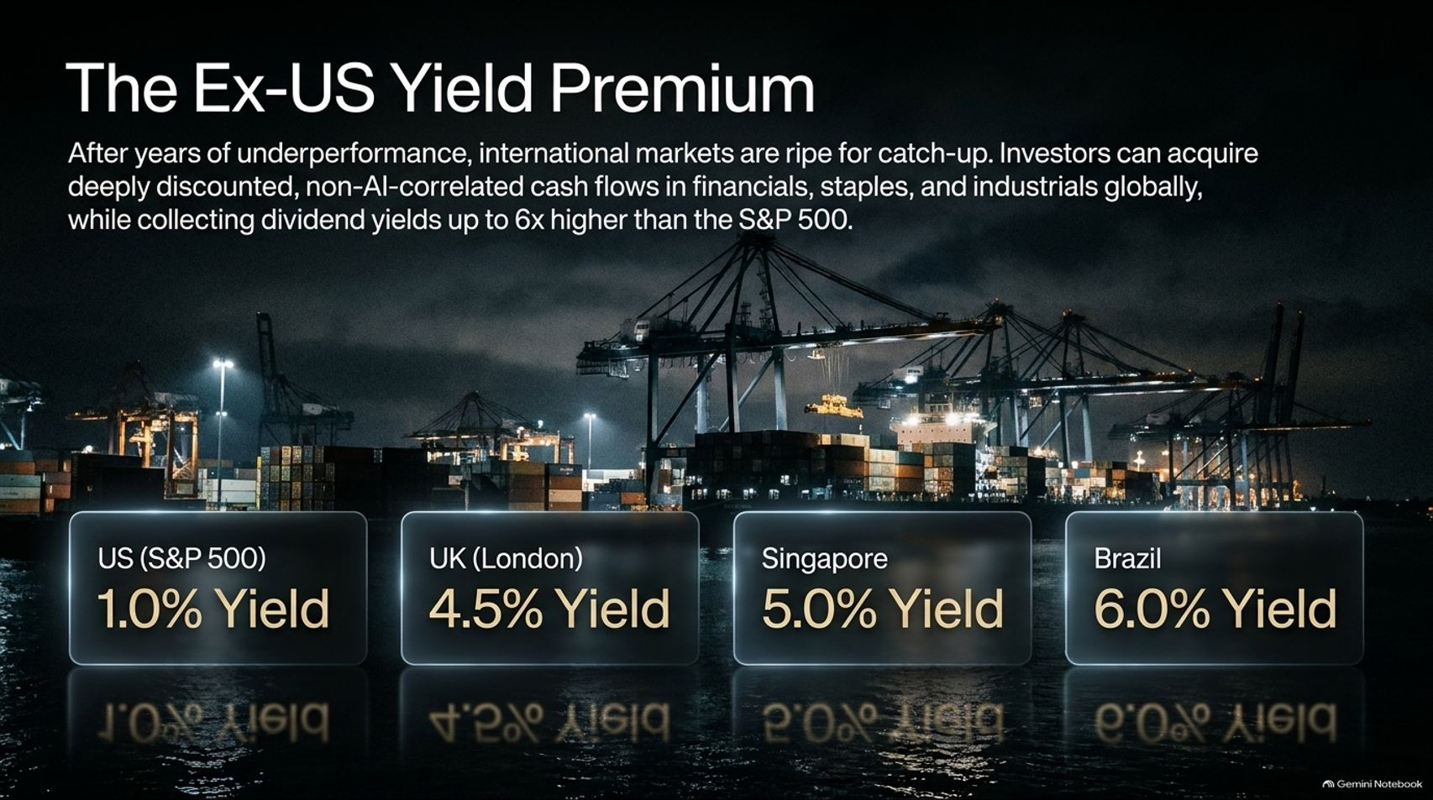
Notes:
Visual Theme: A dimly lit industrial shipping port at dusk, paired with yield comparison cards for the S&P 500, London, Singapore, and Brazil.
Speaker Notes:
Global Yield Discrepancy (Minutes 1–2): After years of underperformance, international markets are ripe for catch-up. Investors can acquire deeply discounted, non-AI-correlated cash flows across financials, staples, and industrials globally.
Comparing Dividends (Minutes 3–4): Look at the yield profile: while the S&P 500 yields a meager 1.0%, international hubs offer significantly higher cash returns: London at 4.5%, Singapore at 5.0%, and Brazil at 6.0%.
Diversification Value (Minutes 5–6): Allocating to stable, dividend-paying international markets provides an essential cushion when US momentum trades correct.

Slide 12

Notes:
Visual Theme: A macro shot of natural gold nuggets embedded in dark quartz ore.
Speaker Notes:
Pillar 1: The Central Bank Bid (Minutes 1–2): Gold is set up for a powerful continuation rally supported by three structural pillars. First is the relentless central bank bid—institutions accumulated 321 tons of gold in Q3 alone, providing an unbreakable price floor.
Pillar 2: Real Rates Rolling Over (Minutes 3–4): Second, real interest rates are rolling over. With inflation persistent and economic cracks showing, the era of aggressive Fed rate hikes is finished.
Pillar 3: Peak Dollar (Minutes 5–6): Third, as capital rotates out of US AI equities, a depreciating dollar provides the final structural tailwind for a sustained gold and hard money rally.

Slide 13
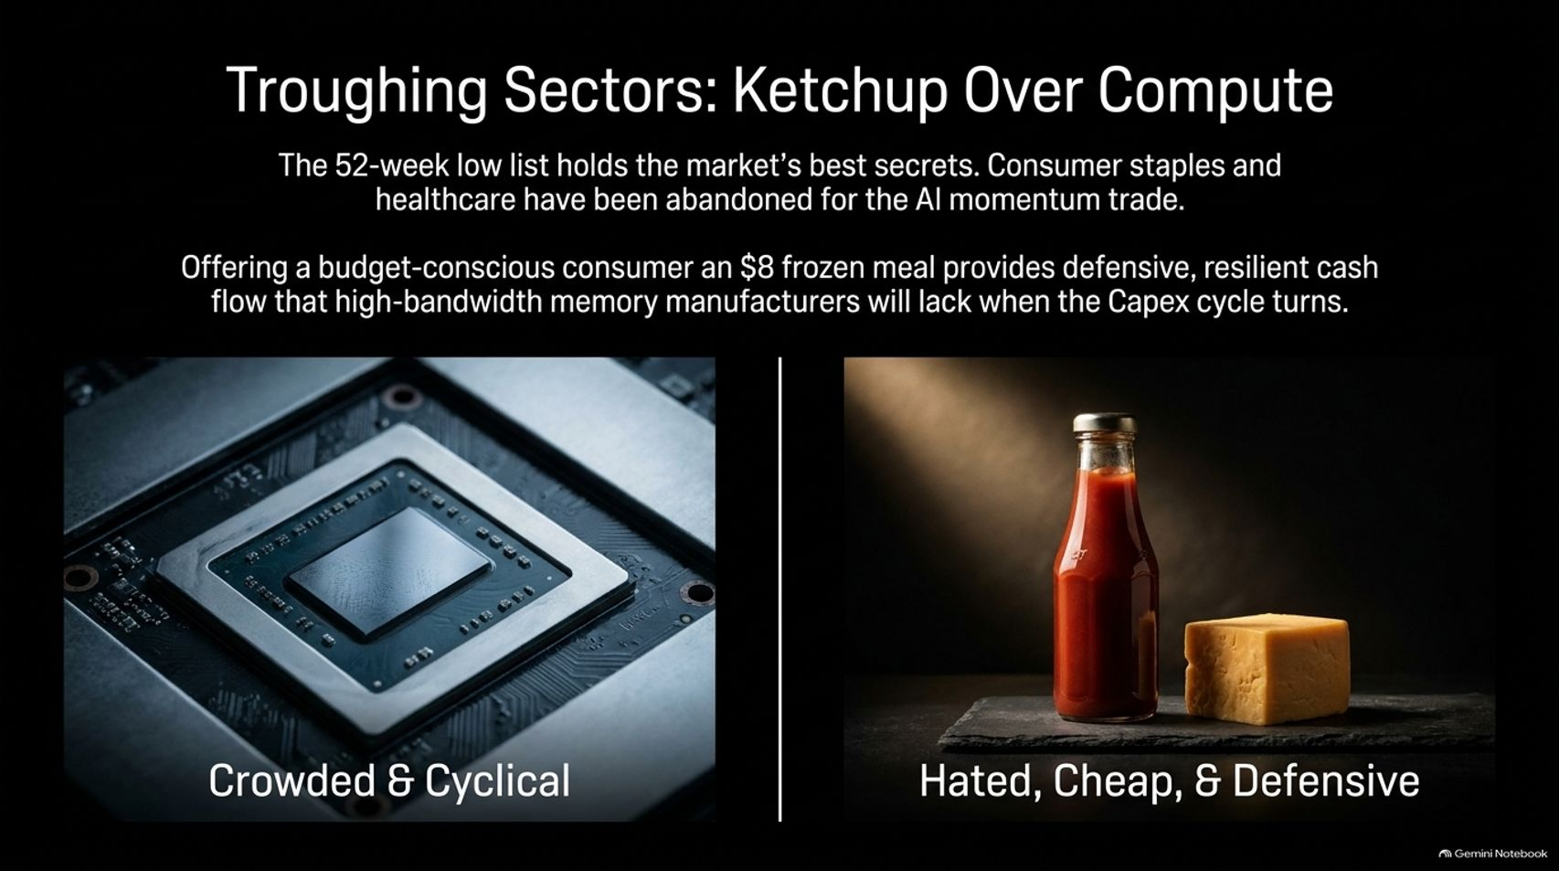

Slide 14
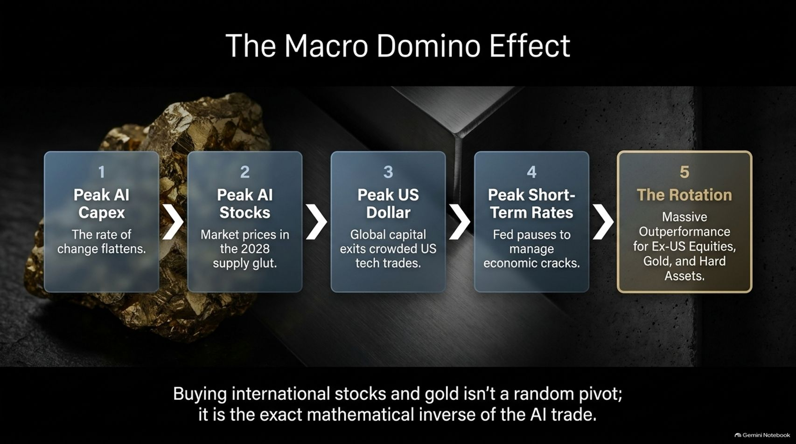
Notes:
Visual Theme: A 5-step sequential process flow tracking the macro domino effect from peak AI capex down to the rotation into hard assets.
Speaker Notes:
Mapping the Sequence (Minutes 1–2): How does this transition play out sequentially?
Peak AI Capex: The rate of growth flattens.
Peak AI Stocks: Markets price in the 2028 supply glut.
Peak US Dollar: Global capital exits crowded US tech trades.
Peak Short-Term Rates: The Fed pauses and pivots to manage economic cracks.
The Rotation: Massive outperformance for Ex-US equities, gold, and hard assets.
Conclusion (Minutes 3–4): Buying international stocks and gold isn't a random tactical pivot; it is the exact mathematical inverse of the AI trade.

Slide 15
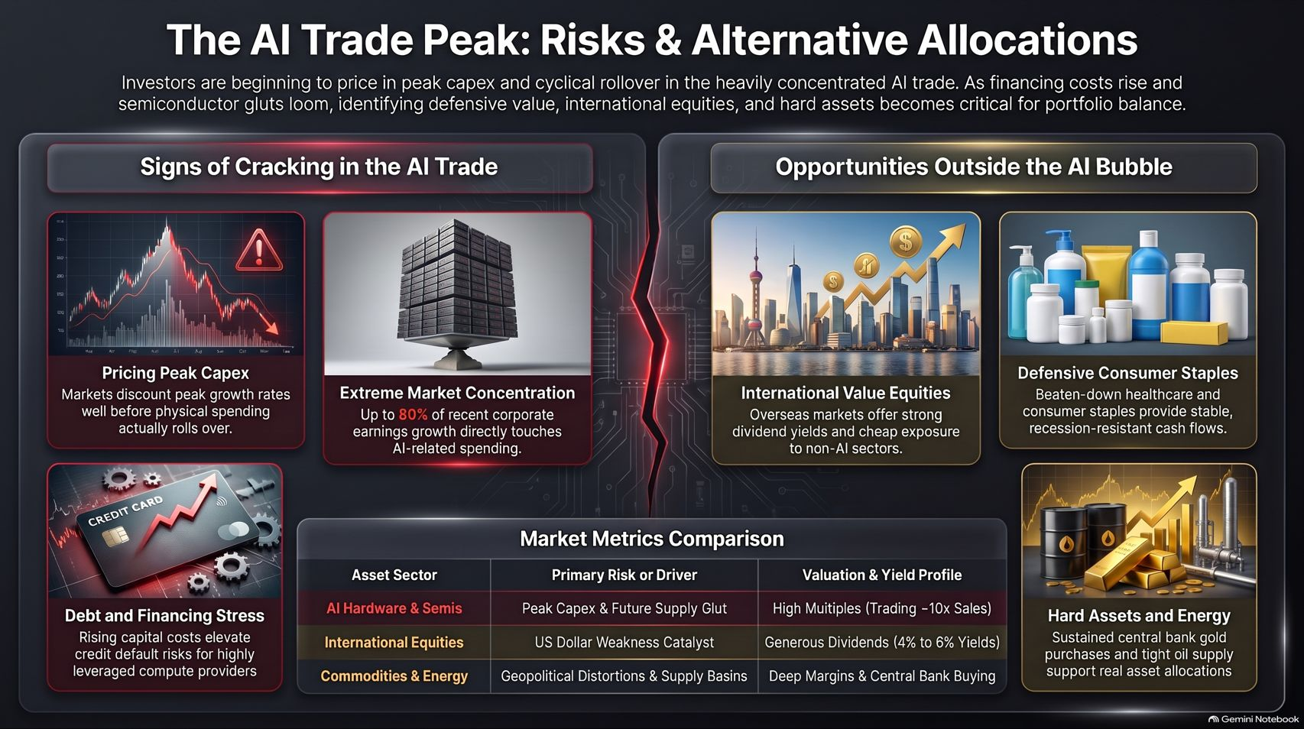
Notes:
Visual Theme: A comprehensive executive summary dashboard synthesizing market risks, valuation metrics, and alternative asset allocations.
Speaker Notes:
Reviewing the Landscape (Minutes 1–2): As we wrap up, the message is clear: investors are beginning to price in peak capex and cyclical rollover in the heavily concentrated AI trade.
Portfolio Balance (Minutes 3–4): With financing costs rising and semiconductor gluts looming, identifying defensive value, international dividend yields, and hard assets is critical for portfolio survival.
Final Takeaway (Minutes 5–6): Having half your retirement tied up in a single consensus trade is a massive structural risk. Building exposure to non-correlated, cash-generative assets is the smartest insurance policy for the next phase of the economic cycle. Thank you.

