Slide 1

Notes:
Visual: An imposing dusk exterior of the Texas State Capitol building under a dramatic, sinking sun.
Suggested Duration: 3 – 4 minutes.
Speaker Notes:
Opening Hook: Welcome, everyone. Let’s start with a stark, unsettling reality check: when a state housing the world’s first trillionaires also watches one in five children grow up in poverty, that is not merely an economic imbalance—that is a spiritual sickness.
The Core Diagnosis: Today, we are exploring The Systemic Sickness: A Blueprint for Unrigging the American Economy. Across this deck, drawn from the diagnostic insights of James Talarico, we will examine why standard political tweaks no longer work.
Setting the Tone: We are not here to debate superficial personalities or partisan talking points. We are here to dismantle a rigged architecture and rebuild an economy that finally rewards honest work instead of idle wealth.
James Talarico: Here Is How The System Was Turned Against You!
https://www.youtube.com/watch?v=FpIN6tYC5XM

Slide 2
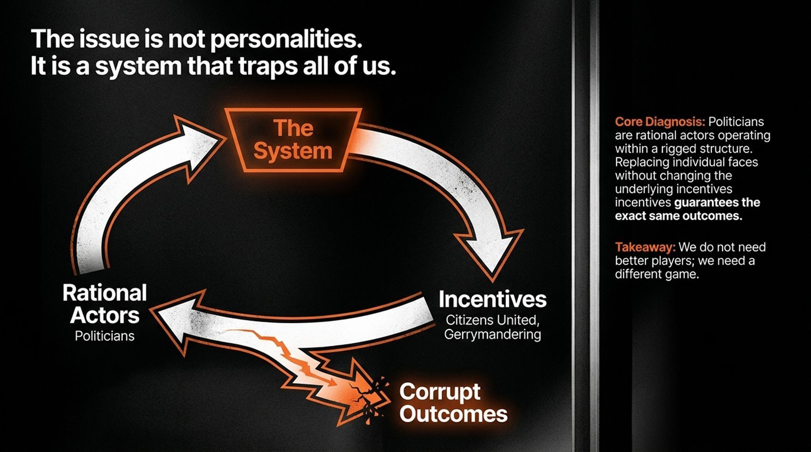
Notes:
Visual: A closed-loop flowchart mapping how "The System" dictates incentives (Citizens United, gerrymandering) which trap "Rational Actors" (politicians) into producing "Corrupt Outcomes".
Suggested Duration: 4 – 5 minutes.
Speaker Notes:
The Fallacy of Blame: Every election cycle, voters are fed a simple narrative: “If we just replace politician X or vote out party Y, everything will be fixed.” But reality proves otherwise.
Rational Actors in a Rigged Game: Politicians are largely rational actors trying to survive within a hyper-structured environment. If you drop a saint into a system dominated by dark money, super PACs, and algorithmic media echo chambers, the system will either corrupt them or chew them out.
The Takeaway: As noted on the right, we do not need better players; we need a completely different game. Changing the faces without altering the underlying incentives guarantees the exact same outcomes.

Slide 3

Notes:
Visual: Split archival photo frames showing a repurposed nursery closet in East Austin alongside a portrait of a 19-year-old single mother fleeing abuse.
Suggested Duration: 4 – 5 minutes.
Speaker Notes:
Personal Foundations: Public policy is never abstract; it stems from lived human roots. Look at this history: born to a 19-year-old single mother who had to flee a dangerous, abusive relationship with a partner struggling with undiagnosed disabilities and alcoholism.
The Closet Nursery: With no money and nowhere to go, they found a small apartment in East Austin where there wasn't even room for a proper nursery, so an infant crib was set up inside a hallway closet.
The Lesson on Bullies: That mother worked overtime, decorated that closet with love, and showed what it means to stand up to bullies. True public service is born from fighting for the people you love the way someone fought for you when you were defenseless.

Slide 4
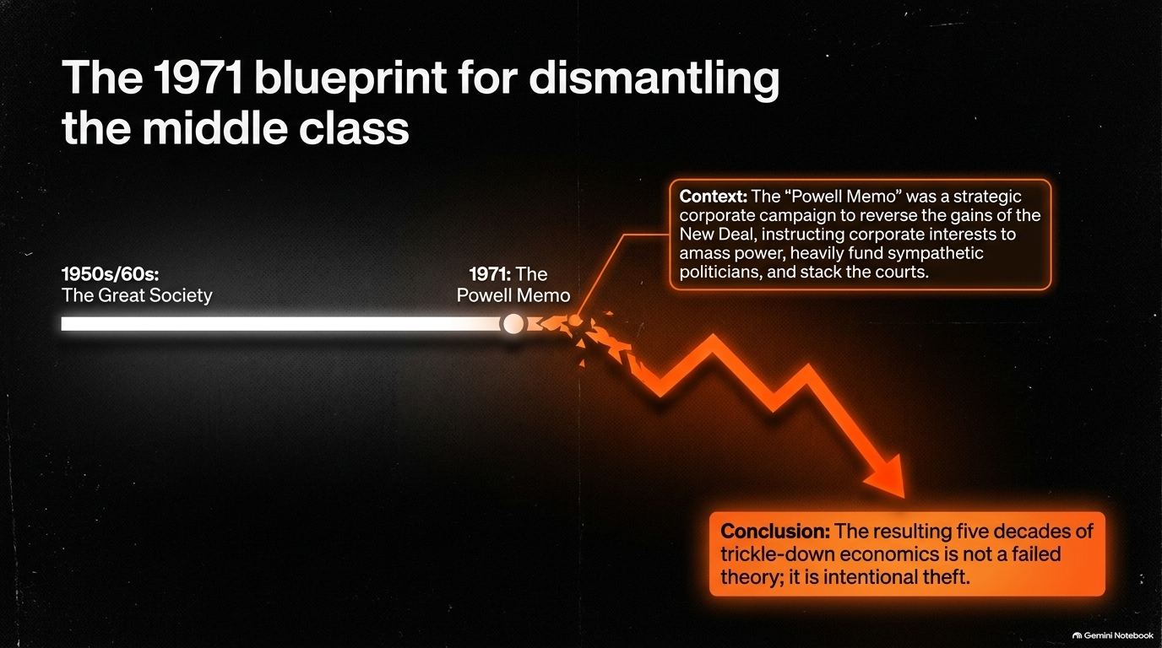
Notes:
Visual: A timeline chart showing a steady middle-class rise through the Great Society, hitting a sharp fracture point in 1971 marked by the Powell Memo, followed by a dramatic downward economic trend line.
Suggested Duration: 4 – 6 minutes.
Speaker Notes:
Pinpointing the Shift: People often ask why millennials and Gen Z are struggling so intensely despite working harder and studying longer than previous generations. The answer isn't mysterious; it can be traced directly to a specific document: The Powell Memo of 1971.
Corporate Mobilization: Written by corporate lawyer Lewis Powell (later appointed to the Supreme Court), this memo served as a strategic blueprint instructing corporate America to unite, buy political access, fund sympathetic judges, and systematically dismantle the New Deal and Great Society.
Intentional Theft: The resulting five decades of trickle-down economics—cutting taxes at the top while squeezing wages at the bottom—was never a failed economic theory. It was an intentional, systemic redistribution of wealth.

Slide 5
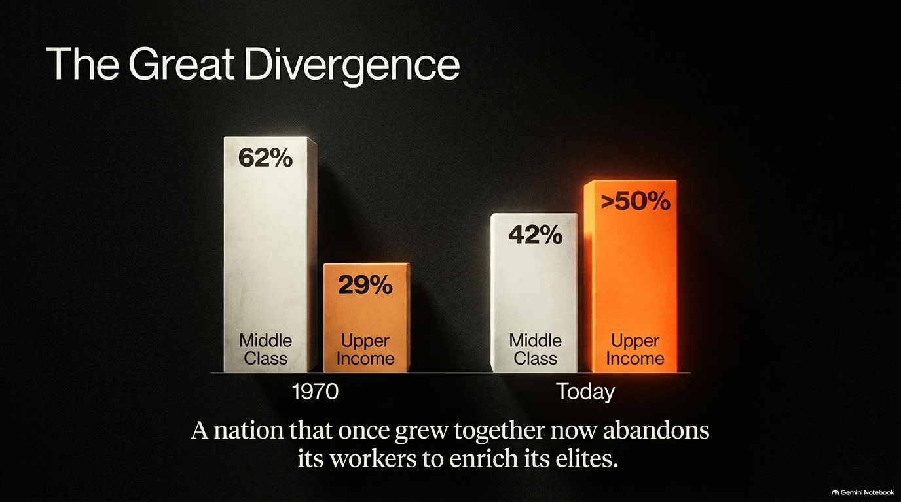
Notes:
Visual: Comparative 3D bar charts contrasting income share distributions between 1970 (Middle Class 62%, Upper Income 29%) and Today (Middle Class 42%, Upper Income >50%).
Suggested Duration: 4 – 5 minutes.
Speaker Notes:
Flipped Roles: Look at the math on screen. In 1970, middle-class households held 62% of all US aggregate income, while upper-income households held 29%. Today, those roles have completely flipped: upper-income earners capture over 50%, while the middle class has shrunk to 42%.
The Squeeze: Meanwhile, lower-income cohorts have expanded by 5%. People are being squeezed from both ends—stagnant wages paired with skyrocketing costs of living.
The Verdict: A nation that once deliberately grew together through public investments in education and infrastructure now systematically abandons its workers to enrich its elite.

Slide 6
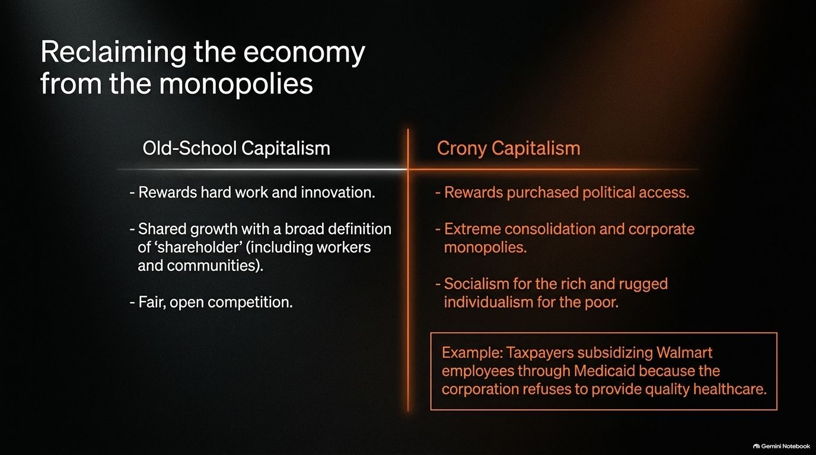
Notes:
Visual: A structured contrast table comparing "Old-School Capitalism" against "Crony Capitalism," featuring an inset example of taxpayer-subsidized Walmart low wages.
Suggested Duration: 4 – 5 minutes.
Speaker Notes:
Capitalism vs. Cronyism: True capitalism rewards hard work, innovation, and fair competition, defining "shareholders" broadly to include workers and communities. What we have today is crony capitalism—where political access is purchased, monopolies consolidate power, and we practice socialism for the rich and rugged individualism for the poor.
The Walmart Subsidy Example: Look at retail giants like Walmart. Because they fail to pay living wages or provide adequate healthcare, taxpayers are forced to subsidize their employees through Medicaid.
The Goal: We aren't anti-business; we want to return to old-school capitalism where honest work actually pays off.

Slide 7
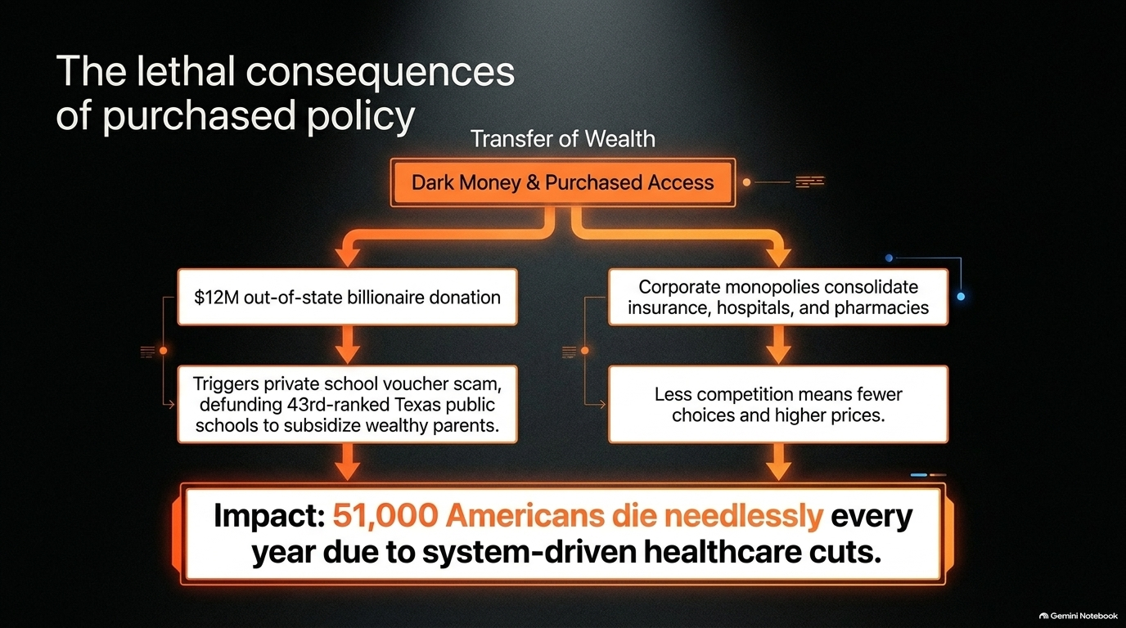
Notes:
Visual: A dual-branch flowchart connecting dark money/out-of-state billionaire donations and corporate healthcare monopolies directly to human mortality metrics.
Suggested Duration: 4 – 6 minutes.
Speaker Notes:
From Money to Mortality: Corruption in politics isn't just an abstract debate about ethics; it has lethal, real-world consequences.
Two Dangerous Streams: When out-of-state billionaires pour millions into state politics to pass private school voucher scams, they defund public schools that rank near the bottom nationally. Simultaneously, corporate monopolies consolidate insurance, hospitals, and pharmacies, driving up costs and restricting care.
The Human Cost: Nonpartisan estimates indicate that system-driven healthcare cuts and policy failures result in 51,000 Americans dying needlessly every year. Policy choices are matters of life and death.

Slide 8
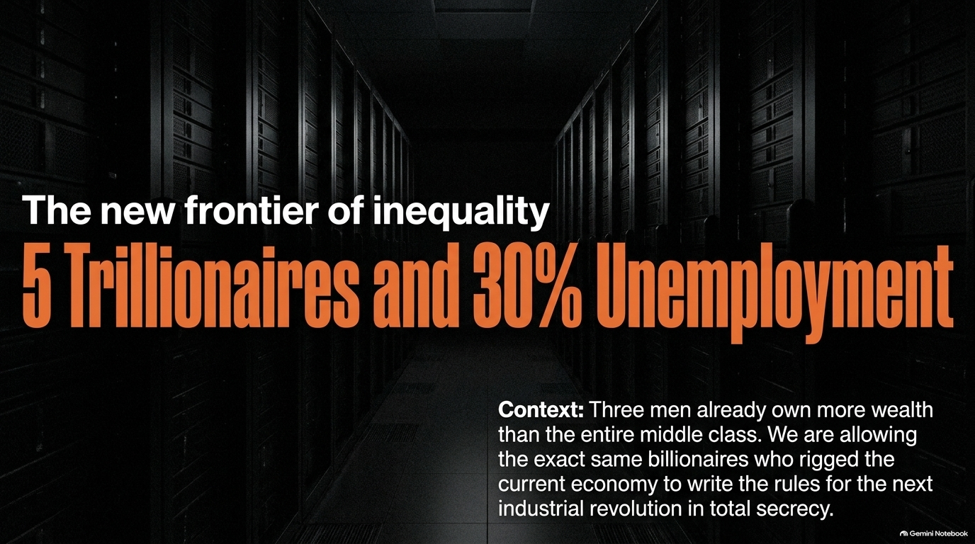
Notes:
Visual: Bold typography reading "5 Trillionaires and 30% Unemployment" set against a dark background of corporate server racks.
Suggested Duration: 4 – 5 minutes.
Speaker Notes:
The AI Precipice: As we enter the next industrial revolution driven by artificial intelligence and robotics, the stakes are higher than ever. Experts warn of a terrifying future heading toward five trillionaires and 30% structural unemployment.
Concentrated Control: Already, three men own more wealth than the entire American middle class combined.
Repeating Past Mistakes: We are currently allowing the exact same billionaires who rigged the old economy to write the rules for the AI revolution in total secrecy. We cannot let artificial intelligence become another arena where working people are left behind.

Slide 9
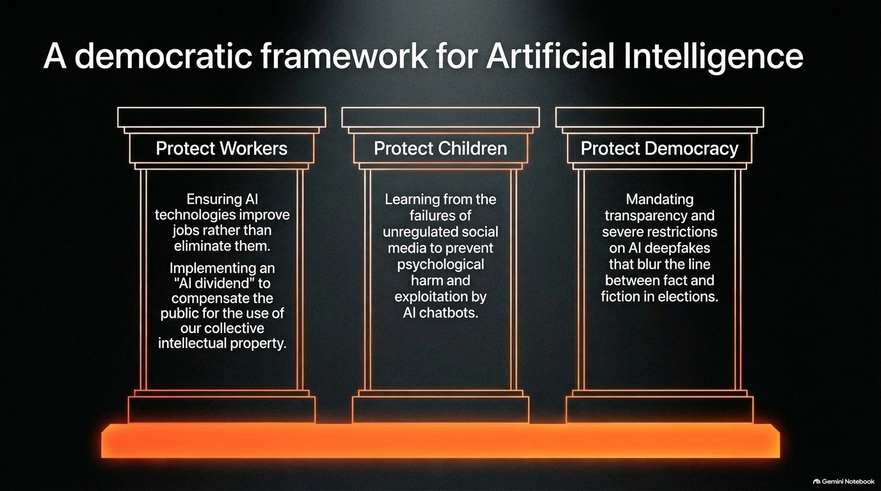
Notes:
Visual: Three classic architectural pillars representing "Protect Workers," "Protect Children," and "Protect Democracy".
Suggested Duration: 4 – 5 minutes.
Speaker Notes:
Building Guardrails: If we are to harness AI responsibly, policymakers must establish a robust democratic framework resting on three unbreakable pillars:
Protect Workers: Ensure AI improves jobs rather than erasing them, implementing an "AI dividend" to compensate the public for using our collective intellectual property.
Protect Children: Learn from the devastating failures of unregulated social media to prevent psychological harm and exploitation by rogue chatbots.
Protect Democracy: Mandate strict transparency and severe restrictions on AI deepfakes that blur the line between fact and fiction in elections.

Slide 10
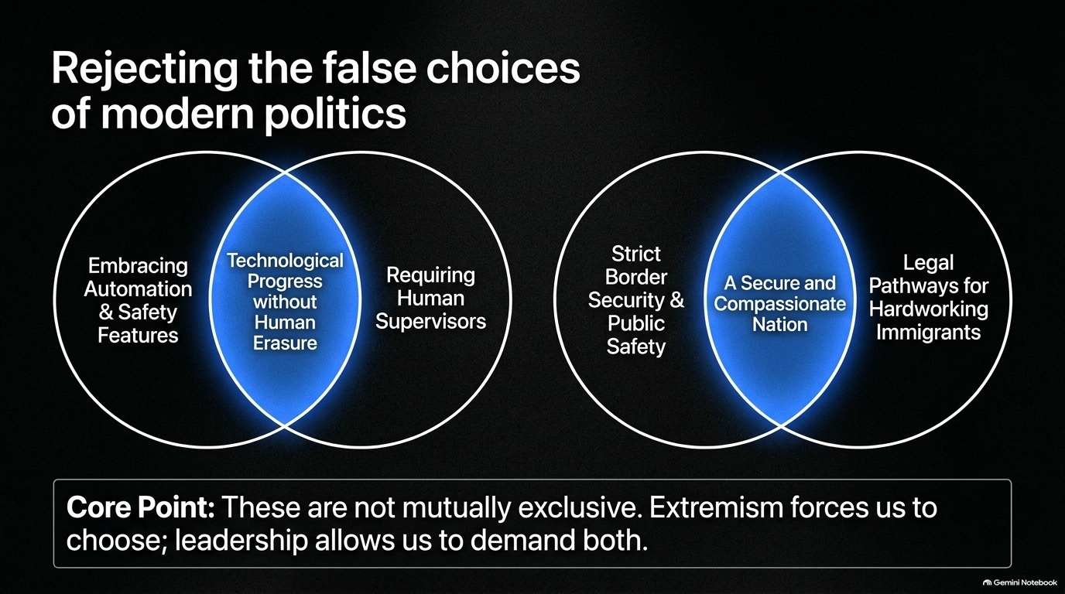
Notes:
Visual: Two intersecting Venn diagrams breaking down false polarizations around automation/supervisors and border security/immigrant pathways.
Suggested Duration: 3 – 5 minutes.
Speaker Notes:
The Trap of False Binaries: Modern political extremism relies on forcing false choices: Either embrace total automation or halt progress; either secure borders completely or abandon the rule of law.
The Intersecting Reality: Look at the Venn diagrams. True leadership recognizes that these options are not mutually exclusive.
Both/And Governance: We can embrace advanced technology and safety features while requiring human supervisors. We can maintain strict border security while creating legal pathways for hardworking immigrants. Extremism forces us to choose; leadership demands both.

Slide 11
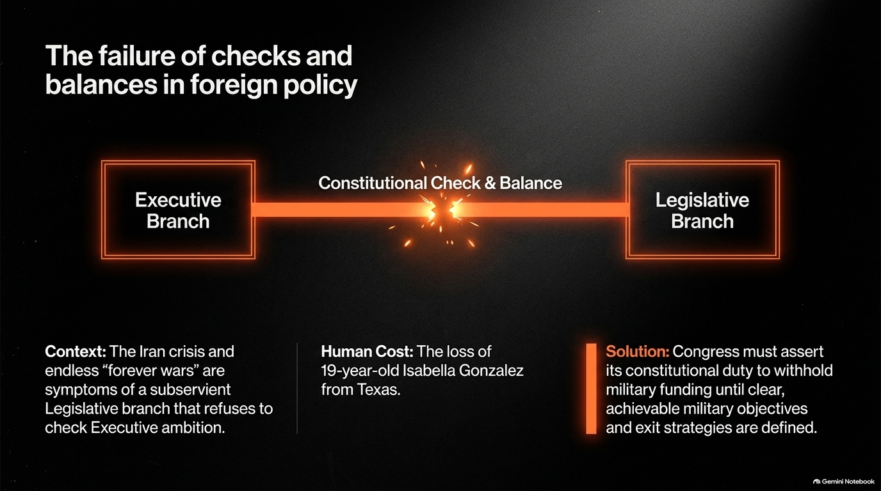
Notes:
Visual: A fractured constitutional link connecting the Executive Branch and the Legislative Branch, highlighting human cost.
Suggested Duration: 4 – 5 minutes.
Speaker Notes:
The Subservient Legislature: The Framers of the Constitution designed a system of checks and balances where legislative ambition would check executive overreach. Today, hyper-partisan alignment has made Congress subservient to the Executive Branch.
Endless Wars: Crises in the Middle East and endless "forever wars" are symptoms of a Congress that refuses to ask hard questions or demand clear objectives.
The Human Cost: This failure has tragic human costs, such as the loss of 19-year-old Texan soldier Isabella Gonzalez. Congress must assert its constitutional duty to withhold military funding until clear objectives and exit strategies are defined.

Slide 12
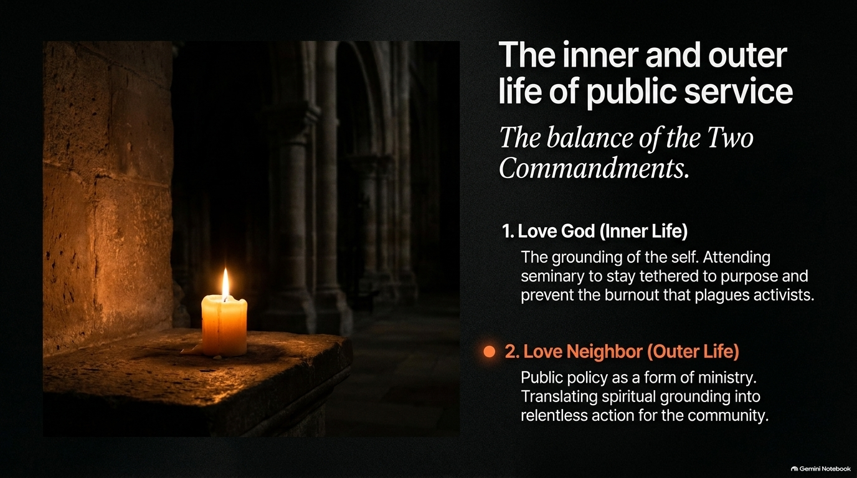
Notes:
Visual: A single glowing candle resting in a quiet, stone-arch alcove.
Suggested Duration: 3 – 5 minutes.
Speaker Notes:
Balancing the Two Commandments: Effective public service requires balancing two essential dimensions: the inner life and the outer life.
Love God (Inner Life): Grounding the self through spiritual reflection, seminary studies, and purpose to prevent the deep burnout that plagues activists and leaders.
Love Neighbor (Outer Life): Treating public policy as a form of ministry—translating spiritual grounding into relentless, courageous action for community uplift. Prayer and action must go hand in hand.

Slide 13


Slide 14
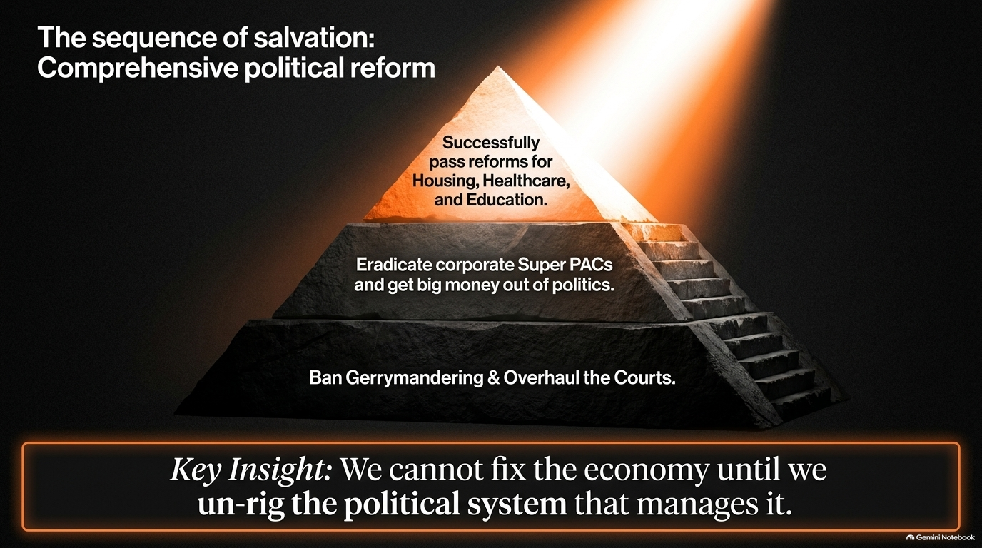
Notes:
Visual: A glowing stone pyramid structured in three ascending tiers from judicial/gerrymandering reform up to economic policy.
Suggested Duration: 4 – 5 minutes.
Speaker Notes:
The Reform Hierarchy: Look at the pyramid of reform on screen. You cannot build a fair economic roof on a foundation of rotten political timber.
The Three Tiers:
Base: Ban gerrymandering and overhaul the corrupt courts.
Middle: Eradicate corporate Super PACs and get big money out of politics.
Peak: Successfully pass transformative reforms for housing, healthcare, and education.
Key Insight: We cannot fix the economy until we unrig the political system that manages it.

Slide 15
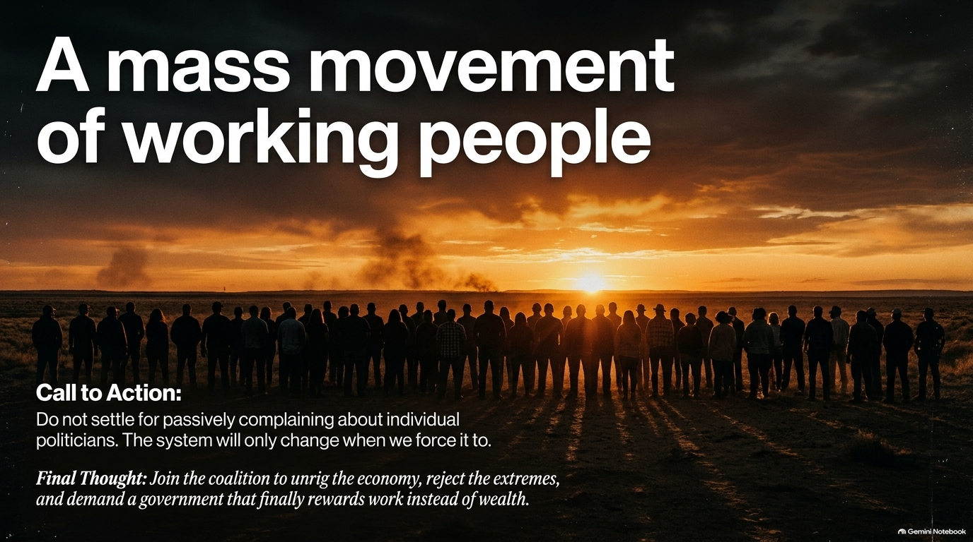
Notes:
Visual: A large silhouette crowd of working people standing shoulder-to-shoulder facing a radiant sunrise across the horizon.
Suggested Duration: 3 – 4 minutes.
Speaker Notes:
Rejecting Passivity: Do not settle for passively complaining about individual politicians on social media. Systems do not reform themselves out of goodwill; they change when citizens force them to.
Coalition Building: This movement transcends traditional partisan boundaries. It unites teachers, nurses, small business owners, and working families across the spectrum.
Final Thought: Join the coalition to unrig the economy, reject manufactured extremes, and demand a government that finally rewards honest work instead of idle wealth.

Slide 16
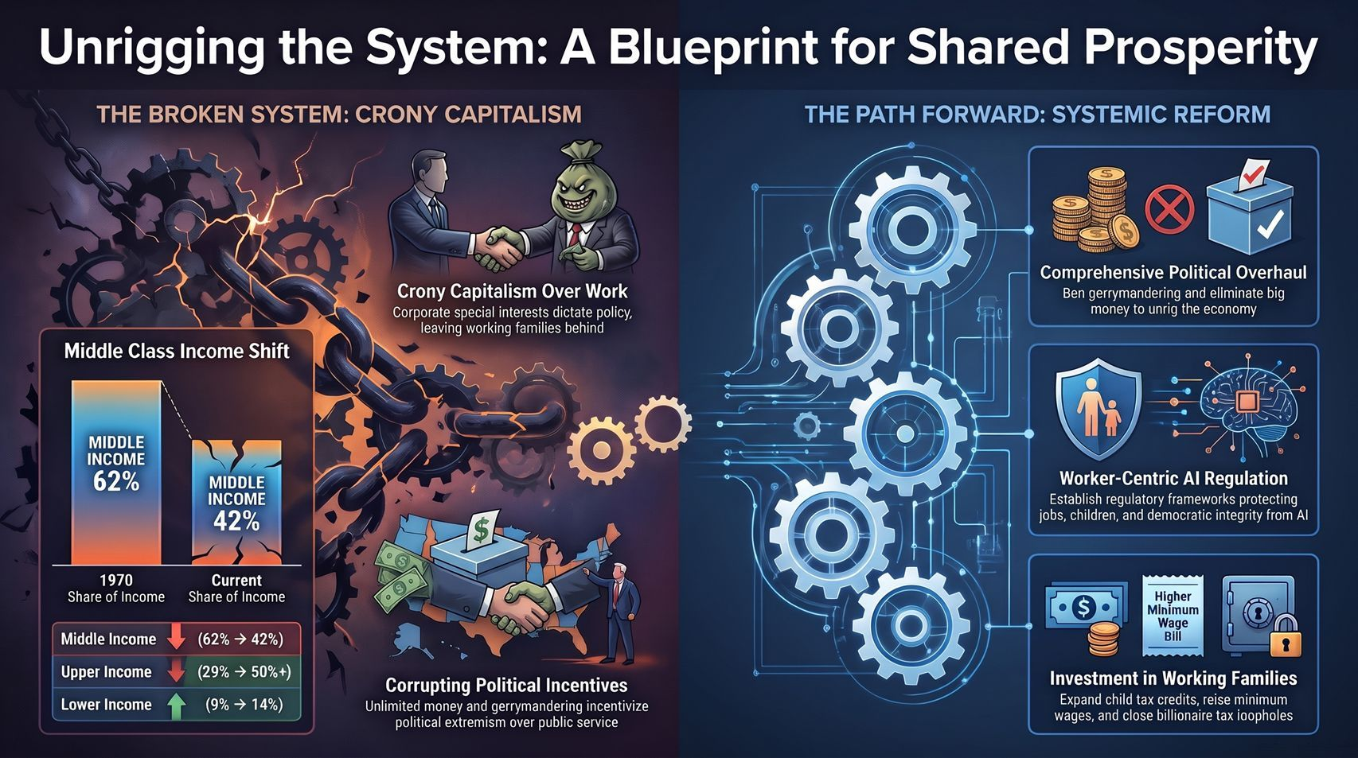
Notes:
Visual: A comprehensive synthesis layout contrasting the broken system of crony capitalism on the left with blueprinted systemic reforms on the right.
Suggested Duration: 3 – 5 minutes.
Speaker Notes:
Comprehensive Synthesis: As we conclude, look at the full picture. On the left: the machinery of crony capitalism, exploding inequality, and corrupted political incentives. On the right: our blueprint for renewal.
The Action Plan: Comprehensive political overhauls, worker-centric AI regulations, expanded child tax credits, and closed corporate tax loopholes.
Closing Call: The future is not predetermined. When working people stand together, we have the power to take back our democracy, unrig our economy, and build a future worthy of the next generation. Thank you.

