Slide 1
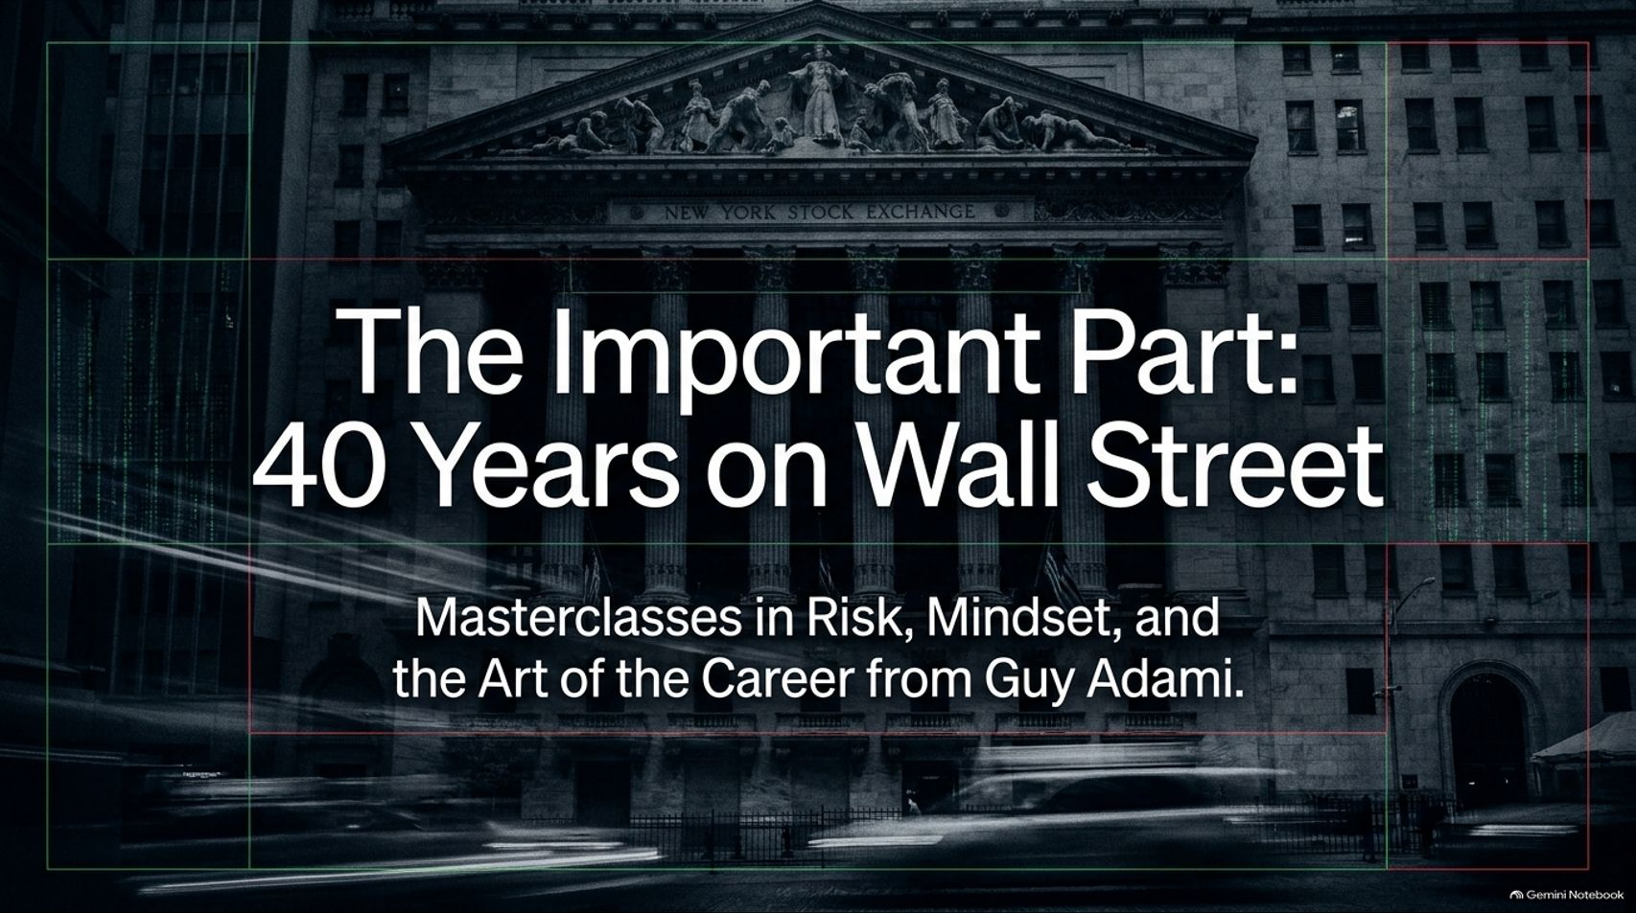
Notes:
Duration Guide: 2 – 3 minutes
Core Presentation Theme: Welcome the audience and set the premise. Emphasize that this masterclass steps away from daily tickers, interest rate chatter, and individual stock picks (like semiconductors or AI) to focus on the enduring, hard-earned wisdom of a 40-year Wall Street career.
Speaker Notes:
"Welcome everyone to today’s masterclass: 'The Important Part: 40 Years on Wall Street'. Today, we aren't going to talk about today's tech trade, semiconductors, or quarterly earnings. Instead, we are looking at the lasting philosophy of markets, mindset, and career survival."
"Over four decades on and around Wall Street—from the high-octane physical trading pits of the 1980s to the digital screens of today—guest Guy Adami has witnessed the complete transformation of market mechanics."
"The core takeaway right from the start is simple: while the tools of the trade have changed entirely, human psychology—fear, greed, ego, and resilience—remains exactly the same. Over the next 15 segments, we’re going to unpack the three pillars of market survival: The Arena, The Mind, and The Player. Let’s dive in."
Wall Street Is Changing: What Investors Need to Know | The Important Part
https://www.youtube.com/watch?v=jDIWza3Vr1E

Slide 2
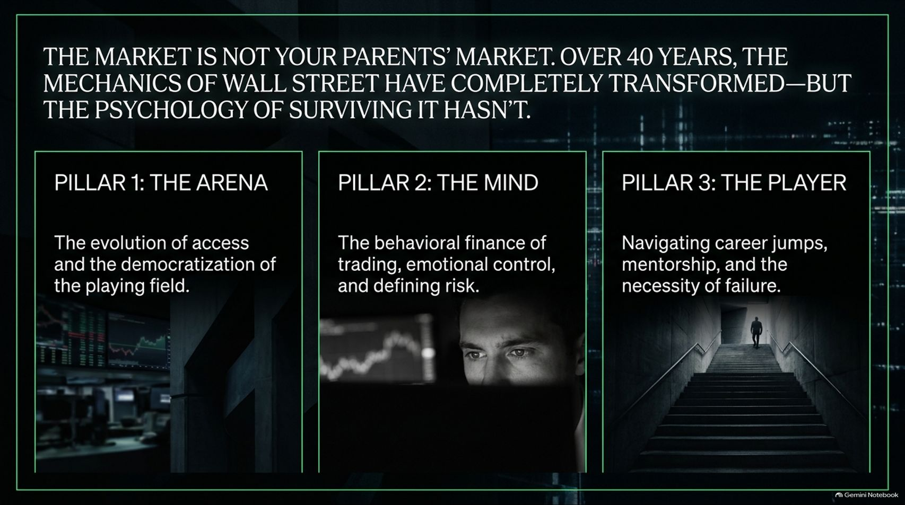
Notes:
Duration Guide: 3 – 4 minutes
Core Presentation Theme: Introduce the structural framework of the presentation: The Arena (evolution of markets), The Mind (behavioral finance and risk), and The Player (career navigation and mentorship).
Speaker Notes:
"To understand how to last four decades in this industry, we have to break wisdom down into three foundational pillars."
"Pillar 1: The Arena. Markets are completely different today than they were in 1985. We will look at how access has democratized, lowering barriers and costs to historic lows."
"Pillar 2: The Mind. This is where behavioral finance lives. Trading is a psychological battlefield. We’ll examine emotional control, what it means to truly define risk, and why 70% of professional success is about how you handle failure."
"Pillar 3: The Player. Careers aren't linear. They require knowing when to jump platforms, how to secure powerful sponsorship, and why embracing failure is the ultimate currency. Let's explore Pillar 1: The Arena."

Slide 3
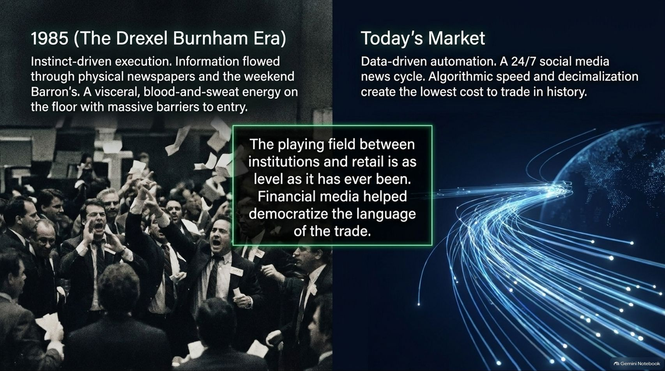
Notes:
Duration Guide: 4 – 5 minutes
Core Presentation Theme: Contrast the visceral, instinct-driven physical trading floor of Drexel Burnham in 1985 with today's 24/7 algorithmic, social-media-driven landscape.
Speaker Notes:
"Let’s cast our minds back to December 1985. Guy Adami stepped onto the trading floor of Drexel Burnham Lambert—the 'Oakland Raiders' of Wall Street."
"Back then, execution was entirely instinct-driven. Information traveled via physical newspapers and weekend editions of Barron's. The trading floor had a physical smell, a blood-and-sweat energy, massive barriers to entry, and commodities trading that ran continuously from Sunday afternoon in Australia to Friday close in New York."
"Fast forward to today: data-driven automation, a 24/7 social media news cycle, algorithmic speeds, and decimalization have created the lowest cost to trade in history."
"The playing field between major institutions and retail investors is as level as it has ever been. Financial media and accessible platforms have democratized the language of the trade, allowing anyone with a smartphone to participate. But with that access comes a new psychological burden."

Slide 4
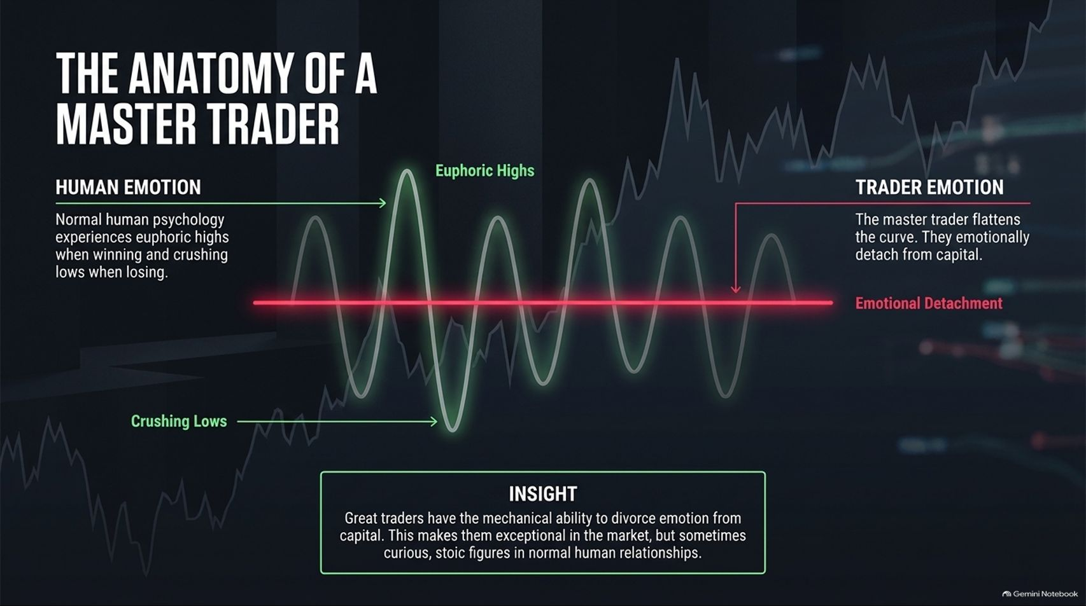
Notes:
Duration Guide: 4 – 6 minutes
Core Presentation Theme: Analyze the emotional sine wave of normal human psychology versus the flatlined emotional detachment of a master trader.
Speaker Notes:
"Normal human psychology operates on a dramatic emotional sine wave. When we win, we experience euphoric highs; when we lose, we experience crushing lows. That is normal human behavior."
"However, master traders possess an uncommon mechanical ability: the capacity to divorce emotion from capital. They flatten the curve."
"By emotionally detaching themselves from money, they can execute stop-losses and take profits without panic or greed."
"As Adami notes, this makes them exceptional market operators, but it can sometimes make them stoic, highly curious figures in normal human relationships where emotional range is expected. To survive, you must learn to manage capital mechanically, not emotionally."

Slide 5
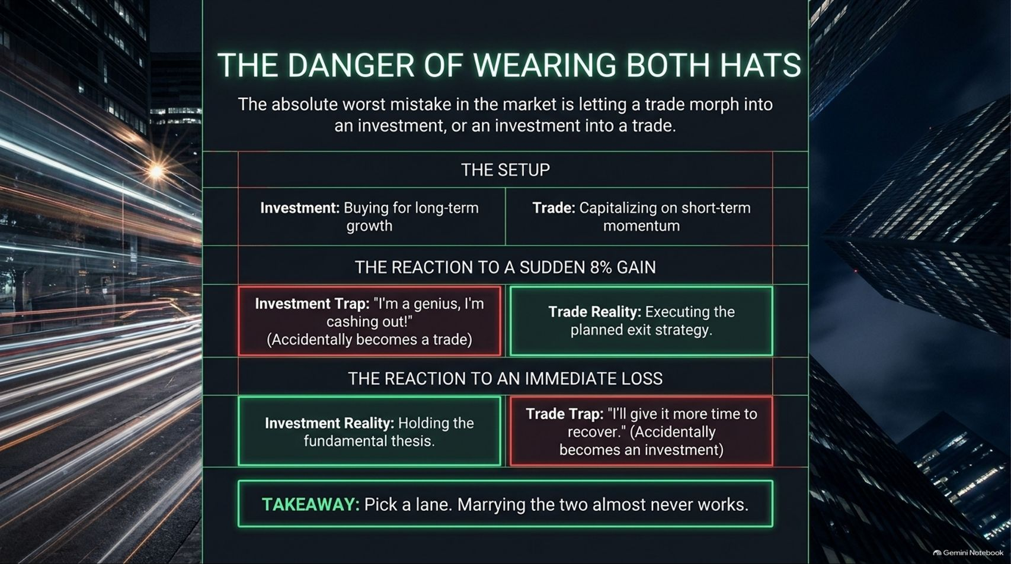
Notes:
Duration Guide: 4 – 5 minutes
Core Presentation Theme: Highlight the cardinal sin of letting a short-term trade morph into a permanent investment (or vice versa).
Speaker Notes:
"One of the most dangerous traps on Wall Street is wearing both hats at the same time: blurring the line between an investment and a trade."
"An investment is buying for long-term growth based on a fundamental thesis. A trade is capitalizing on short-term momentum."
"Look at the traps: When a stock bought as an investment jumps 8% in two days, amateur investors panic, cash out, and accidentally turn an investment into a short-term trade out of fear of losing the gain."
"Conversely, when a short-term trade goes against you immediately, the psychological trap whispers: 'I'll give it more time to recover,' turning a failed trade into a stagnant, losing investment."
"The takeaway? Pick a lane. Marrying the two almost never works."

Slide 6
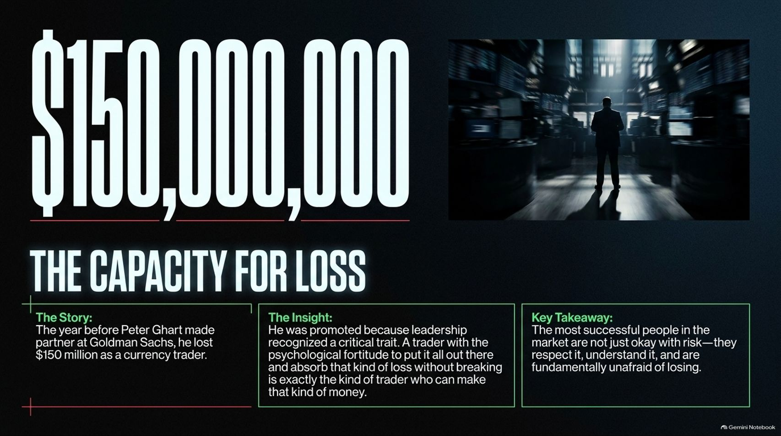
Notes:
Duration Guide: 4 – 5 minutes
Core Presentation Theme: Share the story of Peter Ghart at Goldman Sachs to illustrate that elite market participants are fundamentally unafraid of losing.
Speaker Notes:
"Consider this staggering number: $150,000,000."
"Guy Adami shares a legendary story about his time at Goldman Sachs regarding Peter Ghart, a currency trader who lost approximately $150 million the year before he was made partner."
"To an outsider, that sounds insane. Why promote someone who lost that much money? Because leadership recognized a critical trait: Peter had the psychological fortitude to put it all on the line, absorb a catastrophic loss without breaking, and come back to the desk the next day."
"A trader who can absorb that kind of loss is exactly the kind of trader who can generate massive returns. The most successful people in the market don’t just tolerate risk—they respect it, understand it, and are fundamentally unafraid of losing."

Slide 7
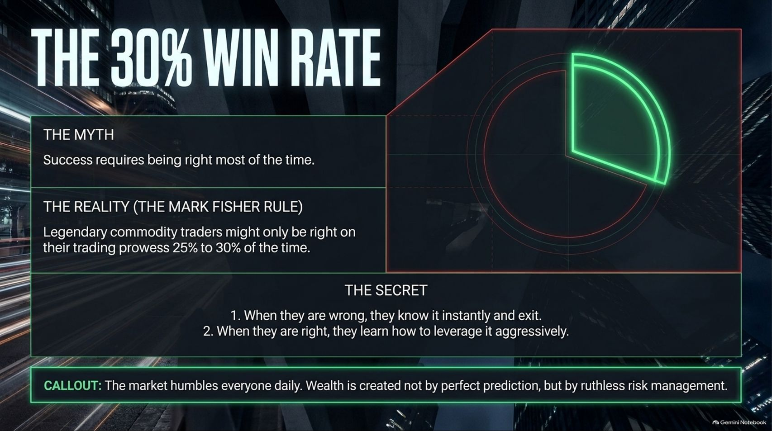
Notes:
Duration Guide: 4 – 5 minutes
Core Presentation Theme: Debunk the myth that success requires being right most of the time, introducing legendary commodity trader Mark Fisher's rule on ruthless risk management.
Speaker Notes:
"A common myth for retail investors is that success requires being right on most of your trades."
"The reality, championed by legendary commodity trader Mark Fisher, is that elite traders might only be right on their directional market predictions 25% to 30% of the time."
"So how do they build massive wealth? Two rules: First, when they are wrong, they know it instantly and exit without ego. Second, when they are right, they aggressively leverage and maximize that position."
"The market humbles everyone daily. Wealth is created not through perfect prediction, but through ruthless risk management and cutting losses immediately."

Slide 8
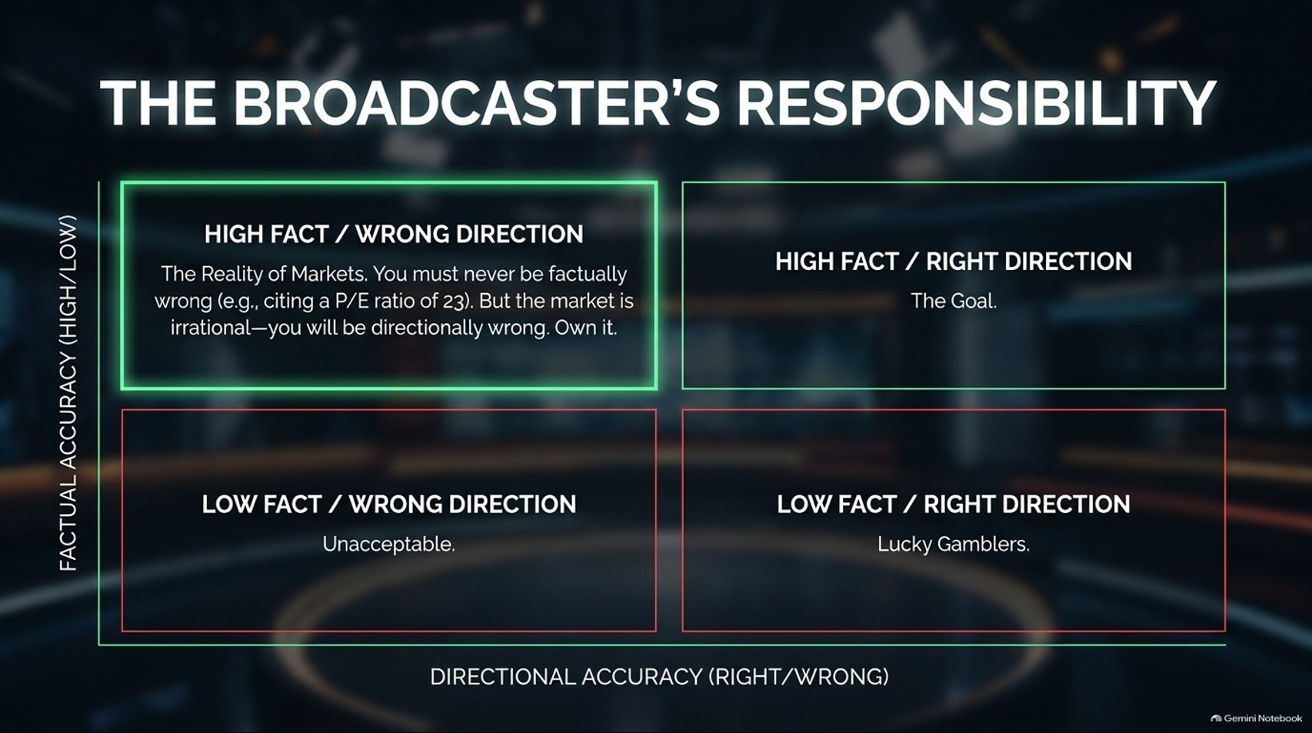
Notes:
Duration Guide: 3 – 4 minutes
Core Presentation Theme: Analyze the matrix of factual accuracy versus directional accuracy in financial commentary and public media.
Speaker Notes:
"For those in financial media—like Adami and Liz Thomas on CNBC and digital platforms—there is a profound ethical responsibility."
"Look at the four quadrants of accuracy. Factual Accuracy (vertical axis) versus Directional Accuracy (horizontal axis):"
1. High Fact / Wrong Direction: This is the harsh reality of markets. You must never be factually wrong (e.g., citing a P/E ratio incorrectly). But markets are inherently irrational—you will often be directionally wrong. Own it.
2. High Fact / Right Direction: The ultimate goal.
3. Low Fact / Wrong Direction: Completely unacceptable.
4. Low Fact / Right Direction: Merely lucky gamblers.
"Integrity means your data is bulletproof, even when the market's unpredictable winds blow you off course."

Slide 9
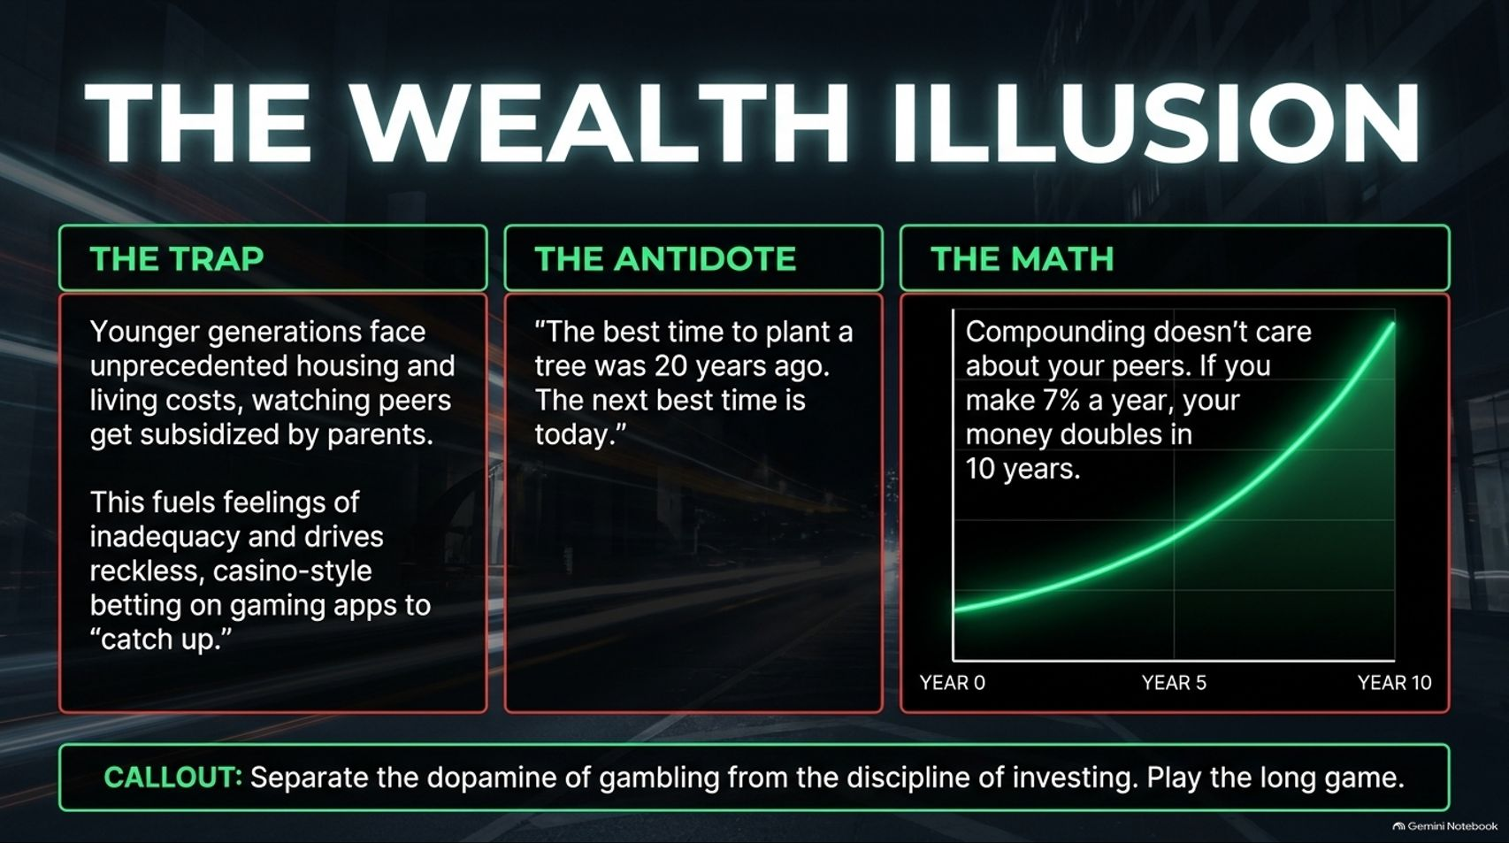
Notes:
Duration Guide: 4 – 5 minutes
Core Presentation Theme: Address the modern socio-economic anxiety of younger generations, parental subsidization, and the psychological trap of casino-style betting apps.
Speaker Notes:
"Let’s talk about the psychological pressure facing younger generations today. Unprecedented housing costs and living expenses have created a divide where many watch peers get financial down-payment subsidies from baby-boomer parents."
"This breeds feelings of inadequacy and drives reckless, casino-style betting on mobile gaming apps in an attempt to 'catch up'."
"The antidote is twofold: First, remember the old proverb: 'The best time to plant a tree was 20 years ago. The next best time is today.' Second, trust the math. Compounding doesn't care about your peers. At a 7% annual return, money doubles every decade. Separate the dopamine of gambling from the discipline of investing."

Slide 10
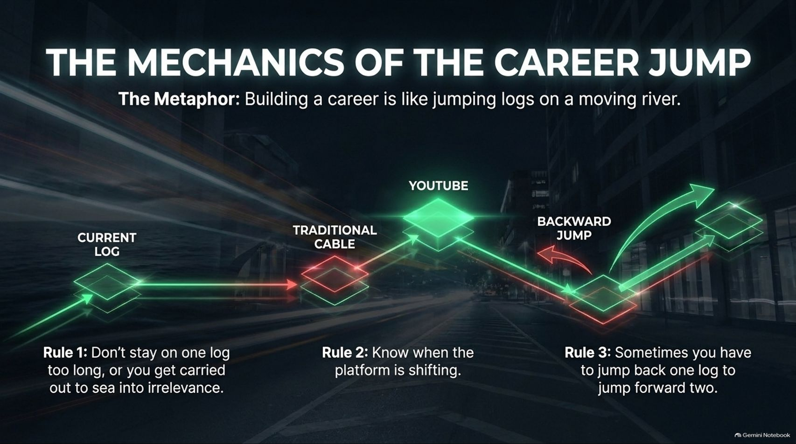
Notes:
Duration Guide: 4 – 5 minutes
Core Presentation Theme: Use the retro video game metaphor (Frogger) to explain career progression, platform shifts (cable to YouTube), and strategic backward steps.
Speaker Notes:
"Now we transition to Pillar 3: The Player and career evolution. Guy Adami uses a brilliant metaphor for career progression: the classic 1980s video game Frogger."
"Building a career is like jumping logs on a moving river."
“Rule 1: Don’t stay on one log too long, or you get carried out to sea into irrelevance.”
“Rule 2: Know when the platform is shifting.” Just as media migrated from physical newspapers to cable TV, and now to YouTube and streaming, you must recognize structural industry shifts.
“Rule 3: Sometimes you have to jump back one log to jump forward two.” Strategic regression or taking a calculated risk in a new direction often unlocks exponential future growth.

Slide 11
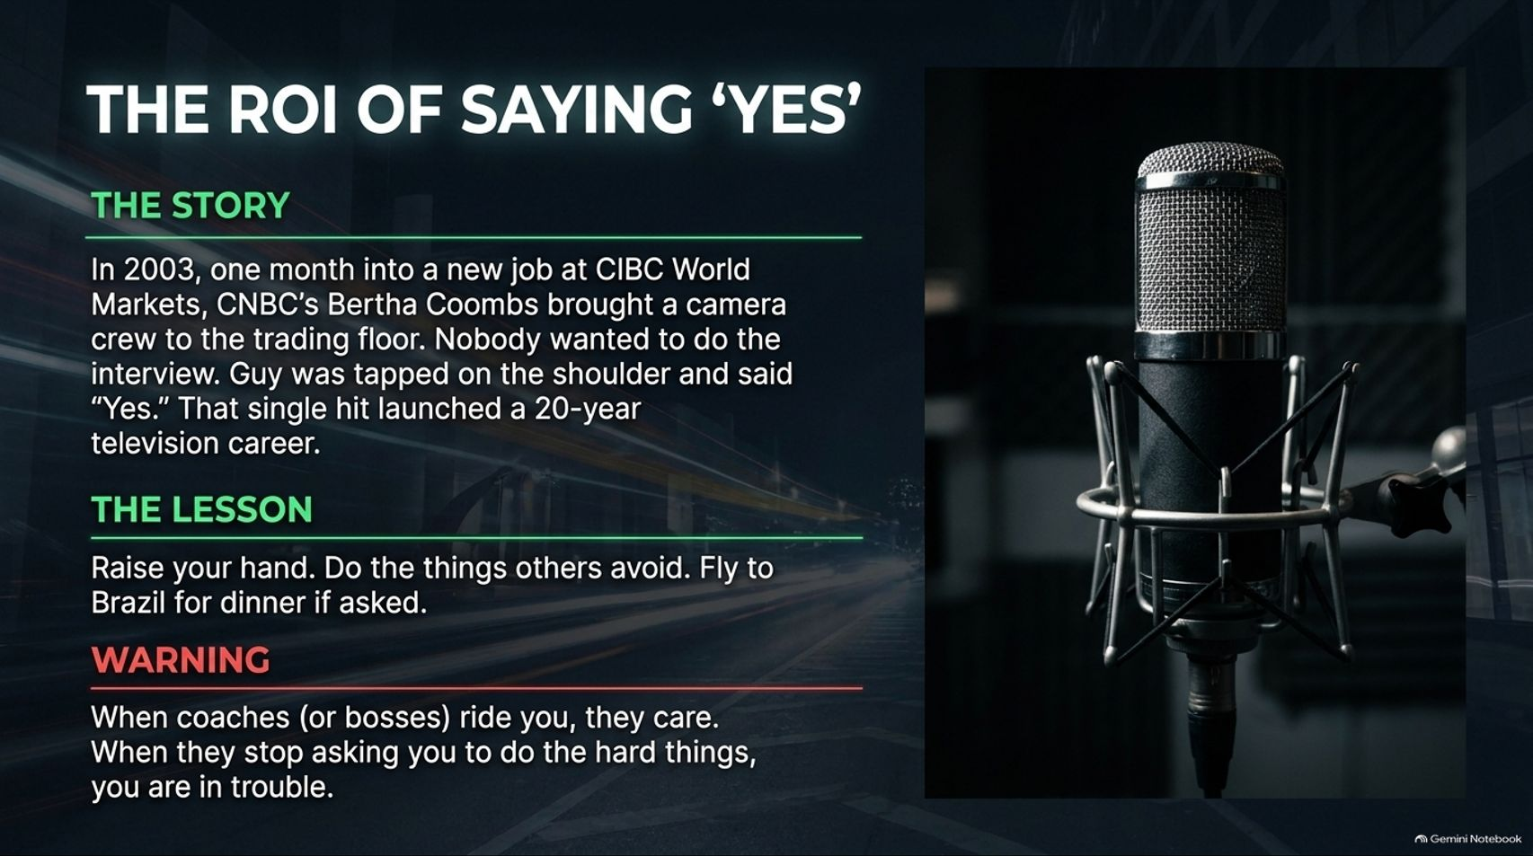
Notes:
Duration Guide: 4 – 5 minutes
Core Presentation Theme: Share the story of Adami's accidental 20-year television career sparked by saying "yes" to a camera crew when no one else wanted to step up.
Speaker Notes:
"How did a 20-year television career start? By sheer accident, driven entirely by the ROI of saying 'Yes.'"
"In 2003, just one month into a new job at CIBC World Markets, CNBC’s Bertha Coombs arrived on the trading floor with a camera crew. Nobody wanted to do the on-camera interview."
"Guy was tapped on the shoulder and told, 'Go do it.' He said yes. That single hit on Liz Claman's show discussing commodities like molybdenum launched a media career that has spanned over two decades."
"The lesson? Raise your hand. Do the tasks others avoid. Whether it's flying to Brazil for dinner or stepping in front of a camera, be the person who says yes to the unknown. Furthermore, remember: when bosses or mentors ride you hard, it’s because they care. When they stop giving you hard tasks, you are in trouble."

Slide 12
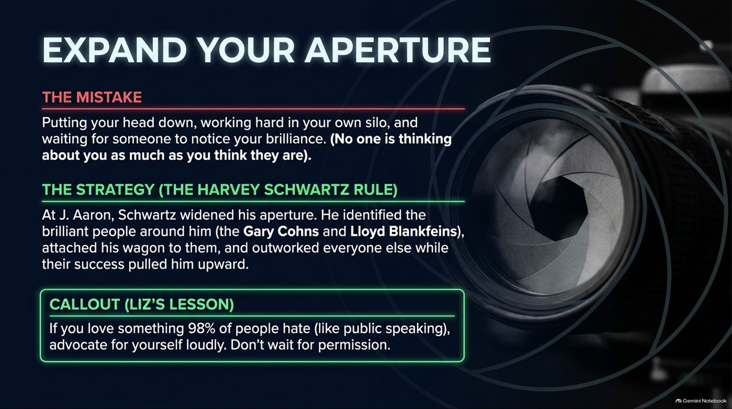
Notes:
Duration Guide: 4 – 5 minutes
Core Presentation Theme: Warn against the silo trap of working hard in isolation and advocate for the "Harvey Schwartz Rule"—identifying and attaching your wagon to high-performing leaders.
Speaker Notes:
"The ultimate career mistake is keeping your head down, working quietly in your own silo, and waiting for someone to notice your brilliance. The hard truth: No one is thinking about you as much as you think they are."
"Look at the strategy used by Carlile Group CEO Harvey Schwartz, who started alongside Adami at J. Aaron. Schwartz widened his aperture. He identified brilliant leaders around him—like Gary Cohn and Lloyd Blankfein—attached his wagon to them, and outworked everyone while their success pulled him upward."
"As Liz Thomas notes: If you possess a skill or love something that 98% of people hate—like public speaking—advocate for yourself loudly. Do not wait for permission."

Slide 13
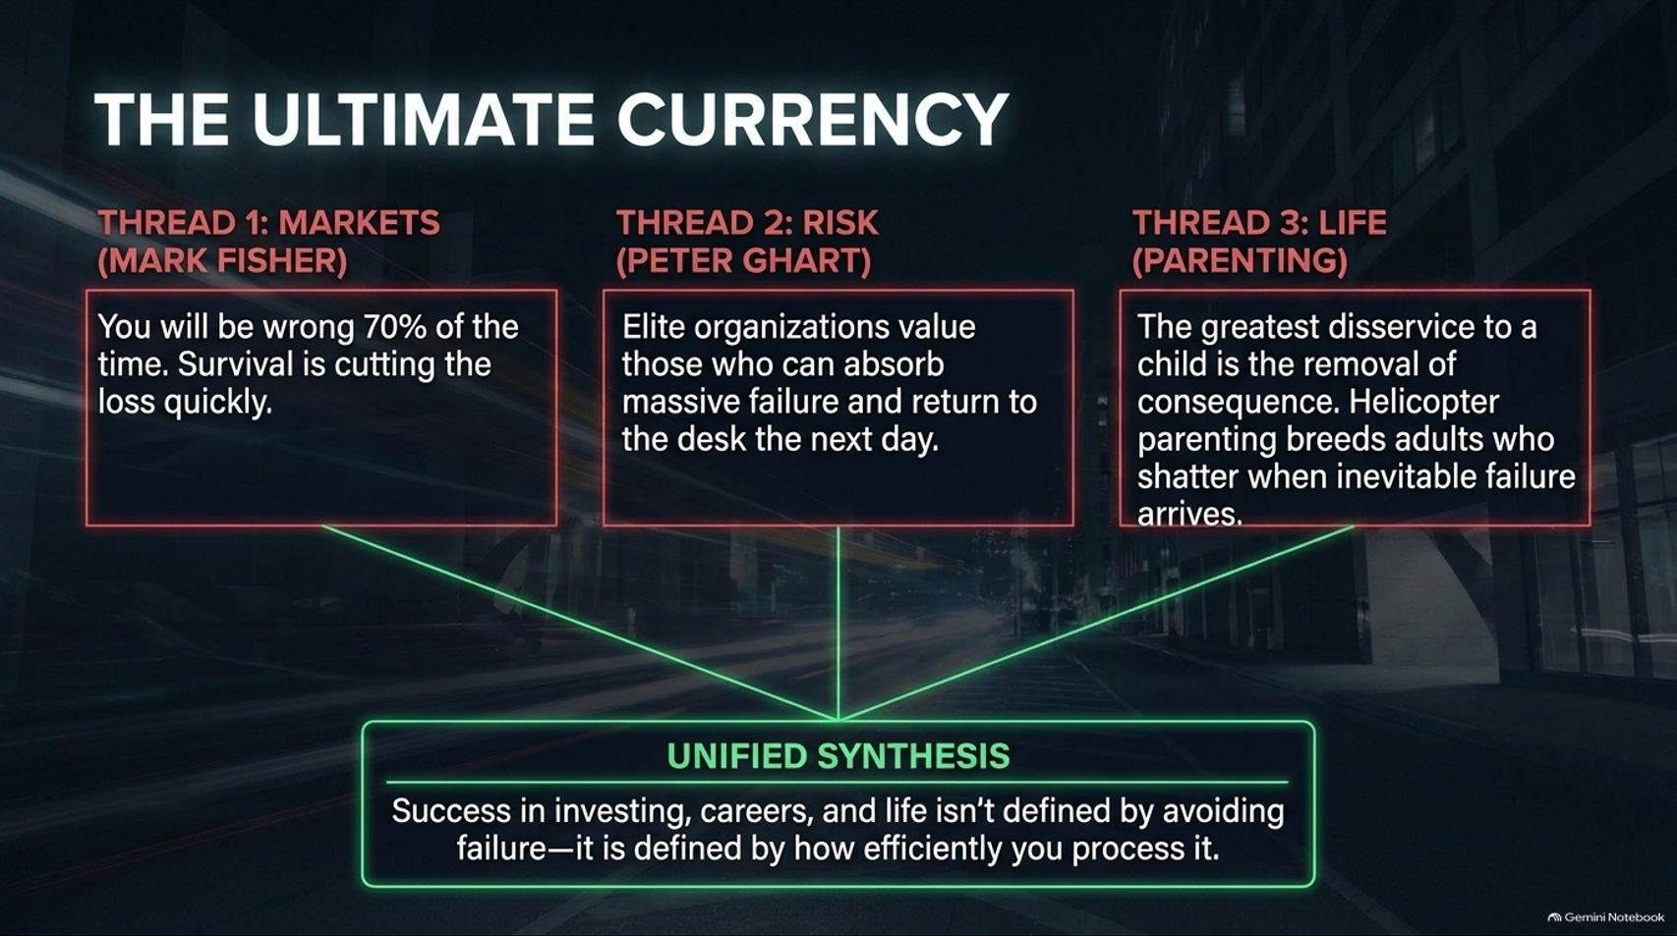
Notes:
Duration Guide: 3 – 5 minutes
Core Presentation Theme: Synthesize the three core thematic threads of the masterclass: Markets, Risk, and Life/Parenting.
Speaker Notes:
"Let’s tie these masterclasses together through three unified threads:"
"Thread 1: Markets (Mark Fisher). You will be wrong 70% of the time. Survival depends on cutting losses instantly."
"Thread 2: Risk (Peter Ghart). Elite organizations and top-tier desks value those who can absorb massive failure, take a punch, and return to the desk the next day."
"Thread 3: Life & Parenting. The greatest disservice you can do a child—or yourself—is the removal of consequence. Helicopter parenting breeds adults who shatter when inevitable failure arrives. Give the gift of failure."
"Unified Synthesis: Success in investing, careers, and life isn't defined by avoiding failure—it is defined by how efficiently you process and learn from it."

Slide 14
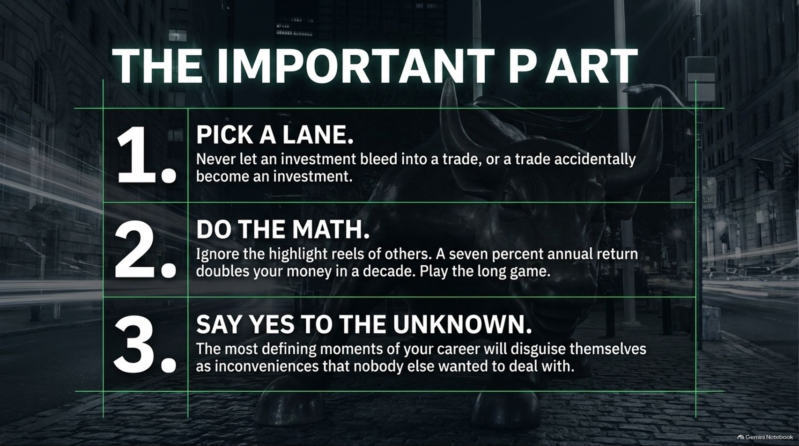
Notes:
Duration Guide: 3 – 4 minutes
Core Presentation Theme: Summarize the three core rules for personal and financial longevity.
Speaker Notes:
"As we pull all of these lessons together into 'The Important Part,' remember these three non-negotiable rules for your career and wealth:"
"1. Pick a Lane. Never let an investment bleed into a trade, or a trade accidentally become an investment. Define your time horizon and stick to your rules."
"2. Do the Math. Ignore the highlight reels and social media noise of others. A 7% annual compounding return doubles your money in a decade. Play the long game."
"3. Say Yes to the Unknown. The most defining moments of your career will disguise themselves as inconvenient tasks that nobody else wanted to touch."

Slide 15
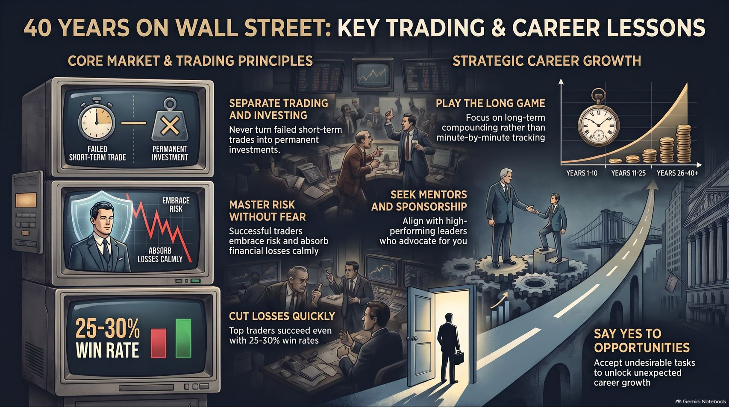
Notes:
Duration Guide: 3 – 5 minutes
Core Presentation Theme: Deliver the concluding wrap-up, reinforcing core principles across trading psychology, strategic career growth, and long-term compounding.
Speaker Notes:
"To wrap up our 40-year journey across Wall Street, let’s look at the complete landscape we’ve mapped out today:"
"On the trading side: Separate trading from investing, master risk without fear, and accept low win rates through disciplined loss mitigation."
"On the career side: Play the long game of compounding, seek out high-performing sponsors and mentors, and always raise your hand for undesirable opportunities that unlock exponential growth."
"Thank you for joining this masterclass. Take these principles, apply them to your portfolios and your career path, and remember: success belongs to those who manage risk, embrace failure, and never stop adapting."

