Slide 1
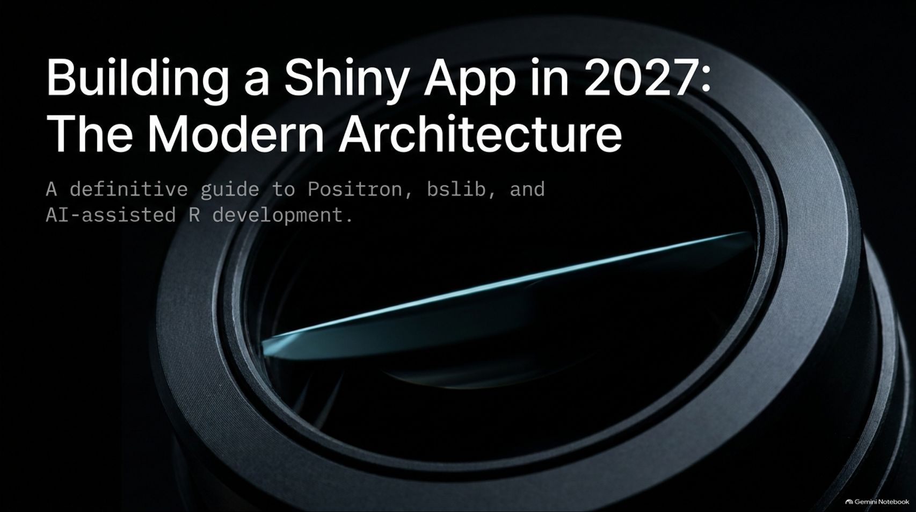
Notes:
Duration Guide: 2 – 3 minutes
Core Presentation Theme: Introduce the modern paradigm of R development. Emphasize that building Shiny applications has evolved significantly through next-generation IDEs like Posit IDE (Positron), modern UI frameworks (bslib), and AI-assisted coding agents.
Speaker Notes:
"Welcome everyone to today’s session on building modern Shiny applications. The title says 'in 2027', and for good reason—the way we write R and build web applications has fundamentally transformed."
"Gone are the days of writing thousands of lines of boilerplate code from scratch, wrestling with outdated Bootstrap 2 layouts, or guessing at syntax. Today, we are looking at a modern, highly integrated architecture built on Positron, bslib, and AI-assisted development."
"Over the next 16 slides, we’ll deconstruct the modern workflow: from remote-first GitHub setup and equipping your AI agent with specific technical skills, to dissecting the dual architecture of the UI and server. Let's explore how the developer's role has shifted from a line-by-line writer to an architectural director."
How do you build a Shiny app in 2027?
https://www.youtube.com/watch?v=QsmPw8OJlrQ

Slide 2
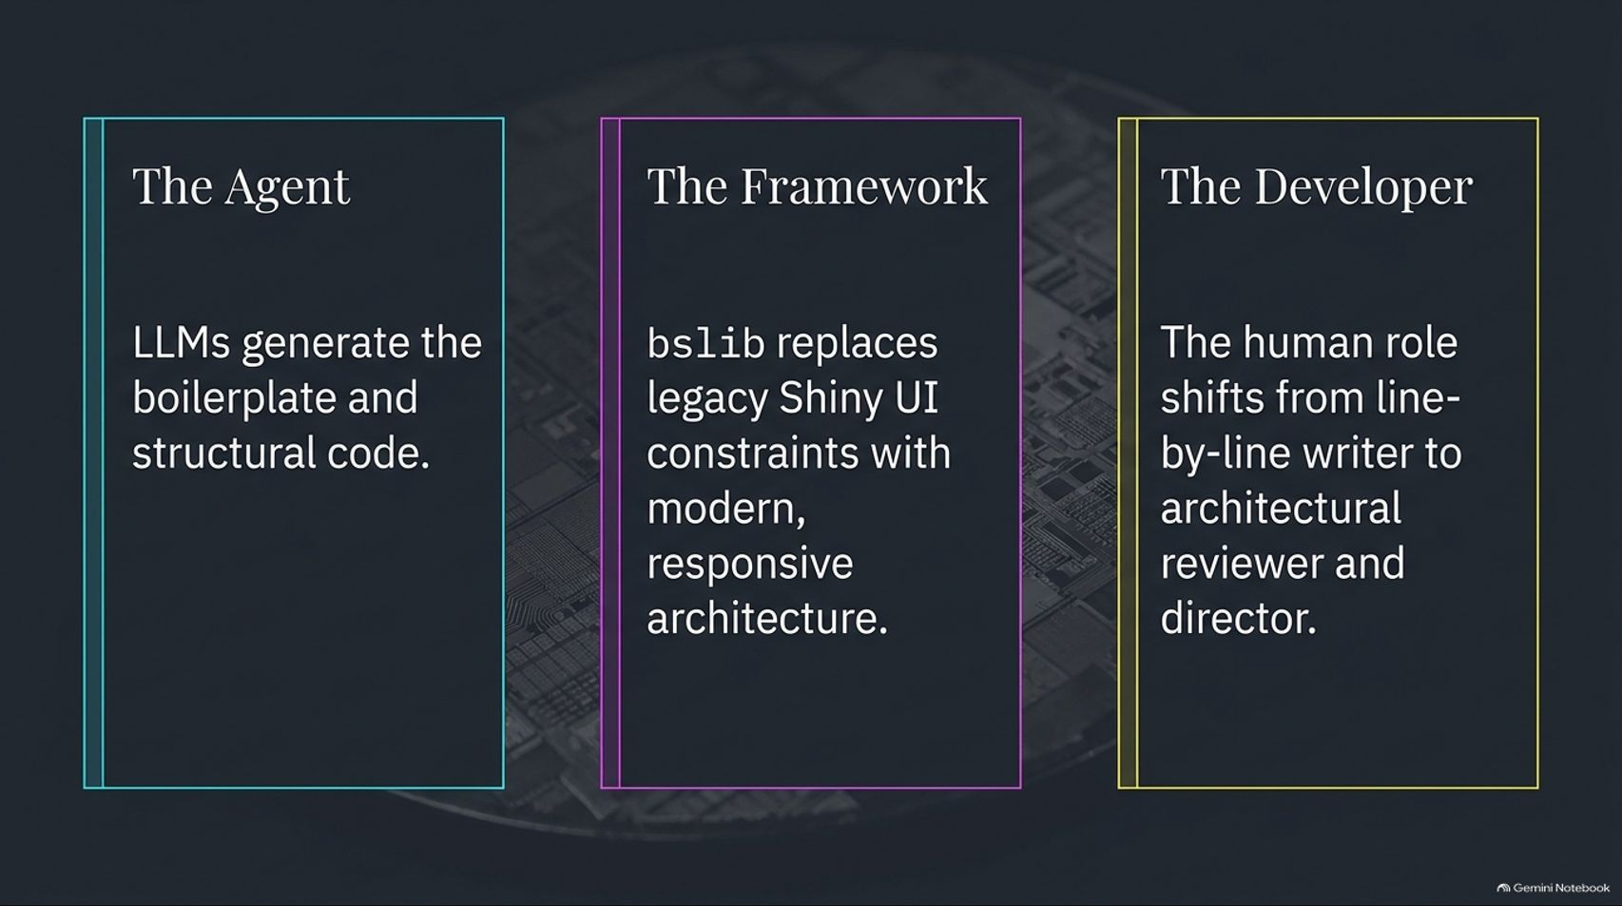
Notes:
Duration Guide: 3 – 4 minutes
Core Presentation Theme: Establish the three foundational pillars of modern app development: LLMs as agents, bslib as the modern framework, and human developers as architectural reviewers.
Speaker Notes:
"To understand modern Shiny development, we have to look at the division of labor between three key entities: The Agent, The Framework, and The Developer."
"First, The Agent. Large Language Models (LLMs) handle the heavy lifting of generating structural code, boilerplate setup, and data-wrangling pipelines."
"Second, The Framework. Modern Shiny relies on bslib, which replaces legacy UI constraints with responsive, elegant, production-ready components and drop-shadows."
"Third, The Developer. The human role shifts entirely. Instead of writing every single line of code by hand, you act as an architectural director, code reviewer, and quality controller. You direct the agent, command the architecture, and ensure the business logic is sound."

Slide 3
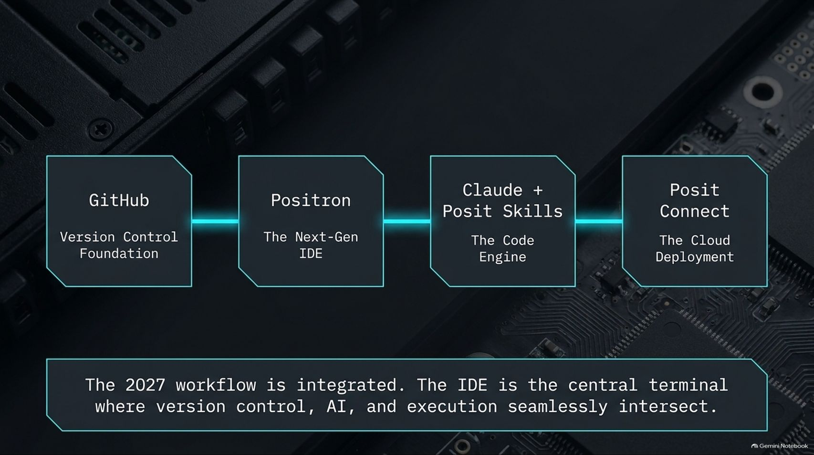
Notes:
Duration Guide: 3 – 5 minutes
Core Presentation Theme: Map out the integrated tooling stack: GitHub for version control, Positron as the next-gen IDE, Claude with Posit Skills as the code engine, and Posit Connect for cloud deployment.
Speaker Notes:
"Let's look at the actual workflow ecosystem. In 2027, your tools are deeply integrated into a single unified terminal experience where version control, AI assistance, and execution intersect seamlessly."
"It starts with GitHub as our version control foundation. We then pull that repository into Positron, the next-generation IDE built on VS Code architecture."
"Inside Positron, we leverage Claude paired with Posit Skills as our code engine—feeding it explicit documentation rather than relying on stale baseline training data."
"Finally, deployment is frictionless through Posit Connect or Posit Connect Cloud, which reads our repository manifest and deploys automatically."

Slide 4
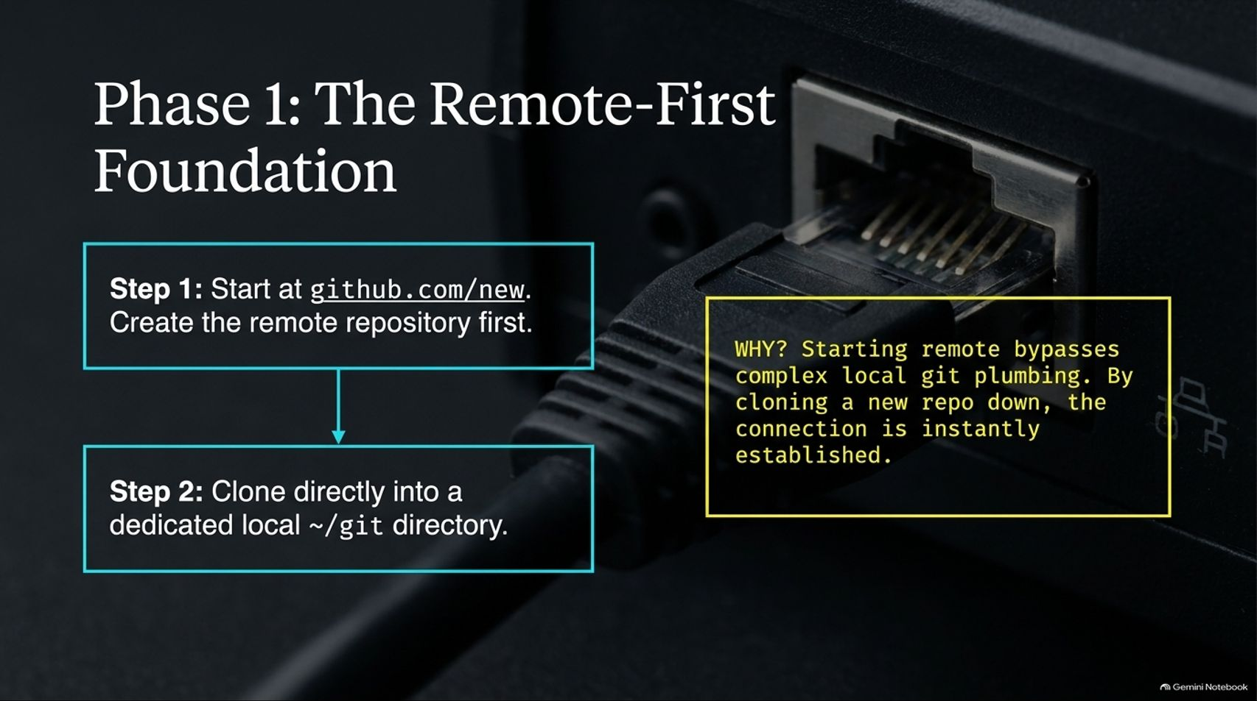
Notes:
Duration Guide: 3 – 4 minutes
Core Presentation Theme: Detail the best practice of starting at [github.com/new](https://github.com/new) to create a remote repository first, then cloning it down to a dedicated local ~/git directory.
Speaker Notes:
"Let’s walk through Phase 1 of our build: establishing a Remote-First Foundation."
"Step 1: Always start at [github.com/new](https://github.com/new) and create your remote repository before touching your local machine."
"Step 2: Clone that repository directly into a dedicated local ~/git directory."
"Why do we do this? Starting remote bypasses complex local git plumbing and remote synchronization errors. By cloning a fresh repo down, the connection between your local environment and GitHub is instantly established, saving you from messy merge conflicts and parallel tracking branches later."

Slide 5
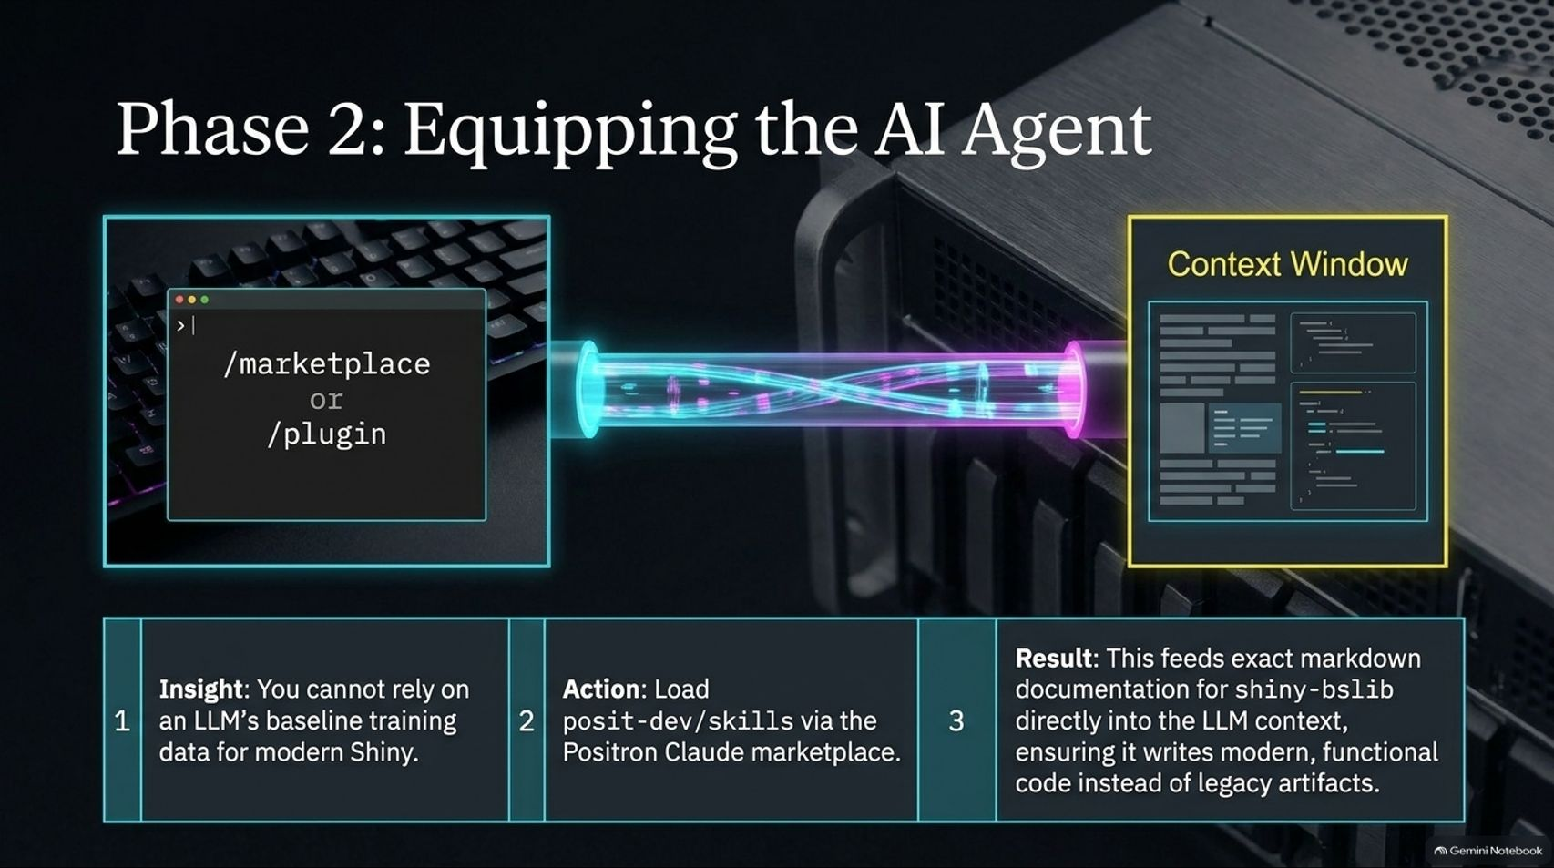
Notes:
Duration Guide: 4 – 5 minutes
Core Presentation Theme: Explain why baseline LLM training data fails for modern Shiny and how loading posit-dev/skills via the Positron marketplace injects exact markdown documentation into the context window.
Speaker Notes:
"Next, Phase 2: Equipping your AI agent. You cannot rely solely on an LLM’s baseline training data for modern Shiny, because older legacy syntax will constantly pollute its output."
"To fix this, we load official documentation skills from [github.com/posit-dev/skills](https://github.com/posit-dev/skills) directly into our IDE using the Positron Claude marketplace (/marketplace or /plugin)."
"This action feeds exact markdown documentation for shiny and bslib directly into the LLM's context window. The result? The AI writes modern, functional code using current functions instead of deprecated legacy artifacts."

Slide 6
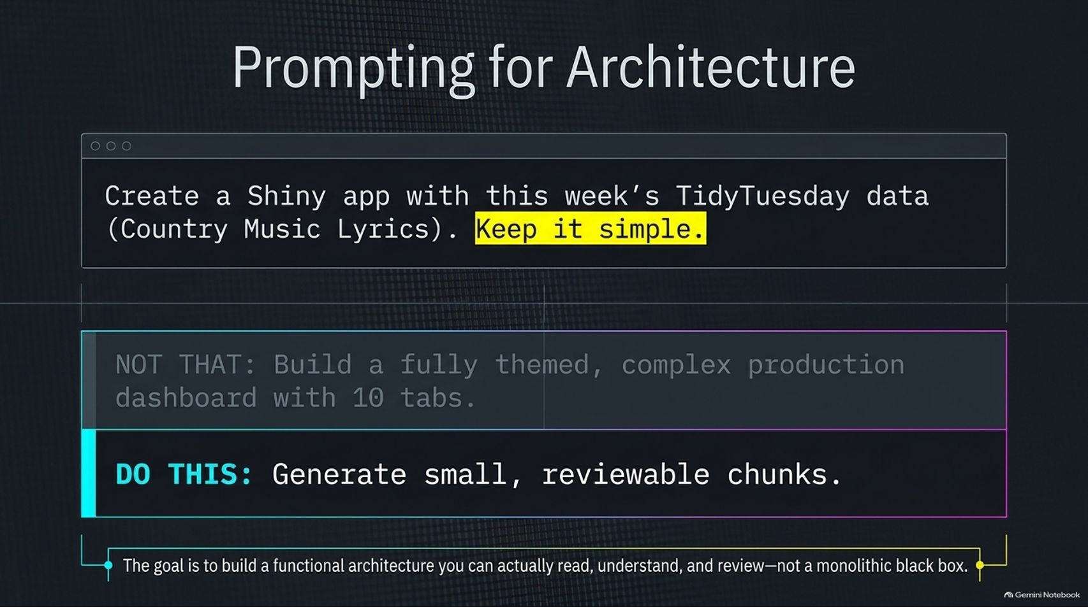
Notes:
Duration Guide: 3 – 5 minutes
Core Presentation Theme: Contrast monolithic prompting ("Build a 10-tab dashboard") with iterative, modular prompting ("Keep it simple, generate reviewable chunks").
Speaker Notes:
"When you prompt your AI assistant, how you ask matters immensely. Look at our prompt: 'Create a Shiny app with this week’s TidyTuesday data (Country Music Lyrics). Keep it simple.'"
"Notice what we avoid: Do not ask it to 'Build a fully themed, complex production dashboard with 10 tabs' all at once. That creates a monolithic black box that is impossible to debug."
"Instead, do this: Instruct the agent to generate small, reviewable chunks. The goal is to build a functional architecture that you can actually read, understand, review, and take apart."

Slide 7
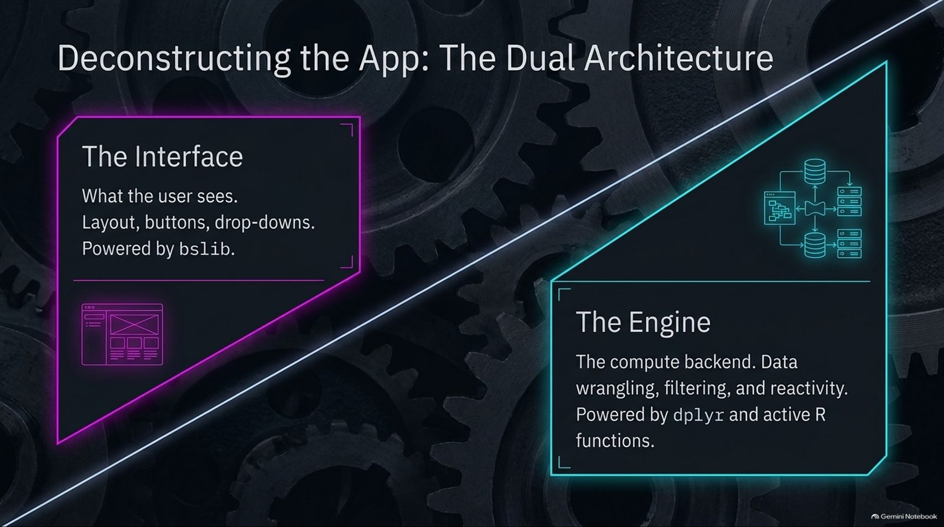
Notes:
Duration Guide: 4 – 5 minutes
Core Presentation Theme: Break down a Shiny app into its two fundamental halves: The Interface (bslib UI) and The Engine (dplyr server logic and reactivity).
Speaker Notes:
"Every Shiny application is built upon a dual architecture: The Interface and The Engine."
"First, The Interface: This is what the user sees—layouts, buttons, drop-downs, cards, and value boxes. In modern architecture, this is entirely powered by bslib."
"Second, The Engine: This is the compute backend. It handles data wrangling, filtering, reactive expressions, and statistical modeling, powered by dplyr and active R functions running behind the scenes."

Slide 8
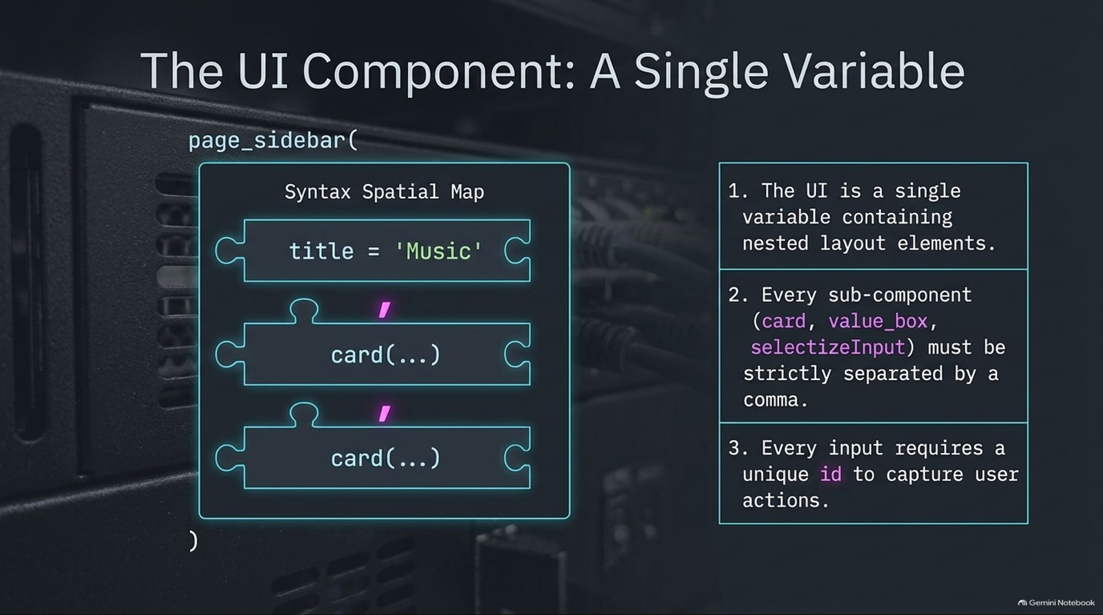
Notes:
Duration Guide: 4 – 5 minutes
Core Presentation Theme: Explain the syntax structure of the UI: a single variable containing nested layout elements separated strictly by commas, utilizing unique input IDs.
Speaker Notes:
"Let's examine the UI component in code. In a modern app using page_sidebar, the entire user interface is constructed as a single variable containing nested layout elements."
"There are three golden rules for UI syntax:"
"1. The UI is a single variable wrapped around layout functions like page_sidebar()."
"2. Every sub-component—such as card(), value_box(), or selectizeInput()—must be strictly separated by a comma. Miss a comma, and the app fails to parse."
"3. Every input component requires a unique id (e.g., inputId = 'terms') so you can capture user actions downstream."

Slide 9
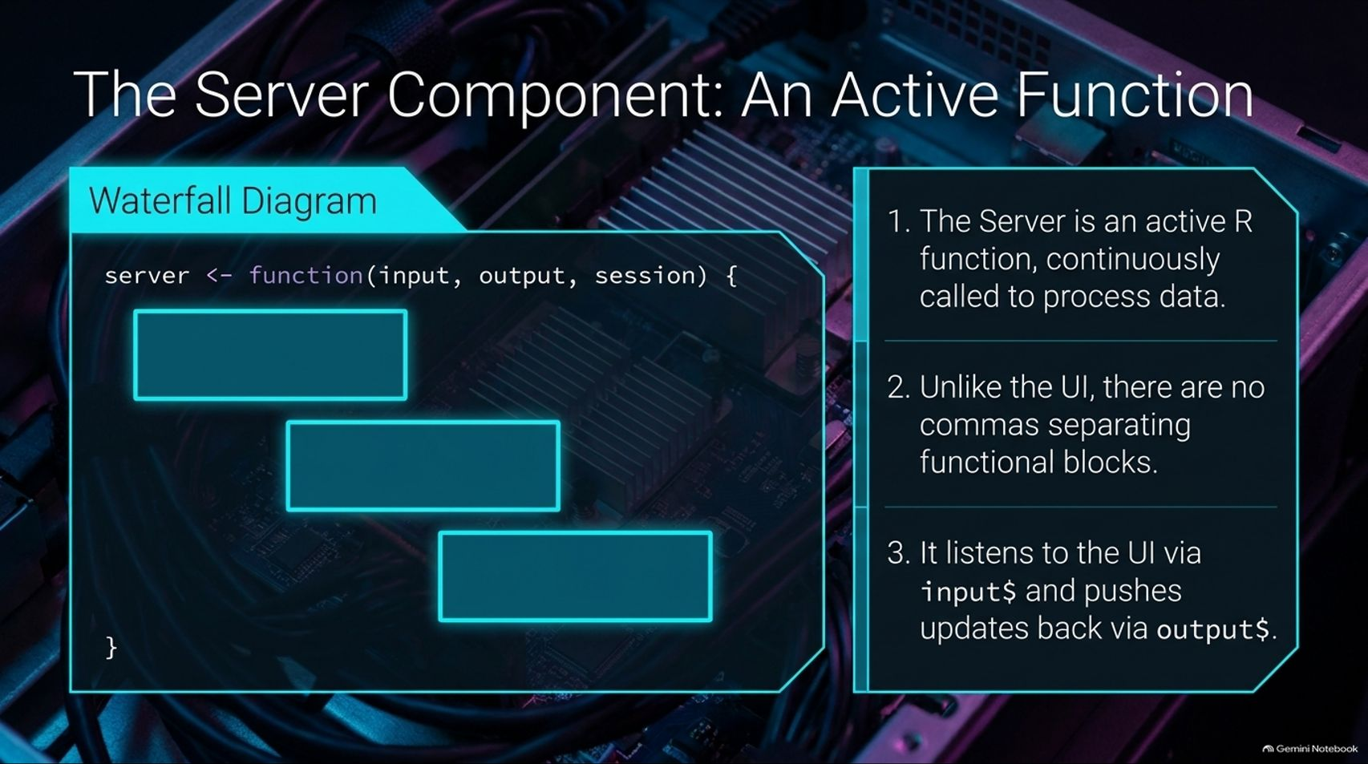
Notes:
Duration Guide: 4 – 5 minutes
Core Presentation Theme: Contrast UI syntax with Server syntax: an active R function (input, output, session) without commas between functional blocks, listening to inputs and pushing updates to outputs.
Speaker Notes:
"Now let's flip over to the server component. While the UI is a static variable of comma-separated layout blocks, the Server is an active R function, continuously called by Shiny to process data."
"Look closely at the syntax differences:"
"1. It is defined as server <- function(input, output, session)."
"2. Unlike the UI, there are no commas separating functional blocks inside the server function. It is standard R procedural and functional code."
"3. It listens to user actions via input$ objects and pushes computed updates back to the UI via output$ objects."

Slide 10
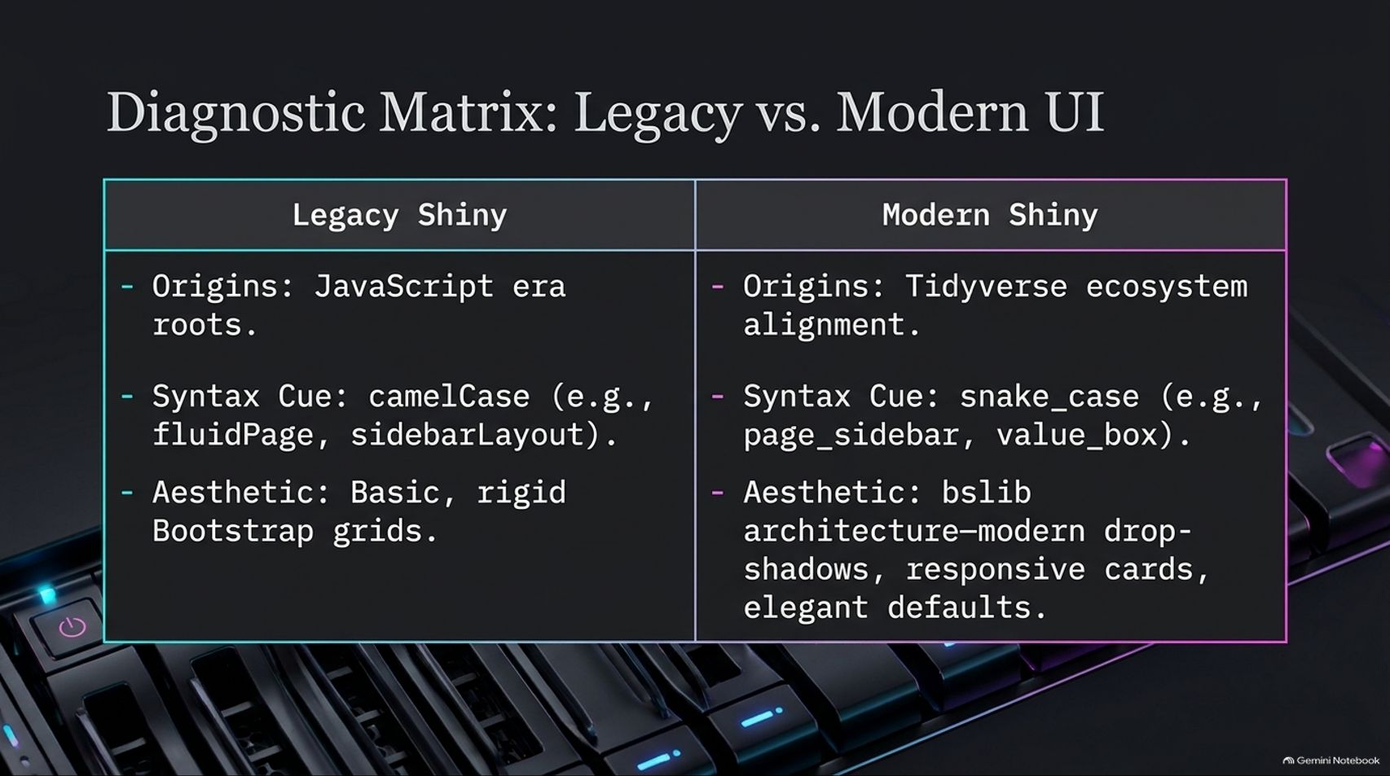
Notes:
Duration Guide: 3 – 4 minutes
Core Presentation Theme: Compare legacy Shiny (JavaScript origins, camelCase, rigid Bootstrap grids) with modern Shiny (Tidyverse alignment, snake_case, bslib responsive cards).
Speaker Notes:
"If you are looking at older R code tutorials online, you will often run into legacy Shiny patterns. Let's run a diagnostic matrix to tell them apart."
"Legacy Shiny has its roots in early JavaScript-to-R ports. Its syntax cues rely on camelCase naming conventions (e.g., fluidPage, sidebarLayout), and its visual aesthetic relies on basic, rigid Bootstrap 3 grids."
"Modern Shiny aligns with the Tidyverse ecosystem. Its syntax cues use snake_case (e.g., page_sidebar, value_box), and its aesthetic is driven by bslib architecture—featuring modern drop-shadows, responsive cards, and elegant default themes."

Slide 11
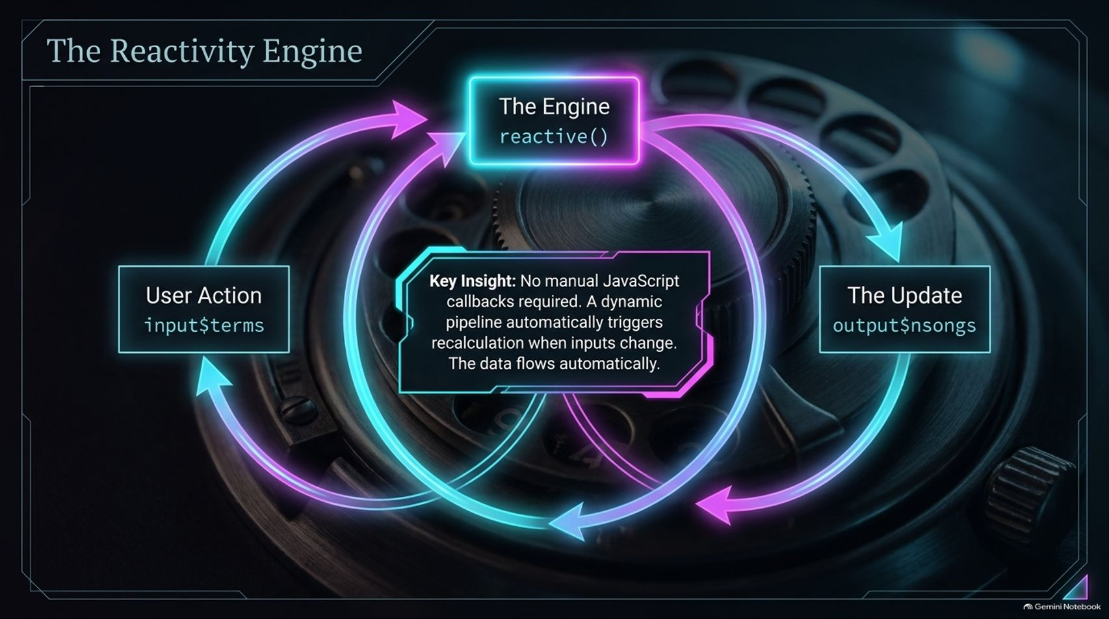
Notes:
Duration Guide: 4 – 5 minutes
Core Presentation Theme: Explain how Shiny’s reactivity pipeline (reactive(), input$, output$) automatically triggers recalculations when inputs change, eliminating manual JavaScript callbacks.
Speaker Notes:
"At the heart of Shiny is The Reactivity Engine. Many developers coming from other web frameworks worry about writing manual event listeners or JavaScript callbacks. Shiny abstracts that away entirely."
"When a user changes an input—for example, selecting search terms (input$terms)—the dynamic reactive pipeline automatically triggers recalculations in your reactive expressions (reactive())."
"Once computed, the updated results flow seamlessly back to the UI (output$nsongs). The data flows automatically without manual page refreshes or complex callback wiring."

Slide 12
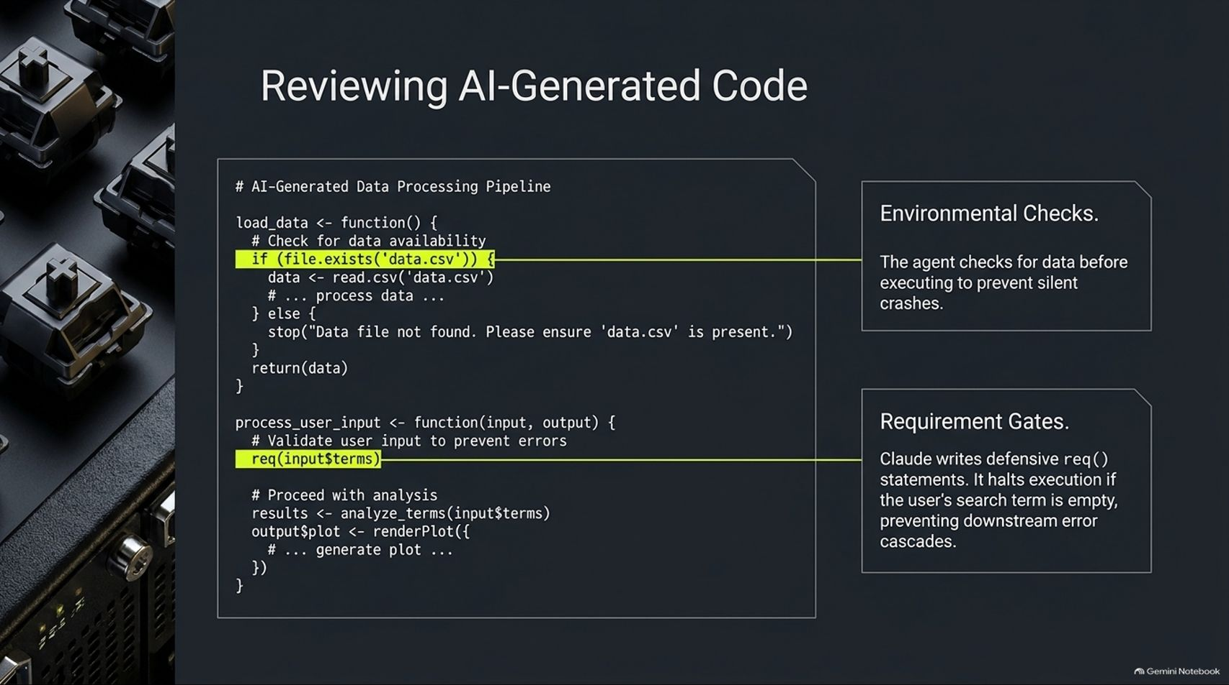
Notes:
Duration Guide: 4 – 5 minutes
Core Presentation Theme: Review defensive AI coding practices, such as file existence checks (file.exists) and requirement gates (req()) to prevent silent crashes and error cascades.
Speaker Notes:
"Because we are using AI assistants like Claude to write code, it's vital to review what the agent generates. Modern AI-generated Shiny code typically includes two essential defensive patterns:"
"First, Environmental Checks: The agent checks if data files exist (if (file.exists('data.csv'))) before executing, halting with a clear error if missing rather than failing silently."
"Second, Requirement Gates: Claude writes defensive req() statements (e.g., req(input$terms)). This halts execution if a user search term is empty, preventing downstream error cascades when plots or tables try to render with NULL data."

Slide 13
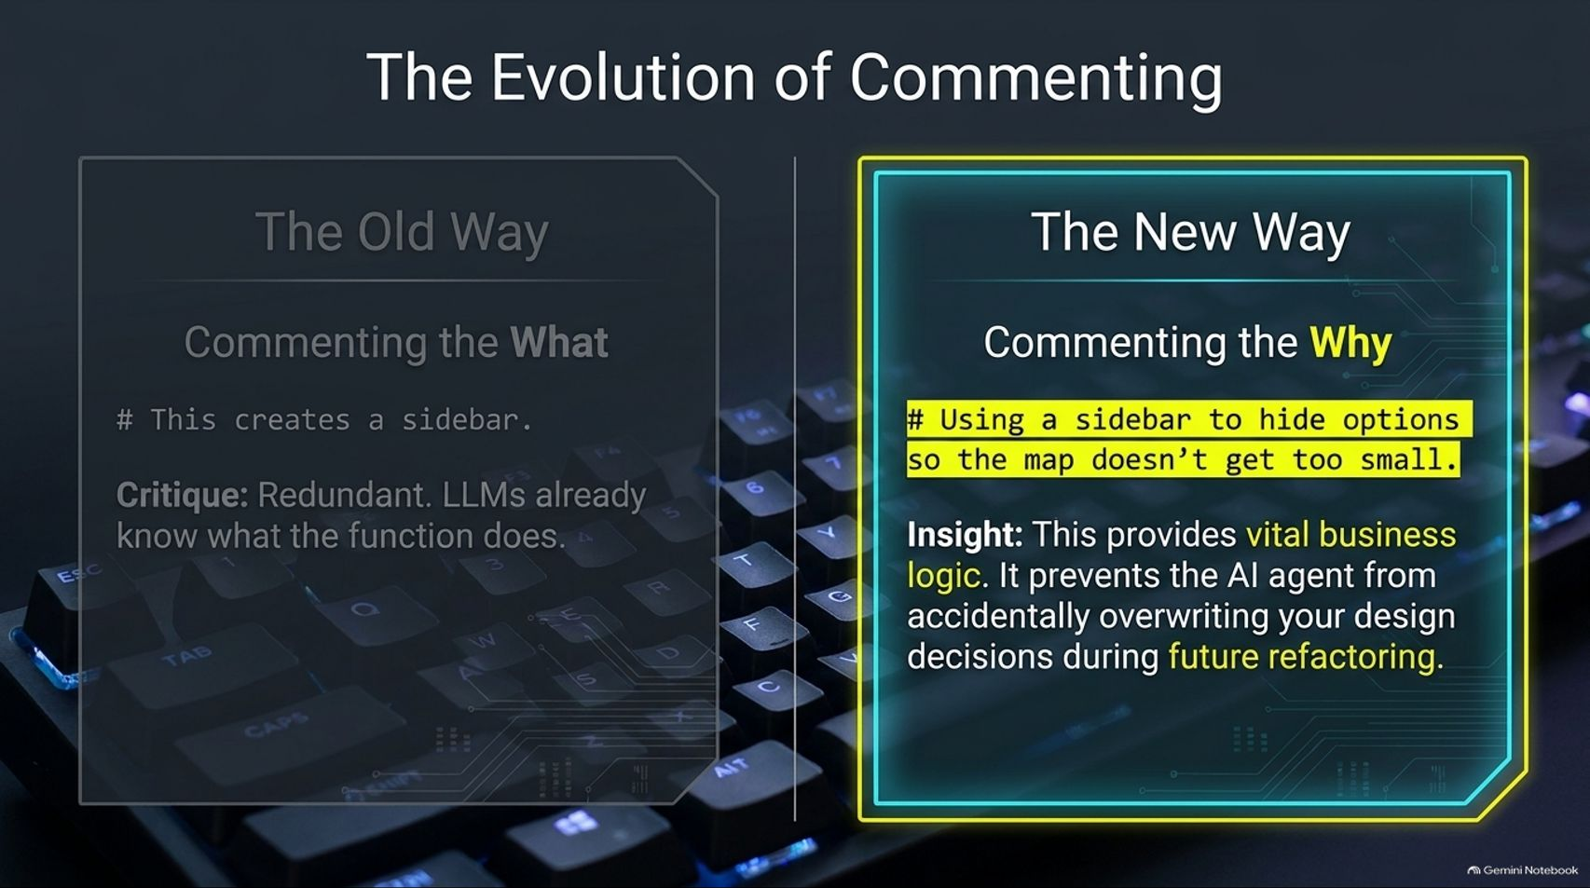
Notes:
Duration Guide: 3 – 4 minutes
Core Presentation Theme: Contrast redundant commenting of the "What" (# This creates a sidebar) with professional commenting of the "Why" (# Using a sidebar to hide options so the map doesn't get too small).
Speaker Notes:
"Let's talk about code comments. In the era of AI-assisted coding, commenting habits must evolve."
"The Old Way was commenting the What—writing comments like # This creates a sidebar. This is redundant because LLMs and modern developers can already read the function name."
"The New Way is commenting the Why—for example: # Using a sidebar to hide options so the map doesn't get too small."
"Why does this matter? Commenting the 'Why' captures vital business logic and architectural reasoning, preventing the AI agent from accidentally overwriting your design decisions during future refactoring."

Slide 14
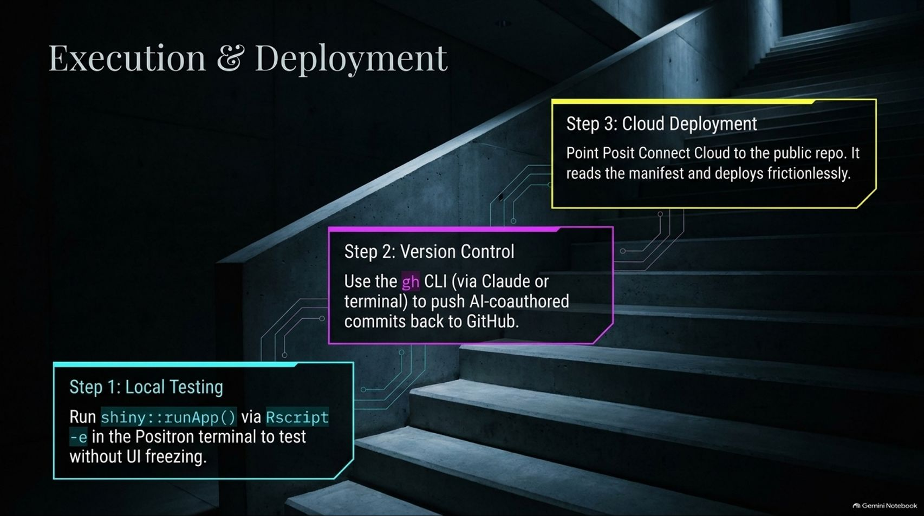
Notes:
Duration Guide: 3 – 5 minutes
Core Presentation Theme: Outline the final three-step deployment pipeline: Local testing via Rscript, version control commit via GitHub CLI, and frictionless cloud deployment on Posit Connect.
Speaker Notes:
"Once your app is built and reviewed, we move to Execution & Deployment in three clean steps:"
"Step 1: Local Testing. Run your app locally using shiny::runApp() via Rscript -e in the Positron terminal to test functionality without freezing your UI."
"Step 2: Version Control. Use the GitHub CLI (gh) via Claude or your terminal to commit and push your AI-coauthored code back to GitHub."
"Step 3: Cloud Deployment. Point Posit Connect Cloud to your public repository. It automatically reads your manifest file and deploys your app frictionlessly to the web."

Slide 15
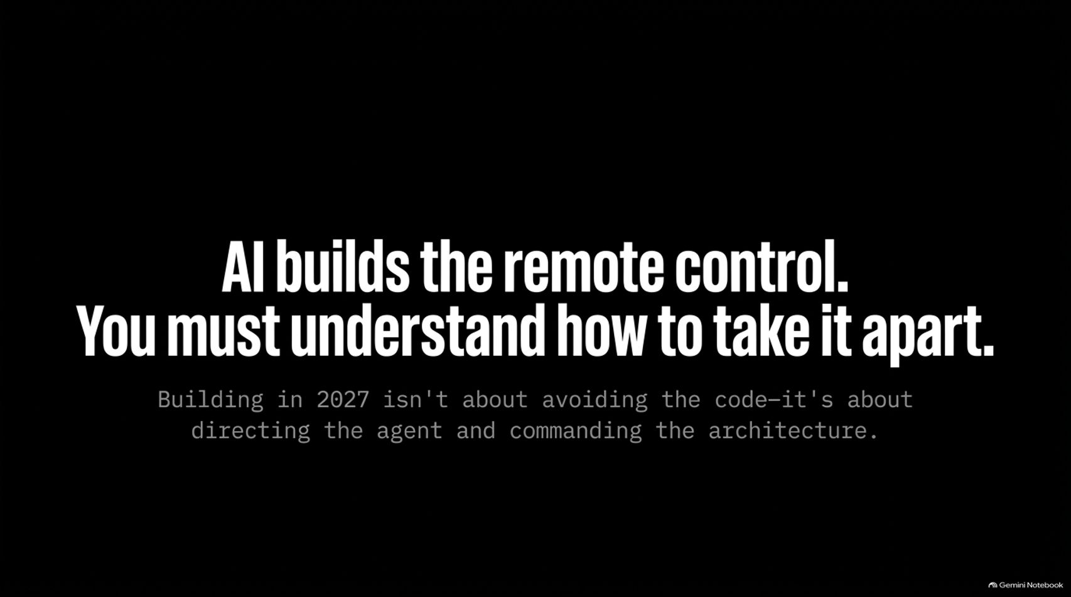
Notes:
Duration Guide: 2 – 3 minutes
Core Presentation Theme: Summarize the core philosophy of 2027 development: AI builds the remote control, but human developers must understand how to take it apart and direct the architecture.
Speaker Notes:
"As we wrap up our architectural guide, remember this core principle: AI builds the remote control. You must understand how to take it apart."
"Building apps in 2027 isn't about avoiding the code or letting black boxes run wild—it’s about directing the AI agent, understanding the underlying bslib and reactive architecture, and maintaining absolute control over your applications."
"Embrace the tools, leverage Posit Skills, write defensive server logic, and keep building!"

Slide 16
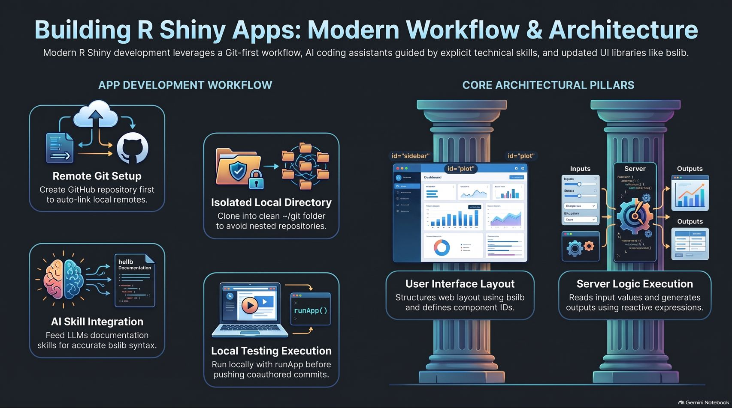
Notes:
Duration Guide: 3 – 5 minutes
Core Presentation Theme: Provide a comprehensive visual wrap-up connecting the App Development Workflow (Git setup, isolated directories, skill integration, local testing) to the Core Architectural Pillars (UI layout and Server logic execution).
Speaker Notes:
"Let’s use this final summary slide as your permanent reference sheet for modern R Shiny development."
"On the left, our App Development Workflow: Always initialize a remote Git repository first, clone into an isolated local ~/git directory, integrate AI technical skills for accurate syntax, and test locally before pushing."
"On the right, our Core Architectural Pillars: Structure your user interface cleanly using responsive bslib components, and execute server logic by mapping reactive inputs to output streams."
"Thank you all for joining this deep dive into modern Shiny architecture. Go build something amazing!"

