Slide 1
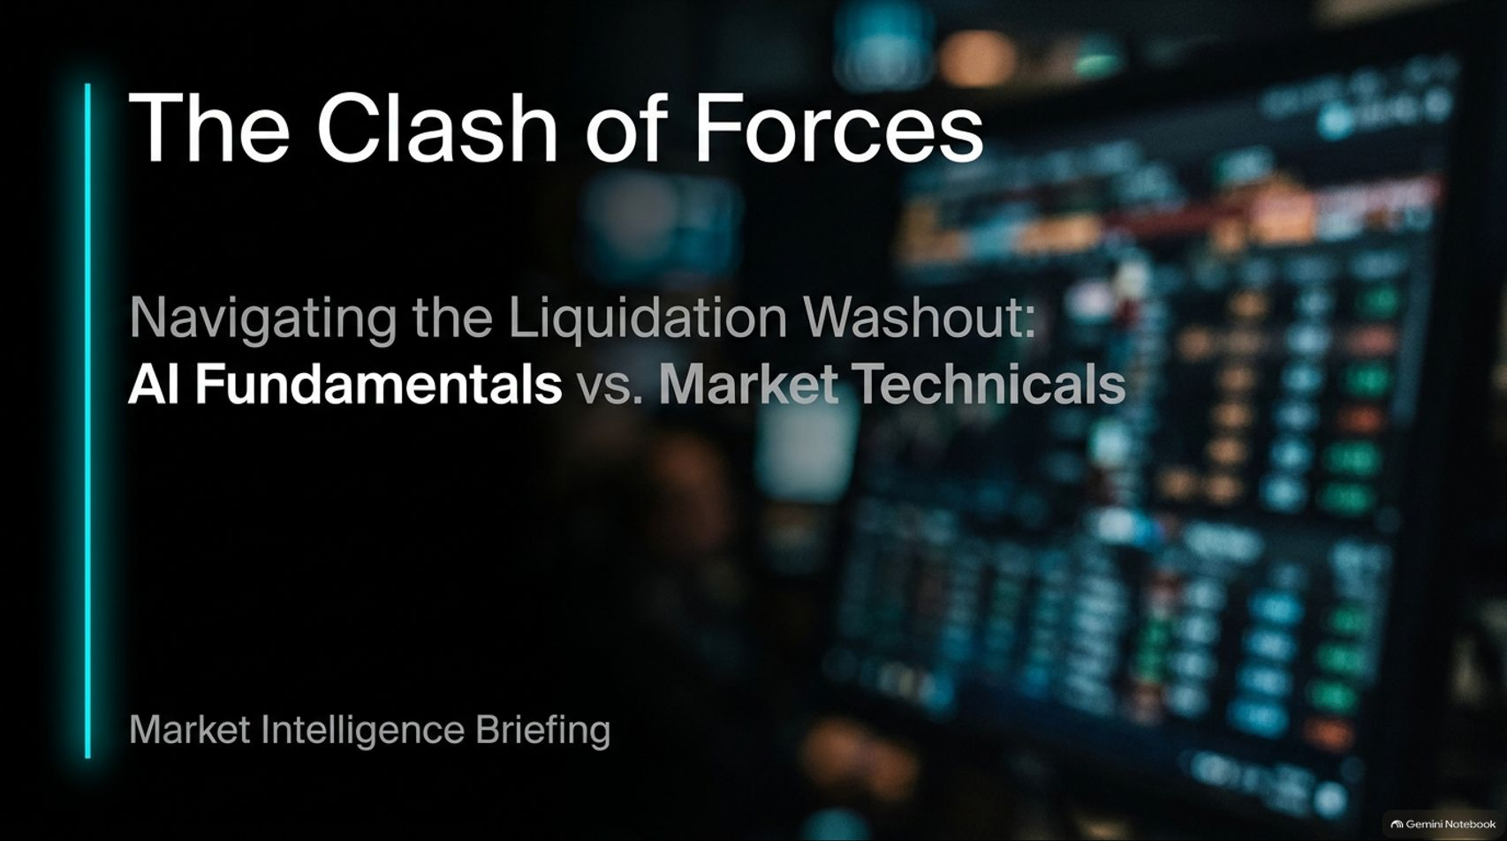
Notes:
Duration Guide: 2 – 3 minutes
Core Presentation Theme: Welcome the audience and set the premise. Introduce the overarching conflict between long-term fundamental conviction in the AI supercycle and immediate-term market technical risks, systematic liquidations, and macro crosscurrents.
Speaker Notes:
"Welcome everyone to today’s Market Intelligence Briefing: 'The Clash of Forces: Navigating the Liquidation Washout—AI Fundamentals vs. Market Technicals'."
"Right now, investors are caught in a massive tug-of-war. On one side, we have undeniable, robust fundamental growth in the artificial intelligence buildout. On the other side, we are experiencing severe technical liquidations, shifting Fed reaction functions, and geopolitical energy shocks."
"Drawing on insights from market strategist Warren Pies, today we are going to dissect how to silo our long-term convictions from short-term market structure risks so you know exactly how to navigate your portfolio through a washout. Let’s dive in."
Is The AI Selloff A Buying Opportunity? | Warren Pies
https://www.youtube.com/watch?v=5aqAPkNvslg

Slide 2
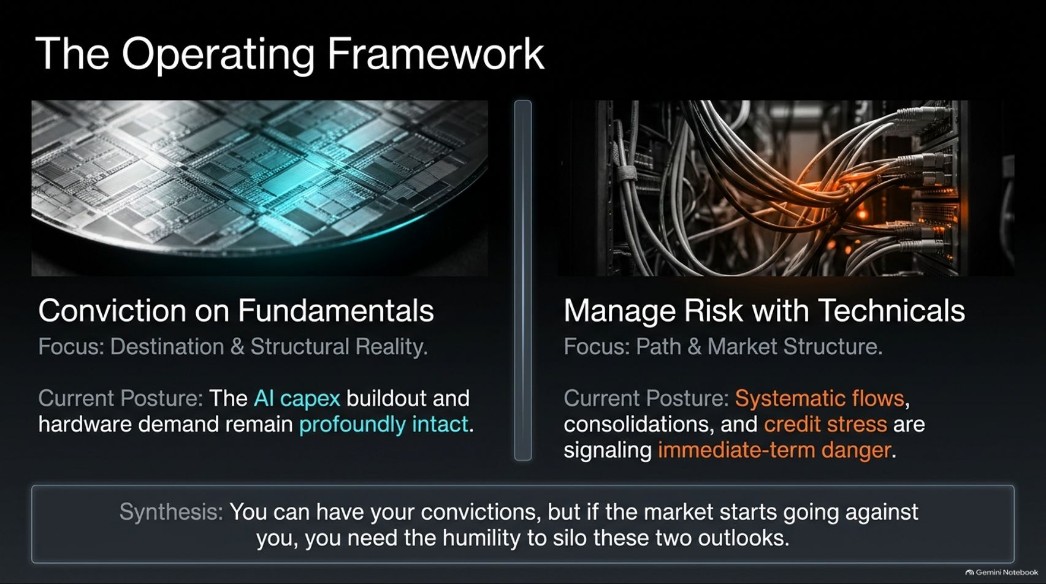
Notes:
Duration Guide: 3 – 4 minutes
Core Presentation Theme: Establish the core operational rule: build conviction on long-term fundamentals (destination), but manage risk using short-term market technicals (path and structure).
Speaker Notes:
"To survive and thrive in volatile markets, you need a strict operating framework. Warren Pies describes it best: 'I build conviction on fundamentals, but manage risk with technicals'."
"Conviction on Fundamentals focuses on the destination and structural reality. Right now, our fundamental posture is that the AI capex buildout and hardware demand remain profoundly intact."
"Manage Risk with Technicals focuses on the path and market structure. Our technical posture recognizes that systematic flows, consolidations, and credit stress are signaling immediate-term danger."
"The synthesis is simple: You can have your fundamental convictions, but if the market starts going against you, you need the humility to silo these two outlooks and protect your capital."

Slide 3
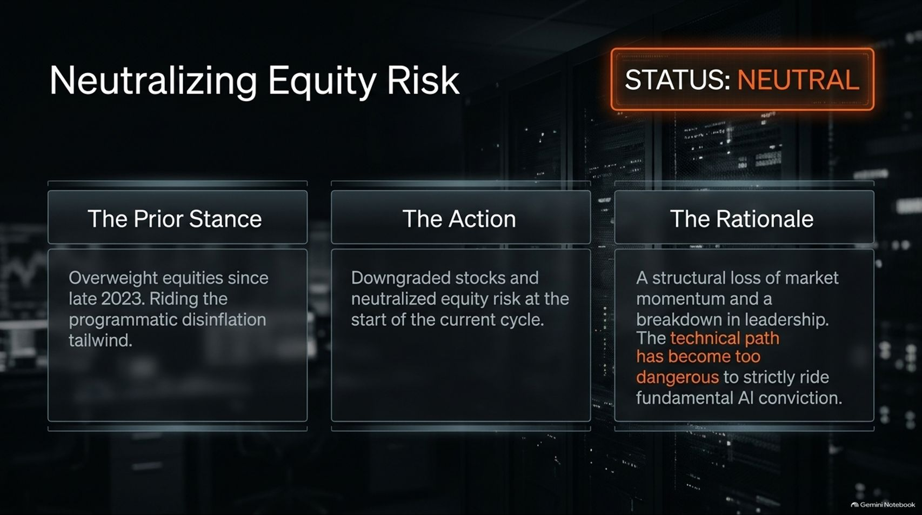
Notes:
Duration Guide: 3 – 5 minutes
Core Presentation Theme: Explain the strategic tactical shift from an overweight equity stance to a neutral posture due to a breakdown in market momentum and leadership.
Speaker Notes:
"Let's look at how this framework translates into real-world positioning."
"The Prior Stance: Since late 2023—after Federal Reserve signals of easing and programmatic disinflation tailwinds—we maintained a bullish, overweight equity tilt."
"The Action: At the start of the recent cycle, we downgraded stocks and neutralized equity risk."
"The Rationale: We observed a structural loss of market momentum and a breakdown in traditional leadership. Even if you love the long-term AI story, the immediate technical path became too dangerous to strictly ride fundamental conviction without protection."

Slide 4
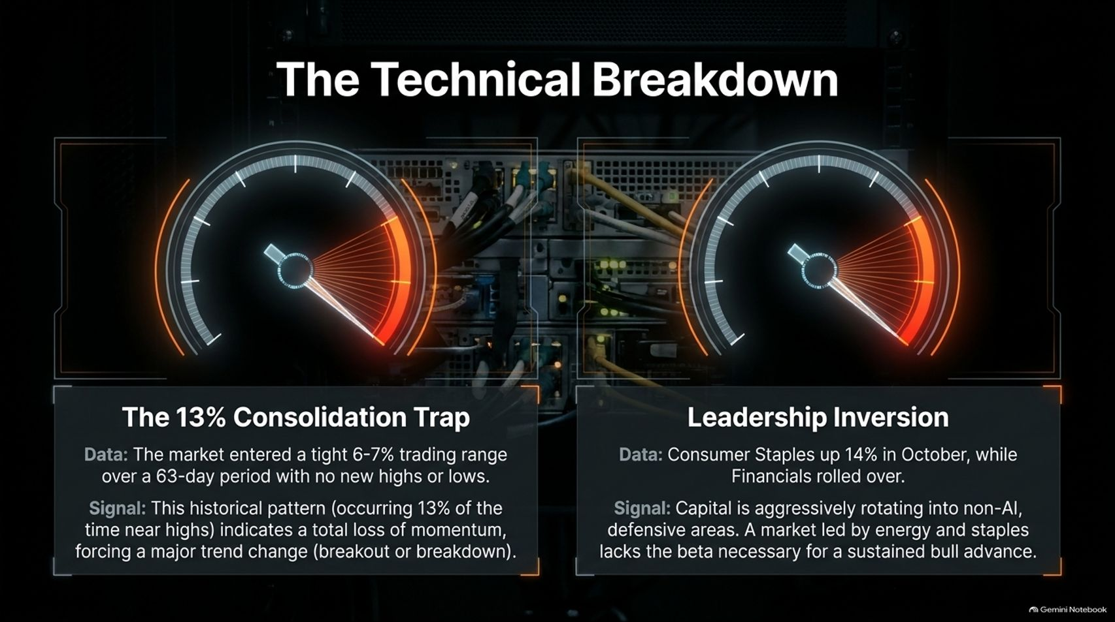
Notes:
Duration Guide: 4 – 5 minutes
Core Presentation Theme: Detail the technical warning signals: the 13% consolidation trap indicating a loss of momentum, and leadership inversion where capital rotates defensively into Consumer Staples.
Speaker Notes:
"What specific technical warning signs forced our hand? Two major signals emerged."
"First, The 13% Consolidation Trap. The market entered a tight 6% to 7% trading range over a 63-day period with no new highs or lows. This pattern—occurring only 13% of the time near highs—indicates a total loss of market momentum, historically preceding a major trend change, whether breakout or breakdown."
"Second, Leadership Inversion. Consumer Staples surged 14% in October, while Financials rolled over. Capital aggressively rotated into non-AI, defensive areas. As history shows, a market led by energy and staples lacks the high beta necessary to sustain a major bull advance."

Slide 5
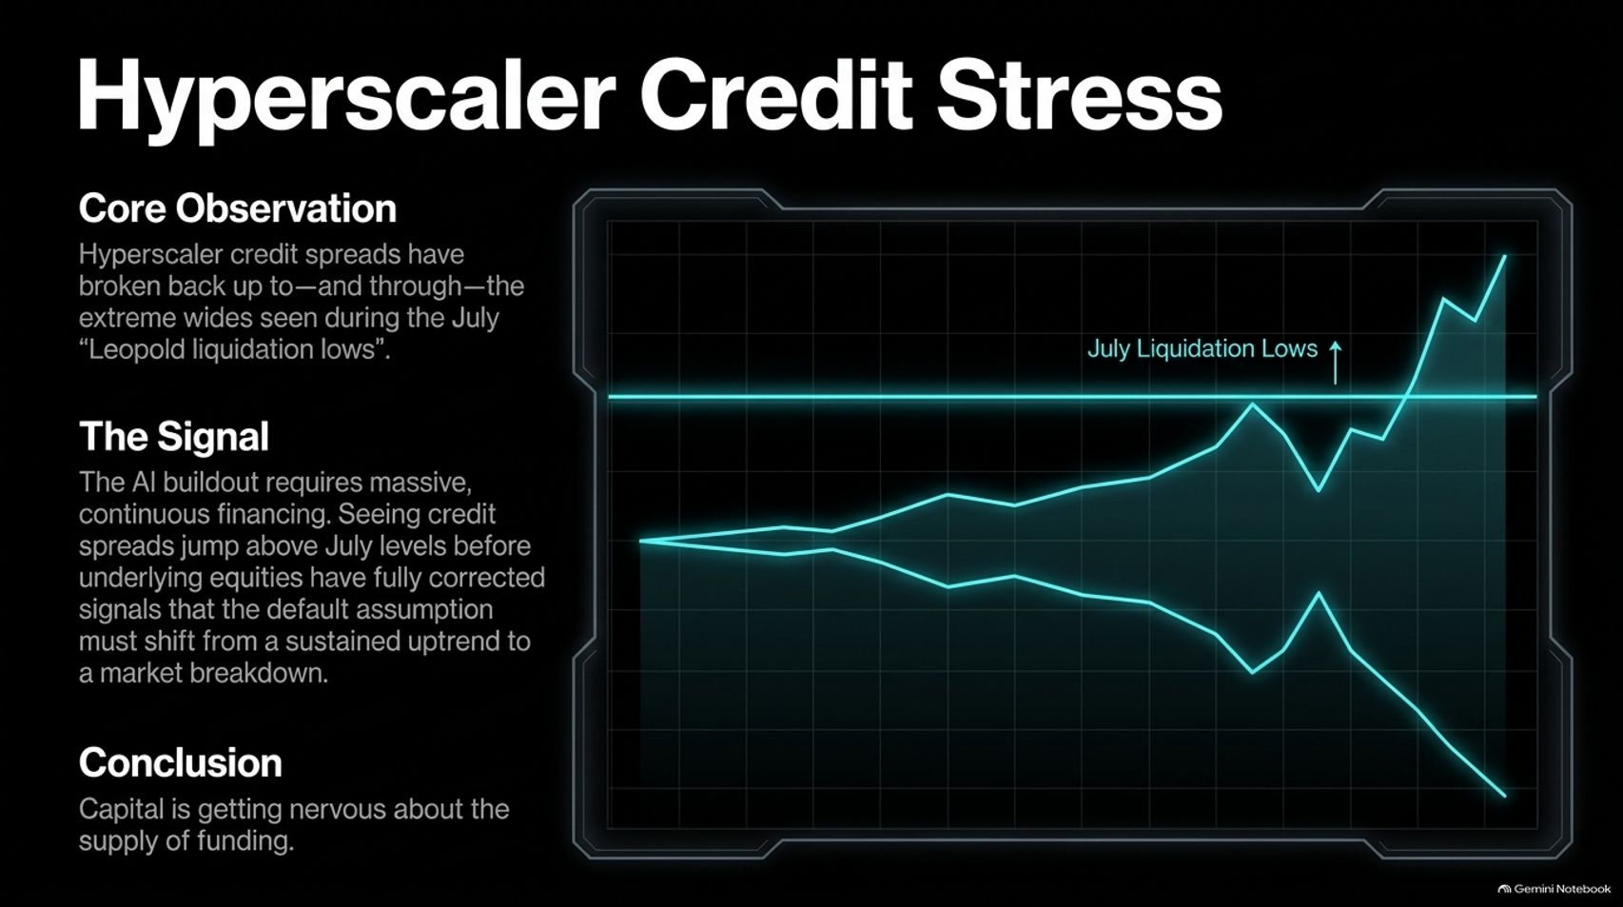
Notes:
Duration Guide: 4 – 5 minutes
Core Presentation Theme: Examine hyperscaler credit spreads breaking out above July liquidation lows, signaling growing stress in external debt financing markets for the AI buildout.
Speaker Notes:
"Beyond equities, we must monitor debt and credit markets. Our core observation: Hyperscaler credit spreads broke back up to—and right through—the extreme wides seen during the July 'Leopold liquidation lows'."
"The Signal: The AI buildout requires massive, continuous external financing. Seeing credit spreads jump above July levels before underlying equities have fully corrected signals that our default assumption must shift from a sustained uptrend to a market breakdown."
"Conclusion: Capital is getting nervous about the supply and cost of funding the AI infrastructure."

Slide 6
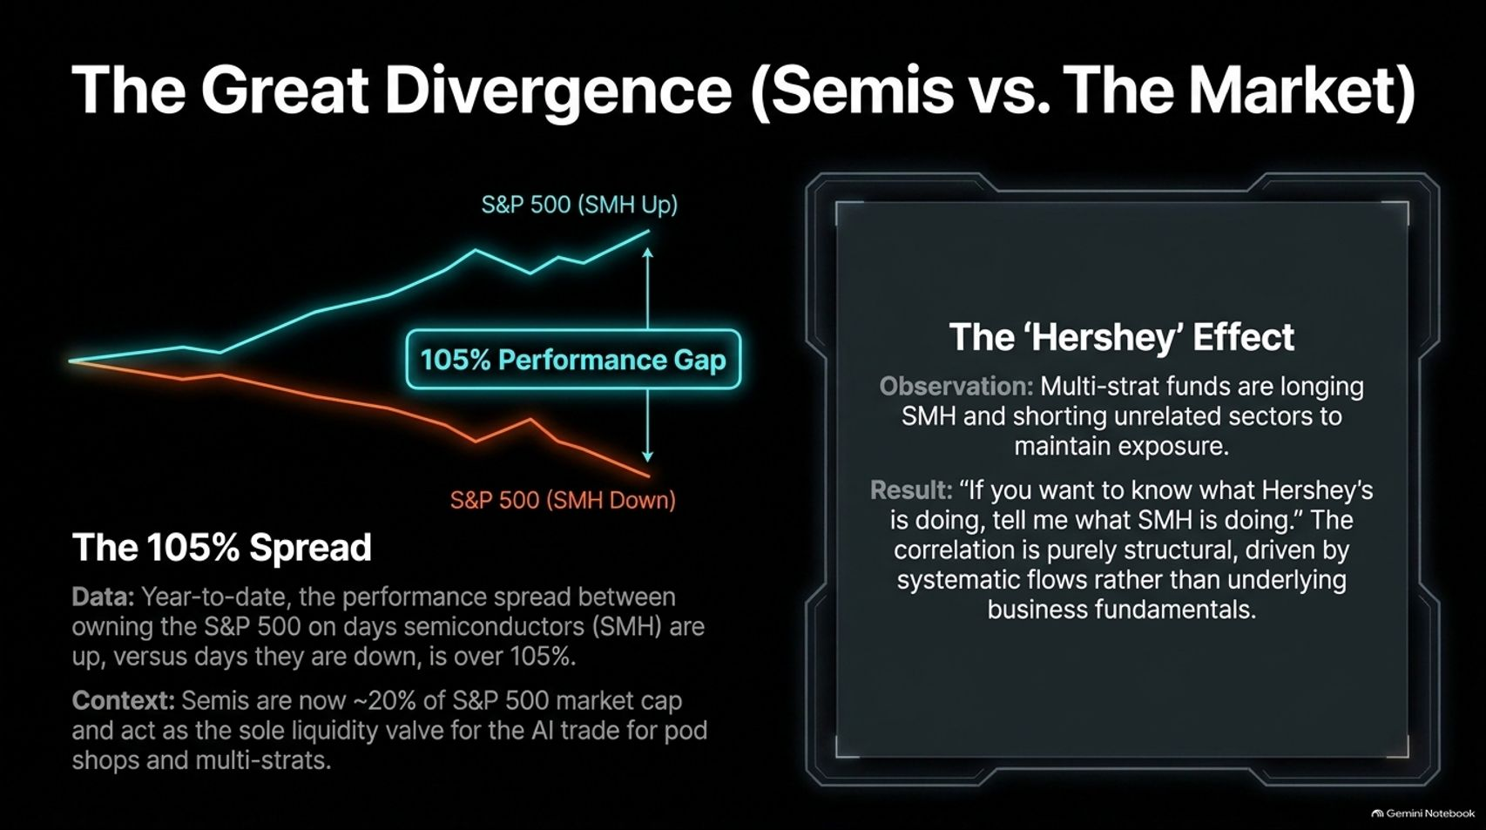
Notes:
Duration Guide: 4 – 5 minutes
Core Presentation Theme: Explain the 105% performance spread between semiconductor-up and semiconductor-down days, and how pod shops use SMH as a structural liquidity valve for the entire S&P 500.
Speaker Notes:
"One of the most fascinating market structure phenomena of this cycle is The Great Divergence between semiconductors and the broader market."
"The 105% Spread: Year-to-date, the performance spread between owning the S&P 500 on days semiconductors (SMH) are up versus days they are down is over 105%!"
"Semis now comprise roughly 20% of the S&P 500 market cap and act as the sole liquidity valve for the AI trade for pod shops and multi-strats."
"The 'Hershey' Effect: Multi-strats long SMH and short unrelated sectors just to maintain exposure. Correlations have become purely structural rather than tied to business fundamentals—leading to the joke: 'If you want to know what Hershey's is doing, tell me what SMH is doing'."

Slide 7
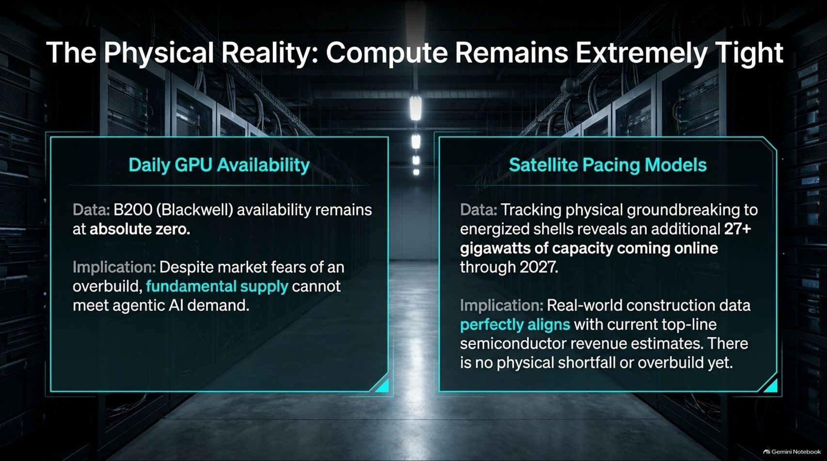
Notes:
Duration Guide: 4 – 5 minutes
Core Presentation Theme: Contrast market panic with physical ground truth: B200 availability is at absolute zero, and satellite pacing models confirm 27+ gigawatts of data center capacity coming online through 2027.
Speaker Notes:
"While the stock market panics, what is the physical reality on the ground? Compute remains extremely tight."
"Daily GPU Availability: Blackwell B200 availability remains at absolute zero. Despite market fears of an overbuild, fundamental supply cannot keep pace with agentic AI demand."
"Satellite Pacing Models: Tracking physical groundbreaking to energized shells reveals an additional 27+ gigawatts of data center capacity coming online through 2027."
"Real-world construction data perfectly aligns with current top-line semiconductor revenue estimates. There is zero physical shortfall or overbuild in the real economy."

Slide 8
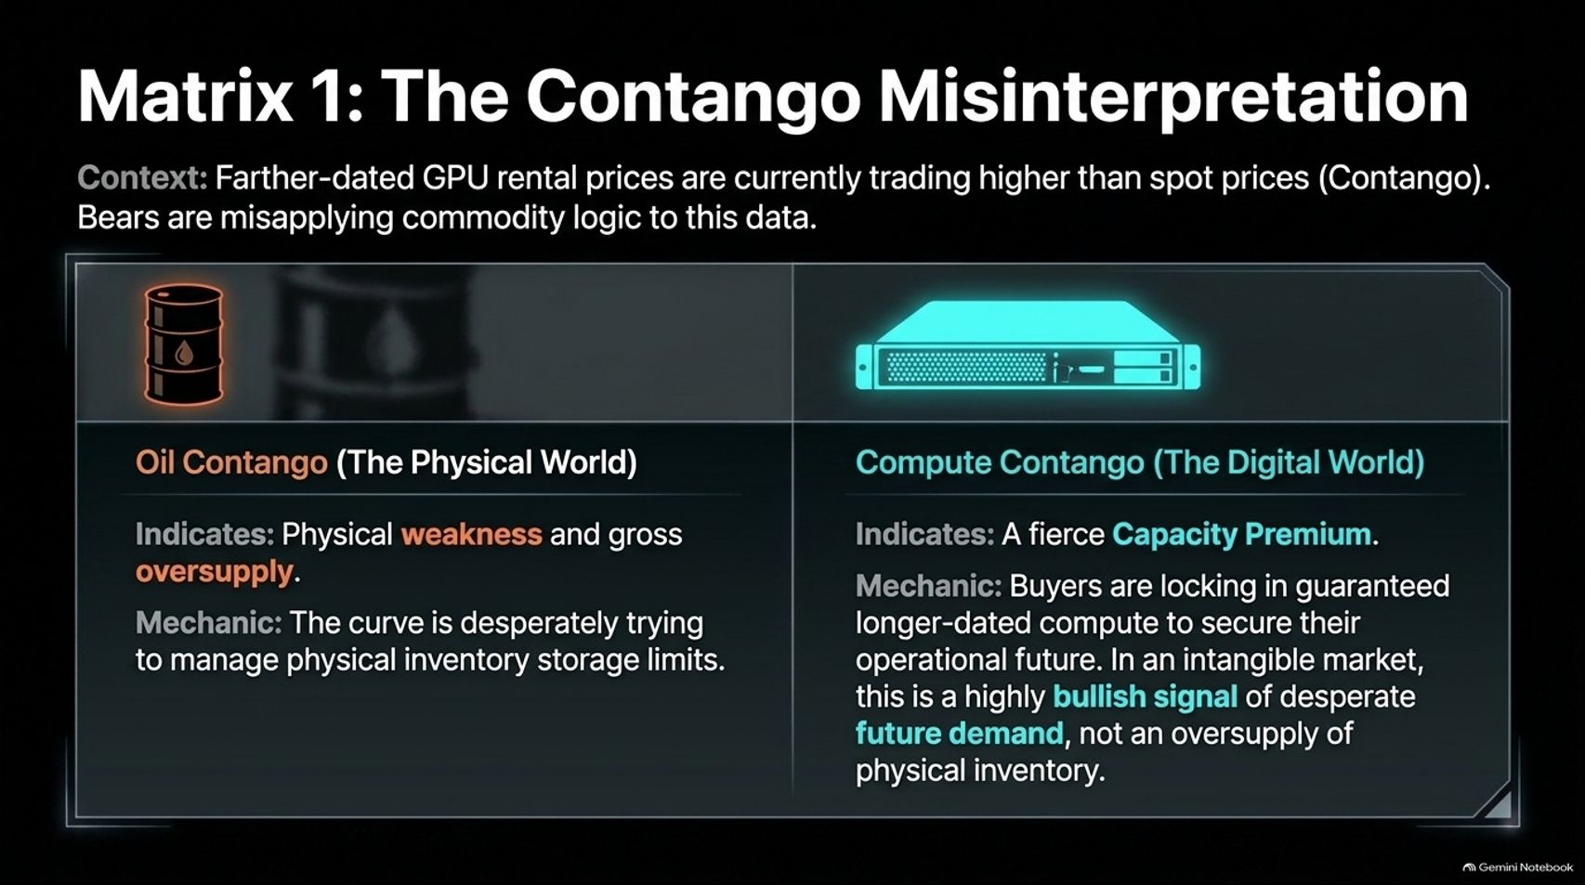
Notes:
Duration Guide: 4 – 5 minutes
Core Presentation Theme: Correct the bear narrative misapplying commodity logic to GPU rental contango, contrasting physical oil contango (oversupply) with digital compute contango (fierce capacity premium).
Speaker Notes:
"Bears love to point out that farther-dated GPU rental prices are trading higher than spot prices—a condition known as Contango. They argue this proves oversupply. But they are misapplying commodity logic."
"In the Oil Market, contango indicates physical weakness and gross oversupply, as the curve desperately tries to manage physical inventory storage limits."
"In the Compute Market, contango indicates a fierce Capacity Premium. Buyers are locking in guaranteed longer-dated compute to secure their operational future. In an intangible market, this is a highly bullish signal of desperate future demand, not oversupply."

Slide 9
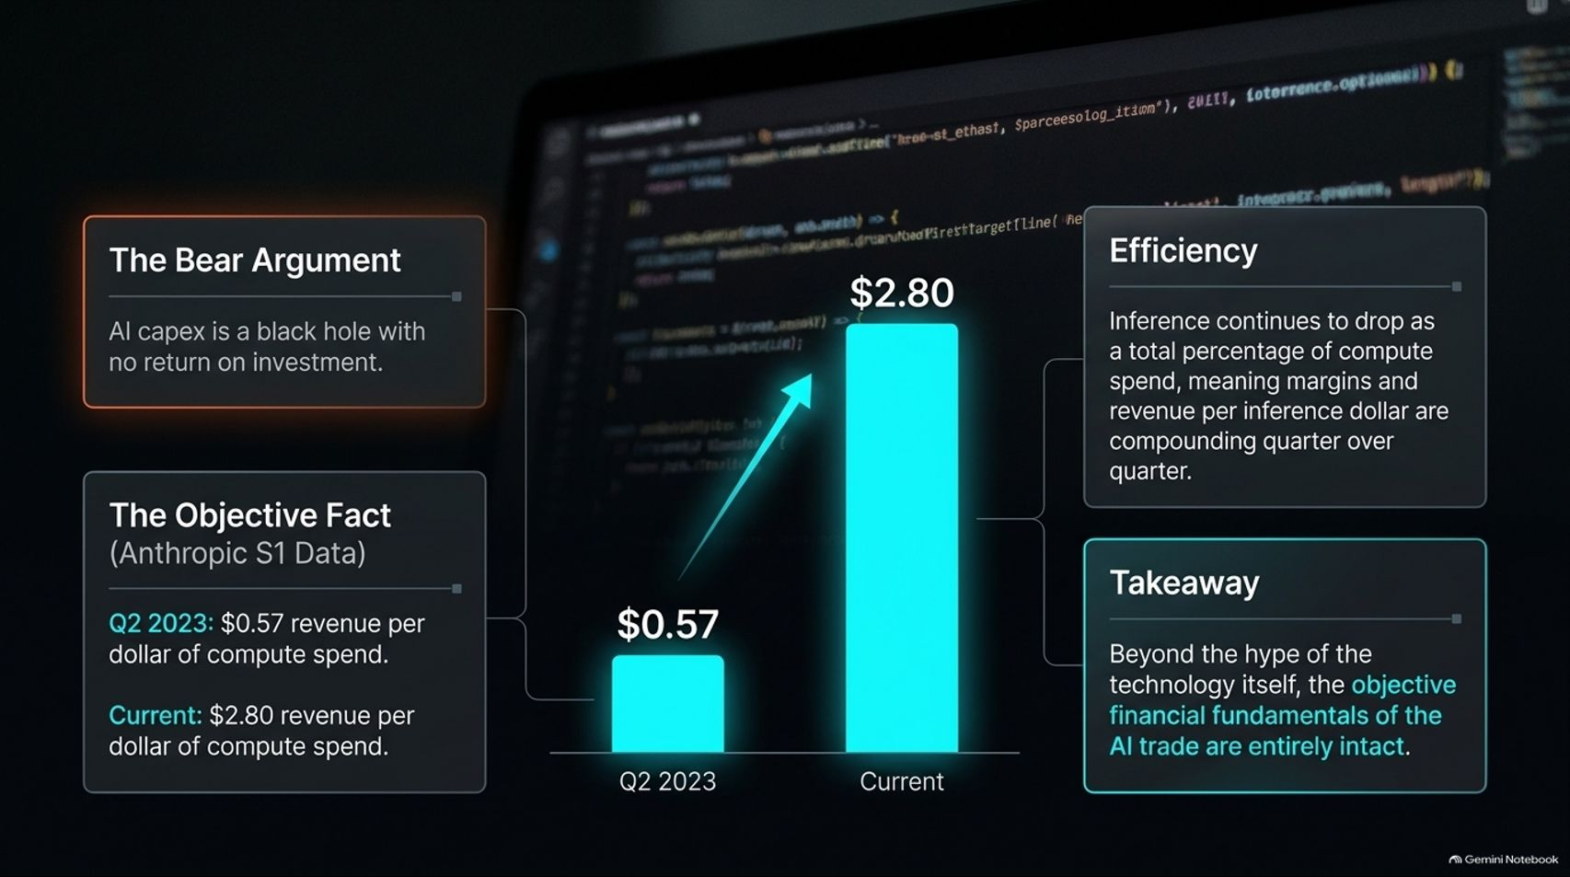
Notes:
Duration Guide: 4 – 5 minutes
Core Presentation Theme: Reference Anthropic S1 data showing that revenue per dollar of compute spend surged from $0.57 in Q2 2023 to $2.80 currently, proving the AI investment thesis is financially sound.
Speaker Notes:
"Let's address the bear argument that AI capex is a black hole with no return on investment."
"Look at the objective facts from Anthropic's S1 data: In Q2 2023, companies generated $0.57 in revenue per dollar of compute spend. Today, that figure has surged to $2.80!"
"Furthermore, inference costs continue to drop as a percentage of total compute spend, meaning margins and revenue per inference dollar are compounding quarter over quarter."
"Takeaway: Beyond the media hype, the objective financial fundamentals of the AI trade are entirely intact."

Slide 10
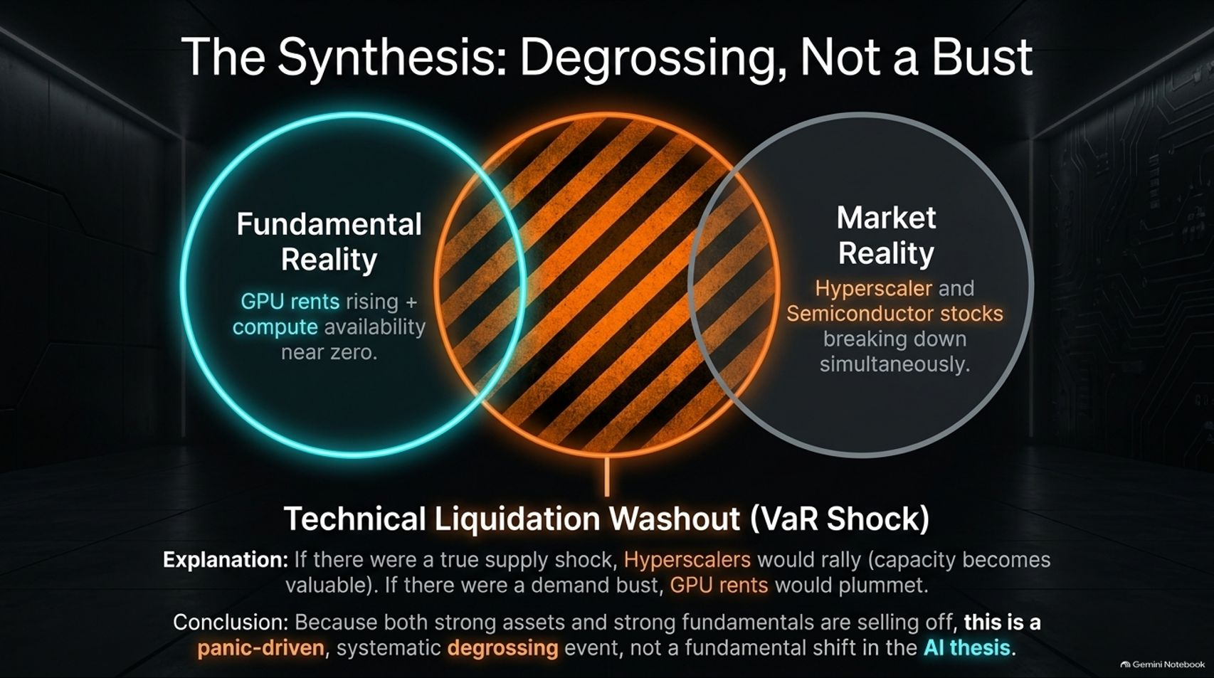
Notes:
Duration Guide: 4 – 5 minutes
Core Presentation Theme: Synthesize fundamental reality (rising GPU rents, near-zero availability) with market reality (stocks breaking down) to prove this is a VaR shock and systematic degrossing event, not an AI bust.
Speaker Notes:
"So how do we synthesize these conflicting worlds? We have Fundamental Reality (GPU rents rising, availability near zero) clashing with Market Reality (hyperscaler and semiconductor stocks breaking down simultaneously)."
"Why are stocks falling if fundamentals are booming? If there were a true fundamental demand bust, GPU rental prices would plummet. If there were a supply shock, hyperscalers would rally because existing capacity becomes immensely valuable."
"Conclusion: Because strong assets and strong fundamentals are selling off together, this is a panic-driven, systematic degrossing and VaR shock event, not a fundamental shift in the AI thesis."

Slide 11
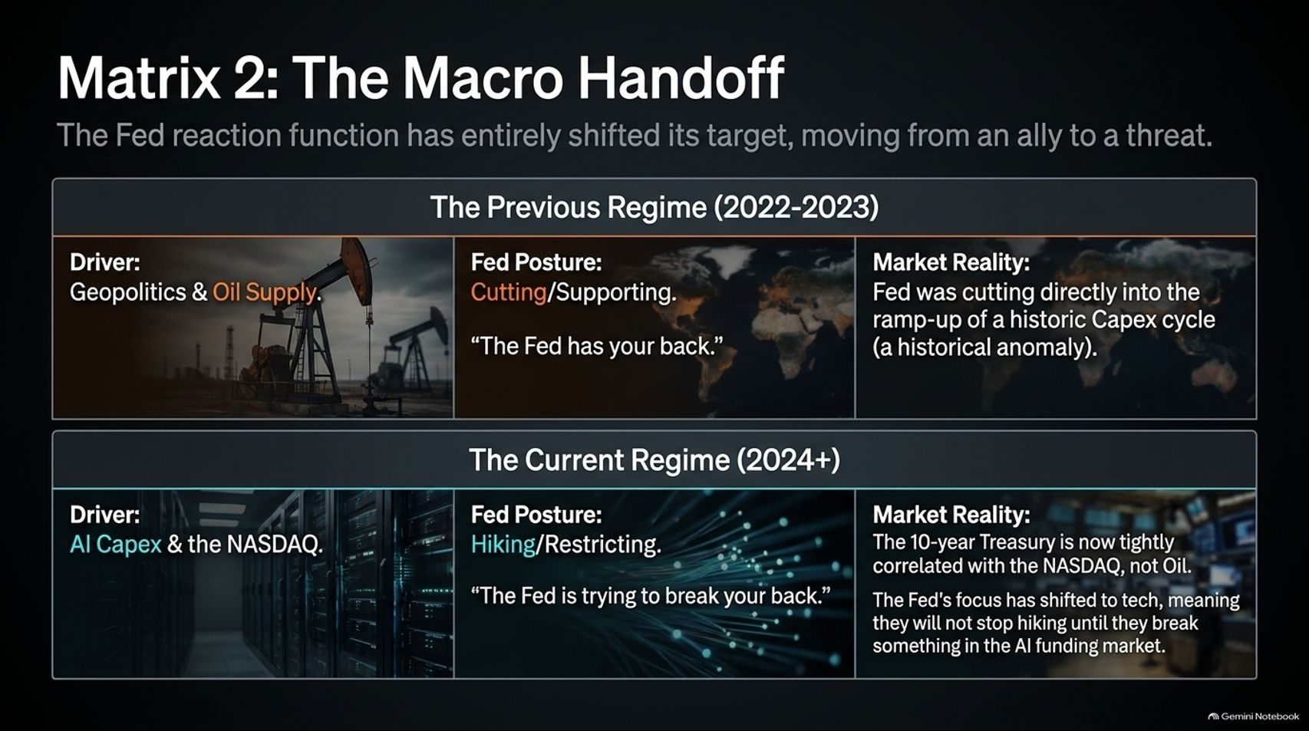
Notes:
Duration Guide: 4 – 5 minutes
Core Presentation Theme: Outline how the Fed's reaction function shifted from an ally cutting into a cape-ex boom (2022-2023) to a threat hiking rates because 10-year yields are now correlated with the NASDAQ, not oil.
Speaker Notes:
"Let's look at the macro backdrop. The Fed reaction function has entirely shifted, moving from an ally to a threat."
"The Previous Regime (2022-2023): Driven by geopolitics and oil supply. The Fed was cutting and supporting markets ("The Fed has your back"), cutting directly into the ramp-up of a historic capex cycle—a historical anomaly."
"The Current Regime (2024+): Driven by AI capex and the NASDAQ. The Fed is hiking and restricting ("The Fed is trying to break your back"). The 10-year Treasury is now tightly correlated with the NASDAQ, not oil. The Fed's focus has shifted to tech, meaning they will not stop hiking until they break something in the AI funding market."

Slide 12
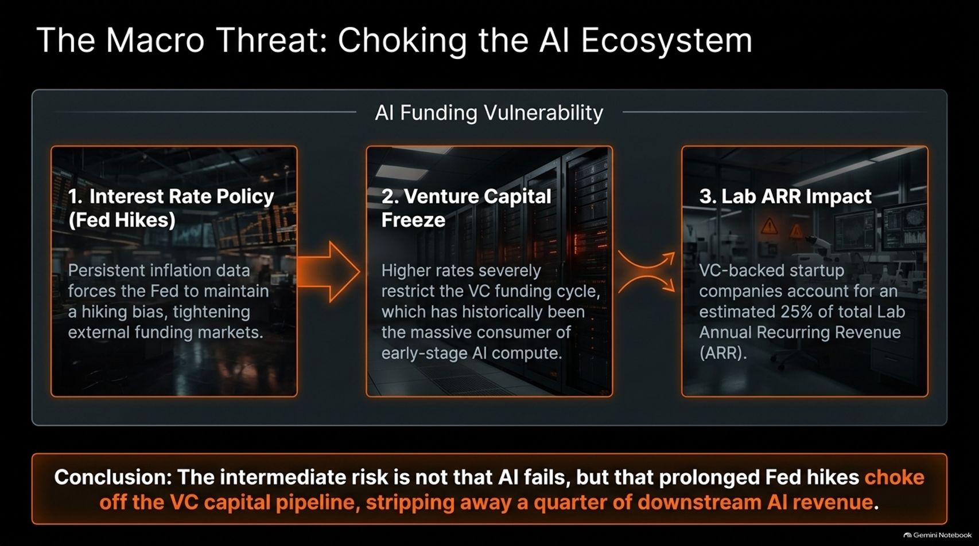
Notes:
Duration Guide: 4 – 5 minutes
Core Presentation Theme: Trace the intermediate risk: persistent inflation forces Fed hikes, choking off venture capital funding cycles which account for 25% of lab Annual Recurring Revenue (ARR).
Speaker Notes:
"What is the actual intermediate macro threat to AI? It's not that the technology fails, but that Fed rate policy chokes off the ecosystem."
"1. Interest Rate Policy: Persistent inflation forces the Fed to maintain a hiking bias, tightening external funding markets."
"2. Venture Capital Freeze: Higher rates severely restrict the VC funding cycle, which has historically been the massive consumer of early-stage AI compute."
"3. Lab ARR Impact: VC-backed startup companies account for an estimated 25% of total Lab Annual Recurring Revenue (ARR)."
"Conclusion: Prolonged Fed hikes threaten to strip away a quarter of downstream AI revenue by starving early-stage startups."

Slide 13
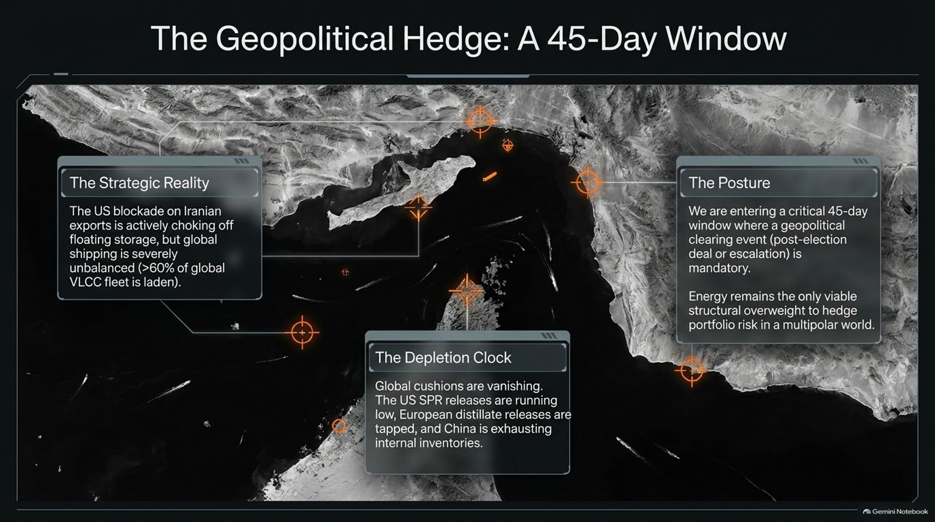
Notes:
Duration Guide: 4 – 5 minutes
Core Presentation Theme: Analyze the geopolitical energy threat in the Middle East, US blockades on Iranian exports, depleting global SPR cushions, and the necessity of structural energy overweights.
Speaker Notes:
"Overlaying the AI and Fed dynamics is a critical geopolitical energy threat. We are entering a crucial 45-day window."
"The Strategic Reality: The US blockade on Iranian exports is actively choking off floating storage, but global shipping is severely unbalanced, with over 60% of the global VLCC tanker fleet laden."
"The Depletion Clock: Global cushions are vanishing. US SPR releases are running low, European distillate reserves are tapped, and China is exhausting internal inventories."
"The Posture: A geopolitical clearing event—whether post-election escalation or deal—is mandatory. In a multipolar world, energy remains the only viable structural overweight to hedge portfolio risk."

Slide 14
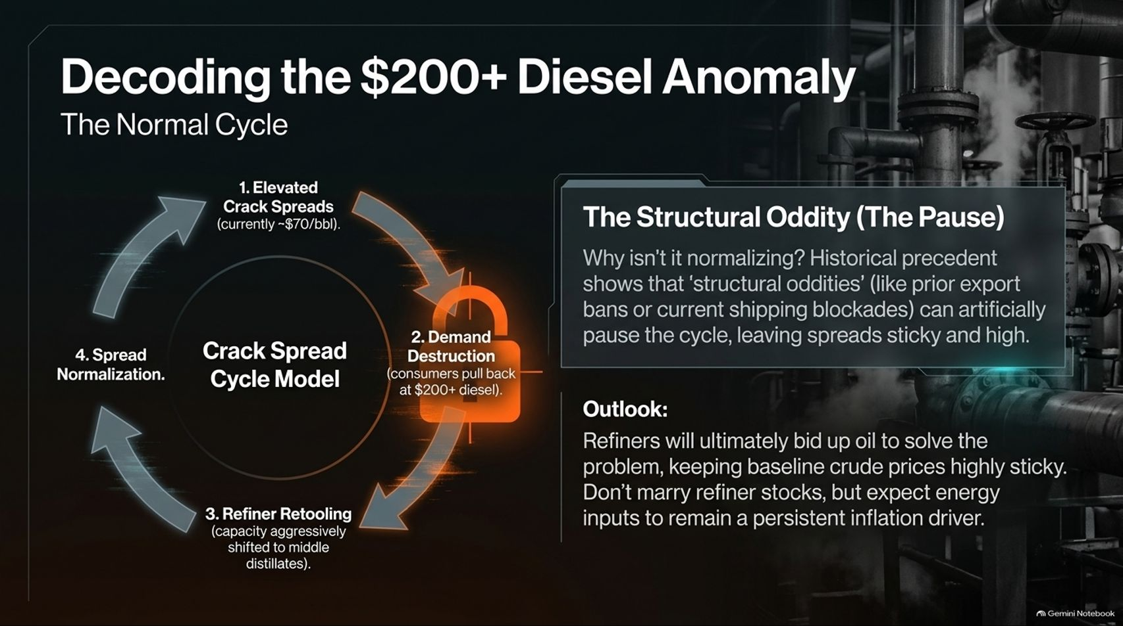
Notes:
Duration Guide: 4 – 5 minutes
Core Presentation Theme: Explain why middle distillate crack spreads remain sticky and elevated at ~$70/bbl due to structural shipping blockades, keeping baseline crude prices sticky despite demand destruction.
Speaker Notes:
"Let's decode the anomaly in energy markets: why are diesel crack spreads sitting at an elevated ~$70/barrel, representing over $200+ diesel anomalies?"
"Normally, the crack spread cycle model moves from elevated cracks to demand destruction, refiner retooling, and normalization."
"The Structural Oddity: Why isn't it normalizing? Historical precedent shows that structural oddities—like export bans or current shipping blockades—artificially pause the cycle, keeping spreads sticky and high."
"Outlook: Refiners will ultimately bid up oil to solve the problem, keeping baseline crude prices sticky. Don't marry refiner stocks, but expect energy inputs to remain a persistent inflation driver."

Slide 15
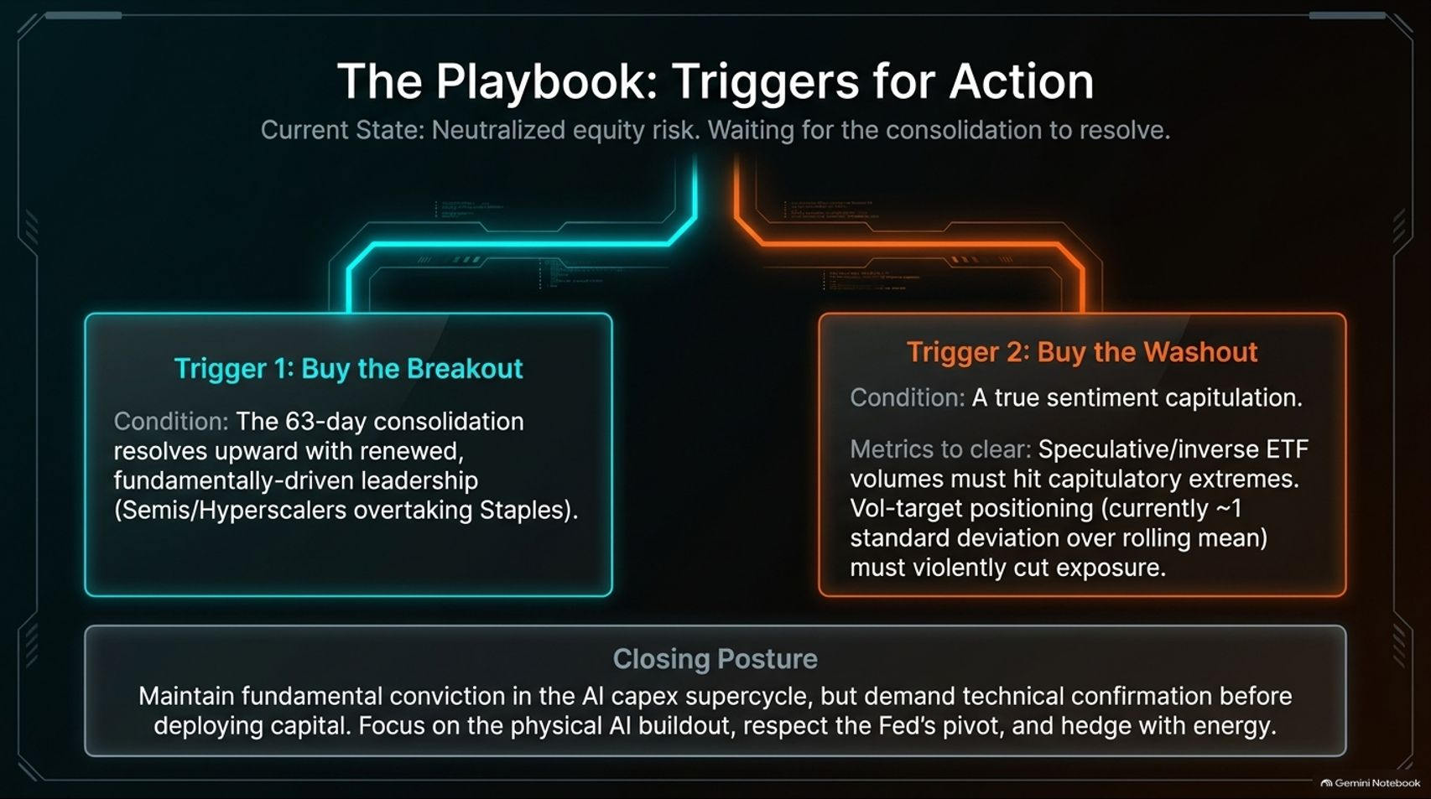
Notes:
Duration Guide: 4 – 5 minutes
Core Presentation Theme: Define the precise tactical triggers to re-engage risk: either waiting for the 63-day consolidation to break out upward, or waiting for a true sentiment capitulation and vol-target liquidation washout.
Speaker Notes:
"Given all these crosscurrents, what is our actionable playbook while equity risk remains neutralized?"
"Trigger 1: Buy the Breakout. Condition: The 63-day consolidation resolves upward with renewed, fundamentally-driven leadership where semis and hyperscalers decisively overtake staples."
"Trigger 2: Buy the Washout. Condition: A true sentiment capitulation. We need metrics to clear: speculative inverse ETF volumes must hit capitulatory extremes, and vol-target positioning (currently ~1 standard deviation over rolling mean) must violently cut exposure."
"Closing Posture: Maintain fundamental conviction in the AI capex supercycle, but demand technical confirmation before deploying new capital. Focus on physical buildout, respect the Fed's pivot, and hedge with energy."

Slide 16
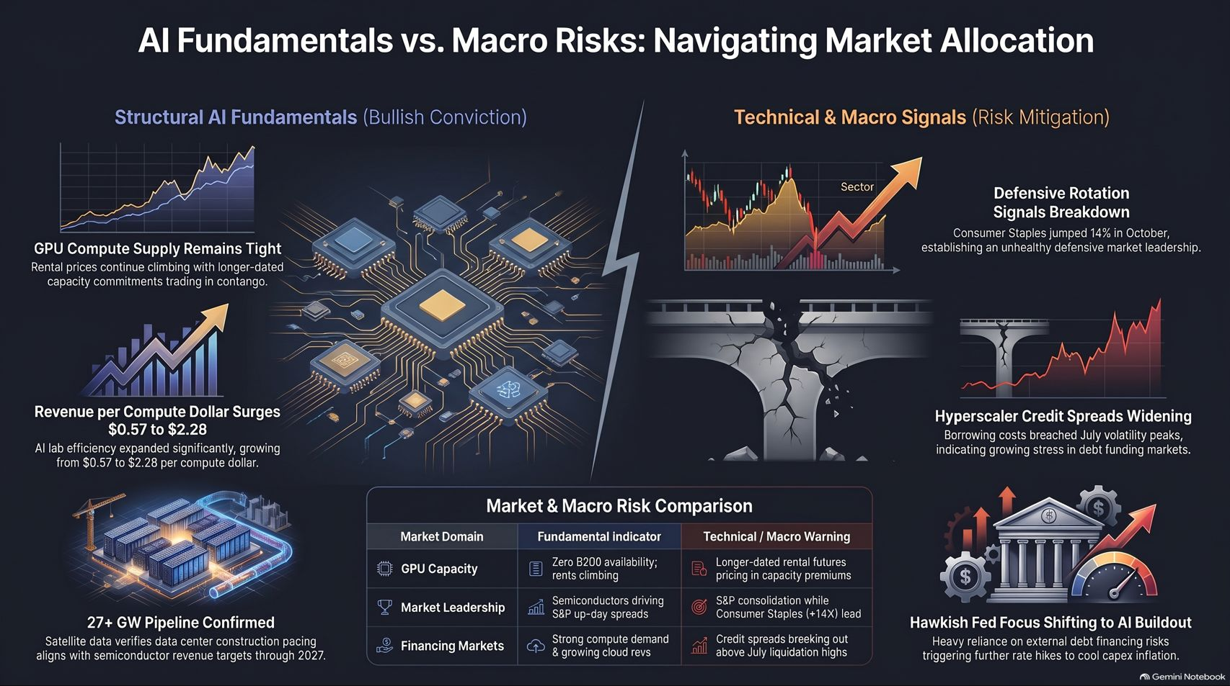
Notes:
Duration Guide: 3 – 5 minutes
Core Presentation Theme: Provide a comprehensive visual reference summary contrasting bullish structural AI fundamentals against technical macro warnings across GPU capacity, market leadership, and financing markets.
Speaker Notes:
"Let's use this final summary slide as your permanent reference sheet for balancing AI fundamentals against macro risks."
"On the left, our Structural AI Fundamentals (Bullish Conviction): GPU rental prices are climbing with capacity contango; revenue per compute dollar surged from $0.57 to $2.28; and satellite data confirms 27+ gigawatts of pipeline growth through 2027."
"On the right, our Technical & Macro Warnings (Risk Mitigation): Consumer Staples jumped 14% showing unhealthy defensive rotation; hyperscaler credit spreads breached July volatility peaks; and hawk-eyed Fed policy threatens debt funding."
"Understand both sides, respect the technical washout, and stay disciplined. Thank you for watching!"

