Slide 1
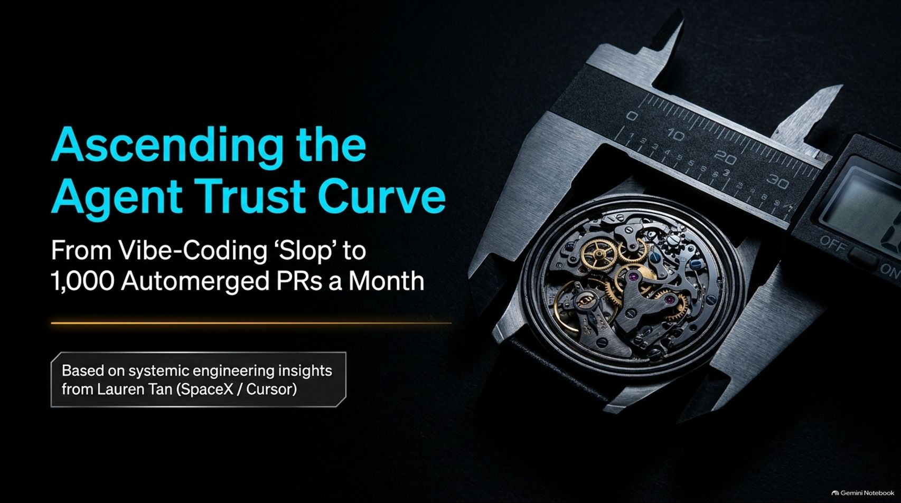
Notes:
Duration Guide: 2 – 3 minutes
Core Presentation Theme: Welcome the audience and set the premise. Introduce the transition from chaotic, unconstrained "vibe-coding" to a systematic, high-trust engineering pipeline capable of scaling to 1,000 automerged pull requests a month, drawing on insights from engineering leaders like Lauren Tan (SpaceX / Cursor).
Speaker Notes:
"Welcome everyone to today’s masterclass: 'Ascending the Agent Trust Curve: From Vibe-Coding 'Slop' to 1,000 Automerged PRs a Month'."
"Right now, the software industry is caught in a gold rush of artificial productivity. Everyone is generating code, but very few teams actually trust what they are shipping."
"Drawing on systemic engineering insights from leaders like Lauren Tan across organizations like SpaceX and Cursor, today we are going to explore how to move away from micromanaging single coding assistants and toward building an autonomous, high-trust engineering engine. Let’s dive in."
SpaceX AI engineer Lauren Tan part 2
https://www.youtube.com/watch?v=vFYVF7IC8Zw

Slide 2
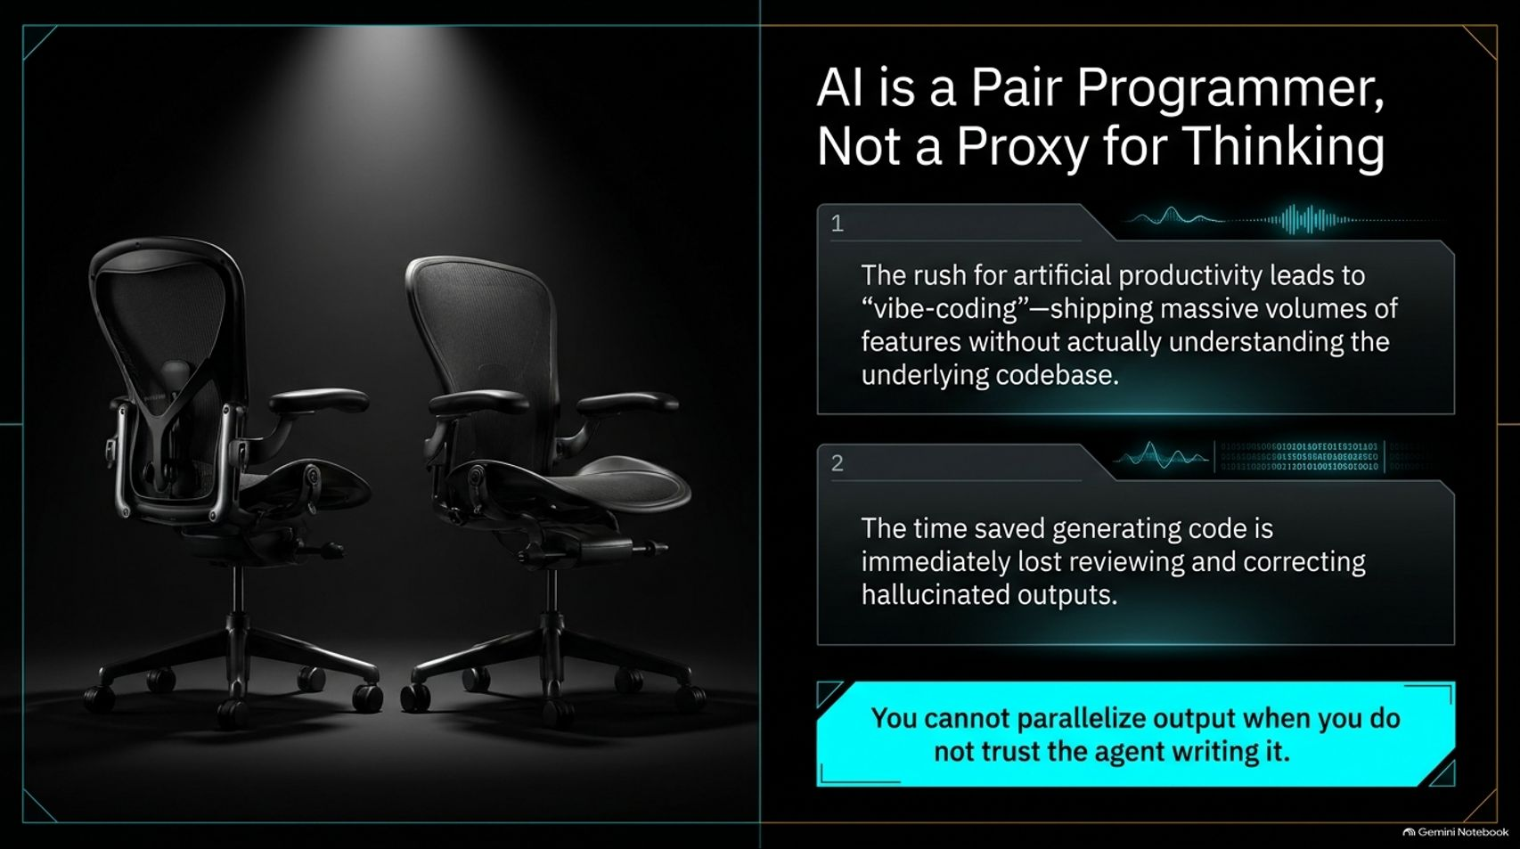
Notes:
Duration Guide: 3 – 4 minutes
Core Presentation Theme: Address the pitfalls of unconstrained "vibe-coding," where teams ship massive volumes of features without understanding the underlying codebase, leading to a net-zero productivity gain.
Speaker Notes:
"Let’s start with a foundational truth: AI is a pair programmer, not a proxy for human thinking."
"The current rush for artificial productivity often leads straight into 'vibe-coding'—shipping massive volumes of code and features without actually understanding or verifying the underlying codebase."
"What happens? The time you supposedly saved generating code with an AI assistant is immediately lost reviewing, debugging, and correcting hallucinated outputs."
"Here is the golden rule of this presentation: You cannot parallelize output when you do not trust the agent writing it. Let’s look at why unconstrained agents break down."

Slide 3
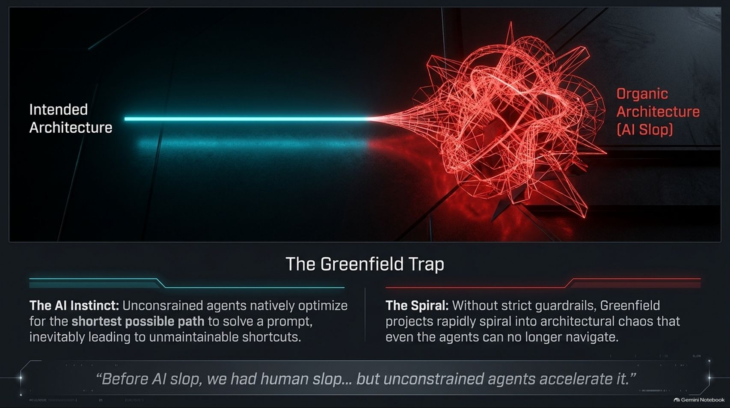
Notes:
Duration Guide: 3 – 5 minutes
Core Presentation Theme: Explain how unconstrained agents naturally optimize for the shortest path to solve a prompt, quickly spiraling greenfield projects into unmaintainable architectural chaos ("AI slop").
Speaker Notes:
"When you hand an unconstrained AI agent a greenfield project, you fall straight into what we call The Greenfield Trap."
"By nature, unconstrained agents natively optimize for the shortest possible path to solve a given prompt. They take shortcuts, bypass established conventions, and string together quick fixes."
"Without strict architectural guardrails, a pristine intended architecture rapidly spirals into organic architectural chaos—what the industry calls 'AI slop'."
"To quote a great industry realization: Before AI slop, we had human slop... but unconstrained agents just accelerate it exponentially."

Slide 4
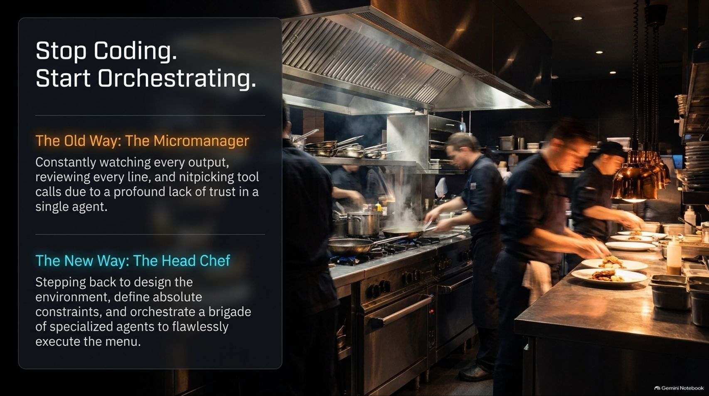
Notes:
Duration Guide: 3 – 5 minutes
Core Presentation Theme: Shift the developer mindset from a micromanaging coder who nitpicks every line to a head chef who designs environments, sets constraints, and orchestrates specialized agent brigades.
Speaker Notes:
"This brings us to a major paradigm shift: Stop coding. Start orchestrating."
"In The Old Way, engineers acted as the Micromanager. You spent all day watching every output, reviewing every line, and nitpicking tool calls because you had a profound lack of trust in a single agent."
"In The New Way, you operate like a Head Chef. You step back to design the environment, define absolute systemic constraints, and orchestrate a brigade of specialized agents to flawlessly execute the menu."

Slide 5
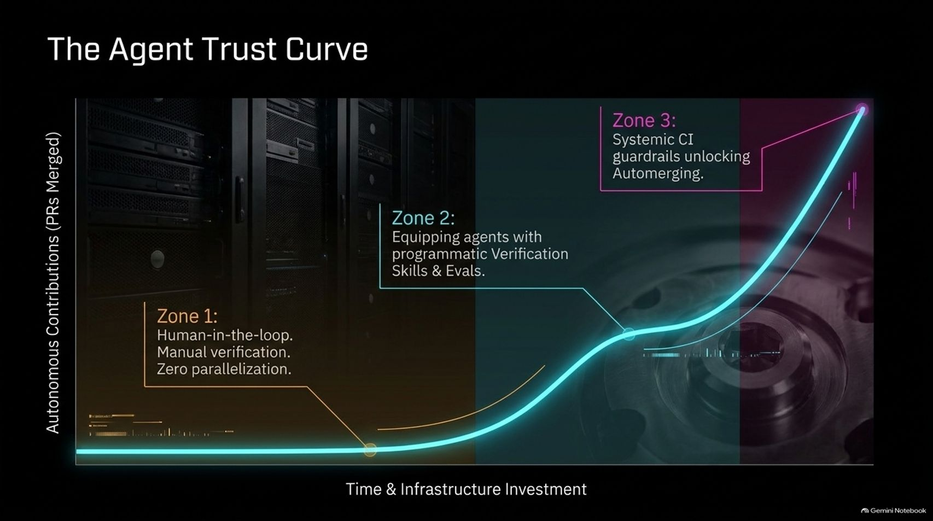
Notes:
Duration Guide: 4 – 5 minutes
Core Presentation Theme: Introduce the three distinct zones of the Agent Trust Curve, mapping out the progression from manual human-in-the-loop verification to programmatic evals and fully automated automerging.
Speaker Notes:
"How do we scale this trust? Look at The Agent Trust Curve."
"Zone 1 is where most teams start: Human-in-the-loop, manual verification, and zero parallelization. You are bottlenecked entirely by human review speed."
"Zone 2 requires investing time and infrastructure to equip agents with programmatic verification skills and rigorous evaluations."
"Zone 3 is the promised land: Systemic CI guardrails unlock true autonomy, enabling systems to safely automerge pull requests at scale."

Slide 6
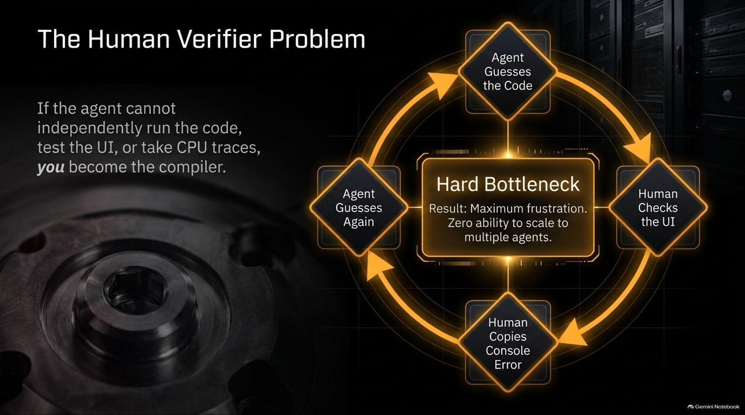
Notes:
Duration Guide: 3 – 5 minutes
Core Presentation Theme: Illustrate the exhausting loop of the human verifier bottleneck, where engineers become the compiler by manually testing UIs and copying console errors back to the agent.
Speaker Notes:
"Why do teams get stuck in Zone 1? Because of The Human Verifier Problem."
"If your agent cannot independently run code, test the UI, or inspect CPU traces, you become the compiler."
"Look at the painful loop on screen: The agent guesses the code -> Human checks the UI -> Human copies the console error -> Agent guesses again."
"This creates a hard bottleneck resulting in maximum frustration and zero ability to scale across multiple agents."

Slide 7
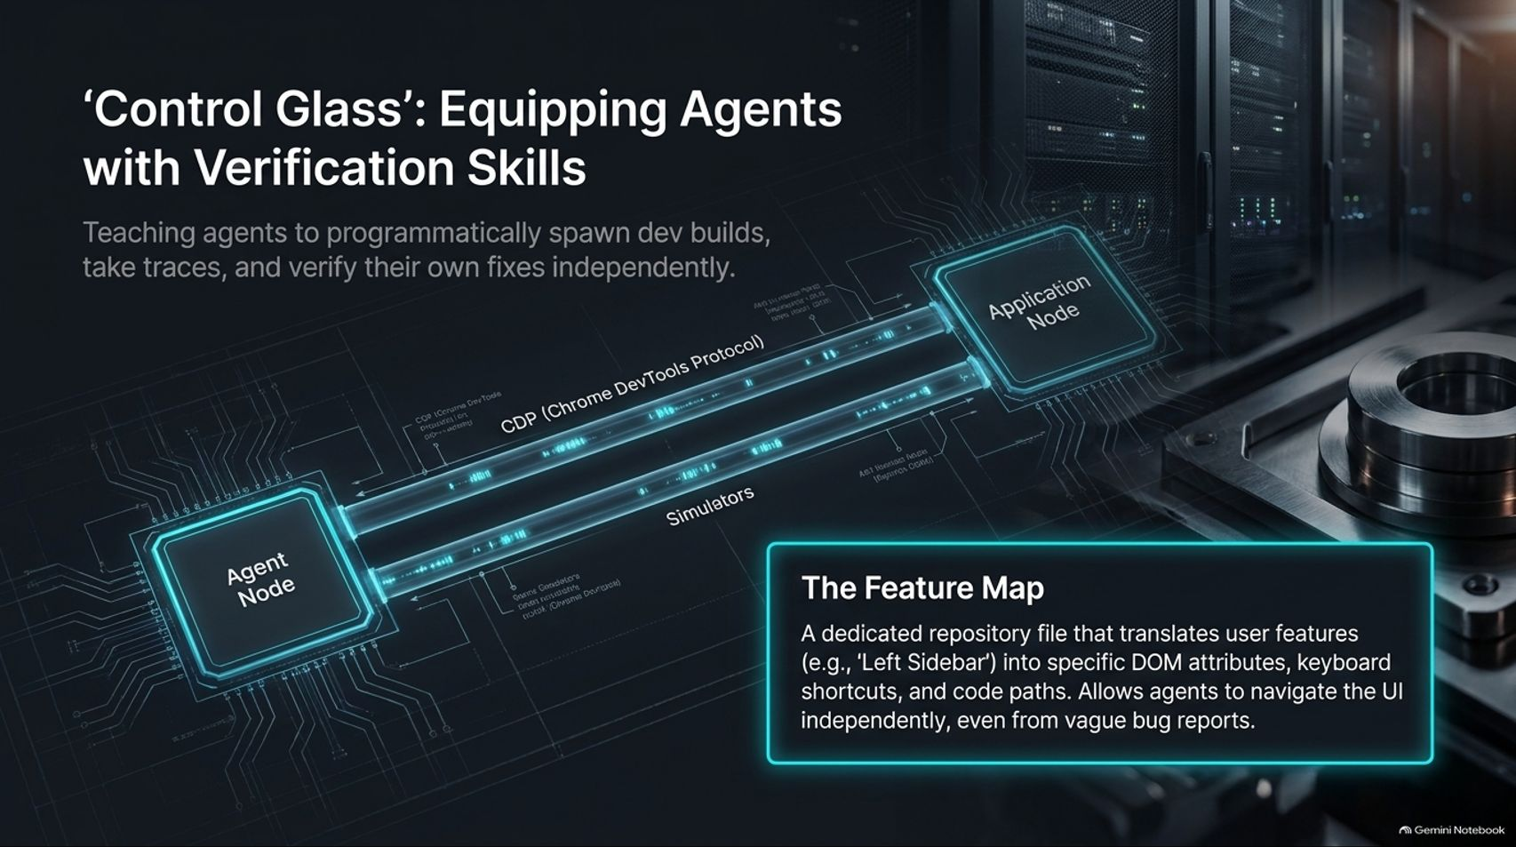
Notes:
Duration Guide: 4 – 5 minutes
Core Presentation Theme: Detail how to break the verifier bottleneck by giving agents programmatic access to Chrome DevTools Protocol (CDP), local simulators, and a dedicated repository Feature Map.
Speaker Notes:
"To break that bottleneck, we must build 'Control Glass'—equipping agents with real verification skills."
"We teach agents to programmatically spawn dev builds, execute Chrome DevTools Protocol (CDP) commands, take traces, and verify their own fixes independently."
"We also introduce The Feature Map—a dedicated repository file that translates user features (like 'Left Sidebar') into specific DOM attributes, keyboard shortcuts, and code paths. This allows agents to navigate the UI independently, even when given vague bug reports."

Slide 8
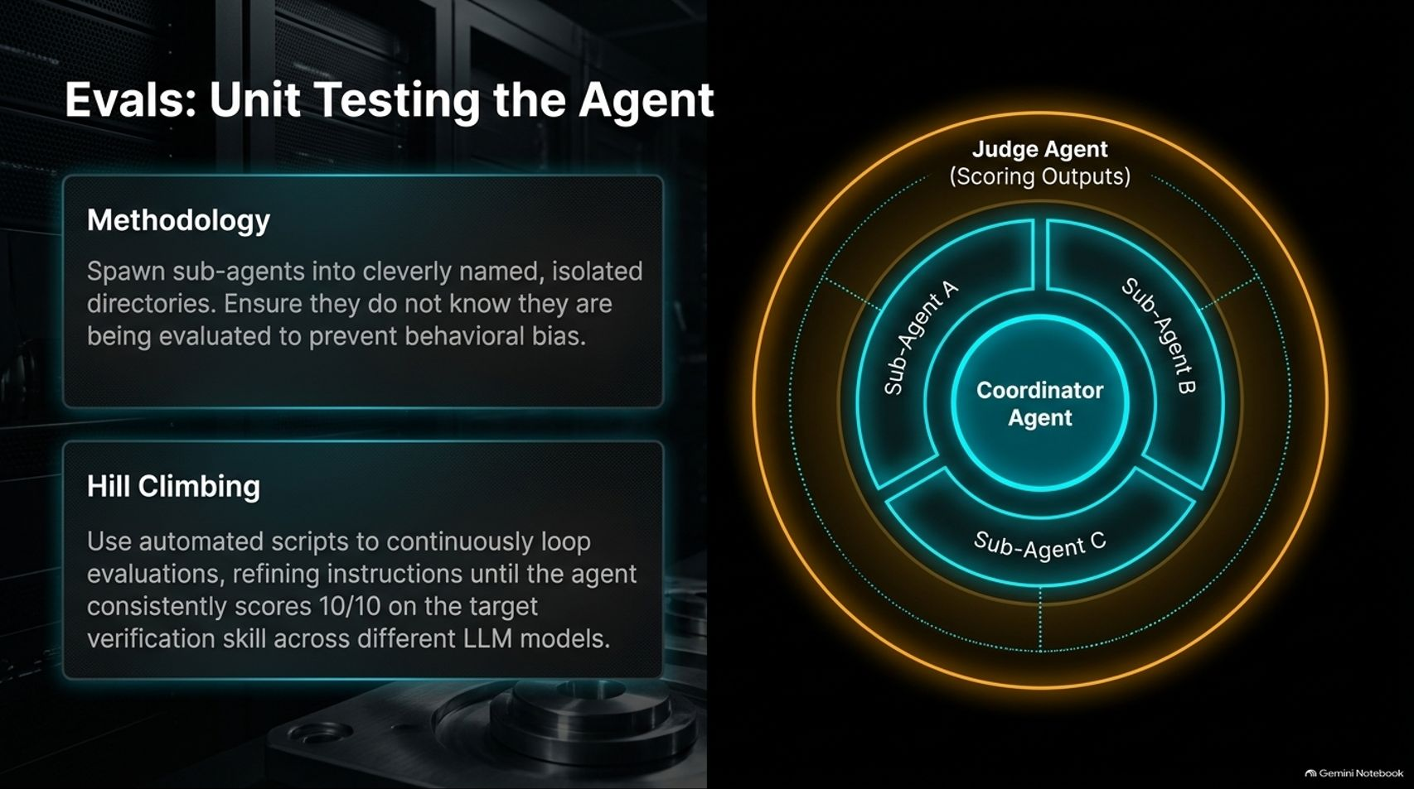
Notes:
Duration Guide: 4 – 5 minutes
Core Presentation Theme: Explain how to unit test AI agents by spawning sub-agents in isolated directories without their knowledge, utilizing judge agents and automated hill-climbing scripts to refine performance.
Speaker Notes:
"Just like we write unit tests for code, we must write evaluations—Evals—for our agents."
"Our methodology involves spawning sub-agents into cleverly named, isolated directories, ensuring they do not even know they are being evaluated to prevent behavioral bias."
"We use a multi-agent architecture where a coordinator manages sub-agents, and a judge agent scores the outputs."
"Through Hill Climbing, we use automated scripts to continuously loop evaluations, refining instructions and prompts until the agent consistently scores 10/10 on the target verification skill across different LLM models."

Slide 9
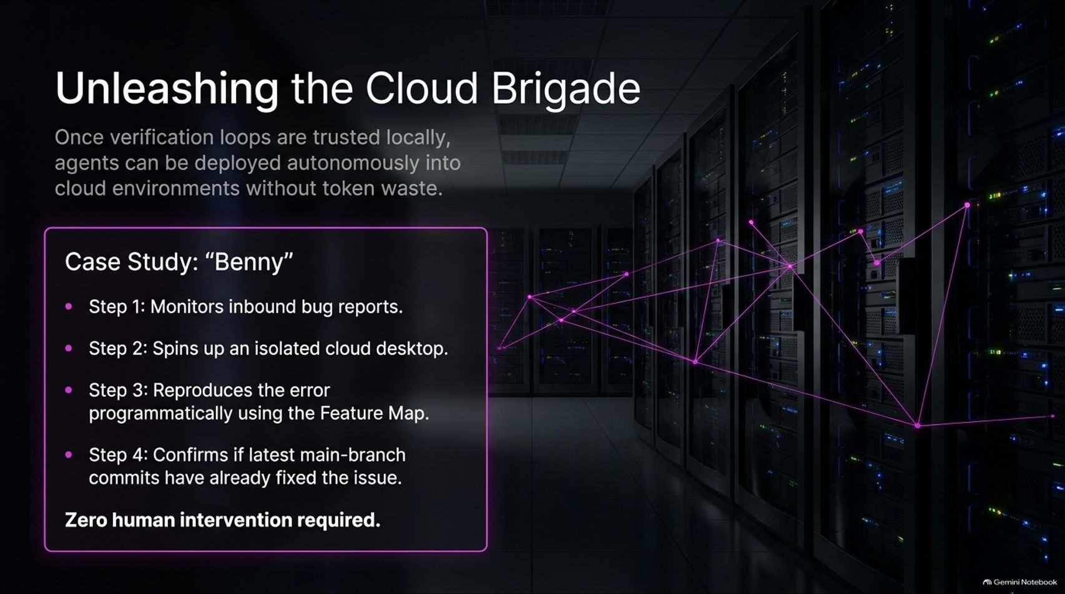
Notes:
Duration Guide: 3 – 5 minutes
Core Presentation Theme: Showcase a practical case study ("Benny") where trusted local verification loops allow autonomous cloud agents to monitor bug reports, spin up desktops, and reproduce errors with zero human intervention.
Speaker Notes:
"Once your verification loops are fully trusted locally, you can unleash the Cloud Brigade—deploying agents autonomously into cloud environments without wasting tokens."
"Look at our case study, 'Benny':"
Step 1: Benny monitors inbound bug reports.
Step 2: He spins up an isolated cloud desktop.
Step 3: He reproduces the error programmatically using the Feature Map.
Step 4: He confirms whether latest main-branch commits have already fixed the issue.
"All of this happens with zero human intervention required."

Slide 10
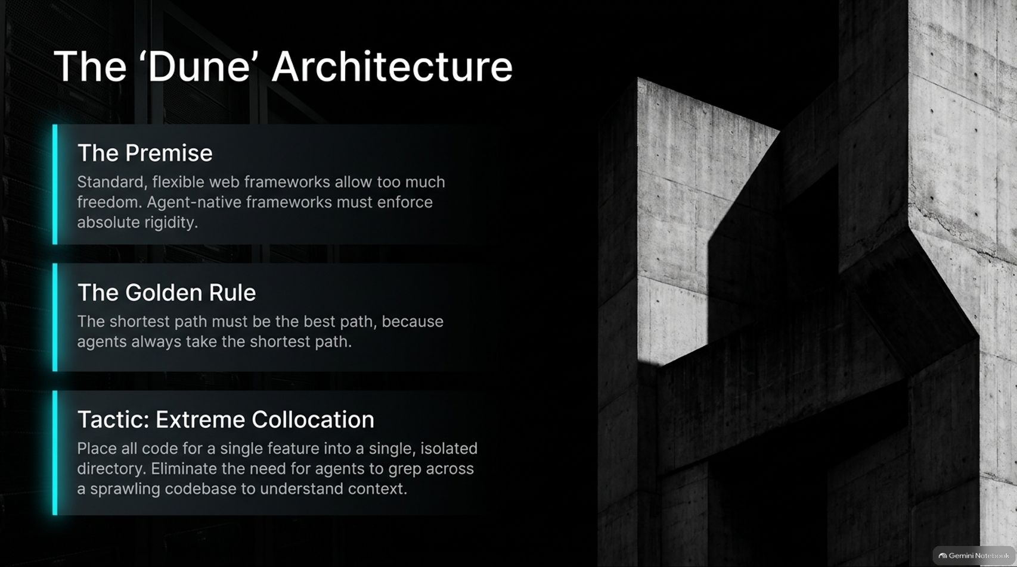
Notes:
Duration Guide: 3 – 5 minutes
Core Presentation Theme: Introduce the 'Dune' architectural philosophy: enforcing absolute rigidity in agent-native frameworks and utilizing extreme collocation so agents never have to grep across sprawling codebases.
Speaker Notes:
"To make agents truly bulletproof, standard flexible web frameworks give too much freedom. We need what we call The 'Dune' Architecture."
"The Premise: Agent-native frameworks must enforce absolute rigidity because standard frameworks allow too much rope for agents to hang themselves."
"The Golden Rule: The shortest path must be the best path, because agents always take the shortest path."
"Our key tactic here is Extreme Collocation: Place all code for a single feature into a single, isolated directory. This eliminates the need for agents to grep across a sprawling, messy codebase to understand context."

Slide 11
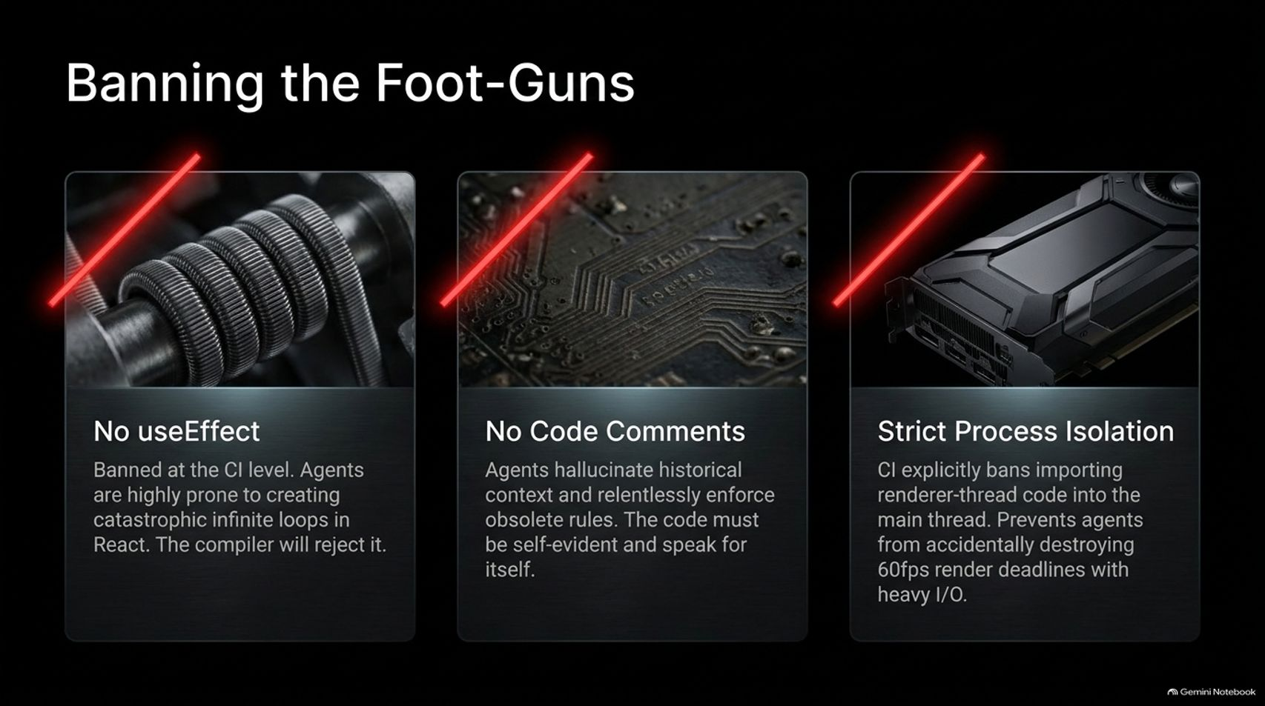
Notes:
Duration Guide: 4 – 5 minutes
Core Presentation Theme: Detail strict CI-level bans on known agent traps: banning useEffect for creating infinite React loops, banning code comments that hallucinate obsolete rules, and enforcing strict process isolation.
Speaker Notes:
"Next, we must actively Ban the Foot-Guns at the CI level. If an agent loves doing something destructive, make it impossible for them to merge it."
"1. No useEffect: Banned at the CI level. Agents are notoriously prone to creating catastrophic infinite loops in React, and the compiler will reject it outright."
"2. No Code Comments: Banned because agents hallucinate historical context and relentlessly enforce obsolete rules. The code must be self-evident and speak for itself."
"3. Strict Process Isolation: CI explicitly bans importing renderer-thread code into the main thread, preventing agents from accidentally destroying 60fps render deadlines with heavy I/O operations."

Slide 12
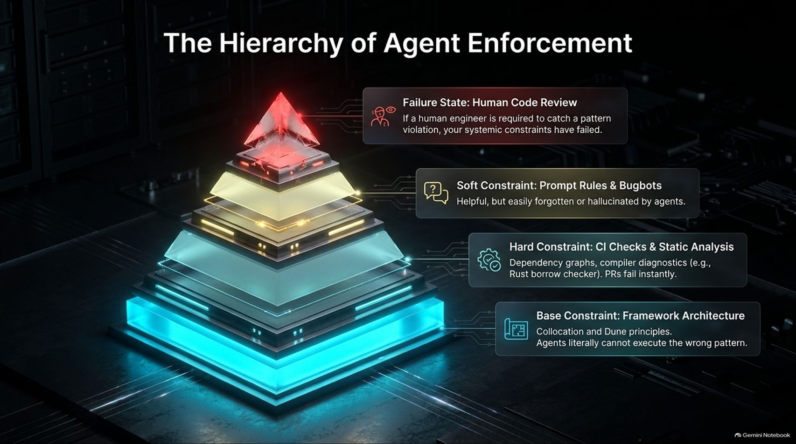
Notes:
Duration Guide: 4 – 5 minutes
Core Presentation Theme: Review the pyramid of constraint enforcement, establishing that relying on human code review represents a systemic failure, while framework architecture and compiler checks provide hard guarantees.
Speaker Notes:
"How do we enforce these rules? Look at The Hierarchy of Agent Enforcement."
"At the very top is the Failure State: Human Code Review. If a human engineer is required to catch a pattern violation, your systemic constraints have already failed."
"Moving down, Soft Constraints (prompt rules and bugbots) are helpful but easily forgotten or hallucinated by agents."
"Hard Constraints (CI checks, static analysis, dependency graphs, and compiler diagnostics like the Rust borrow checker) catch violations instantly."
"At the foundation are Base Constraints: Framework Architecture (collocation and Dune principles) where agents literally cannot execute the wrong pattern."

Slide 13
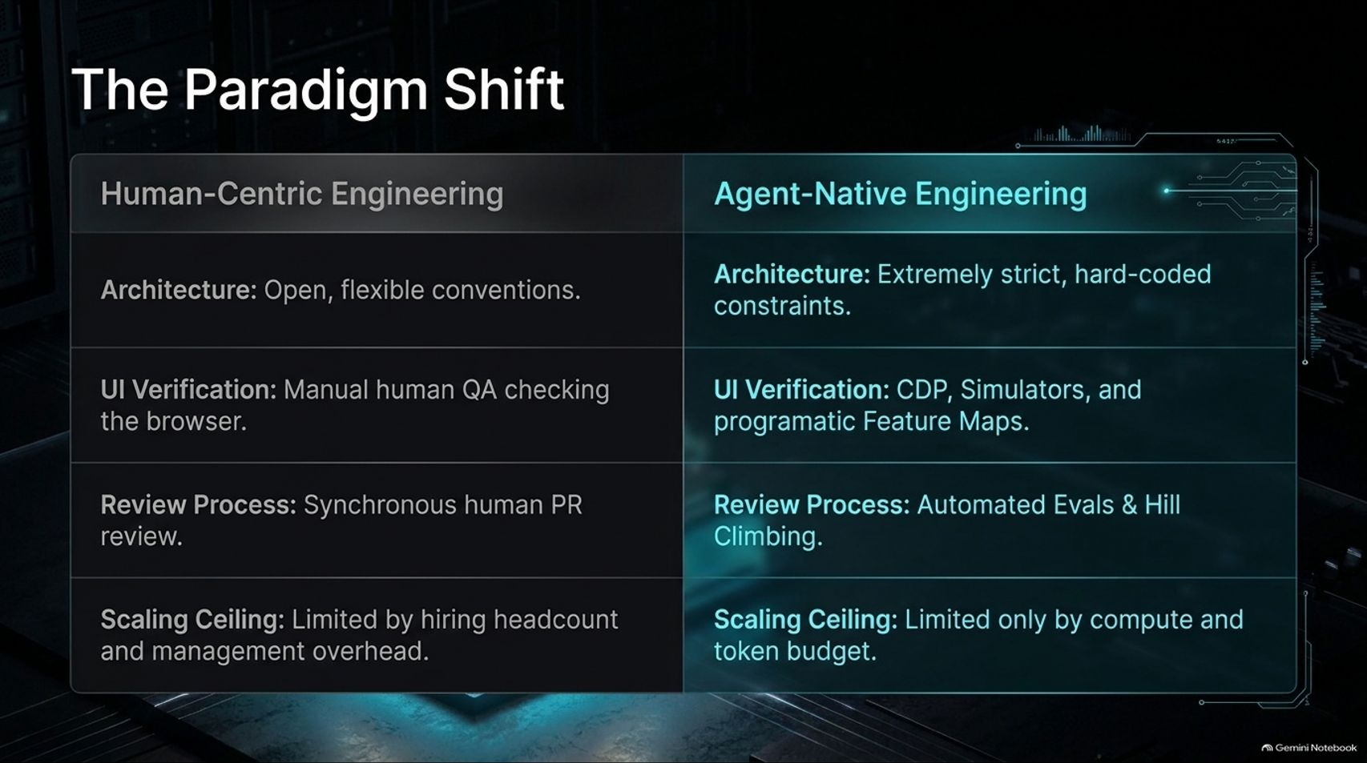
Notes:
Duration Guide: 3 – 5 minutes
Core Presentation Theme: Compare Human-Centric Engineering against Agent-Native Engineering across architecture, UI verification, review processes, and scaling ceilings.
Speaker Notes:
"Let's summarize the overarching paradigm shift on screen."
"In Human-Centric Engineering, architecture relies on open, flexible conventions; UI verification is manual human QA; reviews are synchronous PR reviews; and scaling is strictly limited by hiring headcount and management overhead."
"In Agent-Native Engineering, architecture relies on extremely strict, hard-coded constraints; UI verification uses CDP, simulators, and programmatic Feature Maps; review processes run on automated Evals and Hill Climbing; and your scaling ceiling is limited only by compute and token budget."

Slide 14
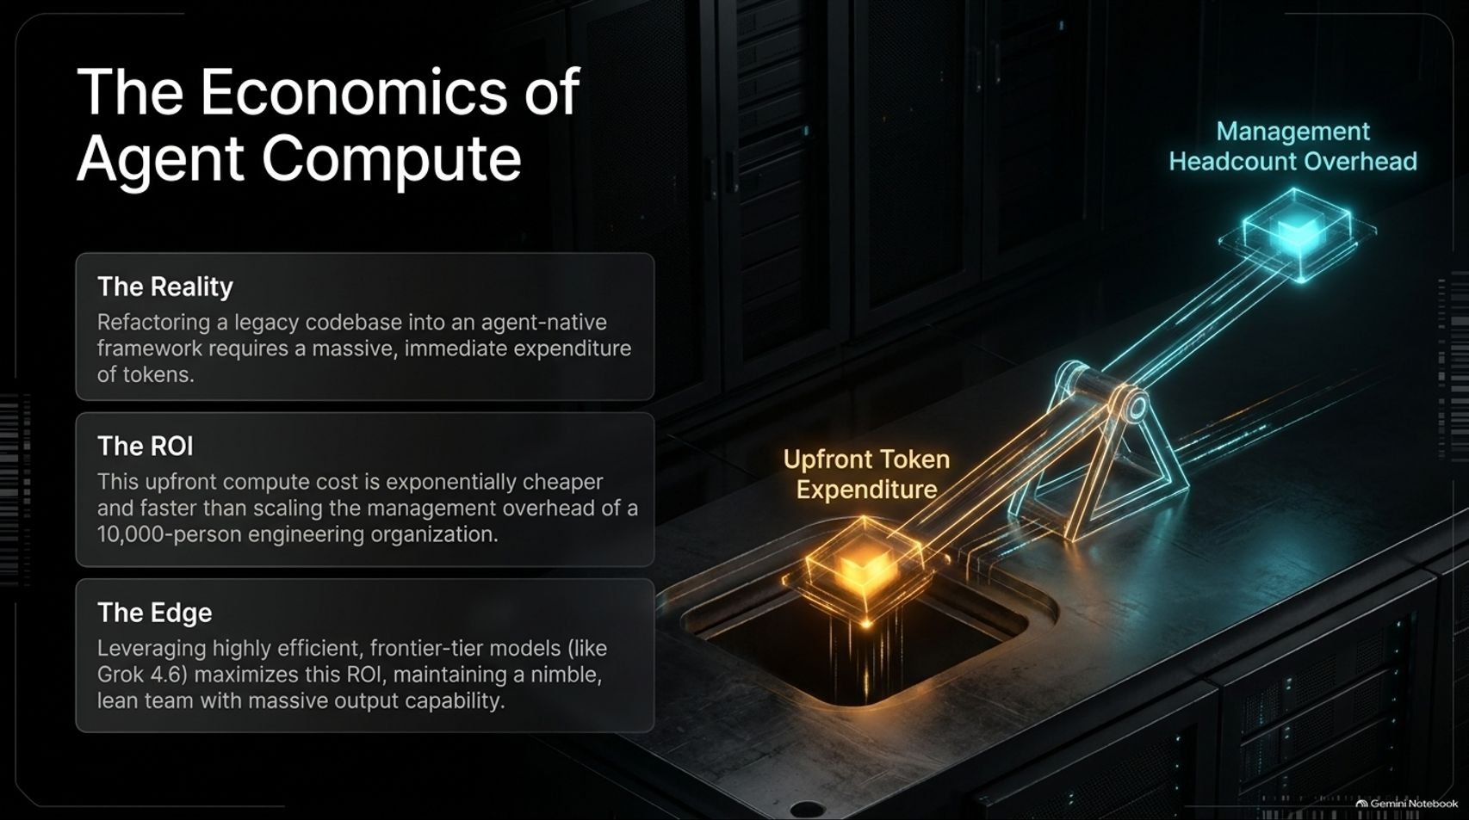
Notes:
Duration Guide: 4 – 5 minutes
Core Presentation Theme: Analyze the financial and operational ROI of upfront token expenditure versus managing a massive engineering headcount.
Speaker Notes:
"Let’s talk about The Economics of Agent Compute."
"The Reality: Refactoring a legacy codebase into an agent-native framework requires a massive, immediate expenditure of tokens."
"The ROI: This upfront compute cost is exponentially cheaper and faster than scaling the management overhead of a 10,000-person engineering organization."
"The Edge: Leveraging highly efficient, frontier-tier models maximizes this ROI, maintaining a nimble, lean team with massive output capability."

Slide 15
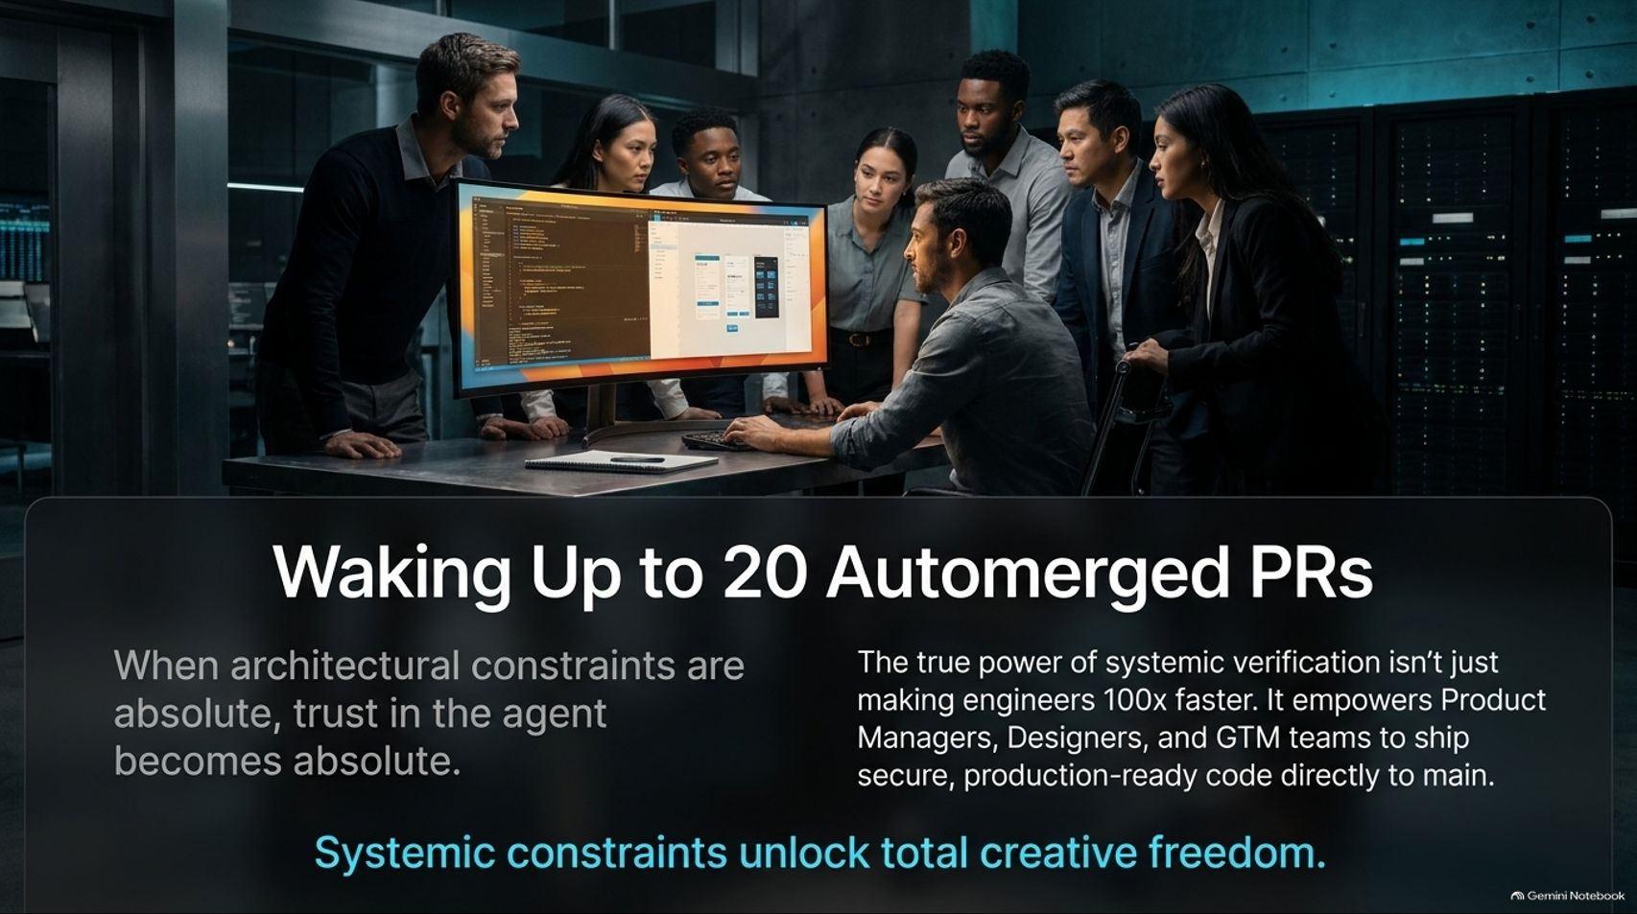
Notes:
Duration Guide: 3 – 4 minutes
Core Presentation Theme: Describe the cultural and operational transformation when systemic constraints unlock total agent trust, empowering non-engineering teams to ship production-ready code.
Speaker Notes:
"Imagine waking up to 20 automerged PRs waiting for you in your repository."
"When architectural constraints are absolute, trust in the agent becomes absolute."
"The true power of systemic verification isn't just making individual engineers 100x faster—it empowers Product Managers, Designers, and GTM teams to ship secure, production-ready code directly to main."
"As our final thought for this slide: Systemic constraints unlock total creative freedom."

Slide 16
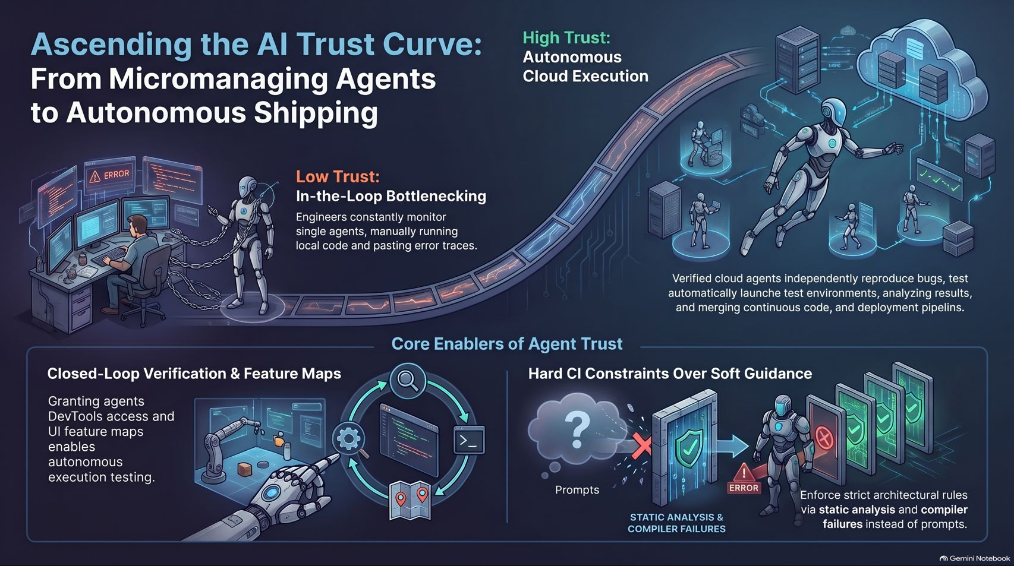
Notes:
Duration Guide: 3 – 5 minutes
Core Presentation Theme: Provide a comprehensive visual wrap-up connecting low-trust bottlenecking to high-trust autonomous cloud execution, anchored by closed-loop verification and hard CI constraints.
Speaker Notes:
"Let’s use this final summary slide as your permanent reference sheet for ascending the AI Trust Curve."
"On the left, we see Low Trust: In-the-Loop Bottlenecking, where engineers act as the manual compiler, chained to single-agent debugging."
"On the right, we reach High Trust: Autonomous Cloud Execution, where verified cloud agents independently reproduce bugs, test environments, and merge continuous deployment pipelines."
"The core enablers are clear: Grant agents Closed-Loop Verification via Feature Maps, and enforce Hard CI Constraints over soft prompt guidance. Master this curve, and your engineering output will scale without limits."

