Slide 1

Notes:
Duration Guide: 2 – 3 minutes
Core Presentation Theme: Welcome the audience and set the premise. Introduce John Huber’s framework for value investing, emphasizing how adaptability, strategic flexibility, and psychological longevity outshine rigid investment style boxes over a multi-decade horizon.
Speaker Notes:
"Welcome everyone to today’s masterclass: 'The Art of Compounding: John Huber’s Playbook for Adaptability, Strategy, and Longevity in Value Investing'."
*"In the investing world, we often get caught up in rigid labels—calling ourselves growth investors, microcap specialists, or compounder purists. But true compounding isn't about fitting neatly into a style box." *
"Today, drawing on deep insights from John Huber (Portfolio Manager at Saber Capital Management), we will explore how value investing is actually an evolving practice. We'll discuss how to manage valuation risks, build anti-fragile portfolios, and structure your career so you can compound capital for 40 years without burning out. Let’s dive in."
How great stocks drop 50% | John Huber
https://www.youtube.com/watch?v=cEK8Ak-q0tg

Slide 2
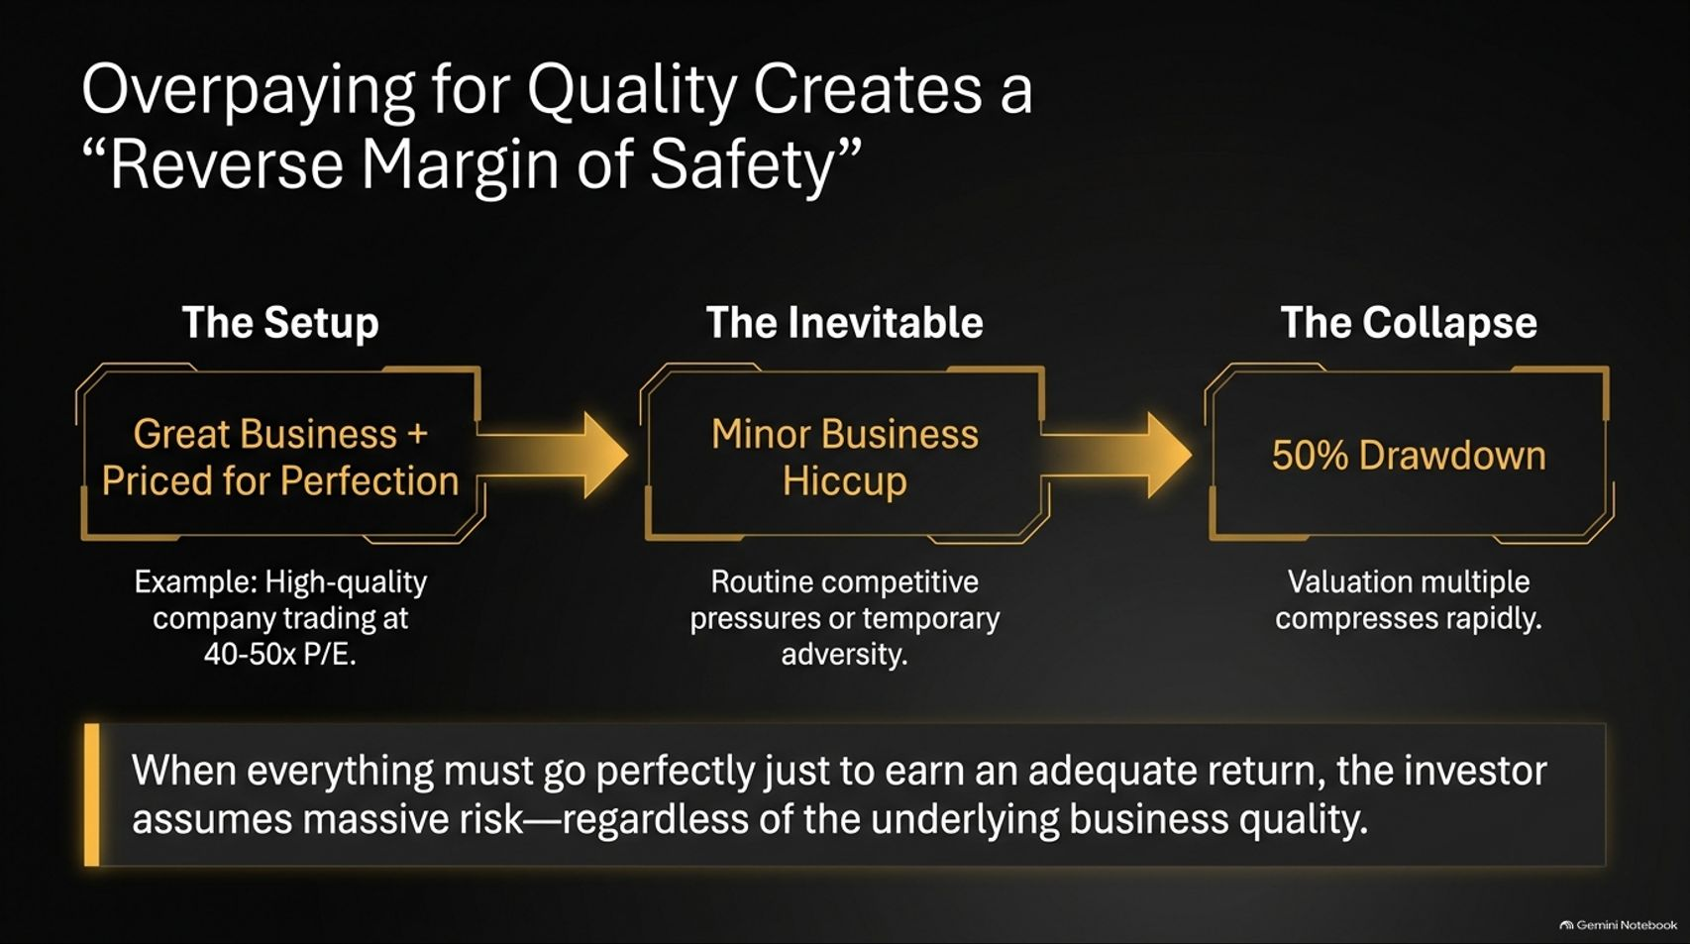
Notes:
Duration Guide: 3 – 5 minutes
Core Presentation Theme: Warn against the dangerous trap of paying extreme multiples (40–50x P/E) for high-quality businesses, showing how a minor operational hiccup can trigger a 50% drawdown.
Speaker Notes:
"Let's start with a crucial valuation lesson: Overpaying for quality creates a 'reverse margin of safety'."
"For the past decade, investors fell in love with high-ROIC 'compounders'. The narrative became: 'If it's a great business, price doesn't matter; just buy and hold forever'. But look at the setup on screen: when you pay 40x or 50x earnings for a company—even a premier business like Copart—you are priced for total perfection."
"What happens when a business hits a routine operational hiccup or competitive pressure? In a stock priced for perfection, even a minor slowdown causes the valuation multiple to compress rapidly. That is how a great company suffers a 50% drawdown."
"When everything must go perfectly just to earn an adequate return, you don't have a margin of safety—you have a reverse margin of safety."

Slide 3
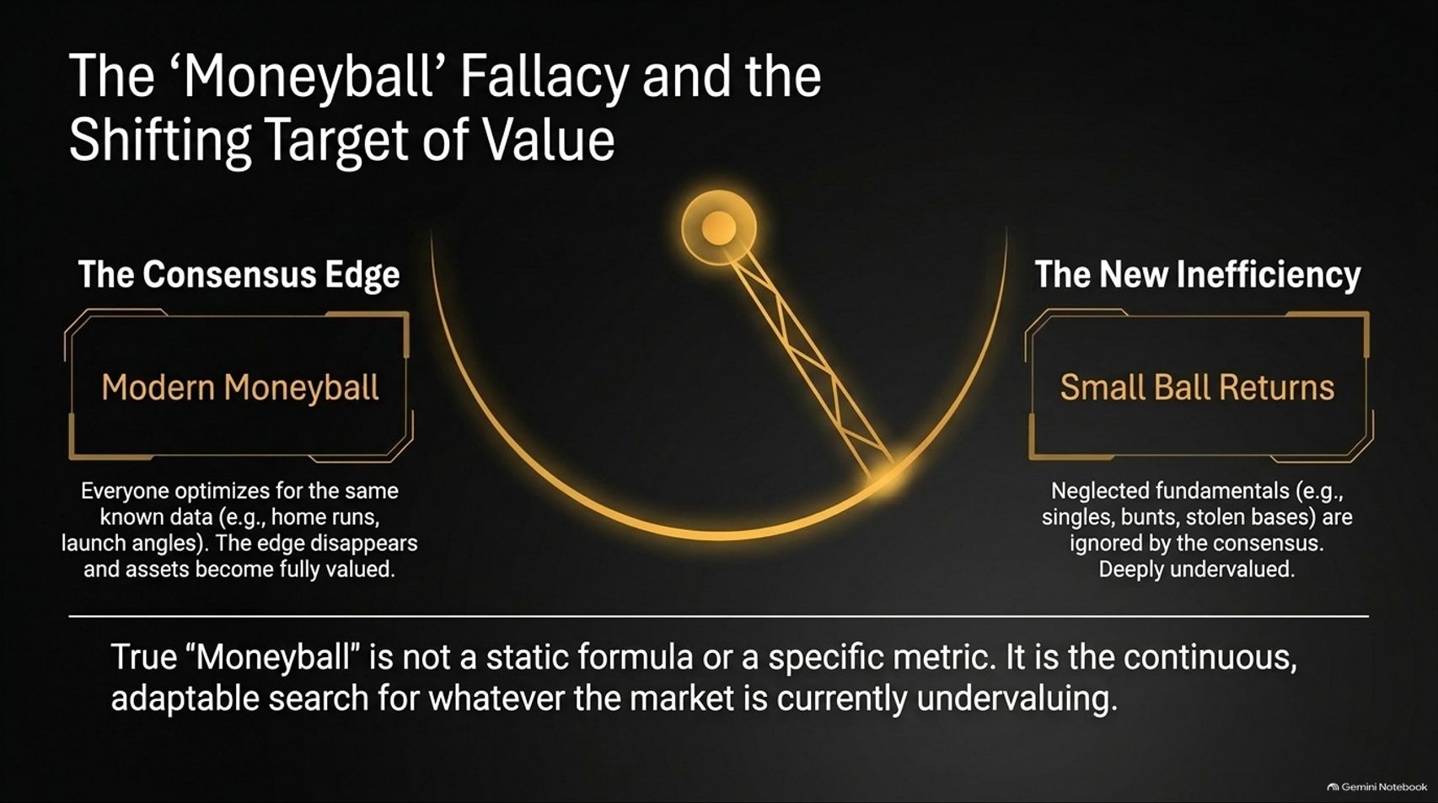
Notes:
Duration Guide: 4 – 5 minutes
Core Presentation Theme: Use the Tampa Bay Rays Moneyball sports analogy to show how analytical edges erode when everyone optimizes for the same metrics, shifting value toward neglected "small ball" fundamentals.
Speaker Notes:
"To understand where market edges come from, let's look at the famous 'Moneyball' Fallacy."
"When the Oakland A's introduced Moneyball, they exploited neglected metrics like on-base percentage. But over 20 years, all of Major League Baseball became obsessed with the exact same data—exit velocity, launch angles, and home runs. Once consensus optimizes for a metric, the edge disappears."
"What did the Tampa Bay Rays discover? They realized that while everyone swung for home runs, 'small ball'—bunts, stolen bases, contact rate, and singles—became severely undervalued. By leaning into these neglected fundamentals, they built a winning roster on a tiny budget."
"The investing takeaway: True 'Moneyball' is not a static formula or a specific metric. It is the continuous, adaptable search for whatever the market is currently mispricing."

Slide 4
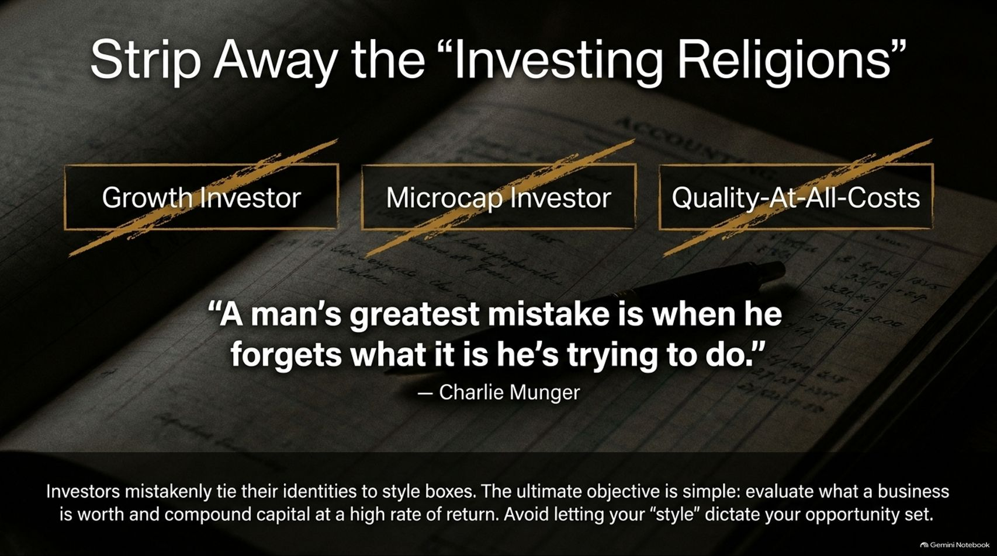
Notes:
Duration Guide: 3 – 4 minutes
Core Presentation Theme: Challenge investors to abandon rigid style boxes (Growth, Microcap, Quality-at-all-costs) and adopt Charlie Munger's first-principles mindset: evaluate what a business is worth and compound capital.
Speaker Notes:
"This brings us to a essential rule of mental discipline: Strip away the 'Investing Religions'."
"Investors love to tie their personal identity to a style box: 'I am a Growth Investor', 'I am a Microcap Investor', or 'I am a Quality Compounder'. But style boxes narrow your opportunity set and breed confirmation bias."
"As Charlie Munger famously warned: 'A man's greatest mistake is when he forgets what it is he's trying to do'."
"What are you trying to do? Your objective isn't to defend a dogma; it is to evaluate what a business is worth and compound capital at a high rate of return. Approach the market from first principles and keep an open mind."

Slide 5
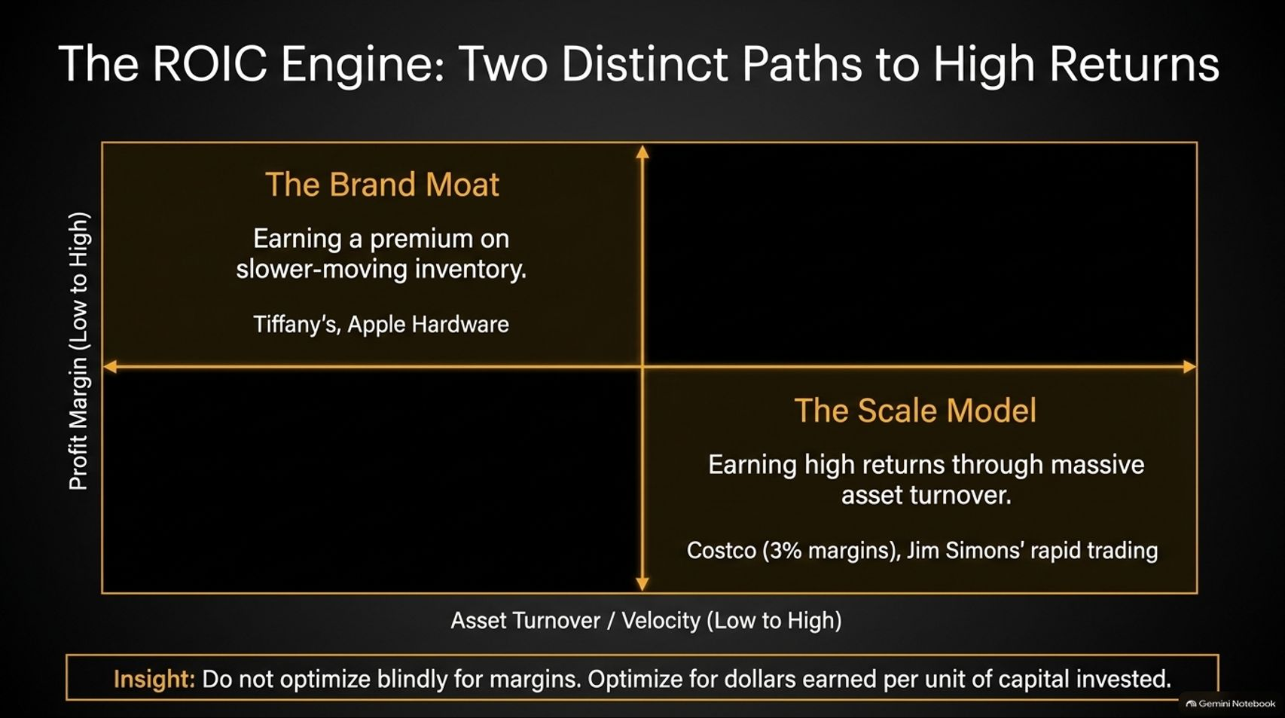
Notes:
Duration Guide: 4 – 5 minutes
Core Presentation Theme: Explain the return on invested capital (ROIC) matrix, highlighting how high returns can be achieved either through high profit margins (The Brand Moat) or high asset turnover (The Scale/Volume Model).
Speaker Notes:
"When analyzing business quality, many analysts make the mistake of focusing strictly on profit margins. But Return on Invested Capital (ROIC) is driven by two distinct levers."
"Look at The Brand Moat quadrant: Companies like Tiffany's or Apple hardware earn high returns by commanding high profit margins on slower-moving inventory."
"Now look at The Scale Model quadrant: Companies like Costco operate on paper-thin 3% profit margins, but achieve massive ROIC through rapid asset turnover and high volume. In portfolio management, Jim Simons at Renaissance Technologies did the exact same thing—earning high returns through rapid portfolio turnover on tiny statistical edges."
"Key Insight: Do not optimize blindly for margins. Optimize for total cash dollars earned per unit of capital invested."

Slide 6
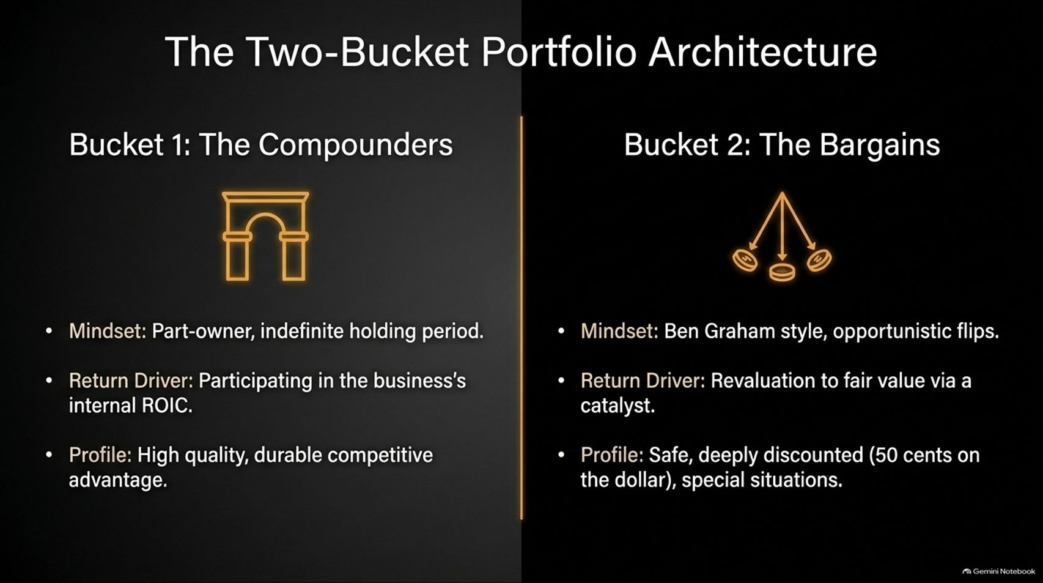
Notes:
Duration Guide: 4 – 5 minutes
Core Presentation Theme: Introduce Saber Capital's two-bucket portfolio framework: balancing long-term core compounders (indefinite part-ownership) with opportunistic bargains (catalyst-driven flips/special situations).
Speaker Notes:
"How do we structure a portfolio to capture different market opportunities? We use The Two-Bucket Portfolio Architecture."
"Bucket 1: The Compounders. This is your part-owner mindset. You own durable, high-ROIC businesses with strong competitive advantages, intending to hold them indefinitely and participate directly in the business's internal cash flow growth."
"Bucket 2: The Bargains. This is the Ben Graham-style opportunistic bucket. You buy safe, deeply discounted assets—trading at 50 cents on the dollar, net-nets, or thrift conversions—looking for a catalyst to revalue the stock to fair value so you can flip the capital into the next opportunity."

Slide 7
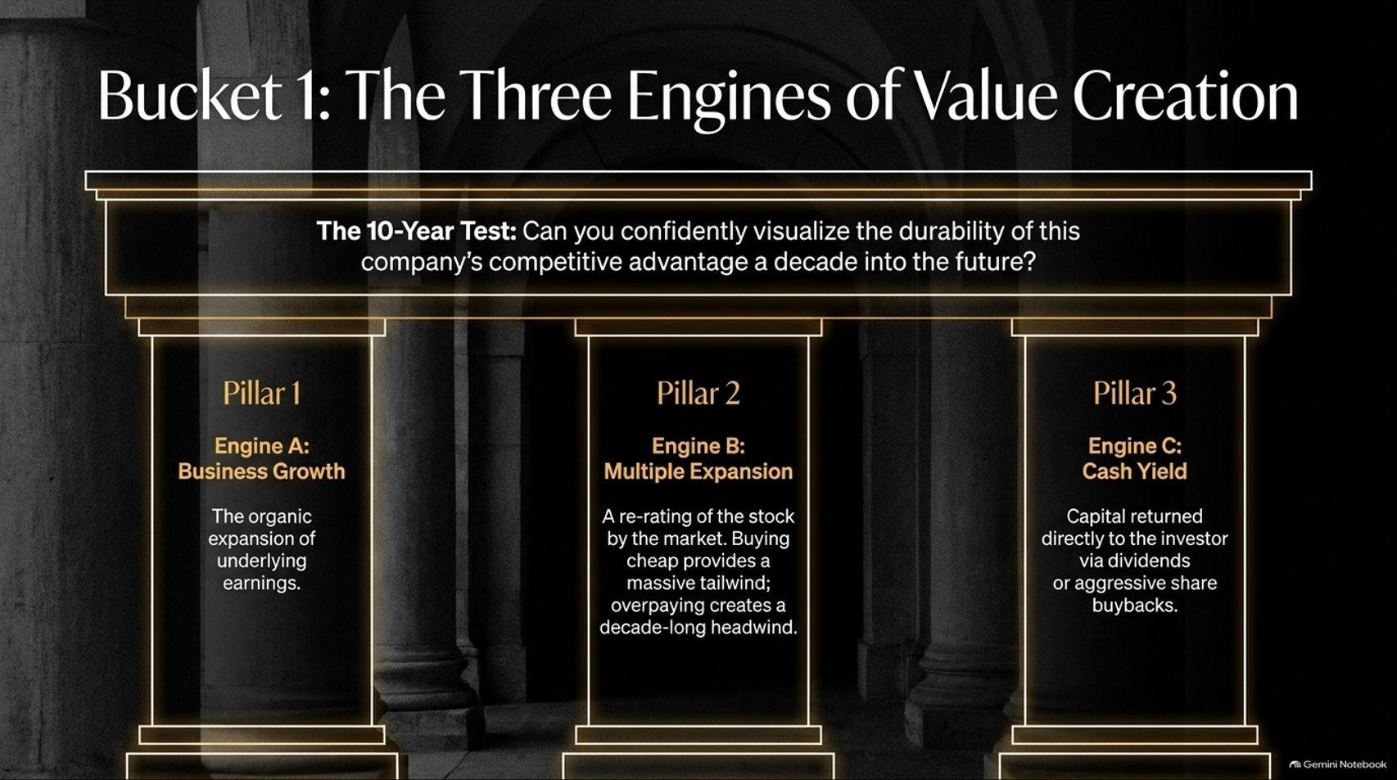
Notes:
Duration Guide: 4 – 5 minutes
Core Presentation Theme: Breakdown the three engines that generate equity returns in compounders (Organic Business Growth, Multiple Expansion, and Cash Yield) and introduce the 10-Year Durability Test.
Speaker Notes:
"When evaluating Bucket 1 Compounders, every stock's return is driven by a simple combination of three engines."
"Engine A: Business Growth. The organic expansion of underlying earnings and free cash flow."
"Engine B: Multiple Expansion. A re-rating of the stock by the market. Buying cheap provides a massive valuation tailwind, while overpaying creates a decade-long headwind."
"Engine C: Cash Yield. Capital returned directly to shareholders via dividends or share buybacks."
"To select candidates for this bucket, apply The 10-Year Test: Close your eyes and look out a decade. Can you confidently visualize the competitive advantage and durability of this business 10 years into the future?"

Slide 8
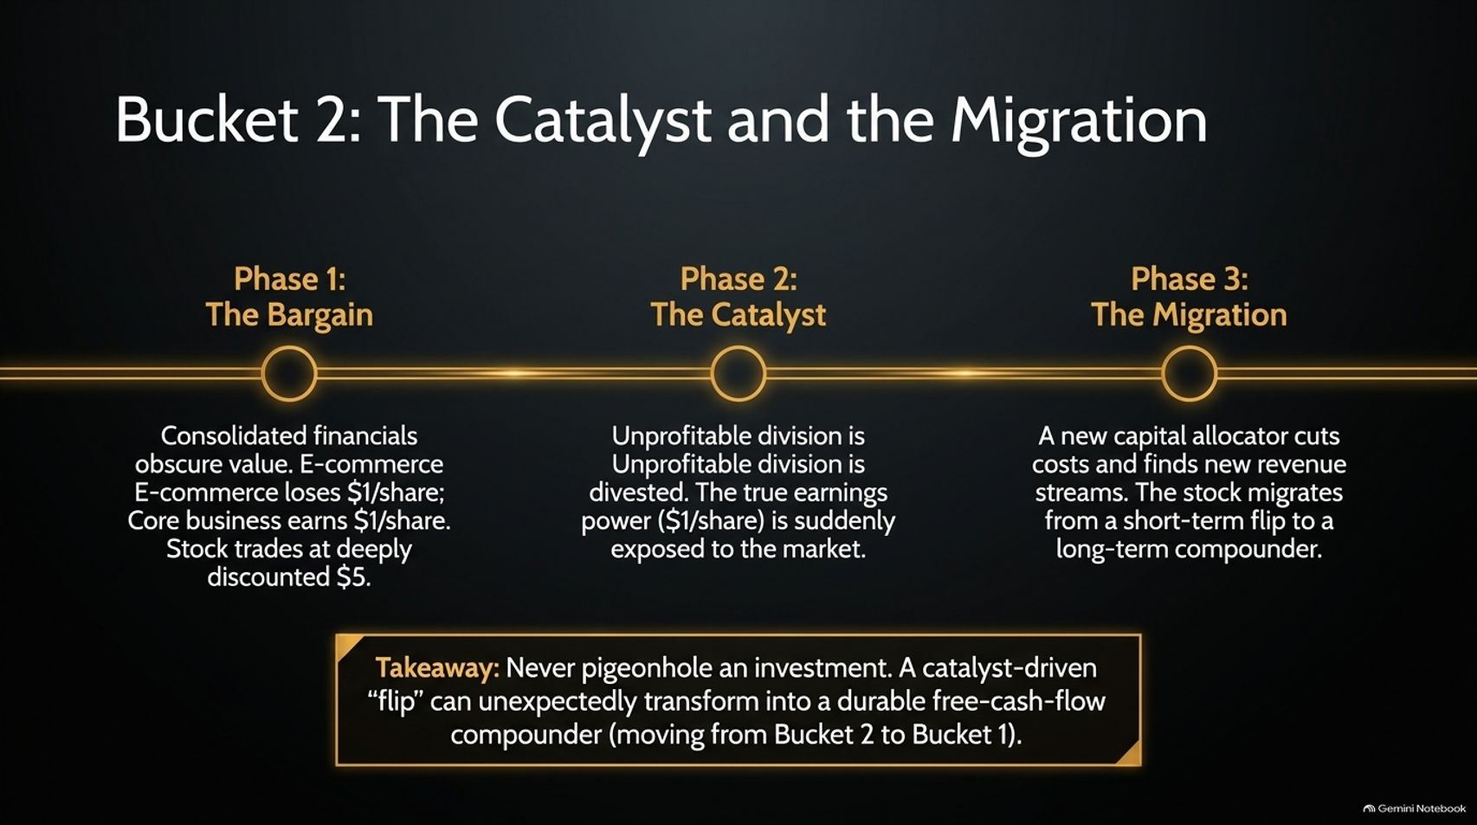
Notes:
Duration Guide: 4 – 5 minutes
Core Presentation Theme: Illustrate how a catalyst-driven bargain (Bucket 2) can unexpectedly transform into a long-term compounder (Bucket 1) using the Pitney Bowes case study.
Speaker Notes:
"Here is where portfolio management gets subtle: Do not pigeonhole an investment. A Bucket 2 bargain can migrate into a Bucket 1 compounder."
"Look at the Pitney Bowes example:"
"Phase 1 (The Bargain): Consolidated financials obscured value. The core business earned $1/share, but an unprofitable e-commerce division lost $1/share, causing the stock to trade at a deeply discounted $5."
"Phase 2 (The Catalyst): An activist investor stepped in, divested the unprofitable division, and exposed the true $1/share core earnings power."
"Phase 3 (The Migration): New leadership didn't just cut costs—they streamlined operations and found new revenue streams. A short-term bargain flip unexpectedly transformed into a durable free-cash-flow compounder."

Slide 9
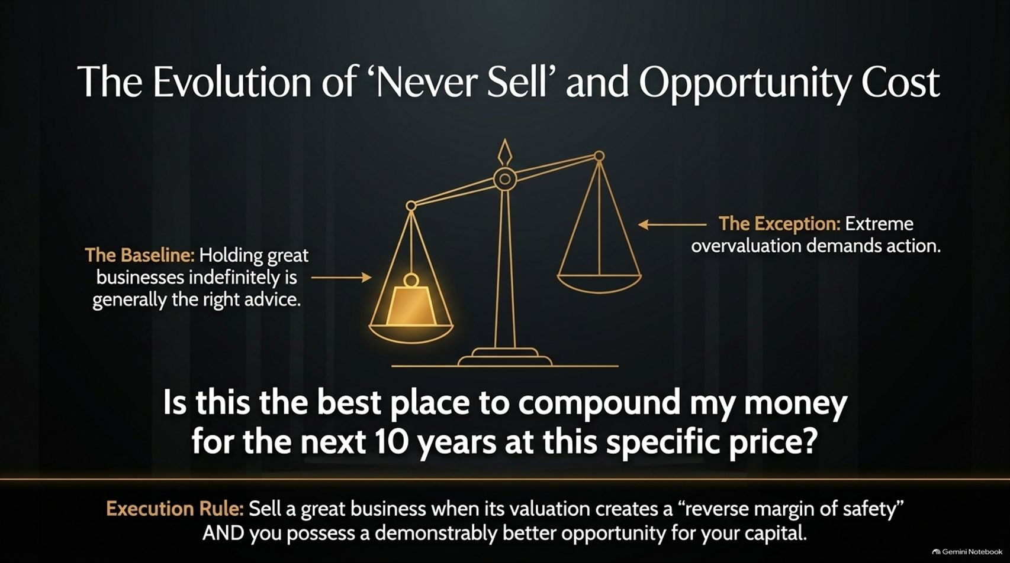
Notes:
Duration Guide: 4 – 5 minutes
Core Presentation Theme: Re-examine the "never sell" philosophy, explaining how extreme overvaluation and opportunity cost demand disciplined trimming or selling.
Speaker Notes:
"Many investors believe that if a company is great, you should 'never sell'. But experience teaches us to refine that rule."
"While holding great businesses indefinitely is generally sound baseline advice, extreme overvaluation is the exception."
"Ask yourself this constant question: 'Is this the best place to compound my money for the next 10 years at this specific price?'"
"Execution Rule: Sell a great business when its valuation creates a severe 'reverse margin of safety' AND you possess a demonstrably better, safer opportunity to compound that capital. Always respect opportunity cost."

Slide 10
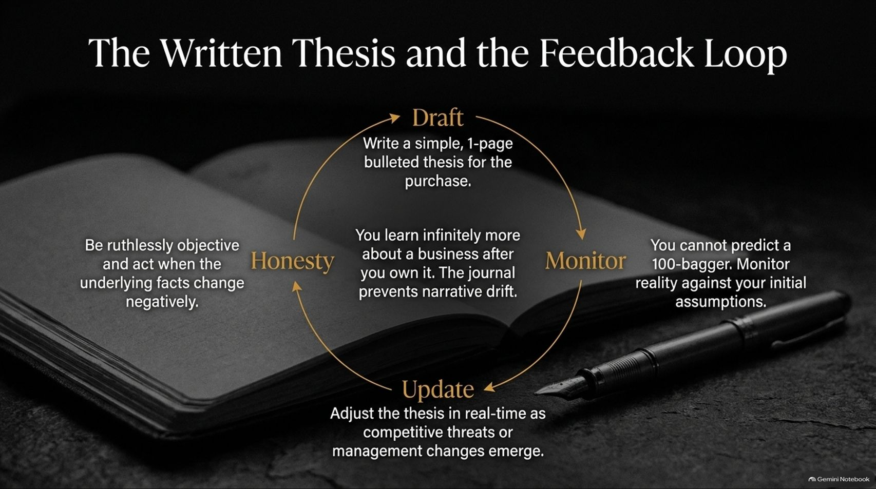
Notes:
Duration Guide: 3 – 5 minutes
Core Presentation Theme: Detail the practice of keeping a simple, 1-page investment journal to combat narrative drift, monitor realities, and maintain objective honesty.
Speaker Notes:
"To avoid psychological traps and narrative drift, you must maintain a written feedback loop."
"1. Draft: Write a simple, 1-page bulleted thesis before buying. Keep it simple."
"2. Monitor: You learn infinitely more about a business after you buy it. You cannot predict 100-baggers in advance; you must monitor real-world performance against your initial assumptions."
"3. Update & Honesty: Adjust your journal notes in real time as competitive threats or management changes emerge. Be ruthlessly objective—if the underlying facts change negatively, have the intellectual honesty to change your mind and act."

Slide 11

Notes:
Duration Guide: 3 – 4 minutes
Core Presentation Theme: Weigh the trade-offs between staying in domestic circle-of-competence markets vs. venturing into deeply discounted global markets (Japan, Korea, Europe).
Speaker Notes:
"Can value investors translate their skills across global markets?"
"The Case for Staying Home: Domestic consumer and B2B businesses allow you to evaluate customer value and competitive moats at a granular, first-hand level. Conviction is easier to build when you truly understand the product."
"The Case for Going Global: International markets—such as Japan, Korea, or Europe—frequently offer deeper statistical value and structural inefficiencies."
"The Balance: Seek value globally, but never compromise your rigorous understanding of underlying business quality just to buy something that looks statistically 'cheap'."

Slide 12
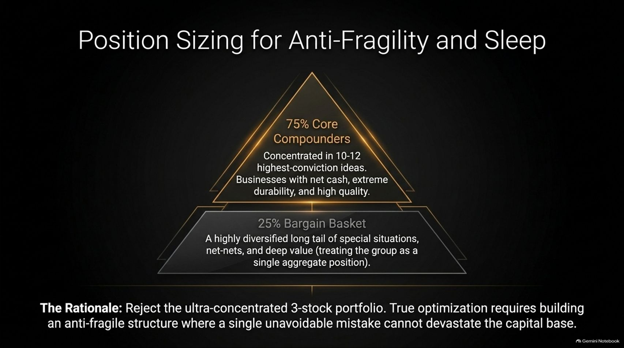
Notes:
Duration Guide: 4 – 5 minutes
Core Presentation Theme: Outline Saber Capital's position-sizing structure: 75% in 10-12 core durable compounders, and 25% in a diversified basket of deep-value bargains.
Speaker Notes:
"Position sizing should be optimized for two things: long-term upside and sleeping well at night."
"Reject the ultra-concentrated '3-stock portfolio' dogma. True portfolio optimization requires building an anti-fragile structure where a single unavoidable error cannot devastate your capital base."
"Structure your portfolio thoughtfully:"
75% Core Compounders: Concentrated in 10 to 12 highest-conviction businesses with net-cash balance sheets and extreme durability.*
25% Bargain Basket: A highly diversified long tail of special situations, net-nets, and deep value—treating the entire basket as a single aggregate position.*

Slide 13
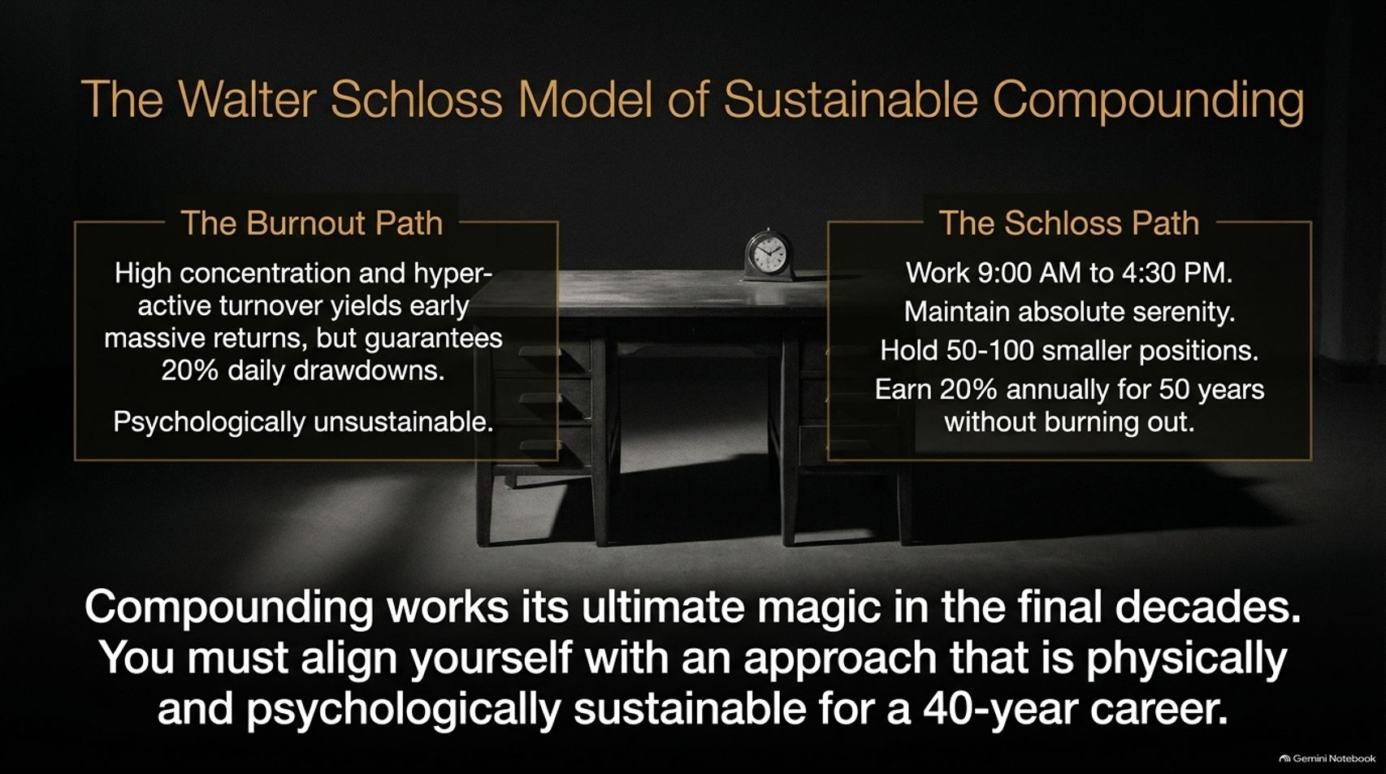
Notes:
Duration Guide: 4 – 5 minutes
Core Presentation Theme: Contrast the hyper-active, high-drawdown "burnout path" with the Walter Schloss model of serene, highly sustainable, multi-decade compounding.
Speaker Notes:
"Compounding is a marathon, not a sprint. Look at the two paths on screen."
"The Burnout Path: Ultra-high concentration and hyper-active turnover might yield huge early returns, but it guarantees 20% daily portfolio swings. It creates intense anxiety and often leads to early career burnout—just like Peter Lynch experienced at Magellan."
"The Schloss Path: Legendary investor Walter Schloss worked 9:00 AM to 4:30 PM, maintained absolute emotional serenity, held 50–100 smaller deep-value positions, and compounded at 20% annually for 50 years!"
"Compounding works its ultimate magic in the final decades. Align yourself with a process that is physically and psychologically sustainable for a 40-year career."

Slide 14
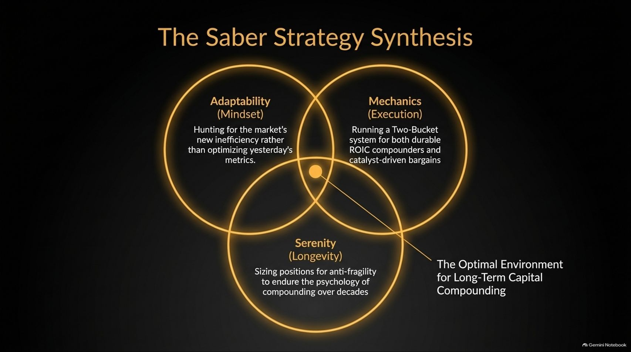
Notes:
Duration Guide: 3 – 5 minutes
Core Presentation Theme: Synthesize the three pillars of Saber Capital's approach: Adaptability of Mindset, Mechanics of Execution, and Serenity of Longevity.
Speaker Notes:
"Let's bring these concepts together in The Saber Strategy Synthesis."
"Optimal long-term compounding exists at the intersection of three circles:"
"1. Adaptability (Mindset): Continuously hunting for the market's newest inefficiency rather than rigidly optimizing yesterday's metrics."
"2. Mechanics (Execution): Operating a structured Two-Bucket portfolio for both durable ROIC compounders and catalyst-driven bargains."
"3. Serenity (Longevity): Sizing positions for anti-fragility so you can emotionally endure the ups and downs of the market over decades."

Slide 15

Notes:
Duration Guide: 2 – 4 minutes
Core Presentation Theme: Embrace Charlie Munger’s practical philosophy: focus entirely on executing the capital allocation decisions directly in front of you today.
Speaker Notes:
"As we wrap up our tactical breakdown, let's leave you with Charlie Munger’s favorite practical advice: 'Do the work that's on your desk today'."
"Forget rigid 10-year master life plans or worrying about unpredictable macro environments."
"When you come to work each morning, focus entirely on evaluating the specific capital allocation choices directly in front of you. Make the best decision for today, let tomorrow's troubles arrive tomorrow, and let long-term compounding take care of itself."

Slide 16
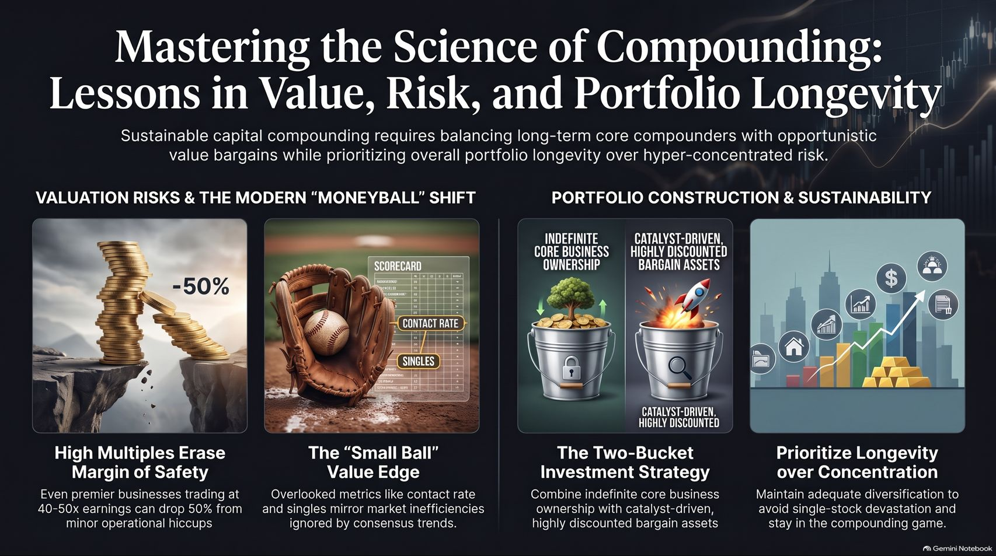
Notes:
Duration Guide: 3 – 5 minutes
Core Presentation Theme: Provide a visual reference summary connecting valuation risks, Moneyball shifts, two-bucket portfolio mechanics, and career longevity.
Speaker Notes:
"Use this final summary slide as your permanent reference sheet for mastering the science of compounding."
"On the left, remember Valuation & Efficiency: High multiples erase your margin of safety, and the 'small ball' edge requires looking where consensus analytics aren't looking."
"On the right, remember Construction & Sustainability: Balance indefinite core business ownership with catalyst bargains, and prioritize anti-fragile portfolio construction so you stay in the compounding game for decades."
"Thank you very much for your time today!"

