Slide 1
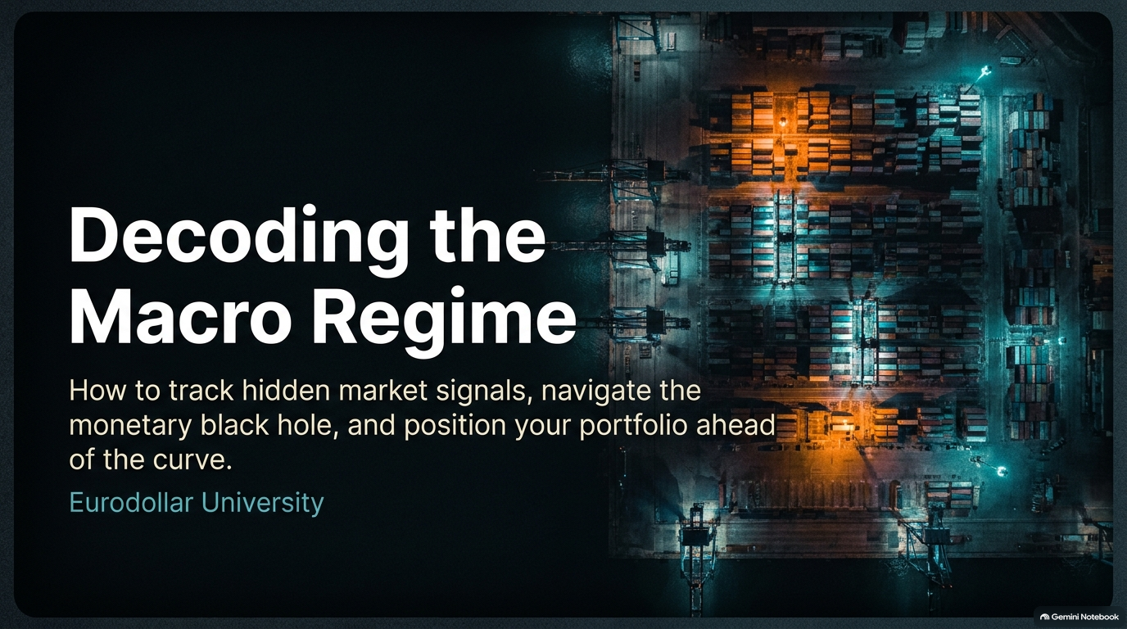
Notes:
Visual: Cargo shipping terminal at night under green and orange lighting.
Duration: 2 – 3 minutes
Speaker Notes:
"Good evening everyone, and welcome. Tonight, we are tackling a critical subject: Decoding the Macro Regime. If you look around the financial landscape today, there is an immense amount of confusing, contradictory noise—shifting narratives from cable news, conflicting central bank rhetoric, and markets that seem to defy gravity.
Our goal today is simple yet profound: we are going to look past the mainstream illusions and learn how to track hidden market signals. We’ll explore what we call the 'monetary black hole'—the untrackable global ledger system—and show you how to position your portfolio ahead of the curve rather than reacting to stale, backward-looking government data. Let's dive in."
Are We Entering a New Economic Era? How to Prepare Your Portfolio Without Trying to Time the Market
https://www.youtube.com/watch?v=6Jjc1zQc-Pw

Slide 2
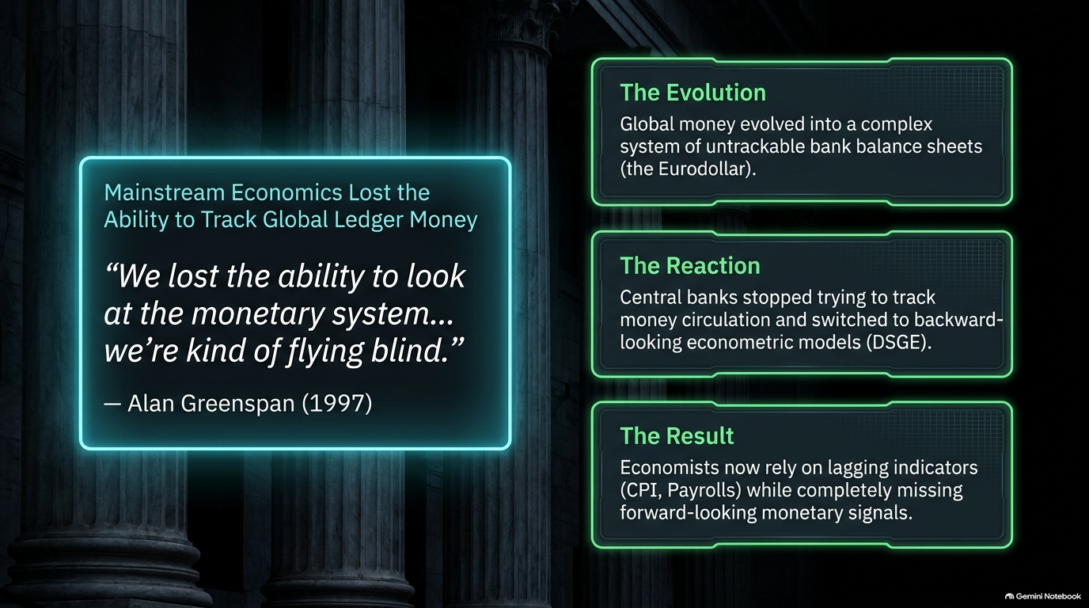
Notes:
Visual: Alan Greenspan quote from 1997 alongside "The Evolution," "The Reaction," and "The Result" boxes.
Duration: 3 – 4 minutes
Speaker Notes:
"To understand why modern macro forecasting feels so broken, we have to go back in time. Back in 1997, Alan Greenspan famously admitted: 'We lost the ability to look at the monetary system... we're kind of flying blind.'
Why did that happen? Because global money evolved. It shifted away from what central banks could easily count into a vast, complex system of untrackable bank balance sheets—what we call the Eurodollar system.
Instead of adapting their methods to track actual money circulation and credit creation, central banks simply threw their hands up. They stopped trying to track money and retreated into backward-looking econometric models, like Dynamic Stochastic General Equilibrium (DSGE) models. The result? Today's economists rely entirely on lagging indicators like CPI inflation prints and official payroll reports, completely missing the forward-looking monetary signals that actually drive the global economy."

Slide 3
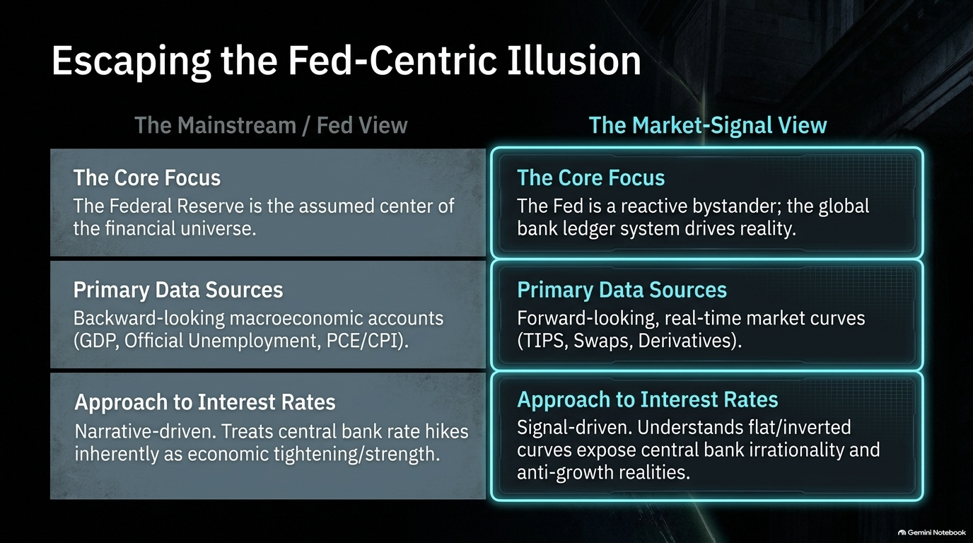
Notes:
Visual: Two-column comparison contrasting "The Mainstream / Fed View" against "The Market-Signal View".
Duration: 3 – 5 minutes
Speaker Notes:
"One of the biggest psychological hurdles you have to clear as an analyst or investor is unlearning what you were taught in school: the belief that the Federal Reserve is the center of the financial universe.
Mainstream economics operates under the Fed-Centric illusion. It treats the Fed as an all-powerful puppet master, relies on lagging macroeconomic accounts like GDP and PCE, and treats every central bank rate hike as inherent economic tightening or strength.
But if you shift to the Market-Signal View, everything changes. You realize the Fed is actually a reactive bystander, scrambling to catch up to a global bank ledger system that drives reality. Instead of looking at backward government data, we look at real-time, forward-looking market curves—like TIPS, interest rate swaps, and derivatives. We understand that flat or inverted curves don't mean the economy is booming; they expose central bank irrationality and systemic anti-growth realities."

Slide 4
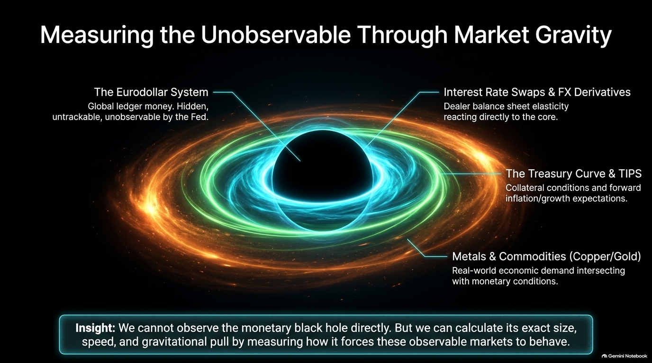
Notes:
Visual: A graphic representing a monetary black hole with orbital rings labeled Eurodollar, Swaps, Treasury Curve, and Commodities.
Duration: 4 – 6 minutes
Speaker Notes:
"If the true monetary system is a hidden, unobservable global ledger, how do we study it? Think of it like astrophysics and a black hole. We cannot observe a black hole directly because light cannot escape it. But astronomers know it's there because they can calculate its exact size, mass, and gravitational pull by watching how it forces surrounding stars and matter to behave.
We do the exact same thing in macroeconomics. The Eurodollar system is our black hole. While we can't see its inner workings directly, we can measure its gravitational pull by looking at observable markets:
Interest Rate Swaps & FX Derivatives: Which show dealer balance sheet elasticity reacting to core liquidity.
The Treasury Curve & TIPS: Which reveal collateral conditions and forward economic expectations.
Metals and Commodities like Copper and Gold: Which intersect real-world industrial demand with monetary conditions.
By measuring how these markets warp and bend, we can map the exact state of global money."

Slide 5
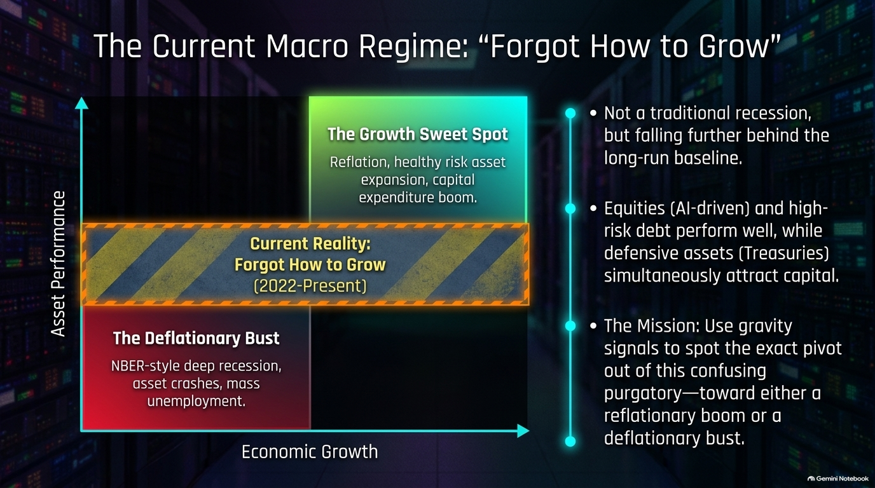
Notes:
Visual: Asset performance vs. economic growth coordinate grid, highlighting the "Current Reality: Forgot How to Grow (2022-Present)" zone.
Duration: 3 – 5 minutes
Speaker Notes:
"So, where do we stand right now? Looking at our regime matrix, we are not in a traditional NBER-style deep recession, nor are we in the 'Growth Sweet Spot' of a healthy reflationary capital expenditure boom.
Instead, we are trapped in what we call 'Forgot How to Grow'—a persistent purgatory lasting from 2022 to the present. In this regime, the economy isn't collapsing into mass unemployment, but it is falling further and further behind its long-run baseline growth trend.
This creates a confusing crosscurrent in asset markets: AI-driven equities and high-risk debt continue to perform well, while defensive safe-haven assets like Treasuries simultaneously attract capital. Our mission as macro investors is to use our gravity signals to spot the exact pivot out of this purgatory—whether toward a true reflationary boom or a deflationary bust."

Slide 6
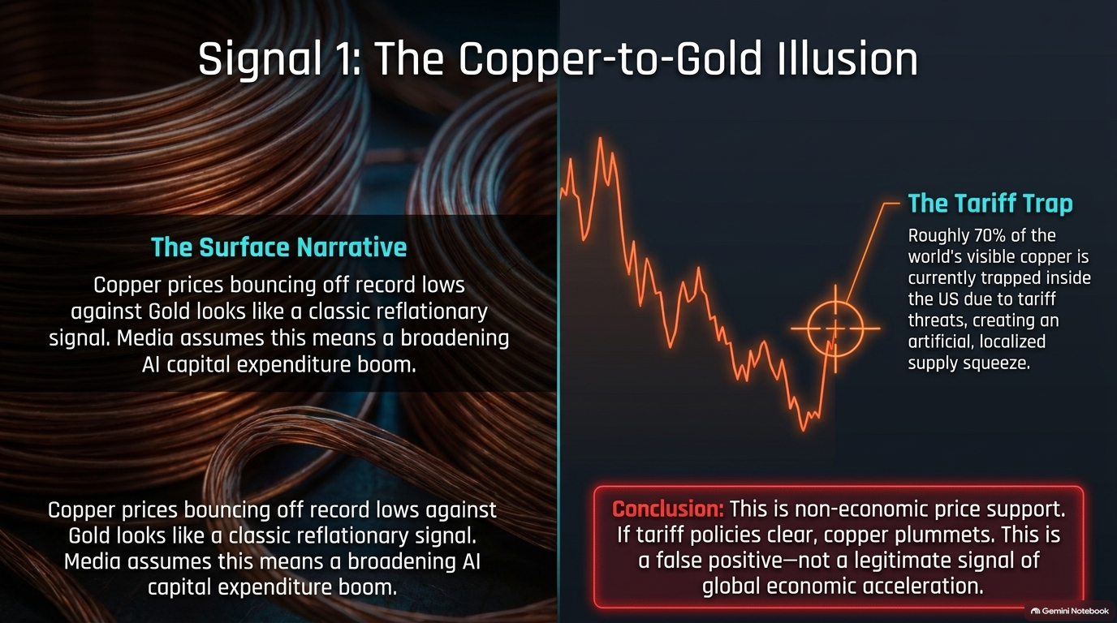
Notes:
Visual: Copper wire coils alongside a declining price chart with a target zone labeled "The Tariff Trap".
Duration: 3 – 5 minutes
Speaker Notes:
"Let's put our framework to the test and examine four critical market signals. Signal one is The Copper-to-Gold Illusion.
On the surface, copper prices bouncing off record lows against gold looks like a classic reflationary signal. Mainstream media sees this and assumes it points to a broadening, AI-driven industrial commodity boom.
But when you look deeper, you find The Tariff Trap. Roughly 70% of the world's visible copper is currently trapped inside the United States due to looming tariff threats, creating an artificial, localized supply squeeze. This is non-economic price support. If those tariff policies clear or shift, copper will plummet. It is a false positive—not a legitimate signal of global economic acceleration."

Slide 7
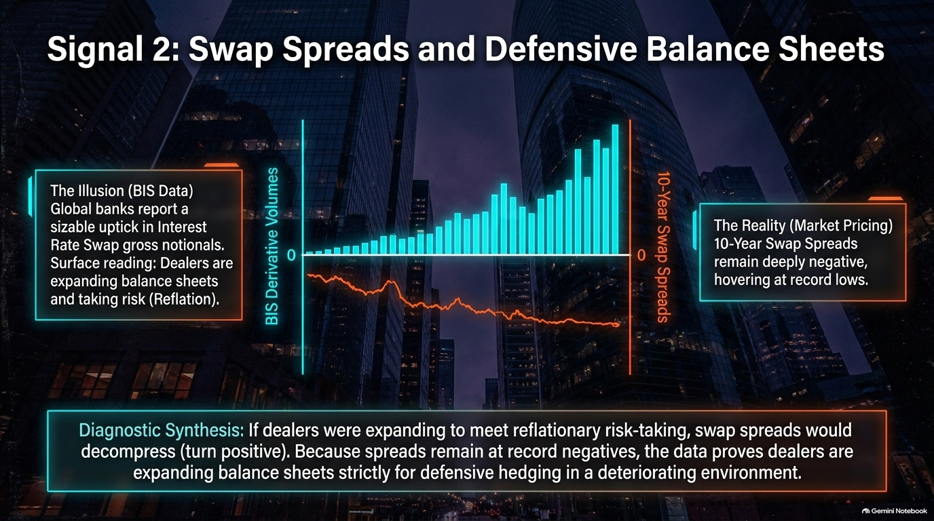
Notes:
Visual: Dual bar/line charts comparing rising BIS derivative volumes against deeply negative 10-year swap spreads.
Duration: 4 – 6 minutes
Speaker Notes:
"Signal two brings us into the core of global banking: Swap Spreads and Defensive Balance Sheets.
If you look solely at Bank for International Settlements (BIS) data, global banks report a massive uptick in Interest Rate Swap gross notionals. A surface reading tells you that dealers are expanding their balance sheets and taking on risk—implying reflation.
However, look at the market pricing on the right: 10-year swap spreads remain deeply negative, hovering near record lows. Here is our diagnostic synthesis: if dealers were expanding to support healthy, reflationary risk-taking, swap spreads would decompress and turn positive. The fact that spreads remain stuck at record negatives proves that dealers are expanding balance sheets strictly for defensive hedging in a deteriorating, high-risk environment."

Slide 8
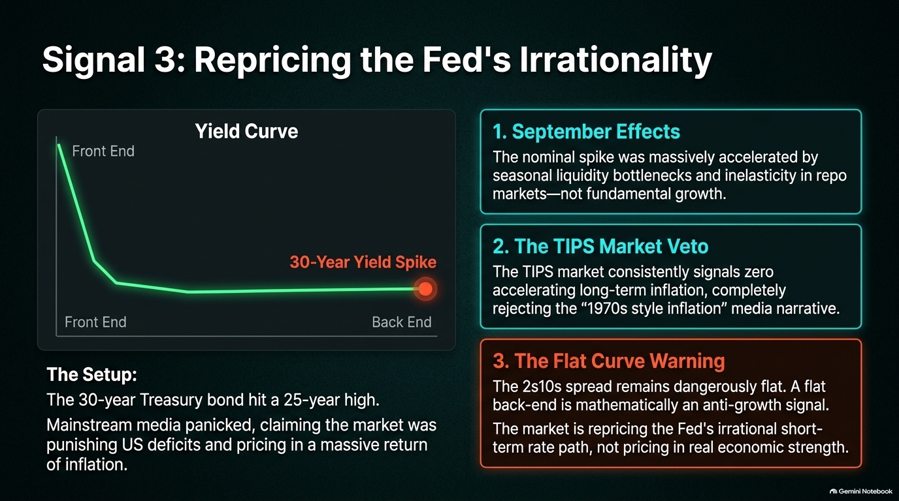
Notes:
Visual: Yield curve graphic highlighting a 30-year yield spike, alongside three analytical boxes (September Effects, TIPS Market Veto, Flat Curve Warning).
Duration: 4 – 5 minutes
Speaker Notes:
"Signal three addresses the noise around long-term interest rates. Recently, the 30-year US Treasury bond hit a 25-year high. Mainstream media panicked, claiming the market was punishing US fiscal deficits and pricing in a massive return of 1970s-style inflation.
We break this down into three realities:
September Effects: The nominal rate spike was heavily accelerated by seasonal liquidity bottlenecks and repo market inelasticity, not fundamental growth.
The TIPS Market Veto: Treasury Inflation-Protected Securities (TIPS) consistently signal zero accelerating long-term inflation, completely rejecting the inflation narrative.
The Flat Curve Warning: The 2s10s yield curve spread remains dangerously flat. A flat back-end is mathematically an anti-growth signal. The market is repricing the Fed's irrational short-term rate path, not pricing in real economic strength."

Slide 9
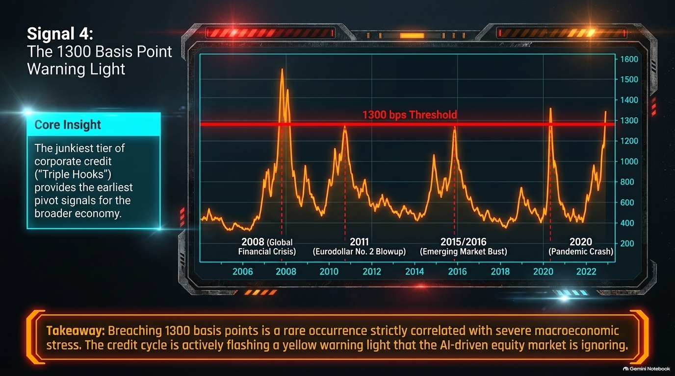
Notes:
Visual: Historical corporate credit spread chart with a red horizontal threshold line at 1300 bps across major crises (2008, 2011, 2015, 2020).
Duration: 3 – 5 minutes
Speaker Notes:
"Signal four looks at the junk credit market—specifically, the junkiest tier of corporate credit, often called 'Triple Hooks' (CCC-rated debt).
Historically, CCC spreads provide the earliest and most reliable pivot signals for the broader economy. Whenever spreads breach the 1300 basis point threshold, it correlates directly with severe macroeconomic stress—such as the 2008 Global Financial Crisis, the 2011 Eurodollar No. 2 blowout, the 2015-2016 emerging market bust, and the 2020 pandemic crash.
Right now, the credit cycle is flashing a yellow warning light that the equity market—infatuated with AI hype—is completely ignoring."

Slide 10
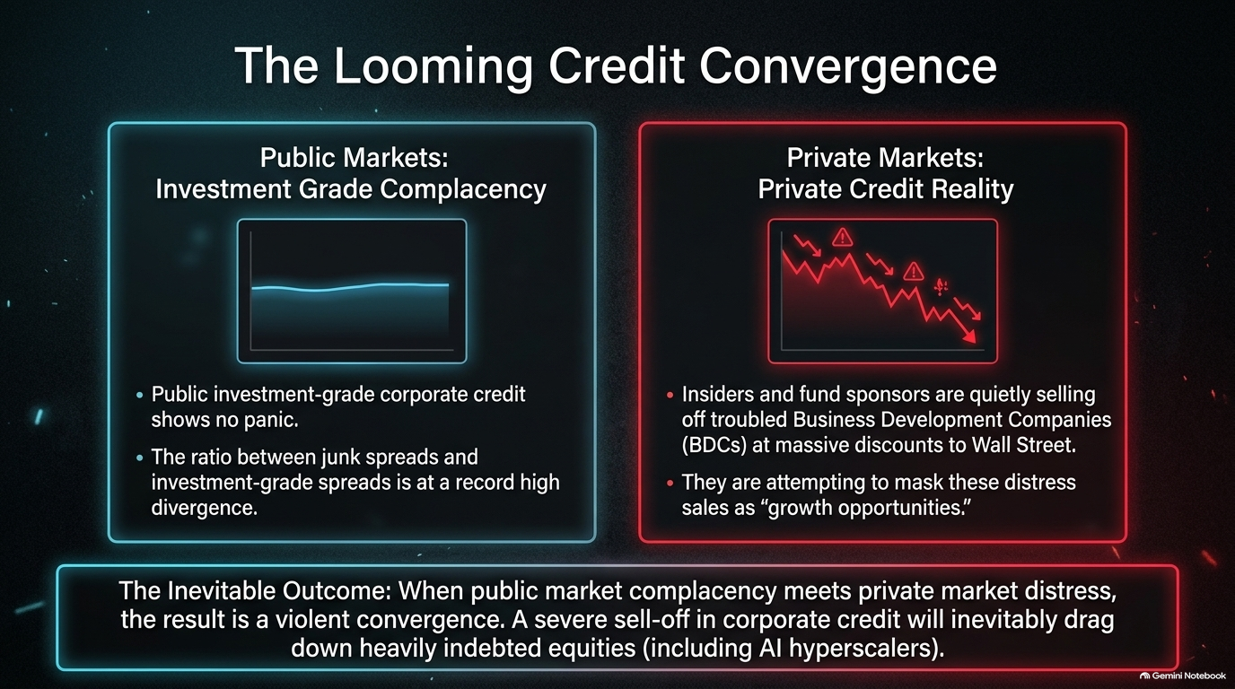
Notes:
Visual: Two-panel comparison of calm public investment-grade markets versus distressed private credit charts.
Duration: 3 – 5 minutes
Speaker Notes:
"This brings us to The Looming Credit Convergence. Right now, there is a massive disconnect in the credit markets.
In public markets, investment-grade corporate credit shows zero panic, and the ratio between junk spreads and investment-grade spreads is at a record divergence. But look at private markets: insiders and fund sponsors are quietly selling off troubled Business Development Companies (BDCs) at massive discounts to Wall Street, attempting to mask these distress sales as 'growth opportunities'.
The inevitable outcome? When public market complacency meets private market distress, the result is a violent convergence. A severe sell-off in corporate credit will inevitably drag down heavily indebted equities, including the AI hyperscalers."

Slide 11
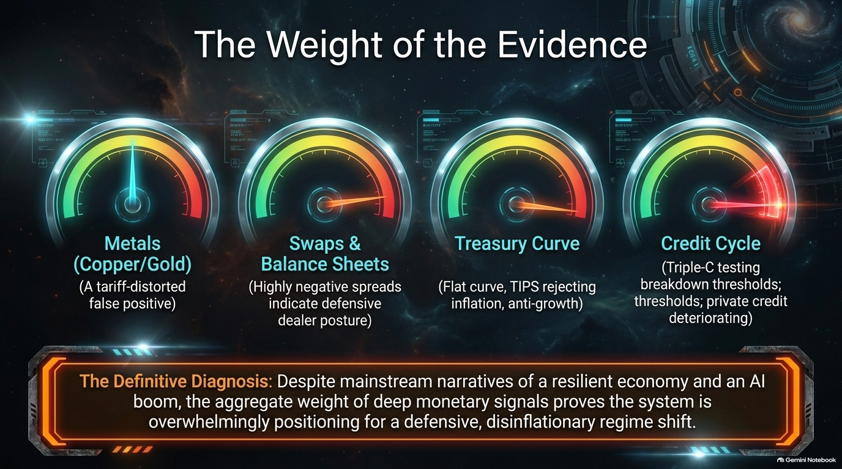
Notes:
Visual: Four dashboard gauges summarizing Metals, Swaps & Balance Sheets, Treasury Curve, and Credit Cycle.
Duration: 3 – 4 minutes
Speaker Notes:
"Let's synthesize what the data is telling us by looking at our diagnostic dashboard.
Metals (Copper/Gold): Shows a tariff-distorted false positive.
Swaps & Balance Sheets: Highly negative spreads indicate a defensive dealer posture.
Treasury Curve: Features a flat curve with TIPS rejecting inflation, signaling anti-growth.
Credit Cycle: CCC-rated debt is testing breakdown thresholds while private credit deteriorates.
The Definitive Diagnosis: Despite mainstream narratives of a resilient economy and an AI-driven boom, the aggregate weight of deep monetary signals proves the global financial system is overwhelmingly positioning for a defensive, disinflationary regime shift."

Slide 12
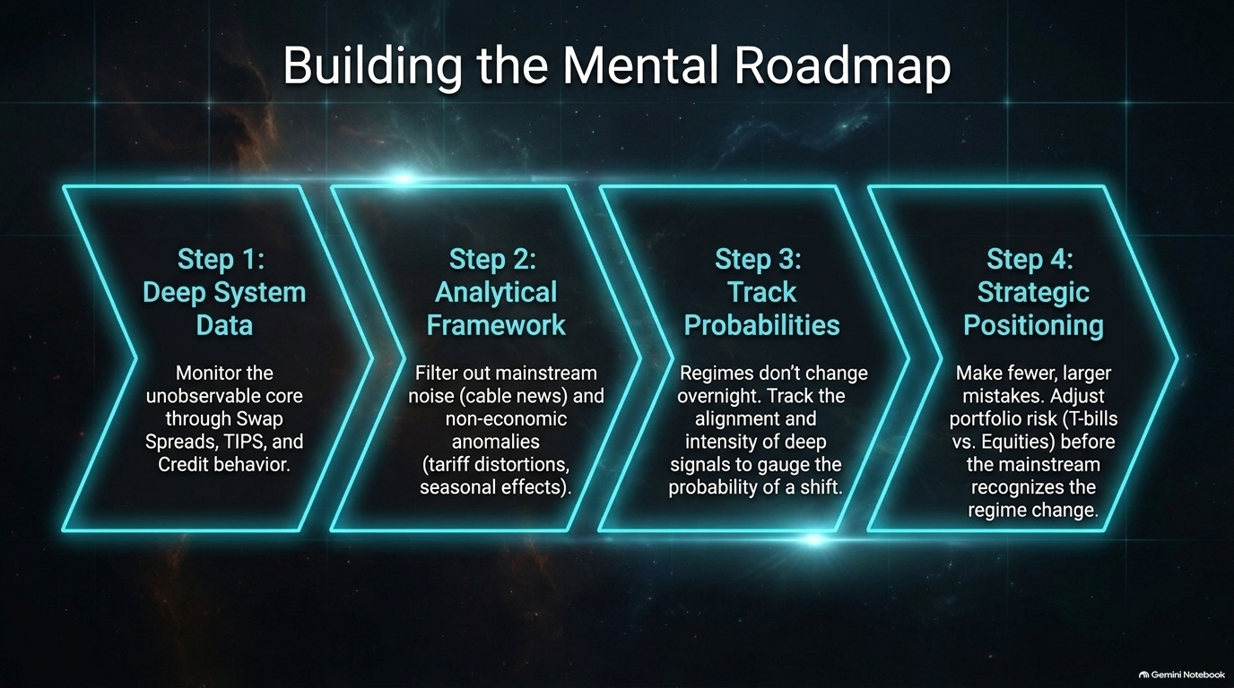
Notes:
Visual: Four sequential chevron arrows outlining Step 1 through Step 4 of the roadmap.
Duration: 3 – 4 minutes
Speaker Notes:
"How do we take action on this? By building a disciplined Mental Roadmap:
Step 1: Deep System Data: Monitor the unobservable core through swap spreads, TIPS, and credit behavior rather than headline news.
Step 2: Analytical Framework: Filter out mainstream noise, cable news chatter, and non-economic anomalies like tariff distortions and seasonal effects.
Step 3: Track Probabilities: Regimes don't change overnight. Track the alignment and intensity of deep signals to gauge the probability of a shift.
Step 4: Strategic Positioning: Make fewer, larger mistakes. Adjust portfolio risk—balancing T-bills versus equities—before the mainstream recognizes the regime change."

Slide 13
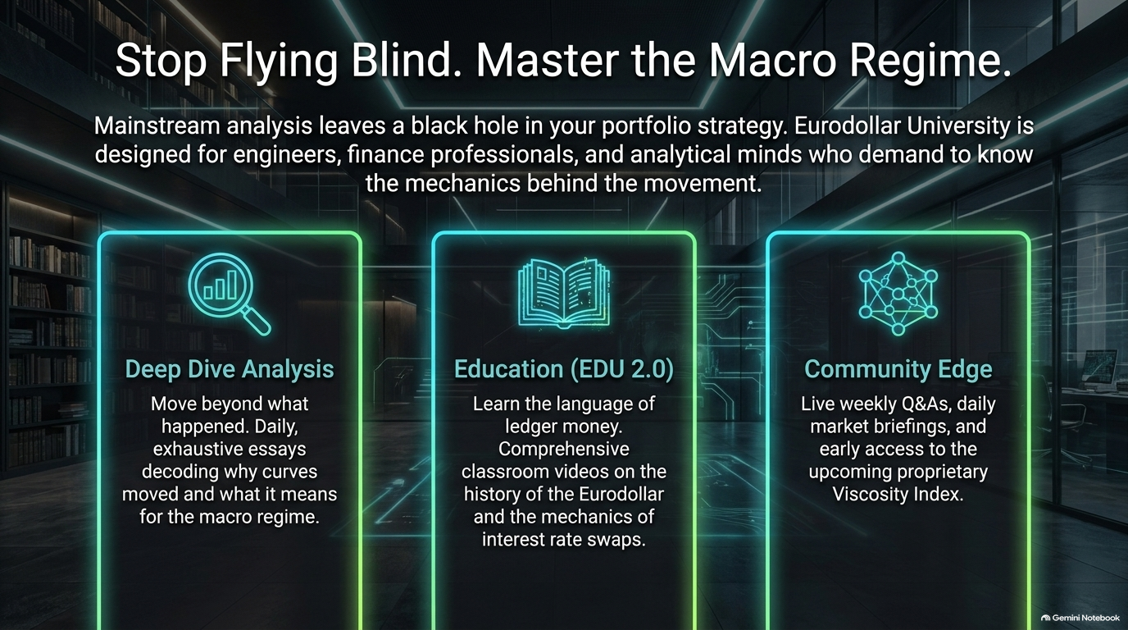
Notes:
Visual: Three vertical neon-trimmed boxes highlighting Deep Dive Analysis, Education (EDU 2.0), and Community Edge.
Duration: 2 – 4 minutes
Speaker Notes:
"Mainstream analysis leaves a dangerous black hole in your portfolio strategy. That is why Eurodollar University was built—specifically for engineers, finance professionals, and analytical minds who demand to know the mechanical reality behind market movements.
Through our platform, you get:
Deep Dive Analysis: Daily essays decoding why curves moved and what they mean for the macro regime.
Education (EDU 2.0): Comprehensive classroom videos on the history of ledger money and interest rate swap mechanics.
Community Edge: Live weekly Q&As, daily market briefings, and early access to our proprietary Viscosity Index."

Slide 14
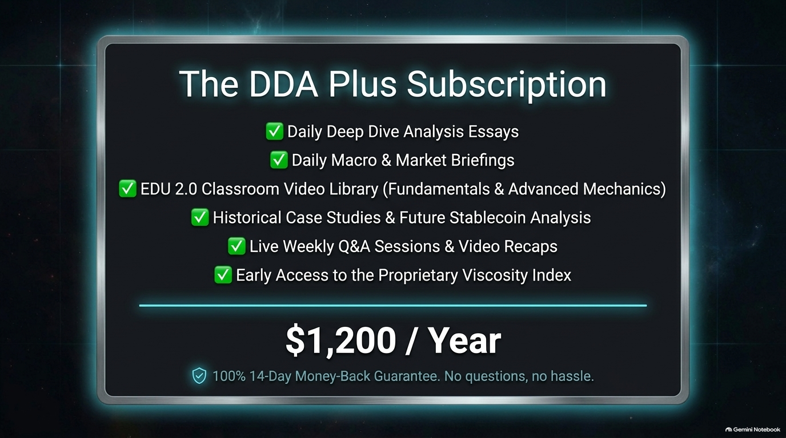
Notes:
Visual: Feature checklist detailing subscription benefits and pricing at $1,200/year with a money-back guarantee.
Duration: 2 – 3 minutes
Speaker Notes:
"Our flagship offering is The DDA Plus Subscription. For $1,200 a year, you get full, uncompromised access to our daily deep dive essays, macro briefings, the complete EDU 2.0 classroom video library covering fundamental and advanced mechanics, historical case studies, live weekly Q&A sessions, and early access to our upcoming proprietary Viscosity Index.
We stand by the quality of this work with a 100% 14-day money-back guarantee—no questions asked, no hassle. It's designed to give you a complete institutional-grade toolkit."

Slide 15

Notes:
Visual: A large QR code alongside text directing viewers to edu.eurodollar.university.
Duration: 1 – 2 minutes
Speaker Notes:
"Stop relying on backward-looking narratives that leave your portfolio exposed. Join the vanguard of investors tracking the true gravitational pull of global money.
You can scan the QR code on your screen right now or visit edu.eurodollar.university to claim your DDA Plus subscription and start mastering the macro regime today."

Slide 16
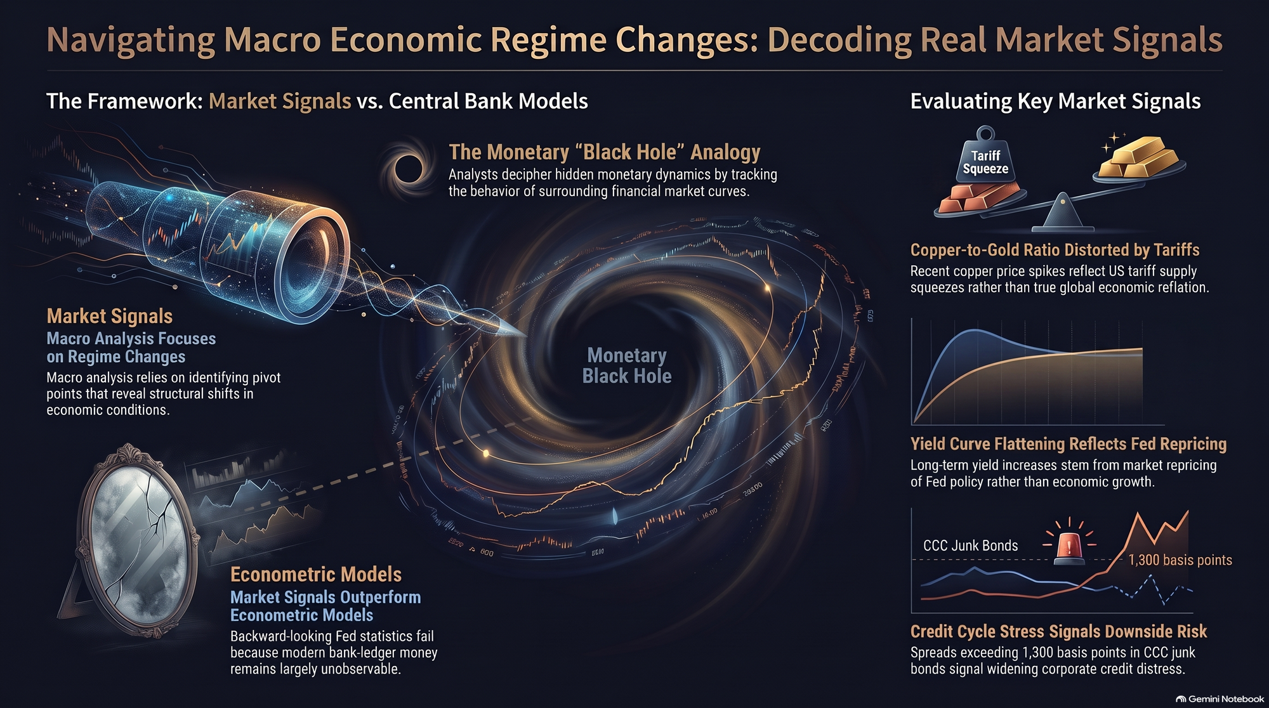
Notes:
Visual: Comprehensive overview slide featuring the market signals vs. central bank models framework and key signal charts.
Duration: 2 – 3 minutes
Speaker Notes:
"To wrap everything up on Slide 16: remember that successful macro investing isn't about guessing what the Federal Reserve will do next headline meeting. It is about understanding the structural differences between broken econometric models and real market signals.
By keeping your eyes on the true indicators—the behavior of swap spreads, TIPS yield curves, and credit cycle stress thresholds—you can see past the tariff traps and seasonal noise. Thank you all for your time tonight, enjoy the rest of your week, and I look forward to seeing our DDA members in next week's live Q&A session!"

