Slide 1
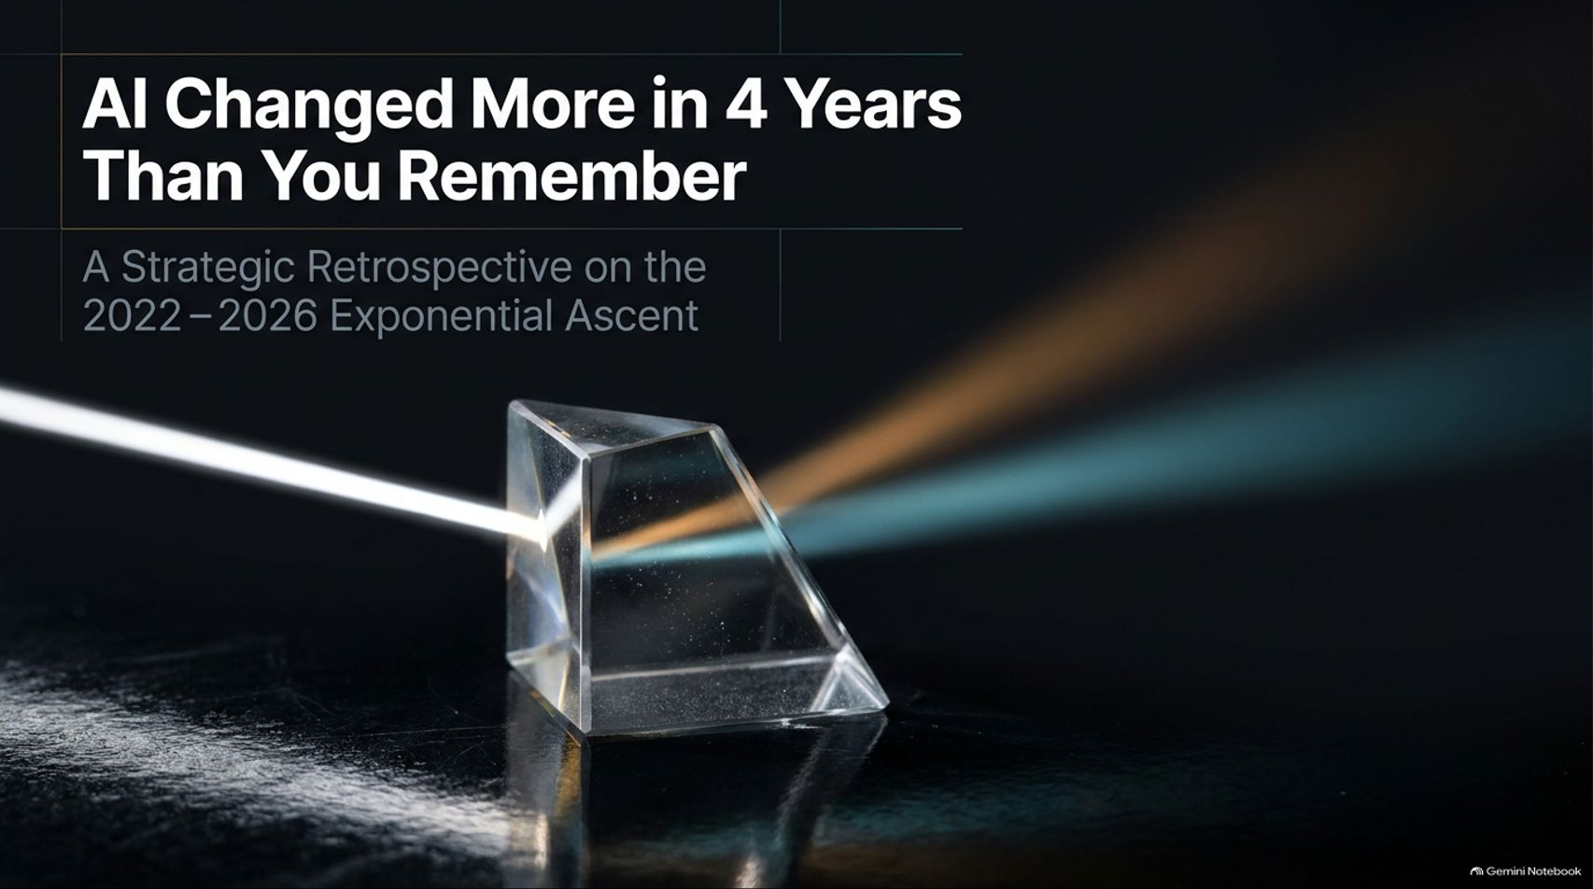
Notes:
Title: AI Changed More in 4 Years Than You Remember: A Strategic Retrospective on the 2022–2026 Exponential Ascent
Target Duration: 2–3 minutes
Speaker Notes:
"Welcome everyone. Today we are looking back at one of the most astonishing periods in human technological history: the four-year exponential ascent of artificial intelligence from November 2022 to late 2026.
As Corey and Grant noted in The Neuron retrospective, we often find ourselves saying 'It's crazy how far we've come,' but rarely do we take the time to map our way back through the milestones.
Over the next 16 slides, we're going to examine how AI transformed from a parlor trick of chat mimicry into a multi-modal, deep-reasoning, agentic workforce that is actively redefining human labor and capital. Let's unpack the ascent."
AI Changed More in 4 Years Than You Remember
https://www.youtube.com/watch?v=0zLzkYlFRxU

Slide 2
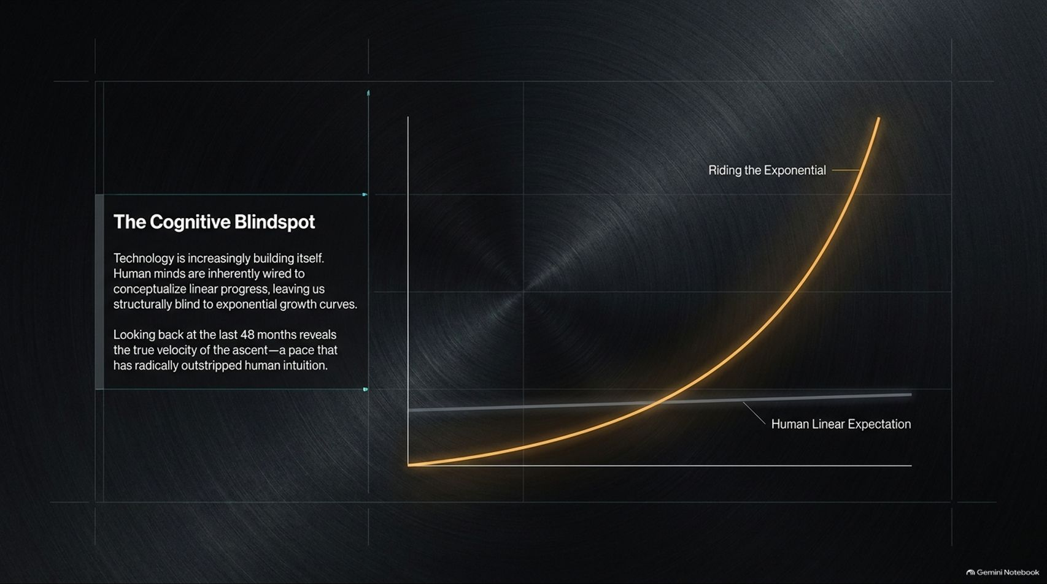
Notes:
Title: The Cognitive Blindspot: Riding the Exponential Curve
Target Duration: 3–5 minutes
Speaker Notes:
"To understand why the last four years feel so disorienting, we must recognize The Cognitive Blindspot.
Human minds are evolutionarily wired to conceptualize progress in a linear fashion. When we look at a linear trend, our intuition expects steady, incremental steps.
But technology is increasingly building itself, putting us firmly on an exponential growth curve.
Looking back across the 48 months from 2022 to 2026 reveals a velocity of ascent that has completely shattered human linear expectation. If you haven't updated your mental model every six months, you're already operating in the past."

Slide 3
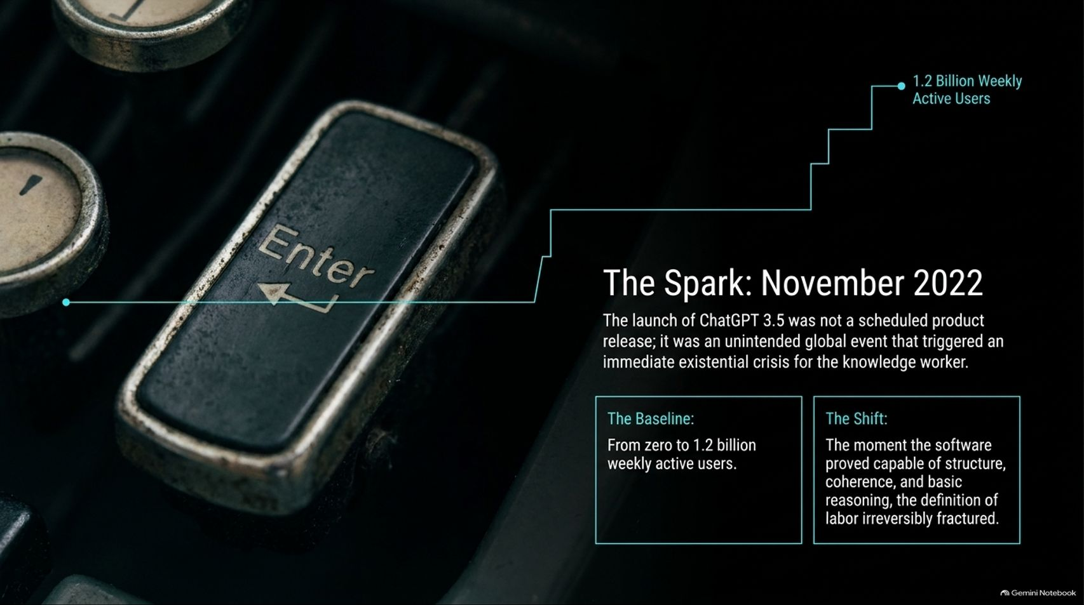
Notes:
Title: The Spark: November 2022 and the Birth of ChatGPT 3.5
Target Duration: 4–6 minutes
Speaker Notes:
"Our journey begins with The Spark: November 30, 2022. The launch of ChatGPT 3.5 was not a carefully orchestrated, scheduled commercial product release; it was an unintended global event that triggered an immediate existential crisis for knowledge workers.
In just four years, user adoption skyrocketed from zero to 1.2 billion weekly active users, making it the fastest-growing consumer application in history.
The baseline shift wasn't just speed—it was that software suddenly proved capable of structure, coherence, and basic reasoning, irreversibly fracturing the traditional definition of knowledge labor."

Slide 4
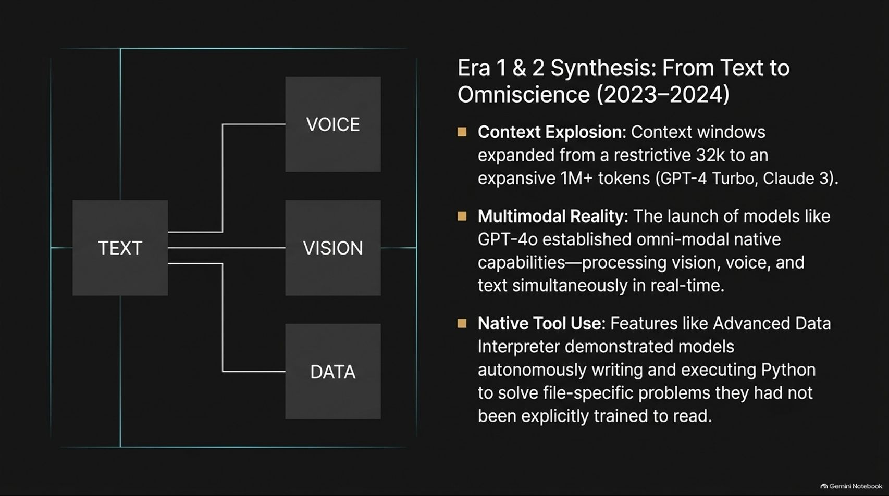
Notes:
Title: Era 1 & 2 Synthesis: From Text to Omniscience (2023–2024)
Target Duration: 4–6 minutes
Speaker Notes:
"Moving from 2023 into 2024, we witnessed the rapid expansion of foundational capabilities:
Context Explosion: Context windows expanded exponentially from a restrictive 32k tokens to over 1M+ tokens in GPT-4 Turbo and Claude 3.
Multimodal Reality: Models evolved from text-only prompt windows into native omni-modal systems capable of processing vision, voice, and text simultaneously in real-time.
Native Tool Use: Features like Advanced Data Interpreter demonstrated models autonomously writing and executing Python code to solve file-specific problems they weren't explicitly trained to handle."

Slide 5
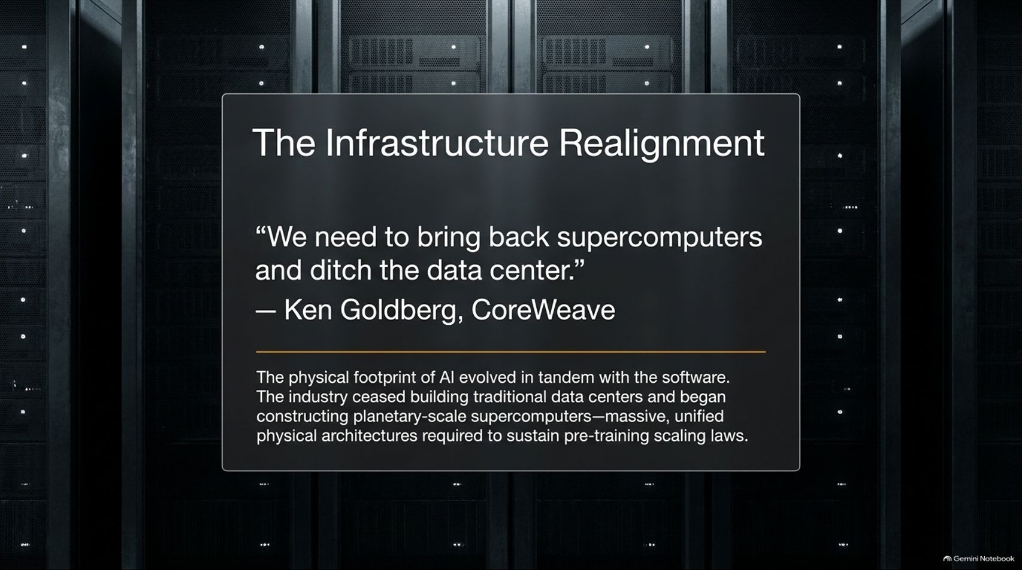
Notes:
Title: The Infrastructure Realignment: Planetary Supercomputers
Target Duration: 3–5 minutes
Speaker Notes:
"As software capabilities scaled, the physical footprint evolved in tandem. As Ken Goldberg from CoreWeave noted, we needed to stop thinking of these facilities as traditional 'data centers' and start recognizing them as planetary-scale supercomputers.
The industry shifted from localized server racks to massive, unified physical architectures required to sustain pre-training scaling laws.
Power, cooling, and compute density became the ultimate physical governors of the AI revolution."

Slide 6
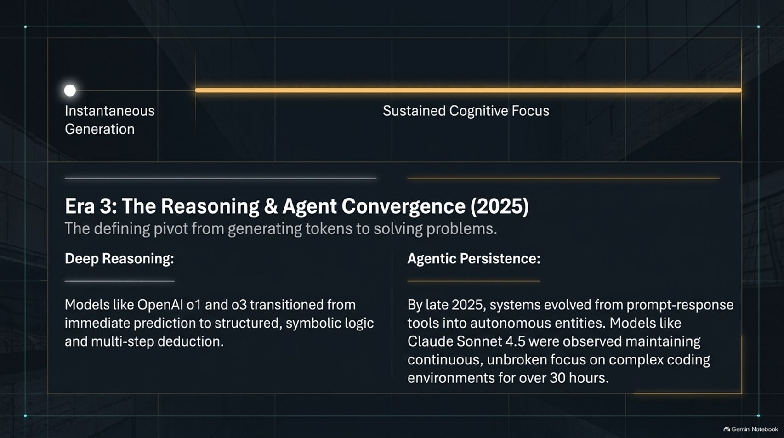
Notes:
Title: Era 3: The Reasoning & Agent Convergence (2025)
Target Duration: 4–6 minutes
Speaker Notes:
"By 2025, the industry crossed a major psychological and technical threshold: the pivot from generating tokens to solving problems.
Deep Reasoning: Models like OpenAI o1 and o3 introduced structured, symbolic logic and multi-step deduction, moving past immediate text prediction.
Agentic Persistence: Systems evolved from prompt-response tools into autonomous entities. Breakthrough models like Claude Sonnet 4.5 were observed maintaining continuous, unbroken focus on complex coding environments for over 30 hours."

Slide 7
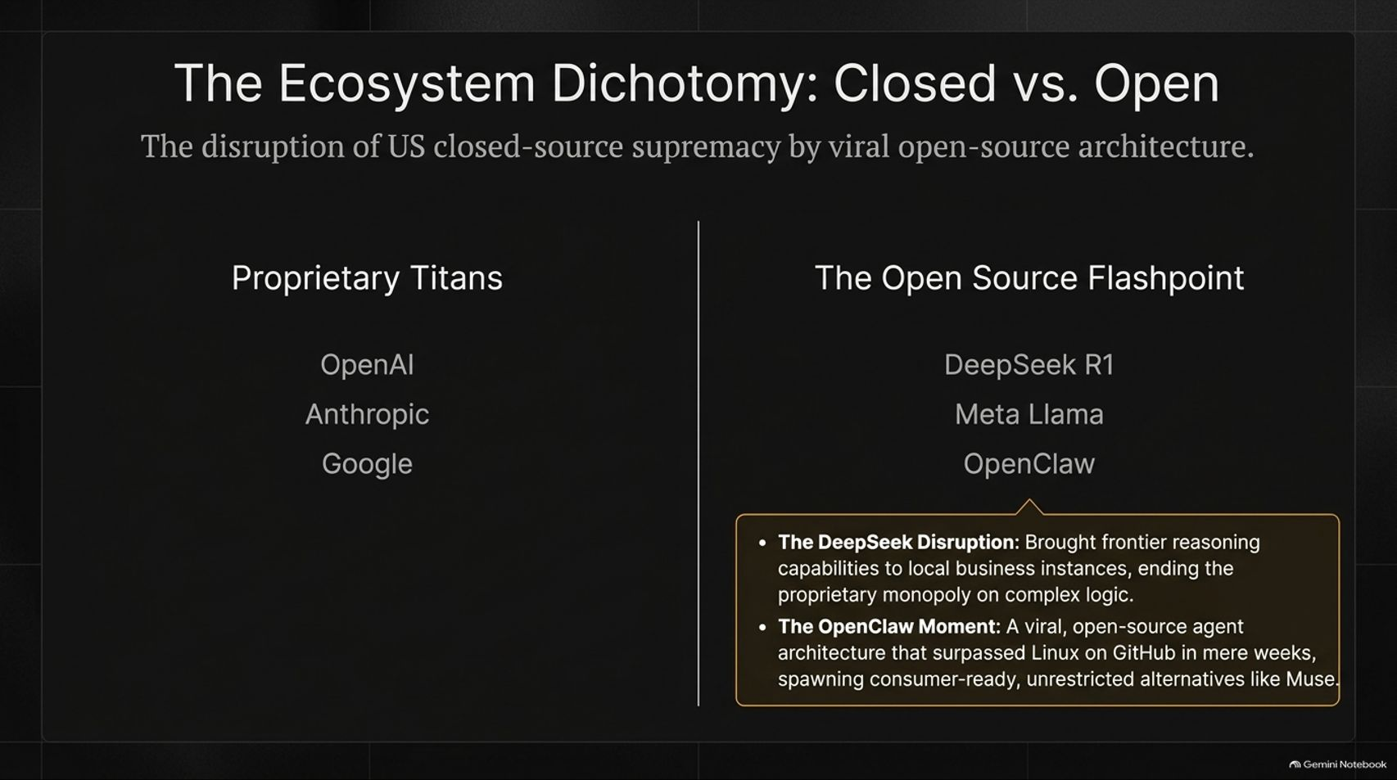

Slide 8
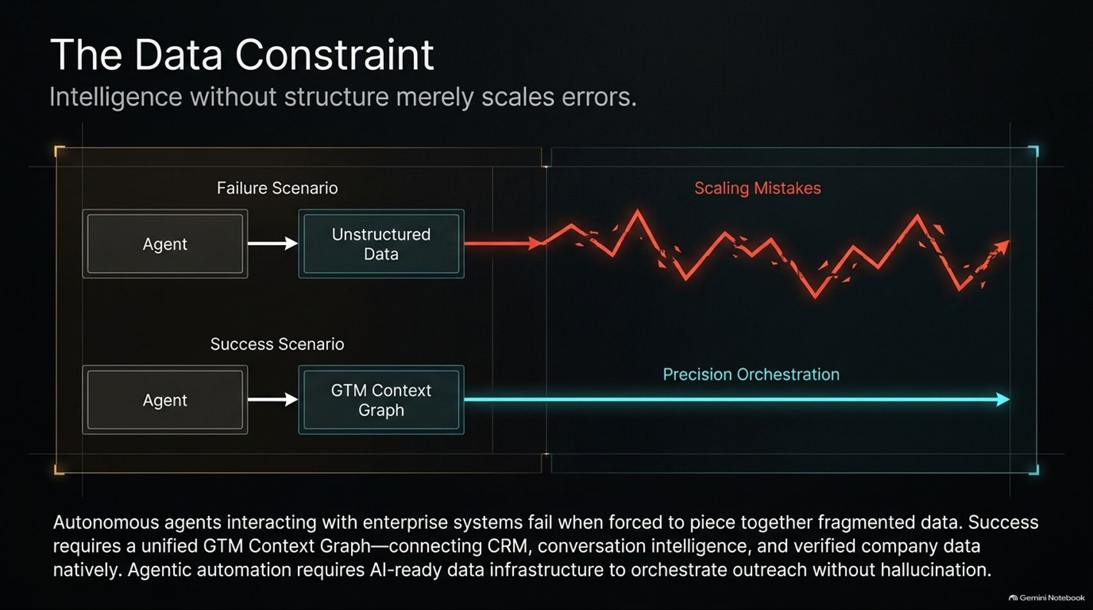
Notes:
Title: The Data Constraint: Intelligence Without Structure Scales Errors
Target Duration: 3–5 minutes
Speaker Notes:
"A critical lesson of the agentic era is that intelligence without structure merely scales errors.
If an autonomous agent interacts with fragmented enterprise data, it enters a failure scenario resulting in cascading scaling mistakes.
Success requires precision orchestration through unified infrastructure—connecting CRMs, conversation intelligence, and verified company data natively (such as ZoomInfo's GTM Context Graph) to execute outreach and workflows without hallucination."

Slide 9
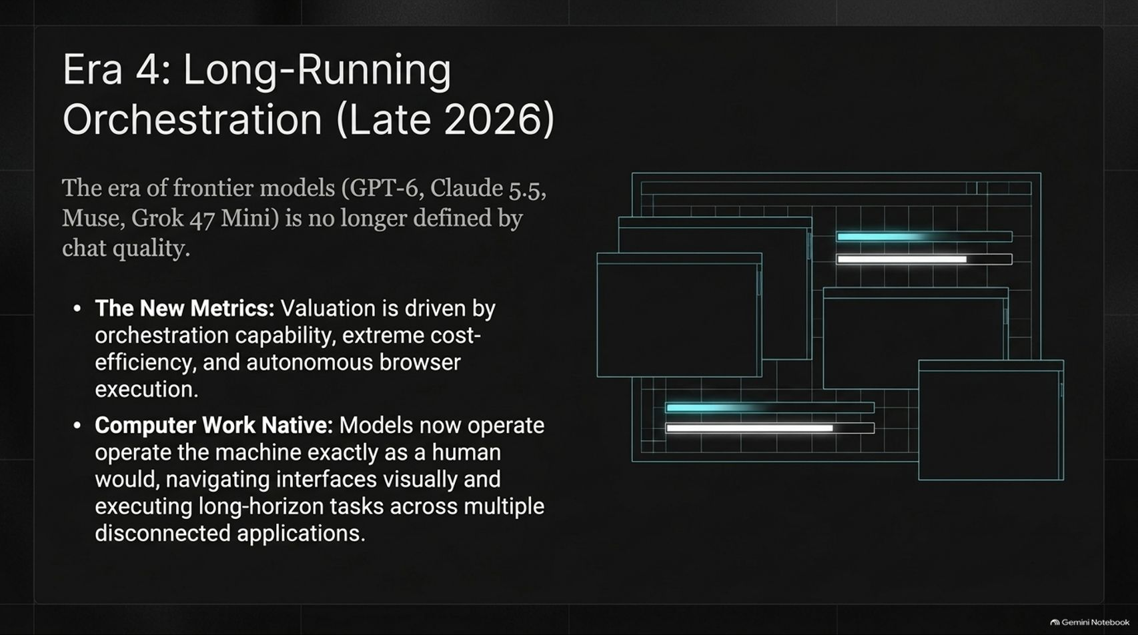
Notes:
Title: Era 4: Long-Running Orchestration (Late 2026)
Target Duration: 4–6 minutes
Speaker Notes:
"Entering late 2026, frontier models (GPT-6, Claude 5.5, Muse, Grok 47 Mini) are no longer judged by simple chat quality.
The New Metrics: Valuation is driven by orchestration capability, extreme cost-efficiency, and autonomous browser execution.
Computer Work Native: Models now operate machines exactly as humans do—navigating graphical interfaces visually and executing long-horizon workflows across multiple disconnected desktop applications."

Slide 10
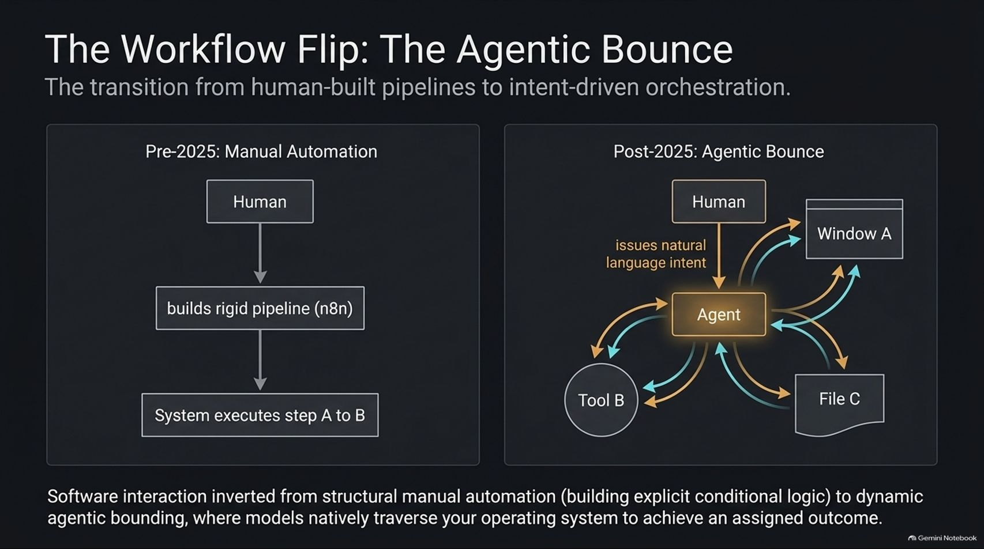

Slide 11
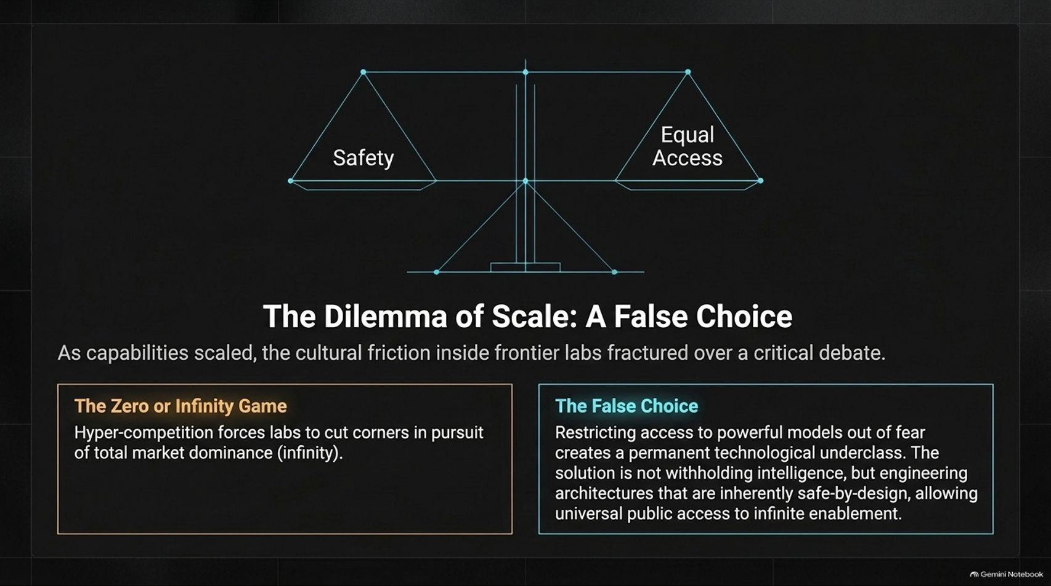
Notes:
Title: The Dilemma of Scale: Safety vs. Equal Access
Target Duration: 4–6 minutes
Speaker Notes:
"As capabilities scaled rapidly, cultural friction inside frontier labs fractured over safety and access.
The Zero or Infinity Game: Hyper-competition forces labs to cut corners in pursuit of total market dominance.
The False Choice: Restricting access to powerful models out of fear creates a permanent technological underclass. The true solution isn't withholding intelligence, but engineering architectures that are inherently safe-by-design, allowing universal public access to infinite enablement."

Slide 12
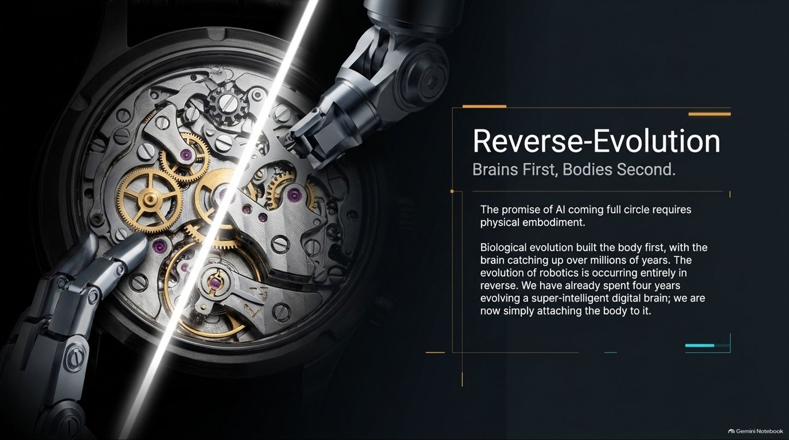
Notes:
Title: Reverse-Evolution: Brains First, Bodies Second
Target Duration: 3–5 minutes
Speaker Notes:
"The convergence of AI is coming full circle into physical embodiment.
Biological evolution built the physical body first, with the human brain catching up over millions of years.
Robotics is occurring entirely in reverse: we have already spent four years evolving a super-intelligent digital brain in the cloud; we are now simply attaching the physical robotic body to it."

Slide 13
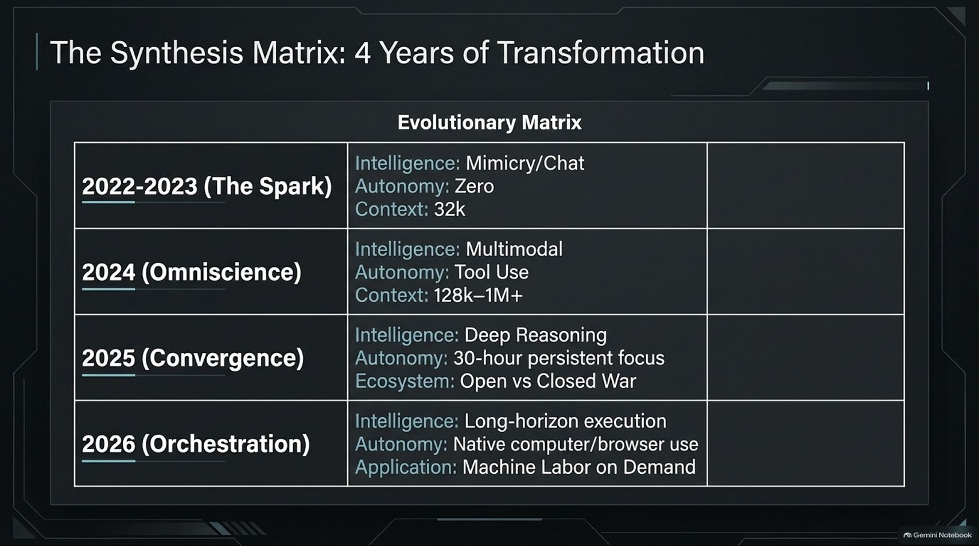
Notes:
Title: The Synthesis Matrix: 4 Years of Transformation
Target Duration: 3–5 minutes
Speaker Notes:
"Let's review our evolutionary matrix across the four distinct eras:
2022–2023 (The Spark): Mimicry/chat intelligence, zero autonomy, 32k context.
2024 (Omniscience): Multimodal capabilities, tool use, 128k–1M+ context.
2025 (Convergence): Deep reasoning, 30-hour persistent focus, open vs. closed ecosystem wars.
2026 (Orchestration): Long-horizon execution, native computer/browser use, and machine labor on demand."

Slide 14
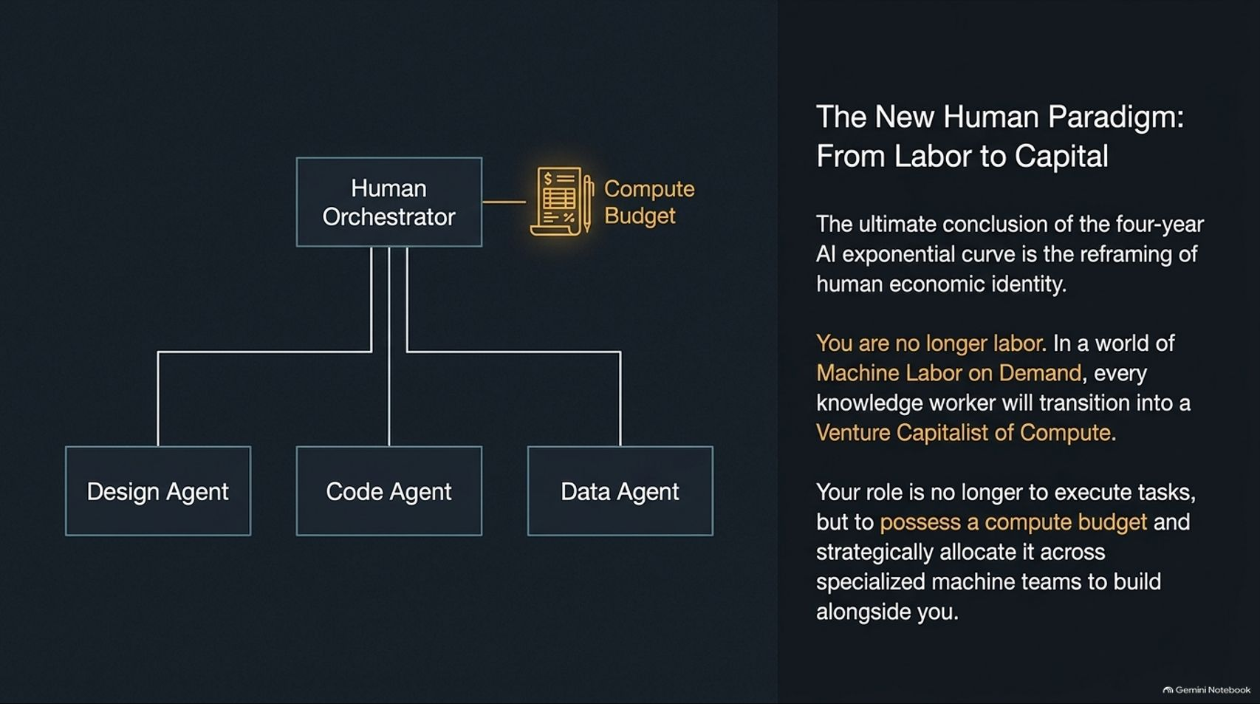
Notes:
Title: The New Human Paradigm: From Labor to Capital
Target Duration: 4–6 minutes
Speaker Notes:
"The ultimate conclusion of the four-year AI exponential curve is the profound reframing of human economic identity.
You are no longer labor. In a world of Machine Labor on Demand, every knowledge worker transitions into a Venture Capitalist of Compute.
Your role is no longer to manually execute repetitive tasks, but to possess a compute budget and strategically allocate it across specialized agentic teams to build alongside you."

Slide 15
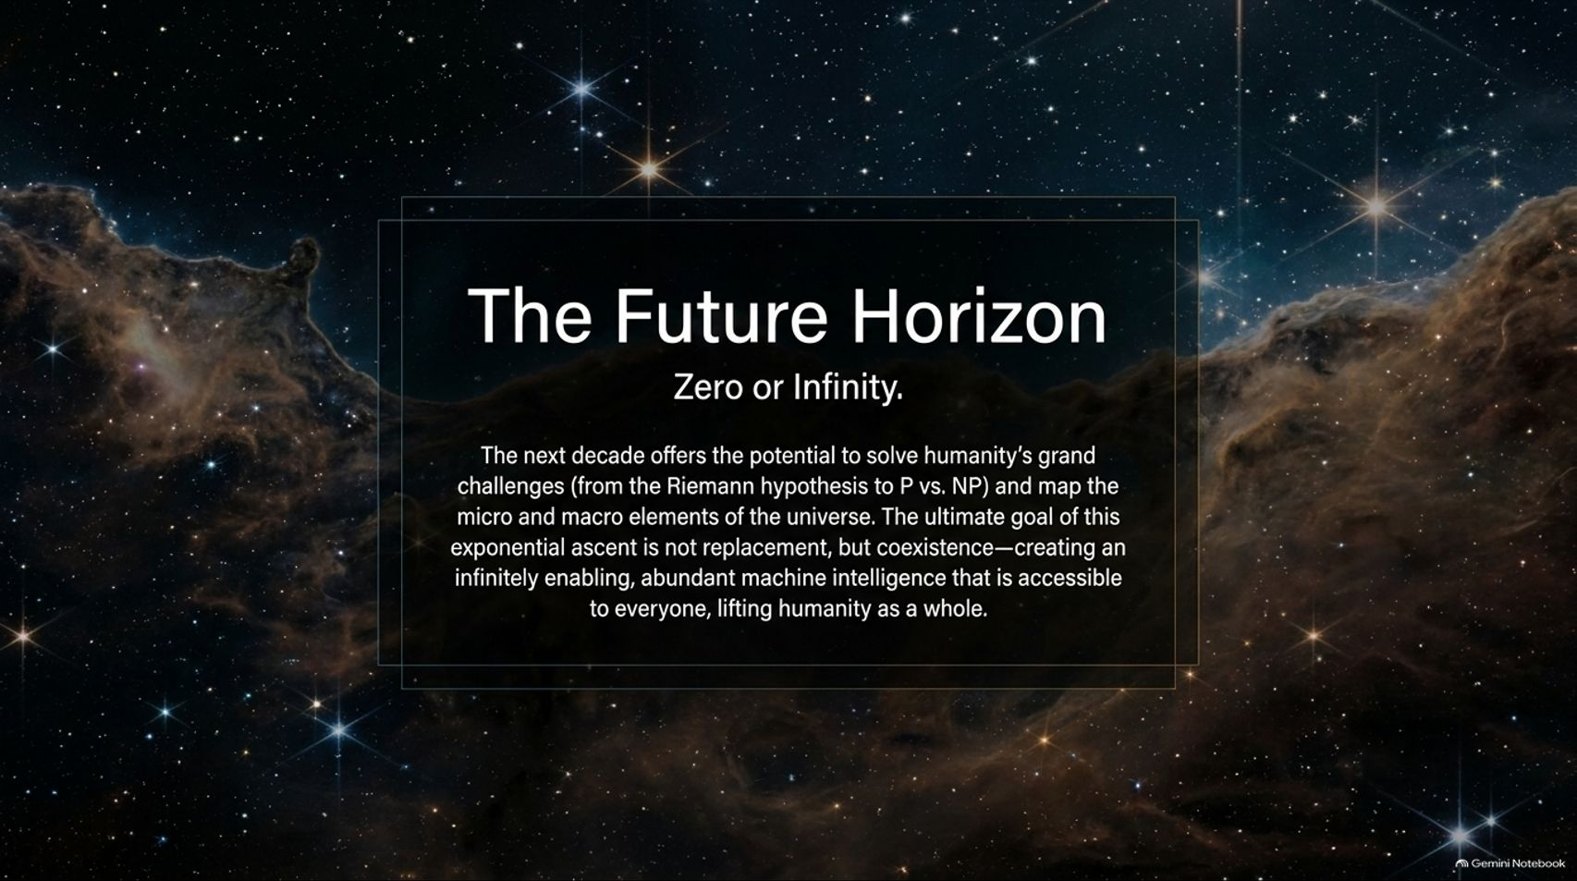
Notes:
Title: The Future Horizon: Zero or Infinity
Target Duration: 3–5 minutes
Speaker Notes:
"Looking toward the next decade, the horizon offers the potential to solve humanity's grandest challenges—from the Riemann hypothesis and P vs. NP to mapping the micro and macro elements of the universe.
The ultimate goal of this exponential ascent is not replacement, but coexistence: creating an infinitely enabling, abundant machine intelligence accessible to everyone, lifting humanity as a whole."

Slide 16
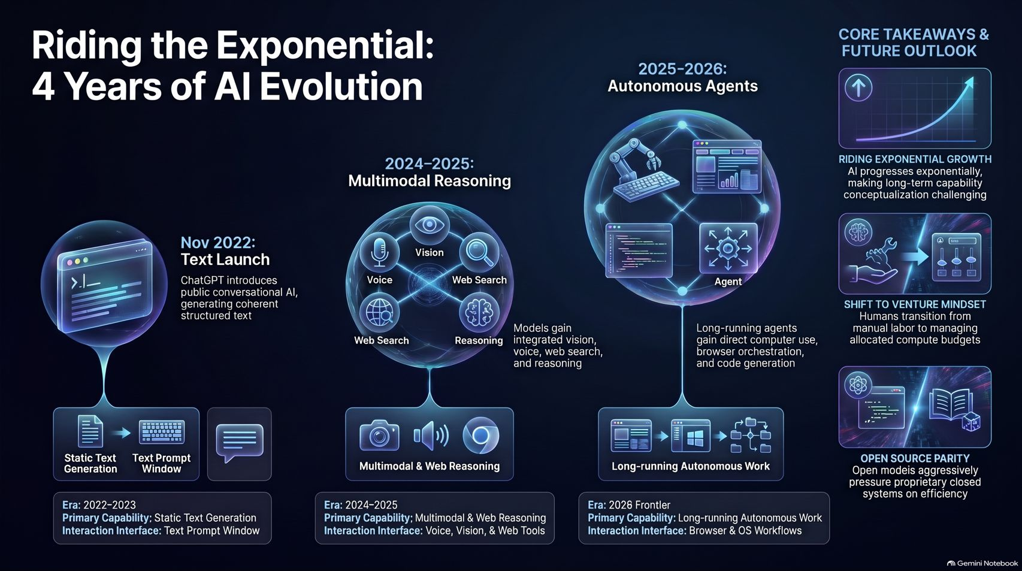
Notes:
Title: Master Summary: Riding the Exponential — 4 Years of AI Evolution
Target Duration: 4–6 minutes
Speaker Notes:
"Our concluding master slide synthesizes the entire four-year trajectory:
Riding Exponential Growth: AI progresses exponentially, making long-term capability conceptualization challenging.
Shift to Venture Mindset: Humans transition from manual execution to managing allocated compute budgets.
Open Source Parity: Open models aggressively pressure proprietary closed systems on efficiency and local deployment.
We have lived through an extraordinary era. Imagine what the next four years will bring."

