Slide 1
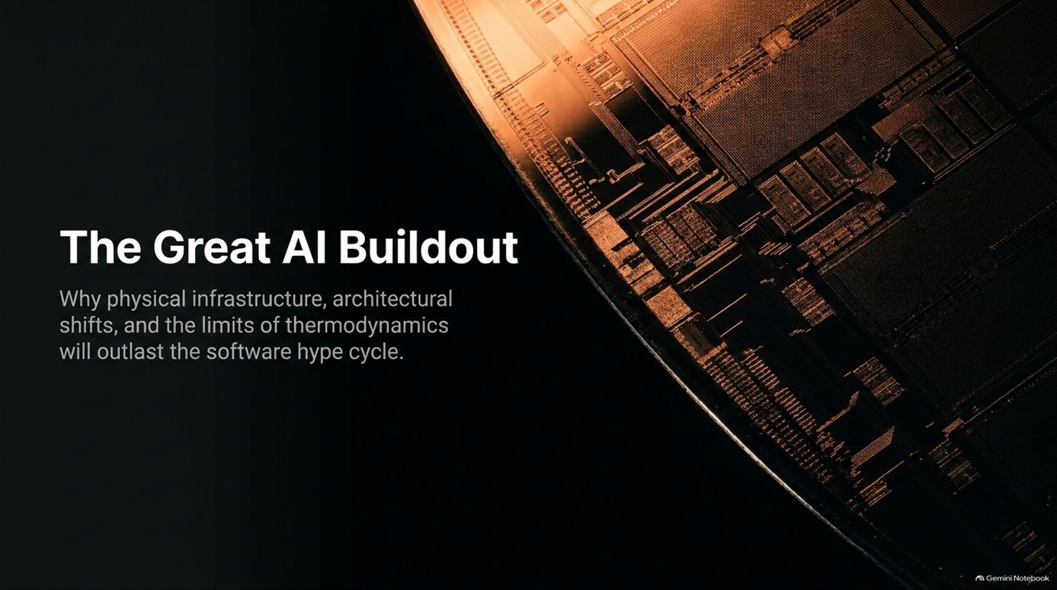
Notes:
Title: The Great AI Buildout: Why physical infrastructure, architectural shifts, and the limits of thermodynamics will outlast the software hype cycle.
Target Duration: 2–3 minutes
Speaker Notes:
"Welcome, everyone. Today we are exploring The Great AI Buildout. While the mainstream media and financial markets fixate on daily software updates, model releases, and short-term hype cycles, the real, enduring story of artificial intelligence is physical, structural, and thermodynamic.
As veteran tech builder and investor Mike Volpi highlights, we are living through a period of infrastructure creation that eclipses past technological revolutions in both capital intensity and intellectual complexity.
Over the next 15 slides, we’re going to examine why physical silicon, power grids, advanced packaging, and architectural realignments will outlast any software correction. Let’s dive in."
Inside the Economics of AI Supply and Demand | Mike Volpi
https://www.youtube.com/watch?v=LI3lxzHfRrU

Slide 2
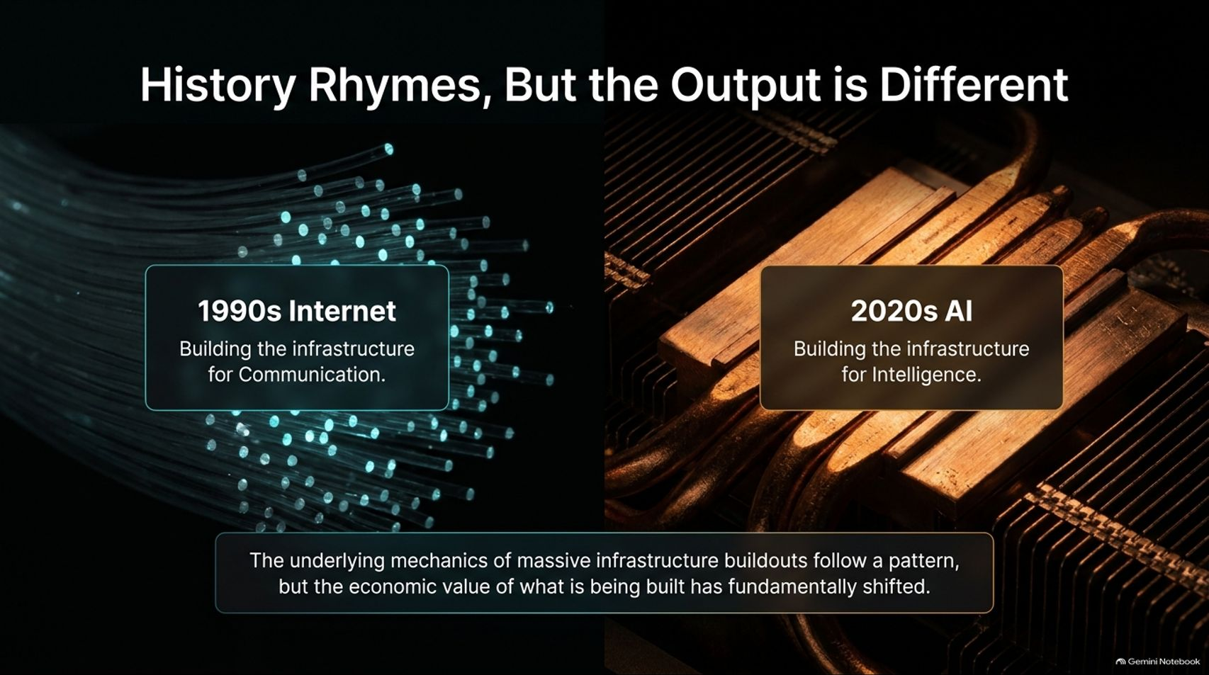
Notes:
Title: History Rhymes, But the Output is Different (1990s Internet vs. 2020s AI)
Target Duration: 3–5 minutes
Speaker Notes:
"History doesn't repeat itself, but it definitely rhymes. When we look back at the late 1990s internet boom, the industry was laying down the infrastructure for communication—fiber optics, routers, and basic connectivity.
Today, in the 2020s AI surge, we are building the infrastructure for intelligence.
While the underlying mechanics of massive infrastructure buildouts follow a familiar historical pattern, the economic value of what is being built has fundamentally shifted. Communication connected people; intelligence is automating cognition itself."

Slide 3
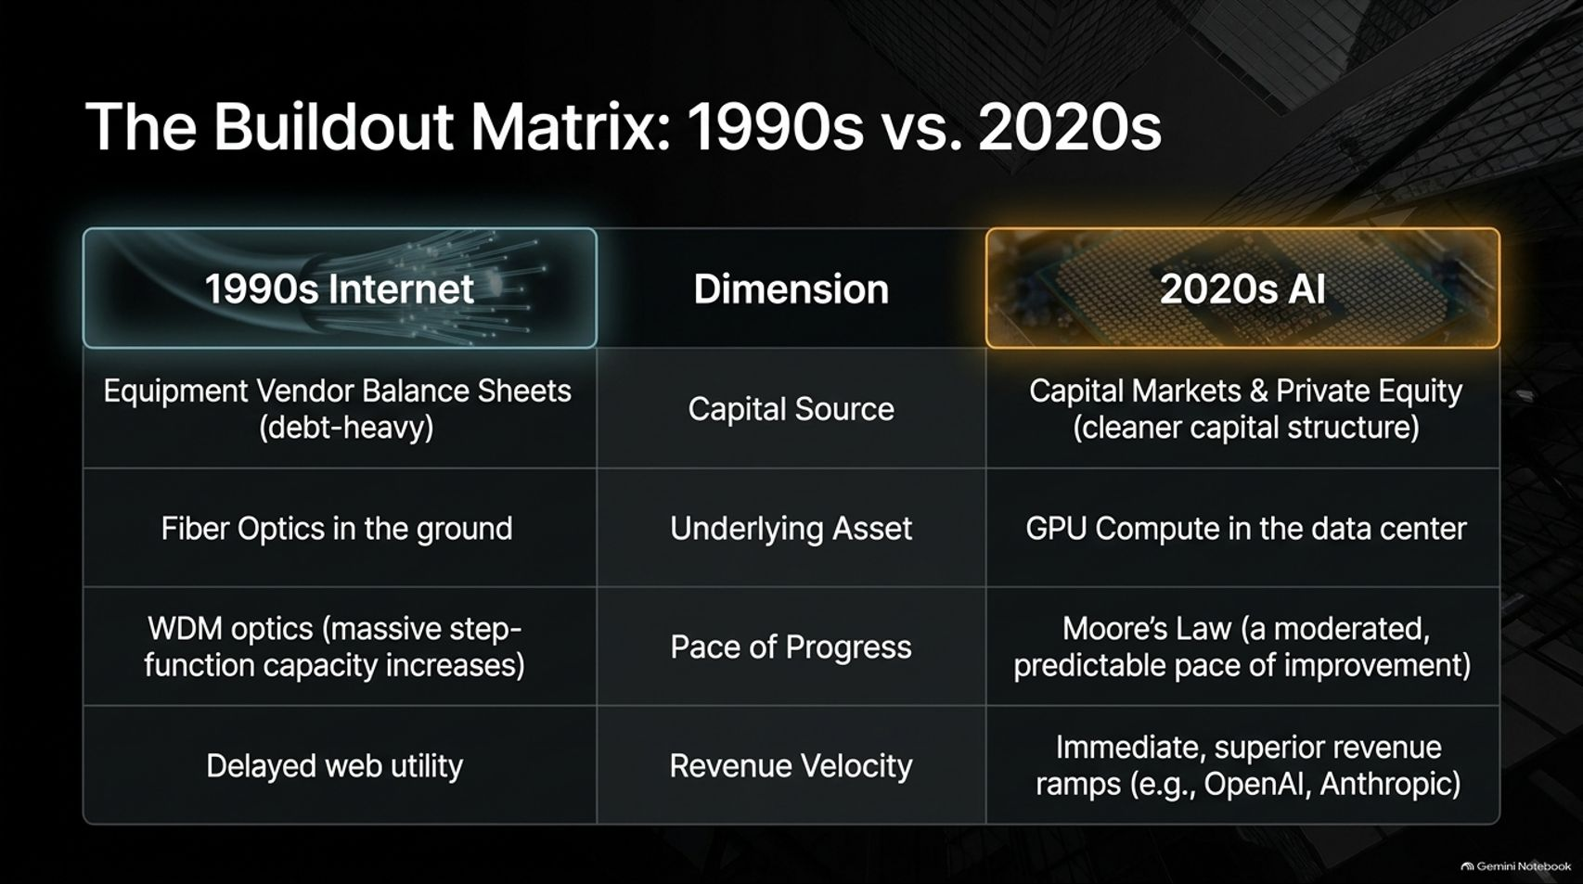
Notes:
Title: The Buildout Matrix: 1990s Internet vs. 2020s AI
Target Duration: 4–6 minutes
Speaker Notes:
"Let’s break down the structural differences across four core dimensions:
Capital Source: In the 90s, equipment vendors carried heavy debt loads on their balance sheets. Today's AI buildout is driven by public equities and private equity with a cleaner capital structure.
Underlying Asset: We went from burying physical fiber optic cables in the ground to pooling massive GPU compute clusters inside modern data centers.
Pace of Progress: Fiber capacity exploded exponentially through WDM optics (putting multiple colors of light on a single strand). Compute, by contrast, follows a more moderated, predictable cadence governed by Moore's Law.
Revenue Velocity: In the 90s, web utility was heavily delayed. Today, frontier labs like OpenAI and Anthropic are experiencing immediate, superior revenue ramps."

Slide 4
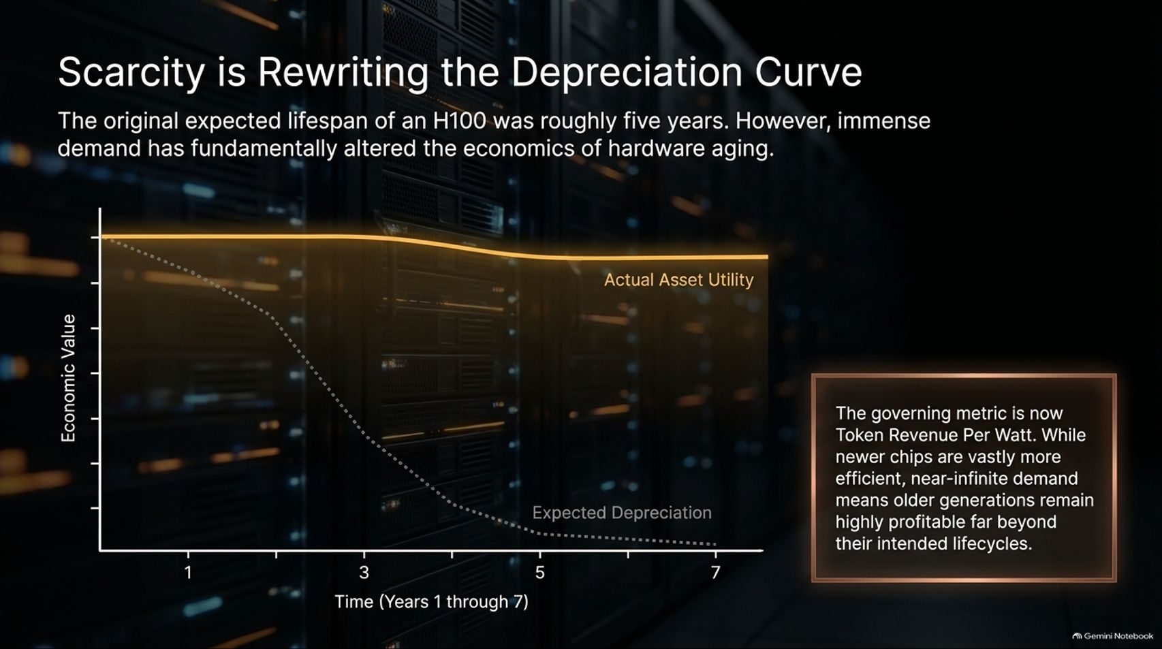

Slide 5
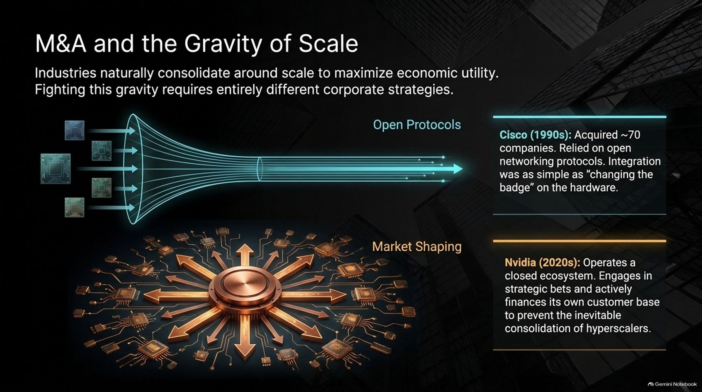
Notes:
Title: M&A and the Gravity of Scale: Cisco vs. Nvidia
Target Duration: 4–6 minutes
Speaker Notes:
"Industries naturally consolidate around scale to maximize economic utility. Fighting this gravity requires entirely different corporate strategies:
Cisco (1990s): Acquired roughly 70 companies, operating in an open networking ecosystem where integration was as simple as 'changing the badge' on standardized hardware.
Nvidia (2020s): Operates a closed, highly integrated ecosystem. Through strategic bets and direct customer financing, Nvidia acts as an industry shaper to prevent the inevitable consolidation of hyperscalers."

Slide 6
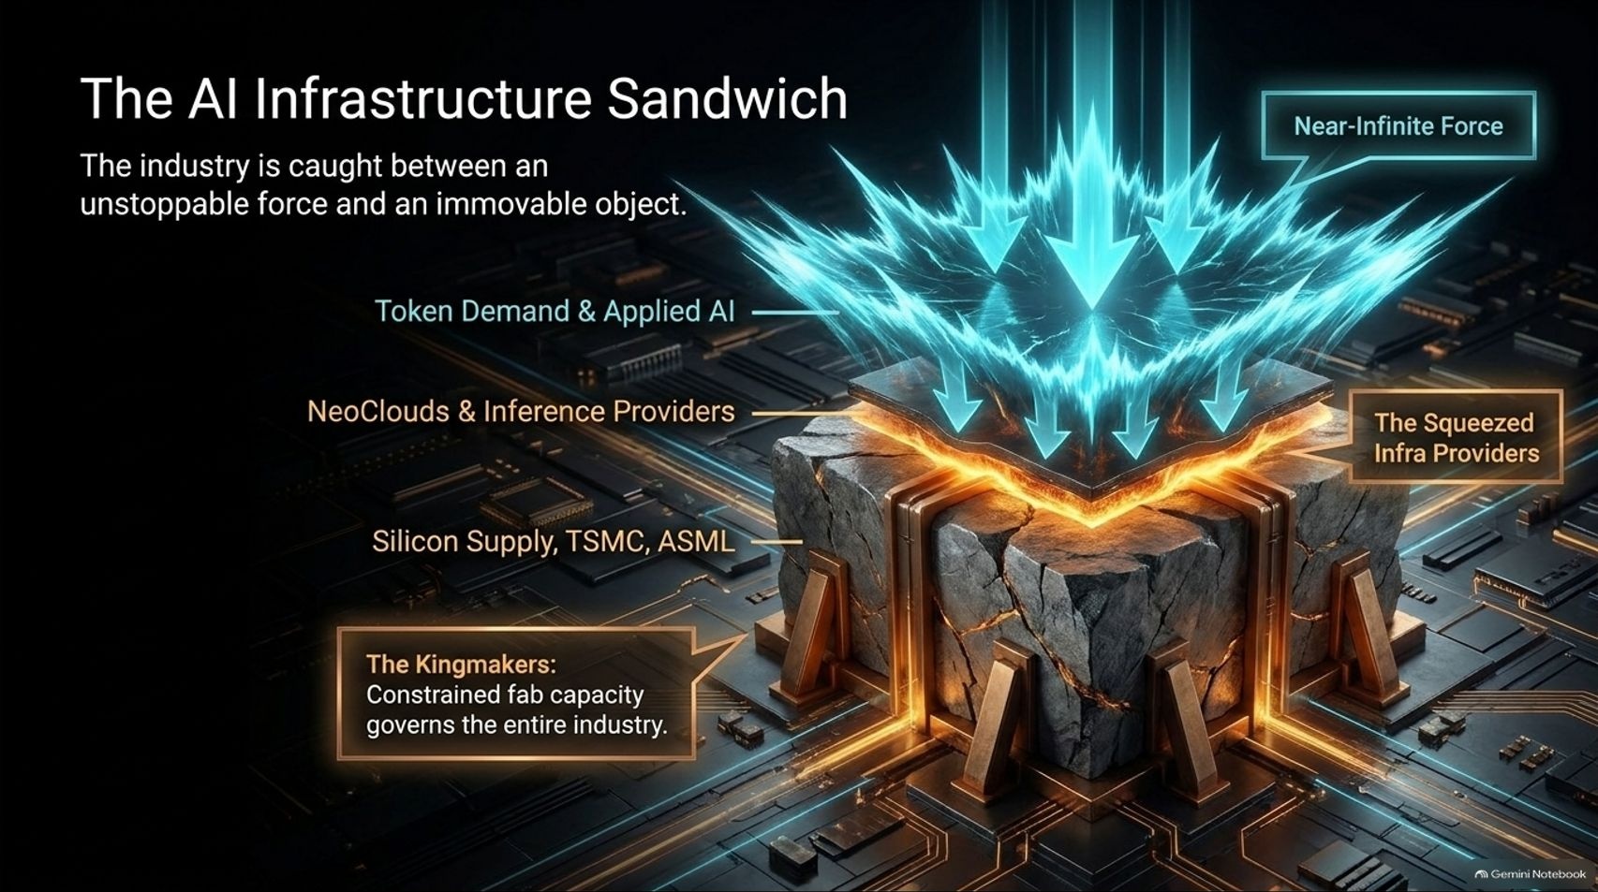
Notes:
Title: The AI Infrastructure Sandwich: Caught Between Forces
Target Duration: 3–5 minutes
Speaker Notes:
"The current AI industry is caught between an unstoppable force and an immovable object—what we call the AI Infrastructure Sandwich.
At the top, we have near-infinite demand for token generation and applied AI. In the middle, neo-clouds and inference providers are squeezed for margins.
At the bottom lie the Kingmakers: TSMC, ASML, and specialized silicon manufacturers. Because fab capacity is severely constrained, manufacturing governs the entire economic output of the ecosystem."

Slide 7
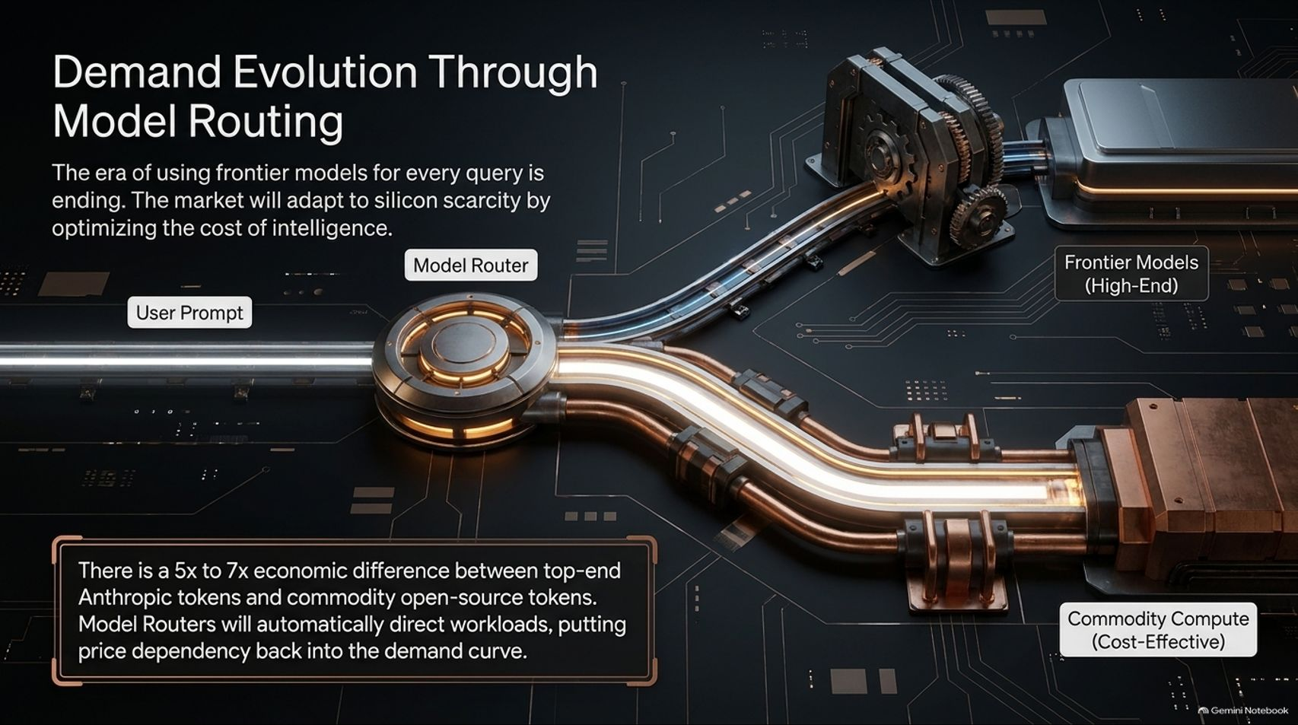
Notes:
Title: Demand Evolution Through Model Routing: Optimizing Cost
Target Duration: 4–6 minutes
Speaker Notes:
"The era of using massive frontier models for every simple query is coming to an end.
There is a 5x to 7x economic difference between top-end proprietary tokens (like Anthropic or OpenAI) and commodity open-source tokens.
To adapt to silicon scarcity, the market is introducing Model Routers. These intelligent routers automatically direct workloads based on complexity, putting price sensitivity and efficiency back into the demand curve."

Slide 8
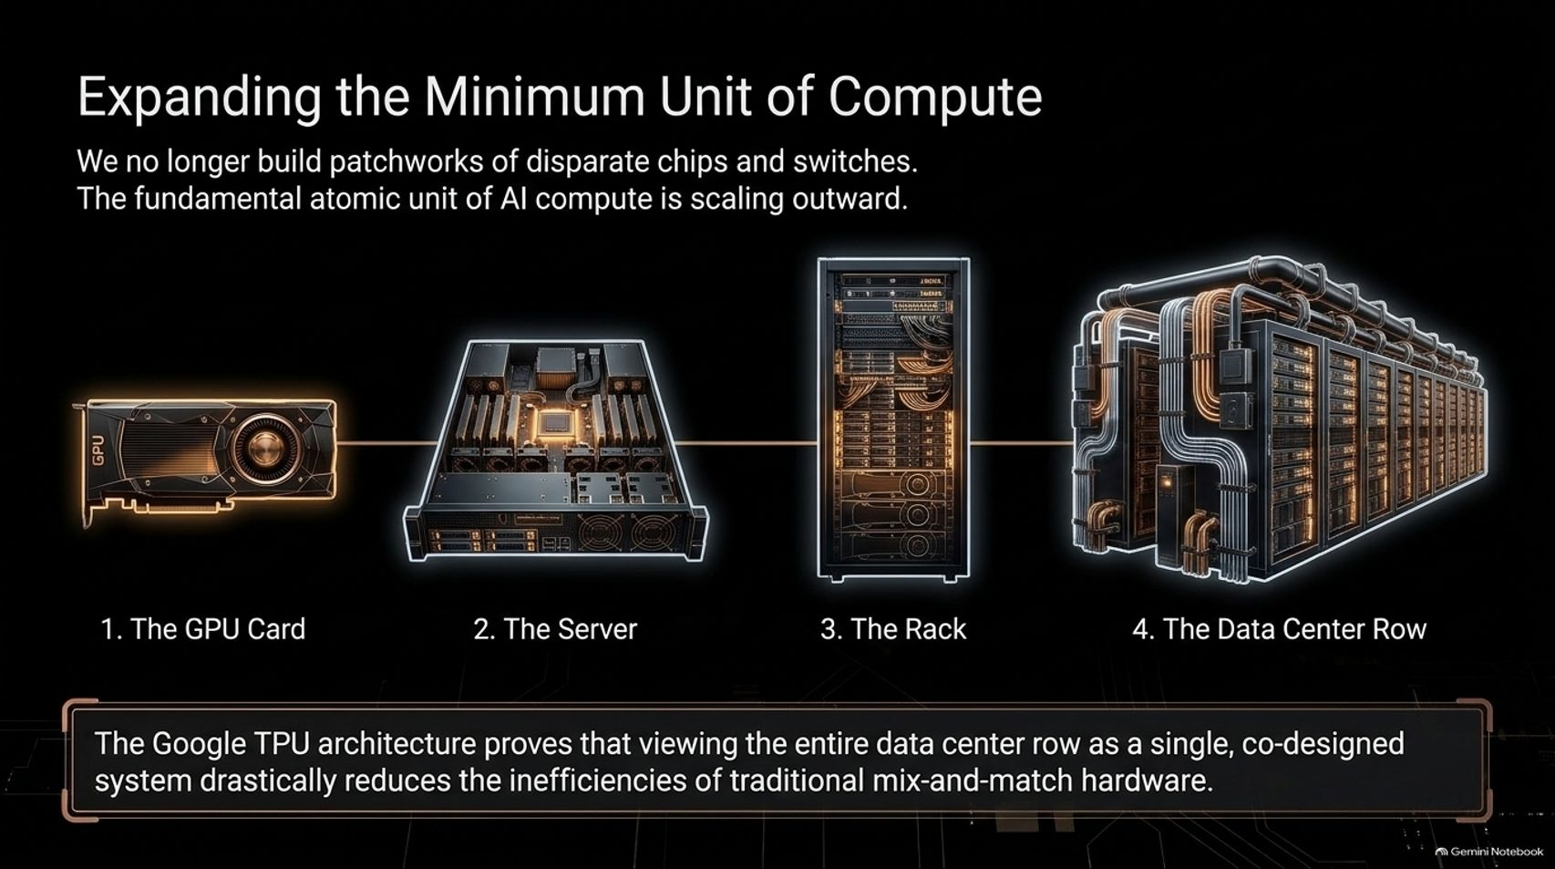

Slide 9
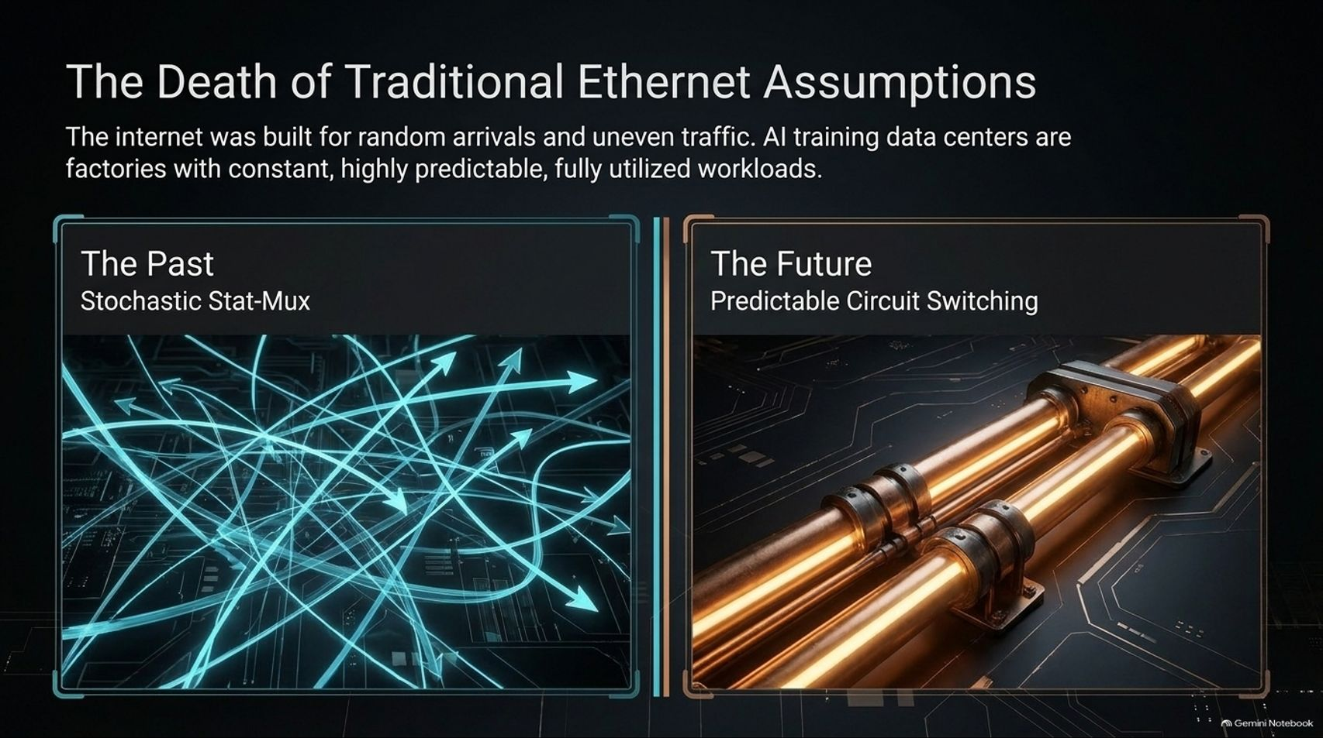
Notes:
Title: The Death of Traditional Ethernet Assumptions
Target Duration: 4–6 minutes
Speaker Notes:
"Traditional internet architecture was built for random arrivals, bursty traffic, and uneven utilization (stochastic stat-mux).
AI training data centers are entirely different: they are industrial factories with constant, highly predictable, fully utilized workloads.
Because GPUs need uninterrupted data flows, the industry is shifting away from complex packet buffering toward predictable circuit switching and high-throughput backend fabrics."

Slide 10
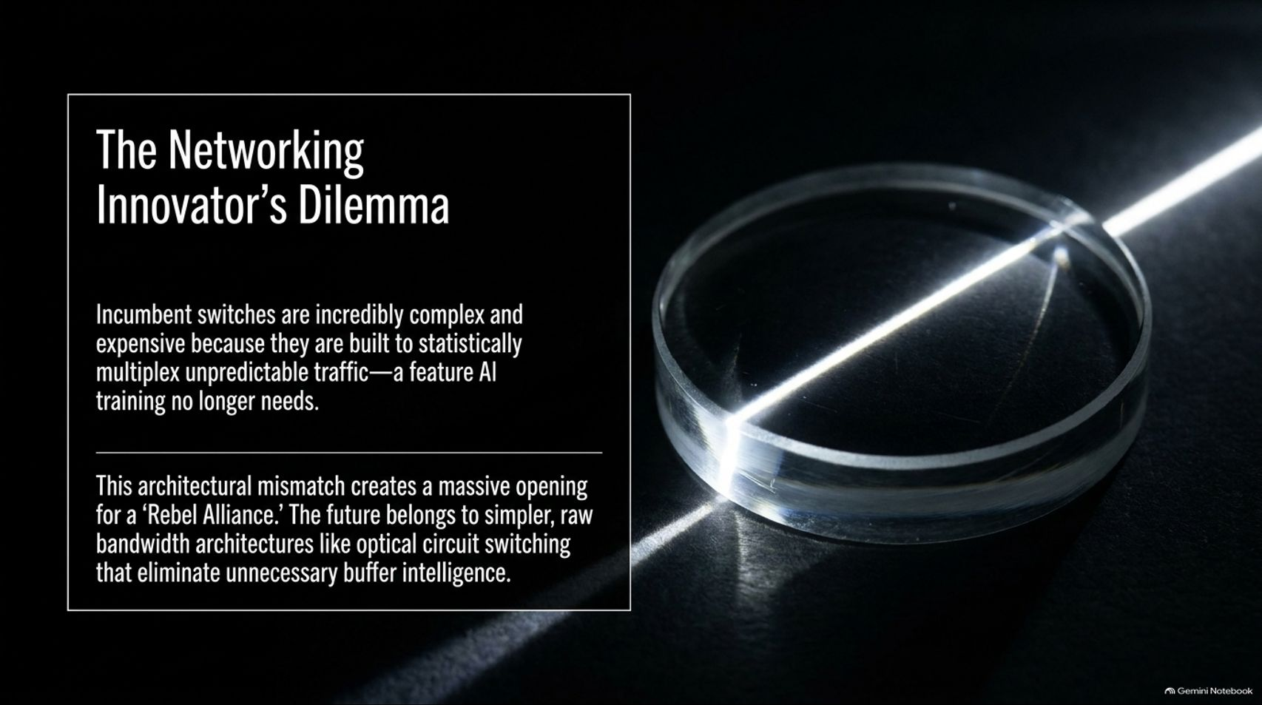
Notes:
Title: The Networking Innovator’s Dilemma: Raw Bandwidth Over Buffers
Target Duration: 3–5 minutes
Speaker Notes:
"This brings us to a classic Innovator’s Dilemma. Incumbent network switches are incredibly complex and expensive because they are built to statistically multiplex unpredictable traffic—a feature AI training no longer requires.
This architectural mismatch creates a massive opening for a 'Rebel Alliance.'
The future belongs to simpler, raw bandwidth architectures, such as optical circuit switching, that eliminate unnecessary buffer intelligence and reduce latency."

Slide 11
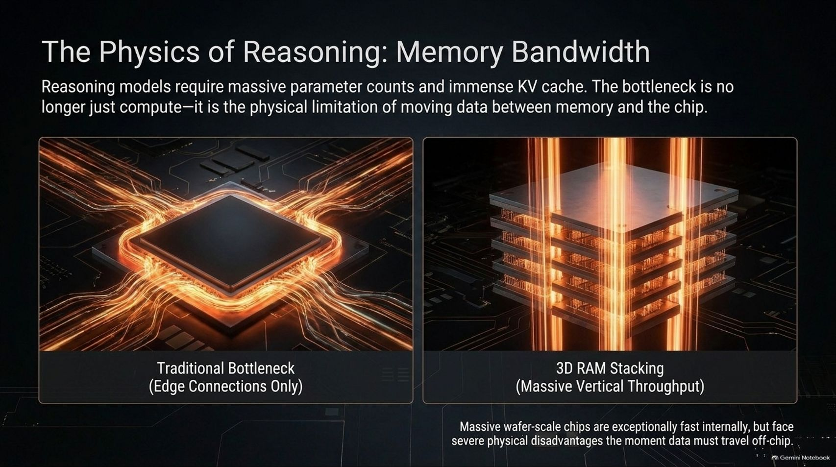
Notes:
Title: The Physics of Reasoning: Memory Bandwidth & KV Cache
Target Duration: 4–6 minutes
Speaker Notes:
"As models shift toward deep reasoning, parameter counts explode, and the KV Cache grows massively.
The primary bottleneck is no longer just raw compute—it is the physical limitation of moving data between memory and the chip core.
While traditional edge-connection architectures choke on off-chip data transfer, 3D RAM Stacking and vertical memory integration unlock massive internal throughput required for reasoning models."

Slide 12
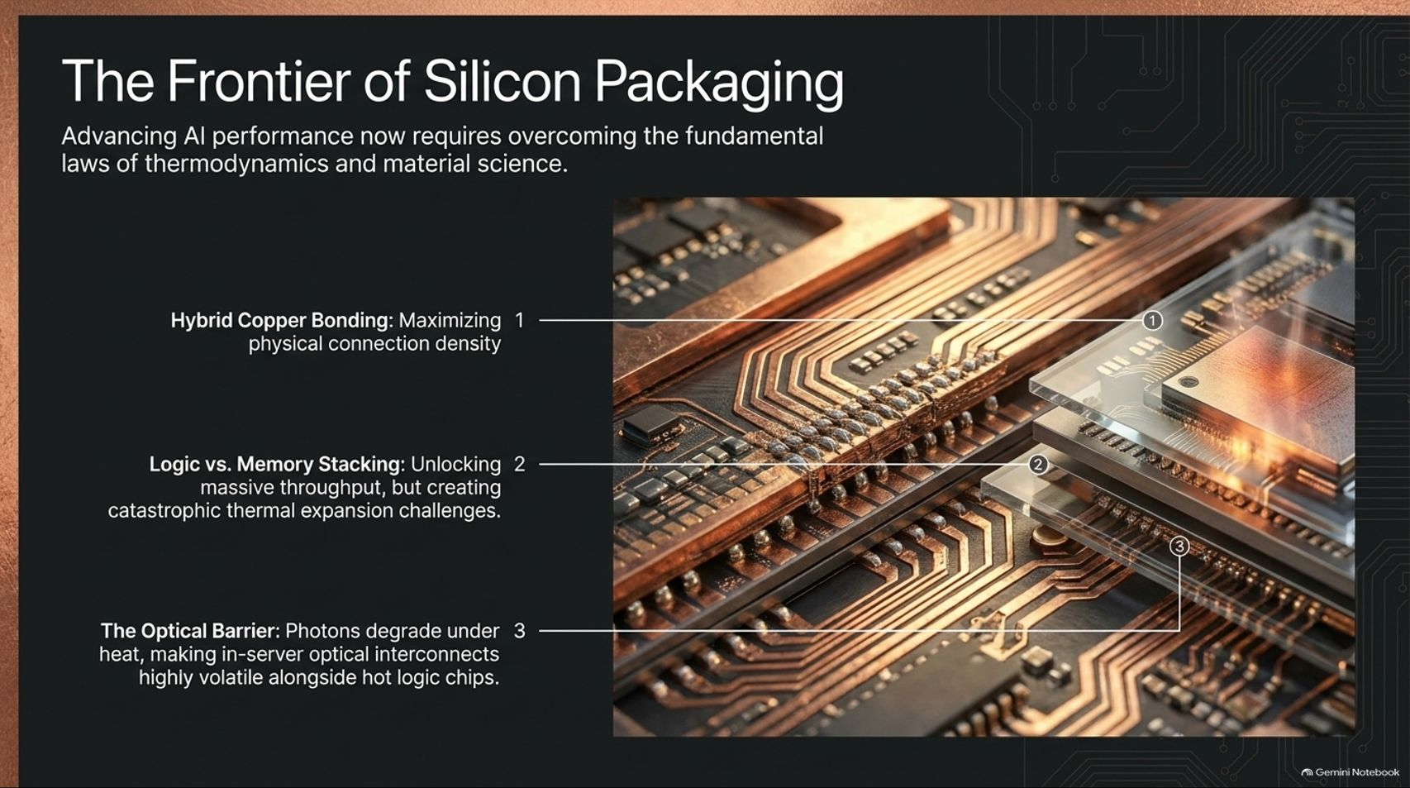
Notes:
Title: The Frontier of Silicon Packaging: Thermodynamics & Materials
Target Duration: 4–6 minutes
Speaker Notes:
"Advancing AI performance now requires overcoming the fundamental laws of thermodynamics and material science:
Hybrid Copper Bonding: Maximizing physical connection density between stacked layers.
Logic vs. Memory Stacking: Unlocking extreme throughput, while creating catastrophic thermal expansion challenges.
The Optical Barrier: Photons degrade under high heat, making in-server optical interconnects extremely volatile alongside hot logic chips."

Slide 13
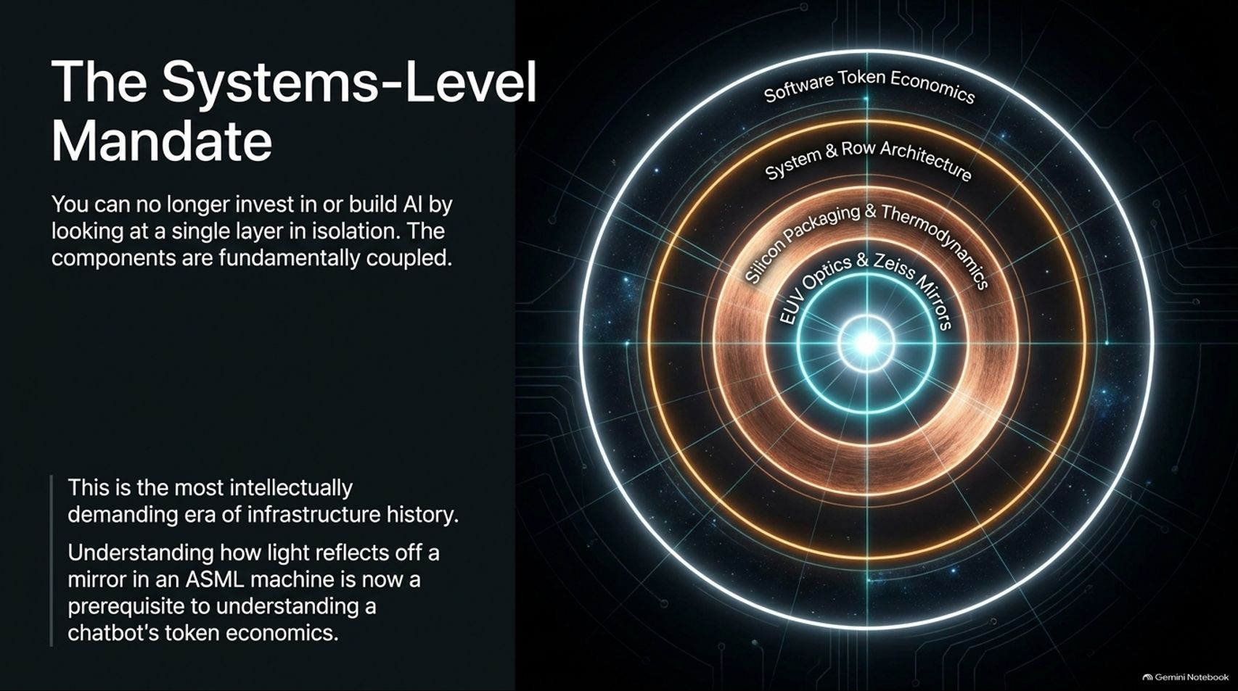
Notes:
Title: The Systems-Level Mandate: Interconnected Engineering
Target Duration: 3–5 minutes
Speaker Notes:
"You can no longer invest in or build AI by looking at a single layer in isolation. The components are fundamentally coupled.
This is the most intellectually demanding era of infrastructure history. As Mike Volpi eloquently stated, understanding how light reflects off a mirror in an ASML EUV machine is now a prerequisite to understanding a chatbot's token economics."

Slide 14
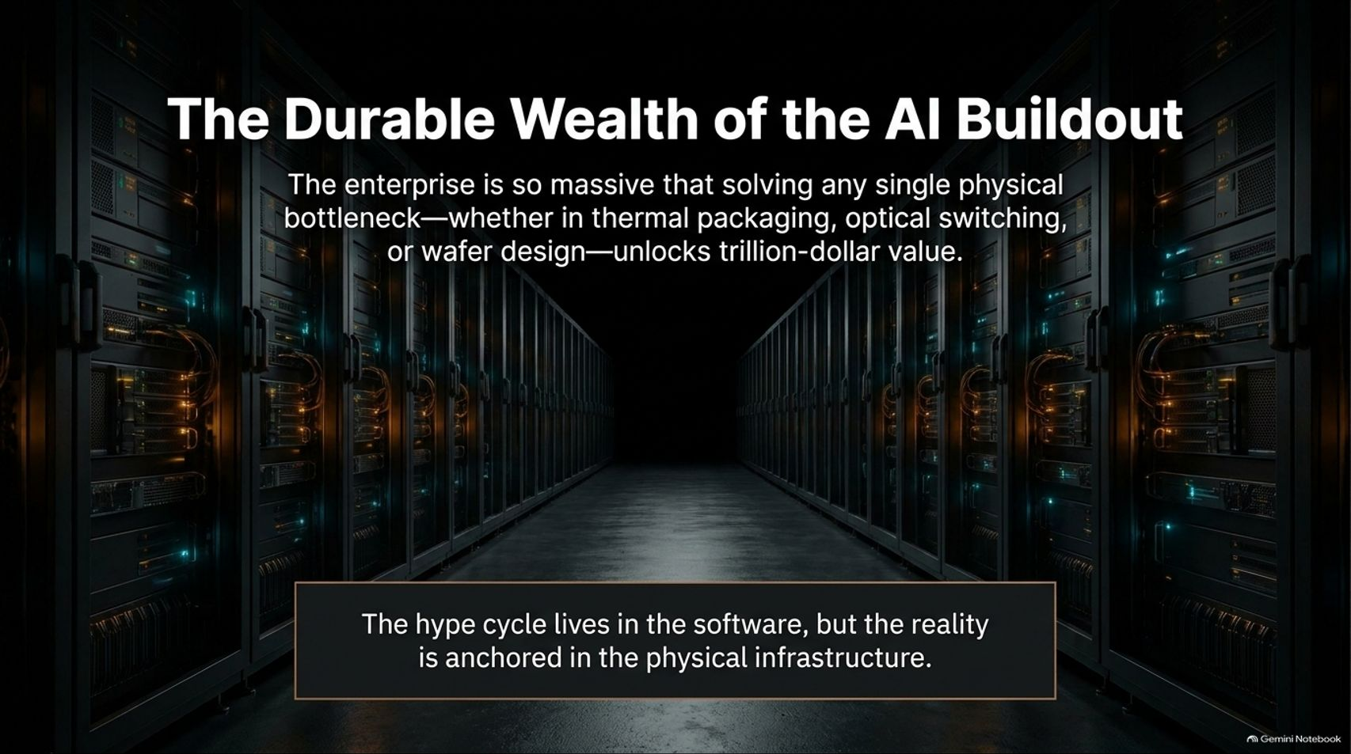
Notes:
Title: The Durable Wealth of the AI Buildout: Physical Anchors
Target Duration: 3–5 minutes
Speaker Notes:
"While software markets experience rapid sentiment shifts and valuation swings, the underlying enterprise of AI infrastructure is monumental.
Solving any single physical bottleneck—whether in thermal packaging, optical switching, or wafer design—unlocks trillion-dollar value.
The hype cycle lives in ephemeral software, but durable wealth is anchored directly in physical infrastructure."

Slide 15
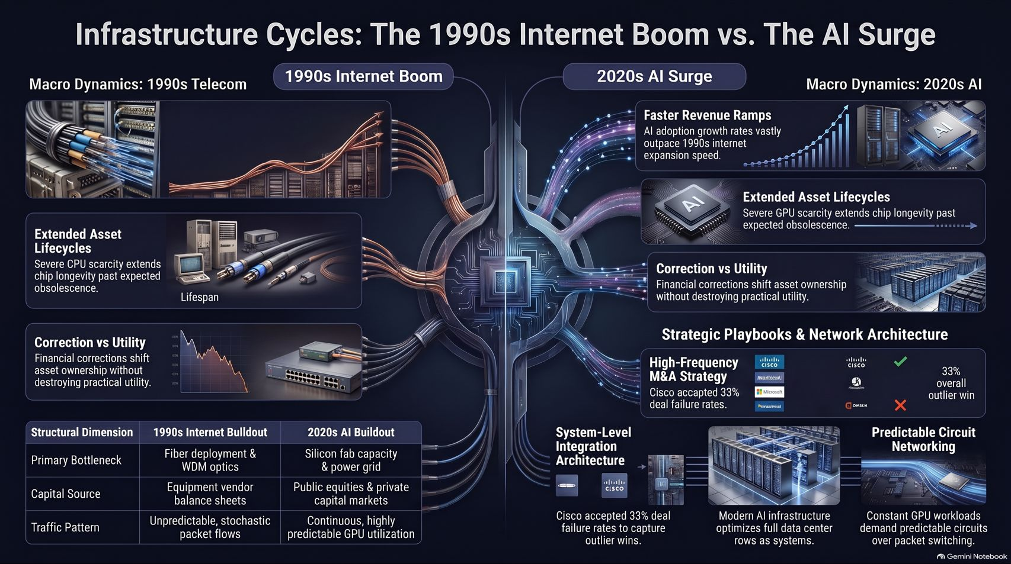
Notes:
Title: Master Summary: Infrastructure Cycles (1990s vs. 2020s)
Target Duration: 4–6 minutes
Speaker Notes:
"To conclude, let's review our master comparison:
Revenue & Utility: Modern AI adoption curves vastly outpace 1990s telecom expansion, backed by immediate utility.
Asset Durability: Severe GPU scarcity extends hardware lifecycles past expected obsolescence.
System Integration: Modern infrastructure treats data center rows as unified supercomputers rather than isolated parts.
The infrastructure buildout is here to stay, and mastering the physical layer is the key to the next decade of technology."

