Slide 1
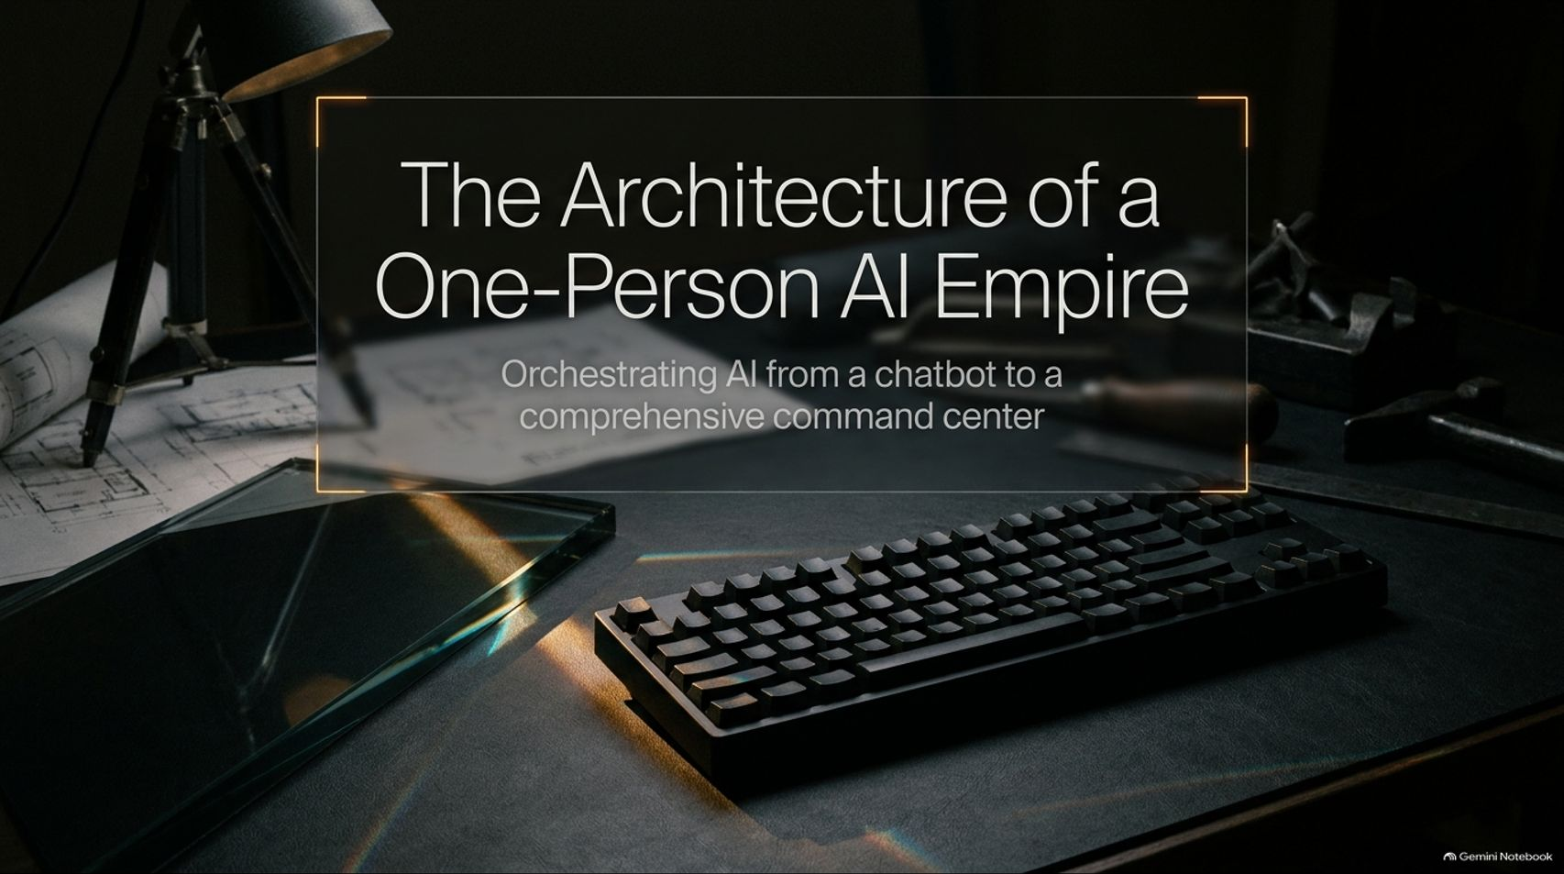
Notes:
Claude AI Expert: How To Build A Second Income With AI Without Quitting Your 9–5
https://www.youtube.com/watch?v=uYZCcrSpCII

Slide 2
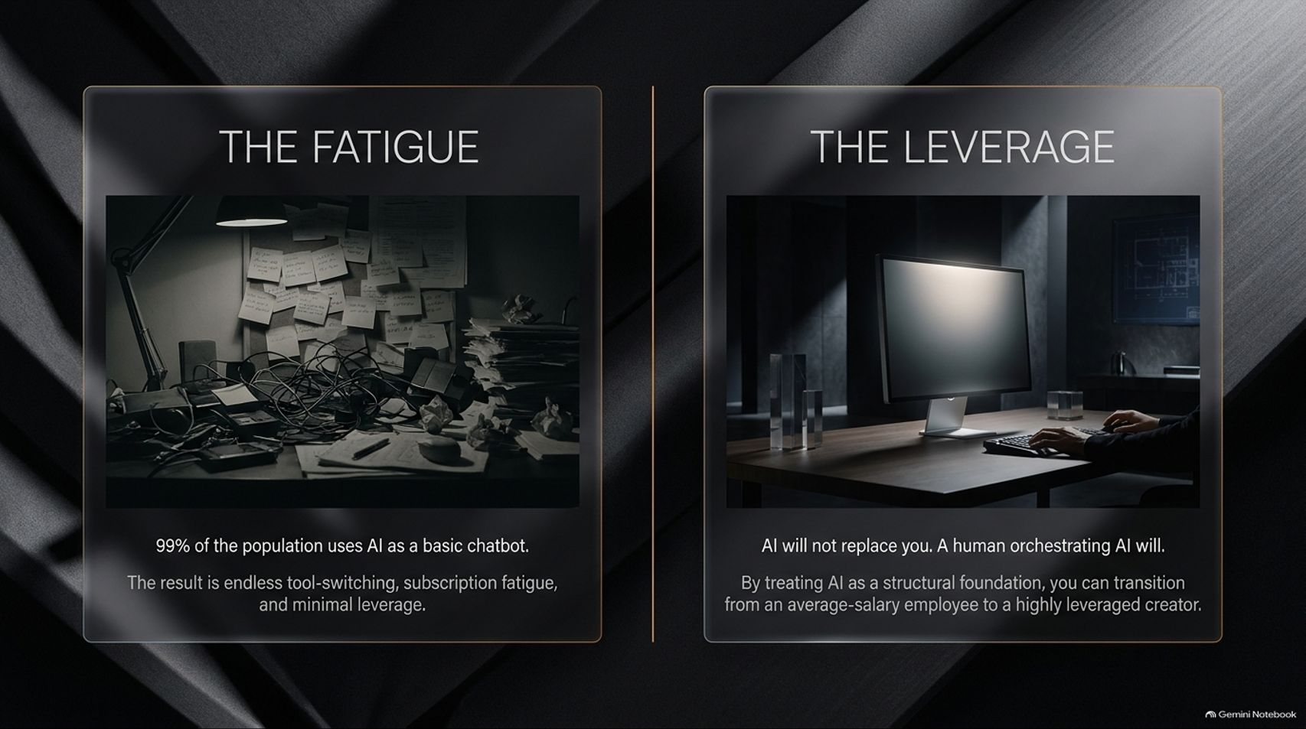
Notes:
Title: The Fatigue vs. The Leverage
Target Duration: 3–5 minutes
Speaker Notes:
"Look at the contrast on this slide. On the left, we have The Fatigue. Right now, 99% of the population uses AI as a basic, reactive chatbot. They open five different tabs, bounce between ChatGPT, Gemini, Claude, and Midjourney, copy-paste context over and over, and end up with endless tool-switching, subscription fatigue, and minimal real-world leverage.
On the right, we have The Leverage. You've probably heard the phrase: 'AI will not replace you; a human orchestrating AI will.' That isn't just a catchy slogan—it is an architectural reality.
When you stop treating AI as a disposable Q&A box and start treating it as a structural foundation—an operating system with persistent memory, defined roles, and direct execution power—you make the leap from an average-salary employee trading time for money to a highly leveraged solo creator."

Slide 3
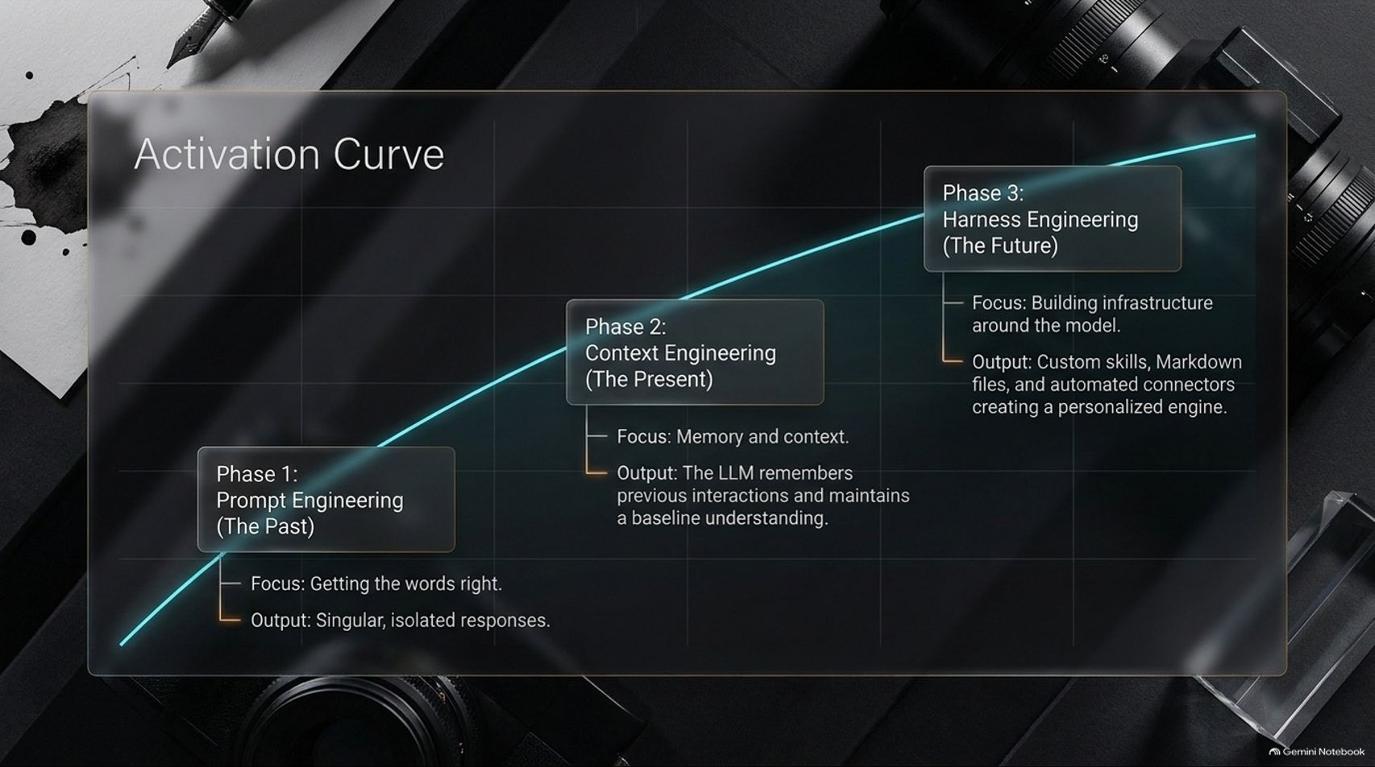
Notes:
Title: Activation Curve (Prompt → Context → Harness Engineering)
Target Duration: 4–6 minutes
Speaker Notes:
"To understand how to build that leverage, look at the Activation Curve, which maps the three distinct eras of working with Large Language Models:
Phase 1: Prompt Engineering (The Past). This was all about getting the magic words right—tweaking adjectives and role-play intros to get singular, isolated responses. Once you closed the chat window, everything vanished.
Phase 2: Context Engineering (The Present). Here, the focus shifts to memory and persistent context. Instead of starting from zero every time, the LLM remembers previous interactions, knows your business goals, and maintains a baseline understanding of who you are.
Phase 3: Harness Engineering (The Future). This is where true scale lives. Harness engineering isn't about the prompt inside the box; it's about building the infrastructure around the model. By combining custom skills, structured local Markdown files, and automated connectors, you transform a raw model into a personalized, autonomous engine."

Slide 4
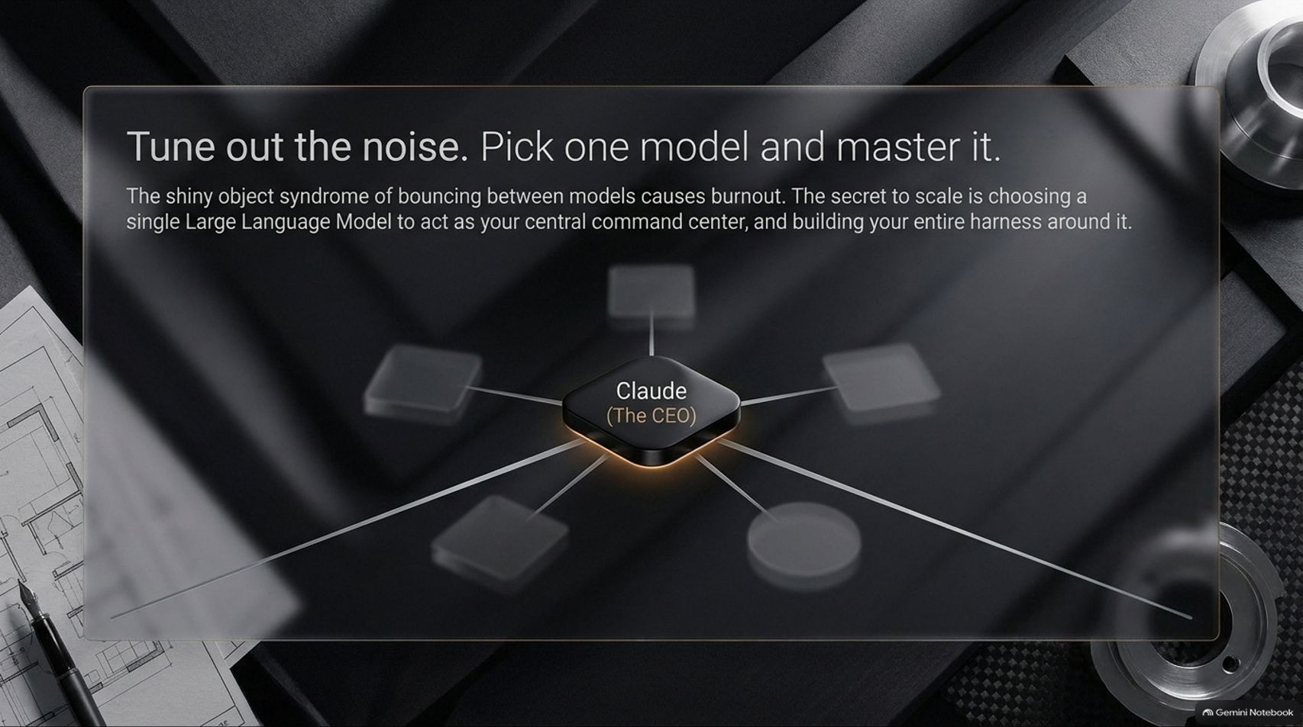

Slide 5
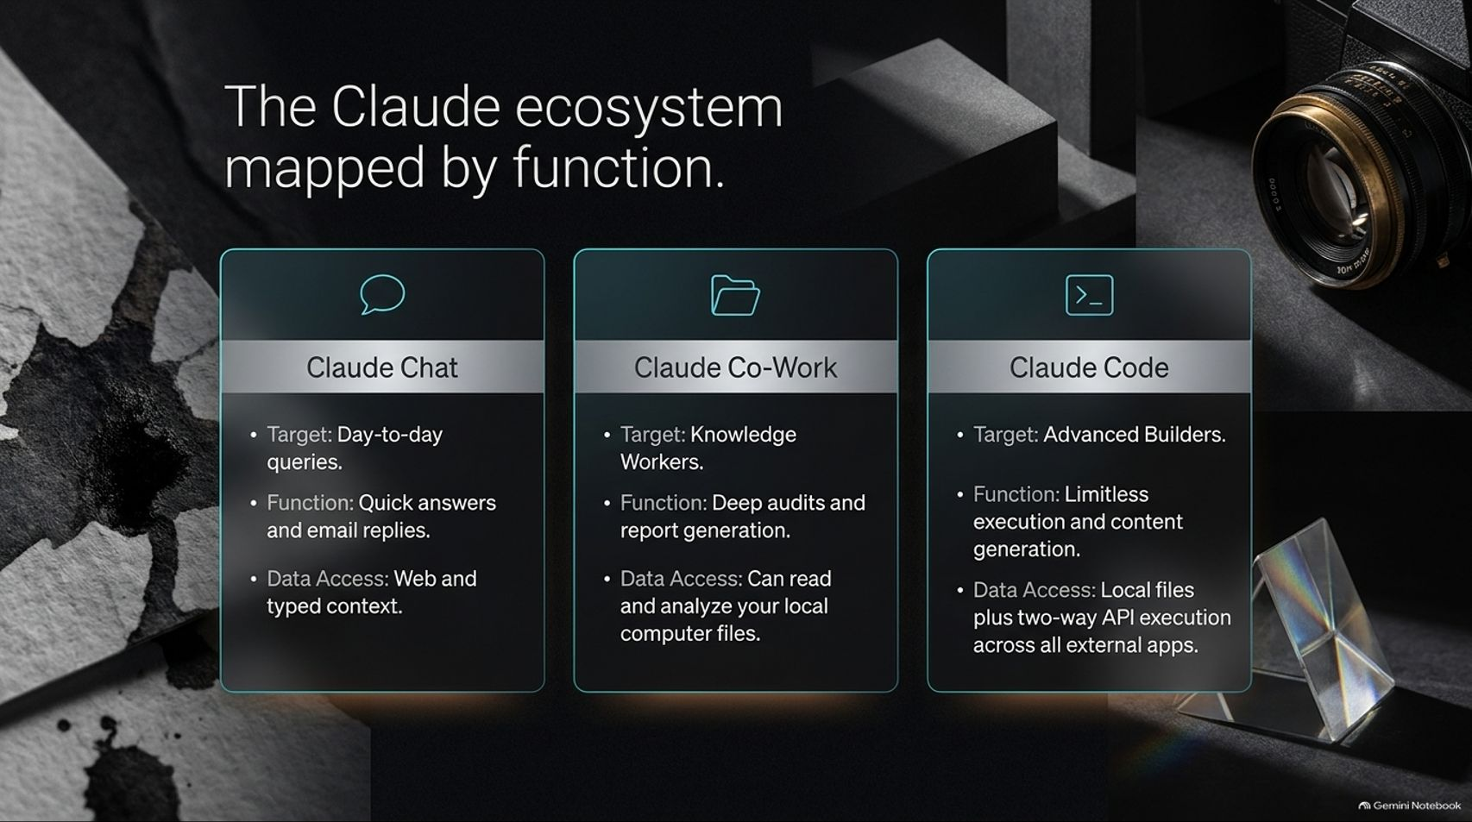
Notes:
Title: The Claude ecosystem mapped by function.
Target Duration: 4–6 minutes
Speaker Notes:
"Once you commit to Claude as your central command center, you need to understand its three distinct operational interfaces and when to deploy each one:
Claude Chat: Built for day-to-day queries, rapid brainstorming, quick answers, and drafting email replies. Its data access is limited to web search and whatever text you manually type or paste into the session.
Claude Co-Work: Designed for knowledge workers. This moves beyond the browser window—it can read, audit, and analyze your local computer files, synthesize dense reports, and run scheduled desktop tasks.
Claude Code: Built for ambitious builders—and remember, you do not need to be a traditional software developer to use it. Claude Code operates directly inside your machine's file system with limitless execution power, reading local folders and triggering two-way API actions across all your external apps."

Slide 6
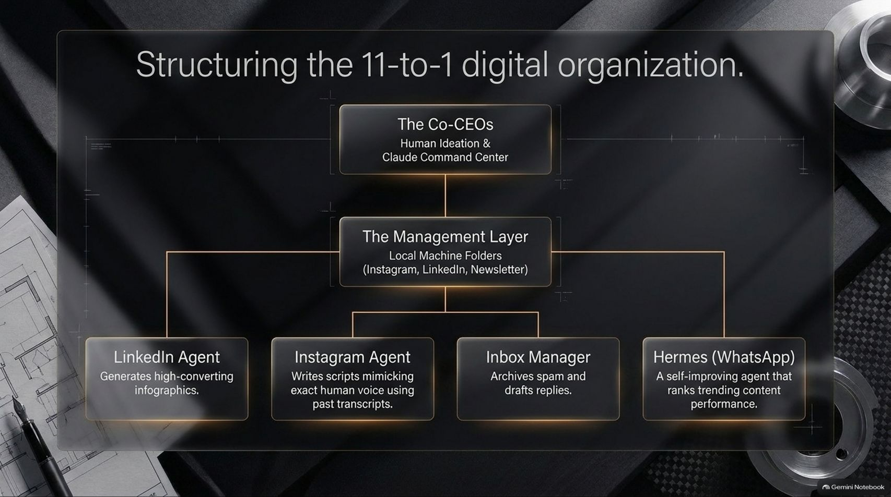
Notes:
Title: Structuring the 11-to-1 digital organization.
Target Duration: 4–6 minutes
Speaker Notes:
"Here is what an actual one-person AI empire looks like in practice—a 11-to-1 digital organization where one human orchestrates a full team of specialized agents:
Top Tier — The Co-CEOs: You handle high-level human ideation, strategy, and taste, paired directly with the Claude Command Center.
Middle Tier — The Management Layer: Instead of hiring middle managers, your management layer consists of structured local machine folders organized by channel—such as Instagram, LinkedIn, and your Newsletter.
Execution Tier — Specialized Agents: Underneath those folders sit dedicated artificial employees: a LinkedIn Agent that generates high-converting infographics, an Instagram Agent that writes scripts mimicking your exact voice from past transcripts, an Inbox Manager that archives spam and drafts replies, and Hermes (via WhatsApp), a self-improving agent that tracks and ranks trending content performance."

Slide 7
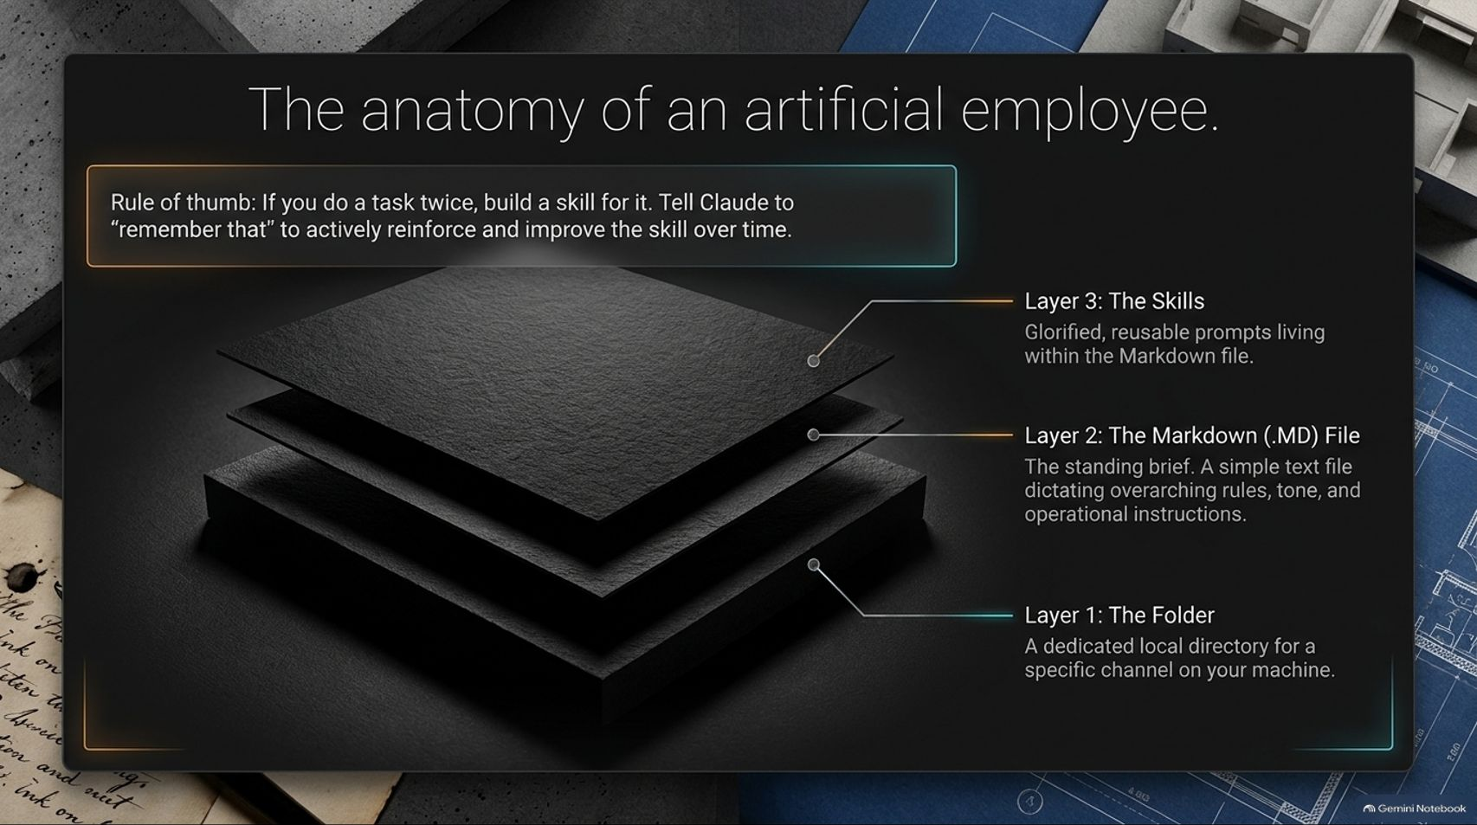

Slide 8
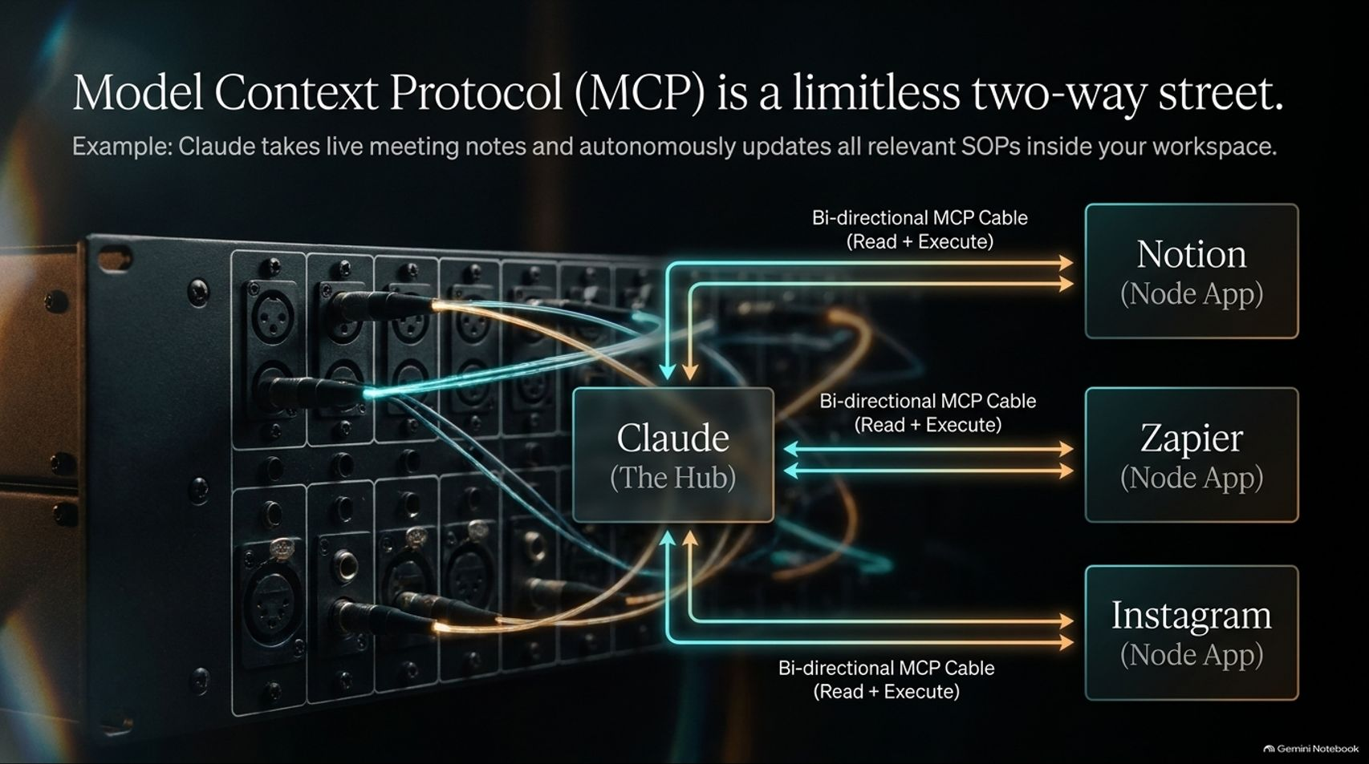
Notes:
Title: Model Context Protocol (MCP) is a limitless two-way street.
Target Duration: 4–6 minutes
Speaker Notes:
"Up until recently, connecting AI to your business tools meant fragile, one-way webhooks or clunky copy-pasting. Model Context Protocol (MCP) changes the game by turning Claude into a central hub with bi-directional cables—meaning it can both read data and execute actions across your software stack.
Imagine this workflow: you finish a client call, Claude takes the live meeting notes, cross-references your project status in Notion, updates your standard operating procedures automatically, triggers follow-up tasks via Zapier, and stages social distribution for Instagram—all from one unified command center."

Slide 9
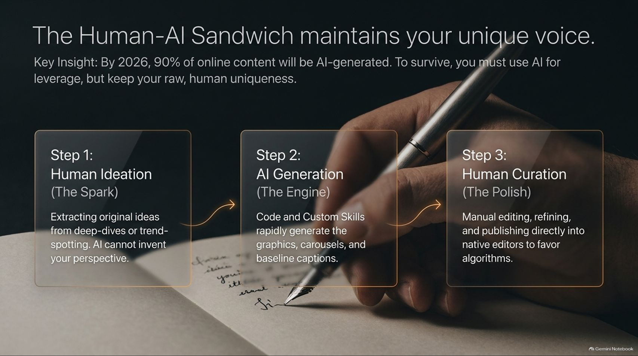
Notes:
Title: The Human-AI Sandwich maintains your unique voice.
Target Duration: 4–6 minutes
Speaker Notes:
"There is a massive trap waiting for creators who over-automate: by 2026, roughly 90% of online content will be AI-generated. If you let AI write from scratch and hit publish automatically, you will drown in a sea of generic, robotic slop.
To survive and stand out, you must use The Human-AI Sandwich:
Step 1: Human Ideation (The Spark). You start. You extract original insights from real conversations, deep dives, and lived experience. AI cannot invent your unique perspective.
Step 2: AI Generation (The Engine). You hand that raw spark to your Claude skills to rapidly generate the heavy lifting—infographics, carousels, research synthesis, and baseline drafts.
Step 3: Human Curation (The Polish). You step back in at the end to manually edit, inject your raw human nuance, and publish directly into native platform editors to favor algorithmic reach."

Slide 10
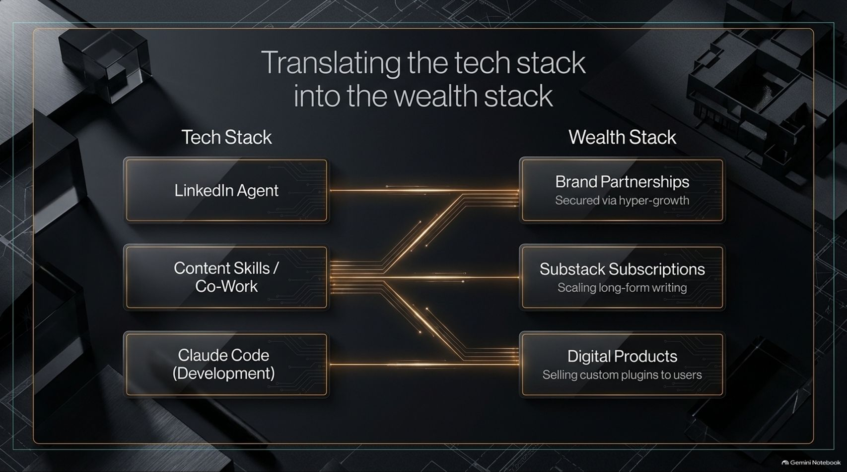
Notes:
Title: Translating the tech stack into the wealth stack
Target Duration: 4–6 minutes
Speaker Notes:
"Building cool workflows means nothing if they don't translate into real economic value. Let's map how the Tech Stack on the left connects directly to the Wealth Stack on the right:
Your LinkedIn Agent drives consistent, high-converting visual authority, which fuels hyper-growth and unlocks lucrative Brand Partnerships.
Your Content Skills & Co-Work workflows synthesize research and long-form drafts, allowing you to scale Substack Subscriptions and paid newsletters without burning out.
Claude Code empowers you to build custom internal tools and plugins rapidly, which you can package and sell directly to your audience as Digital Products."

Slide 11
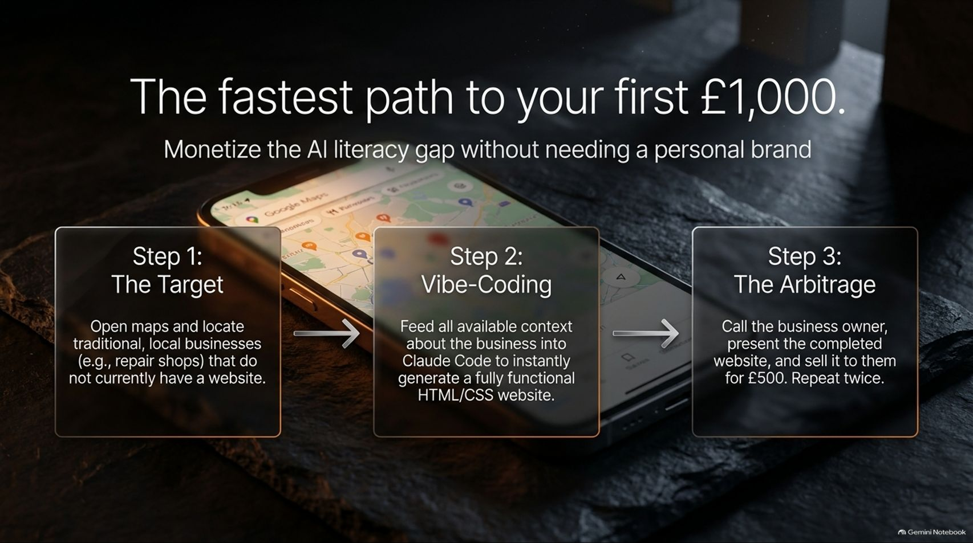
Notes:
Title: The fastest path to your first £1,000.
Target Duration: 4–6 minutes
Speaker Notes:
"What if you are starting from zero today—no audience, no personal brand, and no coding background? You can monetize the massive AI literacy gap in the local economy using a simple three-step arbitrage:
Step 1: The Target. Open Google Maps in your local area and look for traditional, high-trust businesses—plumbers, independent repair shops, local contractors—that have great reviews but zero website or an outdated one from 2012.
Step 2: Vibe-Coding. Gather their business details, reviews, services, and photos, feed that context into Claude Code, and ask it to generate a clean, modern, fully functional HTML/CSS website in minutes.
Step 3: The Arbitrage. Call or visit the business owner, show them the finished live preview—don't pitch a vague promise, show the actual asset—and sell it to them for £500. Do that twice, and you have made your first £1,000."

Slide 12
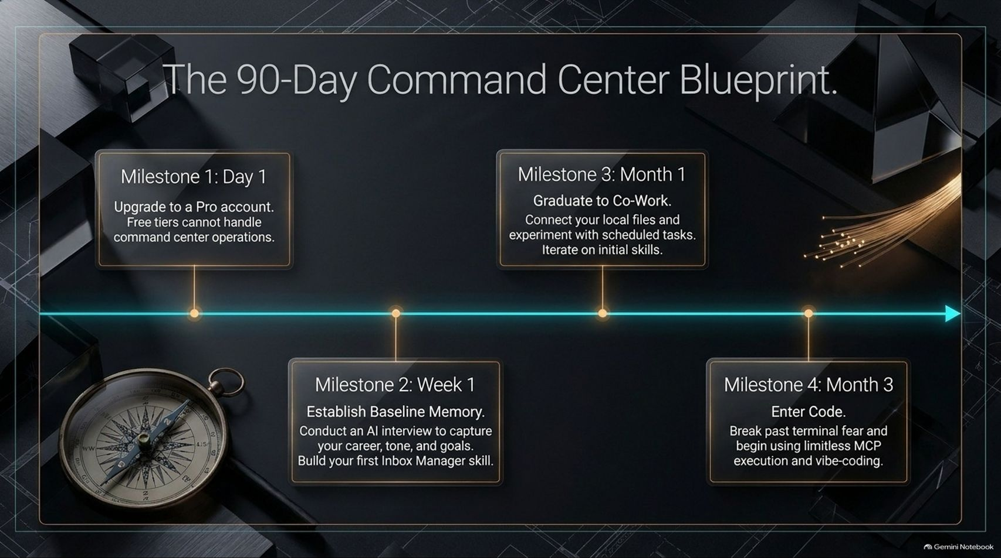
Notes:
Title: The 90-Day Command Center Blueprint.
Target Duration: 4–6 minutes
Speaker Notes:
"Don't try to build an 11-agent system on Tuesday afternoon—you will overwhelm yourself. Follow this disciplined 90-Day Command Center Blueprint:
Milestone 1 (Day 1): Upgrade to a Pro account. Free tiers have tight context windows and rate limits that simply cannot support command center operations.
Milestone 2 (Week 1): Establish baseline memory. Have Claude interview you for 20 minutes to capture your career history, communication tone, and goals, then build your very first Inbox Manager skill.
Milestone 3 (Month 1): Graduate to Claude Co-Work. Connect your local desktop folders, experiment with scheduled recurring tasks, and refine your Markdown files.
Milestone 4 (Month 3): Enter Claude Code. Break past any intimidation around the terminal, wire up your first MCP connectors, and start vibe-coding custom tools."

Slide 13
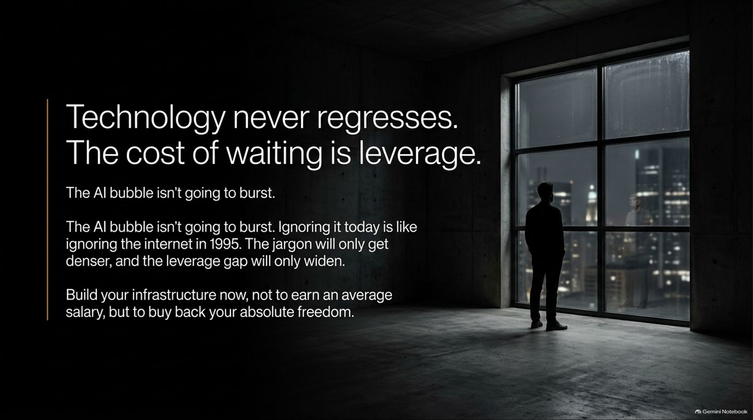
Notes:
Title: Technology never regresses. The cost of waiting is leverage.
Target Duration: 3–5 minutes
Speaker Notes:
"Let's address the biggest excuse keeping people on the sidelines: waiting for the 'AI bubble' to burst or waiting for things to slow down.
Technology never regresses. Ignoring AI infrastructure today is identical to ignoring the internet in 1995. Every month you wait, the technical jargon gets denser, the workflows get more sophisticated, and the leverage gap between builders and passive consumers widens.
Also, be smart about risk: validate demand and build client traction on the side before quitting your 9-to-5. Build your infrastructure now—not just to earn a slightly better salary, but to buy back your time and your absolute freedom."

Slide 14


