Slide 1
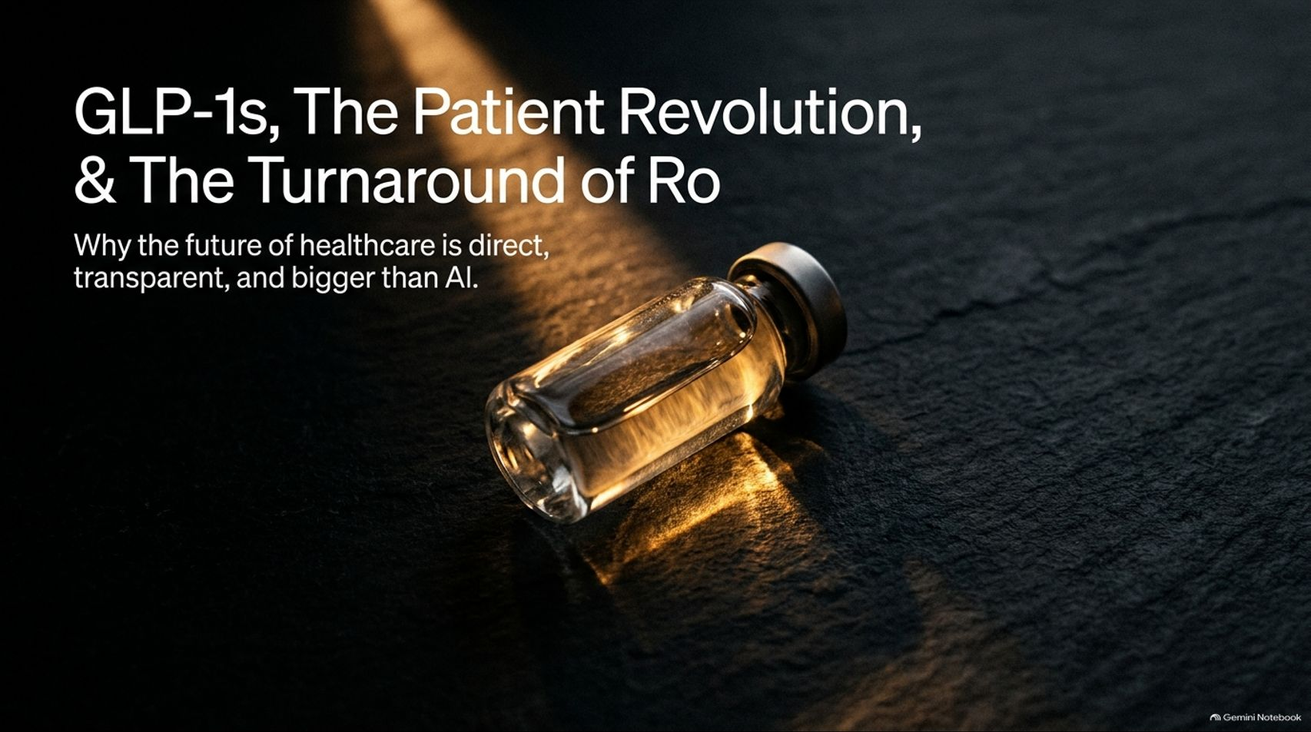
Notes:
Title: GLP-1s, The Patient Revolution, & The Turnaround of Ro
Target Duration: 2–3 minutes
Speaker Notes:
"Welcome everyone. Today we are exploring one of the most consequential shifts in modern business and medicine: how GLP-1 therapeutics, direct-to-consumer infrastructure, and radical patient choice are completely rewiring healthcare, and how digital health pioneer Ro orchestrated a massive turnaround.
For decades, healthcare has operated under a broken premise where the end consumer is insulated from the economics. Today, that legacy structure is fracturing.
Over the next 16 slides, we'll examine why direct patient access is proving bigger than software, how incentive alignment drives deflationary markets, and what it takes to build an enduring, patient-centric empire."
GLP-1s Are a Bigger Business Than AI
https://www.youtube.com/watch?v=aOSuI2qPeB8

Slide 2
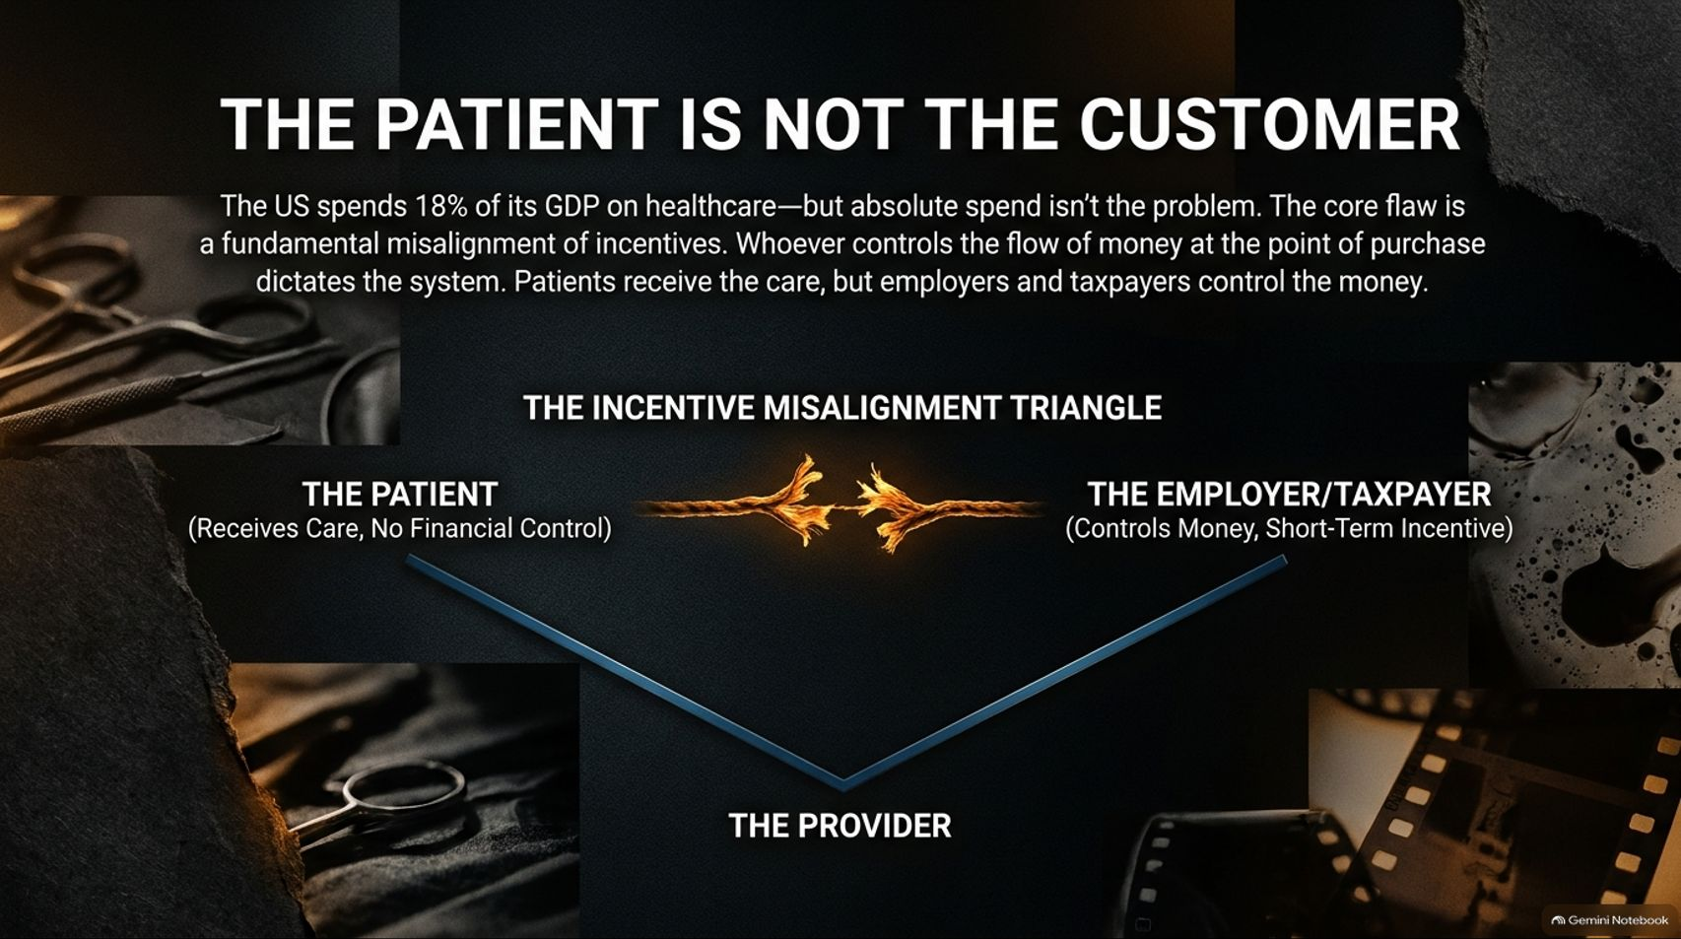
Notes:
Title: The Patient is Not the Customer: The Incentive Misalignment Triangle
Target Duration: 4–6 minutes
Speaker Notes:
"To understand why healthcare is so broken, we must look at the fundamental economic flaw: The patient is not the customer.
The US spends roughly 18% of its GDP on healthcare—absolute spend isn't the root problem. The core flaw is a complete misalignment of incentives among the Patient (who receives care but has zero financial control), the Provider, and the Employer or Taxpayer (who controls the money and optimizes for short-term cost containment).
Whoever controls the flow of money at the point of purchase dictates the system. Until the patient becomes the primary economic customer, true price discovery and quality competition remain impossible."

Slide 3
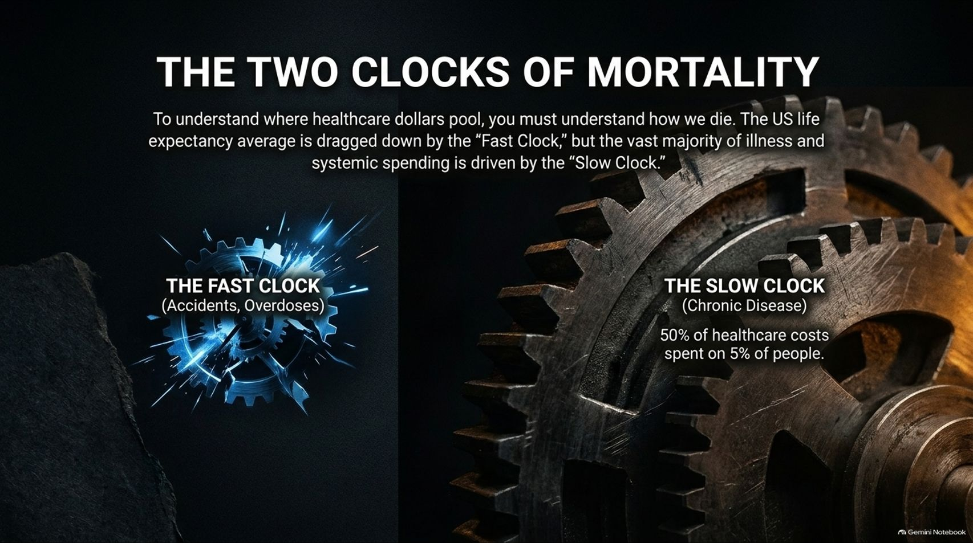
Notes:
Title: The Two Clocks of Mortality: Fast vs. Slow
Target Duration: 3–5 minutes
Speaker Notes:
"To understand where healthcare dollars pool and how chronic disease operates, you must look at The Two Clocks of Mortality.
US life expectancy is often publicly discussed through the lens of the Fast Clock—accidents, acute trauma, and sudden overdoses.
However, the vast majority of human illness and systemic financial spend is driven by the Slow Clock: chronic, metabolic, and cardiovascular disease.
A staggering 50% of all healthcare costs are spent on just 5% of the population. Managing downstream chronic illness without addressing upstream root causes is a losing battle."

Slide 4
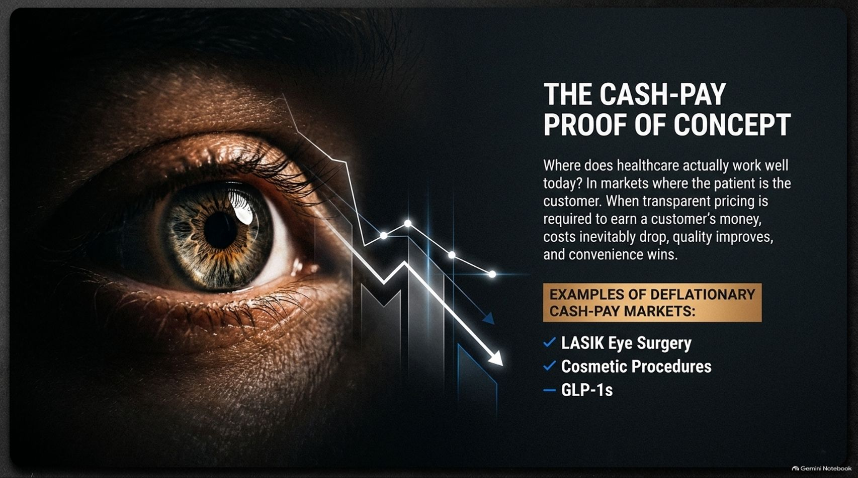
Notes:
Title: The Cash-Pay Proof of Concept: Deflationary Markets
Target Duration: 3–5 minutes
Speaker Notes:
"Where does healthcare actually work well today? Look at markets where the patient is treated as the true customer: LASIK Eye Surgery and Cosmetic Procedures.
In these cash-pay markets, transparent pricing is required to earn a customer's money. When transparency exists, costs inevitably drop over time, quality improves, and consumer convenience wins.
GLP-1s are rapidly becoming the ultimate proof-of-concept for bringing this deflationary, direct-to-consumer dynamic into primary and metabolic health."

Slide 5
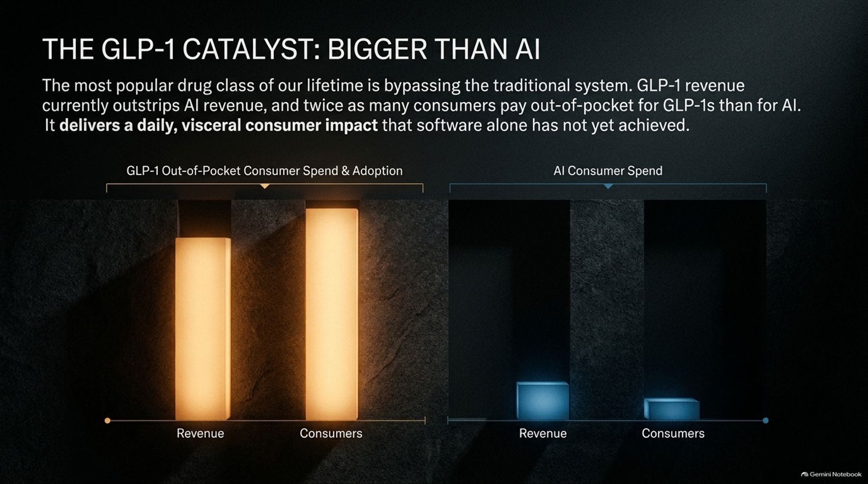

Slide 6
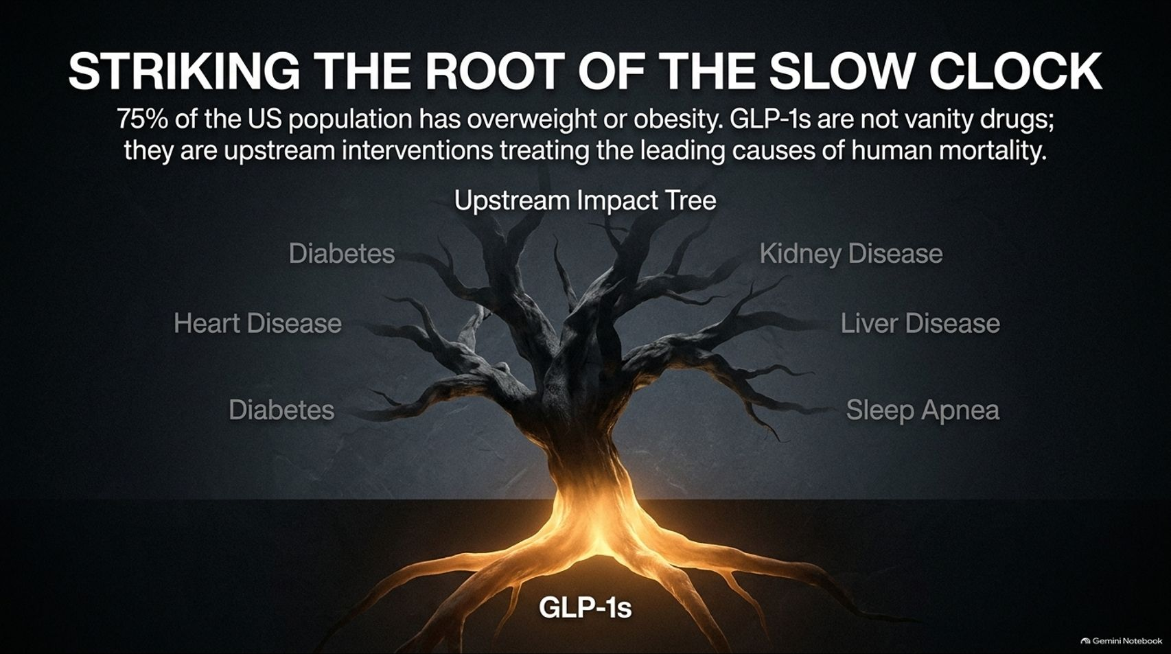
Notes:
Title: Striking the Root of the Slow Clock: Upstream Intervention
Target Duration: 3–5 minutes
Speaker Notes:
"With 75% of the US population classified as overweight or obese, metabolic dysfunction is the common root connecting dozens of downstream illnesses.
GLP-1s are not superficial 'vanity drugs'; they are powerful upstream interventions treating the leading causes of human mortality—including heart disease, Type 2 diabetes, chronic kidney disease, liver disease, and sleep apnea.
By treating the root at the bottom of the impact tree, we prevent the catastrophic system-wide costs that occur further up the chain."

Slide 7
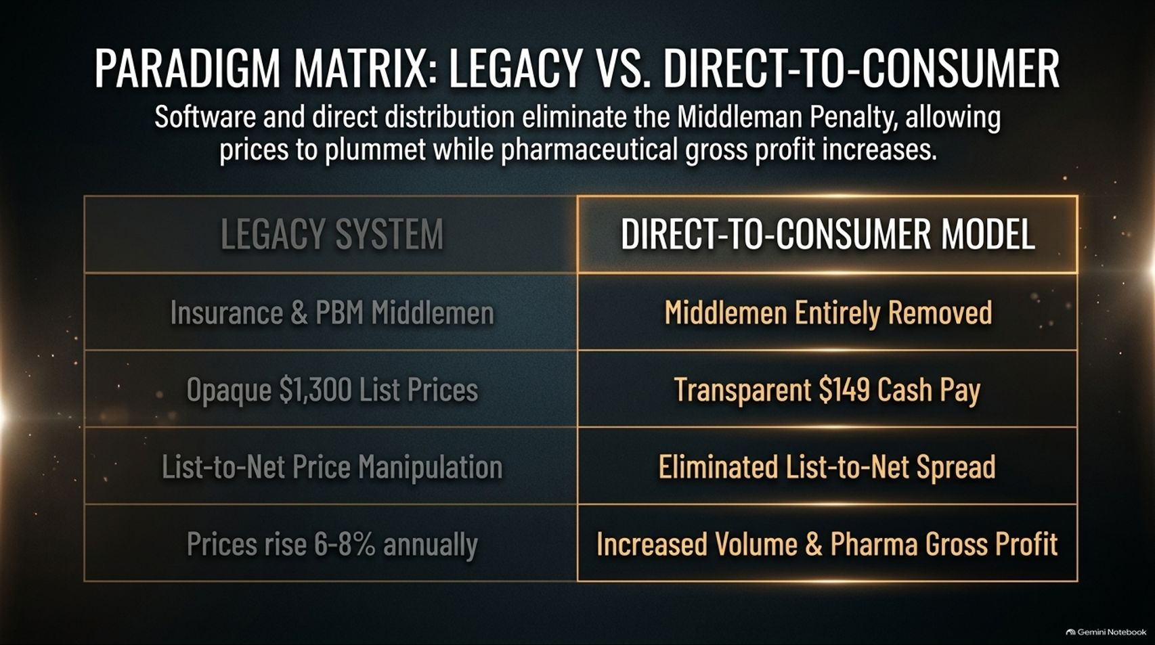

Slide 8
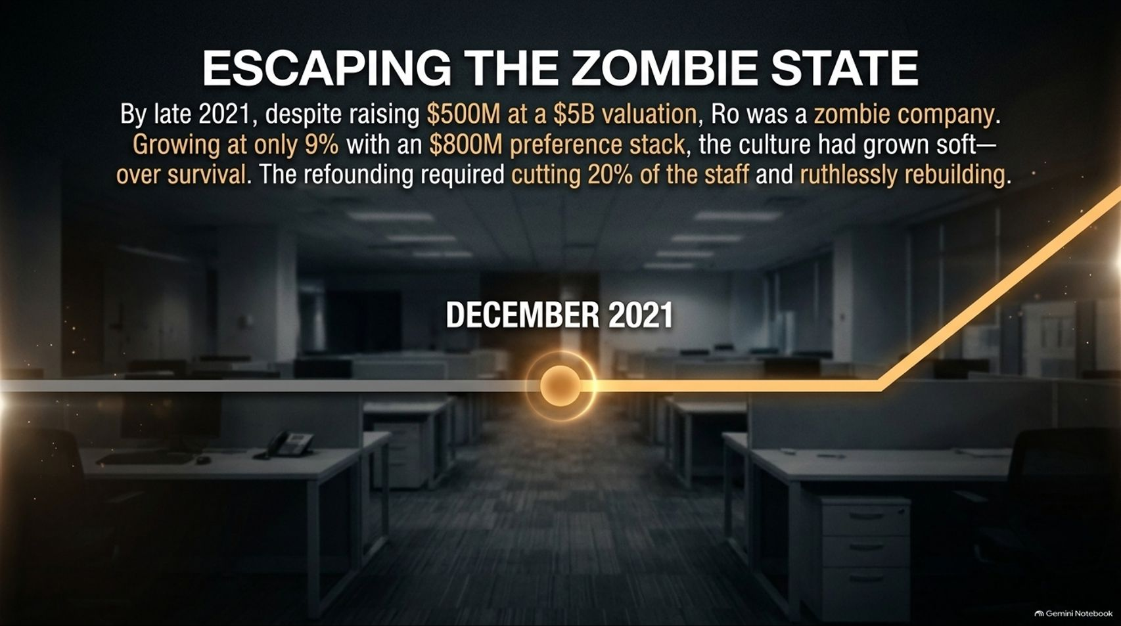
Notes:
Title: Escaping the Zombie State: The Turnaround of Ro
Target Duration: 4–6 minutes
Speaker Notes:
"In business, as in healthcare, reality catches up with complacency. By late 2021—despite raising $500M at a $5B valuation—Ro faced a critical inflection point.
Growth had slowed to 9% against an unwieldy cost structure and heavy preference stack, and the internal culture had drifted toward comfort over survival.
Escaping this 'zombie state' required brutal clarity: cutting 20% of the staff, streamlining operations, and ruthlessly rebuilding the organization around core operational excellence."

Slide 9


Slide 10


Slide 11
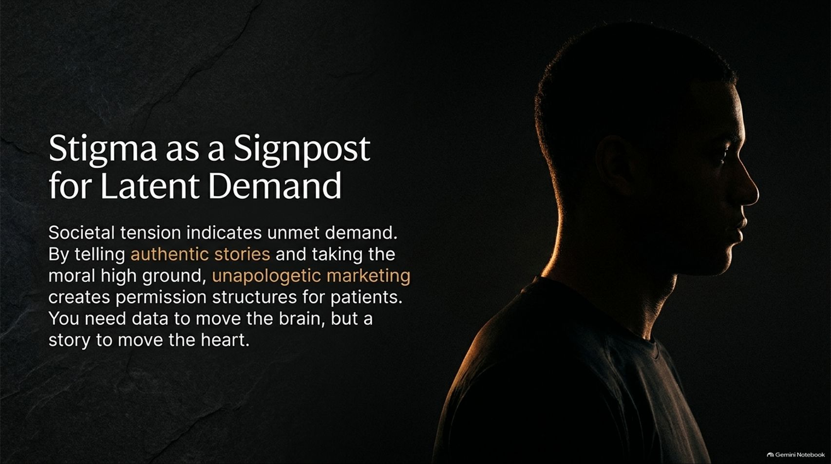
Notes:
Title: Stigma as a Signpost for Latent Demand
Target Duration: 3–5 minutes
Speaker Notes:
"Whenever society attaches intense stigma to a condition—whether sexual health, hair loss, or weight management—it is actually a signpost indicating massive unmet demand and cultural friction.
By telling authentic stories and taking the moral high ground through unapologetic marketing, brands create permission structures for patients to seek help.
As the adage goes: You need data to move the brain, but a story to move the heart."

Slide 12
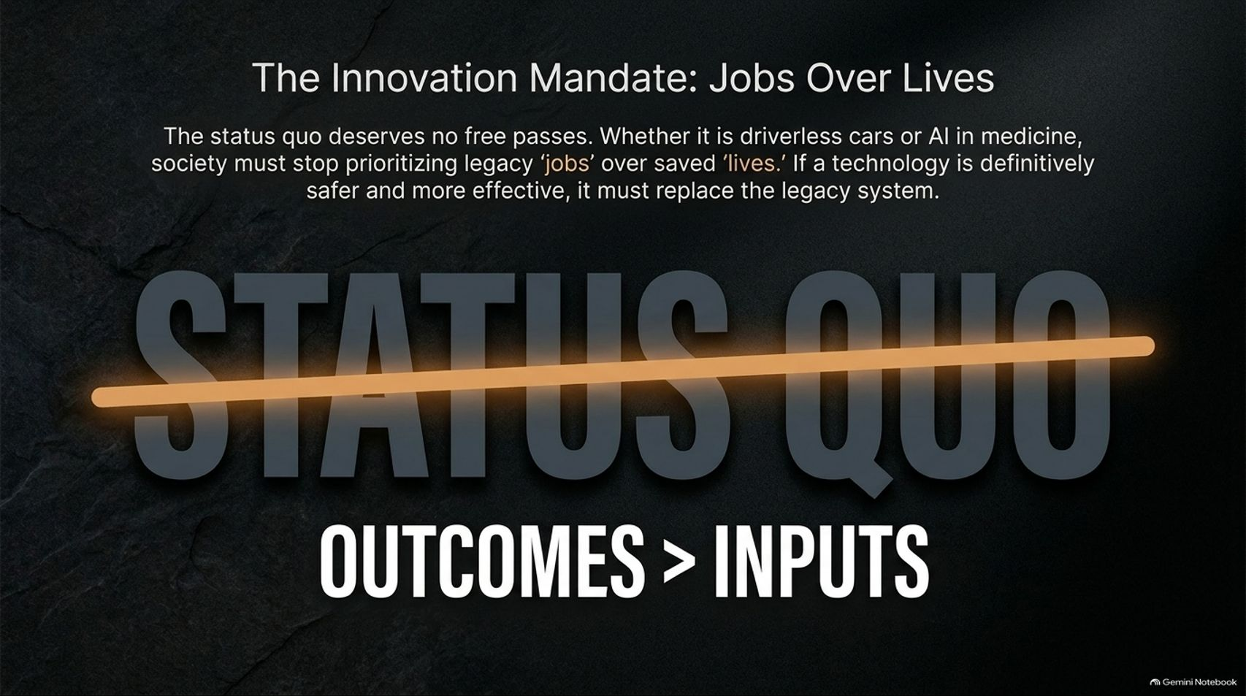

Slide 13
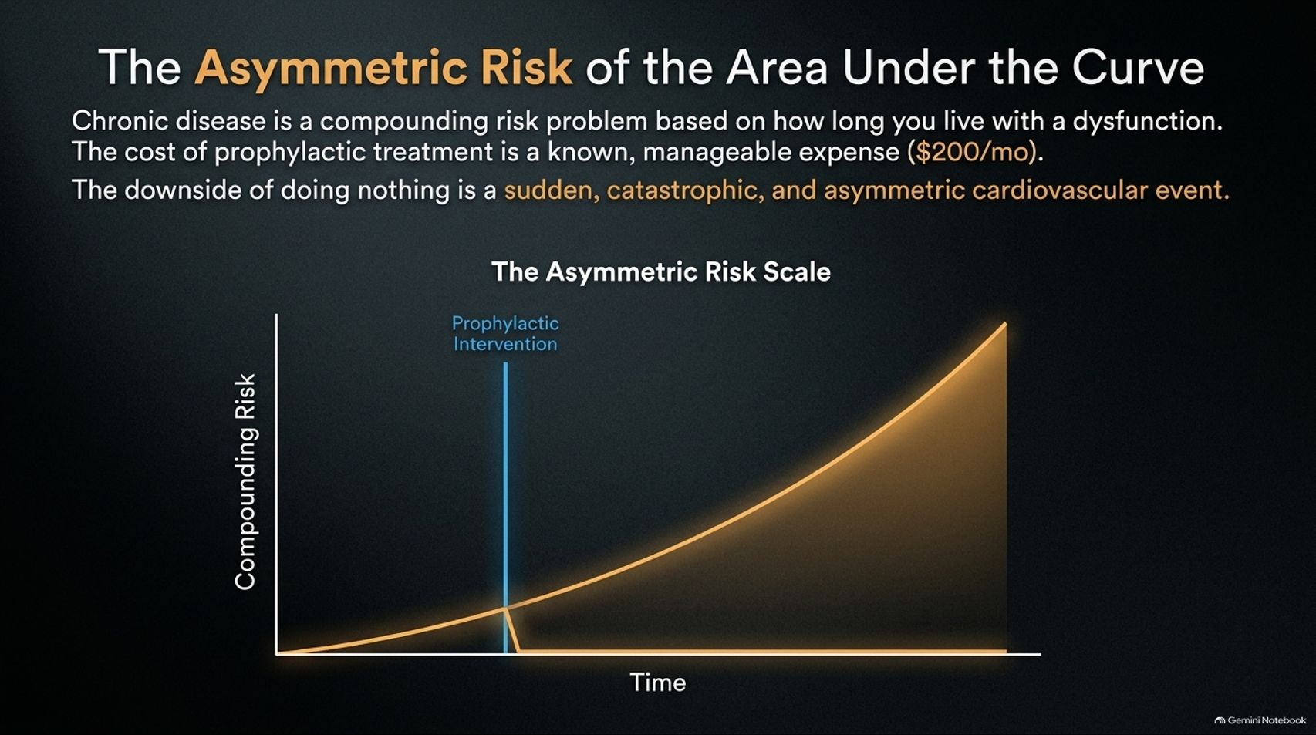
Notes:
Title: The Asymmetric Risk of the Area Under the Curve
Target Duration: 3–5 minutes
Speaker Notes:
"Chronic disease is fundamentally a compounding risk problem based on how long you live with a biological dysfunction.
The cost of proactive, prophylactic treatment is a known, manageable expense (e.g., ~$200/month).
In contrast, the downside of doing nothing is a sudden, catastrophic, and asymmetric cardiovascular or metabolic event. Managing the area under the curve is the key to longevity."

Slide 14
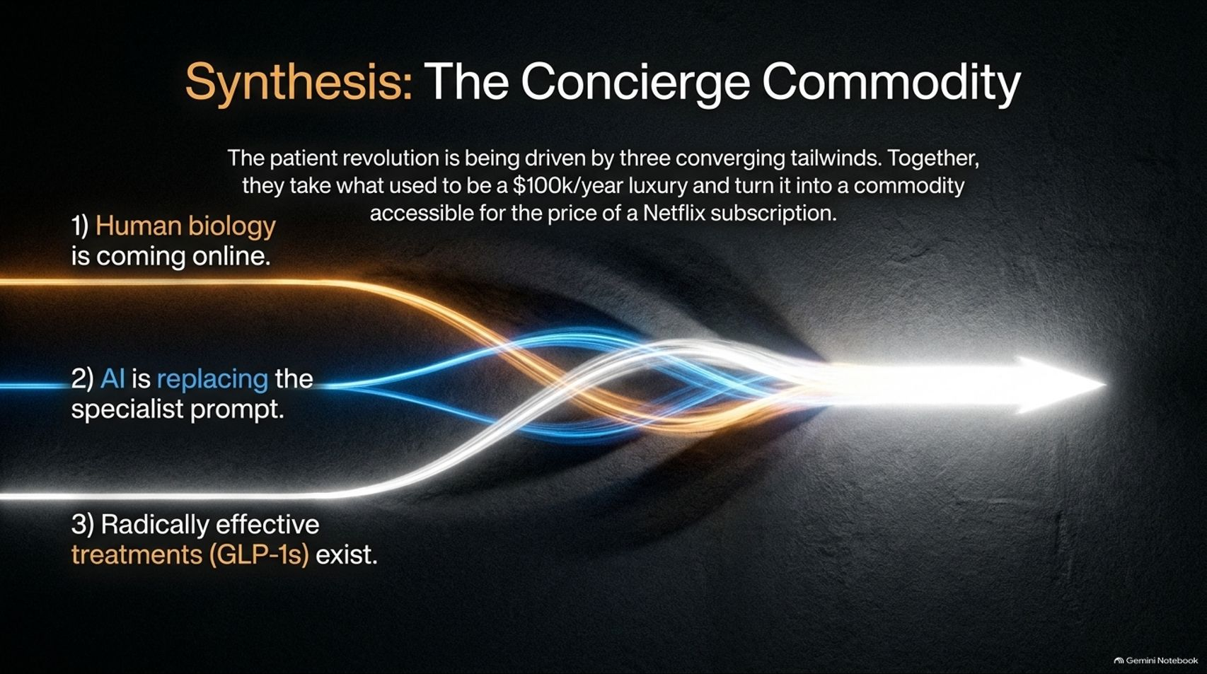

Slide 15
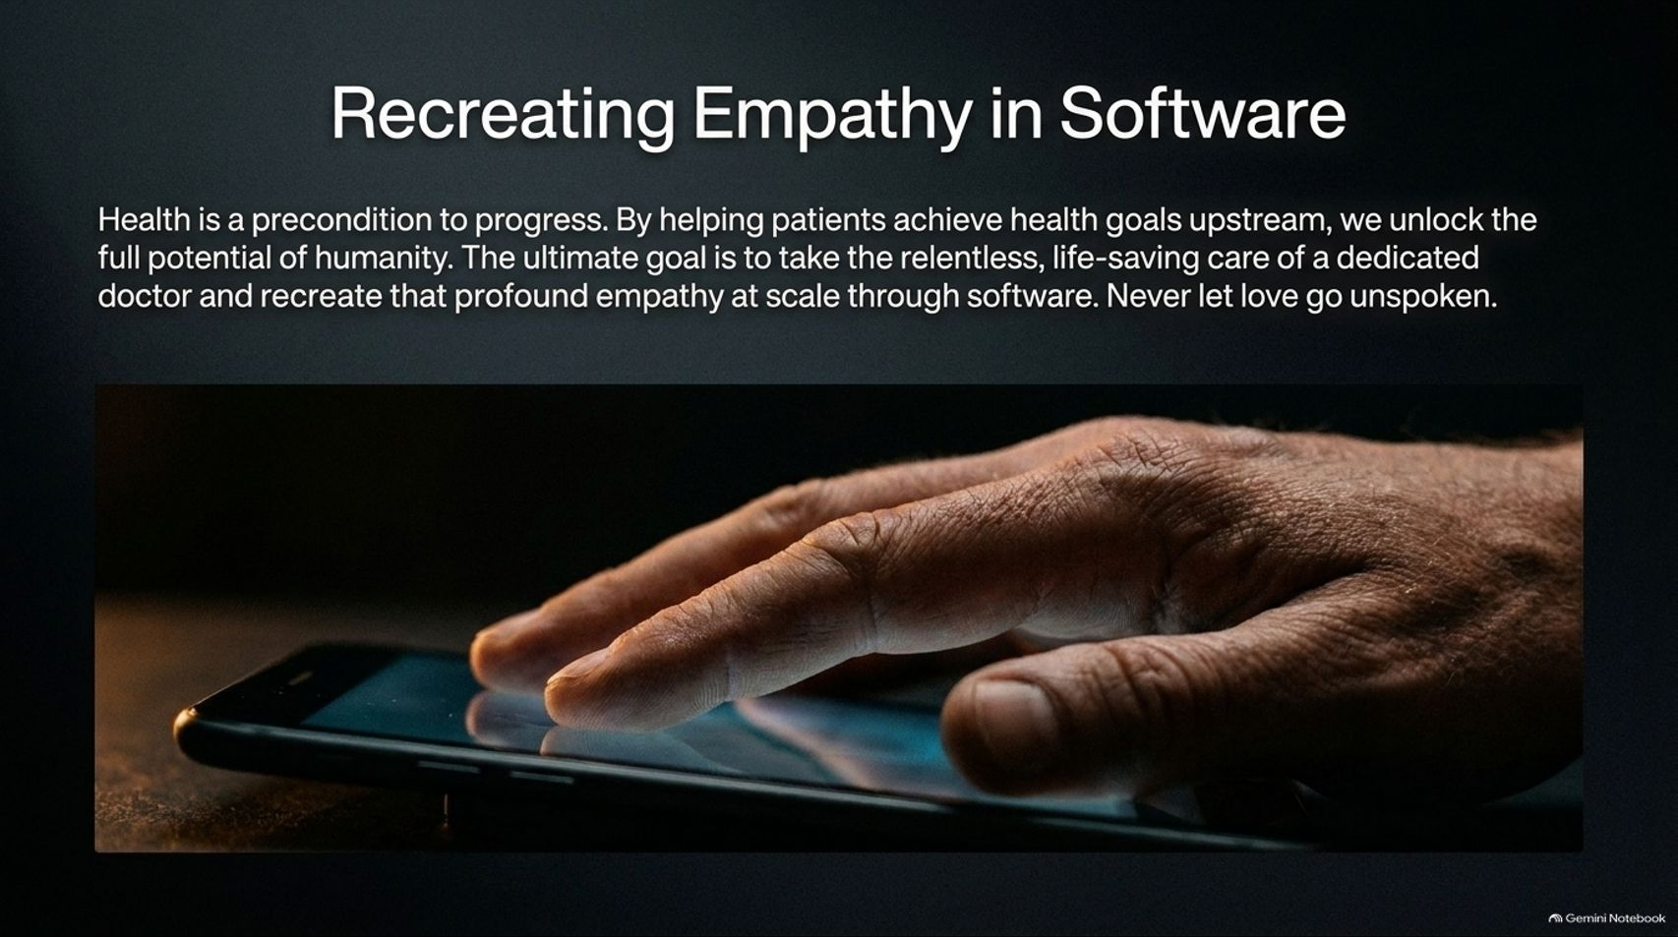
Notes:
Title: Recreating Empathy in Software
Target Duration: 3–5 minutes
Speaker Notes:
"Health is the absolute precondition to human progress. By helping patients achieve their health goals upstream, we unlock the full potential of humanity.
The ultimate mission of modern health platforms is to take the relentless, life-saving care of a dedicated family physician and recreate that profound empathy at scale through software.
As the founding ethos reminds us: Never let love go unspoken."

Slide 16


