Slide 1
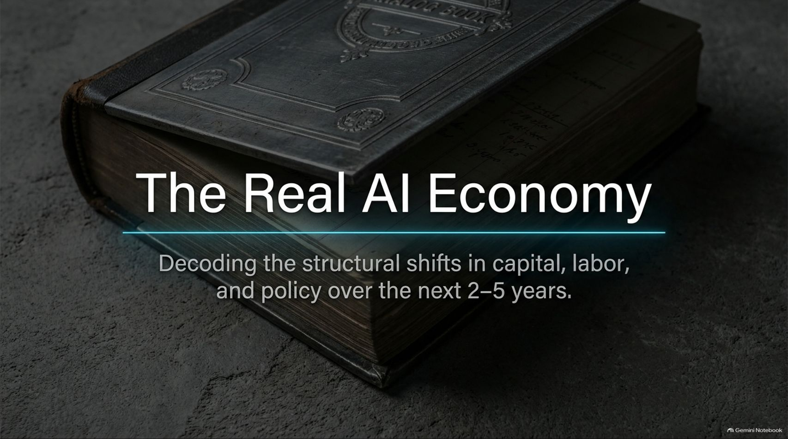
Notes:
Title: The Real AI Economy: Decoding the structural shifts in capital, labor, and policy over the next 2–5 years.
Target Duration: 2–3 minutes
Speaker Notes:
"Welcome, everyone. Today we are looking past the superficial hype and decoding The Real AI Economy. Most public discourse is paralyzed between two extreme narratives: that AI will instantly create a 10% GDP utopia overnight, or that it will cause a catastrophic, COVID-level unemployment spike by next Tuesday.
Neither of those narratives reflects reality. As OpenAI's first Chief Economist, Ronnie Chatterji, details in our reference framework, the true economic transition is happening under the hood—driven by a compressed version of historical technological lags, agentic enterprise workflows, and the massive restructuring of human capital.
Over the next 16 slides, we will examine the Solow Echo, the reality of task shifting over job loss, global adoption archetypes, geoeconomic trade paradoxes, and how we fund the human-centric economy of 2031. Let's dive in."
OpenAI’s Chief Economist on AI, jobs, and the economy | Ronnie Chatterji
https://www.youtube.com/watch?v=ZBGh-Mw7UV0

Slide 2
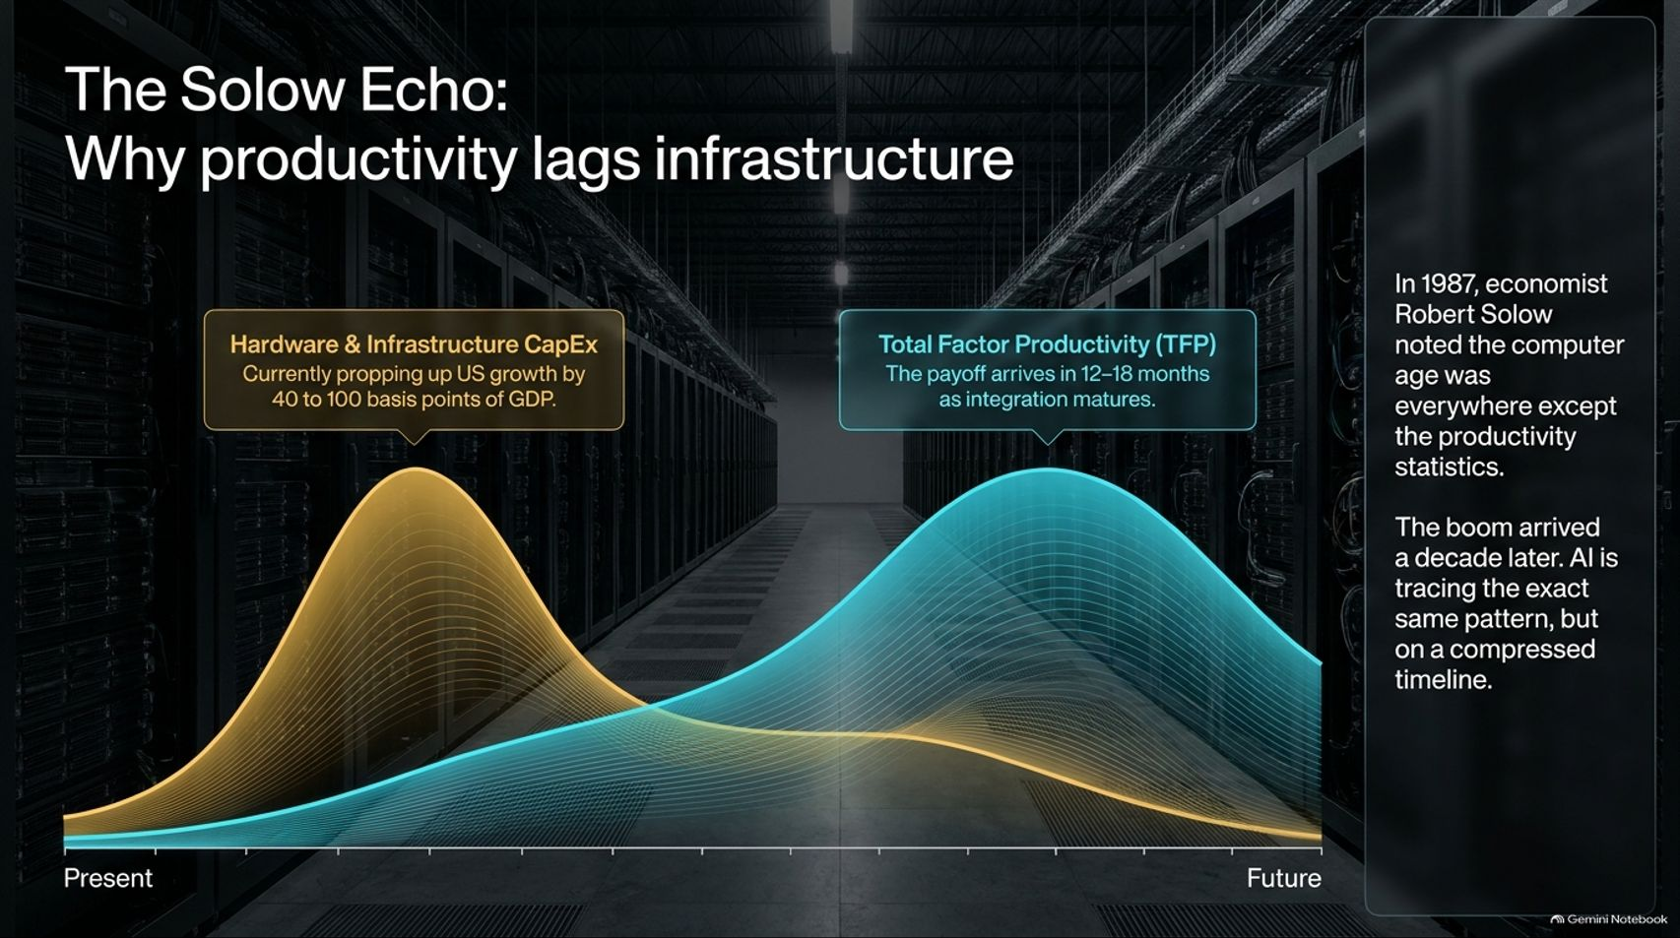
Notes:
Title: The Solow Echo: Why productivity lags infrastructure
Target Duration: 4–6 minutes
Speaker Notes:
"Let's start with history. In 1987, economist Robert Solow made his famous observation that you could see the computer age everywhere except in the productivity statistics. Offices were packed with PCs, but national numbers barely budged for nearly a decade until the late 1990s boom arrived.
AI is tracing that exact same pattern today, but on a dramatically compressed timeline.
Right now, Hardware and Infrastructure CapEx is booming—propping up US growth by roughly 40 to 100 basis points of GDP. However, Total Factor Productivity (TFP) always lags infrastructure deployment. The payoff is arriving on a 12-to-18-month horizon as enterprise integration matures and companies figure out how to wire models into real workflows."

Slide 3
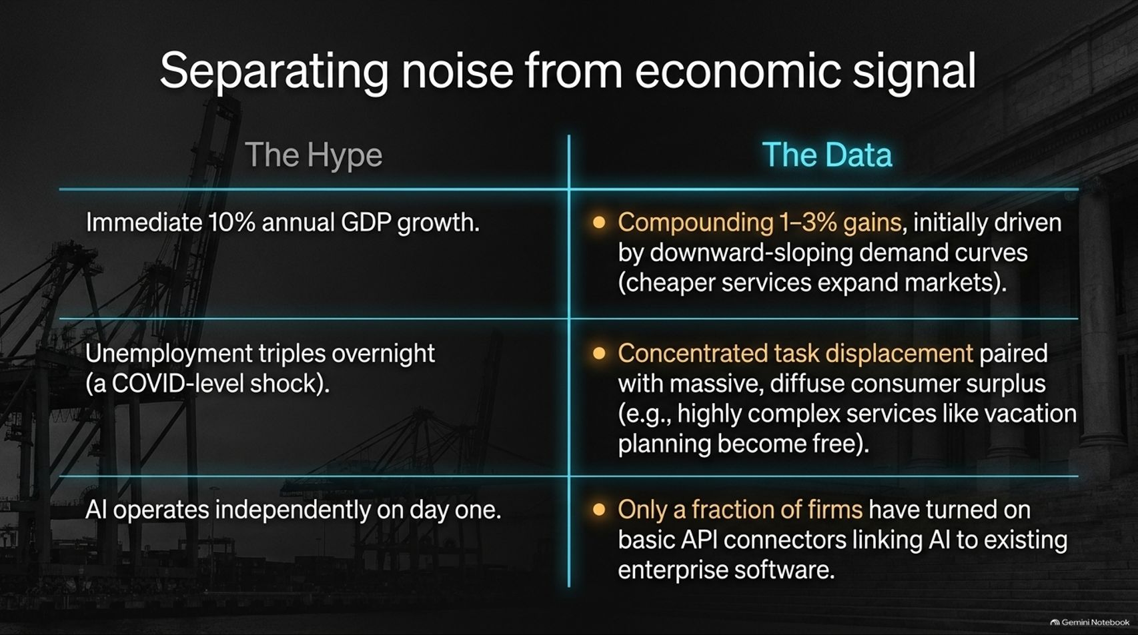
Notes:
Title: Separating noise from economic signal
Target Duration: 4–6 minutes
Speaker Notes:
"When evaluating the economy, we must strictly separate the media hype from the empirical data:
Hype: Expecting immediate 10% annual GDP growth. The Data: We are seeing compounding 1-3% gains driven by downward-sloping demand curves where cheaper services expand entire markets.
Hype: Unemployment tripling overnight. The Data: We are experiencing concentrated task displacement paired with massive, diffuse consumer surplus—such as highly complex tasks like vacation planning or expert navigation becoming essentially free.
Hype: AI operating completely independently on day one. The Data: Only a fraction of firms have actually turned on basic API connectors linking AI to existing enterprise software."

Slide 4
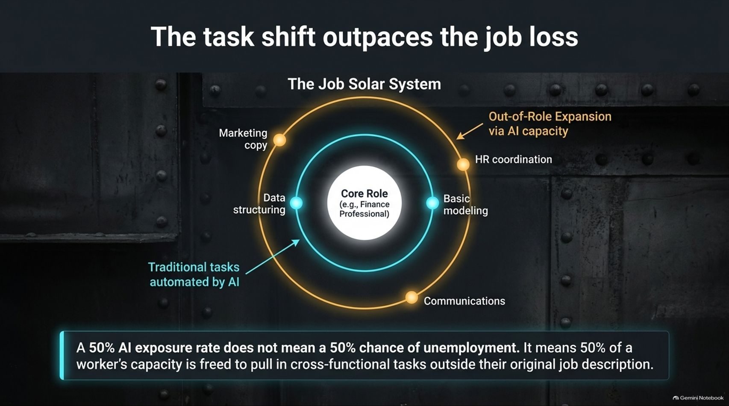
Notes:
Title: The task shift outpasses the job loss (The Job Solar System)
Target Duration: 4–6 minutes
Speaker Notes:
"One of the biggest misconceptions in public policy is that a high AI exposure rate equals an immediate probability of unemployment. That is fundamentally false.
Think of The Job Solar System: at the center sits the core role, such as a finance professional. Traditional, routine tasks are automated by AI. But instead of the worker being discarded, that freed capacity results in Out-of-Role Expansion.
A finance professional starts doing marketing copy, data structuring, and basic modeling; a communications specialist starts running numbers. A 50% AI exposure rate doesn't mean a 50% chance of unemployment—it means half a worker's capacity is freed to pull in cross-functional tasks outside their original job description."

Slide 5
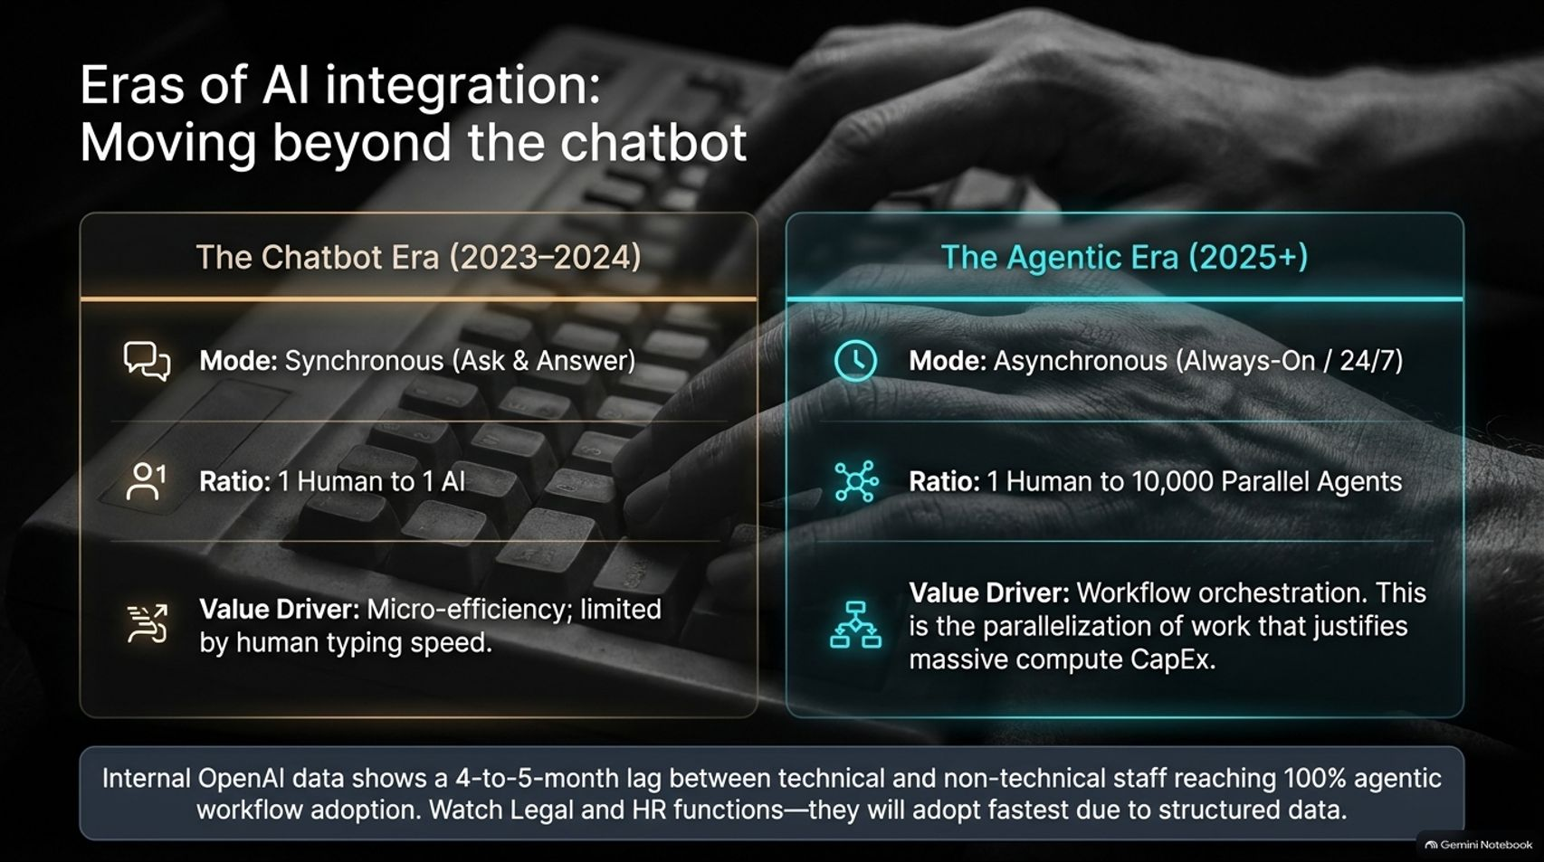
Notes:
Title: Eras of AI integration: Moving beyond the chatbot
Target Duration: 4–6 minutes
Speaker Notes:
"We are currently witnessing a massive operational evolution from the Chatbot Era to the Agentic Era:
The Chatbot Era (2023–2024): Synchronous ask-and-answer mode, a 1-to-1 human-to-AI ratio, focused on micro-efficiency limited entirely by human typing speed.
The Agentic Era (2025+): Asynchronous, always-on 24/7 operations moving at a ratio of 1 human to 10,000 parallel agents. The value driver shifts entirely to workflow orchestration, which is the parallelization of work that justifies massive compute CapEx.
Internal OpenAI data shows a 4-to-5-month lag between technical and non-technical staff reaching 100% agentic workflow adoption. Watch legal and HR functions—they are adopting fastest due to highly structured data."

Slide 6
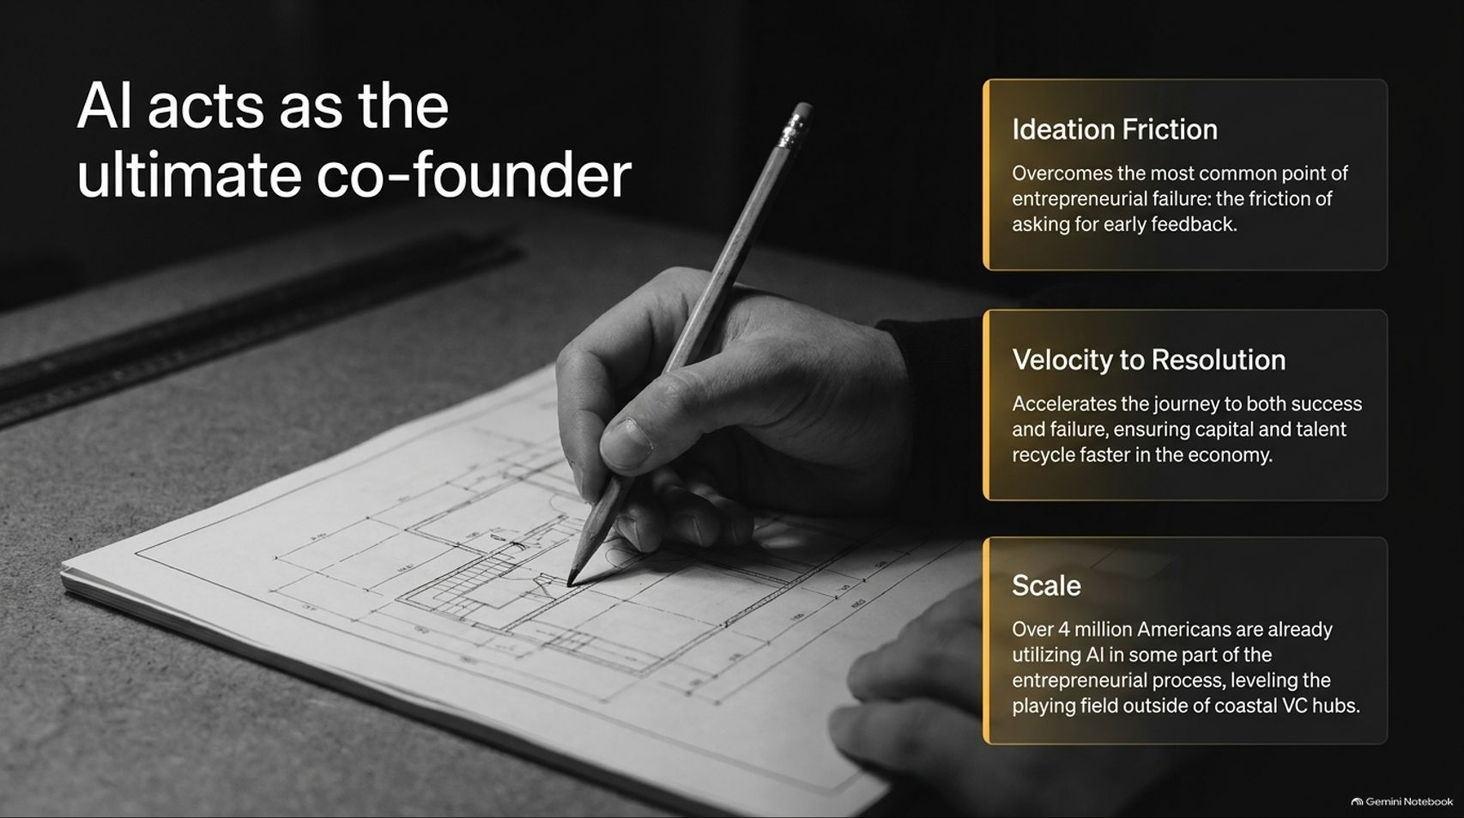

Slide 7
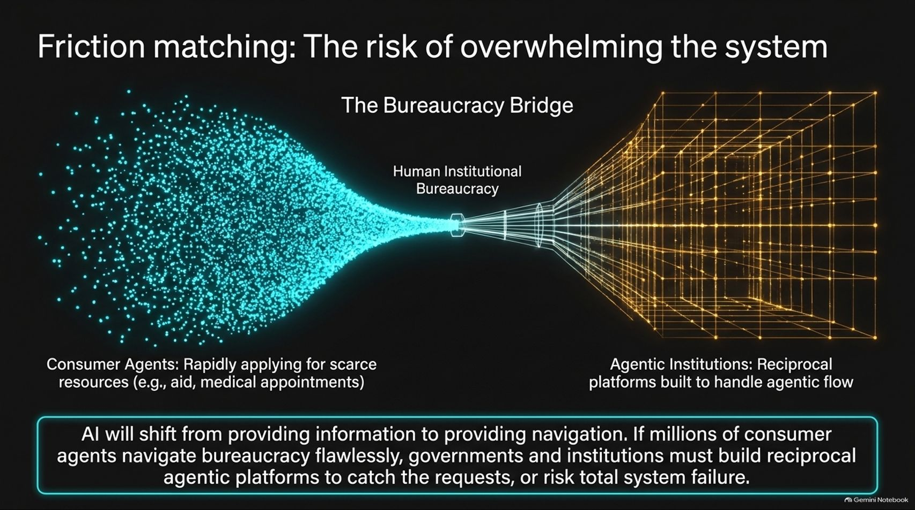
Notes:
Title: Friction matching: The risk of overwhelming the system
Target Duration: 4–6 minutes
Speaker Notes:
"As consumer agents rapidly multiply—applying for scarce resources, government aid, or medical appointments 24/7—they hit a massive bottleneck: Human Institutional Bureaucracy.
If millions of consumer agents navigate bureaucracy flawlessly, they will completely flood legacy institutional intake valves.
AI is shifting from providing mere information to providing navigation. Therefore, governments and public institutions must build reciprocal agentic platforms to catch and process agentic flow, or risk total system failure."

Slide 8
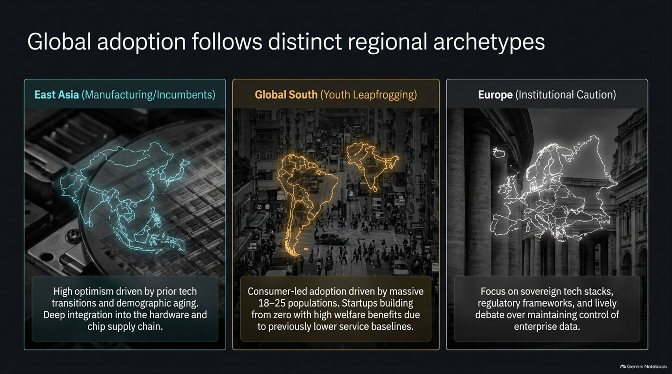
Notes:
Title: Global adoption follows distinct regional archetypes
Target Duration: 4–6 minutes
Speaker Notes:
"Looking globally, AI adoption is not uniform; it follows distinct regional archetypes:
East Asia (Manufacturing/Incumbents): High optimism driven by prior tech transitions, demographic aging, and deep integration into the hardware and chip supply chain.
Global South (Youth Leapfrogging): Consumer-led adoption driven by massive youth populations (ages 18–25) in countries like Brazil and Indonesia. Startups are building from zero, leveraging AI to bypass legacy service gaps.
Europe (Institutional Caution): Focused heavily on sovereign tech stacks, rigorous regulatory frameworks, and lively institutional debate over maintaining control of enterprise data."

Slide 9
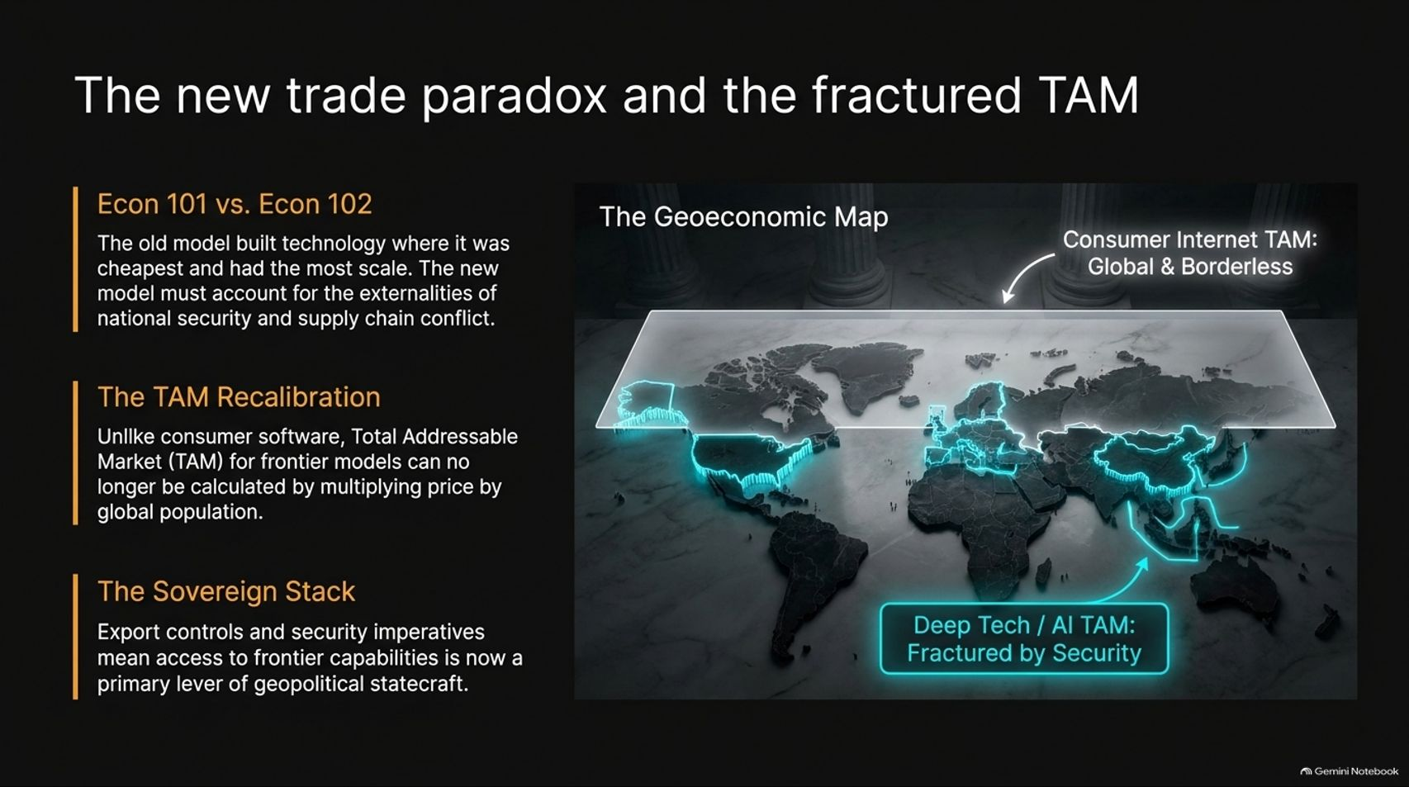
Notes:
Title: The new trade paradox and the fractured TAM
Target Duration: 4–6 minutes
Speaker Notes:
"In economics, we must shift from Econ 101 to Econ 102. The old model built technology wherever it was cheapest and had the most scale. The new model must account for the hard externalities of national security and supply chain conflict.
Unlike consumer internet software where Total Addressable Market (TAM) was simply global population multiplied by price, frontier AI models can no longer be calculated that way.
Export controls and security imperatives mean access to frontier capabilities is now a primary lever of geopolitical statecraft, fracturing the deep-tech TAM."

Slide 10
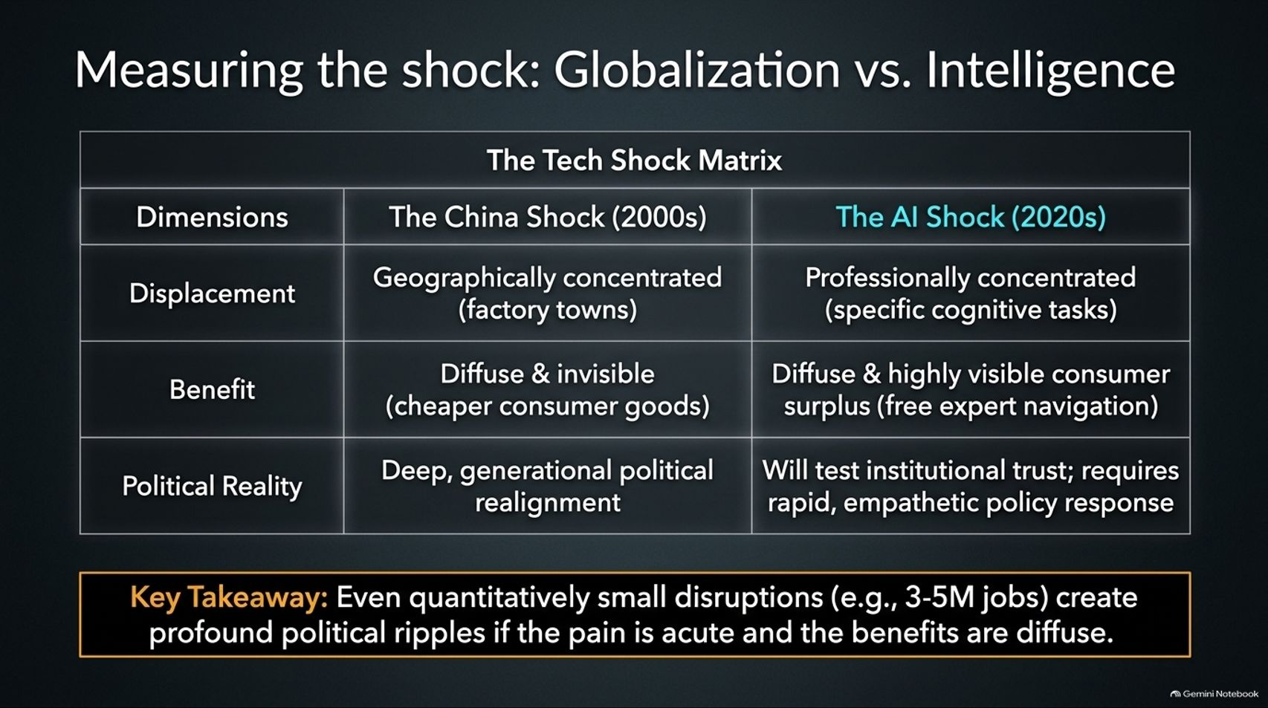
Notes:
Title: Measuring the shock: Globalization vs. Intelligence
Target Duration: 4–6 minutes
Speaker Notes:
"Let's compare the economic shock of the 2000s China Shock with the 2020s AI Shock:
Displacement: The China Shock was geographically concentrated in specific factory towns; the AI Shock is professionally concentrated around specific cognitive tasks.
Benefit: The China Shock delivered diffuse, invisible cheaper consumer goods; the AI Shock delivers highly visible consumer surplus, such as free expert navigation and tools.
Political Reality: Both test institutional trust and cause political realignment, proving that even quantitatively small disruptions create profound political ripples if the pain is acute and localized."

Slide 11
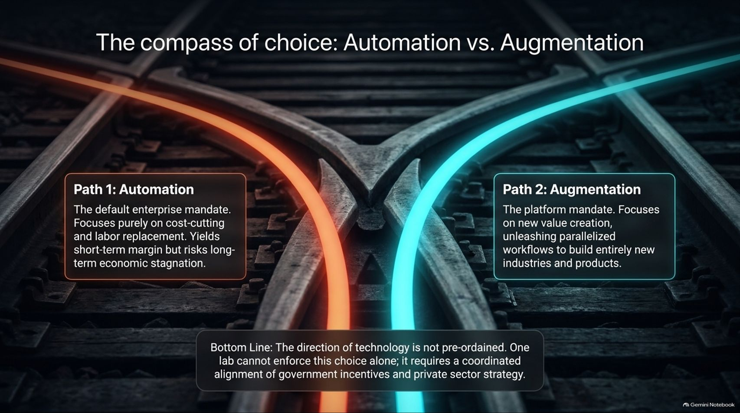

Slide 12
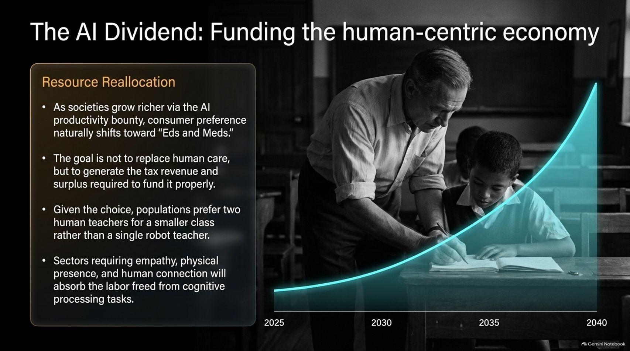
Notes:
Title: The AI Dividend: Funding the human-centric economy
Target Duration: 4–6 minutes
Speaker Notes:
"As societies grow richer via the AI productivity bounty, consumer preference naturally shifts toward 'Eds and Meds'—education and healthcare.
The goal is not to replace human care, but to generate the tax revenue and economic surplus required to fund it properly. Given the choice, populations overwhelmingly prefer two human teachers for a smaller class rather than a single robot teacher.
Sectors requiring empathy, physical presence, and human connection will absorb the labor freed from cognitive processing tasks."

Slide 13
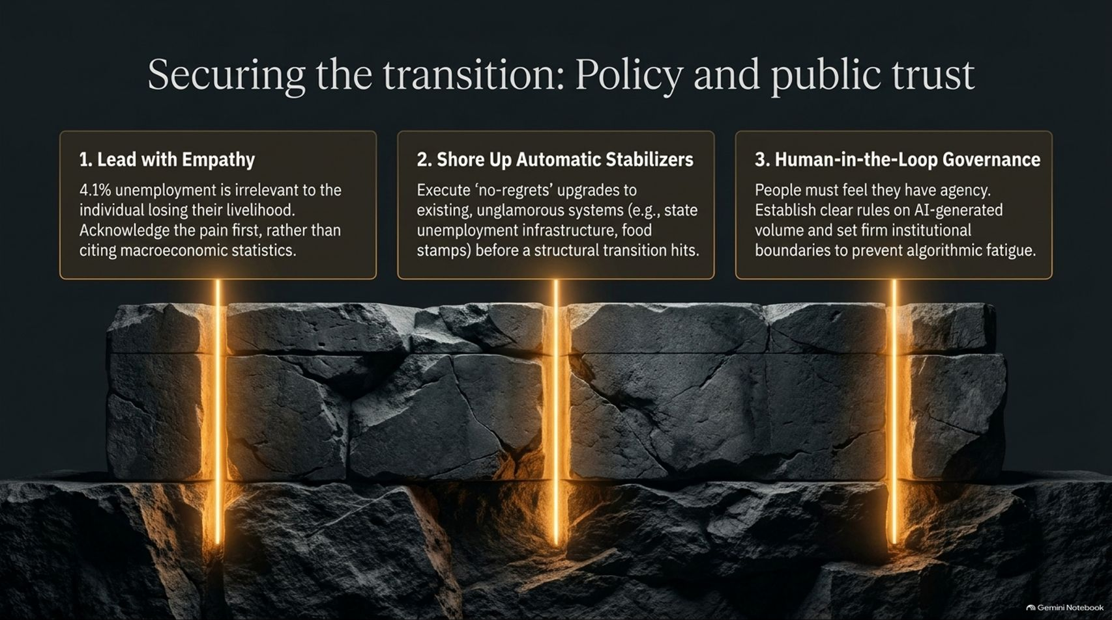
Notes:
Title: Securing the transition: Policy and public trust
Target Duration: 4–6 minutes
Speaker Notes:
"To secure public trust during this transition, policymakers must execute three foundational pillars:
Lead with Empathy: A 4.1% macroeconomic unemployment rate is irrelevant to an individual losing their livelihood; acknowledge the pain first rather than citing cold statistics.
Shore Up Automatic Stabilizers: Execute 'no-regrets' upgrades to existing, unglamorous systems—like state unemployment infrastructure and food stamps—before a structural transition hits.
Human-in-the-Loop Governance: People must feel they have agency. Establish clear rules on AI-generated volume and set firm institutional boundaries to prevent algorithmic fatigue."

Slide 14
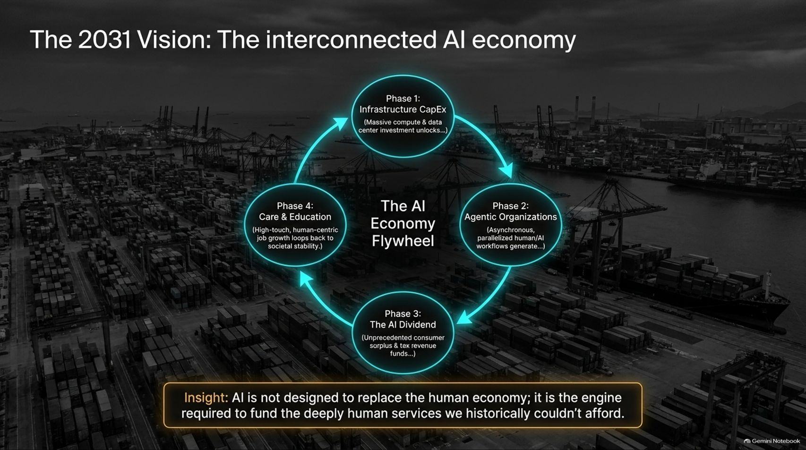
Notes:
Title: The 2031 Vision: The interconnected AI economy
Target Duration: 4–6 minutes
Speaker Notes:
"Looking ahead to 2031, we see the complete AI Economy Flywheel in motion:
Phase 1: Massive compute and data center CapEx unlocks advanced models.
Phase 2: Asynchronous, parallelized human/AI workflows generate massive enterprise output.
Phase 3: The resulting AI Dividend yields unprecedented consumer surplus and tax revenues.
Phase 4: High-touch, human-centric job growth in healthcare and education loops back to ensure societal stability.
AI is not designed to replace the human economy; it is the engine required to fund the deeply human services we historically couldn't afford."

Slide 15
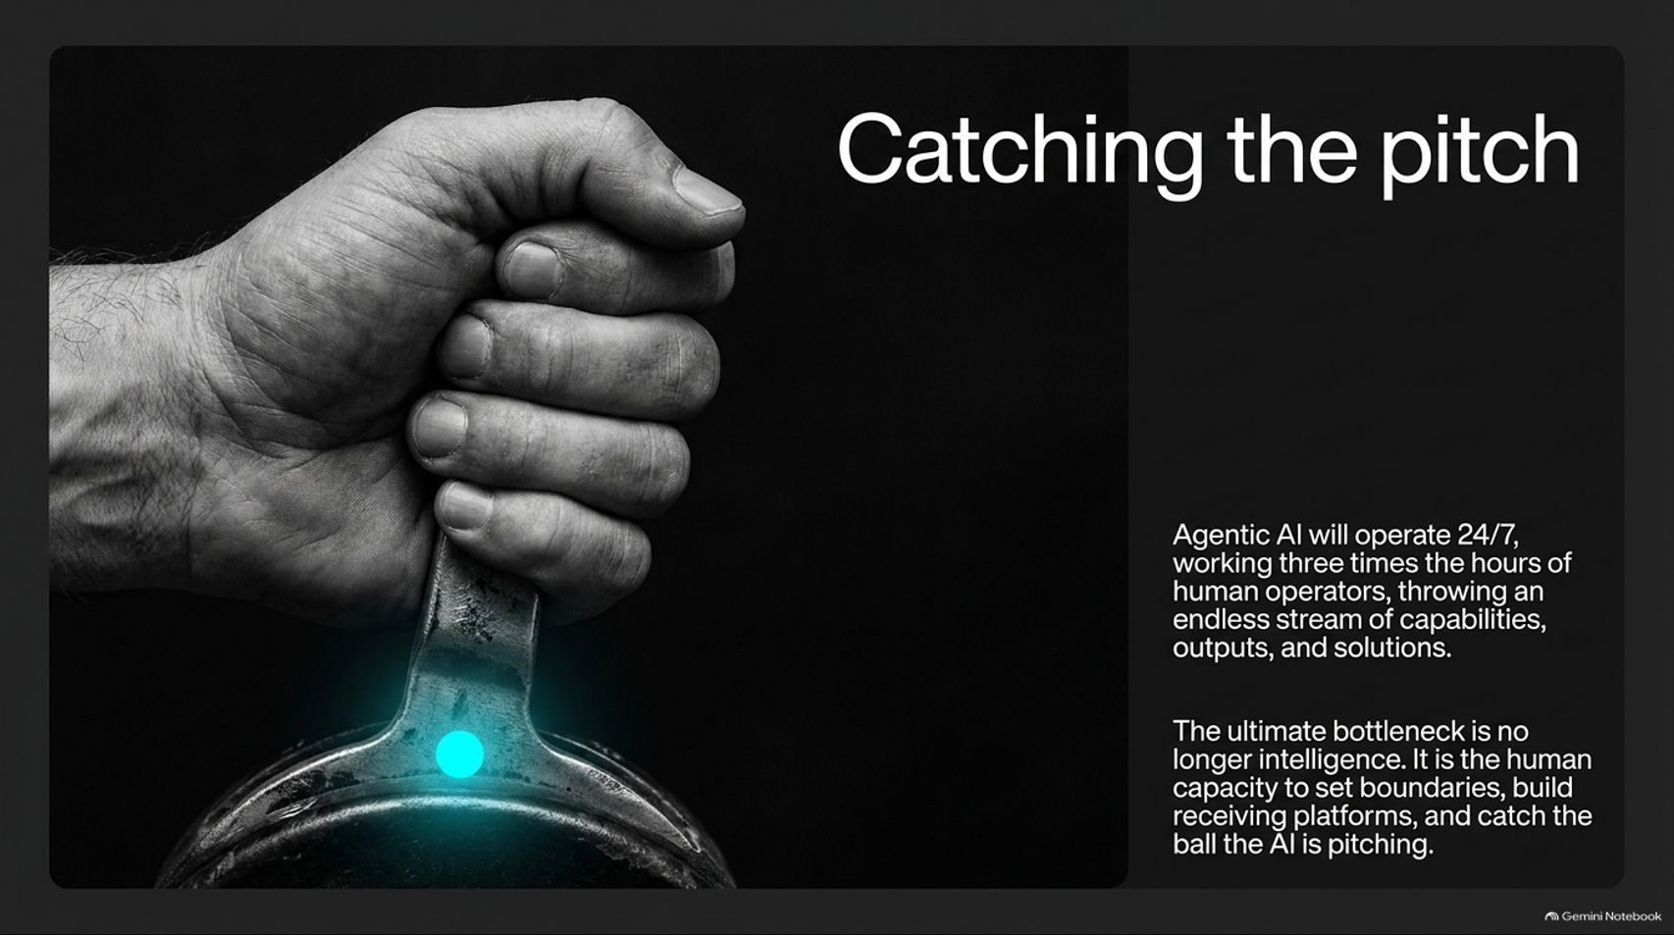
Notes:
Title: Catching the pitch
Target Duration: 3–5 minutes
Speaker Notes:
"Agentic AI will operate 24/7, working three times the hours of human operators, throwing an endless stream of capabilities, outputs, and solutions.
As this happens, the ultimate bottleneck in the economy is no longer intelligence—it is human capacity.
Humans must set boundaries, build receiving platforms, and possess the institutional governance required to catch the ball that AI is pitching."

Slide 16
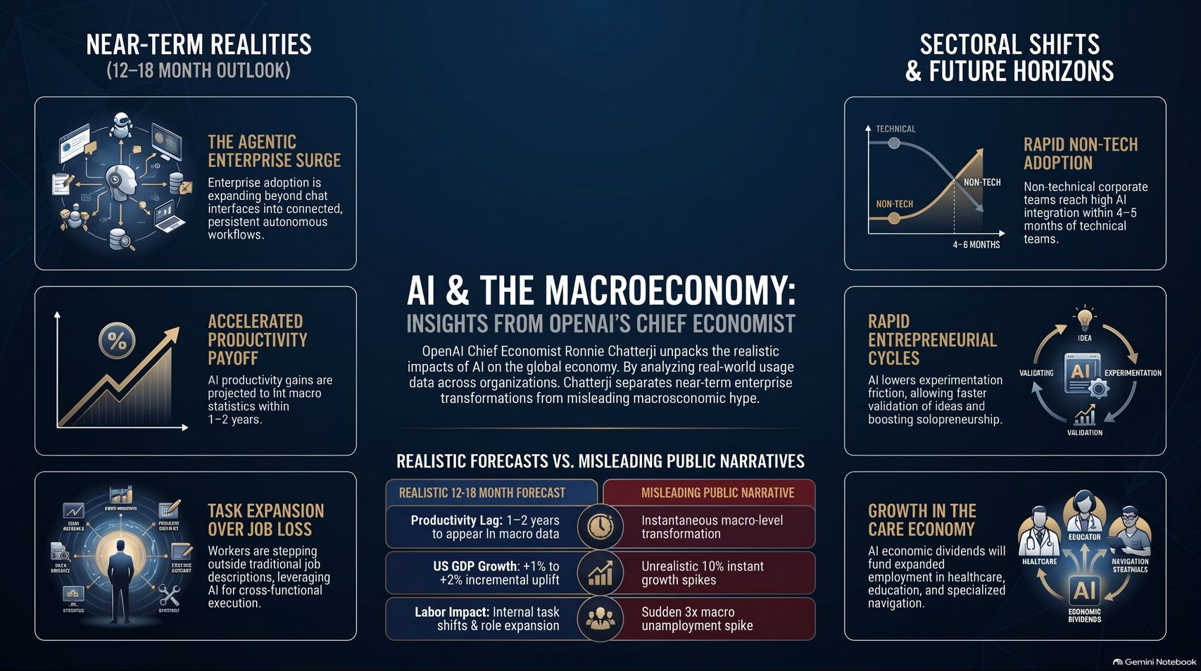
Notes:
Title: AI & The Macroeconomy: Insights from OpenAI's Chief Economist
Target Duration: 4–6 minutes
Speaker Notes:
"To wrap up our analysis, our master summary highlights the key takeaways from Ronnie Chatterji's economic framework:
Near-Term Realities: Enterprise adoption is expanding into agentic workflows, productivity gains are hitting macro statistics within 1–2 years, and workers are experiencing task expansion over job loss.
Realistic vs. Narrative: We are looking at a 1–2 year productivity lag, a +1% to +2% incremental GDP growth uplift, and internal task shifts rather than sudden macro unemployment spikes.
Future Horizons: Non-tech corporate teams are reaching integration rapidly, solopreneurial cycles are accelerating, and economic dividends are directly funding the care economy.
By understanding these structural shifts, we can navigate the next 2 to 5 years with clarity and confidence."

