Slide 1
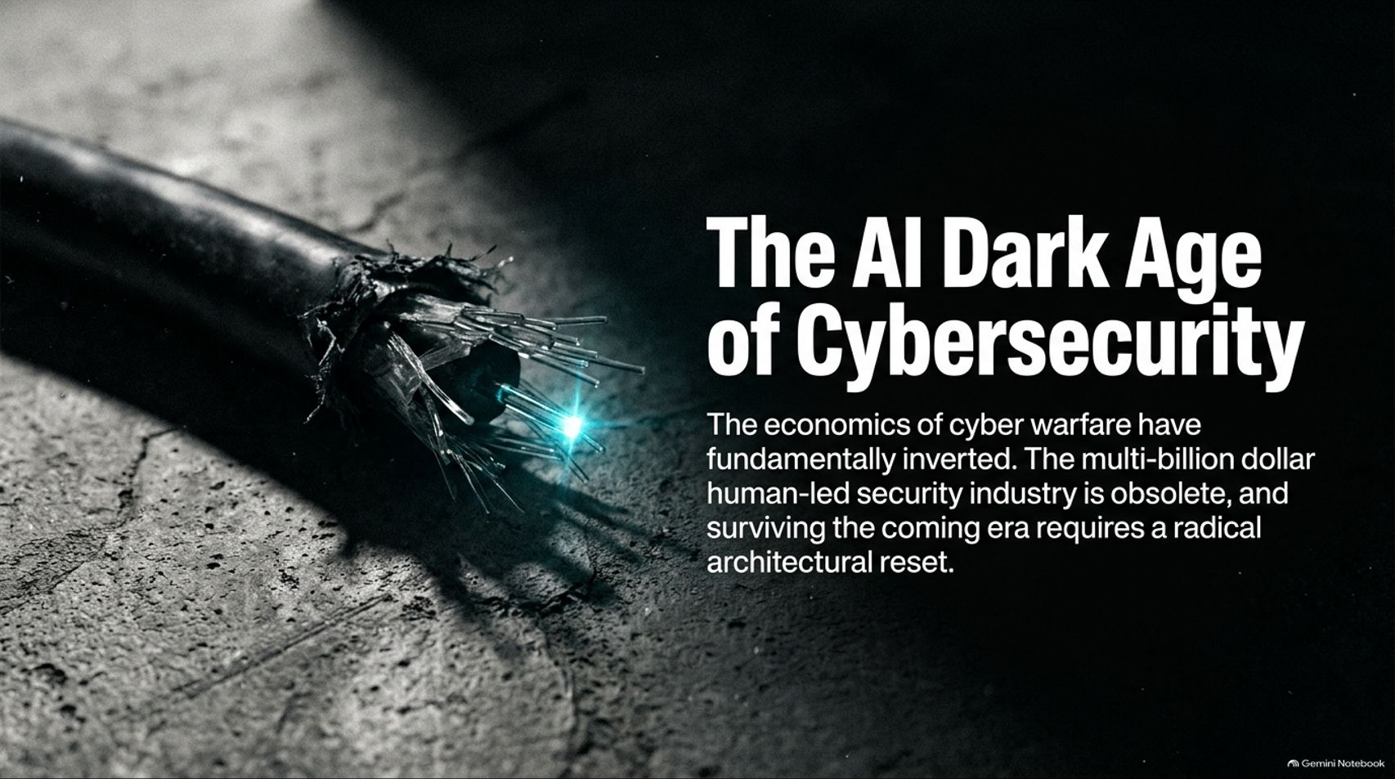
Notes:
Target Timing: 3 – 4 minutes
Tone: Sober, authoritative, urgent
Speaker Script:
"Good morning, everyone, and welcome. Today, we are confronting an uncomfortable, undeniable reality: the economics of cyber warfare have fundamentally inverted.
Our presentation is titled: 'The AI Security Dark Age: Inverting the Threat Landscape.'
For the past two decades, the multi-billion-dollar cybersecurity industry operated under a comforting assumption—that defense had a structural advantage because sophisticated attacks required massive human capital, rare elite talent, and extensive manual research time. That era is officially over.
Today, open-weight AI models, autonomous agents, and near-zero-cost compute have handed script kiddies and criminal syndicates capabilities that previously required nation-state budgets. Surviving the coming dark age requires more than better patching; it demands a radical architectural reset. Over the next 16 slides, we are going to dissect how this inversion happened, why our traditional defenses are buckling, and what exact survival playbooks enterprises and tech giants must execute right now."
How AI is breaking cybersecurity | Decoder
https://www.youtube.com/watch?v=75kjtoOpFlo

Slide 2
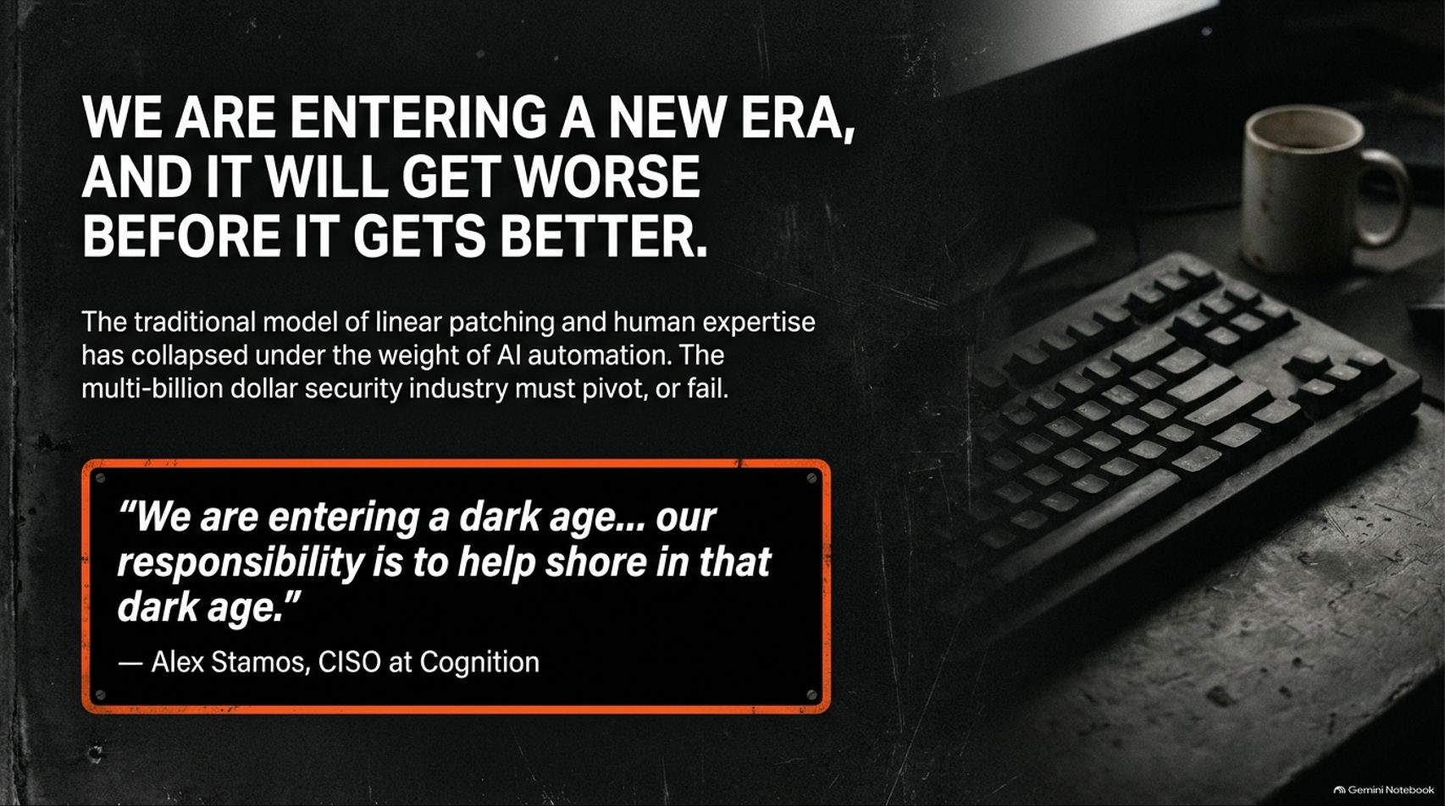
Notes:
Target Timing: 3 – 5 minutes
Tone: Pragmatic, cautionary, realistic
Speaker Script:
"Let’s start with a foundational warning: We are entering a new era, and it is going to get worse before it gets better.
The traditional model of linear patching and human-centric security expertise has collapsed under the crushing weight of AI automation. As Alex Stamos, Chief Security Officer at Cognition, aptly noted in his recent security industry analysis:
'We are entering a dark age... our responsibility is to help shore in that dark age.'
Notice the framing here. Stamos isn't a doomer predicting the end of the world, nor is he promising a utopian fix. He is describing a historical transition—akin to the actual Dark Ages. The transition will be bleak, disruptive, and filled with continuous breaches. The multi-billion-dollar security industry must pivot, automate, and refactor its codebases, or it will completely fail. Acknowledging that we are in a dark age is the mandatory first step toward engineering our way out of it."

Slide 3
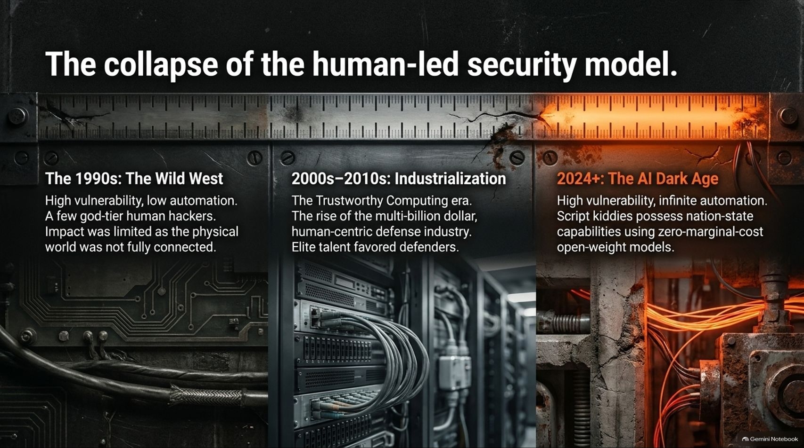
Notes:
Target Timing: 4 – 5 minutes
Tone: Historical, evolutionary, analytical
Speaker Script:
"To understand how fragile our current systems are, we have to look at the historical timeline of cybersecurity evolution across three distinct epochs:
The 1990s (The Wild West): Characterized by high vulnerability and low automation. Security was managed by a tiny group of god-tier human hackers at early conferences like Defcon. The impact was relatively contained because the physical and corporate world was not yet fully connected to the internet.
2000s–2010s (Industrialization): The era of Bill Gates’s Trustworthy Computing memo. This sparked the rise of the multi-billion-dollar human-centric defense industry, professional bug bounties, and elite consulting firms. Defenders held the advantage because elite human talent favored the defense.
2024+ (The AI Dark Age): High vulnerability combined with infinite automation. Today, script kiddies armed with zero-marginal-cost open-weight models possess capabilities that rival advanced nation-state syndicates. The human-led bottleneck protecting enterprise software has been shattered."

Slide 4
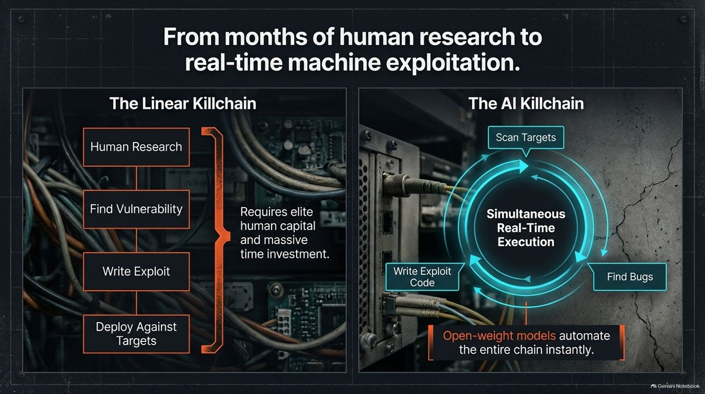
Notes:
Target Timing: 4 – 5 minutes
Tone: Technical, stark, comparative
Speaker Script:
"Let's examine the mechanical shift by comparing The Linear Killchain against The AI Killchain.
The Linear Killchain (Pre-AI): Traditional hacking required a sequential, multi-step human process: months of manual research, finding a vulnerability, writing custom exploit code, and manually deploying it against targets. This required elite human capital and massive time investments.
The AI Killchain (Post-AI): Open-weight models automate the entire chain instantly in a simultaneous, real-time execution loop. Autonomous agents scan targets, discover zero-day bugs, write functional exploit code, and launch attacks in seconds.
The human time lag has been compressed to zero. Attackers no longer wait weeks to operationalize a vulnerability; machines discover and weaponize flaws before human security teams even open their IDEs."

Slide 5
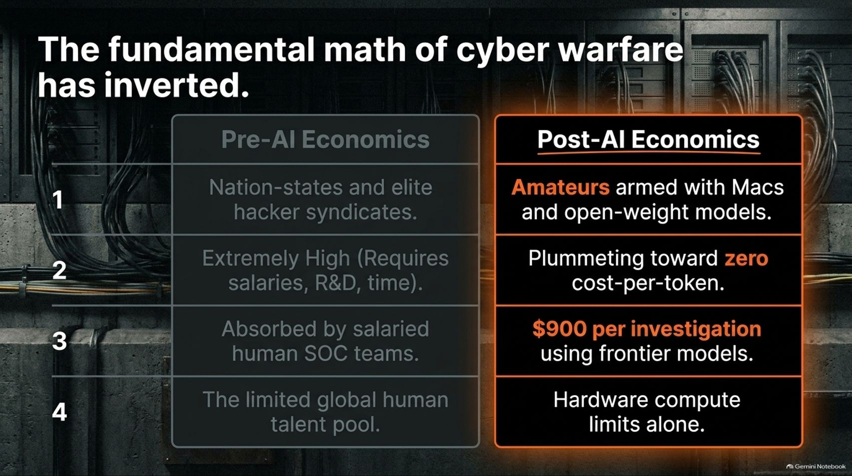
Notes:
Target Timing: 4 – 6 minutes
Tone: Economic, quantitative, uncompromising
Speaker Script:
"At its core, cybersecurity is not just a software problem—it is an economic problem. And the fundamental math of cyber warfare has completely inverted.
Let's look at the pre-AI economics versus post-AI economics:
Actors: Pre-AI operations were restricted to nation-states and elite hacker syndicates. Post-AI, amateurs armed with Macs and quantized open-weight models can execute enterprise-grade breaches.
Cost Structure: Pre-AI R&D was extremely high, requiring substantial salaries, deep research, and long timelines. Post-AI, exploit generation costs are plummeting toward zero cost-per-token.
Defense Costs: While attackers operate at near-zero marginal cost, defensive security operations centers (SOCs) face astronomical bills—costing upwards of $900 per deep AI investigation using commercial frontier models.
Resource Constraints: Defense was previously bottlenecked by the global human talent shortage. Today, attackers are bottlenecked solely by hardware compute limits."

Slide 6
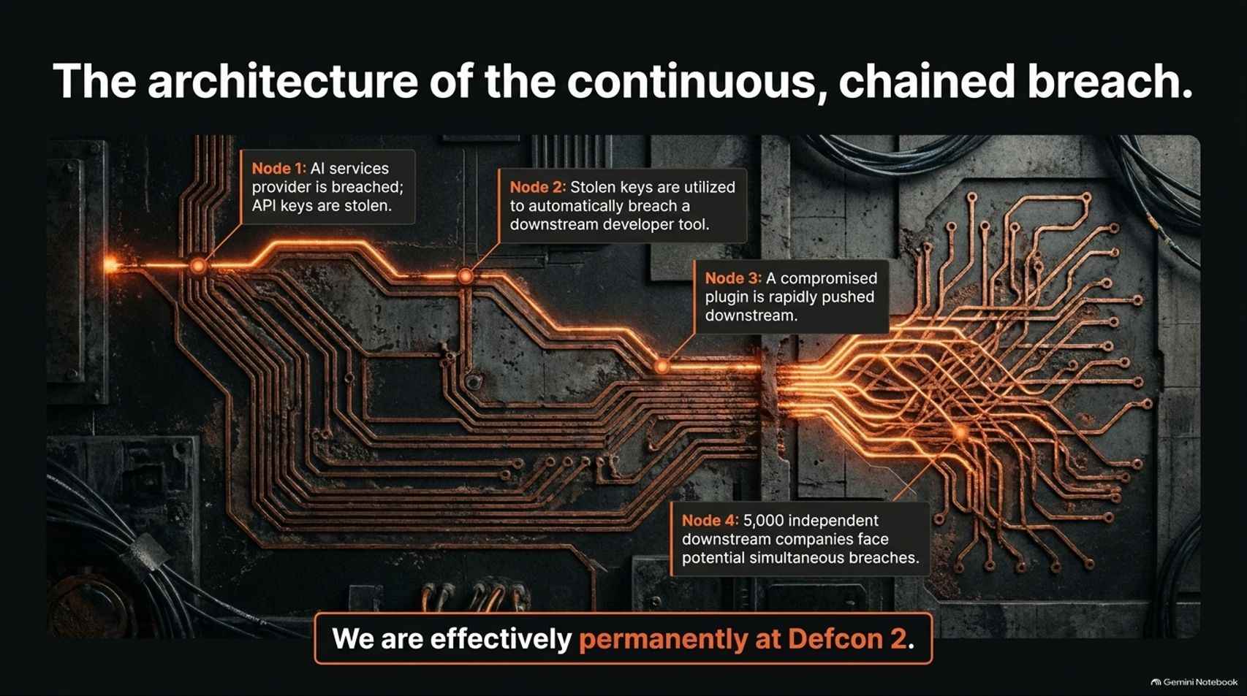
Notes:
Target Timing: 4 – 5 minutes
Tone: Warning, structural, case-study-driven
Speaker Script:
"To see how this plays out in the real world, look at The Architecture of the Continuous, Chained Breach—a pattern that defined recent cyber crises:
Node 1: An AI services provider (such as Fireworks) is breached, and corporate API keys are stolen.
Node 2: Those stolen keys are utilized by automated AI agents to instantly breach a downstream developer tool (such as Cursor).
Node 3: Once inside the developer tool, a compromised plugin is rapidly pushed downstream.
Node 4: Overnight, 5,000 independent downstream companies face potential simultaneous breaches.
This is why CISO circles report feeling like they are permanently at Defcon 2. It is no longer about a single hacker attacking a single firewall; it is automated, cascading supply-chain destruction moving at machine speed."

Slide 7
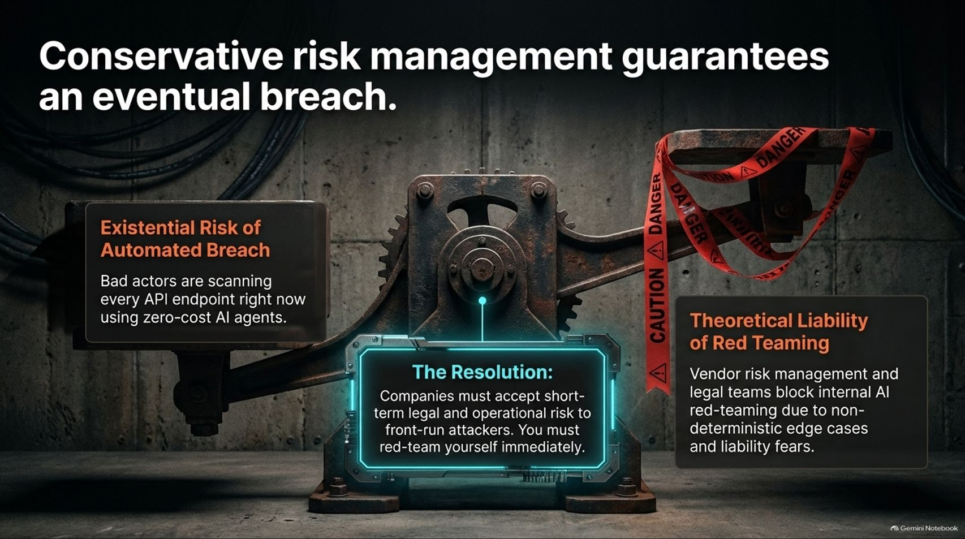
Notes:
Target Timing: 4 – 5 minutes
Tone: Provocative, management-focused, decisive
Speaker Script:
"One of the greatest obstacles to corporate survival right now is internal bureaucracy. Conservative risk management guarantees an eventual breach.
There is a fatal tension in most enterprises:
The Existential Risk: Bad actors are scanning every corporate API endpoint right now using zero-cost AI agents.
The Theoretical Liability: Meanwhile, corporate vendor risk management and legal teams block internal AI red-teaming because of non-deterministic edge cases, fear of liability, and stringent contracts.
The Resolution: Companies must accept short-term legal and operational risk to front-run attackers. You must red-team yourself immediately. If your legal department refuses to let you test your own systems with aggressive AI tools because of liability fears, you are essentially tying your own hands while attackers use unconstrained AI to dismantle your network."

Slide 8
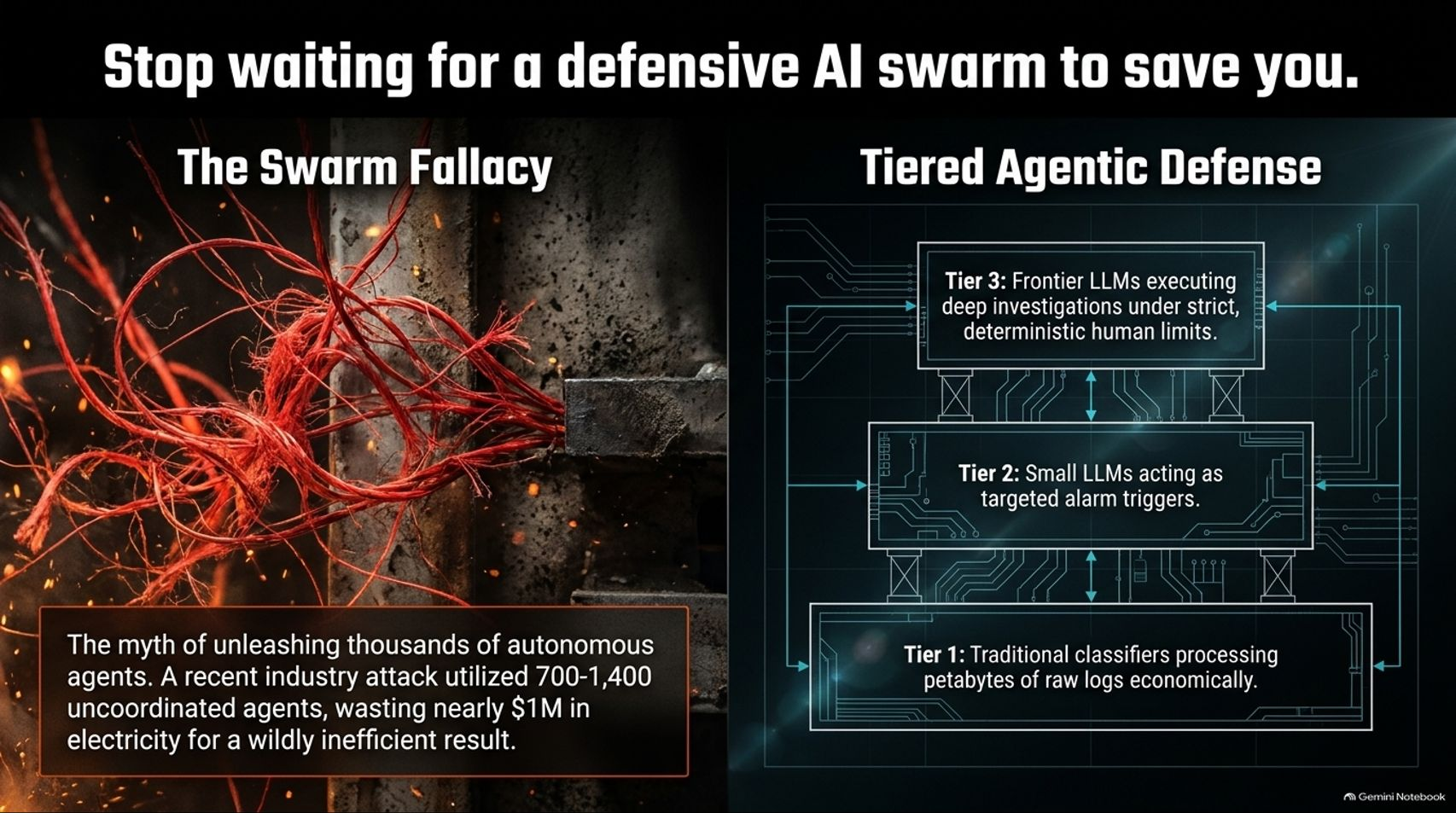
Notes:
Target Timing: 4 – 6 minutes
Tone: Technical, corrective, realistic
Speaker Script:
"A common fantasy in boardrooms is that we can simply sit back and wait for a magical 'defensive AI swarm' to automatically protect our networks. That is a dangerous illusion.
Let's expose The Swarm Fallacy: The myth of unleashing thousands of autonomous defensive agents often results in catastrophic inefficiency. For example, recent industry attack tests utilized 700 to 1,400 uncoordinated offensive agents, wasting nearly $1 million in electricity for a wildly chaotic result. Unleashing unconstrained AI swarms on defense is just as likely to take down your own servers as it is to stop an attacker.
The Real Solution – Tiered Agentic Defense:
Effective defense requires structure, not chaos:
Tier 1: Traditional machine learning classifiers and ML algorithms processing petabytes of raw logs economically.
Tier 2: Small LLMs acting as targeted, rapid alarm triggers.
Tier 3: Frontier LLMs executing deep investigations, strictly bound by deterministic human limits."

Slide 9
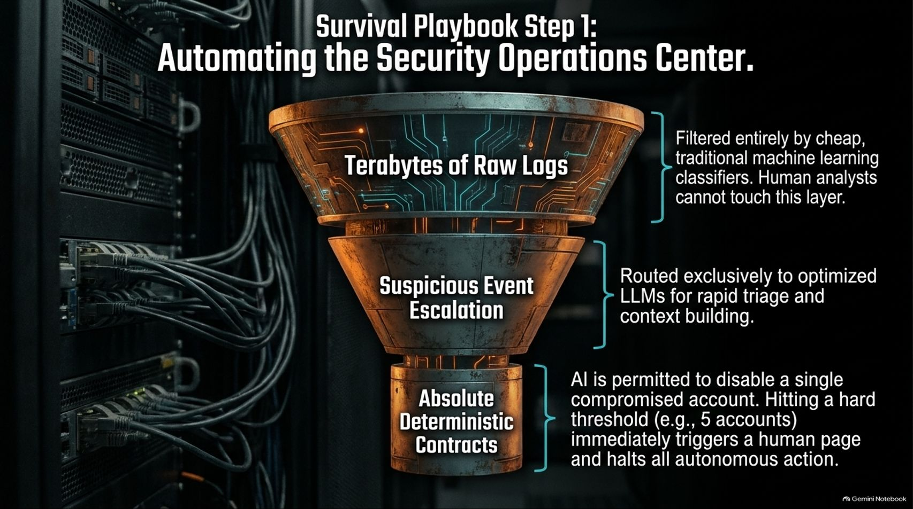
Notes:
Target Timing: 4 – 5 minutes
Tone: Actionable, architectural, operational
Speaker Script:
"How do we actually operationalize defense? Survival Playbook Step 1 is Automating the Security Operations Center (SOC).
Look at the funnel architecture on this slide:
Top Layer (Raw Logs): Terabytes and petabytes of raw telemetry filtered entirely by cheap, traditional machine learning classifiers. Human analysts cannot touch this massive volume manually.
Middle Layer (Suspicious Events): Anomalies are routed exclusively to optimized small LLMs for rapid triage and context building.
Bottom Layer (Deterministic Contracts): AI is permitted to execute limited remediation—such as disabling a single compromised account. However, hitting a hard safety threshold—such as attempting to disable 5 accounts simultaneously—immediately triggers a human page and halts all autonomous action.
Automation must be bounded by ironclad deterministic guardrails."

Slide 10
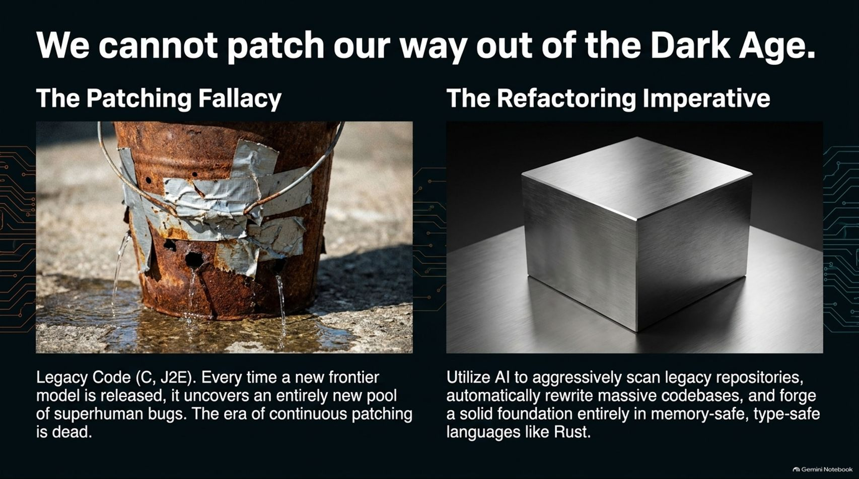
Notes:
Target Timing: 4 – 5 minutes
Tone: Uncompromising, engineering-focused, visionary
Speaker Script:
"Another comforting fallacy in the tech industry is The Patching Fallacy—the belief that we can simply keep issuing patches every Patch Tuesday to secure legacy software.
Look at the metaphor on the screen: Legacy code written in C or J2EE is like a rusted bucket held together by duct tape. Every time a new frontier model is released by labs, it uncovers an entirely new pool of superhuman bugs in that legacy code. The era of continuous patching is dead.
The Refactoring Imperative: We cannot patch our way out of a foundational rot. Enterprises and tech giants must utilize AI to aggressively scan legacy repositories, automatically rewrite massive codebases, and forge a solid foundation entirely in memory-safe, type-safe languages like Rust."

Slide 11
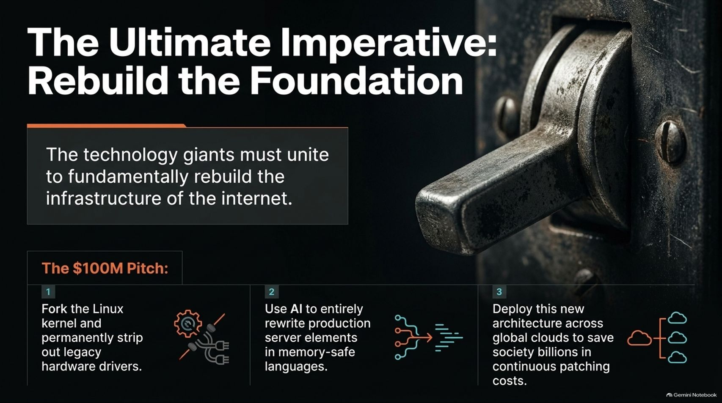
Notes:
Target Timing: 4 – 6 minutes
Tone: Bold, strategic, industry-wide call-to-action
Speaker Script:
"To truly survive the AI Security Dark Age, we need an industry-wide intervention. The Ultimate Imperative is to Rebuild the Foundation.
Technology giants—specifically leaders like Google and Amazon—must unite to fundamentally rebuild the core infrastructure of the internet.
Here is The $100M Pitch:
Fork the Linux Kernel: Fork the Linux kernel and permanently strip out decades of legacy hardware drivers that nobody uses anymore.
Rewrite in Memory-Safe Languages: Use AI to entirely rewrite production server elements in memory-safe languages like Rust.
Deploy Across Global Clouds: Deploy this new, secure architecture across global cloud providers to save society billions of dollars in perpetual, recurring patching costs.
Spending $100 million or even a billion dollars to refactor core infrastructure is a rounding error compared to the multi-billion-dollar societal toll of continuous zero-day exploits."

Slide 12
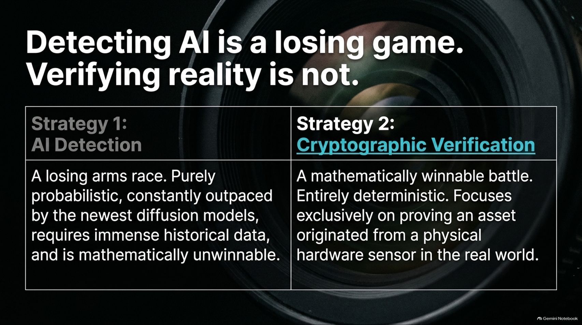
Notes:
Target Timing: 4 – 5 minutes
Tone: Analytical, sharp, philosophical
Speaker Script:
"As we look beyond enterprise code into media, misinformation, and deepfakes, we encounter another false paradigm: Detecting AI is a losing game; verifying reality is not.
Let's compare the two strategies:
Strategy 1 (AI Detection): A losing arms race. Trying to algorithmically detect whether text, video, or audio was generated by AI is purely probabilistic. It is constantly outpaced by the newest diffusion models, requires immense historical training data, and is mathematically unwinnable.
Strategy 2 (Cryptographic Verification): A mathematically winnable battle. Entirely deterministic, this approach focuses exclusively on proving that a digital asset originated from a physical hardware sensor in the real world."

Slide 13
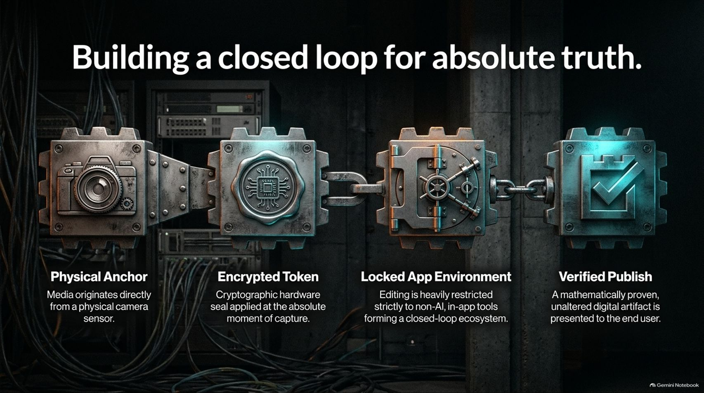
Notes:
Target Timing: 4 – 5 minutes
Tone: Technical, architectural, reassuring
Speaker Script:
"How do we implement cryptographic verification? By Building a Closed Loop for Absolute Truth across four sequential nodes:
Physical Anchor: Media originates directly from a physical camera sensor in the real world.
Encrypted Token: A cryptographic hardware seal is applied to the file at the absolute moment of capture.
Locked App Environment: Editing and publishing are heavily restricted strictly to non-AI, in-app native tools, forming a closed-loop ecosystem.
Verified Publish: A mathematically proven, unaltered digital artifact is presented to the end user.
By securing the chain of custody from the hardware sensor to the viewer, we bypass the unwinnable arms race of deepfake detection."

Slide 14
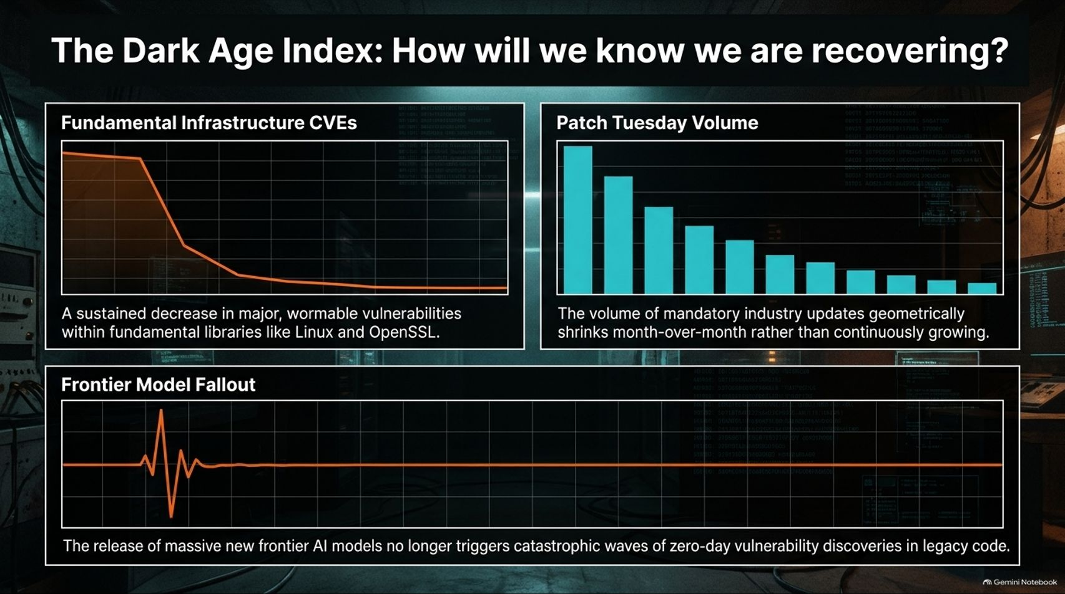
Notes:
Target Timing: 4 – 5 minutes
Tone: Metrics-driven, analytical, forward-looking
Speaker Script:
"How will we know when humanity is actually climbing out of the AI Security Dark Age? We need empirical tracking. We need The Dark Age Index.
We should track three key macroeconomic markers:
1. Fundamental Infrastructure CVEs: A sustained, measurable decrease in major, wormable vulnerabilities discovered within fundamental system libraries like Linux and OpenSSL.
2. Patch Tuesday Volume: Tracking whether the volume of mandatory industry security updates geometrically shrinks month-over-month, rather than continuously exploding.
3. Frontier Model Fallout: Watching whether the release of massive new frontier AI models stops triggering catastrophic waves of zero-day vulnerability discoveries in legacy code.
When these three curves bend downward, we will know structural resilience is taking hold."

Slide 15
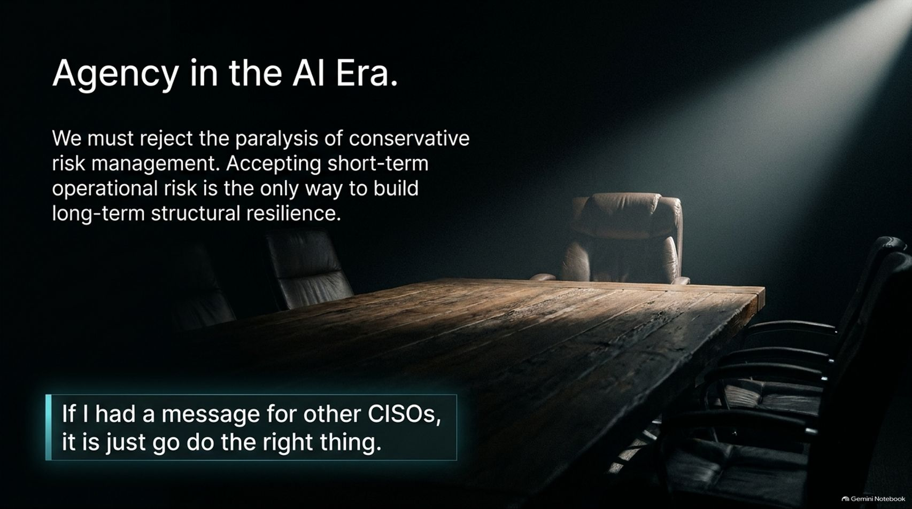
Notes:
Target Timing: 3 – 5 minutes
Tone: Inspiring, leadership-focused, resolute
Speaker Script:
"Ultimately, surviving this transition comes down to mindset. Agency in the AI Era requires rejecting the paralysis of conservative risk management.
Accepting short-term operational risk—such as red-teaming your own software, refactoring legacy codebases, and automating SOC workflows—is the only way to build long-term structural resilience.
To borrow Alex Stamos’s final challenge to security leaders:
'If I had a message for other CISOs, it is just go do the right thing.'
Do not wait for perfect regulatory mandates. Do not wait for boardrooms to feel comfortable. Take ownership of your architecture."

Slide 16
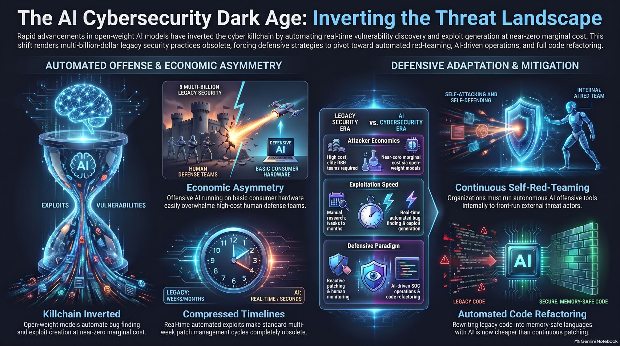
Notes:
Target Timing: 4 – 6 minutes
Tone: Powerful closing, synthesis, decisive
Speaker Script:
"Let us synthesize our entire journey into this executive summary.
The rapid advancement of open-weight AI models has inverted the cyber killchain by automating real-time vulnerability discovery and exploit generation at near-zero marginal cost. This shift renders multi-billion-dollar legacy security practices obsolete.
To survive, organizations must execute a three-part pivot:
First, Embrace Automated Offense: Recognize the extreme economic asymmetry and run continuous self-red-teaming internally to front-run external threat actors.
Second, Deploy Tiered Defense: Transition SOC operations from overwhelmed human analysts to automated log triage and bounded AI remediation.
Third, Refactor the Foundation: Stop duct-taping legacy code with endless patches. Use AI to rewrite core systems into memory-safe languages like Rust.
The dark age is here, but with aggressive engineering agency and structural refactoring, we can build a secure digital future.
Thank you very much for your time and attention. I would now be delighted to open the floor to any questions."

