Slide 1

Notes:
DeepMind Veteran: How to Get Real Value From AI Agent
https://www.youtube.com/watch?v=yIFhTVMOH98

Slide 2
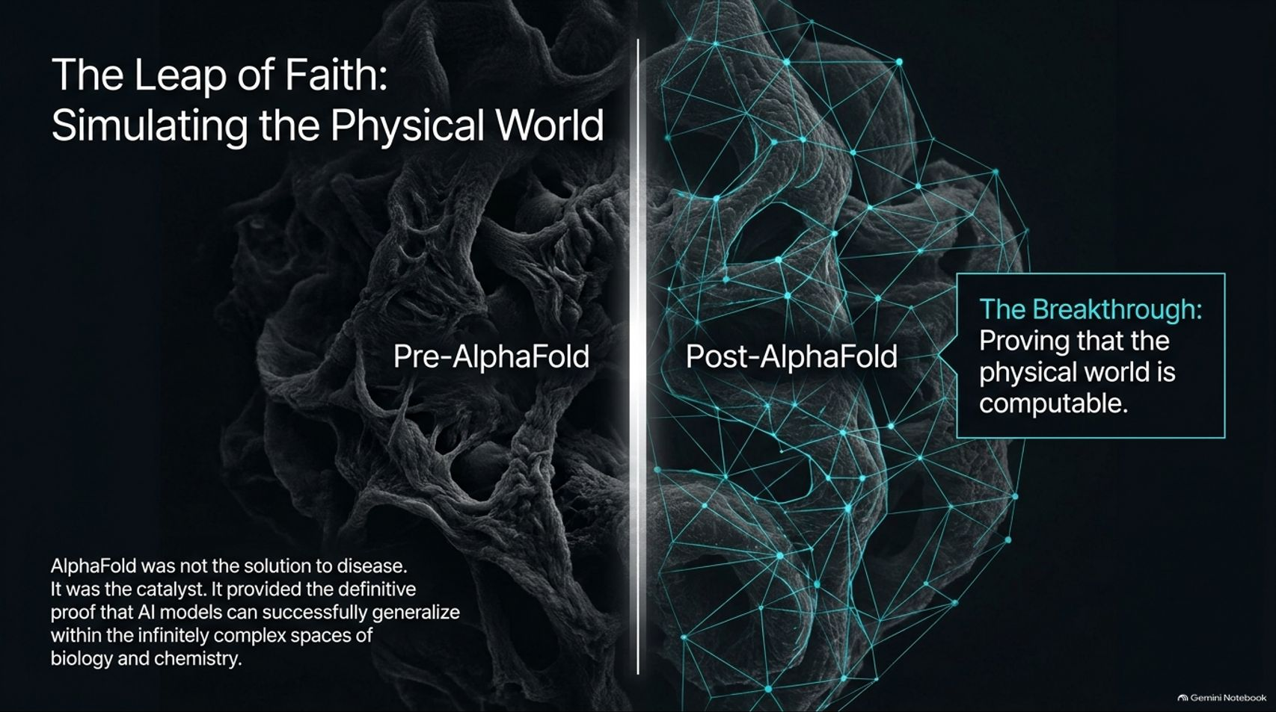
Notes:
Target Timing: 3 – 5 minutes
Tone: Groundbreaking, analytical, perspective-shifting
Speaker Script:
"To understand where drug discovery is heading, we must look at the catalyst that changed everything: AlphaFold.
Look at the visual split on this slide. On the left, Pre-AlphaFold, biology was an overwhelmingly complex, dark continent of unstructured protein folding. On the right, Post-AlphaFold, we crossed a historical Rubicon.
The Breakthrough: AlphaFold was never meant to be the final solution to disease. Instead, it was the ultimate proof point. It provided the definitive empirical evidence that deep learning models could successfully generalize within the infinitely complex spaces of biology and chemistry.
That single milestone gave researchers the courage to take a massive leap of faith: to transition from treating AI as a data-sorting tool to treating AI as a predictive simulator of the physical world. It proved that biology is code, and code can be mastered."

Slide 3
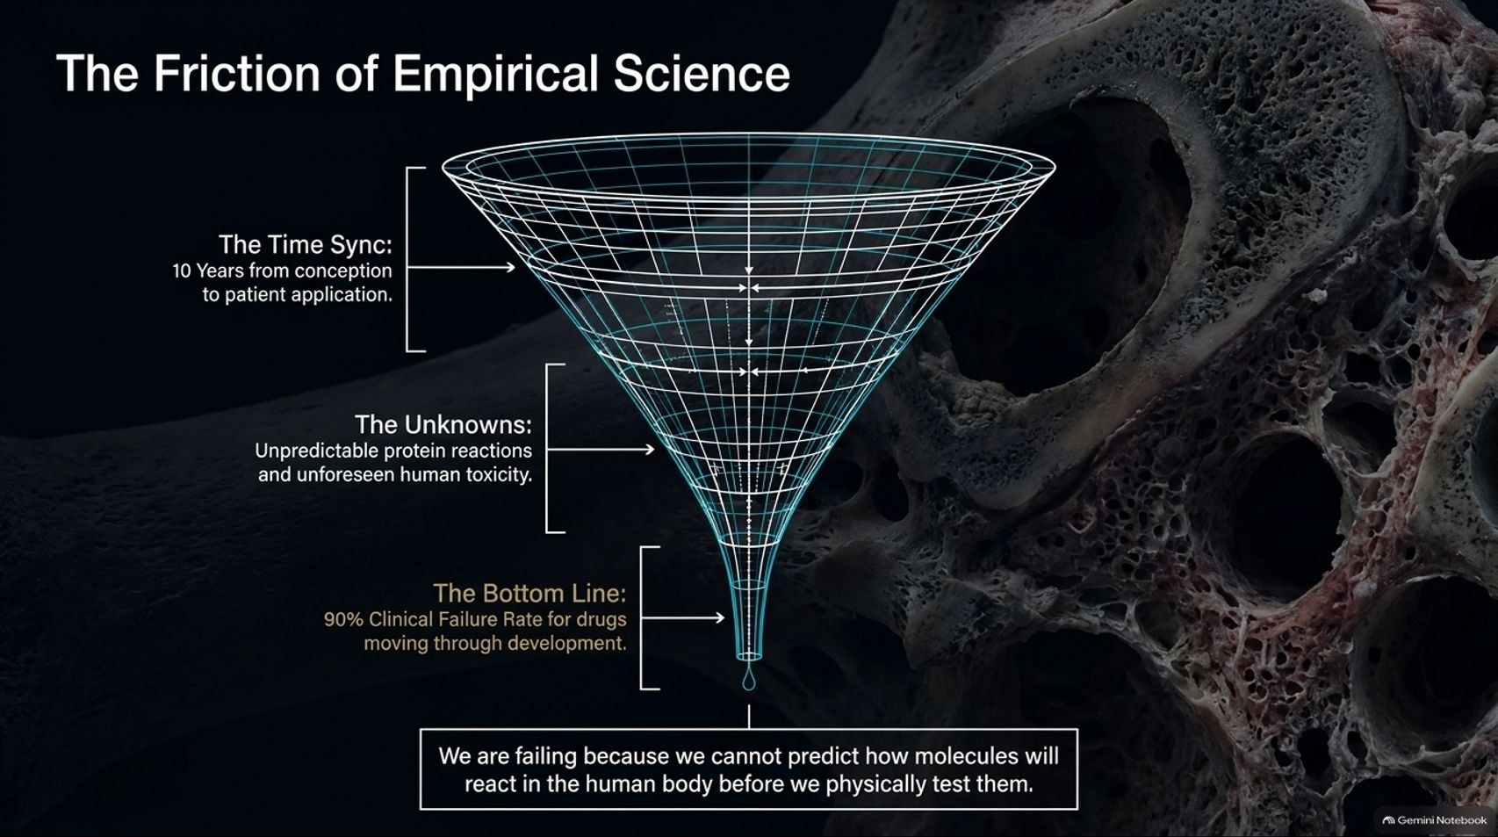
Notes:
Target Timing: 4 – 5 minutes
Tone: Critical, stark, problem-defining
Speaker Script:
"Why was an AI revolution so desperately needed in biology? Because traditional empirical science is choked by friction.
Look at the funnel on this screen representing traditional drug development:
The Time Sync: It takes an astonishing 10 years on average to move from initial molecular conception to an actual patient application.
The Unknowns: Researchers face unpredictable protein reactions, complex cellular pathways, and unforeseen human toxicity.
The Bottom Line: The pharmaceutical industry suffers from a staggering 90% clinical failure rate for drugs moving through development.
Why are we failing? Because under the status quo, we cannot accurately predict how novel molecules will react inside the human body before we physically manufacture and test them in wet labs. We are flying blind until late-stage trials."

Slide 4
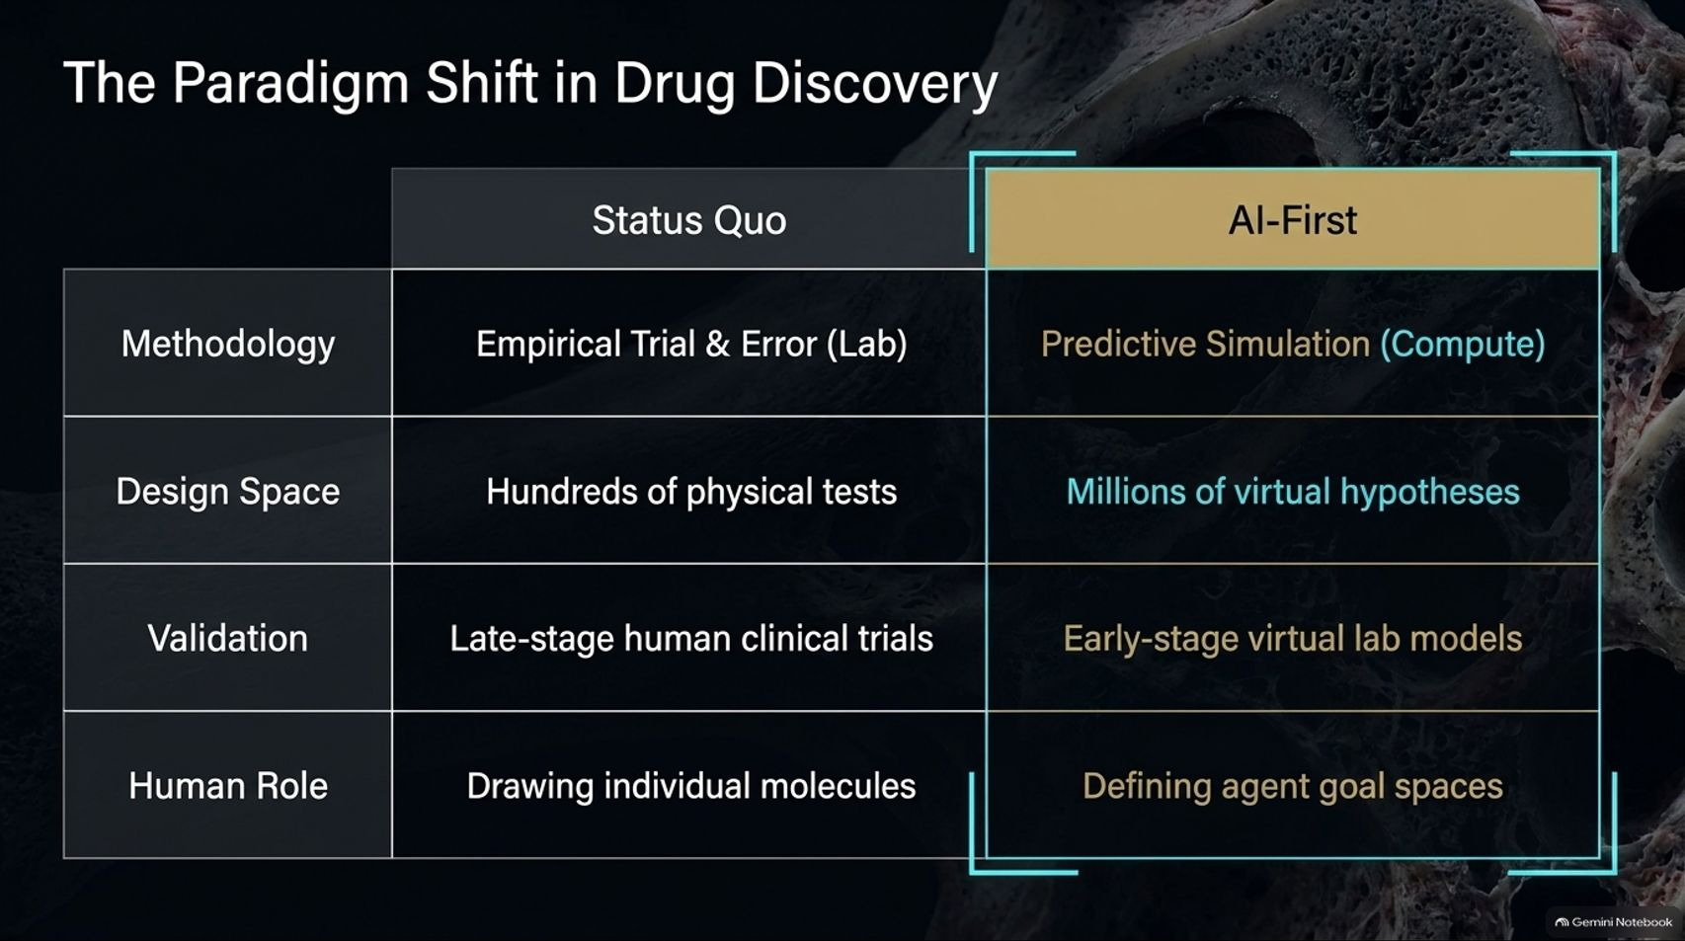
Notes:
Target Timing: 4 – 6 minutes
Tone: Comparative, strategic, visionary
Speaker Script:
"To overcome that 90% failure rate, the industry is undergoing a structural transition from the old Status Quo to an AI-First engine. Let's look at how every pillar of research is inverting:
Methodology: Shifting from manual empirical trial-and-error in wet labs to predictive simulation driven by infinite compute.
Design Space: Moving from testing hundreds of physical molecules to exploring millions of virtual hypotheses on a computer.
Validation: Replacing late-stage human clinical failures with early-stage virtual lab models that filter toxicity before physical synthesis.
Human Role: Evolving from humans manually drawing individual molecules on a whiteboard to defining agent goal spaces and architectural direction.
This is not just accelerating old processes; it is replacing them with a fundamentally superior architecture of discovery."

Slide 5
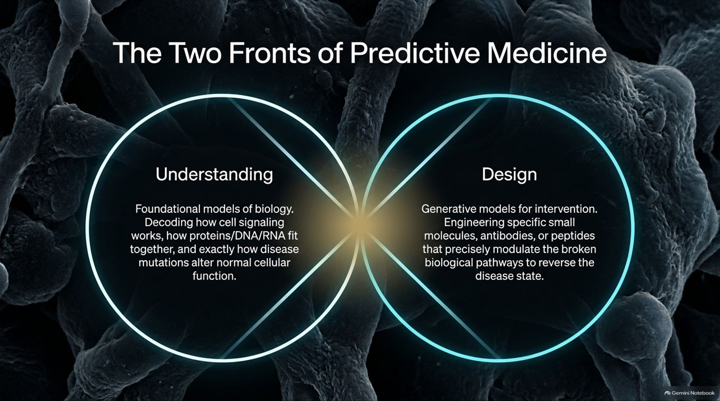
Notes:
Target Timing: 4 – 5 minutes
Tone: Explanatory, structured, foundational
Speaker Script:
"Predictive medicine does not rely on a single model; it operates across Two Interlocking Fronts: Understanding and Design.
1. Understanding (Foundational Biology): Before you can fix a disease, you must decode it. We build foundational AI models to understand how cell signaling works, how proteins, DNA, and RNA fit together, and exactly how disease mutations alter normal cellular function.
2. Design (Generative Intervention): Once disease pathways are mapped, generative models engineer the solution. This means designing specific small molecules, antibodies, or peptides that precisely modulate broken biological pathways to reverse the disease state.
Understanding tells us where the machine is broken; design builds the exact tool to fix it."

Slide 6
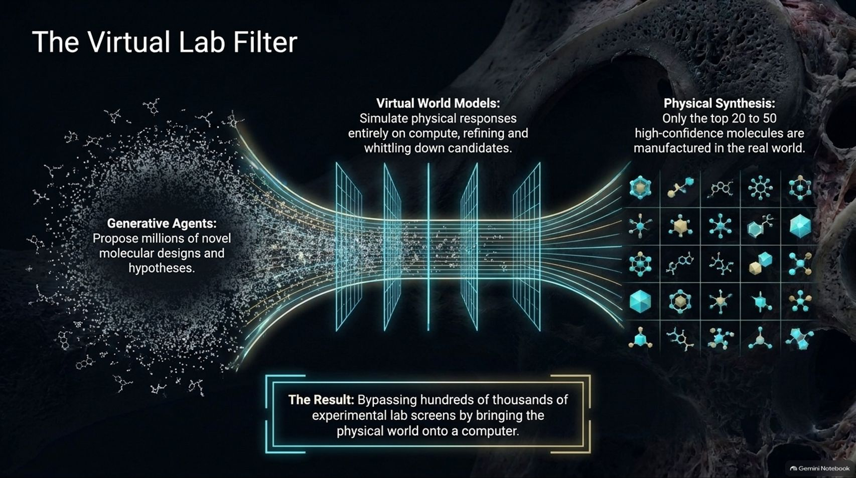
Notes:
Target Timing: 4 – 5 minutes
Tone: Technical, workflow-oriented, efficient
Speaker Script:
"How do these two fronts integrate into a working pipeline? Through The Virtual Lab Filter.
Look at the workflow on this slide:
Generative Agents: Autonomous AI agents propose millions of novel molecular designs and therapeutic hypotheses.
Virtual World Models: Instead of testing millions of compounds in physical labs, computer models simulate physical biological responses entirely on compute, rapidly whittling down candidates.
Physical Synthesis: Only the top 20 to 50 high-confidence molecules out of hundreds of thousands are finally manufactured and tested in the real world.
The Result: We completely bypass hundreds of thousands of experimental lab screens by bringing the physical world onto a computer."

Slide 7
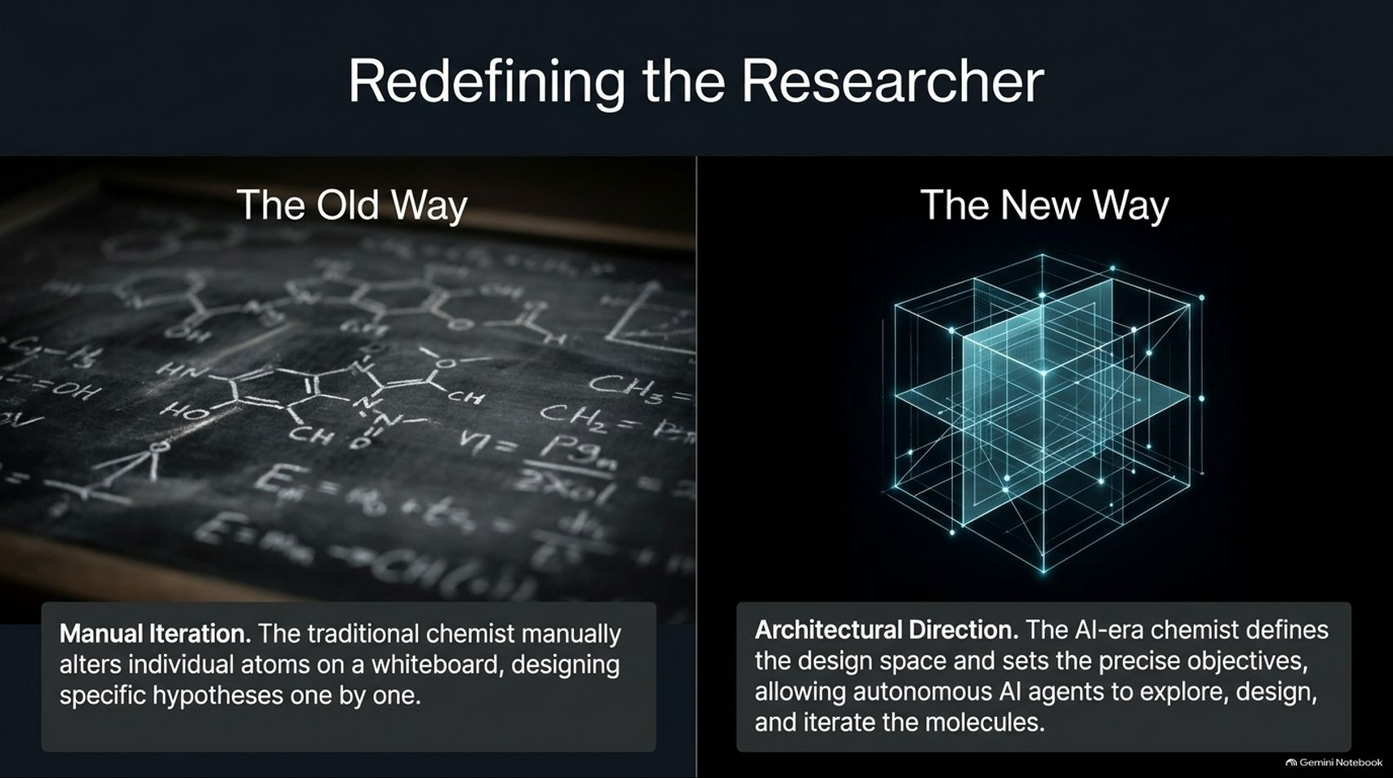
Notes:
Target Timing: 4 – 5 minutes
Tone: Managerial, forward-looking, transformative
Speaker Script:
"As AI takes over repetitive molecular screening, the role of the human scientist is fundamentally changing. We are moving from The Old Way to The New Way.
The Old Way (Manual Iteration): The traditional chemist spent months manually altering individual atoms on a whiteboard, designing specific hypotheses one by one in a slow, linear grind.
The New Way (Architectural Direction): The AI-era chemist operates like an architect. They define the design space, set precise biological objectives, and allow autonomous AI agents to explore, design, and iterate through millions of molecular variations.
The researcher is no longer a manual laborer drawing bonds on paper; they are strategic directors steering autonomous intelligence."

Slide 8
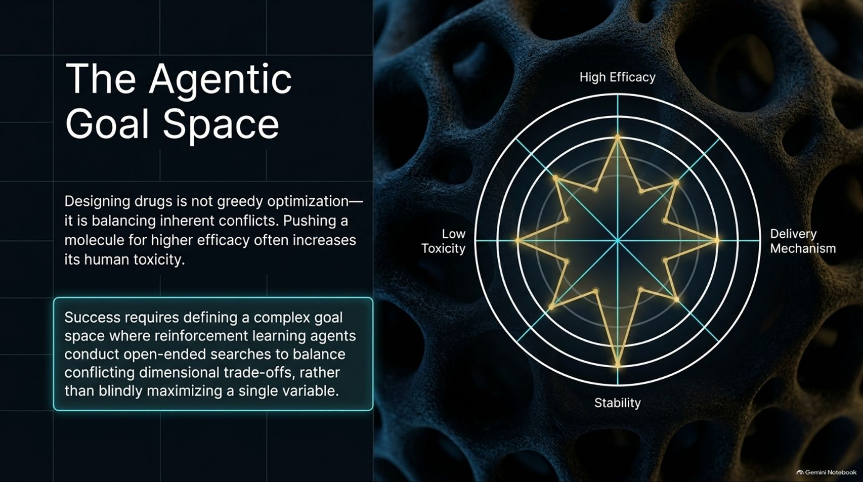
Notes:
Target Timing: 4 – 6 minutes
Tone: Technical, nuanced, strategic
Speaker Script:
"Designing medicines with autonomous agents is not a simple greedy optimization problem. It requires navigating The Agentic Goal Space.
In drug discovery, you are always balancing inherent conflicts. For example, pushing a molecule for higher therapeutic efficacy often inadvertently increases its human toxicity. Improving solubility might hurt its delivery mechanism.
Therefore, success requires defining a complex multi-dimensional goal space where reinforcement learning agents conduct open-ended searches. The agent must balance conflicting dimensional trade-offs—efficacy, toxicity, stability, and delivery—rather than blindly trying to maximize a single variable. It’s a delicate balancing act executed at machine speed."

Slide 9
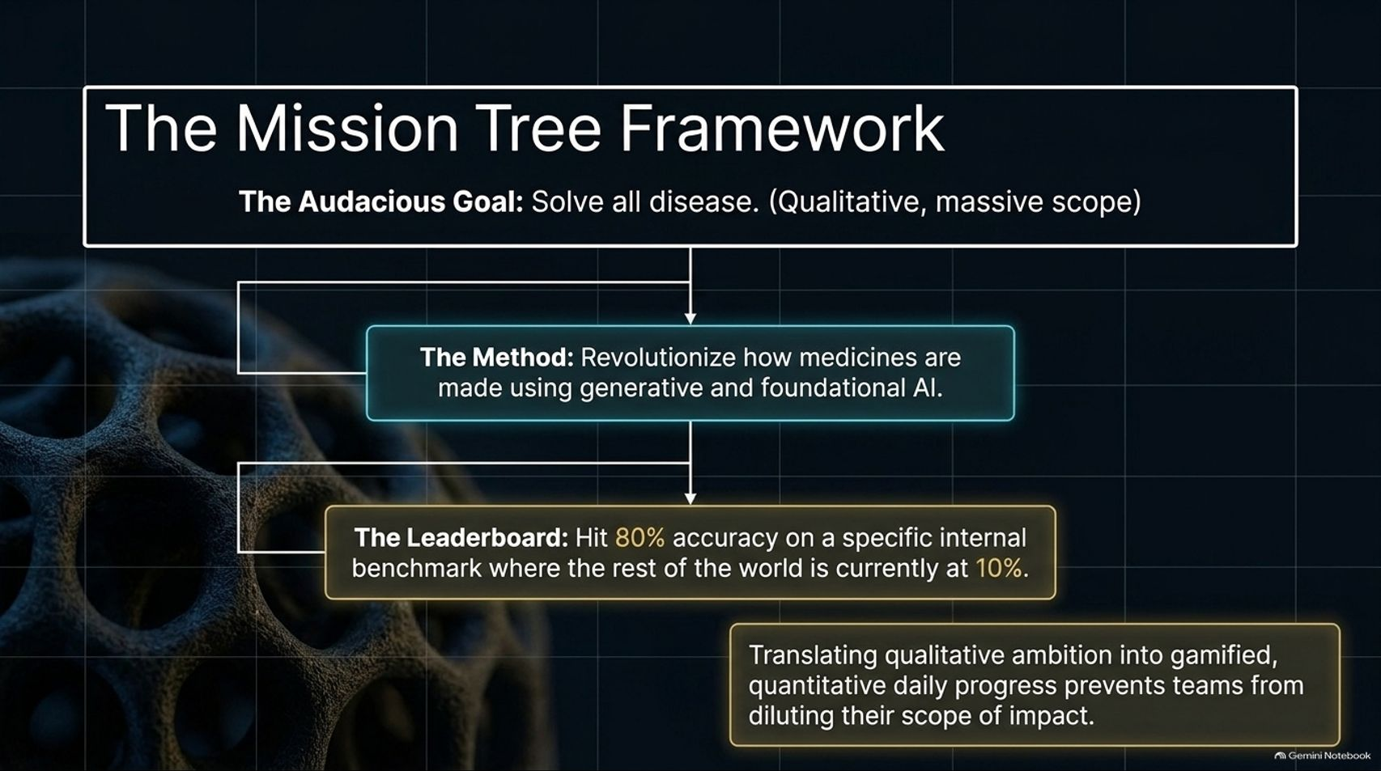
Notes:
Target Timing: 4 – 5 minutes
Tone: Operational, motivational, structured
Speaker Script:
"When an organization adopts an audacious vision—such as 'solving all disease'—how do you prevent that mission from becoming empty corporate fluff? You use The Mission Tree Framework.
Look at how a qualitative vision translates into daily execution:
The Audacious Goal: Solve all disease (Qualitative, massive scope).
The Method: Revolutionize how medicines are made using generative and foundational AI.
The Leaderboard: Hit 80% accuracy on a specific internal benchmark where the rest of the world is currently stuck at 10%.
Translating qualitative ambition into gamified, quantitative daily progress prevents teams from diluting their scope of impact. Every engineer and scientist can see how their daily code commit moves the needle on the master leaderboard."

Slide 10
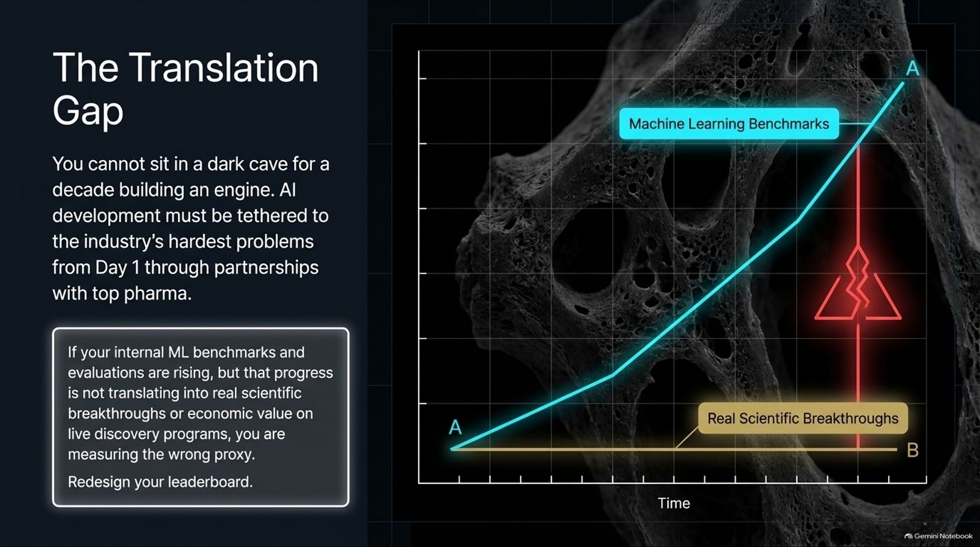
Notes:
Target Timing: 4 – 5 minutes
Tone: Cautious, rigorous, pragmatic
Speaker Script:
"A major danger for AI-first startups is falling into The Translation Gap.
You cannot sit in a dark cave for a decade building an isolated AI engine. AI development must be tethered to the industry’s hardest problems from Day 1 through active partnerships with top pharmaceutical companies.
Look at the graph on this slide: If your internal machine learning benchmarks and evaluations are climbing sharply (the blue line), but that progress is not translating into real scientific breakthroughs or economic value on live discovery programs (the flat yellow line), you are measuring the wrong proxy.
If your metrics diverge from reality, you must immediately redesign your leaderboard. AI models must prove themselves against the industry's toughest live problems."

Slide 11
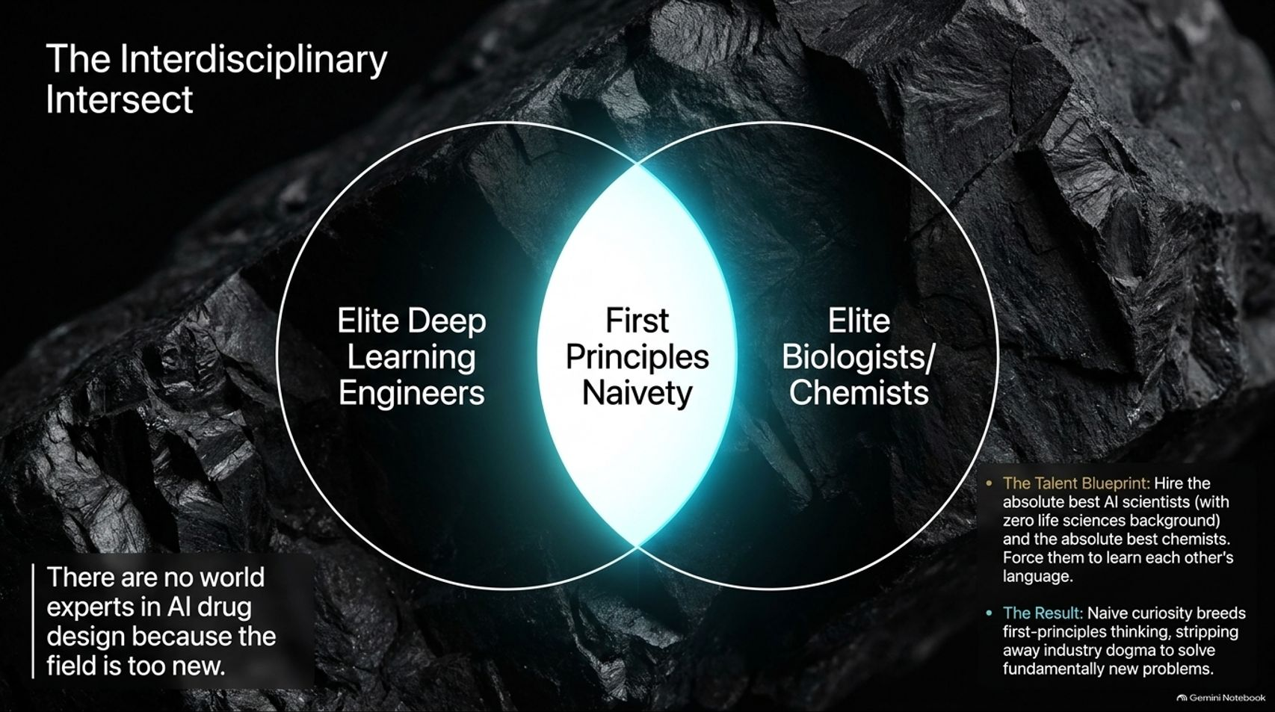
Notes:
Target Timing: 4 – 5 minutes
Tone: Cultural, hiring-focused, innovative
Speaker Script:
"To build these systems, you encounter a fascinating reality: There are no world experts in AI drug design because the field is simply too new. Anyone claiming 10 years of experience in AI drug design is likely using outdated technology.
So how do you build a world-class team? You look at The Interdisciplinary Intersect:
On one side, elite deep learning engineers with zero life sciences background.
On the other side, elite traditional biologists and chemists.
In the glowing center lies First-Principles Naivety.
The Talent Blueprint: Hire the absolute best minds from both camps and force them to learn each other's language. That naive curiosity breeds first-principles thinking, stripping away industry dogma to solve fundamentally new problems."

Slide 12
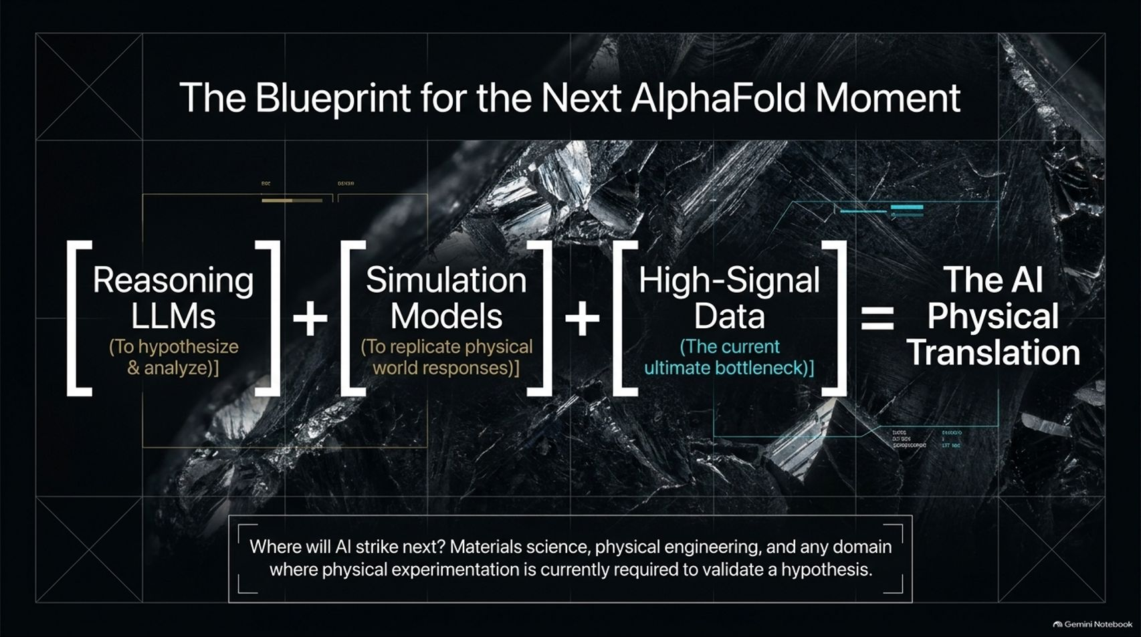
Notes:
Target Timing: 4 – 6 minutes
Tone: Visionary, architectural, expansive
Speaker Script:
"Where is this technology heading next? Let's examine The Blueprint for the Next AlphaFold Moment.
Across multiple scientific domains, the formula for breakthrough discovery relies on three pillars:
$$\text{Reasoning LLMs (to hypothesize \& analyze)} + \text{Simulation Models (to replicate physical responses)} + \text{High-Signal Data (the current ultimate bottleneck)} = \text{The AI Physical Translation}$$
Where will AI strike next? Materials science, physical engineering, and any domain where physical experimentation is currently required to validate a hypothesis. Wherever there is a physical simulation waiting to be unlocked, an AlphaFold moment is coming."

Slide 13
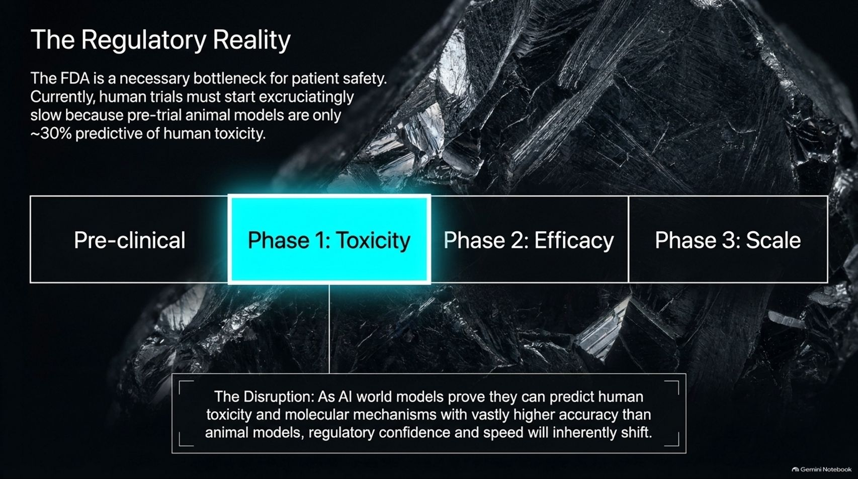
Notes:
Target Timing: 4 – 5 minutes
Tone: Regulatory, optimistic, patient-centric
Speaker Script:
"A common question in biotech is: What about the FDA? Won't regulation bottleneck life-saving AI drugs?
The FDA is a necessary bottleneck for patient safety. Currently, human clinical trials must start excruciatingly slow because pre-trial animal models are only ~30% predictive of human toxicity. A rat is simply not a human.
The Disruption: As AI world models prove they can predict human toxicity and molecular mechanisms with vastly higher accuracy than traditional animal models, regulatory confidence and speed will inherently shift. Over time, predictive AI will give regulators the robust safety data they need to accelerate trials safely."

Slide 14
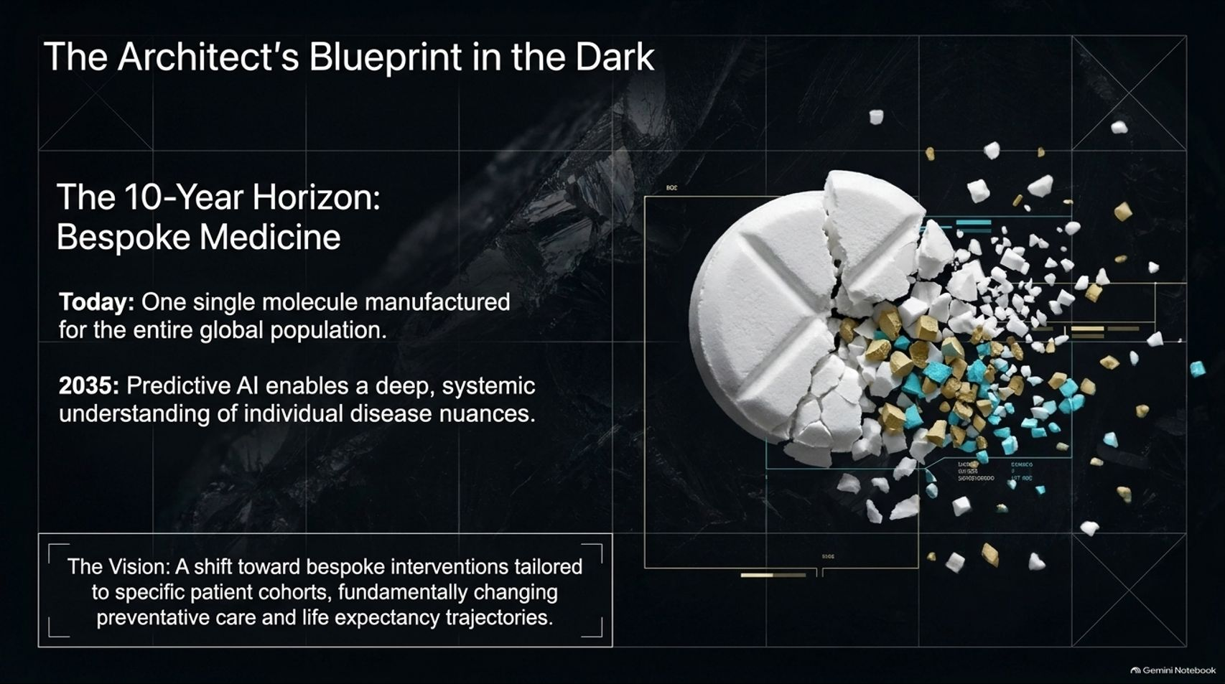
Notes:
Target Timing: 4 – 5 minutes
Tone: Future-focused, inspiring, visionary
Speaker Script:
"Let's look at the 10-year horizon toward Bespoke Medicine.
Today: The pharmaceutical industry manufactures one single molecular pill for the entire global population, assuming biology is uniform.
By 2035: Predictive AI enables a deep, systemic understanding of individual disease nuances.
The Vision: We are witnessing a monumental shift toward bespoke interventions tailored to specific patient cohorts and individuals. This will fundamentally change preventative care, quality of life, and human life expectancy trajectories over the coming decade."

Slide 15
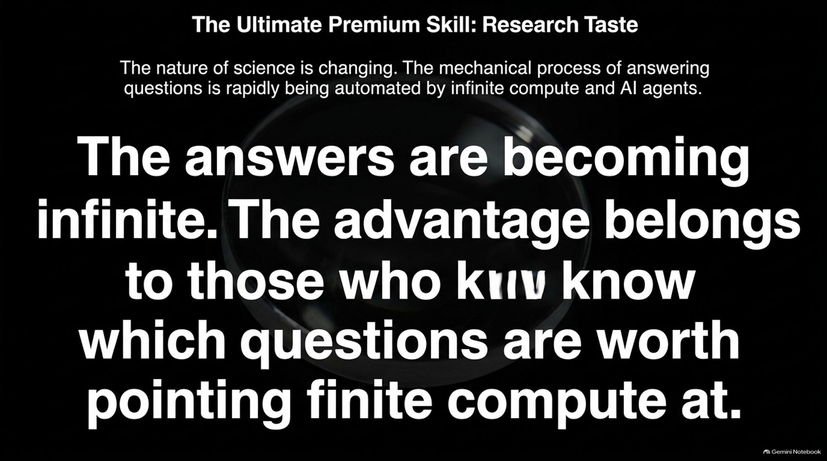
Notes:
Target Timing: 4 – 5 minutes
Tone: Philosophical, advisory, insightful
Speaker Script:
"As we wrap up our technical exploration, we must address a crucial human element: The Ultimate Premium Skill is Research Taste.
The nature of science is rapidly changing. The mechanical process of answering questions is being automated by infinite compute and AI agents.
As Max Jaderberg highlights: The answers are becoming infinite. The advantage belongs to those who know which questions are worth pointing finite compute at.
Anyone can prompt an AI to generate a million hypotheses. Knowing which scientific question matters most—possessing true research taste and intuition—is the ultimate human differentiator in the AI era."

Slide 16
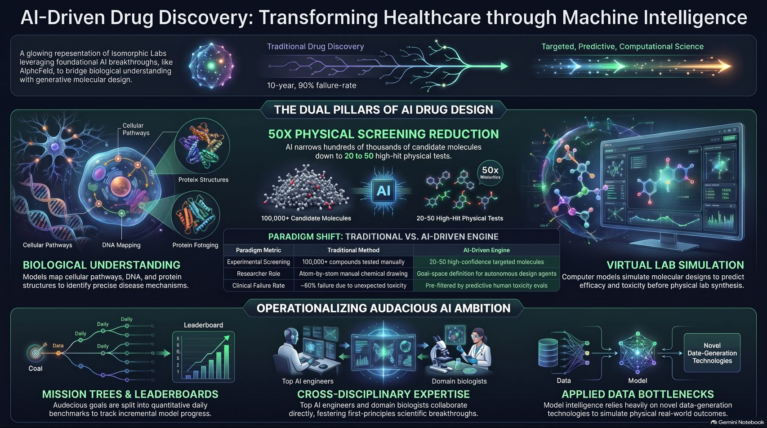
Notes:
Target Timing: 4 – 6 minutes
Tone: Powerful closing, synthesis, visionary
Speaker Script:
"Let us synthesize our entire journey into this executive summary.
AI-driven drug discovery is transforming healthcare by bridging foundational biological understanding with generative molecular design.
By replacing traditional empirical trial-and-error with predictive simulation, we are achieving a 50x reduction in physical screening requirements—whittling hundreds of thousands of candidate molecules down to top high-confidence targets before touching a wet lab.
Operating this new architecture requires rigorous frameworks:
Translating audacious qualitative missions into quantitative daily leaderboards.
Hiring interdisciplinary teams of elite AI engineers and biologists who think from first principles.
Overcoming applied data bottlenecks to simulate the physical world on silicon.
We are actively engineering the end of disease. Thank you very much for your time and attention. I would now be delighted to open the floor to questions."

