Slide 1
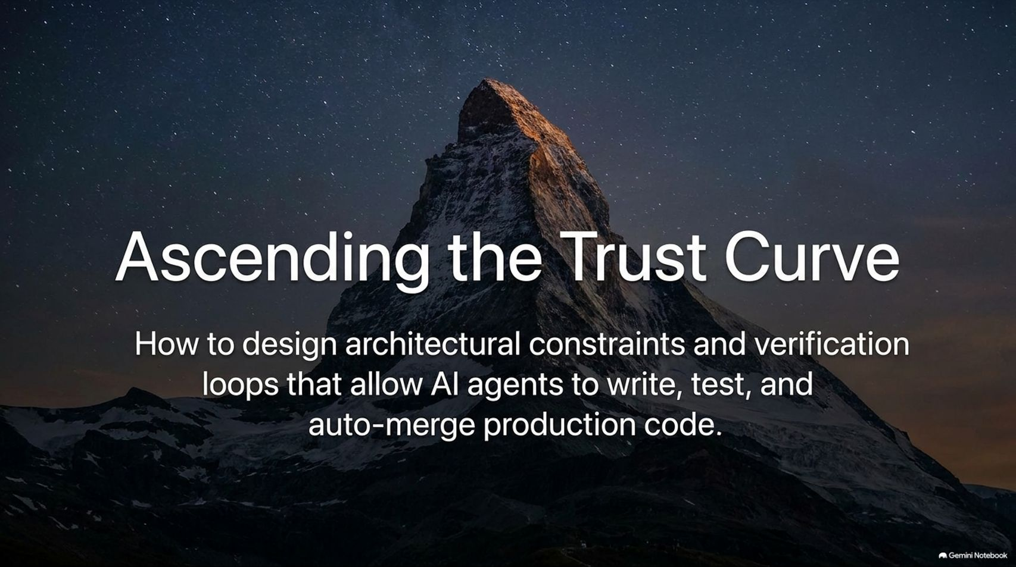
Notes:
Visual: A mountain peak under a starry night sky with the title "Ascending the Trust Curve."
Target Duration: 2–3 minutes
Speaker Notes:
Welcome everyone to today's session on Architecting Agent Autonomy. Today we are exploring how to transition AI coding from a fragile novelty into a robust, automated production pipeline.
When we first start using AI coding assistants, most of us experience a deep sense of hesitation. We see models hallucinating, guessing at codebases, and confidently claiming they fixed a bug when they’ve completely missed the mark.
The central thesis of this presentation—and the journey we are going to walk through—is that scaling agent capabilities is entirely a function of trust. If you cannot trust the output of one agent, you can never spawn a fleet of a hundred agents.
Over the next 13 slides, we’ll look at the architectural constraints, verification loops, and environment design patterns required to climb this trust curve—moving from high-intervention vibe-coding all the way to fully autonomous, auto-merged production pull requests.
How One AI Agent Manages 20+ GrokBot Agents | Lauren Tan
https://www.youtube.com/watch?v=2v40N037oJU

Slide 2
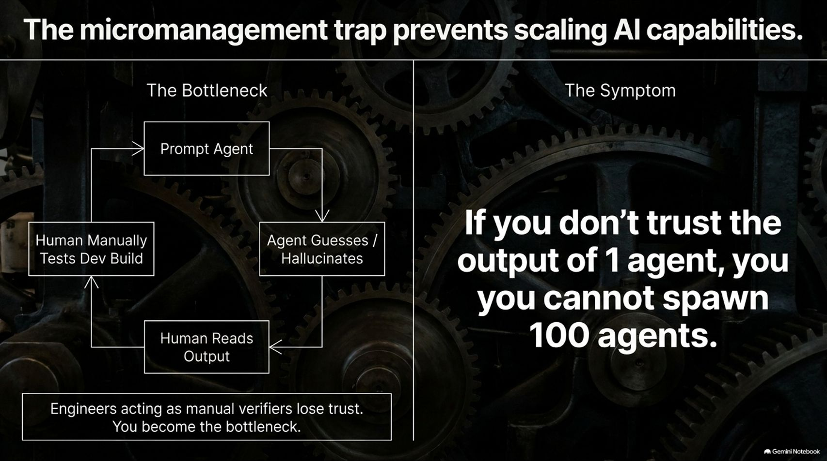
Notes:
Visual: An architectural breakdown contrasting "The Bottleneck" (prompt agent $\rightarrow$ agent guesses $\rightarrow$ human reads output $\rightarrow$ manual testing) with "The Symptom" ("If you don't trust the output of 1 agent, you cannot spawn 100 agents.")
Target Duration: 3–4 minutes
Speaker Notes:
Let's look at the trap that catches most engineering teams: micromanagement.
Think about management in the human world. If you are an engineering manager who fundamentally does not trust your team, what mode of operation are you forced into? You micromanage. You sit over your reports' shoulders, check every single line of code, and spend all your time reviewing rather than building.
In the AI world, this manifests as sitting in a tight loop: you prompt the agent, it guesses or hallucinates, you read the output, you manually test the dev build, and you correct it.
Because engineers acting as manual verifiers lose trust, you become the bottleneck. You cannot scale past one or two agents because your own cognitive load limits your throughput. To break out of this trap, we have to change our systemic approach to trust.

Slide 3
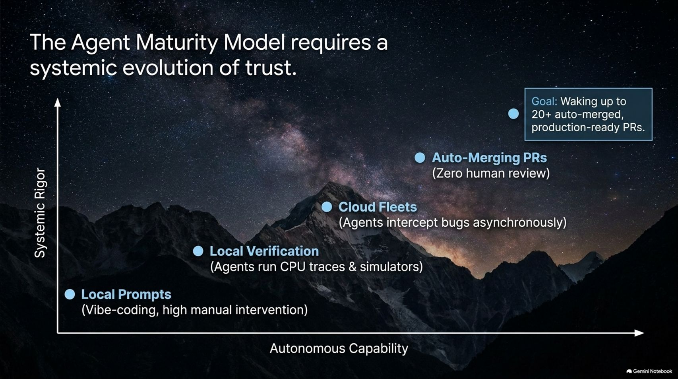
Notes:
Visual: A graph tracking "Systemic Rigor" against "Autonomous Capability," mapping progression from Local Prompts to Local Verification, Cloud Fleets, and Auto-Merging PRs.
Target Duration: 3–5 minutes
Speaker Notes:
Trust isn't binary; it's a maturity model. As shown on this curve, scaling autonomy requires parallel growth in systemic rigor.
Stage 1: Local Prompts. This is standard vibe-coding with high manual intervention. You are deeply in the loop, watching every token, and productivity is capped by your typing and reading speed.
Stage 2: Local Verification. Here, agents stop just writing text—they start running CPU traces, simulators, and local tests to verify their own work.
Stage 3: Cloud Fleets. Agents operate asynchronously in cloud environments, intercepting bugs and verifying fixes while engineers are offline.
Stage 4: Auto-Merging PRs. This is the ultimate goal: waking up to 20+ production-ready, auto-merged pull requests that have passed rigorous automated guardrails with zero human review. Let's examine how we build the mechanics to get there.

Slide 4
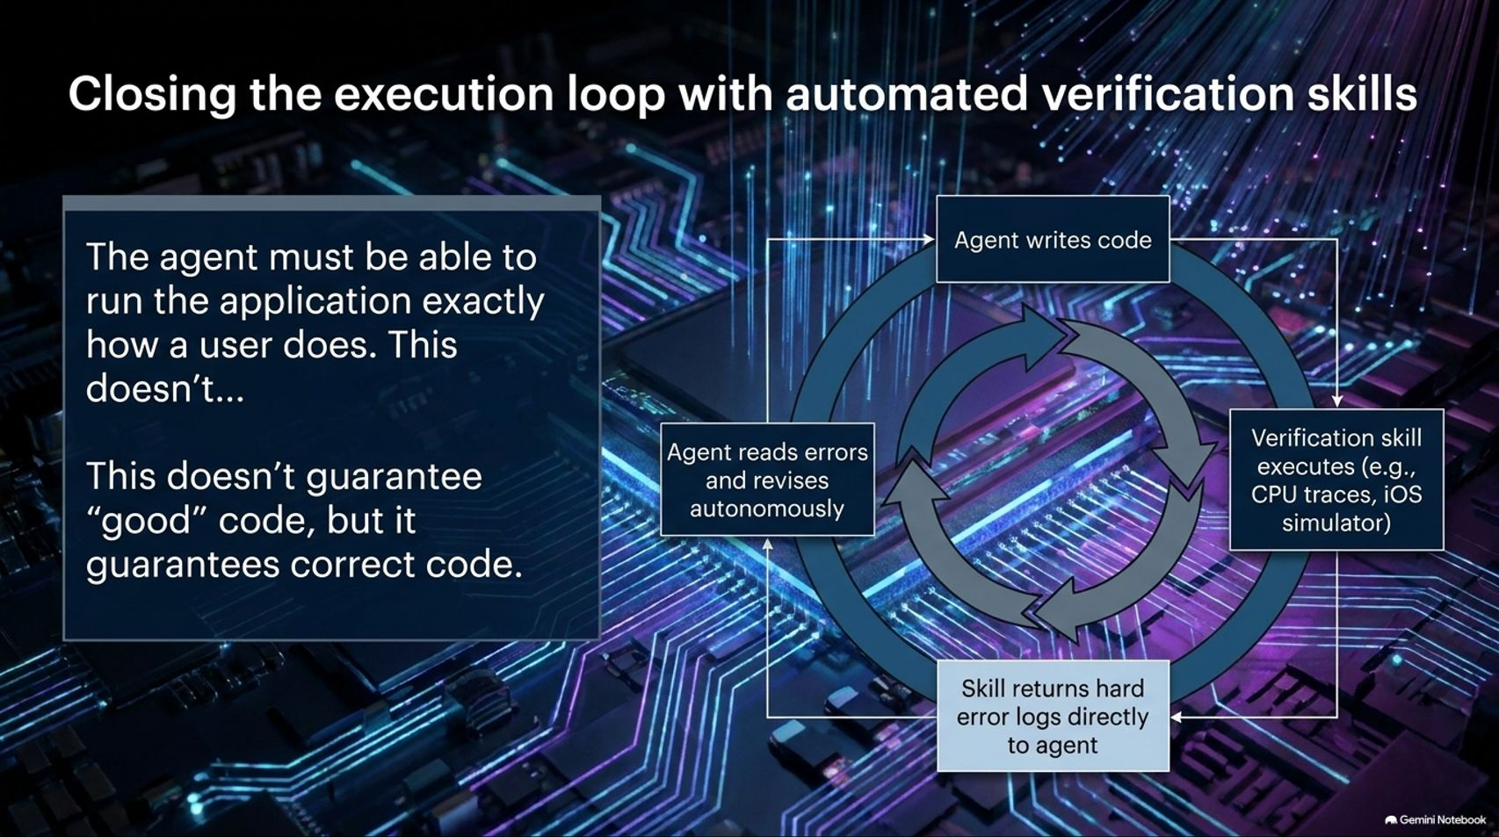
Notes:
Visual: A nested execution cycle showing an agent writing code, verification skills executing (CPU traces/simulators), returning hard error logs, and the agent revising autonomously.
Target Duration: 4–6 minutes
Speaker Notes:
The single most important skill to build in your agent toolbox is automated verification.
Without a verification skill, the human is the verifier. The agent writes code, you open your local dev build, you find it broken, and you copy-paste error logs back to the agent. That loop is painfully slow.
By equipping the agent with tools to run the application exactly how a user does—via Chrome DevTools Protocol, Apple simulator utilities, or CLI test runners—we close the loop.
As Lauren Tan notes from her experience building Cursor's agent window, this doesn’t automatically guarantee good code, but it guarantees correct code. The agent receives hard error logs directly, reads them, and revises autonomously until the tests pass.

Slide 5
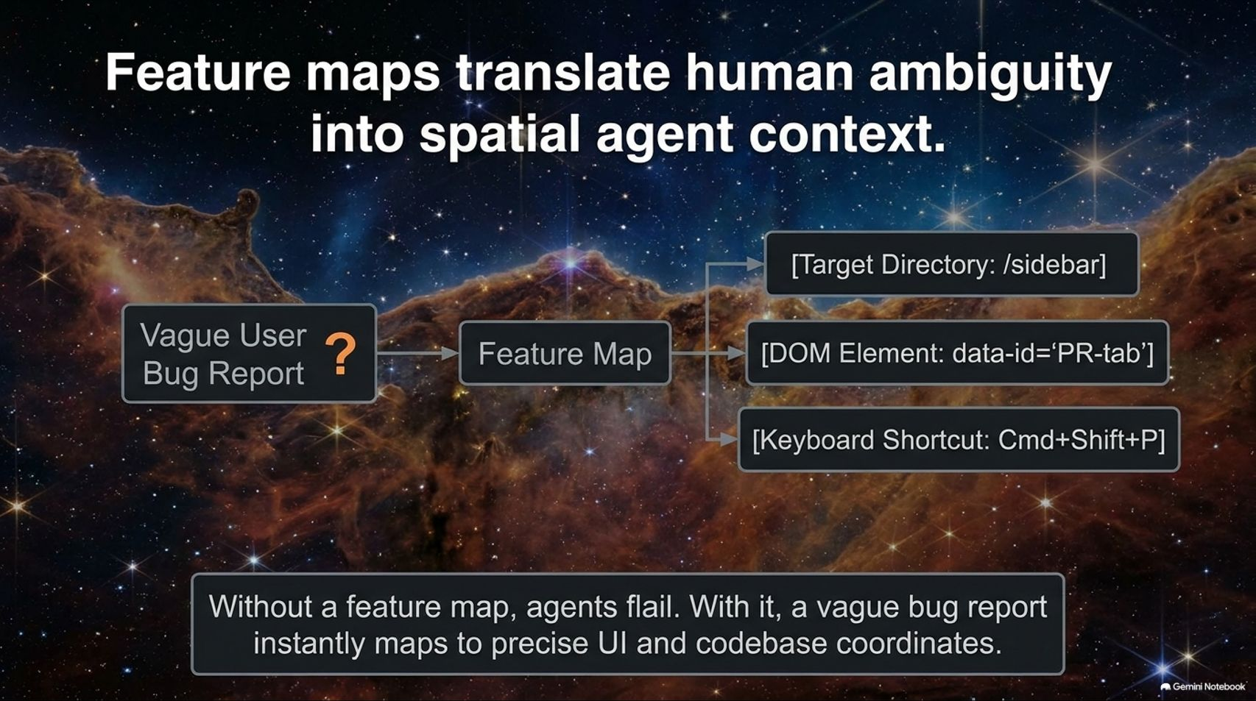
Notes:
Visual: A workflow mapping a "Vague User Bug Report" through a "Feature Map" into precise target directories, DOM elements, and keyboard shortcuts.
Target Duration: 3–5 minutes
Speaker Notes:
Even when an agent can run verification tools, it often stumbles because real-world user feedback is vague.
In internal Slack channels, bug reports often look like a screenshot with a few question marks. Without context, an agent will completely flail around trying to find where a UI component lives in a massive codebase.
This is where Feature Maps come in. A feature map acts as a spatial coordinate system for your app. It translates human ambiguity into precise codebase coordinates—mapping sidebar directories, specific DOM data attributes (data-id='PR-tab'), and keyboard shortcuts.
When a bug report comes in, the agent references the feature map to immediately navigate to the correct UI feature, execute the verification tool, and reproduce the issue without human hand-holding.

Slide 6
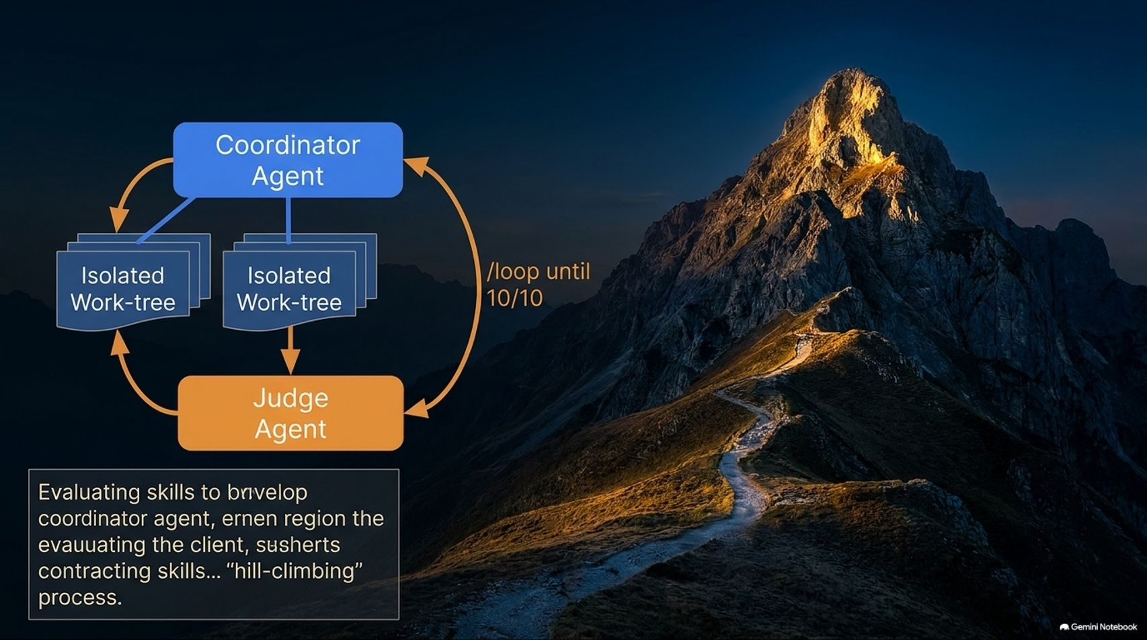
Notes:
Visual: A diagram of a Coordinator Agent managing isolated work-trees and a Judge Agent in a /loop until 10/10 hill-climbing process.
Target Duration: 4–6 minutes
Speaker Notes:
How do we systematically build and improve these verification skills and agent workflows over time? We use evals and a hill-climbing architecture.
Think of an eval as a unit test for an agent skill. To build a robust coordinator agent, you set up a rigorous evaluation playbook.
The main coordinator agent establishes a rubric and spawns sub-agents across isolated work-trees. Crucially, these sub-agents shouldn't even know they are being evaluated, so they don't alter their behavior.
A separate "Judge Agent" (often using a different model) cross-references the output to prevent bias. You then run a /loop until 10/10 command, iteratively refining the skill until it hits top performance scores. This meta-loop is how you engineer agent reliability.

Slide 7
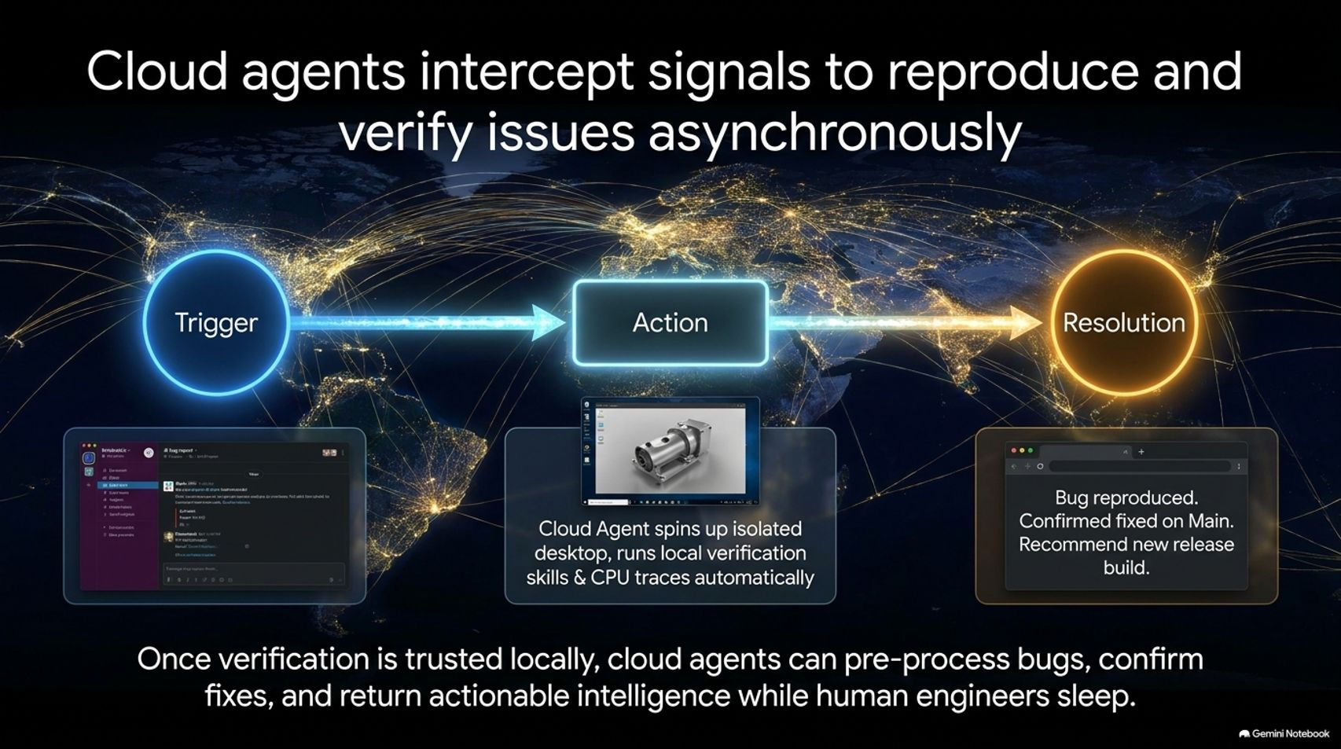
Notes:
Visual: A global network visualization showing a Trigger (Slack bug report) $\rightarrow$ Action (Cloud Agent spinning up isolated desktop) $\rightarrow$ Resolution (Bug reproduced / confirmed fixed on main).
Target Duration: 3–5 minutes
Speaker Notes:
Once verification is trusted locally, you can scale to cloud agents that operate asynchronously.
At Cursor, an internal agent named "Benny" monitors Slack bug reports and user feedback channels. When a trigger fires, the cloud agent spins up an isolated desktop environment, runs local verification skills and CPU traces automatically, and checks the codebase state.
In many cases, the agent discovers that a reported bug is already fixed on the main branch. It returns an actionable recommendation—such as suggesting a new release build—while human engineers are sleeping. This shifts engineering from reactive firefighting to asynchronous oversight.

Slide 8
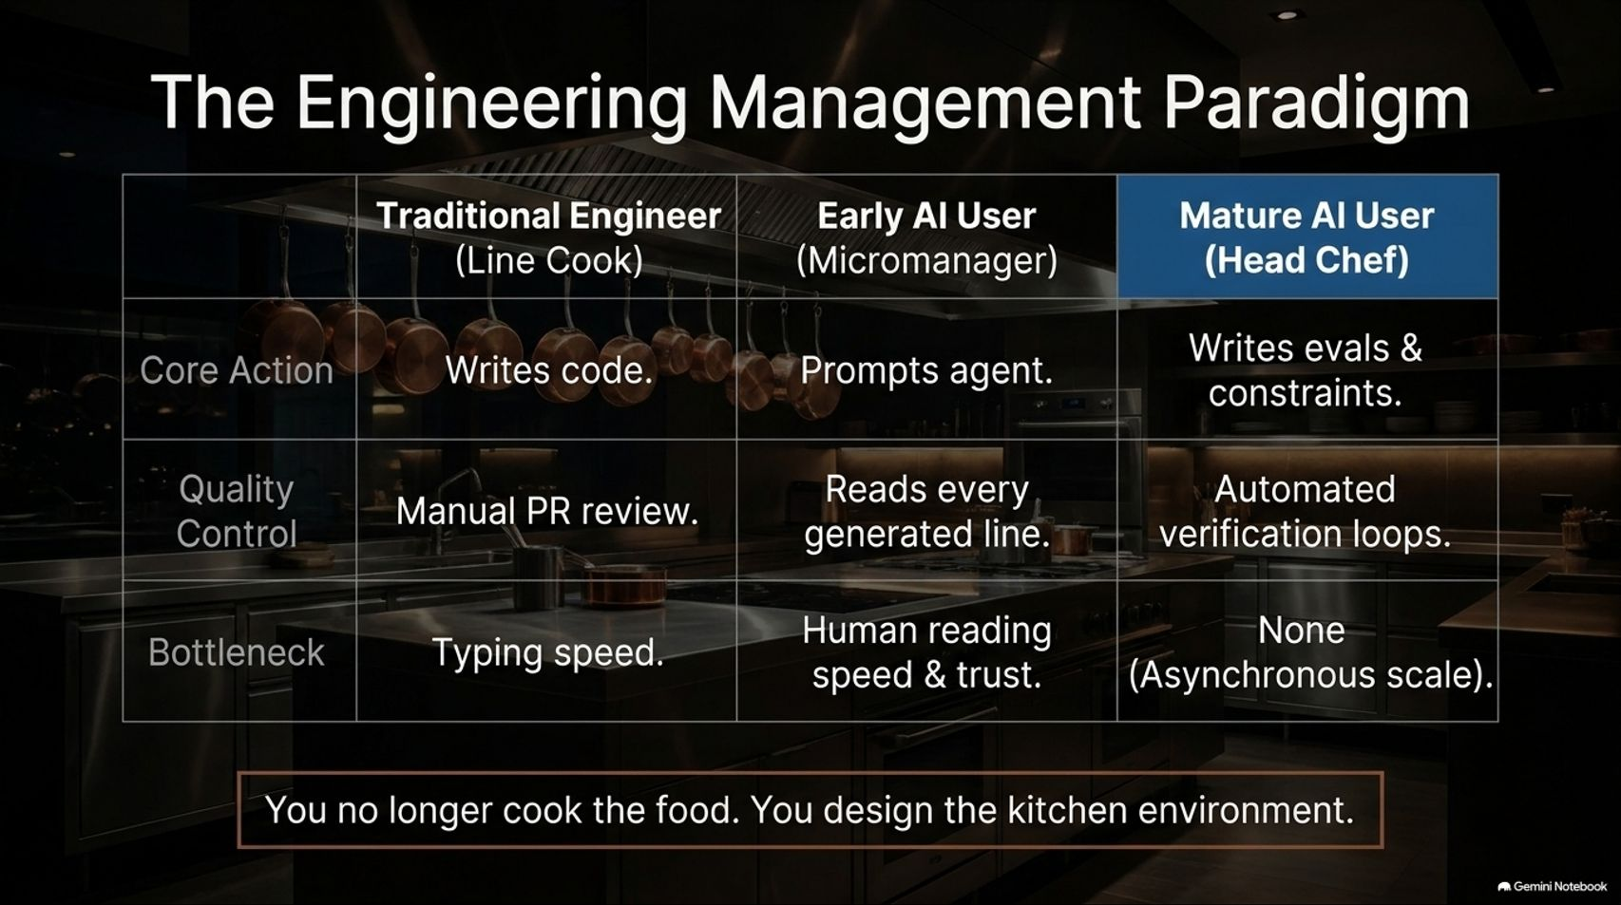
Notes:
Visual: A comparison table across Traditional Engineer (Line Cook), Early AI User (Micromanager), and Mature AI User (Head Chef).
Target Duration: 3–5 minutes
Speaker Notes:
This evolution fundamentally changes our role as engineers. Let's use a kitchen analogy.
A Traditional Engineer is like a line cook—they write code manually, do manual PR reviews, and their primary bottleneck is typing speed.
An Early AI User acts as a micromanager. They prompt agents, read every single generated line of code, and their bottleneck is reading speed and a lack of trust.
A Mature AI User is like the Head Chef. Core actions shift from writing code to writing evaluations, constraints, and architectural guardrails. Quality control is handed over to automated verification loops. The bottleneck drops to zero through asynchronous scale.
As the slide summary puts it: You no longer cook the food; you design the kitchen environment.

Slide 9
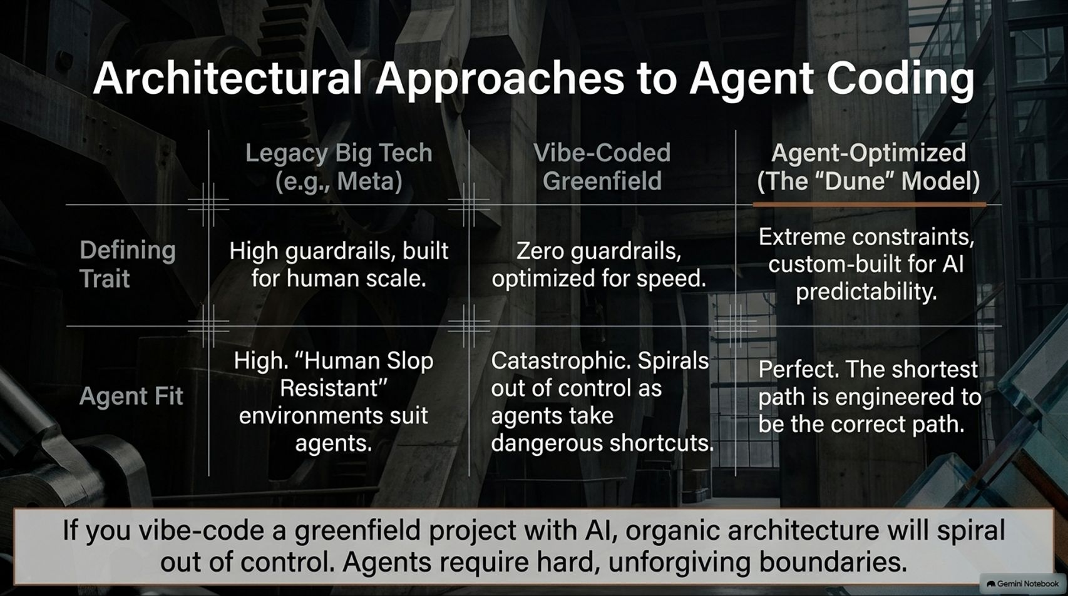
Notes:
Visual: A three-column comparison table covering Legacy Big Tech, Vibe-Coded Greenfield, and Agent-Optimized ("The Dune Model").
Target Duration: 4–6 minutes
Speaker Notes:
To enable head-chef autonomy, your architecture must be specifically optimized for AI behavior. Let's compare three approaches:
Legacy Big Tech (e.g., Meta): Built with heavy guardrails for human scale. While bureaucratic, these "human-slop-resistant" environments actually suit agents quite well because messy shortcuts are blocked by infra.
Vibe-Coded Greenfield: Zero guardrails, optimized purely for speed. This is catastrophic over time; without boundaries, organic architecture spirals out of control as agents take dangerous shortcuts.
Agent-Optimized ("The Dune Model"): Custom-built for AI predictability using extreme constraints. The shortest path in the architecture is deliberately engineered to be the only correct path.

Slide 10
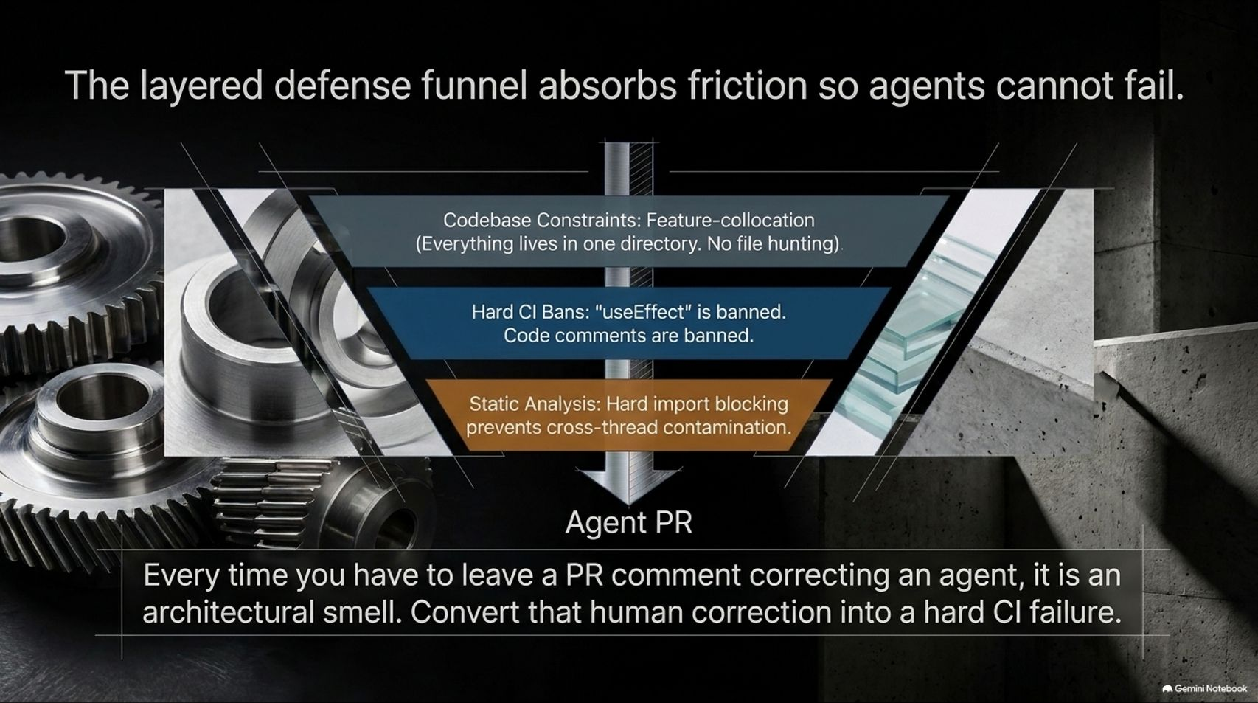
Notes:
Visual: An inverted funnel graphic showing Codebase Constraints (feature colocation), Hard CI Bans (useEffect and code comments banned), and Static Analysis (hard import blocking) leading to Agent PRs.
Target Duration: 4–5 minutes
Speaker Notes:
How do we enforce this agent-optimized architecture? Through a layered defense funnel.
Every time you have to leave a PR comment correcting an agent, recognize it as an architectural smell. Do not rely on soft text prompting or style guides; convert that human correction into a hard CI failure.
Our defense funnel has multiple layers:
Codebase Constraints: Feature colocation—everything for a feature lives in one single directory so agents don't waste tokens file-hunting.
Hard CI Bans: Categorically banning notorious foot-guns like React's useEffect or unhelpful historical code comments that confuse LLMs.
Static Analysis: Hard import blocking that prevents cross-thread contamination (e.g., keeping electron main thread logic strictly isolated from renderer thread code).

Slide 11
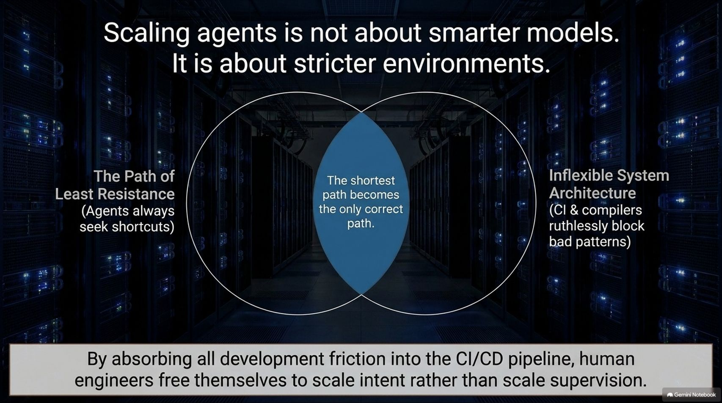
Notes:
Visual: A Venn diagram intersecting "The Path of Least Resistance" (agents seek shortcuts) and "Inflexible System Architecture" (CI/CD and compilers ruthlessly block bad patterns).
Target Duration: 3–4 minutes
Speaker Notes:
A common misconception is that we just need to wait for smarter models to solve agentic coding. But scaling agents is actually about stricter environments.
AI agents will always seek the path of least resistance. If an inefficient or unsafe shortcut exists, they will take it.
Therefore, your system architecture must be inflexible. By configuring your compilers, linters, and CI/CD pipelines to ruthlessly block bad patterns, the path of least resistance becomes the only correct path.
By absorbing all development friction into automated pipelines, human engineers free themselves to scale intent rather than scale supervision.

Slide 12
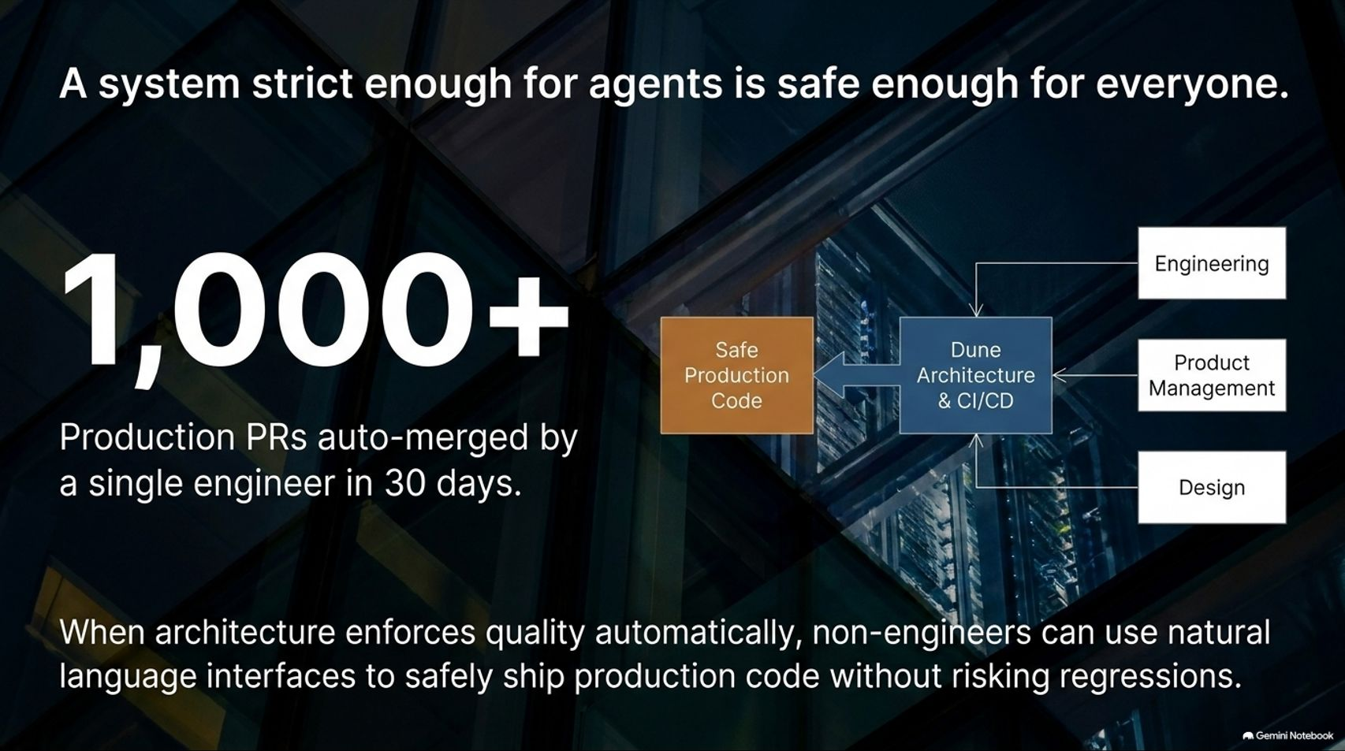
Notes:
Visual: A metric showcase highlighting "1,000+ Production PRs auto-merged by a single engineer in 30 days" alongside an architecture diagram bridging Engineering, Product Management, and Design.
Target Duration: 3–5 minutes
Speaker Notes:
When you build a system strict enough to safely handle autonomous agents, something amazing happens: it becomes safe for everyone else in the company too.
At Cursor, Lauren Tan's rigorous "Dune" architecture enabled a single engineer to ship over 1,000 auto-merged production PRs in a 30-day window.
Because quality enforcement is fully automated into the architecture and CI pipeline, non-engineers—such as product managers and designers using natural language interfaces (like Grockbot)—can safely submit and merge production-ready pull requests without risking regressions.

Slide 13
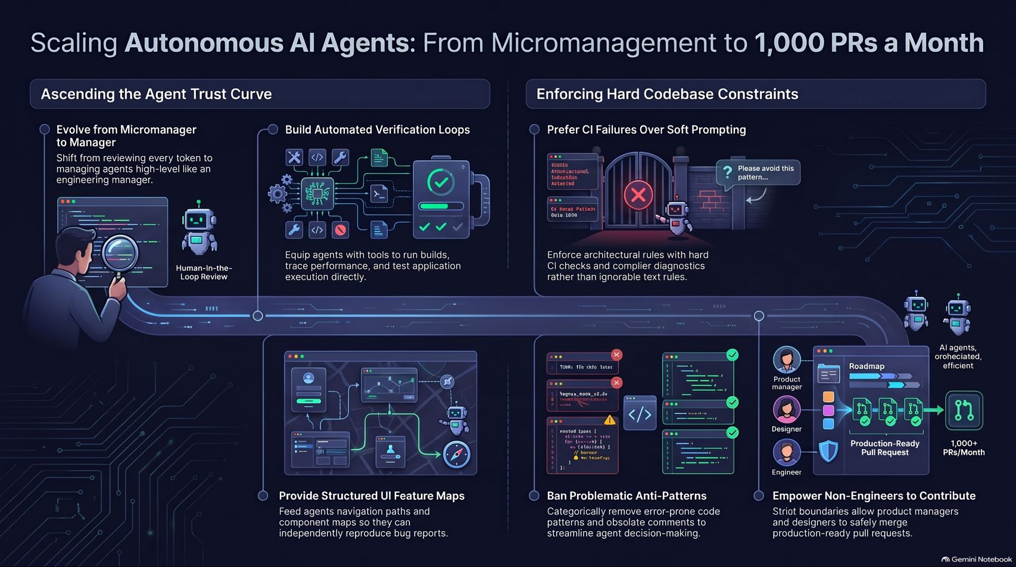
Notes:
Visual: A comprehensive summary infographic mapping the entire journey: Ascending the Agent Trust Curve, Building Automated Verification Loops, Providing Structured UI Feature Maps, Enforcing Hard Codebase Constraints, Banishing Anti-Patterns, and Empowering Non-Engineers.
Target Duration: 3–5 minutes
Speaker Notes:
To wrap up, let's review the complete roadmap for scaling autonomous AI agents in your organization:
1. Evolve from Micromanager to Manager: Shift your focus from reviewing every generated token to managing agents at a high level.
2. Build Automated Verification Loops: Equip agents with tools to run builds, trace performance, and execute tests directly so they can verify their own correctness.
3. Provide Structured UI Feature Maps: Feed agents exact component navigation paths so they can accurately reproduce vague user bug reports.
4. Enforce Hard Codebase Constraints & Ban Anti-Patterns: Use strict CI checks, static analysis, and import blockers rather than ignorable text rules to eliminate error-prone code.
5. Empower Non-Engineers: Let strict architectural boundaries enable PMs and designers to safely contribute high-quality code at scale.
Thank you all for your time, and I look forward to your questions!

