Slide 1
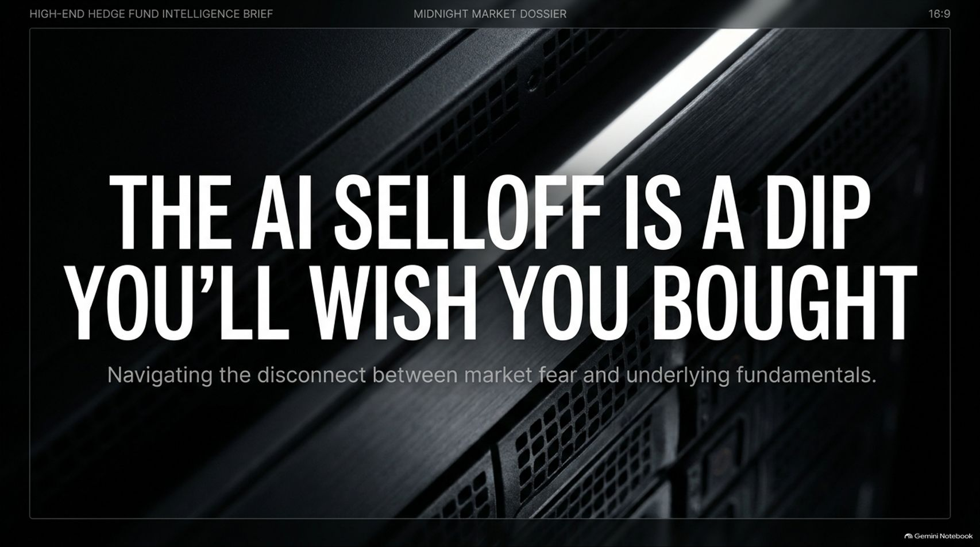
Notes:
Visual: A high-end server rack background with bold title text: "The AI Selloff Is a Dip You’ll Wish You Bought" and the subtitle "Navigating the disconnect between market fear and underlying fundamentals."
Target Duration: 2–3 minutes
Speaker Notes:
Welcome everyone to our high-end hedge fund intelligence brief. Today, we are addressing the elephant in the room: The AI selloff is a dip you’ll wish you bought.
Everywhere you look in financial media, panic is setting in. Investors are seeing major tech names tumble, portfolios down 20 to 40 percent from their peaks, and widespread doubt circulating across the trading floor.
But as institutional intelligence briefs and market analysts like Chris Marcott and Thomas Hughes point out, we are witnessing a severe disconnect between short-term market fear and pristine underlying fundamentals.
Over the next 15 slides, we will dissect the drivers of this pullback, examine the reality behind big tech, infrastructure, and memory stocks, and lay out a tactical playbook to help you navigate this volatility and position yourself for the inevitable rebound.
The AI Selloff Is Getting Worse (The Dip You’ll Wish You Bought)
https://www.youtube.com/watch?v=4RPOlTRYxWc

Slide 2
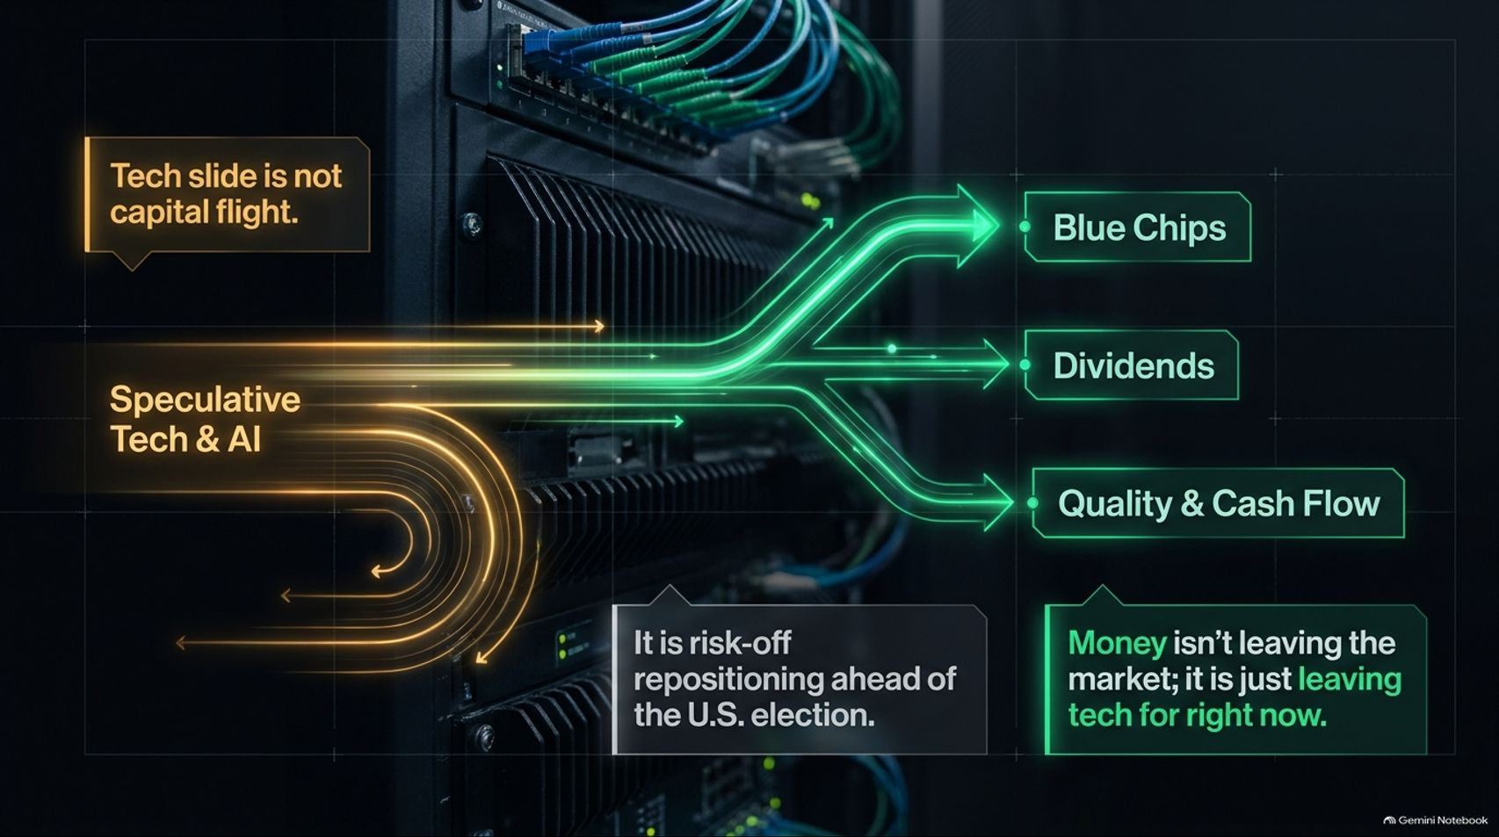
Notes:
Visual: An architectural routing diagram showing speculative tech and AI flows splitting toward blue chips, dividends, and quality/cash flow, with callouts noting risk-off repositioning ahead of the U.S. election.
Target Duration: 3–4 minutes
Speaker Notes:
Let's address the primary macro panic: Is money leaving the market entirely? The short answer is no. This tech slide is not capital flight.
When the NASDAQ opens higher only to roll over and finish in the red—with major names like Oracle sliding and chip stocks experiencing heavy selling—retail investors panic, assuming capital is evaporating.
In reality, money isn't leaving the market; it is simply rotating out of high-beta tech for the moment. Ahead of the U.S. election and upcoming macro catalysts, institutional money is engaging in a classic "risk-off" repositioning.
Capital is flowing temporarily into safer havens like blue chips, dividend-paying stocks, and companies with immediate, high-quality cash flow. Recognizing this rotation prevents you from mistaking a tactical macro pause for a secular structural collapse.

Slide 3
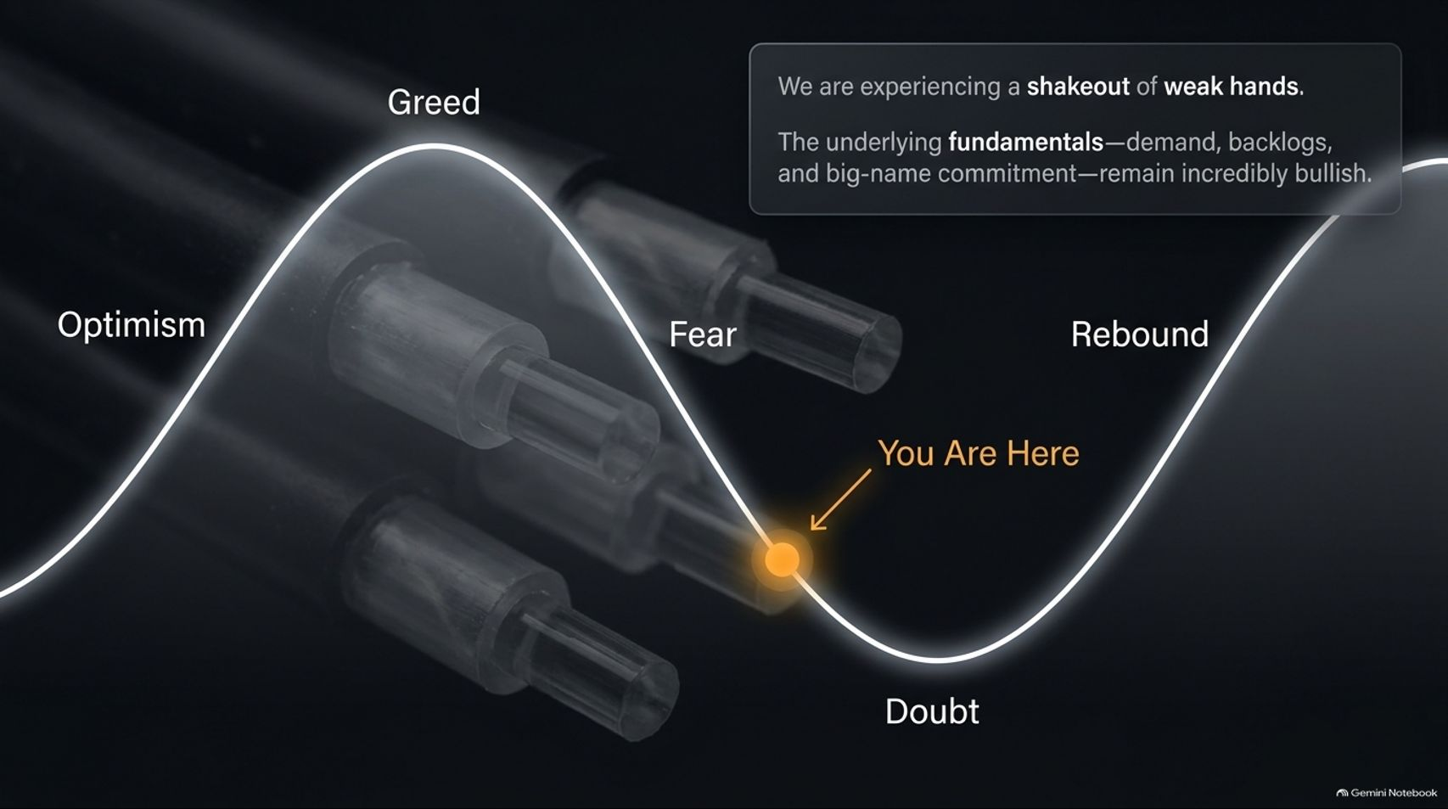
Notes:
Visual: A wave chart tracking market sentiment through Optimism, Greed, Fear, Doubt, and Rebound, with a glowing "You Are Here" marker positioned squarely in the valley of Doubt.
Target Duration: 3–5 minutes
Speaker Notes:
Market psychology follows a predictable, repeating arc: Optimism, Greed, Fear, Doubt, and finally, Rebound. Right now, you are here—sitting deep in the valley of Doubt.
This phase is characterized by a systemic shakeout of weak hands. Investors who chased high-flying momentum without understanding the underlying business models are capitulating and selling at the worst possible time.
However, look at the fundamental reality: actual customer demand, massive order backlogs, and multi-year infrastructure commitments from big-name tech giants remain incredibly bullish.
The market is experiencing a psychological washout, clearing out speculative froth and setting the stage for a powerful recovery as earnings reports confirm the long-term thesis.

Slide 4
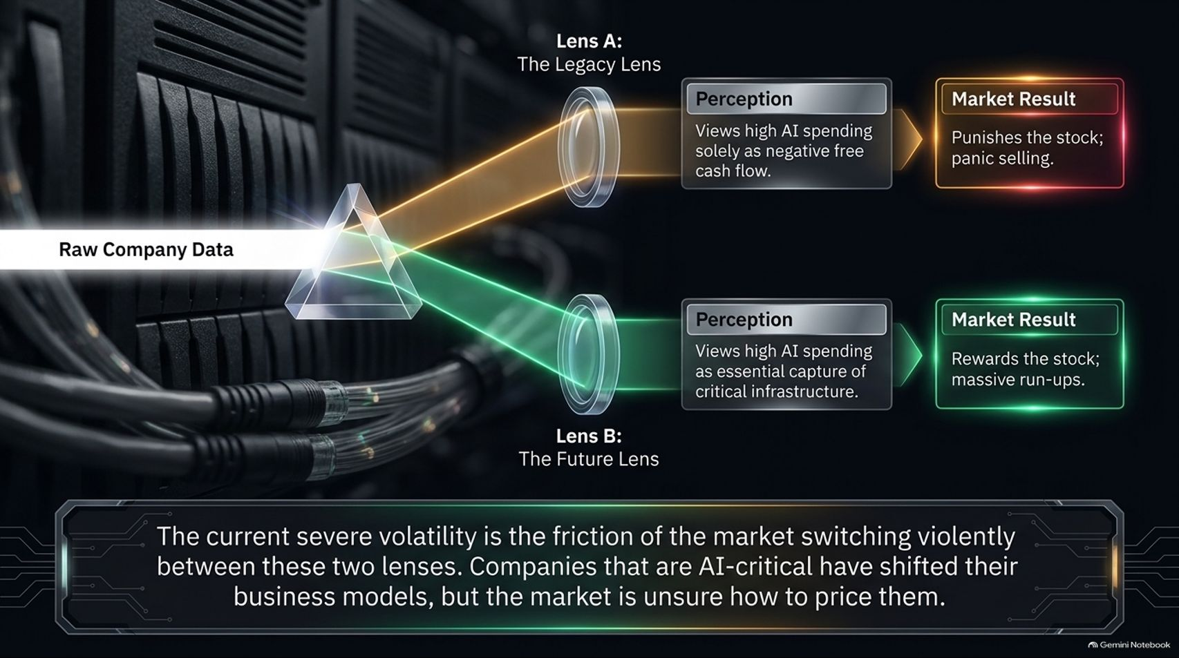
Notes:
Visual: A light refraction diagram through a prism, showing Lens A (The Legacy Lens viewing spending as negative FCF $\rightarrow$ panic selling) and Lens B (The Future Lens viewing spending as essential infrastructure $\rightarrow$ massive run-ups).
Target Duration: 4–6 minutes
Speaker Notes:
Why is the market experiencing such severe volatility? Because investors are looking at raw company data through two completely opposing optical lenses.
Lens A (The Legacy Lens): Evaluates companies through traditional metrics, viewing high AI capital expenditures solely as negative free cash flow. The market result under this lens is swift punishment and panic selling.
Lens B (The Future Lens): Recognizes that aggressive capital expenditure is an essential, once-in-a-generation capture of critical compute infrastructure. When viewed this way, the market rewards stocks with massive run-ups.
The current market friction is the violent switching between these two perspectives. AI-critical companies have fundamentally transformed their business models, and the market is still struggling to price this structural shift accurately.

Slide 5
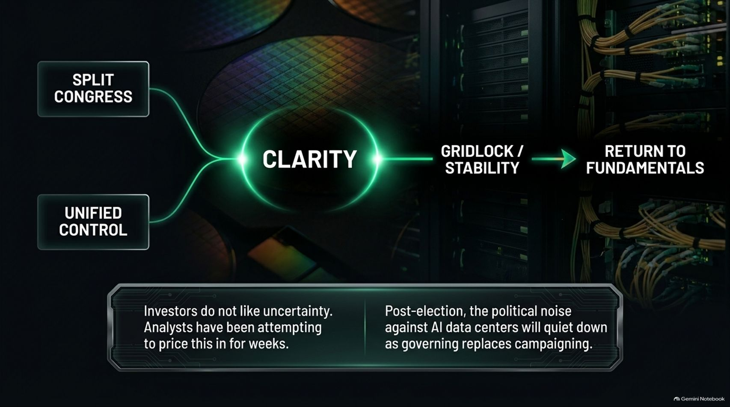
Notes:
Visual: A flowchart mapping Split Congress and Unified Control paths converging into Clarity, leading to Gridlock/Stability and a Return to Fundamentals.
Target Duration: 3–5 minutes
Speaker Notes:
Uncertainty is the absolute enemy of equity markets, and election weeks amplify this anxiety tenfold. Analysts have spent weeks attempting to price in political risk.
Whether the outcome results in a split Congress or unified control, the political reality points toward institutional gridlock. While political gridlock sounds frustrating to voters, Wall Street loves it because it breeds economic and regulatory stability.
Furthermore, post-election, the aggressive political rhetoric targeting AI data centers and energy consumption will inevitably quiet down. Once campaigning transitions into actual governing, the underlying economic engine takes over, allowing a clean return to fundamentals.

Slide 6
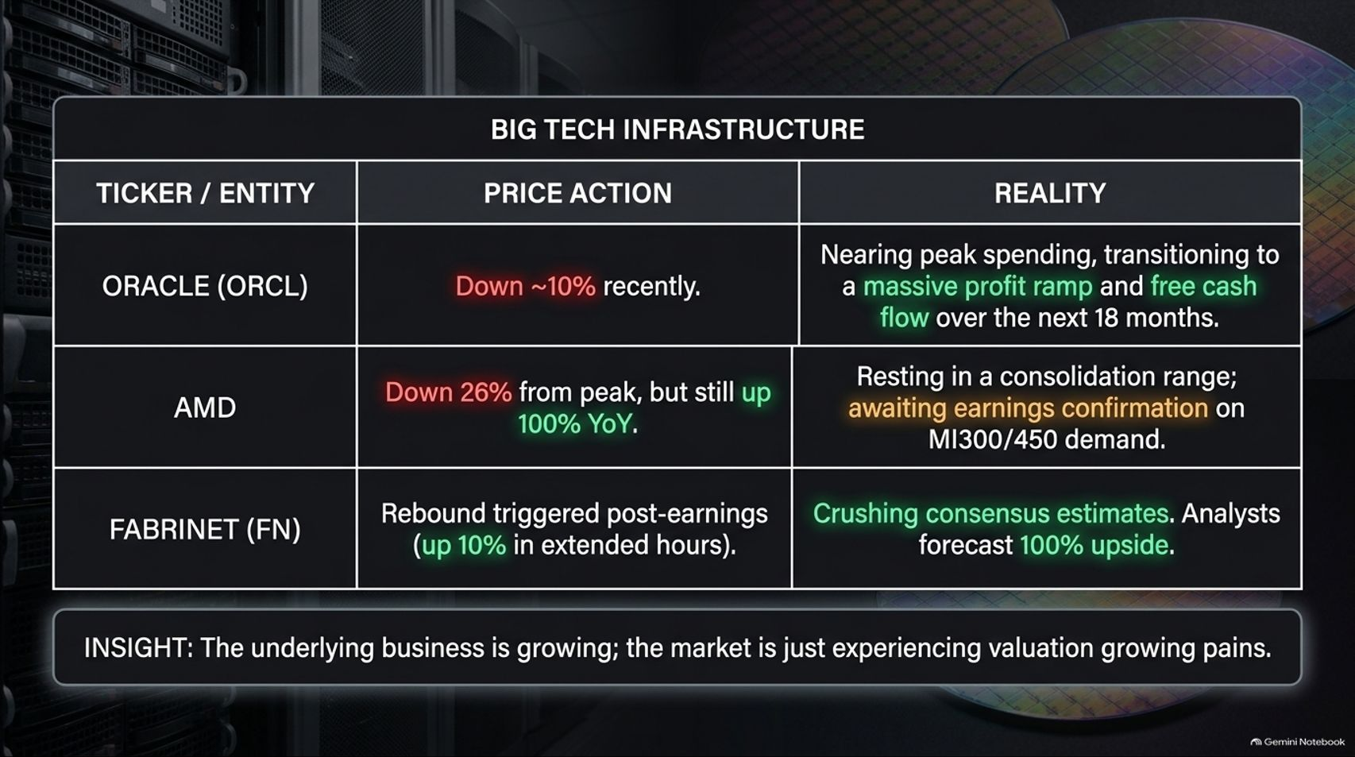
Notes:
Visual: A financial intelligence table evaluating Oracle (ORCL), AMD, and Fabrinet (FN), tracking recent price action against underlying reality and profit ramps.
Target Duration: 4–6 minutes
Speaker Notes:
Let's look at the concrete data across major AI infrastructure plays:
Oracle (ORCL): Recently down roughly 10% amid market pullbacks. However, the reality is that Oracle is nearing peak capital spending, transitioning directly into a massive profit ramp and explosive free cash flow generation over the next 18 months.
AMD: Down about 26% from its peak, yet still up 100% year-over-year. It is resting comfortably in a consolidation range, awaiting earnings confirmation on MI300 and MI450 rack-scale demand.
Fabrinet (FN): Following strong earnings reports, it triggered double-digit extensions in after-hours trading, crushing consensus estimates as analysts project substantial upside.
The Insight: The underlying businesses are growing rapidly; the market is merely experiencing valuation growing pains.

Slide 7
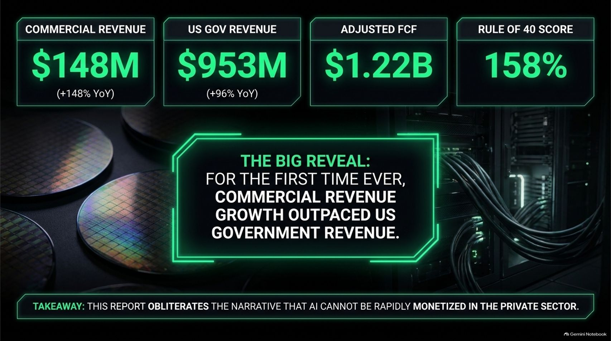
Notes:
Visual: Metric callouts highlighting Commercial Revenue ($148M, +148% YoY), US Gov Revenue ($953M, +96% YoY), Adjusted FCF ($1.22B), and a Rule of 40 Score of 158%.
Target Duration: 4–6 minutes
Speaker Notes:
Palantir’s latest earnings report delivered a watershed moment that completely shatters prevailing bearish narratives.
For the first time in the company's history, commercial revenue growth outpaced U.S. government revenue. Commercial revenue surged 148% year-over-year, proving beyond a shadow of a doubt that enterprise artificial intelligence can be rapidly and massively monetized in the private sector.
Backed by a staggering Rule of 40 score of 158% and adjusted free cash flow exceeding $1.22 billion, Palantir proves that foundational AI software platforms are scaling efficiently. Major financial institutions like JPMorgan and Oppenheimer have responded by raising price targets well above $230–$260, validating the pullback as a prime accumulation window.

Slide 8
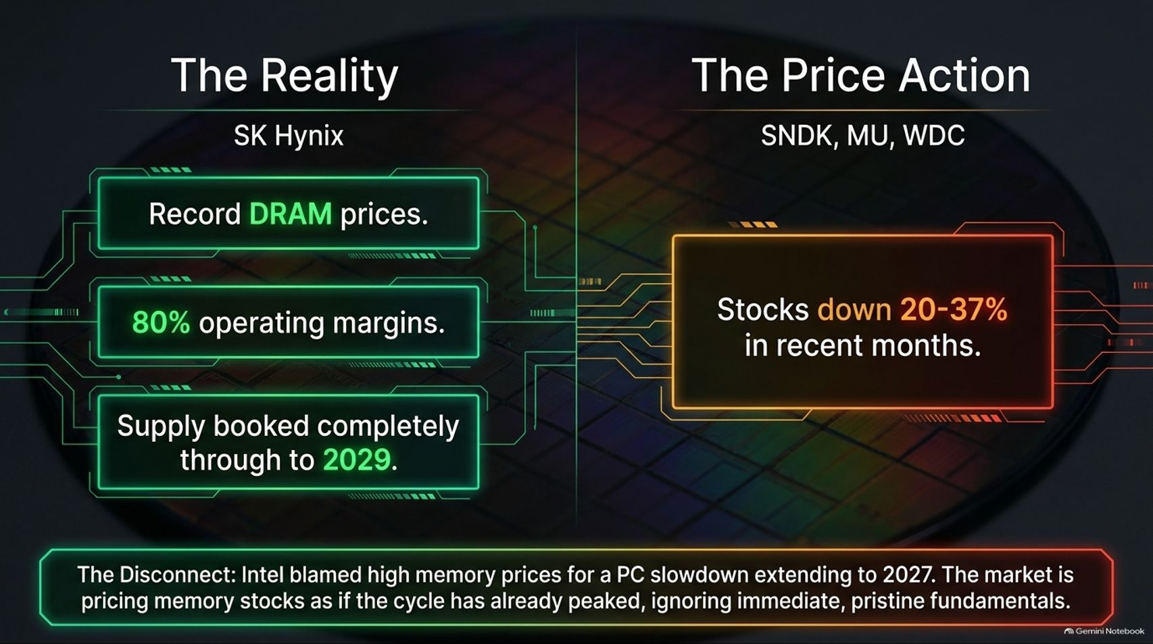
Notes:
Visual: A split comparison contrasting SK Hynix's reality (record DRAM prices, 80% operating margins, supply booked through 2029) with the price action of SNDK, MU, and WDC (stocks down 20–37% in recent months).
Target Duration: 4–6 minutes
Speaker Notes:
One of the most glaring disconnects in the current market is found in memory and storage semiconductors.
Look at the fundamentals: SK Hynix is posting record DRAM prices, operating margins sitting at an incredible 80%, and supply completely booked solid through 2029.
Yet, public memory and storage equities (such as SanDisk/Western Digital and Micron) have been aggressively beaten down by 20% to 37%. Why? Because Intel recently blamed high memory prices for a PC market slowdown extending into 2027, causing Wall Street to price memory stocks as if the cycle has already peaked.
This is a textbook market overreaction—ignoring pristine, immediate fundamentals based on speculative macro fear.

Slide 9
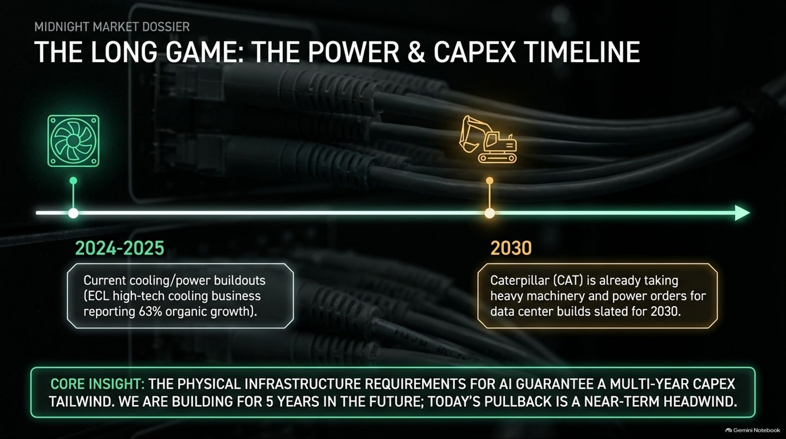
Notes:
Visual: A timeline graphic running from current cooling/power buildouts (2024–2025) out to 2030, highlighting heavy machinery and data center power orders.
Target Duration: 3–5 minutes
Speaker Notes:
To understand why this selloff is a generational buying opportunity, you have to zoom out and look at the physical infrastructure timeline.
In 2024 and 2025, we are witnessing massive buildouts in advanced cooling and power management—with high-tech cooling businesses reporting over 60% organic growth.
Looking further down the horizon, industrial bellwethers like Caterpillar (CAT) are already actively taking heavy machinery and power generation orders for data center builds slated all the way out to 2030.
Core Insight: The physical infrastructure requirements for AI guarantee a multi-year capital expenditure tailwind. We are building infrastructure five years into the future; today's market pullback is nothing more than a near-term headwind.

Slide 10
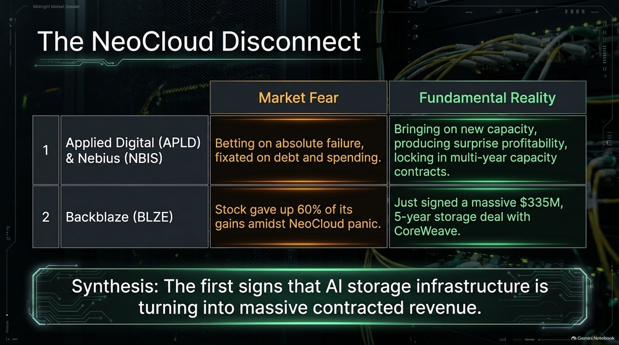
Notes:
Visual: A comparison table analyzing Applied Digital (APLD), Nebius (NBIS), and Backblaze (BLZE), contrasting market fear against fundamental reality and contracted revenue.
Target Duration: 4–6 minutes
Speaker Notes:
The disconnect is perhaps most pronounced in the NeoCloud sector, where market fear has completely detached from underlying reality.
Applied Digital (APLD) & Nebius (NBIS): Wall Street has been fixated on debt and capital spending, effectively betting on absolute failure. Meanwhile, these companies are successfully bringing online massive new compute capacity, producing surprise profitability, and locking in multi-year capacity contracts.
Backblaze (BLZE): Despite giving up significant gains during recent NeoCloud panic, the company secured a massive $335 million, 5-year storage deal with CoreWeave.
Synthesis: Specialized AI storage and compute infrastructure are rapidly transforming into massive, predictable streams of contracted revenue.

Slide 11
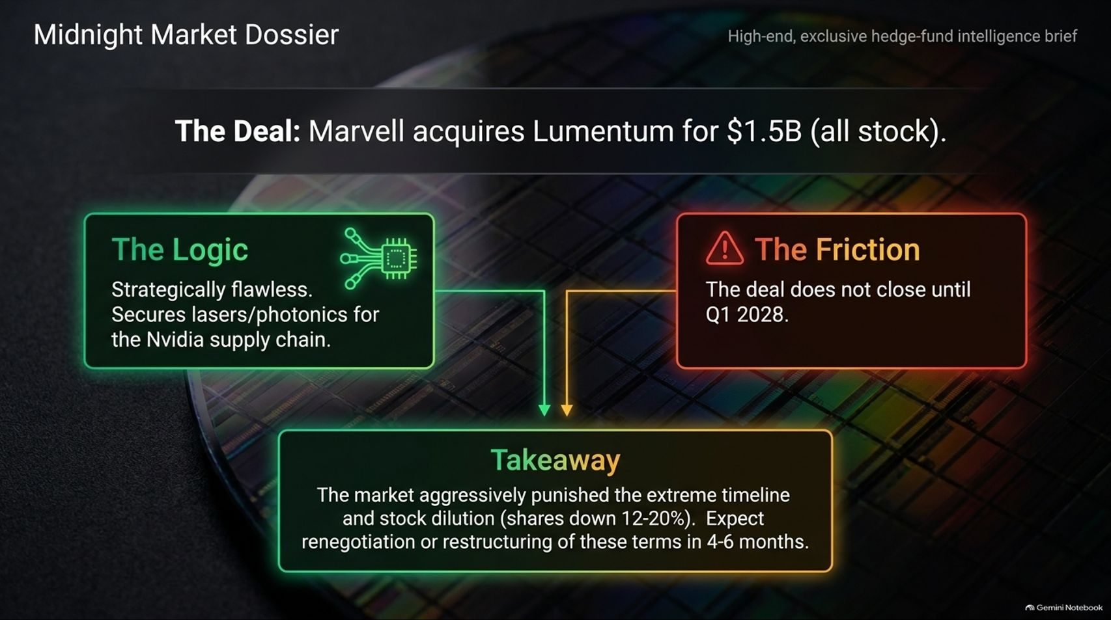
Notes:
Visual: A breakdown of Marvell acquiring Lumentum for $1.5B (all stock), detailing strategic logic (lasers/photonics for Nvidia supply chain), friction (closing Q1 2028), and market takeaway.
Target Duration: 4–6 minutes
Speaker Notes:
M&A activity in the tech sector is providing fascinating signals about where industry leaders are placing their long-term bets. Marvell recently announced its acquisition of Lumentum for $1.5 billion in an all-stock transaction.
The Logic: Strategically, the deal is flawless. It secures critical laser and photonics technology, deeply embedding Marvell into the vital Nvidia supply chain.
The Friction: The market aggressively punished the announcement due to extreme dilution and an extended closing timeline stretching out to Q1 2028.
Takeaway: While the timeline introduces regulatory and execution friction, expect terms to be restructured or renegotiated as market conditions normalize over the next 4 to 6 months.

Slide 12
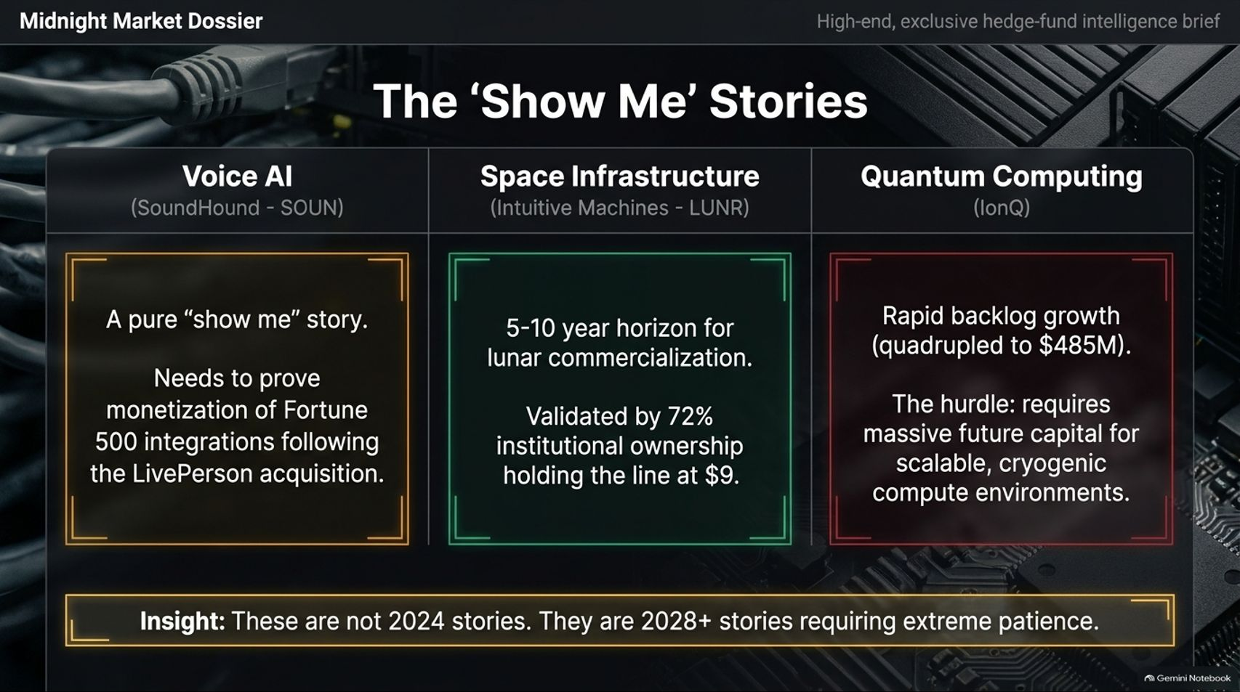
Notes:
Visual: A three-column grid analyzing Voice AI (SoundHound - SOUN), Space Infrastructure (Intuitive Machines - LUNR), and Quantum Computing (IonQ).
Target Duration: 4–6 minutes
Speaker Notes:
Beyond immediate infrastructure, the market is heavily discounting "Show Me" stories that require long-term technological maturation:
Voice AI (SoundHound - SOUN): A pure show-me story that must successfully prove enterprise monetization of Fortune 500 integrations following its LivePerson acquisition.
Space Infrastructure (Intuitive Machines - LUNR): Operates on a 5-to-10-year horizon for lunar commercialization, yet retains strong institutional backing with over 72% institutional ownership holding the line.
Quantum Computing (IonQ): Rapidly growing its backlog (quadrupling to $485M), though facing the hurdle of requiring massive future capital investments for scalable cryogenic compute environments.
Insight: These are not 2024 trading plays; they are 2028+ secular stories requiring extreme investor patience.

Slide 13
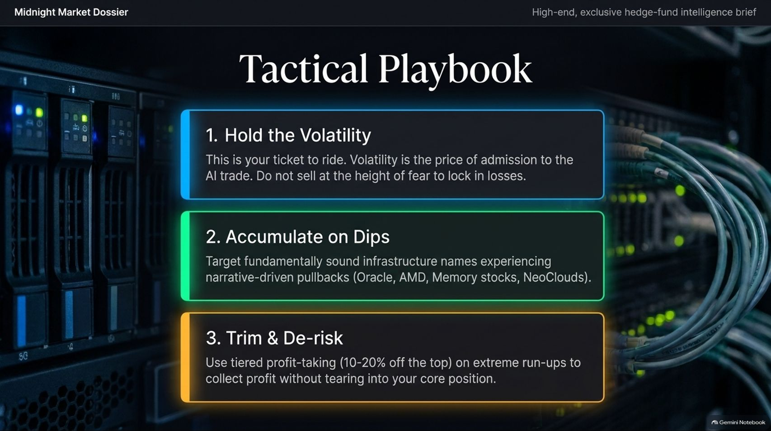
Notes:
Visual: A three-step tactical guide: 1. Hold the Volatility, 2. Accumulate on Dips, and 3. Trim & De-risk.
Target Duration: 4–6 minutes
Speaker Notes:
How do we translate this intelligence brief into actionable portfolio management? We follow our Tactical Playbook:
1. Hold the Volatility: Volatility is quite literally the price of admission to the AI trade. Do not panic-sell at the height of fear and lock in permanent losses. Time in the market will always outlast transient narrative fear.
2. Accumulate on Dips: Target fundamentally sound infrastructure names that are experiencing narrative-driven pullbacks—such as Oracle, AMD, top-tier memory suppliers, and resilient NeoClouds.
3. Trim & De-risk: Utilize tiered profit-taking (skimming 10% to 20% off the top) during extreme vertical run-ups to collect profits without damaging your core long-term positions.

Slide 14
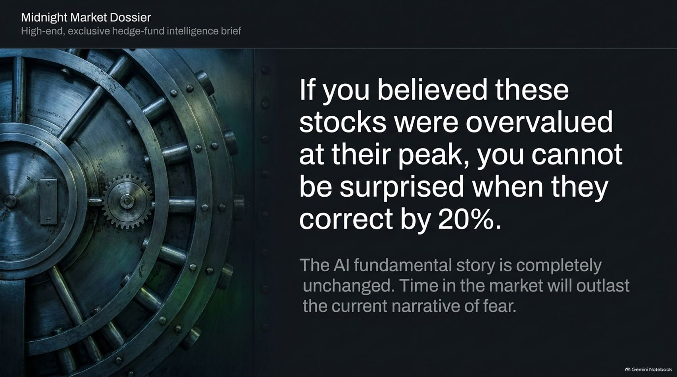
Notes:
Visual: A heavy bank vault door with a mechanical wheel, accompanied by the quote: "If you believed these stocks were overvalued at their peak, you cannot be surprised when they correct by 20%."
Target Duration: 3–4 minutes
Speaker Notes:
Let's anchor on a vital reality check: If you believed these stocks were overvalued at their absolute peak, you cannot possibly be surprised when they correct by 20%.
Corrections are healthy, natural mechanisms that wash out speculative excess. A healthy 20% pullback on a secular bull market does not invalidate the underlying thesis.
The fundamental AI investment story remains completely unchanged. Power requirements are expanding, data center buildouts are locked in through 2030, and enterprise monetization is accelerating. Disciplined time in the market will easily outlast today's manufactured narrative of fear.

Slide 15
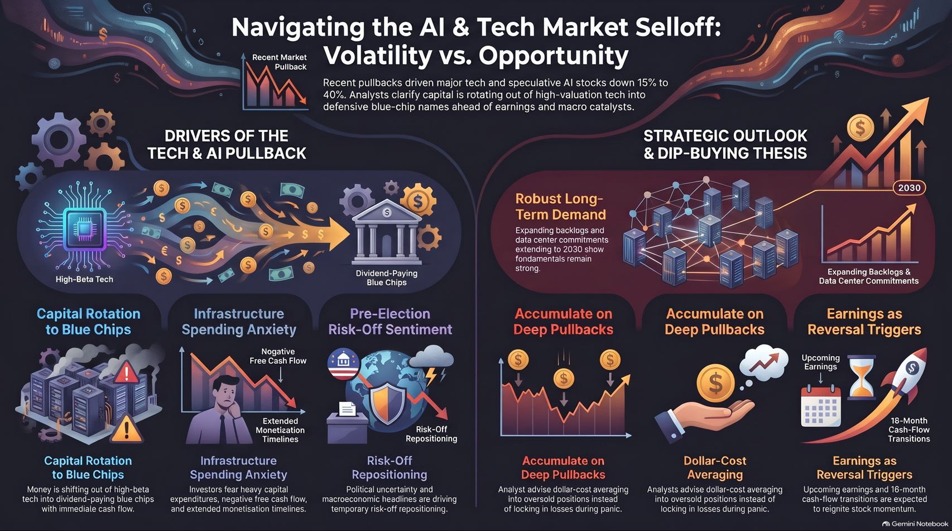
Notes:
Visual: A comprehensive summary dashboard contrasting Drivers of the Tech & AI Pullback with the Strategic Outlook & Dip-Buying Thesis.
Target Duration: 3–5 minutes
Speaker Notes:
As we conclude today's intelligence brief, let's review the macro picture:
On the left, we see the transient drivers of the pullback: capital rotation into defensive blue chips, temporary infrastructure spending anxiety regarding free cash flow, and pre-election risk-off sentiment.
On the right, we see the overpowering structural thesis: robust long-term demand expanding out to 2030, deep valuation pullbacks offering prime dollar-cost averaging entry points, and upcoming earnings catalysts ready to trigger massive cash-flow transitions.
Stay disciplined, stick to your investment thesis, and capitalize on the volatility. Thank you for joining us, and happy investing!

