Slide 1
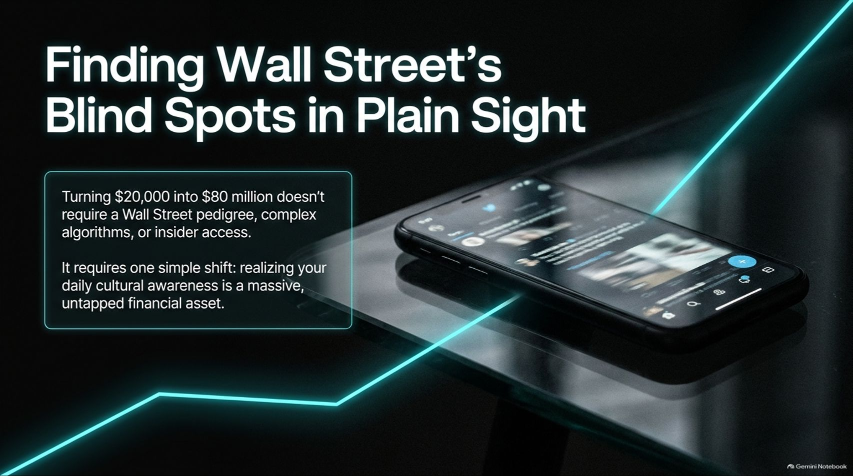
Notes:
Visual: A sleek smartphone resting on a dark glass table displaying a social feed, intersected by glowing neon cyan trend lines, with the title "Finding Wall Street’s Blind Spots in Plain Sight" and a breakout box emphasizing turning $20,000 into $80 million.
Target Duration: 2–3 minutes
Speaker Notes:
Welcome everyone to our deep dive on The Observational Edge. Today, we are exploring how everyday cultural awareness can be converted into a massive financial asset.
Most retail investors assume that generating life-changing returns—such as turning $20,000 into over $80 million, as legendary observational investor Chris Camillo has done—requires an elite Wall Street pedigree, complex algorithmic modeling, or insider access.
As Camillo highlights in his interview, that is a complete myth. The financial markets are meaningfully inefficient. While institutional desks are buried in macro data and Fed rate projections, ground-truth consumer behavior is happening all around us in plain sight. Your daily cultural awareness is the ultimate untapped financial edge.
$80M Trader: I’m begging you to allow yourself to learn how to be rich | Chris Camillo
https://www.youtube.com/watch?v=ipR3gsHE9U0

Slide 2
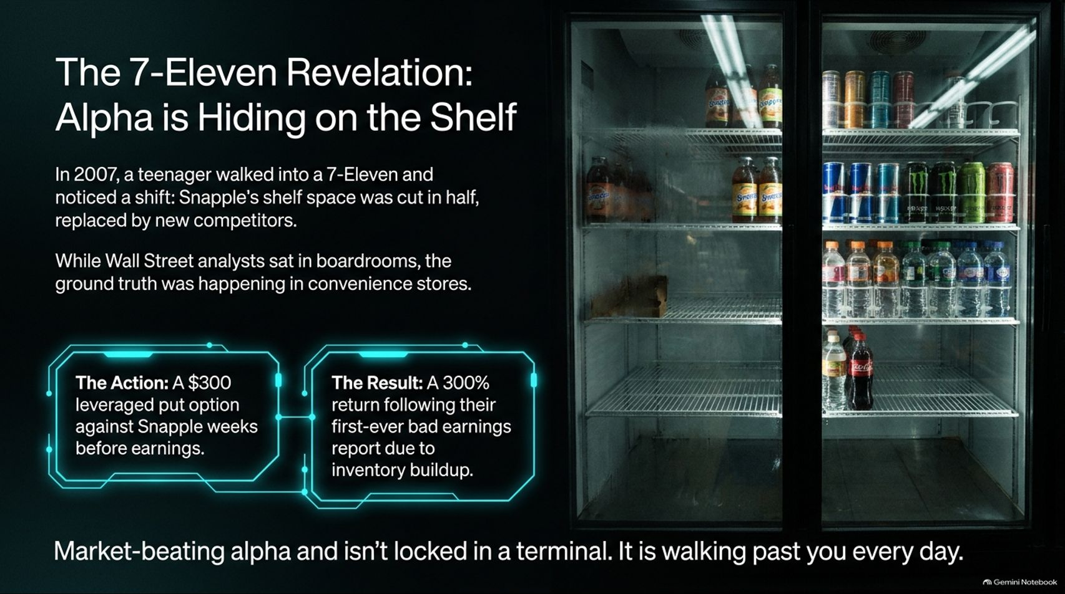
Notes:
Visual: A split layout showing a vintage convenience store beverage refrigerator on the right and breakout containers detailing a $300 leveraged put option and a 300% return on the left.
Target Duration: 3–4 minutes
Speaker Notes:
To understand how this strategy works, let's look back at its genesis: The 7-Eleven Revelation.
Back in 2007, a young Chris Camillo walked into a 7-Eleven to buy his usual Snapple lemon-flavored iced tea. He noticed something odd: Snapple's shelf space had been cut in half, squeezed by new competitors like Arizona Iced Tea.
While Wall Street analysts sat comfortably in boardrooms looking at spreadsheets, the actual ground truth was visible right there in convenience store refrigerators.
Armed with just $300 made from garage sales, he bought put options against Snapple ahead of earnings. When Snapple reported its first-ever bad earnings due to inventory buildup from retailer displacement, that $300 tripled. Market-beating alpha isn't locked behind a Bloomberg terminal; it is walking past you every single day.

Slide 3
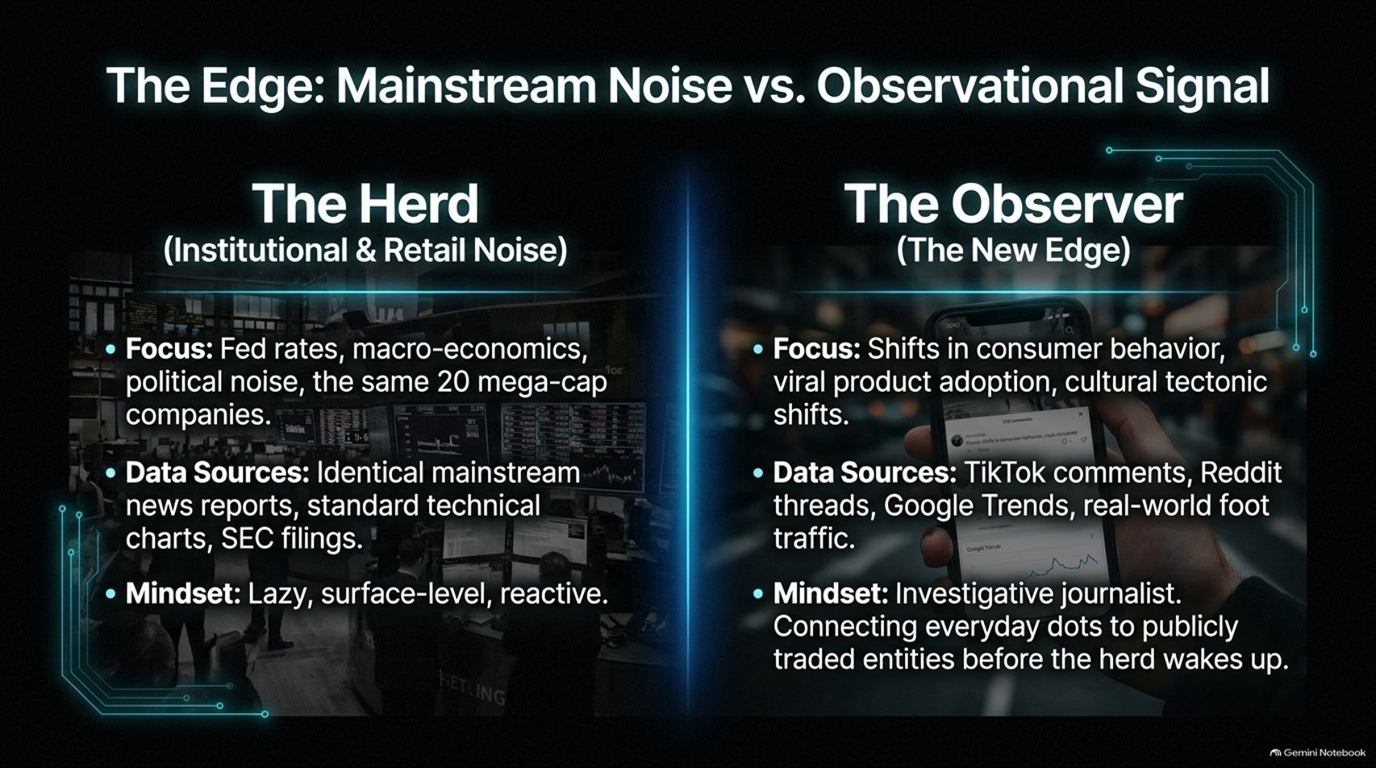
Notes:
Visual: A comparative two-column layout contrasting "The Herd" (surrounded by institutional trading floors and macro tickers) against "The Observer" (holding a smartphone scanning TikTok and Google Trends).
Target Duration: 3–5 minutes
Speaker Notes:
To be successful, you must understand the stark difference between mainstream noise and observational signal.
The Herd (Institutional & Retail Noise): Focuses obsessively on Fed interest rates, macroeconomic political noise, and the same crowded 20 mega-cap companies. Their data sources are identical mainstream news reports, standard technical charts, and backward-looking SEC filings. Their mindset is lazy, surface-level, and reactive.
The Observer (The New Edge): Focuses on shifts in consumer behavior, viral product adoption, and cultural tectonic shifts. They mine TikTok comments, Reddit threads, Google Trends, and real-world foot traffic. Operating with the mindset of an investigative journalist, they connect everyday dots to publicly traded entities long before the herd wakes up.

Slide 4
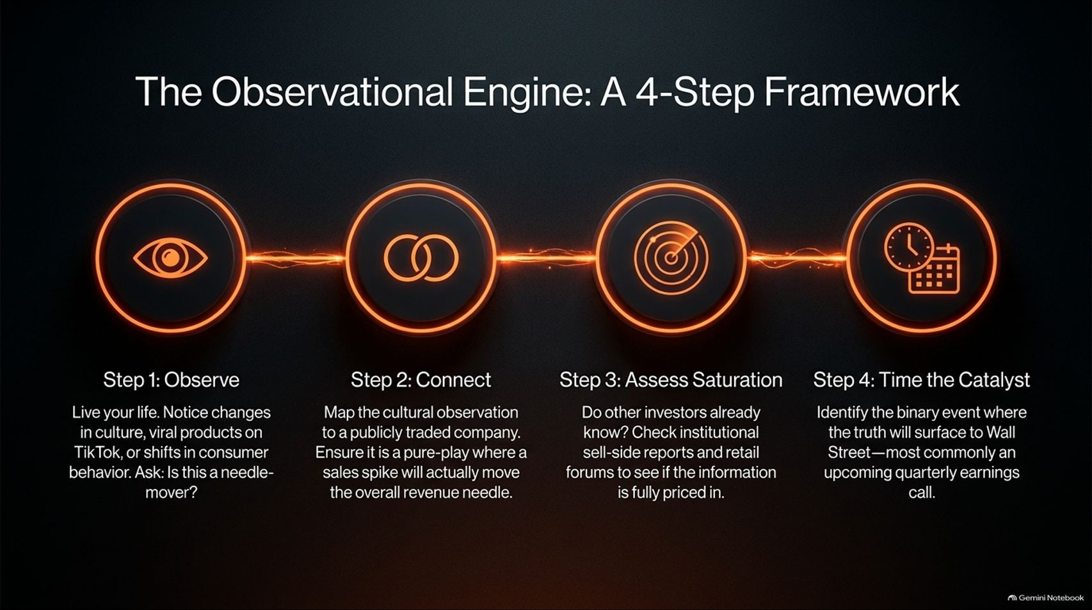
Notes:
Visual: A 4-step linear process flow showing glowing orange node icons for Step 1 (Observe), Step 2 (Connect), Step 3 (Assess Saturation), and Step 4 (Time the Catalyst).
Target Duration: 4–6 minutes
Speaker Notes:
Observational investing is not random guessing; it is a rigorous, repeatable engine built on four distinct steps:
Step 1: Observe: Live your life. Notice changes in culture, viral products on TikTok, or shifts in consumer behavior and ask: Is this a needle-mover?
Step 2: Connect: Map that cultural observation directly to a publicly traded company. Ensure it is a pure-play or large enough unit where a sales spike will actually move the overall revenue needle.
Step 3: Assess Saturation: Do other investors already know? Check institutional sell-side reports and retail forums to see if the information is fully priced in.
Step 4: Time the Catalyst: Identify the binary event where the truth will surface to Wall Street—most commonly an upcoming quarterly earnings call.

Slide 5
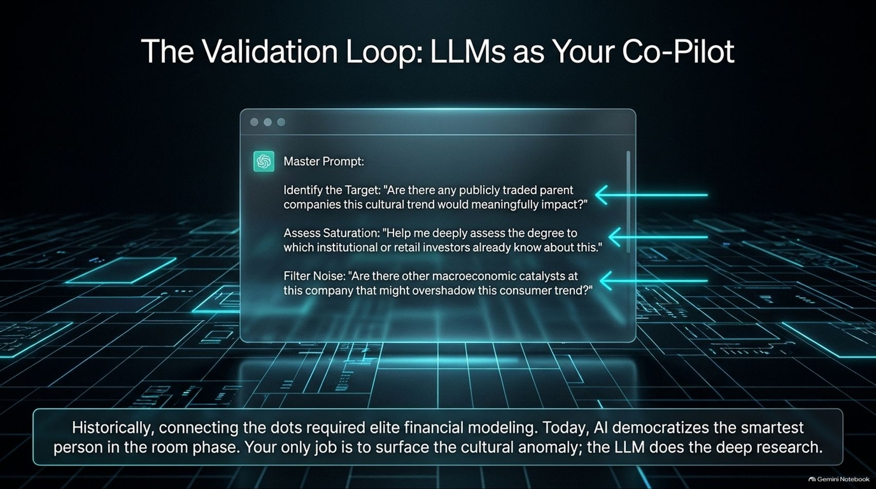
Notes:
Visual: A digital application window displaying a structured "Master Prompt" with glowing pointer arrows targeting target identification, saturation assessment, and noise filtering.
Target Duration: 3–5 minutes
Speaker Notes:
Historically, connecting cultural dots to complex financial models required elite quantitative training and hours of manual research. Today, AI democratizes the "smartest person in the room" phase.
Your only job as an observational investor is to surface the cultural anomaly—the rest can be co-piloted by Large Language Models.
You feed the trend into an LLM with prompts like: "Identify if there are publicly traded parent companies this cultural trend impacts," "Assess the degree to which retail or institutional investors already know about this," and "Filter macroeconomic noise to ensure no other catalysts overshadow this trend." The LLM handles the deep research, allowing regular people to execute like hedge fund analysts.

Slide 6
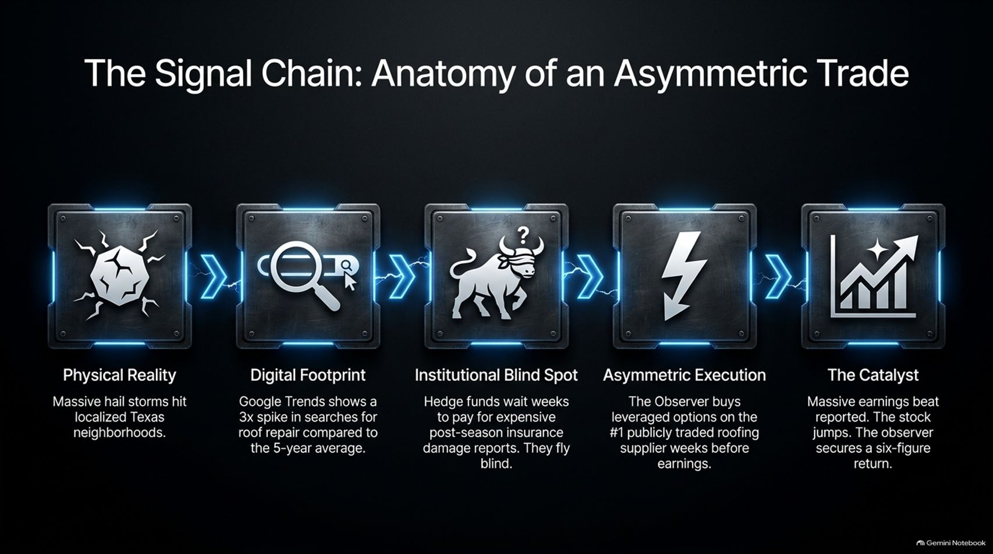
Notes:
Visual: A 5-stage mechanical node chain connecting Physical Reality, Digital Footprint, Institutional Blind Spot, Asymmetric Execution, and The Catalyst.
Target Duration: 4–6 minutes
Speaker Notes:
Let's trace a complete anatomy of an asymmetric trade through the signal chain:
1. Physical Reality: Massive hail storms hit localized Texas neighborhoods.
2. Digital Footprint: Google Trends shows a 3x spike in searches for roof repair compared to the 5-year average.
3. Institutional Blind Spot: Wall Street hedge funds wait weeks to pay for expensive post-season insurance damage reports, effectively flying blind.
4. Asymmetric Execution: The observant trader buys leveraged options on the number one publicly traded roofing supplier weeks before earnings.
5. The Catalyst: Massive earnings are reported, the stock gaps up, and the observer secures a six-figure return.

Slide 7
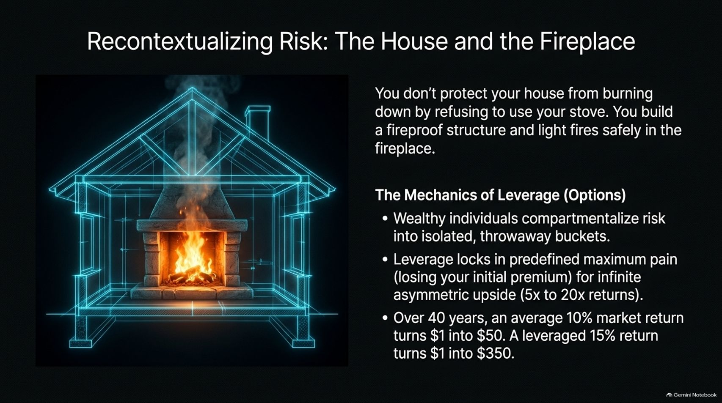
Notes:
Visual: A blueprint wireframe of a house featuring a glowing hearth and fireplace, accompanied by bullet points detailing option leverage mechanics and 40-year wealth compounding.
Target Duration: 3–5 minutes
Speaker Notes:
When discussing options and asymmetric leverage, people often confuse risk with recklessness. As the analogy goes: You don't protect your house from burning down by refusing to use your stove; you build a fireproof structure and light fires safely in the fireplace.
The Mechanics of Leverage: Wealthy and disciplined individuals compartmentalize risk into isolated, throwaway risk buckets.
Options leverage locks in a predefined maximum pain point—losing your initial premium—while unlocking infinite asymmetric upside (5x to 20x returns). Over decades, compounding an observational edge vastly outperforms standard passive index tracking.

Slide 8
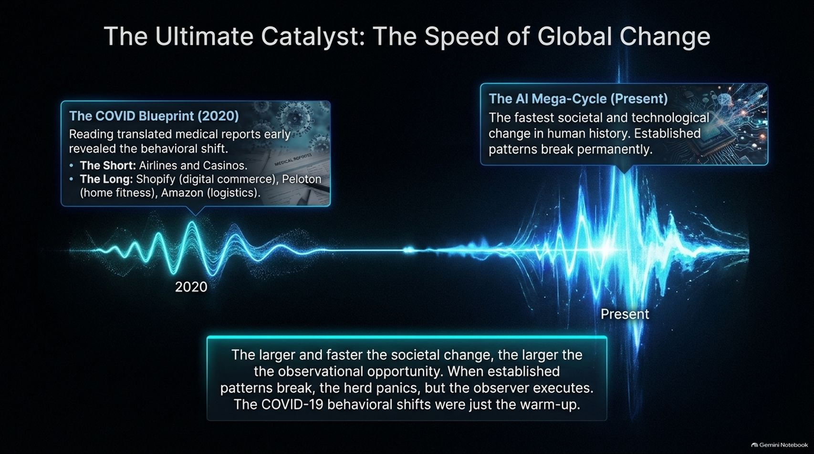
Notes:
Visual: An oscilloscope audio wave graphic showing a spike during the 2020 COVID blueprint era and an even larger structural explosion representing the present AI mega-cycle.
Target Duration: 3–5 minutes
Speaker Notes:
The larger and faster the rate of global societal change, the larger the observational opportunity.
Think back to the COVID Blueprint of 2020: Reading translated medical reports early revealed behavioral shifts. Shorting airlines and casinos while going long digital commerce (Shopify), home fitness (Peloton), and logistics (Amazon) generated historic alpha.
Today, we are in the AI Mega-Cycle—the fastest societal and technological change in human history. When established patterns break permanently, the herd panics, but the observational investor executes. COVID was merely the warm-up.

Slide 9
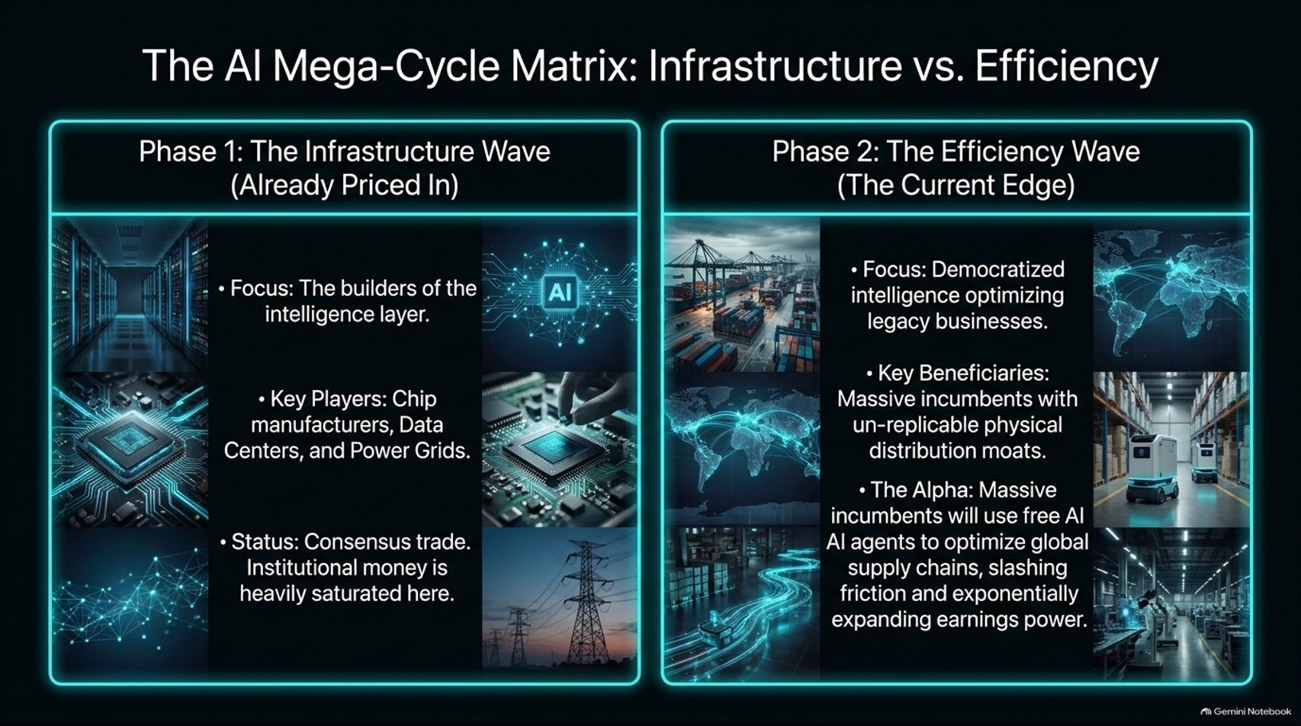
Notes:
Visual: A two-column split comparing Phase 1 (The Infrastructure Wave - chip manufacturers, data centers) against Phase 2 (The Efficiency Wave - AI agents optimizing global supply chains).
Target Duration: 4–6 minutes
Speaker Notes:
Navigating the AI mega-cycle requires understanding its distinct phases:
Phase 1: The Infrastructure Wave: Focused on the builders of the intelligence layer—chip manufacturers, data centers, and power grids. This has largely become a consensus institutional trade where money is heavily saturated.
Phase 2: The Efficiency Wave (The Current Edge): Focuses on democratized intelligence optimizing legacy businesses. The key beneficiaries are massive incumbents with un-replicable physical distribution moats. By deploying free AI agents to slash friction across global supply chains, these legacy giants will experience exponentially expanding earnings power.

Slide 10
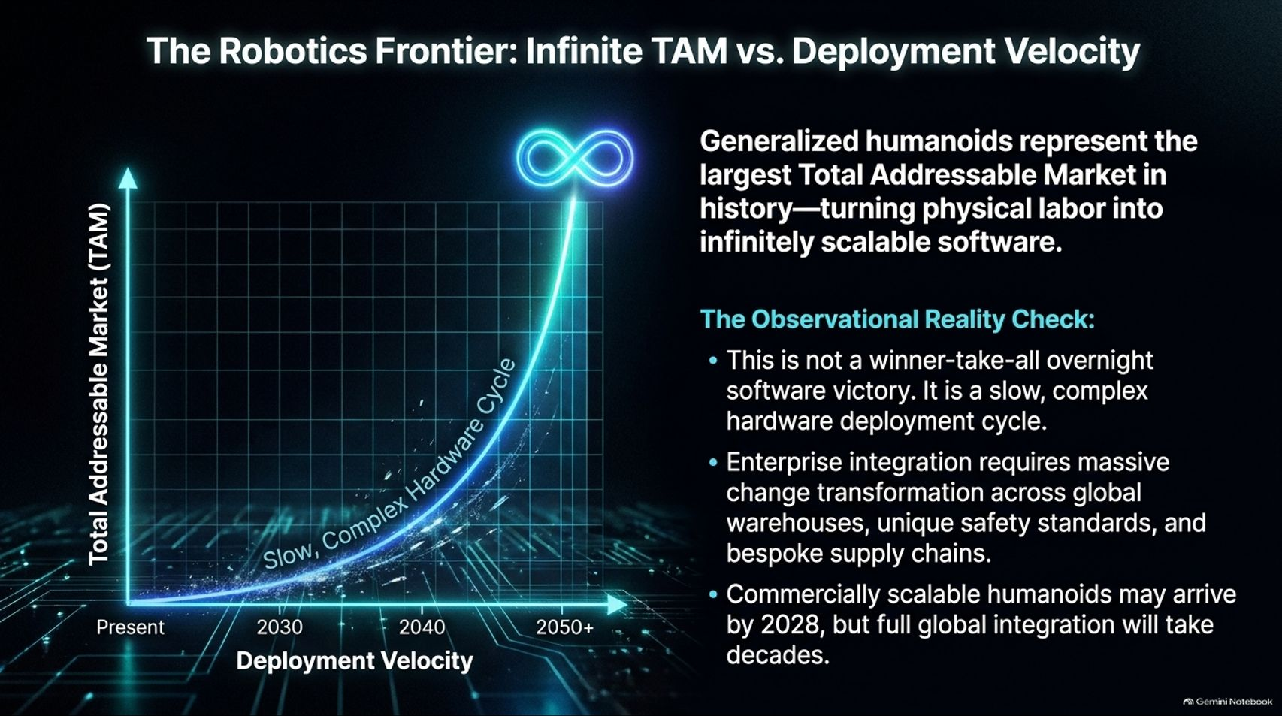
Notes:
Visual: An exponential growth curve chart contrasting Total Addressable Market (TAM) against Deployment Velocity, annotated with text covering humanoid deployment realities.
Target Duration: 3–5 minutes
Speaker Notes:
Generalize humanoids and physical robotics represent the largest Total Addressable Market in history—effectively turning physical labor into infinitely scalable software.
However, we must maintain an Observational Reality Check: This is not a winner-take-all overnight software victory; it is a slow, complex hardware deployment cycle.
Enterprise integration requires massive change management across global warehouses, unique safety certifications, and bespoke supply chains. While commercially scalable humanoids may arrive by 2028, full global enterprise integration will take decades.

Slide 11
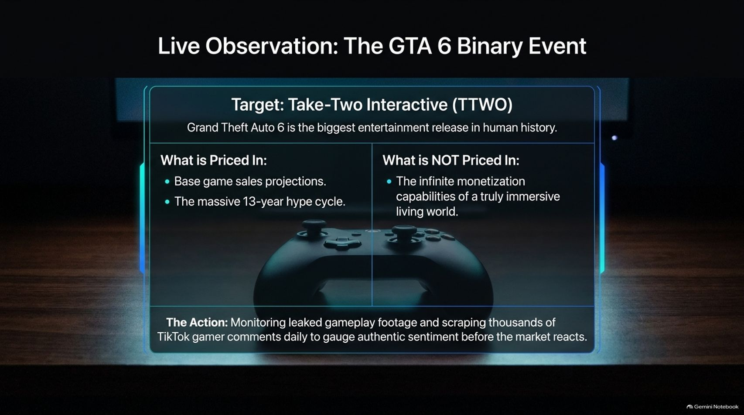
Notes:
Visual: A high-tech HUD box framing a modern gaming controller, contrasting priced-in expectations against unpriced monetization dynamics for Take-Two Interactive (TTWO).
Target Duration: 4–6 minutes
Speaker Notes:
Let's look at a live observational trade: The GTA 6 Binary Event for Take-Two Interactive (TTWO).
Grand Theft Auto 6 is arguably the biggest entertainment release in human history.
What is Priced In: Base game sales projections and the massive 13-year hype cycle.
What is NOT Priced In: The infinite ongoing monetization capabilities of a truly immersive living digital world.
The Action: As Chris Camillo discusses in his interview, monitoring leaked gameplay footage and scraping thousands of TikTok gamer comments daily allows us to gauge authentic consumer sentiment and love-versus-hate ratios before the broader market reacts.

Slide 12
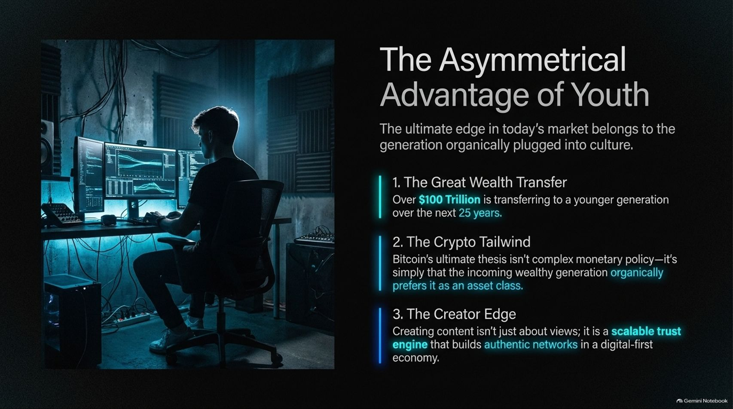
Notes:
Visual: A dark room illuminated by dual monitors displaying data streams, paired with three core pillar cards covering the Great Wealth Transfer, Crypto Tailwind, and Creator Edge.
Target Duration: 3–5 minutes
Speaker Notes:
The ultimate observational edge in today's market belongs to the younger generation organically plugged into culture.
1. The Great Wealth Transfer: Over $100 trillion is transferring to younger generations over the next 25 years.
2. The Crypto Tailwind: Bitcoin's adoption thesis isn't complex central bank monetary policy—it's simply that the incoming wealthy generation organically prefers it as a native asset class.
3. The Creator Edge: Creating content isn't just about view counts; it functions as a scalable trust engine that builds authentic digital networks in a modern economy.

Slide 13
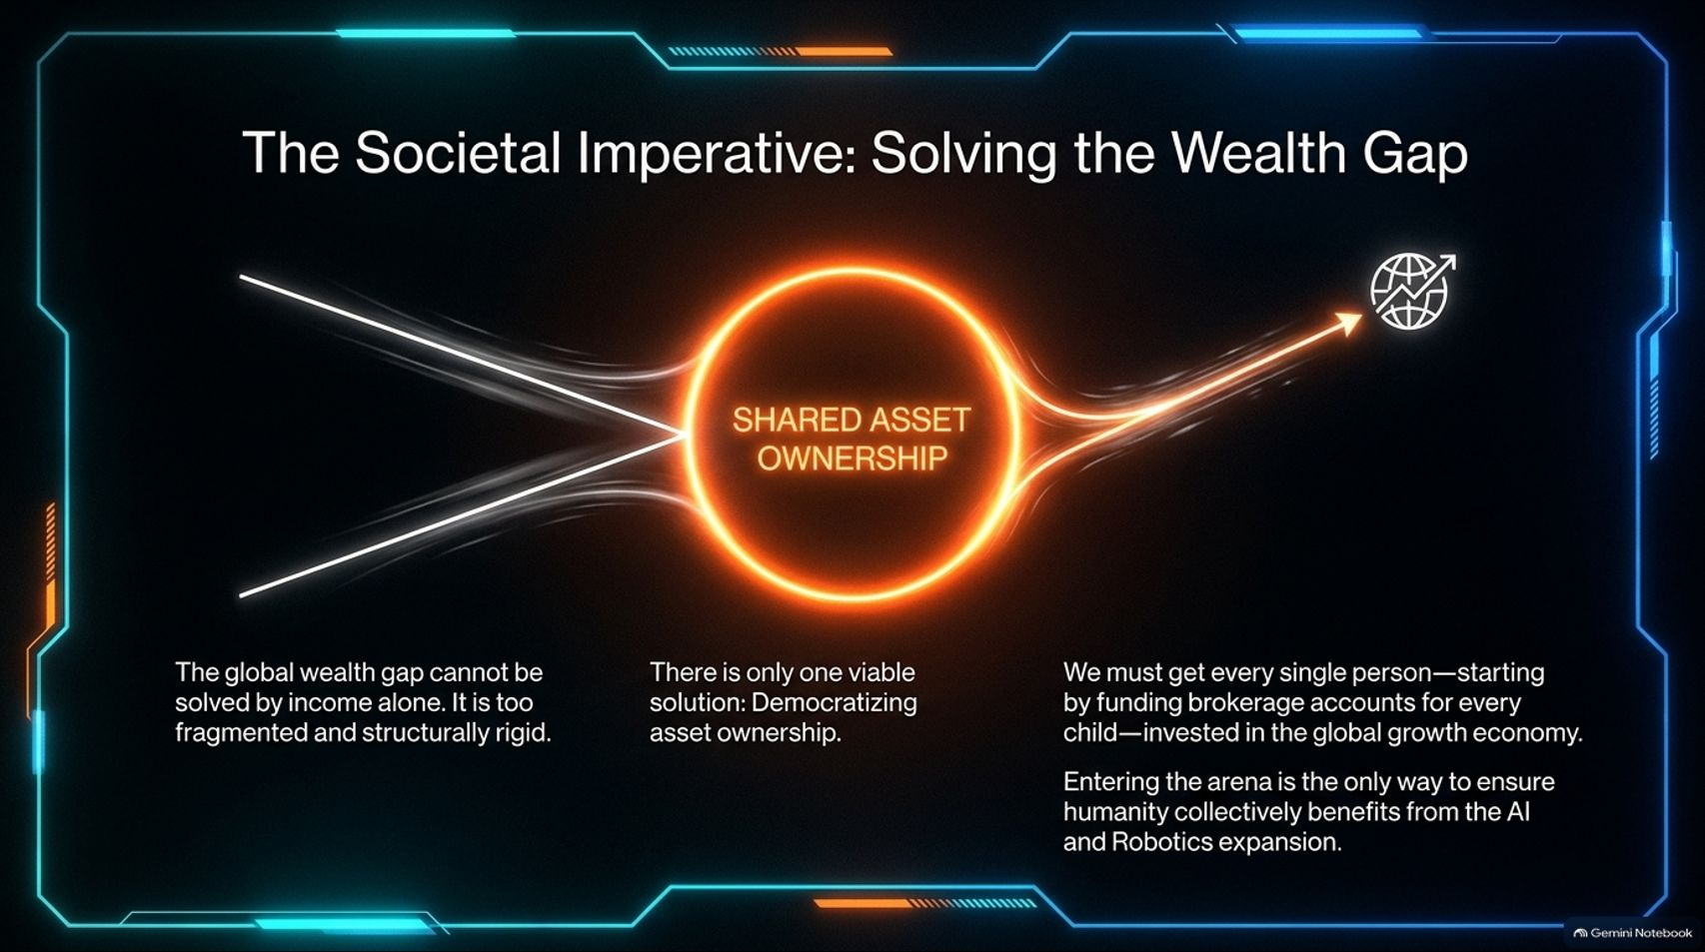
Notes:
Visual: A particle physics energy funnel converging into a glowing core labeled "Shared Asset Ownership," pointing toward global economic inclusion.
Target Duration: 3–5 minutes
Speaker Notes:
As AI and robotics scale, we face a profound societal imperative: Solving the Wealth Gap.
The global wealth gap cannot be solved by income alone; wages are too structurally rigid compared to capital appreciation. There is only one viable economic solution: Democratizing asset ownership.
We must actively get every single person—starting by funding brokerage and investment accounts for every child—invested in the global growth economy. Entering the arena is the only way to ensure humanity collectively benefits from the AI productivity boom.

Slide 14
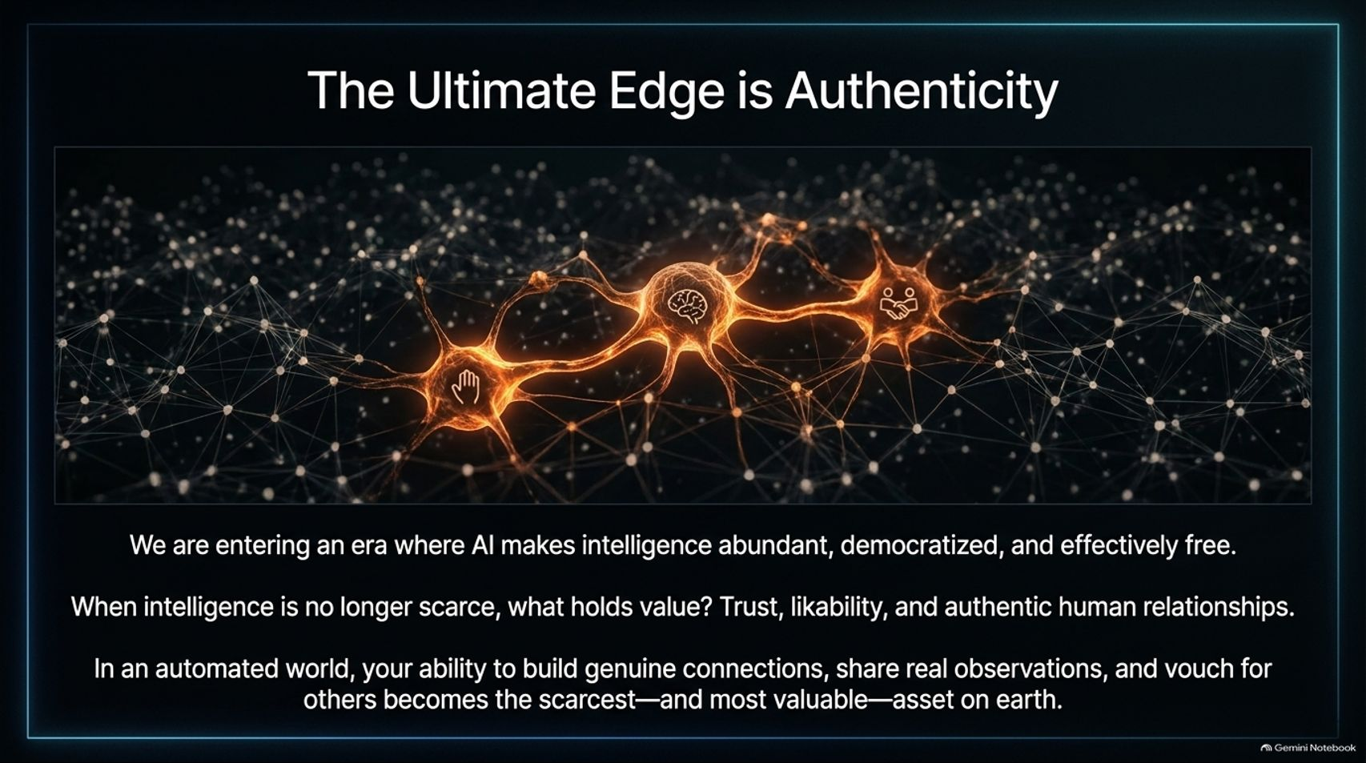
Notes:
Visual: A complex neural network web glowing with orange synapses, illustrating human touchpoints, brain activity, and collaborative handshakes.
Target Duration: 3–5 minutes
Speaker Notes:
We are entering an era where AI makes raw intelligence abundant, democratized, and effectively free.
When intelligence is no longer scarce, what actually holds value? Trust, likability, and authentic human relationships.
In an automated world, your ability to build genuine connections, share real-world observations, and vouch for others becomes the scarcest—and most valuable—asset on earth. Algorithms can process data, but they cannot replicate human authenticity.

Slide 15
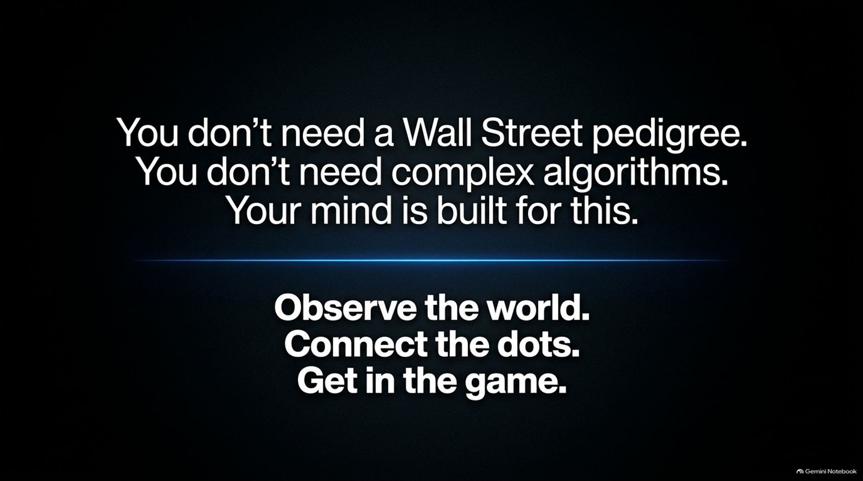
Notes:
Visual: A comprehensive summary dashboard grouping the 4-step observational framework with core execution strategies (AI tools, risk capital isolation, and comment section mining).
Target Duration: 3–5 minutes
Speaker Notes:
Let's summarize our core execution playbook for observational investing:
The 4 Steps: Spot everyday consumer trends, measure revenue impact, check institutional saturation, and time your entry ahead of earnings catalysts.
Core Execution Strategies:
Leverage LLMs to rapidly analyze metrics and competitive catalysts.
Isolate risk capital by using separate, non-essential funds for high-conviction option leverage.
Mine comment sections and forums to find raw consumer truth buried where Wall Street never looks.

Slide 16
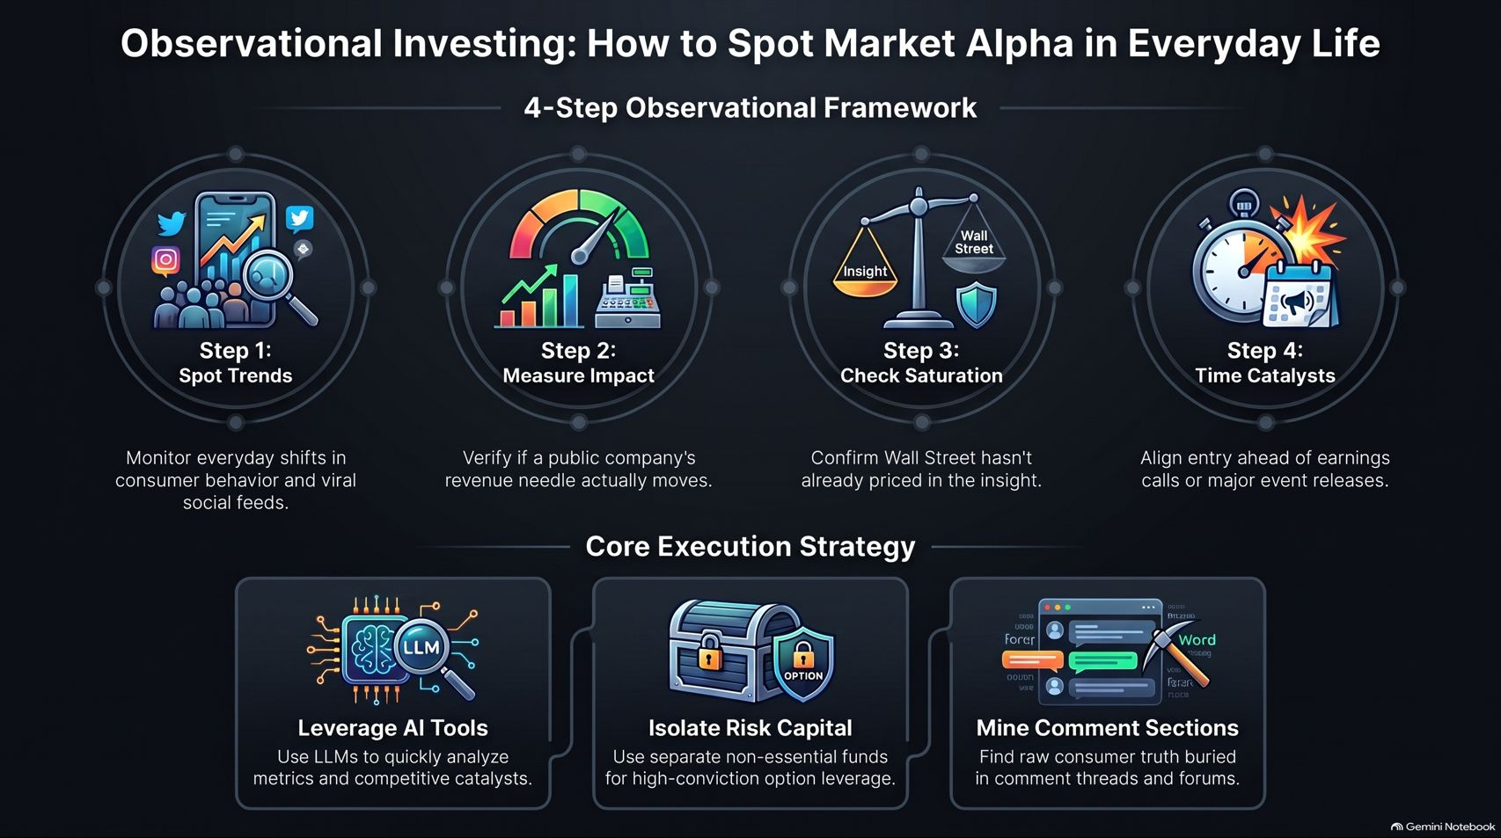
Notes:
Visual: A clean, high-contrast closing slide featuring bold white text emphasizing that no Wall Street pedigree is required, closing with the call to action: "Observe the world. Connect the dots. Get in the game."
Target Duration: 2–3 minutes
Speaker Notes:
To close out today's presentation, remember this core truth: You don't need a Wall Street pedigree. You don't need complex algorithms. Your mind is already built for this.
You live in culture. You experience the shifts, the products, and the behavioral changes every single day before any institutional analyst writes a report about them.
Stop letting the noise paralyze you. Observe the world. Connect the dots. Get in the game. Thank you all for your time!

