Slide 1
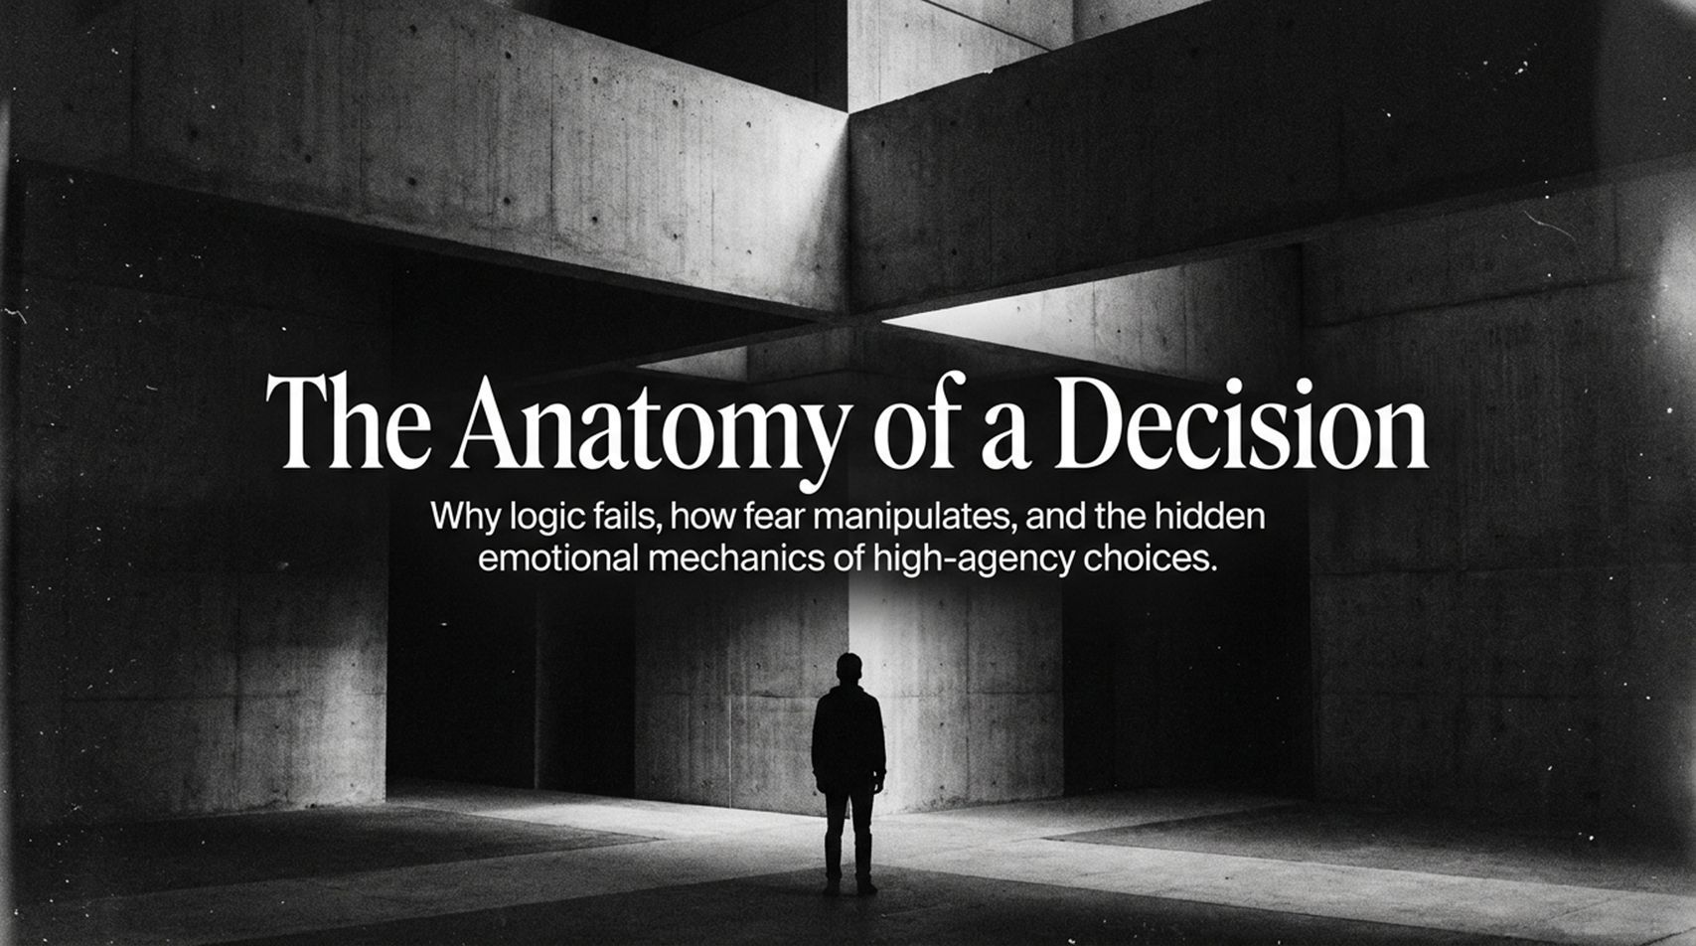
Notes:
Visual: Minimalist industrial concrete architecture, a solitary figure standing in the light.
Suggested Duration: 3 – 4 minutes.
Speaker Notes:
Opening Hook: Welcome, everyone. Let’s start with a stark reality check. If you look at your life right now—your level of fulfillment, your career stagnation, your relationship breakthroughs or breakdowns—you are living the exact output of a series of choices you made yesterday. As Alex Hormozi famously stated: “The life that you want is on the other side of a few hard decisions, and the reason you’re unhappy is because you’re not making them.”
Setting the Stage: Today, we aren't just talking about productivity hacks or time management matrices. We are dissecting the hidden emotional mechanics of high-agency choices. We are going to explore why logic completely fails when the stakes are highest, how fear actively manipulates your worldview, and how you can reclaim absolute control over your life’s trajectory by changing how you decide.
Core Premise: Most people think indecision stems from a lack of information or a failure of data processing. By the time we leave this room today, you will see that indecision is almost never an informational problem—it is an emotional trap. Let’s look at why the stakes couldn't be higher.
Being Indecisive Is Ruining Your Life (here’s how to fix it) - Joe Hudson
https://www.youtube.com/watch?v=xNwYaTf7Zn8

Slide 2
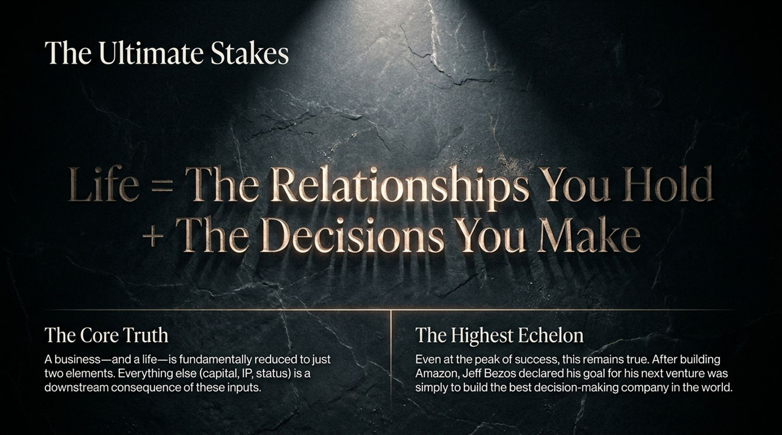
Notes:
Visual: Textured stone background with glowing typography highlighting the equation of life.
Suggested Duration: 3 – 5 minutes.
Speaker Notes:
The Fundamental Equation: Life equals the relationships you hold plus the decisions you make. Think about that deeply. When business leaders scale billion-dollar enterprises, they quickly realize that a business can be fundamentally reduced to just two elements: the relationships held within the ecosystem and the decisions made at the executive level. Everything else—capital, intellectual property, brand status—is merely a downstream consequence of these two inputs.
The Highest Echelon: This truth holds true even at the absolute peak of human success. Think about Jeff Bezos. After building Amazon into the largest e-commerce empire on the planet, what did he declare as his primary goal for his next venture? Not another retail storefront, not another cloud server provider—he stated his goal was simply to build the best decision-making company in the world.
Transition: If decision-making is the ultimate master skill for titans and everyday individuals alike, we need to look under the hood to see how human decisions are actually manufactured by the brain.

Slide 3
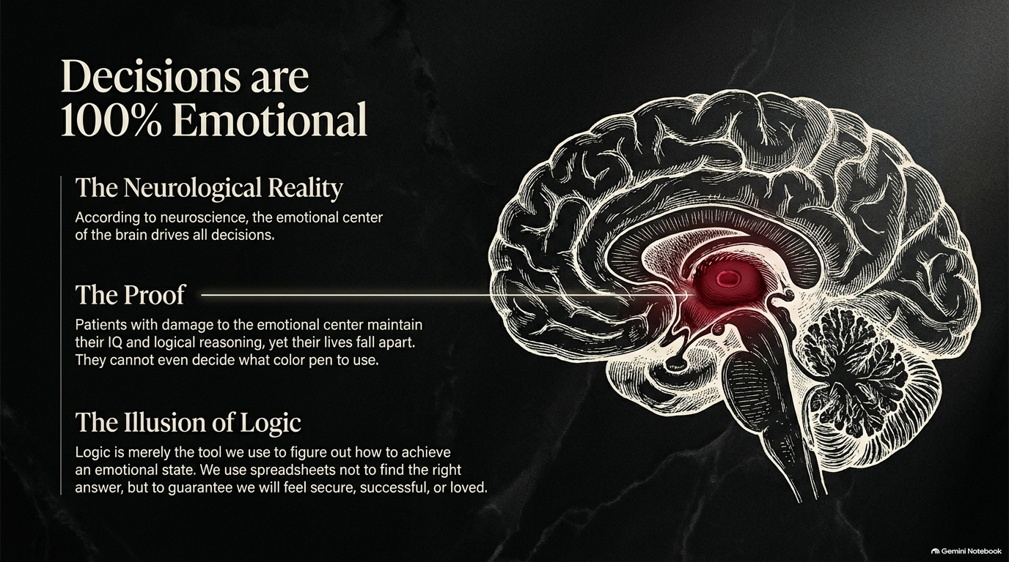
Notes:
Visual: Detailed anatomical illustration of the human brain with the emotional center highlighted in glowing red.
Suggested Duration: 4 – 6 minutes.
Speaker Notes:
The Neurological Reality: We love to pride ourselves on being rational, logical creatures. We build elaborate spreadsheets, weigh pros and cons, and conduct meticulous SWOT analyses. But neuroscience tells us a radically different truth: decisions are 100% emotional.
The Proof from Science: Look at neurological case studies of patients who have suffered damage specifically to the emotional center of the brain while leaving their logical reasoning and IQ completely intact. Do these people become super-rational geniuses? No. Their lives completely fall apart. They can sit in a room for 15 minutes completely paralyzed, unable to decide what color pen to use or where to have lunch, because logic alone cannot assign value or preference.
The Illusion of Logic: Logic is not the engine of choice; logic is merely the janitor. It’s the tool we use after the fact to figure out how to achieve an emotional state, or to justify emotional repression. We build spreadsheets not to find the mathematically right answer, but to guarantee we will feel secure, successful, or loved—and to protect ourselves from feeling like a failure, a loser, or rejected.

Slide 4
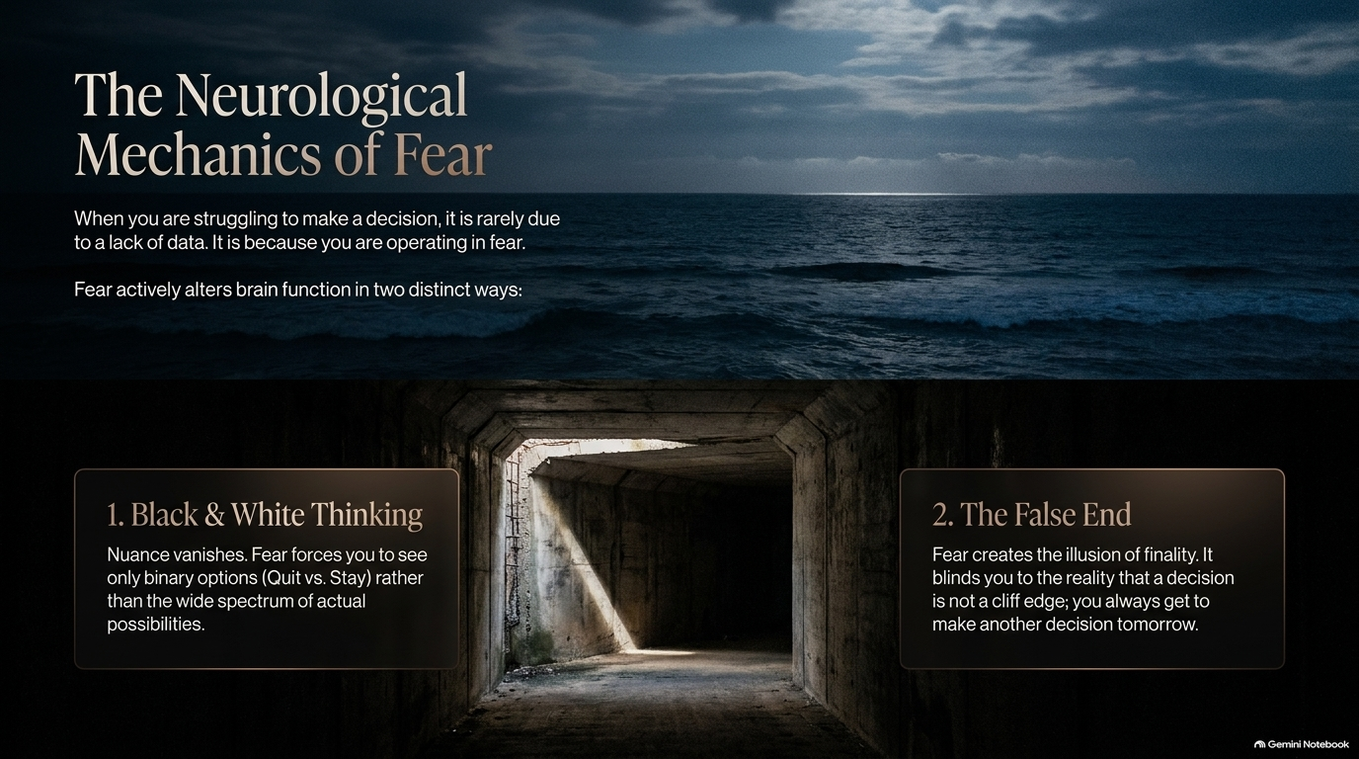
Notes:
Visual: Dark, churning ocean juxtaposed with a narrow, shadowy concrete tunnel.
Suggested Duration: 3 – 5 minutes.
Speaker Notes:
The Root Cause: When you are struggling to make a decision—stuck in analysis paralysis for months over whether to switch careers, buy a house, or end a relationship—it is rarely due to a lack of data. It is because you are operating in a state of fear.
Mechanism 1: Black & White Thinking: Fear actively alters brain function in two distinct ways. First, it forces Black & White Thinking. Nuance completely vanishes. Fear narrows your entire universe down into a primitive binary choice: Quit or Stay? Marry or Leave? Fight or Flee? It blinds you to the wide, creative spectrum of actual possibilities that exist outside that narrow tunnel.
Mechanism 2: The False End: Second, fear creates the illusion of finality. It convinces you that this single choice is a sheer cliff edge—that if you get it wrong, your life is permanently ruined. It blinds you to the liberating reality that life is an ongoing portfolio, and a decision is never a final destination; you always get to make another decision tomorrow.

Slide 5
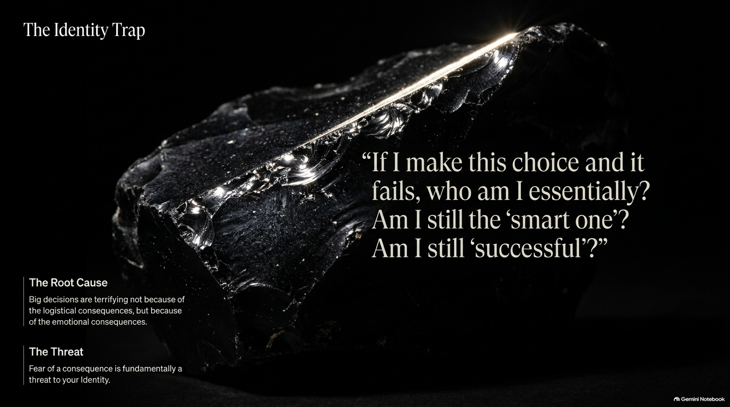
Notes:
Visual: A raw, dark obsidian rock catching a sharp, single beam of light.
Suggested Duration: 3 – 5 minutes.
Speaker Notes:
The Core Question: Why is fear the default emotion governing our hardest choices? Because big decisions are terrifying not primarily because of their logistical consequences, but because of their identity consequences.
The Internal Monologue: When faced with a major pivot, the subconscious voice isn't asking, "Will my cash flow drop by 5%?" The voice is screaming: "If I make this choice and it fails, who am I essentially? Am I still the 'smart one'? Am I still 'successful'? Am I still lovable?"
The Threat to Self-Worth: Fear of an external consequence is fundamentally a proxy threat to your identity. Whenever a decision feels agonizing, it is because a fragile piece of your self-image is tied up in the outcome. True high-agency decision-making requires untangling your core worth from external results.

Slide 6
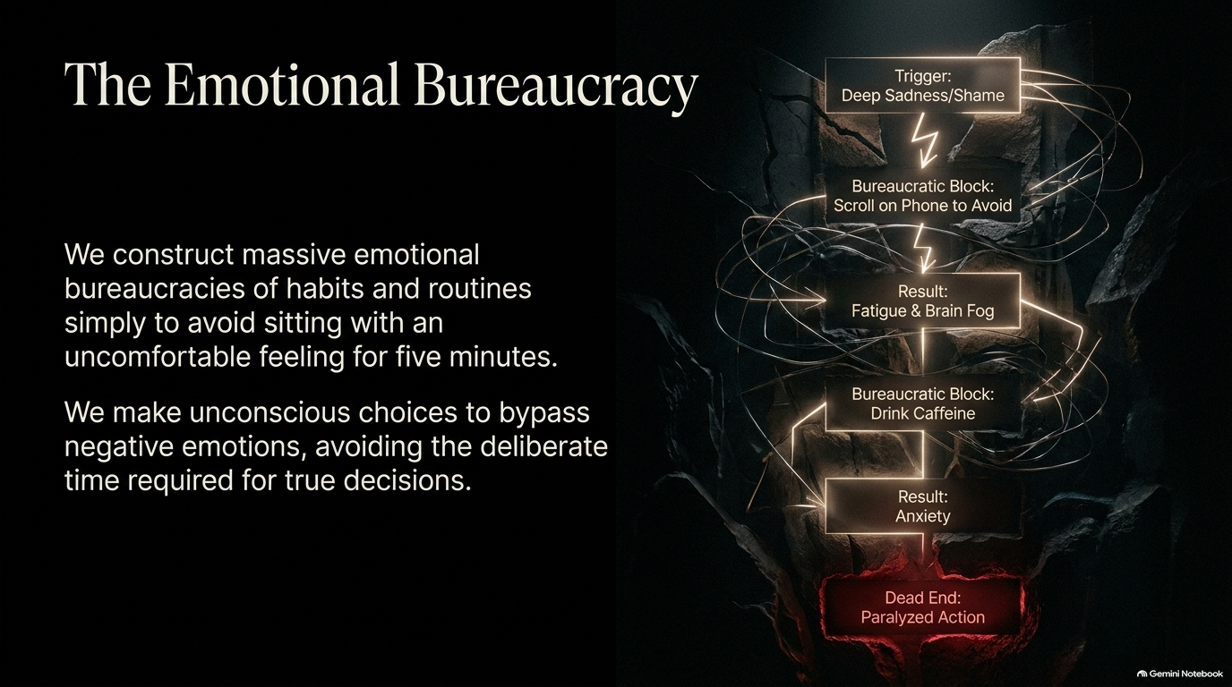
Notes:
Visual: Flowchart diagram of avoidance loops breaking down against a cracked stone wall.
Suggested Duration: 4 – 5 minutes.
Speaker Notes:
The Architecture of Avoidance: Look at how we react when an uncomfortable emotion arises. We construct massive, complex emotional bureaucracies of habits and routines simply to avoid sitting with a difficult feeling for five minutes.
Walking Through the Loop: Trace the flowchart on the screen. It starts with a trigger: Deep sadness or shame. Instead of processing it, our brain deploys a bureaucratic block: Scroll on the phone to numb out. The resulting output? Fatigue and brain fog. To combat the fog, we deploy another block: Drink caffeine or chase quick dopamine. That spikes our nervous system, resulting in Anxiety.
The Dead End: Eventually, all these layers of self-medication lead to a complete dead end: Paralyzed action. We make unconscious choices all day long just to bypass negative emotions, completely starving ourselves of the deliberate time required for true, high-agency decisions.

Slide 7
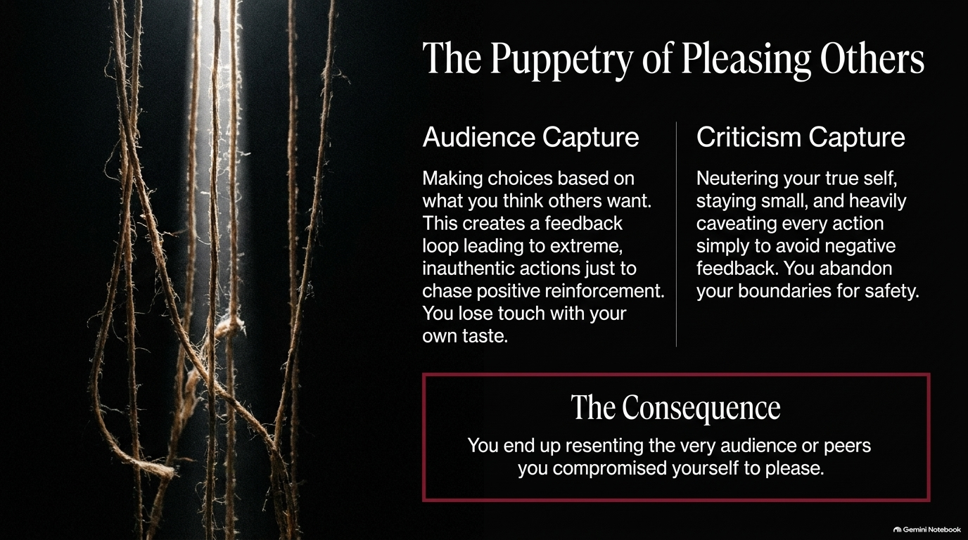
Notes:
Visual: Tightly wound, dangling ropes and cords hanging in deep shadow.
Suggested Duration: 3 – 5 minutes.
Speaker Notes:
Audience Capture: When we surrender our agency, we often fall into two psychological traps. The first is Audience Capture—making choices based entirely on what you think others want. In the creator economy and in daily social life, this creates a toxic feedback loop. You chase positive reinforcement so aggressively that you completely lose touch with your own taste, your own voice, and your own authentic desires.
Criticism Capture: The flip side is Criticism Capture—neutering your true self, staying small, and heavily caveat-ing every action and statement simply to avoid negative feedback. You abandon your personal boundaries entirely in exchange for the illusion of safety.
The Consequence: What is the ultimate price of living as a puppet to other people’s expectations? You end up deeply resenting the very audience, peers, or partners you compromised yourself to please.

Slide 8
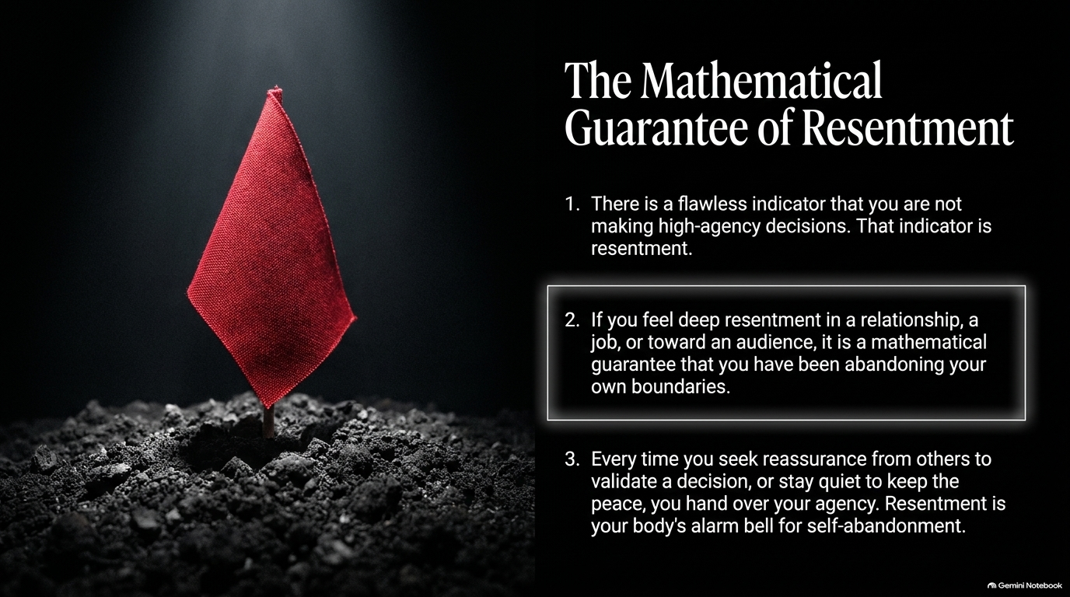
Notes:
Visual: A stark red flag planted firmly in barren, dark soil.
Suggested Duration: 3 – 4 minutes.
Speaker Notes:
The Ultimate Red Flag: How do you know with absolute certainty that you are operating out of low agency rather than authentic choice? There is a flawless, mathematical indicator: Resentment.
The Law of Boundaries: If you feel deep resentment in a relationship, a job, or toward an audience, it is a mathematical guarantee that you have been abandoning your own boundaries.
The Body’s Alarm Bell: Every time you seek reassurance from others to validate a decision, or stay quietly compliant to "keep the peace," you are handing over your personal power. Resentment is not an external problem; it is your body’s built-in alarm bell signaling self-abandonment. Whenever you feel it flare up, stop asking what the other person did wrong, and start asking: "Where did I betray my own principles to please them?"

Slide 9
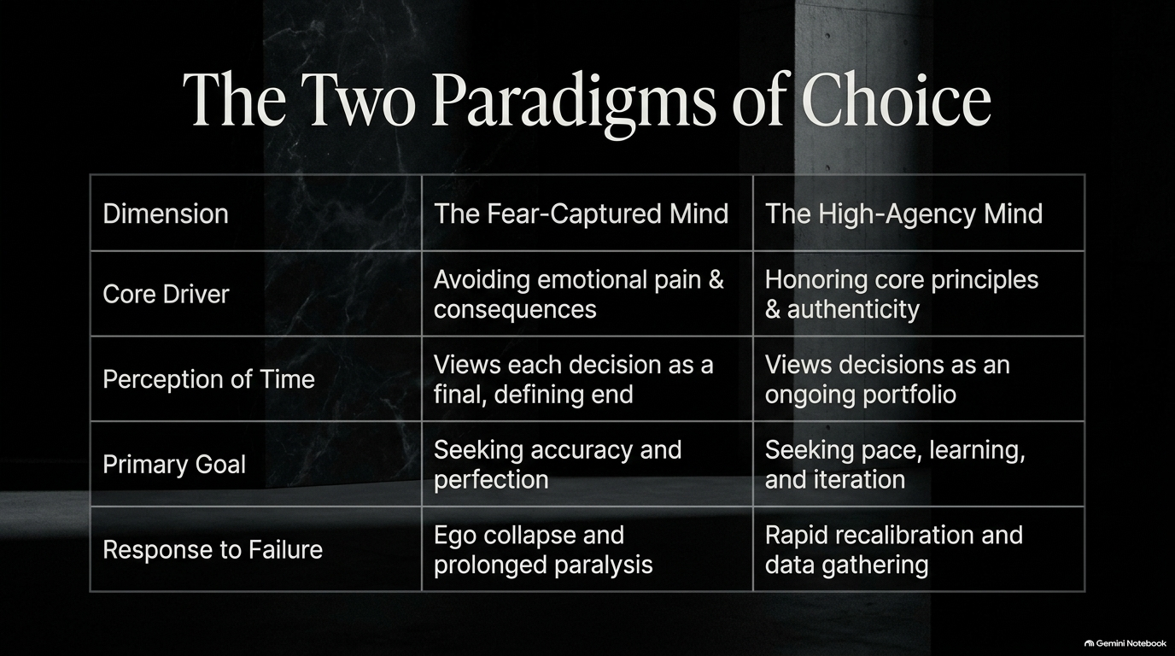
Notes:
Visual: A structured comparison matrix contrasting fear-captured and high-agency mindsets.
Suggested Duration: 4 – 5 minutes.
Speaker Notes:
Comparative Analysis: Let’s look at the two fundamentally opposed operating systems available to us.
Core Drivers & Time: The Fear-Captured Mind is driven entirely by avoiding emotional pain and negative consequences. It views each decision as a terrifying, final, defining end. In contrast, the High-Agency Mind is driven by honoring core principles and authenticity. It views decisions as an ongoing portfolio, much like a master hedge fund manager who knows a single losing trade doesn't bankrupt the fund.
Goals & Failure: While the fear-driven mind seeks paralyzed perfection and accuracy, the high-agency mind prioritizes pace, learning, and iteration. When failure strikes, the fear-captured mind suffers ego collapse and prolonged paralysis; the high-agency mind executes rapid recalibration and gathers fresh data.

Slide 10
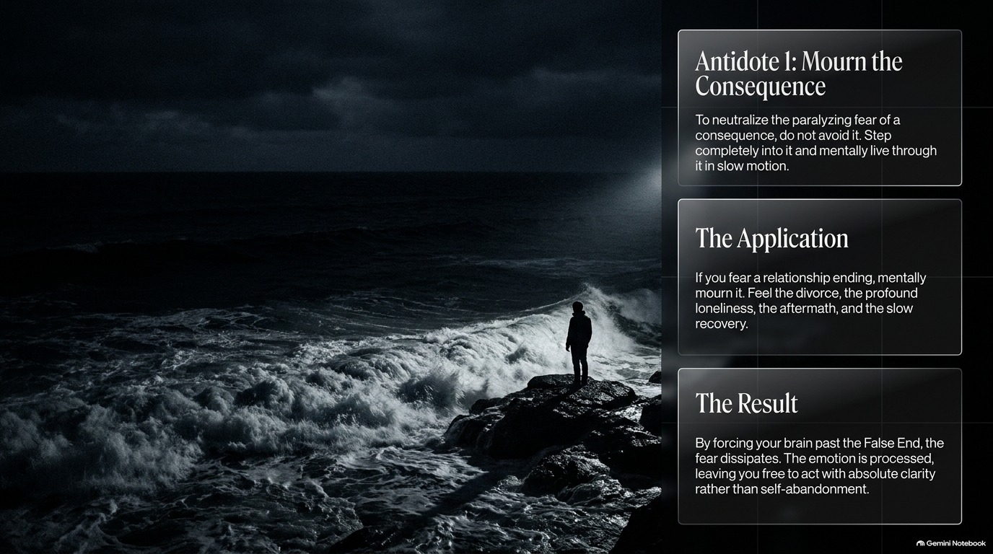
Notes:
Visual: A lone figure standing on a dark, rocky cliff overlooking rough seas.
Suggested Duration: 4 – 6 minutes.
Speaker Notes:
Breaking the False End: How do we dismantle the paralyzing fear of a negative consequence? Do not avoid it. Counterintuitively, you must step completely into it and mentally live through the worst-case scenario in slow motion.
The Application: Joe Hudson shares a profound practice from his own 27-year marriage. When fear of losing his partner or a relationship flares up, instead of running from it or clinging out of desperation, he and his wife deliberately mourn the marriage in advance. They mentally walk through the breakup, the profound loneliness, the aftermath, the administrative wreckage, and the slow recovery.
The Result: By forcing your brain past the "False End," the acute panic dissolves. The emotion is fully processed, leaving you free to act with absolute clarity and grounded authenticity rather than desperate self-abandonment.

Slide 11
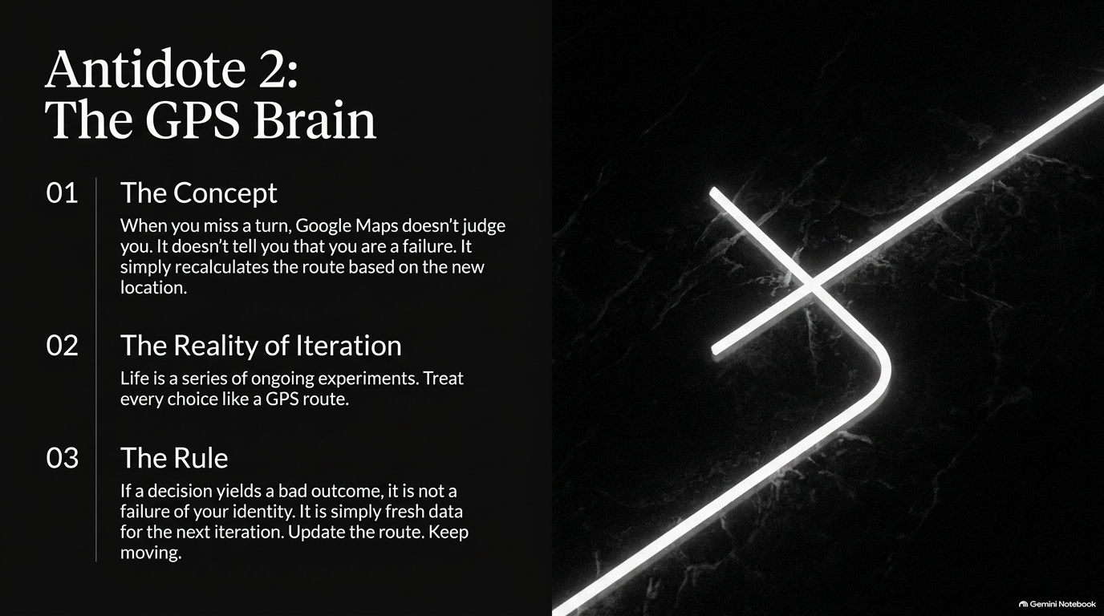
Notes:
Visual: Glowing, intersecting geometric lines on a dark background representing dynamic recalculation.
Suggested Duration: 3 – 5 minutes.
Speaker Notes:
The Google Maps Metaphor: Think about how navigation software works. When you miss a turn on Google Maps, the app doesn't flash red lights, burst into tears, or judge your character. It doesn't tell you that you are a failure as a driver. It simply recalculates the route instantly based on your new coordinates.
The Reality of Iteration: We must adopt the exact same software architecture for our lives. Life is not a pass/fail examination; it is a series of ongoing experiments.
The Rule: If a decision yields a bad outcome or a failed business venture, it is not a failure of your identity. It is simply fresh, valuable data for your next iteration. Update the route, discard the ego attachment, and keep moving forward.

Slide 12
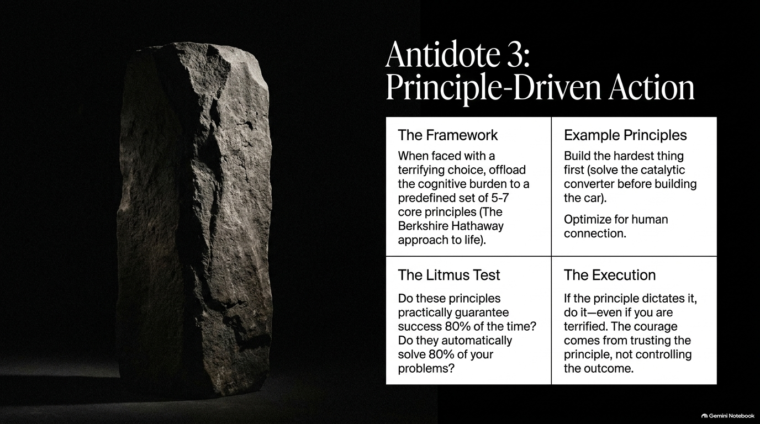
Notes:
Visual: A monolithic, unyielding stone pillar standing tall in a shaft of light.
Suggested Duration: 4 – 6 minutes.
Speaker Notes:
Offloading Cognitive Burden: When faced with a terrifying, complex choice, how do you eliminate decision fatigue? You offload the cognitive burden to a predefined set of 5 to 7 core principles—mirroring the legendary investment approach of Berkshire Hathaway.
Example Principles: What does this look like in practice? One powerful principle: When building something new, go straight to the thing you know the least about and build it first. Just like building the catalytic converter before designing the car frame, you solve your highest-risk variables upfront. Another principle: Optimize relentlessly for human connection and authenticity.
The Litmus Test & Execution: Do these principles guarantee success 80% of the time and solve 80% of your recurring problems? If yes, when a terrifying decision arises, you don't guess—you simply execute whatever the principle dictates, trusting the process over the outcome.

Slide 13
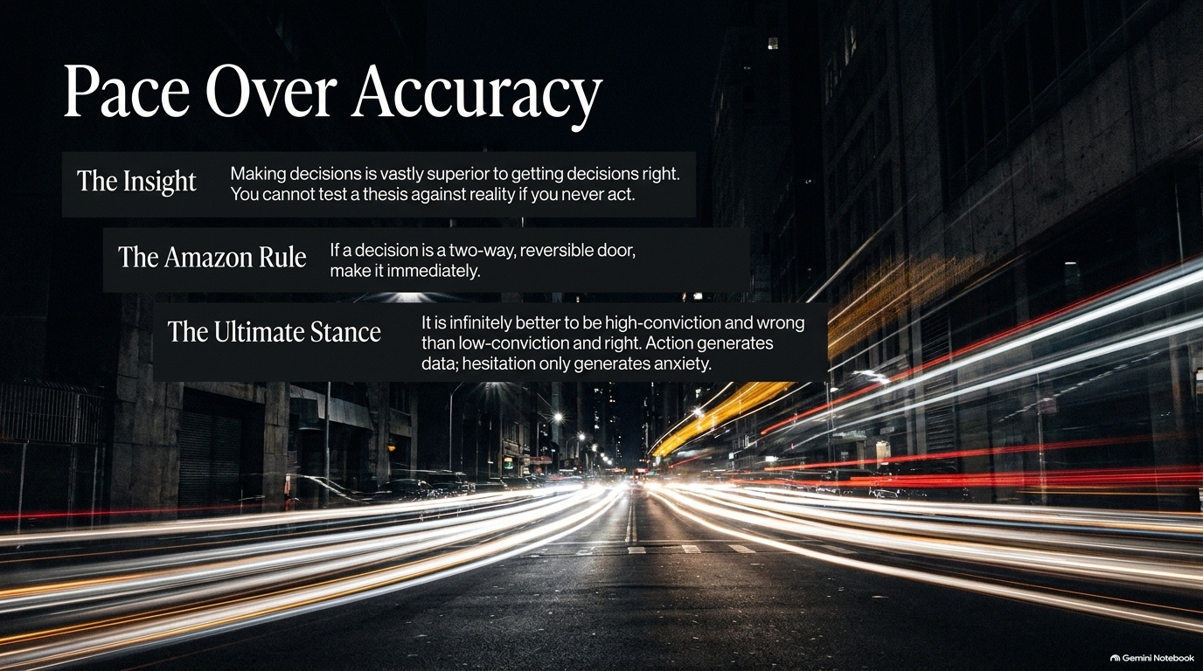
Notes:
Visual: Long-exposure urban night photography showing streaking lights and high-speed motion.
Suggested Duration: 3 – 5 minutes.
Speaker Notes:
The Core Insight: Making decisions quickly and iterating is vastly superior to obsessing over getting decisions right on the first try. You cannot test a thesis against reality if you never take action.
The Amazon Rule: Think of Jeff Bezos’ framework for decision types: Two-way doors (reversible decisions) should be made at lightning speed by low-level teams. If a decision is reversible, speed trumps perfection every single time.
The Ultimate Stance: As the adage goes: It is infinitely better to be high-conviction and wrong than low-conviction and right. Why? Because high-conviction action generates real-world data and rapid learning; endless hesitation generates only anxiety.

Slide 14
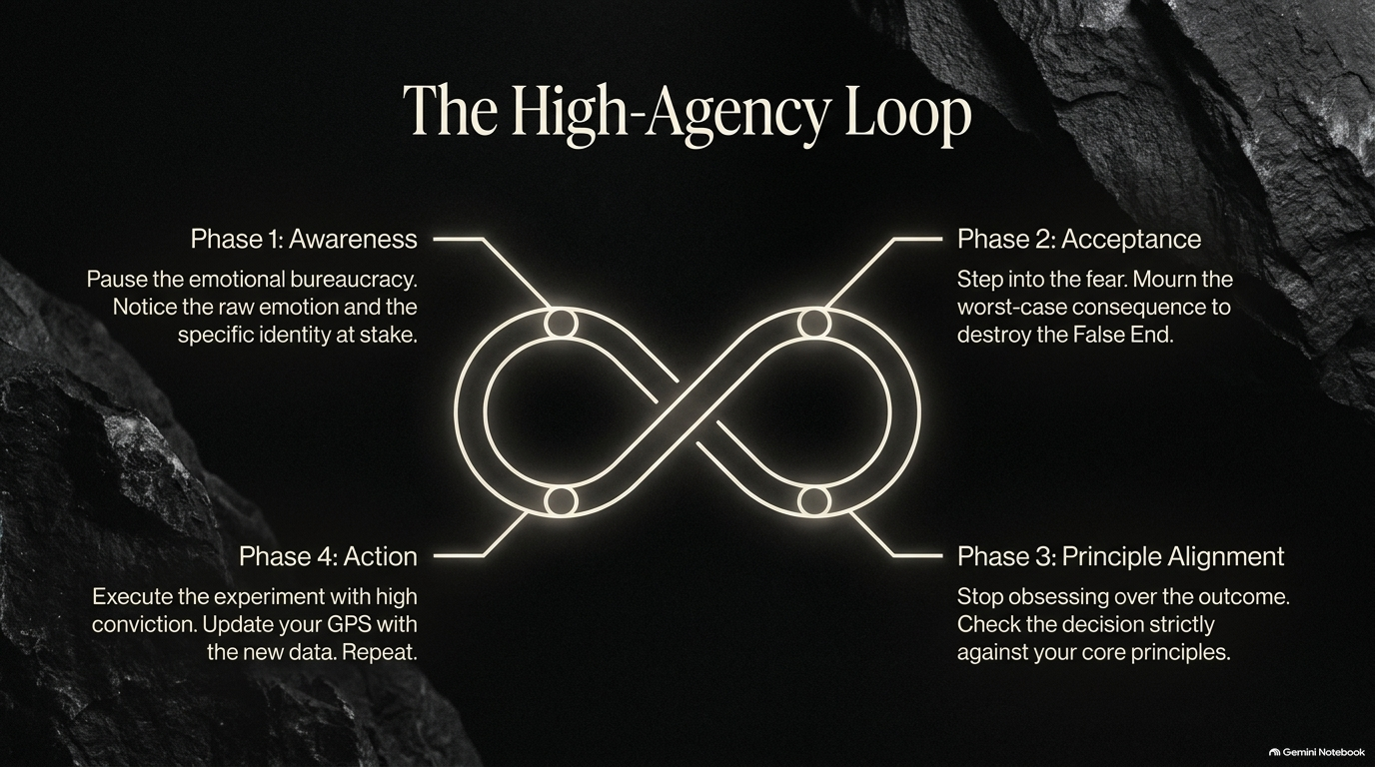
Notes:
Visual: A continuous, glowing infinity loop broken down into four distinct phases.
Suggested Duration: 4 – 6 minutes.
Speaker Notes:
Synthesizing the Framework: Let’s pull all these pieces together into the High-Agency Loop, your master operating rhythm for any challenge:
Phase 1: Awareness. Pause the emotional bureaucracy. Notice the raw physical emotion and identify precisely which part of your identity feels threatened.
Phase 2: Acceptance. Step directly into the fear. Mourn the worst-case consequence to shatter the illusion of the "False End".
Phase 3: Principle Alignment. Stop obsessing over controlling the external outcome. Check the decision strictly against your core principles.
Phase 4: Action. Execute the experiment with high conviction. Update your internal GPS with the incoming data, and repeat the loop.

Slide 15

Notes:
Visual: A classical marble statue being actively carved and chiseled out of raw rock.
Suggested Duration: 3 – 4 minutes.
Speaker Notes:
The Michelangelo Effect: Think back to Michelangelo carving the statue of David out of a massive, discarded block of flawed marble. The sculptor didn't add anything to the stone; he simply chipped away everything that wasn't David.
Applying It to Yourself: Becoming decisive and highly agentic is not about acquiring artificial new traits, faking confidence, or building a thicker skin. It is the lifelong, liberating process of chipping away the fear, the people-pleasing, the audience capture, and the identity armor until only your essential, authentic self remains.

Slide 16
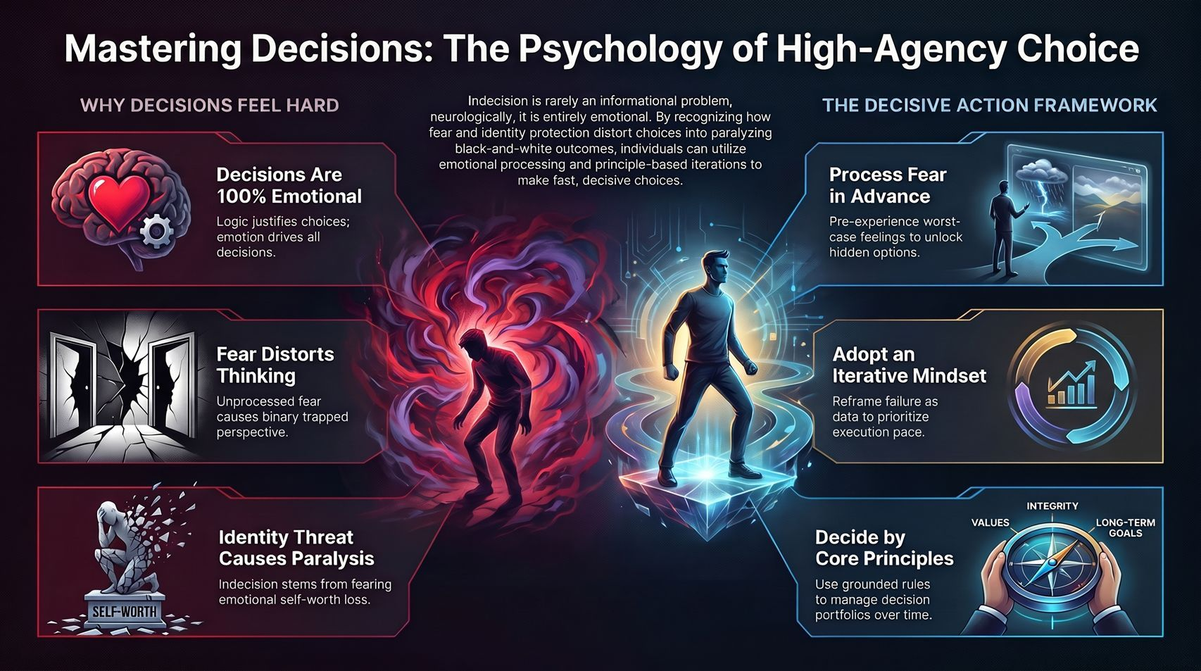
Notes:
Visual: A comprehensive synthesis dashboard contrasting fear-driven paralysis with the decisive action framework.
Suggested Duration: 4 – 5 minutes.
Speaker Notes:
Bringing It Home: Look at the landscape we’ve mapped out today. Indecisioin is never an informational deficiency; neurologically and emotionally, it is a defensive reaction to identity threat.
Your Action Plan: By recognizing how fear and identity protection distort choices into black-and-white traps, you can step out of the emotional bureaucracy.
Closing Charge: Process your fears in advance, adopt an iterative GPS mindset, and anchor your life to unwavering core principles. Stop seeking comfort, start embracing friction, and make decisions that make you deeply proud to be yourself. Thank you.

