Slide 1
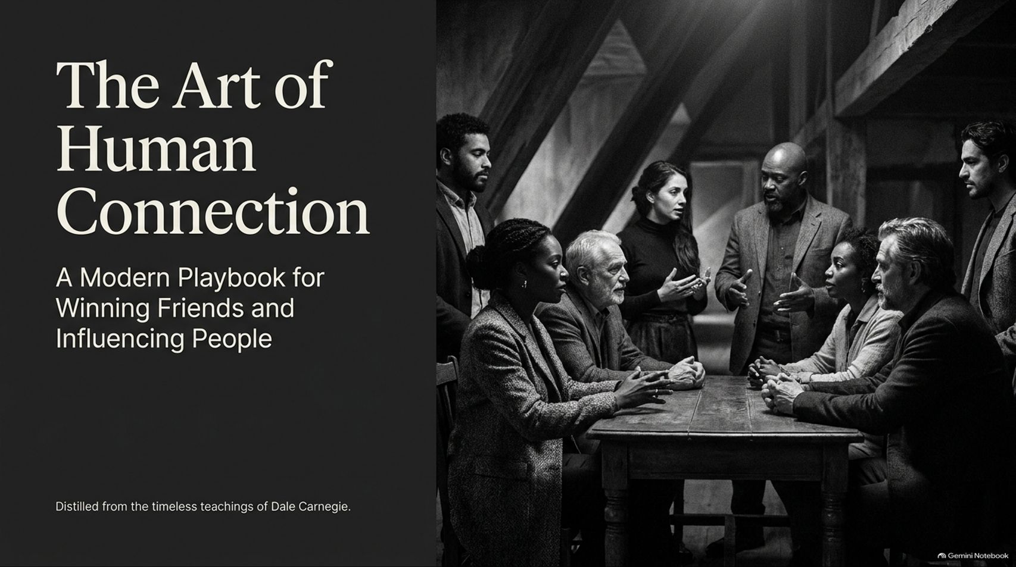
Notes:
Visual: Dark, sophisticated title slide showing a diverse group of professionals seated around a conference table in deep conversation, titled: "The Art of Human Connection: A Modern Playbook for Winning Friends and Influencing People," sub-titled: "Distilled from the timeless teachings of Dale Carnegie."
Speaker Notes (Target: 2–3 minutes):
Welcome, everyone, to today's masterclass on "The Art of Human Connection."
In a world increasingly obsessed with technical certifications, AI tools, and hard metrics, we often overlook the underlying currency that truly drives careers, leadership, and happiness: how we relate to one another.
Today, we are going to explore the master principles distilled from Dale Carnegie’s legendary work. Whether you are leading an enterprise, managing a team, or navigating personal relationships, these timeless rules will give you an unshakeable edge. Let’s dive in.
How to Win Friends and Influence People by Dale Carnegie Full Audiobook Summary
https://www.youtube.com/watch?v=xjolnAhCEdQ

Slide 2
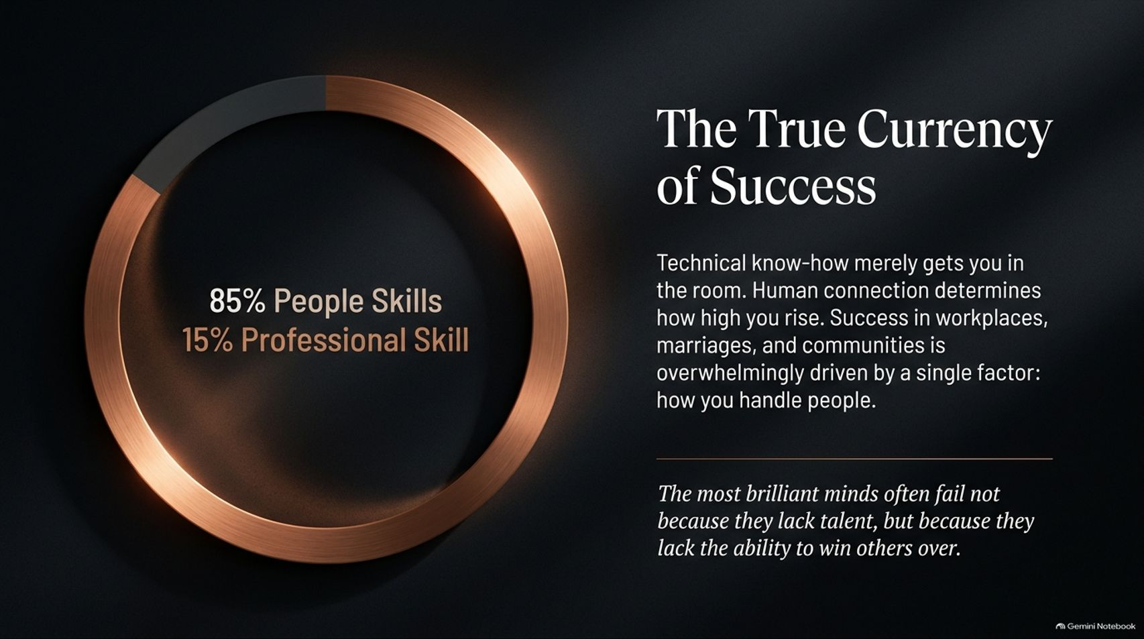
Notes:
Visual: A glowing circular progress ring highlighting "85% People Skills" versus "15% Professional Skill", accompanied by key messaging on human connection and workplace success.
Speaker Notes (Target: 3–4 minutes):
Let's start with a foundational reality check: Success in life is 15% professional skill and 85% people skills.
Think about the most brilliant minds you've ever encountered. Why do some technical geniuses plateau while average intellects rise to the top? It is because the most brilliant minds often fail not because they lack talent, but because they lack the ability to win others over.
Technical know-how merely gets you in the room; human connection determines how high you rise. Whether in marriages, communities, or corporate boardrooms, success is overwhelmingly driven by how you handle people.

Slide 3
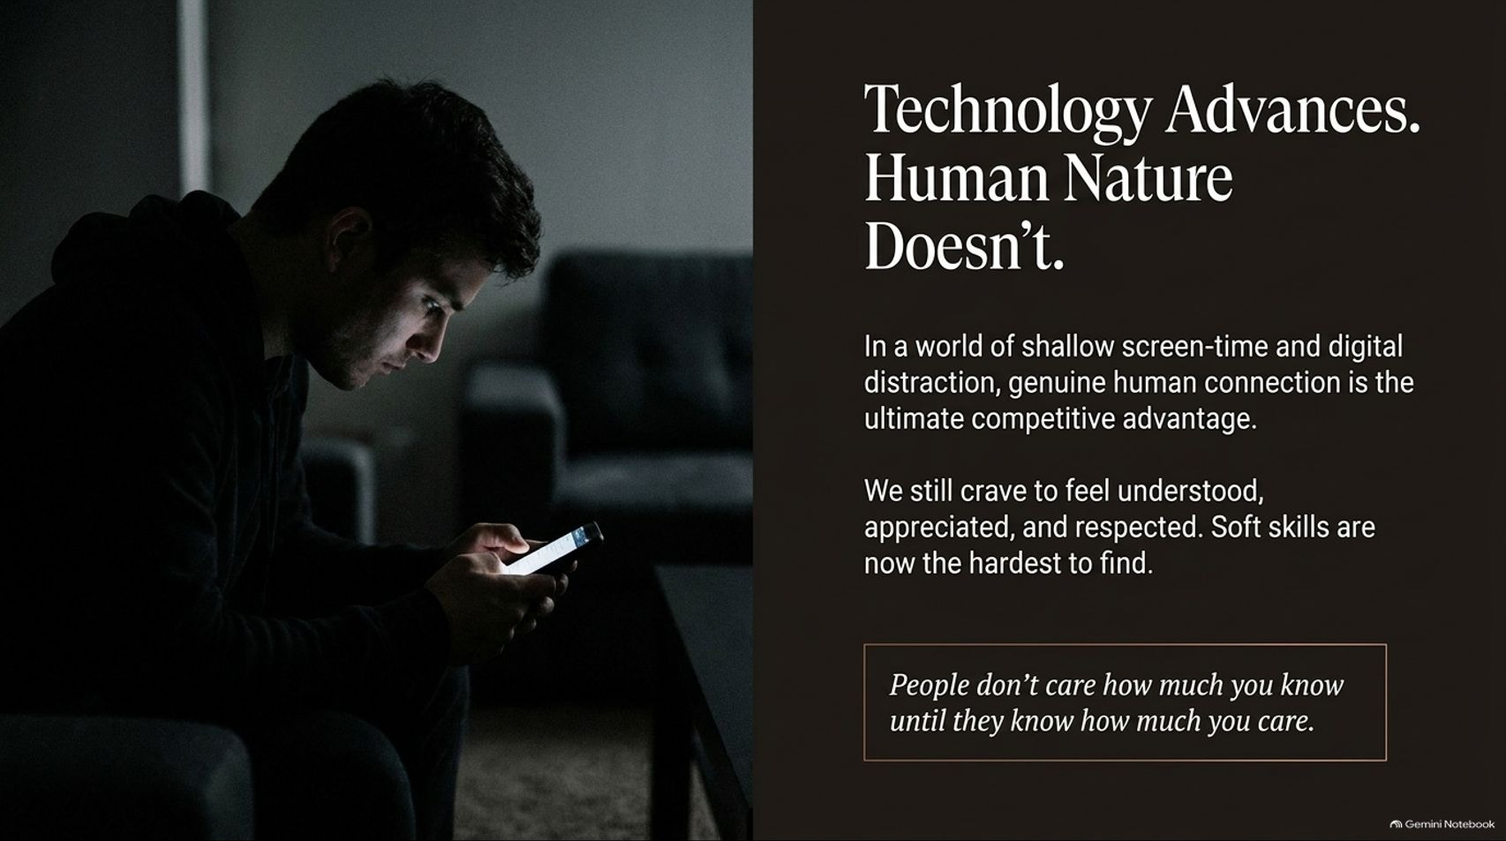
Notes:
Visual: A moody image of a person sitting alone in a dark room illuminated only by a smartphone screen, paired with quotes on soft skills and Carnegie’s core adage: "People don't care how much you know until they know how much you care."
Speaker Notes (Target: 3–5 minutes):
We live in an era of unprecedented technological acceleration. Yet, human nature hasn't changed an inch.
In a world of shallow screen-time, endless notifications, and digital distraction, genuine human connection is the ultimate competitive advantage. We still crave to feel understood, appreciated, and respected.
As the old saying goes, people don't care how much you know until they know how much you care. In today's automated workspace, soft skills have become the hardest skills to find. Mastering them makes you truly irreplaceable.

Slide 4
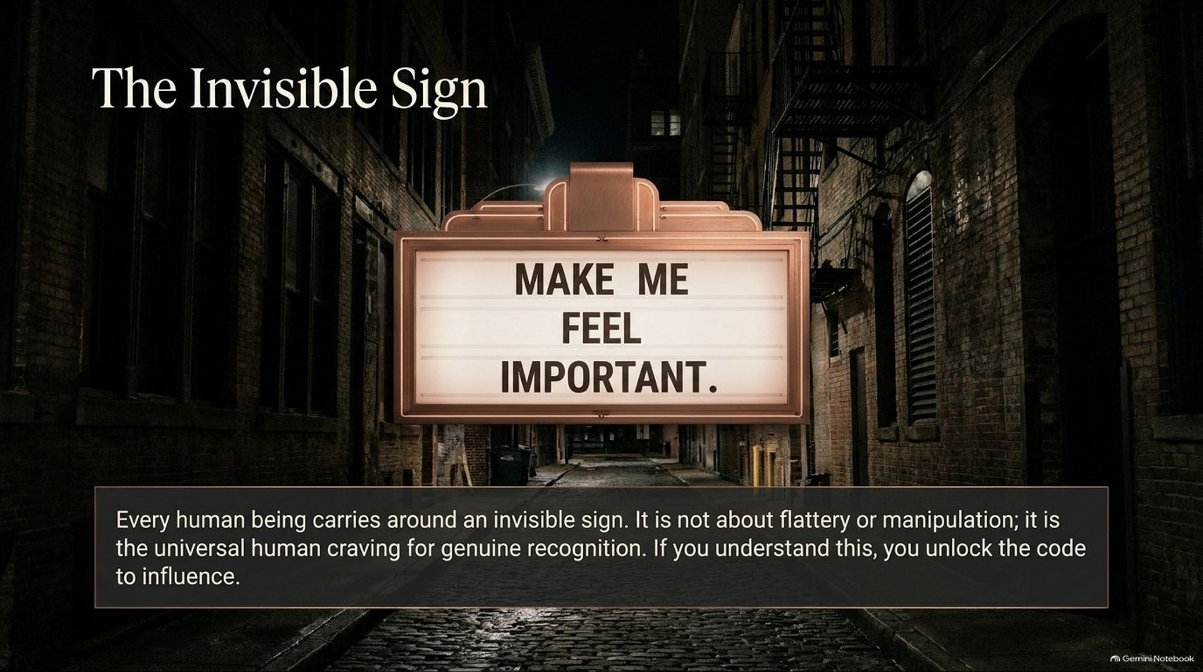
Notes:
Visual: A vintage urban street marquee glowing in a dark alleyway displaying the words: "MAKE ME FEEL IMPORTANT."
Speaker Notes (Target: 3–4 minutes):
Every single human being you encounter every day carries around an invisible sign that reads: "MAKE ME FEEL IMPORTANT."
This is not a trick of flattery or cheap manipulation; it is a reflection of the universal human craving for genuine recognition.
When you understand this fundamental truth, you unlock the master code to human influence. People want to matter. When you make them feel genuinely seen, valued, and respected, you open doors that no amount of technical authority ever could.

Slide 5
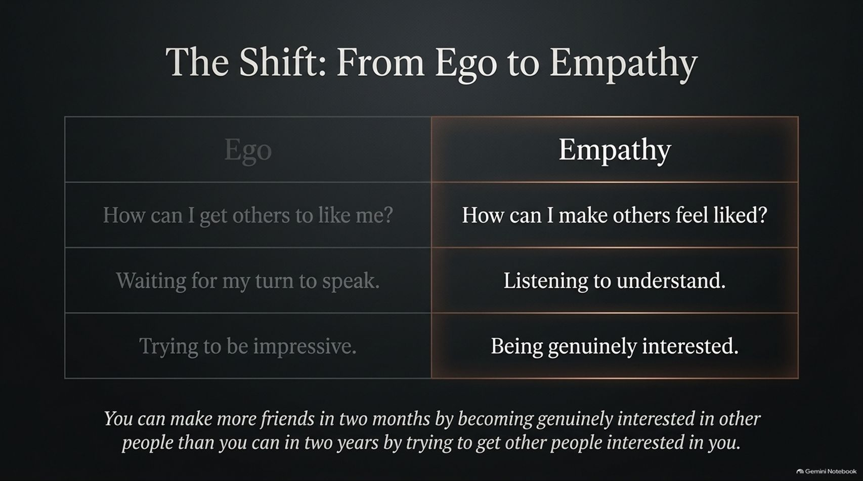
Notes:
Visual: A clear comparative table contrasting "Ego" behaviors (how can I get others to like me, waiting to speak, trying to be impressive) against "Empathy" (making others feel liked, listening to understand, being genuinely interested).
Speaker Notes (Target: 3–5 minutes):
True connection requires a radical mindset shift: moving from ego to empathy.
The ego-driven approach asks: "How can I get people to like me? How can I look impressive?" But the empathetic approach asks: "How can I make others feel liked? How can I understand their world?"
As Carnegie famously noted: You can make more friends in two months by becoming genuinely interested in other people than you can in two years by trying to get other people interested in you. Drop the need to dominate; choose curiosity instead.

Slide 6
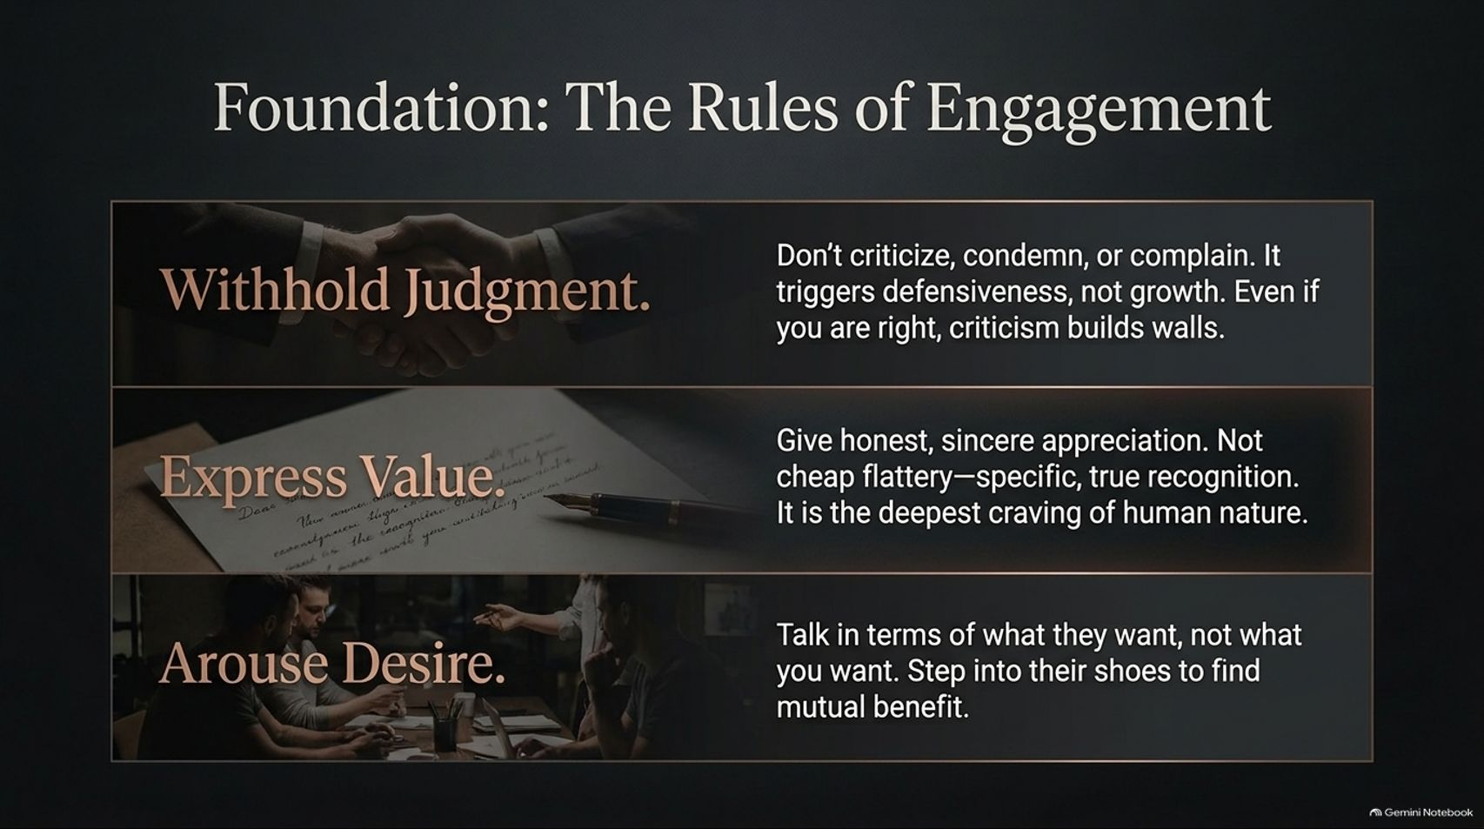
Notes:
Visual: Three horizontal stacked cards over a handshake and vintage paper background outlining: Withhold Judgment, Express Value, and Arouse Desire.
Speaker Notes (Target: 3–5 minutes):
Before we can build influence, we must master three fundamental rules of engagement:
Withhold Judgment: Never criticize, condemn, or complain. It triggers immediate defensiveness, not growth. Even if you are right, criticism builds insurmountable walls.
Express Value: Give honest, sincere appreciation. Not cheap flattery, but specific, true recognition. It is the deepest craving of human nature.
Arouse Desire: Talk in terms of what they want, not what you want. Step into their shoes to find mutual benefit.

Slide 7
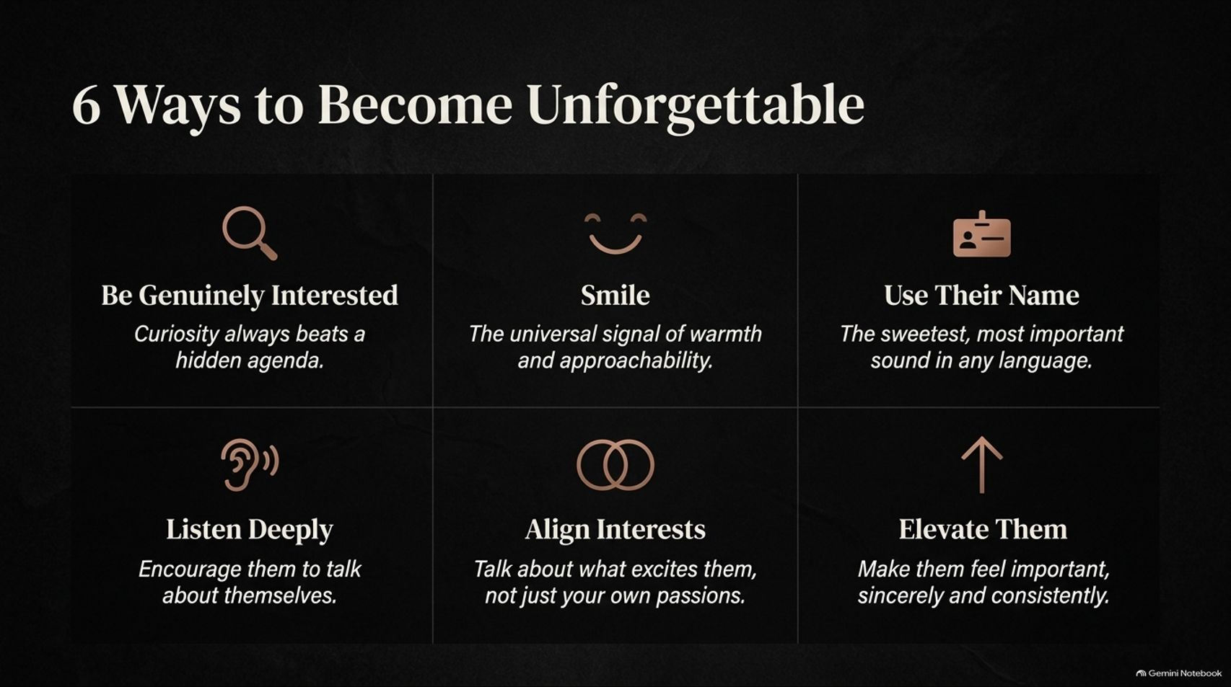
Notes:
Visual: A clean 2x3 grid showcasing the six core Carnegie principles: Be Genuinely Interested, Smile, Use Their Name, Listen Deeply, Align Interests, and Elevate Them.
Speaker Notes (Target: 4–5 minutes):
How do you translate these ideas into daily habits that make you unforgettable? Follow these six principles:
Be Genuinely Interested: Curiosity always beats a hidden agenda.
Smile: It is the universal signal of warmth and approachability.
Use Their Name: To any person, their name is the sweetest and most important sound in any language.
Listen Deeply: Encourage others to talk about themselves rather than waiting for your turn.
Align Interests: Talk about what excites them, not just your own passions.
Elevate Them: Make them feel important, sincerely and consistently.

Slide 8
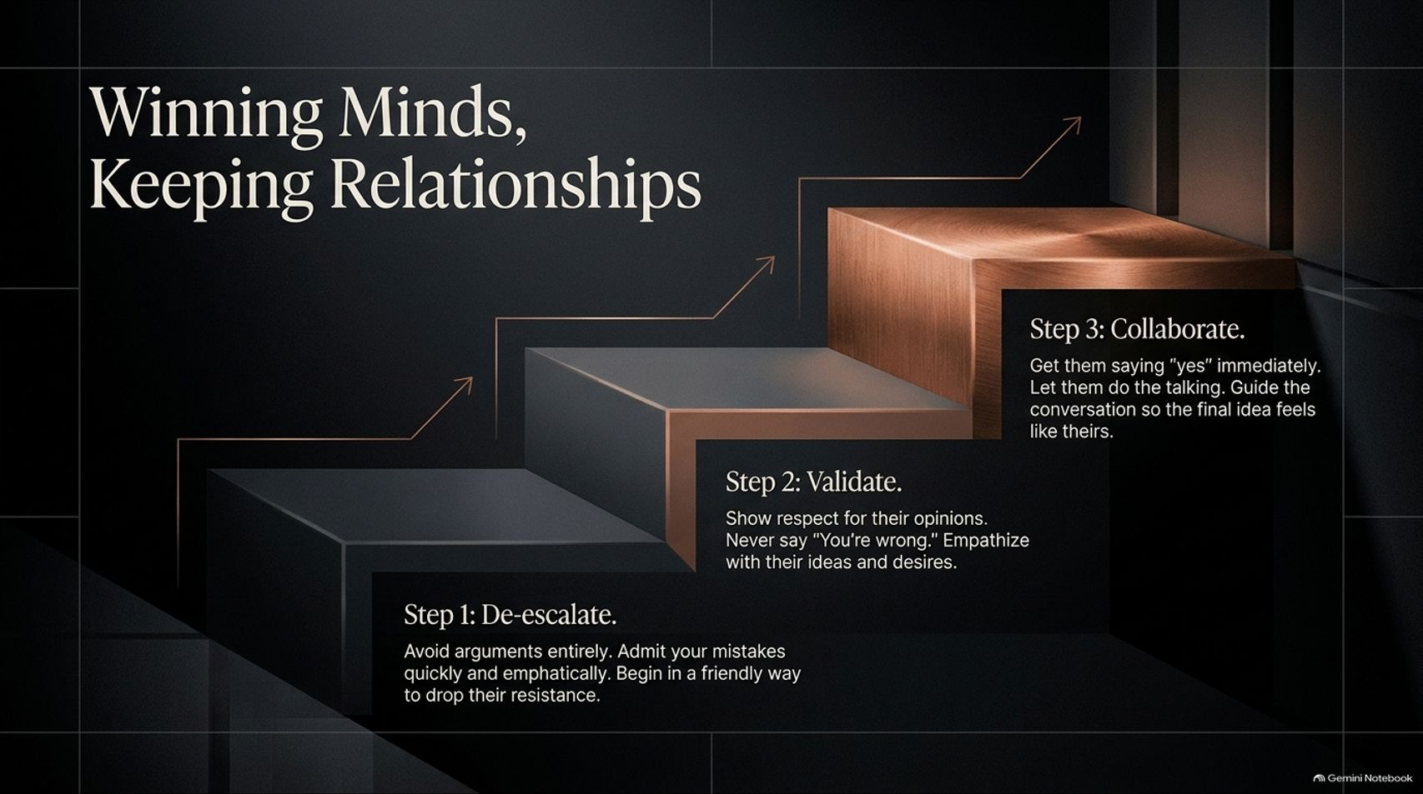
Notes:
Visual: A 3-step sculptural staircase showing Step 1: De-escalate, Step 2: Validate, and Step 3: Collaborate, overlaid with ascending trend arrows.
Speaker Notes (Target: 3–5 minutes):
When disagreements arise, how do we win minds without breaking relationships? We follow a 3-step staircase:
Step 1: De-escalate: Avoid arguments entirely. Admit your mistakes quickly and emphatically to drop the other person's resistance.
Step 2: Validate: Show deep respect for their opinions. Never tell someone "You're wrong." Empathize with their desires.
Step 3: Collaborate: Get them saying "yes" immediately. Let them do the talking so the final idea feels like theirs.

Slide 9
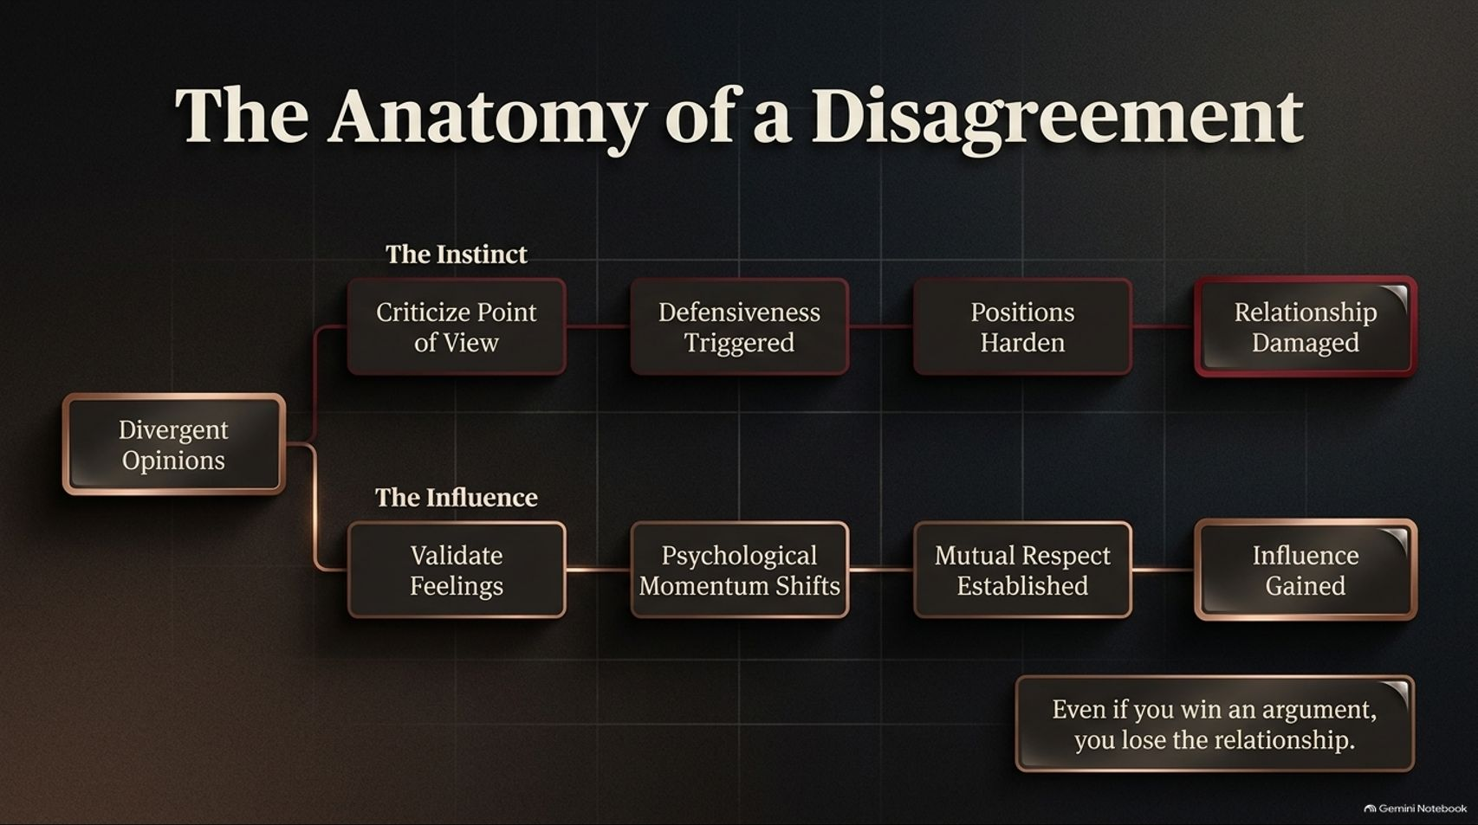
Notes:
Visual: Two branching flowchart paths contrasting "The Instinct" (Criticize $\rightarrow$ Defensiveness $\rightarrow$ Hardened Positions $\rightarrow$ Damaged Relationship) against "The Influence" (Validate $\rightarrow$ Momentum Shifts $\rightarrow$ Respect $\rightarrow$ Influence Gained).
Speaker Notes (Target: 3–5 minutes):
Look closely at the anatomy of a disagreement. When faced with divergent opinions, our default human instinct is to criticize the opposing point of view. That triggers immediate defensiveness, hardens positions, and damages the relationship.
The path of true influence takes a different route. When you validate feelings first, psychological momentum shifts. Mutual respect is established, and influence is gained.
Remember the golden rule at the bottom: Even if you win an argument, you lose the relationship.

Slide 10
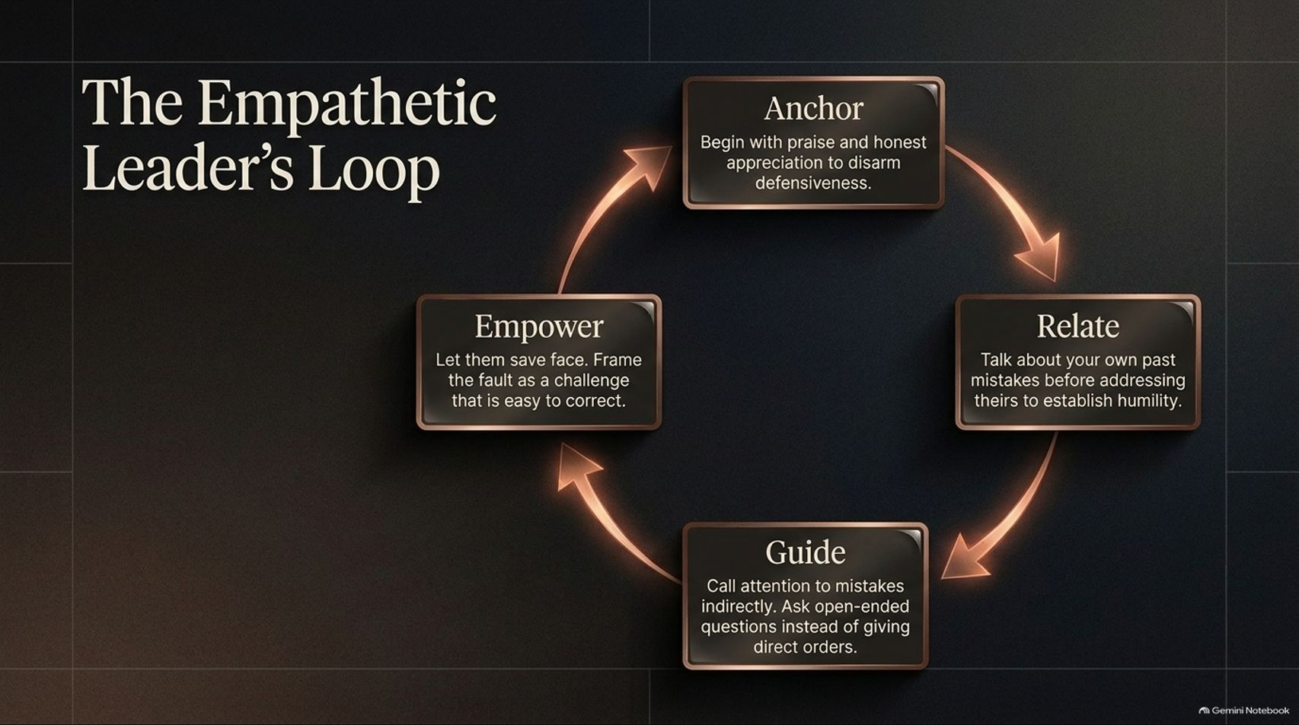
Notes:
Visual: A circular 4-step workflow graphic with glowing arrows connecting Anchor, Relate, Guide, and Empower.
Speaker Notes (Target: 3–5 minutes):
Effective leadership is a continuous loop of empathy, structured across four phases:
Anchor: Begin with praise and honest appreciation to disarm defensiveness.
Relate: Talk about your own past mistakes before addressing theirs to establish humility.
Guide: Call attention to mistakes indirectly. Ask open-ended questions instead of giving direct orders.
Empower: Let them save face. Frame the fault as an exciting challenge that is easy to correct.

Slide 11
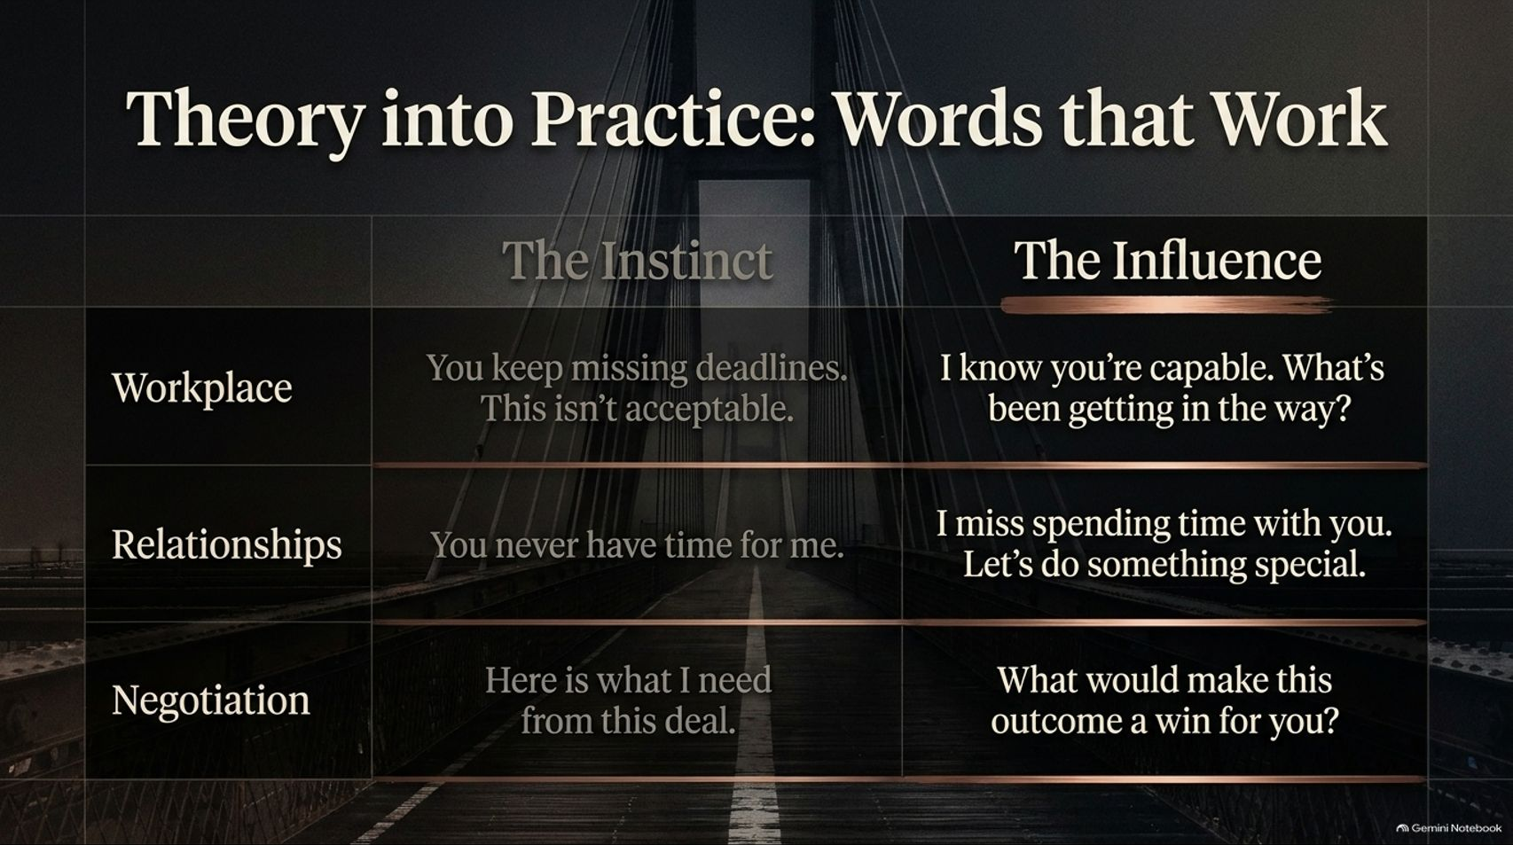
Notes:
Visual: A comparative table contrasting "The Instinct" (harsh, directive phrasing) with "The Influence" (empathetic, question-based framing) across Workplace, Relationships, and Negotiation contexts.
Speaker Notes (Target: 3–5 minutes):
Let's look at how this translates into everyday language:
In the Workplace: Instead of saying, "You keep missing deadlines. This isn't acceptable," shift to influence: "I know you're capable. What's been getting in the way?"
In Relationships: Instead of complaining, "You never have time for me," try expressing vulnerability: "I miss spending time with you. Let's do something special."
In Negotiations: Instead of demanding, "Here is what I need from this deal," ask: "What would make this outcome a win for you?"

Slide 12
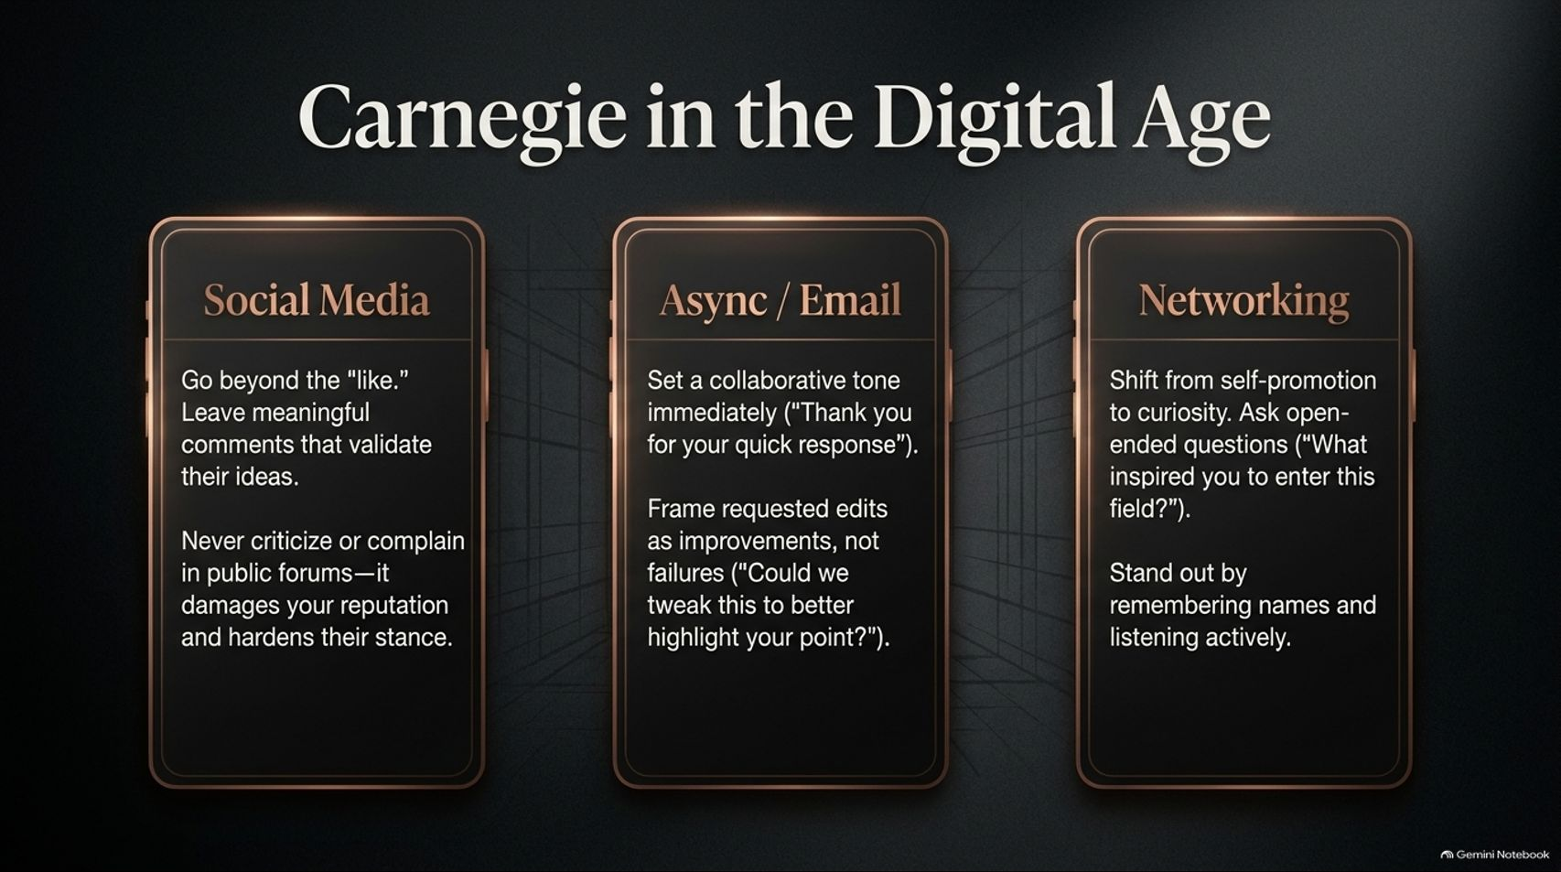
Notes:
Visual: Three vertical smartphone mockups detailing how to apply Carnegie's principles across Social Media, Async/Email, and Professional Networking.
Speaker Notes (Target: 3–5 minutes):
Do these principles apply in our digital, screen-bound world? Absolutely. In fact, they are more critical than ever:
Social Media: Go beyond the casual "like." Leave meaningful comments that validate others' ideas. Never criticize in public forums—it only hardens stances.
Async / Email: Set a collaborative tone immediately ("Thank you for your quick response"). Frame requested edits as improvements ("Could we tweak this to better highlight your point?") rather than failures.
Networking: Shift from self-promotion to curiosity by asking open-ended questions ("What inspired you to enter this field?").

Slide 13
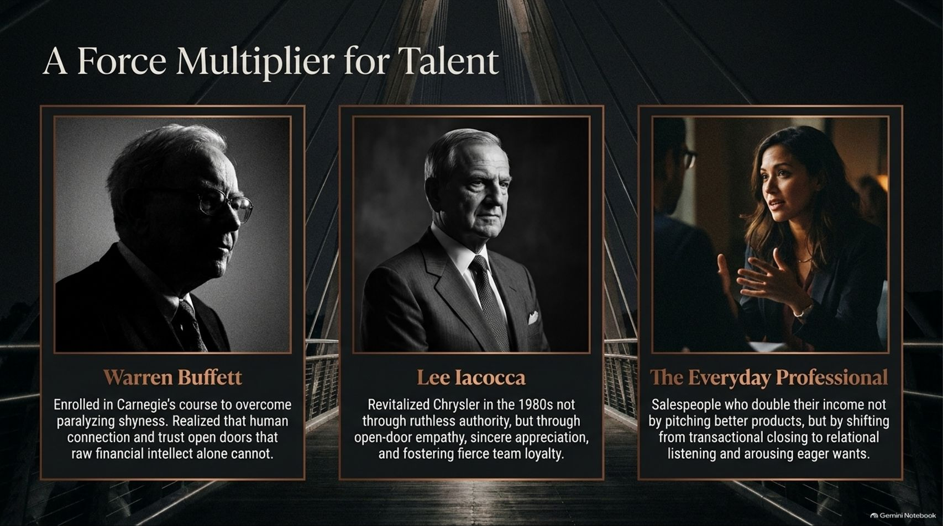
Notes:
Visual: Three portrait feature cards highlighting historical and professional giants: Warren Buffett, Lee Iacocca, and The Everyday Professional.
Speaker Notes (Target: 3–5 minutes):
People skills are the ultimate force multiplier for talent. Look at history's greatest achievers:
Warren Buffett enrolled in a Dale Carnegie course early in life specifically to overcome paralyzing shyness. He realized that human connection and trust open doors that raw financial intellect alone cannot.
Lee Iacocca revitalized Chrysler in the 1980s not through ruthless authority, but through open-door empathy, sincere appreciation, and fierce team loyalty.
Everyday Professionals who double their income do so not by pushing better products, but by shifting from transactional closing to relational listening.

Slide 14
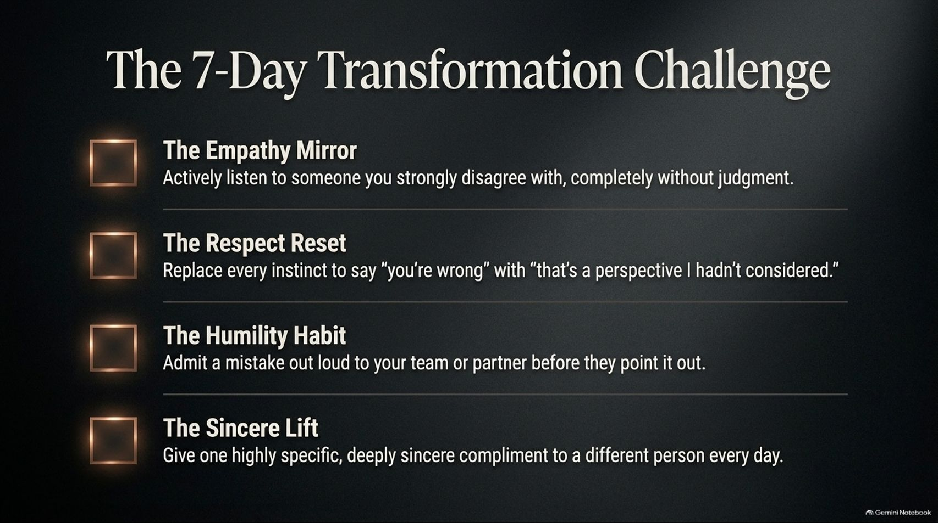
Notes:
Visual: A checklist slide featuring four actionable daily challenges: The Empathy Mirror, The Respect Reset, The Humility Habit, and The Sincere Lift.
Speaker Notes (Target: 3–4 minutes):
Theory without practice changes nothing. Here is your 7-Day Transformation Challenge:
The Empathy Mirror: Actively listen to someone you strongly disagree with, completely without judgment.
The Respect Reset: Replace every instinct to say "you're wrong" with "that's a perspective I hadn't considered."
The Humility Habit: Admit a mistake out loud to your team or partner before they point it out.
The Sincere Lift: Give one highly specific, deeply sincere compliment to a different person every day.

Slide 15
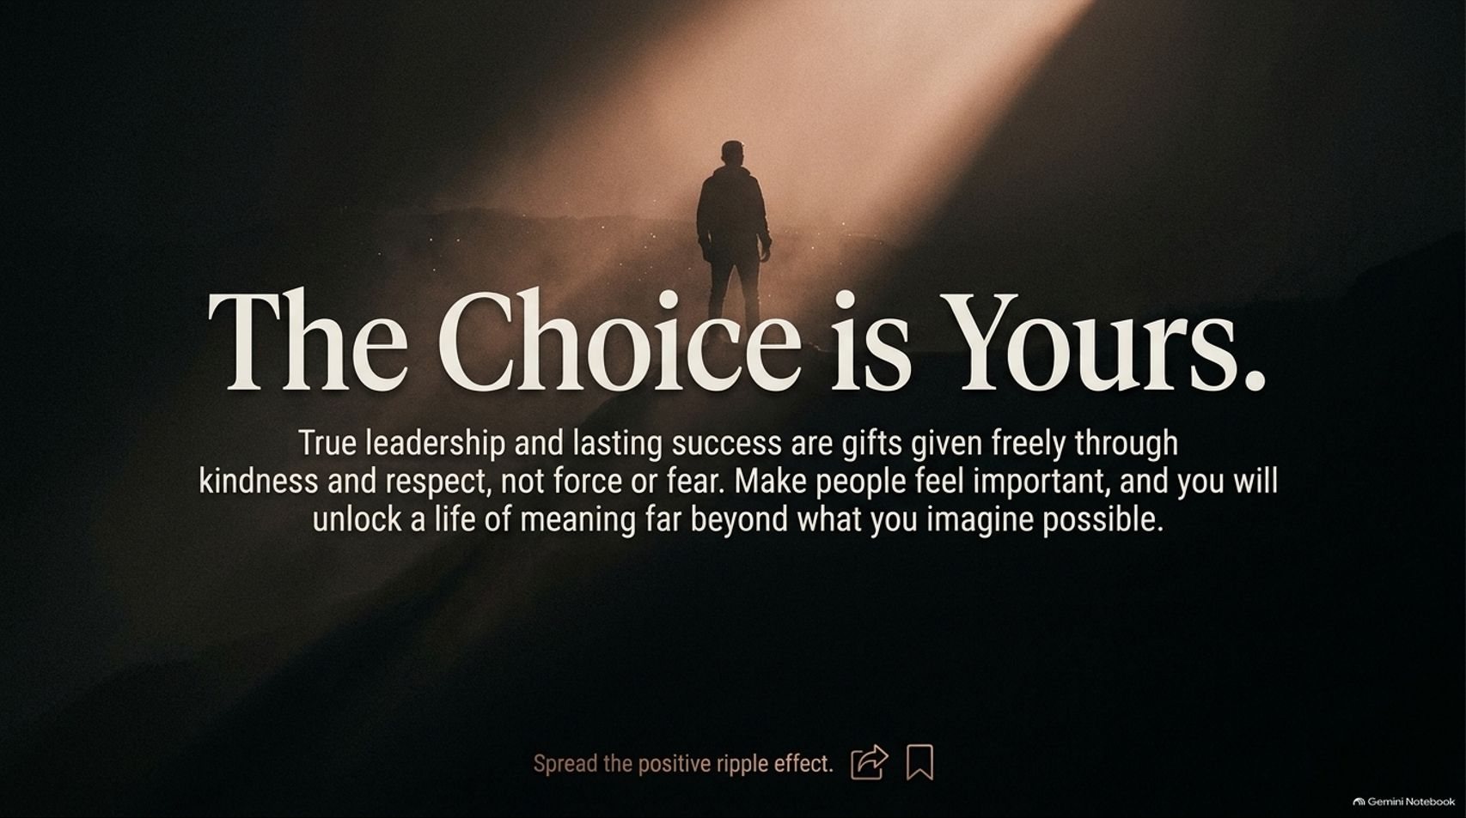
Notes:
Visual: A cinematic, inspiring wide-angle shot of a lone figure standing atop a mountain peak under a warm beam of light, featuring a closing summary statement on leadership and legacy.
Speaker Notes (Target: 2–3 minutes):
True leadership and lasting success are gifts given freely through kindness and respect, never through force or fear.
Make people feel important, and you will unlock a life of meaning far beyond what you imagine possible. Spread the positive ripple effect in every room you enter.

Slide 16
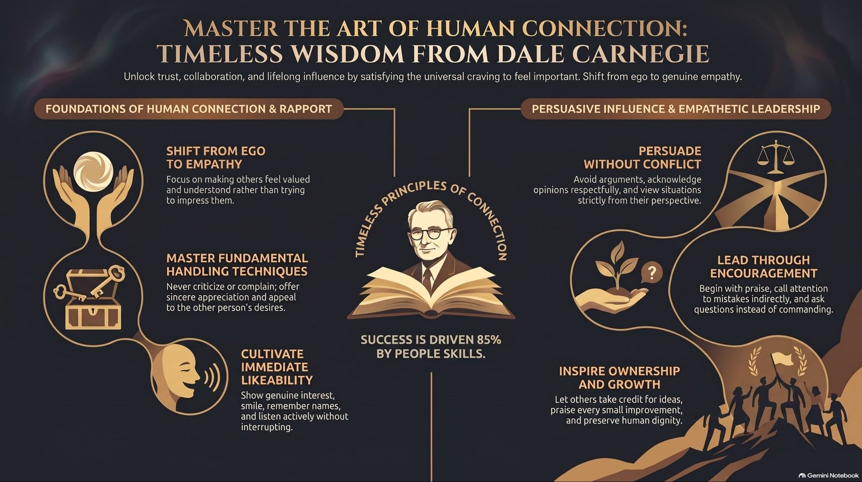
Notes:
Visual: A comprehensive master summary infographic uniting all core pillars: Foundations of Human Connection & Rapport, Timeless Principles of Connection, and Persuasive Influence & Empathetic Leadership.
Speaker Notes (Target: 3–5 minutes):
As we wrap up our masterclass, look at this complete ecosystem of connection.
From shifting your mindset from ego to empathy, to mastering fundamental handling techniques, smiling, listening, persuading without conflict, and leading through encouragement—every single principle boils down to one central truth.
When you make people feel genuinely valued and important, you don't just win friends or influence deals—you win hearts and loyalty for a lifetime. Thank you all, and let's open the floor for questions.

