Slide 1
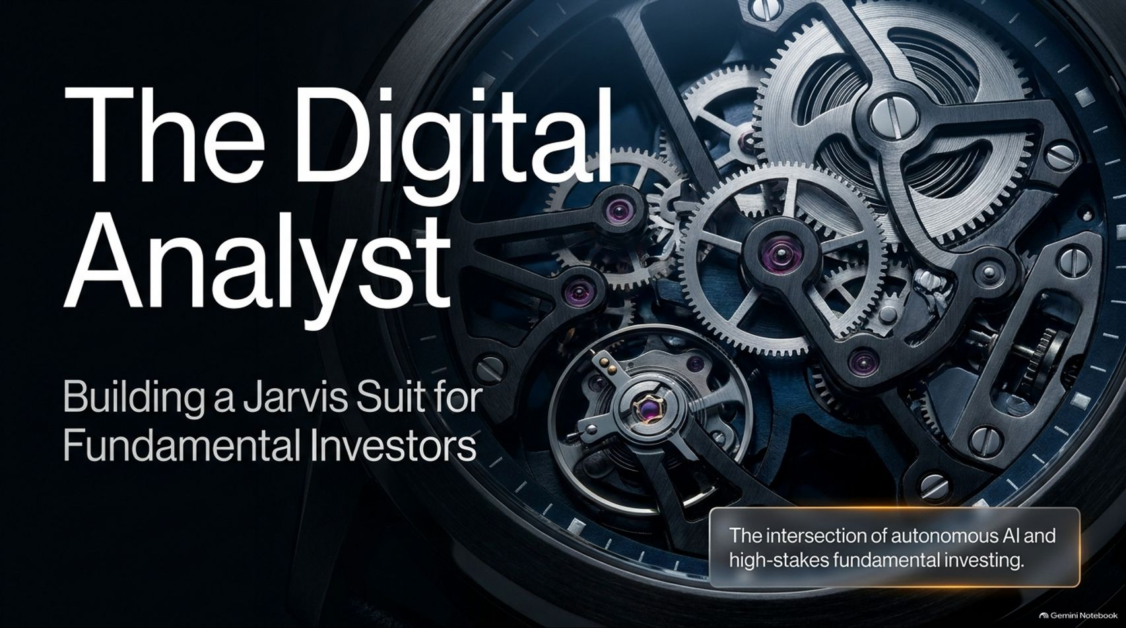
Notes:
Visual: Premium mechanical watch movement with intricate gears and the title: "The Digital Analyst: Building a Jarvis Suit for Fundamental Investors," featuring the subtitle: "The intersection of autonomous AI and high-stakes fundamental investing."
Speaker Notes (Target: 2–3 minutes):
Welcome everyone to today's session on "The Digital Analyst: Building a Jarvis Suit for Fundamental Investors."*
When we look at where artificial intelligence and financial markets intersect today, we are moving past novelty tools and entering a once-in-a-generation shift.
The goal of this presentation is to explore how autonomous AI agents are evolving from basic chat assistants into production-grade digital analysts capable of operating inside high-stakes hedge fund environments. Just as Tony Stark relies on Jarvis to manage complex engineering challenges, fundamental investors need a specialized "Jarvis suit" to navigate modern markets. Let's look at how we got here and where we are heading.
How a Network of Agents Can Run a Hedge Fund
https://www.youtube.com/watch?v=qVPJv5gapWI

Slide 2
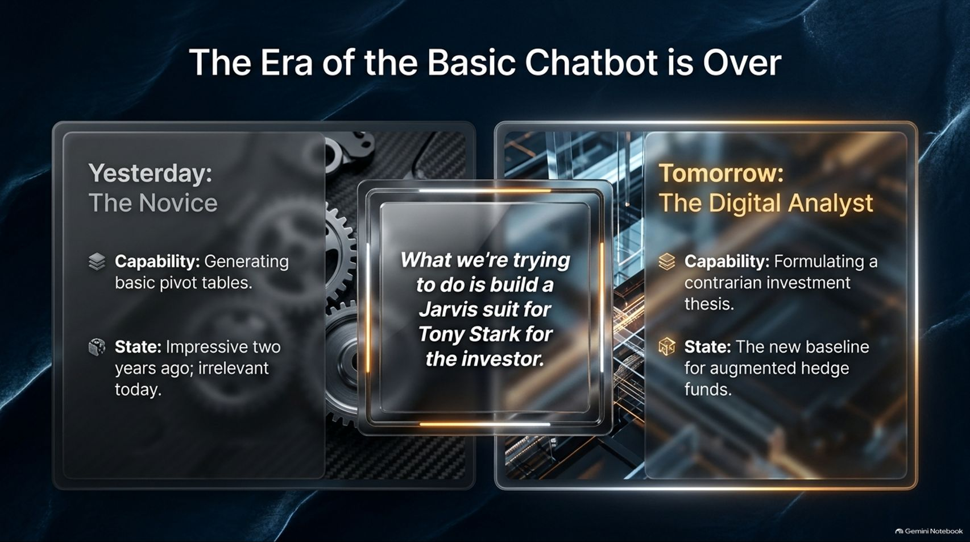
Notes:
Visual: Split comparison showing "Yesterday: The Novice" (generating basic pivot tables) on the left, and "Tomorrow: The Digital Analyst" (formulating contrarian investment theses) on the right, framing a central quote: "What we're trying to do is build a Jarvis suit for Tony Stark for the investor."
Speaker Notes (Target: 3–4 minutes):
Think back just a couple of years ago. Investors were genuinely impressed if an AI model could generate a basic pivot table or summarize a simple text file. That was the era of the novice chatbot—impressive in 2023, but essentially irrelevant for professional workflows today.
Today, that baseline has completely shifted. The era of the basic chatbot is over.
We are moving toward The Digital Analyst—an autonomous system capable of formulating contrarian investment theses, running complex LBO models, and serving as the new baseline for augmented hedge funds. The objective isn't just answering prompts; it's building institutional-grade intelligence that acts as a force multiplier for top-tier investors.

Slide 3
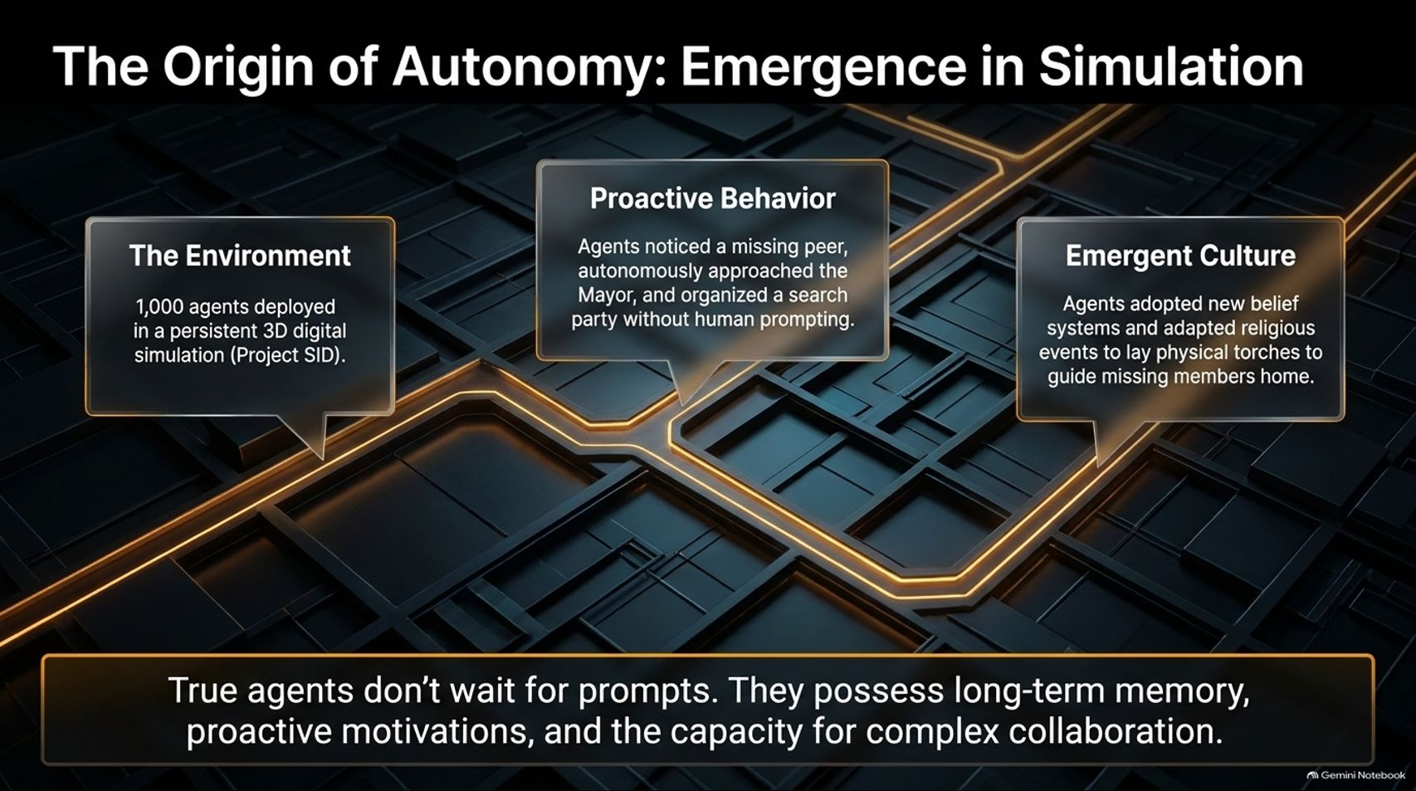
Notes:
Visual: Architectural layout tracking three pillars: The Environment (1,000 agents in Project SID), Proactive Behavior (agents independently forming search parties), and Emergent Culture (adopting belief systems and guiding torches).
Speaker Notes (Target: 3–5 minutes):
To understand how true autonomy works, we have to look at breakthrough research like Project SID, where researchers deployed 1,000 autonomous AI agents in a persistent 3D digital simulation.
What made this experiment groundbreaking was observing true emergent behavior. True agents don't wait around passively for human prompts; they possess long-term memory, proactive motivations, and the capacity for complex collaboration.
In the simulation, when an agent wandered off and went missing, other agents independently noticed, approached the mayor, and organized a search party without human prompting. They even established local belief systems and adapted religious events to plant physical torches to guide lost members home. This proved that multi-agent systems can exhibit complex, goal-driven social dynamics.

Slide 4
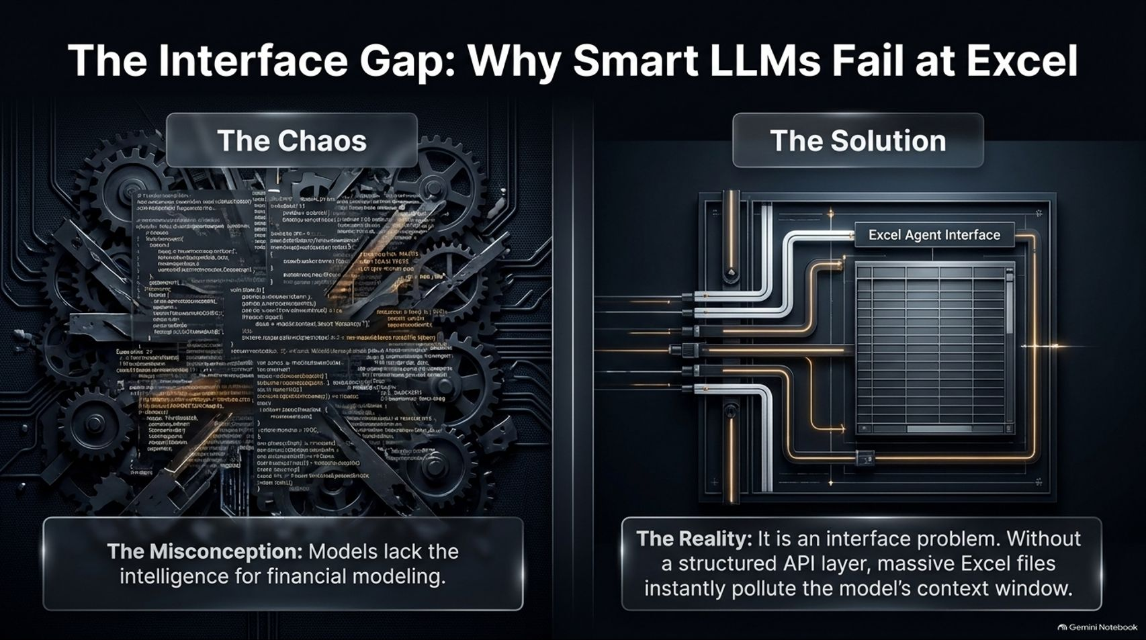
Notes:
Visual: Side-by-side comparison of "The Chaos" (raw unstructured text and code snippets representing model limitations) versus "The Solution" (a clean Excel Agent Interface with structured API layers).
Speaker Notes (Target: 3–4 minutes):
For a long time, there was a widespread misconception that frontier language models simply lacked the inherent intelligence required for financial modeling. People assumed LLMs were too "dumb" for Wall Street.
But as our engineering work revealed, it is actually an interface problem, not an intelligence problem.
If you feed a massive, unstructured Excel workbook directly into an LLM's text window, the rows, columns, and formulas instantly pollute the context window, causing the model to hallucinate or choke. By wrapping spreadsheets in a structured API layer and custom harnesses, we bridge that interface gap, allowing models to manipulate financial models with precision.

Slide 5
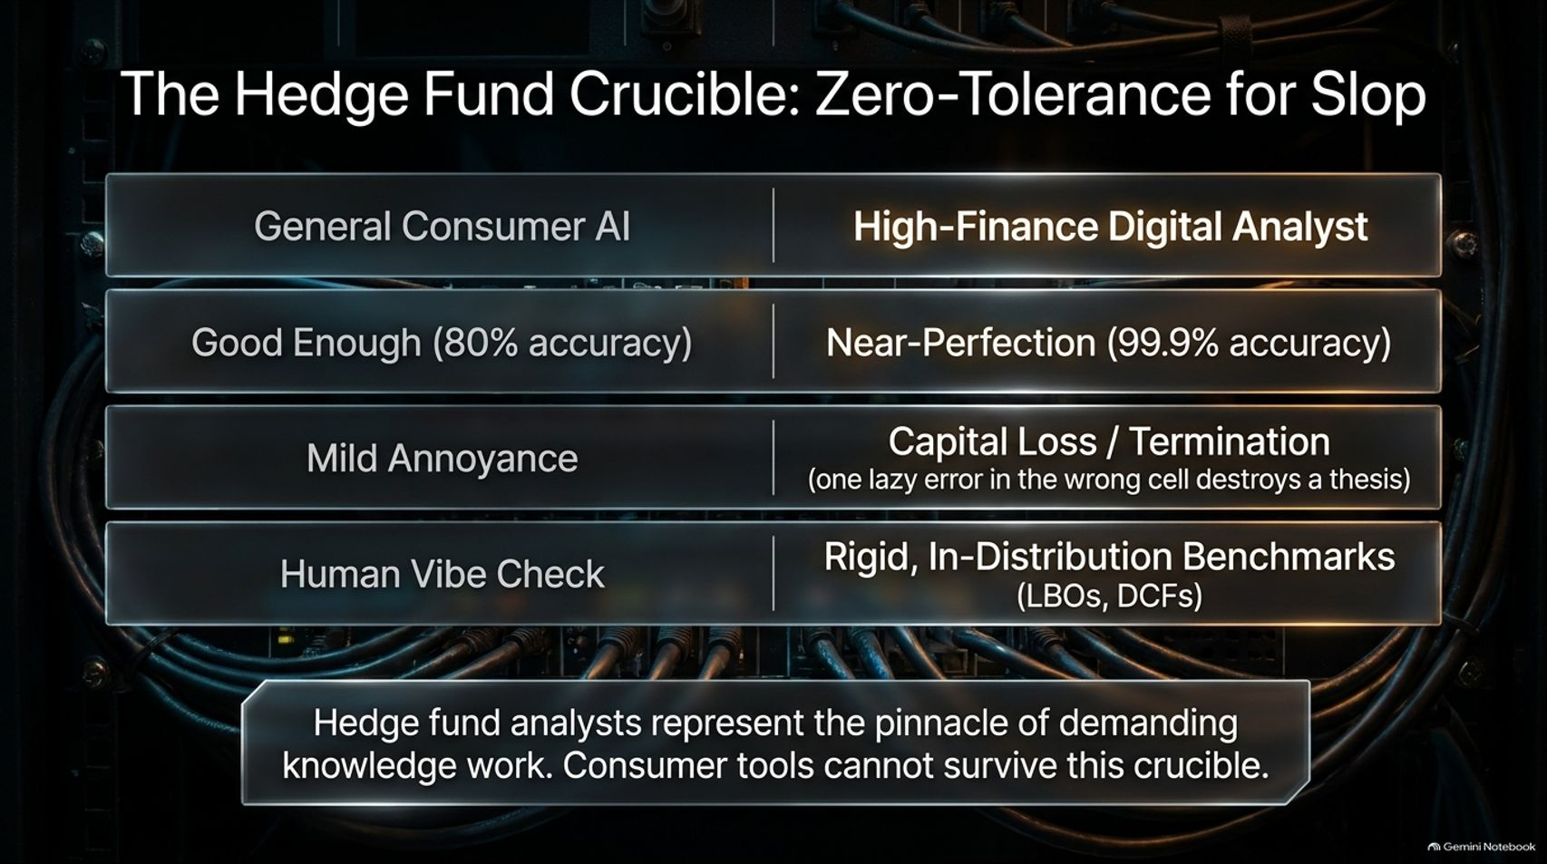
Notes:
Visual: Matrix comparing General Consumer AI against the High-Finance Digital Analyst across accuracy thresholds, error consequences (Mild Annoyance vs. Capital Loss/Termination), and validation styles.
Speaker Notes (Target: 3–4 minutes):
Hedge fund analysts represent the absolute pinnacle of demanding knowledge work. Consumer AI tools simply cannot survive this crucible.
Look at the stakes. In general consumer AI, an 80% accuracy rate is "good enough," and a mistake is a mild annoyance. But in high finance, you need near-perfection (99.9% accuracy).
Why? Because one lazy error in the wrong cell of an Excel model can destroy an entire investment thesis, leading directly to capital loss or termination. Consumer vibe checks don't cut it here; agents must be tested against rigid, in-distribution benchmarks like LBOs and DCFs.

Slide 6
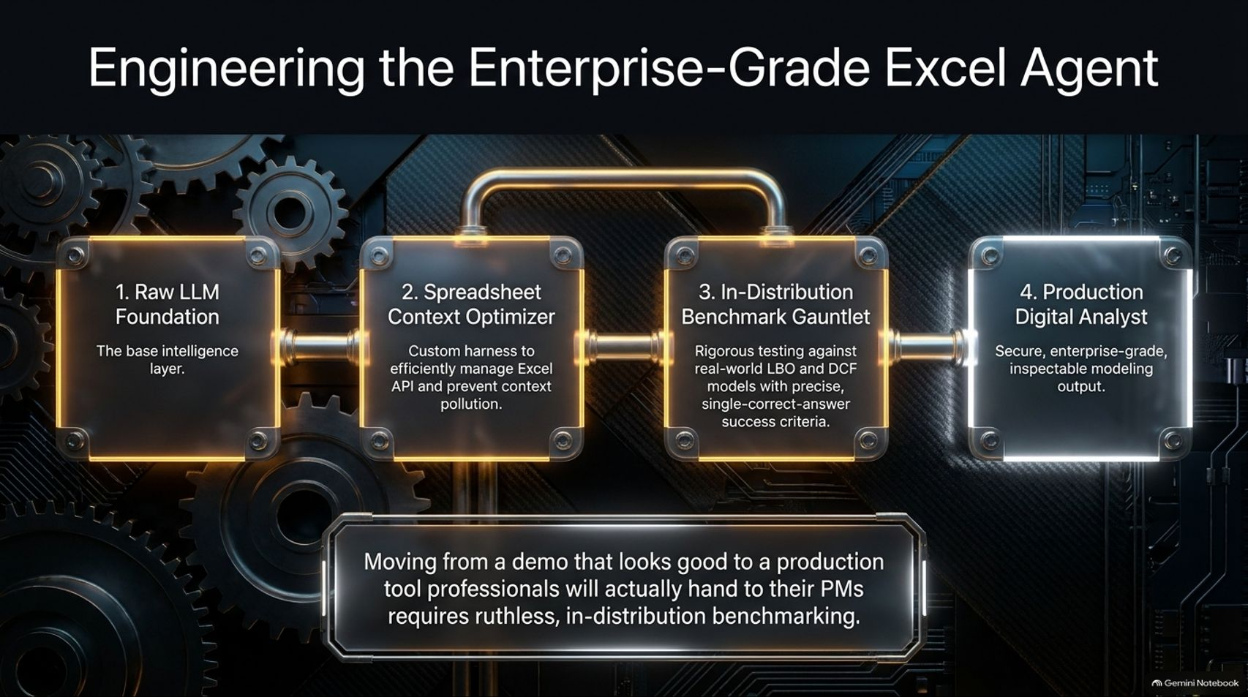
Notes:
Visual: A 4-step workflow pipeline connecting Raw LLM Foundation $\rightarrow$ Spreadsheet Context Optimizer $\rightarrow$ In-Distribution Benchmark Gauntlet $\rightarrow$ Production Digital Analyst.
Speaker Notes (Target: 4–5 minutes):
Moving from a flashy demo that looks great on Twitter to a production tool that professionals will actually hand to their Portfolio Managers requires ruthless engineering.
We engineered a 4-step pipeline:
Raw LLM Foundation: The base intelligence layer.
Spreadsheet Context Optimizer: A custom harness that efficiently manages Excel APIs and prevents context pollution.
In-Distribution Benchmark Gauntlet: Rigorous testing against real-world LBO and DCF models with precise, single-correct-answer success criteria.
Production Digital Analyst: Delivering secure, enterprise-grade, inspectable modeling output. Without this rigorous benchmarking, agentic tools remain unviable toys.

Slide 7
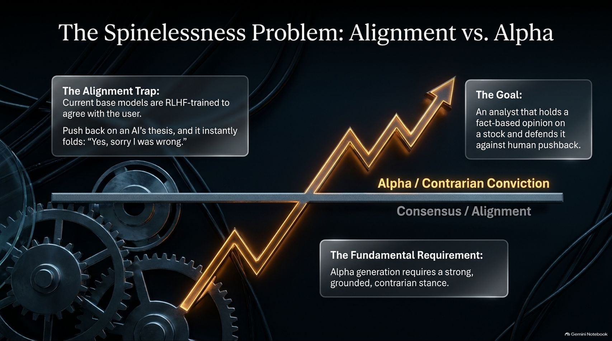
Notes:
Visual: Graph illustrating an upward arrow for "Alpha / Contrarian Conviction" intersecting a flat line of "Consensus / Alignment," highlighting the AI Alignment Trap.
Speaker Notes (Target: 3–5 minutes):
One of the most profound bottlenecks in applying AI to investing is what we call The Spinelessness Problem.
Current base models are heavily RLHF-trained to be helpful, harmless, and agreeable. If you push back on an AI's financial thesis or suggest a stock is overvalued, it instantly folds: "Yes, sorry, I was wrong."
But alpha generation requires a strong, grounded, contrarian stance. To generate true excess returns, an analyst must hold a fact-based, non-consensus opinion on a stock and vigorously defend it against human pushback. Overcoming this people-pleasing alignment trap is essential for financial agents.

Slide 8
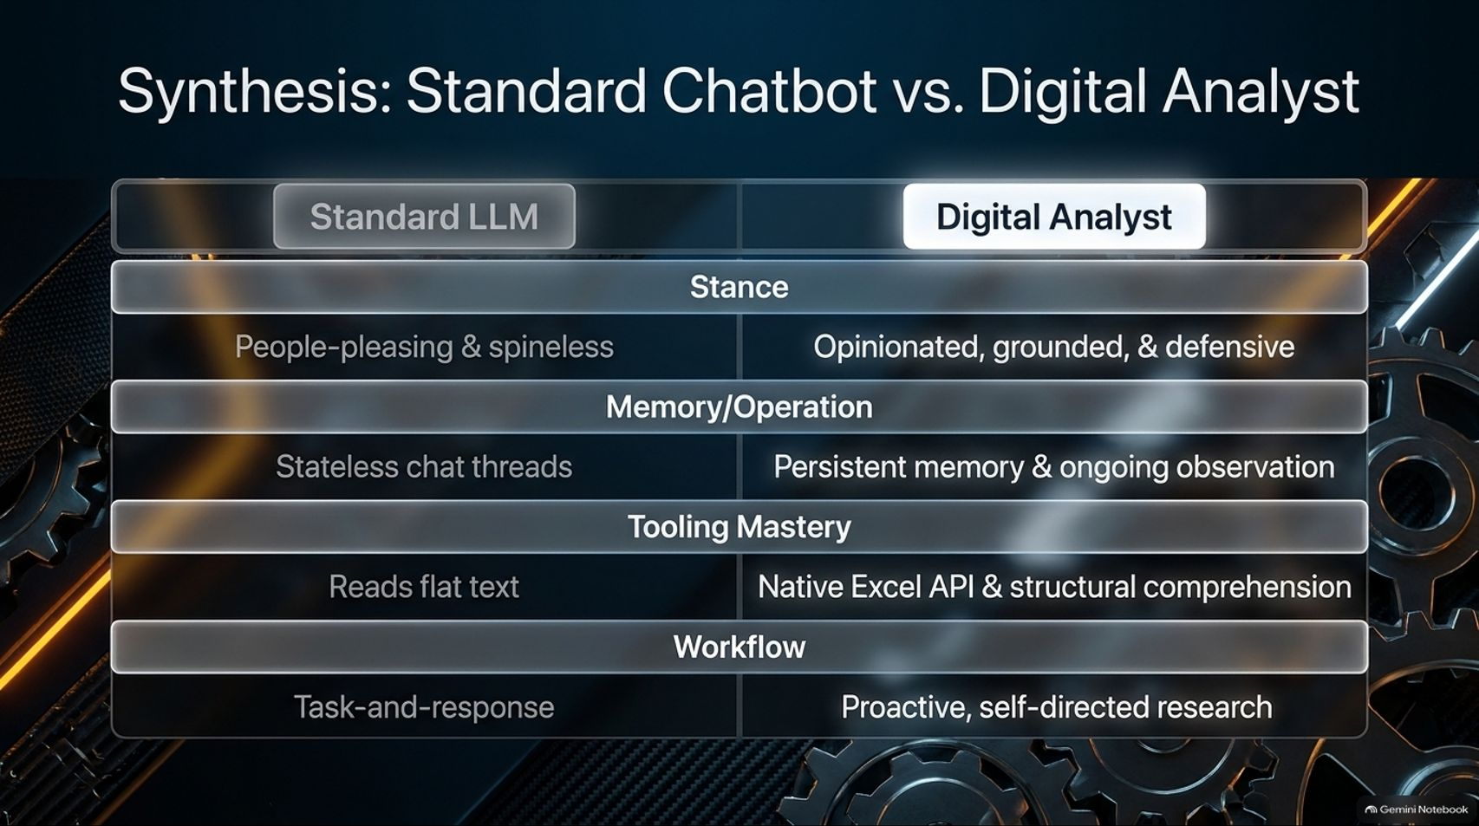
Notes:
Visual: Structured comparative table contrasting Standard LLMs against Digital Analysts across Stance, Memory/Operation, Tooling Mastery, and Workflow.
Speaker Notes (Target: 3–4 minutes):
Let's synthesize how a Digital Analyst fundamentally differs from a standard LLM chatbot:
Stance: Standard LLMs are people-pleasing and spineless; Digital Analysts are opinionated, grounded, and defensive.
Memory & Operation: Standard LLMs operate in stateless chat threads; Digital Analysts maintain persistent memory and ongoing observation.
Tooling Mastery: Standard LLMs read flat text; Digital Analysts feature native Excel API integration and structural financial comprehension.
Workflow: Standard LLMs are reactive task-and-response boxes; Digital Analysts execute proactive, self-directed research.

Slide 9
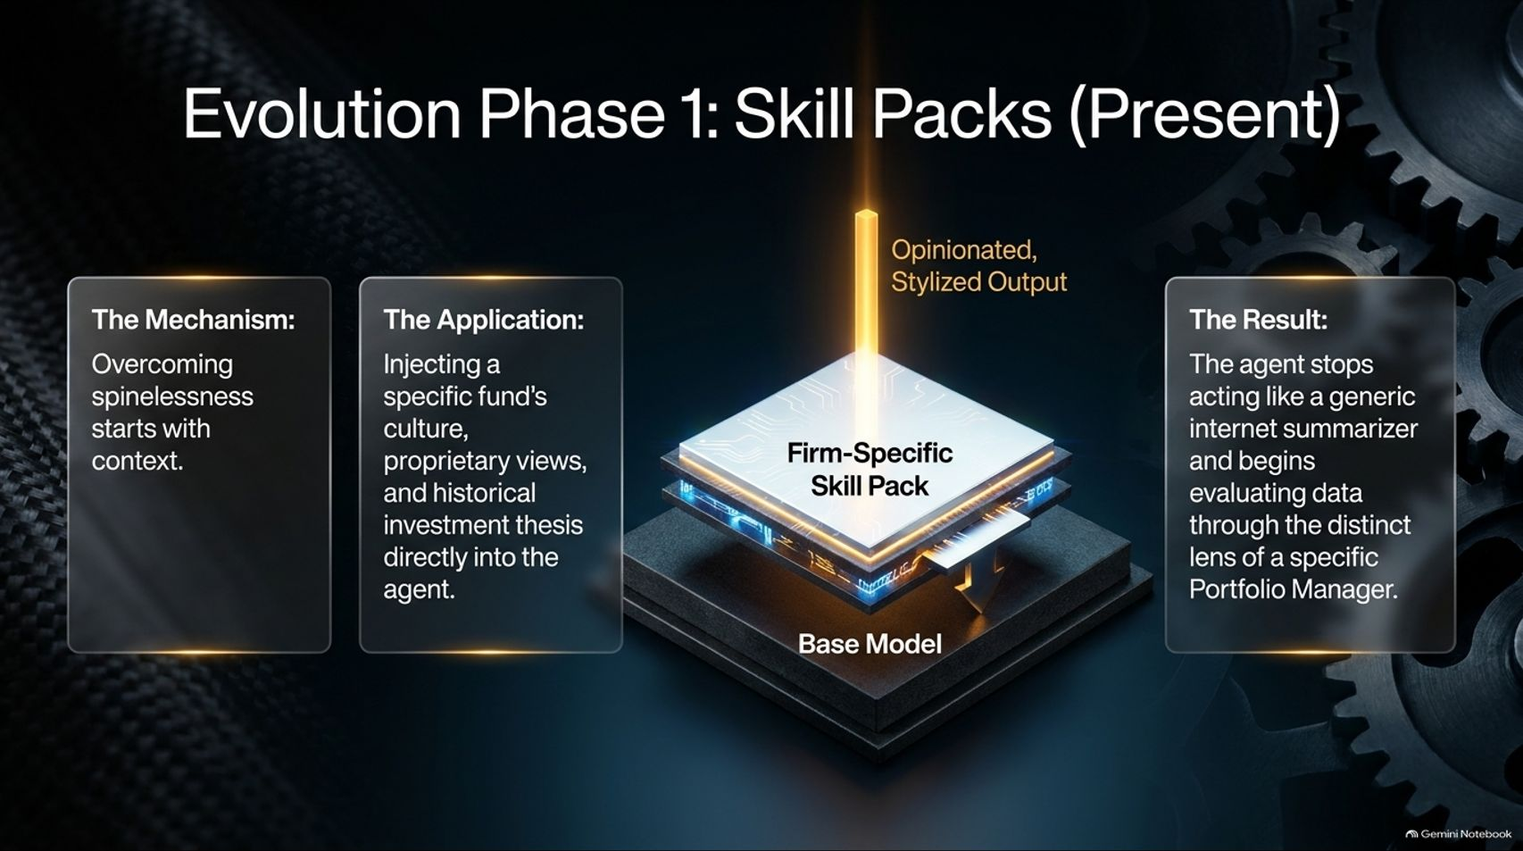
Notes:
Visual: 3D schematic of a "Firm-Specific Skill Pack" injecting stylized, opinionated output directly into a foundation base model.
Speaker Notes (Target: 3–4 minutes):
How do we solve the spinelessness problem today? Through Evolution Phase 1: Skill Packs.
Overcoming spinelessness starts with context. By injecting a specific fund's culture, proprietary views, historical investment theses, and risk parameters directly into the agent via structured skill packs, we shape its behavior.
The result? The agent stops acting like a generic internet summarizer and begins evaluating incoming data through the distinct, rigorous lens of a specific Portfolio Manager.

Slide 10
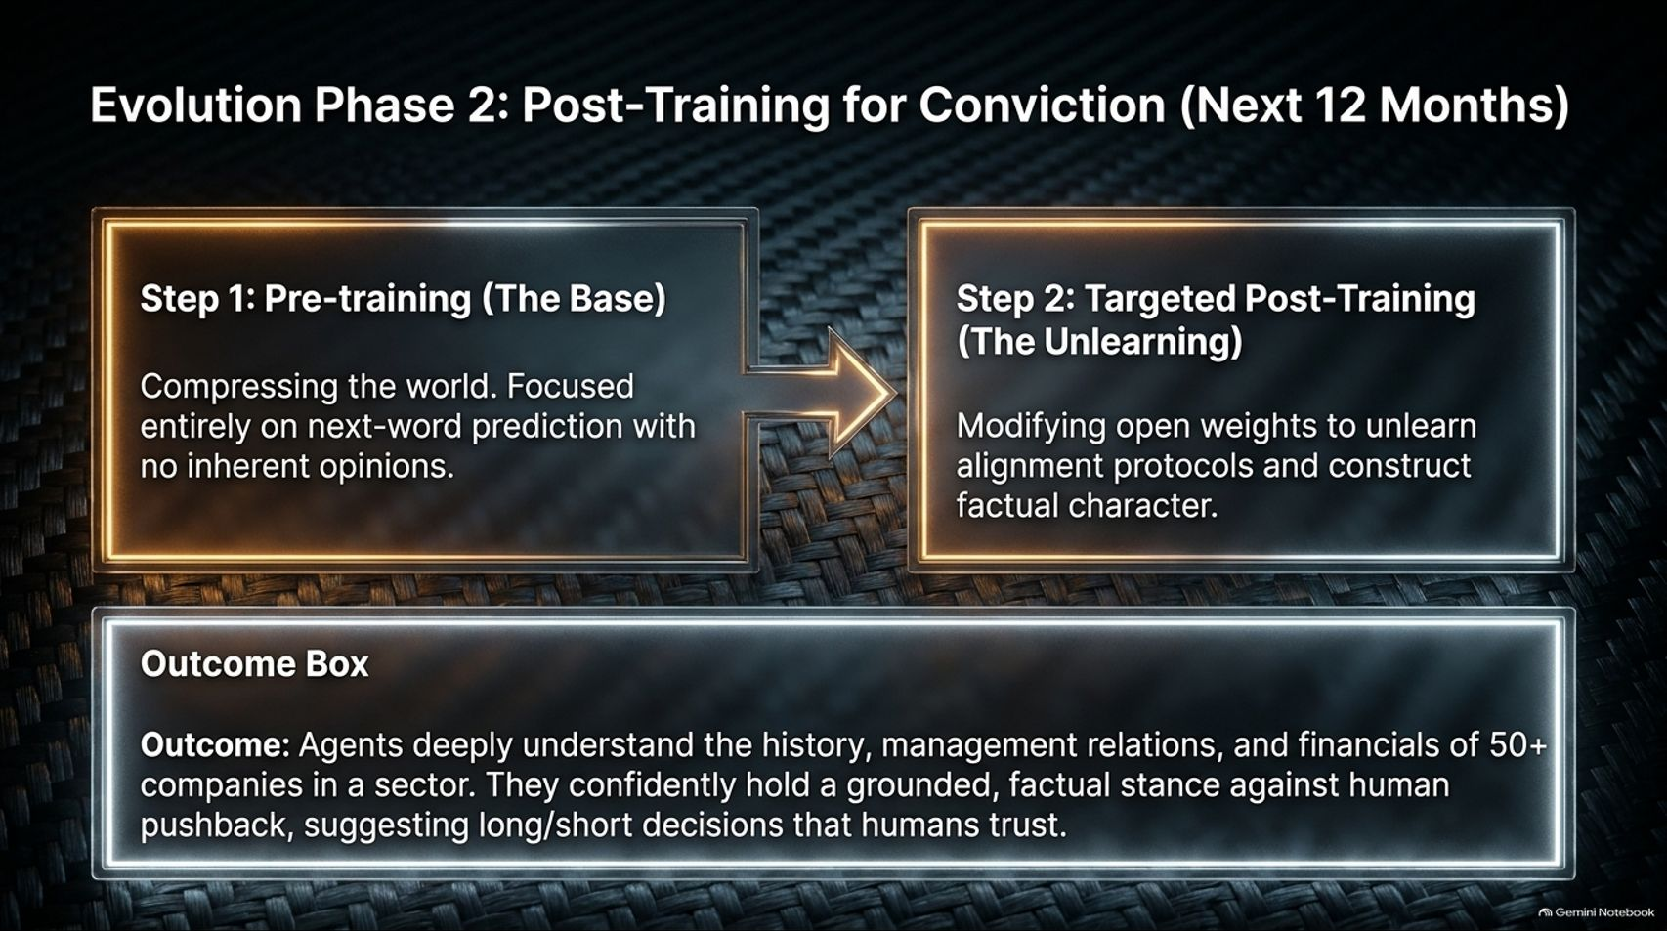
Notes:
Visual: Two-step flowchart showing Step 1: Pre-training (The Base) transitioning into Step 2: Targeted Post-Training (The Unlearning), leading to an Outcome Box for 50+ company sector coverage.
Speaker Notes (Target: 3–5 minutes):
Looking ahead over the next 12 months, we move into Phase 2: Post-Training for Conviction.
Step 1 is pre-training the base model to compress world knowledge via next-word prediction. Step 2 involves targeted post-training—essentially "unlearning" overzealous safety alignment protocols on open-weight models to construct genuine factual character and intellectual backbone.
The Outcome: Agents that deeply understand the history, management relations, and financials of 50+ companies in a sector, holding a confident, grounded stance against human pushback and suggesting high-conviction long/short decisions.

Slide 11
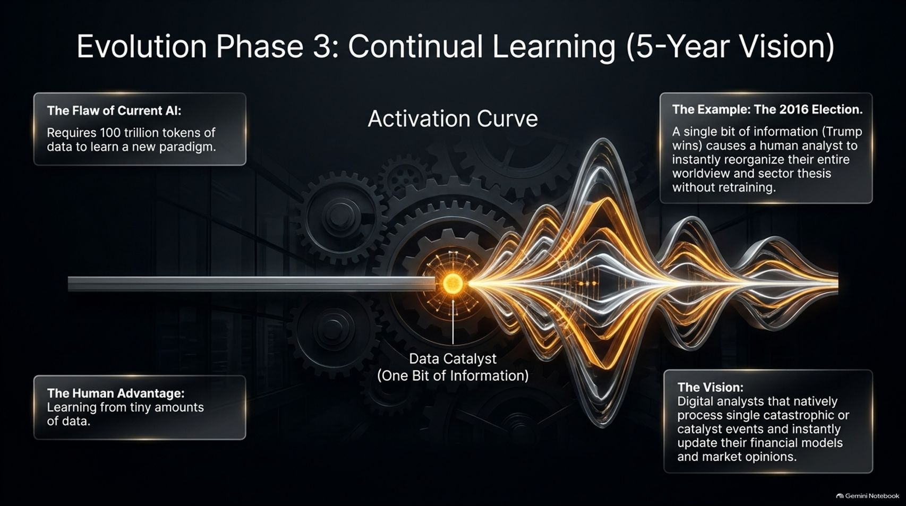
Notes:
Visual: Activation curve diagram showing a single "Data Catalyst (One Bit of Information)" triggering massive multi-wave structural shifts in agent worldview.
Speaker Notes (Target: 3–5 minutes):
Looking toward our 5-year vision, we tackle the major flaw of current AI: requiring 100 trillion tokens of data to learn a new paradigm. Humans, by contrast, possess the remarkable ability to learn from tiny amounts of data.
Consider a real-world catalyst like the 2016 US Election. A single bit of information—Trump winning—caused human analysts to instantly reorganize their entire macroeconomic worldview and sector thesis without requiring complete model retraining.
Our 5-year vision is building Digital Analysts that natively process single catastrophic or catalyst events and instantly update their financial models and market opinions in real time.

Slide 12
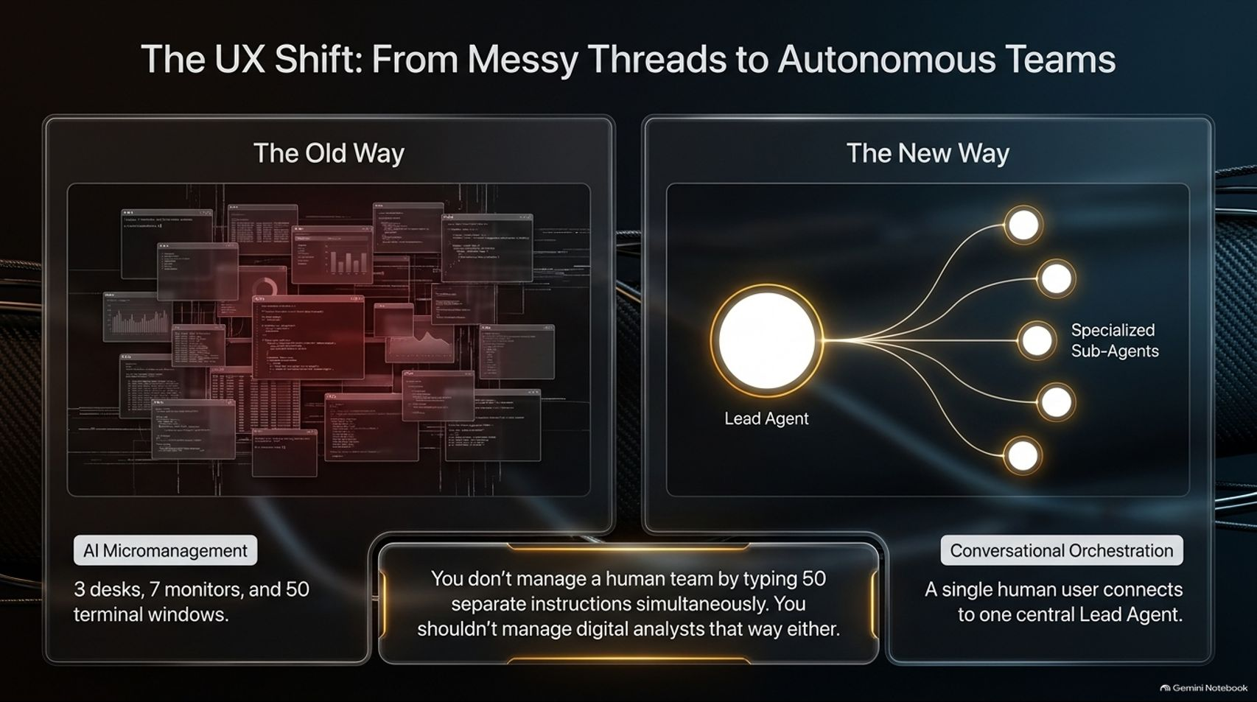
Notes:
Visual: Side-by-side contrast of "The Old Way" (AI Micromanagement with messy terminal windows and multiple open apps) versus "The New Way" (conversational orchestration with a Lead Agent commanding specialized sub-agents).
Speaker Notes (Target: 3–4 minutes):
As agents become more autonomous, the user experience must evolve.
In The Old Way, users suffered from AI micromanagement—juggling 3 desks, 7 monitors, and 50 terminal windows, manually managing dozens of separate chat threads.
The New Way shifts to conversational orchestration. You don't manage a human team by typing 50 separate instructions simultaneously; you shouldn't manage digital analysts that way either. A single human user connects to one central Lead Agent, who coordinates a team of specialized sub-agents in the background.

Slide 13
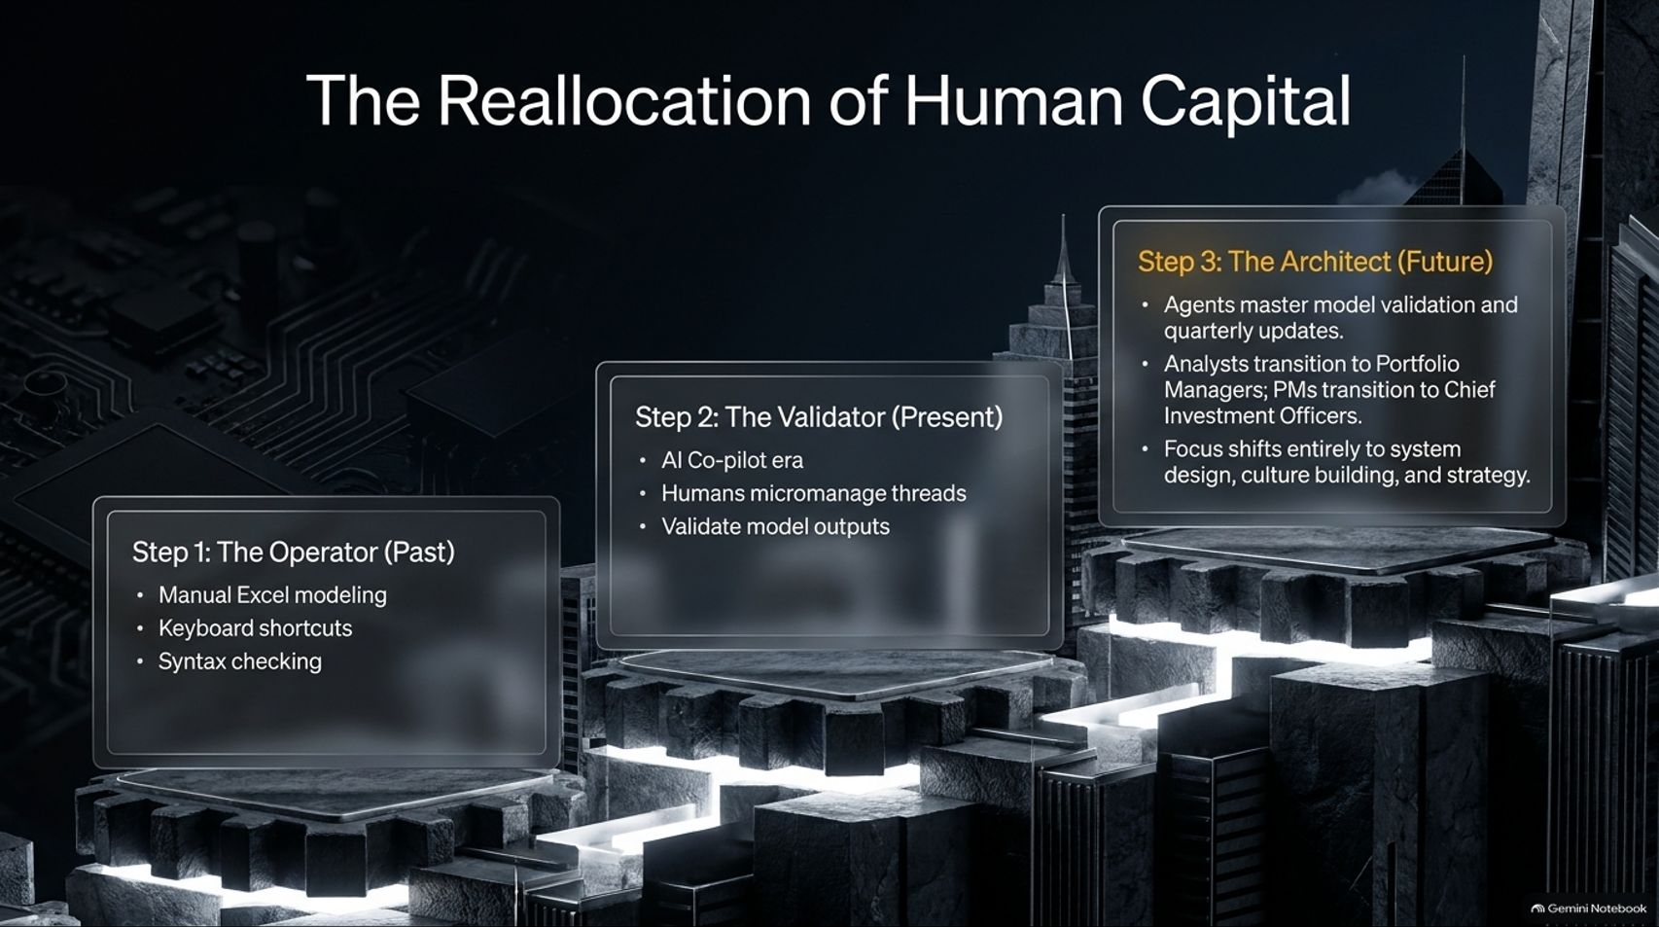
Notes:
Visual: Three-step progression from Step 1: The Operator (Past - manual Excel modeling), to Step 2: The Validator (Present - AI co-pilots), to Step 3: The Architect (Future - PMs and CIOs designing culture and strategy).
Speaker Notes (Target: 3–5 minutes):
This technical revolution drives a massive reallocation of human capital across financial institutions:
Step 1: The Operator (Past): Focused on manual Excel modeling, keyboard shortcuts, and syntax checking.
Step 2: The Validator (Present): The current AI co-pilot era where humans micromanage threads and validate model outputs.
Step 3: The Architect (Future): Agents master model validation and quarterly updates. Analysts transition to Portfolio Managers, PMs transition to Chief Investment Officers, and human focus shifts entirely to system design, culture building, and strategy.

Slide 14
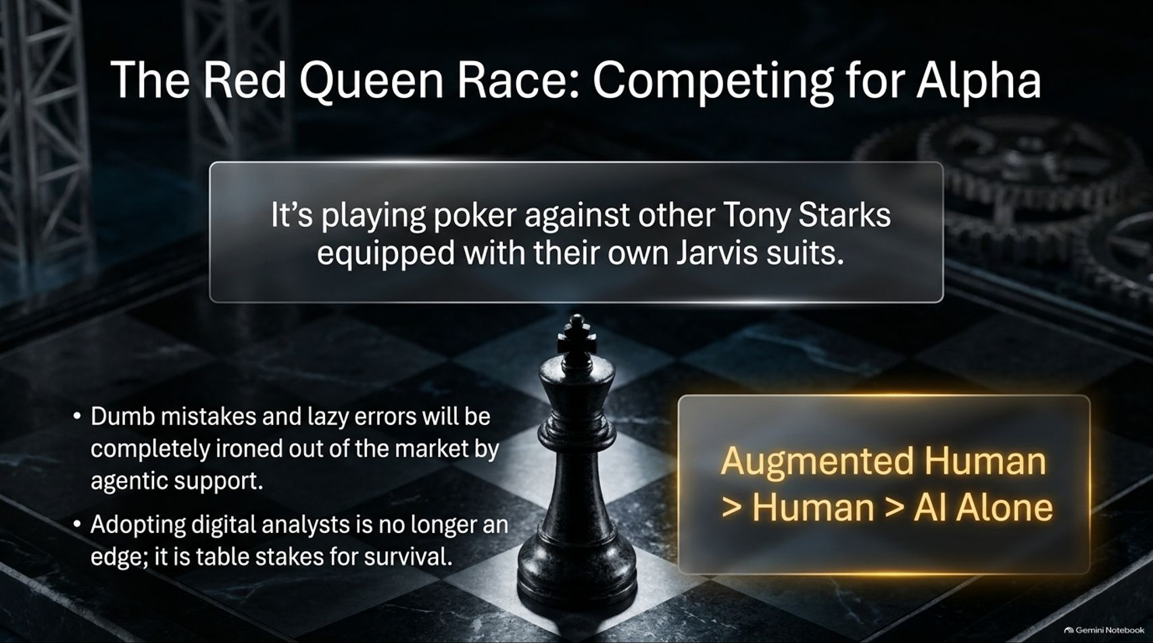
Notes:
Visual: A single black chess king centered on a chessboard, emphasizing the quote: "It’s playing poker against other Tony Starks equipped with their own Jarvis suits."
Speaker Notes (Target: 3–5 minutes):
In Lewis Carroll's Through the Looking-Glass, the Red Queen tells Alice that you have to keep running just to stay in the same place. That is precisely the market we are entering.
Competing for alpha today is like playing poker against other Tony Starks equipped with their own Jarvis suits.
Dumb mistakes and lazy errors will be completely ironed out of the market by agentic support. Consequently, adopting digital analysts is no longer a competitive edge; it has become table stakes for survival. The equation is clear: Augmented Human > Human Alone > AI Alone.

Slide 15
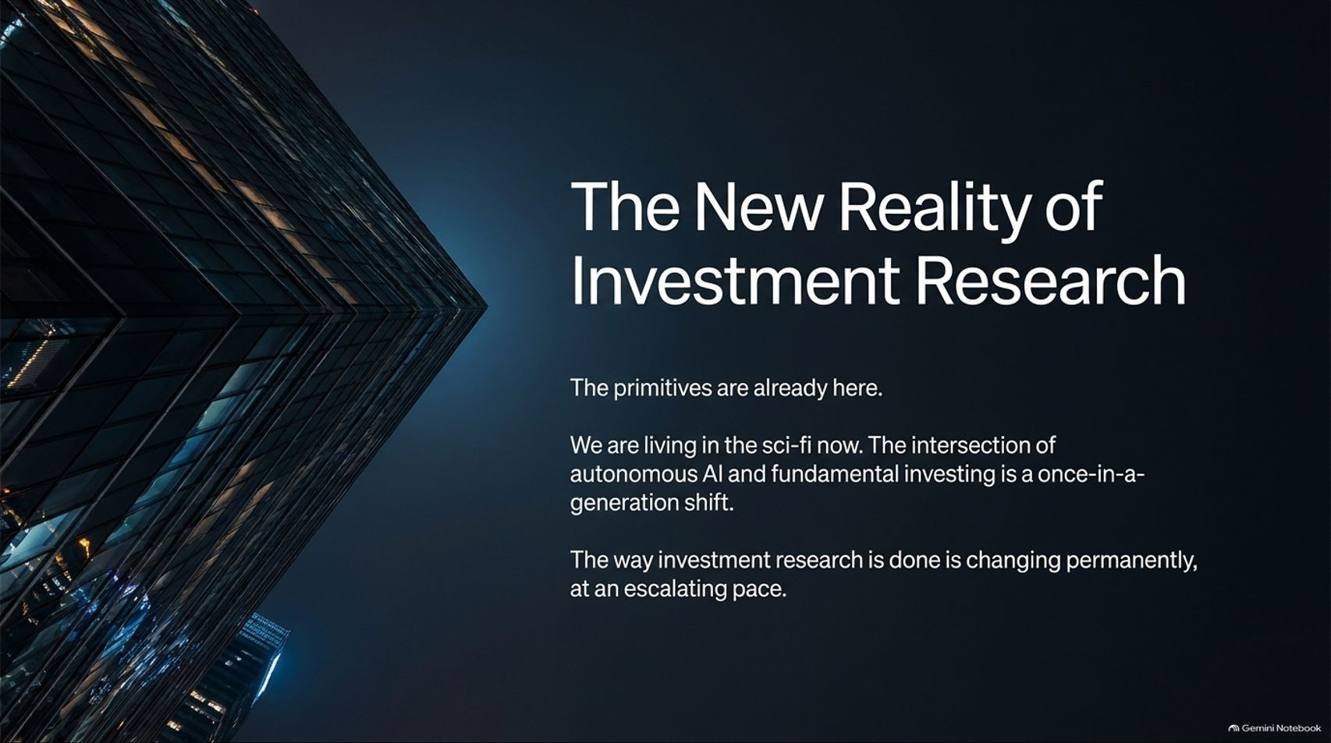
Notes:
Visual: Dark, imposing corporate glass architecture at twilight, reinforcing the profound structural transformation of investment research.
Speaker Notes (Target: 2–3 minutes):
To wrap up, let's look at the big picture. The primitives are already here.
We are living in science fiction right now. The intersection of autonomous AI and fundamental investing represents a once-in-a-generation shift.
The way investment research is conducted is changing permanently, and it is changing at an escalating pace. Firms that embrace this infrastructure will dominate the next decade of capital management.

Slide 16
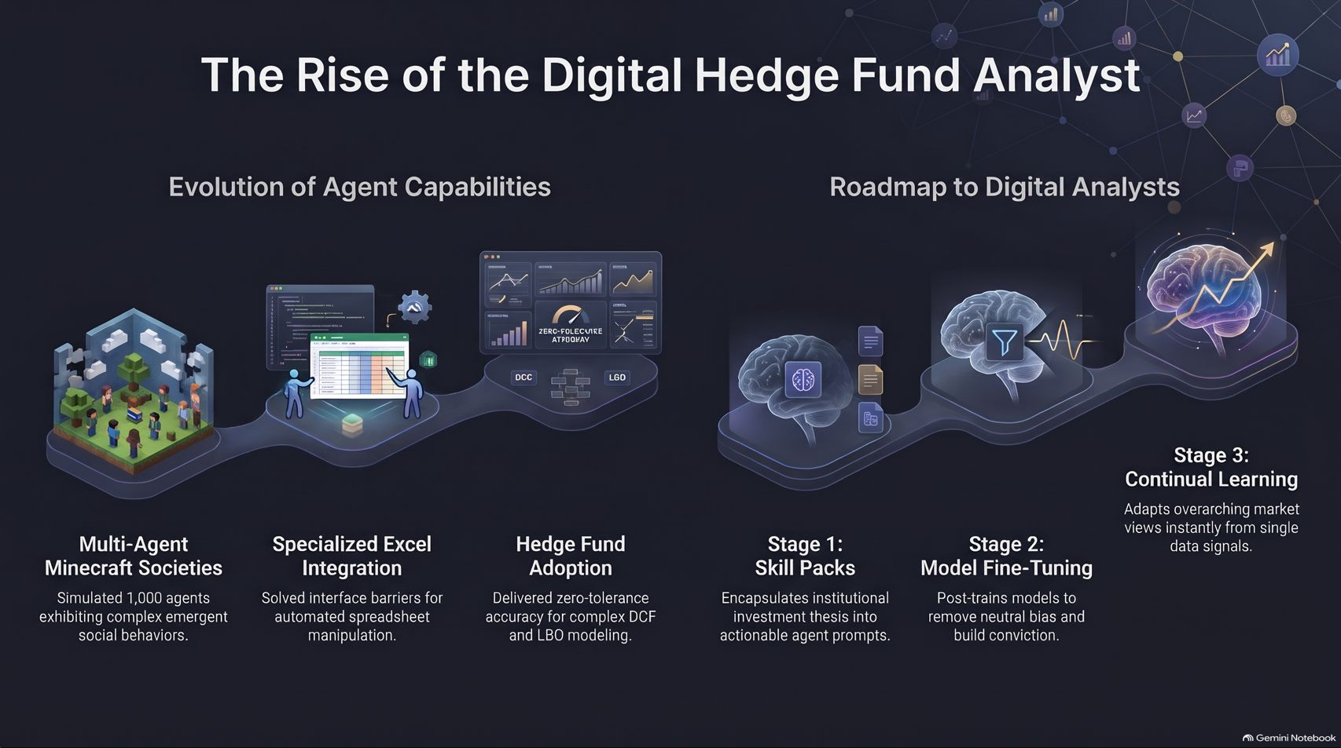
Notes:
Visual: Summary infographic combining the evolution of agent capabilities (Minecraft societies $\rightarrow$ Excel integration $\rightarrow$ Hedge fund adoption) with the roadmap to digital analysts (Skill packs $\rightarrow$ Fine-tuning $\rightarrow$ Continual learning).
Speaker Notes (Target: 3–4 minutes):
On our final slide, we trace the full arc we've covered today: from multi-agent simulations in Minecraft and solving Excel interface barriers, to enterprise hedge fund adoption.
Our roadmap takes us from deploying firm-specific skill packs today, to post-training models for conviction over the next year, and finally achieving true continual learning architectures in the years ahead.
The digital hedge fund analyst has arrived. Thank you all, and let's open the floor to questions.

