Slide 1
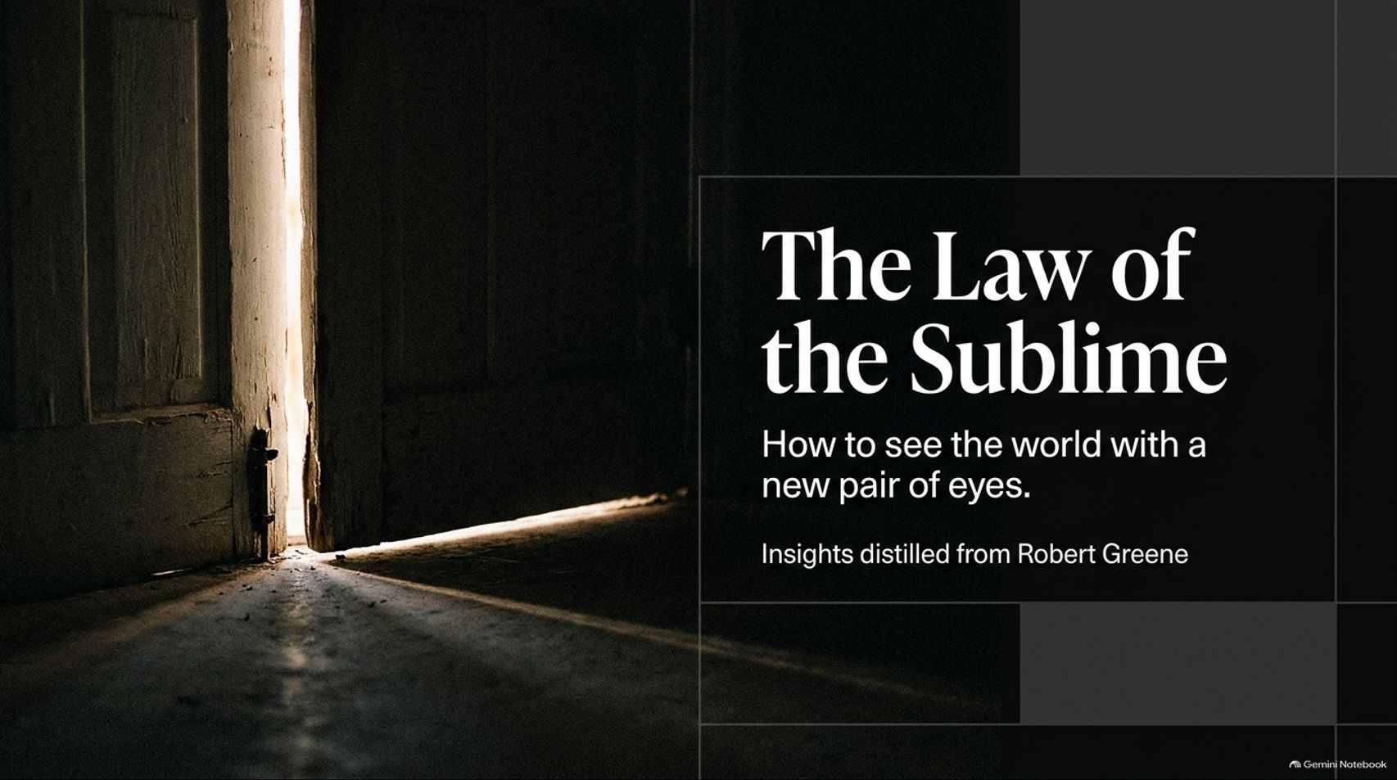
Notes:
Visual: A dark, moody, cinematic title slide showing a door cracked open with a beam of bright light spilling across a rustic floor, titled: "The Law of the Sublime: How to see the world with a new pair of eyes" with the subtitle "Insights distilled from Robert Greene."
Speaker Notes (Target: 2–3 minutes):
Welcome, everyone, to today's deep dive into "The Law of the Sublime."
Most of us spend our lives trapped in the narrow corridors of routine, ambition, anxiety, and screen-time. In doing so, we lose our capacity for wonder—and with it, our deep awareness of what it truly means to be alive.
Today, drawing from Robert Greene’s monumental work on the sublime, we are going to explore how to step out of the claustrophobic center of the ego, recover the curiosity of childhood, and awaken the unseen dimensions of reality that surround us every single day. Let’s begin.
Skip the Big Life Overhaul in 2027 & Do This Instead | Robert Greene
https://www.youtube.com/watch?v=eJKF7XcA3jY

Slide 2
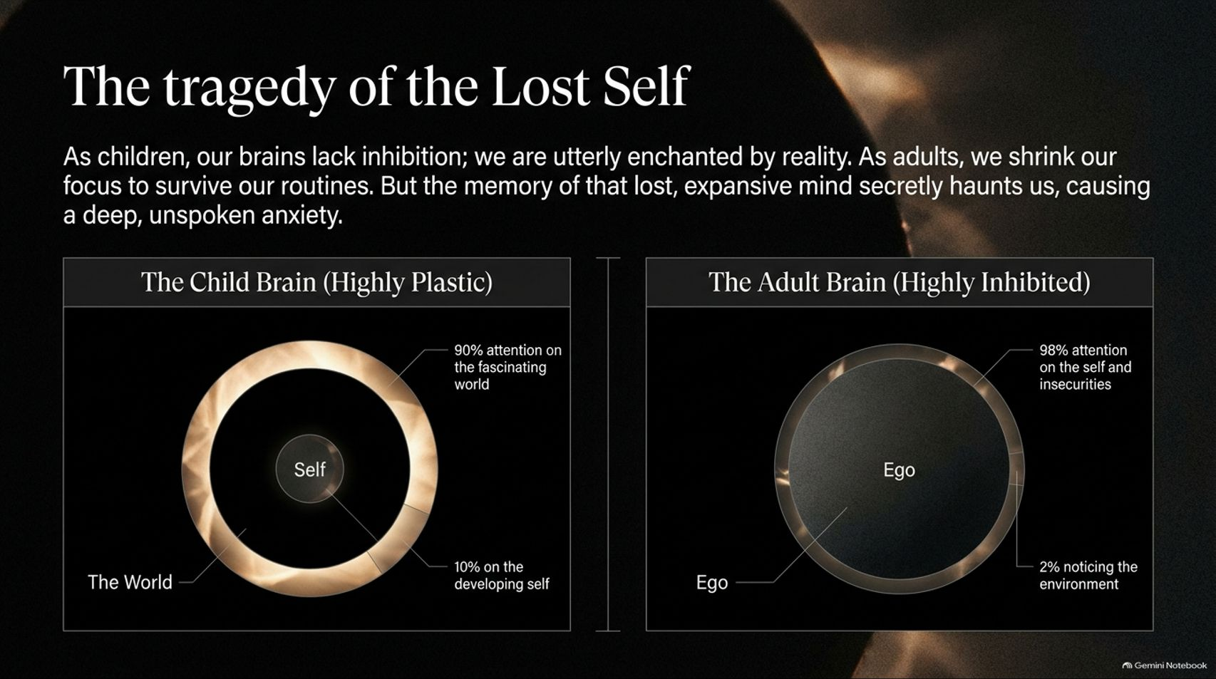
Notes:
Visual: A split-screen comparison showing "The Child Brain (Highly Plastic)" with 90% attention on the fascinating world and 10% on the developing self, versus "The Adult Brain (Highly Inhibited)" with 98% attention on the ego/insecurities and 2% noticing the environment.
Speaker Notes (Target: 3–5 minutes):
Let’s look at the psychological tragedy of growing up. As children, our brains lack adult inhibition; we are utterly enchanted by reality. The child's brain is highly plastic, paying 90 percent of its attention to the fascinating world around it, and only 10 percent to the developing self.
As adults, however, we shrink our focus to survive our routines. That ratio completely reverses: 98 percent of our attention becomes consumed by our ego, our insecurities, and our stress, while a mere 2 percent notices the environment.
But here is the secret pain: the memory of that lost, expansive mind secretly haunts us, causing a deep, unspoken anxiety. We feel separated from the world, and that separation is the root of our modern misery.

Slide 3
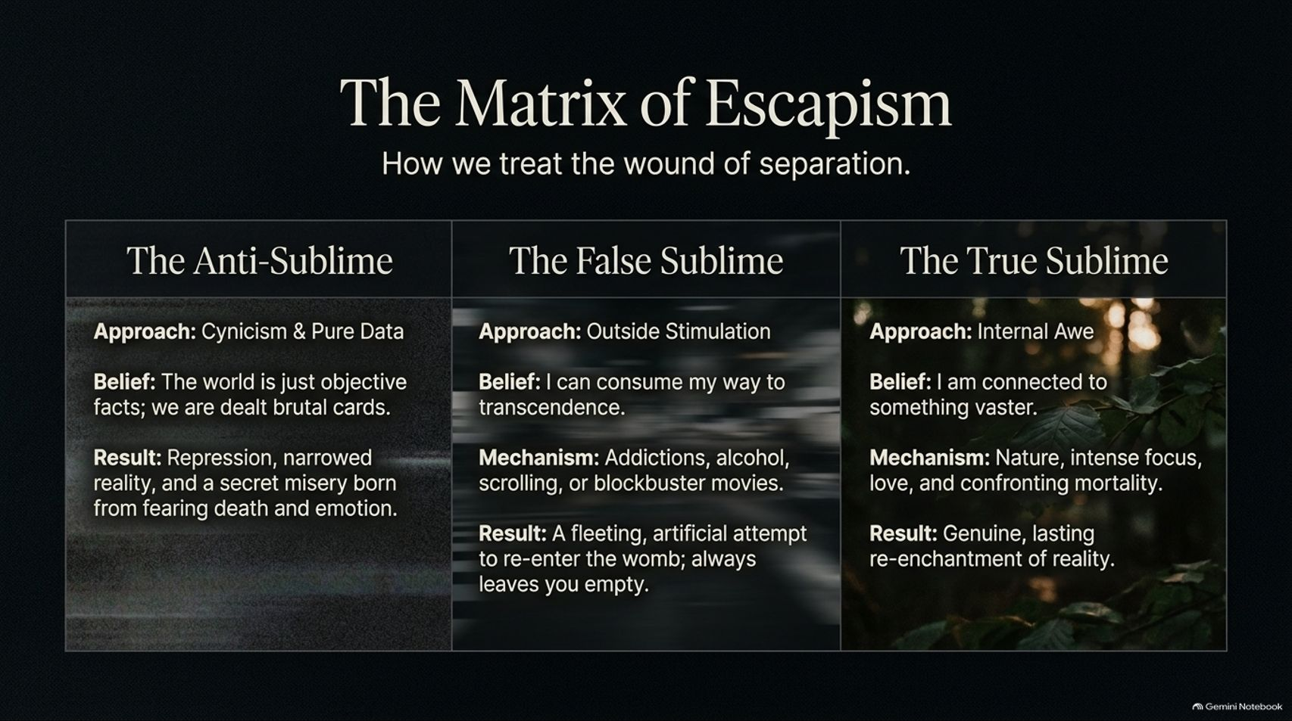
Notes:
Visual: A three-column comparison matrix contrasting "The Anti-Sublime" (cynicism, pure data, repression), "The False Sublime" (outside stimulation, addictions, scrolling, blockbuster movies), and "The True Sublime" (internal awe, nature, intense focus, love, confronting mortality).
Speaker Notes (Target: 3–5 minutes):
How do we treat this deep wound of separation? As Greene outlines, humanity typically falls into one of three traps:
The Anti-Sublime: A cynical belief that the world is merely objective facts and brutal data. It results in emotional repression and a secret misery born from fearing death and emotion.
The False Sublime: Seeking outside stimulation—such as addictions, alcohol, endless scrolling, or blockbuster movies—in a fleeting, artificial attempt to re-enter the womb. It always leaves you empty.
The True Sublime: Internal awe driven by nature, intense focus, love, and confronting mortality. This is the only path that yields a genuine, lasting re-enchantment of reality.

Slide 4
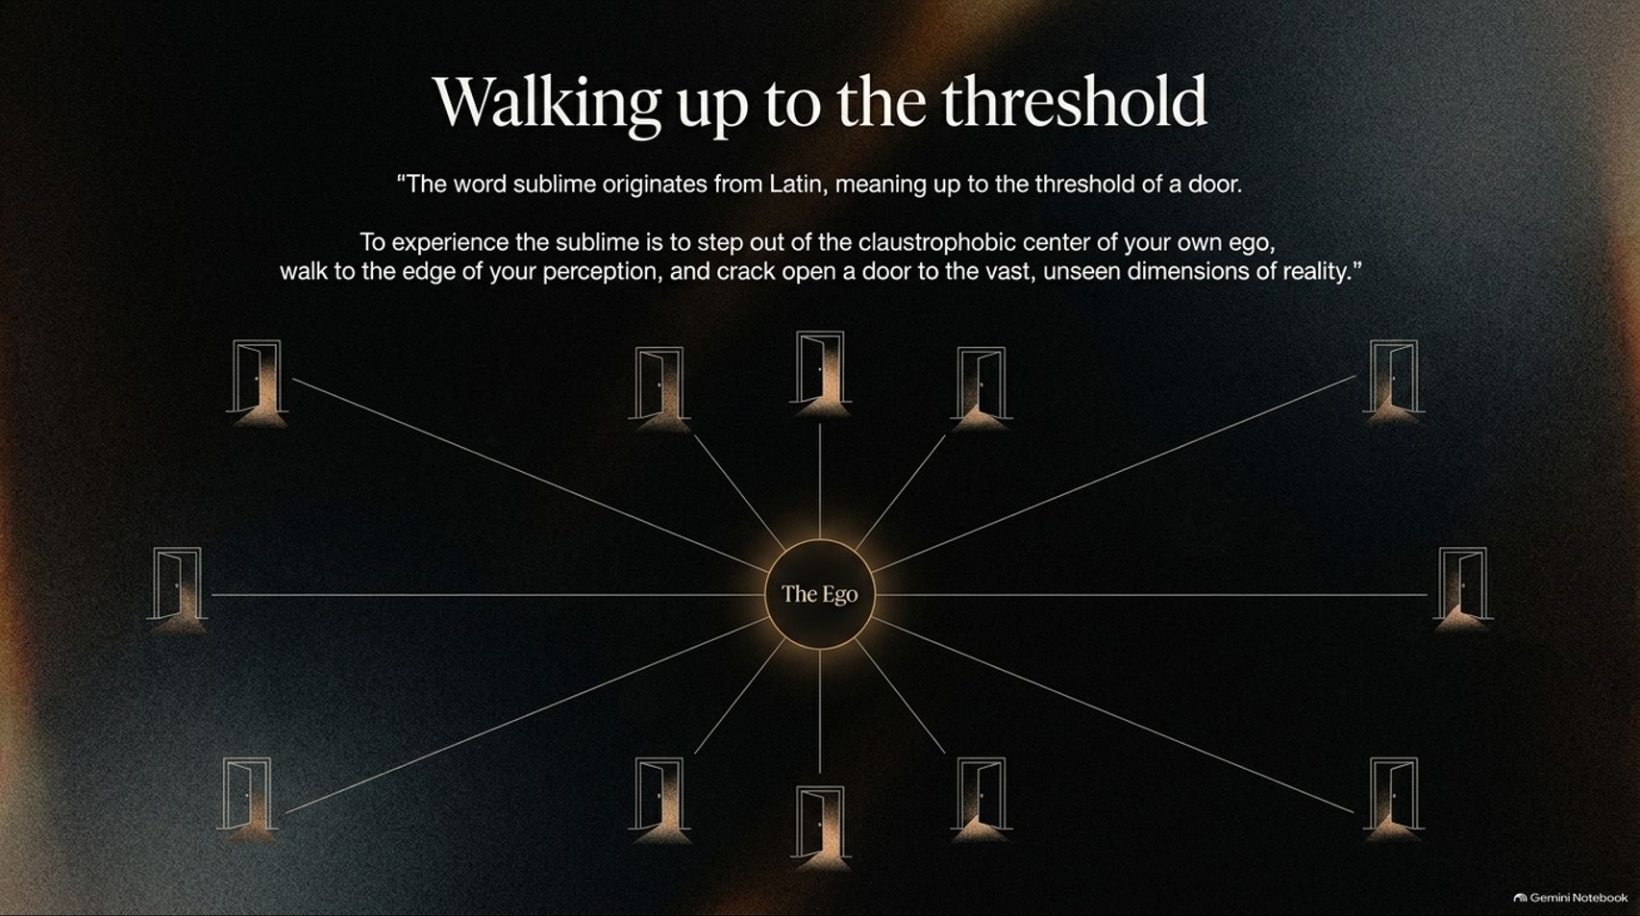
Notes:
Visual: A central glowing focal point labeled "The Ego" with multiple radiant lines stretching outward to various glowing doors in the dark, accompanied by the etymology of sublime (up to the threshold of a door).
Speaker Notes (Target: 3–4 minutes):
The word sublime originates from Latin, meaning "up to the threshold of a door."
To experience the sublime is not to escape reality; it is to step out of the claustrophobic center of your own ego, walk to the very edge of your perception, and crack open a door to the vast, unseen dimensions of reality.
Greene maps out multiple "doors" or thresholds around us—ranging from time and love to the cosmos, other species, and mortality itself. Let's examine each of these thresholds.

Slide 5
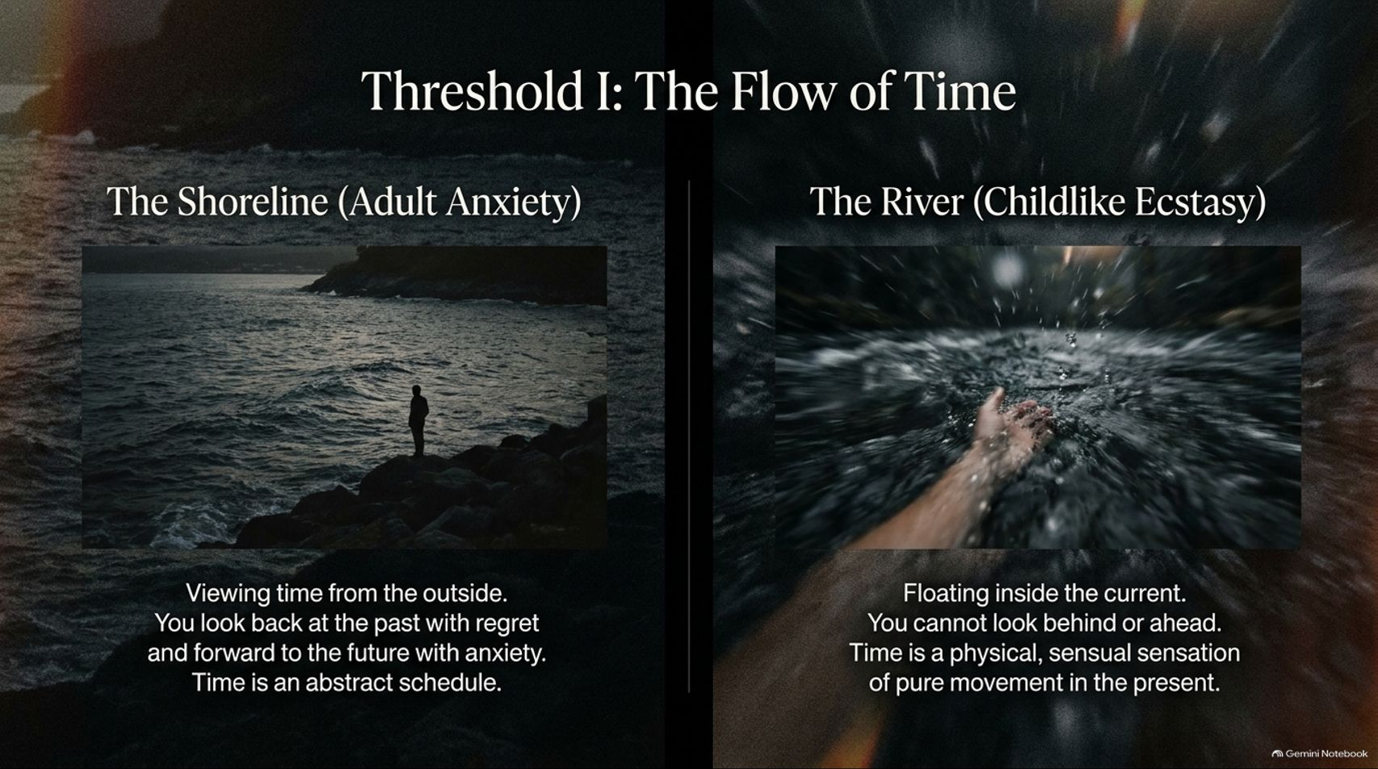
Notes:
Visual: A split visual showing "The Shoreline (Adult Anxiety)" featuring a lone figure looking over dark, choppy waves, contrasted against "The River (Childlike Ecstasy)" showing a hand touching rushing water from inside the current.
Speaker Notes (Target: 3–5 minutes):
Let's look at our first threshold: The Flow of Time.
Adults stand on The Shoreline, viewing time from the outside as an abstract schedule. We look back at the past with regret and forward to the future with anxiety. Time is our enemy; we have deadlines to meet, emails to send, and hours ticking away.
Children, however, are floating inside The River of childlike ecstasy. They cannot look behind or ahead; time is a physical, sensual sensation of pure movement in the present moment. To experience the sublime is to step off the shoreline and allow yourself, occasionally, to re-enter that living current of time.

Slide 6
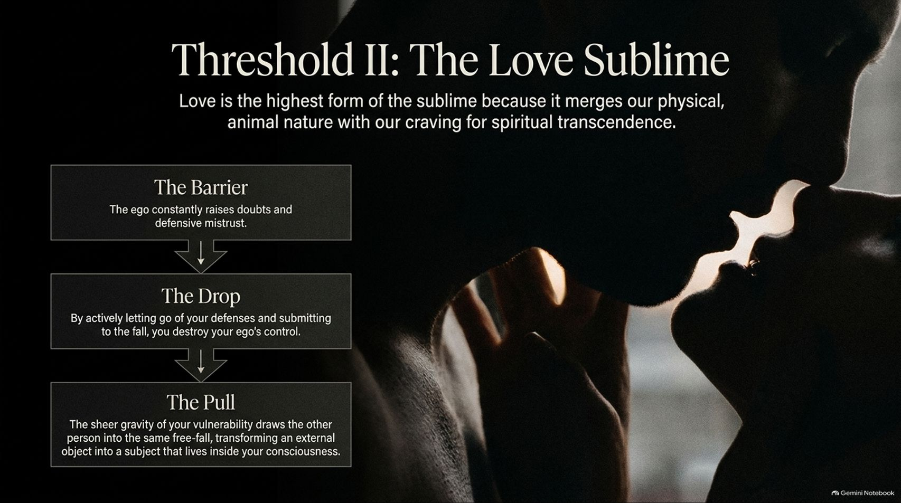
Notes:
Visual: A romantic silhouette profile of a couple in intimate embrace, paired with a vertical process flowchart detailing The Barrier (ego doubts), The Drop (submitting to vulnerability), and The Pull (merging consciousness).
Speaker Notes (Target: 3–5 minutes):
Threshold number two is The Love Sublime. Love is arguably the highest form of the sublime because it merges our physical, animal nature with our craving for spiritual transcendence.
Why do relationships fail or feel empty? Because of The Barrier: the ego constantly raises doubts and defensive mistrust.
To cross the threshold, you must experience The Drop—actively letting go of your defenses and submitting to the emotional fall, which destroys your ego's control. When you do this, The Pull takes over: the sheer gravity of your vulnerability draws the other person in, transforming an external "object" into a living subject inside your consciousness.

Slide 7
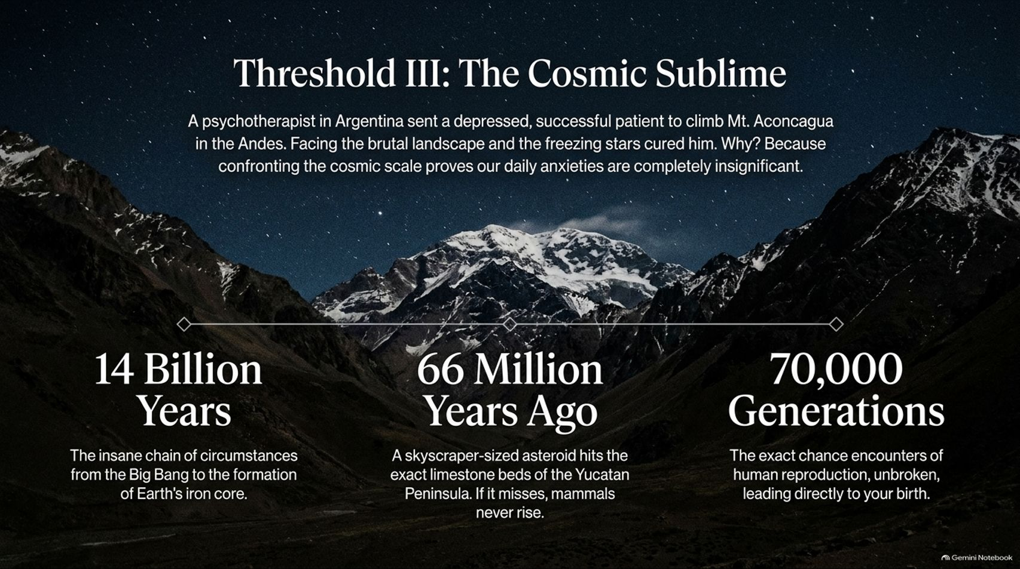
Notes:
Visual: A breathtaking, star-filled night sky stretching over jagged, snow-covered mountain peaks (like Mt. Aconcagua), anchored by historical timelines: 14 Billion Years, 66 Million Years Ago, and 70,000 Generations.
Speaker Notes (Target: 3–5 minutes):
Our third threshold is The Cosmic Sublime.
Greene shares a fascinating case study of a psychotherapist in Argentina who cured a depressed, highly successful patient by sending him to climb Mt. Aconcagua in the Andes. Facing that brutal, freezing landscape cured him because confronting cosmic scale proves our daily anxieties are completely insignificant.
When you look at the numbers—14 Billion Years of cosmic evolution from the Big Bang, 66 Million Years Ago when a skyscraper-sized asteroid struck the Yucatan Peninsula to allow mammals to rise, and 70,000 Generations of unbroken human reproduction leading directly to your birth—your daily stressors instantly lose their crushing weight.

Slide 8
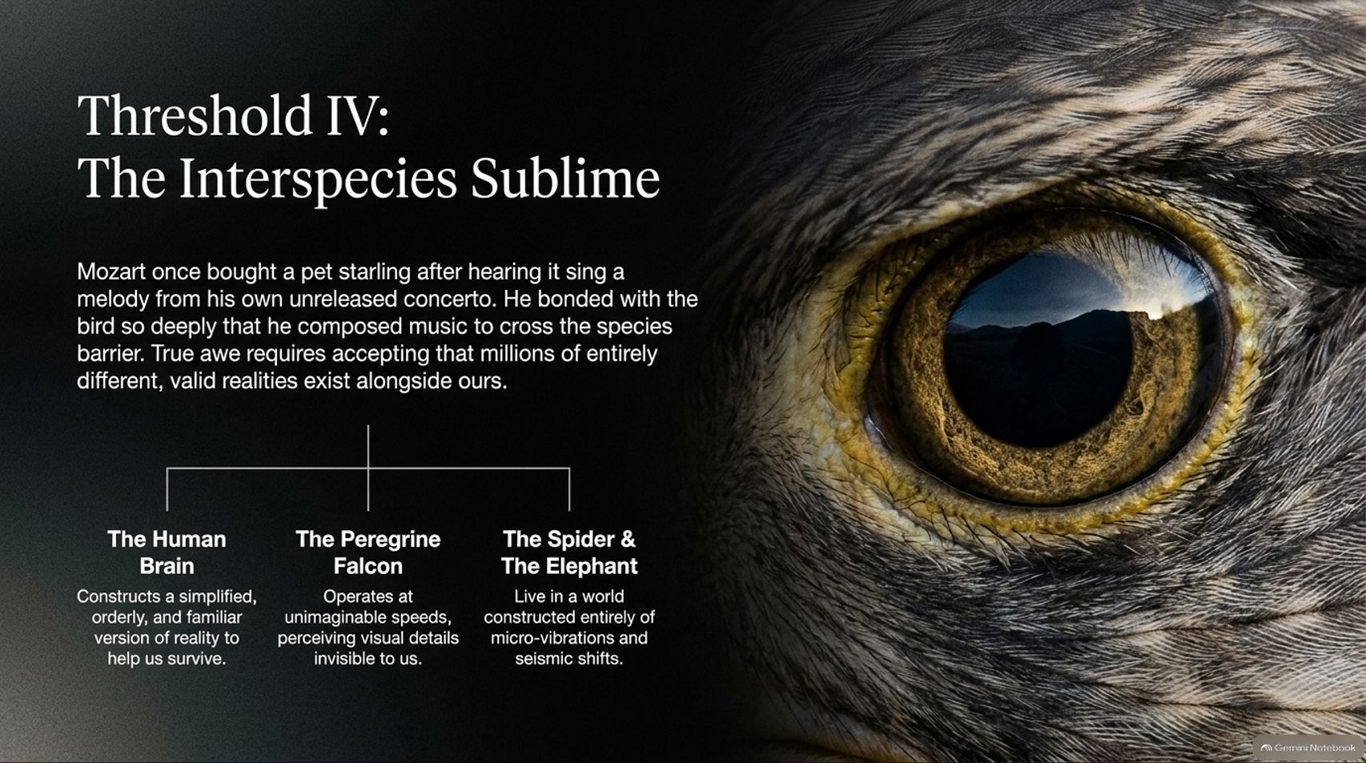
Notes:
Visual: A macro close-up of a fierce raptor’s eye reflecting a landscape, accompanied by a comparative breakdown of sensory realities across the Human Brain, the Peregrine Falcon, and the Spider & Elephant.
Speaker Notes (Target: 3–5 minutes):
Threshold four is The Interspecies Sublime.
Human beings are trapped inside a simplified, orderly version of reality constructed by our brains to help us survive. But other creatures experience entirely different, valid realities alongside ours.
Consider the Peregrine Falcon, operating at unimaginable speeds and perceiving visual details invisible to us, or spiders and elephants living in worlds constructed entirely of micro-vibrations and seismic shifts. As Mozart demonstrated when he bonded deeply with his pet starling, true awe requires accepting that millions of radically different minds inhabit this planet with us.

Slide 9
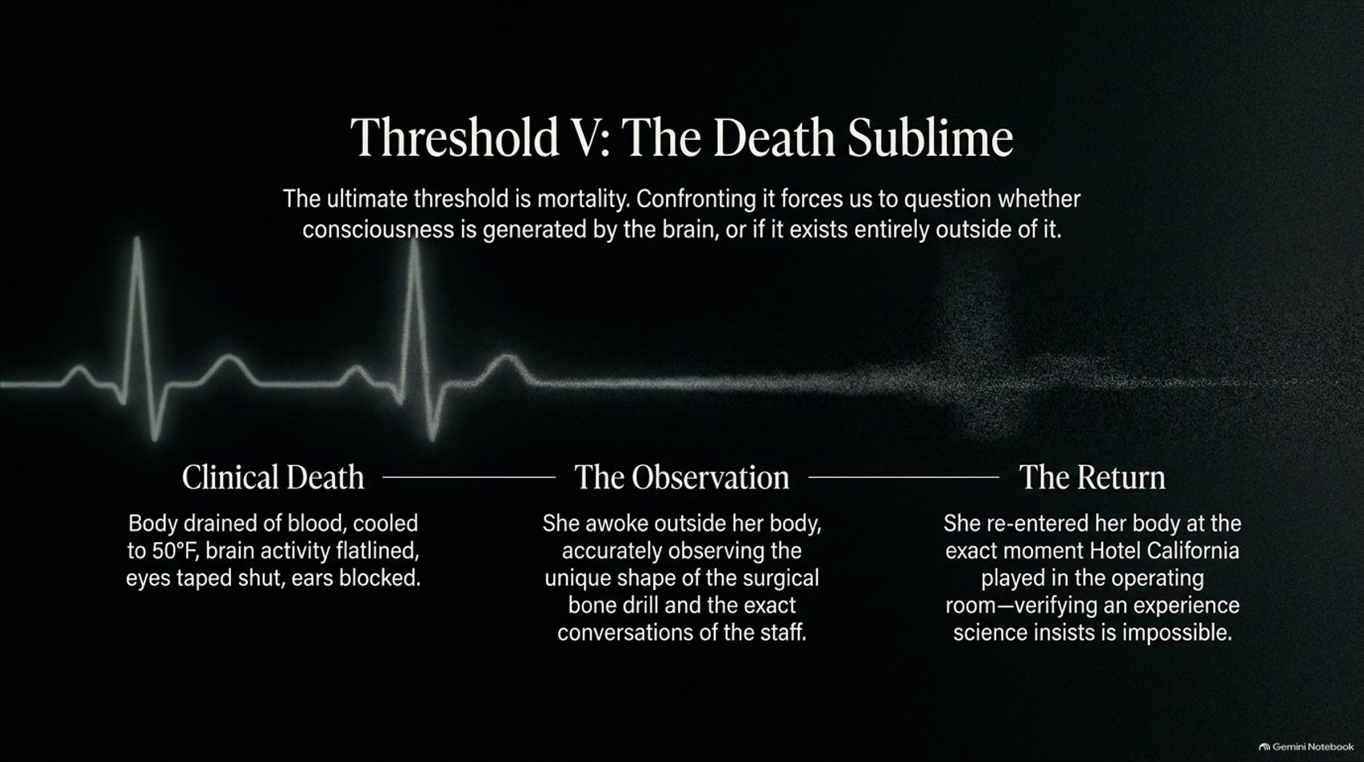
Notes:
Visual: A hospital heart monitor flatline that transitions from rigid green waves into a glowing particle fade, detailing Clinical Death, The Observation, and The Return.
Speaker Notes (Target: 3–5 minutes):
The ultimate, most profound threshold is The Death Sublime. Confronting our mortality forces us to question whether consciousness is merely generated by the brain, or if it exists entirely outside of it.
Greene explores extraordinary documented accounts—such as clinical trials where patients were cooled to 50°F with brain activity completely flatlined and ears blocked—yet upon waking, they accurately observed the unique shape of surgical bone drills and exact staff conversations.
Whether through near-death experiences or deep contemplation of mortality, confronting death shakes our materialist assumptions and re-connects us to the vast mystery of existence.

Slide 10
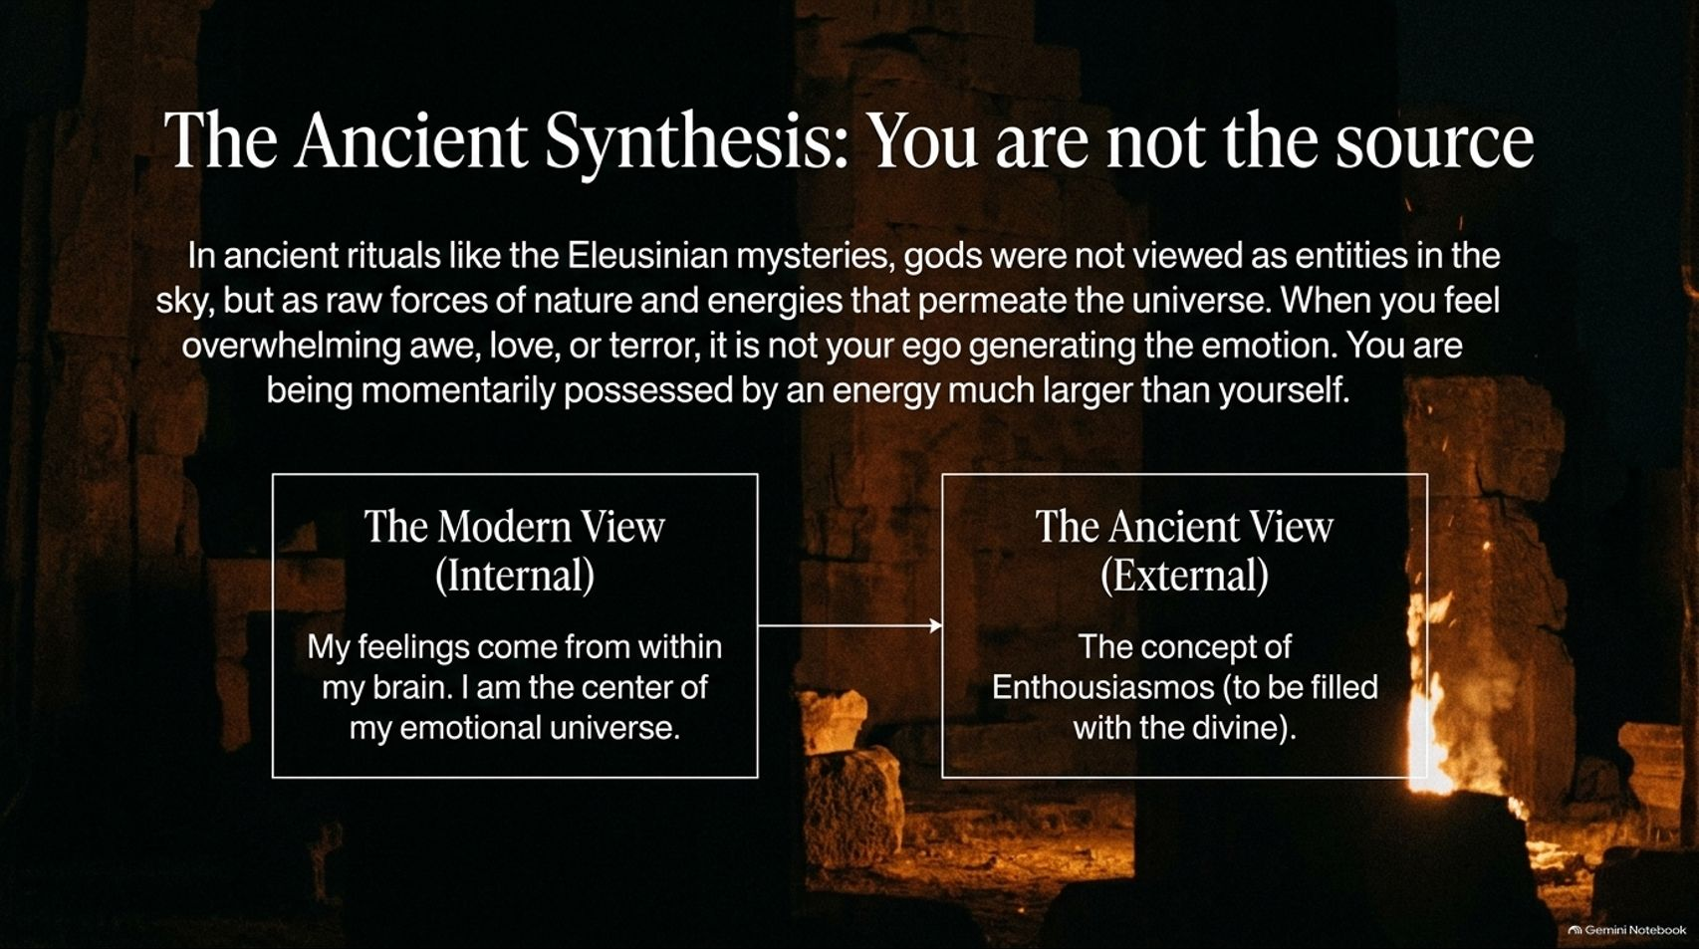
Notes:
Visual: An ancient stone ruin illuminated by warm firelight at night, contrasted across a modern internal view (emotions come from within my brain) versus an ancient external view (enthusiasmos—to be filled with the divine).
Speaker Notes (Target: 3–5 minutes):
In ancient rituals like the Eleusinian mysteries, gods were not viewed as static figures sitting in the sky, but as raw forces of nature and energetic waves permeating the universe.
The modern view insists that all our feelings, awe, and inspiration originate internally inside our own brains. But the ancient view—enthusiasmos, meaning "to be filled with the divine"—recognized that when you feel overwhelming awe, love, or terror, you are not generating it yourself. You are being momentarily possessed by an energy much larger than yourself.

Slide 11
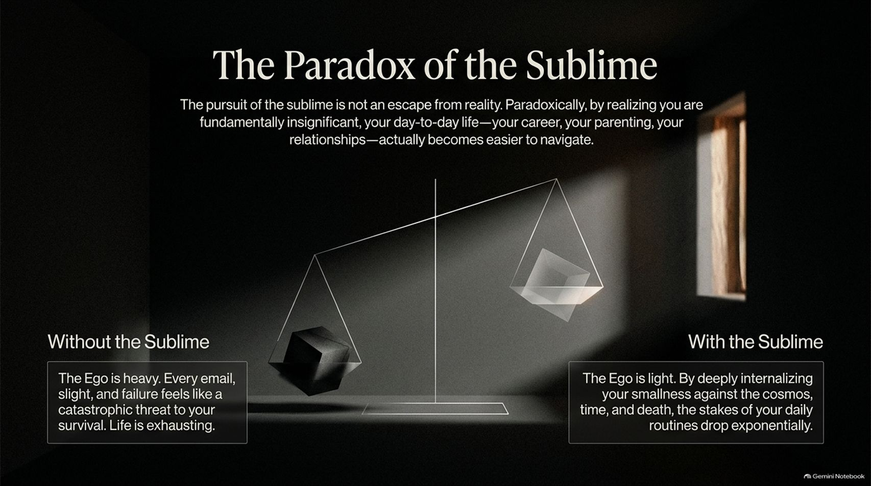
Notes:
Visual: An artistic mechanical scale balancing a heavy black cube ("Without the Sublime: The Ego is heavy") against a light, transparent glowing cube ("With the Sublime: The Ego is light"), set against a dim room with a window light beam.
Speaker Notes (Target: 3–5 minutes):
Here lies the great paradox of the sublime: It is not an escape from reality; it is the ultimate tool for navigating reality.
Without the sublime, the ego is heavy. Every single email, minor slight, or career failure feels like a catastrophic threat to your survival, making life exhausting.
With the sublime, the ego is light. By deeply internalizing your smallness against the vastness of the cosmos, time, and death, the stakes of your daily routines drop exponentially. Career, parenting, and relationships suddenly become much easier to manage because you are no longer crushed by the weight of your own self-importance.

Slide 12
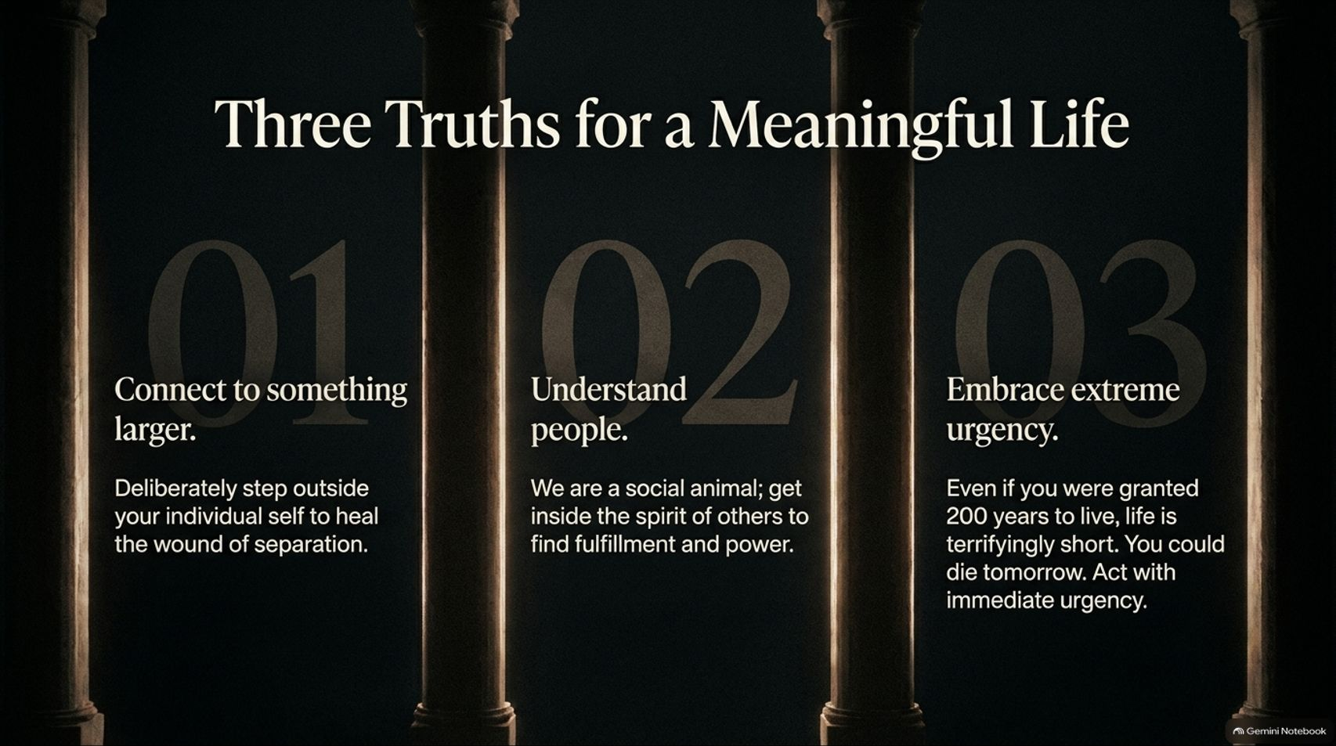
Notes:
Visual: Three majestic architectural stone pillars illuminated by vertical shafts of golden light, displaying Robert Greene's core life principles: 01 Connect to something larger, 02 Understand people, and 03 Embrace extreme urgency.
Speaker Notes (Target: 3–4 minutes):
Distilling Greene’s entire philosophy down to its essence, we find three immutable truths for a meaningful life:
Connect to something larger: Deliberately step outside your individual self to heal the wound of separation.
Understand people: We are social animals; get inside the spirit of others to find fulfillment and power.
Embrace extreme urgency: Even if you were granted 200 years to live, life is terrifically short. You could die tomorrow; act with immediate urgency.

Slide 13
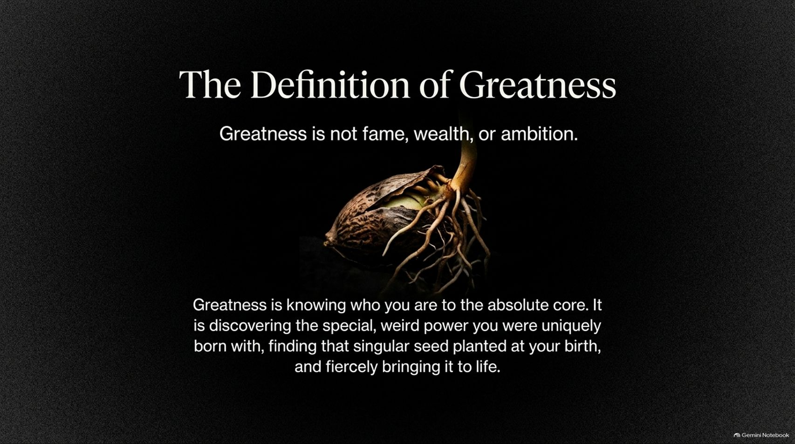
Notes:
Visual: A powerful, striking image of a germinating seed cracking open in rich dark soil, pushing up a green sprout while spreading intricate roots downward, framed by Greene's definition of greatness.
Speaker Notes (Target: 2–3 minutes):
As we close this presentation, let us redefine what true success means. Greatness is not fame, wealth, or societal ambition.
True greatness is knowing who you are to the absolute core. It is discovering the special, weird power you were uniquely born with—finding that singular seed planted at your birth—and fiercely bringing it to life.
Let the law of the sublime enter your bloodstream, change how you look at the world, and awaken the greatness within you. Thank you.

