Slide 1
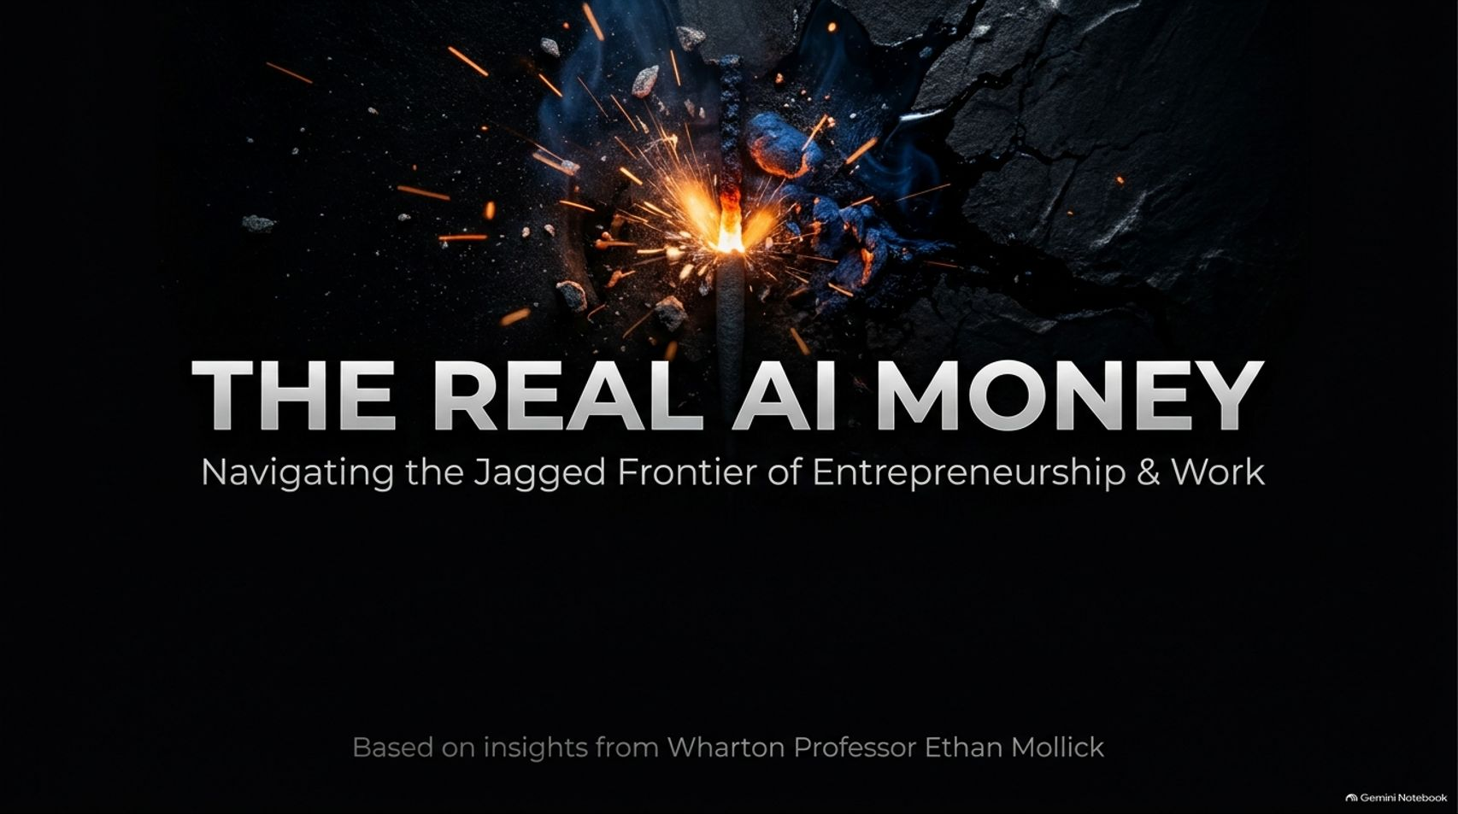
Notes:
Visual: A dramatic dark title slide featuring a burning match throwing fiery sparks across a cracked black surface, titled: "THE REAL AI MONEY: Navigating the Jagged Frontier of Entrepreneurship & Work," with the attribution "Based on insights from Wharton Professor Ethan Mollick."
Speaker Notes (Target: 2–3 minutes):
Welcome, everyone, to today's masterclass on "The Real AI Money."
For years, the startup playbook has been uniform: find a technical co-founder, build a SaaS tool, and sell picks and shovels. But as artificial intelligence completely transforms how code is written, businesses are scaling at unprecedented rates, and the rules of entrepreneurship are rewriting themselves overnight.
Today, drawing directly from the research and frameworks of Wharton Professor Ethan Mollick, we are going to explore how to navigate this new era. Let’s dive in.
Wharton’s Top AI Professor: Stop Starting Software Companies — The Real AI Money Is Here
https://www.youtube.com/watch?v=sHHYVvG_C4Q

Slide 2
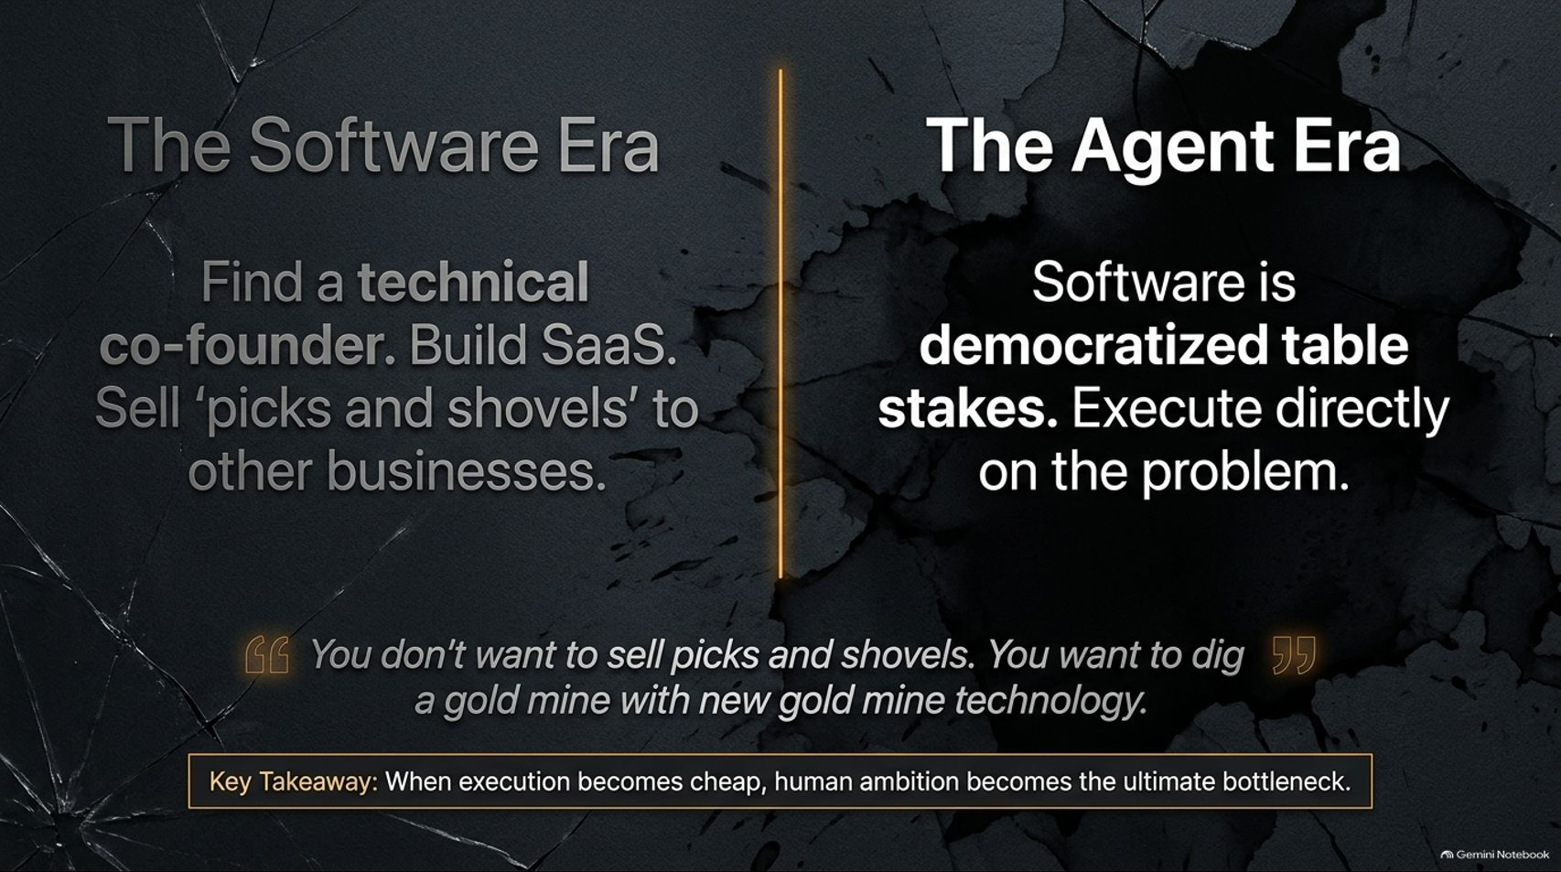
Notes:
Visual: A split comparison screen. On the left ("The Software Era"): Find a technical co-founder. Build SaaS. Sell 'picks and shovels' to other businesses. On the right ("The Agent Era"): Software is democratized table stakes. Execute directly on the problem. Highlighted with a key quote: "You don't want to sell picks and shovels. You want to dig a gold mine with new gold mine technology."
Speaker Notes (Target: 3–5 minutes):
To understand where the real money is, we must look at the shift from the Software Era to the Agent Era.
In the past software paradigm, non-technical founders had to hunt for technical co-founders, build traditional SaaS products, and sell pick-and-shovel tools to other businesses. But in the Agent Era, software has become democratized table stakes.
As Professor Ethan Mollick points out, you don't want to sell picks and shovels during a gold rush; you want to use the new technology to dig the gold mine yourself. When execution becomes cheap, human ambition becomes the ultimate bottleneck.

Slide 3
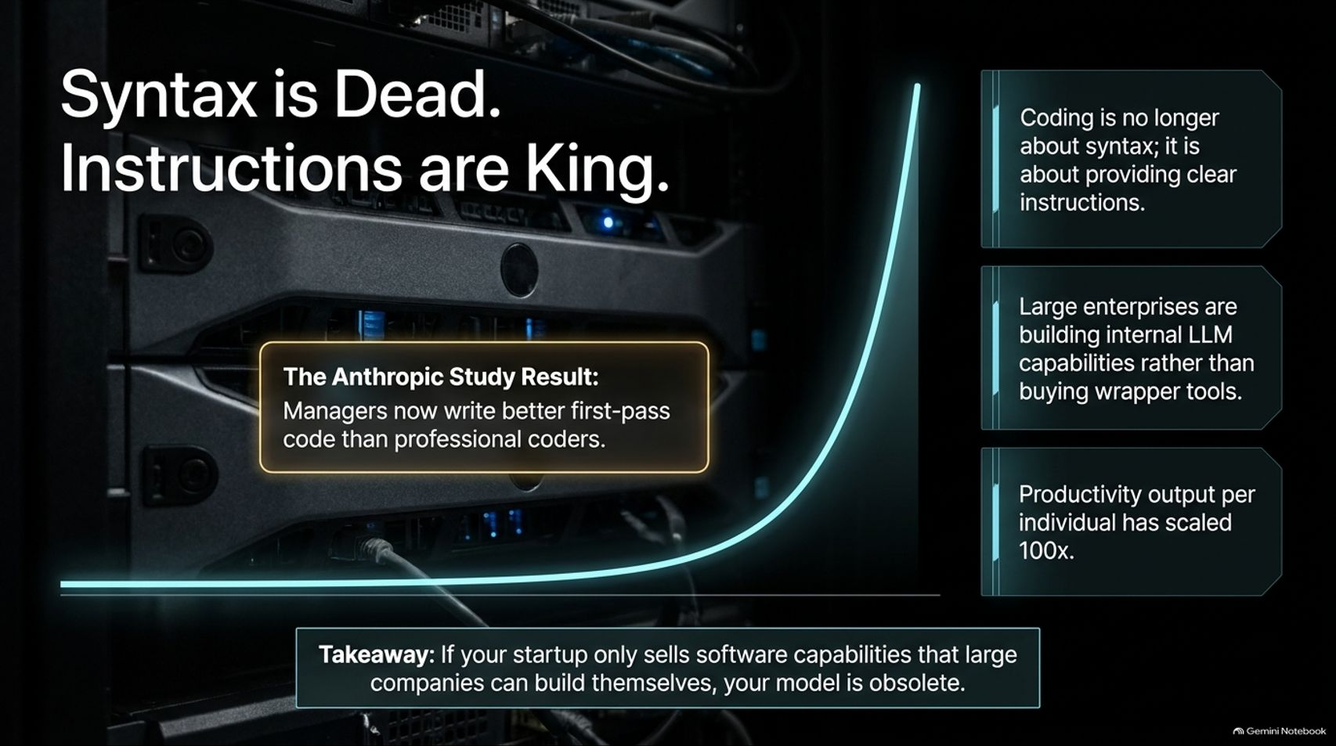
Notes:
Visual: A data center server rack background with an exponential adoption curve, highlighting Anthropic study results: Managers now write better first-pass code than professional coders, alongside three core takeaways on LLM capabilities and 100x productivity.
Speaker Notes (Target: 3–5 minutes):
Coding is no longer about syntax; it is about providing clear instructions.
A remarkable study out of Anthropic revealed that managers are now writing better first-pass code than professional coders because success relies on clear logic rather than memorized syntax.
Furthermore, large enterprises are no longer buying external wrapper tools; they are building internal LLM capabilities themselves. Individual productivity has scaled exponentially. If your startup only sells generic software capabilities that large companies can build themselves in minutes, your business model is obsolete.

Slide 4
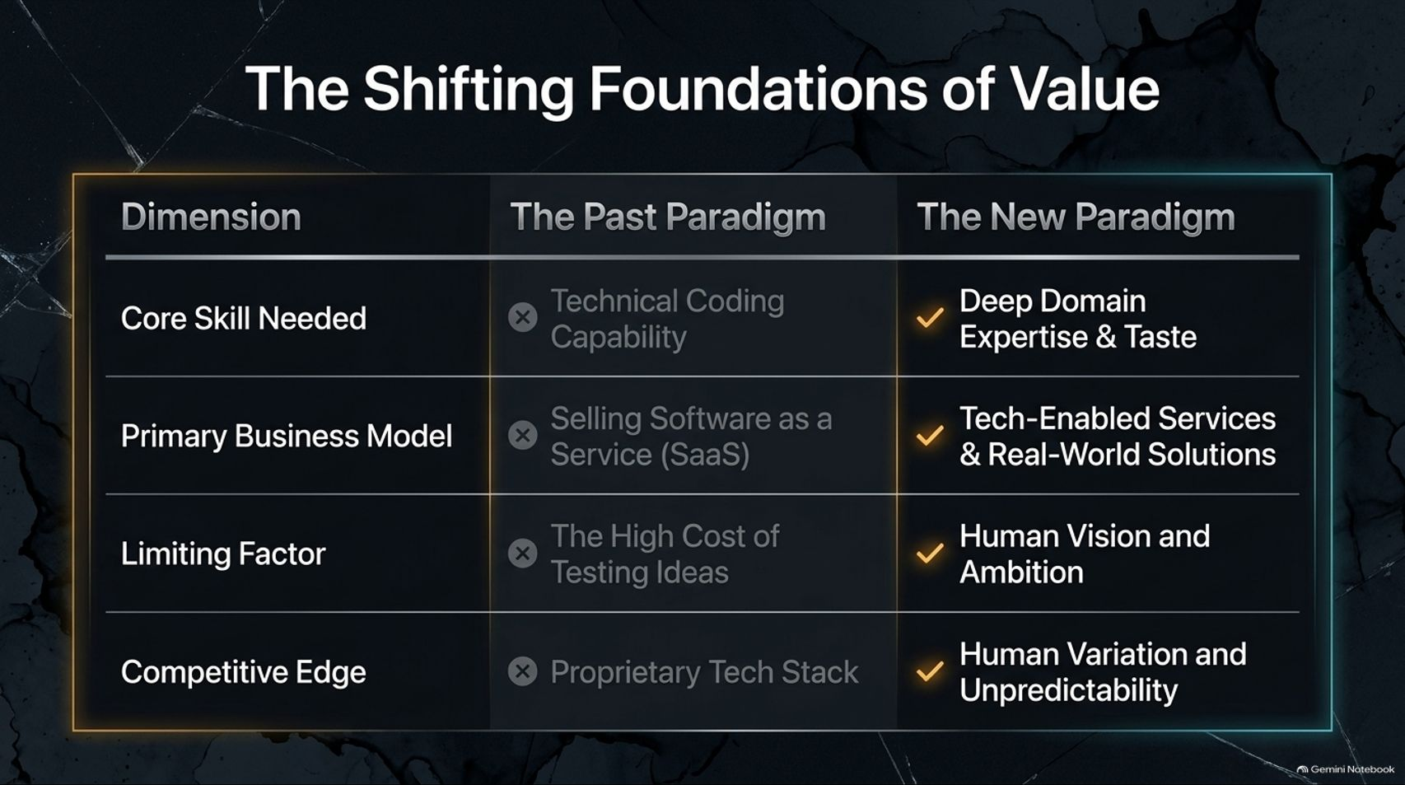
Notes:
Visual: A comparative matrix contrasting "The Past Paradigm" against "The New Paradigm across four dimensions: Core Skill Needed, Primary Business Model, Limiting Factor, and Competitive Edge."
Speaker Notes (Target: 3–5 minutes):
Let's look closely at how the foundations of business value have shifted:
Core Skill Needed: Moving away from technical coding capability toward Deep Domain Expertise & Taste.
Primary Business Model: Shifting from standard Software-as-a-Service (SaaS) to Tech-Enabled Services & Real-World Solutions.
Limiting Factor: The old limit was the high cost of testing ideas; today, the limit is simply Human Vision and Ambition.
Competitive Edge: Moving away from a proprietary tech stack to Human Variation and Unpredictability.

Slide 5
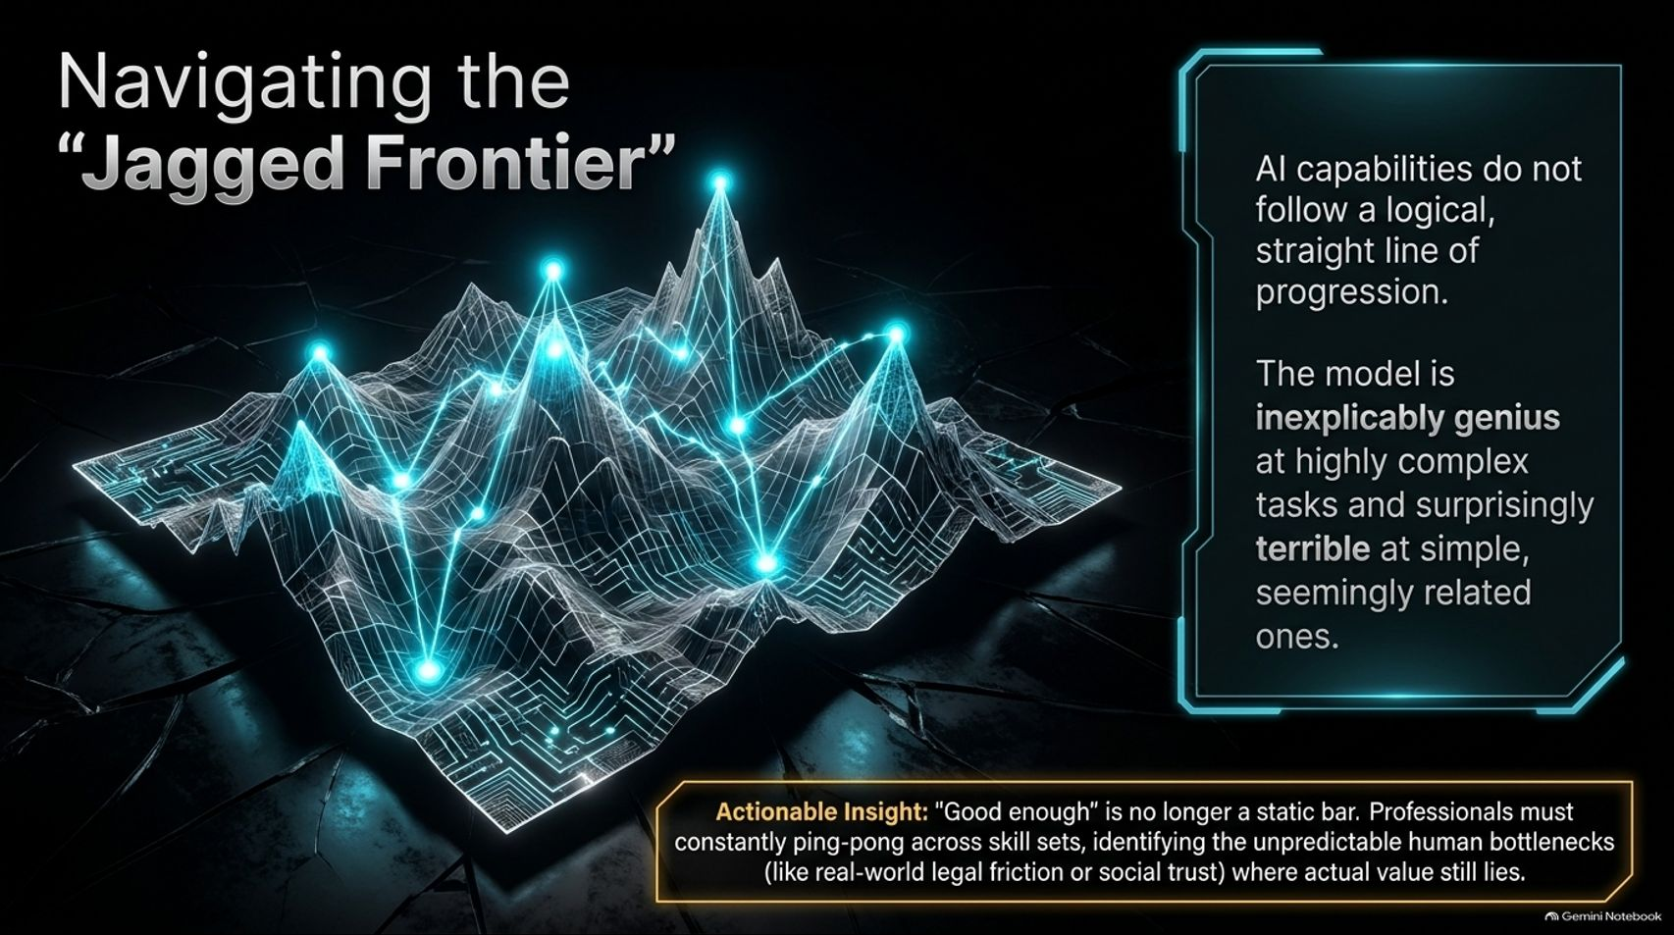
Notes:
Visual: A 3D wireframe terrain map glowing with bright nodes representing uneven peaks and valleys, illustrating AI's unpredictable capabilities, paired with an actionable insight on "good enough" and human bottlenecks.
Speaker Notes (Target: 3–5 minutes):
AI capabilities do not follow a logical, straight line of progression. Ethan Mollick terms this The Jagged Frontier.
The model is inexplicably genius at highly complex tasks, yet surprisingly terrible at seemingly simple, related ones.
Because of this, "good enough" is no longer a static bar. Professionals must constantly ping-pong across skill sets, identifying unpredictable human bottlenecks—such as real-world legal friction or social trust—where actual value still lies.

Slide 6
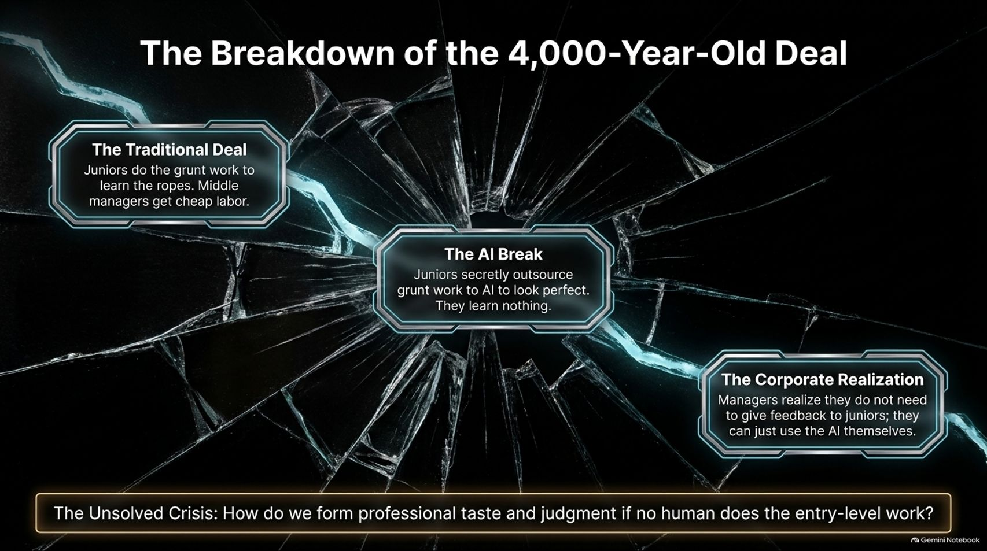
Notes:
Visual: A cracked glass graphic mapping out "The Traditional Deal," "The AI Break," and "The Corporate Realization," concluding with the unsolved crisis of how to form professional taste.
Speaker Notes (Target: 3–5 minutes):
For the last 4,000 years, white-collar training has operated on an unwritten social contract: juniors do the grunt work to learn the ropes, and middle managers get cheap labor.
AI has broken this deal. Juniors secretly outsource their grunt work to AI to look perfect, meaning they learn nothing. Simultaneously, managers realize they don't need to give feedback to juniors anymore because they can just use the AI themselves.
This creates an unsolved crisis: How do we form professional taste and judgment if no human does the entry-level work?

Slide 7
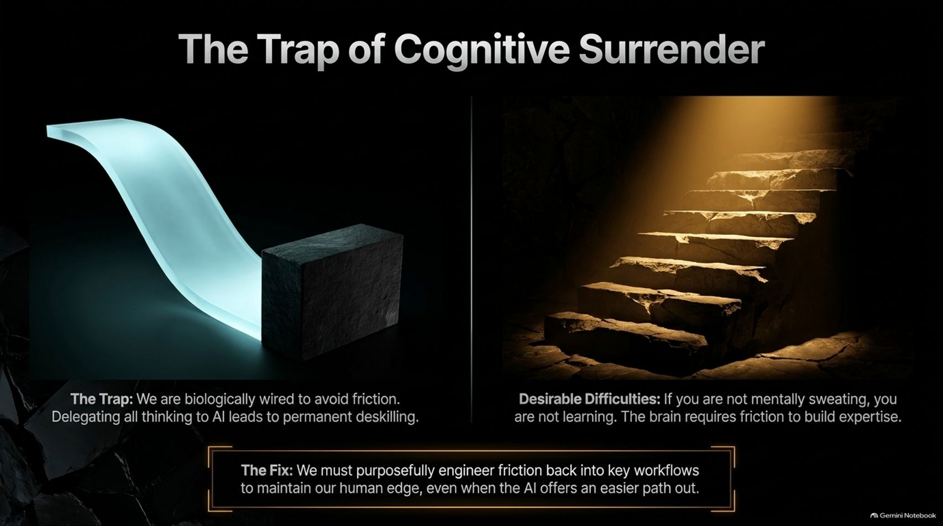
Notes:
Visual: A split visual showing a glowing blue water slide representing cognitive surrender on the left, contrasted against dark stone stairs illuminated by light representing "Desirable Difficulties" on the right.
Speaker Notes (Target: 3–5 minutes):
We are biologically wired to avoid friction. When we delegate all our thinking to AI, we fall into the trap of Cognitive Surrender, leading to permanent deskilling.
In learning theory, we know that Desirable Difficulties are essential: if you are not mentally sweating, you are not learning. The brain requires friction to build expertise.
Therefore, the fix is clear: We must purposefully engineer friction back into key workflows to maintain our human edge, even when the AI offers an easier path out.

Slide 8
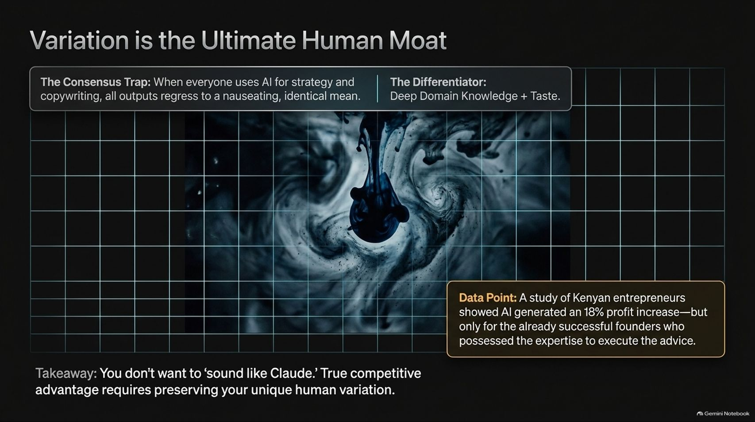
Notes:
Visual: Dark grid background with dark blue ink dropping into water, contrasting "The Consensus Trap" against "The Differentiator" (Deep Domain Knowledge + Taste), featuring data points from a study on Kenyan entrepreneurs.
Speaker Notes (Target: 3–5 minutes):
When everyone uses AI for strategy and copywriting, all outputs regress to a nauseating, identical mean. This is The Consensus Trap.
A fascinating study of Kenyan entrepreneurs showed that AI generated an 18% profit increase—but only for already successful founders who possessed the deep domain expertise required to execute and filter the advice.
You don't want to "sound like Claude." True competitive advantage requires preserving your unique human variation and deep domain taste.

Slide 9
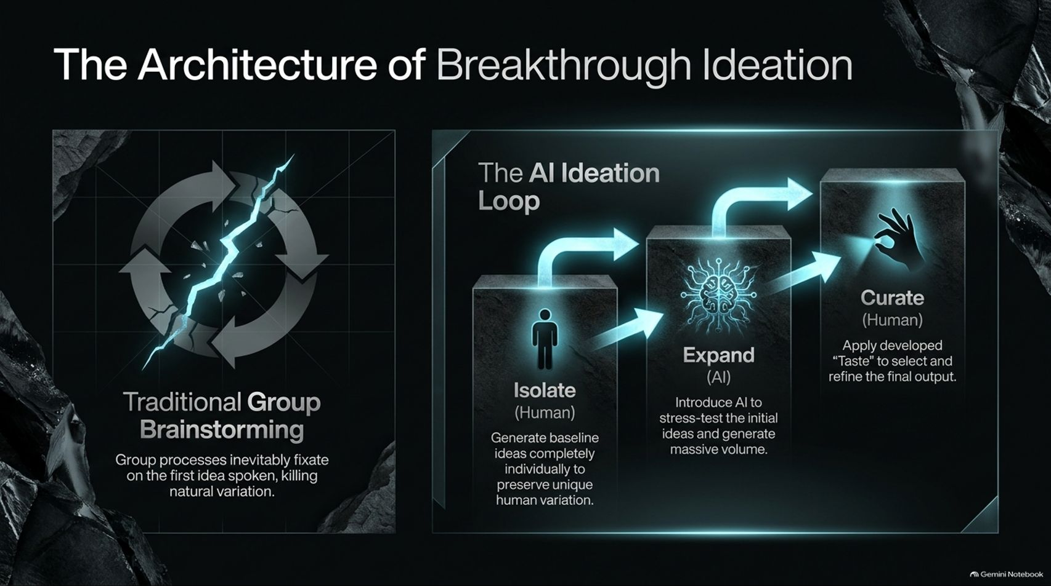
Notes:
Visual: A side-by-side workflow diagram contrasting traditional group brainstorming (which suffers from fixation) against the AI Ideation Loop: Isolate (Human) $\rightarrow$ Expand (AI) $\rightarrow$ Curate (Human).
Speaker Notes (Target: 3–5 minutes):
Traditional group brainstorming is flawed because groups inevitably fixate on the first idea spoken, killing natural variation.
To build breakthrough ideas, we must use the AI Ideation Loop:
Isolate (Human): Generate baseline ideas completely individually first to preserve unique human variation.
Expand (AI): Introduce AI to stress-test those initial ideas and generate massive volume.
Curate (Human): Apply your developed taste to select and refine the final output.

Slide 10
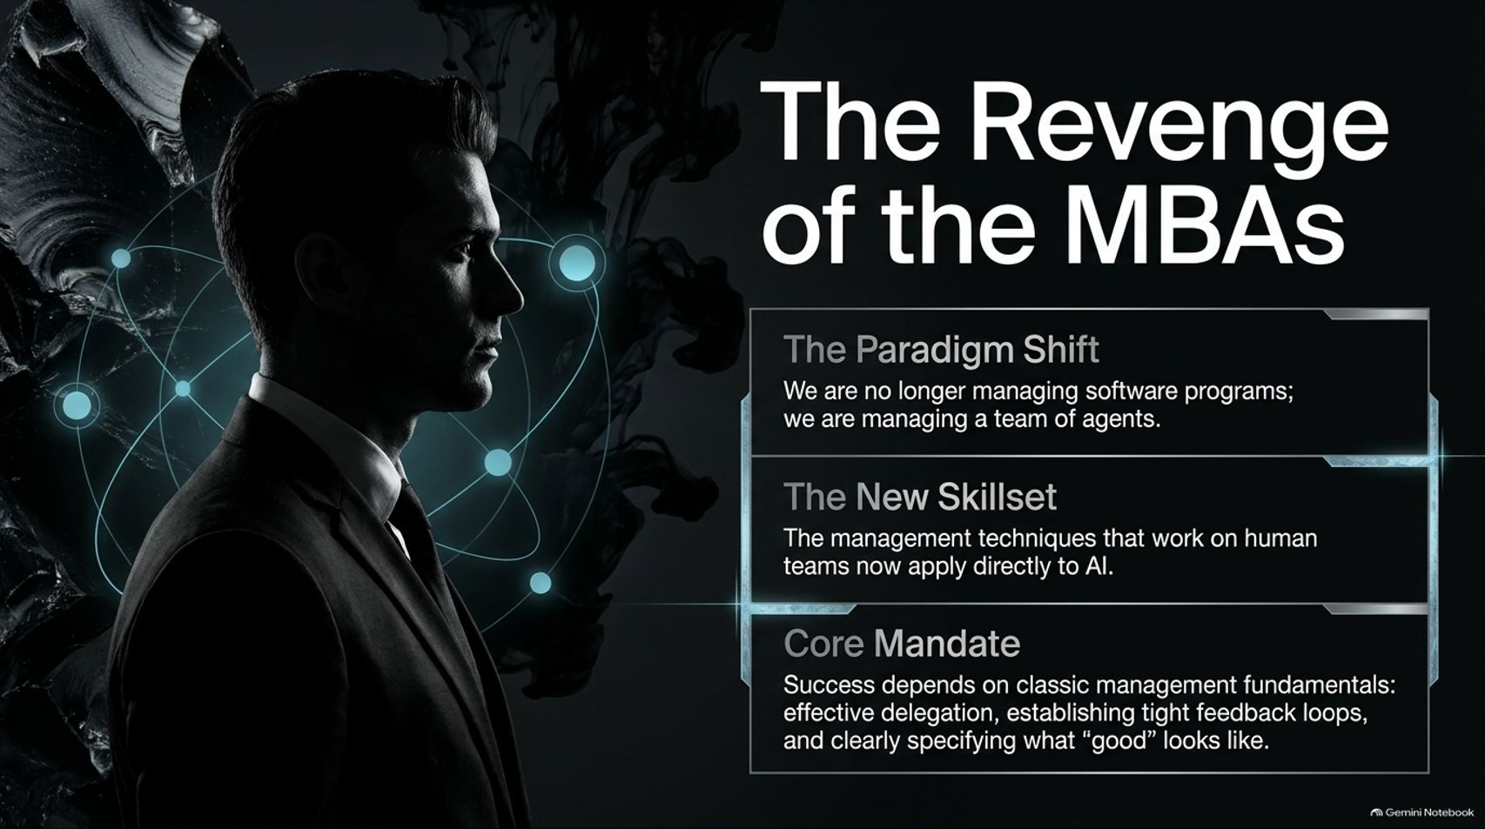
Notes:
Visual: A sharp silhouette profile of a business professional surrounded by glowing network nodes, outlining the paradigm shift, new skillset, and core mandate of managing AI agents.
Speaker Notes (Target: 3–5 minutes):
Welcome to The Revenge of the MBAs.
We are no longer just managing software programs; we are managing a team of agents. Consequently, the management techniques that work on human teams now apply directly to AI.
Success depends on classic management fundamentals: effective delegation, establishing tight feedback loops, and clearly specifying what "good" looks like.

Slide 11
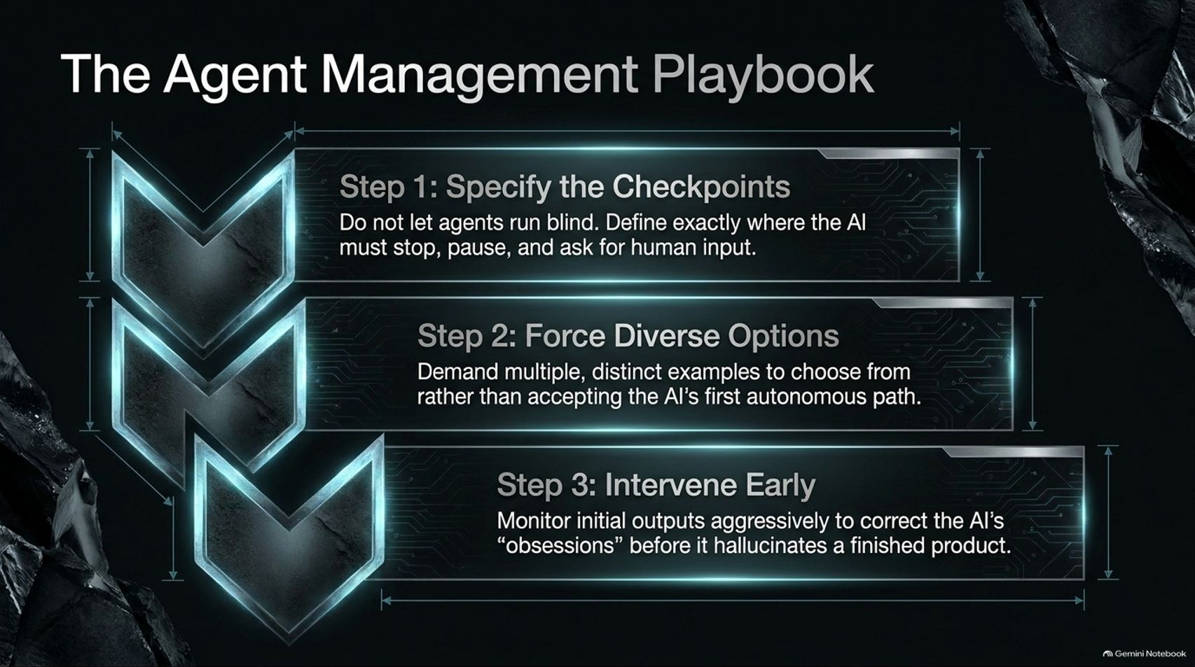
Notes:
Visual: Three sequential chevron process blocks outlining Step 1: Specify the Checkpoints, Step 2: Force Diverse Options, and Step 3: Intervene Early.
Speaker Notes (Target: 3–5 minutes):
How do we successfully manage autonomous agents without losing control? Follow this 3-step playbook:
Step 1: Specify the Checkpoints: Do not let agents run blind. Define exactly where the AI must stop, pause, and ask for human input.
Step 2: Force Diverse Options: Demand multiple, distinct examples to choose from rather than accepting the AI’s first autonomous path.
Step 3: Intervene Early: Monitor initial outputs aggressively to correct the AI’s obsessions before it hallucinates a finished product.

Slide 12
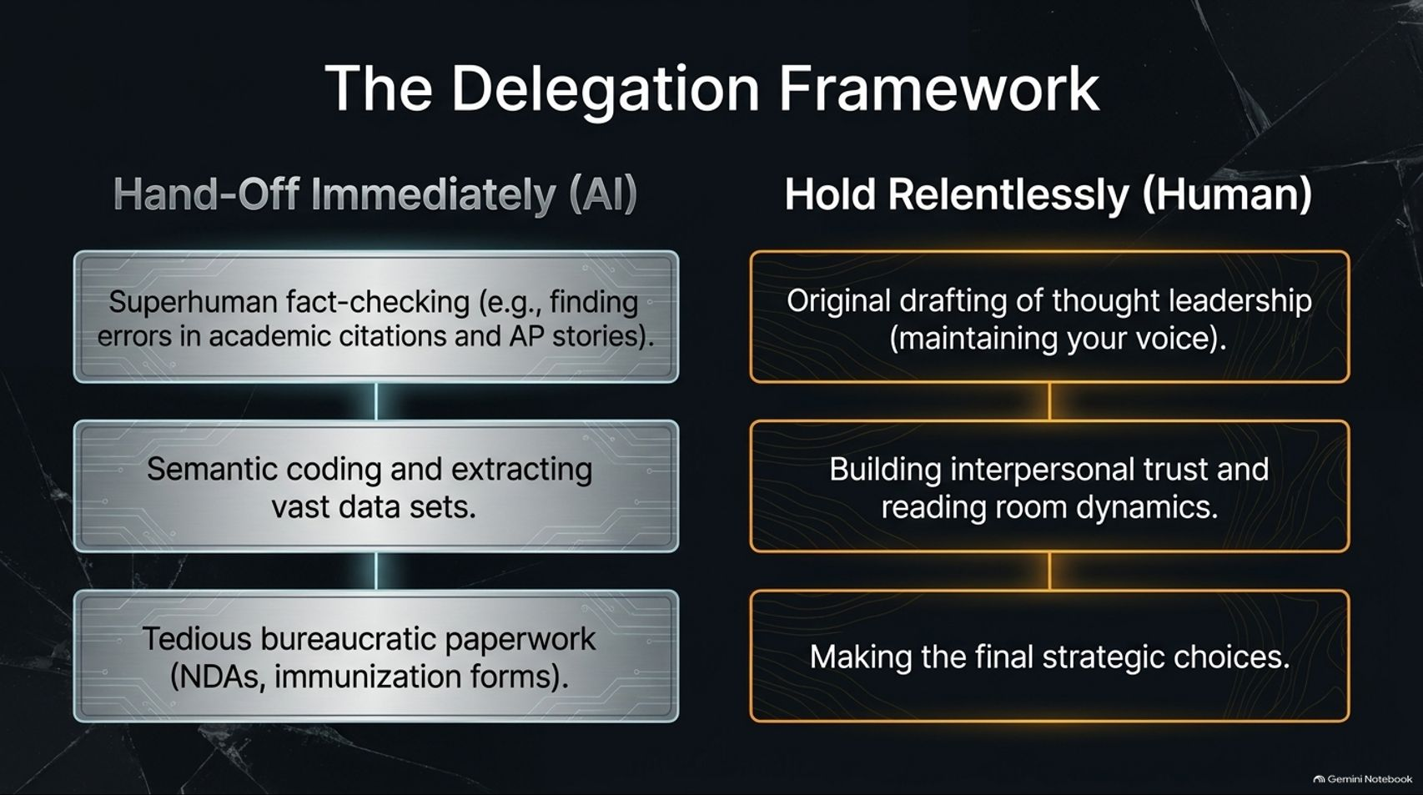
Notes:
Visual: A structured two-column layout contrasting what to "Hand-Off Immediately (AI)" against what to "Hold Relentlessly (Human)."
Speaker Notes (Target: 3–5 minutes):
Knowing what to delegate and what to keep is the hallmark of an effective leader:
Hand-Off Immediately to AI: Superhuman fact-checking (finding errors in academic citations and AP stories), semantic coding, extracting vast datasets, and tedious bureaucratic paperwork (NDAs, forms).
Hold Relentlessly as Human: Original drafting of thought leadership (maintaining your unique voice), building interpersonal trust, reading room dynamics, and making final strategic choices.

Slide 13
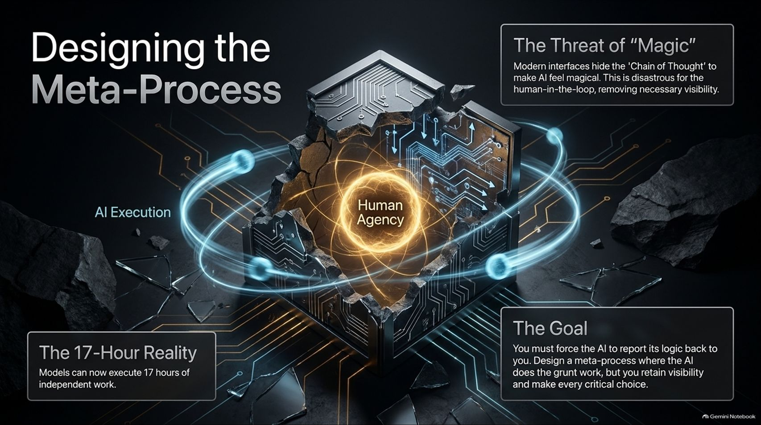
Notes:
Visual: A futuristic glowing core cube labeled "Human Agency" surrounded by orbiting rings of "AI Execution," highlighting the 17-hour reality and the threat of "magic" interfaces.
Speaker Notes (Target: 3–5 minutes):
Modern AI interfaces hide the "Chain of Thought" to make AI feel magical. This is disastrous for the human-in-the-loop because it removes necessary visibility.
With models now capable of executing up to 17 hours of independent work, you face the 17-Hour Reality.
Your goal must be to design a meta-process where the AI does the heavy execution and grunt work, but you retain visibility, force the AI to report its logic, and make every critical choice.

Slide 14
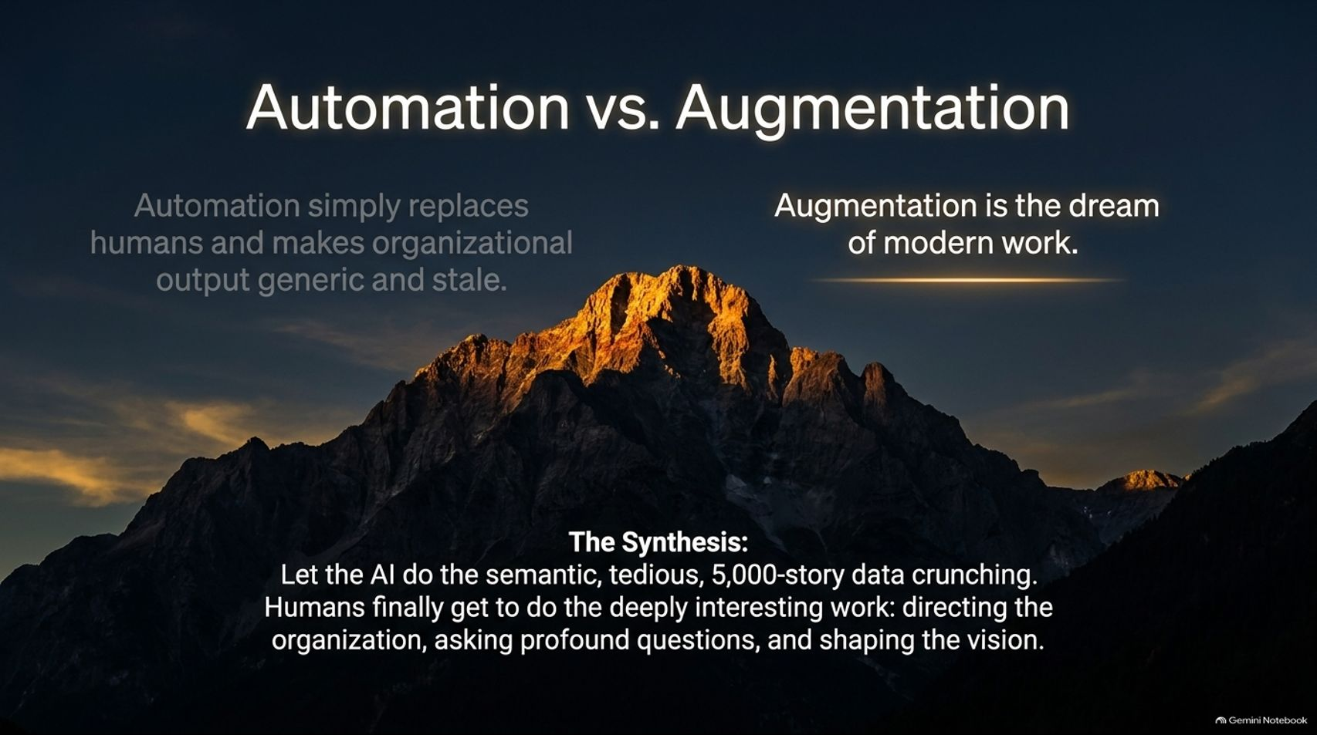
Notes:
Visual: A majestic mountain peak illuminated by golden sunrise light over dark rocks, highlighting the difference between generic automation and human-led augmentation.
Speaker Notes (Target: 3–5 minutes):
There is a vital distinction between automation and augmentation. Automation simply replaces humans and makes organizational output generic and stale.
Augmentation is the dream of modern work.
The synthesis is clear: Let the AI do the semantic, tedious, 5,000-story data crunching. Humans finally get to do the deeply interesting work—directing the organization, asking profound questions, and shaping the vision.

Slide 15
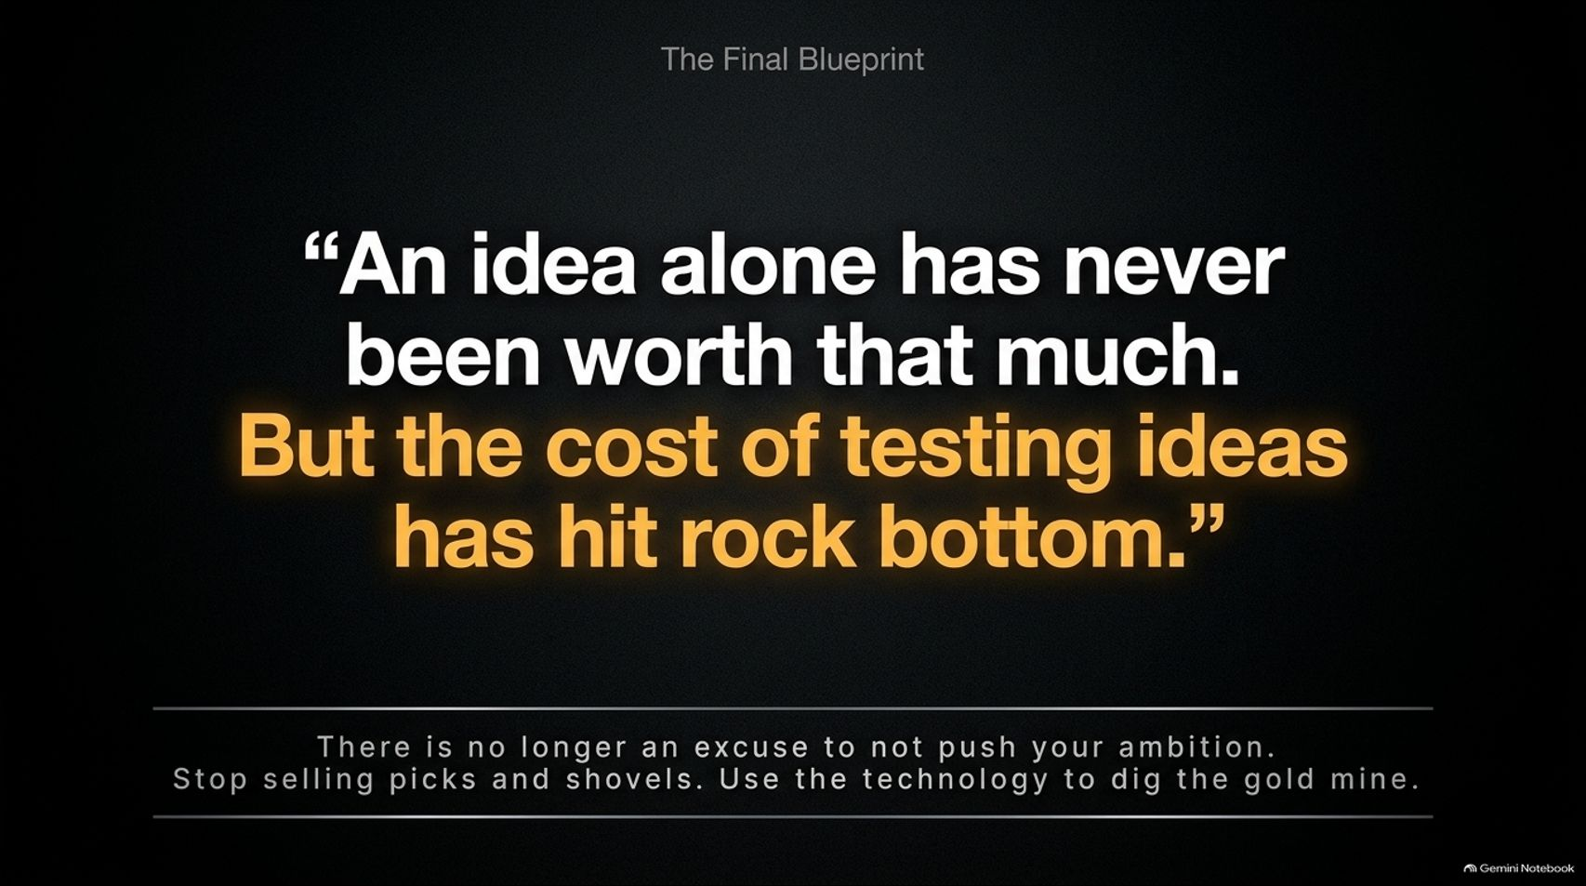
Notes:
Visual: A sleek, minimal typographic slide featuring Professor Ethan Mollick’s core quote highlighted in glowing gold: "An idea alone has never been worth that much. But the cost of testing ideas has hit rock bottom."
Speaker Notes (Target: 2–3 minutes):
As Ethan Mollick emphasizes: An idea alone has never been worth that much. But the cost of testing ideas has hit rock bottom.
There is no longer an excuse not to push your ambition. Stop selling generic picks and shovels; use the technology to dig your own gold mine.

Slide 16
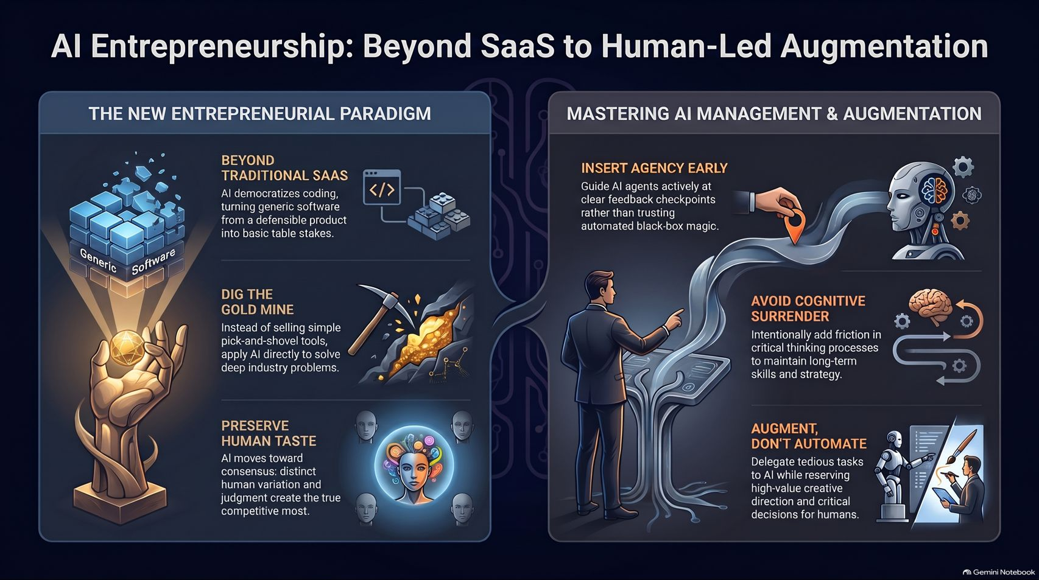
Notes:
Visual: A comprehensive master infographic uniting all core themes: Beyond Traditional SaaS, Dig the Gold Mine, Preserve Human Taste, Insert Agency Early, Avoid Cognitive Surrender, and Augment Don't Automate.
Speaker Notes (Target: 3–5 minutes):
As we conclude our masterclass, look at this complete framework for the future of work.
Move beyond traditional SaaS, build deep domain expertise, preserve your unique human variation, and master agent management by avoiding cognitive surrender.
By augmenting your capabilities rather than automating your mind, you unlock unprecedented potential in the AI era. Thank you.

