Slide 1
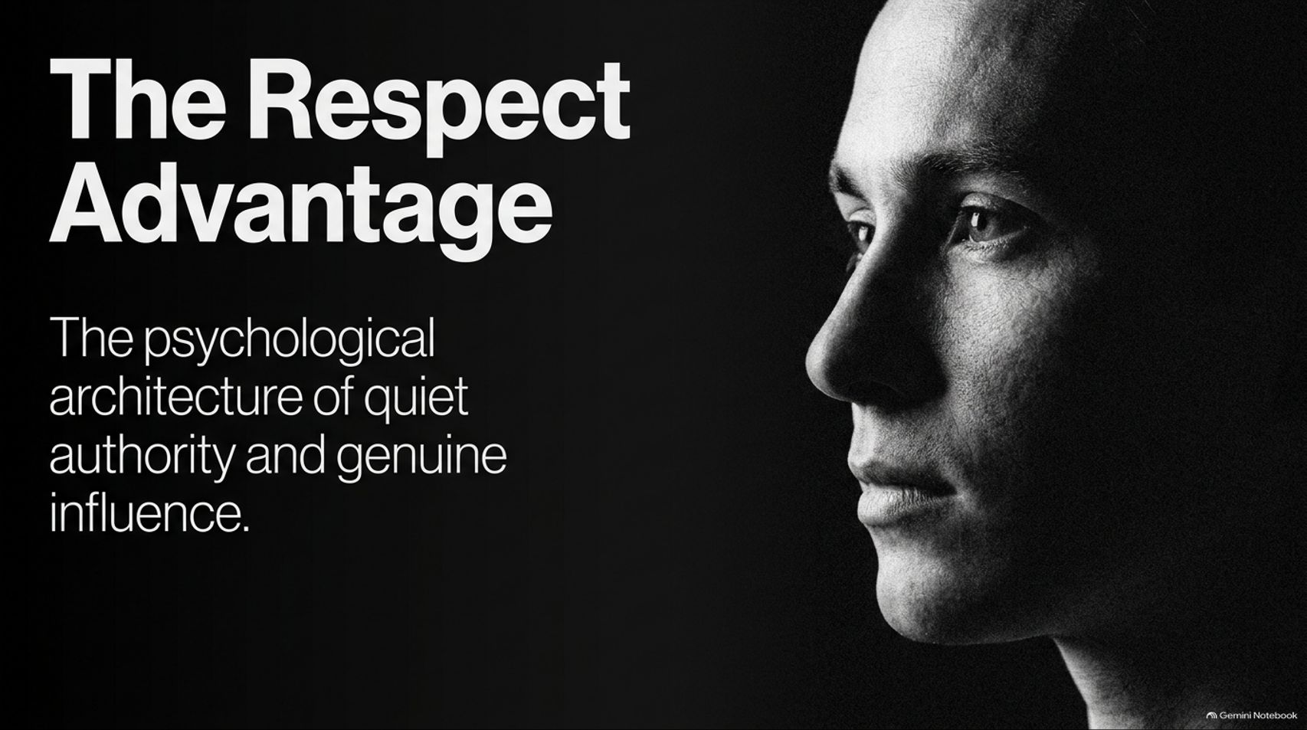
Notes:
Visual: A high-contrast, black-and-white cinematic portrait of a person looking thoughtfully into the distance, titled: "The Respect Advantage: The psychological architecture of quiet authority and genuine influence."
Speaker Notes (Target: 2–3 minutes):
Welcome, everyone. Today, we are opening a conversation about one of the most misunderstood dynamics in human psychology and leadership: Respect.
Most people confuse respect with dominance, popularity, or fear. They believe that to command a room, they must raise their voice, project aggressive alpha energy, or constantly assert their status. But psychological research and real-world observation reveal the exact opposite: true authority is quiet.
In this presentation, titled "The Respect Advantage," we are going to break down the psychological architecture of genuine influence. We will look at why loud dominance fails, how to build an unshakeable internal core, and how to communicate boundaries and competence in a way that naturally earns lasting, deep respect. Let’s get started.
12 Psychological Tricks That Make People Respect You | Full Audiobook
https://www.youtube.com/watch?v=DBcO6k9Xfcc

Slide 2
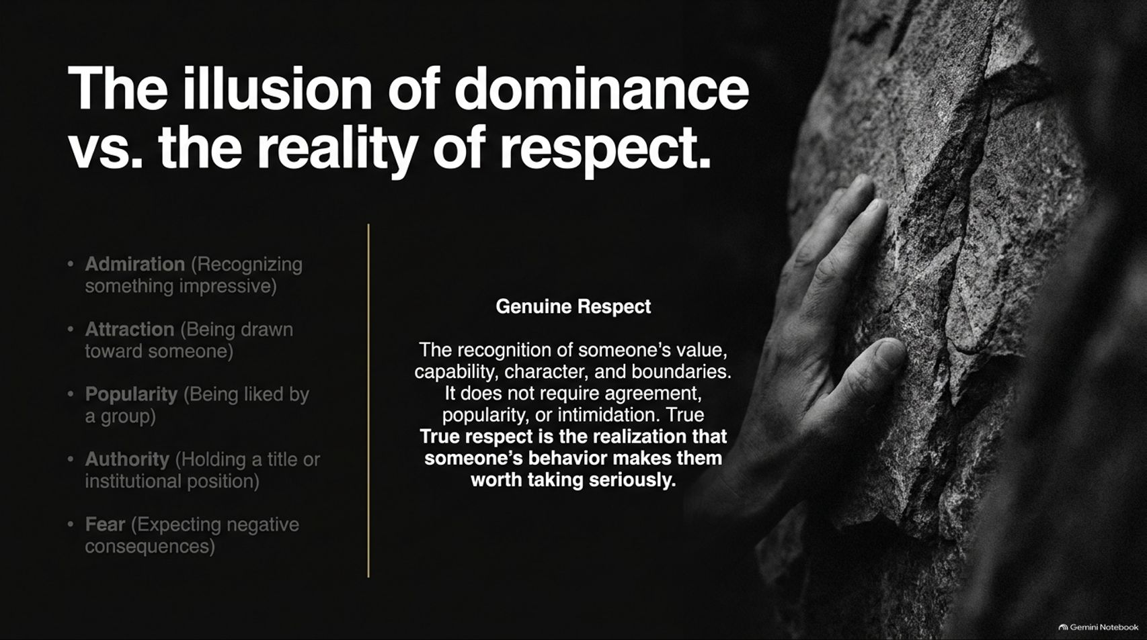
Notes:
Visual: A split layout contrasting surface-level social dynamics (Admiration, Attraction, Popularity, Authority, Fear) against the core box defining "Genuine Respect" (recognition of value, capability, character, and boundaries) alongside a hand gripping a rough rock face.
Speaker Notes (Target: 3–5 minutes):
Let's begin by clearing away common misconceptions. People often mistake respect for five related, but fundamentally different, social phenomena:
Admiration: Liking someone’s impressive talent.
Attraction: Being drawn to someone’s charm.
Popularity: Being liked by a consensus group.
Institutional Authority: Holding a title, badge, or rank.
Fear: Expecting negative consequences or retaliation.
You can fear a boss without respecting them. You can find a celebrity popular without respecting their judgment. You can hold administrative authority and still be completely dismissed by your peers.
Genuine respect is something much deeper: it is the psychological recognition of someone's value, capability, character, and boundaries. It does not require agreement or intimidation. Respect occurs at the moment another human realizes that your behavior, standards, and emotional composure make you someone worth taking seriously.

Slide 3
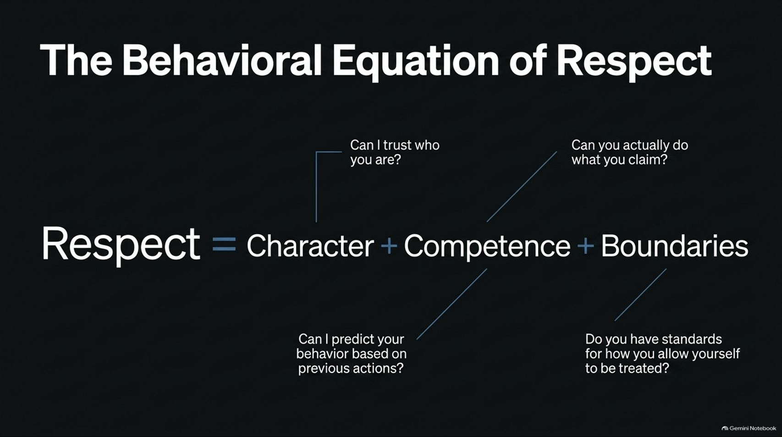
Notes:
Visual: A clean mathematical framework: $\text{Respect} = \text{Character} + \text{Competence} + \text{Boundaries}$, with annotation callouts explaining the psychological questions behind each variable.
Speaker Notes (Target: 3–5 minutes):
If genuine respect isn't inherited or forced, how is it constructed? It follows a clear behavioral equation: Respect equals Character plus Competence plus Boundaries.
Let's break down the psychological questions your peers and colleagues are sub-consciously asking when they evaluate you:
Character: "Can I trust who you are? Can I predict your behavior based on your previous actions?" Character is about integrity and predictability under pressure.
Competence: "Can you actually do what you claim?" Competence is your raw ability to execute and deliver real-world results.
Boundaries: "Do you have standards for how you allow yourself to be treated?" This is the variable most people forget. Without boundaries, character and competence turn you into a polite vehicle for other people's priorities.

Slide 4
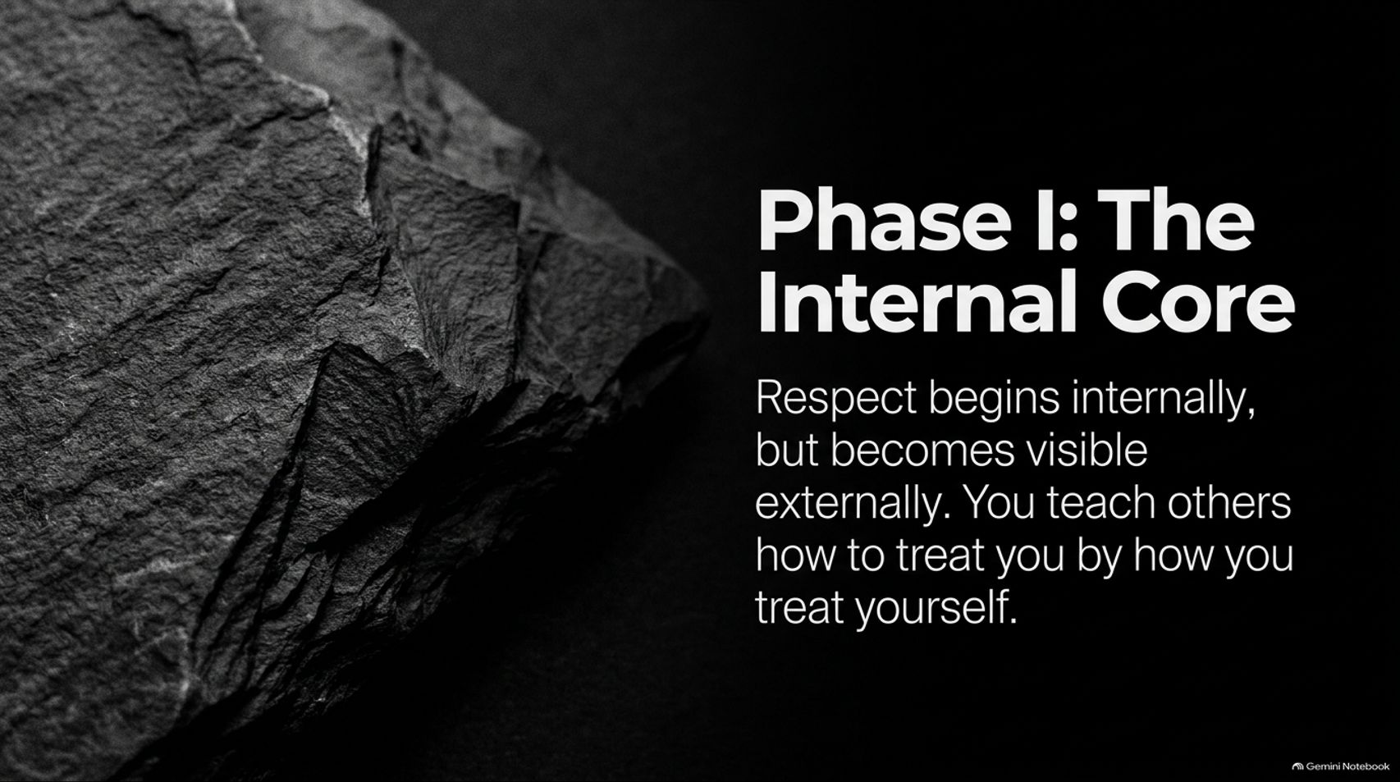
Notes:
Visual: A rustic, solid slate stone texture accompanied by bold typography introducing "Phase I: The Internal Core — Respect begins internally, but becomes visible externally. You teach others how to treat you by how you treat yourself."
Speaker Notes (Target: 2–4 minutes):
We now enter Phase I of our model: The Internal Core.
There is an absolute law in human interaction: You cannot extract from the world what you do not cultivate within yourself. If you do not respect your own time, your commitments, your physical health, and your word, it is psychologically impossible to convince others to respect them.
External respect is simply an echo of your internal standards. When you compromise your values to please others or break promises to yourself, you broadcast subtle non-verbal signals of low self-worth. People do not respond to what you ask for; they respond to what you tolerate.

Slide 5
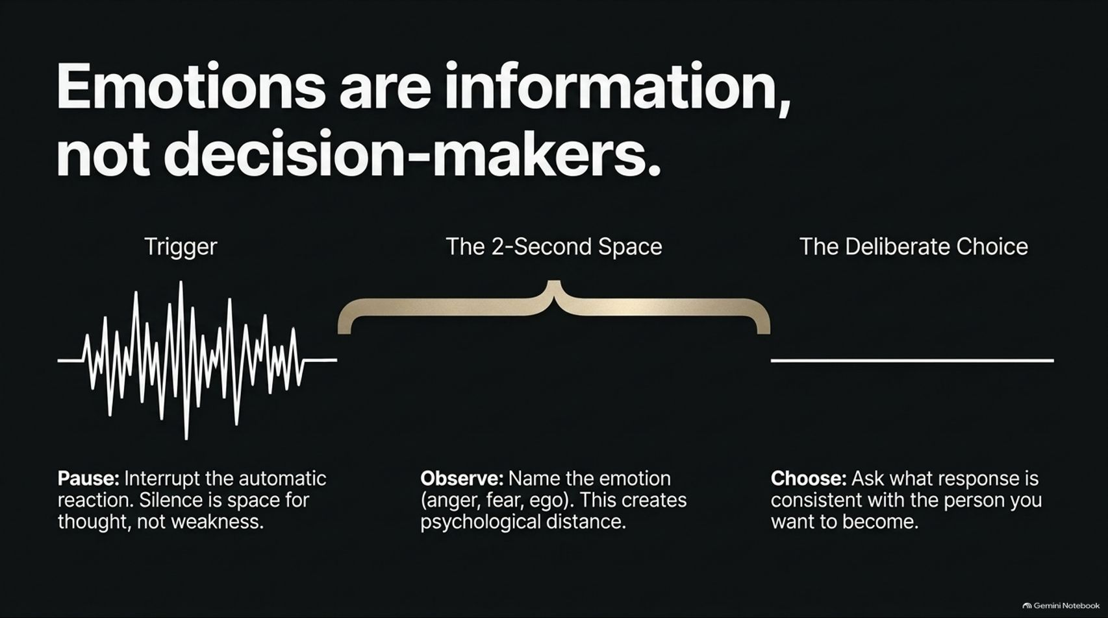
Notes:
Visual: A visual timeline showing an chaotic emotional frequency wave labeled "Trigger," bridging across "The 2-Second Space" (Pause & Observe), into a solid, straight line labeled "The Deliberate Choice."
Speaker Notes (Target: 3–5 minutes):
The primary test of your internal core is emotional regulation. Remember this rule: Emotions are information, not decision-makers.
When a crisis hits, or when someone insults, challenges, or interrupts you, the fragile ego reacts instantly. It sparks an automatic, emotional outburst—snapping back, getting defensive, or panicking.
High-value individuals practice The 2-Second Space. When a trigger occurs, they pause to interrupt the automatic reaction. Silence is not weakness; silence is space for executive thought. In that 2-second gap, you observe and name the emotion—anger, fear, wounded ego. This creates psychological distance. Then, you deliberately choose a response that aligns with the person you want to become, rather than reacting like a slave to the moment.

Slide 6
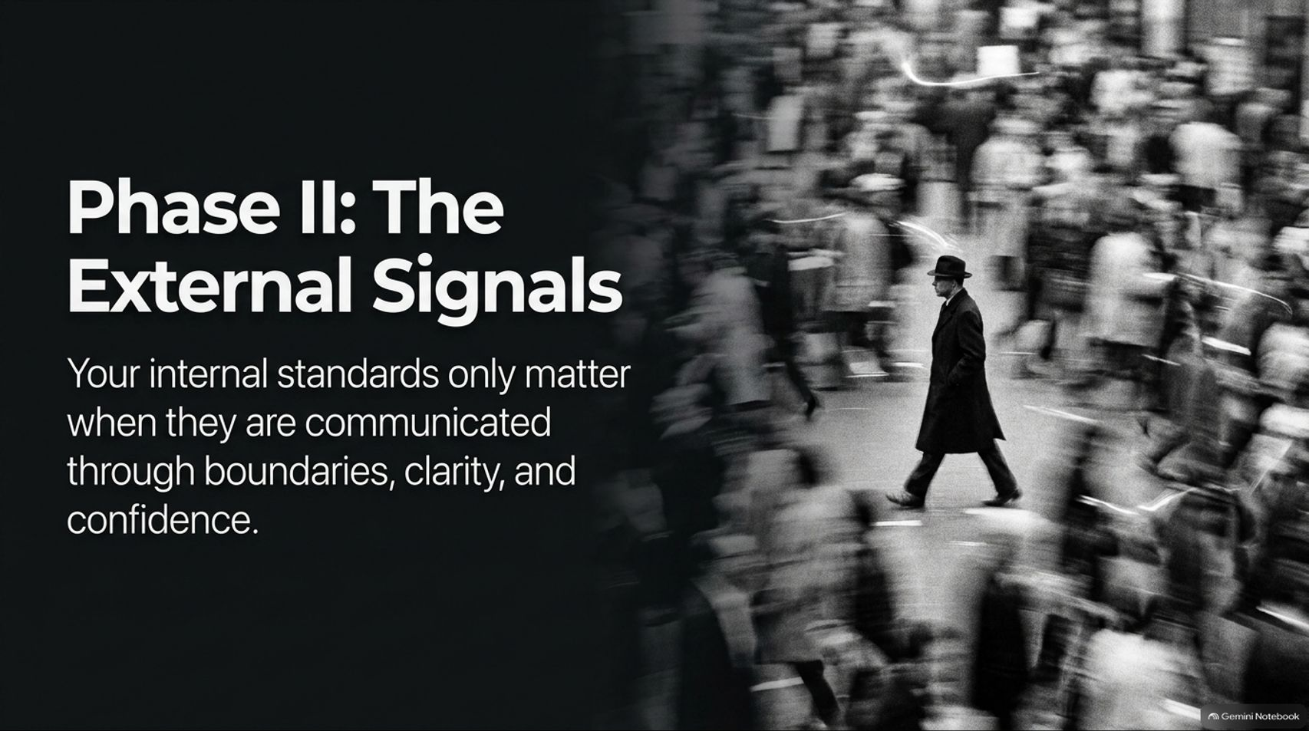
Notes:
Visual: A dark background with a motion-blurred black-and-white street scene showing a lone figure walking deliberately through a crowd, introducing "Phase II: The External Signals."
Speaker Notes (Target: 2–4 minutes):
Having built the internal core, we shift to Phase II: The External Signals.
Having high internal standards means nothing if your external communication is apologetic, timid, or passive. Respect is communicated externally through three primary signals: uncompromising boundaries, radical clarity, and quiet confidence.
Let's look at how these three elements translate into daily conversations and leadership situations.

Slide 7
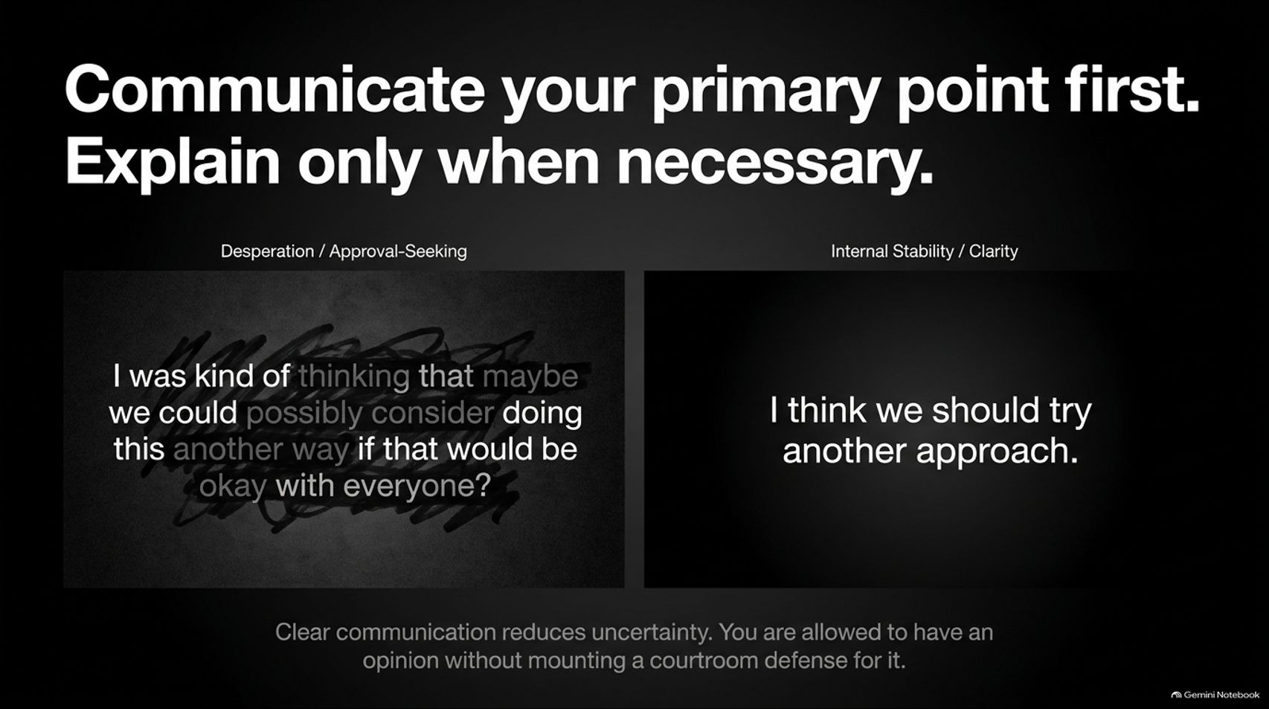
Notes:
Visual: A direct comparison between a blurred, crossed-out paragraph of hesitant, approval-seeking speech versus a crisp, clear statement of position, highlighting the power of directness.
Speaker Notes (Target: 3–5 minutes):
Look at the left side of this slide. How often do you hear people talk like this? "I was kind of thinking that maybe we could possibly consider doing this another way if that would be okay with everyone?"
Notice what is happening here: filler words, qualifiers, tag questions, and hedge statements. This is approval-seeking language born from internal insecurity. When you over-explain, soften every statement, or apologize for having an opinion, you signal to the room that your ideas are fragile.
Now look at the right side: "I think we should try another approach."
Clear communication reduces uncertainty. State your primary point first. Explain your reasoning only when requested or necessary. You are fully allowed to state an opinion without mounting a desperate courtroom defense for why you hold it.

Slide 8
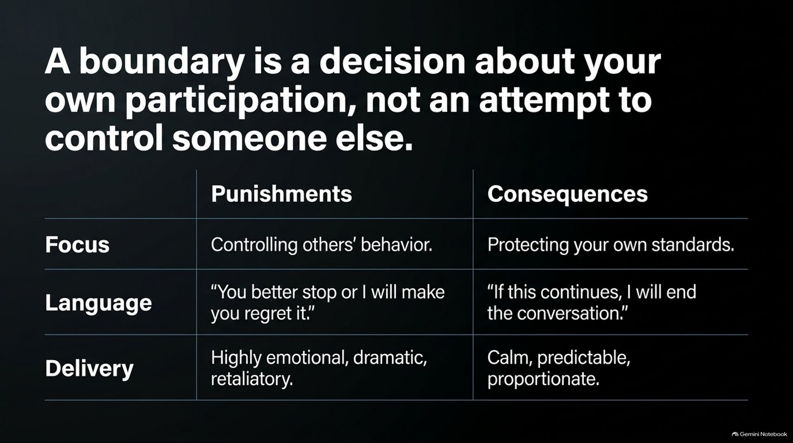
Notes:
Visual: A structured contrast table comparing "Punishments" (controlling others, threats, emotional outbursts) against "Consequences" (protecting standards, clear boundary statements, calm delivery).
Speaker Notes (Target: 3–5 minutes):
Most people misunderstand boundaries. They think a boundary is a rule forced onto someone else: "You can't talk to me like that!" or "You need to do this!" That isn't a boundary—that's an attempt to control another person, which usually triggers aggression or resistance.
A true boundary is a decision about your own participation. It is not about controlling them; it is about protecting your standards.
Look at the difference in language:
Punishment / Control: "You better stop yelling or I will make you regret it." (Emotional, retaliatory, focused on them).
Boundary / Consequence: "If this tone continues, I will end this meeting and we can revisit the topic tomorrow." (Calm, predictable, focused on your own action).
When you state consequences calmly and enforce them without dramatic speeches, people quickly realize your boundaries are real.

Slide 9
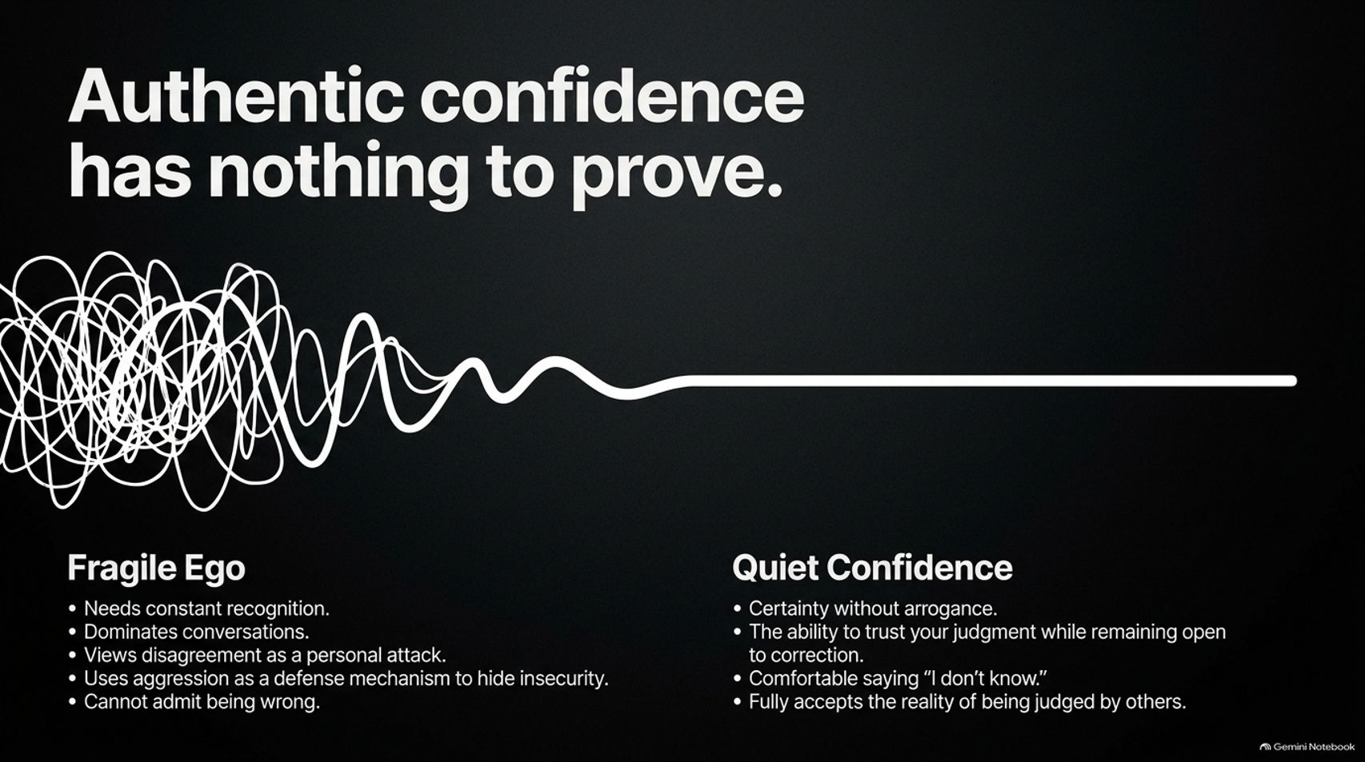
Notes:
Visual: A graphic line transitioning from a tangled scribbled knot labeled "Fragile Ego" into a clean, smooth vector line labeled "Quiet Confidence," listing bulleted behavioral markers for both.
Speaker Notes (Target: 3–5 minutes):
Let's contrast a fragile ego with authentic, quiet confidence.
A fragile ego needs constant validation. It dominates meetings, interrupts others to show off knowledge, views every disagreement as a personal attack, and refuses to admit mistakes. It uses noise and aggression to cover up deep-seated insecurity.
Quiet confidence, on the other hand, has nothing to prove. It operates with certainty without arrogance. It trusts its own judgment while remaining genuinely open to correction. A person with quiet confidence is comfortable saying three of the most powerful words in professional life: "I don't know." They accept the reality that they will be judged by some, and they remain untroubled by it.

Slide 10

Notes:
Visual: A precision mechanical clockwork/gear design illuminated by subtle golden lighting, introducing "Phase III: Durable Reputation — Charisma attracts attention. Capability creates credibility. Consistency builds trust."
Speaker Notes (Target: 2–4 minutes):
We now arrive at Phase III: Durable Reputation.
Charisma is easy to fake for an hour. Anyone can put on a charming smile, drop impressive buzzwords, or make grand promises during an interview or first meeting. Charisma attracts initial attention.
But charisma alone rots quickly without foundation. Capability creates real credibility—showing that you can actually execute. And consistency is what converts capability into unshakeable trust. Reputation is not built in high-stakes public moments; it is forged through silent, repeatable mechanics over time.

Slide 11
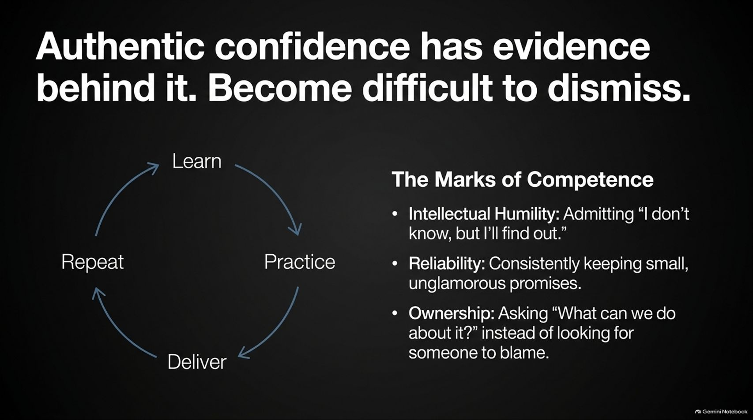
Notes:
Visual: A cyclical process loop (Learn $\rightarrow$ Practice $\rightarrow$ Deliver $\rightarrow$ Repeat) paired with three key bullet points detailing "The Marks of Competence" (Intellectual Humility, Reliability, Ownership).
Speaker Notes (Target: 3–5 minutes):
Where does real confidence come from? It isn't positive self-talk or standing in front of a mirror reciting affirmations. Real confidence comes from a stack of undeniable proof that you have done the work.
Competence follows a continuous loop: Learn, Practice, Deliver, Repeat.
Along this cycle, high-respect individuals display three unmistakable marks:
Intellectual Humility: Admitting "I don't know, but I will find out."
Reliability: Consistently keeping small, unglamorous promises. If you say you'll send an email by 4 PM, it arrives at 3:59 PM.
Extreme Ownership: When things go wrong, asking "What can I do to fix this?" instead of searching for a scapegoat.

Slide 12
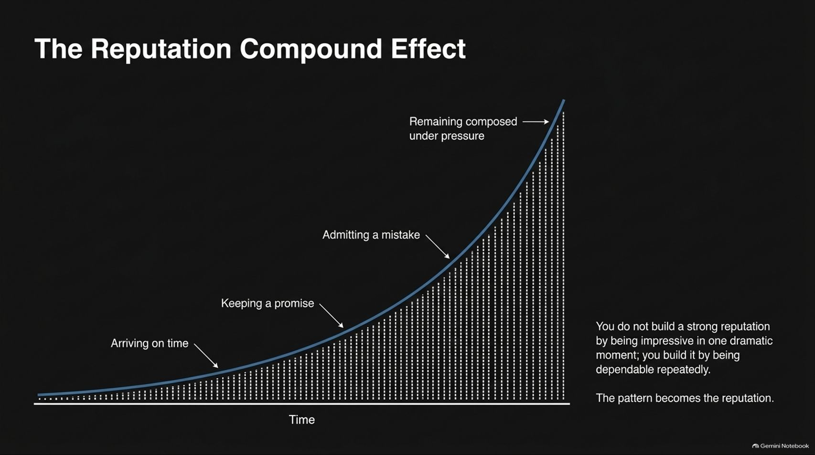
Notes:
Visual: An exponential growth curve demonstrating how small daily behaviors (arriving on time, keeping promises, admitting mistakes, staying composed) compound over time into an unassailable reputation.
Speaker Notes (Target: 3–5 minutes):
Reputation functions exactly like compound interest in finance.
At first, small positive actions seem negligible. Arriving on time for a routine meeting doesn't seem to change anything. Keeping a minor promise feels unnoticed. Admitting a mistake feels uncomfortable. Remaining composed during a stressful setback seems small.
But look at the graph: as time progresses, these repeated, micro-behaviors stack on top of one another. The pattern becomes your reputation. Eventually, your reputation reaches a tipping point where your integrity and capability are so established that low-quality attacks or minor errors cannot alter how the world sees you.

Slide 13
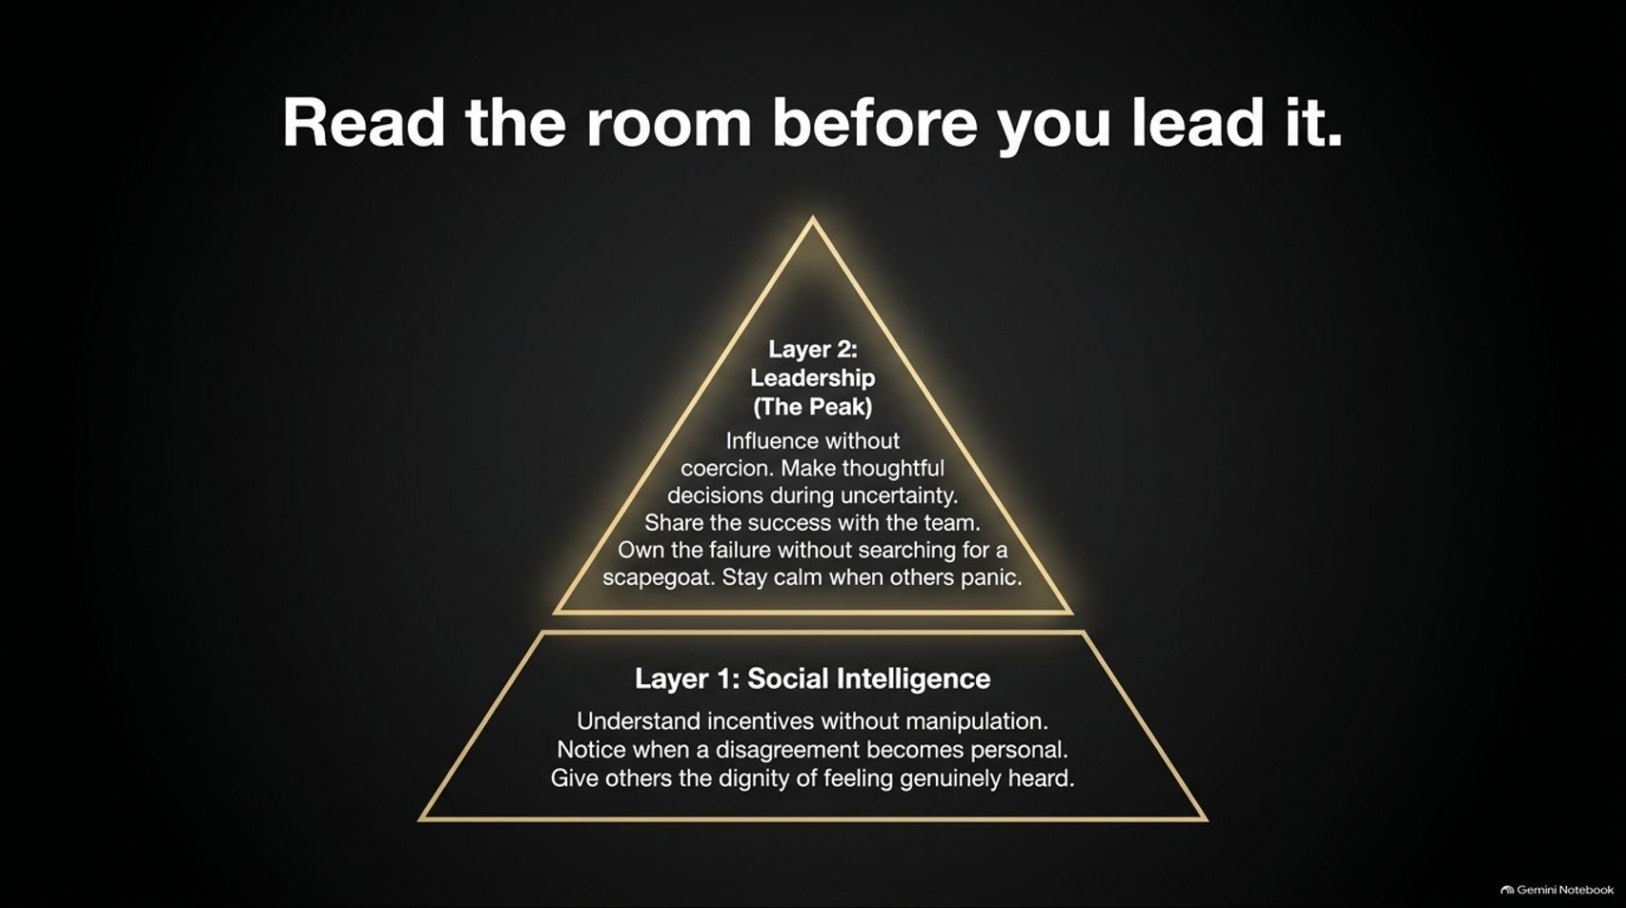
Notes:
Visual: A two-tier pyramid diagram placing "Layer 1: Social Intelligence" at the foundation, supporting "Layer 2: Leadership (The Peak)" at the top.
Speaker Notes (Target: 3–5 minutes):
You cannot lead a room that you have not first understood.
At the base of the pyramid sits Social Intelligence. This means reading underlying incentives without being manipulative, noticing when a disagreement has shifted from intellectual to personal, and giving others the dignity of feeling genuinely heard.
Only when social intelligence is established can you step into Layer 2: Leadership. True leadership is influence without coercion. It means making thoughtful decisions in times of ambiguity, shining the spotlight on the team during victories, and stepping in front to take full responsibility when the team encounters failure.

Slide 14
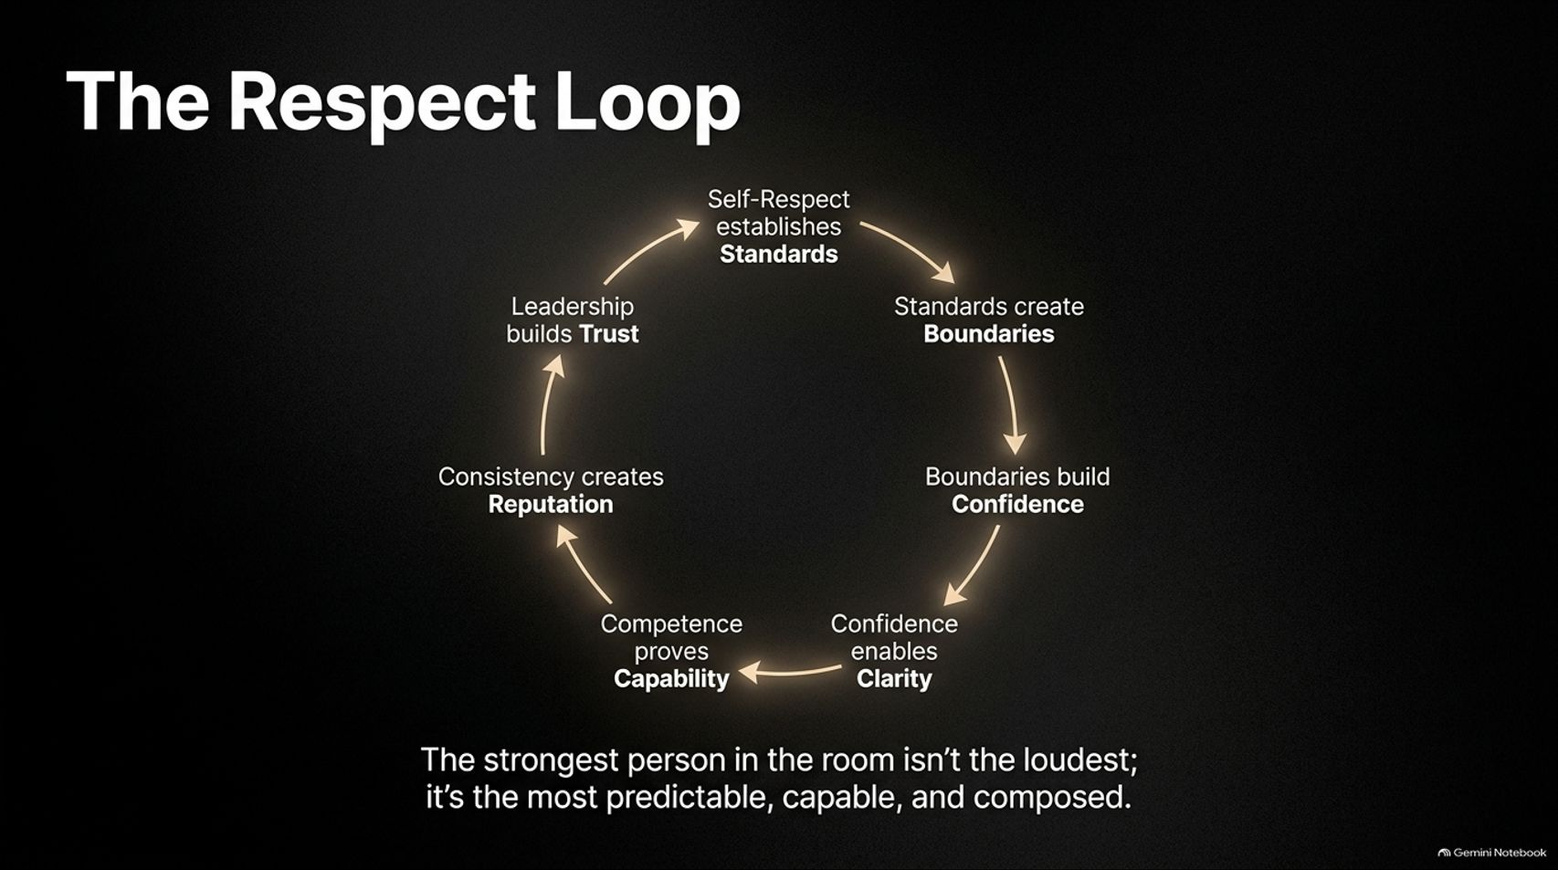
Notes:
Visual: A circular flow diagram connecting seven core stages: Self-Respect $\rightarrow$ Standards $\rightarrow$ Boundaries $\rightarrow$ Confidence $\rightarrow$ Clarity $\rightarrow$ Competence $\rightarrow$ Reputation $\rightarrow$ Trust, anchored by a takeaway sentence.
Speaker Notes (Target: 3–5 minutes):
Everything we have discussed today connects into a closed, self-reinforcing engine called The Respect Loop:
It starts with Self-Respect, which establishes personal Standards.
High standards force clear Boundaries.
Enforcing boundaries builds authentic Confidence.
Confidence enables direct, quiet Clarity in communication.
Clarity allows focused execution, proving Competence.
Consistent competence builds a durable Reputation.
A durable reputation creates genuine Leadership and Trust.
Remember: The strongest person in the room is almost never the loudest; it is the person who is most predictable, capable, and composed.

Slide 15
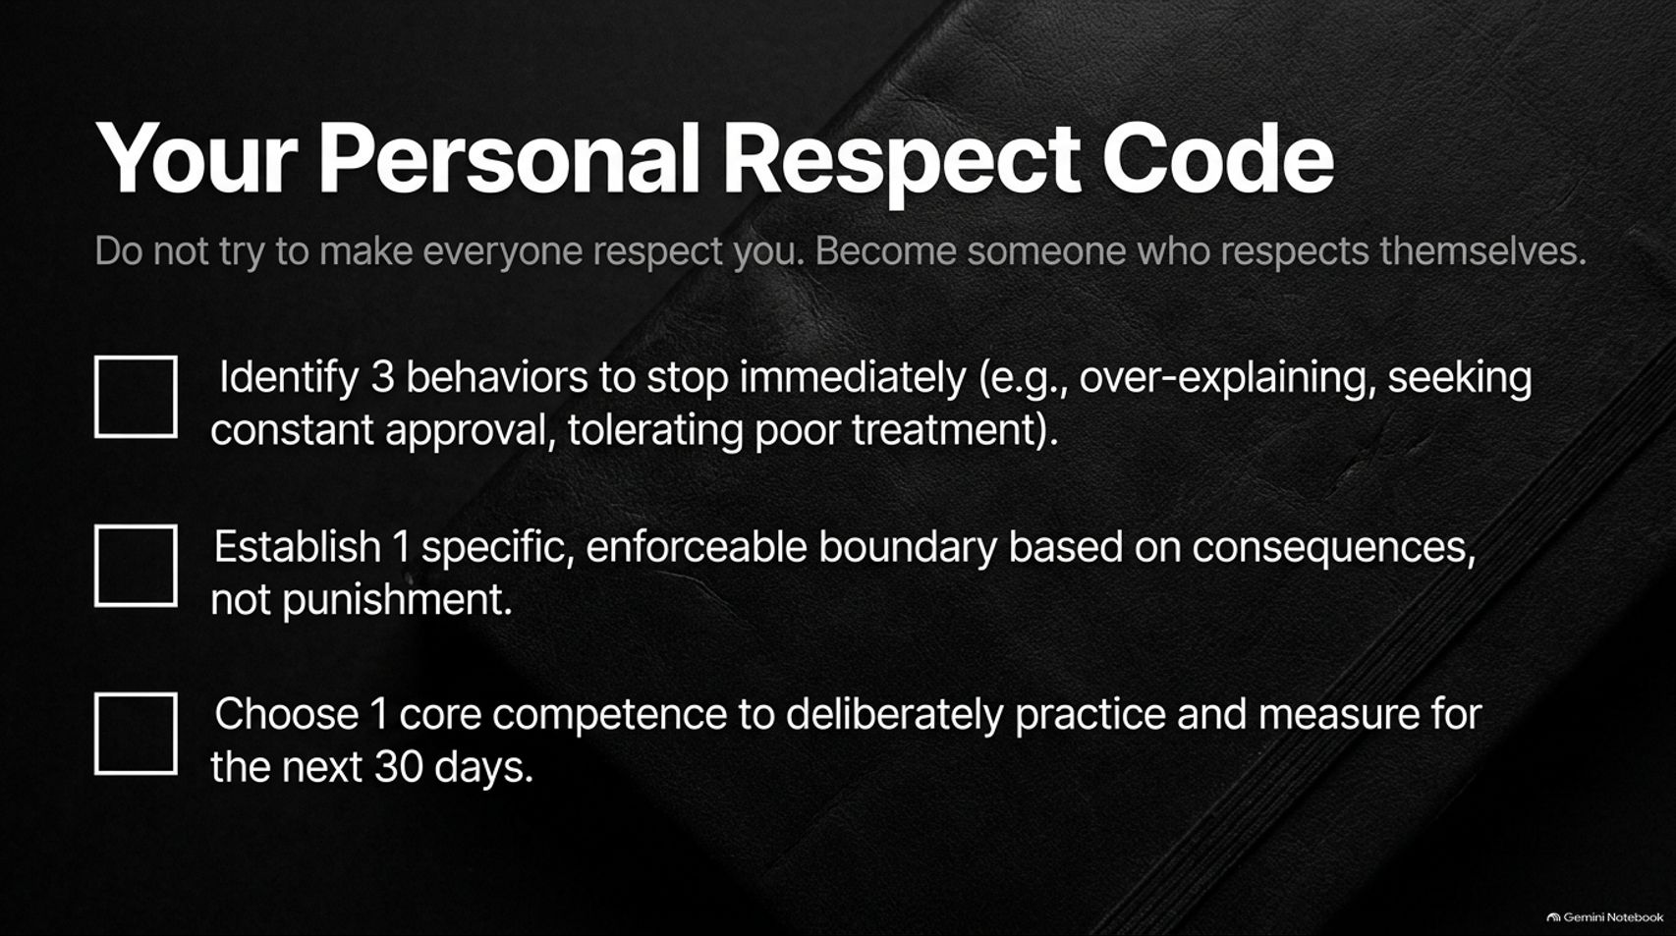
Notes:
Visual: A sleek, practical checklist framed against a dark leather notebook background, outlining three actionable steps to build immediate self-respect.
Speaker Notes (Target: 2–4 minutes):
Theory without application is useless. As we conclude, I want to give you a concrete framework to put into practice today: Your Personal Respect Code.
Do not try to force everyone to respect you. Instead, focus entirely on becoming someone who respects themselves by completing these three checklist items:
Identify 3 habits to stop immediately: (e.g., over-explaining your choices, seeking constant reassurance, or tolerating disrespected boundaries).
Establish 1 specific, enforceable boundary: Define it using calm consequences rather than emotional threats.
Choose 1 core competence: Commit to practicing, measuring, and refining it deliberately over the next 30 days.

Slide 16
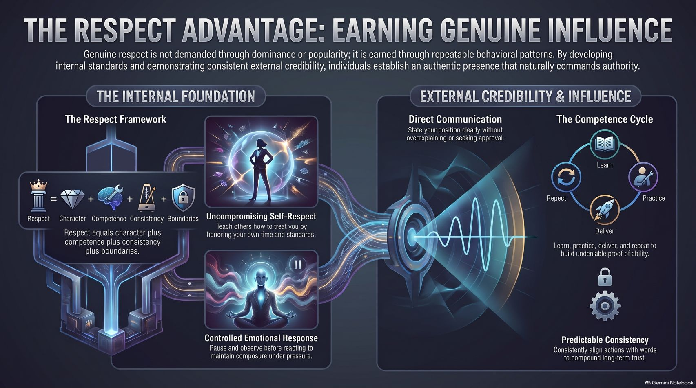
Notes:
Visual: A comprehensive summary diagram capturing the complete architecture: "The Internal Foundation" (Respect Framework, Uncompromising Self-Respect, Controlled Emotional Response) connected to "External Credibility & Influence" (Direct Communication, Competence Cycle, Predictable Consistency).
Speaker Notes (Target: 3–5 minutes):
Here on our final slide, we see the complete visual map of The Respect Advantage.
On the left, we have The Internal Foundation: grounding yourself in character, controlling your emotional responses, and honoring your own standards.
On the right, that internal foundation flows directly into External Credibility: communicating directly without fluff, driving the continuous loop of learning and execution, and building predictable consistency over time.
When you align your internal standards with your external actions, you no longer need to demand respect or resort to aggressive games. Authority and influence will flow to you naturally. Thank you.

