Slide 1
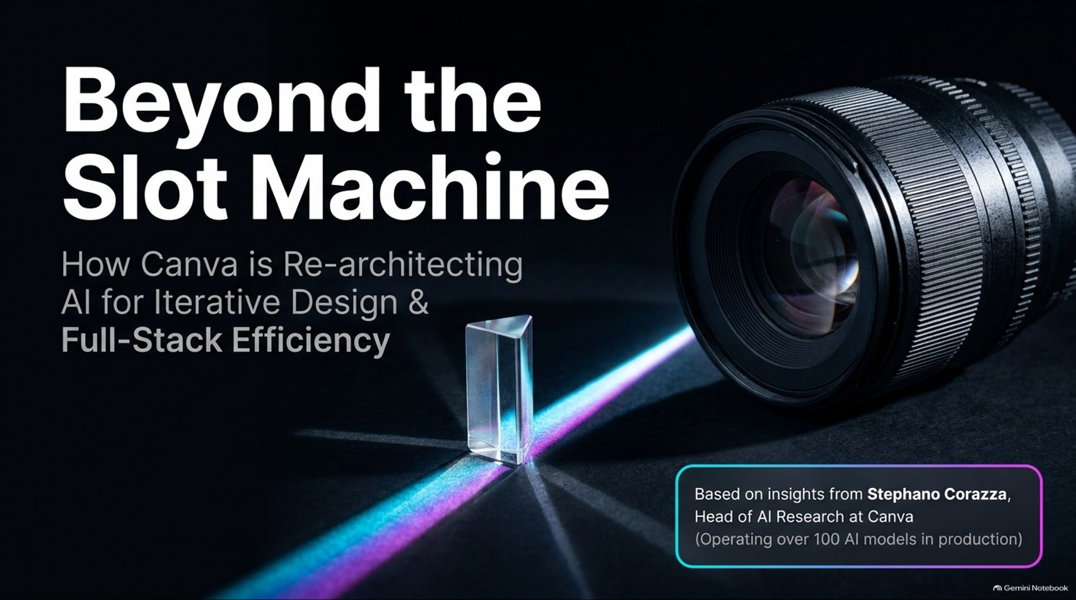
Notes:
Target Time: ~2.5 Minutes (350 words)
Speaker Script
"Good morning, everyone. Today, we’re going to talk about a fundamental shift in how we approach generative AI for visual design.
If you look at the current landscape of AI image generation, most tools operate like a slot machine. You type in a prompt, pull the lever, and hope for a lucky outcome. But professional design doesn't work on luck; it requires precision, intent, and above all, predictability.
In this deck, we are exploring how Canva is re-architecting AI to move away from single-shot slot machines toward systems designed specifically for iterative design and full-stack efficiency.
The insights in this presentation are grounded directly in the work of Stephano Corazza, Head of AI Research at Canva. Under his leadership, Canva’s AI research team operates over 100 AI models in production. They are tackling a core problem: how do we transition generative AI from an unpredictable gimmick into a fast, controllable, and economically viable creative partner?
Throughout this talk, we’ll dive into how Canva approaches model size, architectural design with two-stage pipelines, layout controllability, and full-stack hardware and kernel optimization to lower inference costs to near-zero. Let's examine why the old paradigm of 'Prompt and Pray' is officially coming to an end."
AI Design Still Feels Like a Slot Machine
https://www.youtube.com/watch?v=heE80uxOmus

Slide 2
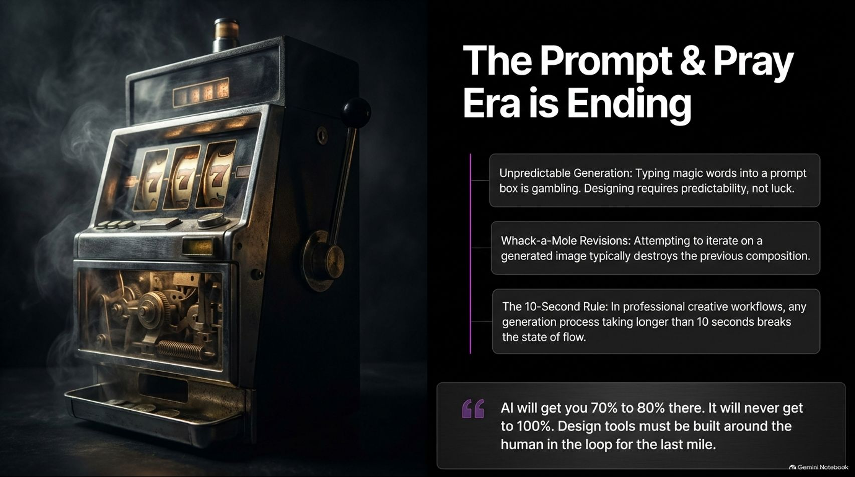
Notes:
Target Time: ~3.5 Minutes (500 words)
Speaker Script
"Let's break down the reality of single-shot generation as it exists today. We call this the 'Prompt & Pray' era.
First, Unpredictable Generation. Typing magic words into a prompt box is gambling. When a designer is building a brand asset or a corporate pitch deck, they aren't looking for a surprise roll of the dice; they need consistent composition, exact brand colors, and structured spatial layout.
Second, Whack-a-Mole Revisions. Have you ever tried asking a standard diffusion model to move an object 'two inches to the right'? In traditional pixel-generation pipelines, modifying a small detail destroys the entire rest of the image. You fix one element, and three other elements hallucinate or change completely.
Third, The 10-Second Rule. In creative workflows, latency kills flow state. Stephano Corazza points out a rule borrowed from game development: if an action takes longer than 10 seconds, it completely breaks the user’s creative flow. Early AI pioneers were willing to wait 60 seconds for a magic image, but for everyday professional workflows, waiting minutes for every minor tweak is unviable.
As Stephano emphasizes: 'AI will get you 70% to 80% there. It will never get to 100%. Design tools must be built around the human in the loop for the last mile.'
Until we have telepathic helmets that transfer 100% of human creative intent, design software must be engineered around rapid, controllable iteration for that final 20% to 30%."

Slide 3
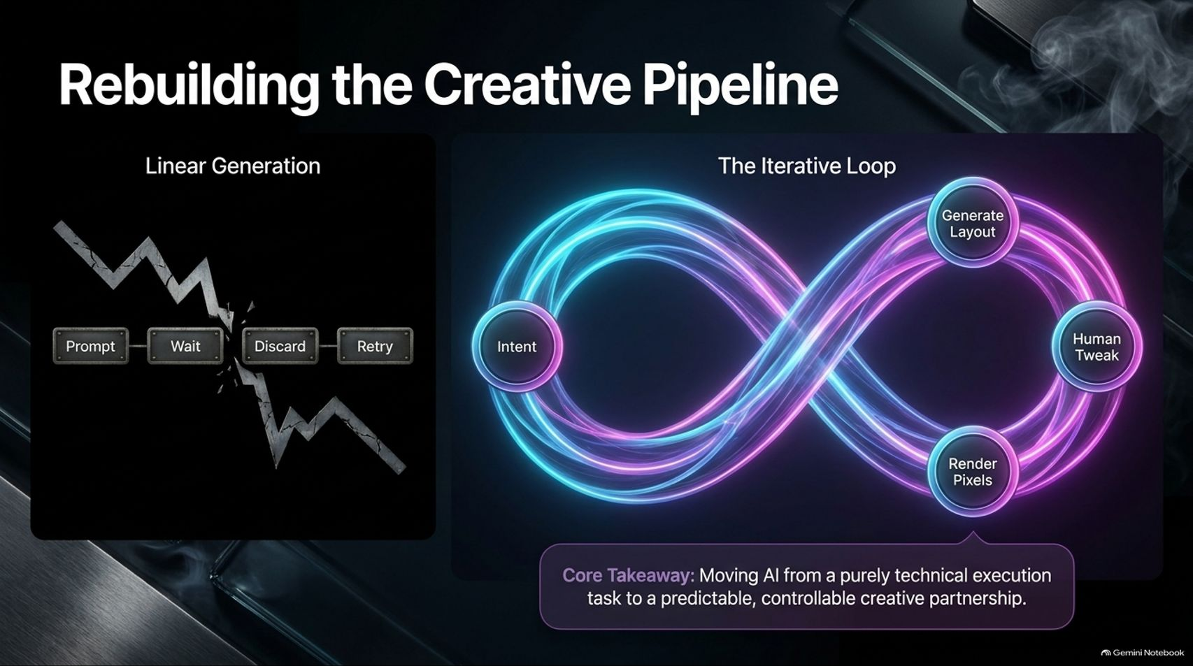
Notes:
Target Time: ~3 Minutes (420 words)
Speaker Script
"To solve the slot machine problem, we have to completely rebuild the underlying creative pipeline.
On the left side of this slide, you see the traditional Linear Generation process. You input a prompt, wait for rendering, look at a flat pixel block, realize it's off by 10%, discard it, and retry. This brittle chain throws away valuable context and data at every step, wasting both compute and human time.
On the right, we introduce The Iterative Loop. Instead of jumping straight from user intent to final pixels, we decouple the process into separate phases:
Expressing Intent.
Generating Layout as a structured scene blueprint.
Enabling Human Tweaks non-destructively on that blueprint.
Rendering Pixels only when ready.
Moving AI from a purely technical execution task to a predictable creative partnership requires bringing human interaction into the process before final pixel rendering occurs. This structural shift guarantees non-destructive control and preserves layout context throughout the design process."

Slide 4
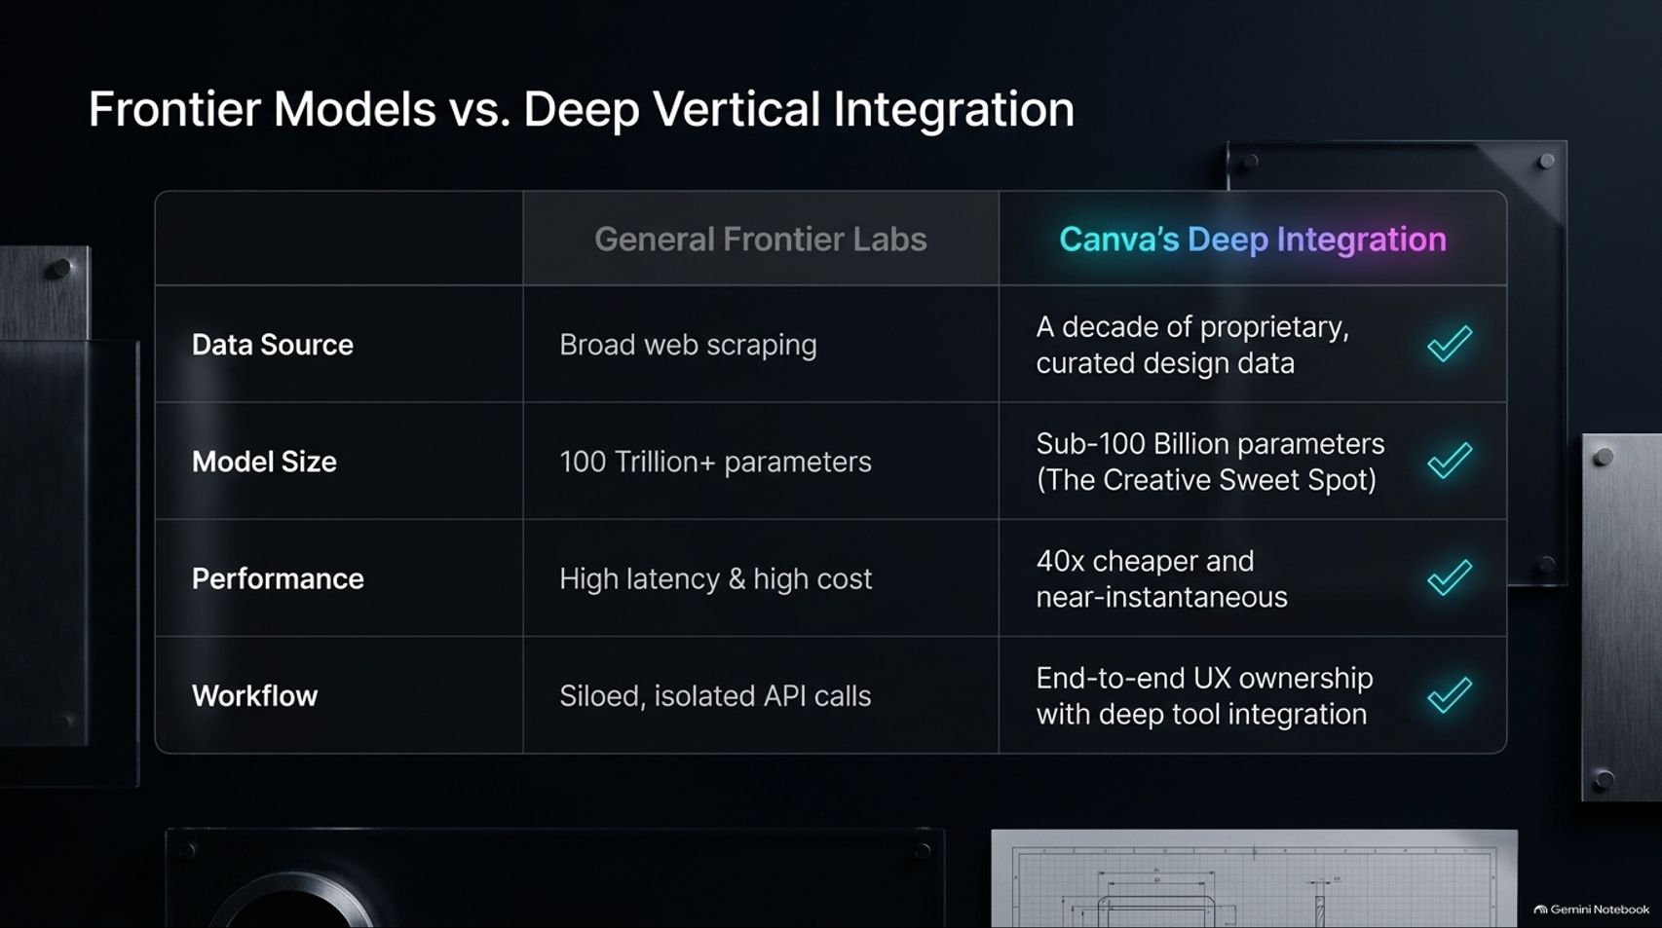
Notes:
Target Time: ~4 Minutes (580 words)
Speaker Script
"There is a prevalent belief in Silicon Valley that the solution to every AI challenge is simply building a bigger general frontier model. But when you compare General Frontier Labs to Canva's Deep Vertical Integration, the advantages of domain-specific architecture become clear:
Data Source: General frontier labs rely on broad web scraping. Canva leverages over a decade of proprietary, curated design data, licensed assets, and user-permitted creative templates.
Model Size: Frontier labs build models with hundreds of billions or trillions of parameters. Canva focuses on sub-100 Billion parameter models, finding this to be the creative 'sweet spot' for design tasks.
Performance: Frontier APIs carry high latency and cost per call. Canva's vertically integrated stack delivers results 40x cheaper and near-instantaneously.
Workflow: Instead of isolated API calls returning flat static images, Canva owns the end-to-end UX, integrating model outputs directly into editable document canvases.
By fine-tuning sub-100B parameter models on clean, domain-specific design data, a specialized architecture can match or exceed the design quality of frontier models at a fraction of the cost and latency."

Slide 5
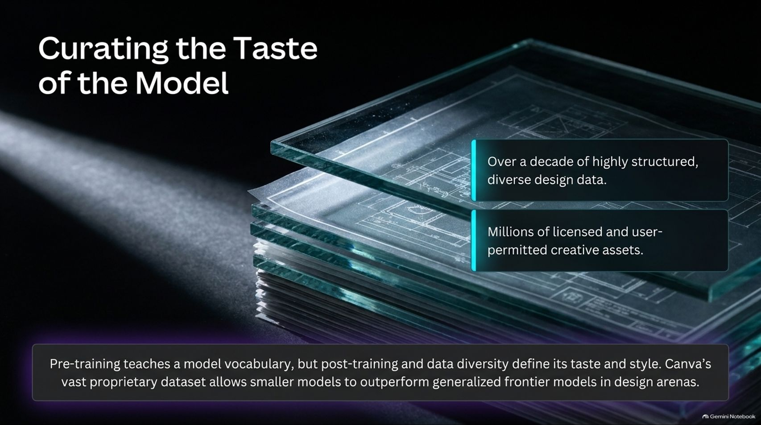
Notes:
Target Time: ~3.5 Minutes (480 words)
Speaker Script
"Data quality dictates model performance.
Pre-training teaches a model vocabulary and syntax, but post-training, reinforcement learning, and data curation define its taste and aesthetic style.
Canva’s dataset is built on over ten years of highly structured design data and millions of licensed, high-quality creative assets. This structural advantage allows Canva’s smaller models to outperform broad web-scraped foundation models in design arenas.
Stephano notes an insightful analogy regarding human development: pre-training is like teaching a child a broad vocabulary. But learning many words doesn't automatically make someone a great stand-up comedian or professional graphic designer. The style, delivery, and judgment come from curated post-training and high-quality exposure."

Slide 6
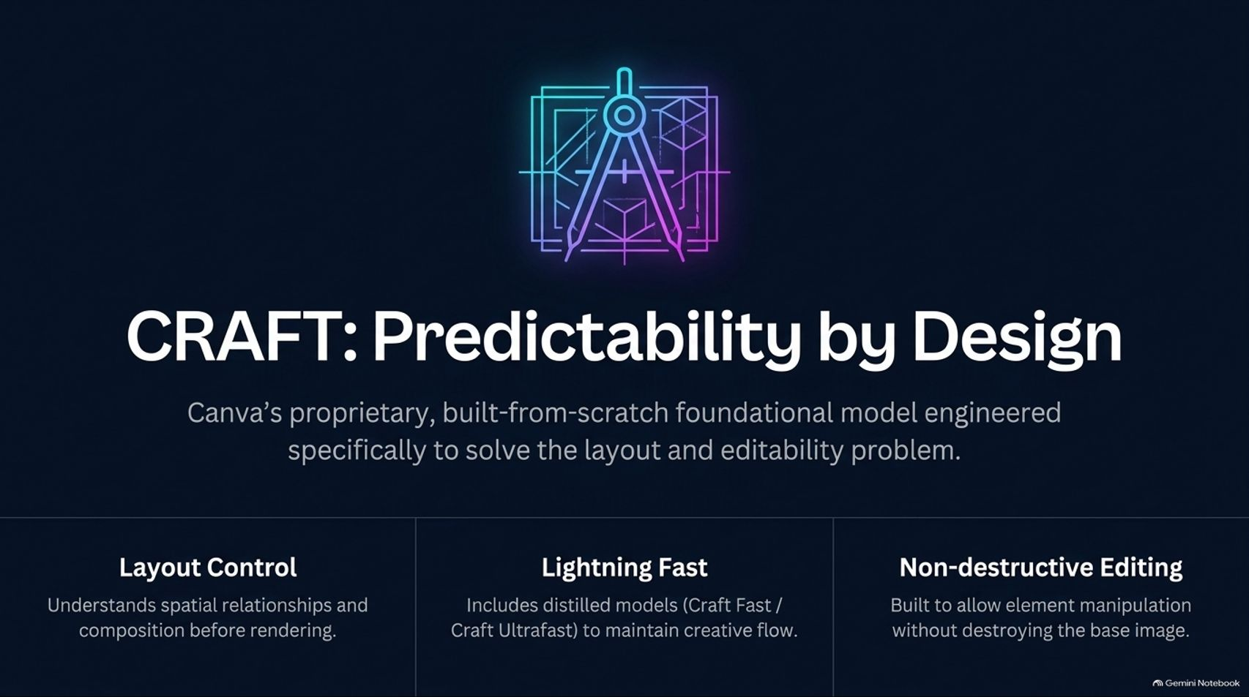
Notes:
Target Time: ~3.5 Minutes (500 words)
Speaker Script
"To operationalize these principles, Canva engineered CRAFT—a proprietary foundational image generation model built from scratch specifically to solve the layout and editability problem.
Instead of adapting an off-the-shelf public model, CRAFT was built around three core pillars:
Layout Control: CRAFT separates spatial planning from pixel synthesis, understanding bounding boxes and compositions before generating pixels.
Lightning Fast: CRAFT includes distilled variants (like Craft Fast and Craft Ultrafast) to keep generation speeds well within the 10-second flow-state threshold.
Non-destructive Editing: Elements can be resized, rotated, or repositioned without corrupting the surrounding image composition."

Slide 7
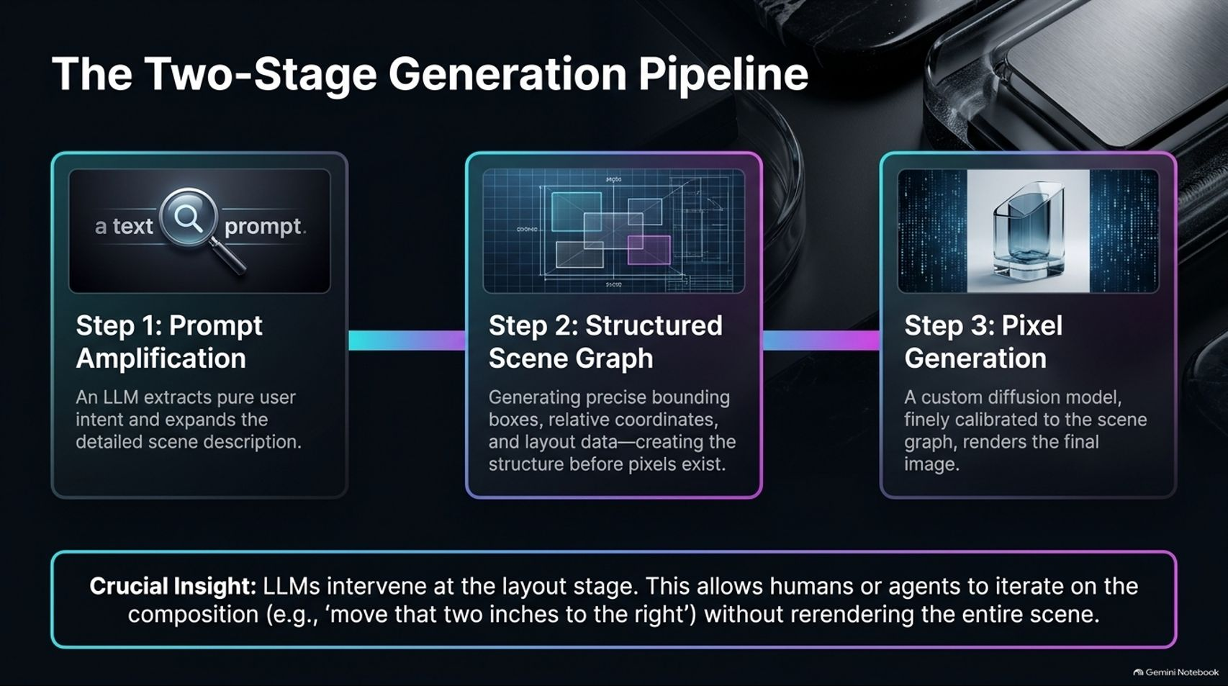
Notes:
Target Time: ~4.5 Minutes (650 words)
Speaker Script
"Let's look at the mechanics of how CRAFT generates a visual layout:
Step 1: Prompt Amplification. An LLM takes the raw human prompt, extracts intent, and expands it into a highly detailed scene description.
Step 2: Structured Scene Graph. The system constructs a structured scene graph containing precise bounding boxes, relative coordinates, layer ordering, and spatial layout data—all before pixels are created.
Step 3: Pixel Generation. A custom diffusion model, calibrated specifically to the scene graph, renders the final pixel canvas.
Crucial Insight: Because the LLM structures the layout at Stage 2, designers can edit spatial properties (e.g., 'move the header text two inches right') directly on the scene graph. The system updates the layout without having to re-prompt or rerender the entire scene from scratch."

Slide 8
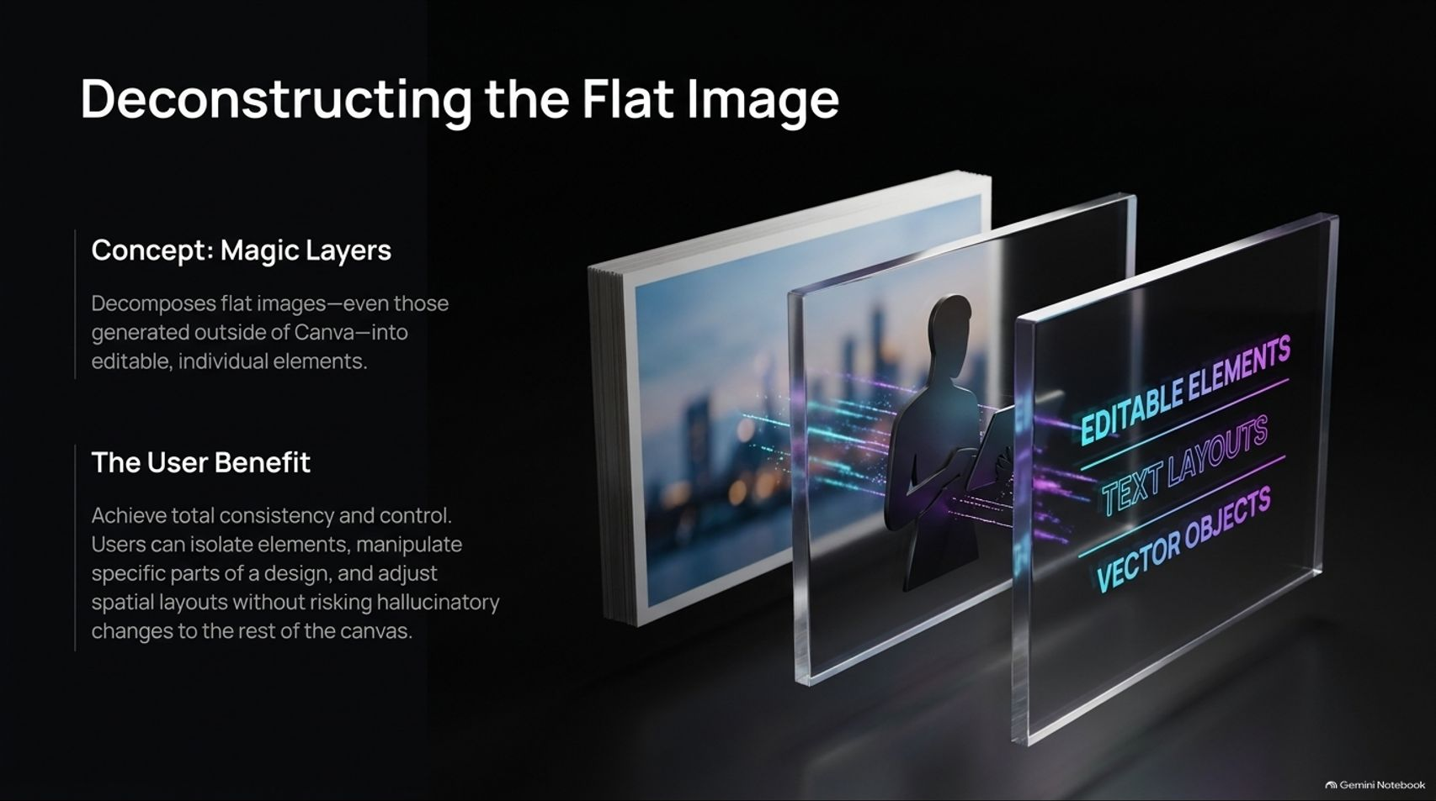
Notes:
Target Time: ~3 Minutes (420 words)
Speaker Script
"A key innovation supporting this pipeline is Magic Layers.
Magic Layers takes flat, single-layer images—including images generated outside of Canva—and automatically decomposes them into distinct, editable vector, text, and graphic layers.
This gives users full spatial control. Designers can isolate subject elements, adjust background typography, and swap components without triggering unintended visual artifacts or hallucinating changes across the canvas."

Slide 9
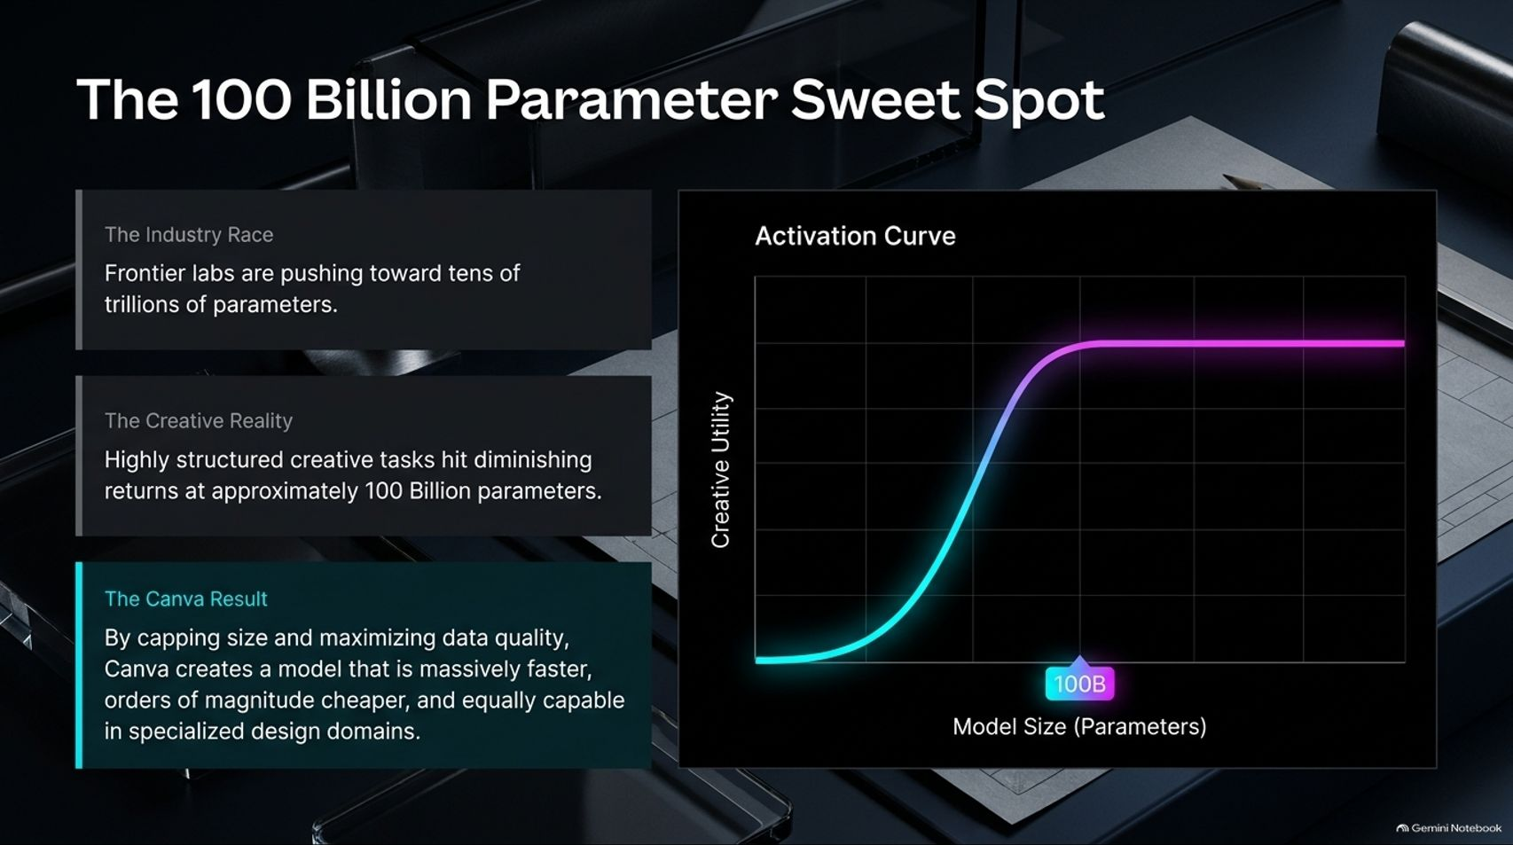
Notes:
Target Time: ~3.5 Minutes (510 words)
Speaker Script
"While frontier labs race toward multi-trillion parameter models, empirical testing demonstrates diminishing returns for specialized visual design tasks past 100 Billion parameters.
As illustrated by the activation curve on this slide, creative utility hits a plateau around 100B parameters. By capping model size at this threshold and focusing engineering efforts on data quality and full-stack hardware efficiency, Canva delivers near-instantaneous inference at a fraction of standard API operational costs."

Slide 10
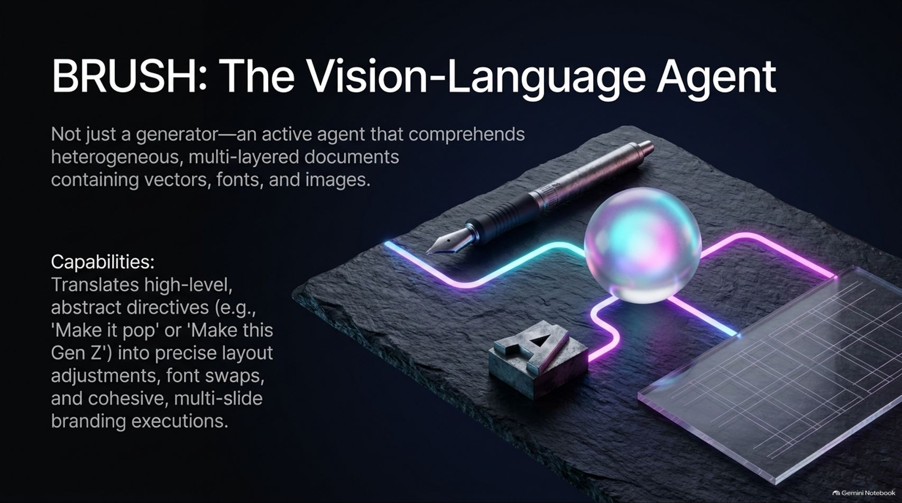
Notes:
Target Time: ~4 Minutes (560 words)
Speaker Script
"Alongside CRAFT, Canva introduced BRUSH, a specialized Vision-Language Agent.
BRUSH isn't just an image generator; it is an active design agent capable of inspecting and manipulating complex, multi-layered document structures consisting of vectors, typography, and images.
BRUSH translates high-level, abstract human feedback (such as 'Make this deck look more professional' or 'Adapt this for a Gen Z audience') into precise layout adjustments, font updates, and brand-compliant visual themes across multi-slide presentations."

Slide 11
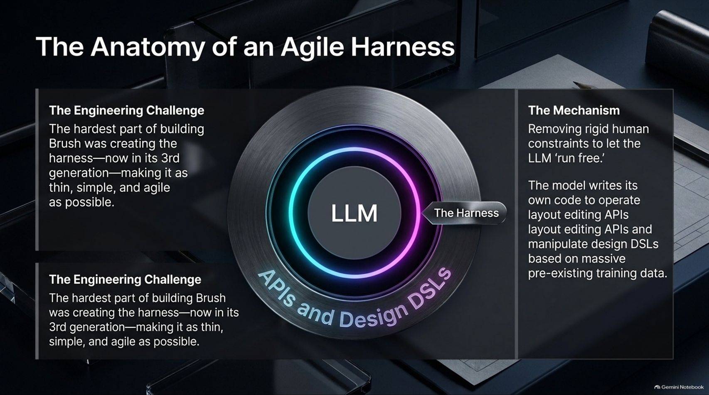
Notes:
Target Time: ~4 Minutes (580 words)
Speaker Script
"Building an effective agent like BRUSH requires an agile agent harness. Stephano Corazza notes that developing this harness—now in its third generation—was one of the most challenging engineering tasks his team faced.
Rather than wrapping the model in rigid, hardcoded rules, Canva designed a thin, flexible harness that allows the LLM to execute layout APIs and design Domain Specific Languages (DSLs) directly.
By aligning the harness with standard code generation patterns, the agent operates natively within established programming primitives, increasing reliability and execution speed."

Slide 12
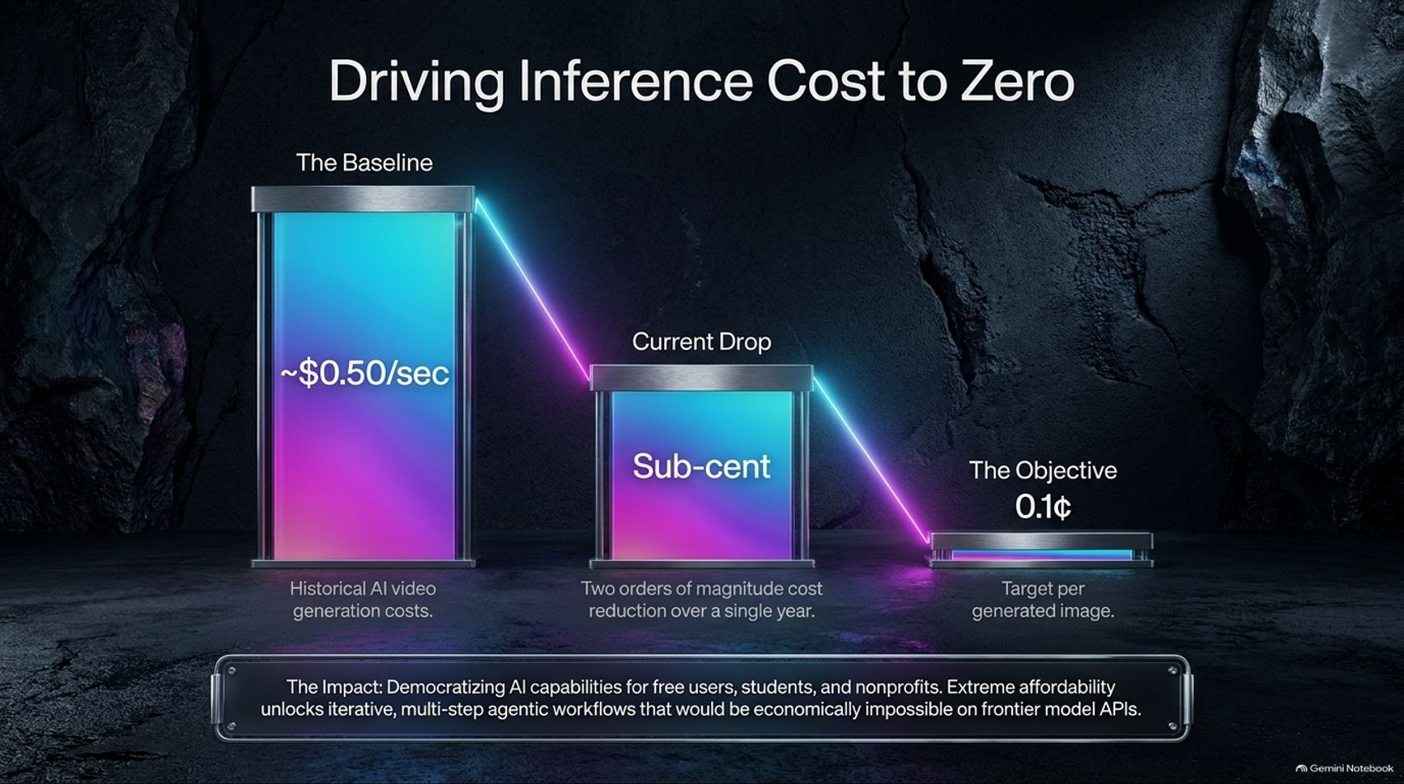
Notes:
Target Time: ~3.5 Minutes (490 words)
Speaker Script
"Lowering inference costs is essential for democratizing AI features.
Historically, AI video and complex image generation cost around $0.50 per second of generated content. Through kernel tuning, distillation, and optimized model serving, Canva reduced generation costs by two orders of magnitude into the sub-cent range, with a target cost of 0.1¢ per generation.
Extreme affordability enables multi-step agentic workflows and keeps advanced AI tools accessible to free users, students, and non-profits."

Slide 13
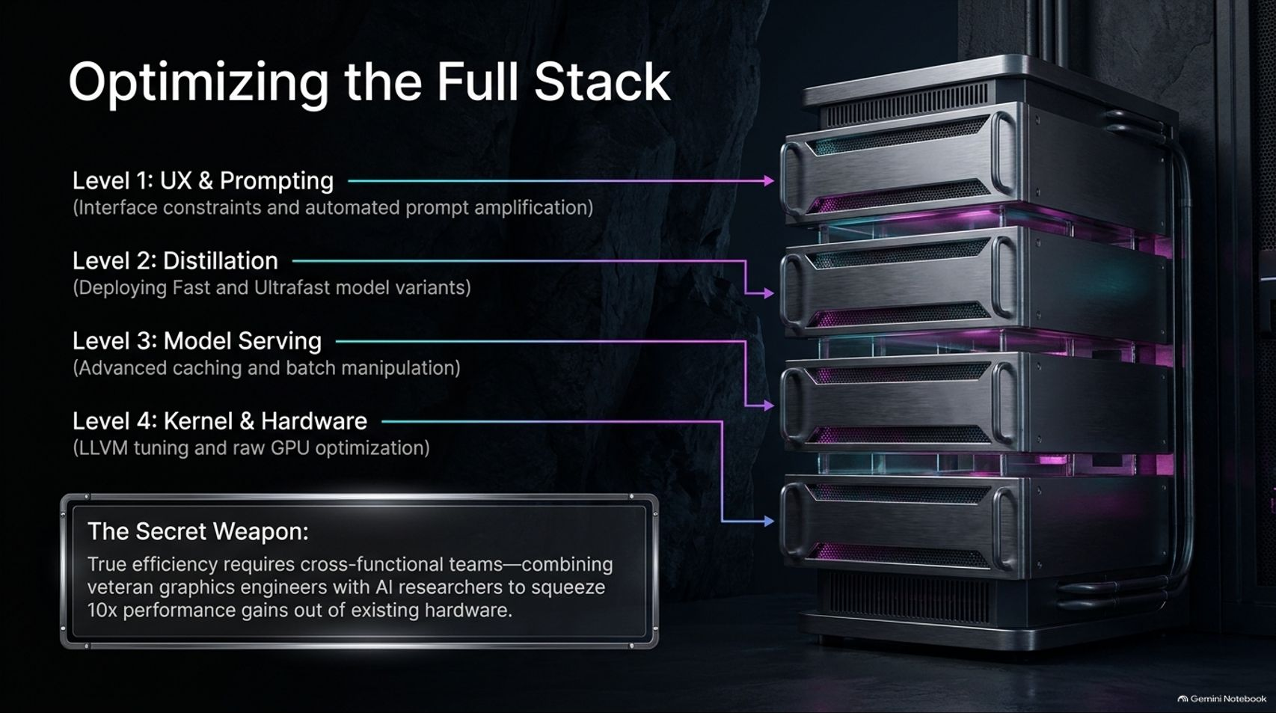
Notes:
Target Time: ~4.5 Minutes (630 words)
Speaker Script
"Achieving these cost and latency targets requires optimizing across all four levels of the tech stack:
Level 1 (UX & Prompting): Automated prompt amplification and UI layout constraints.
Level 2 (Distillation): Training smaller, faster model variants like Craft Fast and Craft Ultrafast.
Level 3 (Model Serving): Efficient GPU batching, memory management, and caching layers.
Level 4 (Kernel & Hardware): Low-level LLVM compiler tuning and GPU hardware acceleration.
Cross-functional collaboration between AI researchers and systems engineers allows organizations to maximize performance output from existing hardware infrastructure."

Slide 14
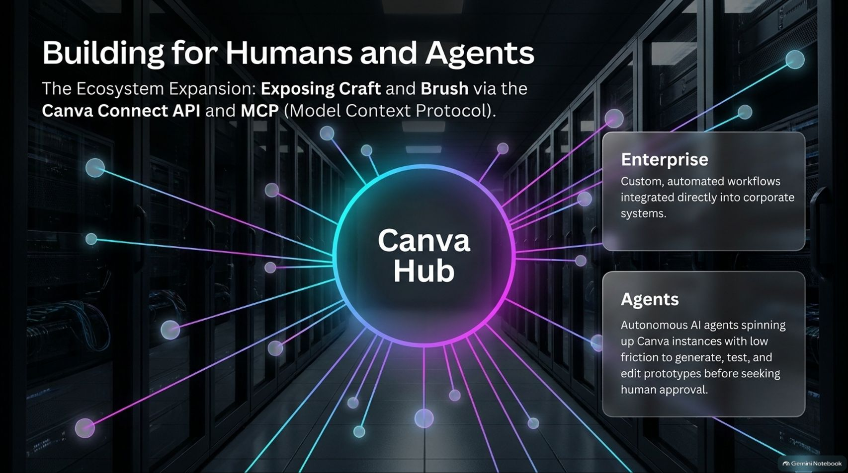
Notes:
Target Time: ~3.5 Minutes (480 words)
Speaker Script
"Canva is expanding its ecosystem architecture to support both human creators and autonomous AI agents via the Canva Connect API and MCP (Model Context Protocol) integration.
Enterprise Integration: Enterprise clients can connect Canva's layout and generation capabilities directly into internal brand and marketing automation pipelines.
Agentic Workflows: External AI agents can use low-friction MCP interfaces to generate, test, and revise design prototypes automatically before submitting them for human review."

Slide 15
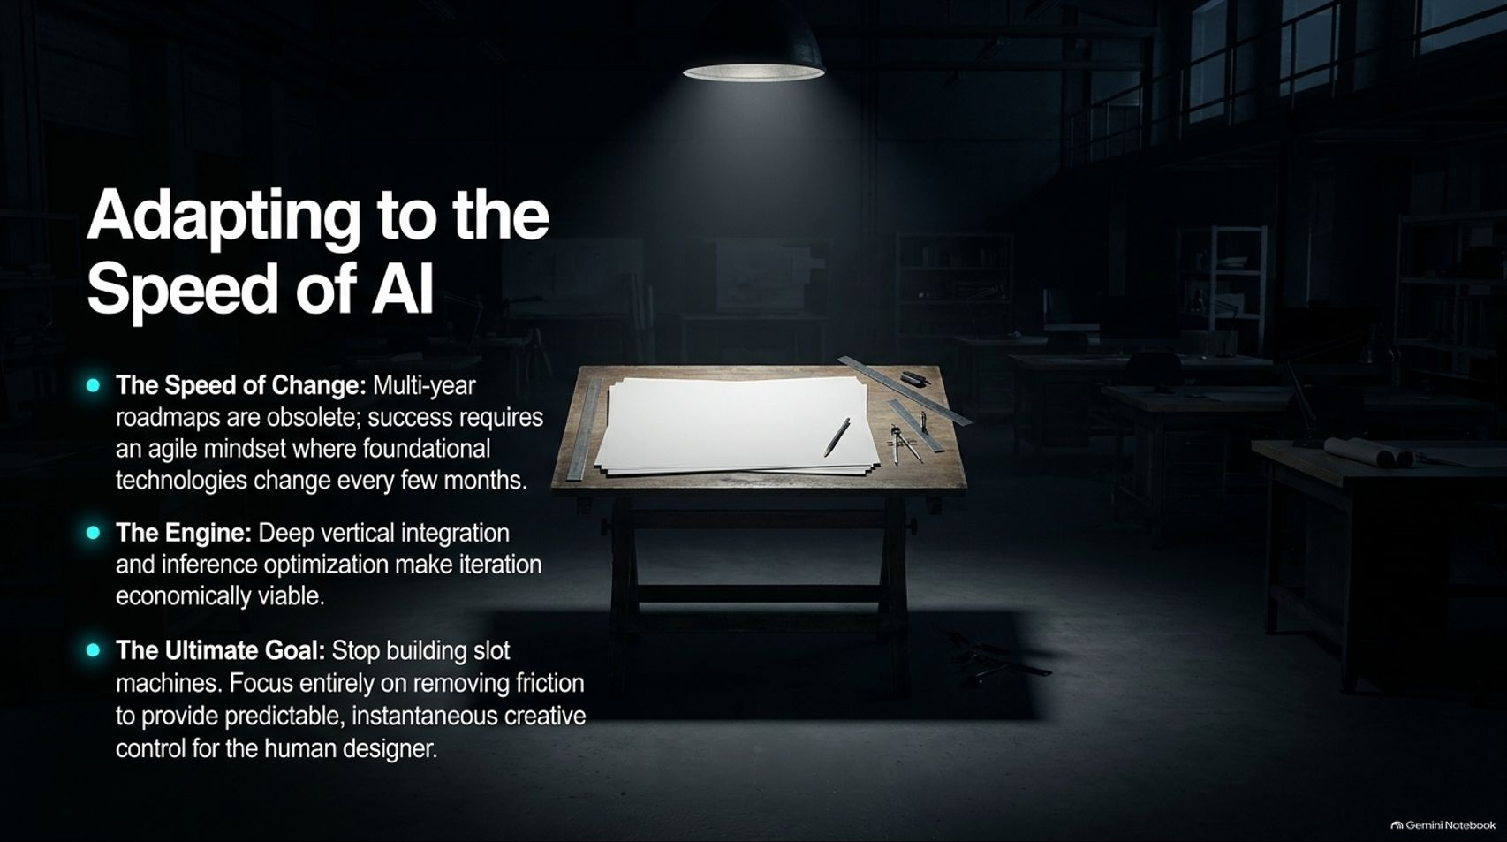
Notes:
Target Time: ~3.5 Minutes (500 words)
Speaker Script
"Operating in modern AI research requires a fundamental shift in planning and strategy.
Multi-year technology roadmaps are largely obsolete when core capabilities evolve every few months. Success depends on maintaining an agile development mindset.
By pairing deep vertical stack integration with ultra-low inference costs, design tools can move away from unpredictable slot machines and deliver fast, controllable creative environments for human creators."

Slide 16
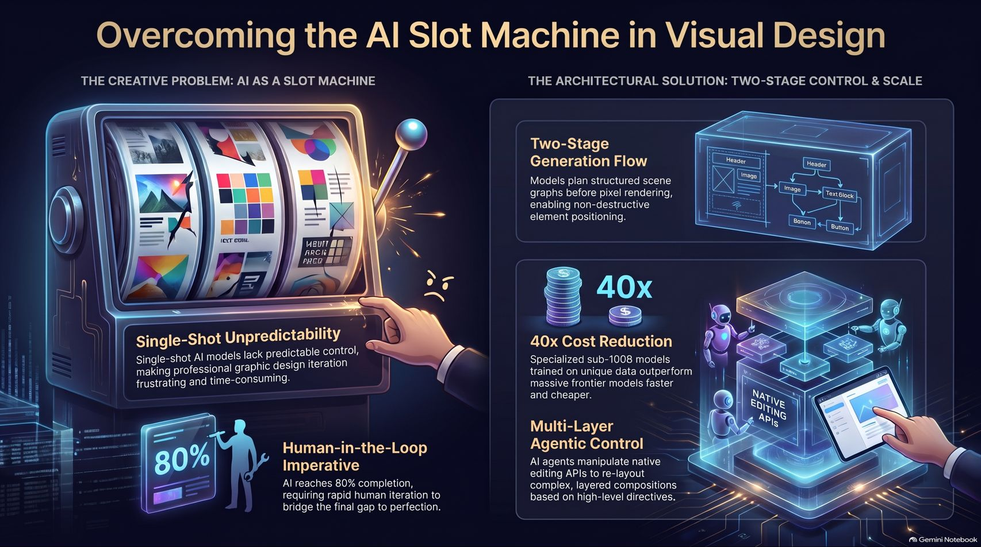
Notes:
Target Time: ~4.5 Minutes (620 words)
Speaker Script
"To conclude, let's summarize the core contrast highlighted in today's deck:
On the left, the Slot Machine Problem: single-shot generation models lack layout predictability, leading to frustrating 'whack-a-mole' revisions. Because AI models complete roughly 80% of a creative task, software must be designed around human-in-the-loop iteration for the remaining 20%.
On the right, The Architectural Solution:
Two-Stage Generation Flow: Decoupling structured scene graphs from pixel rendering to enable non-destructive editing.
40x Cost & Latency Reduction: Utilizing sub-100B parameter models optimized on domain-specific design data.
Multi-Layer Agentic Control: Empowering vision-language agents to modify structured design layouts through native editing APIs.
By focusing on predictable control, high-speed execution, and deep vertical integration, we can build generative AI tools that truly support the creative process. Thank you!"

