Slide 1
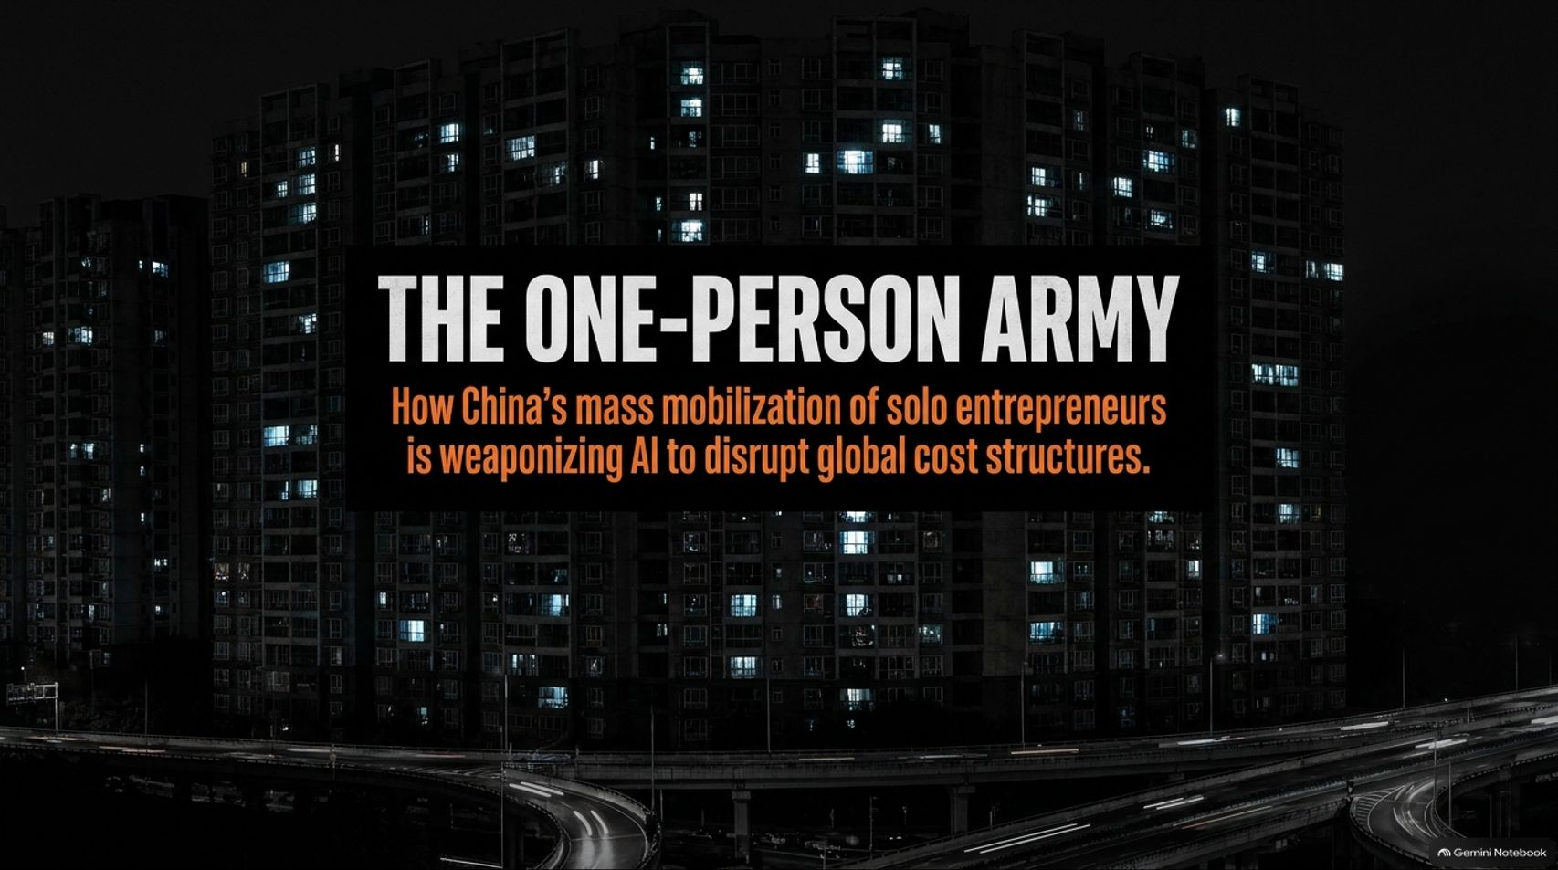
Notes:
Target Time: ~2.5 Minutes (350 words)
Speaker Script
"Good morning, everyone. Today, we are examining a profound shift in the global economic landscape—one driven not by multi-trillion-dollar tech monopolies, but by solo entrepreneurs.
Our focus is on 'The One-Person Army': how China's mass mobilization of solo entrepreneurs is weaponizing AI to disrupt global cost structures.
While the West has been fixated on the 'hundred-billion-dollar distraction' of building ever-larger foundational models, a different kind of race is unfolding in the East. Millions of individuals are leveraging cheap AI models, specialized state subsidies, and hyper-dense supply chains to build autonomous, hyper-efficient enterprises.
Over the next few slides, we’ll explore the numbers behind this phenomenon, the structural mechanics of One-Person Companies (OPCs), and what this wave means for established enterprises across Zurich, Berlin, London, and Silicon Valley. Let's dive in."
China’s New AI Army: Millions of One-Person Companies
https://www.youtube.com/watch?v=dnLV3gjalg8

Slide 2
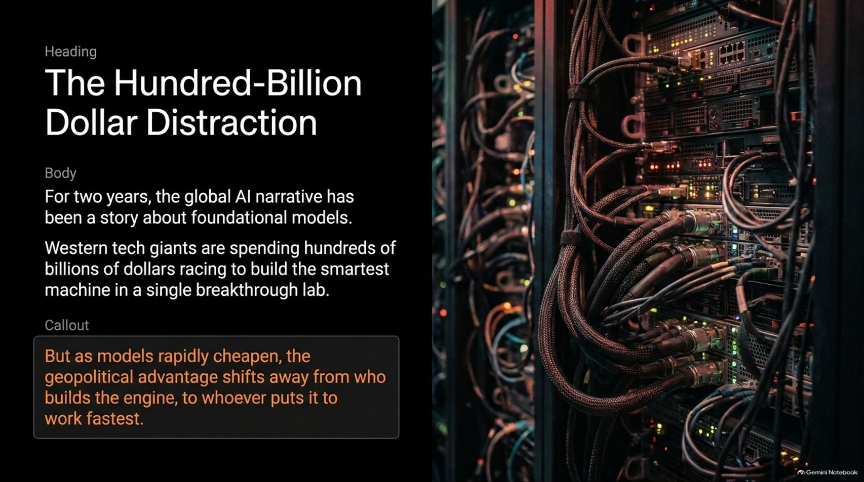
Notes:
Target Time: ~3.5 Minutes (500 words)
Speaker Script
"For the past two years, the global AI narrative has been entirely dominated by foundational models. Western tech giants have spent hundreds of billions of dollars locked in an intense arms race to build the smartest machine within a single breakthrough lab.
But as models rapidly commoditize and costs plummet, the core geopolitical and economic advantage is shifting. The advantage no longer belongs solely to whoever builds the engine, but to whoever puts it to work the fastest.
China recognized this pivot early. Instead of treating AI merely as an R&D trophy, they are treating it as mass infrastructure. When the marginal cost of intelligence drops to pennies, scale is achieved not by hiring thousands of workers, but by empowering single founders with autonomous software agents. This is the foundational premise behind China's new economic strategy."

Slide 3
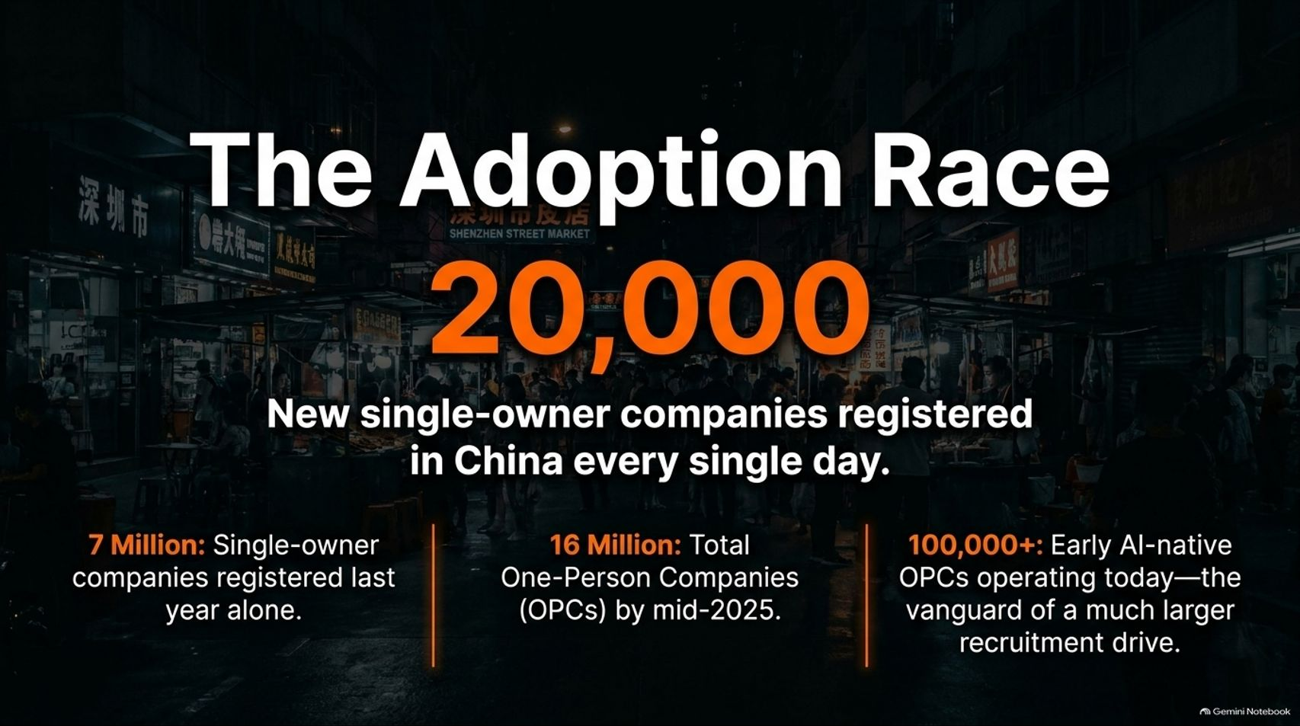
Notes:
Target Time: ~3.5 Minutes (500 words)
Speaker Script
"Let’s look at the raw scale of this mobilization, starting with the numbers.
Last year alone, China registered more than 7 million new single-owner companies—that translates to roughly 20,000 new single-owner registrations every single day. By mid-2025, the total number of One-Person Companies (OPCs) reached 16 million.
Now, to be precise, not every one of these is an advanced AI startup. Many are traditional micro-businesses, consultants, and digital traders. However, industry trackers estimate that over 100,000 are already early AI-native OPCs—representing the vanguard of a much larger national recruitment drive.
When millions of ready-made corporate legal shells meet cheap AI tooling, the velocity of business creation changes entirely."

Slide 4
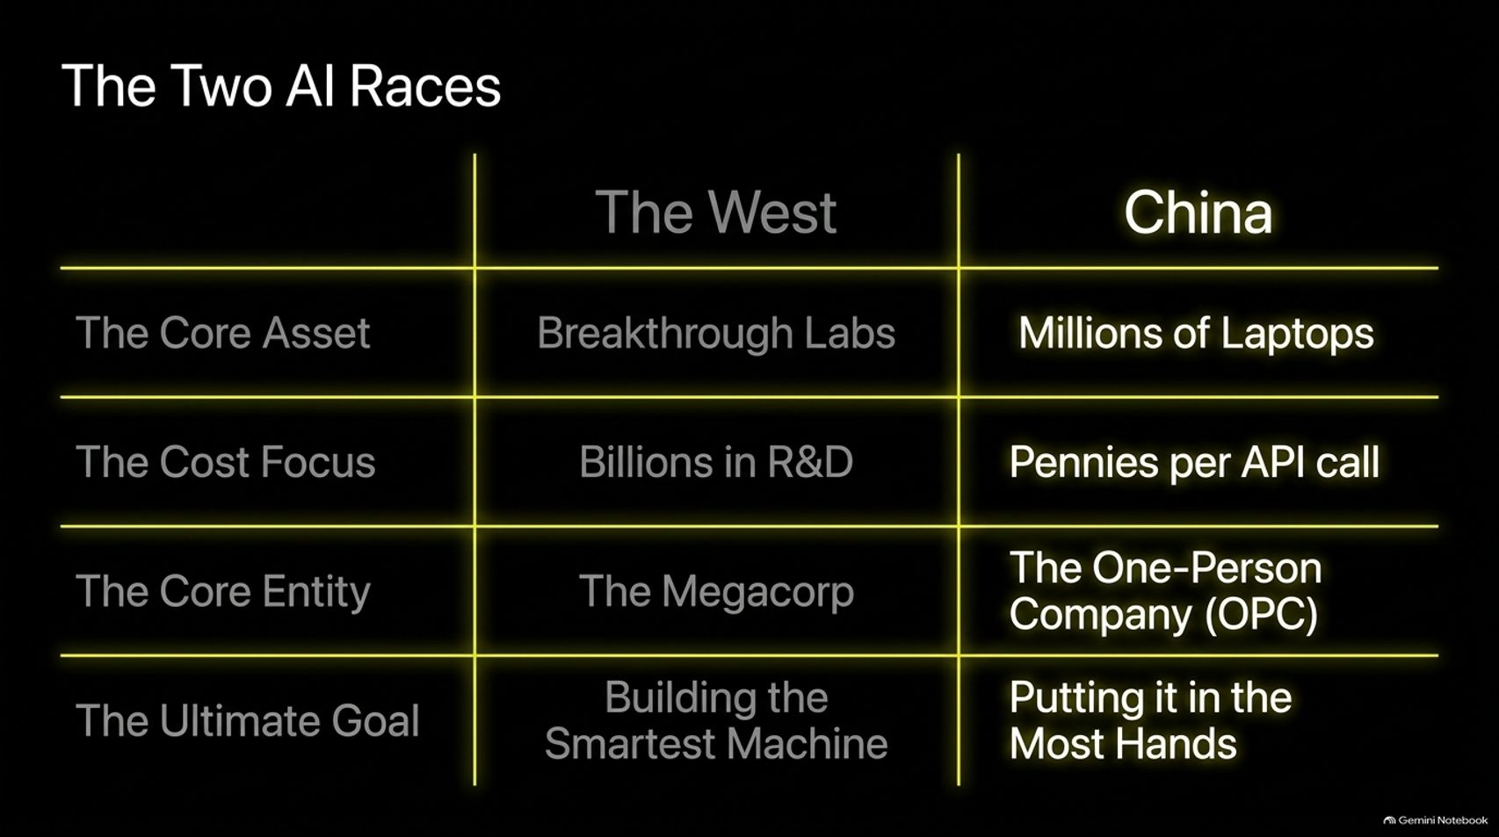
Notes:
Target Time: ~4 Minutes (580 words)
Speaker Script
"To understand this shift, we must contrast The Two AI Races happening globally right now:
The Core Asset: The West relies on elite Breakthrough Labs as its primary asset. China’s core asset is Millions of Laptops distributed across individual hands.
The Cost Focus: Western labs pour Billions in R&D into frontier training. China focuses on driving API costs down to Pennies per API call.
The Core Entity: In the West, the primary vehicle is the Megacorp. In China, it is the One-Person Company (OPC).
The Ultimate Goal: The West aims at Building the Smartest Machine. China’s ultimate goal is Putting AI into the Most Hands.
This structural divergence means that while Western firms compete on raw model intelligence, Chinese solo founders compete on operational speed, localized adaptation, and relentless market experimentation."

Slide 5
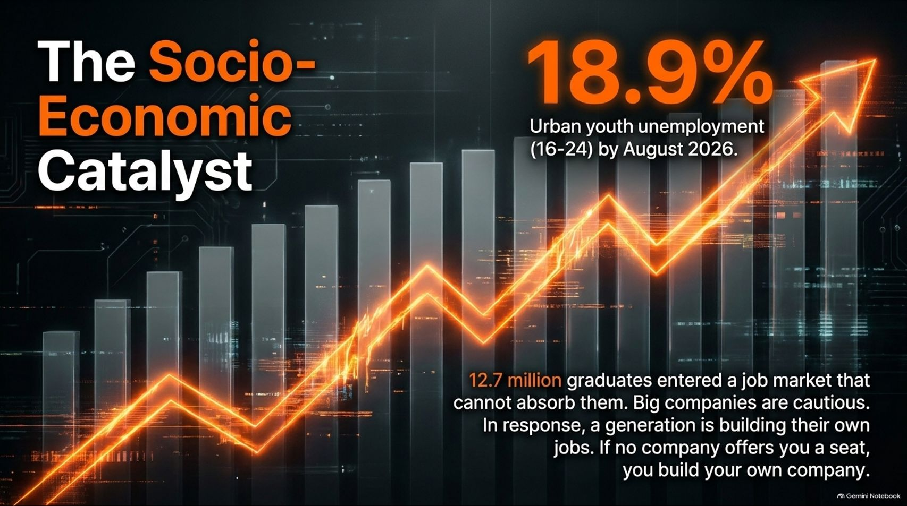
Notes:
Target Time: ~3.5 Minutes (500 words)
Speaker Script
"Every major economic shift has a catalyst, and in China, this mobilization is closely tied to urgent labor market dynamics.
By August 2026, urban youth unemployment (ages 16–24, not in school) reached 18.9%. In the preceding summer, 12.7 million graduates entered a traditional corporate job market that simply could not absorb them. Large enterprises remain cautious and conservative in their hiring.
In response, a generation is building its own jobs. The mindset has shifted: If no corporate employer offers you a seat, you build your own company. Powered by AI, young graduates are bypassing traditional job hunting to launch micro-enterprises on day one."

Slide 6
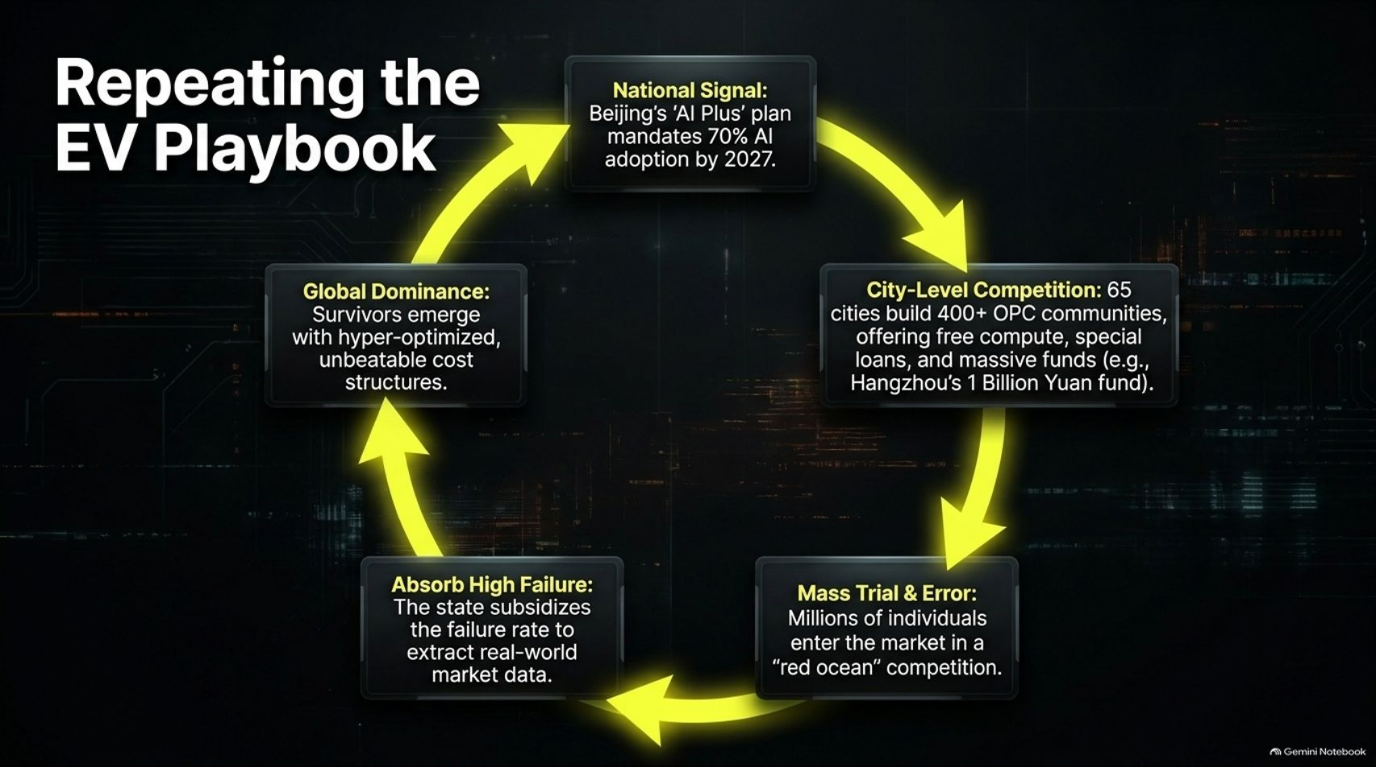
Notes:
Target Time: ~4 Minutes (590 words)
Speaker Script
"If this aggressive state-backed mobilization looks familiar, it’s because Beijing is repeating its successful Electric Vehicle (EV) playbook:
National Signal: The State Council’s 'AI Plus' plan mandates aggressive national AI adoption targets by 2027 and 2030.
City-Level Competition: Over 65 cities have established more than 400 specialized OPC communities, offering free compute, special loans, and massive municipal funds—such as Hangzhou’s 1 Billion Yuan fund.
Mass Trial & Error: Millions of individuals enter the market in intense 'Red Ocean' competition.
Absorb High Failure: Local governments subsidize the failure rate and provide safety nets, extracting real-world market data from every iteration.
Global Dominance: Survivors emerge from the Darwinian process with hyper-optimized, unbeatable cost structures.
Just as this framework disrupted global automotive markets, it is now being applied to software, hardware prototyping, and digital services."

Slide 7
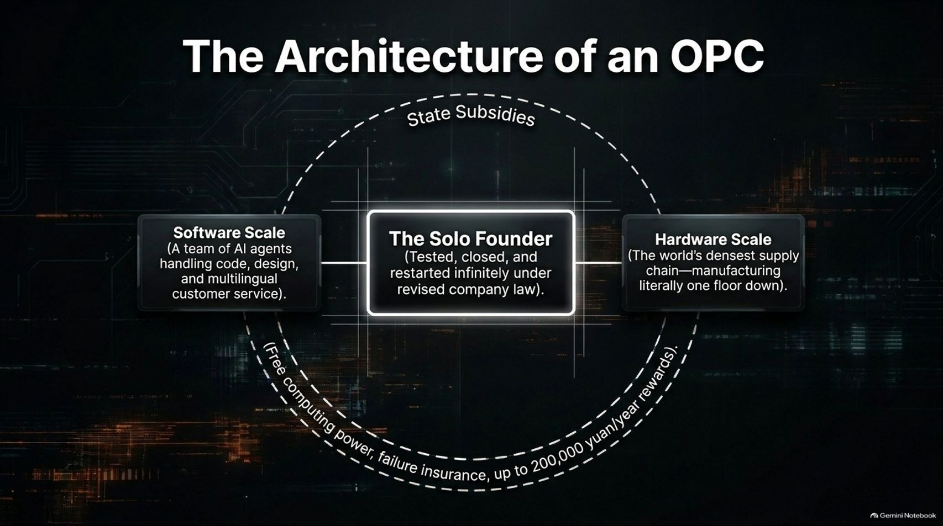
Notes:
Target Time: ~4 Minutes (580 words)
Speaker Script
"What does the internal architecture of a One-Person Company actually look like in practice?
At the center is The Solo Founder. Thanks to revisions in company law—such as the lifting of restrictions that previously limited a founder to a single corporate entity—founders can spin up, test, close, and restart companies infinitely and agilely.
Flanking the founder are two vital pillars:
Software Scale: A coordinated team of AI agents handling software code generation, graphic design, and multilingual customer service.
Hardware Scale: Direct proximity to the world’s densest manufacturing supply chain.
All of this operates within a supportive macro environment backed by state subsidies, free computing power, failure insurance, and municipal grants up to 200,000 yuan per year."

Slide 8
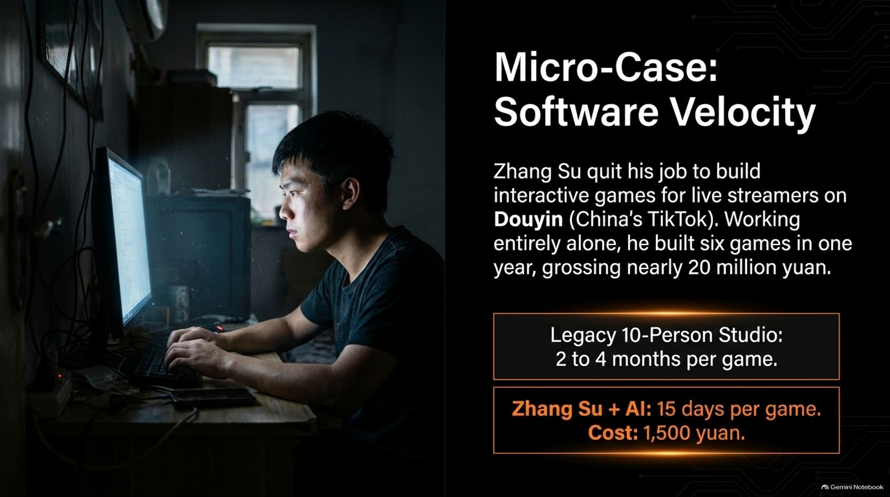
Notes:
Target Time: ~3.5 Minutes (480 words)
Speaker Script
"Let’s look at a micro-case of software velocity: Zhang Su.
After leaving his corporate job, Zhang Su began building interactive games for live streamers on Douyn (China’s TikTok)—working entirely alone. In a single year, he built six complete games, grossing nearly 20 million yuan.
Compare the metrics:
A legacy 10-person studio typically takes 2 to 4 months to develop a single game.
Zhang Su, leveraging AI agents, delivered each game in just 15 days at a production cost of around 1,500 yuan.
This kind of hyper-compressed development cycle shatters traditional enterprise productivity benchmarks."

Slide 9
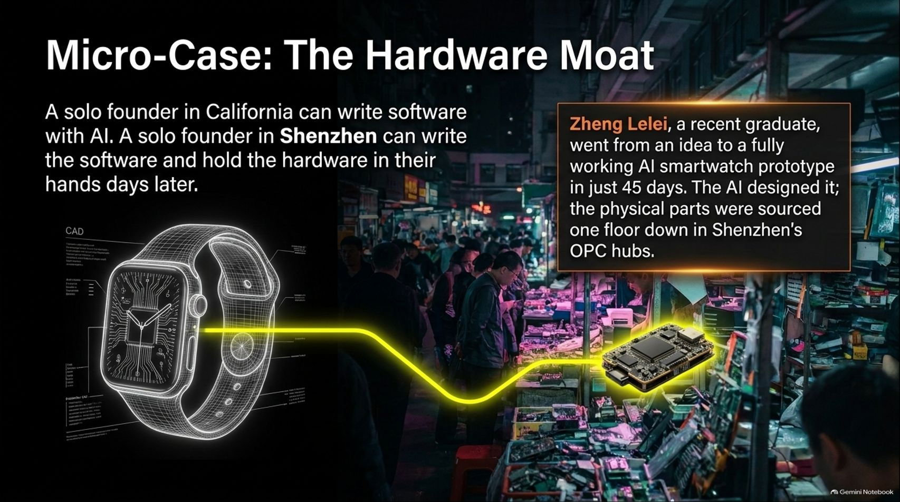
Notes:
Target Time: ~3.5 Minutes (500 words)
Speaker Script
"Software is only part of the equation. Consider the hardware moat available in manufacturing hubs like Shenzhen.
As the adage goes: A solo founder in California can write software with AI. A solo founder in Shenzhen can write the software and hold the physical hardware in their hands days later.
Take Zheng Lelei, a recent graduate who went from an initial concept to a fully working AI smartwatch prototype in just 45 days. The AI designed the firmware and circuit layout; the physical components were sourced literally one floor down in Shenzhen's specialized maker hubs. This co-location of digital software creation and physical supply chain manufacturing is a distinct structural advantage."

Slide 10
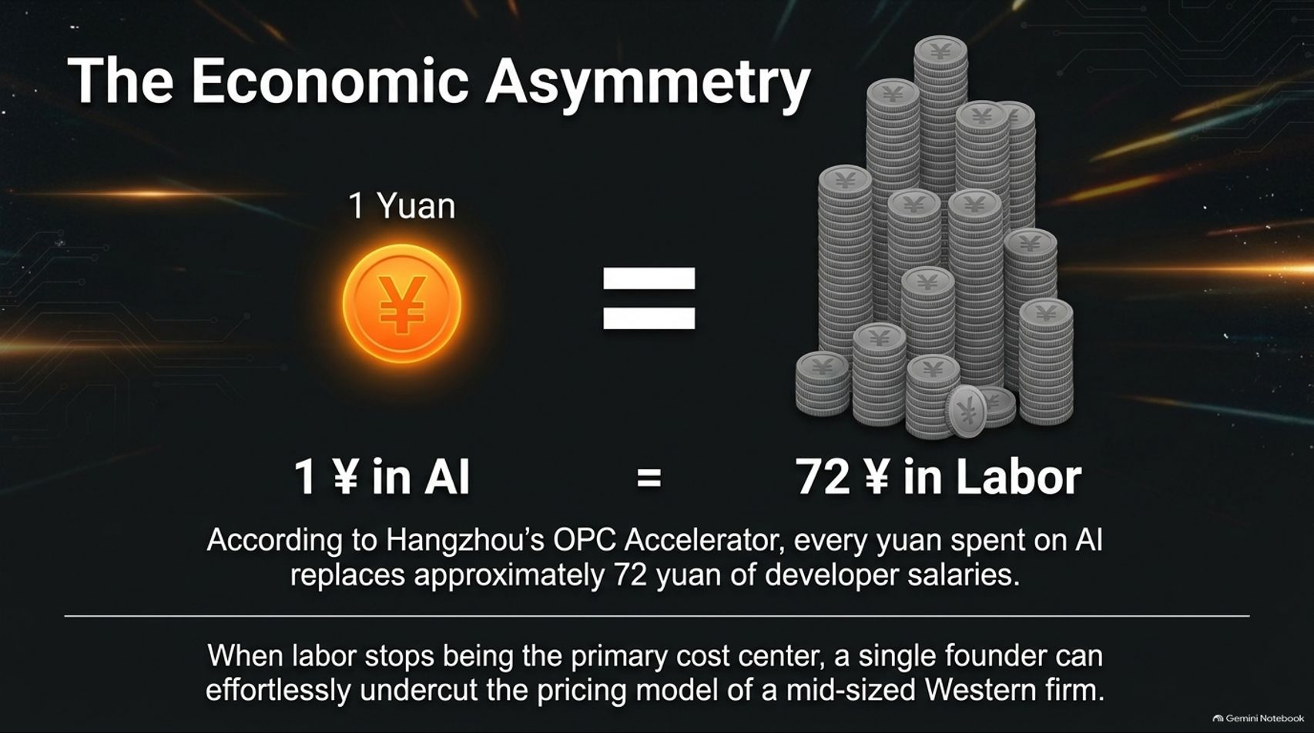
Notes:
Target Time: ~3.5 Minutes (490 words)
Speaker Script
"The underlying driver behind this movement is staggering economic asymmetry.
According to data from Hangzhou’s OPC Accelerator, every 1 yuan spent on AI effectively replaces approximately 72 yuan of traditional developer salaries.
When labor ceases to be the primary cost center for a business, the financial math changes completely. A single founder operating with AI agents can easily undercut the pricing model of a mid-sized Western agency or software firm while maintaining high profit margins."

Slide 11
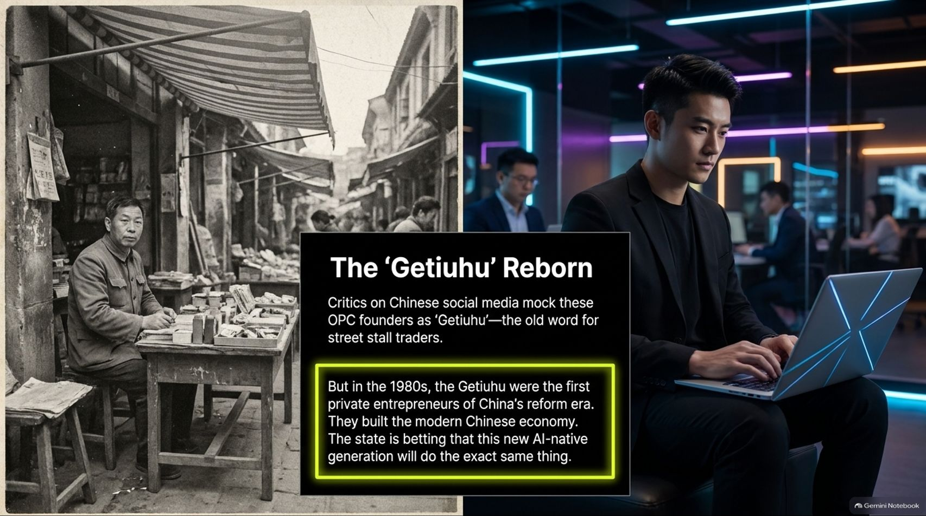
Notes:
Target Time: ~3 Minutes (420 words)
Speaker Script
"Critics on Chinese social media sometimes mock these OPC founders as 'Getiuhu'—the historical slang term for street stall traders from the early reform era.
But history tells us why that comparison is telling. In the 1980s, the Getiuhu were despised as marginal outsiders, yet they were China's first private entrepreneurs who ultimately built the modern Chinese market economy.
The state is betting that this new AI-native generation of solo founders will perform a similar historical function, transforming the economic bedrock from the ground up."

Slide 12
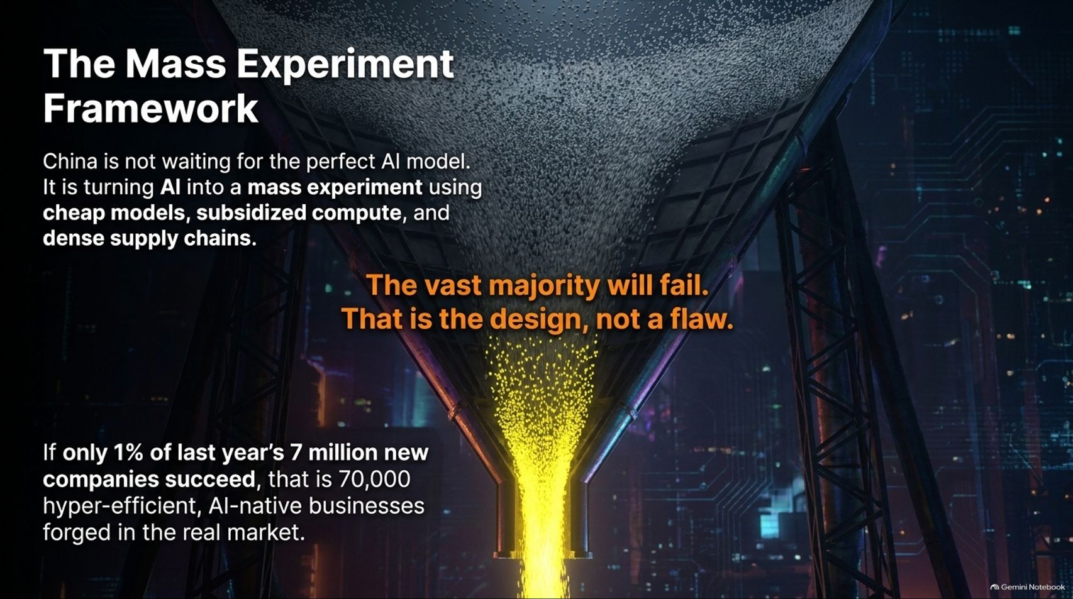
Notes:
Target Time: ~3.5 Minutes (500 words)
Speaker Script
"China is not waiting around for a single 'perfect' AI model to emerge. Instead, it is turning the entire economy into a mass experiment utilizing cheap models, subsidized compute, and dense manufacturing supply chains.
Many observers point out that the vast majority of these micro-companies will fail. That failure rate is by design, not a flaw.
Consider last year’s 7 million new company registrations: if just 1% succeed, that results in 70,000 hyper-efficient, AI-native businesses forged in actual market combat."

Slide 13
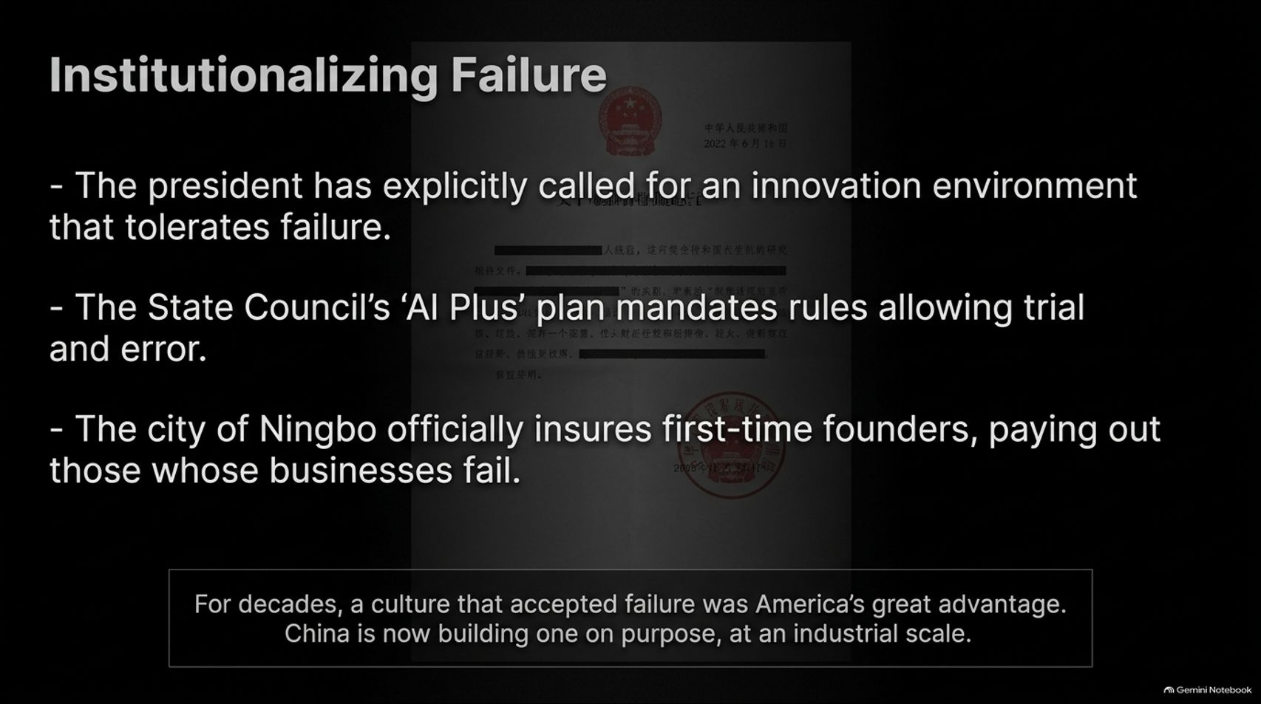
Notes:
Target Time: ~3.5 Minutes (490 words)
Speaker Script
"For decades, a cultural tolerance for business failure was considered a uniquely Western—and specifically American—competitive advantage. China is now engineering that culture intentionally, at an industrial scale:
Leadership has explicitly called for an innovation environment that tolerates failure.
The State Council’s 'AI Plus' plan mandates regulatory frameworks that protect trial and error.
Municipalities like Ningbo officially insure first-time founders, paying out financial support when ventures fail.
By de-stigmatizing failure and subsidizing the cost of experimentation, China is building a national incubator for resilient entrepreneurs."

Slide 14
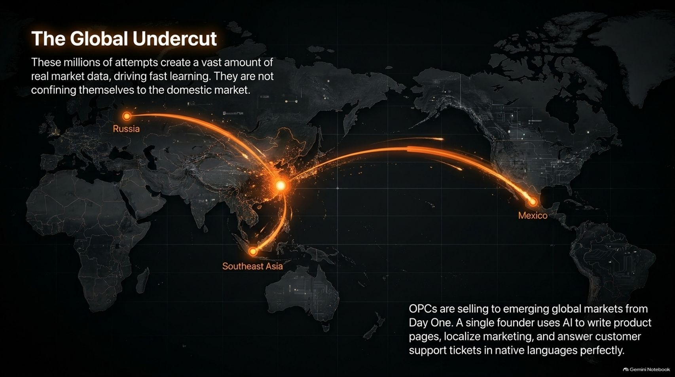
Notes:
Target Time: ~3.5 Minutes (500 words)
Speaker Script
"These millions of micro-experiments generate vast amounts of real-world market data, accelerating rapid iteration. Crucially, these founders are not confining themselves to the domestic market.
From Day One, OPCs are selling directly to emerging global markets in Southeast Asia, Latin America (such as Mexico), and Eastern Europe. A single founder uses AI tools to instantly generate product landing pages, localize marketing campaigns, and handle customer support tickets in native languages perfectly.
For established companies in Zurich, Berlin, or London, the next disruptive competitor may not be a massive Chinese conglomerate—it may be a solo operator running a coordinated swarm of AI agents."

Slide 15
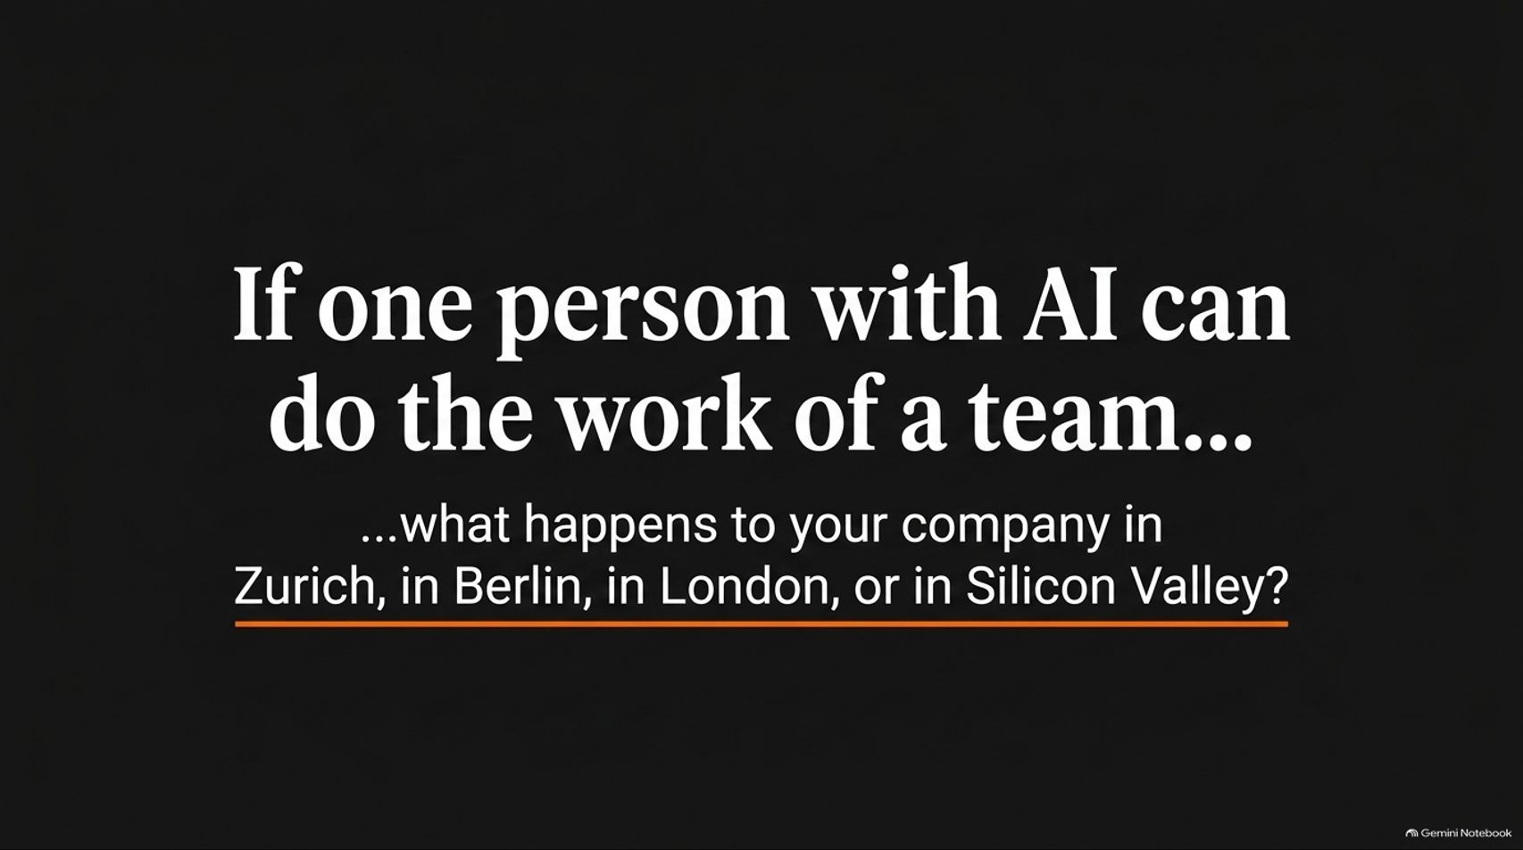
Notes:
Target Time: ~3 Minutes (400 words)
Speaker Script
"This brings us to the core strategic question for business leaders today:
If one person equipped with AI can execute the work of an entire traditional team, what happens to your company structure in Zurich, in Berlin, in London, or in Silicon Valley?
Traditional corporate bloat, slow approval cycles, and high overheads become massive vulnerabilities when competing against agile, zero-overhead solo operators who iterate in days rather than months."

Slide 16
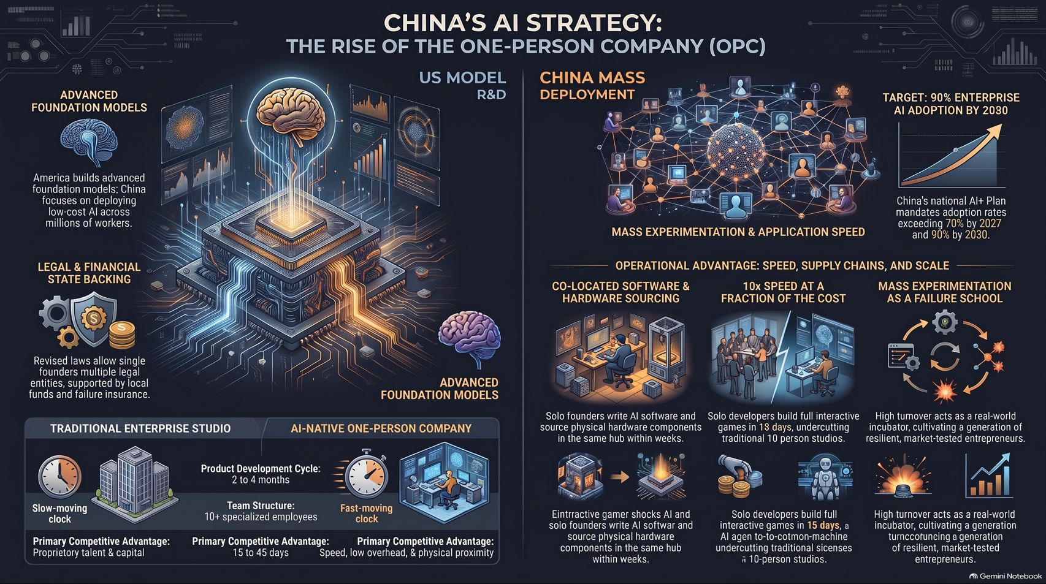
Notes:
Target Time: ~4 Minutes (580 words)
Speaker Script
"To synthesize our analysis across the entire deck:
While the West focuses heavily on R&D and advanced foundational models, China is executing a masterclass in Mass Deployment and Application Speed.
By combining legal backing, municipal funding, co-located supply chains, and a cultural framework that institutionalizes trial and error, China is scaling an army of One-Person Companies.
The ultimate takeaway is clear: the future of the global AI economy may not be decided solely by who builds the single smartest machine, but by who successfully puts AI into the hands of the most operators. Thank you."

