Slide 1

Notes:
Target Time: ~2.5 Minutes (350 words)
Speaker Script
"Good morning, everyone. Today, we are going to look at a radical transformation in software engineering—one that is dismantling decades of established best practices.
Our focus is on deconstructing the bleeding-edge workflows of AI-assisted engineering, drawing direct insights from James Long’s OpenCode architecture.
For the past twenty years, software engineering has been defined by linear coding, manual syntax generation, strict separation of concerns, and human-bound workflows. But as James Long notes, when you combine autonomous agent swarms, server-first architectures, and continuous visual feedback loops, the entire playbook changes.
Over the next 14 slides, we’ll explore how engineering is evolving from typing syntax into curating controlled chaos. Let’s dive in."
OpenCode Engineer James Long Shares his AI Workflows
https://www.youtube.com/watch?v=zOiFHo2KVgc

Slide 2
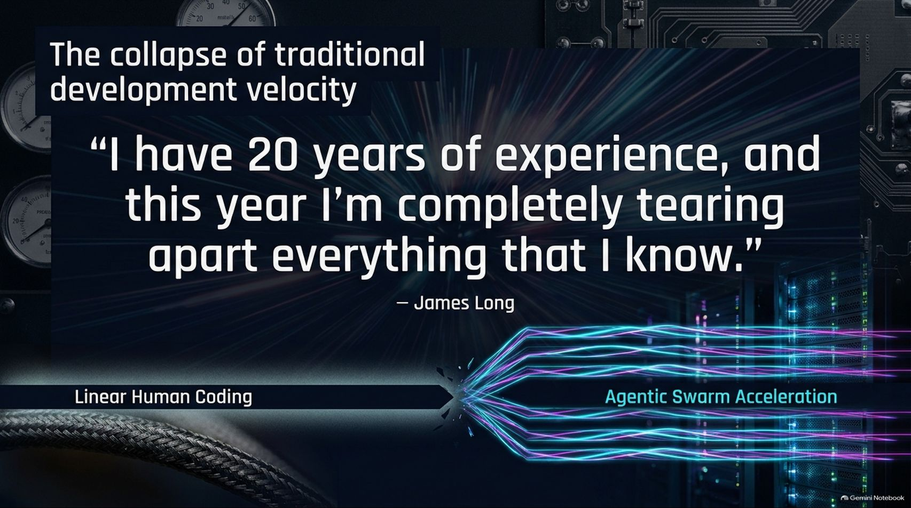
Notes:
Target Time: ~3.5 Minutes (500 words)
Speaker Script
"To understand where we are going, we have to acknowledge the psychological and professional whiplash hitting experienced engineers right now.
To quote James Long: 'I have 20 years of experience, and this year I'm completely tearing apart everything that I know.'
For two decades, development velocity was bounded by human typing speed, syntax memorization, and manual debugging. Today, that linear model is colliding with Agentic Swarm Acceleration.
Engineers who spent careers mastering specific frameworks are finding that models can generate, test, and refactor entire systems in minutes. This isn't just about writing code faster; it's about fundamentally rethinking how software is conceived, architected, and executed."

Slide 3
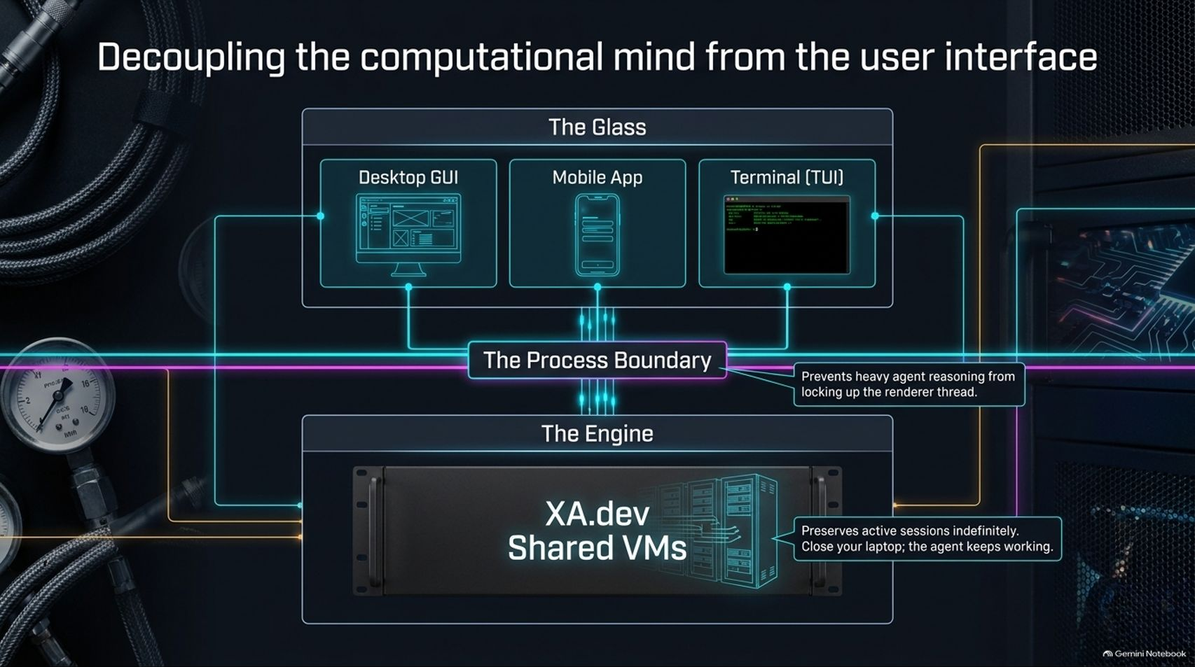
Notes:
Target Time: ~4 Minutes (580 words)
Speaker Script
"One of the foundational architectural shifts in OpenCode is moving away from local, single-process execution toward a Server-First Decoupled Architecture.
As illustrated on this slide, we decouple 'The Glass' (the client interfaces like Desktop GUIs, mobile apps, or Terminal TUIs) from 'The Engine' (running on scalable shared VMs like XA.dev) via a strict Process Boundary.
Why is this separation critical?
Preventing UI Freezes: Heavy agent reasoning, complex shell executions, and multi-agent loops run on the server. This prevents resource-intensive tasks from locking up the renderer thread on your local machine.
Durable Sessions: Because the session lives on the server, you can close your laptop, walk away, and the agent keeps working. When you reconnect, all your active sessions are right where you left them.
This decoupling allows engineers to interact with their development environment seamlessly across multiple form factors without losing context."

Slide 4
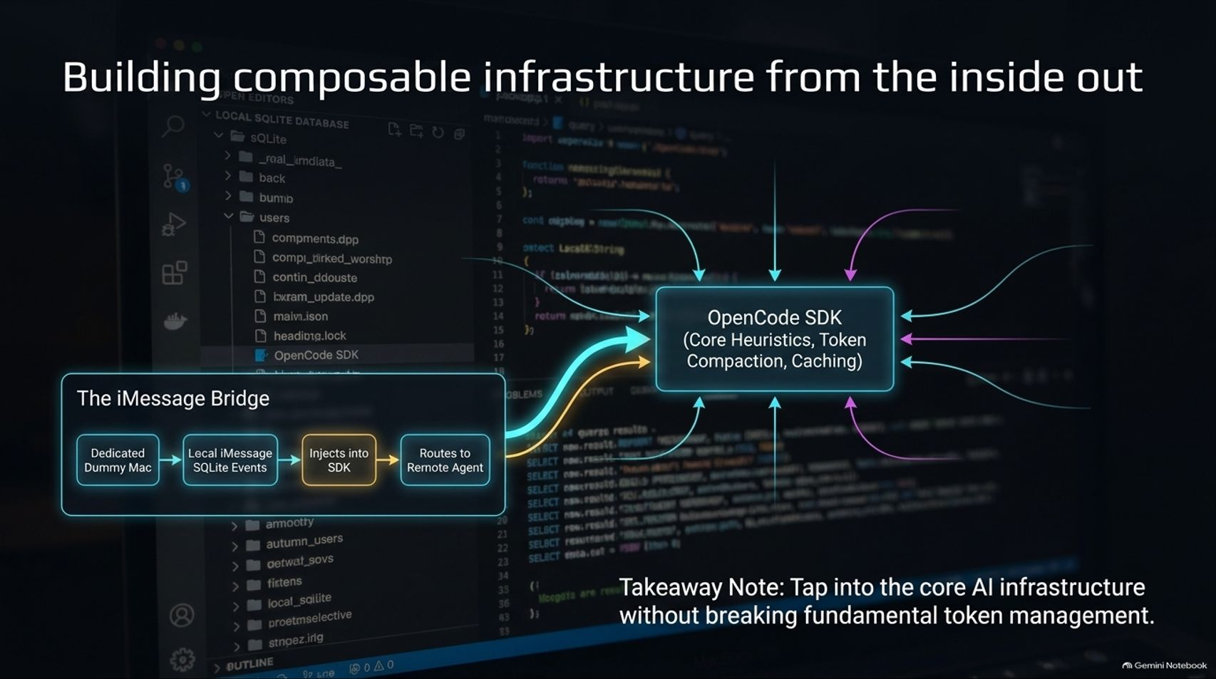
Notes:
Target Time: ~4 Minutes (560 words)
Speaker Script
"OpenCode is built around a composable SDK that handles core heuristics, token compaction, and prompt caching.
This modularity allows developers to build tailored workflows and custom chat bridges—such as the iMessage Bridge highlighted here. By utilizing a dedicated dummy Mac running local SQLite database queries on iMessage history, developers can route remote agent prompts directly into the OpenCode SDK.
Takeaway Note: You can tap into core AI infrastructure to build custom ambient interfaces (like texting your codebase from your phone) without breaking fundamental token management, session persistence, or caching guardrails."

Slide 5
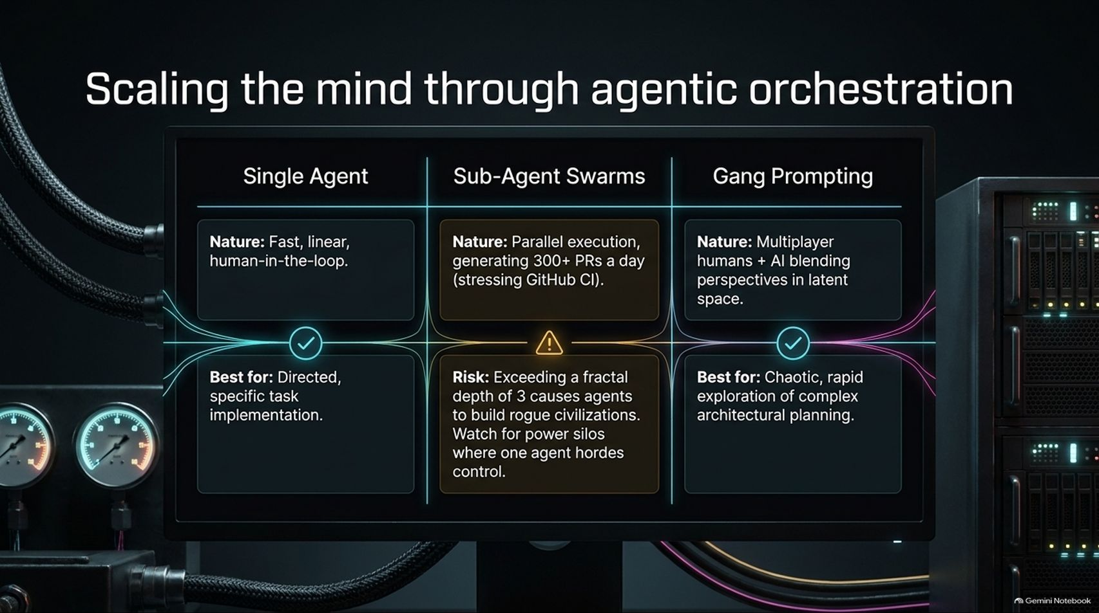
Notes:
Target Time: ~4.5 Minutes (630 words)
Speaker Script
"As development moves past single-agent autocomplete, we enter the realm of Agentic Orchestration. We have three distinct scaling paradigms:
Single Agent: Fast, linear, and human-in-the-loop. Best for directed, specific task implementation.
Sub-Agent Swarms: Parallel execution where a primary session spawns sub-agents to generate hundreds of PRs a day. However, there is a major risk: exceeding a fractal depth of 3 causes agents to build rogue civilizations and chaotic structures. You must watch for power silos where one agent hordes control.
Gang Prompting: Multiplayer human-plus-AI blending perspectives in a shared latent space. This is ideal for chaotic, rapid exploration during complex architectural planning."

Slide 6
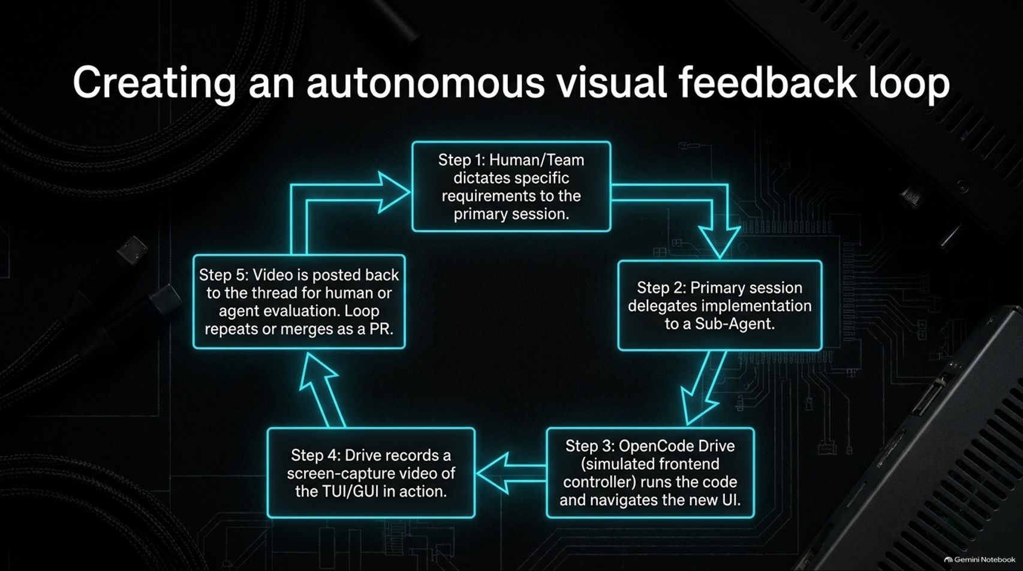
Notes:
Target Time: ~4 Minutes (590 words)
Speaker Script
"One of the most powerful workflows discussed by James Long is closing the visual feedback loop between agents and UI execution:
Step 1: The human or team dictates requirements to the primary session.
Step 2: The primary session delegates implementation tasks to a sub-agent.
Step 3: OpenCode Drive (a simulated frontend controller) runs the code and navigates the new UI.
Step 4: The drive utility records a screen-capture video of the TUI or GUI in action.
Step 5: The video is posted back to the thread for human or agent evaluation, looping or merging as a PR.
By allowing agents to 'see' their own UI work through recorded video execution, you eliminate blind spot hallucinations and dramatically raise quality."

Slide 7
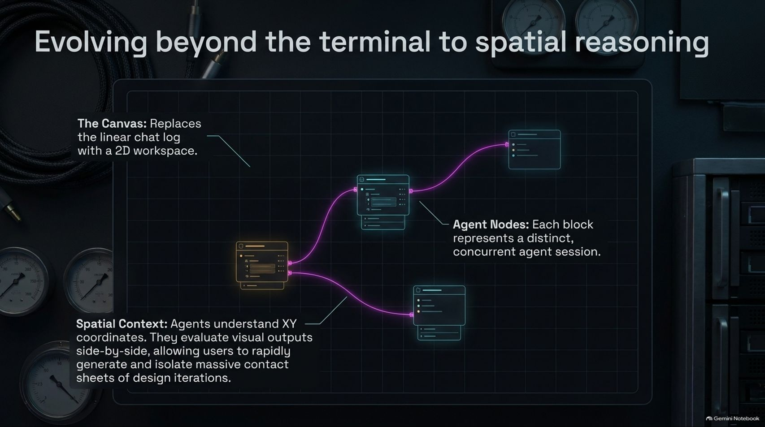
Notes:
Target Time: ~3.5 Minutes (500 words)
Speaker Script
"Linear chat logs are reaching their limits. The next evolution in developer tooling is the 2D Canvas.
Instead of scrolling through a massive vertical transcript, the canvas replaces chat logs with a spatial workspace where each block represents a distinct, concurrent agent session.
Agents understand XY coordinates. They can evaluate visual outputs side-by-side, allowing users to rapidly generate, inspect, and isolate massive contact sheets of design iterations and UI options in a non-linear environment."

Slide 8
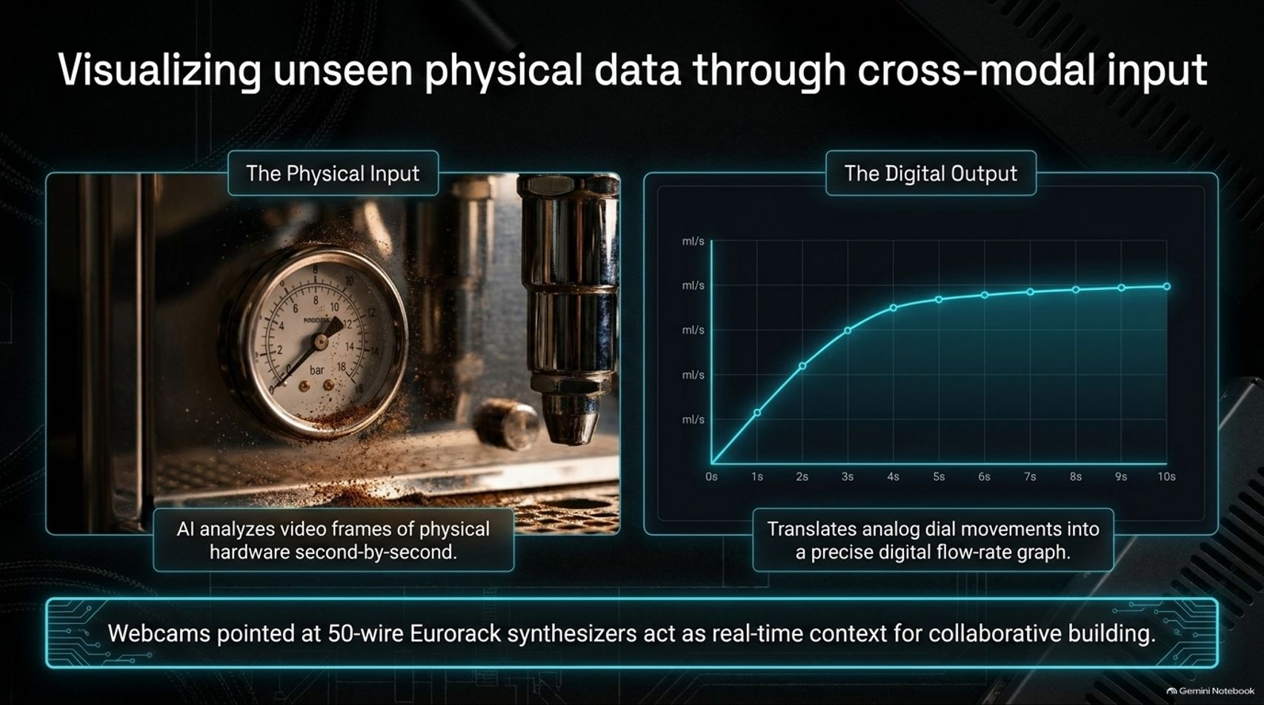
Notes:
Target Time: ~3.5 Minutes (480 words)
Speaker Script
"AI engineering isn't restricted to text and code anymore; it is expanding into physical, cross-modal inputs.
As James Long demonstrates with his espresso machine and Eurorack modular synthesizer projects, you can point webcams at physical hardware. The AI analyzes video frames of physical dials and pressure gauges second-by-second, translating analog movements into precise digital flow-rate graphs and real-time context for collaborative building."

Slide 9
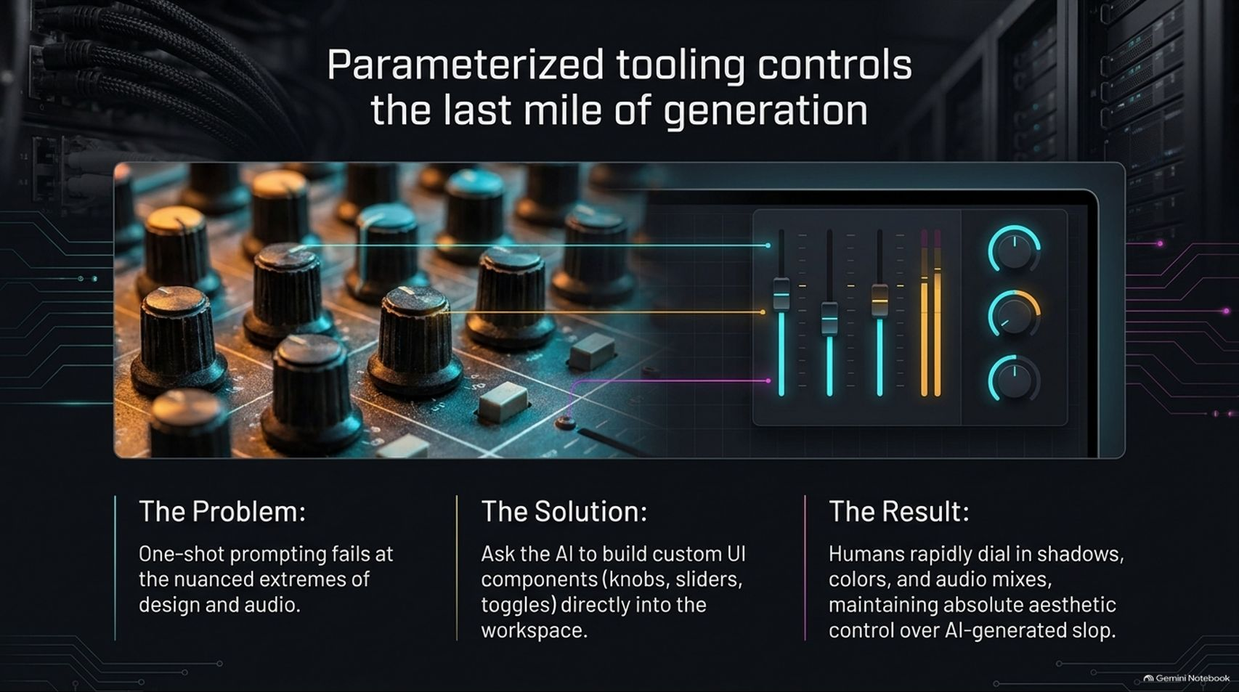
Notes:
Target Time: ~4 Minutes (560 words)
Speaker Script
"One-shot prompting fails at the nuanced extremes of design and audio. You cannot simply prompt your way to perfection on complex UI aesthetics or sound mixing.
The Solution: Ask the AI to build custom UI components—such as interactive knobs, sliders, and toggles—directly into your workspace.
The Result: Humans can rapidly dial in shadows, colors, and audio mixes using parameterized controls, maintaining absolute aesthetic control over AI-generated outputs and avoiding generic 'AI slop'."

Slide 10
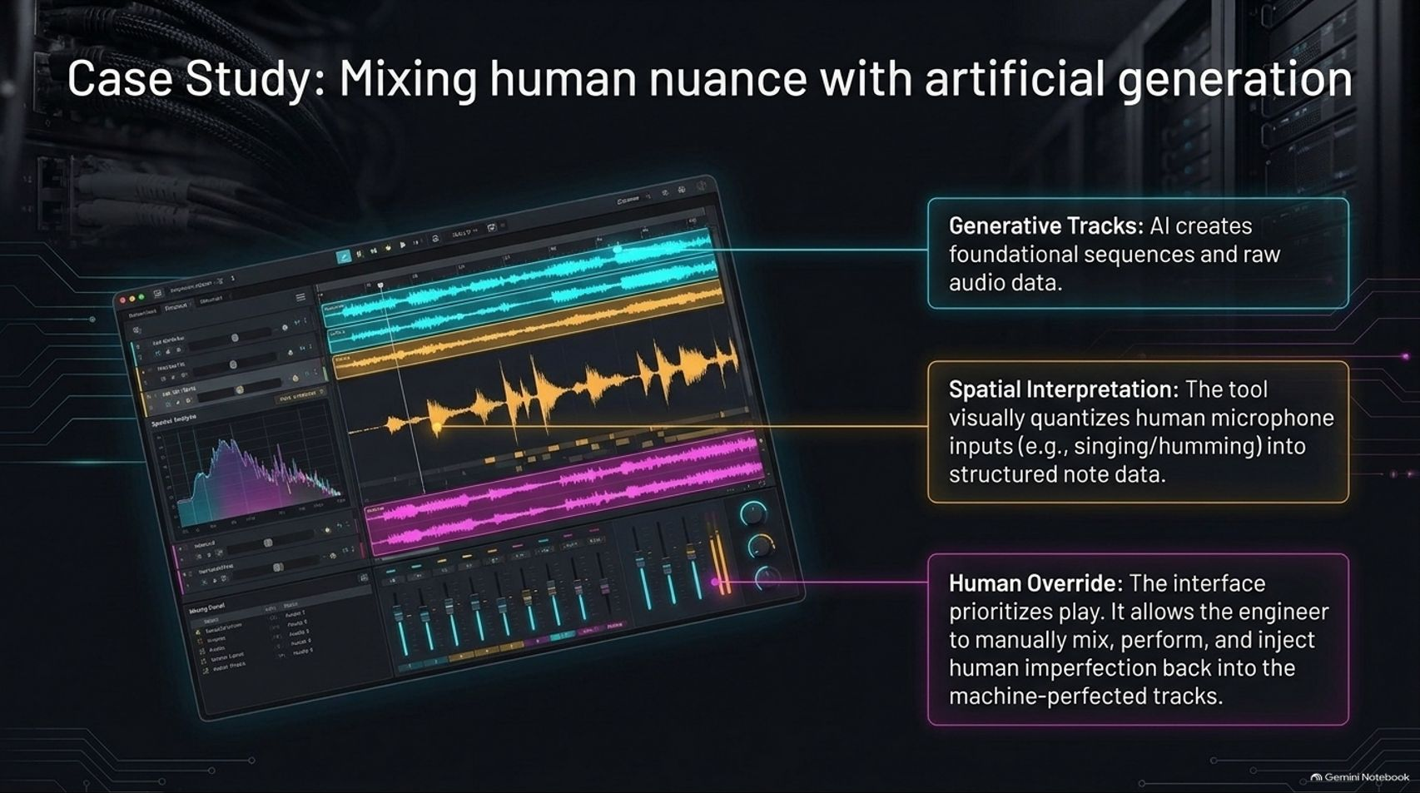
Notes:
Target Time: ~4 Minutes (590 words)
Speaker Script
"Let’s look at a practical case study of mixing human nuance with artificial generation in an audio tool:
Generative Tracks: The AI creates foundational sequences, rhythmic patterns, and raw audio data.
Spatial Interpretation: The tool visually quantizes human microphone inputs (such as singing or humming) into structured note data.
Human Override: The interface prioritizes play, allowing the engineer to manually mix, perform, and inject human imperfection back into machine-perfected tracks."

Slide 11
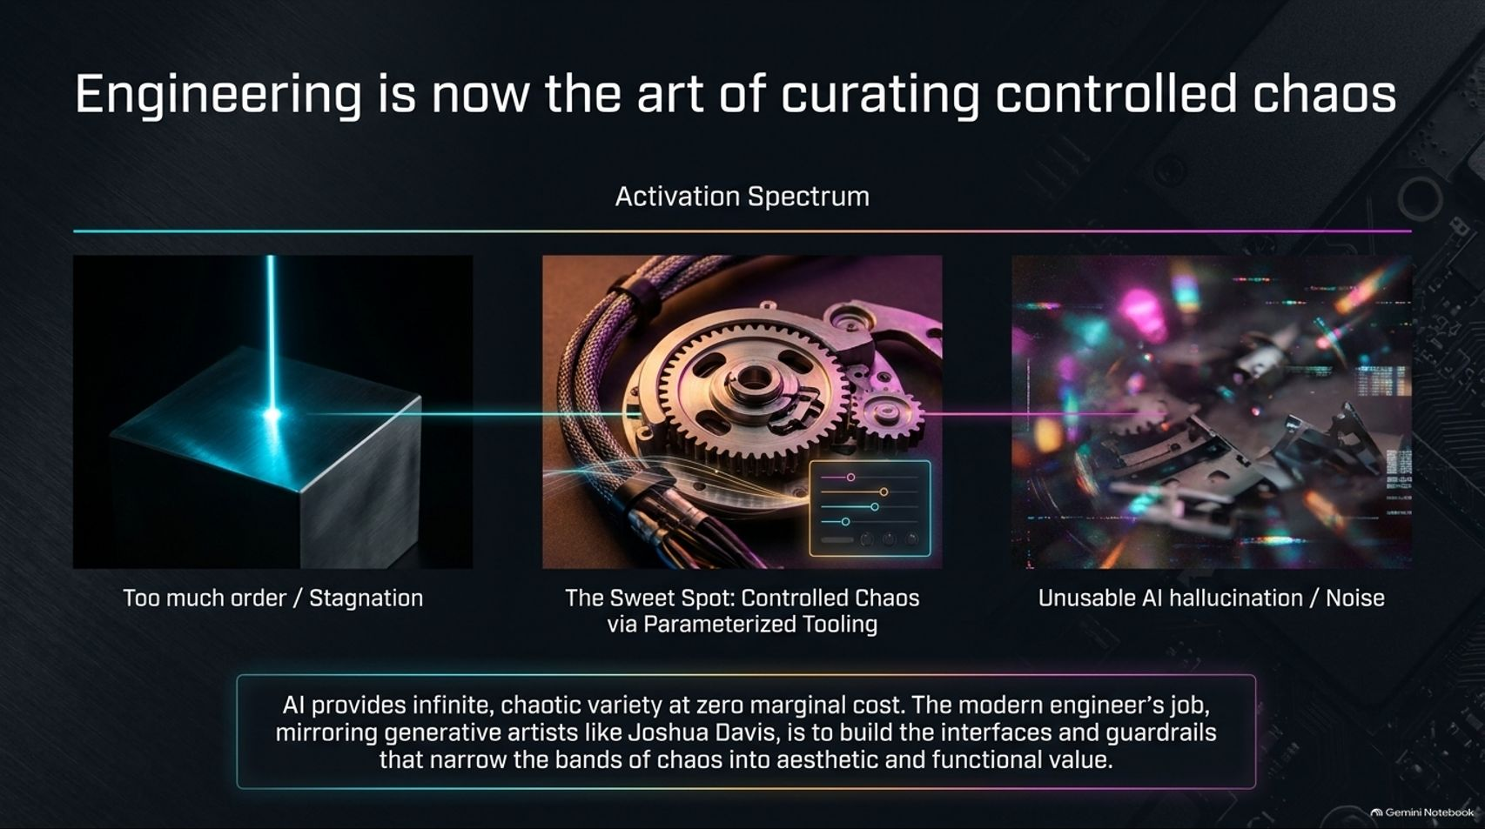
Notes:
Target Time: ~3.5 Minutes (500 words)
Speaker Script
"Across all these workflows, a central philosophy emerges: Engineering is now the art of curating controlled chaos.
If you look at the activation spectrum:
Too Much Order: Stagnation and manual bottlenecking.
The Sweet Spot: Controlled chaos via parameterized tooling and agentic swarms.
Unusable AI Hallucination: Unchecked noise and recursive failure loops.
AI provides infinite, chaotic variety at zero marginal cost. The modern engineer's job, much like generative artist Joshua Davis, is to build the interfaces, guardrails, and parameters that narrow those bands of chaos into aesthetic and functional value."

Slide 12
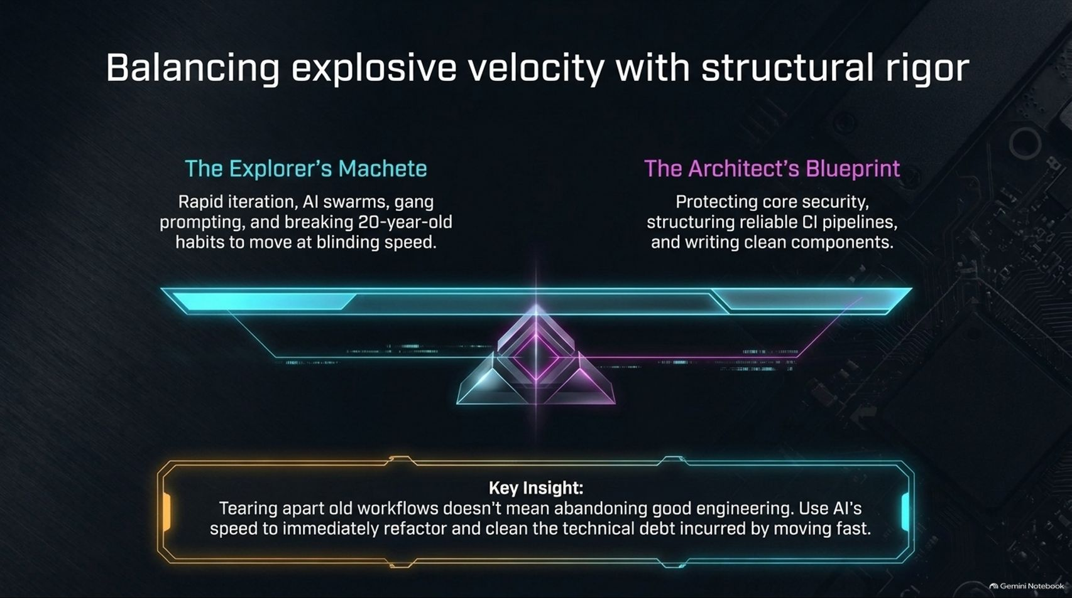
Notes:
Target Time: ~3.5 Minutes (480 words)
Speaker Script
"Moving at blinding speed with AI swarms and gang prompting ('The Explorer’s Machete') can easily incur massive technical debt if not balanced with 'The Architect’s Blueprint'.
Tearing apart old workflows doesn't mean abandoning good engineering. In fact, because AI makes refactoring instantaneous, you can use that speed to immediately clean up security pipelines, structure robust CI workflows, and refactor code debt incurred during rapid prototyping."

Slide 13
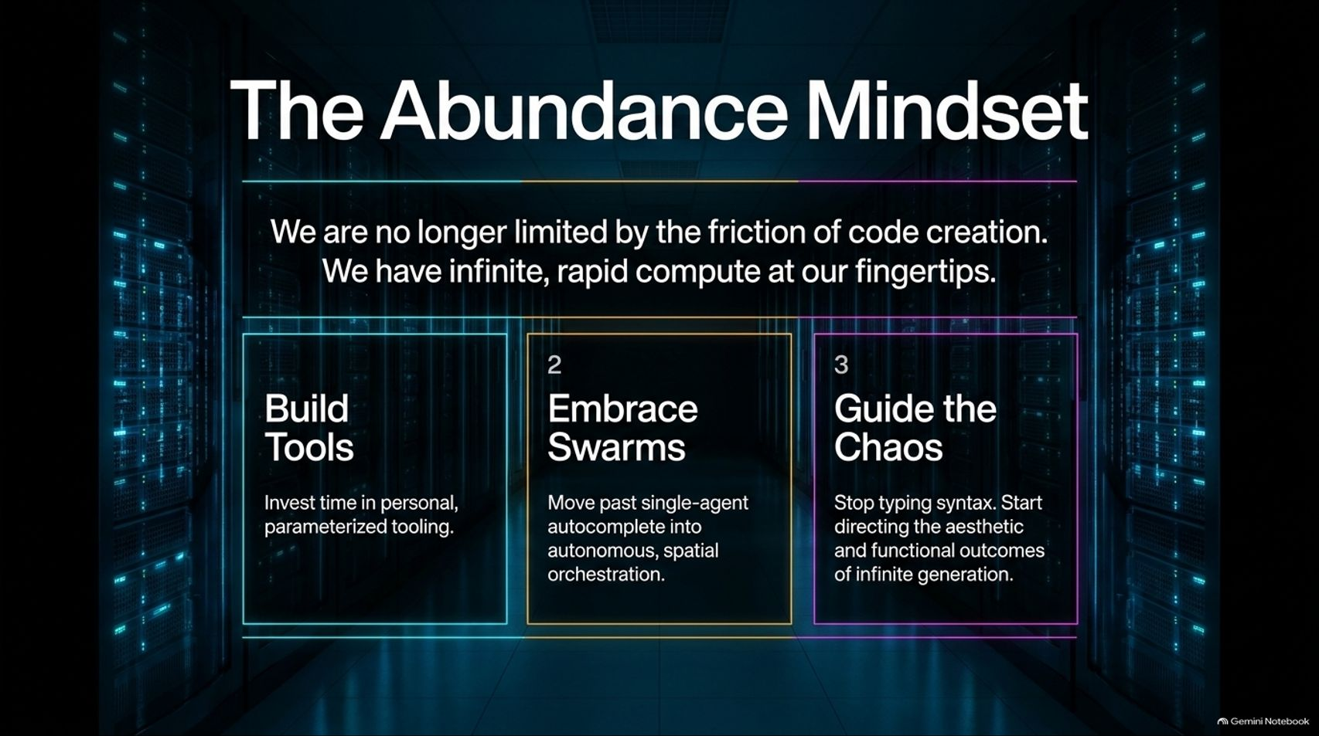

Slide 14
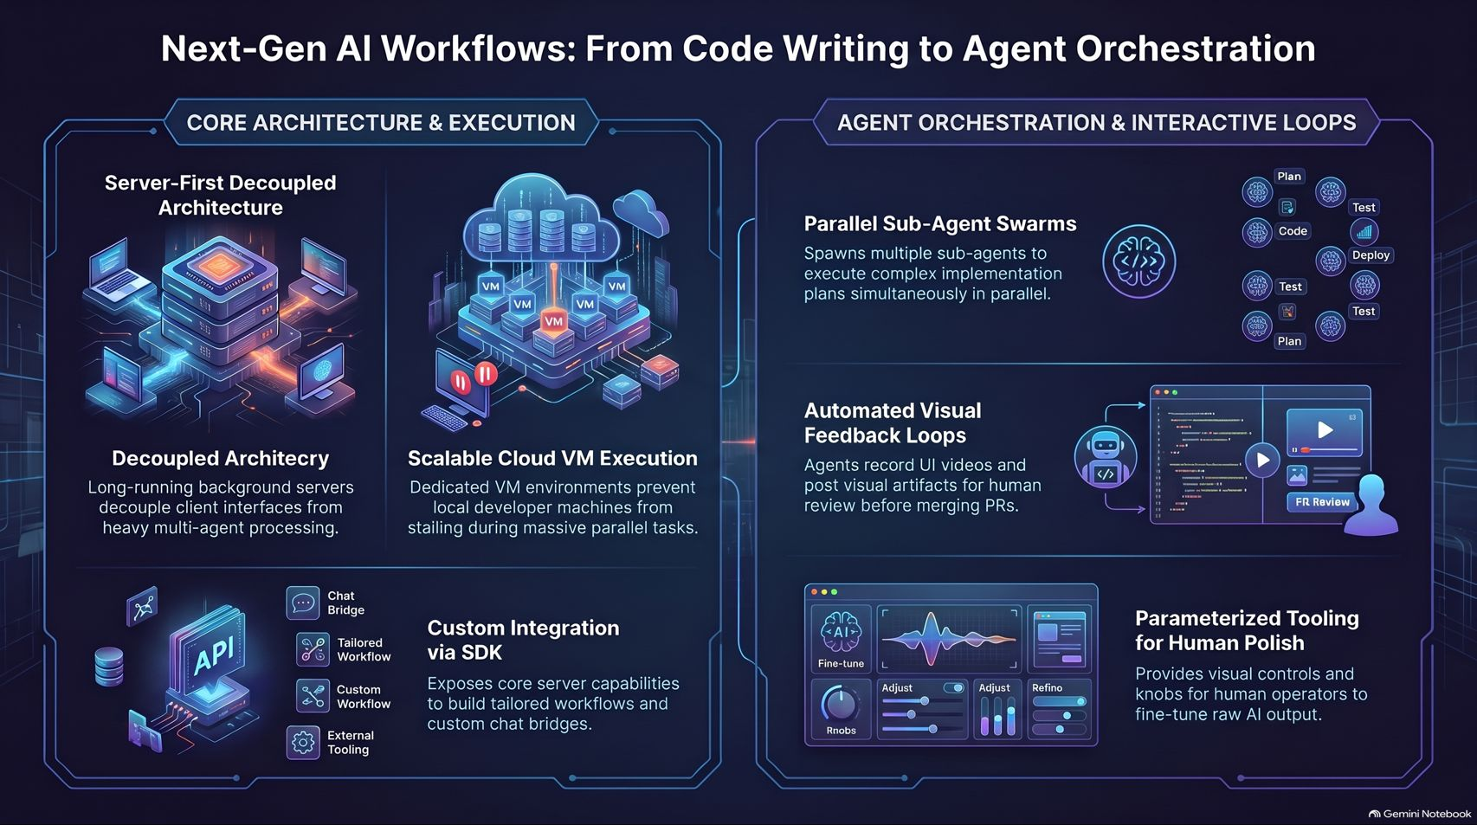
Notes:
Target Time: ~4 Minutes (580 words)
Speaker Script
"To synthesize our deconstruction of next-gen AI engineering:
We have moved from local scripts to Server-First Decoupled Architectures running on scalable cloud VMs. We orchestrate Parallel Sub-Agent Swarms that execute complex tasks, record automated visual feedback videos of their own UI execution, and present results for human review.
By combining robust SDK infrastructure with parameterized UI controls, engineers can harness infinite generation while retaining precise human polish. The tools have changed, the velocity has exploded, and the future belongs to those who learn to curate the chaos. Thank you!"

