Slide 1
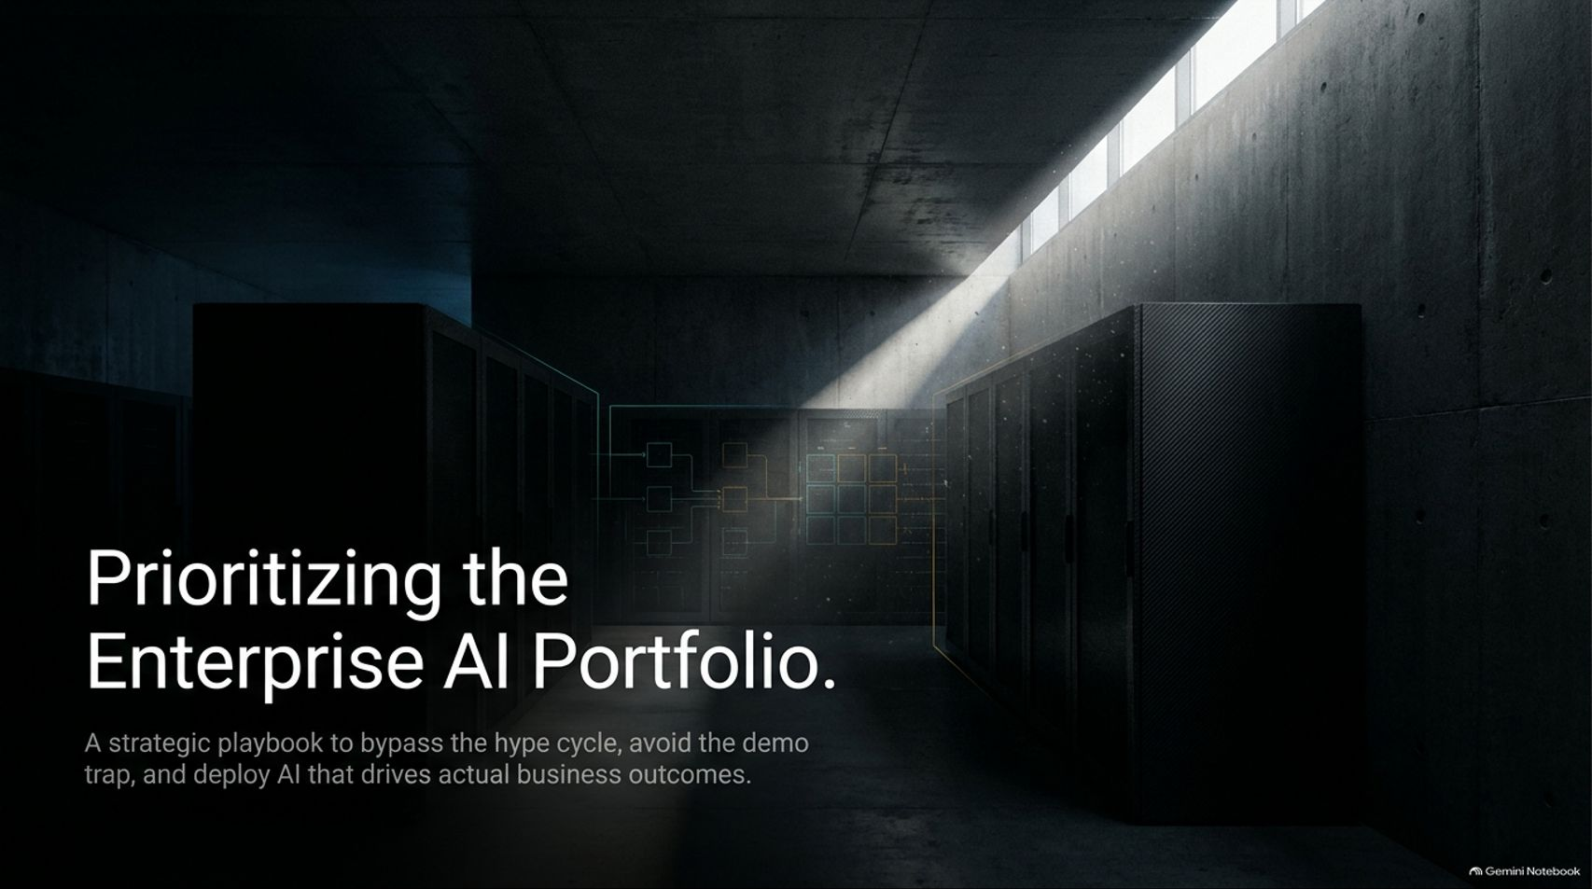
Notes:
Target Time: ~2.5 Minutes (350 words)
Speaker Script
"Good afternoon, everyone, and welcome to today’s executive session on enterprise AI strategy.
As organizations round out their planning cycles, leadership teams are constantly bombarded with a staggering array of AI tools, vendor pitches, and market noise. The central challenge for any executive today isn't discovering that artificial intelligence exists—it's figuring out how to bypass the hype cycle, avoid the demo trap, and deploy solutions that drive actual business outcomes.
In this presentation, we’re going to walk through a strategic playbook designed to help you prioritize your AI portfolio without guessing. Drawing from insights across enterprise deployment and executive leadership discussions, we will explore how to anchor your AI initiatives in your core business identity, secure your data infrastructure, establish smart governance, and measure organic adoption. Let’s dive in."
How to Prioritise an AI Portfolio Without Guessing
https://www.youtube.com/watch?v=SSBkIUYp9vQ

Slide 2

Notes:
Target Time: ~3.5 Minutes (500 words)
Speaker Script
"Let’s start with a foundational mindset shift. Too many executive mandates begin with a reactive panic: 'We need to implement AI.'
When leadership sees competitors rushing into the market or hears about the latest technological breakthrough, the immediate impulse is often to scream down instructions to subordinates to buy software, deploy chatbots, or sign vendor contracts. This noise clouds judgment.
The executive mandate should never start with what technology to buy. Instead, the fundamental question must be: What urgent business problems require solving?
As Okigo, Director of Technology and Engineering at AI in Nigeria, points out in our reference discussions, rushing off to implement tools just because another company did it usually results in solutions that fizzle out within a week because they solve nothing of substance. The problem must always dictate the implementation—never the other way around."

Slide 3
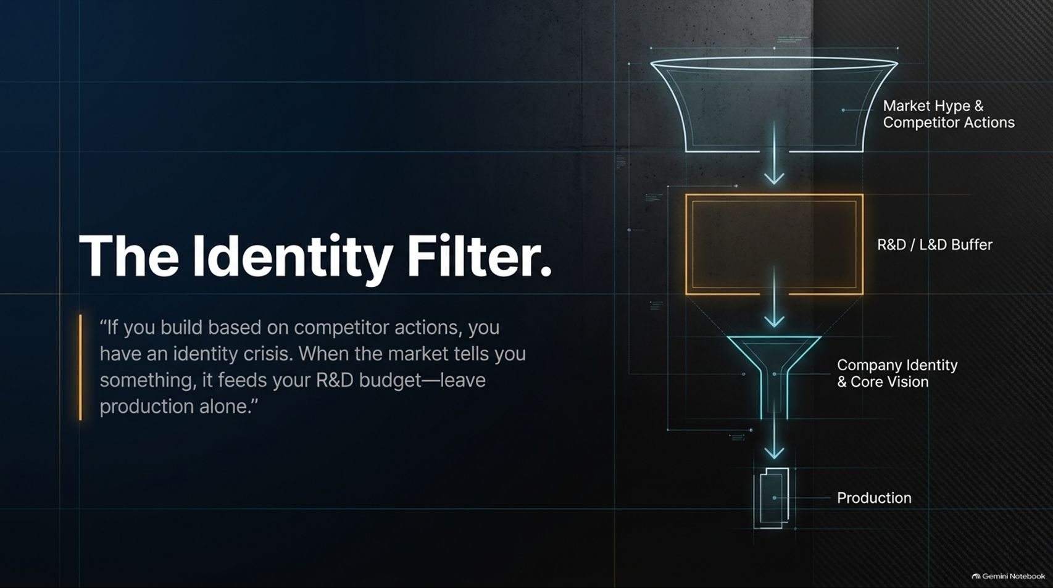
Notes:
Target Time: ~3.5 Minutes (500 words)
Speaker Script
"When market pressure hits and competitors launch new AI features, why do organizations panic? That panic is rarely just about technology—it is a symptom of an identity crisis.
To quote our strategic framework: 'If you build based on competitor actions, you have an identity crisis. When the market tells you something, it feeds your R&D budget—leave production alone.'
As Mr. Obina Ukatuku notes from his executive experience, companies are not set up to buy toys or chase fleeting trends; they exist to offer specific services aligned with their long-term vision. When external market signals arrive, they must first pass through your Research & Development (R&D) and Learning & Development (L&D) buffers. You study the technology, internalize what it means for your unique mission, and only then decide if it belongs in production."

Slide 4
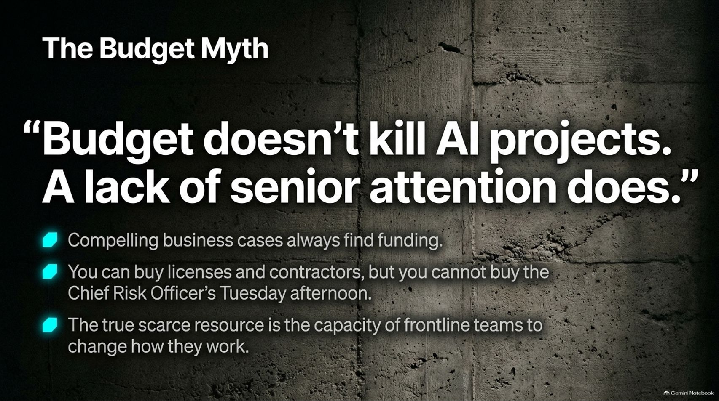
Notes:
Target Time: ~4 Minutes (580 words)
Speaker Script
"A common refrain in corporate boardrooms is that budget limitations are what stall or kill enterprise AI initiatives. But in a properly functioning organization, budget doesn't kill AI projects—a lack of senior attention does.
Consider these three operational truths:
Compelling business cases always find funding. When an initiative directly supports strategic revenue or operational goals, capital is never the primary bottleneck.
You can buy licenses and contractors, but you cannot buy the Chief Risk Officer’s Tuesday afternoon. Executive ownership and continuous senior engagement cannot be outsourced.
The true scarce resource is the capacity of frontline teams to change how they work.
If leadership treats AI as a delegable IT project rather than an operational transformation requiring personal executive time, the initiative is dead on arrival."

Slide 5
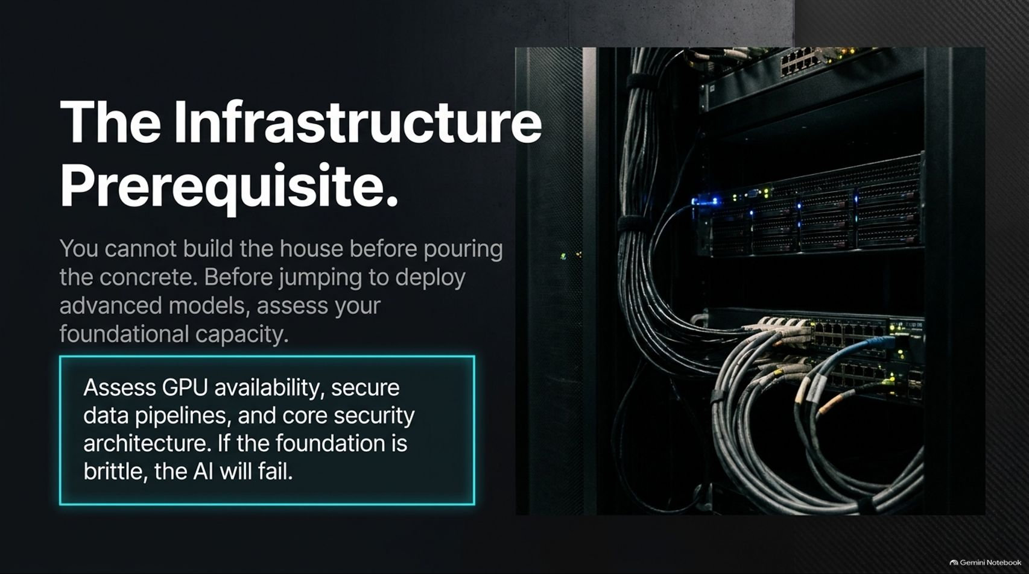
Notes:
Target Time: ~3.5 Minutes (500 words)
Speaker Script
"You cannot build a house before pouring the concrete. Before jumping to deploy advanced foundational models or autonomous agents, enterprises must honestly assess their foundational capacity.
This means auditing GPU availability, securing robust data pipelines, and fortifying core security architecture. As Okigo emphasizes, if you dive straight into building complex applications without the underlying infrastructure to support them, you will hit a brick wall halfway through. If the technical foundation is brittle, the AI will fail."

Slide 6
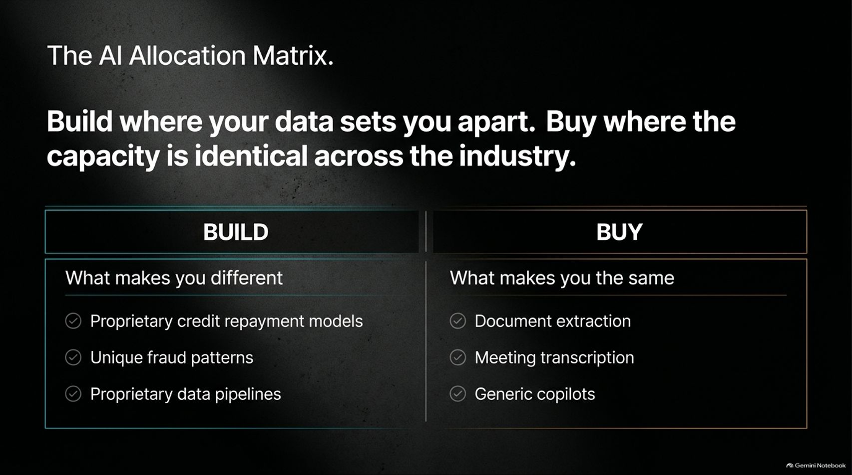
Notes:
Target Time: ~4 Minutes (560 words)
Speaker Script
"How should leadership allocate resources across different AI opportunities? The rule of thumb is simple: Build where your data sets you apart. Buy where the capacity is identical across the industry.
Let’s look at the allocation matrix:
BUILD (What makes you different): Focus custom engineering and proprietary modeling on your unique differentiators—such as proprietary credit repayment models trained on your customer behavior, unique fraud patterns specific to your transaction channels, and custom data pipelines.
BUY (What makes you the same): Procure off-the-shelf standard utilities for commodity tasks where differentiation adds no value—such as document extraction, meeting transcription, and generic productivity copilots."

Slide 7
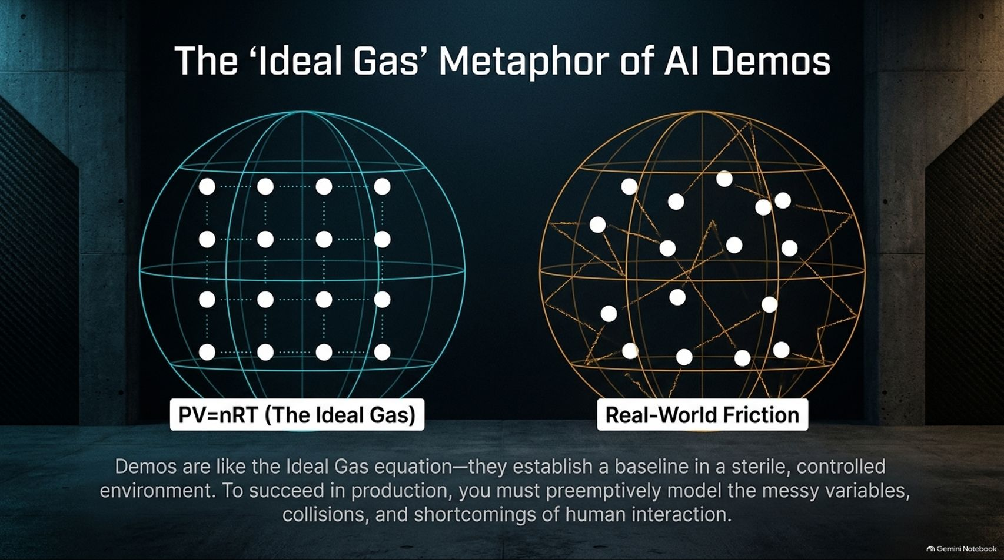
Notes:
Target Time: ~3.5 Minutes (500 words)
Speaker Script
"Why do so many impressive AI demos fail miserably once they hit production? Think of vendor demos through the lens of chemistry: The Ideal Gas Equation ($PV=nRT$).
In chemistry, ideal gas laws establish a baseline in a sterile, controlled environment by assuming molecules don't interact or lose energy. Vendor demos operate the same way: clean, rehearsed data extracts, scripted questions from a friendly audience, standalone environments, and standby engineers ready to fix errors.
Real-world production, however, is full of friction. To succeed in production, you must preemptively model messy variables, unpredictable user behavior, and system collisions before they happen."

Slide 8
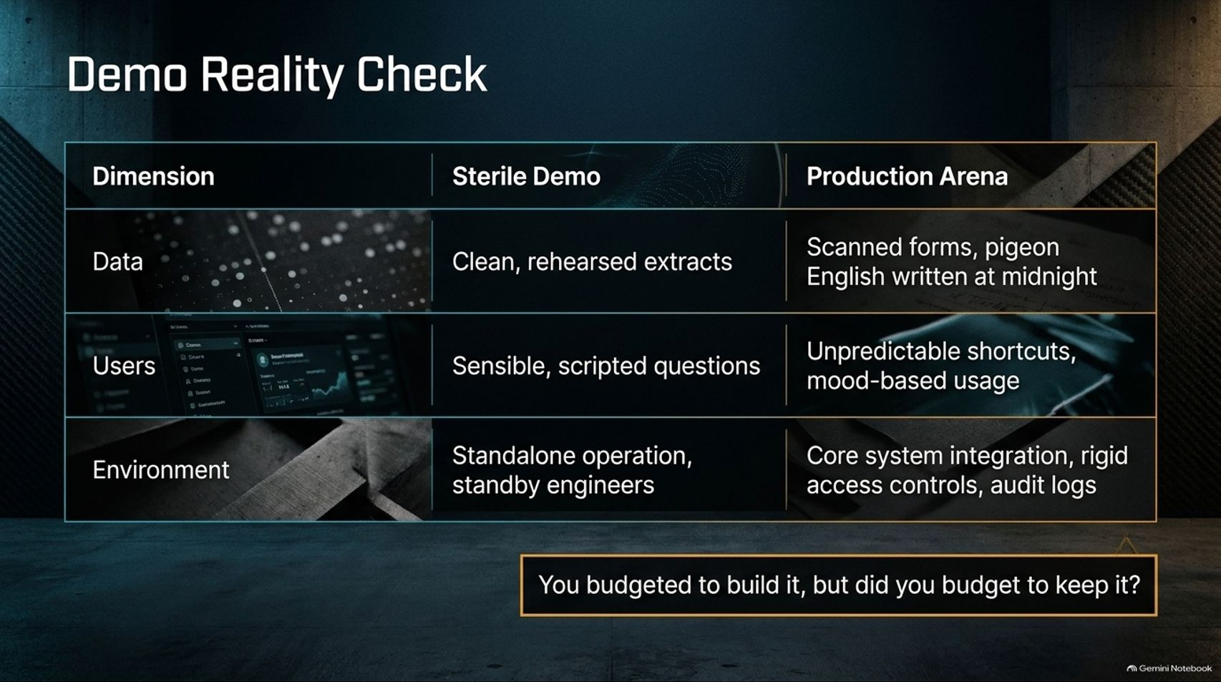
Notes:
Target Time: ~3.5 Minutes (490 words)
Speaker Script
"Let’s do a direct reality check between the sterile demo environment and the production arena across three key dimensions:
Data: Demos use clean, rehearsed extracts. Production faces scanned forms, pigeon English written at midnight, and corrupted records.
Users: Demos involve sensible, scripted questions. Production users take unpredictable shortcuts, use tools based on mood, and test boundaries.
Environment: Demos run in standalone isolation with standby support. Production requires integration with core systems, strict access controls, and comprehensive audit logs.
The crucial financial question every executive must ask during planning is: You budgeted to build it, but did you budget to keep it?"

Slide 9
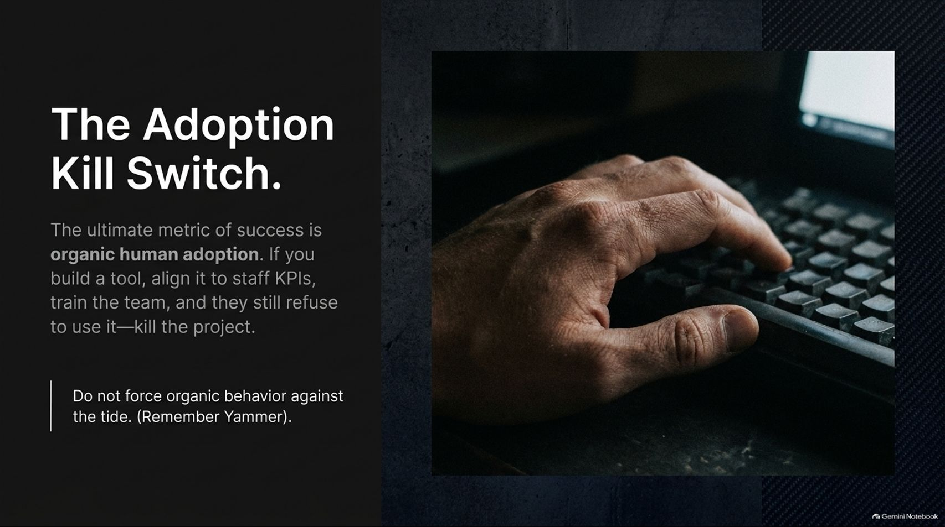
Notes:
Target Time: ~4 Minutes (580 words)
Speaker Script
"What is the ultimate metric of success for an enterprise AI deployment? It is organic human adoption.
If you build an AI tool, align it with staff Key Performance Indicators (KPIs), train the team thoroughly, and they still actively refuse to use it—kill the project.
As Mr. Obina Ukatuku vividly illustrates from corporate history (cue the cautionary memory of enterprise collaboration tools like Yammer), you cannot force organic behavior against the tide. If employees who know their jobs and want to meet their targets reject a tool after proper onboarding, the tool is broken or unneeded. Do not throw good money after bad trying to mandate usage."

Slide 10
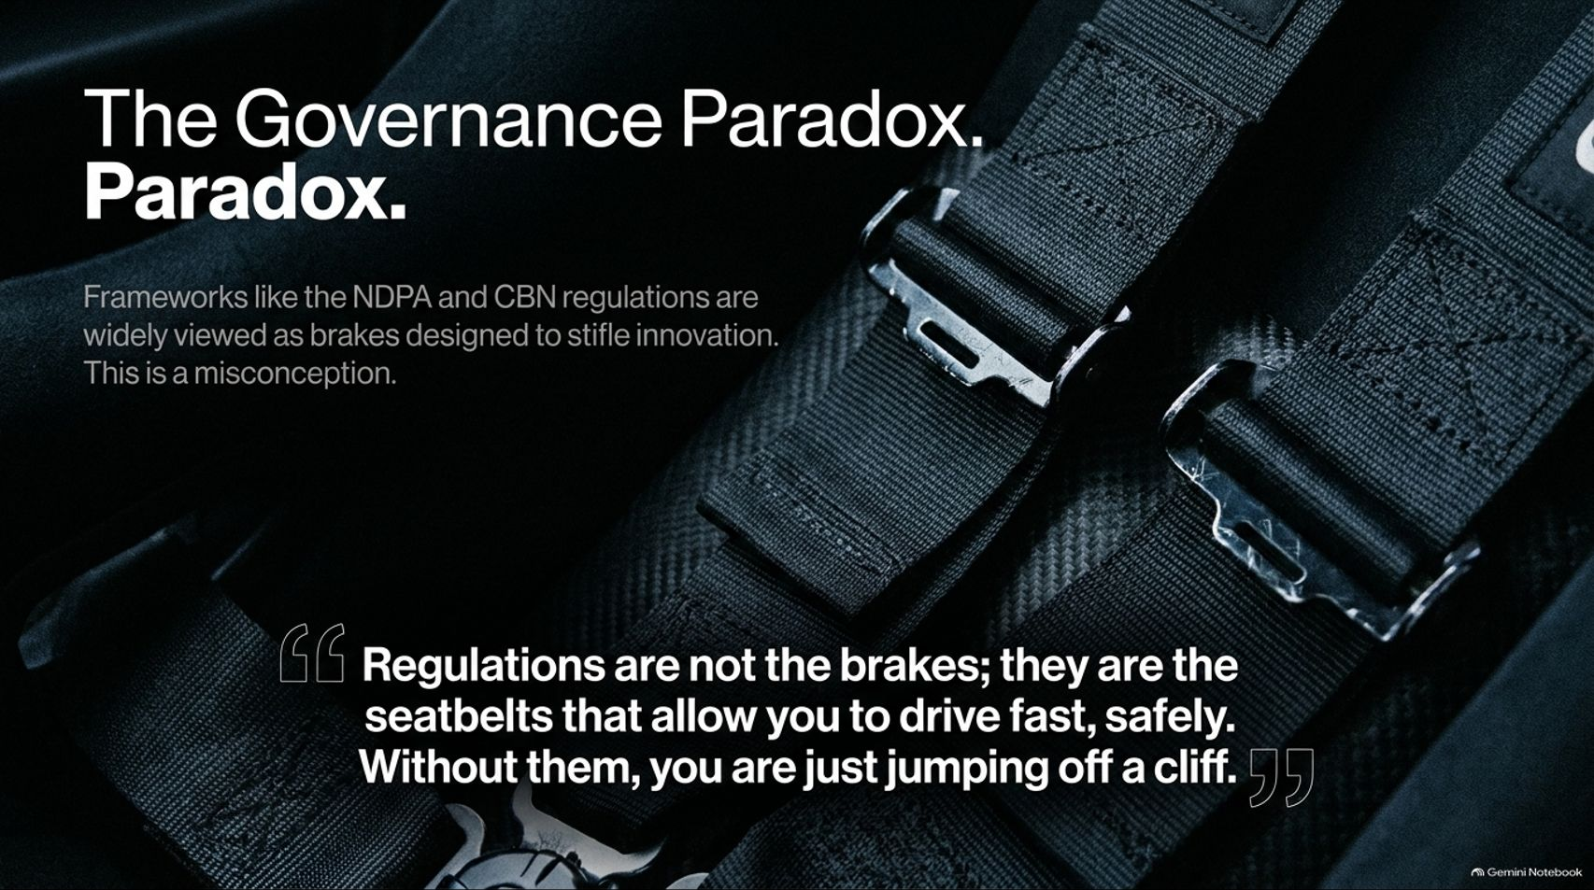
Notes:
Target Time: ~3.5 Minutes (500 words)
Speaker Script
"Regulatory frameworks like the Nigeria Data Protection Act (NDPA) and Central Bank guidelines are frequently viewed by business units as brakes designed solely to stifle innovation.
This is a dangerous misconception.
To quote Okigo’s core governance philosophy: 'Regulations are not the brakes; they are the seatbelts that allow you to drive fast, safely. Without them, you are just jumping off a cliff.' Governance guardrails ensure that when your AI systems scale, they do not violate privacy laws or trigger catastrophic enterprise failures."

Slide 11
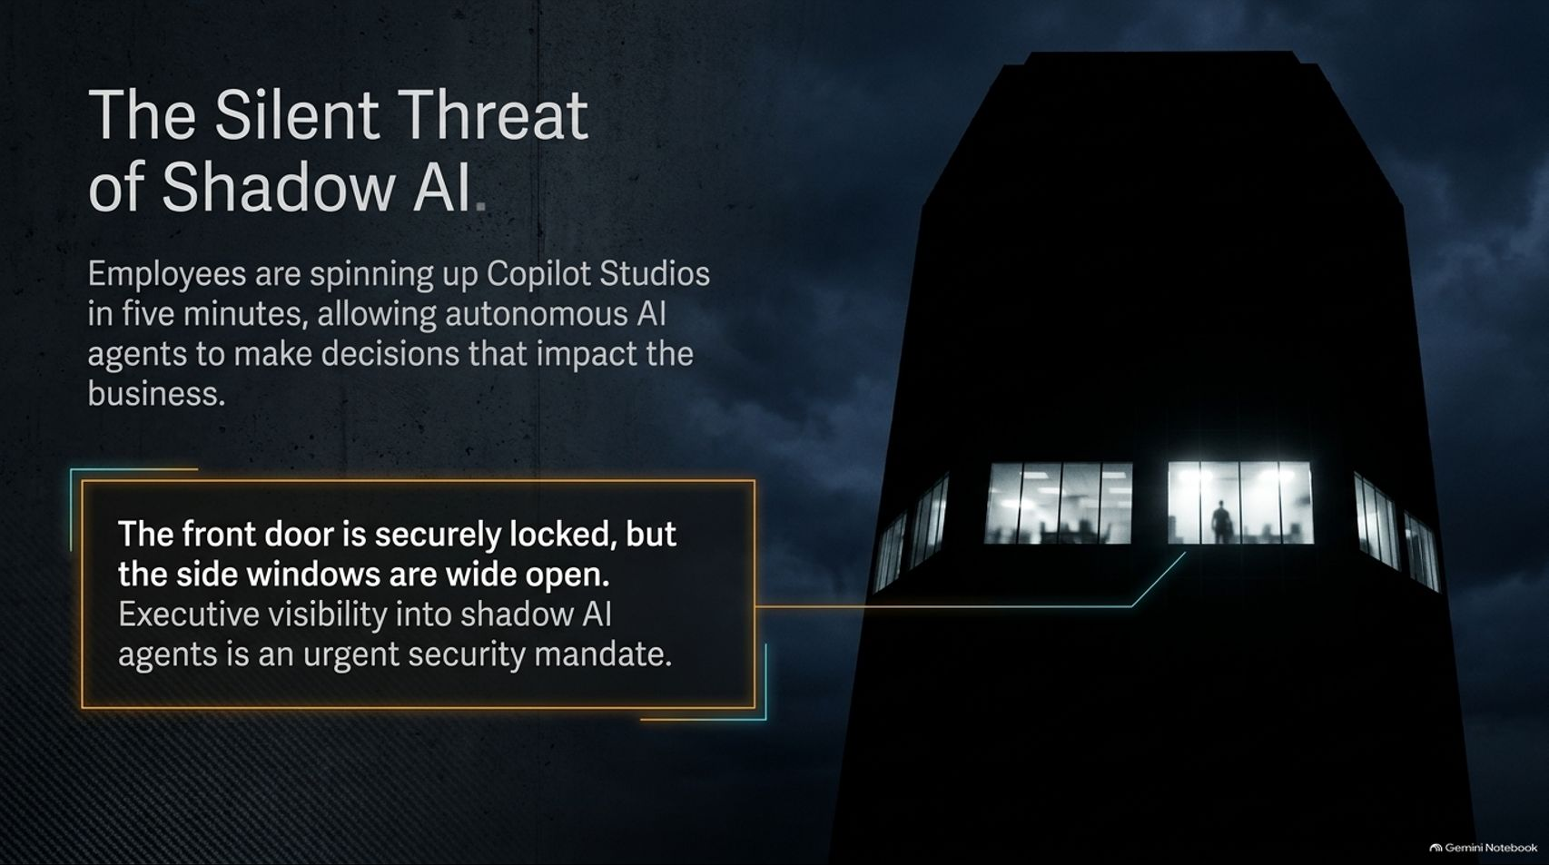
Notes:
Target Time: ~3.5 Minutes (490 words)
Speaker Script
"While executives focus heavily on securing official AI projects, a silent threat is growing inside organizations: Shadow AI.
Employees are spinning up low-code agent builders like Copilot Studio in five minutes, deploying autonomous AI agents that make operational decisions impacting the business without IT or compliance oversight.
As Okigo points out, the front door is securely locked, but the side windows are wide open. Gaining executive visibility into unauthorized shadow AI agents is an urgent security mandate before an unmonitored agent causes systemic damage."

Slide 12

Notes:
Target Time: ~4 Minutes (580 words)
Speaker Script
"For startups and resource-conscious enterprises looking to leverage AI while maintaining strict data privacy, how do you navigate the tension between innovation and security?
Here is the hard rule: Never put sensitive customer data into public AI tools, regardless of their privacy claims. You cannot have 100% full control over third-party cloud data handling.
The Play: Invest in local, isolated hardware—such as a local AI machine or Mac Mini running around $600—to securely run open-source models and RAG (Retrieval-Augmented Generation) pipelines entirely in-house. Scale your infrastructure only as your verified use cases scale, protecting privacy from Day One."

Slide 13
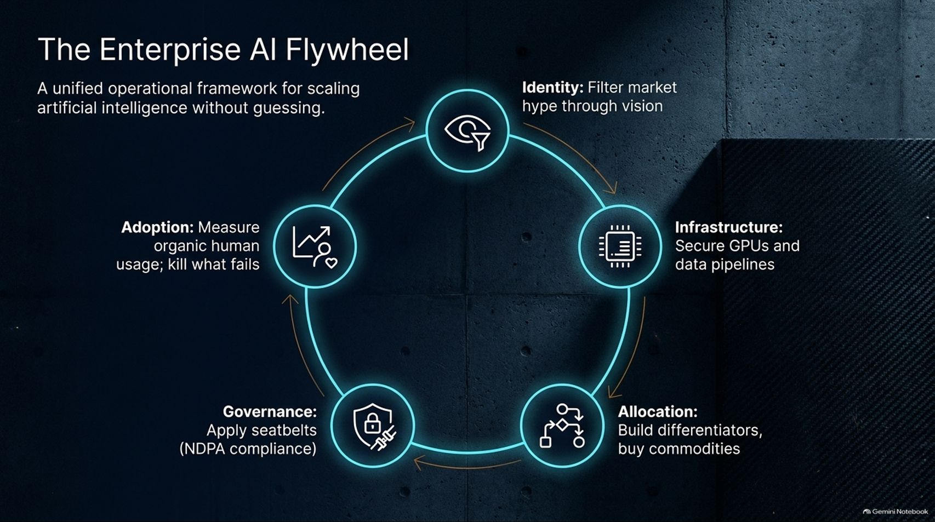
Notes:
Target Time: ~3.5 Minutes (500 words)
Speaker Script
"To tie our operational framework together, let’s look at The Enterprise AI Flywheel—a unified operational model for scaling artificial intelligence without guessing:
Identity: Filter market hype through your core vision and business mission.
Infrastructure: Secure GPUs, data pipelines, and internal computing capacity.
Allocation: Build differentiators where your data matters; buy standard commodities.
Governance: Apply regulatory seatbelts for compliance and safe speed.
Adoption: Measure organic human usage and ruthlessly kill what fails.
When these five elements reinforce each other, AI spending transforms from a speculative gamble into a disciplined engine of growth."

Slide 14
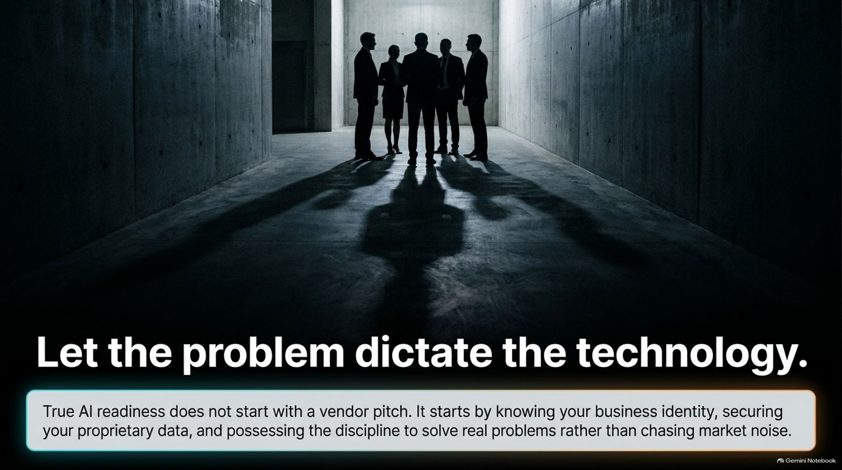
Notes:
Target Time: ~3 Minutes (400 words)
Speaker Script
"As we synthesize our playbook, the overarching message for leadership is clear: Let the problem dictate the technology.
True AI readiness does not start with a flashy vendor pitch or FOMO-driven purchasing. It starts by knowing your business identity, securing your proprietary data, and possessing the operational discipline to solve real business problems rather than chasing market noise."

Slide 15
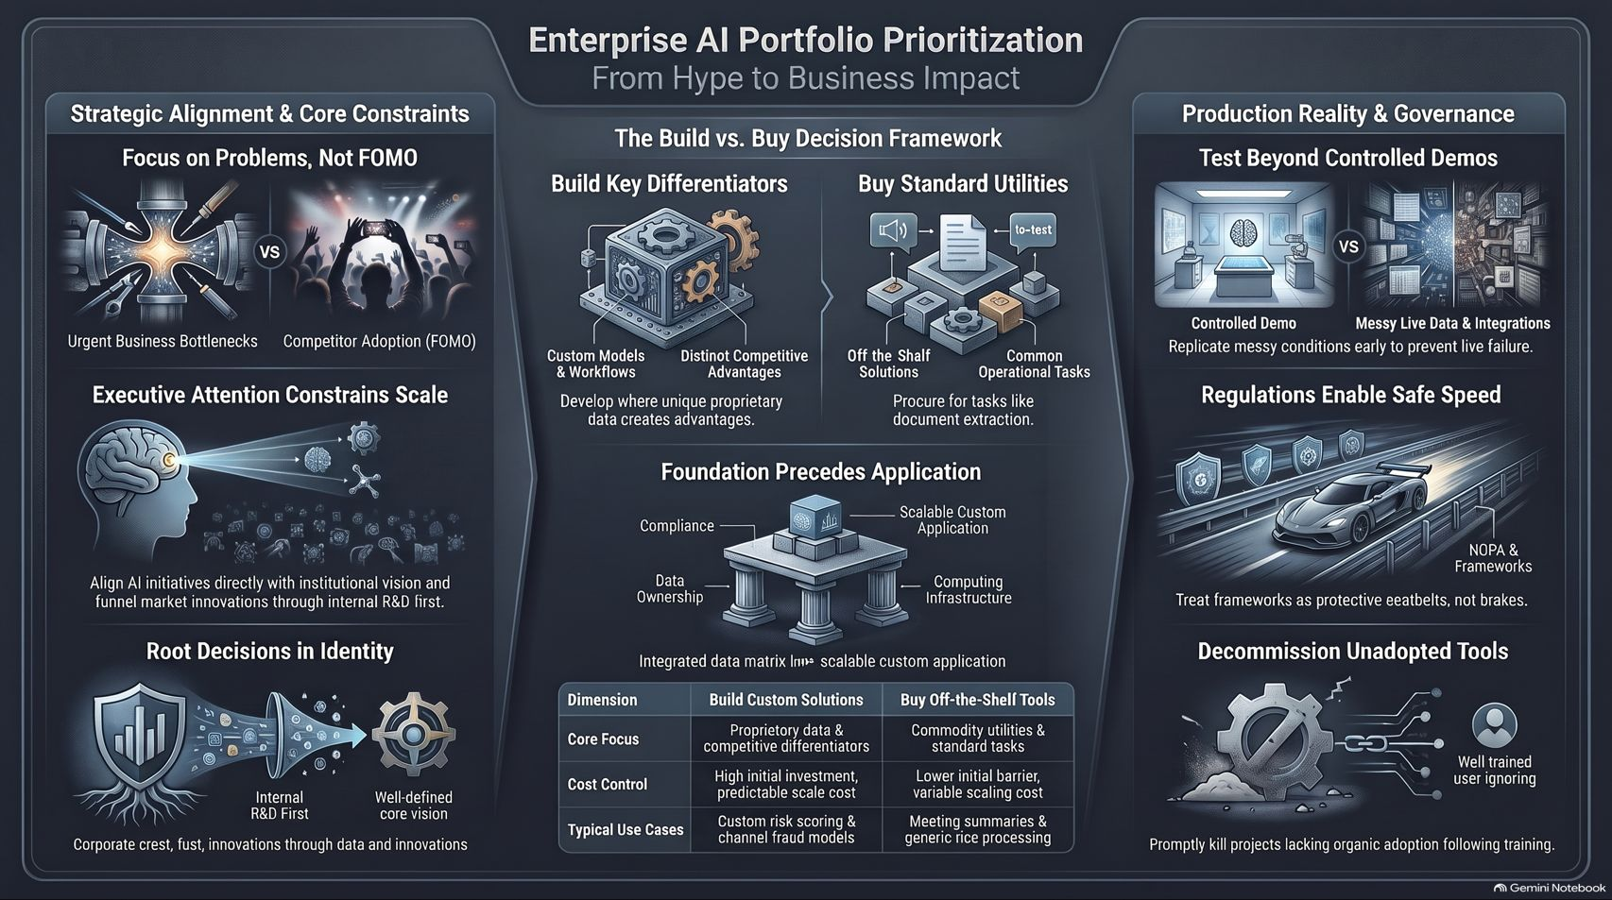
Notes:
Target Time: ~4 Minutes (580 words)
Speaker Script
"To conclude our overview across the entire playbook, let’s review our core pillars for moving from hype to business impact:
Strategic Alignment: Focus strictly on urgent business bottlenecks rather than competitor FOMO, aligning AI directly with institutional vision.
Build vs. Buy: Use custom models for proprietary data advantages while procuring off-the-shelf solutions for standard operational tasks.
Production Reality: Test beyond controlled demos by simulating messy real-world data and user friction early.
Governance & Adoption: Treat compliance frameworks as protective seatbelts, and promptly decommission unadopted tools that lack organic staff buy-in.
By anchoring your strategy in discipline, security, and real problem-solving, your enterprise can build an AI portfolio that delivers lasting value. Thank you!"

