Slide 1
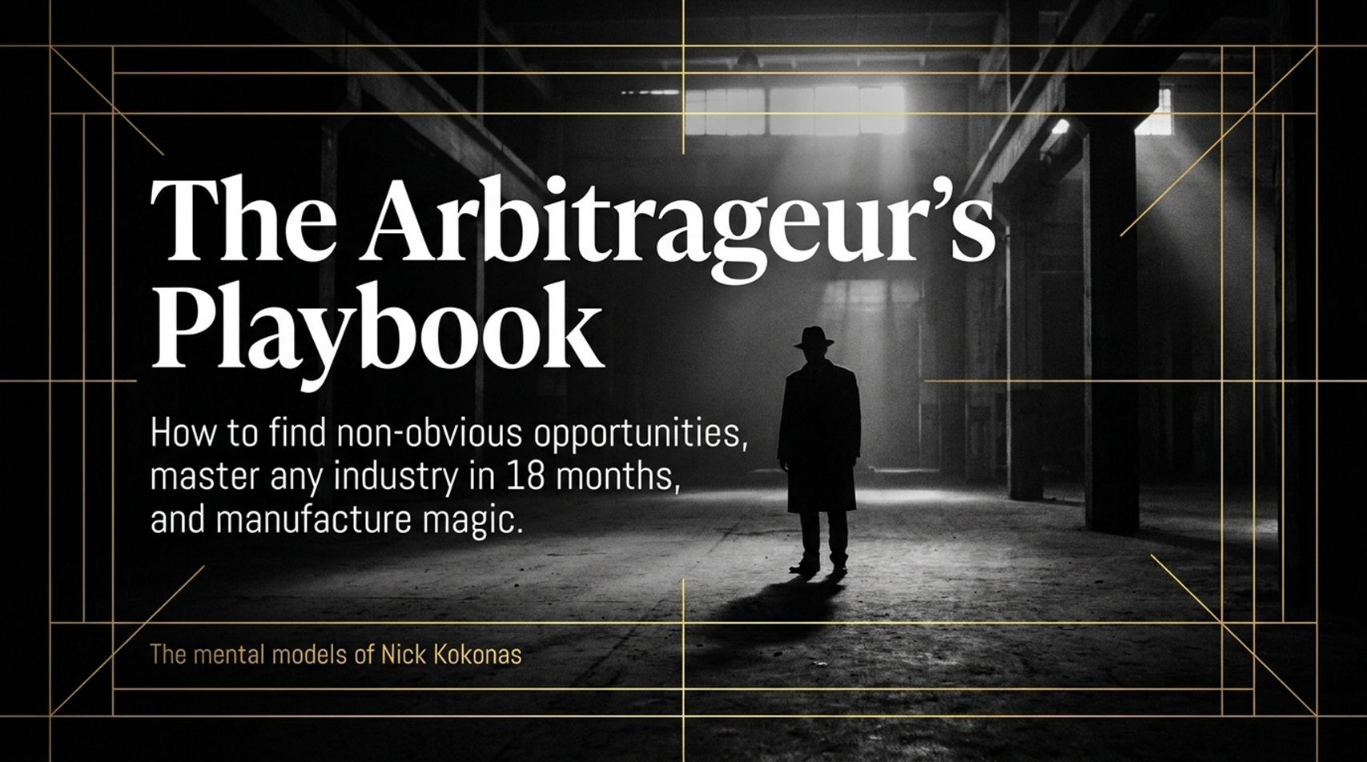
Notes:
Slide Title: The Arbitrageur’s Playbook: How to find non-obvious opportunities, master any industry in 18 months, and manufacture magic.
Target Duration: 3 Minutes
Speaker Talking Points
Opening Hook: Welcome, everyone. Today, we are exploring a mindset that spans financial derivatives, world-class gastronomy, and immersive live-action platforms. This framework is built entirely on the mental models of Nick Kokonas.
Core Premise: Most people view business as a linear climb up a single hill. True arbitrageurs look for systemic mispricings, structural latencies, and hidden rules that others take for granted.
Overview of the Journey: Over the next 16 slides, we will deconstruct how to find non-obvious opportunities, master new industries rapidly, and engineer exceptional outcomes from first principles.
The Arbitrage Hunter: how to find non-obvious opportunities to make millions
https://www.youtube.com/watch?v=YdRLpWQARtA

Slide 2
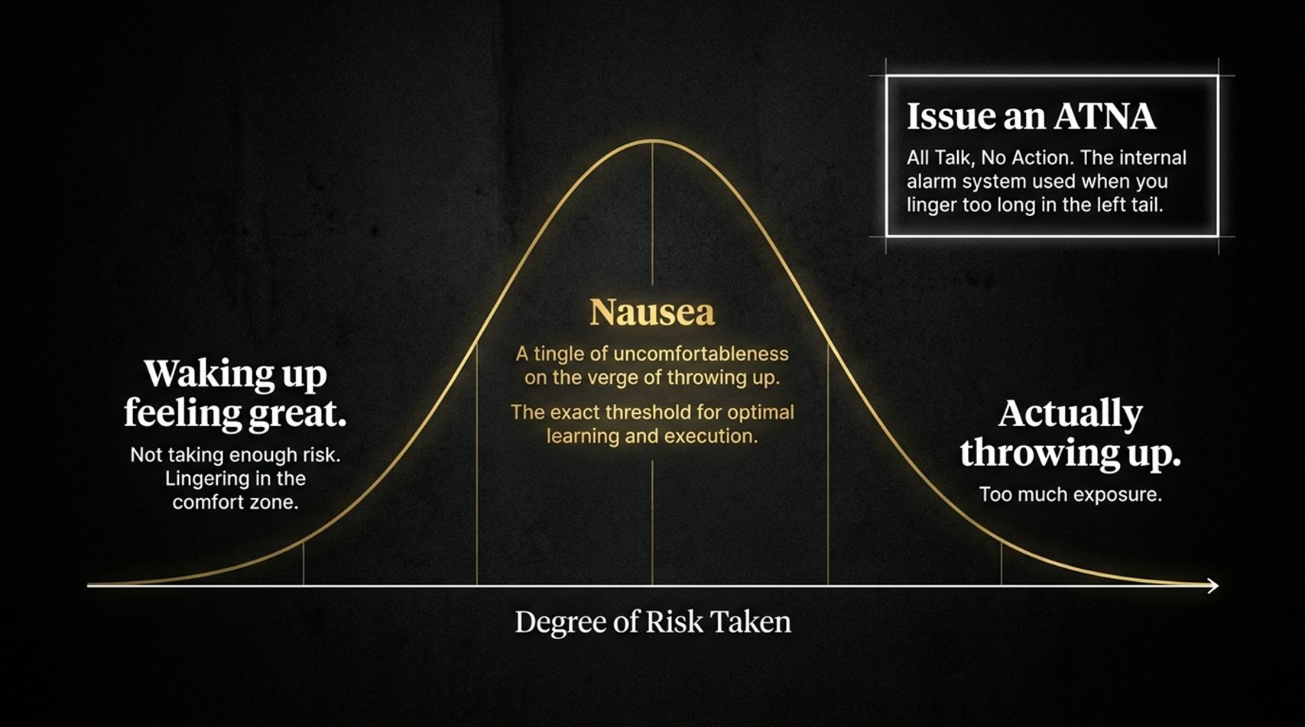
Notes:
Slide Title: The Arbitrage Mindset: Rules of Unconventional Entrepreneurship
Target Duration: 4 Minutes
Speaker Talking Points
The Core Framework: This slide maps out the complete mental architecture of unconventional entrepreneurship. Let's break down the pillars:
Seek the Tingle of Uncomfortableness: If you feel completely safe every day, you aren't taking enough risk.
Step Down the Mountain to Reset: Expertise can become a trap; true innovators willingly return to beginner status.
Grind Out Volume: World-class output requires producing and filtering through hundreds of bad iterations.
Drive Arbitrage via Time Scale: Spot where legacy systems introduce unnecessary delays.
Read the Rules to Find High Hoops: Deeply studying regulations exposes hidden structural advantages.

Slide 3
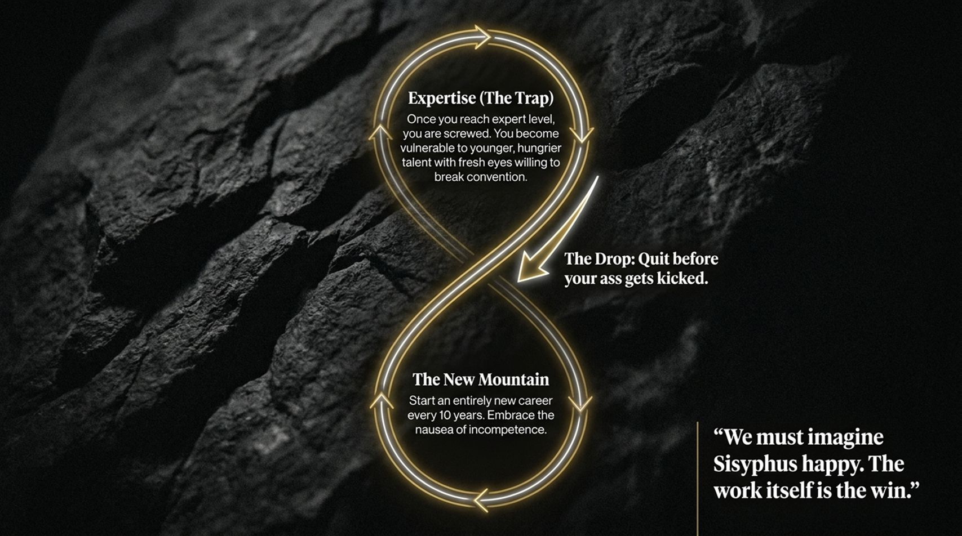
Notes:
Slide Title: Expertise is a Trap: The Sisyphus Loop
Target Duration: 4 Minutes
Speaker Talking Points
The Expertise Trap: Once you reach the top of an industry and achieve expert level, you often become rigid, vulnerable to younger, hungrier talent with fresh eyes who are willing to break conventions.
The Drop: You must know when to quit or pivot before your current expertise gets stale and your advantages are commoditized.
The New Mountain: Embrace the nausea of incompetence by starting an entirely new career or venture every decade. As Albert Camus noted: "We must imagine Sisyphus happy. The work itself is the win."

Slide 4
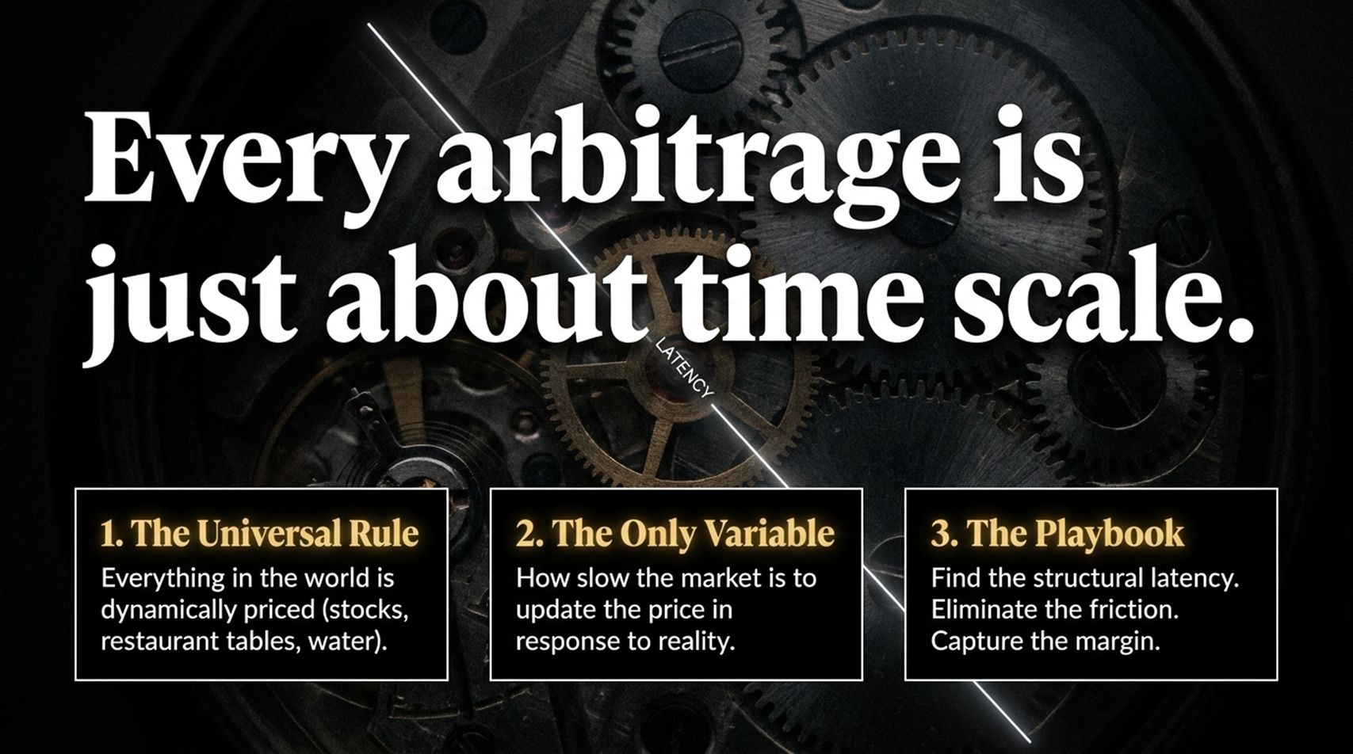
Notes:
Slide Title: Every arbitrage is just about time scale.
Target Duration: 4 Minutes
Speaker Talking Points
The Universal Rule: Everything in the world is dynamically priced—whether it's stocks, restaurant tables, or water.
The Only Variable: The critical variable is how slow or fast a market is to update its pricing in response to reality.
The Playbook: To capture margin, you must find structural latency, eliminate operational friction, and execute faster than the market can adjust.

Slide 5
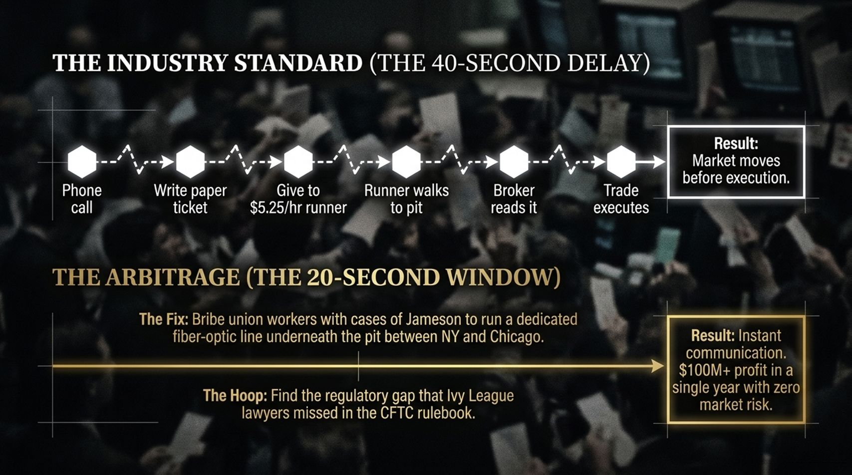
Notes:
Slide Title: The Industry Standard vs. The Arbitrage Window
Target Duration: 5 Minutes
Speaker Talking Points
The Legacy Delay: In traditional floor trading, a phone call, a paper ticket, a low-wage runner, and manual broker processing created a 40-second delay, causing the market to move before execution.
The Arbitrage Solution: By finding regulatory gaps and bypassing standard latency—such as running dedicated fiber-optic lines—traders captured instantaneous communication.
The Lesson: Speed and regulatory navigation can unlock massive multi-million-dollar spreads with zero market risk.

Slide 6
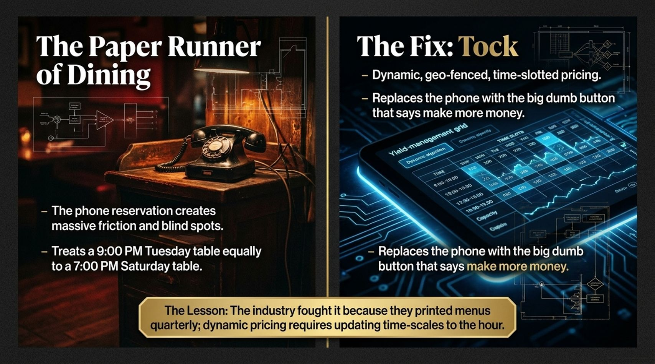
Notes:
Slide Title: The Paper Runner of Dining & The Tock Solution
Target Duration: 4 Minutes
Speaker Talking Points
The Restaurant Blind Spot: Traditional phone reservations create massive friction and treat a 9:00 PM Tuesday table identically to a 7:00 PM Saturday table.
The Tock Fix: Moving to dynamic, geo-fenced, time-slotted pricing replaces archaic phone bookings with a streamlined system that maximizes revenue and eliminates costly no-shows.
The Industry Pushback: Legacy operators fought this innovation because their menus were printed quarterly, whereas true dynamic pricing requires updating timescales to the hour.

Slide 7
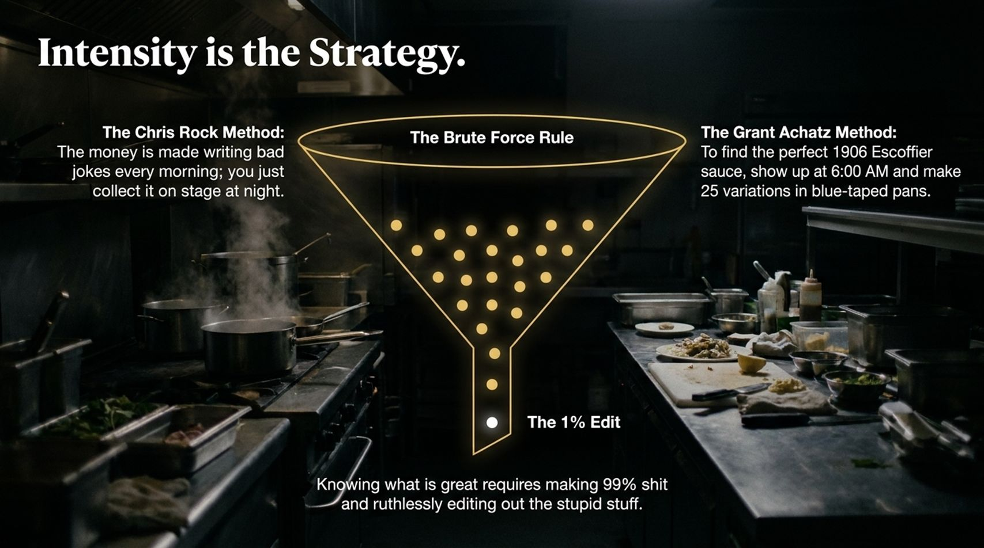
Notes:
Slide Title: Intensity is the Strategy
Target Duration: 4 Minutes
Speaker Talking Points
The Brute Force Rule: Knowing what is great requires making 99% garbage and ruthlessly editing out the inferior choices.
The Culinary Parallel: Just like Chef Grant Achatz making 25 variations of a sauce in blue-taped pans at 6:00 AM, greatness is a function of high-volume iteration, not instant genius.
The Creative Method: Write bad jokes or test dozens of variations every morning so you can perform flawlessly on stage at night.

Slide 8
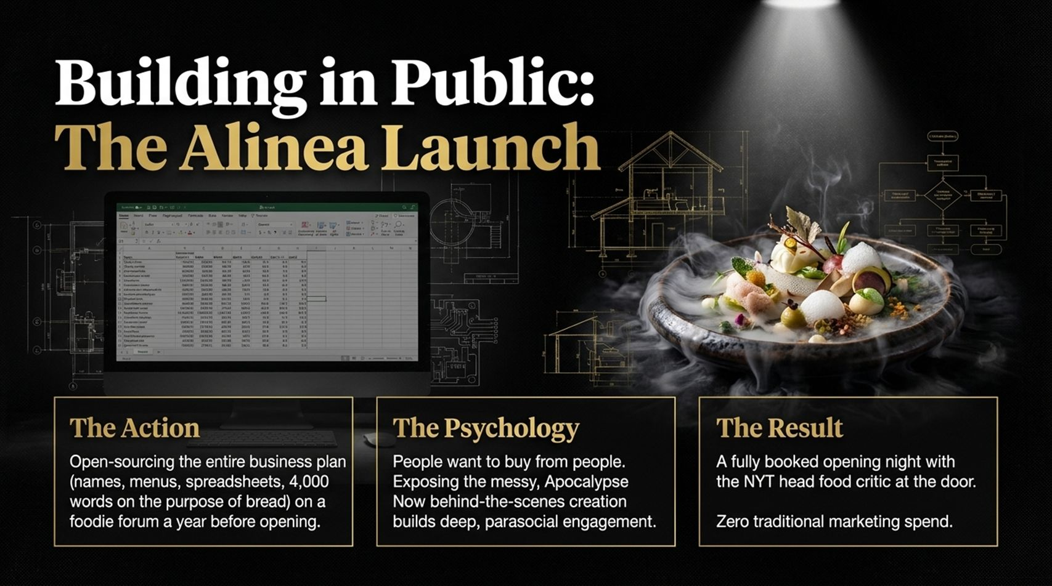
Notes:
Slide Title: Building in Public: The Alinea Launch
Target Duration: 4 Minutes
Speaker Talking Points
The Action: Open-sourcing an entire business plan—including names, spreadsheets, and detailed philosophy—on a foodie forum a year before opening.
The Psychology: People want to buy from people. Exposing the behind-the-scenes creation process builds deep, authentic parasocial engagement before launch day.
The Result: A fully booked opening night with the New York Times head food critic at the door, achieved with zero traditional marketing spend.

Slide 9
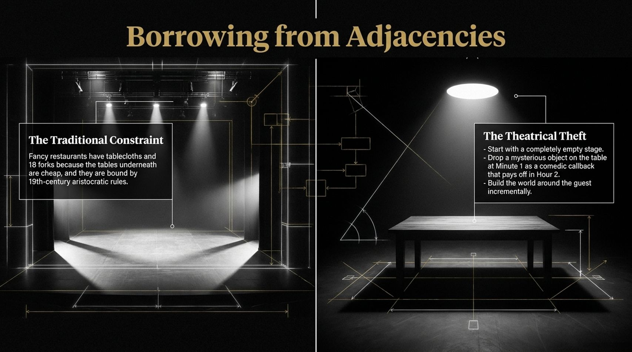
Notes:
Slide Title: Borrowing from Adjacencies
Target Duration: 4 Minutes
Speaker Talking Points
The Traditional Constraint: Fancy restaurants are often bound by 19th-century aristocratic rules, heavy tablecloths, and excessive cutlery.
The Theatrical Theft: Borrowing concepts from immersive theater—starting with an empty stage, introducing mysterious elements early that pay off later, and building the world around the guest incrementally.
The Takeaway: True innovation often happens when you import working frameworks from completely unrelated industries.

Slide 10
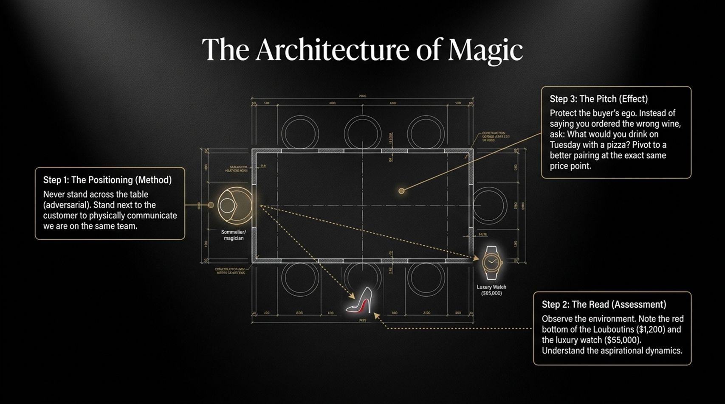
Notes:
Slide Title: The Architecture of Magic
Target Duration: 4 Minutes
Speaker Talking Points
Step 1 (Positioning): Never stand across the table in an adversarial posture. Stand next to the customer to physically communicate that you are on the same team.
Step 2 (The Read): Observe environmental cues and aspirational dynamics without making assumptions.
Step 3 (The Pitch): Protect the buyer's ego. Pivot smoothly to options that match their exact profile and price point without friction.

Slide 11
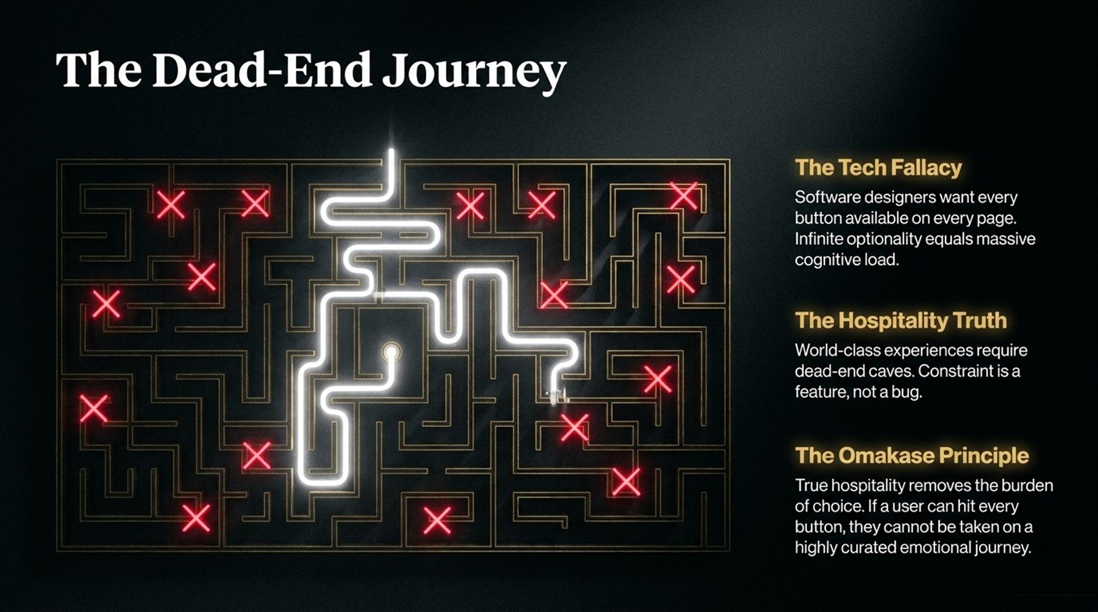
Notes:
Slide Title: The Dead-End Journey
Target Duration: 4 Minutes
Speaker Talking Points
The Tech Fallacy: Software designers often want every button available on every page, creating infinite optionality and massive cognitive load.
The Hospitality Truth: World-class experiences require curated constraints. Constraint is a feature, not a bug.
The Omakase Principle: True hospitality removes the burden of choice so customers can experience a seamless, guided emotional journey.

Slide 12
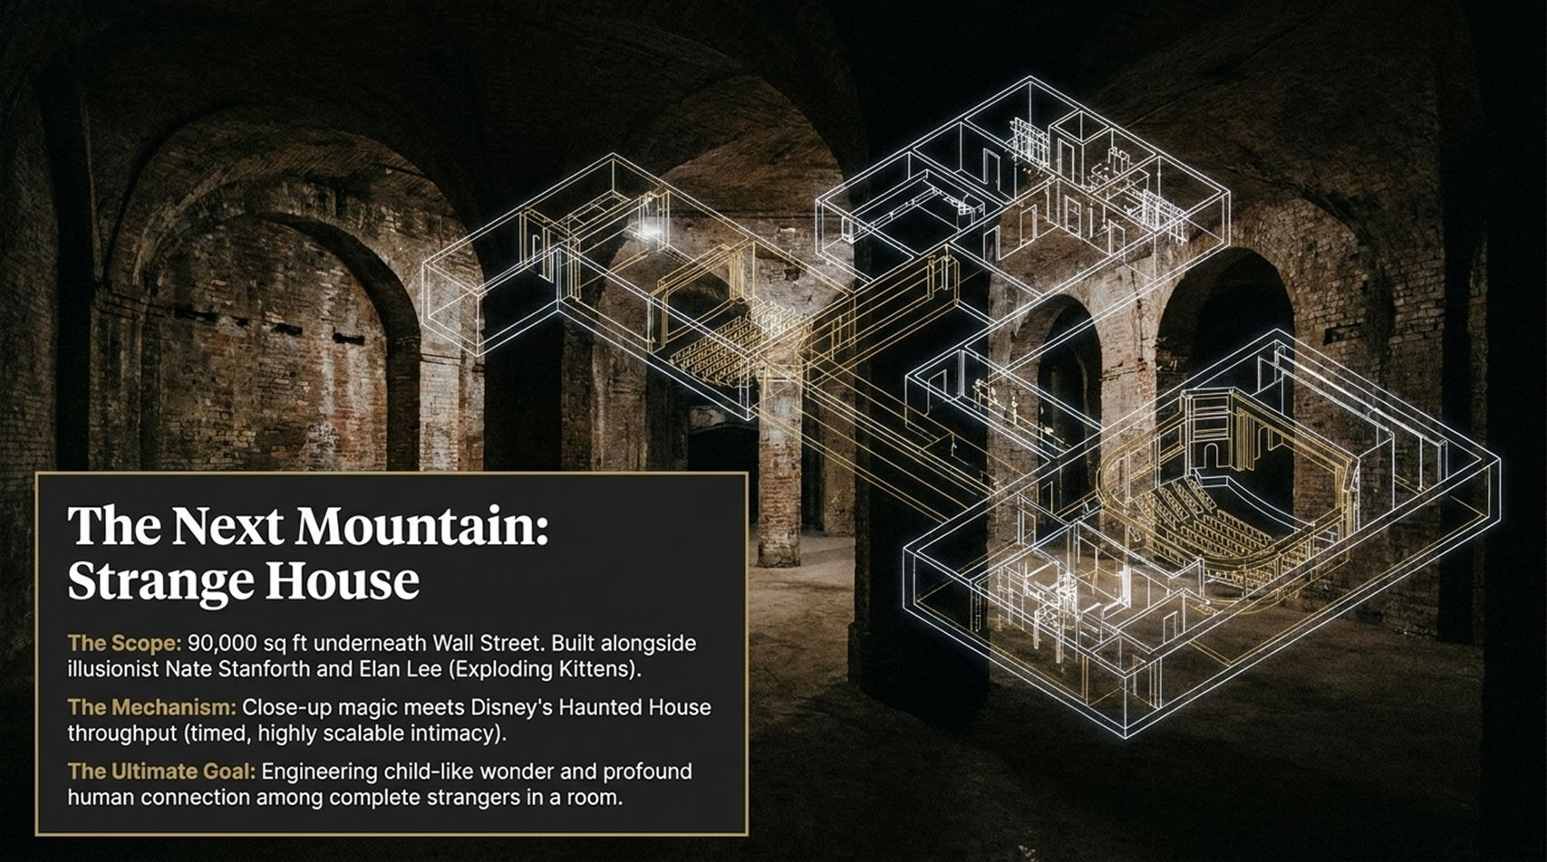
Notes:
Slide Title: The Next Mountain: Strange House
Target Duration: 4 Minutes
Speaker Talking Points
The Scope: Building a 90,000-square-foot immersive experience underneath Wall Street alongside illusionist Nate Stanworth and Elan Lee.
The Mechanism: Merging close-up magic with Disney-style Haunted House throughput to deliver timed, highly scalable intimacy.
The Ultimate Goal: Engineering childlike wonder and profound human connection among complete strangers in a shared room.

Slide 13
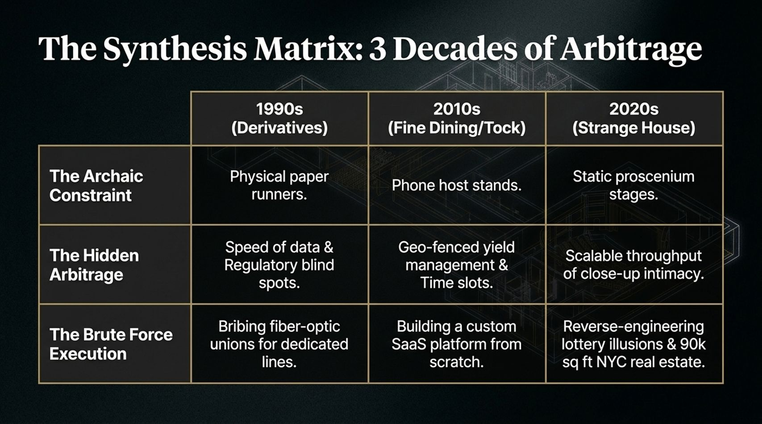
Notes:
Slide Title: The Synthesis Matrix: 3 Decades of Arbitrage
Target Duration: 5 Minutes
Speaker Talking Points
Matrix Overview: Let's look across three distinct decades of execution:
1990s (Derivatives): Overcoming physical paper runners by exploiting data speed and regulatory blind spots through dedicated fiber lines.
2010s (Fine Dining/Tock): Replacing phone host stands with geo-fenced yield management and custom SaaS platforms.
2020s (Strange House): Moving beyond static proscenium stages to engineer scalable, high-intimacy real estate experiences.

Slide 14
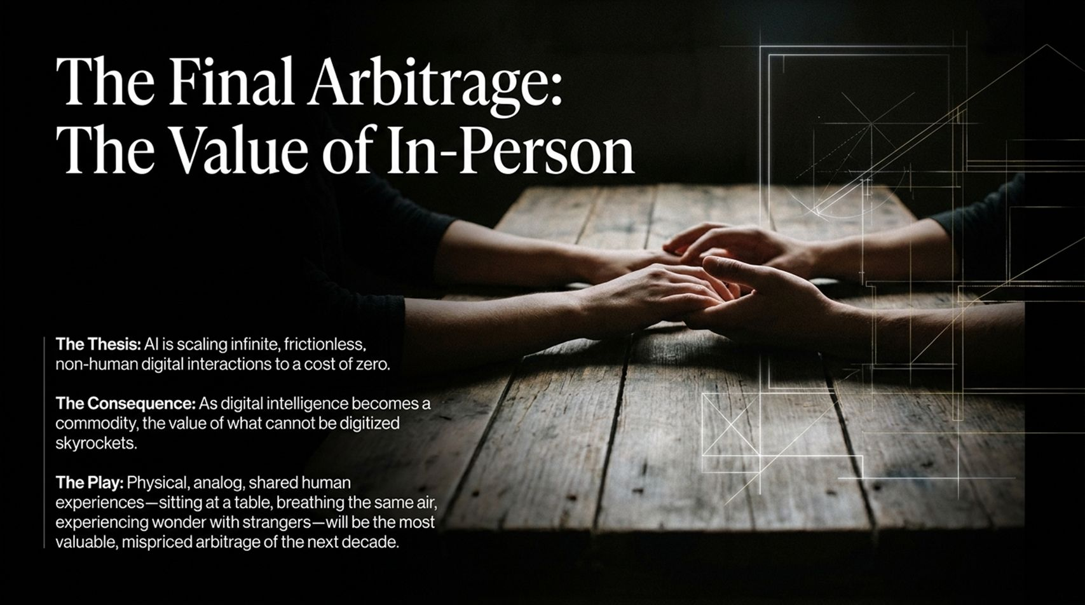
Notes:
Slide Title: The Final Arbitrage: The Value of In-Person
Target Duration: 4 Minutes
Speaker Talking Points
The Thesis: AI is scaling infinite, frictionless digital interactions down to a cost of zero.
The Consequence: As digital intelligence becomes a commoditized utility, the value of what cannot be digitized skyrockets.
The Play: Physical, analog, shared human experiences—breathing the same air and experiencing wonder with strangers—will be the most valuable arbitrage of the coming decade.

Slide 15
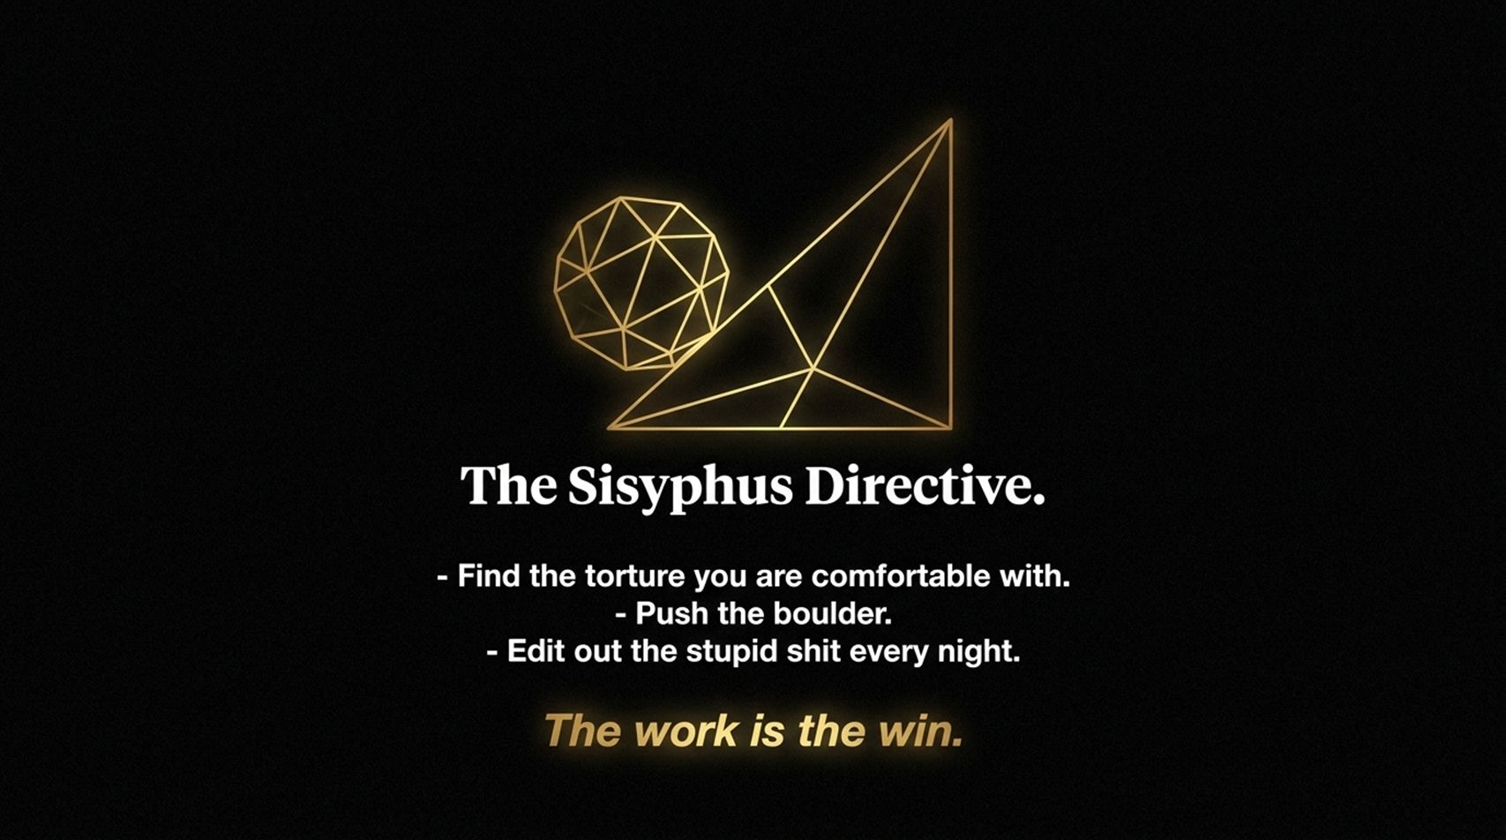
Notes:
Slide Title: The Sisyphus Directive
Target Duration: 3 Minutes
Speaker Talking Points
Core Action Items:
Find the torture you are comfortable with.
Push the boulder relentlessly.
Edit out the redundant or ineffective parts every single night.
Final Mantra: The work is the win. Finding fulfillment in the continuous loop of iteration is what separates enduring builders from transient speculators.

Slide 16
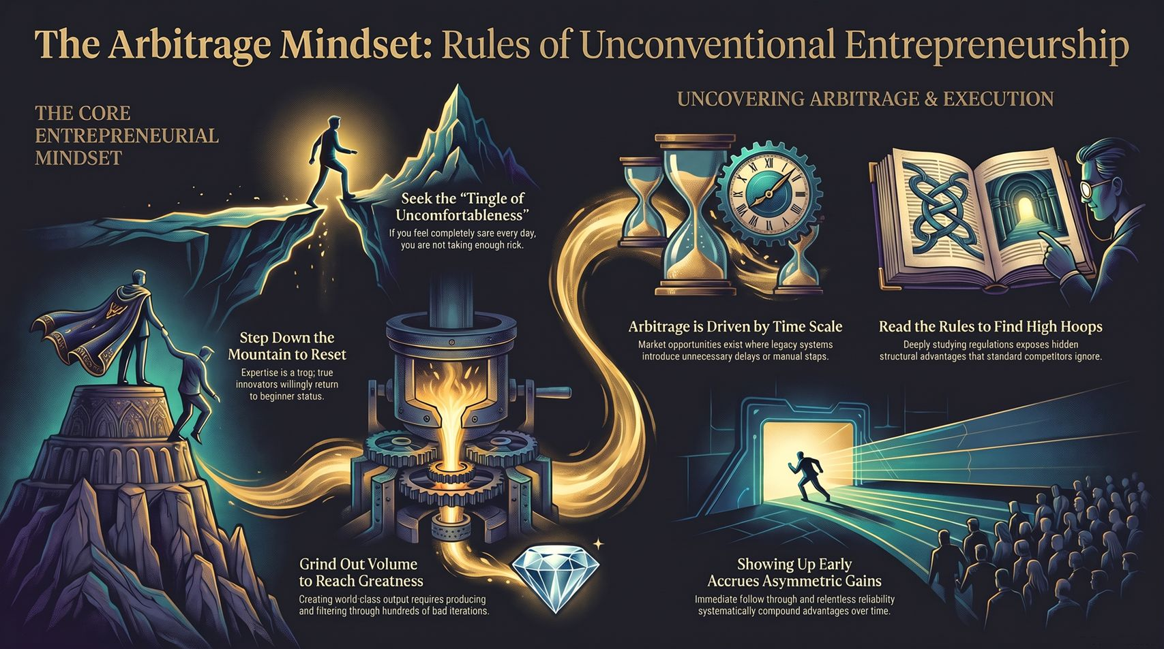
Notes:
Slide Title: Open Discussion & Q&A
Target Duration: 3 Minutes
Speaker Talking Points
Closing Question: As we open the floor for questions, ask yourself: What unexamined constraint in your industry can you turn into your primary competitive advantage?
Call to Action: Stop competing on crowded turf. Find your structural latency, embrace calculated discomfort, and build your own playbook. Thank you!

