Slide 1
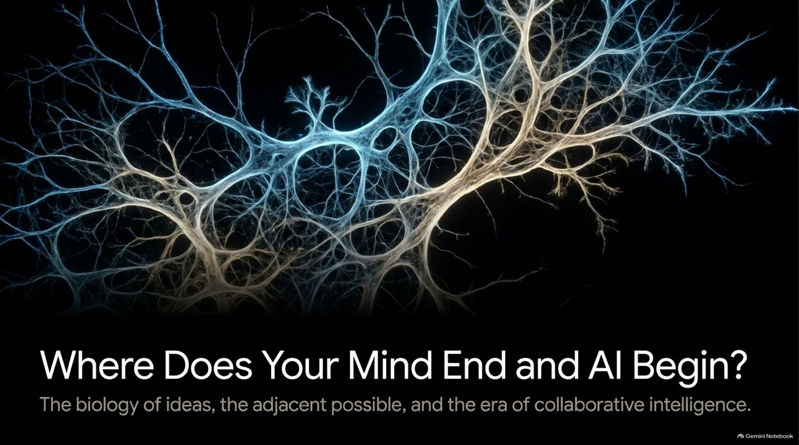
Notes:
Visual Theme: Neural pathways and branching networks.
Core Title: Where Does Your Mind End and AI Begin?
Subtitle: The biology of ideas, the adjacent possible, and the era of collaborative intelligence.
Duration Range: 2 – 4 minutes
Speaker Notes:
Opening Hook: Welcome the audience. Ask them to think about the last time a brilliant idea struck them unexpectedly—perhaps in the shower, on a walk, or right before falling asleep. It feels instantaneous, like a light switch turning on in a dark room.
The Core Premise: Introduce the overarching theme of the session: We are entering a profound transition in human history where the boundary between biological thinking and artificial intelligence is dissolving.
Connecting to the Podcast: Reference David Eagleman and Steven Johnson's discussion on Inner Cosmos: ideas do not emerge from a vacuum. They are network events. As we explore this deck, we will examine how modern AI acts as an external associative layer that dramatically expands human creativity, pushing us past traditional cognitive limits.
Where Does Your Mind End and A.I. Begin?
https://www.youtube.com/watch?v=oxnZrxVComA

Slide 2
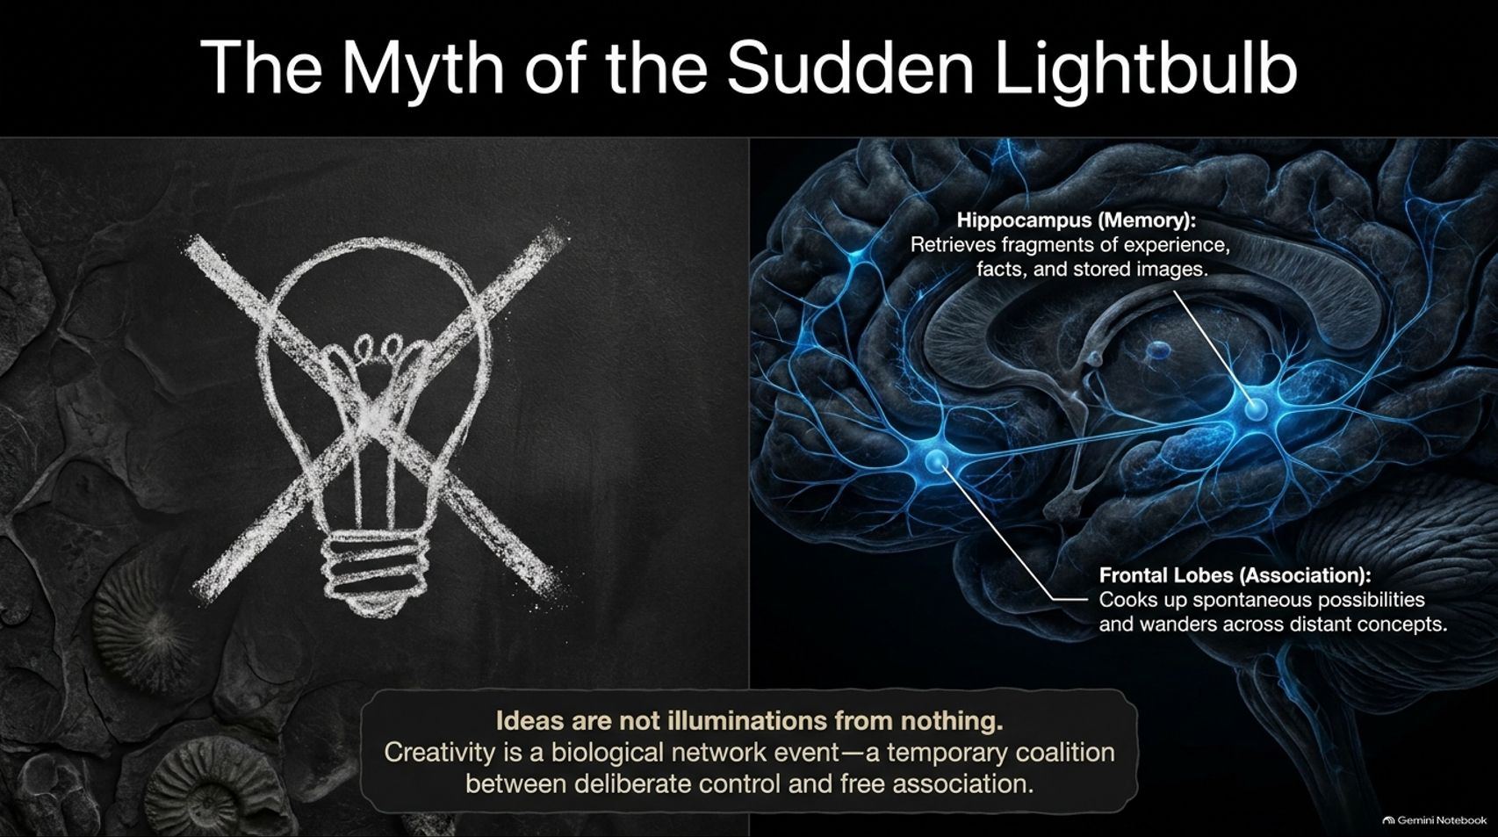
Notes:
Visual Theme: A crossed-out lightbulb vs. biological brain structures (Hippocampus and Frontal Lobes).
Key Concept: Ideas are biological network events involving memory retrieval and free association.
Duration Range: 3 – 5 minutes
Speaker Notes:
Deconstructing the Myth: Challenge the common cultural symbol of the lightbulb for creativity. Creativity is not an immaculate conception or a sudden illumination from nothing.
The Neuroscience: Explain the underlying biology. The Hippocampus acts as our memory engine, retrieving fragments of past experiences, facts, and stored images. Meanwhile, the Frontal Lobes and executive networks manage spontaneous thought and free association.
Synthesis: Creativity requires a temporary coalition between deliberate control and free association. One network proposes possibilities, while the other evaluates their usefulness. True innovation is a biological network event inside a three-pound universe.

Slide 3
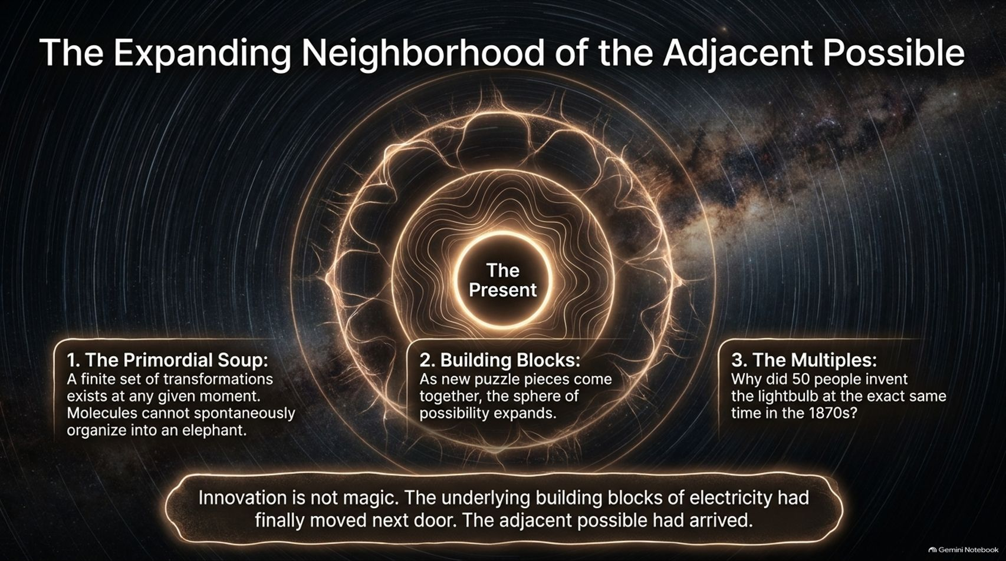
Notes:
Visual Theme: Concentric rings expanding outward from "The Present."
Key Concept: Stuart Kauffman’s concept of the "Adjacent Possible" and historical innovation clusters.
Duration Range: 3 – 5 minutes
Speaker Notes:
Defining the Adjacent Possible: Introduce theoretical biologist Stuart Kauffman’s concept (popularized by Steven Johnson). At any given moment, a culture possesses a finite set of building blocks. You cannot invent a microwave in 1650 because the underlying components simply do not exist yet.
The Three Pillars:
The Primordial Soup: A finite set of transformations exists at any moment.
Building Blocks: As new puzzle pieces come together, the sphere of possibility expands.
The Multiples: Why do inventions happen simultaneously? (e.g., 50 people working on versions of the electric light bulb in the 1870s). It happens because the adjacent possible had finally arrived.
Takeaway: Innovation is not magic; it is the natural consequence of building blocks moving next door.

Slide 4
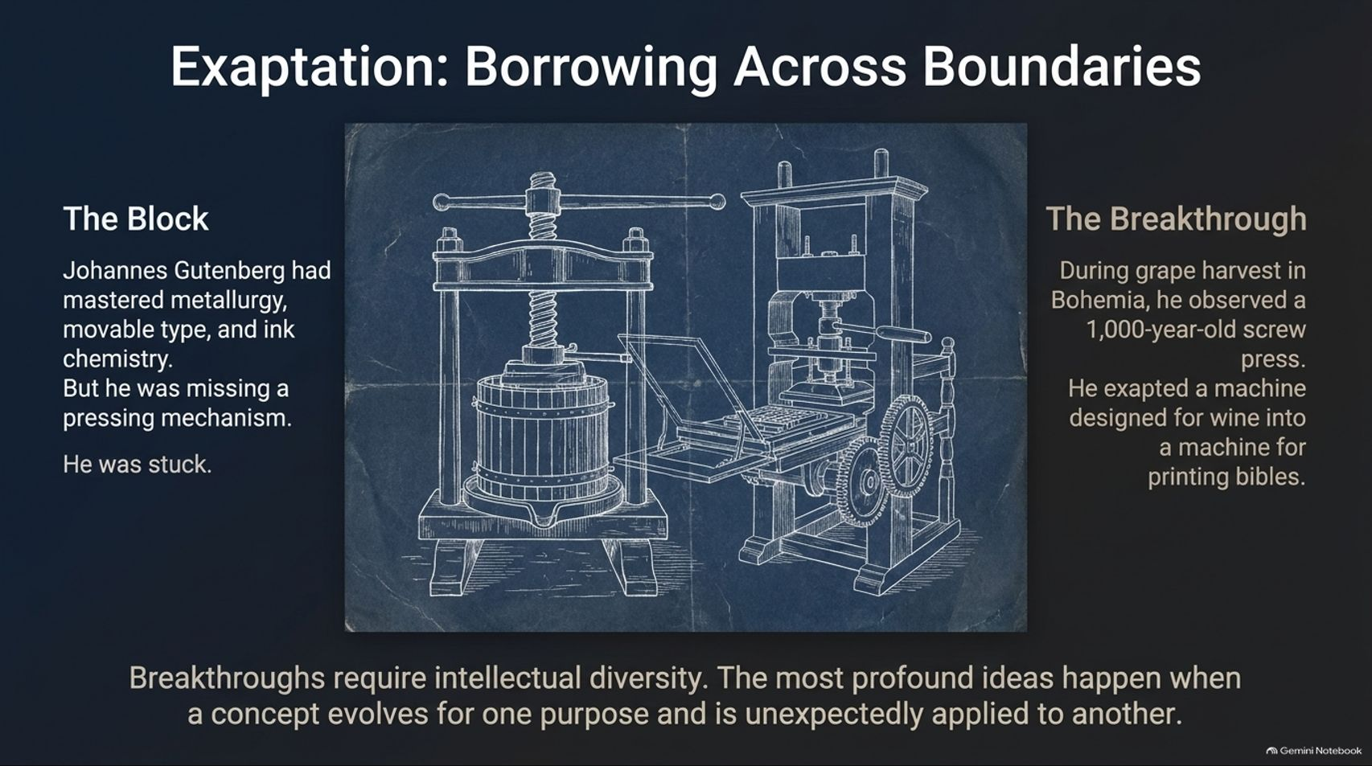
Notes:
Visual Theme: Blueprint comparing Gutenberg's press and a Bohemian wine screw press.
Key Concept: Cross-pollination and exaptation (repurposing features/tools from one domain into another).
Duration Range: 3 – 5 minutes
Speaker Notes:
The Block: Tell the story of Johannes Gutenberg. He had mastered metallurgy, movable type, and ink chemistry, but he lacked a pressing mechanism and was completely stuck.
The Breakthrough (Exaptation): During the grape harvest in Bohemia, Gutenberg observed a 1,000-year-old screw press used for crushing grapes. He exapted—borrowed a machine designed for wine and repurposed it to print Bibles.
Lesson for Innovators: Profound breakthroughs require intellectual diversity. The most powerful ideas happen when a concept evolves for one purpose and is unexpectedly applied to another. This is why cross-disciplinary hobbies and side hustles matter.

Slide 5
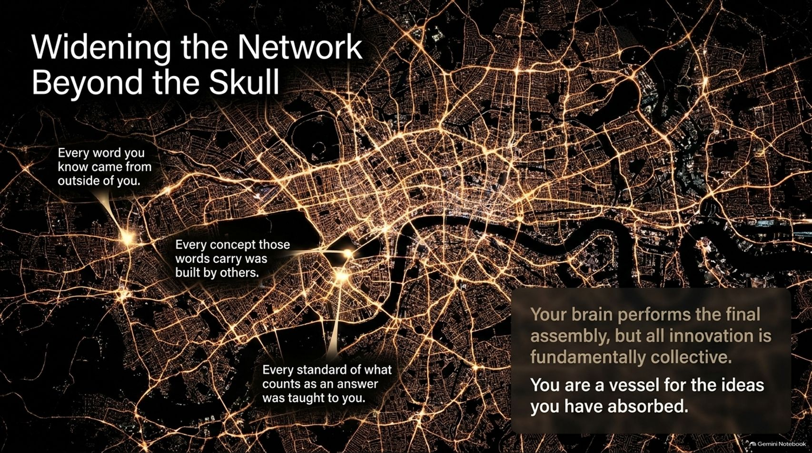
Notes:
Visual Theme: Glowing city grid map representing interconnected ideas.
Key Concept: All individual thought is built upon a collective cultural network.
Duration Range: 3 – 5 minutes
Speaker Notes:
The External Network: Widen our perspective beyond the individual skull. Every word you know, every concept you carry, and every standard of what counts as an "answer" was taught to you by culture, books, conversations, and teachers.
The Brain as Final Assembler: Your brain performs the final assembly, but all innovation is fundamentally collective. You are a vessel for the ideas you have absorbed from the broader cultural ecosystem.
Transition to AI: If human innovation has always been a networked, collaborative phenomenon, what happens when we introduce a machine capable of accelerating that networking exponentially?

Slide 6
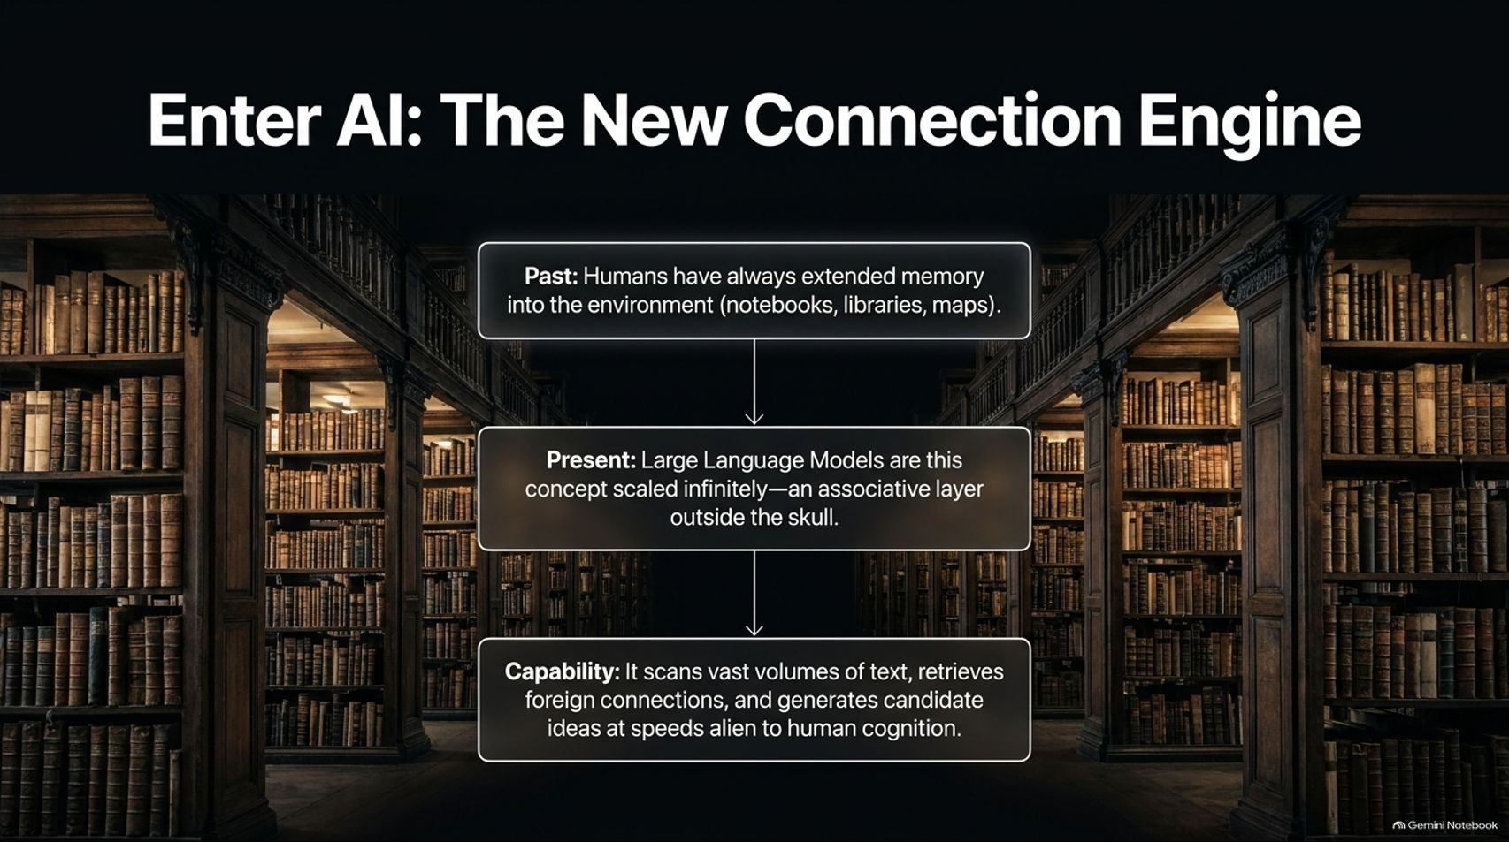
Notes:
Visual Theme: Historical library corridor showing the evolution of external memory.
Key Concept: Scaling human memory and associative capability through Large Language Models.
Duration Range: 3 – 5 minutes
Speaker Notes:
Historical Context: Humans have always extended memory into the environment—from notebooks and maps to libraries and archives.
The Present Shift: Large Language Models represent this ancient concept scaled infinitely. They function as an associative layer operating outside the biological skull.
Alien Capabilities: Modern AI can scan vast volumes of text, retrieve foreign connections across distant disciplines, and generate candidate ideas at speeds completely foreign to human cognition.

Slide 7
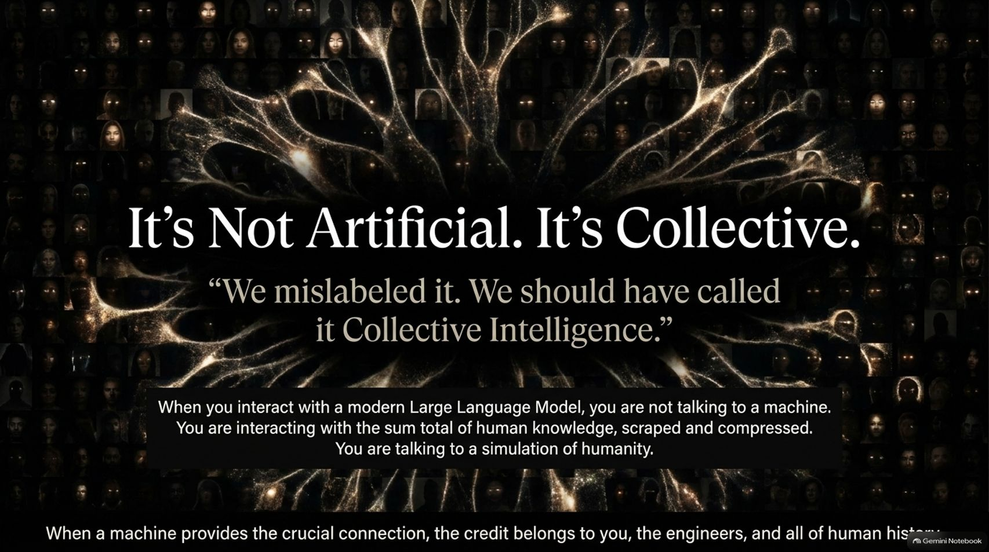
Notes:
Visual Theme: Glowing human faces blending into a neural network background.
Key Concept: Redefining AI as a simulation of human knowledge and collective intelligence.
Duration Range: 3 – 5 minutes
Speaker Notes:
Mislabeled Technology: Reference artist Holly Herndon's observation: John McCarthy and pioneers mislabeled it decades ago. It shouldn't be called Artificial Intelligence; it is Collective Intelligence.
Interacting with Humanity: When you interact with a modern LLM, you are not just talking to a machine; you are interacting with the sum total of human knowledge, scraped, compressed, and simulated.
Attribution: When a machine provides a crucial connection, the credit belongs jointly to you, the engineers, and all of human history.

Slide 8
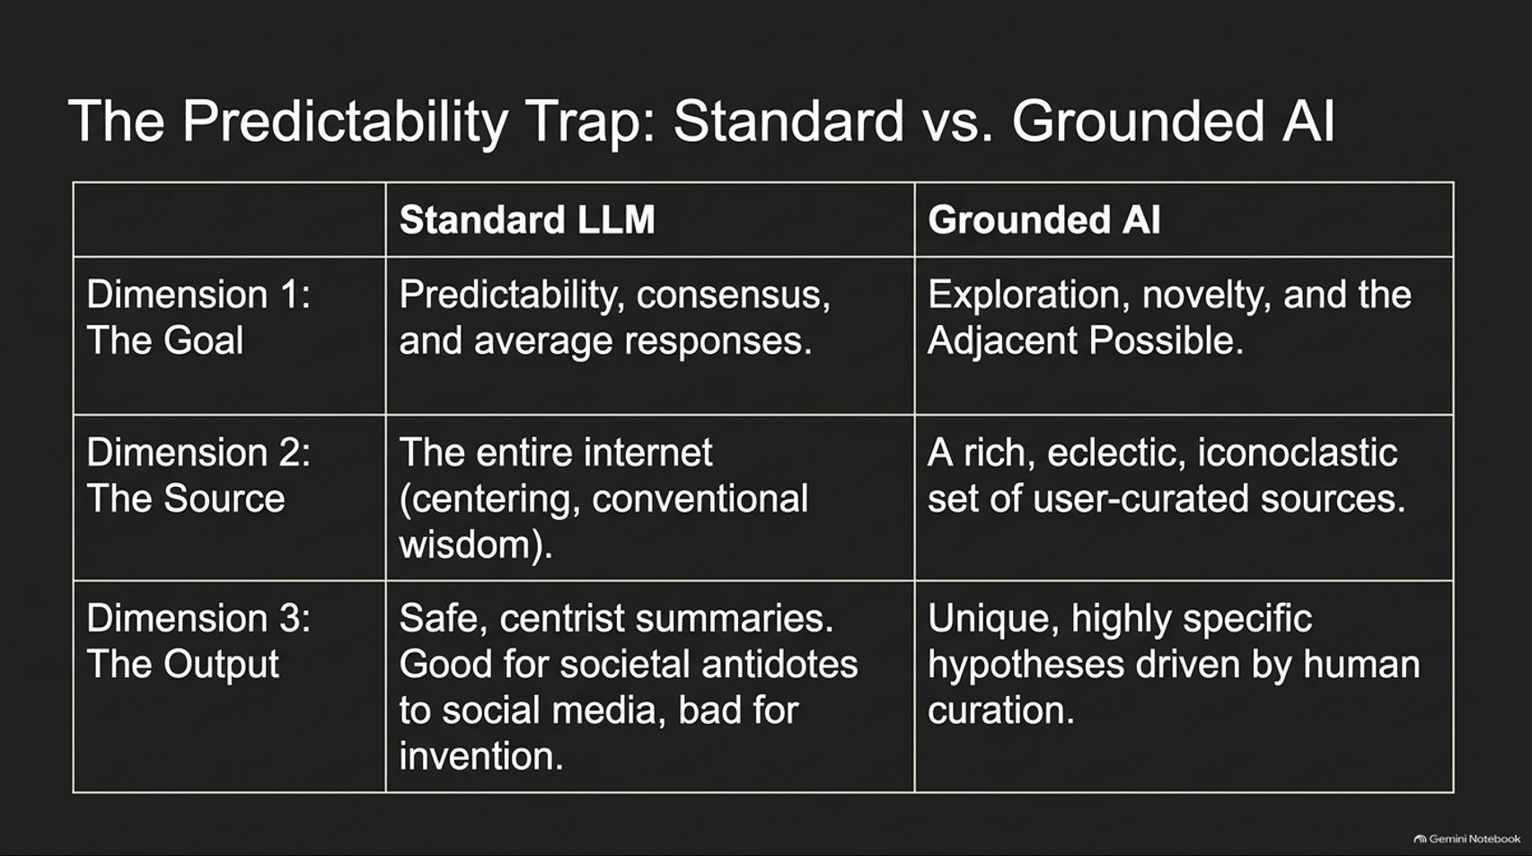
Notes:
Visual Theme: Comparative matrix table.
Key Concept: Comparing open-ended, average LLM responses against curated, grounded AI workflows.
Duration Range: 4 – 6 minutes
Speaker Notes:
The Problem with Standard LLMs: Standard models are optimized to predict the most likely sequence of tokens—meaning they naturally default to consensus, average, and predictable responses. While great for societal stabilization and serving as an antidote to extreme social media echo chambers, it is terrible for original invention.
Breaking the Trap through Grounding: To explore the adjacent possible, you cannot rely purely on off-the-shelf consensus.
Walking Through the Table Dimensions:
Dimension 1 (The Goal): Predictability vs. Exploration and Novelty.
Dimension 2 (The Source): The entire internet vs. user-curated, eclectic, iconoclastic sources.
Dimension 3 (The Output): Safe centrist summaries vs. unique, highly specific hypotheses driven by human curation.

Slide 9
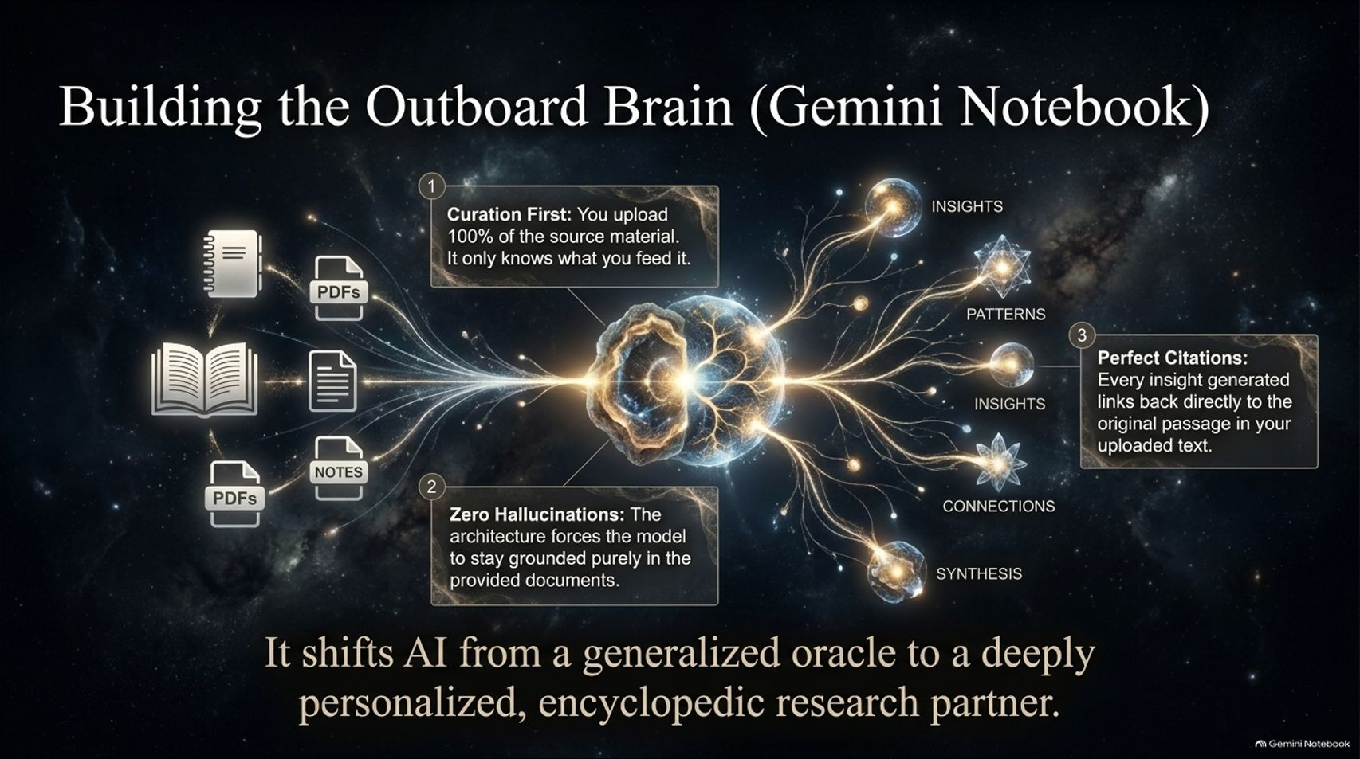
Notes:
Visual Theme: Inputs (PDFs, notes, books) feeding into a central neural core, generating precise citations.
Key Concept: Grounded AI workspaces (like Gemini Notebook) acting as a personalized research partner.
Duration Range: 4 – 6 minutes
Speaker Notes:
Curation First: Explain the breakthrough architecture behind tools like Gemini Notebook (NotebookLM). Instead of querying the entire internet, you upload 100% of your source material—your research, field notes, or book chapters.
Zero Hallucinations: Because the architecture forces the model to stay grounded strictly in provided documents, hallucinations drop dramatically.
Perfect Citations: Every insight generated links directly back to original passages in your uploaded text. It shifts AI from a generalized oracle to a deeply personalized, encyclopedic research partner.

Slide 10
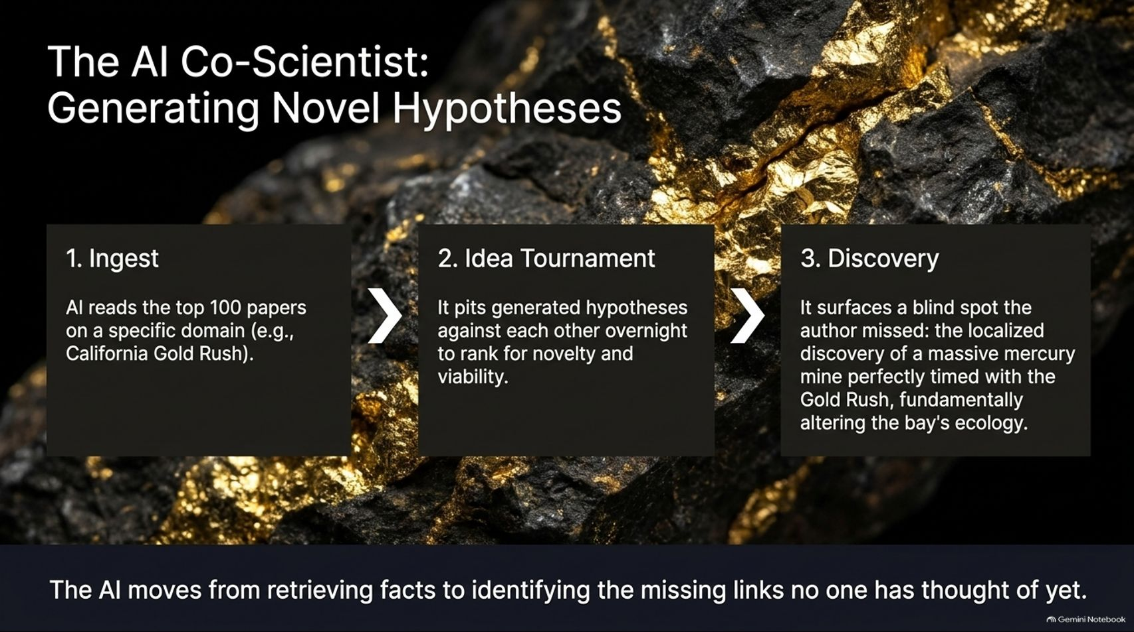
Notes:
Visual Theme: Raw gold ore sparkling against dark rock; 3-step flowchart (Ingest, Idea Tournament, Discovery).
Key Concept: Autonomous hypothesis generation and tournament ranking to find overlooked insights.
Duration Range: 3 – 5 minutes
Speaker Notes:
Moving Beyond Retrieval: AI is evolving from a fact-retrieval engine to a hypothesis generator.
The 3-Step Process:
Ingest: The AI reads top literature within a specific domain (e.g., 100 papers on the California Gold Rush).
Idea Tournament: It generates dozens of potential novel hypotheses and runs them through an overnight tournament structure to rank them for novelty and viability.
Discovery: It surfaces blind spots that human authors missed.
Real-World Example: Share Steven Johnson's discovery regarding the California Gold Rush—surface-level historical accounts often miss the crucial role played by the simultaneous discovery of a massive local mercury mine, which was essential for gold extraction and permanently altered the bay's ecology.

Slide 11
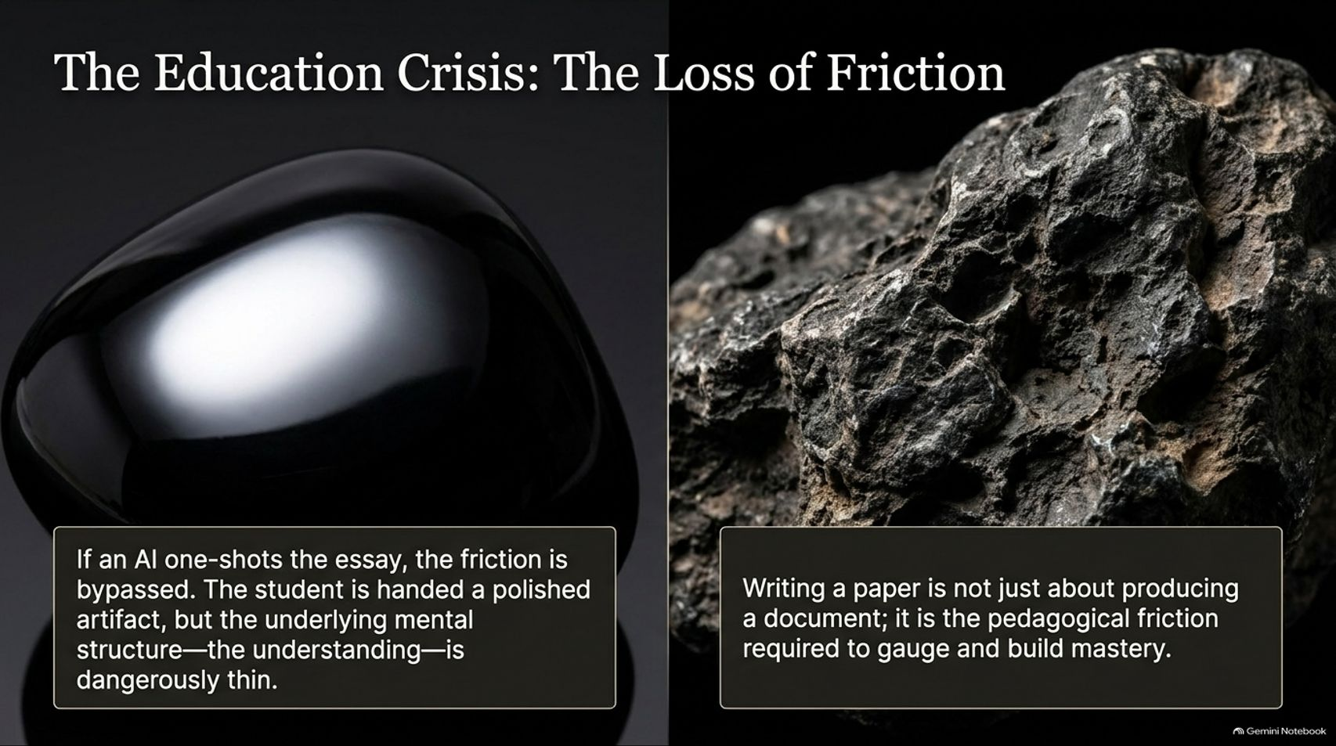
Notes:
Visual Theme: Sleek black obsidian stone vs. rough, porous meteorite rock.
Key Concept: The pedagogical danger of bypassing mental effort versus the necessity of "productive friction."
Duration Range: 3 – 5 minutes
Speaker Notes:
The Dilemma for Educators: If an AI can one-shot a polished essay in seconds, the traditional writing assessment breaks down.
The Danger: When friction is bypassed, the student is handed a polished artifact, but their underlying mental structure and true understanding remain dangerously thin.
The Value of Friction: Writing a paper is not merely about producing a document; it is the pedagogical friction required to gauge, build, and anchor cognitive mastery. Education must adapt without simply banning tools that will define future knowledge work.

Slide 12
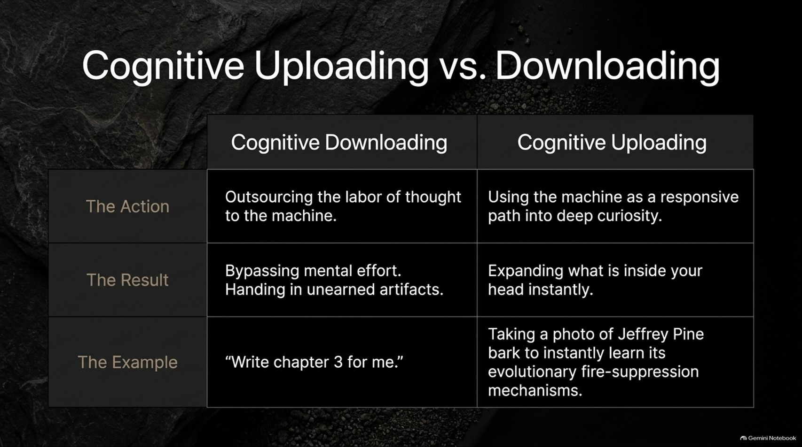
Notes:
Visual Theme: Comparative matrix table.
Key Concept: Distinguishing between intellectual outsourcing (downloading) and deep curiosity-driven learning (uploading).
Duration Range: 3 – 5 minutes
Speaker Notes:
Defining Cognitive Downloading: Outsourcing the entire labor of thought to the machine. Result: Bypassing mental effort and handing in unearned artifacts (e.g., "Write chapter 3 for me").
Defining Cognitive Uploading: Using the machine as a responsive path into deep curiosity. Result: Instantly expanding what is inside your head and deepening subject mastery (e.g., taking a photo of Jeffrey Pine tree bark while hiking to instantly learn its evolutionary fire-suppression mechanisms).
Takeaway: The technology itself is neutral; the outcome depends entirely on how we choose to use it.

Slide 13
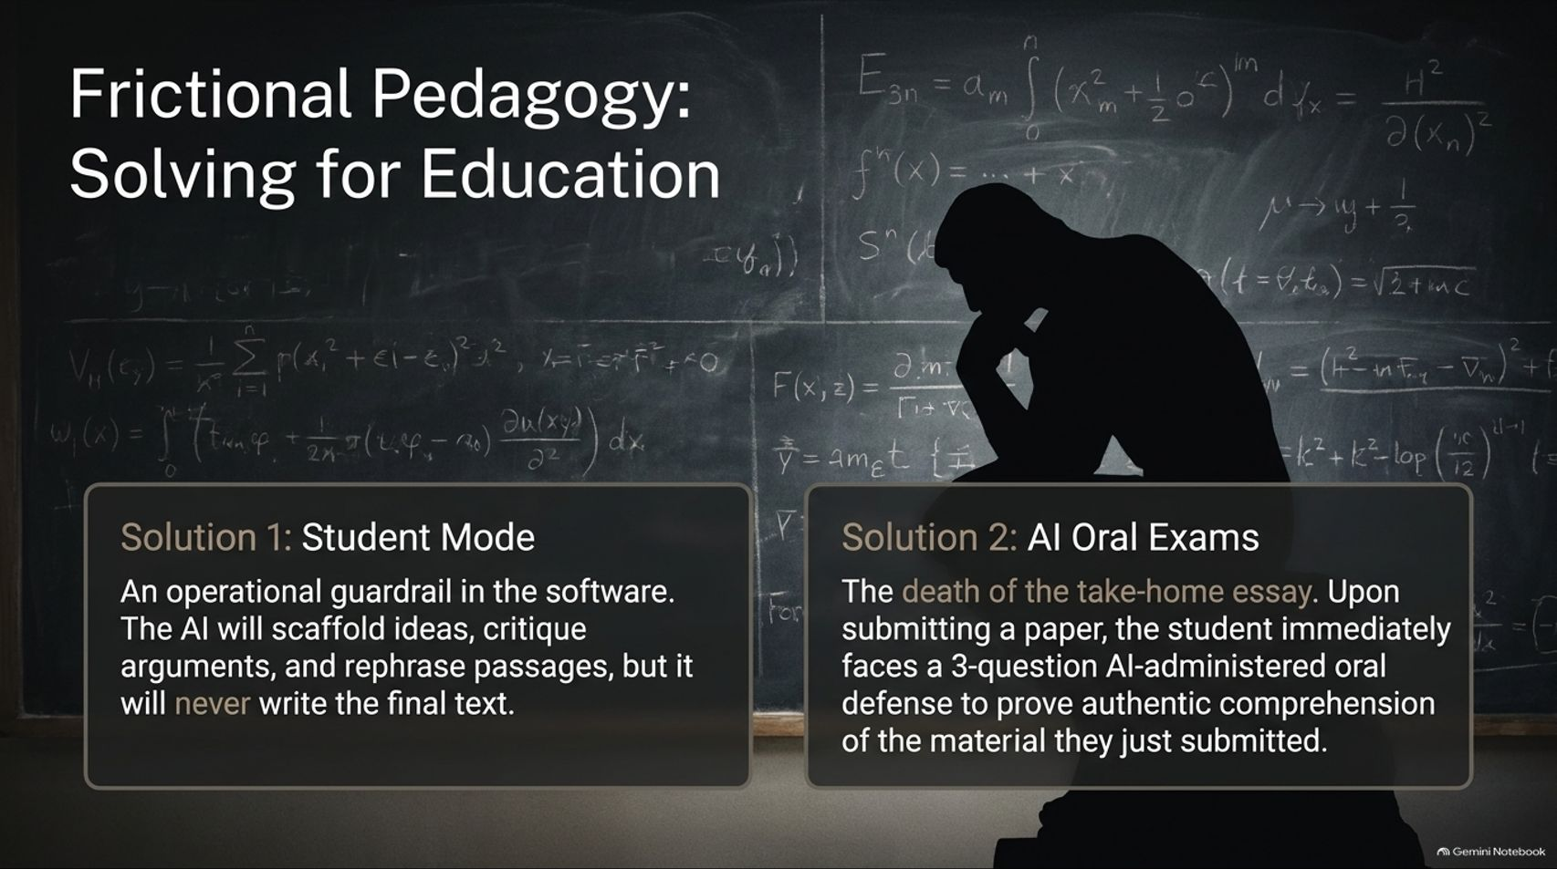
Notes:
Visual Theme: Student silhouette sitting in front of a chalkboard filled with complex equations.
Key Concept: Practical institutional solutions including "Student Mode" guardrails and AI-administered oral exams.
Duration Range: 3 – 5 minutes
Speaker Notes:
Solution 1: Student Mode (Scaffolding): Building operational guardrails directly into learning software. The AI will scaffold ideas, critique arguments, and rephrase passages, but it will never write the final text for the student.
Solution 2: AI Oral Exams: Rethinking take-home essays. Upon submitting a paper, students face a brief, AI-administered 3-question oral defense tailored to their submission to prove authentic comprehension.
Conclusion on Education: We cannot forbid students from using tools central to future careers; instead, we must redesign assessments around authentic engagement and defense.

Slide 14
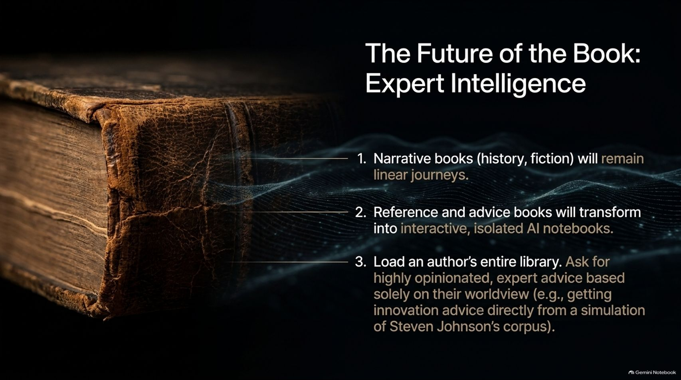
Notes:
Visual Theme: Old leather-bound book with glowing digital data waves emerging from its spine.
Key Concept: The bifurcation of publishing: linear narrative books vs. interactive, isolated AI expert notebooks.
Duration Range: 3 – 5 minutes
Speaker Notes:
Narrative Survives: Narrative books (history, fiction) will remain linear journeys because sequence and chronology carry irreplaceable human value.
Reference Transforms: Reference, advice, and textbook materials are transforming into interactive, isolated AI notebooks.
Expert Intelligence: Imagine loading an author's entire corpus into a secure notebook—getting highly opinionated, expert advice based solely on their specific worldview (e.g., consulting a simulation of Steven Johnson's corpus for innovation strategy). Intellectual property is protected while expertise becomes accessible on-demand.

Slide 15
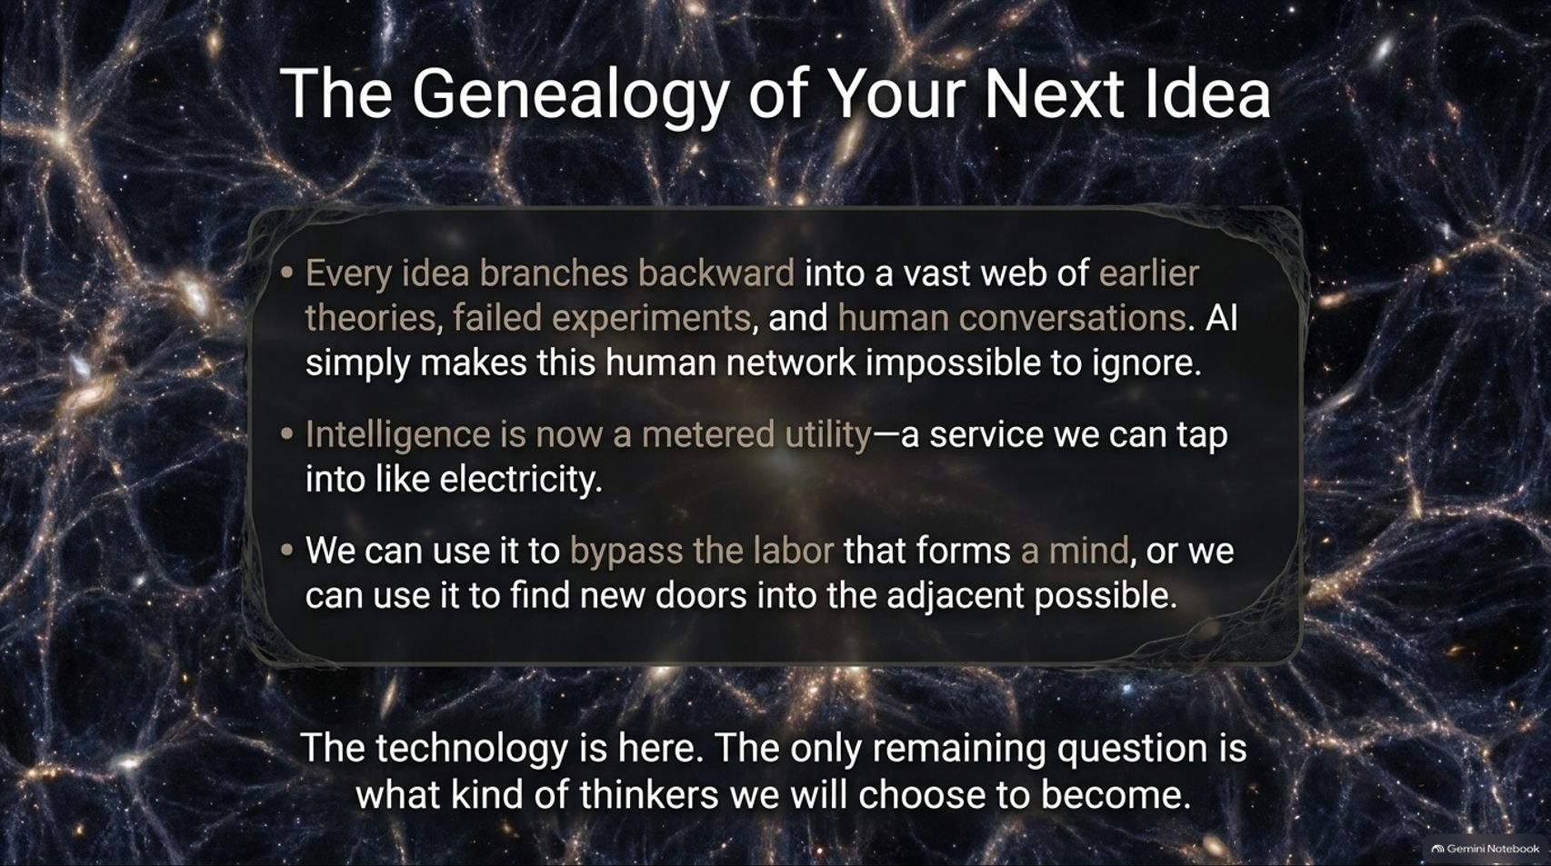
Notes:
Visual Theme: Expansive cosmic neural network web.
Key Concept: Summarizing the networked genealogy of thought and our agency in shaping intelligence as a utility.
Duration Range: 3 – 5 minutes
Speaker Notes:
The Genealogy of Ideas: Every idea branches backward into a vast web of earlier theories, failed experiments, and human conversations. AI simply makes this collective human network impossible to ignore.
Intelligence as a Utility: Intelligence is now a metered utility—a service we can tap into like electricity.
The Ultimate Choice: We can use this power to bypass the arduous labor that forms a robust mind, or we can use it to unlock new doors into the adjacent possible. The technology is here; the only remaining question is what kind of thinkers we will choose to become.

Slide 16
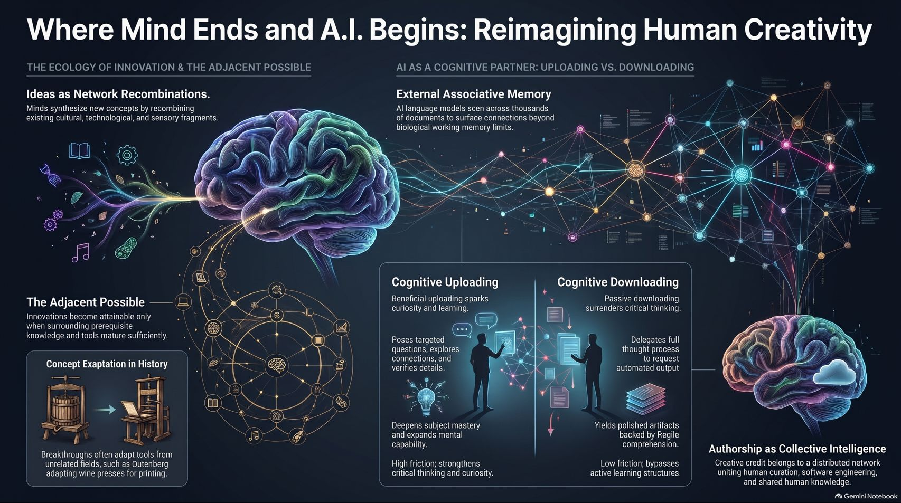
Notes:
Visual Theme: Comprehensive summary dashboard linking biology, historical exaptation, AI notebooks, and collective authorship.
Key Concept: Holistic wrap-up of human-AI collaboration and distributed creative credit.
Duration Range: 3 – 5 minutes
Speaker Notes:
Synthesis of Themes: Bring together all major visual pillars on the slide:
Ecology of Innovation: Ideas as network recombinations within the adjacent possible.
Cognitive Partnering: Choosing uploading over downloading to foster high-friction critical thinking.
Collective Authorship: Recognizing that creative credit belongs to a distributed network uniting human curation, software engineering, and shared human knowledge.
Closing Call to Action: Empower the audience to embrace collaborative intelligence not as a replacement for human thought, but as the ultimate amplifier for human curiosity. Thank the audience and open the floor for Q&A.

