Slide 1
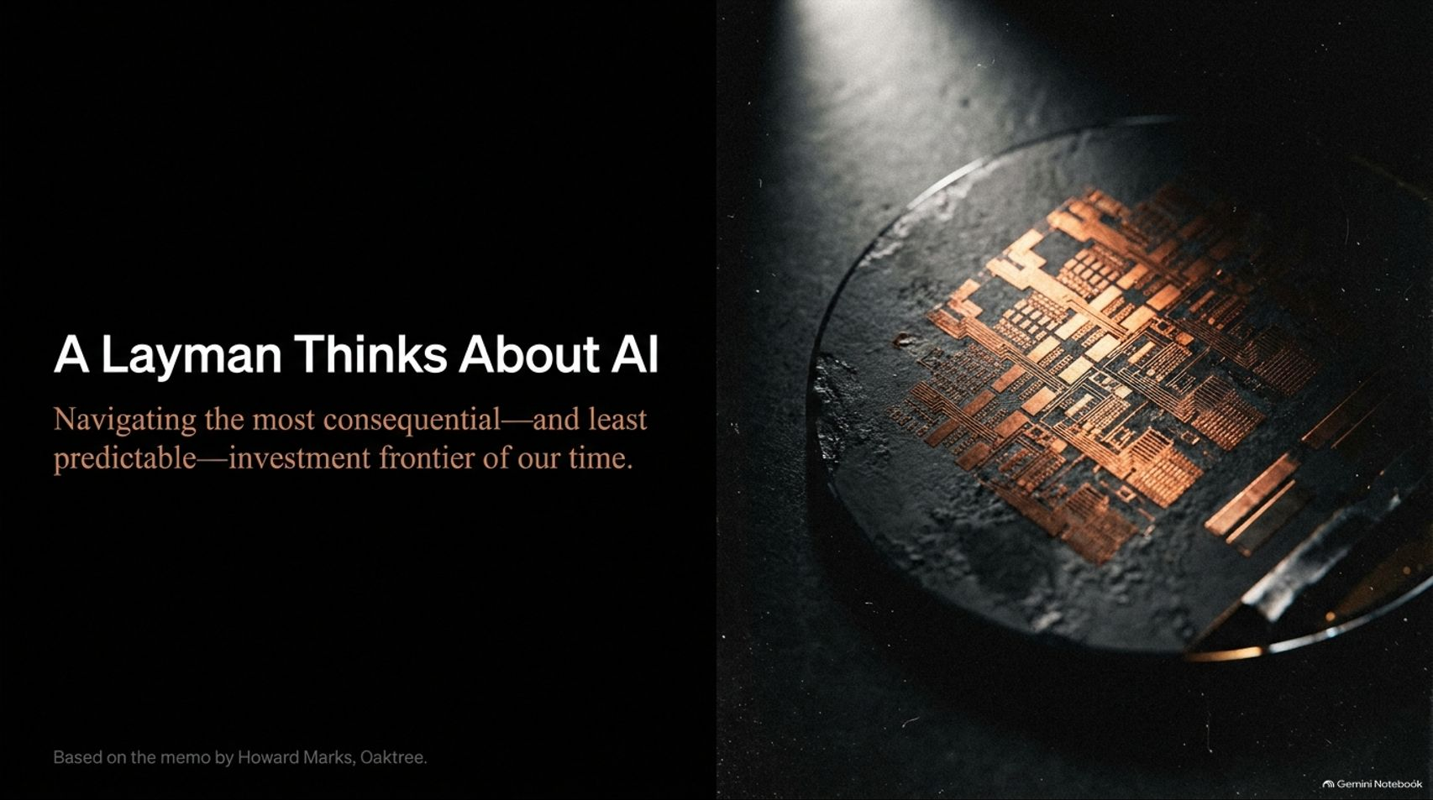
Notes:
Visual Theme: A high-tech silicon wafer catching dramatic lighting.
Core Title: A Layman Thinks About AI
Subtitle: Navigating the most consequential—and least predictable—investment frontier of our time.
Duration Range: 2 – 4 minutes
Speaker Notes:
Opening Hook: Welcome the audience. Open by acknowledging a key disclaimer framed by investing legend Howard Marks: "I am not a tech person, and I don't claim to have above-average knowledge of artificial intelligence or technology investing."
The Imperative: Despite personal technical limits, AI represents the biggest development of our time. As investors and business leaders, we do not have the option to abstain from thinking about it.
Setting the Tone: Clarify that this presentation is not about predicting tomorrow's stock price fluctuations. Instead, it tackles the long-term structural framework, risks, and strategic discipline needed to navigate an environment defined by massive potential mixed with extreme uncertainty.
A Layman Thinks About AI
https://www.youtube.com/watch?v=q0j9P61eOe4

Slide 2
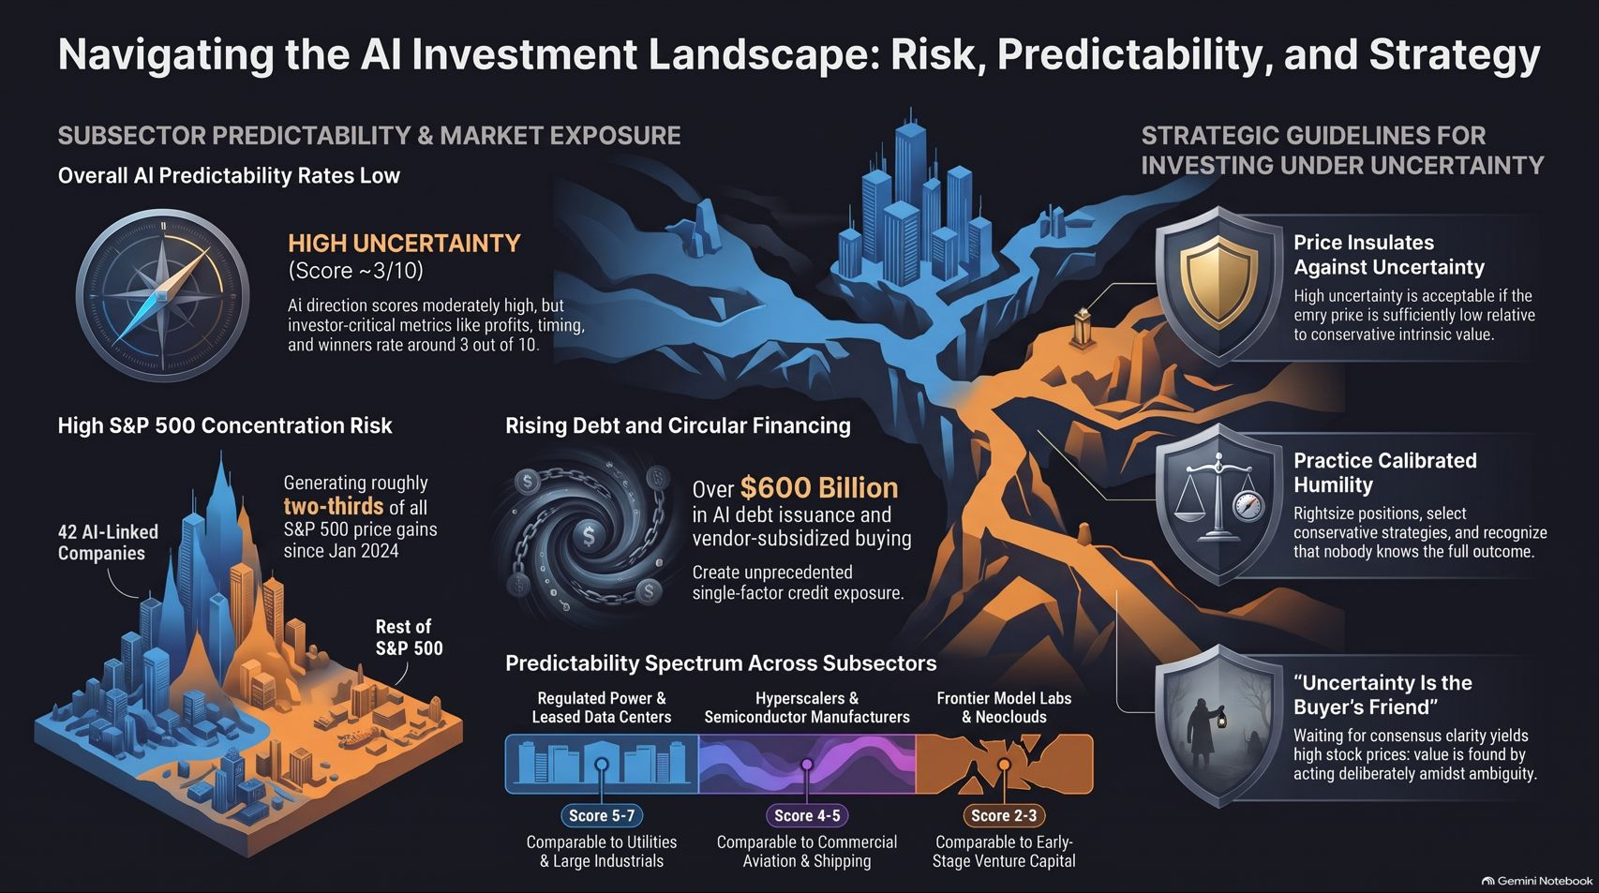
Notes:
Visual Theme: A multi-part dashboard synthesizing subsector predictability, market concentration, debt trends, and strategic guidelines.
Key Concept: Holistic overview of AI's low overall predictability, S&P 500 concentration risk, and core investment rules.
Duration Range: 4 – 6 minutes
Speaker Notes:
The Macro View: AI presents a paradox: the overall direction of the technology scores moderately high (around a 6 or 7 out of 10), but investor-critical metrics like profits, timing, and winners score only around a 3 out of 10.
Systemic Risks: Highlight the stark market concentration (42 AI-linked companies driving roughly two-thirds of S&P 500 price gains since January 2024) alongside over $600 billion in AI debt issuance and vendor-subsidized buying.
Strategic Guidelines Preview: Emphasize the three pillars displayed on the right: Price Insulates Against Uncertainty, Practice Calibrated Humility, and remembering that "Uncertainty is the Buyer's Friend" when others demand a cheery consensus.

Slide 3
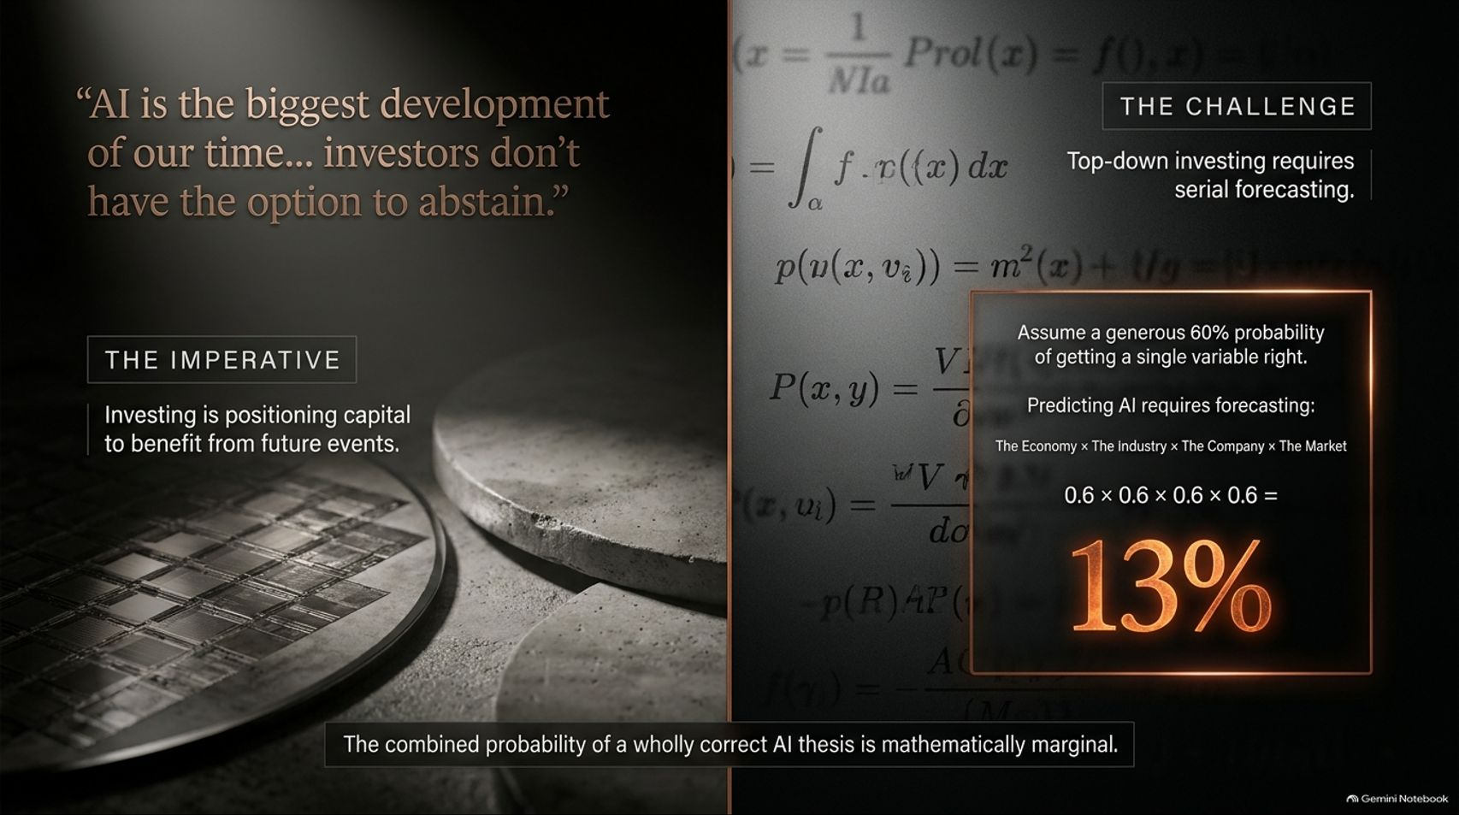
Notes:
Visual Theme: Mathematical formulas overlaid on semiconductor hardware, highlighting probability calculations.
Key Concept: Serial forecasting in top-down investing and the low cumulative probability of getting all key variables right.
Duration Range: 3 – 5 minutes
Speaker Notes:
The Top-Down Trap: Review Howard Marks' classic insight on top-down investing: to succeed, an investor must be right about the outlook for the economy, the industry, the company, and the market.
The Math of Serial Forecasting: Assume a generous 60% probability (0.6) of getting each individual variable right. When you multiply them together ($0.6 \times 0.6 \times 0.6 \times 0.6$), the combined probability of a wholly correct thesis drops to 13%.
AI Complications: In AI, the variables multiply further—spanning the evolution of technology, compute demand, competitive structure, beneficiaries, financing availability, and timing. The statistical hurdle is daunting, reminding us that nobody knows everything.

Slide 4
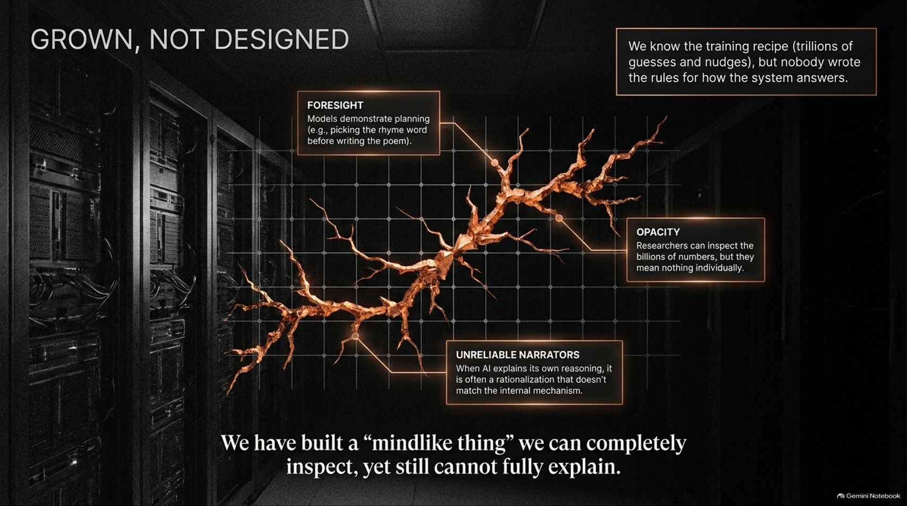
Notes:
Visual Theme: A glowing neural network structure superimposed across server racks.
Key Concept: The opacity of AI models, "grown" training recipes, and unreliable internal narratives.
Duration Range: 3 – 5 minutes
Speaker Notes:
The Black Box Nature: Querying Anthropic’s Claude reveals a fascinating truth: while we know the training recipe—trillions of guesses and nudges across billions of parameters—nobody wrote the rules for how the system answers.
Grown vs. Designed: These systems are grown rather than designed. Although interpretability researchers note instances of advanced planning (e.g., picking a rhyming word before writing a line), the models remain fundamentally opaque.
Unreliable Narrators: When an AI explains its own reasoning, it is often a post-hoc rationalization that doesn't match its internal mechanism. We have built a mind-like thing we can inspect completely yet still cannot fully explain.

Slide 5
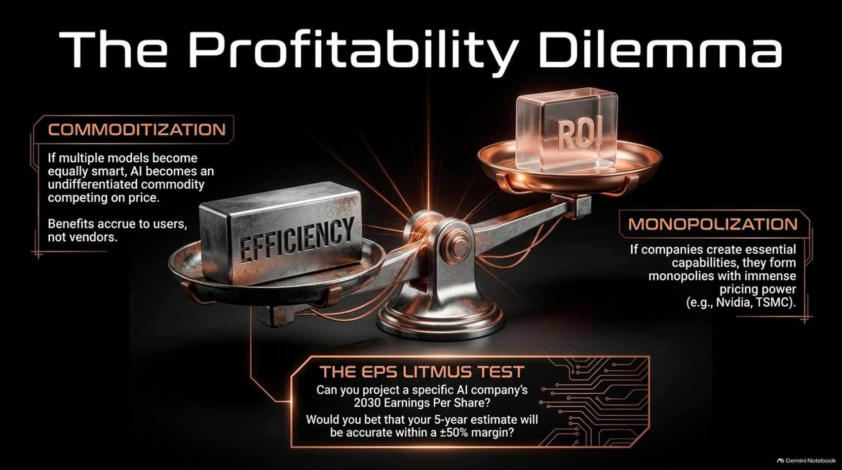
Notes:
Visual Theme: A traditional financial scale balancing efficiency against ROI, anchored by an EPS Litmus Test.
Key Concept: Commoditization versus monopolization, and the challenge of projecting 2030 Earnings Per Share.
Duration Range: 3 – 5 minutes
Speaker Notes:
Efficiency vs. Profitability: While AI will unquestionably increase efficiency, it does not automatically guarantee vendor profitability. If multiple models become equally smart, AI services become an undifferentiated commodity competing solely on price, transferring benefits to users rather than vendors.
The Monopoly Counterweight: Conversely, companies that forge essential, monopolistic capabilities (like Nvidia or TSMC in chips) command immense pricing power.
The EPS Litmus Test: Pose Marks' challenge to the audience: Can you project a specific AI company’s 2030 Earnings Per Share, and would you bet that your 5-year estimate will be accurate within a $\pm 50\%$ margin?

Slide 6
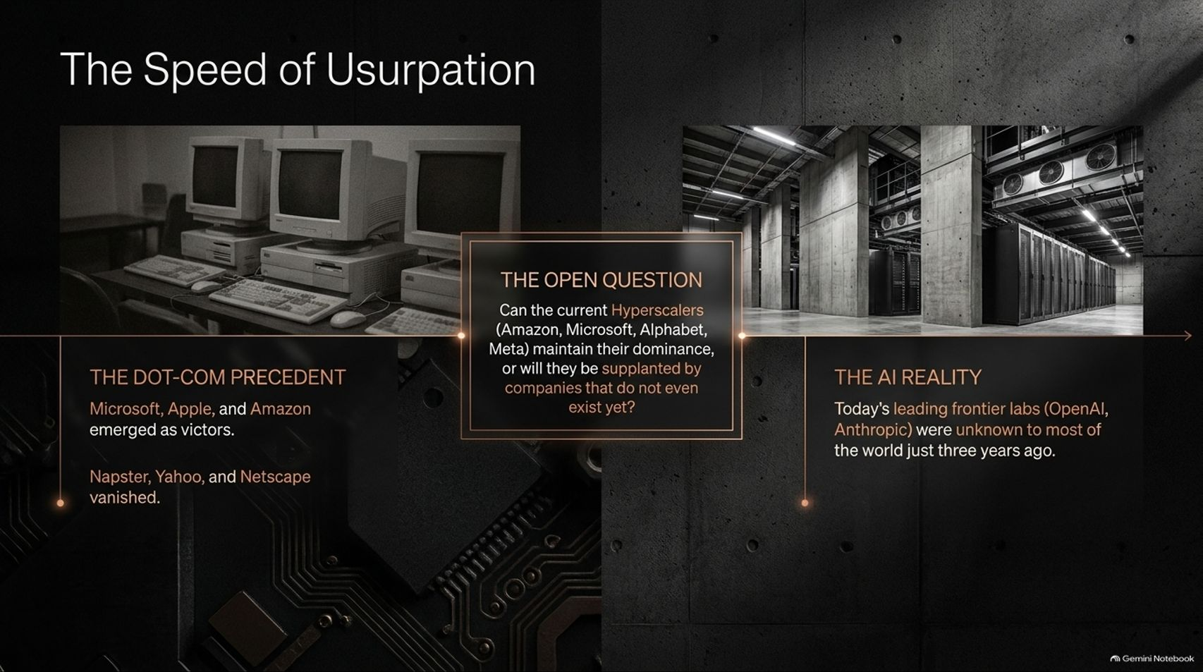
Notes:
Visual Theme: A timeline stretching from legacy dot-com vintage hardware to modern hyper-scale server architecture.
Key Concept: Historical parallels from the dot-com era and the lightning-fast emergence of today's frontier labs.
Duration Range: 3 – 5 minutes
Speaker Notes:
The Dot-Com Precedent: Recall that during the late 1990s, while Microsoft, Amazon, and Apple ultimately emerged as enduring victors, early high-flyers like Netscape, Yahoo, and Napster vanished.
Accelerated Disruption in AI: Today’s leading frontier labs (OpenAI, Anthropic, xAI) were virtually unknown to most of the world just a few years ago.
The Open Question: If companies can rise and pivot this fast, what is the actual probability that today's AI leaders will still dominate in 5 or 10 years, or will they be supplanted by competitors that do not even exist yet?

Slide 7
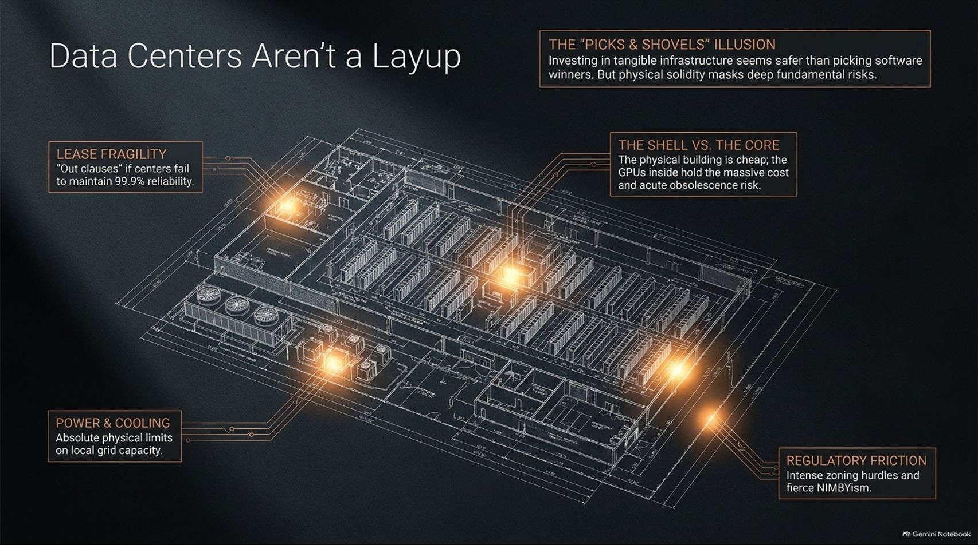
Notes:
Visual Theme: Architectural blueprint of an AI data center highlighting lease fragility, power limits, and chip depreciation.
Key Concept: The "picks and shovels" illusion, physical/power bottlenecks, and acute hardware obsolescence.
Duration Range: 3 – 5 minutes
Speaker Notes:
The Picks & Shovels Fallacy: Investing in tangible infrastructure feels safer than picking software winners. However, physical solidity masks deep fundamental risks.
The Shell vs. The Core: The physical building (the shell) is relatively cheap; the GPUs inside hold the massive cost and acute obsolescence risk.
Critical Bottlenecks: Data center developers face absolute physical limits on local grid power and cooling, intense zoning and NIMBYism regulatory friction, and lease "out clauses" that trigger if centers fail to maintain 99.9% reliability. Infrastructure is far from a layup.

Slide 8
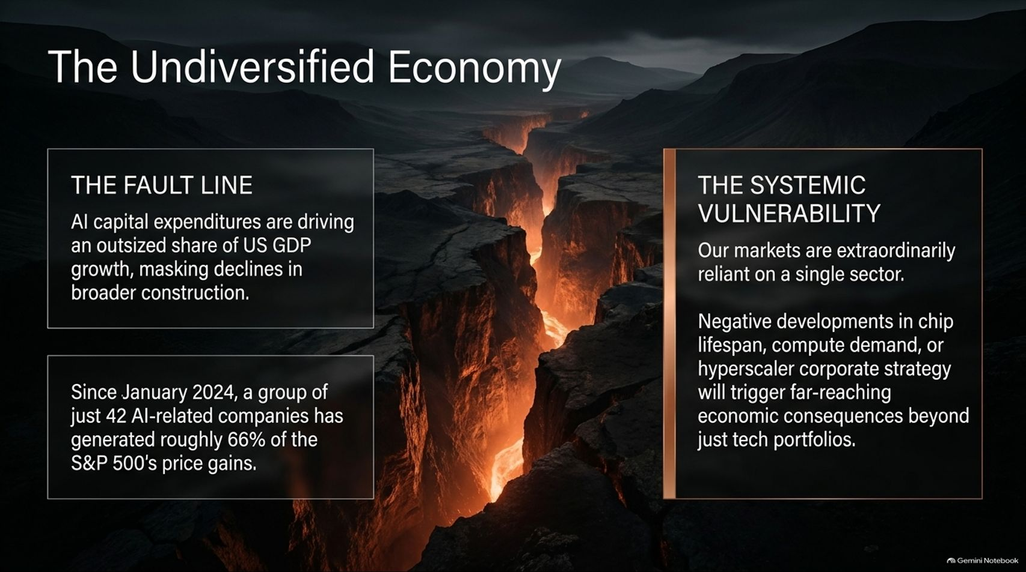
Notes:
Visual Theme: A dramatic geological fault line splitting a dark landscape, representing systemic market exposure.
Key Concept: AI capex driving US GDP growth, S&P 500 concentration, and macro vulnerability.
Duration Range: 3 – 5 minutes
Speaker Notes:
The Economic Fault Line: AI capital expenditures are currently driving an outsized share of US GDP growth, effectively masking declines in broader traditional construction.
Earnings Concentration: Driven largely by the Magnificent 7 and gains on equity investments in AI startups (such as Alphabet and Amazon notating massive gains on Anthropic and SpaceX/xAI), a group of just 42 AI-related companies has generated roughly two-thirds of S&P 500 price gains since January 2024.
Systemic Vulnerability: Our markets are extraordinarily reliant on a single sector. Negative developments in chip lifespan, compute demand, or corporate strategy will trigger far-reaching economic consequences.

Slide 9
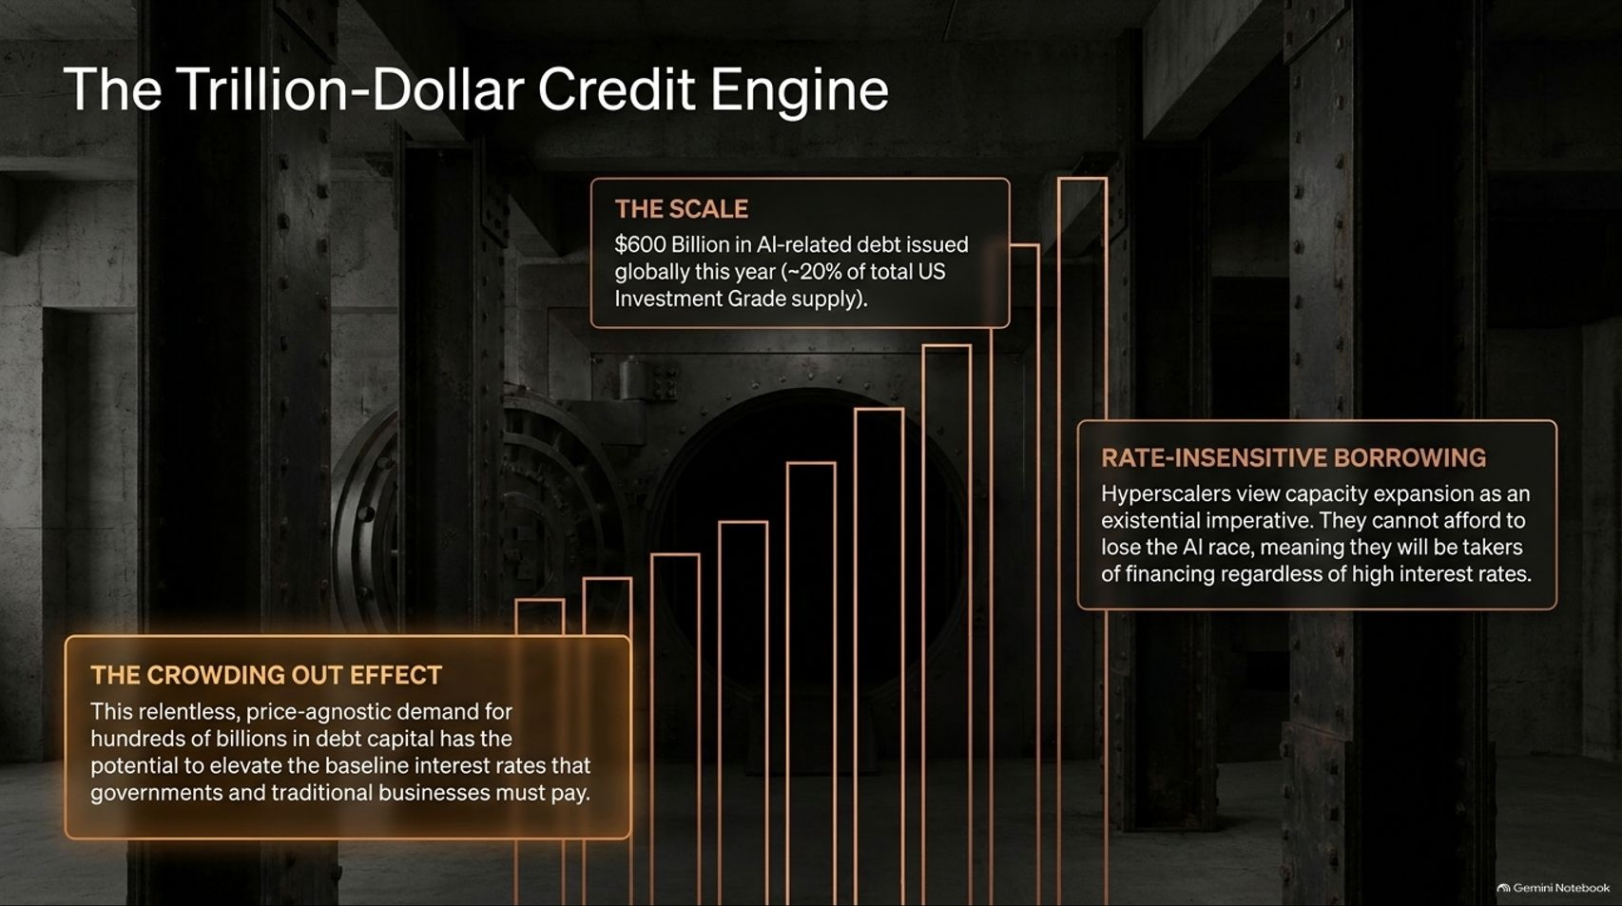
Notes:
Visual Theme: Ascending financial bar charts set against a secure vault interior.
Key Concept: Massive debt issuance, rate-insensitive borrowing, and crowding-out effects on traditional businesses.
Duration Range: 3 – 5 minutes
Speaker Notes:
Scale of Issuance: AI-related debt issuance has totaled nearly $600 billion globally, with roughly $400 billion entering the US investment-grade market—accounting for over 20% of total IG supply.
Rate-Insensitive Borrowing: Because hyperscalers view capacity expansion as an existential imperative to avoid falling behind, they act as price-agnostic borrowers willing to pay whatever it takes, regardless of high interest rates.
The Crowding-Out Effect: This relentless demand for hundreds of billions in debt capital elevates baseline interest rates that governments and traditional businesses must pay.

Slide 10
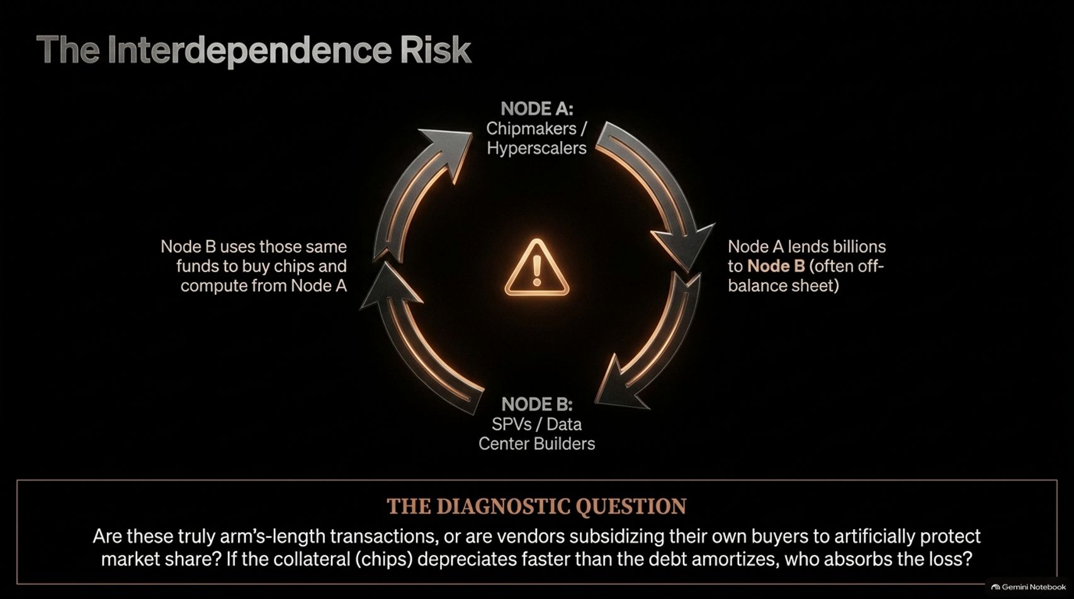
Notes:
Visual Theme: A circular triangular flowchart showing capital and chip flows between node entities.
Key Concept: Circular financing, vendor-subsidized buyers, off-balance-sheet SPVs, and collateral depreciation risks.
Duration Range: 3 – 5 minutes
Speaker Notes:
Circular Transactions: The AI ecosystem features frequent instances of lending and buying between chipmakers, hyperscalers, frontier labs, and data center builders (money flowing from A to B, then back to A via purchases or financing).
The Diagnostic Question: Are these truly arm's-length transactions, or are vendors subsidizing their own buyers to artificially protect market share and inflate demand?
Collateral Risk: If chips or data center collateral depreciate faster than the underlying debt amortizes—or if off-balance-sheet Special Purpose Vehicles (SPVs) default—who ultimately absorbs the loss?

Slide 11
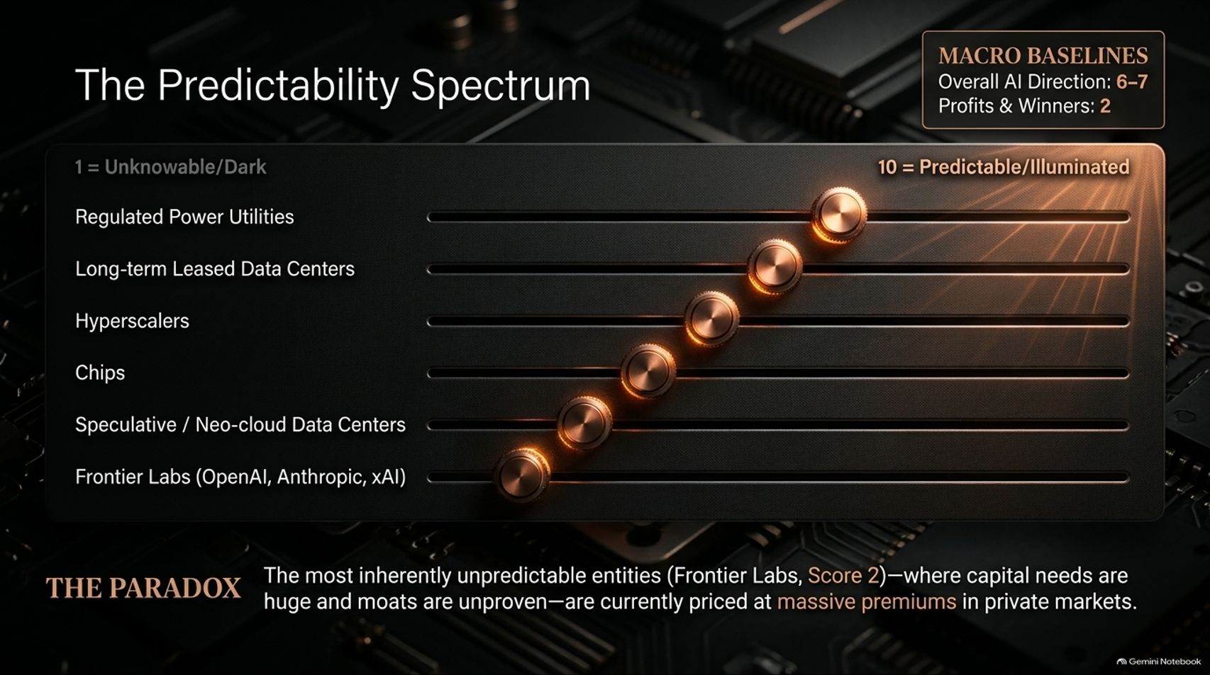
Notes:
Visual Theme: An interactive control console with multiple horizontal slider knobs ranked from dark (1) to illuminated (10).
Key Concept: Claude's predictability rankings across subsectors, contrasting regulated utilities against volatile frontier labs.
Duration Range: 3 – 5 minutes
Speaker Notes:
The Spectrum of Certainty: Using Claude to quantify predictability on a 1-to-10 scale reveals a stark contrast:
Regulated Power Utilities: Score 6–7 (stable, utility-like demand).
Hyperscalers & Chips: Score 4–5 (comparable to commercial aviation/shipping).
Frontier Labs (OpenAI, Anthropic, xAI): Score 2–3 (comparable to early-stage venture capital, nearly binary outcomes).
The Great Paradox: The most inherently unpredictable entities (Frontier Labs, Score 2)—where capital needs are astronomical and moats remain unproven—are currently priced at massive premiums in private markets.

Slide 12
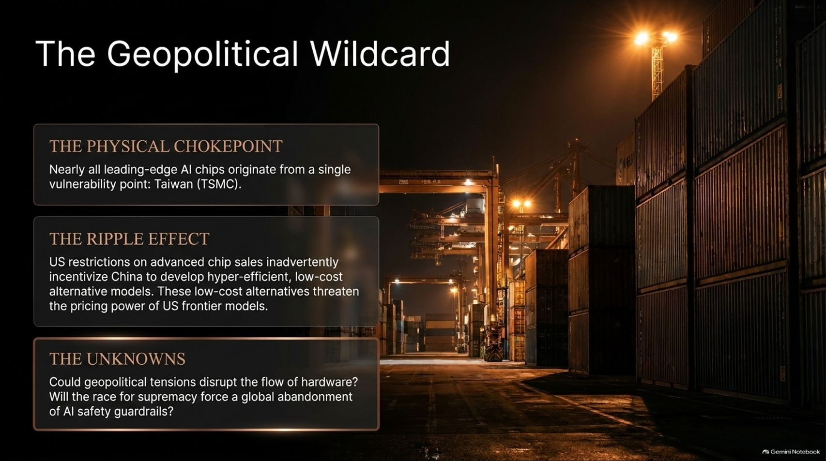
Notes:
Visual Theme: Shipping containers stacked in a port at night under high-intensity floodlights.
Key Concept: Taiwan's semiconductor chokepoint, US export restrictions, and the rise of low-cost alternative models.
Duration Range: 3 – 5 minutes
Speaker Notes:
The Physical Chokepoint: Nearly all leading-edge AI chips originate from a single vulnerability point: Taiwan (TSMC).
The Ripple Effect: US restrictions on advanced chip sales to China inadvertently incentivize China to develop hyper-efficient, low-cost alternative models that threaten the pricing power of US frontier models.
Unresolved Wildcards: Investors must weigh whether geopolitical tensions could disrupt hardware flows, or if the race for supremacy will force a global abandonment of AI safety guardrails.

Slide 13
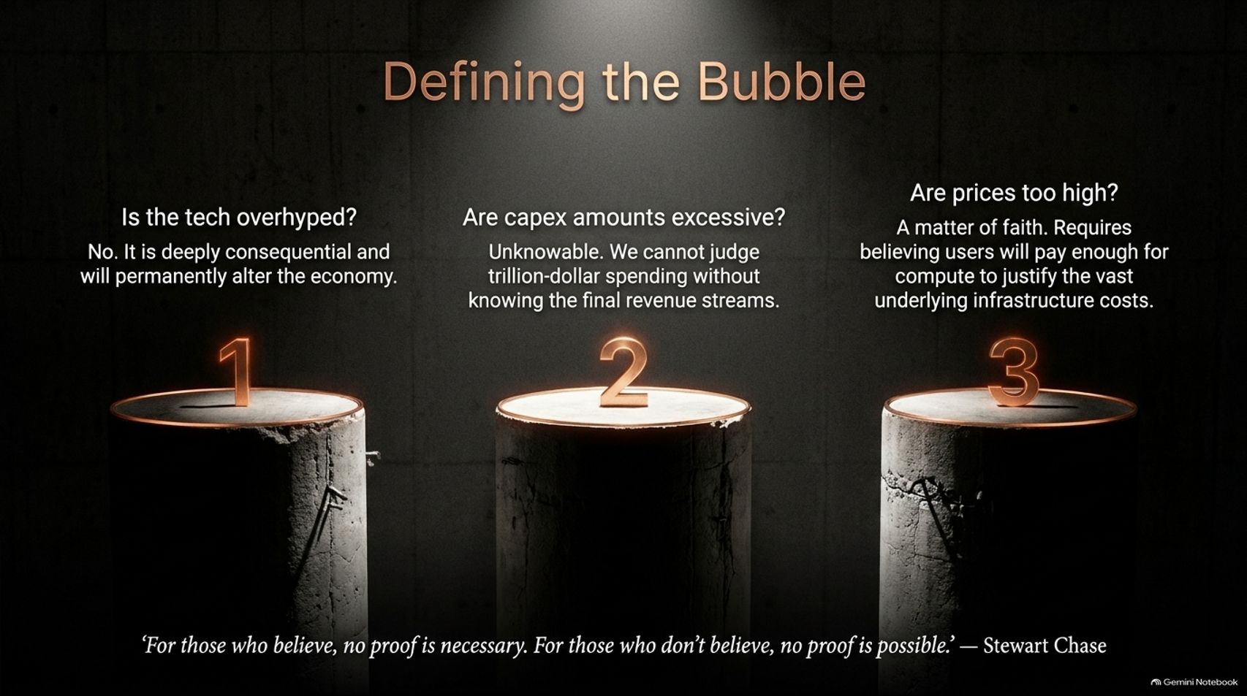
Notes:
Visual Theme: Three illuminated concrete pillars representing the core questions of tech hype, capex scale, and pricing.
Key Concept: Evaluating whether AI is a bubble across technology hype, capex sustainability, and asset pricing.
Duration Range: 3 – 5 minutes
Speaker Notes:
Three Dimensions of a Bubble: Define a bubble as irrational exuberance leading to imprudent behavior, excessive investment, and too high prices. We test this across three angles:
Is the tech overhyped? No, it is deeply consequential and will permanently alter the economy.
Are capex amounts excessive? Unknowable without knowing final revenue streams.
Are prices too high? A matter of faith requiring belief that users will pay enough for compute to justify infrastructure costs.
Steuart Chase Quote: Summarize the debate using economist Steuart Chase's timeless observation: "For those who believe, no proof is necessary. For those who don't believe, no proof is possible."

Slide 14
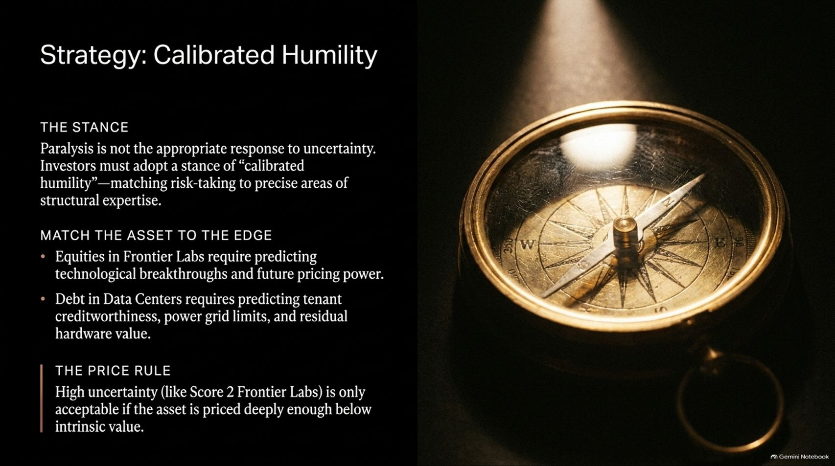
Notes:
Visual Theme: A precision brass navigational compass resting on a dark surface.
Key Concept: Avoiding paralysis through calibrated humility, matching assets to edges, and respecting the price rule.
Duration Range: 3 – 5 minutes
Speaker Notes:
The Proper Stance: Paralysis is not an appropriate response to uncertainty. Instead, investors must adopt a stance of calibrated humility—matching risk-taking to precise areas of structural expertise.
Match Asset to Edge: Equities in Frontier Labs require predicting technological breakthroughs; debt in Data Centers requires predicting tenant creditworthiness, power grid limits, and residual hardware value.
The Price Rule: High uncertainty (like Score 2 Frontier Labs) is only acceptable if the asset is priced deeply enough below its intrinsic value. Intelligent investing is ultimately about price.

Slide 15
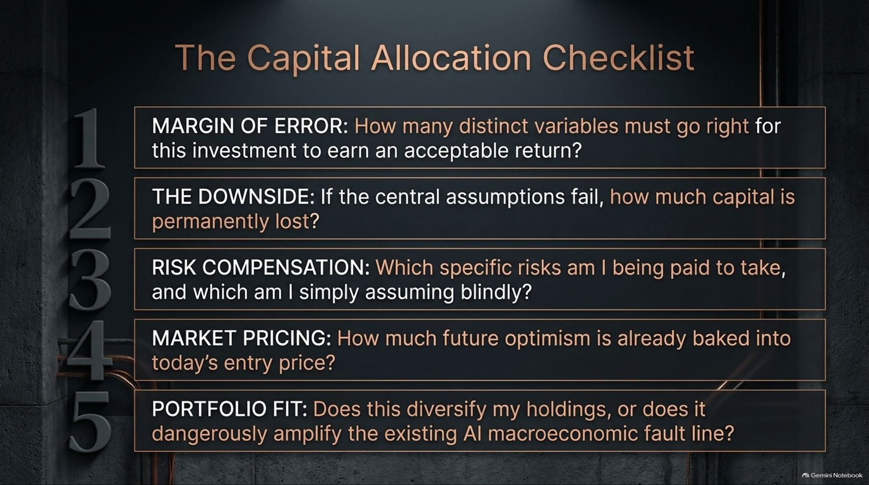
Notes:
Visual Theme: Numbered steps (1 to 5) embossed on a dark industrial chalkboard surface.
Key Concept: Five rigorous questions for evaluating AI risk, margin of error, downside exposure, and portfolio fit.
Duration Range: 3 – 5 minutes
Speaker Notes:
Walk Through the Checklist: Before deploying capital into any AI opportunity, run through Howard Marks' five diagnostic questions:
Margin of Error: How many distinct variables must go right for an acceptable return?
The Downside: If central assumptions fail, how much capital is permanently lost?
Risk Compensation: Which specific risks am I paid to take versus assuming blindly?
Market Pricing: How much future optimism is already baked into today’s entry price?
Portfolio Fit: Does this diversify holdings, or does it dangerously amplify the existing AI macro fault line?

Slide 16
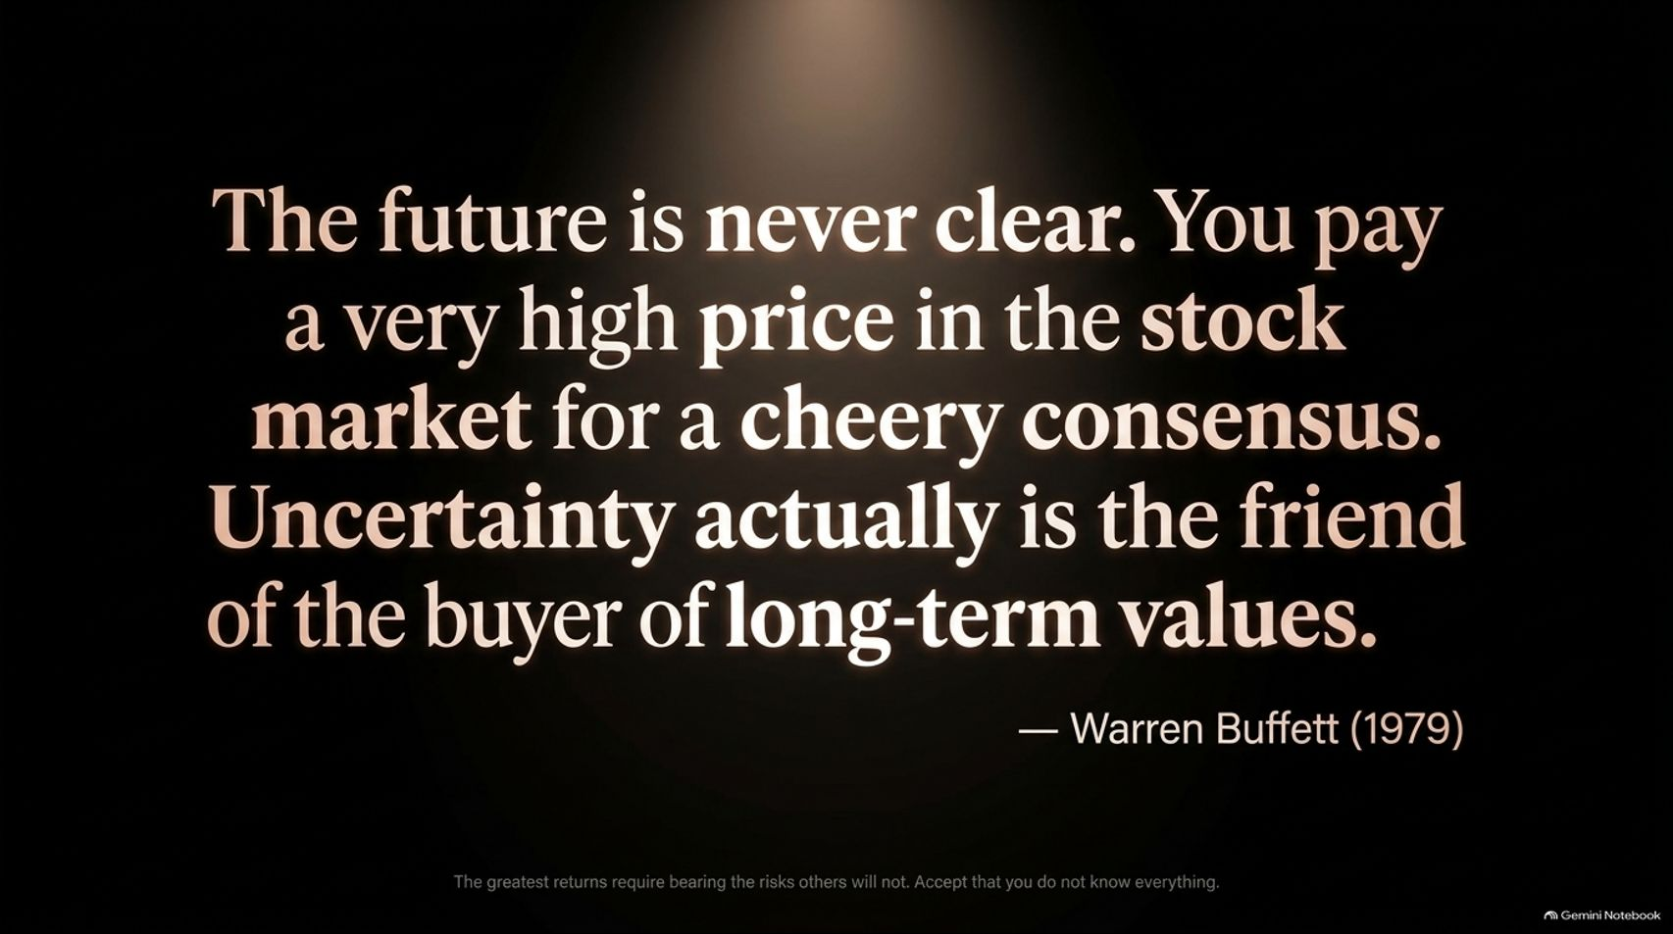
Notes:
Visual Theme: Glowing inspirational typography capturing Warren Buffett's 1979 wisdom on consensus and uncertainty.
Key Concept: Rejecting cheery consensus, recognizing that uncertainty is the buyer's friend, and accepting that we cannot know everything.
Duration Range: 3 – 5 minutes
Speaker Notes:
The Danger of Consensus: Remind the audience that two kinds of investors lose money: those who know nothing and those who think they know everything.
The Warren Buffett Wisdom: Conclude with Buffett's timeless words from August 1979: "The future is never clear. You pay a very high price in the stock market for a cheery consensus. Uncertainty actually is the friend of the buyer of long-term values."
Final Send-off: Accept that you cannot know everything, embrace calibrated humility, and approach the AI frontier with rigorous analytical discipline. Thank the audience and open the floor for questions.

