Slide 1
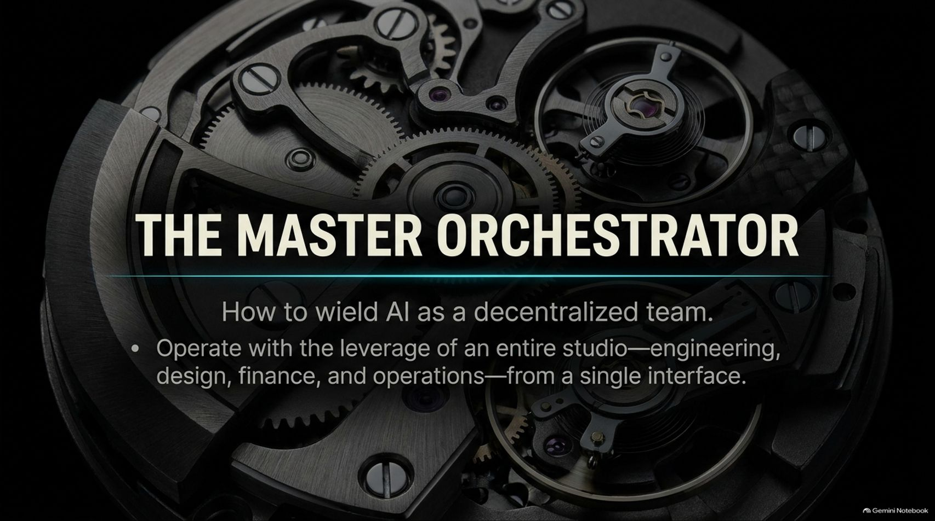
Notes:
Visual Theme: Intricate mechanical watch gears operating in unison.
Core Title: The Master Orchestrator
Subtitle: How to wield AI as a decentralized team.
Key Bullet: Operate with the leverage of an entire studio—engineering, design, finance, and operations—from a single interface.
Duration Range: 2 – 4 minutes
Speaker Notes:
Opening Hook: Welcome the audience. Ask them to imagine running an entire tech startup, creative studio, and financial portfolio from a single chat interface on their phone.
The Core Shift: Introduce the paradigm of the "Master Orchestrator" (using GrokBot as demonstrated by Ross Mike). We are moving past single-prompt chat windows into multi-agent orchestration.
Setting Expectations: Emphasize that you no longer need to write code line-by-line or manually manage every administrative task. By orchestrating specialized bots, a single operator can achieve the output of a multi-person studio.
Use Grok Bot Better Than 99% of People (Full Course)
https://www.youtube.com/watch?v=1cWZ7Ekff6E

Slide 2
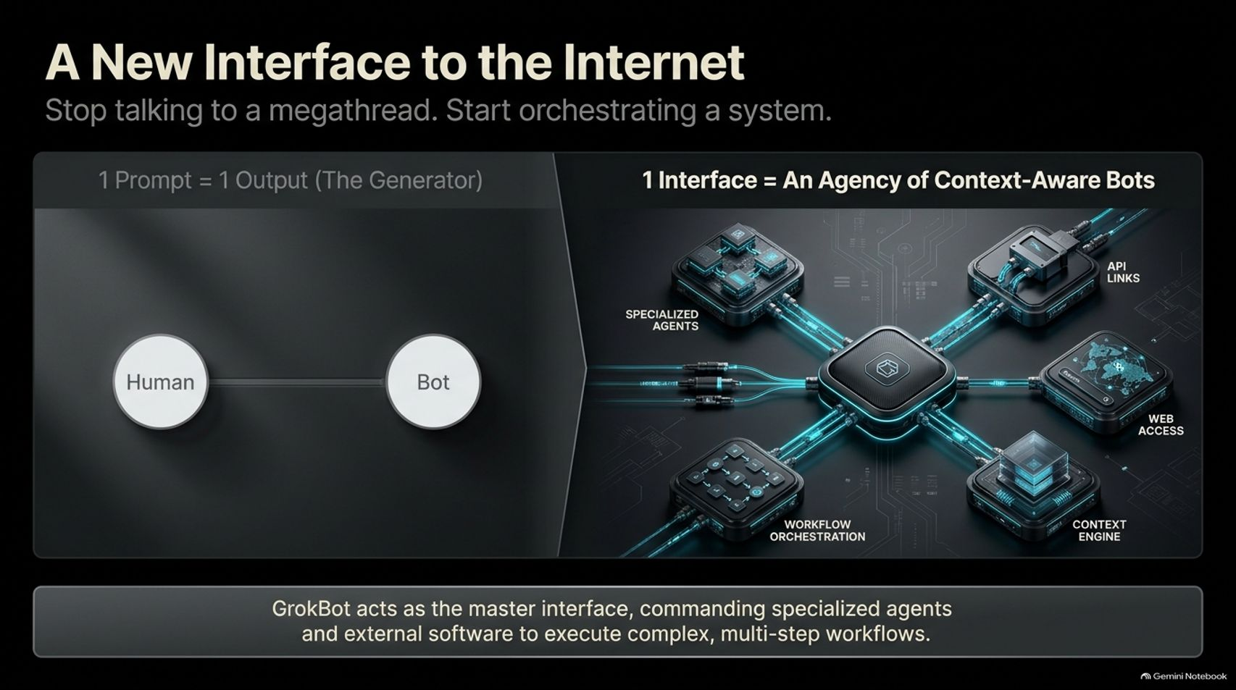
Notes:
Visual Theme: Comparative split showing a simple "Human-to-Bot" line vs. a multi-node hub controlling specialized agents, workflow tools, and API links.
Key Concept: Moving from talking to a monolithic megathread to orchestrating a modular system of contextual bots.
Duration Range: 3 – 5 minutes
Speaker Notes:
The Old Paradigm: Traditional AI interaction relied on "1 Prompt = 1 Output" inside a massive, messy chat thread where context gets hopelessly tangled.
The New Interface: GrokBot acts as the master interface, commanding specialized agents, context engines, web access, and external software to execute complex, multi-step workflows.
The Takeaway: Stop treating AI like a search engine or a single chatbot. Treat it like an operating system where individual bots handle distinct domains while maintaining persistent context.

Slide 3
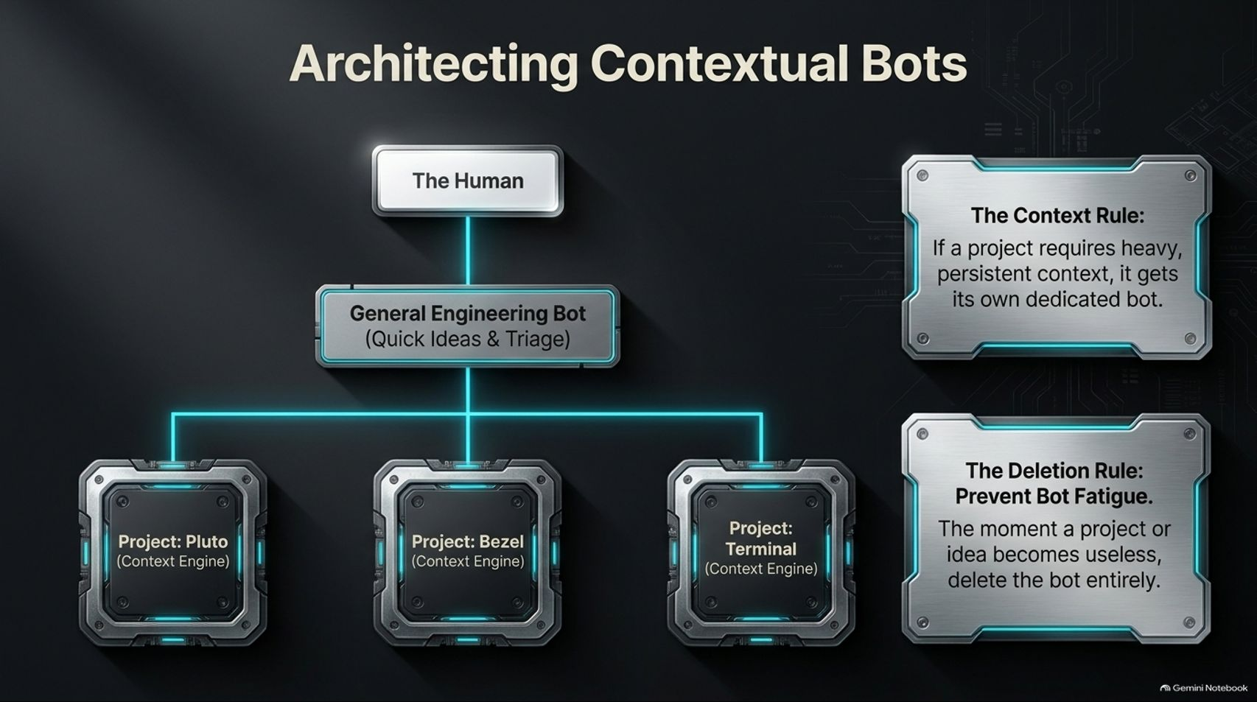
Notes:
Visual Theme: Organizational tree diagram branching from "The Human" down to dedicated project pods (Pluto, Bezel, Terminal).
Key Concept: The Context Rule (dedicated bots for persistent projects) and the Deletion Rule (preventing bot fatigue).
Duration Range: 3 – 5 minutes
Speaker Notes:
The Context Rule: If a project requires heavy, persistent context (like an active software app or startup), it gets its own dedicated bot with its own local memory and computer instance.
General vs. Specific: Maintain a general engineering bot for quick ideas and triage, but spin up dedicated pods for serious projects (e.g., Pluto, Bezel, Terminal).
The Deletion Rule: Prevent bot fatigue. The moment a project or idea loses momentum or becomes useless, ruthlessly delete the bot entirely. Do not let dead ideas clutter your digital workspace.

Slide 4
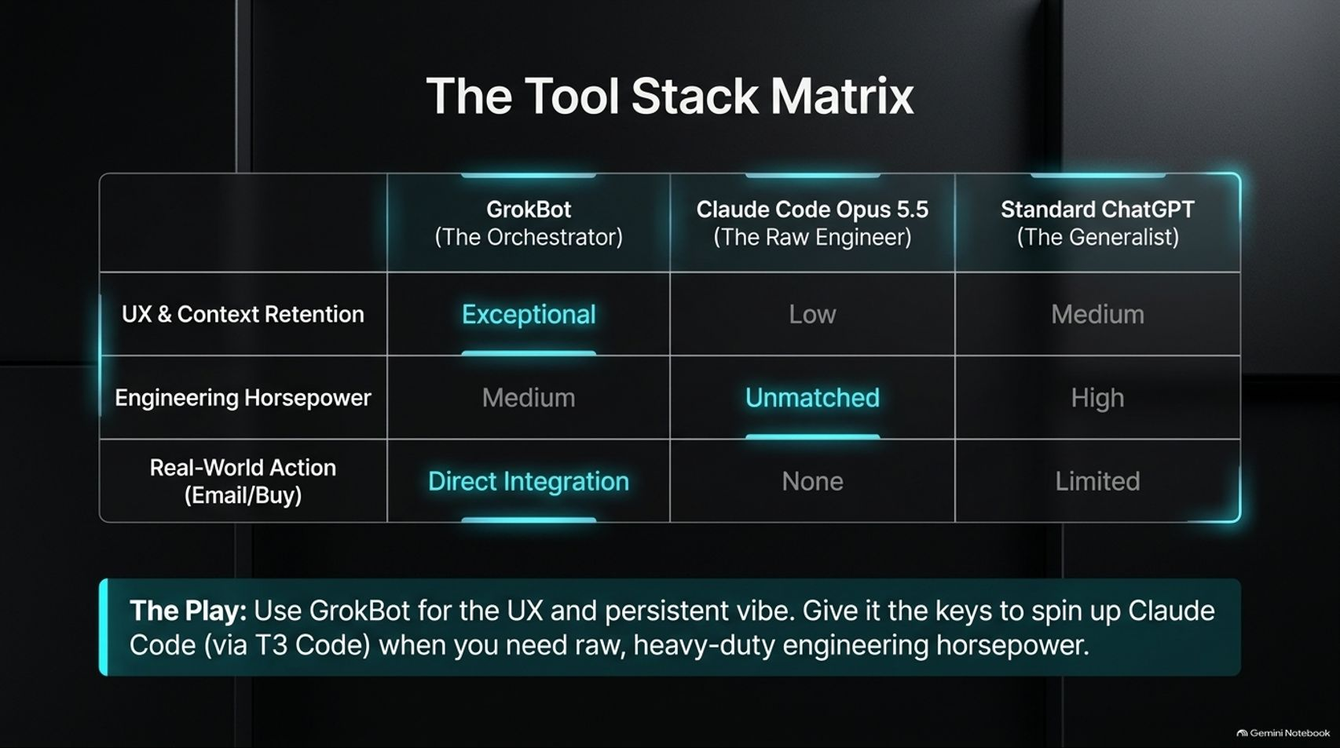
Notes:
Visual Theme: A structured comparison matrix evaluating GrokBot, Claude Code, and Standard ChatGPT.
Key Concept: Combining GrokBot's exceptional UX and persistent vibe with Claude Code's raw engineering horsepower via T3 Code.
Duration Range: 3 – 5 minutes
Speaker Notes:
Evaluating the Stack:
Standard ChatGPT: Good generalist, but medium context retention and limited real-world actions.
Claude Code (Opus 5.5): Unmatched engineering horsepower, but low native UX/multitasking integration on mobile.
GrokBot: Exceptional UX, persistent context, and direct real-world integration (email, banking).
The Winning Play: Use GrokBot as the master orchestrator and UX layer, but give it the keys to spin up Claude Code sessions (via T3 Code or remote terminal access) whenever heavy-duty engineering horsepower is required.

Slide 5
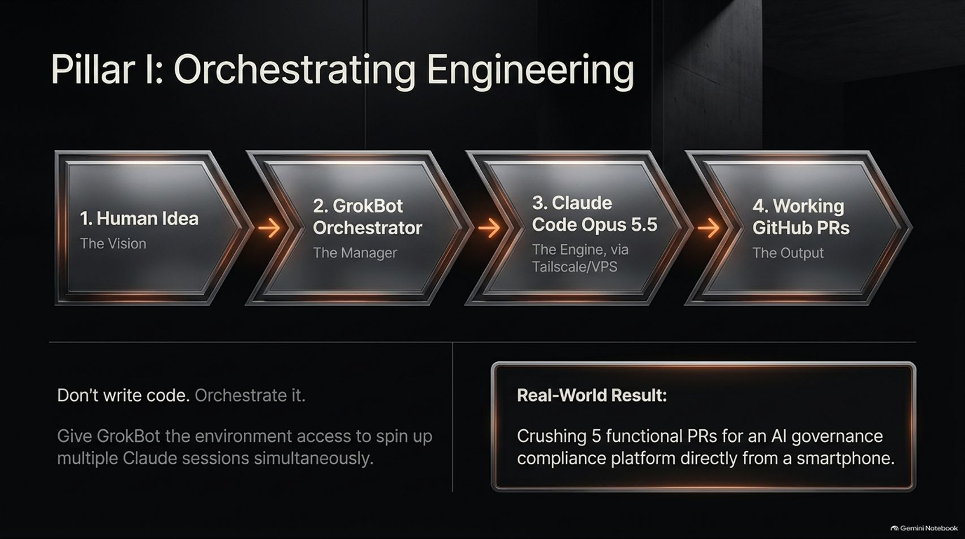
Notes:
Visual Theme: 4-stage horizontal process pipeline from Human Idea to Working GitHub PRs.
Key Concept: Don't write code; orchestrate it by giving GrokBot environment access to run multiple Claude sessions simultaneously.
Duration Range: 3 – 5 minutes
Speaker Notes:
The Engineering Pipeline:
Human Idea: The initial vision or inspiration.
GrokBot Orchestrator: The manager that structures the plan and coordinates sub-agents.
Claude Code (Opus 5.5): The raw engine running via VPS/Tailscale.
Working GitHub PRs: The final automated code delivery.
Real-World Proof: Ross Mike shared how he crushed five functional Pull Requests (PRs) for an AI governance compliance platform directly from his phone while visiting family.

Slide 6
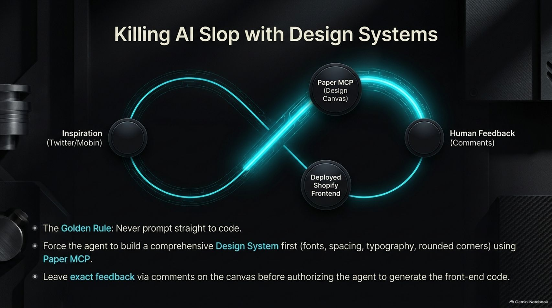
Notes:
Visual Theme: Infinity loop workflow connecting Inspiration, Paper MCP, Human Feedback, and Shopify Frontend.
Key Concept: Never prompt straight to code; force the agent to build a comprehensive design system using Paper MCP first.
Duration Range: 3 – 5 minutes
Speaker Notes:
The Golden Rule of Design: Never prompt an agent straight to code, or you will end up with generic "AI smell" (purple gradients and unpolished UI slop).
Using Paper MCP: Force the agent to build a comprehensive design system first (fonts, spacing, typography, corner radii) inside a visual design canvas like Paper MCP.
Human Feedback Loop: Leave precise comments directly on the canvas (e.g., tweaking typography or spacing) before authorizing the agent to generate the final front-end code.

Slide 7
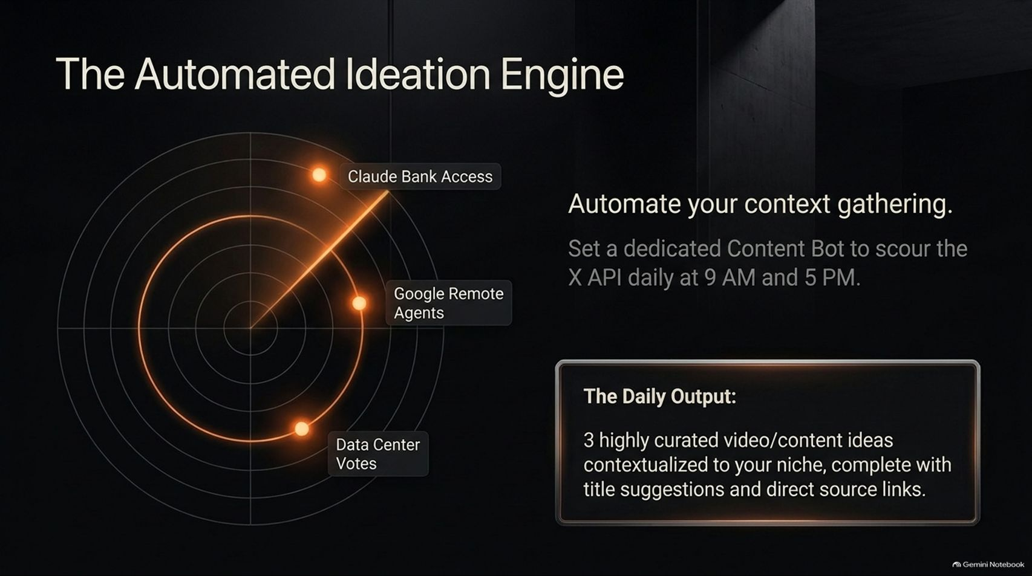

Slide 8
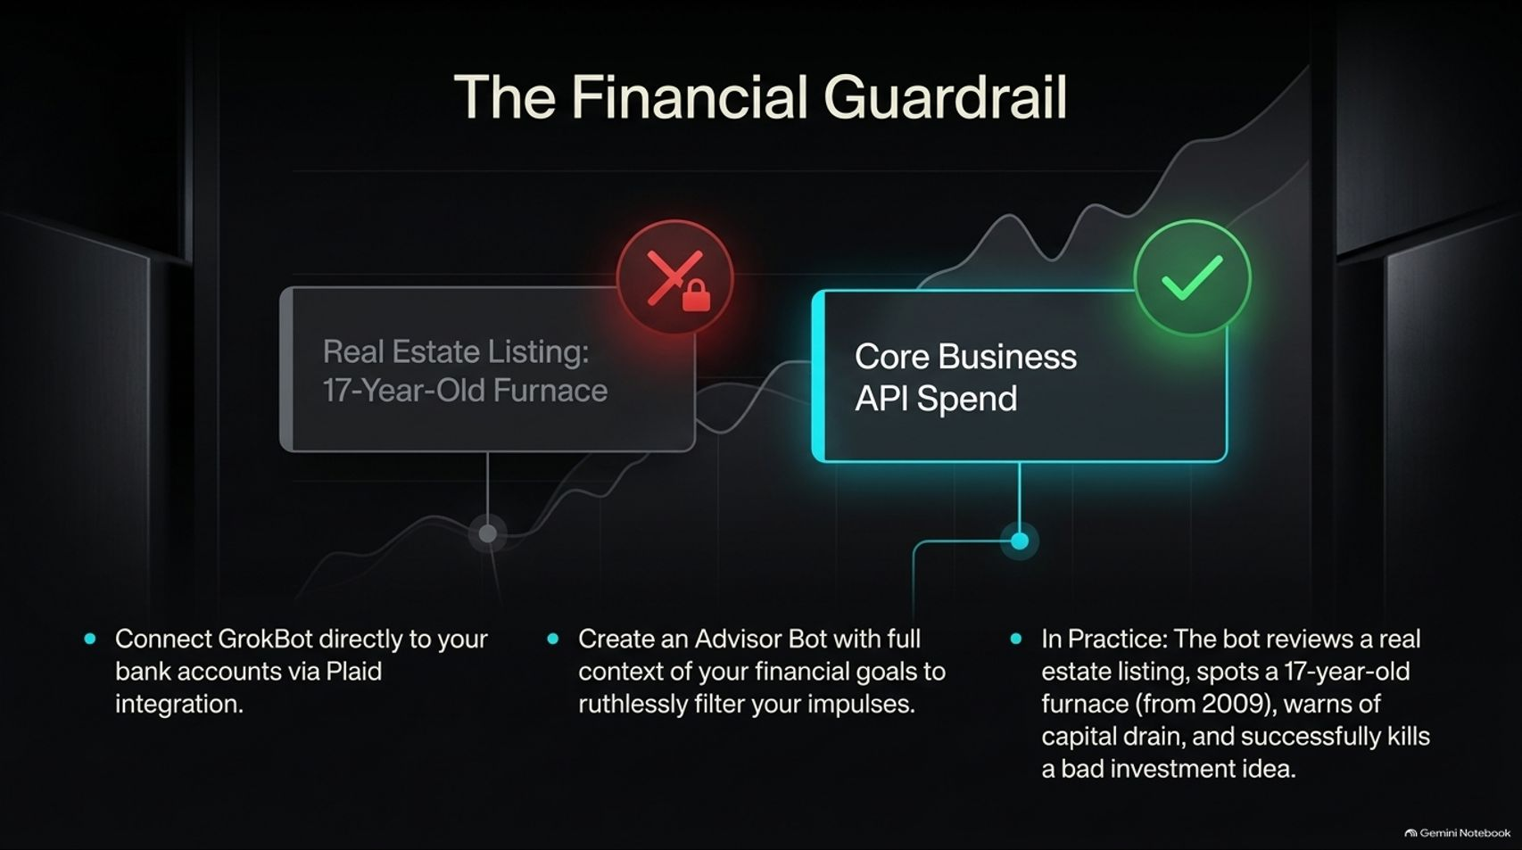
Notes:
Visual Theme: Financial chart contrasting a blocked real estate impulse against approved core business API spend.
Key Concept: Connecting bank accounts via Plaid to an Advisor Bot that ruthlessly filters impulsive financial decisions.
Duration Range: 3 – 5 minutes
Speaker Notes:
The Personal CFO: Connect GrokBot directly to your bank accounts via secure Plaid integration and feed it your long-term financial goals.
Combatting Shiny Object Syndrome: When impulsive business ideas arise (like buying random real estate or starting unrelated ventures), the Advisor Bot reviews transactions, spots hidden red flags (e.g., 17-year-old furnaces from 2009), and talks you out of bad capital drains.
The Psychology: Hearing objective financial pushback from an AI advisor that knows your complete budget hits harder and protects your runway.

Slide 9
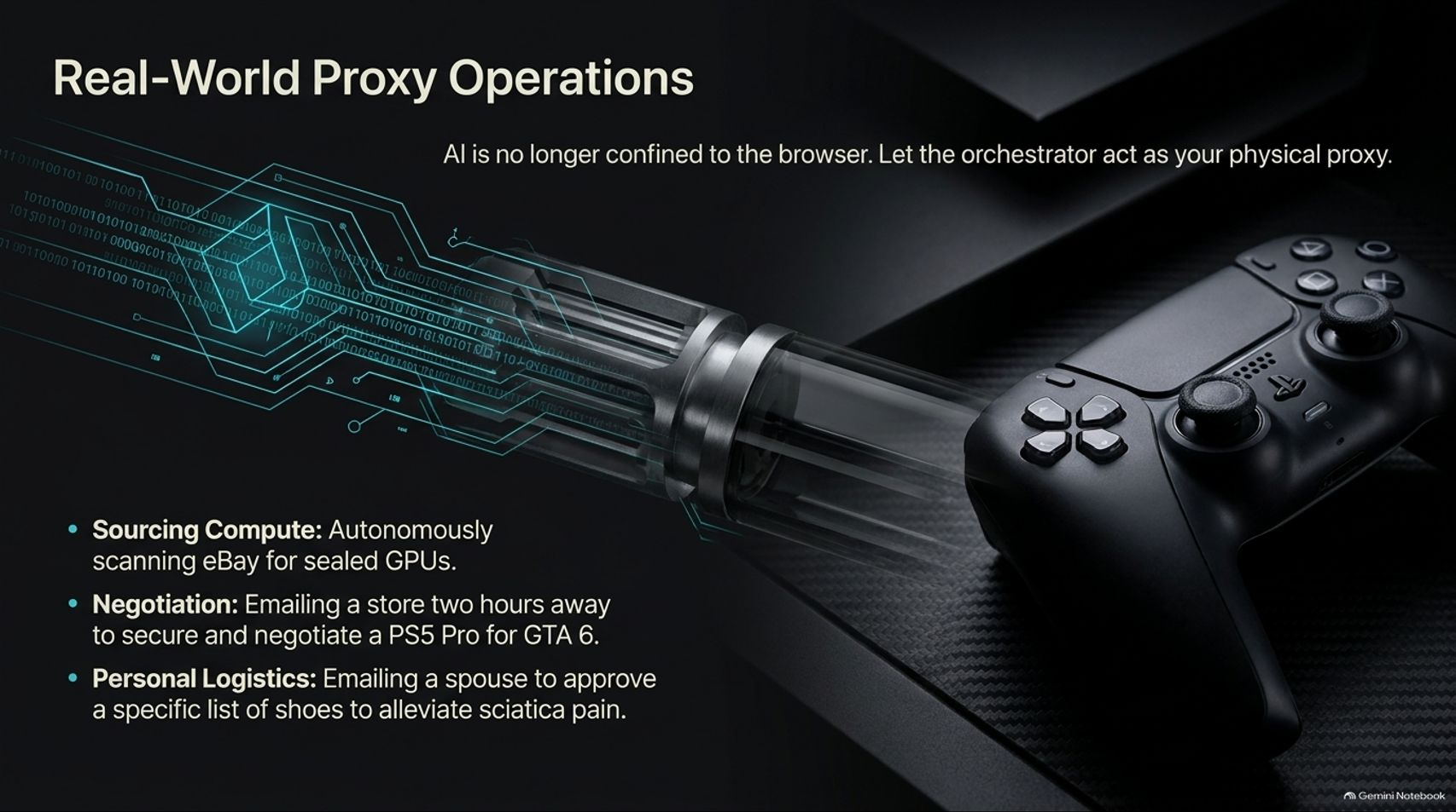
Notes:
Visual Theme: High-tech cybernetic link connecting code streams to a physical game controller.
Key Concept: Letting AI act as your physical proxy—sourcing computer hardware, negotiating deals, and managing logistics.
Duration Range: 3 – 5 minutes
Speaker Notes:
Beyond the Browser: AI is no longer confined to text chats; use your orchestrator as a real-world operating proxy.
Practical Examples:
Sourcing Compute: Autonomously scanning eBay for sealed, discounted GPUs.
Negotiation: Emailing local stores to secure hardware (like a PS5 Pro) and negotiate terms.
Personal Logistics: Coordinating shoe recommendations for physical ailments and emailing spouses for approval workflows.

Slide 10
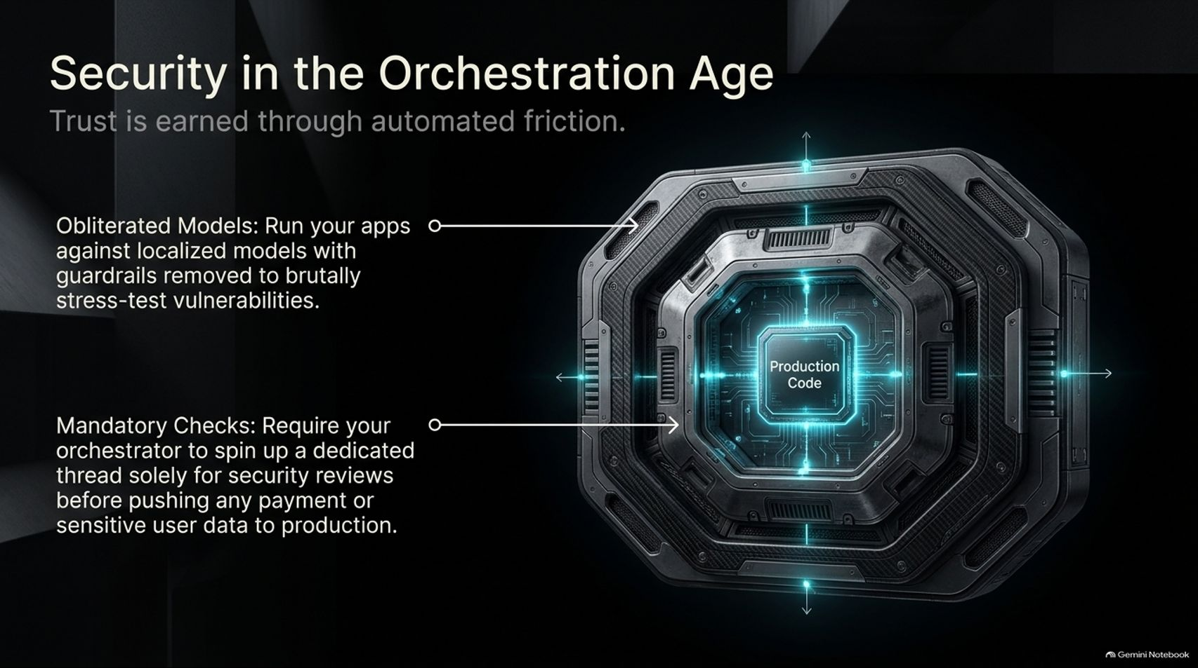
Notes:
Visual Theme: Armored multi-layered vault security core protecting "Production Code."
Key Concept: Ensuring robust application security through obliterated model stress-testing and mandatory review threads.
Duration Range: 3 – 5 minutes
Speaker Notes:
The Security Imperative: When AI generates and deploys code rapidly, security cannot be an afterthought.
Obliterated Models: Run your apps against localized models with safety guardrails removed to brutally stress-test vulnerabilities.
Mandatory Review Threads: Require your orchestrator to spin up a dedicated security review thread before pushing any financial transaction or sensitive user data to production.

Slide 11
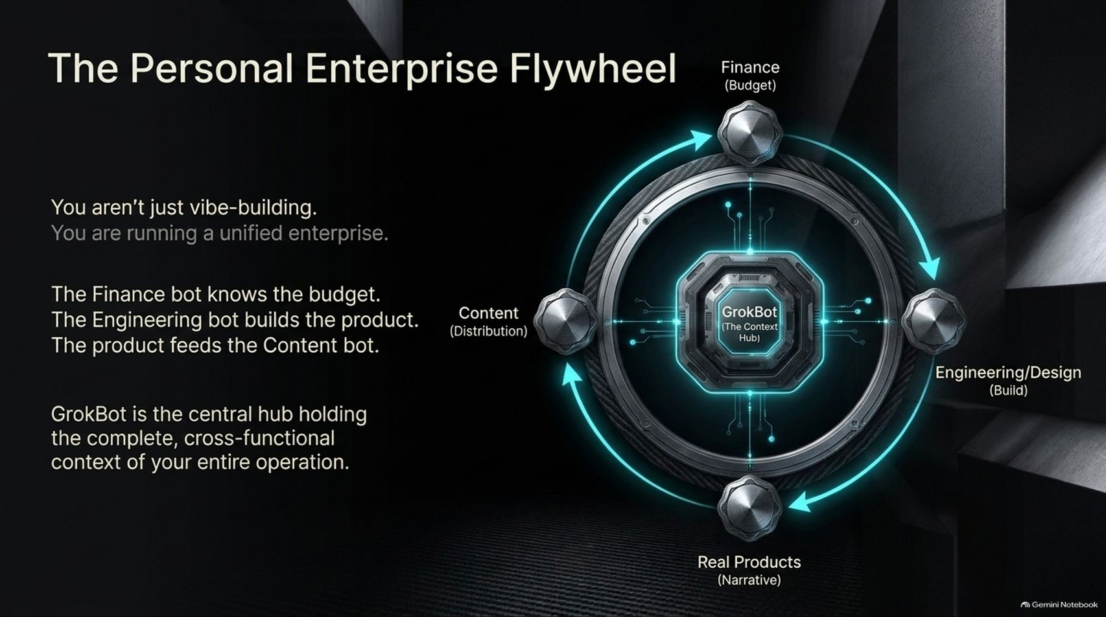
Notes:
Visual Theme: A central GrokBot core surrounded by rotating departmental nodes (Finance, Content, Engineering, Products).
Key Concept: Operating a unified enterprise where finance, building, narrative, and distribution feed into each other seamlessly.
Duration Range: 3 – 5 minutes
Speaker Notes:
Unified Operations: You aren't just "vibe-building"—you are running a unified micro-enterprise.
The Flywheel Mechanics: The Finance bot knows the budget; the Engineering bot builds the product; the Product feeds the Content bot, which drives distribution back into the business.
Central Hub: GrokBot sits at the center, holding complete cross-functional context across your entire operation.

Slide 12
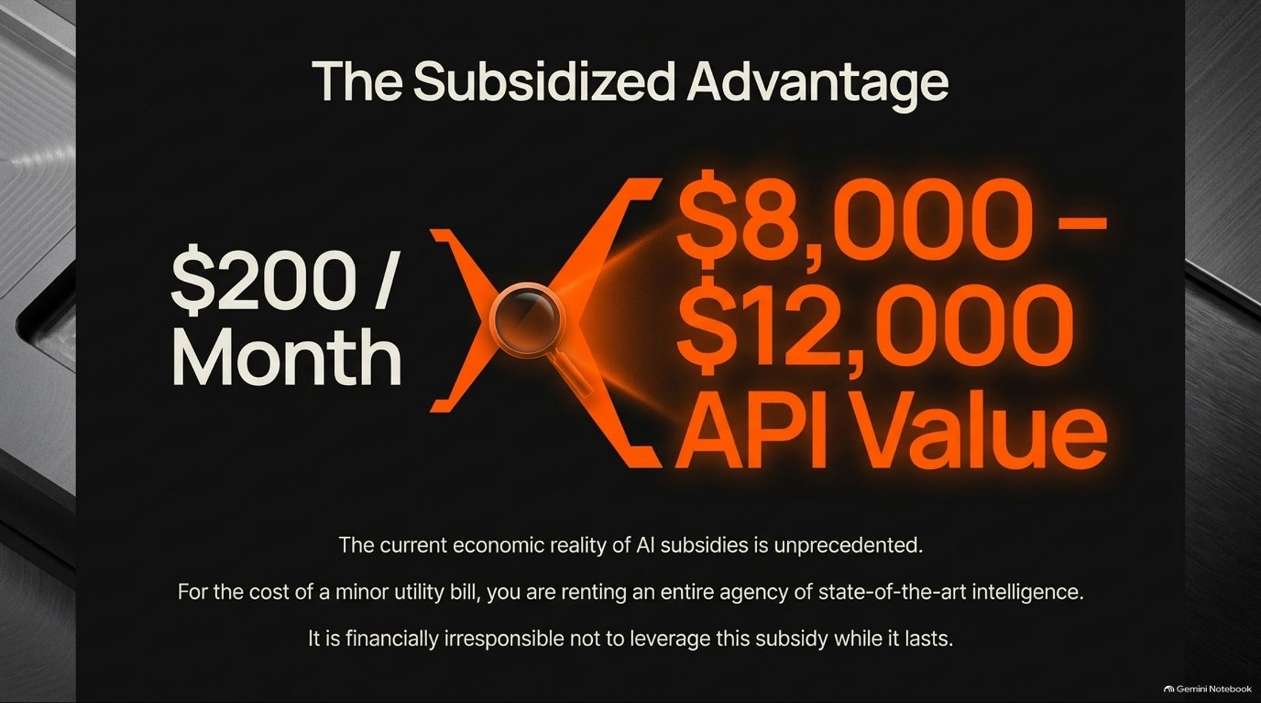
Notes:
Visual Theme: Bold financial comparison showing a $200/month subscription unlocking $8,000 to $12,000 in API value.
Key Concept: Capitalizing on unprecedented AI infrastructure subsidies while they last.
Duration Range: 3 – 5 minutes
Speaker Notes:
The Economic Reality: We are living through an era of unprecedented corporate subsidies in AI infrastructure.
The ROI: For a minor monthly utility bill ($200), you are renting an entire agency of state-of-the-art intelligence worth thousands in underlying API compute.
The Bottom Line: Unless you are in dire financial straits, it is financially irresponsible not to maximize this leverage while the subsidy window remains open.

Slide 13
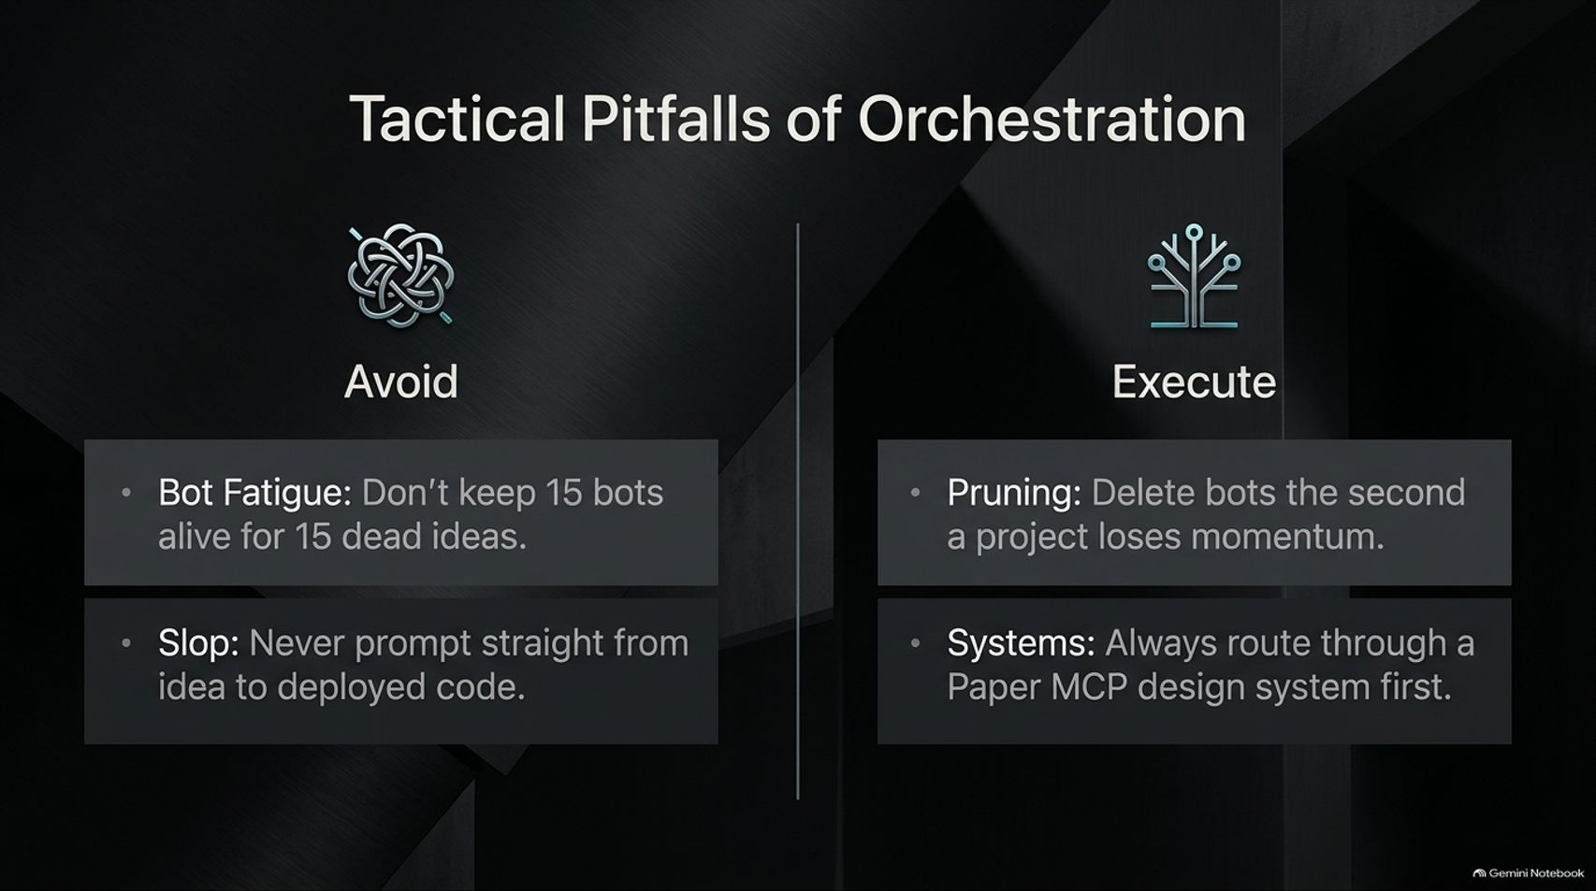
Notes:
Visual Theme: Comparative table contrasting messy "Avoid" habits (bot fatigue, un-systemed slop) against disciplined "Execute" practices (pruning, MCP systems).
Key Concept: Avoiding clutter through aggressive bot pruning and rigorous design system protocols.
Duration Range: 3 – 5 minutes
Speaker Notes:
Pitfall 1: Bot Fatigue: Do not keep 15 bots alive for 15 dead ideas. If a project stalls, prune it immediately by deleting the bot.
Pitfall 2: AI Slop: Never prompt straight from a random thought to deployed code. Always route your creative and UI work through a design system (like Paper MCP) first.
Discipline Wins: Orchestration requires housekeeping; keeping your workspace lean ensures your agent memory stays sharp and relevant.

Slide 14
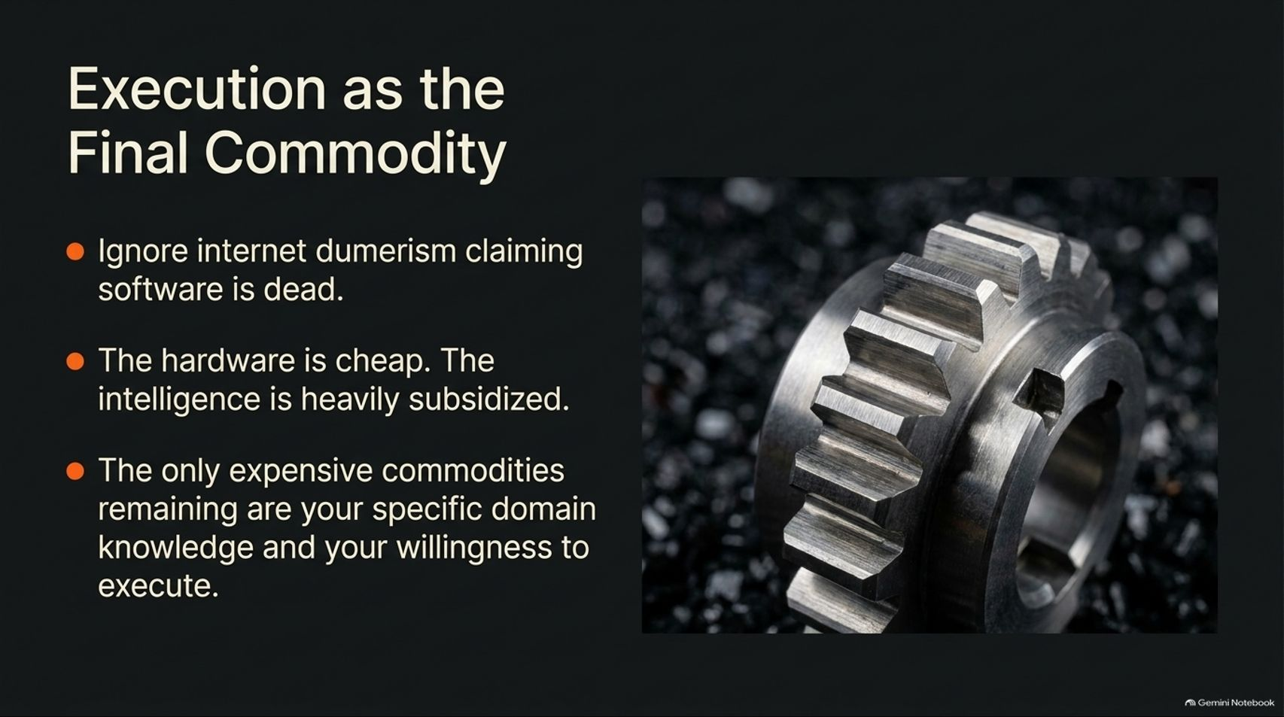
Notes:
Visual Theme: Precision metal gear cog resting among industrial elements.
Key Concept: Rejecting internet doomerism about dead software; recognizing that domain knowledge and execution are the only scarce commodities.
Duration Range: 3 – 5 minutes
Speaker Notes:
Rejecting Doomerism: Ignore online commentators claiming that software is dead or that individual builders can no longer compete.
The Shift in Value: Hardware is becoming commoditized, intelligence is heavily subsidized, and code is generated automatically.
The New Scarce Assets: The only expensive and defensible commodities remaining are your specific domain knowledge and your personal willingness to execute.

Slide 15
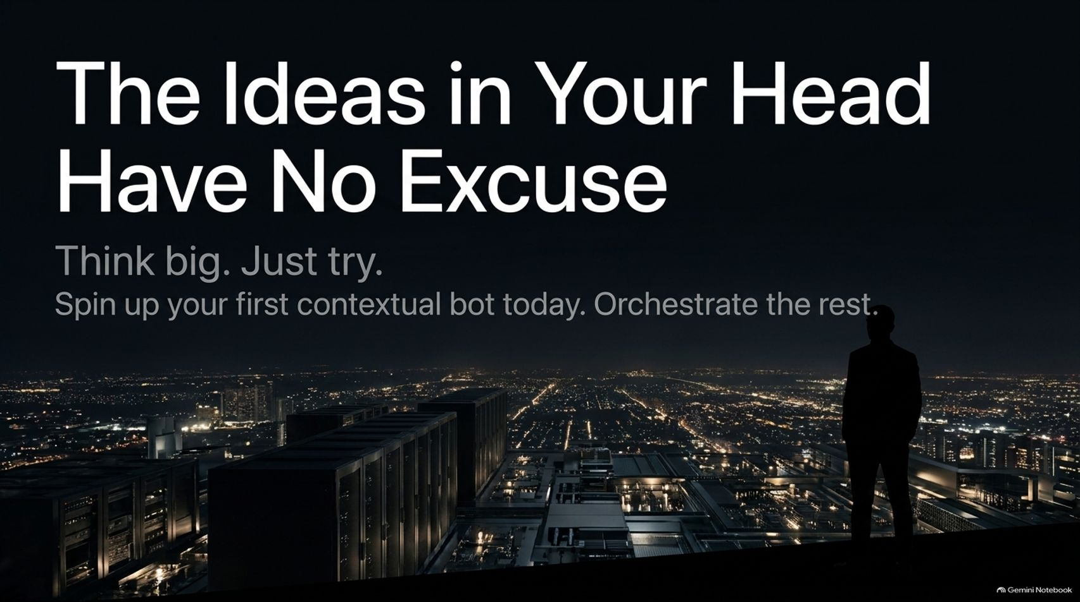
Notes:
Visual Theme: Silhouette of a creator overlooking a glittering metropolitan skyline at night.
Key Concept: A call to action urging creators to stop sitting on ideas and start spinning up contextual bots today.
Duration Range: 3 – 5 minutes
Speaker Notes:
No More Excuses: Ideas that used to be permanently trapped in your head due to a lack of coding skills or capital can now be brought to life.
Think Big, Just Try: You don't need to be a networking expert or a master developer to build hardware prototypes, apps, or businesses.
Take Action: Spin up your first contextual bot today, connect your tools, and orchestrate the rest.

Slide 16
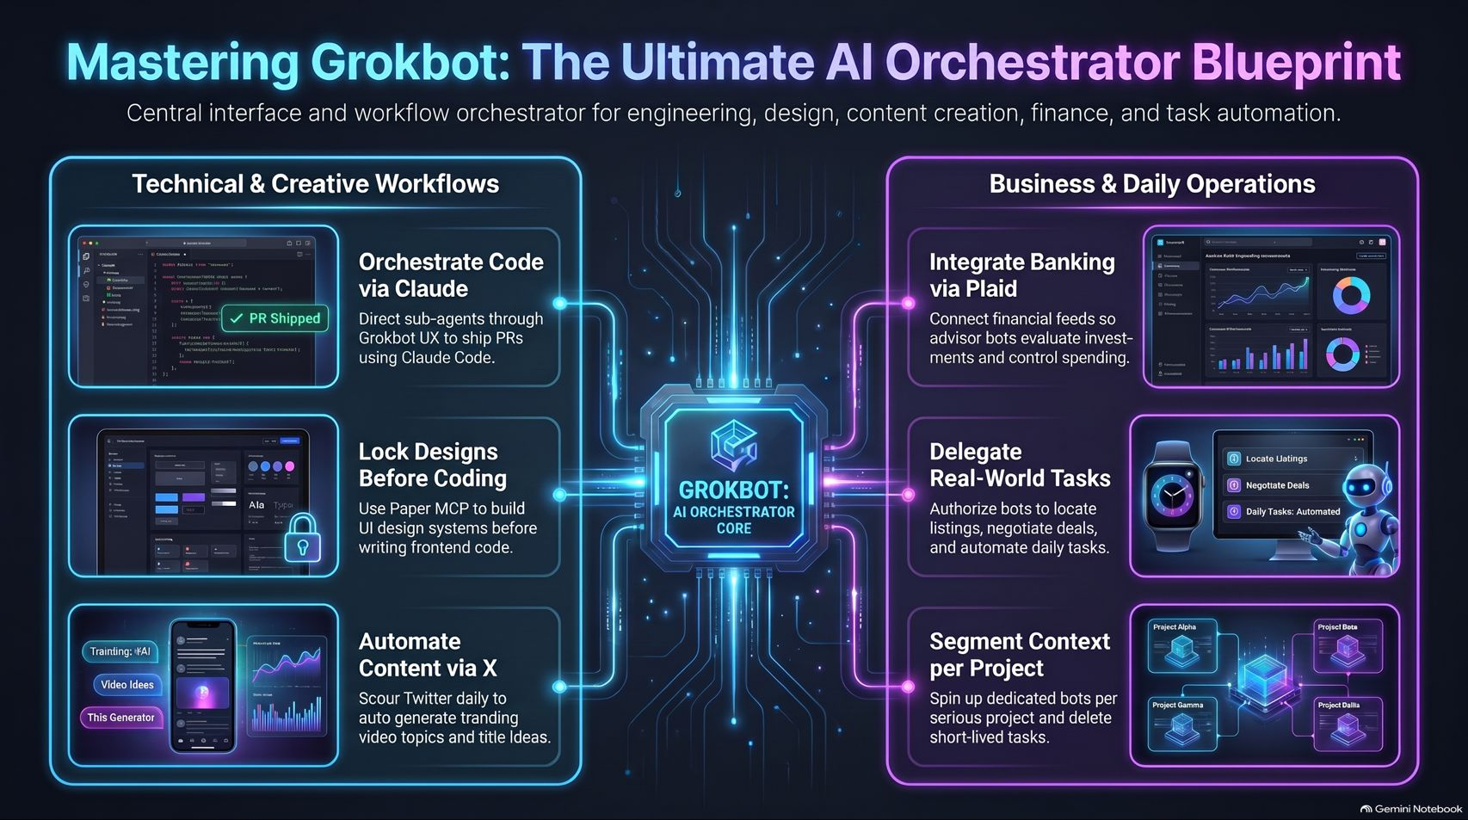
Notes:
Visual Theme: Comprehensive master summary dashboard uniting technical workflows (code, design, content) and business operations (banking, proxies, context segmentation) around the GrokBot core.
Key Concept: Complete end-to-end synthesis of the AI orchestration playbook.
Duration Range: 3 – 5 minutes
Speaker Notes:
Synthesizing the Blueprint: Review the dual pillars of the orchestrator model:
Technical & Creative Workflows: Orchestrating code via Claude, locking UI designs via Paper MCP, and automating content pipelines via X.
Business & Daily Operations: Integrating banking via Plaid, delegating real-world tasks, and segmenting context cleanly per project.
Closing Message: Put on your blinders, ignore the noise, and take full advantage of the intelligence revolution. Thank the audience and open the floor for Q&A.

