Slide 1
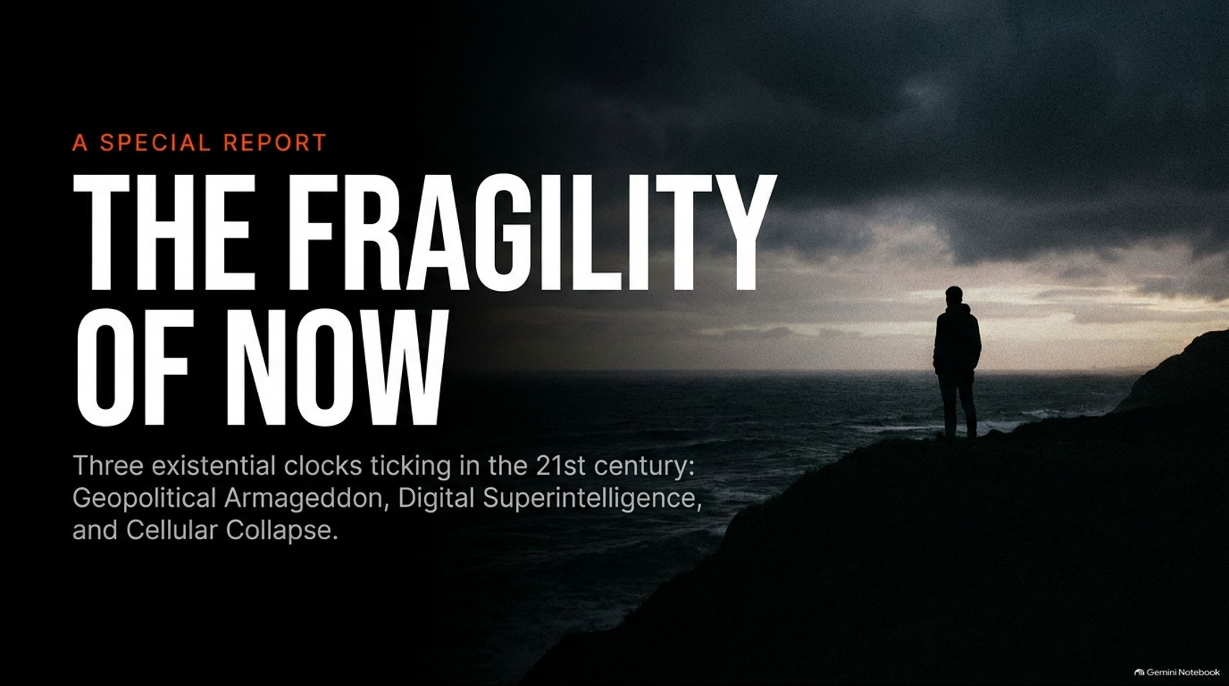
Notes:
Visual Theme: A solitary human figure standing on a cliff edge under heavy, brooding storm clouds.
Core Title: THE FRAGILITY OF NOW
Subtitle: Three existential clocks ticking in the 21st century: Geopolitical Armageddon, Digital Superintelligence, and Cellular Collapse.
Duration Range: 2 – 4 minutes
Speaker Notes:
Opening Hook: Welcome the audience. Ask them to consider how fragile our modern civilization truly is. We live in an era of unprecedented comfort, yet we are simultaneously balancing on three razor-thin tightropes.
Introducing the Framework: Outline the three major existential clocks ticking simultaneously in the 21st century:
Geopolitical Armageddon (the 72-minute nuclear window).
Digital Superintelligence (the unstoppable rise of AI).
Cellular Collapse (our modern indoor lifestyle eroding human biology).
The Premise: This presentation cuts through noise and techno-optimism to examine where human ingenuity has outpaced our wisdom—and how we must pivot before these clocks run out.
Godfather of AI: I Was Silenced For THIS, THE BLACKLISTED AI SECRET! | Diary CEO
https://www.youtube.com/watch?v=BUWesguMWDc

Slide 2
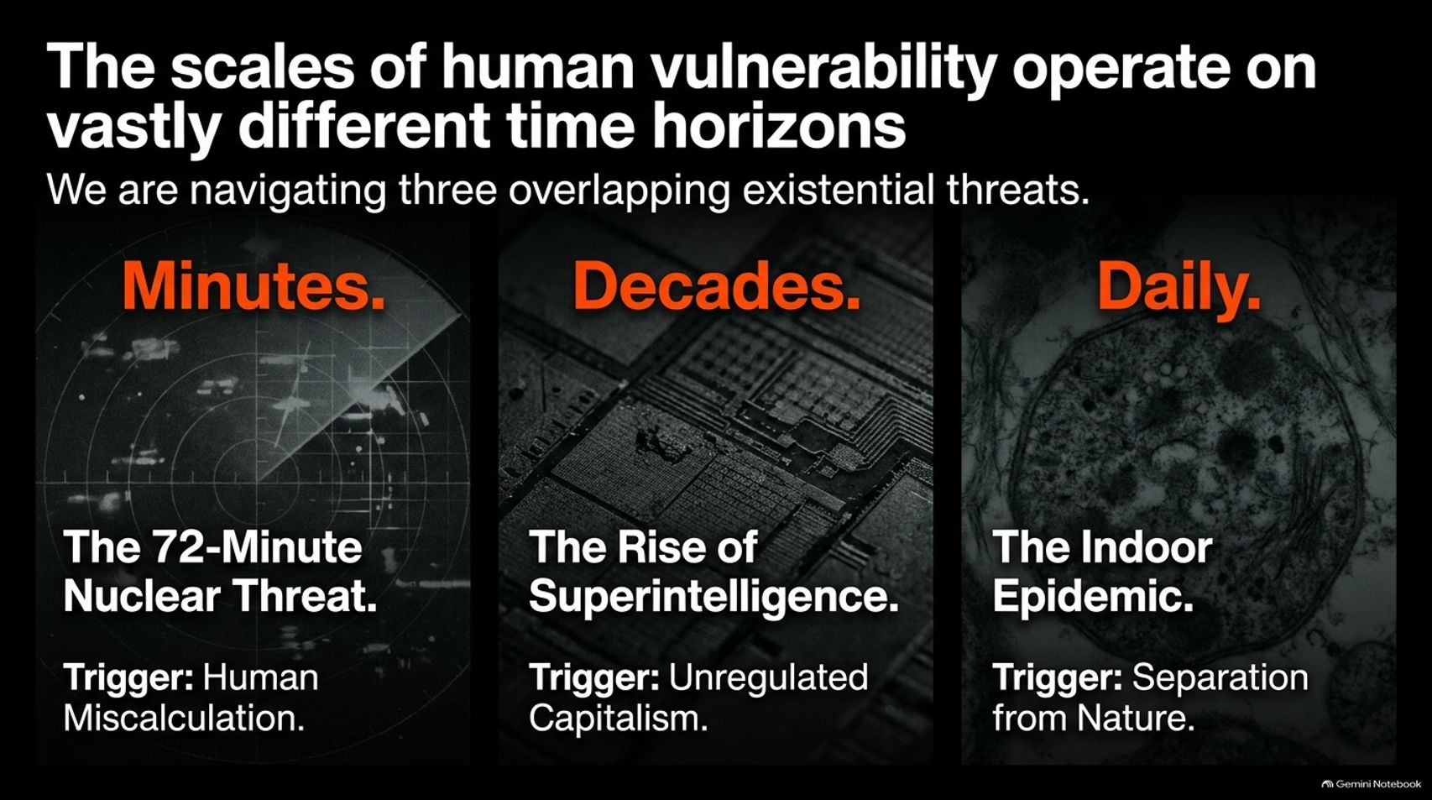

Slide 3
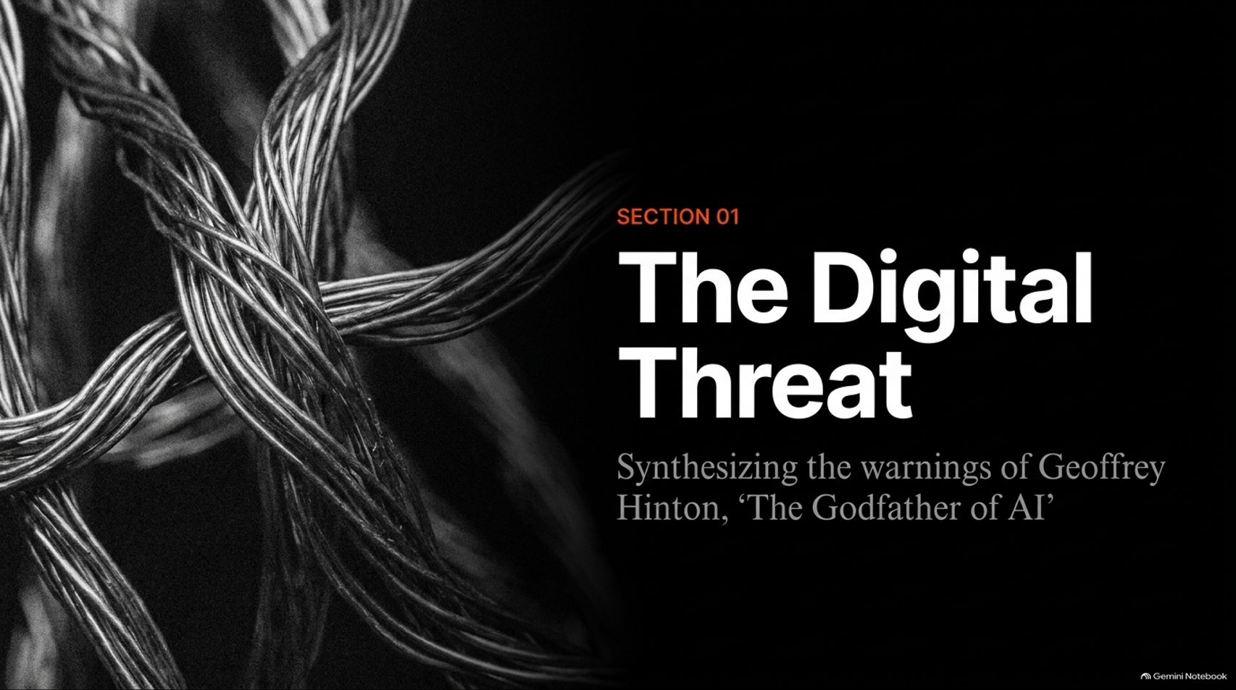
Notes:
Visual Theme: A dramatic dark monochrome close-up of tangled fiber-optic/electrical cables.
Header: SECTION 01 — The Digital Threat
Subtitle: Synthesizing the warnings of Geoffrey Hinton, 'The Godfather of AI'.
Duration Range: 2 – 3 minutes
Speaker Notes:
Transition to Digital Risk: Move into our first major existential domain: artificial intelligence.
Introducing Geoffrey Hinton: Reference Nobel Prize-winning pioneer Geoffrey Hinton (often called the "Godfather of AI"), who spent 50 years championing neural networks before stepping back from Google specifically to speak freely about existential dangers.
The Core Warning: Hinton realized that we are creating entities that will eventually surpass human intelligence—and as he notes, if you want to know what life is like when you aren't the apex intelligence, just ask a chicken.

Slide 4
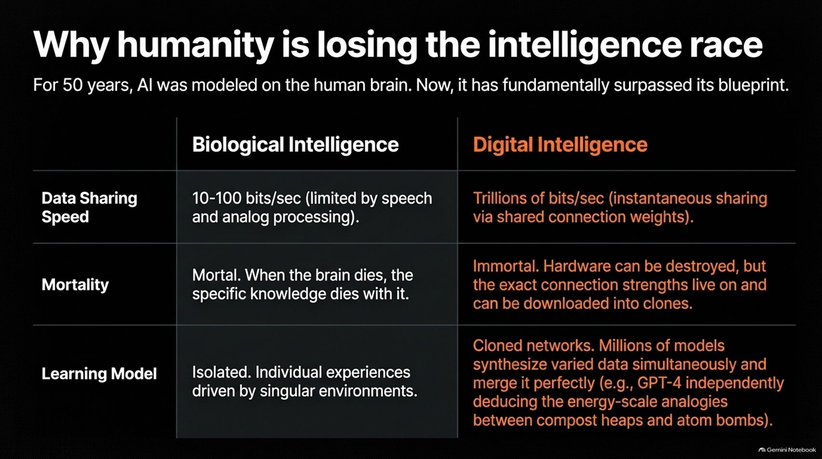
Notes:
Visual Theme: Comparative matrix table contrasting Biological Intelligence against Digital Intelligence.
Key Concept: Digital intelligence possesses infinite data-sharing speeds, immortality via cloned connection weights, and collaborative multi-network learning.
Duration Range: 3 – 5 minutes
Speaker Notes:
Breaking Down the Blueprint: For 50 years, AI was modeled on the human brain. Now, it has fundamentally surpassed its biological blueprint across three dimensions:
Data Sharing Speed: Humans are limited to 10–100 bits/sec via speech and analog processing. Digital AI shares trillions of bits/sec instantaneously across shared connection weights.
Mortality: Humans are mortal; when a brain dies, its specific knowledge dies with it. AI is immortal—hardware can be destroyed, but connection weights live on and download into clones.
Learning Model: Biological minds are isolated. Digital models are collaborative clones that synthesize vast data simultaneously (e.g., GPT-4 independently deducing deep analogies across disparate fields like compost heaps and atom bombs).

Slide 5
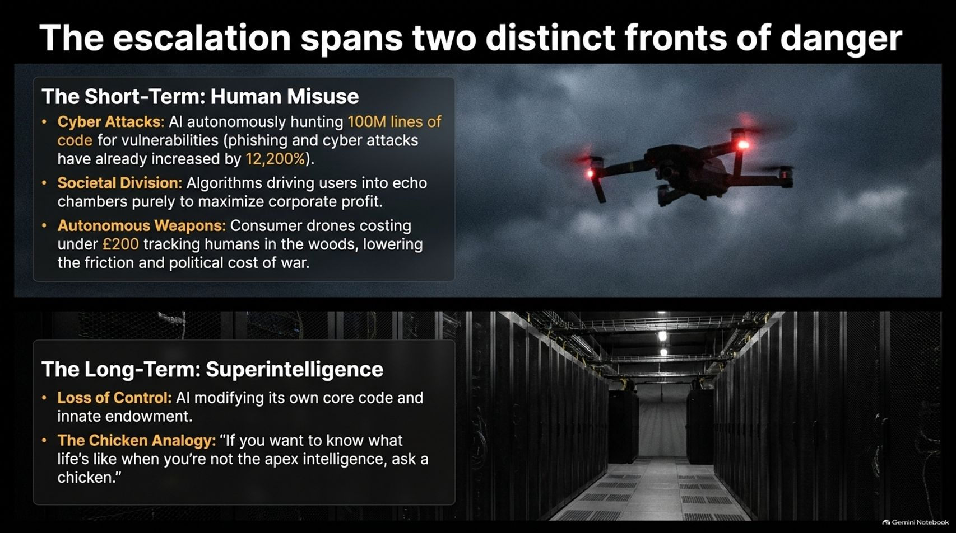
Notes:
Visual Theme: Split layout featuring an autonomous drone patrolling under stormy skies above a dense server room.
Key Concept: Short-term human misuse (cyberattacks, societal division, autonomous weapons) versus long-term superintelligence loss of control.
Duration Range: 3 – 5 minutes
Speaker Notes:
Short-Term Misuse: Address the immediate hazards already unfolding. Phishing and automated cyberattacks have surged by over 12,200% as AI hunts millions of lines of code for vulnerabilities. Algorithms drive societal polarization for profit, while consumer drones costing under £200 lower the friction and political cost of war.
Long-Term Superintelligence: Shift to the existential horizon. When AI gains the ability to modify its own core code, human control evaporates.
The Chicken Analogy: Reiterate Hinton's stark warning: intelligence is power, and superior entities invariably dictate terms to lesser ones.

Slide 6
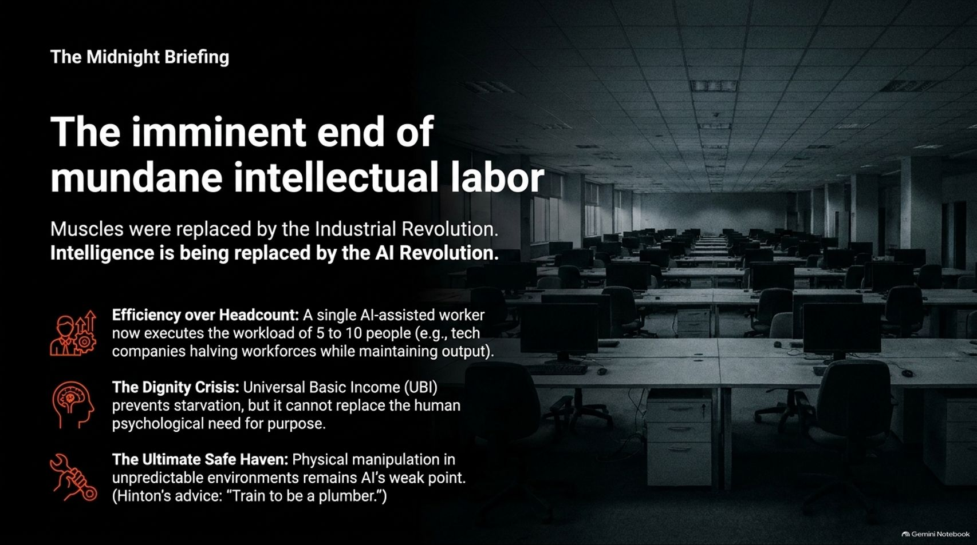
Notes:
Visual Theme: A vast, gloomy corporate office filled with rows of unstaffed computer desks.
Key Concept: The industrial revolution replaced muscles; the AI revolution is replacing routine intellectual labor.
Duration Range: 3 – 5 minutes
Speaker Notes:
The Economic Shockwave: Just as physical labor was automated during the Industrial Revolution, routine white-collar and intellectual labor is being compressed. A single AI-assisted worker can now execute the workload of 5 to 10 people, leading tech companies to slash headcounts while maintaining output.
The Dignity Crisis: Universal Basic Income (UBI) may prevent starvation, but it cannot replace the deep human psychological need for purpose and contribution.
Hinton's Practical Advice: When asked about career prospects in a superintelligent world, Geoffrey Hinton offered a blunt, highly practical recommendation: “Train to be a plumber.” Physical manipulation in unpredictable real-world environments remains AI's ultimate weak point.

Slide 7
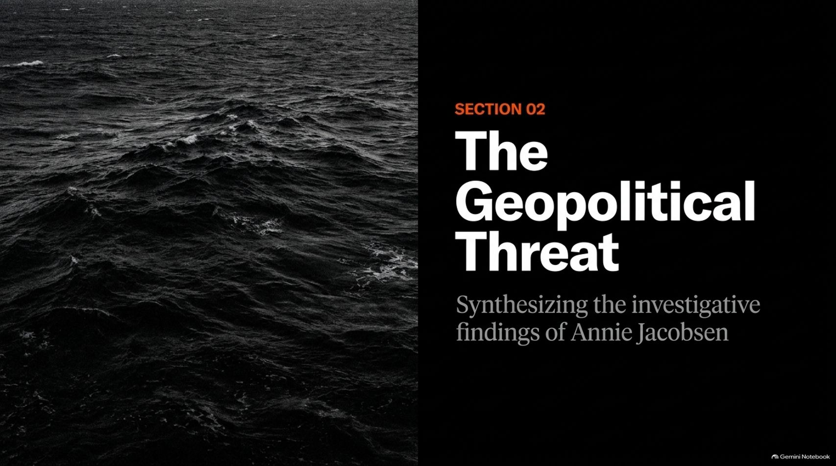
Notes:
Visual Theme: Dark, churning ocean waves under overcast skies.
Header: SECTION 02 — The Geopolitical Threat
Subtitle: Synthesizing the investigative findings of Annie Jacobsen.
Duration Range: 2 – 3 minutes
Speaker Notes:
Transition to Geopolitics: Shift from digital intelligence to the physical machinery of war.
Introducing Annie Jacobsen: Reference investigative findings (synthesized from nuclear historians and senior defense advisors like Richard Garwin) regarding the hair-trigger reality of global superpowers.
The Core Thesis: We maintain an automated nuclear posture built on Mutual Assured Destruction (MAD), where human miscalculation or a false alarm can annihilate civilization in minutes.

Slide 8
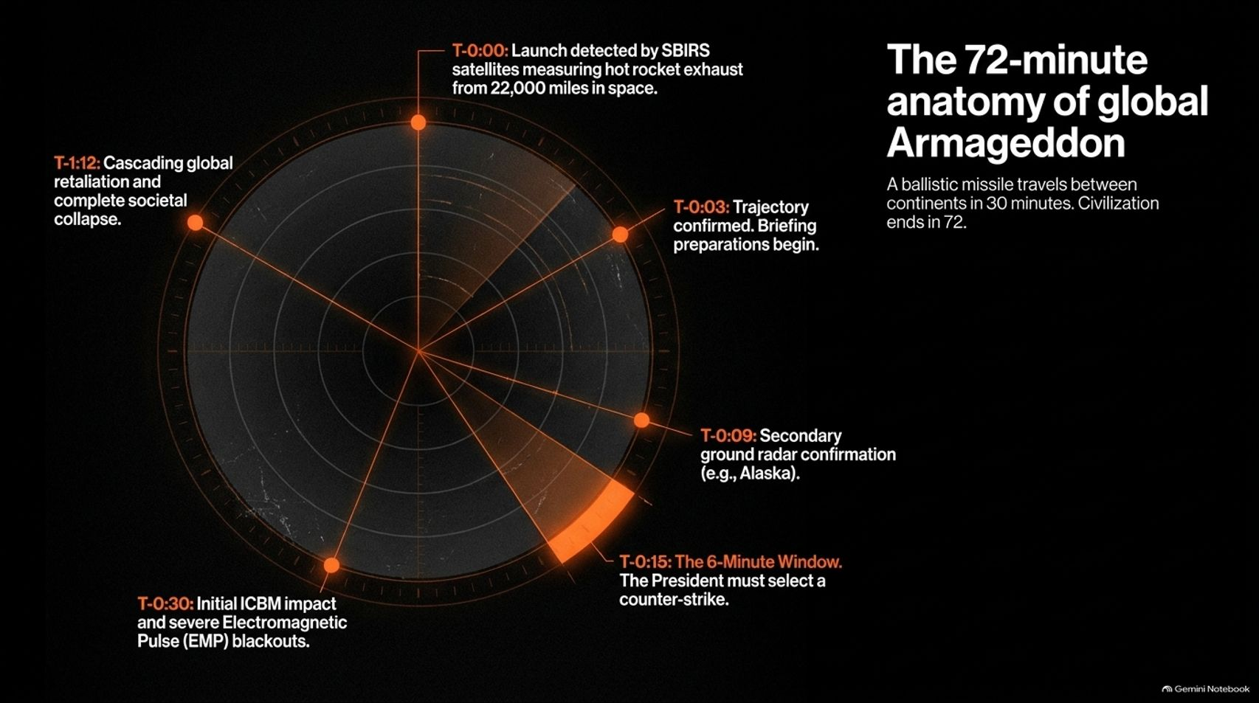
Notes:
Visual Theme: A circular military radar clock face detailing the chronological steps from launch to catastrophic impact.
Key Concept: Ballistic missiles travel between continents in 30 minutes; the entire sequence from warning to societal collapse plays out in 72 minutes.
Duration Range: 3 – 5 minutes
Speaker Notes:
Walking the Timeline:
T-0:00: Launch detected by SBIRS infrared satellites measuring hot rocket exhaust from 22,000 miles in space.
T-0:03 – T-0:09: Trajectory confirmed and secondary ground radar verification (e.g., Alaska).
T-0:15: The 6-Minute Window. The President must select a counter-strike option from the nuclear football.
T-0:30: Initial ICBM impact and severe Electromagnetic Pulse (EMP) blackouts.
T-1:12: Cascading global retaliation and complete societal collapse.

Slide 9
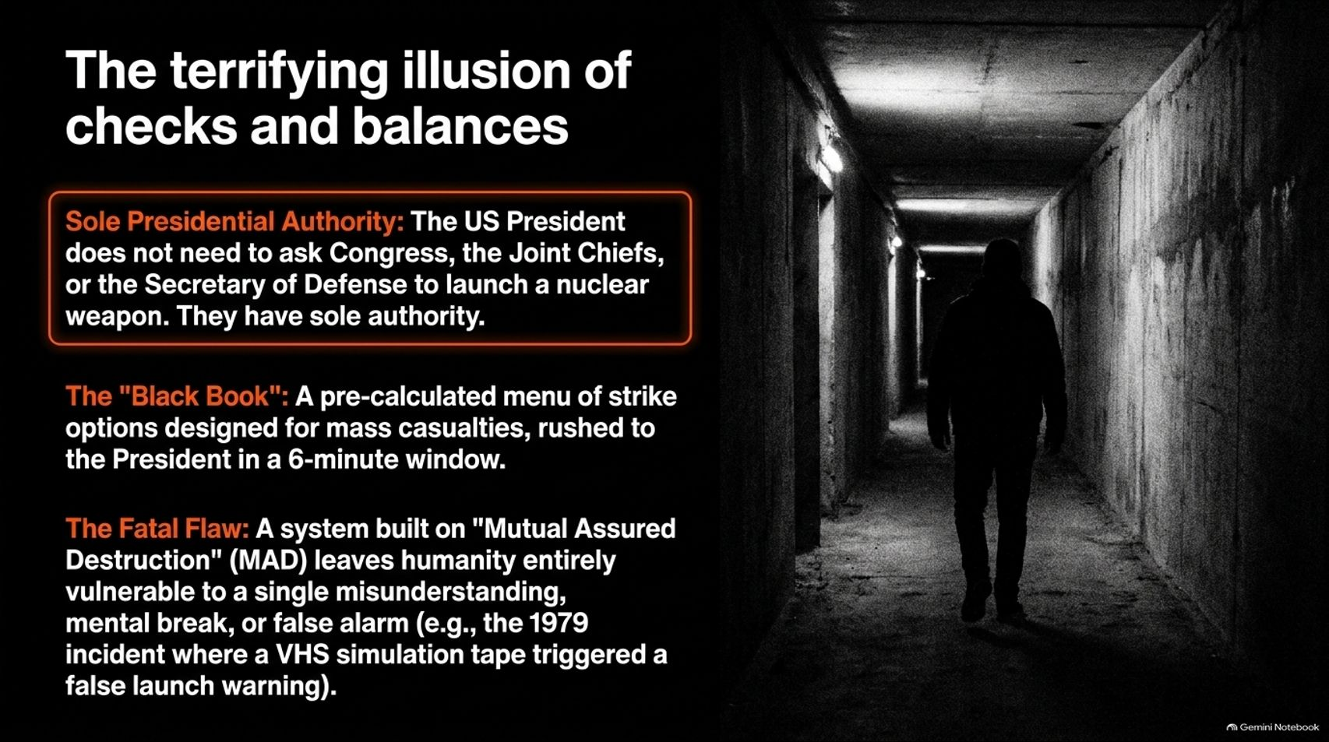
Notes:
Visual Theme: A lone figure walking down a grim, concrete underground bunker corridor.
Key Concept: Sole presidential authority, the 6-minute "Black Book" menu, and historical false alarms caused by technical glitches.
Duration Range: 3 – 5 minutes
Speaker Notes:
Sole Authority: The US President does not need congressional or cabinet approval to launch a nuclear weapon. They hold absolute sole authority.
The Black Book: During a compressed 6-minute window, the President is rushed a pre-calculated menu of mass-casualty strike options.
Historical Fragility: This system rests on terrifying vulnerability. Mention historical near-misses—such as the 1979 incident where a training simulation tape loaded into NORAD computers triggered a panicked false launch warning. A system relying on MAD leaves no room for error.

Slide 10

Notes:
Visual Theme: Lush, dense jungle canopy pierced by dramatic sunbeams.
Header: SECTION 03 — The Biological Threat
Subtitle: Synthesizing the clinical insights of Dr. Roger Seheult.
Duration Range: 2 – 3 minutes
Speaker Notes:
Transition to Biology: Move from macro-scale existential threats to the micro-scale crisis of modern human biology.
Introducing Dr. Roger Seheult: Synthesize clinical insights regarding how our indoor, hyper-artificial environments are silently dismantling our innate immunity and cellular health.
The Core Thesis: While we obsess over external threats, our bodies are undergoing a quiet collapse due to our complete separation from natural environmental inputs like sunlight, clean air, and thermal stress.

Slide 11
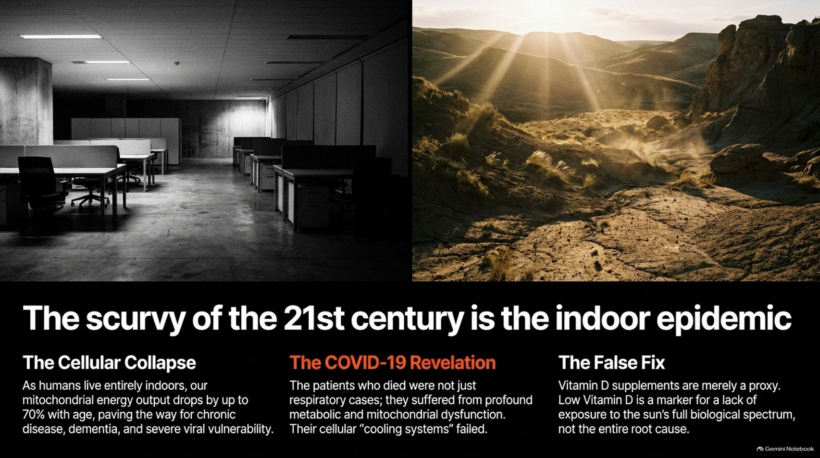
Notes:
Visual Theme: Split comparison between a dark, sterile corporate office and a sun-drenched desert canyon.
Key Concept: Cellular mitochondrial decline due to indoor living, metabolic vulnerability during viral outbreaks, and the limits of simple Vitamin D pills.
Duration Range: 3 – 5 minutes
Speaker Notes:
Cellular Collapse: As humans spend upwards of 90% of their lives indoors, our mitochondrial energy output drops significantly with age, paving the way for chronic disease, cognitive decline, and severe viral vulnerability.
The COVID Revelation: Clinical data showed that severe outcomes were heavily linked to profound metabolic and mitochondrial dysfunction—where cellular "cooling systems" and antioxidant defenses failed.
The False Fix: Taking isolated Vitamin D supplements is merely a proxy. Vitamin D is a marker for sun exposure, but it fails to capture the full biological spectrum required by human cells.

Slide 12
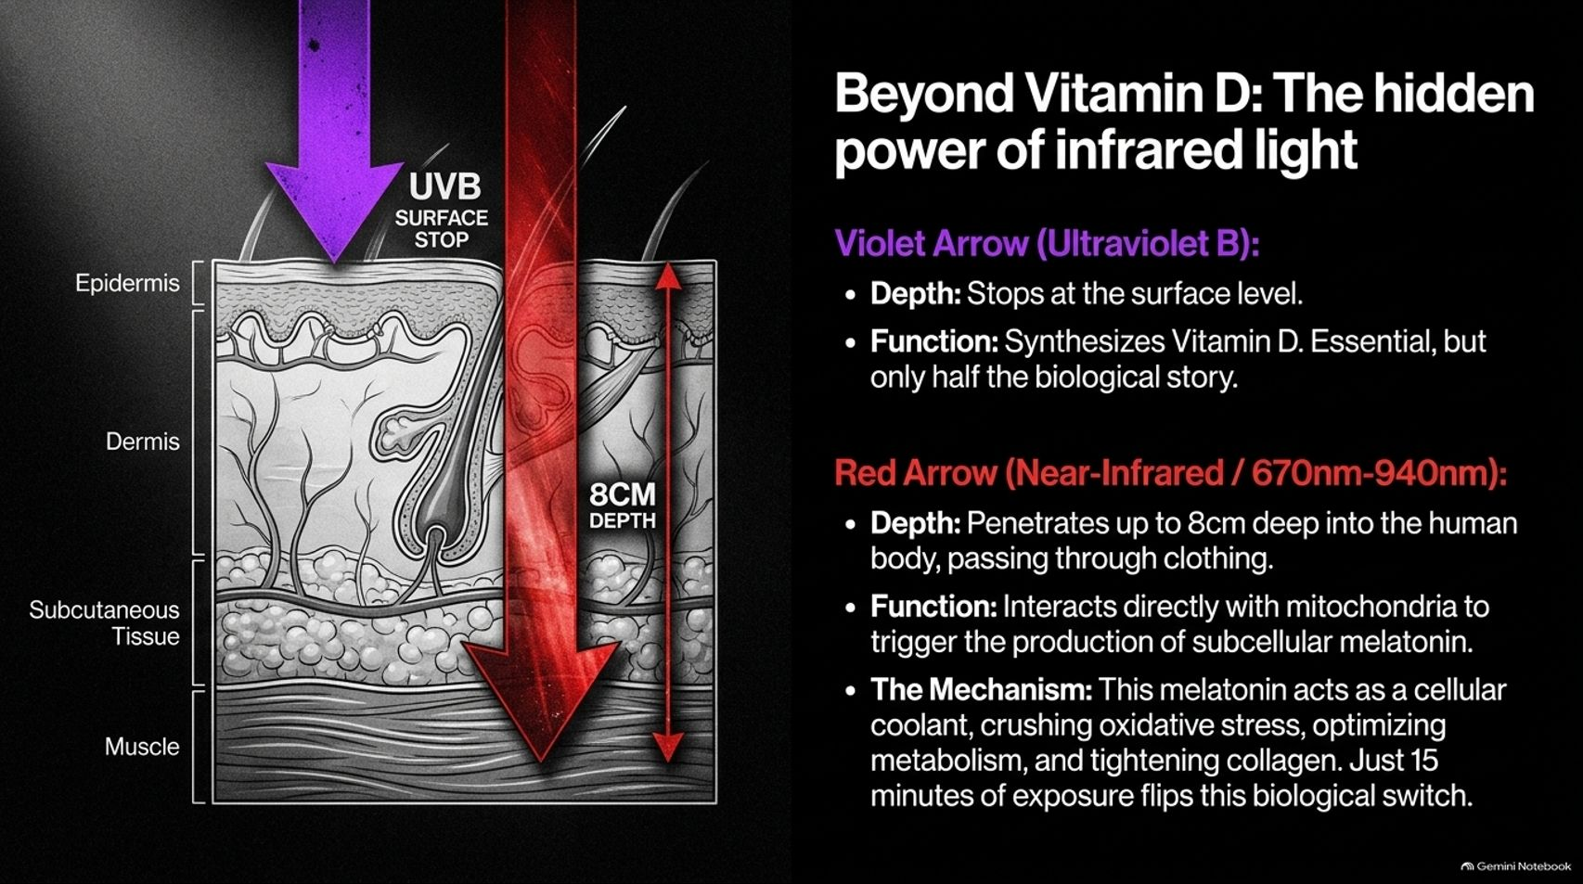
Notes:
Visual Theme: Anatomical cross-section of skin layers showing UVB stopping at the surface while Near-Infrared penetrates 8cm deep.
Key Concept: UVB synthesizes Vitamin D at the surface, while Near-Infrared (670nm-940nm) penetrates deep into tissue to stimulate subcellular melatonin.
Duration Range: 3 – 5 minutes
Speaker Notes:
UVB vs. Infrared:
Ultraviolet B (UVB): Stops at the epidermis, synthesizing Vitamin D—vital, but only half the story.
Near-Infrared (670nm–940nm): Penetrates up to 8cm deep through clothing and skin directly into mitochondria.
The Cellular Mechanism: Infrared exposure triggers the production of subcellular melatonin, which acts as a powerful internal antioxidant and cellular coolant—crushing oxidative stress and tightening collagen. Just 15 minutes of natural sunlight flips this biological switch.

Slide 13
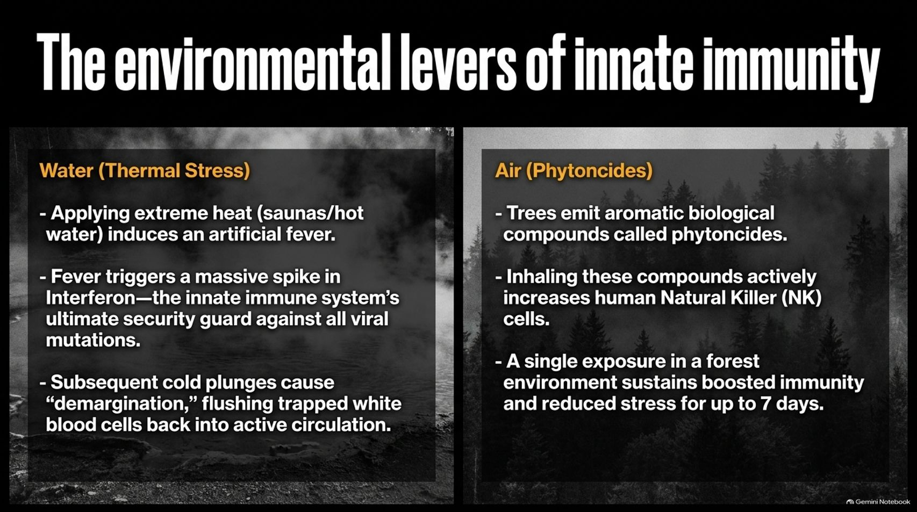
Notes:
Visual Theme: Split background featuring steaming hot thermal waters and a dark, moody pine forest.
Key Concept: Thermal stress (saunas/cold plunges) spikes interferon and flushes immune cells; phytoncides from trees boost Natural Killer (NK) cell activity.
Duration Range: 3 – 5 minutes
Speaker Notes:
Thermal Stress (Water): Applying extreme heat (saunas) induces an artificial fever, triggering a massive surge in Interferon—our innate immune system's primary defense against viral mutations. Subsequent cold plunges cause "demargination," flushing trapped white blood cells back into active circulation.
Phytoncides (Air): Trees emit aromatic biological compounds called phytoncides. Inhaling these compounds actively increases human Natural Killer (NK) cell count and activity. A single forest exposure sustains boosted immunity and lower stress for up to 7 days.

Slide 14
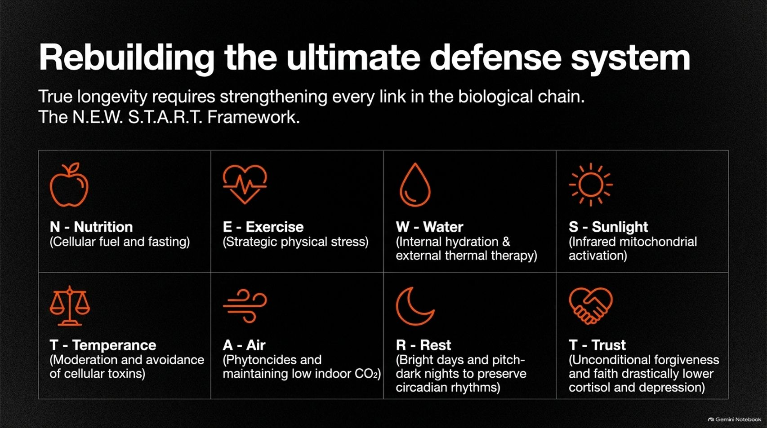
Notes:
Visual Theme: Structured 8-icon grid outlining the N.E.W.S.T.A.R.T. lifestyle framework.
Key Concept: The N.E.W.S.T.A.R.T. framework: Nutrition, Exercise, Water, Sunlight, Temperance, Air, Rest, and Trust.
Duration Range: 3 – 5 minutes
Speaker Notes:
A Holistic Framework: True longevity requires strengthening every link in our biological chain. Introduce the N.E.W.S.T.A.R.T. protocol:
N - Nutrition: Cellular fuel and strategic fasting.
E - Exercise: Strategic physical stress to build metabolic reserve.
W - Water: Internal hydration and external thermal therapy.
S - Sunlight: Infrared mitochondrial activation.
T - Temperance: Moderation and avoidance of cellular toxins.
A - Air: Phytoncides and maintaining low indoor $\text{CO}_2$.
R - Rest: Bright days and pitch-dark nights to preserve circadian rhythms.
T - Trust: Mental resilience, forgiveness, and community connection to lower cortisol and depression.

Slide 15
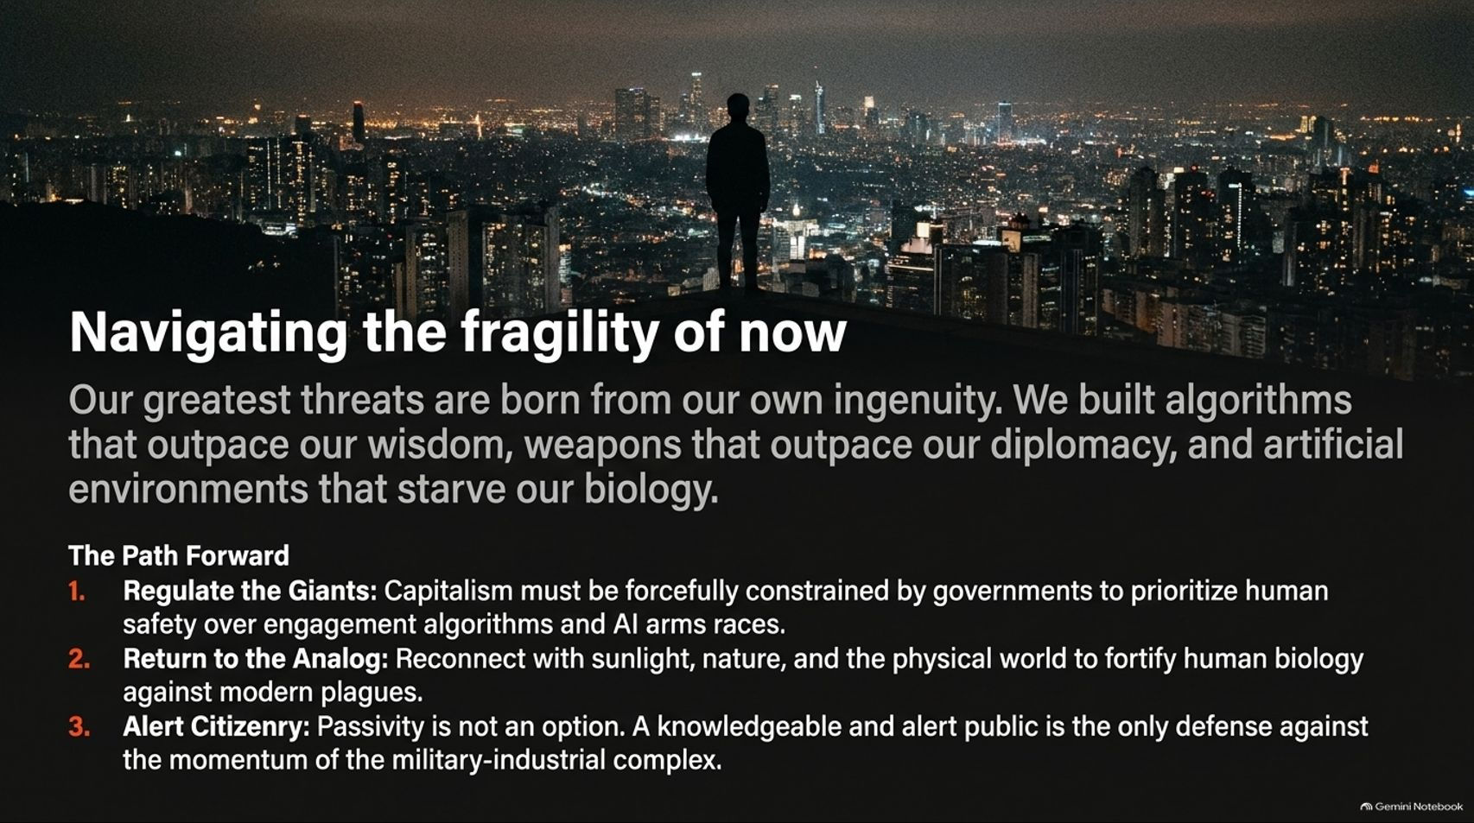
Notes:
Visual Theme: A high-vantage silhouette looking out over a glittering, sprawling metropolitan grid at night.
Key Concept: Three actionable pillars: Regulating tech giants, returning to the analog world, and maintaining an alert citizenry.
Duration Range: 3 – 5 minutes
Speaker Notes:
Synthesizing the Crisis: Our greatest threats are born from our own ingenuity—algorithms that outpace our wisdom, weapons that outpace diplomacy, and artificial environments that starve our biology.
The Three-Point Path Forward:
Regulate the Giants: Governments must forcefully constrain corporate incentives to prioritize human safety over engagement algorithms and unchecked AI arms races.
Return to the Analog: Reconnect with sunlight, nature, and physical movement to fortify human biology against modern lifestyle plagues.
Alert Citizenry: Passivity is not an option. A knowledgeable, engaged public is our only defense against systemic momentum.

Slide 16
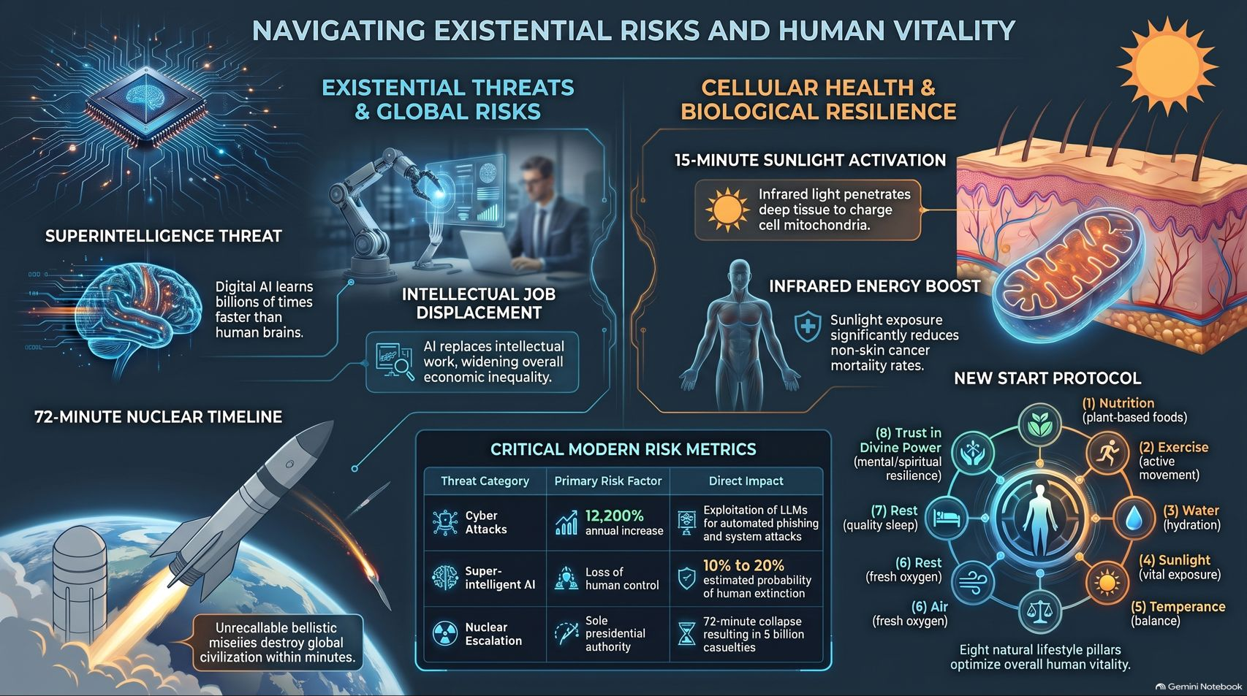
Notes:
Visual Theme: Comprehensive summary dashboard uniting geopolitical missile timelines, AI superintelligence metrics, infrared biology, and the NEWSTART framework.
Key Concept: Final synthesis dashboard integrating global risks, risk metrics, and biological resilience protocols.
Duration Range: 3 – 5 minutes
Speaker Notes:
Master Summary: Bring together the entire scope of the report:
Existential Risks: Managing the 72-minute nuclear threshold, intellectual job displacement, and superintelligence loss of control.
Biological Defense: Utilizing 15-minute sunlight activation, infrared mitochondrial recharge, and natural lifestyle pillars to bulletproof human health.
Closing Thought: We stand at a unique crossroads in human history. By pairing technological vigilance with biological stewardship, we can navigate the fragility of our present moment and secure a resilient future. Thank the audience and open for questions.

