Slide 1
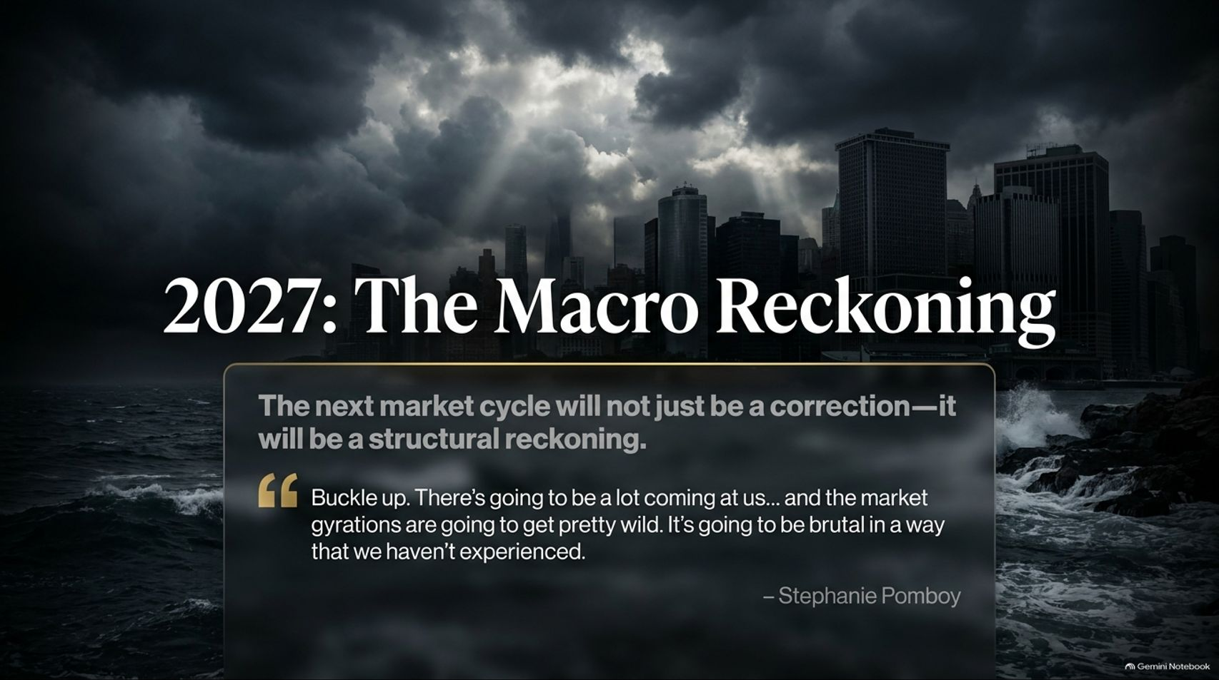
Notes:
Visual Theme: A dramatic, dark cinematic cityscape under brooding storm clouds with rough ocean waves crashing against a seawall.
Core Title: 2027: The Macro Reckoning
Quote / Subtitle: "The next market cycle will not just be a correction—it will be a structural reckoning." — Stephanie Pomboy: "Buckle up. There’s going to be a lot coming at us... and the market gyrations are going to get pretty wild. It’s going to be brutal in a way that we haven't experienced."
Duration Range: 2 – 4 minutes
Speaker Notes:
Opening Hook: Welcome the audience and immediately set a sober tone. Point out that the financial landscape heading into late 2026 and 2027 is facing structural imbalances far deeper than a standard cyclical correction.
The Pomboy Warning: Reference Stephanie Pomboy's stark assessment: market gyrations are going to get wild, and the upcoming reckoning will be brutal in a way most modern investors have never experienced.
The Premise: This presentation cuts through mainstream optimism to examine the four cascading pillars of economic vulnerability—consumer exhaustion, corporate margin pressure, state-level regulatory drag, and inevitable central bank capitulation.
Stephanie Pomboy: 2027 Is Going To Be "Brutal In A Way We Haven't Experienced"
https://www.youtube.com/watch?v=8N0HT0IgL0g

Slide 2
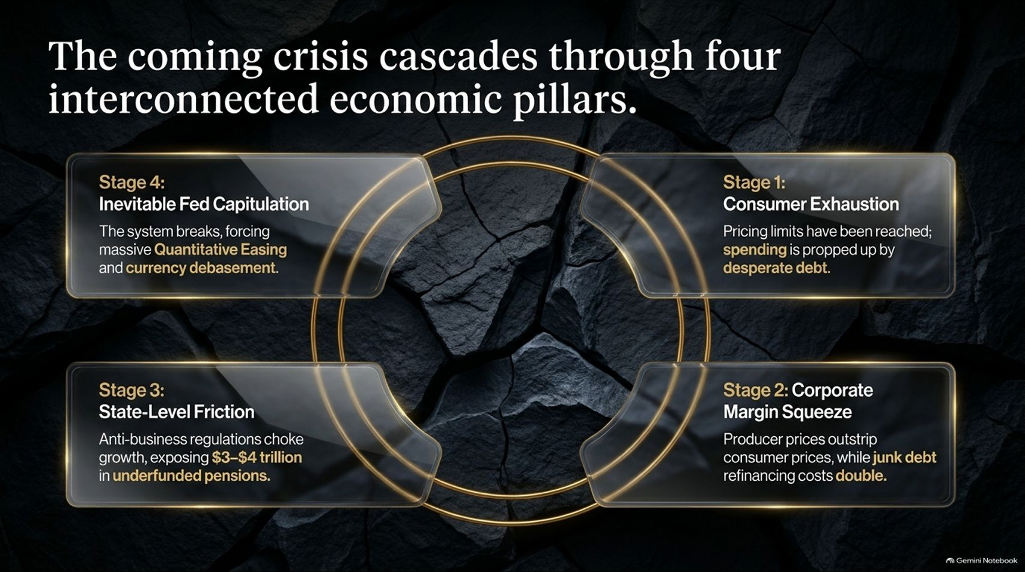
Notes:
Visual Theme: A four-quadrant glass layout superimposed over a dark, fractured geological stone background, linked by a golden ring.
Core Concept: A domino effect starting from consumer exhaustion and rippling through corporate margins, state friction, and Federal Reserve intervention.
Duration Range: 3 – 5 minutes
Speaker Notes:
Interconnected Vulnerability: Explain that economic crises do not happen in a vacuum. They cascade through four distinct stages:
Stage 1: Consumer Exhaustion — Pricing limits have been reached, and spending is propped up entirely by desperate debt.
Stage 2: Corporate Margin Squeeze — Producer prices outstrip consumer prices while junk debt refinancing costs double.
Stage 3: State-Level Friction — Anti-business state regulations choke growth, exposing trillions in underfunded pensions.
Stage 4: Inevitable Fed Capitulation — The system breaks, forcing massive quantitative easing and currency debasement.
Takeaway: Understanding this sequence allows investors to position ahead of the curve rather than reacting to panic.

Slide 3
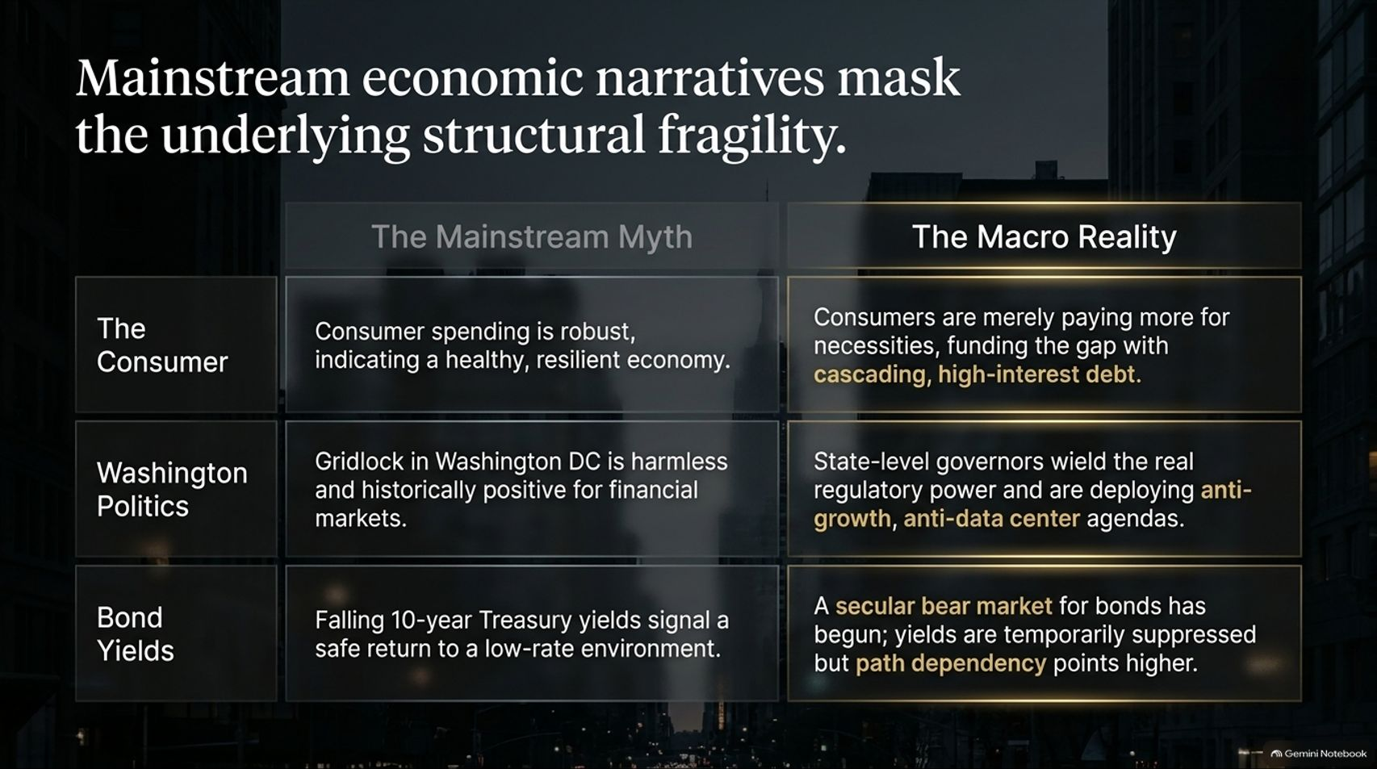
Notes:
Visual Theme: A clean, comparative two-column table contrasting "The Mainstream Myth" against "The Macro Reality".
Core Concept: Debunking common assumptions regarding consumer health, political gridlock, and bond yields.
Duration Range: 3 – 5 minutes
Speaker Notes:
Shattering Myths: Address the dangerous gaps between headline data and underground reality:
The Consumer: Mainstream says spending is robust. Reality: Consumers are paying more merely for necessities, funding the gap with cascading high-interest debt.
Washington Politics: Mainstream says political gridlock is harmless. Reality: State-level governors wield the real regulatory power and are deploying aggressive anti-growth agendas.
Bond Yields: Mainstream says falling yields signal a safe return to low rates. Reality: A secular bear market for bonds has begun; yields are temporarily suppressed, but path dependency points higher.

Slide 4
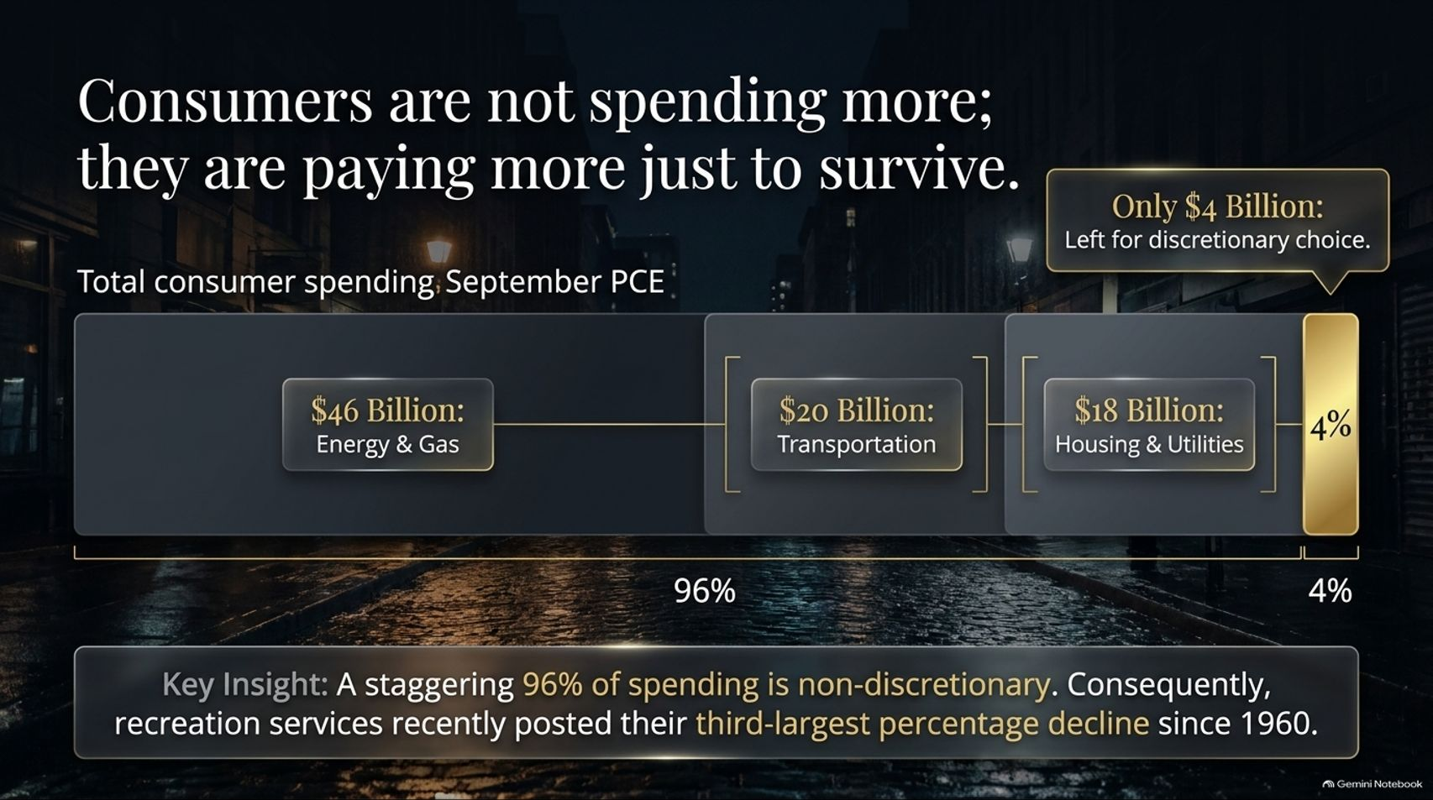
Notes:
Visual Theme: A horizontal spending allocation bar chart showing 96% going to non-discretionary needs and only 4% left for discretionary choice.
Core Concept: Breaking down September PCE data: 96% of spending goes to essentials, leading to historic collapses in recreation services.
Duration Range: 3 – 5 minutes
Speaker Notes:
The Consumer Reality Check: Highlight Pomboy's analysis of recent personal consumption expenditure (PCE) data.
The Numbers: Out of over $113 billion in monthly spending increases, the vast majority went straight into energy/gas ($46B), transportation ($20B), housing & utilities ($18B), food, and healthcare.
The 96% Rule: A staggering 96% of consumer spending is non-discretionary. Consumers are not out buying luxuries; they are paying more just to stay even. Consequently, recreation services recently posted their third-largest percentage decline since 1960.

Slide 5
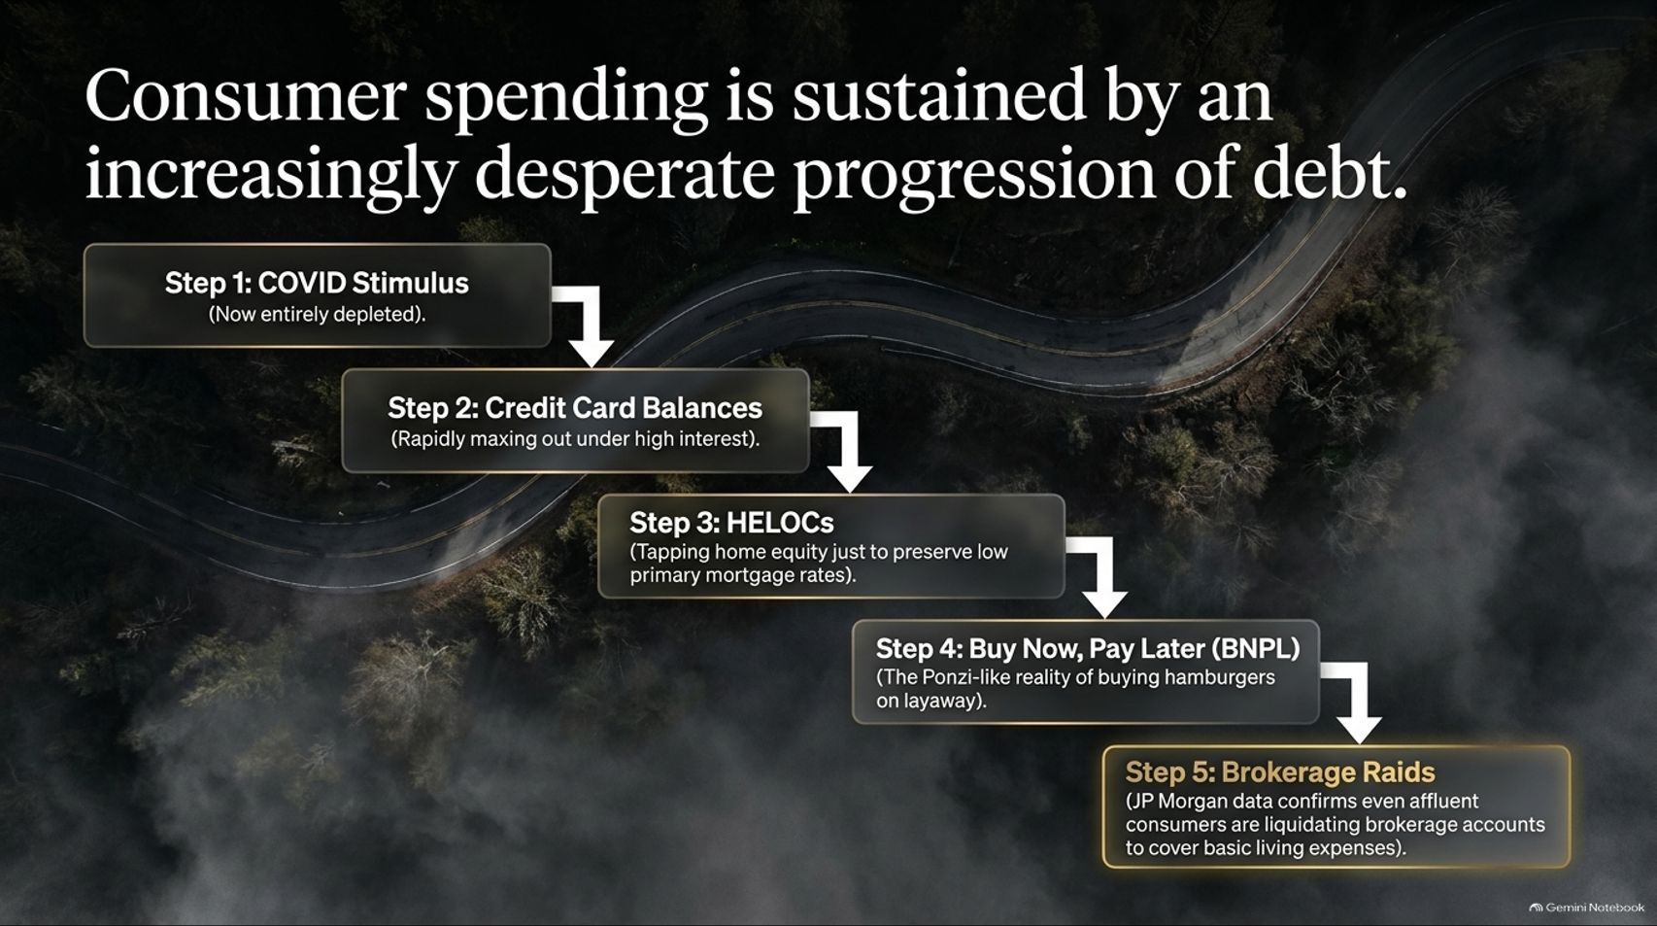
Notes:
Visual Theme: A winding mountain road graphic detailing a 5-step downward debt cascade.
Core Concept: The depletion of COVID stimulus followed by credit cards, HELOCs, Buy-Now-Pay-Later, and finally brokerage account liquidations.
Duration Range: 3 – 5 minutes
Speaker Notes:
The Debt Escalator: Walk through how households have kept the illusion of spending alive:
Step 1: COVID stimulus (now entirely depleted).
Step 2: Credit card balances rapidly maxing out under high interest.
Step 3: HELOCs (tapping home equity just to preserve low primary mortgage rates).
Step 4: Buy Now, Pay Later (the Ponzi-like reality of buying hamburgers on layaway).
Step 5: Brokerage raids (JP Morgan data confirms even affluent consumers are liquidating investment accounts to cover basic living expenses).

Slide 6
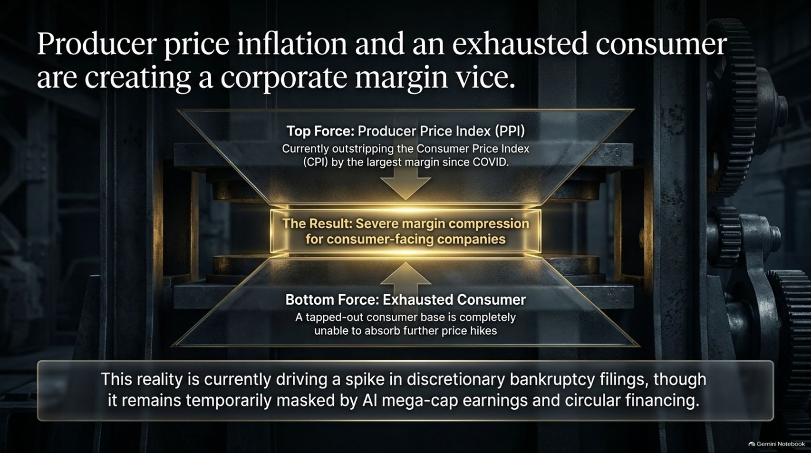
Notes:
Visual Theme: A heavy industrial mechanical press squeezing a glowing profit margin box between PPI and Consumer Exhaustion forces.
Core Concept: Producer Price Index (PPI) outpacing Consumer Price Index (CPI) while tapped-out consumers refuse further price hikes.
Duration Range: 3 – 5 minutes
Speaker Notes:
The Squeeze: Corporations face a brutal vise. On top, Producer Price Inflation (PPI) is outstripping the Consumer Price Index (CPI) by the largest margin since COVID. On the bottom, an exhausted consumer base cannot absorb further price hikes.
Masked Distress: This dynamic is currently driving a spike in discretionary bankruptcy filings, though it remains temporarily masked by headline AI mega-cap earnings and circular financing.

Slide 7
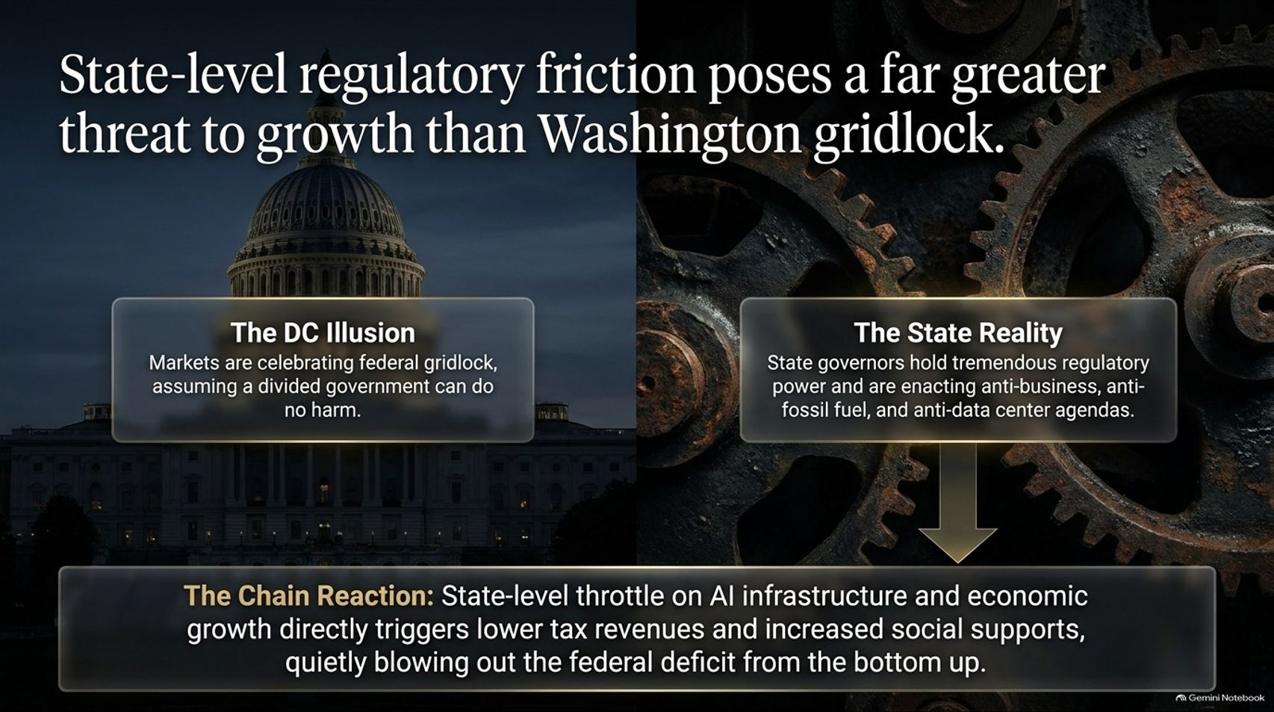
Notes:
Visual Theme: Split comparison between the US Capitol dome on the left and heavy industrial factory gears on the right.
Core Concept: Markets celebrate federal gridlock, ignoring that state governors hold immense regulatory power over energy, infrastructure, and data centers.
Duration Range: 3 – 5 minutes
Speaker Notes:
The DC Illusion: Wall Street breathes a sigh of relief when Washington is deadlocked, assuming a divided government can do no harm.
The State Reality: True economic friction is shifting to the state level. Governors wield immense regulatory authority and are enacting anti-business and anti-fossil-fuel agendas.
The Chain Reaction: Throttling AI infrastructure and local economic growth directly depresses tax revenues and spikes social support needs, quietly blowing out the federal deficit from the bottom up.

Slide 8

Notes:
Visual Theme: Heavy steel suspension bridge cables on the left paired with a glowing financial pressure gauge on the right pointing toward "Extreme Stress".
Core Concept: Widening credit spreads and lower-rated companies forced to refinance 4% debt at yields exceeding 8%.
Duration Range: 3 – 5 minutes
Speaker Notes:
The Credit Canary: While 10-year Treasury yields fluctuate, lower-rated credit spreads are steadily widening.
The Refinancing Cliff: Junk-rated companies that previously secured debt at a 4% coupon are now forced to refinance that paper at yields over 8%.
The Impact: Debt service costs are doubling for riskier companies at the exact moment top-line revenue growth is slowing, setting the stage for a wave of private credit defaults.

Slide 9
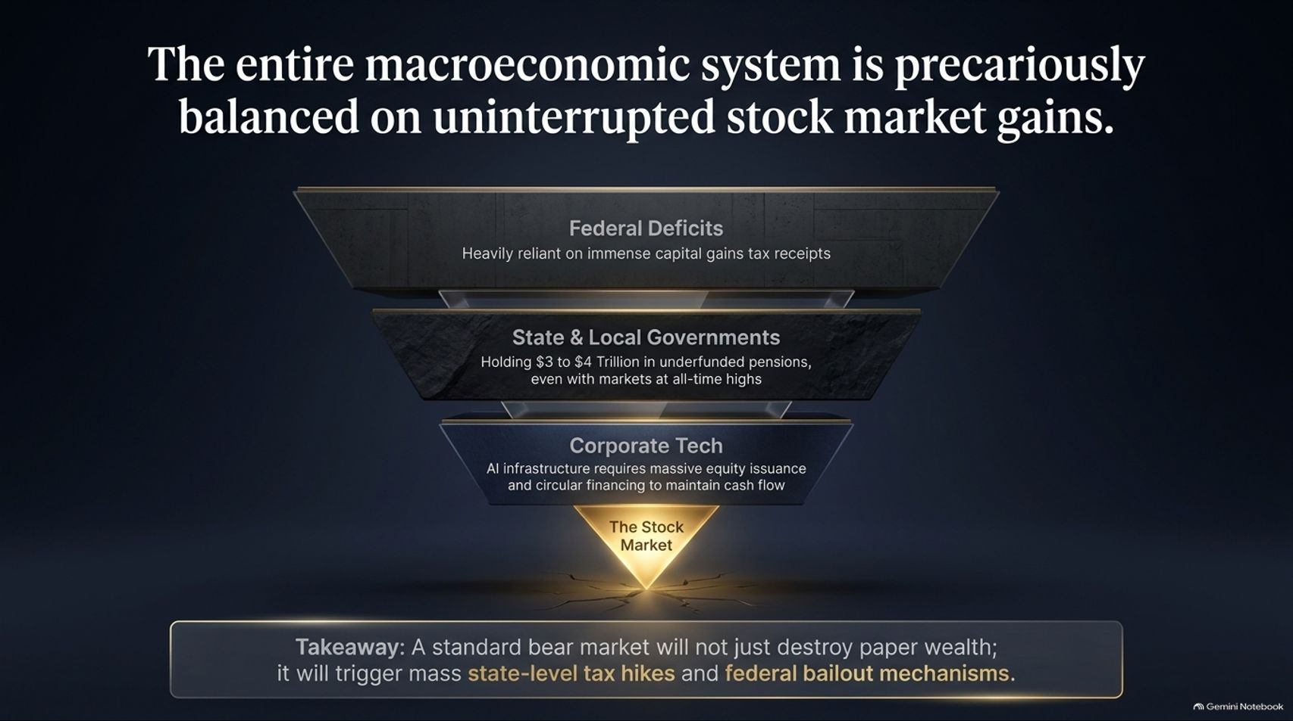
Notes:
Visual Theme: A heavy industrial funnel resting on a glowing, cracking stock market baseline.
Core Concept: Federal deficits, underfunded state pensions, and corporate tech all rely entirely on all-time high equity markets.
Duration Range: 3 – 5 minutes
Speaker Notes:
The Ultimate Foundation: Show how the entire macroeconomic pyramid depends on equity valuations:
Federal Deficits: Heavily reliant on immense capital gains tax receipts.
State & Local Governments: Holding $3 to $4 trillion in underfunded pensions, viable only while markets sit at all-time highs.
Corporate Tech: AI infrastructure requires massive equity issuance and circular financing to maintain cash flow.
The Takeaway: A standard bear market will not just destroy paper wealth; it will trigger mass state-level tax hikes and federal bailout mechanisms.

Slide 10
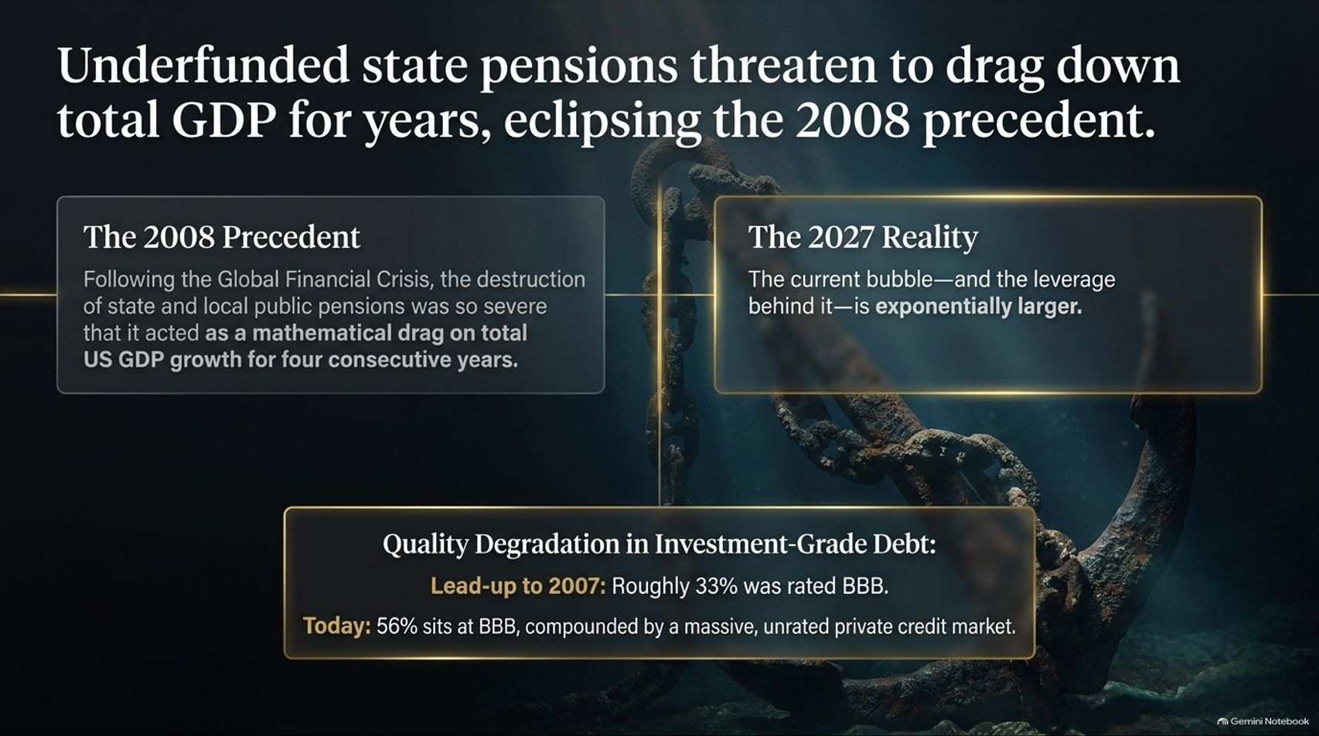
Notes:
Visual Theme: A massive, rusted marine ship anchor wrapped in heavy iron chains underwater.
Core Concept: Post-2008 pension drag lasted 4 years; today's bubble and leverage are exponentially larger, compounded by 56% BBB-rated debt.
Duration Range: 3 – 5 minutes
Speaker Notes:
Historical Precedent: Following the Global Financial Crisis, the destruction of public pensions acted as a mathematical drag on total US GDP growth for four consecutive years.
The 2027 Reality: The current asset bubble—and the leverage behind it—is exponentially larger. Furthermore, quality degradation in investment-grade debt is severe: leading up to 2007, roughly 33% was rated BBB; today, 56% sits at BBB, compounded by a massive, unrated private credit market.

Slide 11
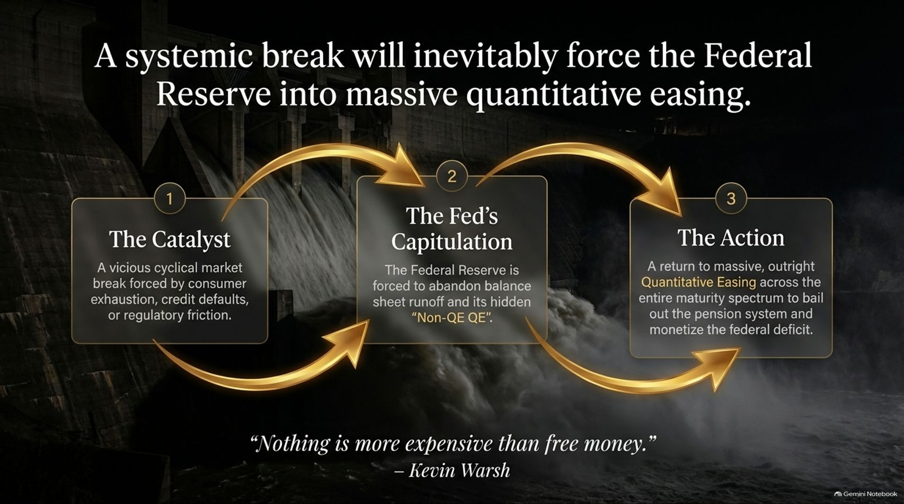
Notes:
Visual Theme: A massive concrete hydroelectric dam with roaring whitewater rapids driven by a cyclical 3-step golden arrow loop.
Core Concept: Market breaks force the Fed to abandon balance sheet runoff and return to outright QE across the entire maturity spectrum.
Duration Range: 3 – 5 minutes
Speaker Notes:
The Feedback Loop: Walk through the inevitable rescue cycle:
Step 1 (The Catalyst): A vicious cyclical market break forced by consumer exhaustion, credit defaults, or regulatory friction.
Step 2 (The Fed's Capitulation): The Federal Reserve is forced to abandon balance sheet runoff and its hidden "Non-QE QE".
Step 3 (The Action): A return to massive, outright Quantitative Easing across the entire maturity spectrum to bail out the pension system and monetize the federal deficit.
Kevin Warsh Quote: Recall the warning: "Nothing is more expensive than free money."

Slide 12

Notes:
Visual Theme: A glowing industrial pressure valve releasing steam and currency debasement pressures.
Core Concept: When central banks rescue debt markets, currency purchasing power is debased, driving global actors like China to buy gold.
Duration Range: 3 – 5 minutes
Speaker Notes:
The Ultimate Release Valve: When central banks are forced to rescue debt markets and monetize unprecedented deficits, the only available release valve for systemic pressure is the currency itself.
The Result: The purchasing power of the US Dollar will be heavily debased. The financial story of the late 2020s will fundamentally be a currency story.
Global Indicator: This is precisely why major global actors, notably China, are currently buying gold "hand over fist" to front-run dollar debasement.

Slide 13

Notes:
Visual Theme: A polished steel vault door with heavy gears and combination dials.
Core Concept: Avoid long-duration bonds and junk credit; hold short-term treasuries and precious metals.
Duration Range: 3 – 5 minutes
Speaker Notes:
Actionable Allocation: Translate macro analysis into portfolio defense:
What to AVOID:
Long-Duration Bonds: You will lose immense purchasing power in nominal dollars as fiat is debased.
Junk & Private Credit: Extreme vulnerability to impending refinancing blowups.
What to HOLD:
Short-Term Treasuries: Stay safely at the front end of the yield curve to maintain liquidity.
Hard Assets & Precious Metals: Gold is the ultimate, necessary protection against the coming wave of currency debasement.

Slide 14
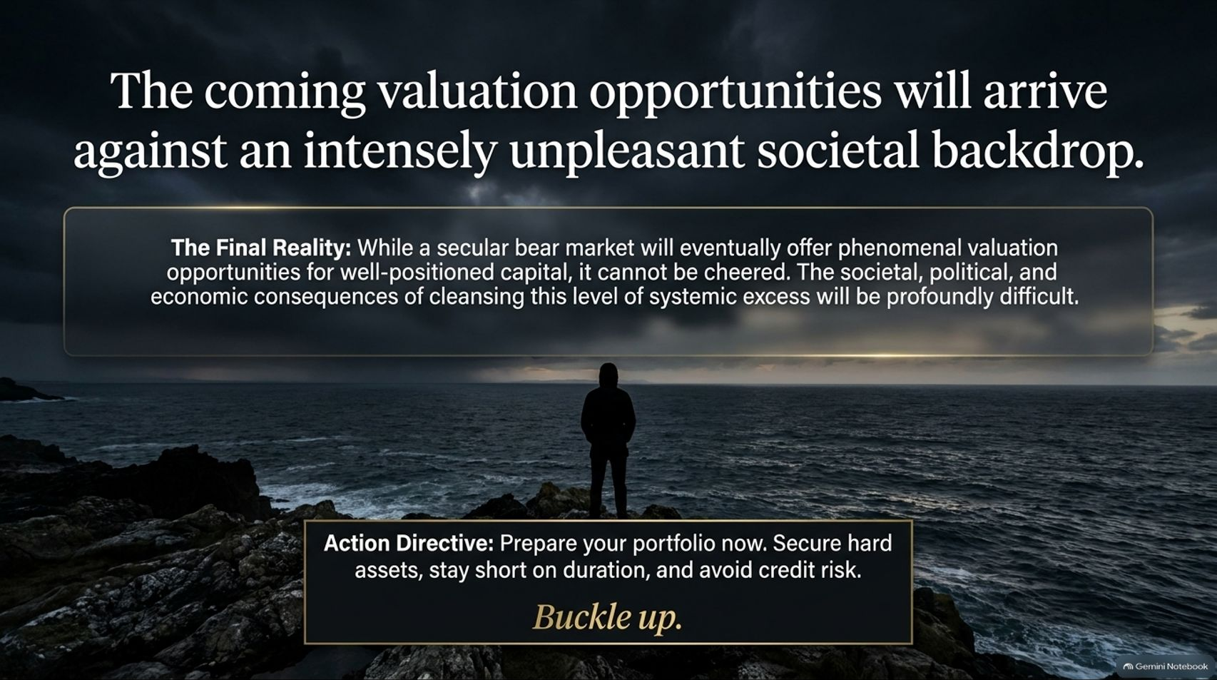
Notes:
Visual Theme: A lone figure standing on a rocky shore looking out over a dark, moody sea under slate-gray skies.
Core Concept: While bear markets offer phenomenal long-term valuations, cleansing systemic excess comes with profound societal difficulty.
Duration Range: 3 – 5 minutes
Speaker Notes:
The Paradox of Opportunity: A secular bear market will eventually offer phenomenal entry valuations for well-positioned capital, but it cannot be cheered.
The Human Cost: The societal, political, and economic consequences of cleansing this level of systemic excess will be profoundly difficult.
Final Directive: Prepare your portfolio now. Secure hard assets, stay short on duration, avoid credit risk, and buckle up.

Slide 15
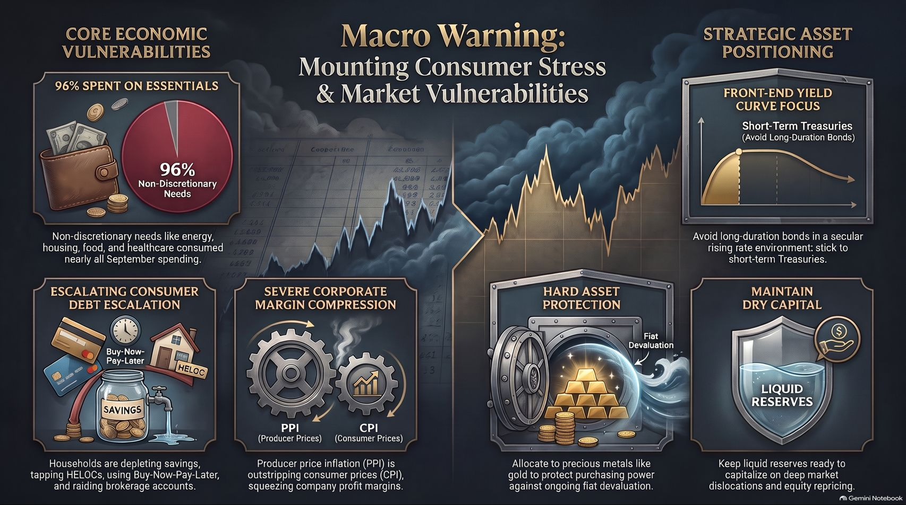
Notes:
Visual Theme: A master synthesis dashboard featuring financial ledgers, a 96% pie chart, bank vaults with gold bars, shield icons, and yield curve graphs.
Core Concept: Comprehensive executive summary uniting consumer stress, corporate margin compression, and strategic asset positioning.
Duration Range: 3 – 5 minutes
Speaker Notes:
Executive Summary: Bring together the core pillars of the presentation:
Core Vulnerabilities: 96% spent on essentials, escalating consumer debt, and severe corporate margin squeeze.
Strategic Positioning: Focus on front-end yield curves, maintain liquid reserves, and allocate to hard assets to protect against fiat devaluation.
Closing Remark: Thank the audience, emphasize the importance of rigorous preparation ahead of 2027, and open the floor for questions.

