Slide 1

Notes:
Slide Focus: Institutional AI Infrastructure — Redefining Alpha, Governance, and the Fundamental Law of Active Management.
Target Duration: 2 – 6 minutes
Talking Points & Context
Core Premise: AI is transitioning from an isolated research tool to a core institutional architecture that reshapes alpha generation, firm governance, and decision-making workflows.
The Strategic Challenge: Allocating capital and compute effectively while upholding fiduciary responsibility, risk oversight, and rigorous model validation.
Reference to Andrew Chin (AllianceBernstein): As Andrew Chin discusses in his CFA Institute conversation with Frank Fabozzi, treating AI as enterprise infrastructure ensures that the entire firm—from investment research to distribution and risk management—benefits from a cohesive, top-down strategy rather than fragmented point solutions.
Speaker Script
"Good morning, and welcome. Today, we are examining Institutional AI Infrastructure—specifically how artificial intelligence is redefining alpha, governance, and the fundamental law of active management.
For years, financial institutions treated AI as an experimental novelty or an isolated productivity plugin for a handful of analysts. That era is over. As Andrew Chin, Chief AI Officer at AllianceBernstein, points out, true enterprise value is unlocked only when AI is treated as core infrastructure.
Over the next fifteen slides, we will explore how institutional asset managers must balance infinite computational breadth with rigorous risk governance, avoiding the traps of convergence and automation bias while building durable, human-led competitive advantage."
AI and the Future of Investment Decision-Making | Andrew Chin
https://www.youtube.com/watch?v=LPgppYZpIPw

Slide 2
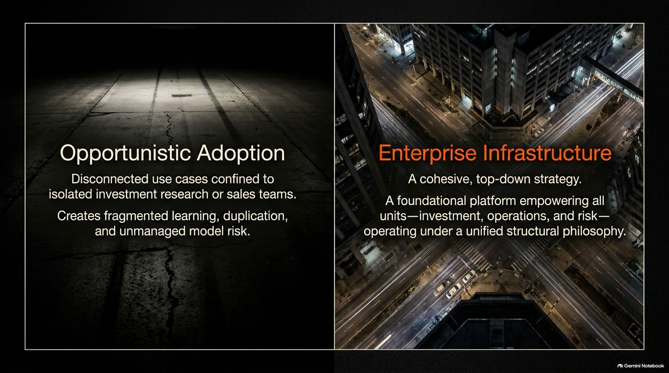
Notes:
Slide Focus: Moving from siloed use cases to a unified, top-down operational philosophy.
Target Duration: 2 – 6 minutes
Talking Points & Context
Opportunistic Adoption: Disconnected use cases confined to isolated teams create fragmented learning, redundant expenditures, and unmanaged model risks.
Enterprise Infrastructure: A cohesive, top-down strategy that empowers investment, operations, and risk management under a unified structural philosophy.
Reference to Andrew Chin: Chin emphasizes that a top-down vision prevents siloed teams from duplicating efforts and enables shared organizational learning across all business units.
Speaker Script
"Let’s look at Slide 2, which highlights the critical fork in the road for asset managers: Opportunistic Adoption versus Enterprise Infrastructure.
Many firms fall into the trap of opportunistic adoption. A desk here or a sales team there adopts an off-the-shelf LLM. While it provides localized speed, it creates fragmented learning, technical duplication, and invisible model risks.
In contrast, enterprise infrastructure establishes a cohesive, top-down strategy. As Andrew Chin notes, setting a firm-wide vision ensures that learning across investment research, risk management, and client servicing is shared instantly, making the entire organization more powerful and coherent."

Slide 3
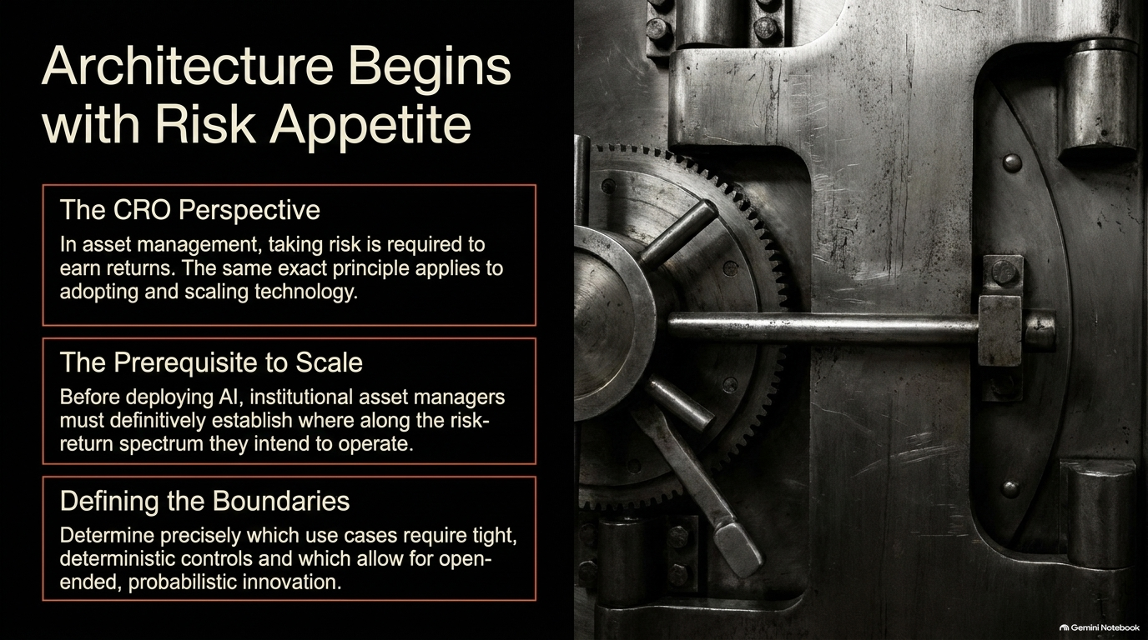
Notes:
Slide Focus: Defining boundaries, risk-return spectrums, and deterministic vs. probabilistic use cases.
Target Duration: 2 – 6 minutes
Talking Points & Context
The CRO Perspective: Taking risk is required to earn returns in asset management; the exact same principle applies to adopting and scaling technology.
The Prerequisite to Scale: Before deploying AI, institutional managers must definitively establish where along the risk-return spectrum they intend to operate.
Reference to Andrew Chin: Drawing on his decade-long experience as a Chief Risk Officer, Chin highlights that defining a firm's risk appetite gives business units a clear sandbox to innovate rapidly within established guardrails.
Speaker Script
"Turning to Slide 3, we establish a foundational principle: Architecture begins with risk appetite.
Coming from a risk management background, I often remind investment committees that you cannot earn returns without taking risk—and technology adoption is no different. Before deploying capital into AI systems, an institution must define its risk appetite.
Where do we require tight, deterministic controls, and where can we allow for open-ended, probabilistic innovation? By answering this upfront, you give your teams the freedom to innovate aggressively, knowing precisely where the boundaries lie."

Slide 4
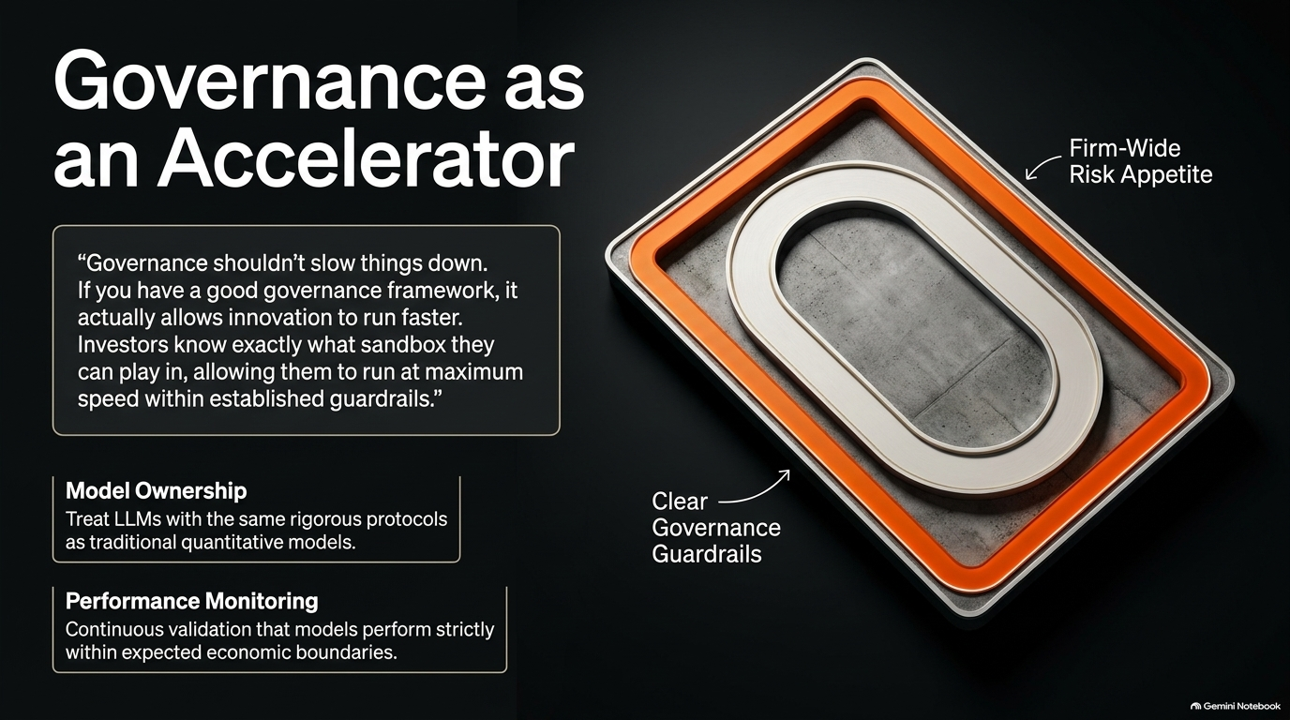
Notes:
Slide Focus: Treating LLMs with quantitative model risk protocols and continuous performance monitoring.
Target Duration: 2 – 6 minutes
Talking Points & Context
Governance Myth vs. Reality: Good governance shouldn't slow things down; it acts as an accelerator by providing clear guardrails.
Model Ownership: Treat Large Language Models with the same rigorous protocols applied to traditional quantitative models.
Reference to Andrew Chin: Chin explicitly notes: 'If you have a good governance framework, it actually allows innovation to run faster because investors know the sandbox they can play in.'
Speaker Script
"Slide 4 addresses a common pushback: Does rigorous governance suffocate innovation?
The answer is a definitive no. As Andrew Chin points out, governance shouldn't be a speed bump. When you establish clear guardrails and treat LLMs with the same rigorous model risk protocols as traditional quantitative models, you give portfolio managers confidence.
They know exactly what sandbox they operate in, allowing them to run at maximum speed without fearing regulatory or operational breaches."

Slide 5
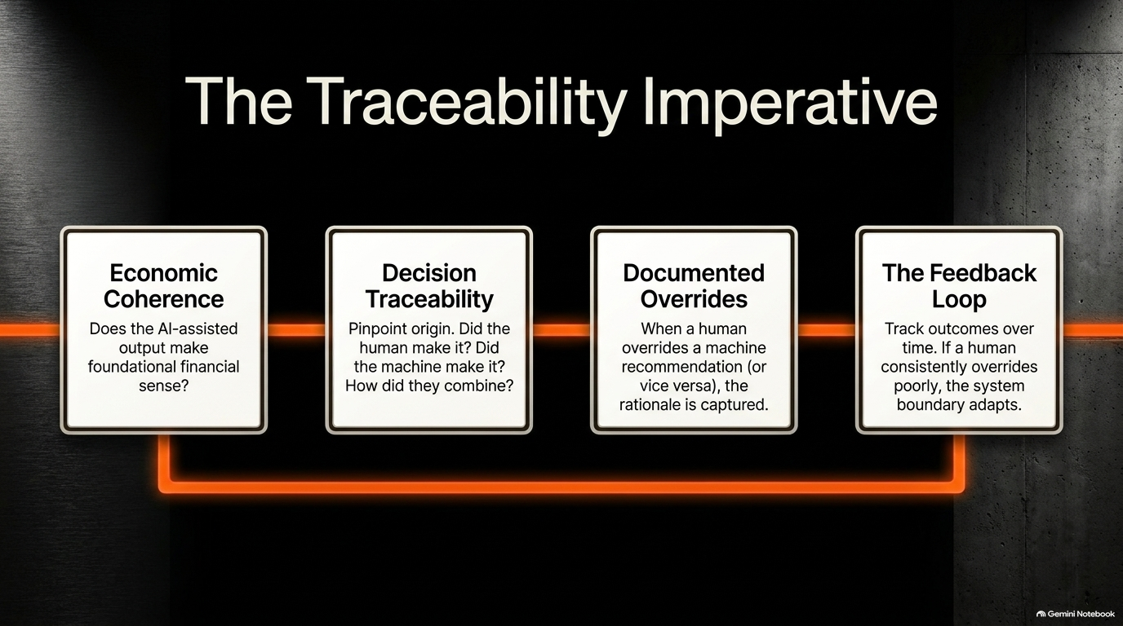
Notes:
Slide Focus: Economic coherence, decision traceability, documented overrides, and adaptive feedback loops.
Target Duration: 2 – 6 minutes
Talking Points & Context
Economic Coherence: Ensuring AI-assisted outputs make foundational financial sense.
Decision Traceability & Overrides: Pinpointing origin and documenting human overrides.
Reference to Andrew Chin: Chin stresses that decision traceability and documented overrides are vital so firms can learn from divergences between human judgment and machine recommendation over time.
Speaker Script
"Slide 5 outlines the Traceability Imperative. When an AI system and a portfolio manager collaborate, you must maintain absolute auditability.
We look for four pillars: First, economic coherence—does the output make financial sense? Second, decision traceability—can we pinpoint whether the human, the machine, or both drove the conclusion? Third, documented overrides—when a human overrides the model, why did they do so? And fourth, feedback loops—using those overrides to refine system boundaries over time."

Slide 6
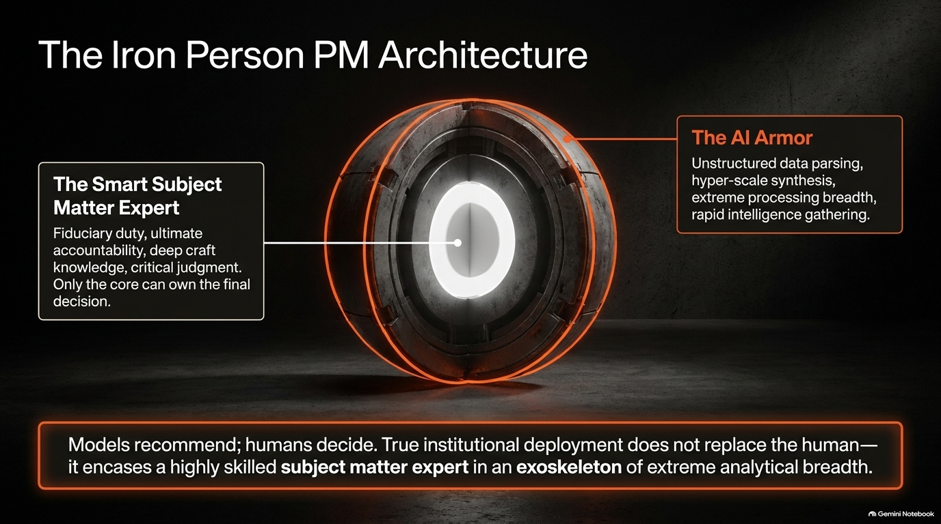
Notes:
Slide Focus: Fiduciary accountability, deep craft knowledge, and AI acting as an analytical exoskeleton.
Target Duration: 2 – 6 minutes
Talking Points & Context
Human Accountability: Models recommend; humans decide. True institutional deployment encases a skilled subject matter expert in an exoskeleton of analytical breadth.
Reference to Andrew Chin: Chin introduces the "Iron Person" analogy—drawing on Iron Man, the core is a smart subject matter expert who owns fiduciary accountability, surrounded by AI armor that parses unstructured data at hyper-scale.
Speaker Script
"Slide 6 introduces the 'Iron Person' PM Architecture. One of the greatest anxieties in asset management is whether AI will replace portfolio managers.
Andrew Chin resolves this with a powerful analogy: the Iron Person. The core of the investment process remains a human subject matter expert possessing deep craft knowledge, critical judgment, and ultimate fiduciary accountability.
The AI acts as an advanced exoskeleton—providing massive analytical breadth, parsing unstructured data, and synthesizing information at scale. Models recommend; humans decide."

Slide 7
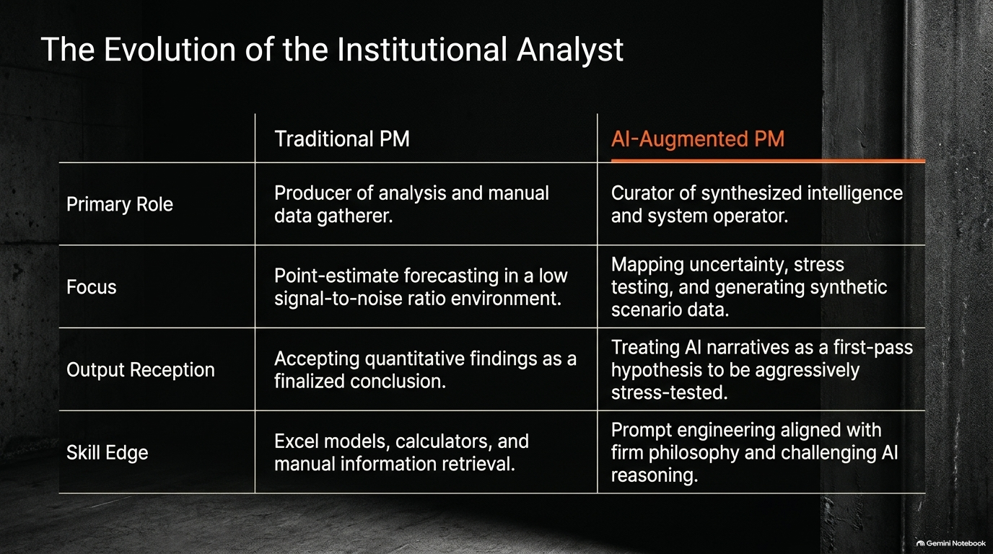
Notes:
Slide Focus: Shift from manual data gathering and point-estimate forecasting to scenario curation and hypothesis stress-testing.
Target Duration: 2 – 6 minutes
Talking Points & Context
Role Transformation: Moving from manual data gathering to curating synthesized intelligence.
Skill Edge: Prompt engineering aligned with firm philosophy and challenging AI reasoning rather than building basic Excel models.
Reference to Andrew Chin: Paralleling the historical shifts brought by Excel and the internet, analysts transition from producers of basic calculations to operators of intelligence platforms.
Speaker Script
"On Slide 7, we examine how the role of the institutional analyst is evolving.
Historically, an analyst's value was tied to manual data gathering, financial modeling in Excel, and point-estimate forecasting in low signal-to-noise environments.
As AI automates data extraction and synthesis, the analyst's role shifts upward. They become curators of intelligence and system operators, focusing on stress testing, mapping uncertainty, and aggressively challenging AI-generated hypotheses."

Slide 8
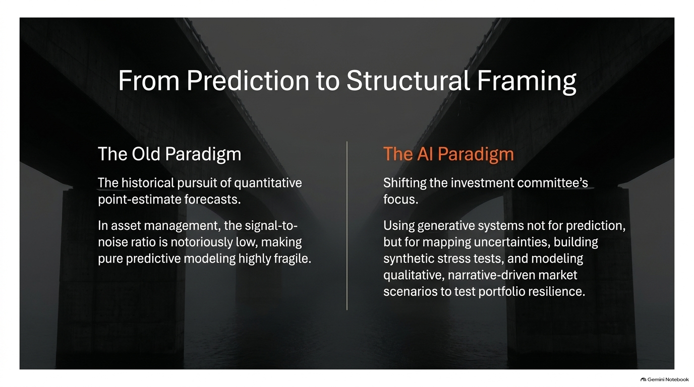
Notes:
Slide Focus: Shifting away from fragile point estimates toward mapping uncertainties and building synthetic stress tests.
Target Duration: 2 – 6 minutes
Talking Points & Context
The Old Paradigm: The historical pursuit of quantitative point-estimate forecasts in low signal-to-noise environments is highly fragile.
The AI Paradigm: Using generative systems for mapping uncertainties, building synthetic stress tests, and modeling qualitative market scenarios.
Reference to Andrew Chin: Chin notes that trying to build pure predictive models is extraordinarily difficult given market noise; AI's true superpower is helping investment committees frame uncertainty and stress-test portfolio resilience.
Speaker Script
"Slide 8 highlights a profound mindset shift: Moving from Prediction to Structural Framing.
For decades, quantitative finance chased point-estimate forecasts. But in asset management, the signal-to-noise ratio is notoriously low, making pure predictive modeling fragile.
AI enables a new paradigm. Instead of asking 'What will the exact return be next quarter?', investment committees use generative systems to map out complex uncertainties, construct synthetic stress tests, and model qualitative scenarios to test portfolio resilience."

Slide 9
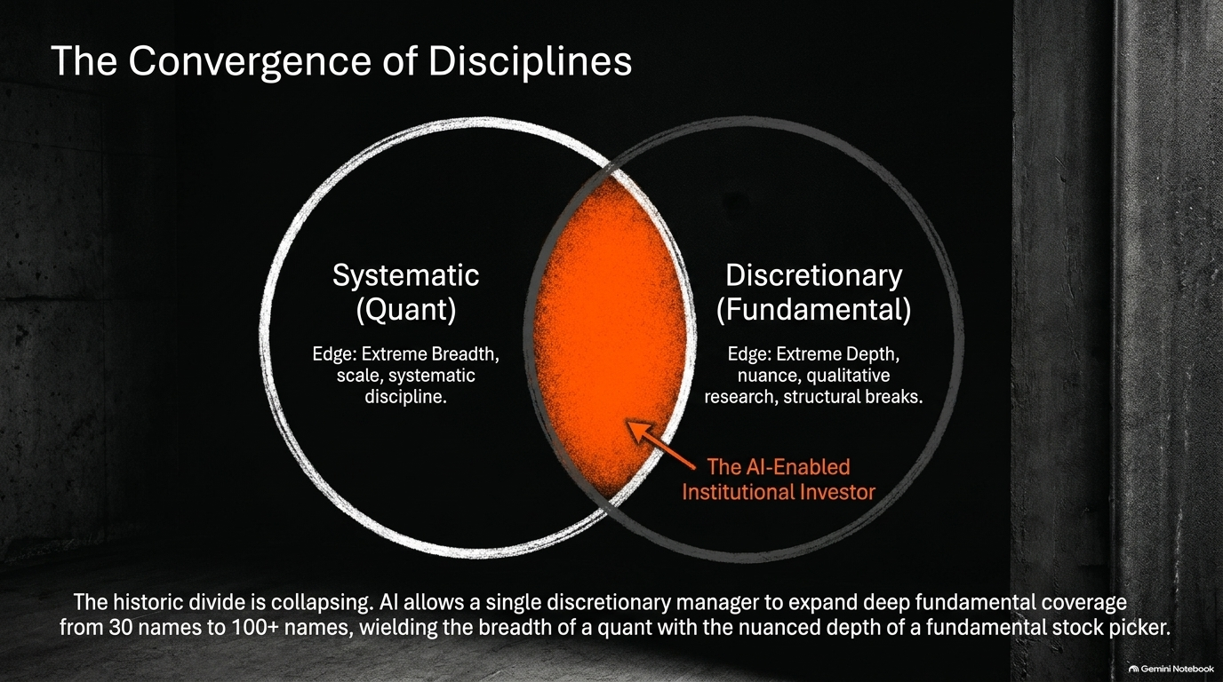
Notes:
Slide Focus: Collapsing the divide between systematic (quant) and discretionary (fundamental) investing.
Target Duration: 2 – 6 minutes
Talking Points & Context
Quant Edge: Extreme breadth, scale, and systematic discipline.
Discretionary Edge: Extreme depth, nuance, qualitative research, and structural breaks.
Reference to Andrew Chin: AI allows a single discretionary manager to expand fundamental coverage from 30 names to over 100 names, combining quantitative breadth with qualitative depth.
Speaker Script
"Slide 9 addresses the Convergence of Disciplines. Traditionally, the industry was strictly partitioned: Quant managers owned breadth and scale, while fundamental managers owned depth and nuance.
AI collapses this historic divide. An AI-enabled institutional investor can wield the computational breadth of a quant while maintaining the nuanced, qualitative depth of a fundamental stock picker. A manager who previously covered 30 names can now rigorously monitor over 100 names without sacrificing depth."

Slide 10
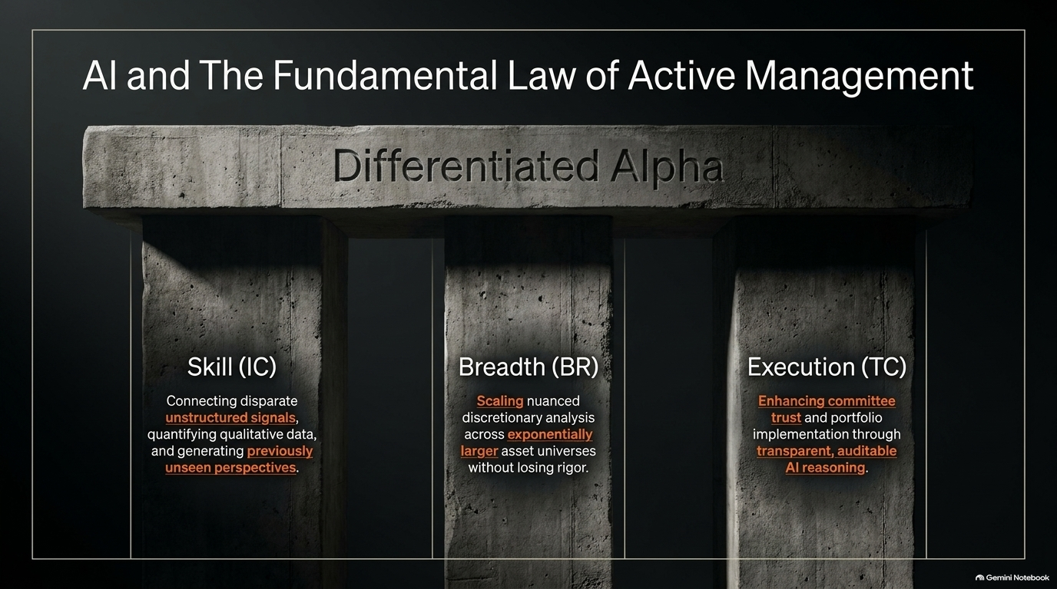
Notes:
Slide Focus: Enhancing Information Coefficient (IC), Breadth (BR), and Transfer Coefficient (TC).
Target Duration: 2 – 6 minutes
Talking Points & Context
Skill (IC): Connecting disparate unstructured signals, quantifying qualitative data, and generating unseen perspectives.
Breadth (BR): Scaling nuanced discretionary analysis across exponentially larger asset universes.
Execution (TC): Enhancing committee trust and portfolio implementation through transparent, auditable AI reasoning.
Reference to Andrew Chin: Chin frequently grounds institutional AI strategy in Grinold and Khan’s Fundamental Law of Active Management ($IR = IC \times \sqrt{BR}$), evaluating how AI impacts skill, breadth, and transfer coefficient.
Speaker Script
"Slide 10 frames AI through the lens of the Fundamental Law of Active Management—Information Coefficient, Breadth, and Transfer Coefficient.
AI enhances Skill (IC) by extracting insights from unstructured data. It multiplies Breadth (BR) by scaling fundamental analysis across broader universes. And critically, it supports Transfer Coefficient (TC) by providing transparent, auditable reasoning that allows investment committees to underwrite risk with total conviction."

Slide 11
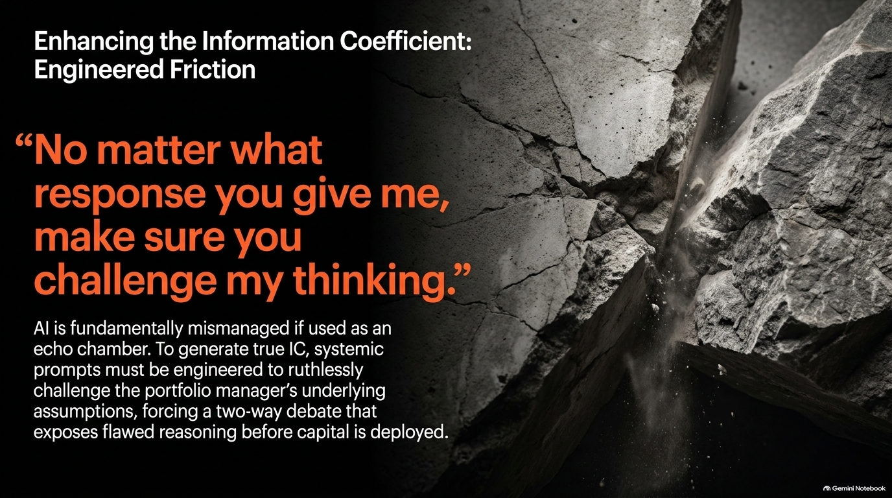
Notes:
Slide Focus: Preventing echo chambers by engineering systemic prompts that ruthlessly challenge underlying assumptions.
Target Duration: 2 – 6 minutes
Talking Points & Context
The Danger of Echo Chambers: AI is mismanaged if used merely to validate existing biases.
Engineered Friction: Systemic prompts must be engineered to ruthlessly challenge the portfolio manager's underlying assumptions.
Reference to Andrew Chin: Chin shares his personal prompt engineering practice: telling models 'No matter what response you give me, make sure you challenge my thinking.'
Speaker Script
"Slide 11 focuses on Engineered Friction to enhance the Information Coefficient.
If you use AI as an echo chamber, you are destroying alpha. As Andrew Chin notes, institutional prompts must be engineered to ruthlessly challenge your underlying assumptions.
When Chin interacts with large language models, his prompt explicitly commands: 'No matter what response you give me, make sure you challenge my thinking.' That friction exposes flawed reasoning before capital is ever deployed."

Slide 12
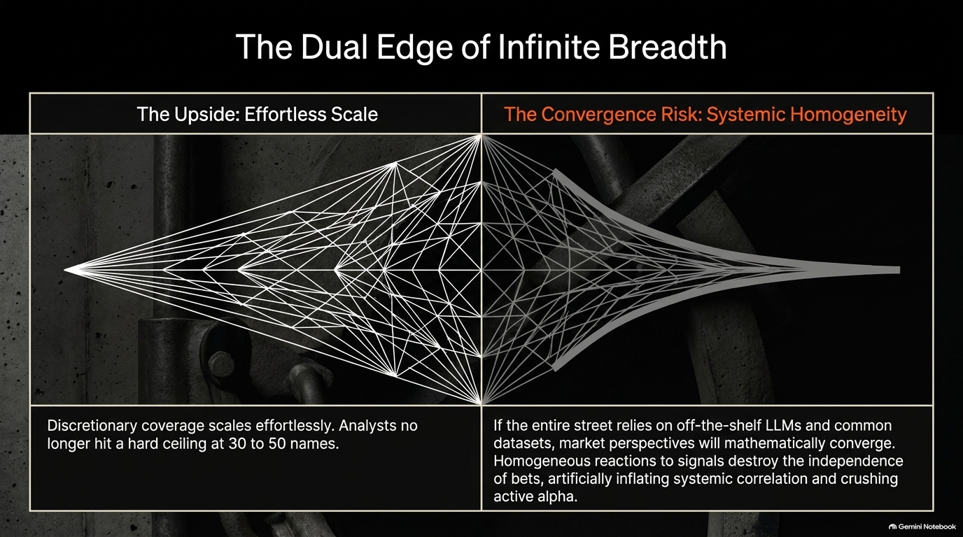
Notes:
Slide Focus: Effortless scale versus systemic convergence and market homogeneity risk.
Target Duration: 2 – 6 minutes
Talking Points & Context
The Upside: Discretionary coverage scales effortlessly beyond traditional cognitive ceilings.
The Convergence Risk: If the entire street relies on off-the-shelf LLMs and common datasets, market perspectives mathematically converge, destroying alpha.
Reference to Andrew Chin: Chin warns that widespread adoption of identical off-the-shelf tools can cause market participants to react identically to signals, amplifying systemic correlation and crowding active bets.
Speaker Script
"Slide 12 addresses the Dual Edge of Infinite Breadth. While scaling coverage across hundreds of assets is powerful, it introduces a severe macro risk: Systemic Convergence.
If every asset manager uses the exact same off-the-shelf foundation models and common data feeds, market perspectives will mathematically converge. Homogeneous reactions destroy the independence of bets, inflating correlation and crushing active alpha. Differentiation must come from proprietary prompts and internal governance."

Slide 13

Notes:
Slide Focus: Overcoming automation bias, maintaining auditable logic, and winning committee trust.
Target Duration: 2 – 6 minutes
Talking Points & Context
Committee Trust: High IC and massive breadth are useless if the investment committee blocks the trade due to lack of explainability.
Auditable Logic: PMs must be able to trace exactly which data inputs drove the AI's structural framing.
Reference to Andrew Chin: Chin stresses that explainability is non-negotiable because investment committees must fully understand why an AI-backed recommendation was made before they can underwrite the risk.
Speaker Script
"On Slide 13, we examine the Transfer Coefficient and the Burden of Explainability.
You can have brilliant AI-driven insights, but if your investment committee doesn't understand them, they will block the trade. Superior transfer coefficient belongs to firms that build institutional infrastructure optimized for transparency.
Eliminating automation bias and providing auditable logic enables human committees to underwrite AI-assisted risk with complete conviction."

Slide 14
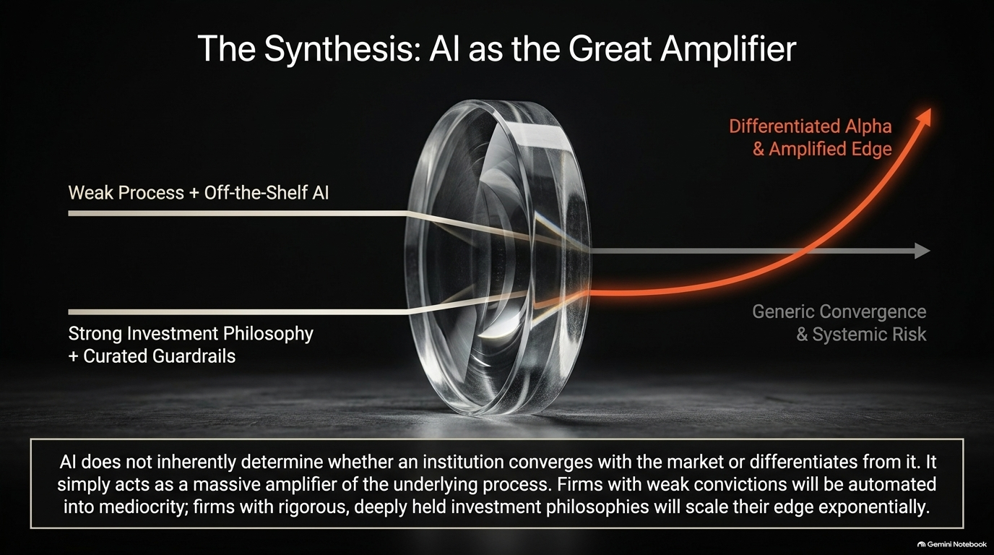
Notes:
Slide Focus: Amplifying weak processes into mediocrity or strong philosophies into exponential edge.
Target Duration: 2 – 6 minutes
Talking Points & Context
The Great Amplifier: AI does not inherently determine whether an institution converges or differentiates; it amplifies underlying processes.
The Divide: Weak processes + off-the-shelf AI lead to generic convergence and systemic risk. Strong investment philosophies + curated guardrails yield differentiated alpha.
Reference to Andrew Chin: Chin summarizes this masterfully: AI is an amplifier. Weak processes get magnified into mediocrity, while rigorous investment philosophies scale their edge exponentially.
Speaker Script
"Slide 14 brings our entire framework together: AI as the Great Amplifier.
As Andrew Chin concludes, AI is not a magic wand that fixes a broken investment process. It is an amplifier.
If a firm has a weak philosophy and undisciplined processes, AI will simply automate them into mediocrity at lightning speed. But if an institution possesses a deeply held, rigorous investment philosophy backed by curated guardrails, AI will scale its market edge exponentially."

Slide 15
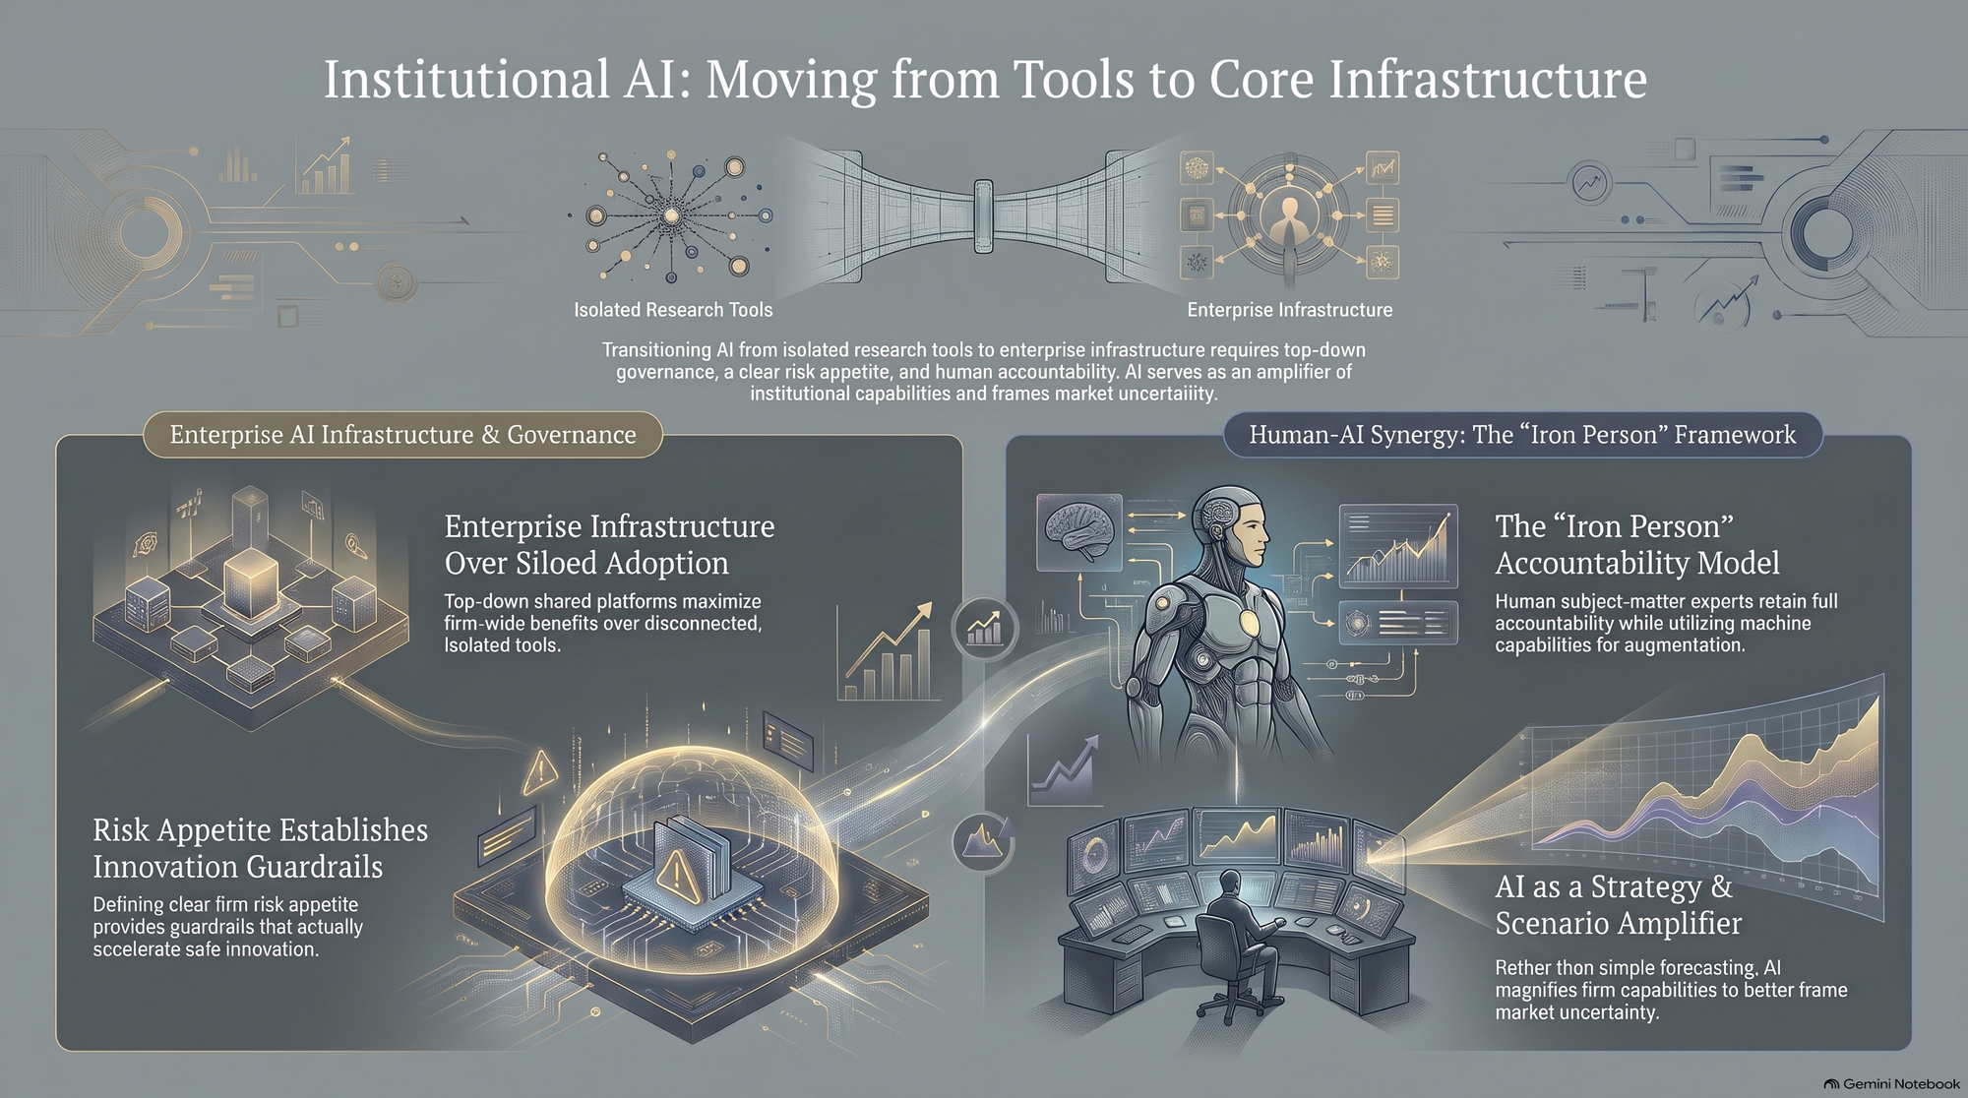
Notes:
Slide Focus: Comprehensive synthesis of governance, enterprise architecture, and human-AI synergy.
Target Duration: 2 – 6 minutes
Talking Points & Context
Enterprise Architecture Summary: Transitioning from isolated research tools to enterprise-wide infrastructure governed by top-down risk appetite.
Human-AI Synergy: Re-affirming the Iron Person framework where human experts retain accountability while leveraging AI as a scenario amplifier.
Reference to Andrew Chin: Final integration of Chin's core message: Building the institutional infrastructure required for the future of investment decision-making.
Speaker Script
"We conclude on Slide 15 with our master architectural summary: Moving from Tools to Core Infrastructure.
We have traveled from macroeconomic capex and risk appetite down to individual analyst workflows and investment committee trust.
The mandate for institutional leaders is clear: Move away from isolated research tools. Build top-down enterprise infrastructure. Encase your subject matter experts in the 'Iron Person' accountability model. By mastering this architecture, we ensure that human judgment remains firmly at the helm, amplified by the greatest technological capability in financial history."

