Slide 1
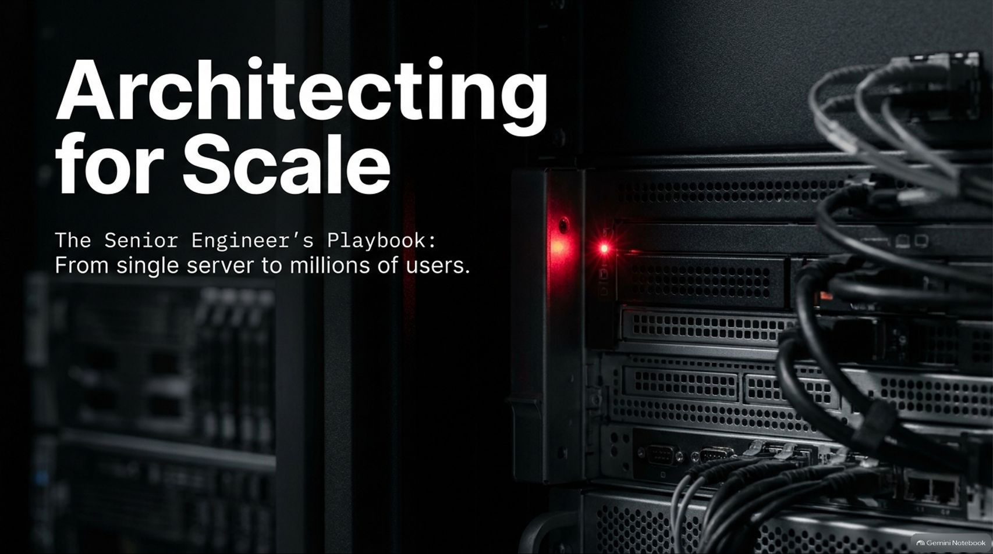
Notes:
Target Time: ~2.5 Minutes (350 words)
Speaker Script
"Good morning, everyone. Today, we are stepping into the senior engineer's playbook to explore how production systems evolve from a simple single-server setup into resilient architectures supporting millions of users.
When building software, it’s easy to write code that works locally on your machine. But architecting for scale requires a completely different mindset. You have to anticipate hardware failures, network partitions, traffic spikes, and data bottlenecks before they happen.
In this session, we’ll deconstruct the entire system design roadmap—from foundational databases, load balancing algorithms, and database optimization sequences to advanced communication protocols, security perimeters, and multi-region resilience. Let's dive into how systems grow without breaking."
Design Scalable Systems Step by Step (Full Course)
https://www.youtube.com/watch?v=4ZNmvPL7oxA

Slide 2
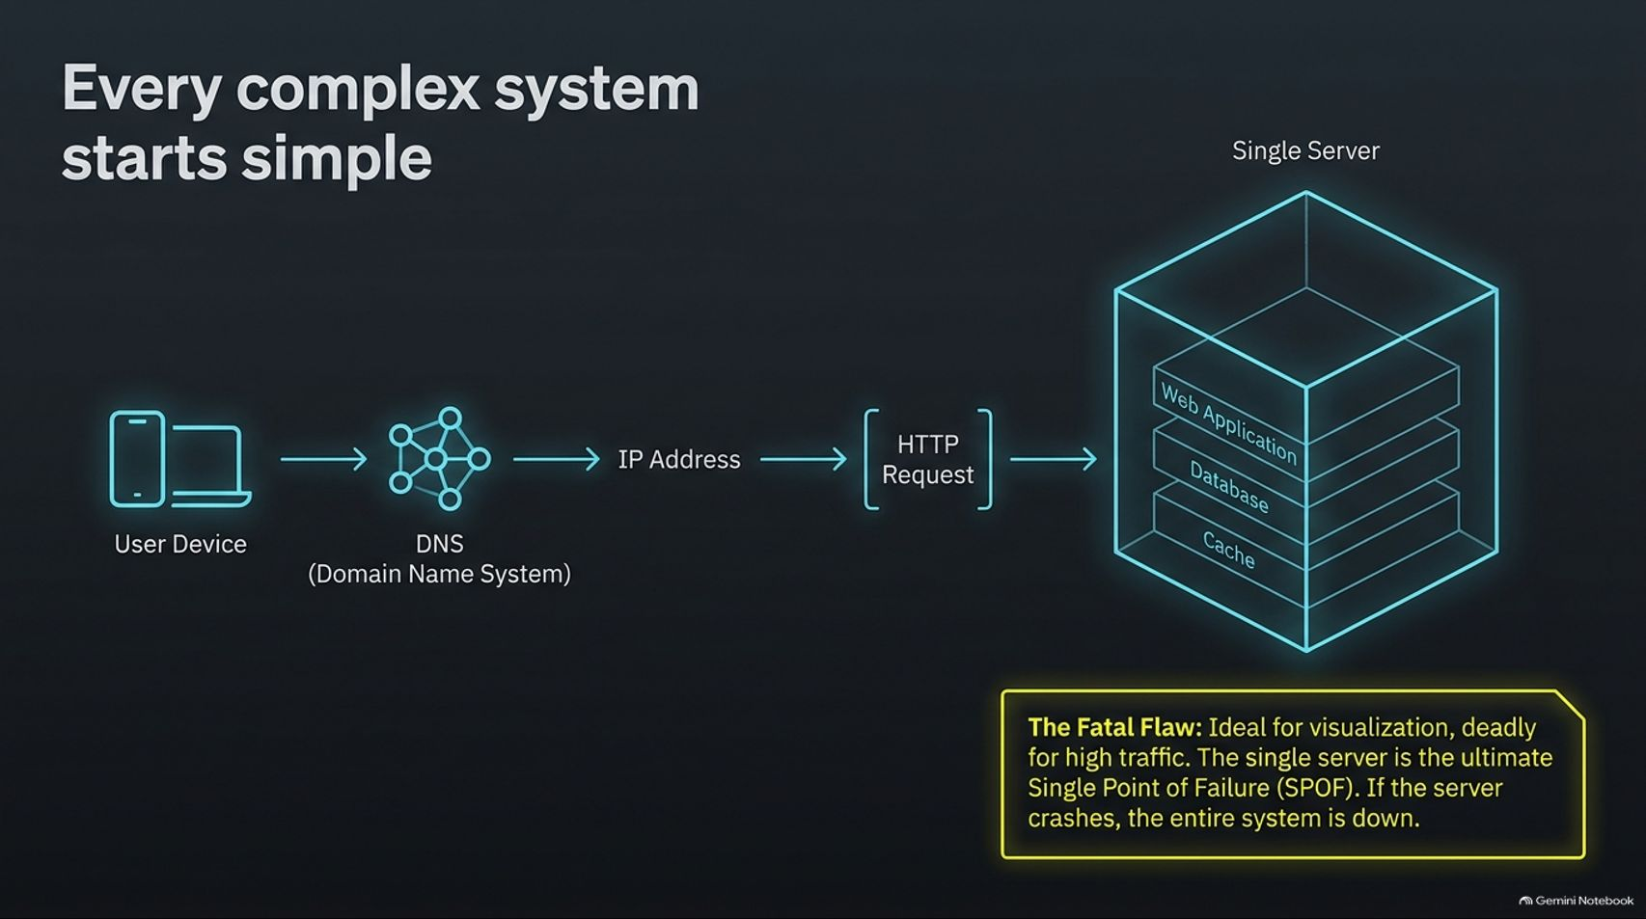
Notes:
Target Time: ~3 Minutes (420 words)
Speaker Script
"Every massive distributed system you use today—whether it's Netflix, Uber, or Google—started in exactly the same place: a single server.
As illustrated on this slide, a basic application begins with a user device making a DNS lookup to resolve a domain name into an IP address. That triggers an HTTP request directly to a single server containing your web application, database, and cache all bundled together.
While this setup is ideal for local development, rapid prototyping, and visualization, it has a fatal flaw: It is the ultimate Single Point of Failure (SPOF). If high traffic hits this server, or if the hardware crashes, your entire system goes down. There is zero redundancy. Recognizing when to move beyond this single-server baseline is the first test of a senior engineer."

Slide 3
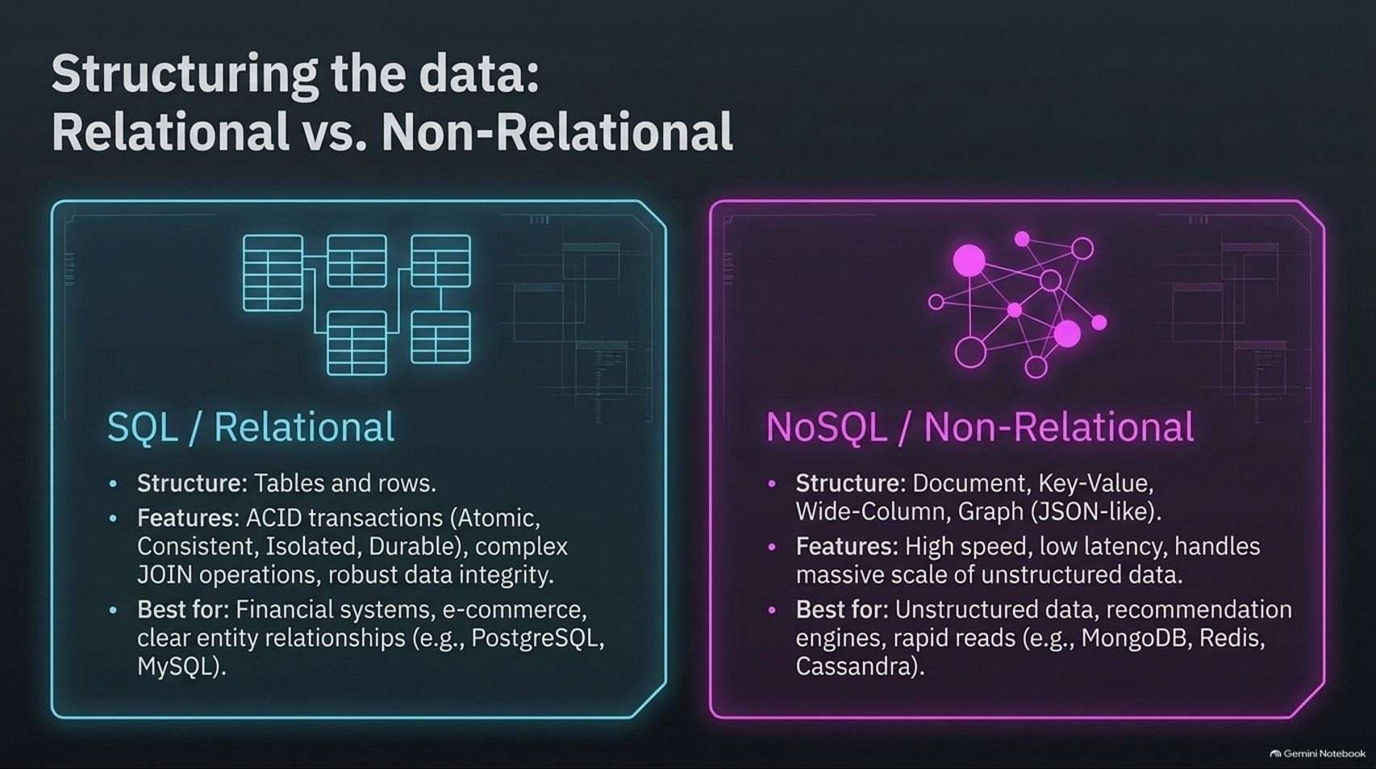
Notes:
Target Time: ~3.5 Minutes (500 words)
Speaker Script
"As your application grows, choosing the right data store is critical. We generally categorize databases into two core paradigms: SQL (Relational) and NoSQL (Non-Relational).
SQL / Relational (e.g., PostgreSQL, MySQL): Structured around tables and rows. Their superpower is ACID compliance (Atomicity, Consistency, Isolation, Durability) and complex JOIN operations that guarantee strict data integrity. They are the gold standard for financial systems, e-commerce orders, and clear entity relationships.
NoSQL / Non-Relational (e.g., MongoDB, Redis, Cassandra): Structured around documents, key-values, wide-columns, or graphs. They excel at high speed, low latency, and handling massive scales of unstructured data or rapid reads and writes.
Choosing between them isn't about which is better; it's about matching your access patterns to the right persistence engine."

Slide 4
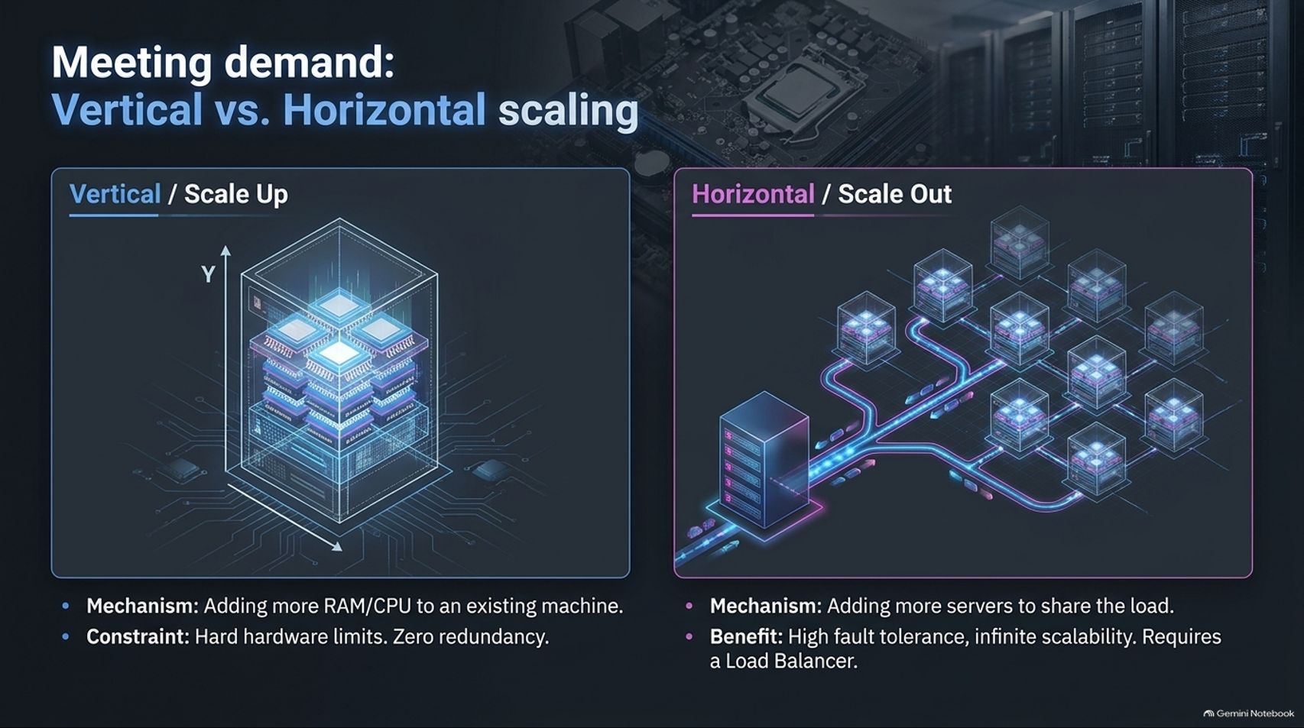
Notes:
Target Time: ~4 Minutes (560 words)
Speaker Script
"When traffic surges, how do you expand your system's capacity? You have two choices: Vertical Scaling or Horizontal Scaling.
Vertical Scaling (Scale Up): This means adding more CPU, RAM, or storage to your existing machine. It's simple to implement because you don't change your application code. However, it has hard physical hardware limits and zero redundancy—if that bigger server dies, you still go down.
Horizontal Scaling (Scale Out): This means adding more servers to share the load. It offers high fault tolerance and theoretically infinite scalability. But it comes with a catch: it requires distributed architecture and a Load Balancer to distribute incoming traffic across those multiple nodes."

Slide 5
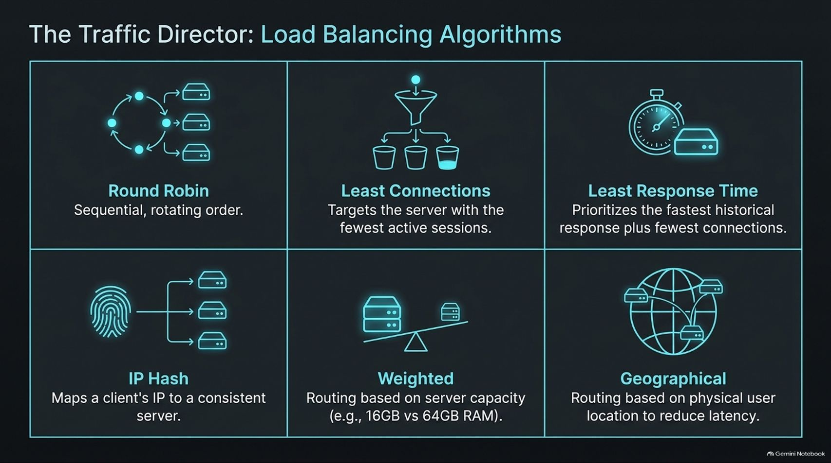
Notes:
Target Time: ~4 Minutes (580 words)
Speaker Script
"Once you scale horizontally, your load balancer acts as the traffic director. The algorithm you choose to route requests dictates how efficiently your cluster performs:
Round Robin: Distributes requests sequentially in a rotating order. Simple, but assumes all servers have equal capacity and workload.
Least Connections: Routes traffic to the server with the fewest active sessions right now. Great for long-lived connections.
Least Response Time: Prioritizes servers with the fastest historical response times combined with the fewest active connections.
IP Hash: Uses the client's IP address to map them to a consistent server, ensuring session stickiness.
Weighted: Allocates traffic based on server capacity (e.g., routing more traffic to a 64GB RAM machine than a 16GB machine).
Geographical: Routes users to the closest physical data center to minimize network latency."

Slide 6
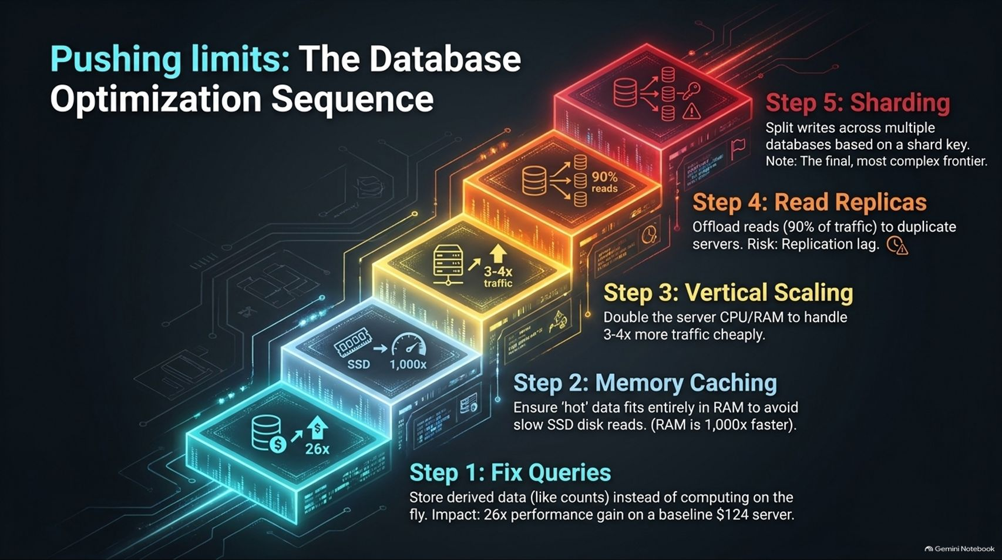
Notes:
Target Time: ~4.5 Minutes (630 words)
Speaker Script
"Before you rush into complex distributed architectures, you should follow a strict database optimization sequence:
Step 1: Fix Queries. Optimize your SQL queries and store derived data (like pre-computed like counts) instead of calculating them on the fly. Fixing bad queries can yield massive performance gains on a basic server.
Step 2: Memory Caching. Ensure 'hot' data fits entirely in RAM (using tools like Redis) to avoid slow SSD disk reads. RAM access is roughly 1,000x faster than disk.
Step 3: Vertical Scaling. Upgrade your database server's CPU and RAM to handle 3 to 4x more traffic cheaply.
Step 4: Read Replicas. Offload read traffic (which typically accounts for 90% of traffic) to duplicate read-only servers. Just watch out for replication lag.
Step 5: Sharding. Split writes across multiple database instances based on a shard key. This is the final, most complex frontier of database scaling."

Slide 7
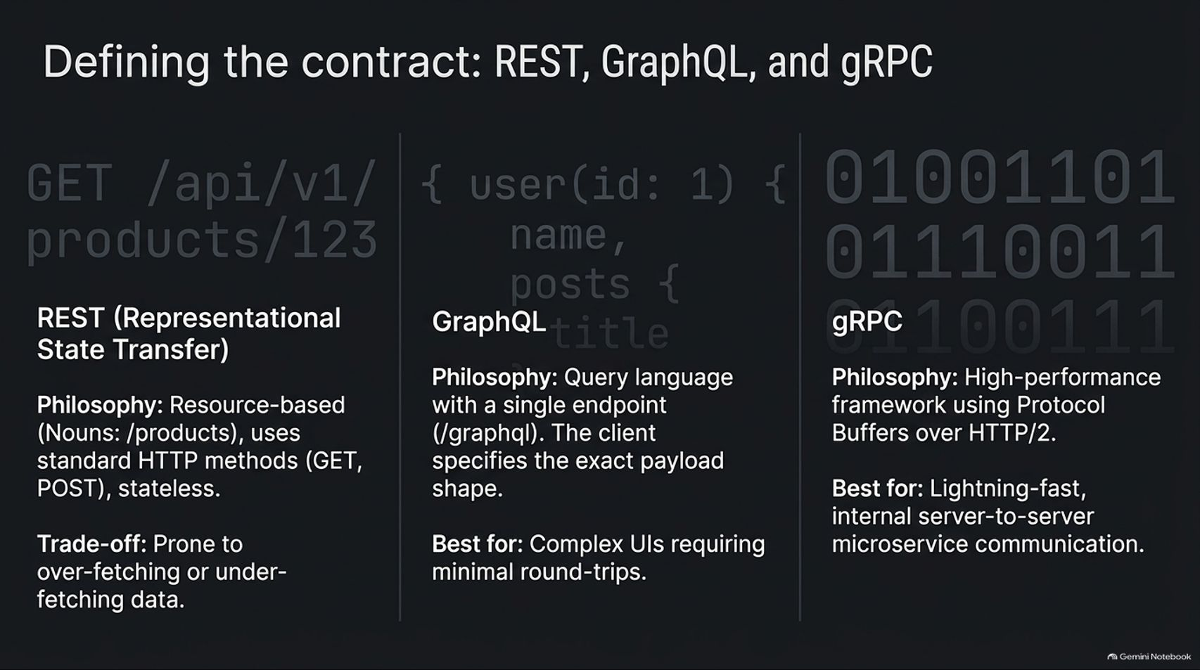
Notes:
Target Time: ~4 Minutes (590 words)
Speaker Script
"How your services communicate is defined by your API protocol contract:
REST (Representational State Transfer): Resource-based (e.g., /api/v1/products/123), using standard HTTP methods and stateless payloads. Its main trade-off is over-fetching or under-fetching data.
GraphQL: A query language with a single endpoint (/graphql) where the client specifies the exact shape of the payload. Ideal for complex client UIs requiring minimal round-trips.
gRPC: A high-performance remote procedure call framework using Protocol Buffers over HTTP/2. It serializes data into binary, making it lightning-fast and the industry standard for internal server-to-server microservice communication."

Slide 8
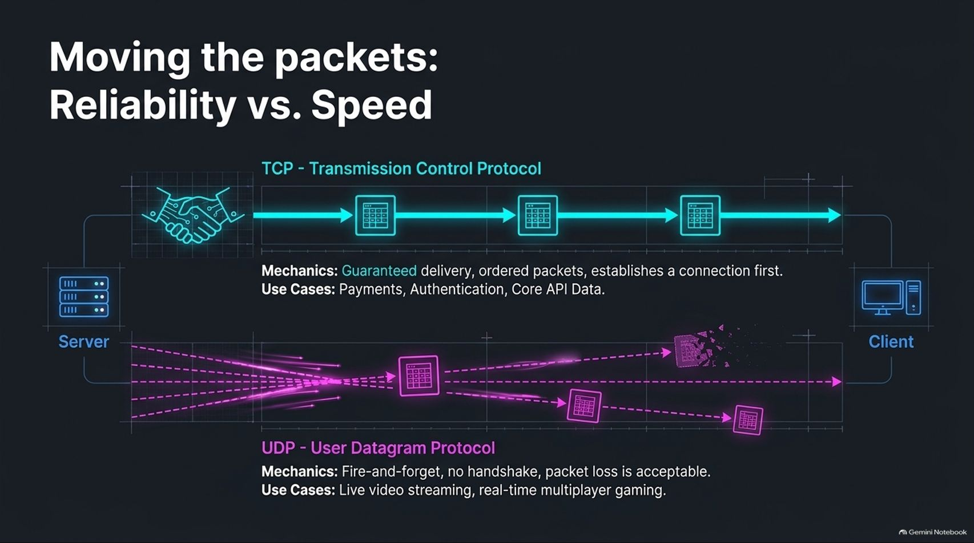
Notes:
Target Time: ~3.5 Minutes (500 words)
Speaker Script
"Beneath our API protocols lie transport layer foundations: TCP and UDP.
TCP (Transmission Control Protocol): Built on a connection handshake. It guarantees reliable, ordered packet delivery with error checking and retransmission. It is essential for payments, authentication, and core API data where packet loss is unacceptable.
UDP (User Datagram Protocol): A fire-and-forget protocol with no handshake. Packets may arrive out of order or drop entirely, but speed is maximized. It's used for real-time applications where a dropped frame doesn't break the experience, such as live video streaming and multiplayer gaming."

Slide 9
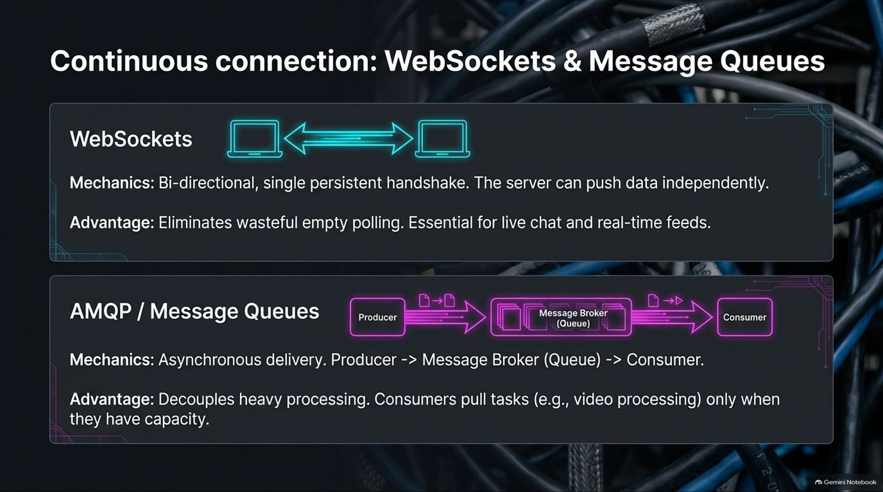
Notes:
Target Time: ~4 Minutes (570 words)
Speaker Script
"Standard HTTP requests are synchronous and request-response driven. For real-time and asynchronous workloads, we use WebSockets and Message Queues:
WebSockets: Establish a single persistent TCP handshake enabling full, bi-directional communication. The server can push data independently to the client, eliminating wasteful HTTP polling. Essential for live chat and real-time feeds.
AMQP / Message Queues (e.g., RabbitMQ, Kafka): Provide asynchronous delivery where a producer drops a task into a message broker queue, and independent consumers pull tasks only when they have capacity. This decouples heavy background processing, like video encoding or report generation, from user-facing request threads."

Slide 10
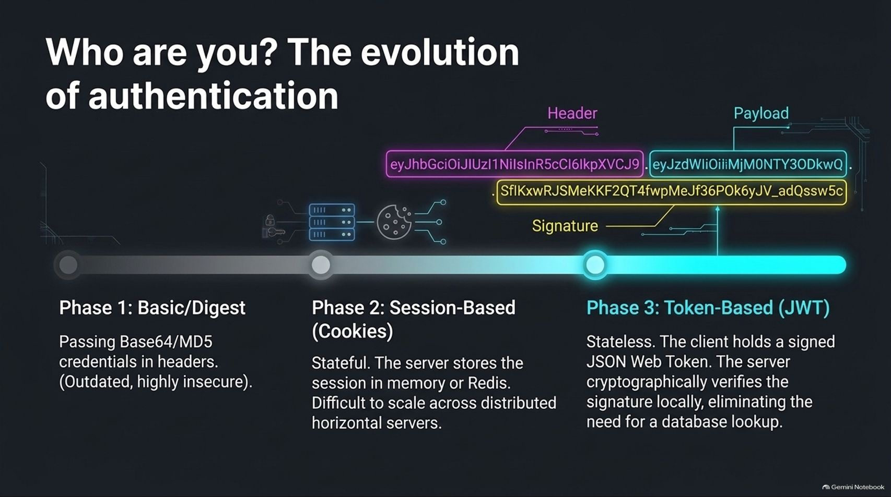
Notes:
Target Time: ~4 Minutes (580 words)
Speaker Script
"Authentication has evolved across three major phases:
Phase 1: Basic / Digest: Passing Base64-encoded username and password credentials in HTTP headers. Highly insecure and largely outdated.
Phase 2: Session-Based (Cookies): Stateful authentication where the server stores session IDs in memory or Redis. While secure, it is difficult to scale efficiently across distributed horizontal servers without sticky sessions.
Phase 3: Token-Based (JWT): Stateless authentication. The client holds a signed JSON Web Token containing header, payload, and cryptographic signature data. The server verifies the signature locally using a secret key, eliminating database lookups on every request."

Slide 11
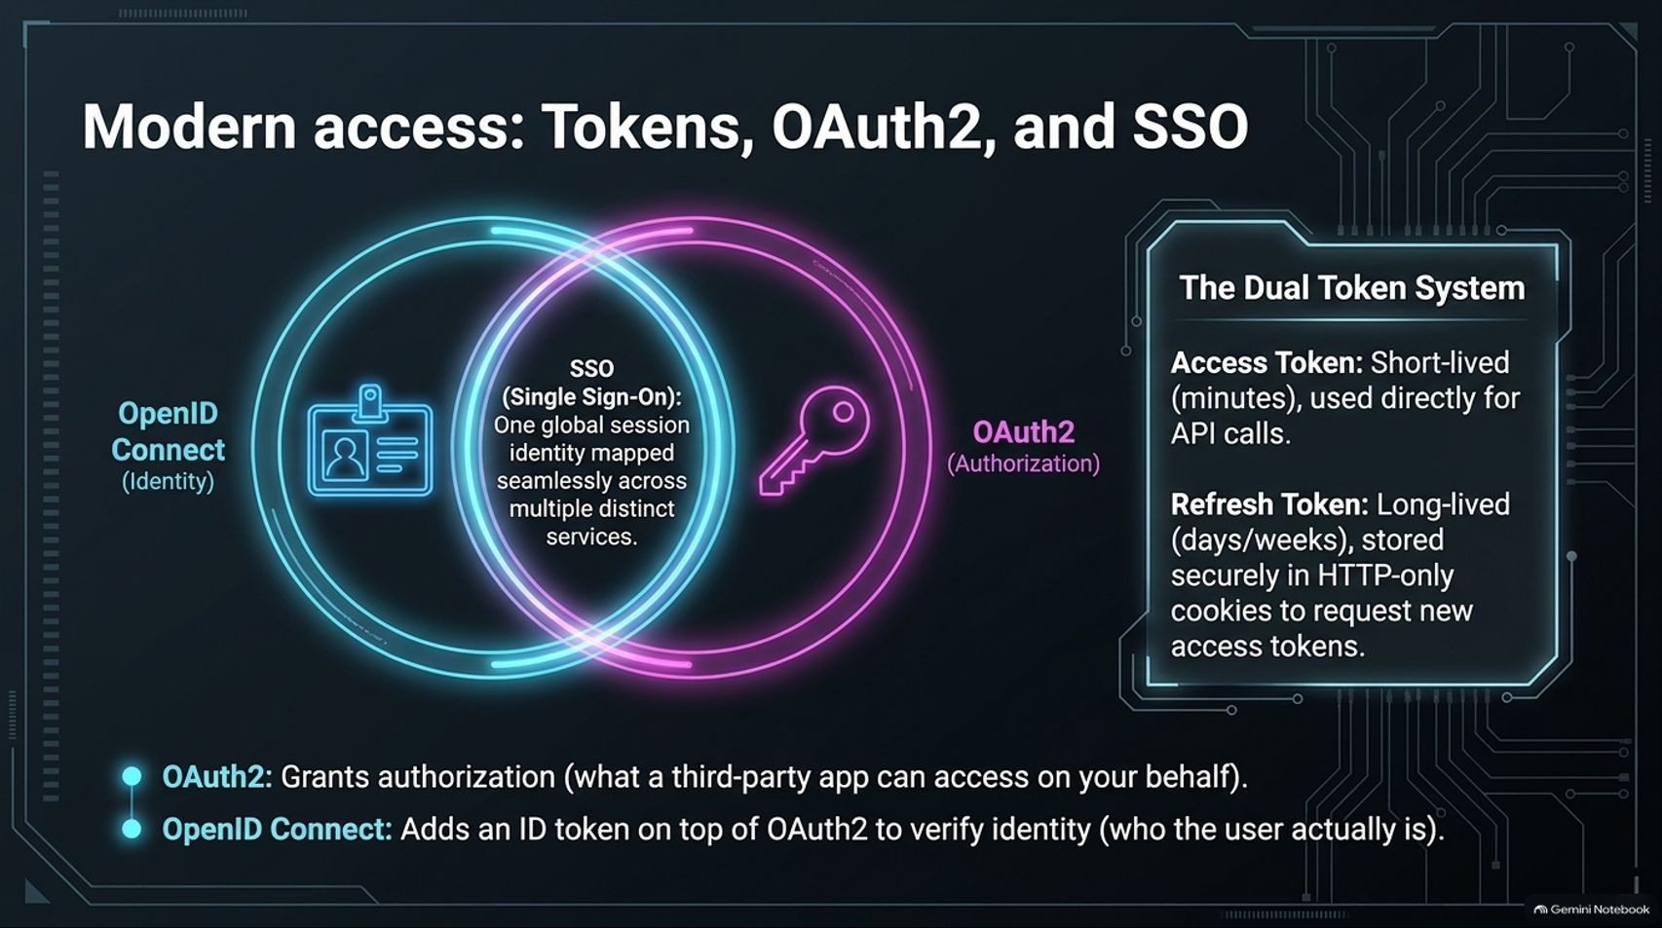
Notes:
Target Time: ~3.5 Minutes (500 words)
Speaker Script
"In modern distributed ecosystems, authentication and authorization are often separated using OAuth 2.0 and OpenID Connect (OIDC):
OAuth 2.0: Handles authorization—granting a third-party application limited access to resources on your behalf without handing over your password.
OpenID Connect (OIDC): Builds on top of OAuth 2.0 to handle identity (authentication), verifying who the user actually is via an ID token.
The Dual Token System: Uses short-lived Access Tokens (lasting minutes) for direct API calls, paired with long-lived Refresh Tokens stored securely in HTTP-only cookies to request new access tokens when they expire."

Slide 12
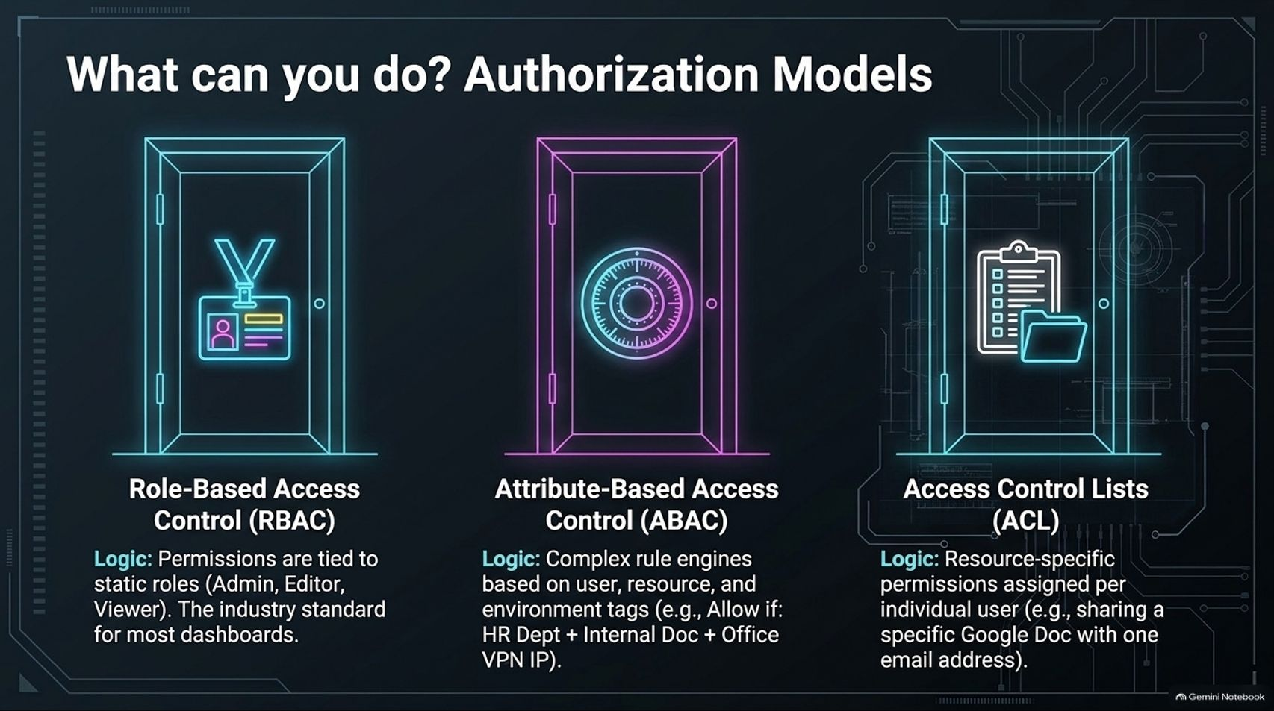
Notes:
Target Time: ~3.5 Minutes (490 words)
Speaker Script
"Once a user is authenticated, authorization models determine what resources they can access:
Role-Based Access Control (RBAC): Permissions are tied to static roles like Admin, Editor, or Viewer. It is simple, predictable, and the industry standard for most dashboard applications.
Attribute-Based Access Control (ABAC): Uses complex rule engines evaluating user, resource, and environment tags (e.g., Allow access if User.Department == HR AND Resource.Classification == Internal AND Environment.VPN == True).
Access Control Lists (ACL): Resource-specific permissions assigned per individual user, such as sharing a specific Google Doc with a single email address."

Slide 13
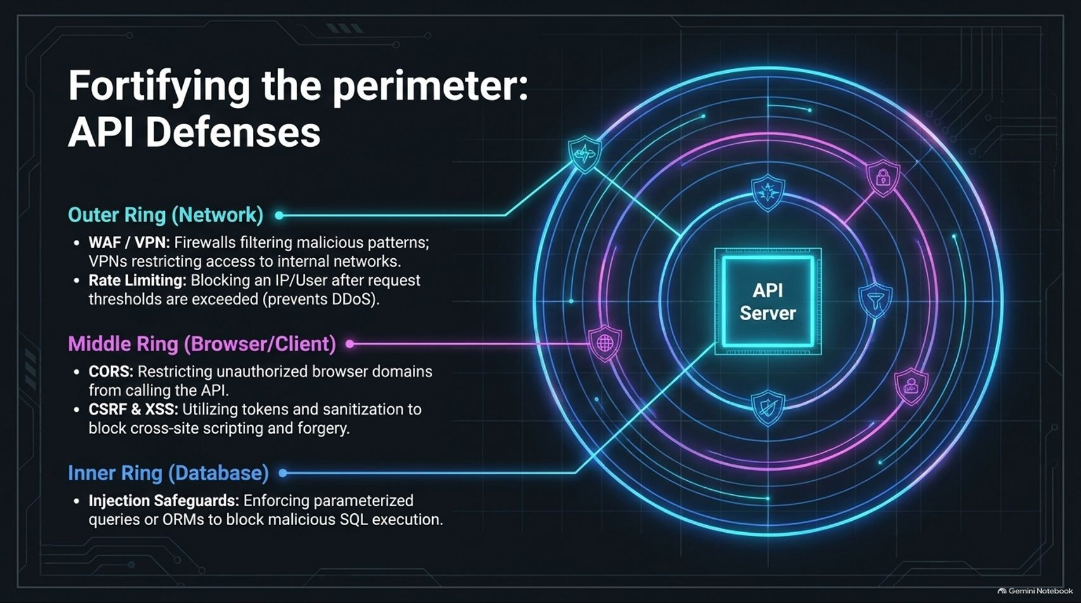
Notes:
Target Time: ~4 Minutes (580 words)
Speaker Script
"Security must be layered in concentric rings around your API server:
Outer Ring (Network): Web Application Firewalls (WAF) and VPNs filter malicious attack patterns and restrict internal network access. Rate limiting blocks IP addresses or users exceeding request thresholds to prevent DDoS attacks.
Middle Ring (Browser/Client): CORS restricts unauthorized browser domains from calling your API. Anti-CSRF tokens and input sanitization block cross-site scripting and forgery.
Inner Ring (Database): Enforcing parameterized queries or ORMs blocks malicious SQL injection attempts at the data layer."

Slide 14
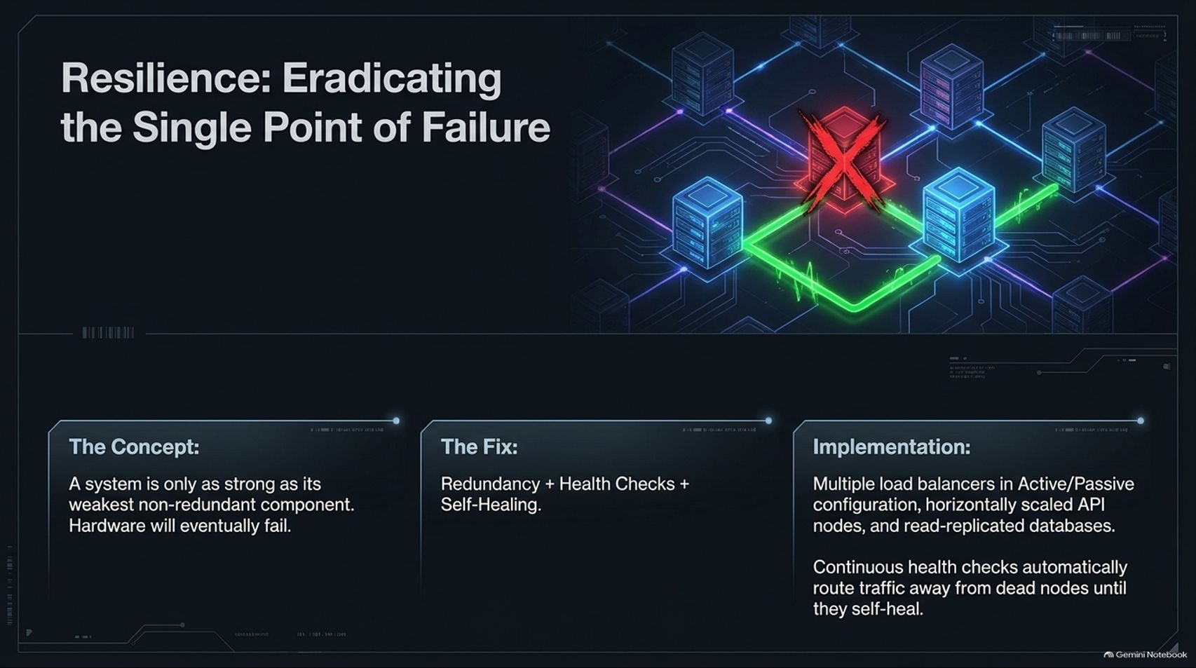
Notes:
Target Time: ~3.5 Minutes (500 words)
Speaker Script
"A distributed system is only as strong as its weakest non-redundant component. Hardware will eventually fail.
To achieve high availability, we must eradicate every Single Point of Failure through Redundancy, Health Checks, and Self-Healing.
This means deploying multiple load balancers in an Active/Passive failover configuration, running horizontally scaled stateless API nodes, and maintaining primary-replica database clusters. Continuous health checks automatically route traffic away from dead nodes until automated orchestration heals or replaces them."

Slide 15
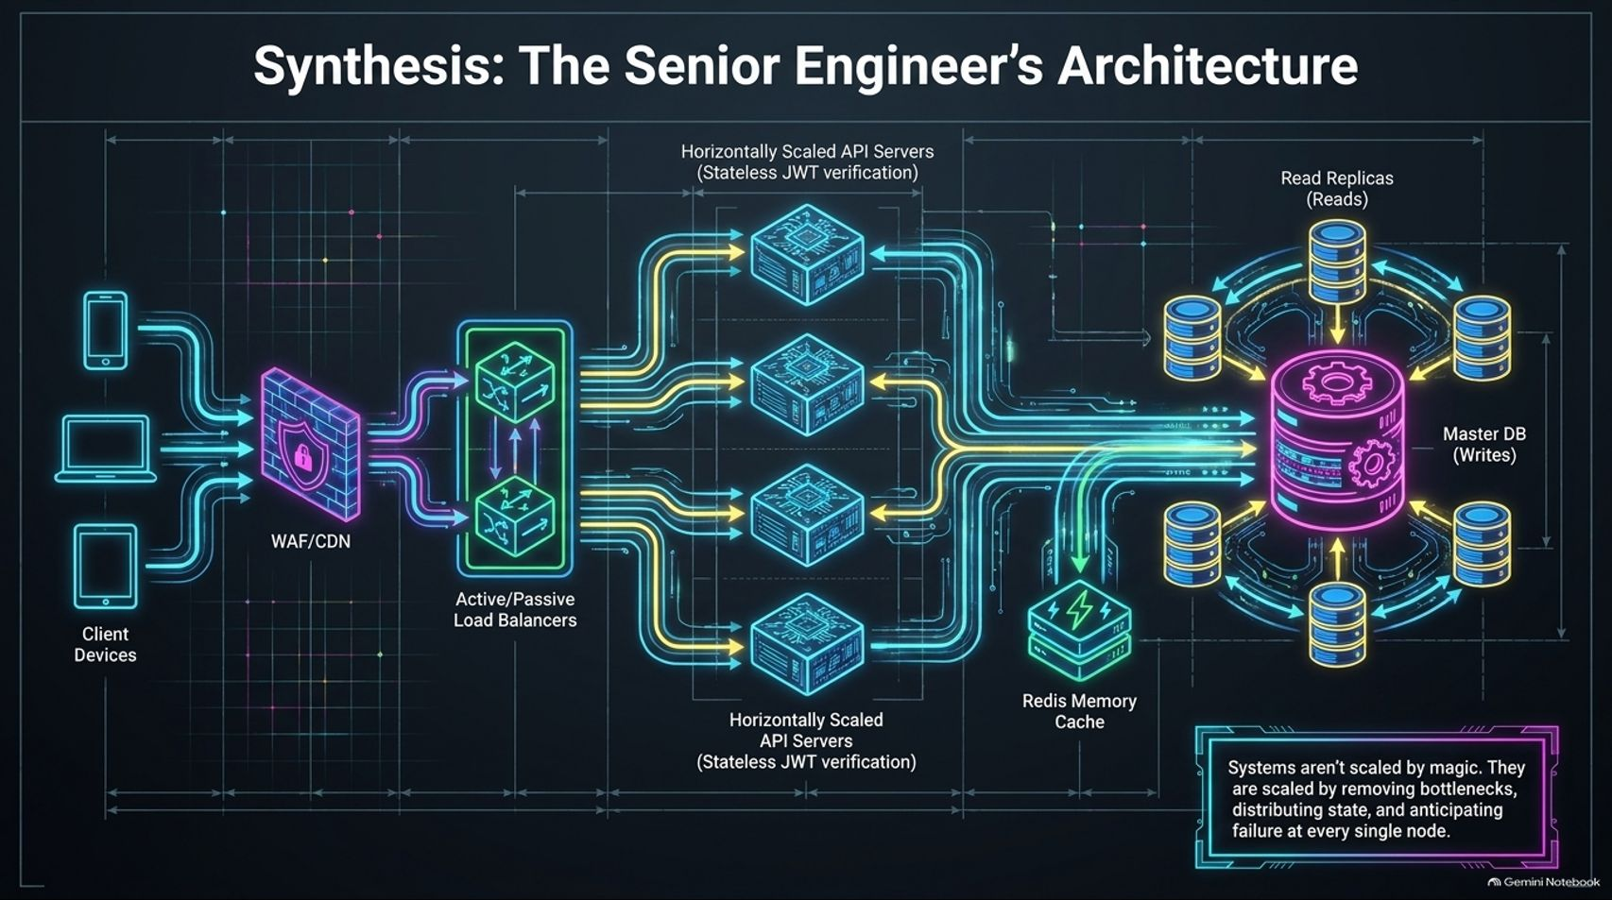
Notes:
Target Time: ~4 Minutes (580 words)
Speaker Script
"Let’s tie everything together into the complete Senior Engineer's Architecture blueprint:
Client requests enter through a WAF/CDN perimeter.
Traffic hits Active/Passive load balancers distributing requests across a cluster of stateless, JWT-verifying API servers.
Hot data is cached in Redis to minimize database load.
Heavy writes go to the Master Database, which asynchronously replicates data across multiple Read Replicas.
As this architecture demonstrates, systems aren't scaled by magic. They are scaled by systematically removing bottlenecks, distributing state, and anticipating failure at every single node."

Slide 16
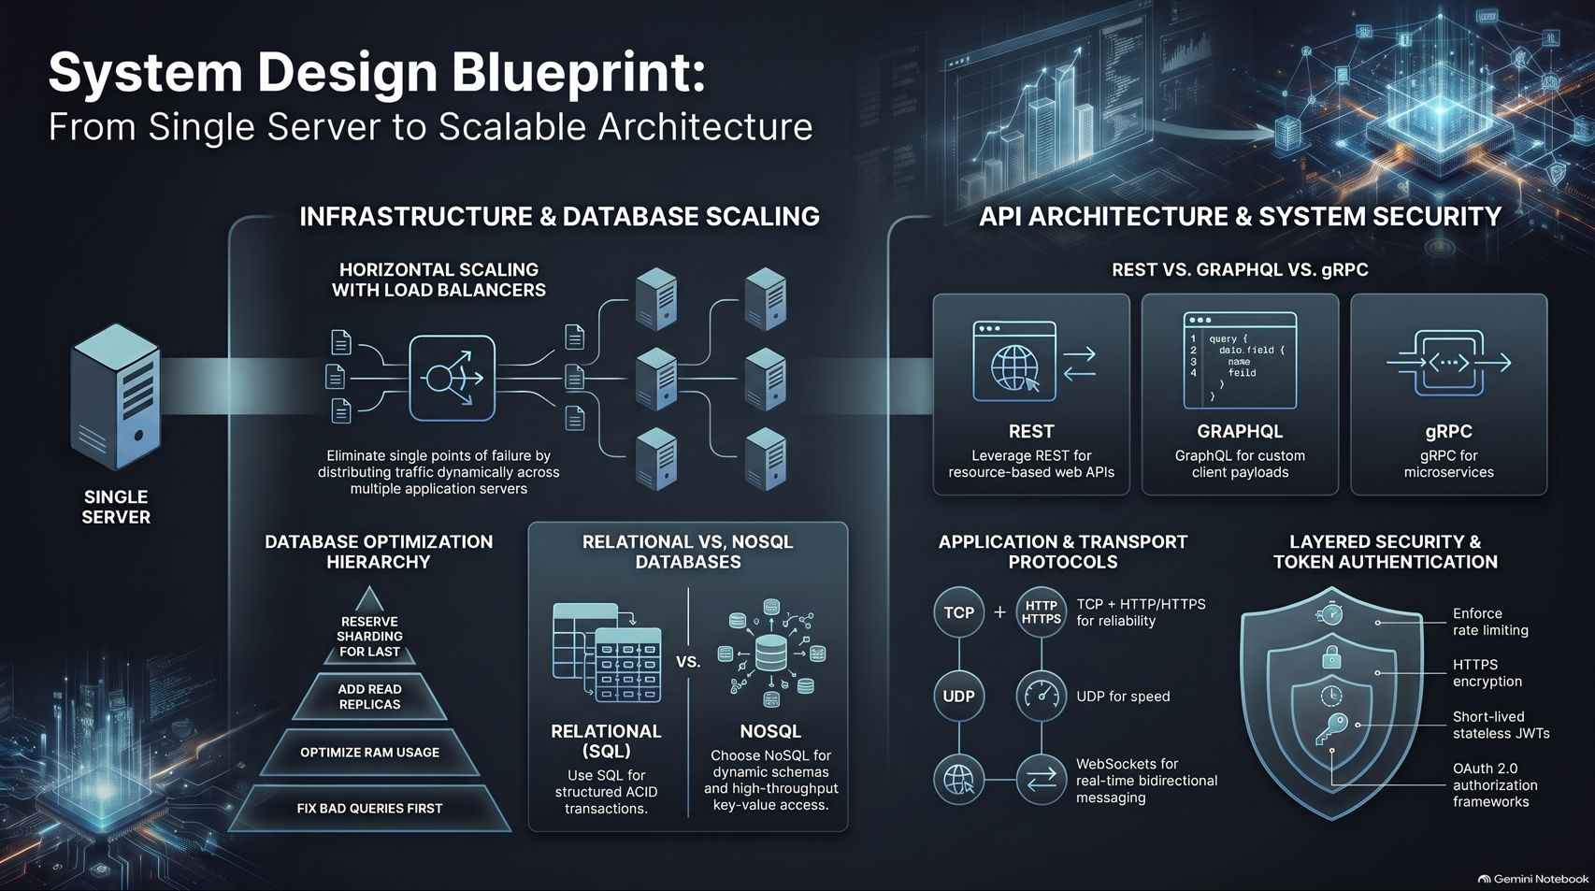
Notes:
Target Time: ~4.5 Minutes (620 words)
Speaker Script
"To synthesize our complete system design playbook across infrastructure, APIs, and security:
Infrastructure & Data: We transition from single servers to horizontally scaled clusters behind load balancers, optimizing databases progressively from query tuning and caching to read replicas and sharding.
APIs & Protocols: We select the right communication contract—REST for standard web resources, GraphQL for flexible client payloads, and gRPC for high-performance microservices—while leveraging TCP for reliability, UDP for speed, and WebSockets for real-time events.
Security & Auth: We enforce layered perimeter defenses, stateless JWT verification, OAuth2/OIDC standards, and robust RBAC/ABAC authorization models.
Mastering these core patterns gives you the blueprint to take any system from a fragile prototype to a robust platform supporting millions of users. Thank you!"
For a visual walkthrough and deeper explanation of these scaling patterns, you can watch the Design Scalable Systems Step by Step Course.

