Slide 1

Notes:
Target Time: ~2.5 Minutes (350 words)
Speaker Script
"Welcome, everyone. Today we are addressing a critical conversation about the scenario nobody in finance wants to talk about: The Binary Choice.
We are living through an exponential age defined by the convergence of accelerating technology, artificial intelligence, and a global monetary architecture built entirely on debt. As automation and AI advance rapidly, human labor is being augmented and replaced at an unprecedented scale.
In this presentation, we will explore why money is the foundational layer of society, why technology is naturally deflationary, and why our current financial path presents a stark, binary choice: absolute freedom through a decentralized free market, or absolute subjugation under a centralized control system. Let’s examine the underlying forces shaping our future."
The Trap Jeff Booth Says Most Bitcoiners Can’t See
https://www.youtube.com/watch?v=wdk5JZ9hPzs

Slide 2
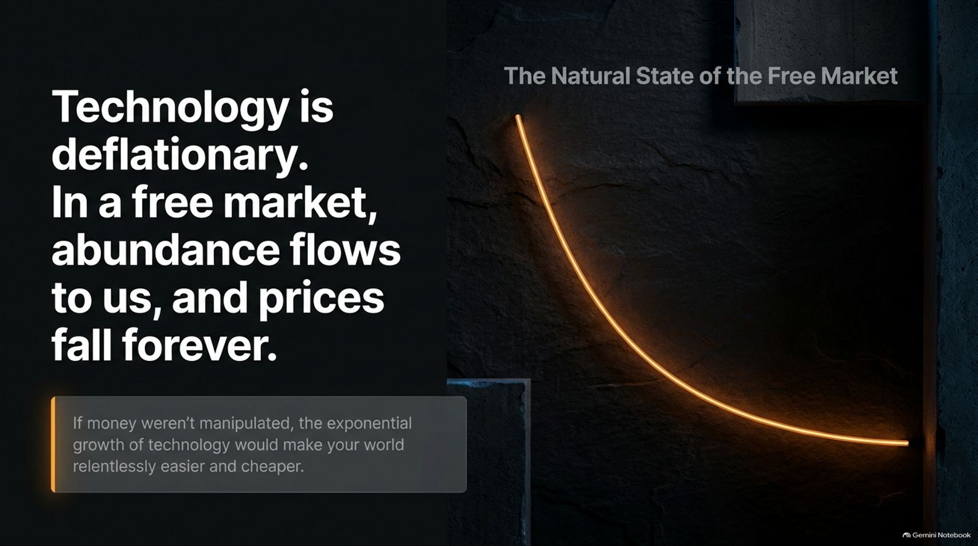
Notes:
Target Time: ~3 Minutes (420 words)
Speaker Script
"To understand where we are going, we must first establish a foundational economic axiom: Technology is inherently deflationary.
In a true free market, human innovation compounds over time. We stand on the shoulders of giants, solving problems faster and cheaper. Because technology increases productivity and reduces the cost of creation, abundance should naturally flow to all of us. In an honest market, prices should fall forever.
If money wasn't manipulated, the exponential growth of technology would make your world relentlessly easier and cheaper. You would enjoy the fruits of 8 billion people working in an infinite cooperative game of abundance. The only reason prices go up instead of down is because the money itself is being debased."

Slide 3

Notes:
Target Time: ~3.5 Minutes (500 words)
Speaker Script
"When people experience the squeeze of rising costs of living, deteriorating quality of life, and stolen purchasing power, where do they turn? They look to the political system. They vote, they protest, and they demand change.
However, operating inside a broken monetary system creates a closed-loop trap—what we call The Illusion of Agency.
When civil unrest erupts due to economic hardship, governments respond by printing more money out of thin air to appease the public or fund security forces. This further destroys purchasing power, which deepens division and causes more unrest. Voting or protesting inside a broken system only provides the political justification to print more money, which ultimately strengthens the control system over you."

Slide 4
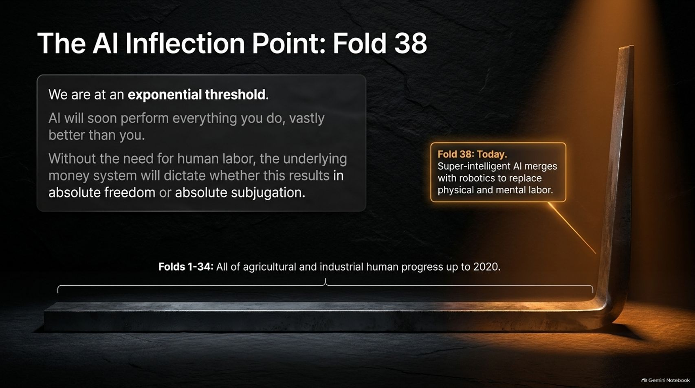

Slide 5
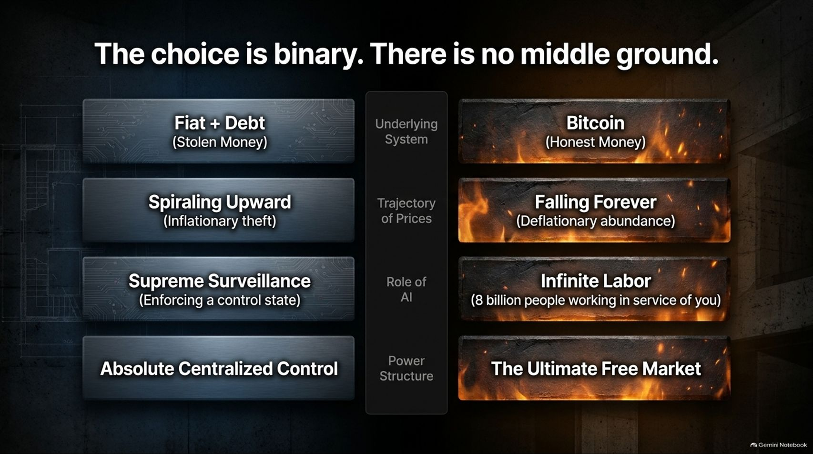
Notes:
Target Time: ~4 Minutes (580 words)
Speaker Script
"When you map out the trajectory of our current path versus an honest market alternative, the choices divide cleanly into two opposing systems:
System 1 (Fiat + Debt): Built on stolen money and spiraling debt. It relies on inflationary theft, where prices rise forever, AI is deployed for supreme surveillance, and power concentrates into absolute centralized control.
System 2 (Bitcoin): Built on honest, decentralized code. It embraces falling prices and deflationary abundance, utilizes AI to provide infinite labor in service of humanity (where 8 billion people benefit from abundance), and fosters the ultimate free market.
There is no middle ground. You cannot reform a broken fiat system from within; you must choose which system your time and energy support."

Slide 6

Notes:
Target Time: ~3.5 Minutes (500 words)
Speaker Script
"Why is it so difficult for mainstream economists and investors to understand Bitcoin? It comes down to physics and perspective. Think of Measuring Light from a Black Hole.
The existing fiat system possesses immense gravitational mass—over $365 Trillion in global debt. That debt is the money.
Einstein proved that gravity bends light. If you attempt to measure Bitcoin’s success or value through the lens of fiat pricing, your perception is bent by the immense mass of the broken control system. You cannot clearly see a new reality when measuring it with the ruler of the old control system."

Slide 7
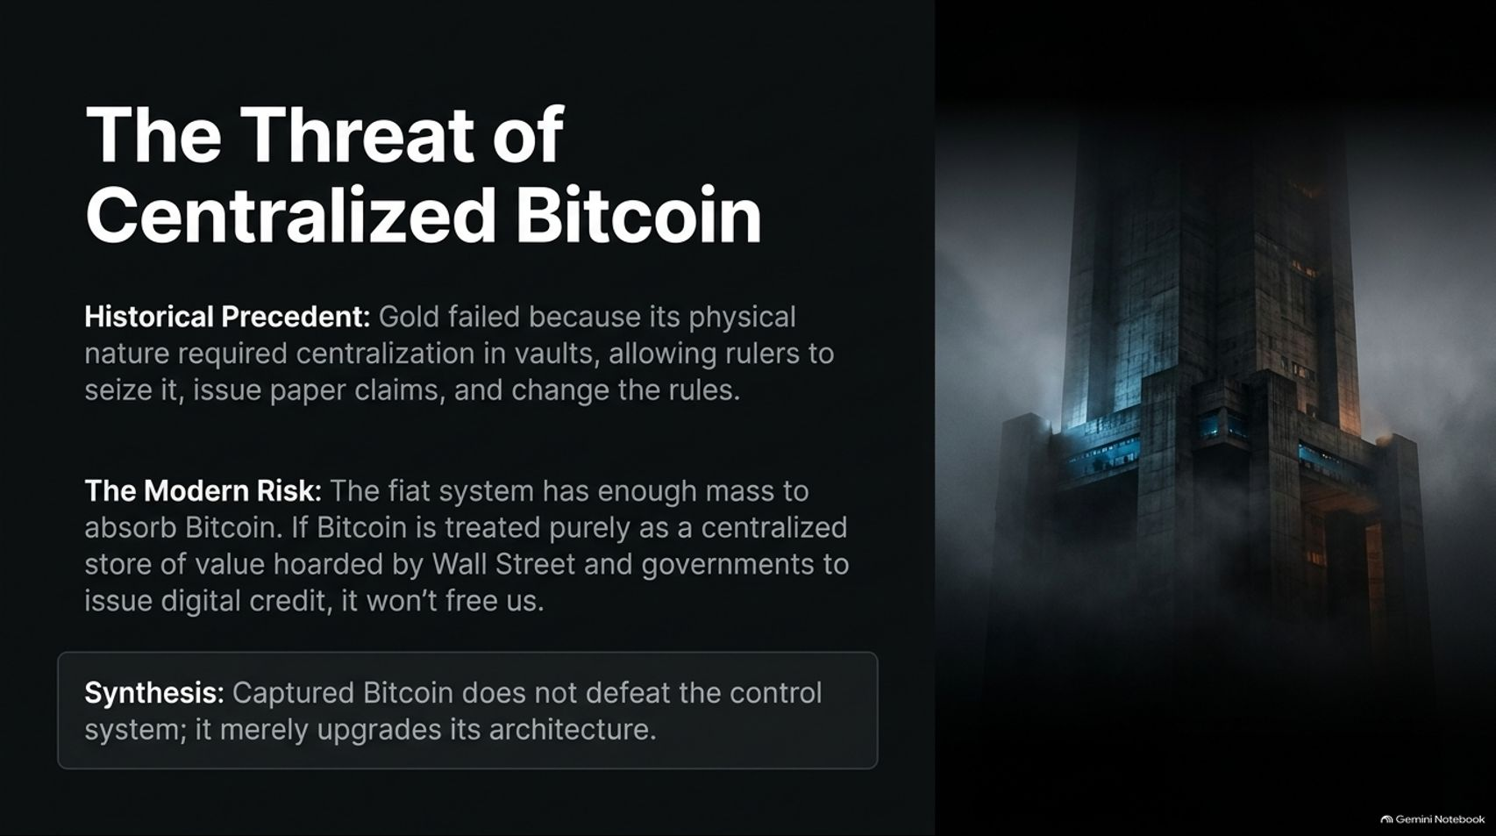
Notes:
Target Time: ~4 Minutes (570 words)
Speaker Script
"Even within the Bitcoin ecosystem, there is a major historical risk we must confront: The Threat of Centralized Bitcoin.
History teaches us a vital lesson through gold. Gold ultimately failed because its physical nature required centralization in vaults, allowing rulers and governments to seize it, issue paper claims against it, and change the rules.
The modern risk is that the fiat system has enough financial mass to absorb Bitcoin. If Bitcoin is treated purely as a centralized store of value hoarded by Wall Street and governments to back digital credit, it won't free us. Captured Bitcoin does not defeat the control system; it merely upgrades its architecture."

Slide 8


Slide 9


Slide 10

Notes:
Target Time: ~3.5 Minutes (500 words)
Speaker Script
"Despite the consolidation of traditional finance, a parallel system is quietly being built beneath the surface—The Unseen Emergence of Freedom Tech.
Brilliant minds are constructing a new, unmeasurable layer of the internet bound by Bitcoin. Key tools driving this revolution include:
Nostr: Uncensorable, decentralized communication protocols.
Fedimint & eCash: Scalable, completely private digital cash pegged to Bitcoin.
This infrastructure creates a private, untrackable layer operating entirely outside the surveillance state."

Slide 11

Notes:
Target Time: ~3.5 Minutes (490 words)
Speaker Script
"How do we break free from the trap? It requires actively Reclaiming Your Agency through three practical steps:
Self-Custody: Hold your own keys. Relying exclusively on institutional custodians recreates the exact trap that destroyed the gold standard.
Defund the Surveillance State: Utilize privacy tech like eCash and Nostr so your communications and spending are decoupled from centralized tracking.
Build Circular Economies: Stop trading your time exclusively for broken money. Spend, earn, and build relationships within local communities that transact in truth."

Slide 12

Notes:
Target Time: ~4 Minutes (570 words)
Speaker Script
"When we look at the big picture, The Sovereign Architecture breaks cleanly through the concrete foundation of fiat debt across three distinct layers:
Layer 1 (Base Settlement): The Bitcoin protocol providing unalterable, decentralized honest money.
Layer 2 (Transactional Privacy): Technologies like Fedimint and eCash that decouple economic energy from identity and surveillance.
Layer 3 (Social Consensus): Protocols like Nostr enabling uncensorable communication and community coordination.
Freedom is not granted by a ballot box or a political leader; it is architected through cryptographic tools that mathematically deny control to third parties."

Slide 13
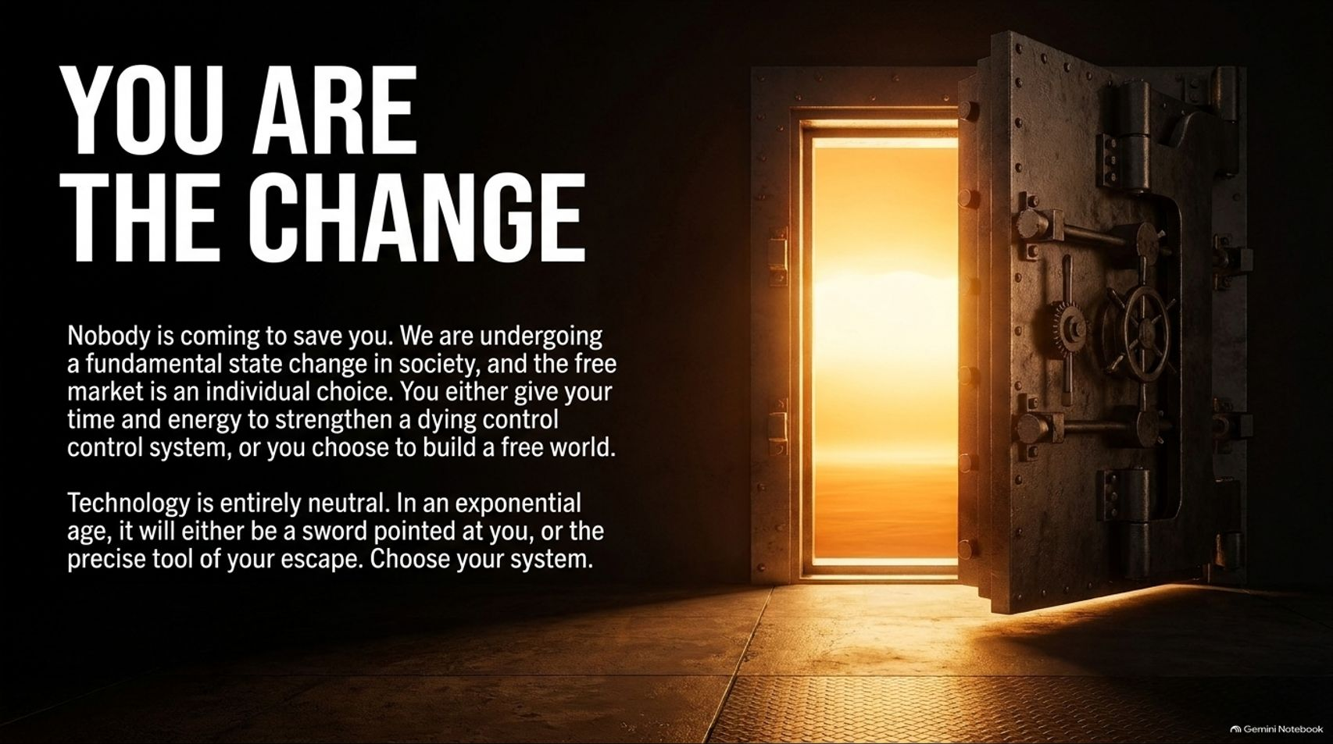
Notes:
Target Time: ~3 Minutes (420 words)
Speaker Script
"Ultimately, You Are The Change. Nobody is coming to save us from this transition.
We are undergoing a fundamental state change in society, and participating in the free market is an individual choice. You either give your time, data, and energy to strengthen a dying control system, or you choose to build a free world.
Technology is entirely neutral. In an exponential age, it will either be a sword pointed at your throat by centralized authorities, or the precise tool of your liberation. Choose your system."

Slide 14
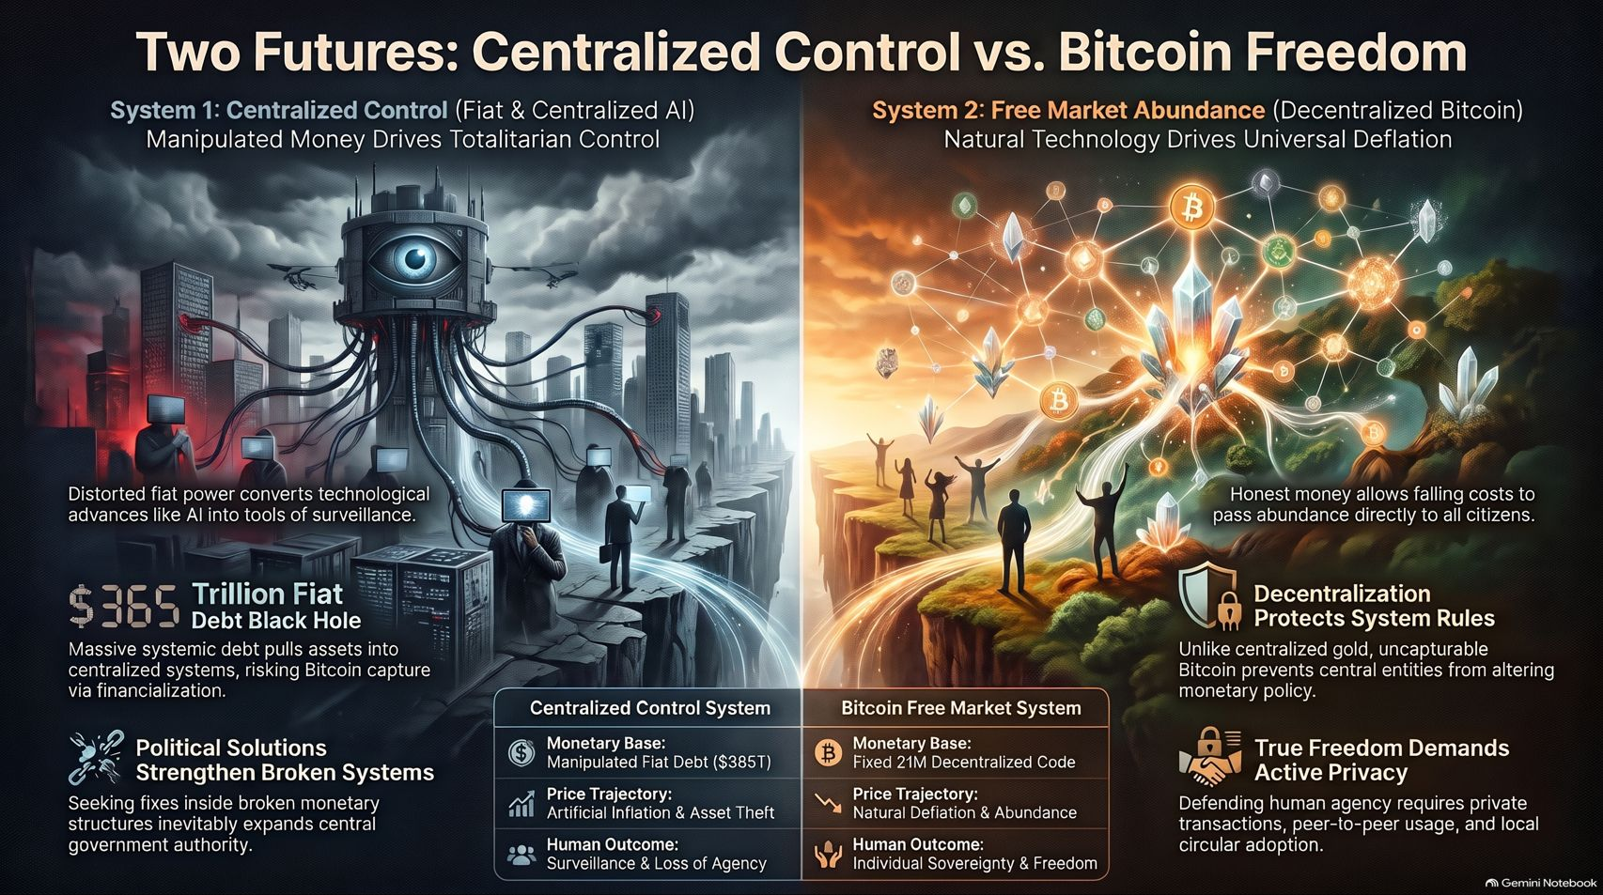
Notes:
Target Time: ~4.5 Minutes (630 words)
Speaker Script
"To conclude our playbook, let’s contrast the two distinct futures laid out before humanity:
System 1 (Centralized Control): Driven by manipulated fiat debt ($385T+ global debt black hole) and centralized AI surveillance. Political solutions only serve to strengthen broken systems, leading to artificial inflation, asset theft, and the ultimate loss of human agency.
System 2 (Bitcoin Free Market): Anchored by a fixed monetary base of 21 million decentralized coins, natural deflationary abundance, and uncapturable protocol rules. By defending human agency through private transactions, peer-to-peer usage, and local circular adoption, we secure true individual sovereignty and freedom."
For a complete video discussion on these monetary concepts and the future of Bitcoin and freedom technology, refer to Natalie Brunell’s interview with Jeff Booth.

