Slide 1

Notes:
Estimated Time: 2.5 – 3 minutes
Slide Focus: Title slide; framing 400 years of financial manias through Edward Chancellor’s historical lens.
Speaker Notes: Welcome everyone. Today we’re going to examine the anatomy of financial manias—and more importantly, what four centuries of speculative booms and busts reveal about the markets we are navigating right now.
The title of this presentation, Devil Takes the Hindmost, comes from Edward Chancellor’s seminal 1999 book on the history of financial speculation [03:13]. Chancellor is one of the world's foremost financial historians—he spent years working alongside Jeremy Grantham at GMO and has written extensively on credit cycles and interest rates [02:46, 03:21].
Where does that phrase—"devil takes the hindmost"—come from? During the infamous South Sea Bubble of 1720, a London banker named Martin famously remarked: "When the rest of the world is mad, we must imitate them in some manner, and let the devil take the hindmost" [19:47]. That single sentence captures the psychology of every financial mania in history. People often know they are participating in an overvalued market, yet they jump in anyway, convinced they are nimble enough to pocket quick gains and exit before the inevitable collapse—leaving the "hindmost," or the last ones in, to absorb the ruin [19:06, 20:09]. Notice the hourglass on the screen: every speculative cycle operates on borrowed time. Over the next several slides, we’ll break down the exact blueprint of how bubbles form, why human behavior never seems to change, and what signals tell us when the sand is running out.
What 400 Years of Financial Manias Teach Us About Today | Edward Chancellor
https://www.youtube.com/watch?v=bhgiF3nWr7w

Slide 2

Notes:
Estimated Time: 3 – 4 minutes
Slide Focus: Historical timeline from 1636 Tulip Mania to the 2024 AI & Crypto Everything Bubble.
Speaker Notes: Look at the clockwork mechanism on this slide. In politics or warfare, history rarely repeats itself in neat, predictable patterns. As Mark Twain famously quipped, history doesn't repeat, it rhymes. Yet as Edward Chancellor observes, in the world of finance, there is a profound circularity at work [00:00, 55:55]. Why? Because while technologies, financial instruments, and regulations evolve, human nature—our greed, envy, fear of missing out, and susceptibility to crowd psychology—does not change [04:22, 08:52].
Tracing the dial around this timeline, we see the exact same behavioral loop playing out over nearly four hundred years:
1636 – Dutch Tulip Mania: In the world’s first modern commercial society, rare variegated tulip bulbs traded via futures contracts for the price of an Amsterdam townhouse [12:54, 13:18, 13:57].
1720 – The South Sea Bubble: A frenzy built around state-backed trade monopolies, political bribery, and easy credit [28:02, 28:24].
1845 – British Railway Mania: A genuine technological revolution in transportation that sparked massive, redundant capital overbuilding [32:54, 33:12, 33:46].
1929 – The Roaring Twenties: Fueled by mass production, radio, margin debt, and the ticker tape [37:27, 56:47]. (Note: On our graphic, 1989 appears twice—pointing to both the Roaring 20s echo and the Japanese Asset Bubble.)
1989 – The Japanese Asset Bubble: A credit and real estate mania so extreme that the grounds of the Imperial Palace in Tokyo were famously valued higher than all the real estate in California [42:15].
1999 – The Dotcom & Telecom Boom: Just as Chancellor’s book hit shelves, internet stocks detached completely from earnings [04:38].
2024 and Today – The AI & Crypto Everything Bubble: We see a convergence of artificial intelligence infrastructure spending, cryptocurrencies, meme stocks, and retail speculation [38:02, 38:41, 49:54].
When you study this circularity, you stop asking "Is this time different?" and start recognizing: "If it walks like a bubble and quacks like a bubble, it is one" [00:20, 56:16].

Slide 3
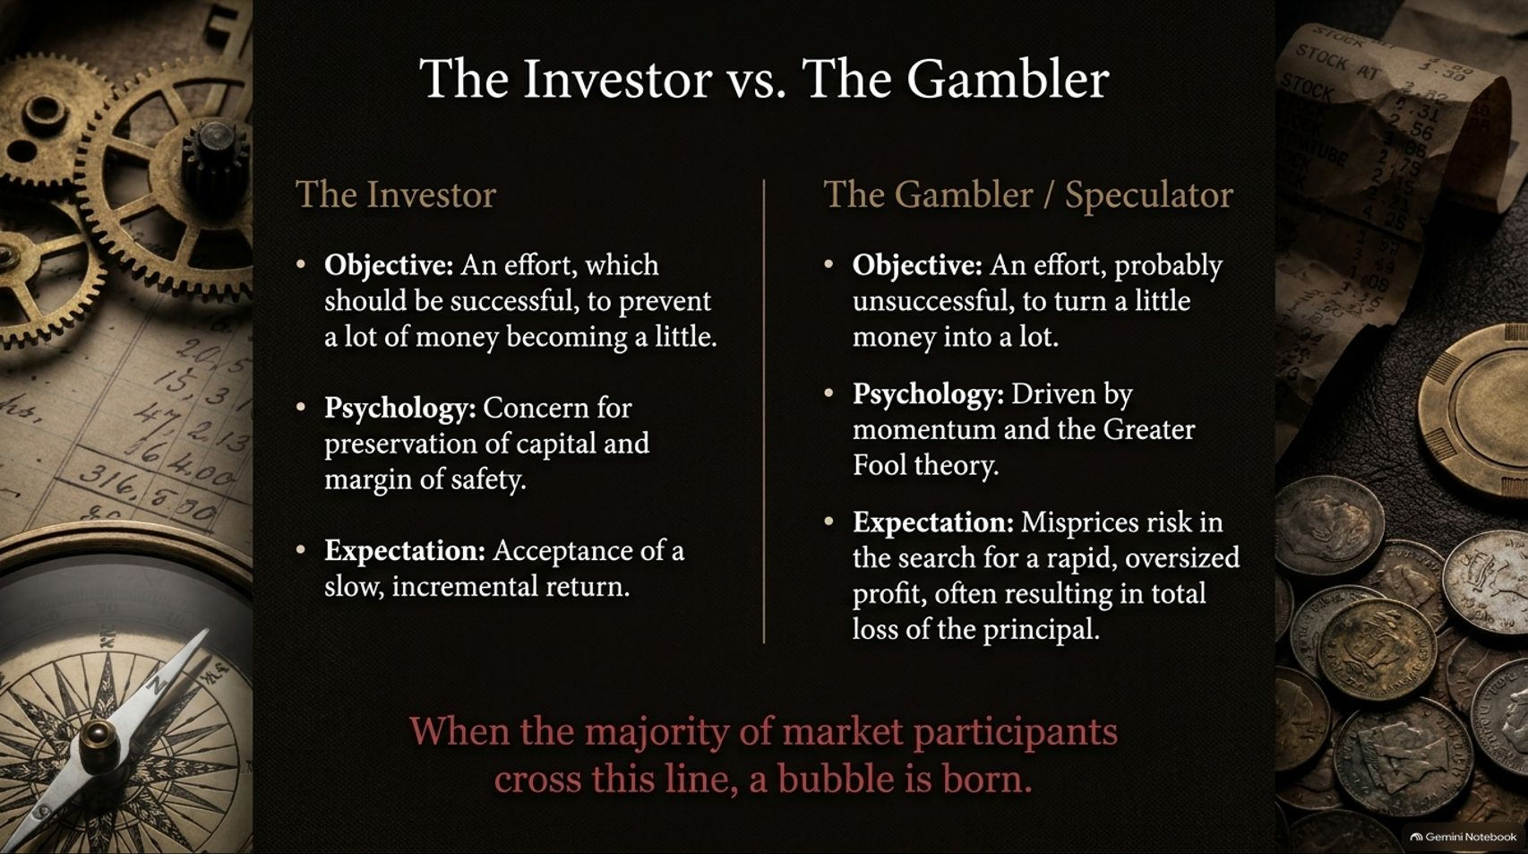
Notes:
Estimated Time: 3 – 4 minutes
Slide Focus: Fred Schwed’s distinction between investing and speculating/gambling.
Speaker Notes: Before we dissect how a bubble grows, we need a clear baseline definition of what separates genuine investing from gambling. On this slide, we draw on a classic distinction from Fred Schwed’s 1940 Wall Street satire, Where Are the Customers' Yachts? [10:29].
Look at the left column: The Investor. Schwed defines investment as "an effort, which should be successful, to prevent a lot of money becoming a little" [10:08]. True investing is fundamentally defensive [10:50]. Its psychology centers on capital preservation and demanding a margin of safety [10:50]. Because the investor insists on paying a reasonable price relative to future cash flows, they accept a slow, incremental, compounding return [11:00].
Now look at the right column: The Gambler or Speculator. Speculation is "an effort, probably unsuccessful, to turn a little money into a lot" [10:02]. The speculator isn't analyzing balance sheets or discounted cash flows; they are driven by price momentum and the Greater Fool Theory—buying an overpriced asset purely because they expect someone else to buy it from them at an even higher price [19:27, 20:09]. In their rush for rapid, windfall profits, speculators systematically misprice risk [11:11, 11:18]. And as history shows, in their search for the quick dollar, they frequently end up losing the whole dollar [11:26].
Look at today’s retail trading landscape—zero-commission apps, prediction markets, and short-dated options [11:40, 11:49]. Much of what is marketed today as "democratized investing" is actually pure gambling [11:49, 49:35]. A financial bubble is born the moment the majority of market participants cross that center line from investor to gambler [10:21].

Slide 4
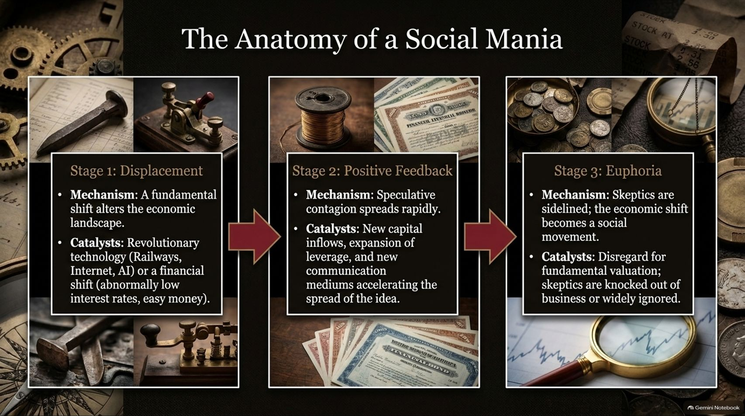
Notes:
Estimated Time: 3.5 – 4.5 minutes
Slide Focus: Charles Kindleberger’s three-stage framework (Displacement, Positive Feedback, Euphoria) and the social context of manias.
Speaker Notes: How does a market transition from rational investing to collective madness? Economic historian Charles Kindleberger—whom Edward Chancellor interviewed while researching his book—laid out a classic three-stage taxonomy for every bubble [05:46, 06:00].
Stage 1 is Displacement. Every mania begins with an exogenous shock that fundamentally alters the economic horizon [06:26]. Sometimes this is a genuine technological breakthrough—the steam locomotive in the 1840s, the internet in the 1990s, or generative AI today [06:26, 33:12]. Other times, as Chancellor detailed in his book The Price of Time, the displacement is purely monetary: central banks holding interest rates abnormally low for too long, flooding the system with cheap credit [06:34, 06:40].
Stage 2 is Positive Feedback. Rising asset prices attract new capital inflows. Early winners brag about their gains, drawing in neighbors, colleagues, and institutions [06:56]. Leverage expands to amplify returns, and new communication mediums accelerate the spread of the narrative. Speculative contagion becomes self-reinforcing [06:56].
Stage 3 is Euphoria. At this stage, traditional valuation metrics are openly mocked as obsolete. Crucially, Chancellor notes that peak euphoria isn't just about wild optimism—it’s about the elimination of dissent [07:15]. Short-sellers and value-oriented skeptics are either driven out of business by career risk and redemptions, or they are simply ignored [07:15].
Furthermore, Chancellor emphasizes that a financial mania cannot be understood purely through spreadsheets; it is a social mania [07:47, 09:28]. Just like Charles Mackay’s accounts of witch hunts or dancing manias in the 19th century, speculative bubbles become cultural movements—often tacitly or actively encouraged by political authorities who enjoy the illusion of prosperity [08:28, 09:01, 09:28].

Slide 5
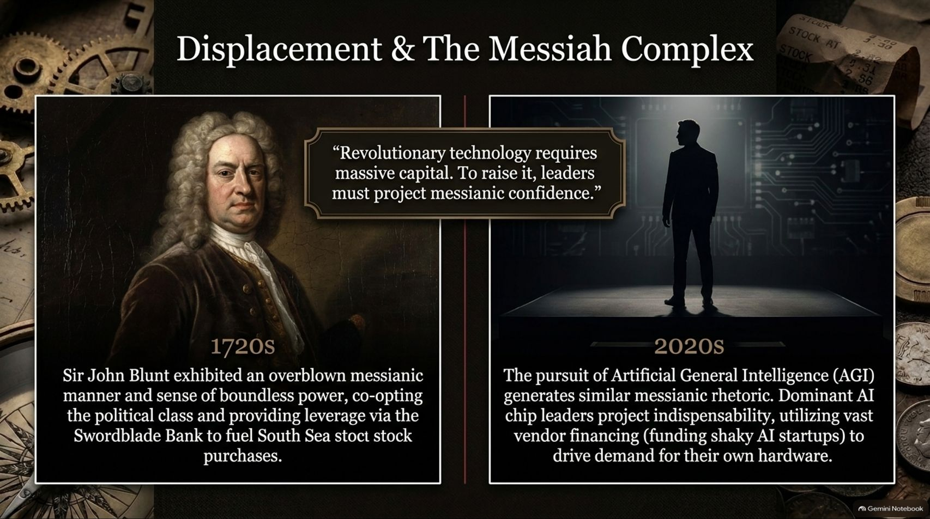
Notes:
Estimated Time: 3.5 – 4.5 minutes
Slide Focus: Comparison between Sir John Blunt in the 1720s and modern AI leaders in the 2020s; vendor financing and messianic leadership.
Speaker Notes: Every great social movement needs a prophet, and financial manias are no different [27:15]. Revolutionary technologies or grand financial schemes require staggering amounts of upfront capital. To persuade investors to part with trillions of dollars before profits exist, leaders must project an almost messianic confidence [26:52].
Look at the parallel across 300 years on this slide: On the left, we have Sir John Blunt in the 1720s, the chief architect of the South Sea Company [24:48]. Chancellor describes Blunt as possessing an "overblown messianic manner and sense of boundless power" [24:58]. Blunt didn't just sell a story; he engineered the financing [28:02]. He co-opted the British political establishment with bribes and used his affiliated institution, the Swordblade Bank, to lend money to investors specifically so they could buy more South Sea stock—creating an artificial, circular demand loop [28:02, 28:17, 28:24].
Now look at the right side: The 2020s. Today, the pursuit of Artificial General Intelligence—or superintelligence—naturally invites messianic rhetoric about transforming human civilization [26:24, 26:36]. Leaders of frontier labs and dominant chipmakers frame their technology as an existential necessity [25:46, 26:43]. Even more striking is the financial engineering: dominant hardware providers have deployed tens of billions of dollars in vendor financing—investing in or lending to cash-burning AI startups and data center operators who then turn around and use that very capital to purchase GPUs [25:54, 26:08, 28:17].
Just as we saw in the telecom boom of 1999 and the South Sea Bubble of 1720, circular vendor financing makes underlying end-user demand look far stronger than it actually is—until the credit cycle turns [26:08, 26:17].

Slide 6
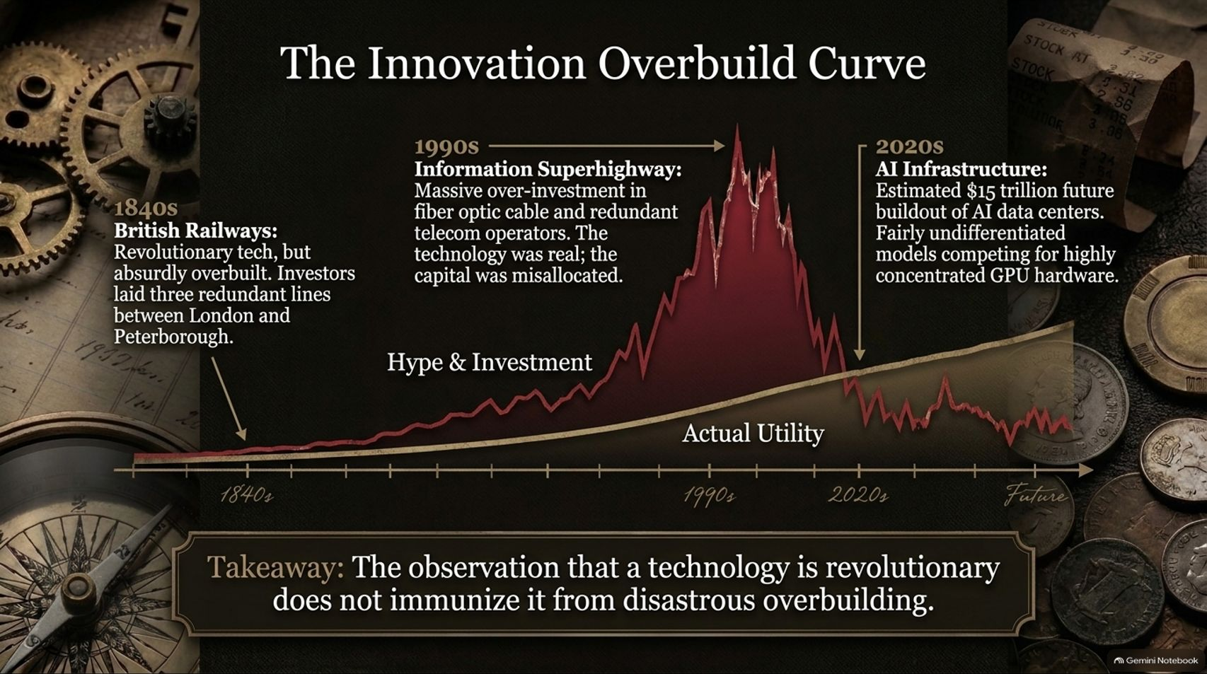
Notes:
Estimated Time: 4 – 5 minutes
Slide Focus: British Railways (1840s), Telecom/Fiber Optic (1990s), and AI Data Centers (2020s); real tech vs. misallocated capital.
Speaker Notes: One of the biggest traps investors fall into during a tech boom is confusing technological reality with investment profitability [33:12, 43:18]. Look at this chart. Notice the smooth, steadily rising gold line labeled Actual Utility, contrasted with the jagged, towering red spike labeled Hype & Investment.
History gives us three textbook examples of this exact curve:
1840s British Railways: Were railways revolutionary? Absolutely—they transformed commerce and society [33:12]. Yet investors became so intoxicated by the vision that Parliament authorized absurdly redundant capital allocation [33:18, 33:46]. At the height of the mania, companies laid three separate, competing railway lines between London and Peterborough, and three between Leeds and Manchester [33:46]. The tracks were real, the utility was real, and almost everyone lost money [33:12, 33:46].
1990s Information Superhighway: Fast-forward 150 years [33:59]. Telecom companies raised hundreds of billions in debt to lay millions of miles of fiber-optic cable across the globe [33:59, 46:02]. Within a few years, bandwidth prices collapsed by over 90%, bankrupting giants like WorldCom and Global Crossing [46:39]. The internet changed the world, just as promised, yet the infrastructure builders were wiped out [46:39, 47:36].
2020s AI Infrastructure: Today, we are staring at projections of up to $15 trillion in cumulative AI and data center capital expenditures [34:38]. Meanwhile, numerous frontier and open-source AI models are rapidly commoditizing—performing nearly identically while driving inference costs down by 95% or more [34:12, 45:23].
The takeaway is simple: recognizing that a technology is revolutionary does not immunize it from disastrous overbuilding. When massive capital chases commoditized infrastructure, society gets cheap utility, while shareholders bear the write-downs [46:39].

Slide 7
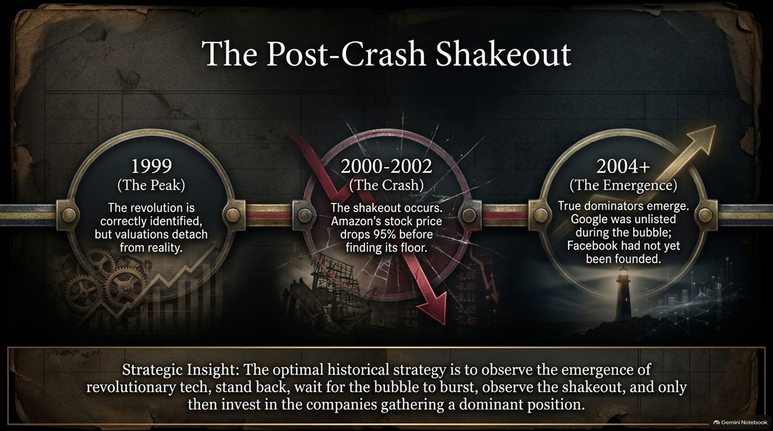
Notes:
Estimated Time: 3 – 4 minutes
Slide Focus: Dotcom timeline (1999 Peak, 2000–2002 Crash, 2004+ Emergence) and Chancellor’s optimal investment strategy.
Speaker Notes: If bubbles consistently overbuild revolutionary technologies, how should a disciplined investor actually play a technological revolution? Slide 7 gives us the historical playbook from the Dotcom era.
In 1999, investors correctly identified that the internet would change everything [47:36]. The problem wasn't their vision; it was that valuations detached completely from reality.
Then came 2000 to 2002: The Crash. Even the genuine long-term survivors suffered catastrophic drawdowns [47:50]. Amazon—arguably the greatest retail success story of the modern era—saw its stock price plummet by 95% from peak to trough before finding a floor [47:50]. Most of the high-flying darlings of 1999—Pets.com, Webvan, Boo.com—vanished entirely.
Now look at 2004 and beyond: The Emergence. As Chancellor points out, bubbles are notoriously terrible at picking long-term winners while the mania is underway [47:00]. During the height of the 1999 internet bubble, Google wasn't even publicly listed, and Facebook hadn't even been founded yet [48:01]. The companies that eventually captured the lion's share of economic value emerged after the speculative rubble was cleared away [48:08].
This leads to our strategic insight: the optimal historical strategy during a technological revolution is patience [48:21]. You observe the technology, stand back while speculative capital subsidizes the infrastructure overbuild, wait for the bubble to burst and the shakeout to occur, and then deploy capital into the surviving businesses establishing durable, dominant moats [48:21].

Slide 8
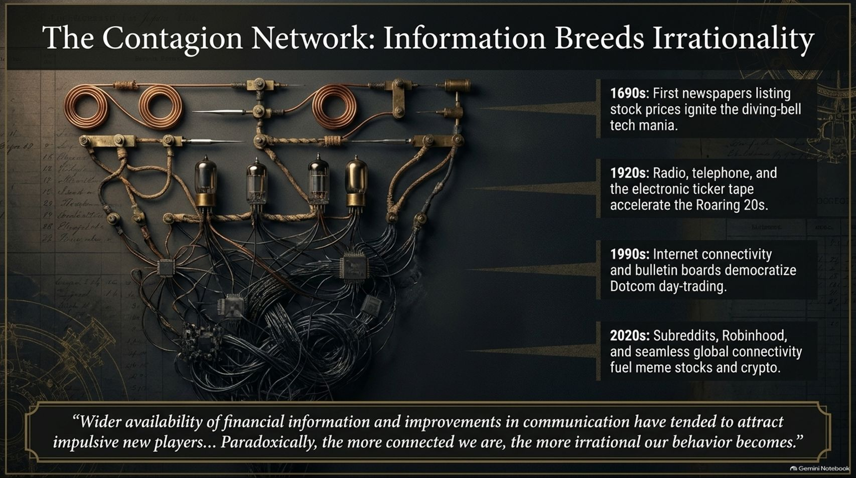
Notes:
Estimated Time: 3.5 – 4.5 minutes
Slide Focus: Evolution of communication mediums (1690s newspapers, 1920s radio/ticker, 1990s internet, 2020s subreddits/apps).
Speaker Notes: Standard economic theory assumes that the faster and wider financial information spreads, the more efficient and rational markets become. Edward Chancellor’s historical research proves the exact opposite [36:32].
Look at the progression of communication breakthroughs mapped on this slide:
1690s London: The printing of the very first daily newspapers carrying stock tables didn't create calm, analytical investors—it immediately ignited England’s first stock market mania, centered around treasure-hunting diving-bell companies [15:34, 15:58, 37:02].
1920s America: The arrival of commercial radio, widespread telephone access, and the electronic stock ticker allowed real-time price action to reach living rooms nationwide, supercharging the Roaring Twenties [37:27].
1990s: Dial-up internet, online discount brokers, and Yahoo! Finance message boards democratized day-trading and fueled the Dotcom frenzy [37:45].
2020s: Today, we have instant, zero-friction global connectivity [37:55]. A narrative sparked on a Reddit forum like WallStreetBets, amplified on X or TikTok, and executed on a smartphone app like Robinhood can mobilize millions of retail traders across every continent within hours [38:02, 38:12].
Chancellor notes that even in quiet rural villages in Somerset, England, locals who ought to be buying farmland are trading crypto and AI stocks on their phones [38:58]. Why does better information breed worse behavior? Because instantaneous price feeds trigger our evolutionary herd instincts [39:29]. Watching neighbors get rich in real time creates unbearable FOMO [06:56]. Paradoxically, the more connected we are, the faster irrational contagion spreads [39:29].

Slide 9
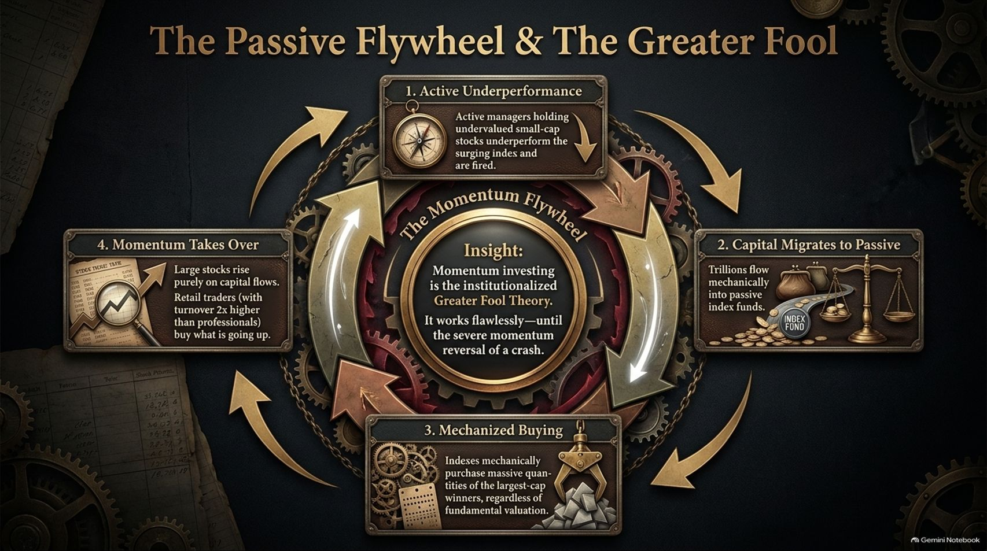
Notes:
Estimated Time: 4 – 5 minutes
Slide Focus: How passive indexing and retail momentum create a structural "Momentum Flywheel".
Speaker Notes: In previous eras, bubbles were driven mostly by human emotion and loose credit [13:57]. Today, we have added an automated, structural engine to the mania: the Passive Flywheel [23:13].
Walk through the four steps of this gear mechanism with me:
Active Underperformance: During a concentrated market rally, disciplined active managers who hold undervalued small- and mid-cap stocks inevitably lag the surging mega-cap index [23:26]. Clients lose patience and fire those active managers [23:26].
Capital Migrates to Passive: Where does that redeemed money go? Trillions of dollars flow automatically into passive index funds and ETFs [23:34].
Mechanized Buying: Passive funds do not perform fundamental valuation. They are price-insensitive buyers [23:34]. For every dollar that enters an index fund, the largest-cap winners receive the largest automatic allocation, pushing their prices up regardless of earnings or multiples [23:34].
Momentum Takes Over: Seeing the largest stocks go up relentlessly, quantitative momentum funds front-run the flows, and retail traders—whose share turnover in the U.S. is now roughly double that of institutional investors—pile into whatever is rising [23:46, 23:54].
As Chancellor bluntly puts it in the center of this slide: Momentum investing is simply the institutionalized Greater Fool Theory [21:05]. Over the past 15 years, this flywheel has worked almost flawlessly, making traditional value investing look broken [22:51, 22:59]. Yet momentum is a double-edged sword [22:18]. When flows eventually reverse, that exact same passive and leveraged machinery works in reverse—creating violent, air-pocket crashes with no valuation-minded buyers left to catch the falling knife [22:18, 24:15].

Slide 10
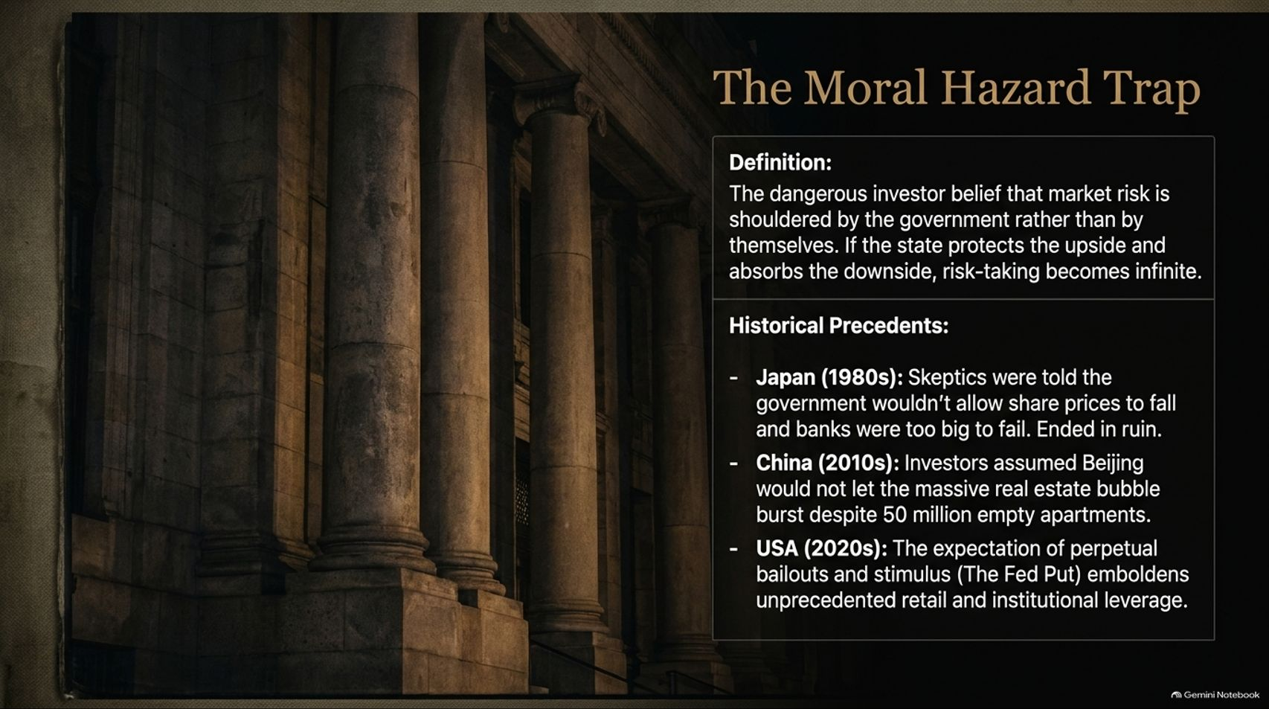
Notes:
Estimated Time: 3.5 – 4.5 minutes
Slide Focus: Definition of Moral Hazard and historical precedents in Japan (1980s), China (2010s), and the USA (2020s).
Speaker Notes: Why do modern bubbles grow so large and last so long before breaking? A major culprit is Moral Hazard—the dangerous belief among investors that while they get to keep all the upside of their bets, the government or central bank will step in to absorb the downside [40:43, 42:59].
When investors believe the state has put a floor under asset prices, normal risk aversion evaporates and leverage becomes effectively infinite. Look at three major historical precedents:
Japan in the 1980s: Skeptics who warned about absurd Tokyo stock and land valuations were dismissed with the assurance that the Ministry of Finance would never allow share prices to fall and that Japanese banks were "too big to fail" [40:50]. When the bubble finally broke, it triggered three decades of stagnation and bank insolvencies [40:56, 42:29].
China in the 2010s: For over a decade, analysts pointed out that China had built roughly 50 million empty apartments at unsustainable debt levels [41:26, 41:32]. Yet investors kept buying property developer bonds, convinced Beijing would never let the real estate sector collapse—until policymakers finally drew the "Three Red Lines" in 2020 and triggered a historic property bust [41:40, 42:42].
The United States in the 2020s: Generations of investors have been conditioned by the "Fed Put"—the expectation that every market dip will be met with emergency rate cuts, quantitative easing, or fiscal stimulus. This expectation has emboldened unprecedented levels of retail and institutional risk-taking.
Moral hazard doesn't prevent bubbles from bursting; it simply inflates them to a much larger size before reality inevitably asserts itself [41:47, 41:53].

Slide 11
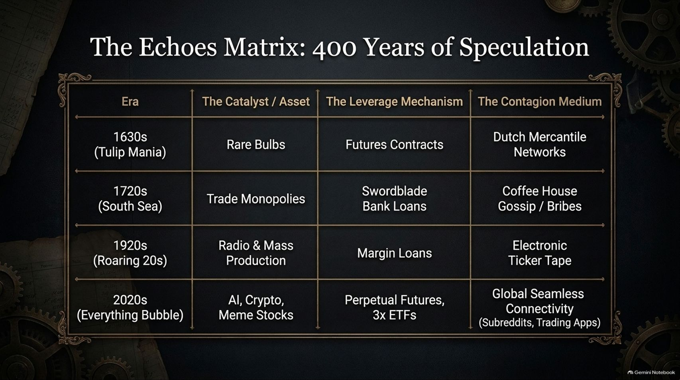
Notes:
Estimated Time: 3 – 4 minutes
Slide Focus: Comparative matrix across the 1630s, 1720s, 1920s, and 2020s.
Speaker Notes: Let’s pause and synthesize the structural anatomy we’ve uncovered so far. Every great mania in history rests on three pillars: an exciting Catalyst, a Leverage Mechanism to amplify bets, and a Contagion Medium to spread the mania.
Look down the columns of this matrix:
In the 1630s, the asset was rare tulip bulbs [13:18]; the leverage was newly invented futures contracts [13:57]; and the contagion spread through bustling Dutch mercantile networks and taverns [12:54].
In the 1720s, the catalyst was state-granted trade monopolies in the South Seas; the leverage came from easy loans issued by the Swordblade Bank [28:02]; and the contagion spread via London coffee-house gossip and political bribes [28:24].
In the 1920s, the catalyst was radio, automobiles, and mass electrification [37:27]; the leverage was 10-to-1 margin loans from brokers [56:47]; and the contagion moved over the electronic ticker tape [37:27].
Now look at the bottom row—the 2020s. Our catalysts are AI, cryptocurrencies, and meme stocks [38:02, 38:41, 49:54]. Our leverage mechanisms have evolved into 100x perpetual crypto futures and 3x daily leveraged single-stock ETFs [51:10, 51:22]. And our contagion medium is seamless, 24/7 global connectivity through subreddits, social media, and gamified trading apps [38:12, 38:41].
The costumes change every century, and the technology gets faster, but the underlying engine—novelty plus cheap leverage plus rapid communication—remains identical.

Slide 12
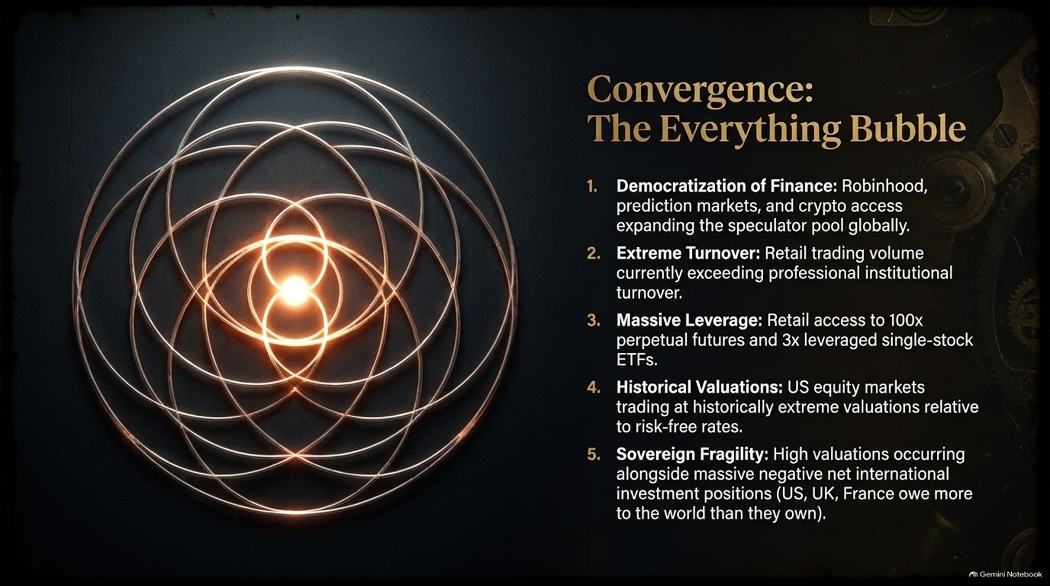
Notes:
Estimated Time: 4 – 5 minutes
Slide Focus: Five converging indicators of the modern bubble (drawing on Richard Bernstein & Chancellor’s Reuters analysis).
Speaker Notes: In his recent analysis of today’s markets—drawing on frameworks from veteran strategist Richard Bernstein and his own joint research with Jeremy Grantham—Edward Chancellor argues that we are witnessing a convergence of speculative extremes even larger than the 2021 meme-stock peak [48:55, 49:18, 55:29]. Look at the five factors converging right now:
Democratization of Finance: Platforms like Robinhood, crypto exchanges, and event prediction markets have dramatically expanded the global speculator pool, turning everyday smartphone users into active traders [11:40, 11:49, 50:35].
Extreme Turnover: Data from major market makers like Citadel Securities shows retail trading turnover surging past even the highs of 2021, with retail volume outpacing traditional institutional turnover [23:54, 50:17].
Massive Leverage: Speculators aren't just buying shares with cash; they are using 3x leveraged single-stock ETFs on volatile semiconductor names and up to 100x leverage on perpetual futures [51:10, 51:22]. We’ve even seen retail traders—known as "ants" in South Korea—aggressively bidding up leveraged chip stocks with tacit political encouragement [51:40, 51:47].
Historical Valuations: U.S. equity markets are trading near record valuation multiples at a time when risk-free Treasury yields are no longer zero, compressing the equity risk premium to near nothing [58:33, 58:49].
Sovereign Fragility: Here is what makes today uniquely perilous compared to 1929 or 1999 [52:51, 53:11]. In 1929 and 1999, the U.S. government ran budget surpluses and had low debt [53:11]. Today, major Western economies—the U.S., the UK, and France—carry massive fiscal deficits, heavy refinancing schedules, and deep negative Net International Investment Positions, meaning they owe far more to foreign creditors than they own abroad [52:34, 53:38].
When this bubble eventually unwinds, governments may lack the fiscal balance sheet to ride to the rescue the way they did in 2008 or 2020 [53:21, 53:29].

Slide 13
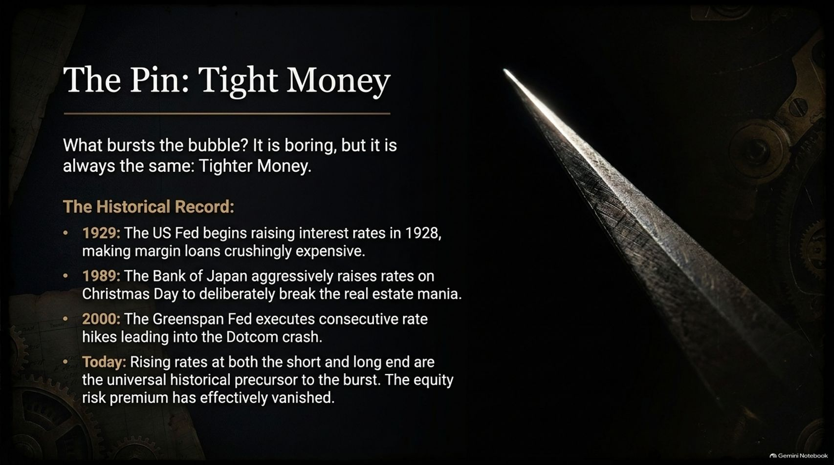
Notes:
Estimated Time: 3.5 – 4.5 minutes
Slide Focus: Rising interest rates and tighter liquidity as the universal historical catalyst that pops bubbles.
Speaker Notes: Whenever a market reaches extreme valuations, investors inevitably ask: "What is the pin that will pop the bubble?" People look for dramatic geopolitical shocks or sudden corporate scandals. Yet as Chancellor points out, the actual answer is almost always the same—and it is remarkably boring: Tighter Money [00:32, 56:30].
Speculative manias are like fires that require a constant supply of cheap oxygen—liquidity and low interest rates [06:40, 56:30]. When central banks or bond markets raise the cost of money, the math behind leveraged speculation breaks down [56:39]:
1929: The bubble didn't burst out of thin air; the Federal Reserve began hiking interest rates in early 1928, gradually making brokers' margin loans crushingly expensive until the structure snapped in October 1929 [56:39].
1989: On Christmas Day 1989, Bank of Japan Governor Yasushi Mieno aggressively hiked interest rates with the explicit goal of puncturing Tokyo's real estate and stock mania—and succeeded [42:02, 42:15].
2000: Alan Greenspan’s Federal Reserve executed a series of consecutive rate hikes through 1999 and early 2000, starving cash-burning Dotcom startups of fresh capital [56:55]. Even the 2008 housing crash followed the Fed's rate-hiking cycle from 2004 to 2006, and the 2022 crypto/SPAC bust followed the Fed's rapid tightening [57:06, 57:33].
Look at today: interest rates at both the short end and the long end of the yield curve are dramatically higher than they were five years ago, and inflation-protected bonds offer real yields that rival or exceed the earnings yield on equities [58:12, 58:33, 58:41]. With the equity risk premium virtually gone, tight money is already pressing against the bubble [58:49].

Slide 14
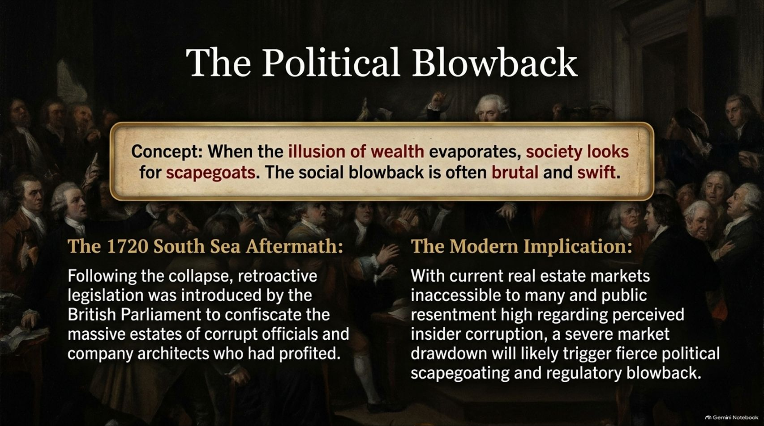
Notes:
Estimated Time: 3 – 4 minutes
Slide Focus: Post-crash scapegoating in 1720 vs. modern political resentment and regulatory backlash.
Speaker Notes: Financial crashes never stay confined to Wall Street or the City of London; they always spill over into politics [29:04, 54:25]. When the illusion of paper wealth suddenly evaporates and ordinary citizens see their savings marked down, society immediately goes hunting for scapegoats [20:55, 54:25]. The resulting political blowback is often swift and brutal.
Look back at the aftermath of the 1720 South Sea Bubble [29:16]. Public fury was so intense that the British Parliament passed unprecedented retroactive legislation to confiscate the personal estates of corrupt company directors and government ministers—including the Chancellor of the Exchequer, Sir John Aislabie [29:16, 29:22]. Even the father of famous historian Edward Gibbon had his fortune seized simply for having profited during the mania [29:38].
Now consider the modern implication. Even before a major equity market drawdown, public frustration is simmering across Western democracies [30:58]. Housing and real estate have become unaffordable for an entire younger generation, while voters perceive widespread insider enrichment, political favoritism, and unchecked speculation among elites [30:58, 31:31].
As Chancellor warns, if a severe market crash hits an already polarized electorate—especially at a time when heavily indebted governments cannot easily bail everyone out—we should expect fierce political scapegoating, populist backlash, windfall taxes, and heavy-handed regulatory crackdowns [31:46, 53:29, 54:25].

Slide 15

Notes:
Estimated Time: 3.5 – 4.5 minutes
Slide Focus: Sir Richard Steele’s 1690s contrarian wisdom and Chancellor’s practical investment advice.
Speaker Notes: If history shows that bubbles are recurring, predictable traps, how do we protect ourselves and prosper? Slide 15 brings us back to the late 1690s and an English playwright, essayist, and entrepreneur named Sir Richard Steele [15:14].
Observing England’s very first stock market boom and bust, Steele noted tongue-in-cheek that stock prices seemed to rise and fall in tandem with the height of ladies’ headdresses—meaning financial manias are essentially passing fashions [16:13, 16:20]. He then wrote down what Chancellor considers the single most important sentence any serious investor needs to know [16:36, 17:00]:
"Be diffident when others exalt, and with a secret joy buy when others think it is in their interest to sell" [16:48].
Two centuries before Warren Buffett told investors to be fearful when others are greedy, Steele articulated the essence of rational contrarianism [16:54, 17:14]. Interestingly, Steele didn't always follow his own advice—he later got swept up in a speculative venture during the 1720 South Sea Bubble—which proves just how hard it is to resist the crowd in real time [17:33, 17:47].
What is Chancellor’s overriding practical takeaway for investors today? Step away from passive index funds [59:43]. Major indexes have become dangerously overconcentrated in the most expensive, momentum-driven speculative themes [59:54]. Instead, rely on disciplined, active, human-led value assessment—holding real cash-generating assets bought with a margin of safety, and keeping dry powder ready for the day when everyone else is forced to sell [10:50, 01:00:06].

Slide 16
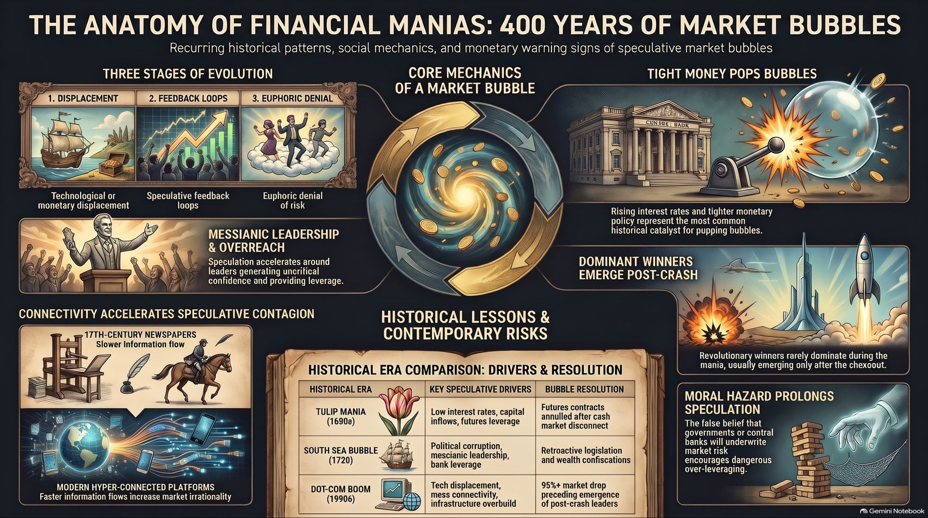
Notes:
Estimated Time: 3 – 4 minutes
Slide Focus: Visual synthesis of the entire presentation; Q&A transition.
Speaker Notes: To wrap up, this final visual brings all the pieces of our 400-year puzzle together onto a single page.
On the top left, we see the Three Stages of Evolution—how a technological or monetary displacement sparks positive feedback loops, culminating in euphoric denial where skeptics are silenced [05:53, 07:15]. Directly beneath that, we see how Messianic Leadership and Hyper-Connected Networks—from 17th-century newspapers to modern trading apps—accelerate speculative contagion across society [26:52, 37:02, 38:02].
At the center is the Core Mechanics of a Market Bubble—the recurring circularity of finance where human behavior shifts from cautious capital preservation to momentum-driven gambling [00:06, 10:21].
And on the right, we have the three crucial lessons for navigating what comes next:
Tight Money Pops Bubbles: Regardless of the hype, rising interest rates and tighter liquidity remain the universal catalyst that ends the party [58:12].
Moral Hazard Prolongs Speculation: Believing central banks or governments will always underwrite risk encourages dangerous over-leveraging—especially dangerous today given strained sovereign balance sheets [42:59, 52:51].
Dominant Winners Emerge Post-Crash: Revolutionary technologies are real, but the lasting market leaders rarely dominate at the peak of the mania; they emerge after the shakeout [47:30, 48:08].
History doesn't guarantee exact timing, because manias can always stretch further than rational observers expect [58:27, 58:54]. But by understanding the anatomy of the cycle, you can avoid being the "hindmost" when the music stops [19:47, 20:09]. Thank you—I’d love to open the floor for your thoughts and questions.

