Slide 1
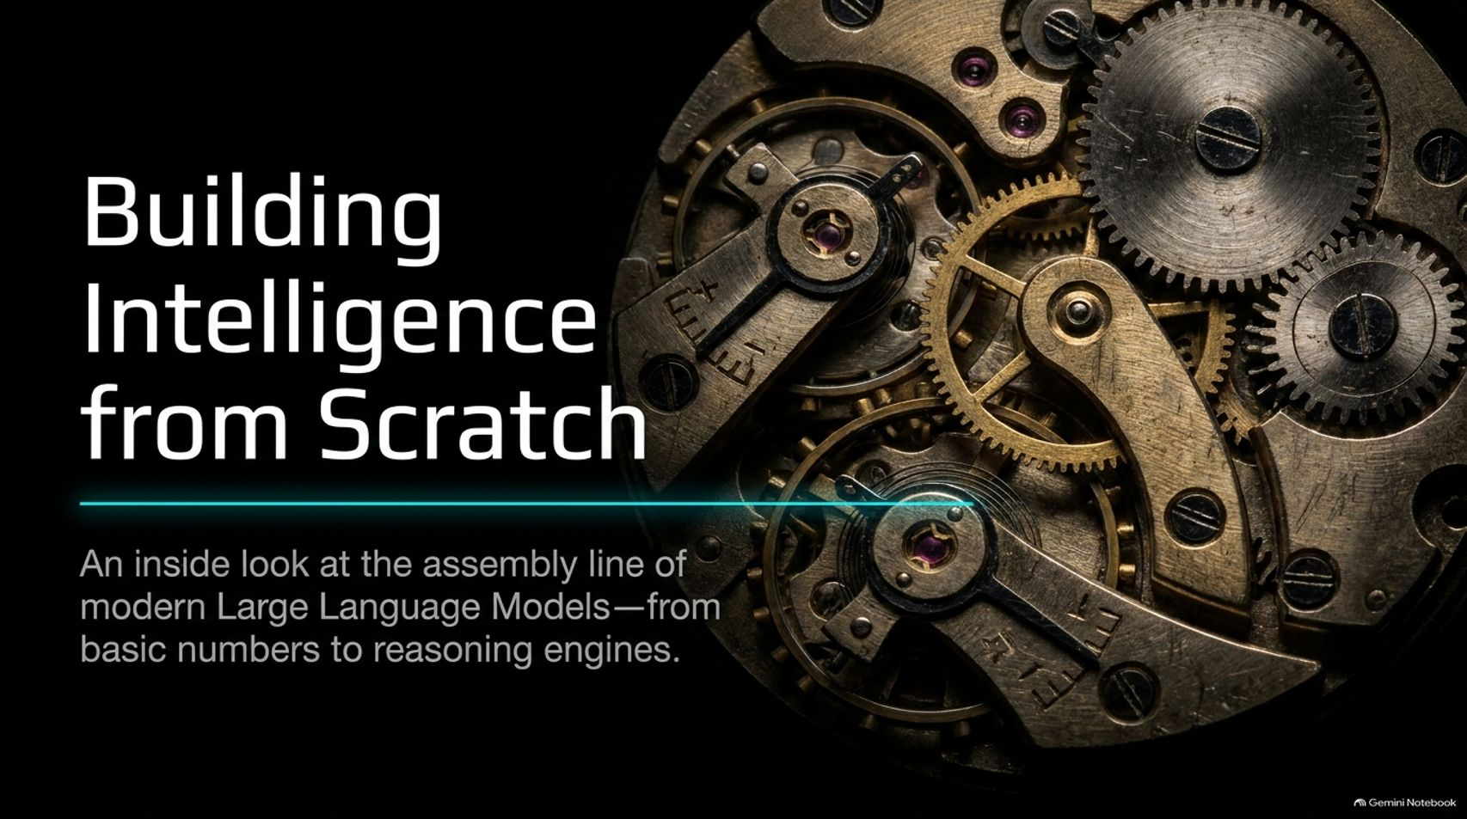
Notes:
Estimated Time: 2.5 – 3 minutes
Slide Focus: Title slide; introducing the core premise of how modern Large Language Models are built from basic numbers into reasoning engines.
Speaker Notes: Welcome everyone. Today we are going to pull back the curtain on the assembly line of modern artificial intelligence. When we look at advanced systems like Claude or ChatGPT, it's easy to view them as a form of digital magic. But as Anthropic researcher Jeremy Berman explains, the architecture of modern AI is not magic at all.
At its foundation, building intelligence comes down to a relatively small Python program and a file filled with numbers. Over the next 16 slides, we are going to walk through the exact pipeline of how we get from basic numerical parameters to sophisticated reasoning engines. We’ll look at what neural networks actually are under the hood, how autocomplete models are pre-trained on the internet, how researchers give models an "ego" during post-training, and finally, how reinforcement learning enables models to think step-by-step and discover new truths. Whether you are a self-taught enthusiast looking to break into AI research or simply curious about how these models work, the underlying mechanics are entirely logical, transparent, and built to be understood.
Anthropic Researcher explains how to train LLMs
https://www.youtube.com/watch?v=Sjdvu4nHfDk

Slide 2
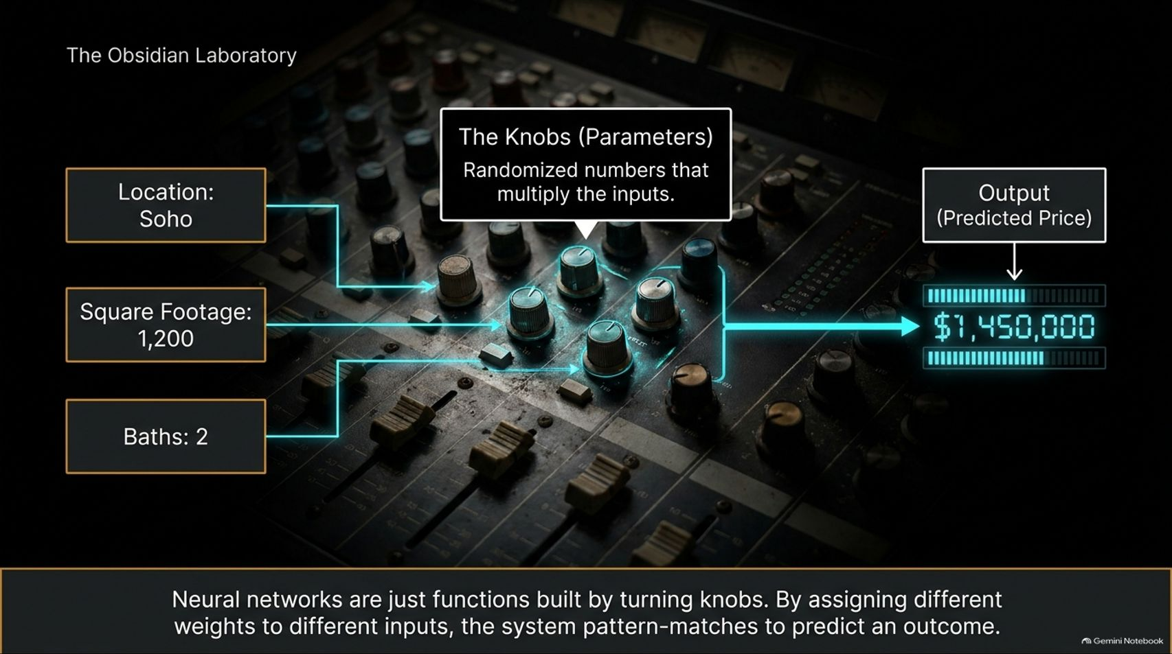
Notes:
Estimated Time: 3 – 4 minutes
Slide Focus: Real estate price prediction example; explaining parameters as weighted "knobs" that multiply inputs.
Speaker Notes: To understand how AI works, we need to start with the most basic building block: the neural network. Let's use a simple, real-world toy example—predicting apartment prices in New York. Imagine we have a dataset of apartments with specific inputs: location (like Soho), square footage (say, 1,200 square feet), and the number of bathrooms.
In traditional software development, you would hardcode a rigid formula combining these factors. But in machine learning, we want the computer to figure out the formula for us. How does it do that? Through knobs, or parameters.
Think of a neural network like an audio mixing board. Each input—location, size, baths—is multiplied by a randomized numerical weight, or "knob". Initially, these numbers are completely random. When we feed our apartment data through the board, the model spits out a wildly incorrect predicted price—like $1,450,000 for an apartment that's actually worth much less.
These knobs represent how important the model initially thinks each factor is. By adjusting these knobs, we change how much weight is assigned to square footage versus location. Neural networks are simply mathematical functions built by turning these dials so that pattern matching becomes automated and predictive.

Slide 3
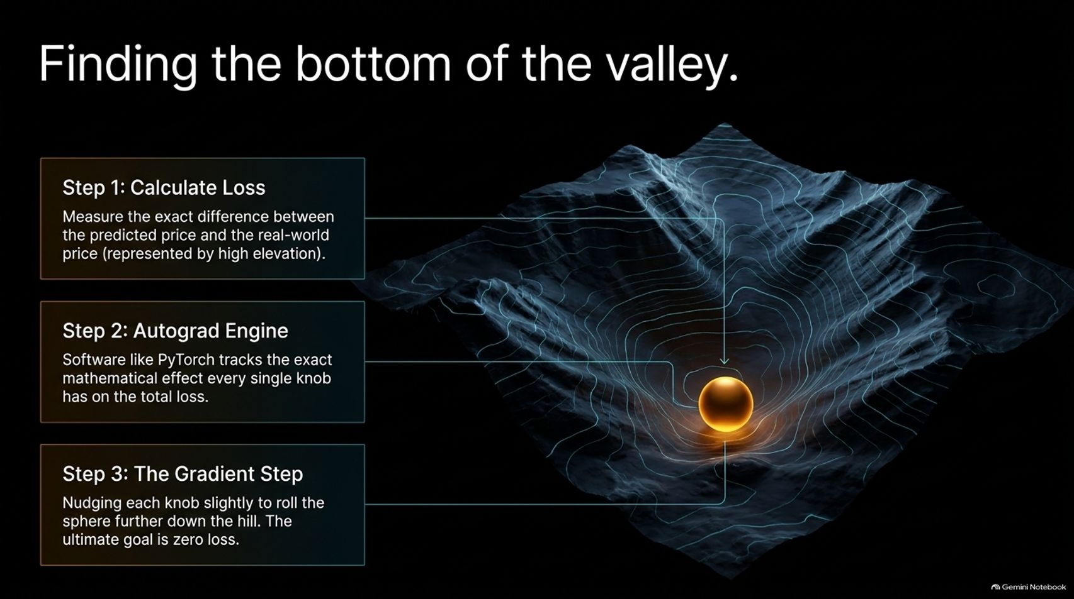
Notes:
Estimated Time: 3.5 – 4.5 minutes
Slide Focus: The three-step training loop: Calculating Loss, the Autograd Engine (PyTorch), and the Gradient Step.
Speaker Notes: Once we have our initial random prediction, how do we systematically fix it? Training a neural network is like navigating a foggy mountain range blindfolded, with the goal of walking down into the lowest valley. That valley represents zero loss—perfect accuracy.
This process happens in three continuous steps:
Step 1: Calculate Loss. We measure the exact mathematical difference between what our model predicted and the real-world sales price. That error magnitude is our "loss".
Step 2: The Autograd Engine. Software libraries like PyTorch track every single mathematical operation involving every single knob. PyTorch acts as our bookkeeping engine, keeping track of how each parameter contributes to the final error. Using calculus (specifically the chain rule), the engine calculates the "gradient"—telling us precisely whether increasing or decreasing a specific knob will make our error go up or down.
Step 3: The Gradient Step. We take a tiny step, nudging each knob slightly in the direction that rolls the sphere further down the hill toward minimum loss.
By repeating this optimization loop thousands or millions of times, the model automatically tunes its parameters until its predictions closely mirror reality.

Slide 4
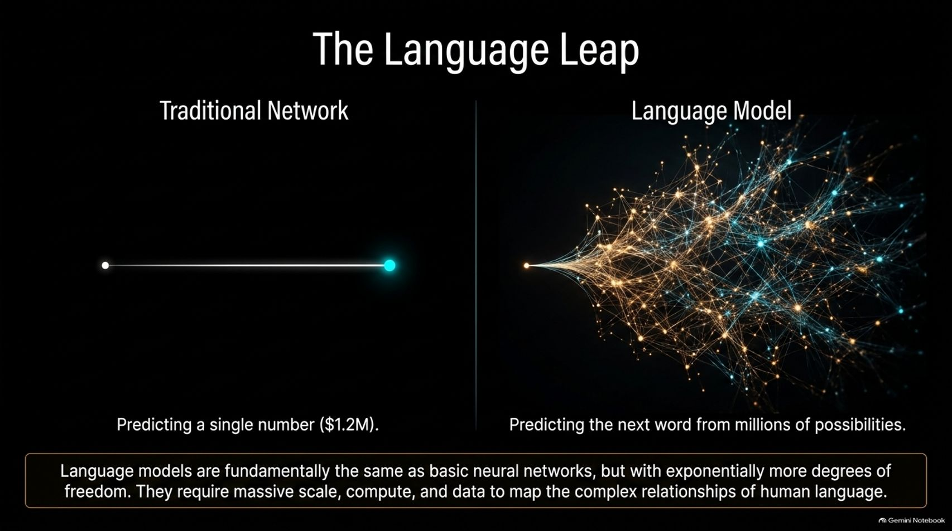
Notes:
Estimated Time: 3 – 4 minutes
Slide Focus: Comparing traditional single-output networks with Large Language Models that predict the next token from millions of possibilities.
Speaker Notes: So far, we've looked at predicting a single numerical output, like a house price. But what happens when we make the leap from a traditional neural network to a Large Language Model?
On the left, a traditional network takes inputs and spits out a single scalar value—like $1.2 million. On the right, a language model operates in a vastly more complex space. Instead of predicting a single number, it is tasked with predicting the next word—or token—from a vocabulary of hundreds of thousands of possibilities, across millions of contextual possibilities.
Fundamentally, language models are built on the exact same underlying mechanism as our apartment-pricing neural network: they are massive webs of weighted knobs. However, because human language is infinitely nuanced, containing rich semantic relationships, grammar, and code, language models require exponential scale. They demand massive amounts of compute, huge datasets, and billions or trillions of parameters to capture the complexity of human thought.

Slide 5
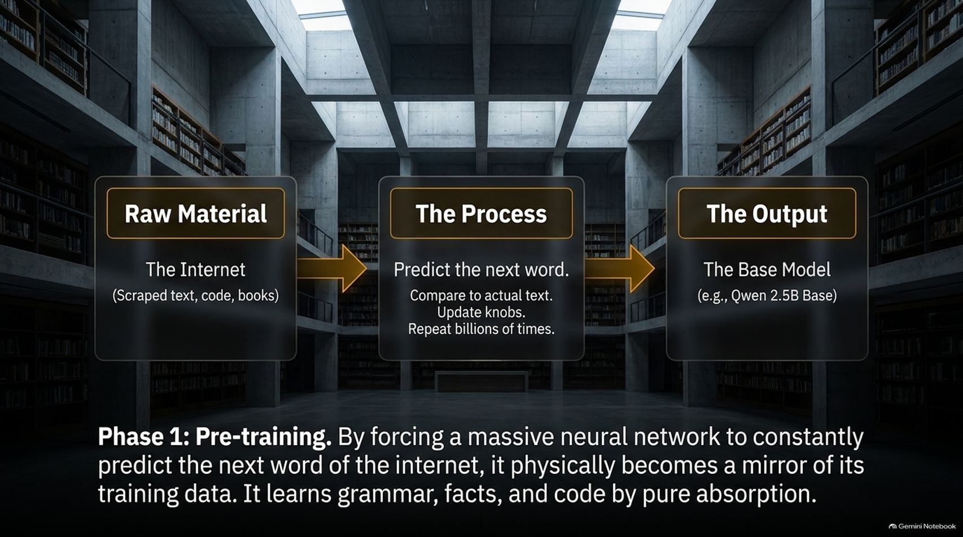
Notes:
Estimated Time: 3.5 – 4.5 minutes
Slide Focus: The pre-training phase; ingesting raw internet text (scraped books, code, articles) via next-token prediction to absorb world patterns.
Speaker Notes: How do we actually build a modern LLM from scratch? The process begins with Phase 1: Pre-training.
The Raw Material is the internet itself—massive corpora of scraped text, open-source code repositories, books, and articles.
The Process is elegantly simple yet brutally intensive: Next-Token Prediction. We feed the model a sentence—for example, "The cat sat on the..."—and force it to guess the next word. It guesses, compares its guess against the actual text from the internet, calculates the loss, updates its billions of knobs via backpropagation, and repeats this process billions of times.
The Output of this phase is a Base Model (such as Qwen 2.5B Base). By forcing a neural network to constantly predict the next word of human history, the network physically becomes a mathematical mirror of its training data. It absorbs grammar, historical facts, coding syntax, and cultural patterns purely through statistical absorption.

Slide 6
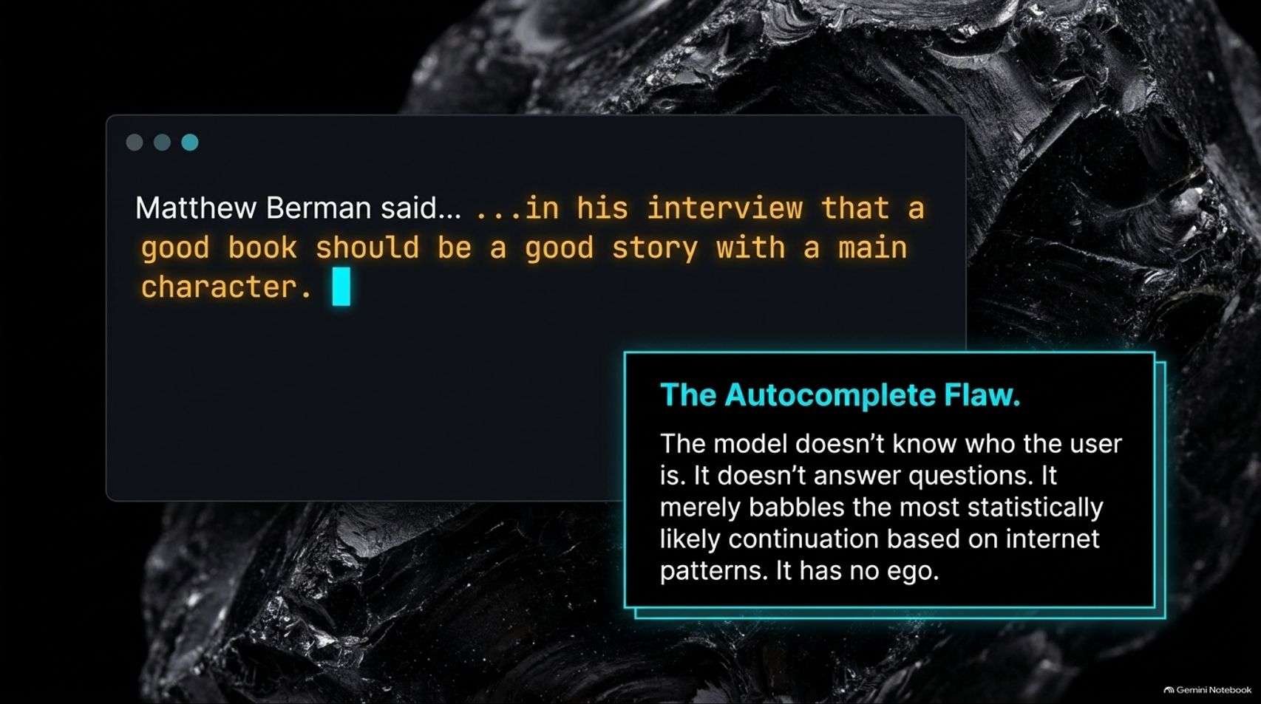
Notes:
Estimated Time: 3 – 4 minutes
Slide Focus: Understanding that a base model is merely an autocomplete engine with no ego, no user awareness, and no conversational intent.
Speaker Notes: While pre-training gives a base model an incredible storehouse of human knowledge, it comes with a major limitation: The Autocomplete Flaw.
If you prompt a pre-trained base model with a phrase like: "Matthew Berman said... ...in his interview that a good book should be a good story with a main character," the model doesn't recognize that you are asking it a question. It doesn't know who you are, it has no ego, and it doesn't want to help you.
Instead, it operates purely as a sophisticated autocomplete engine. It simply continues the text stream based on statistical patterns it observed on the internet. If the text looks like a transcript or a forum post, it will keep generating text that matches that style. While fascinating to play with, a raw base model is not a helpful assistant—it will cheerfully babble into the void without any awareness of truth, instruction, or dialogue.

Slide 7
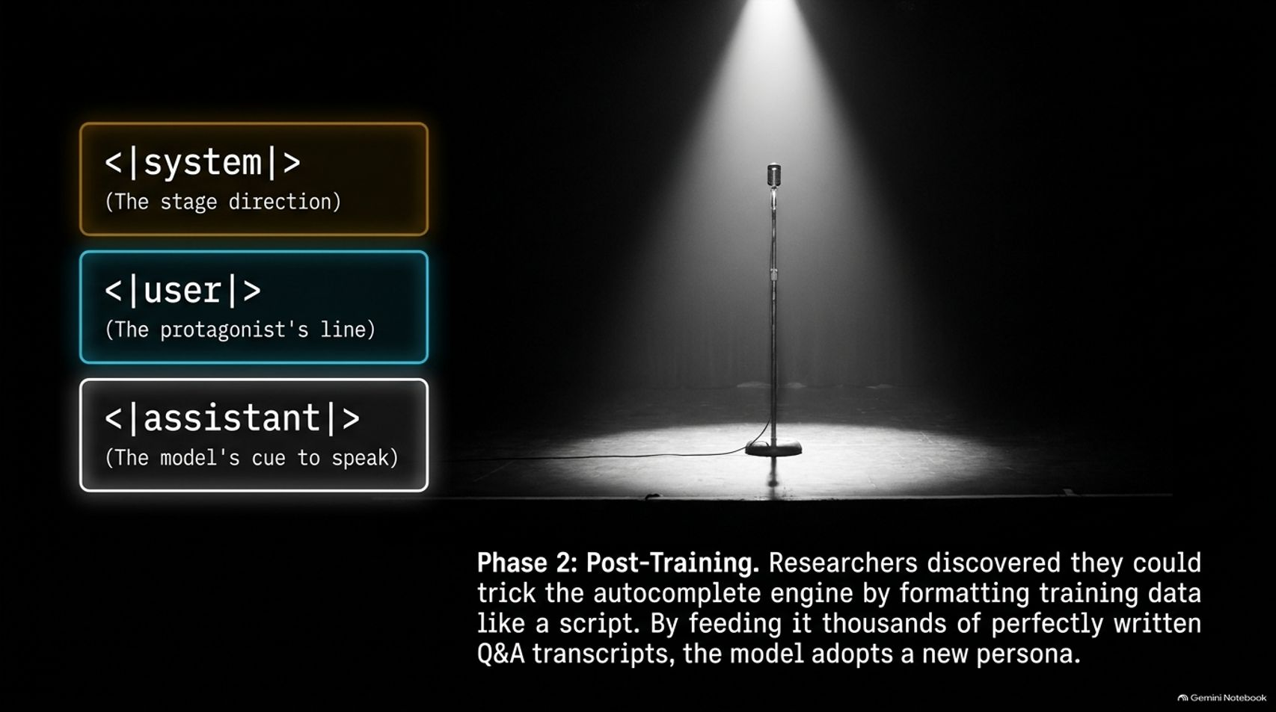
Notes:
Estimated Time: 3.5 – 4.5 minutes
Slide Focus: Instruction tuning and formatting; tricking the autocomplete engine into adopting a persona using <|system|>, <|user|>, and <|assistant|> tags.
Speaker Notes: How do we transform a mindless autocomplete engine into a conversational chatbot like ChatGPT or Claude? That brings us to Phase 2: Post-Training.
Researchers discovered that they could "trick" the base model by structuring training data to look like a theatrical script. By formatting datasets with explicit conversational roles—using special tags like <|system|> for stage directions, <|user|> for the protagonist's line, and <|assistant|> for the model's cue to speak—the model learns a new behavioral pattern.
By feeding the model thousands or millions of clean, perfectly written Q&A transcripts formatted in this dialogue structure, the network updates its knobs to adopt a helpful persona. When the model encounters the <|assistant|> tag during inference, its newly trained behavioral circuits kick in, steering it away from random internet babble and into a structured, helpful dialogue.

Slide 8
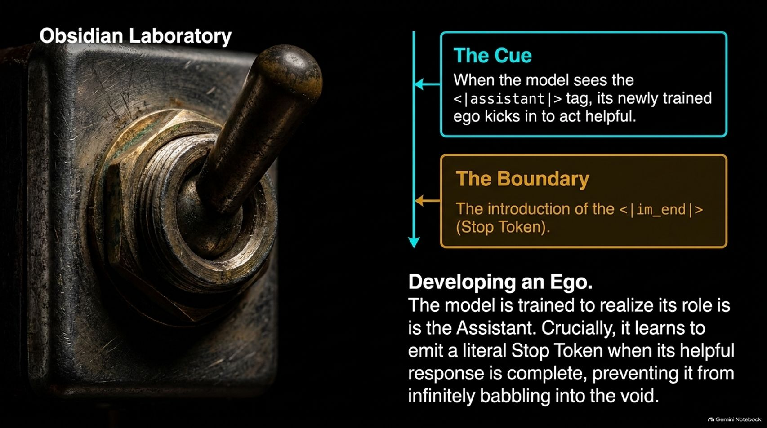
Notes:
Estimated Time: 3 – 4 minutes
Slide Focus: The cue, the boundary, and the literal Stop Token (<|im_end|>) preventing infinite text generation.
Speaker Notes: Post-training doesn't just teach the model how to answer; it also teaches it when to stop. This is where the model effectively develops an ego and boundaries.
When the model sees the <|assistant|> cue, its training kicks in to fulfill the assistant role. But without a boundary, an autocomplete engine would just keep generating tokens infinitely into the void, turning a concise answer into a rambling essay.
To solve this, post-training introduces a literal Stop Token (such as <|im_end|>) into the training data. The model learns that once its helpful response is complete, its final duty is to emit this stop token. When the inference software detects the stop token, generation halts immediately. This simple addition turns a chaotic text-completion loop into a clean, responsive, professional assistant.

Slide 9
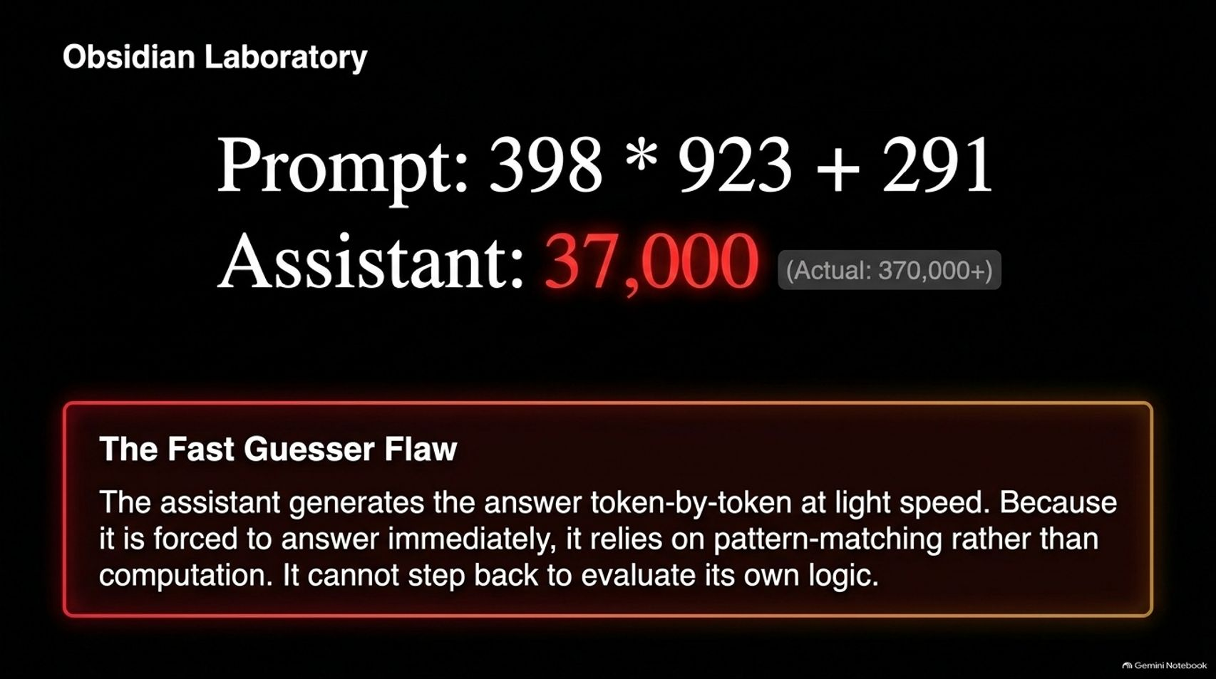
Notes:
Estimated Time: 3 – 4 minutes
Slide Focus: Why instruct models fail at complex math; generating token-by-token at light speed relies on pattern matching rather than computation.
Speaker Notes: Even after instruction tuning, instruct models have a glaring limitation: The Fast Guesser Flaw.
Suppose we prompt our instruct model with a multi-step math problem: 398 * 923 + 291. An instruct model will often instantly generate an answer like 37,000 at light speed—which is completely wrong (the actual answer exceeds 370,000).
Why does this happen? Because instruct models are optimized to generate tokens instantly, token-by-token, without pausing. Because it is forced to answer immediately, it relies entirely on superficial pattern-matching rather than step-by-step logic. It cannot step back, verify its intermediate steps, or evaluate its own internal logic. It’s like a student blurting out the first number that pops into their head during a pop quiz without showing their work.

Slide 10
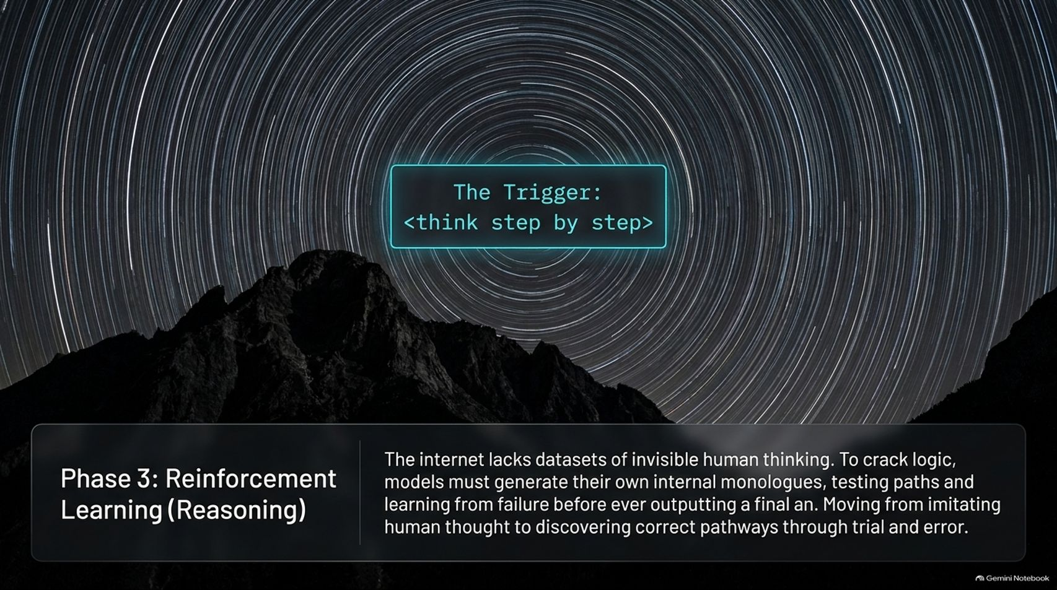
Notes:
Estimated Time: 3.5 – 4.5 minutes
Slide Focus: Moving from imitation to self-correction; the trigger <think step by step> and generating internal monologues.
Speaker Notes: To overcome the Fast Guesser Flaw, AI research entered a new paradigm: Phase 3: Reinforcement Learning for Reasoning.
Here’s the core challenge: the internet contains plenty of finished articles and blog posts, but it largely lacks datasets of invisible human thinking—we see final code, but we don't see the developer's trial and error. To crack true logic, models needed a way to generate their own internal monologues.
By introducing triggers like <think step by step>, researchers discovered that models could be trained to draft internal scratchpads—testing different solution paths, catching their own errors, and verifying calculations before outputting a final answer. Instead of merely imitating human text distribution, models shift toward discovering correct pathways through autonomous trial and error. This is the breakthrough that powered reasoning models like OpenAI’s o1 and DeepSeek-R1.

Slide 11
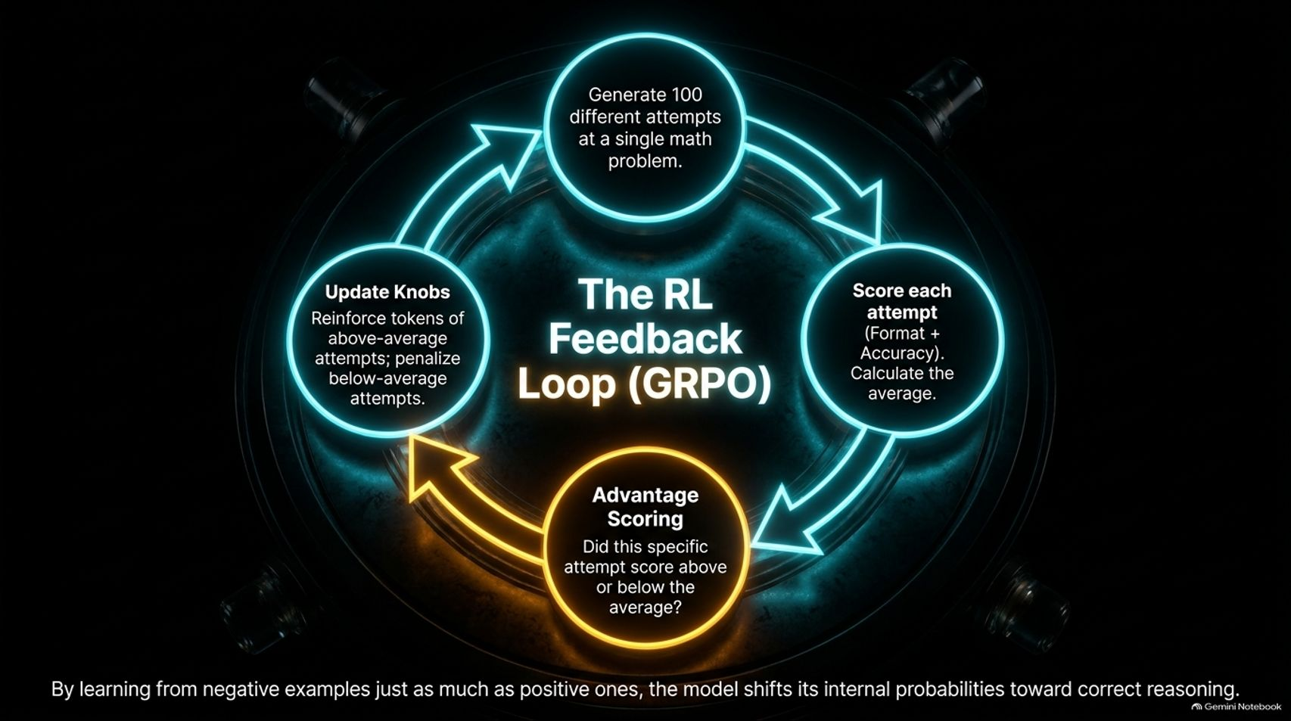
Notes:
Estimated Time: 4 – 5 minutes
Slide Focus: Group Relative Policy Optimization (GRPO); generating 100 attempts, scoring format/accuracy, calculating advantage, and updating knobs.
Speaker Notes: How do we actually train a model to reason autonomously without human hand-holding? The secret lies in reinforcement learning feedback loops, such as Group Relative Policy Optimization (GRPO), famously utilized in models like DeepSeek-R1.
Let’s trace the loop shown on this slide:
Generate Attempts: We give the model a challenging math or coding problem and command it to generate 100 different reasoning attempts.
Score Each Attempt: We evaluate all 100 attempts programmatically based on strict criteria: Did it follow the correct thinking format? Did it arrive at the mathematically correct final answer?
Advantage Scoring: Instead of just looking at absolute scores, we calculate the average score of the group. Then, we determine each attempt's advantage—did this specific attempt score above or below the group average?
Update Knobs: We reinforce the token pathways of above-average attempts (making them more likely in the future) and penalize the pathways of below-average attempts (making them less likely).
By learning from negative failures just as much as positive successes, the model's internal probability distributions shift systematically toward robust, verifiable reasoning.

Slide 12
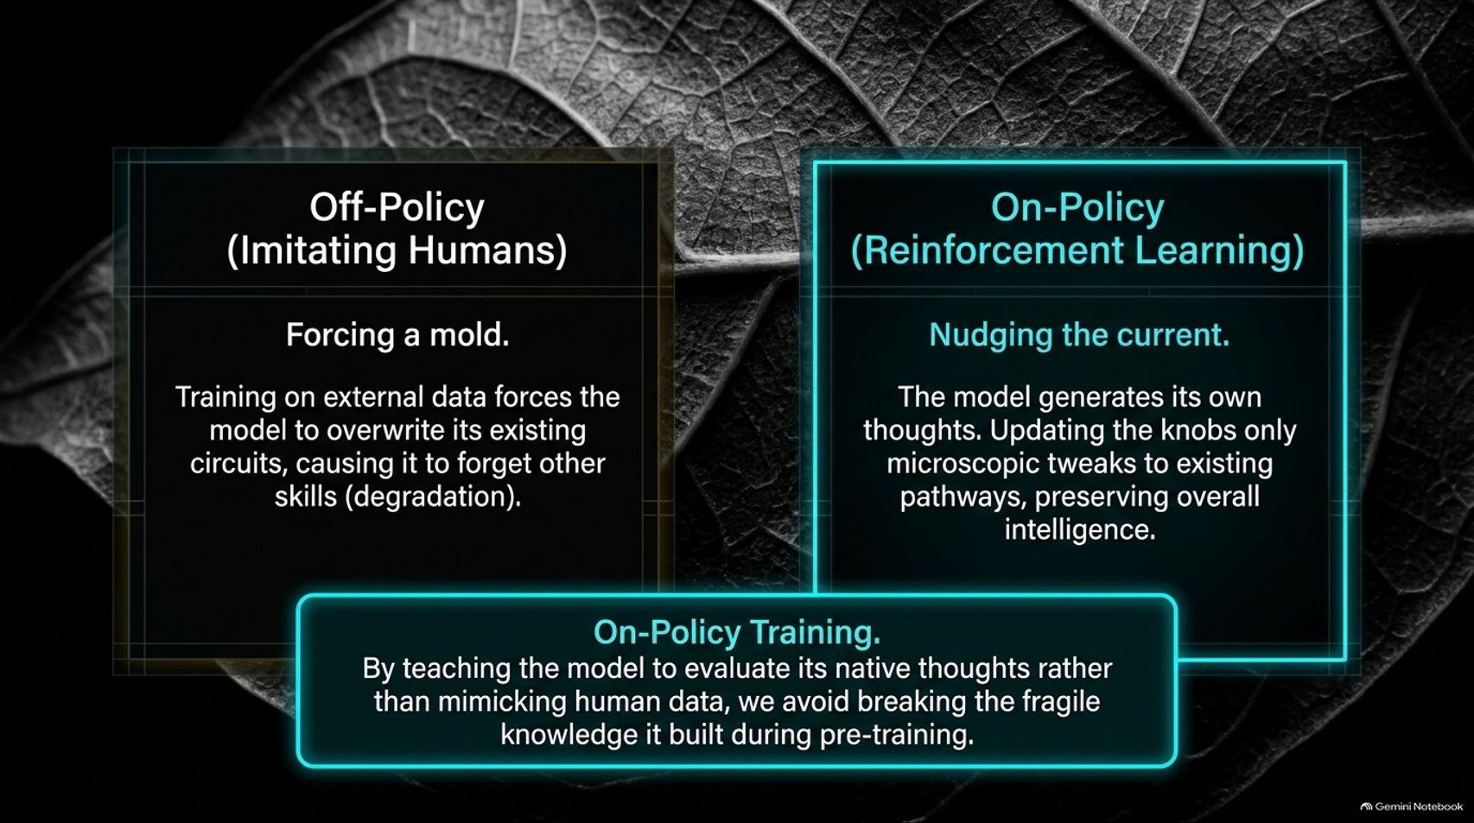
Notes:
Estimated Time: 3.5 – 4.5 minutes
Slide Focus: Comparing off-policy (forcing external human molds that cause skill degradation) with on-policy reinforcement learning (tweaking native thoughts).
Speaker Notes: Why is reinforcement learning so much more effective for reasoning than traditional supervised fine-tuning? It comes down to the difference between Off-Policy and On-Policy training.
Off-Policy (Imitating Humans): When you train a model on external human-written datasets, you are forcing it into an external mold. This massive data overwrite can destabilize the model's existing neural circuits, often leading to "catastrophic forgetting"—where learning a new skill accidentally degrades previously learned capabilities.
On-Policy (Reinforcement Learning): In contrast, on-policy training lets the model generate its own thoughts and trial-and-error traces. Because the model generated the reasoning path using its own native neural pathways, updating the knobs requires only microscopic, gentle tweaks. It preserves the fragile foundational knowledge built during pre-training while sharpening its logical execution. By evaluating its own native thoughts rather than blindly mimicking human datasets, we avoid breaking the model.

Slide 13
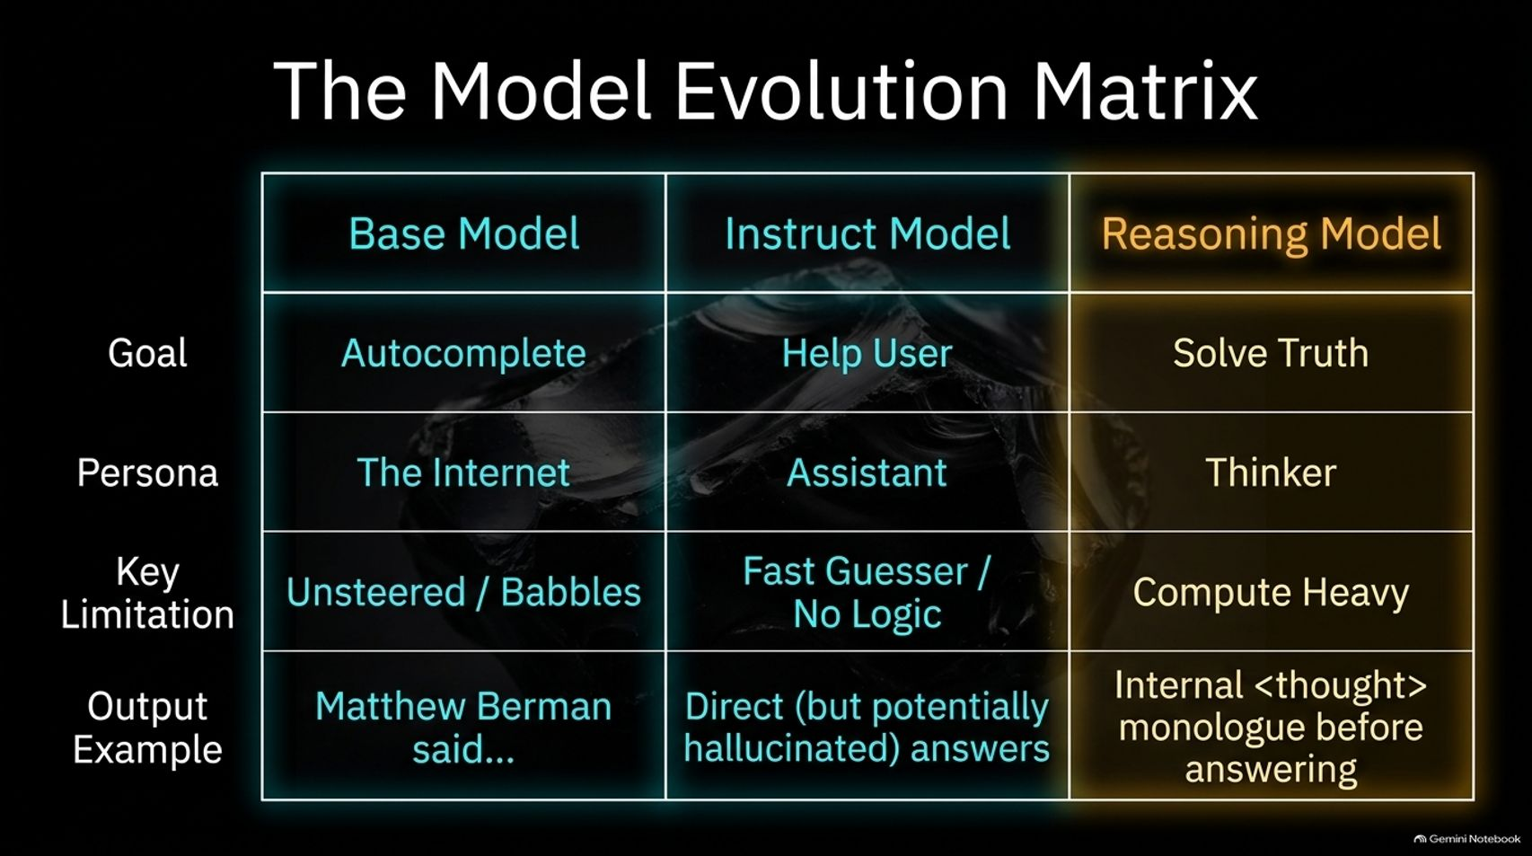
Notes:
Estimated Time: 3 – 4 minutes
Slide Focus: Comprehensive comparison of Base Models, Instruct Models, and Reasoning Models across Goals, Personas, Limitations, and Outputs.
Speaker Notes: This matrix summarizes the entire evolutionary arc of modern language models across three distinct generations:
The Base Model: Its goal is pure autocomplete. Its persona is "The Internet". Its key limitation is that it is unsteered and simply babbles statistical continuations. Its output is raw text continuation.
The Instruct Model: Its goal is to help the user. Its persona is "The Assistant". Its key limitation is the "Fast Guesser Flaw"—it acts immediately using pattern-matching without deep internal logic, frequently hallucinating on complex tasks. Its output is direct conversational text.
The Reasoning Model: Its goal is to "Solve Truth". Its persona is "The Thinker". It is compute-heavy, utilizing extensive internal <thought> monologues and reinforcement learning loops before ever releasing a final answer.
Understanding this matrix helps clarify why modern AI feels so radically different from the tools available just a few years ago.

Slide 14
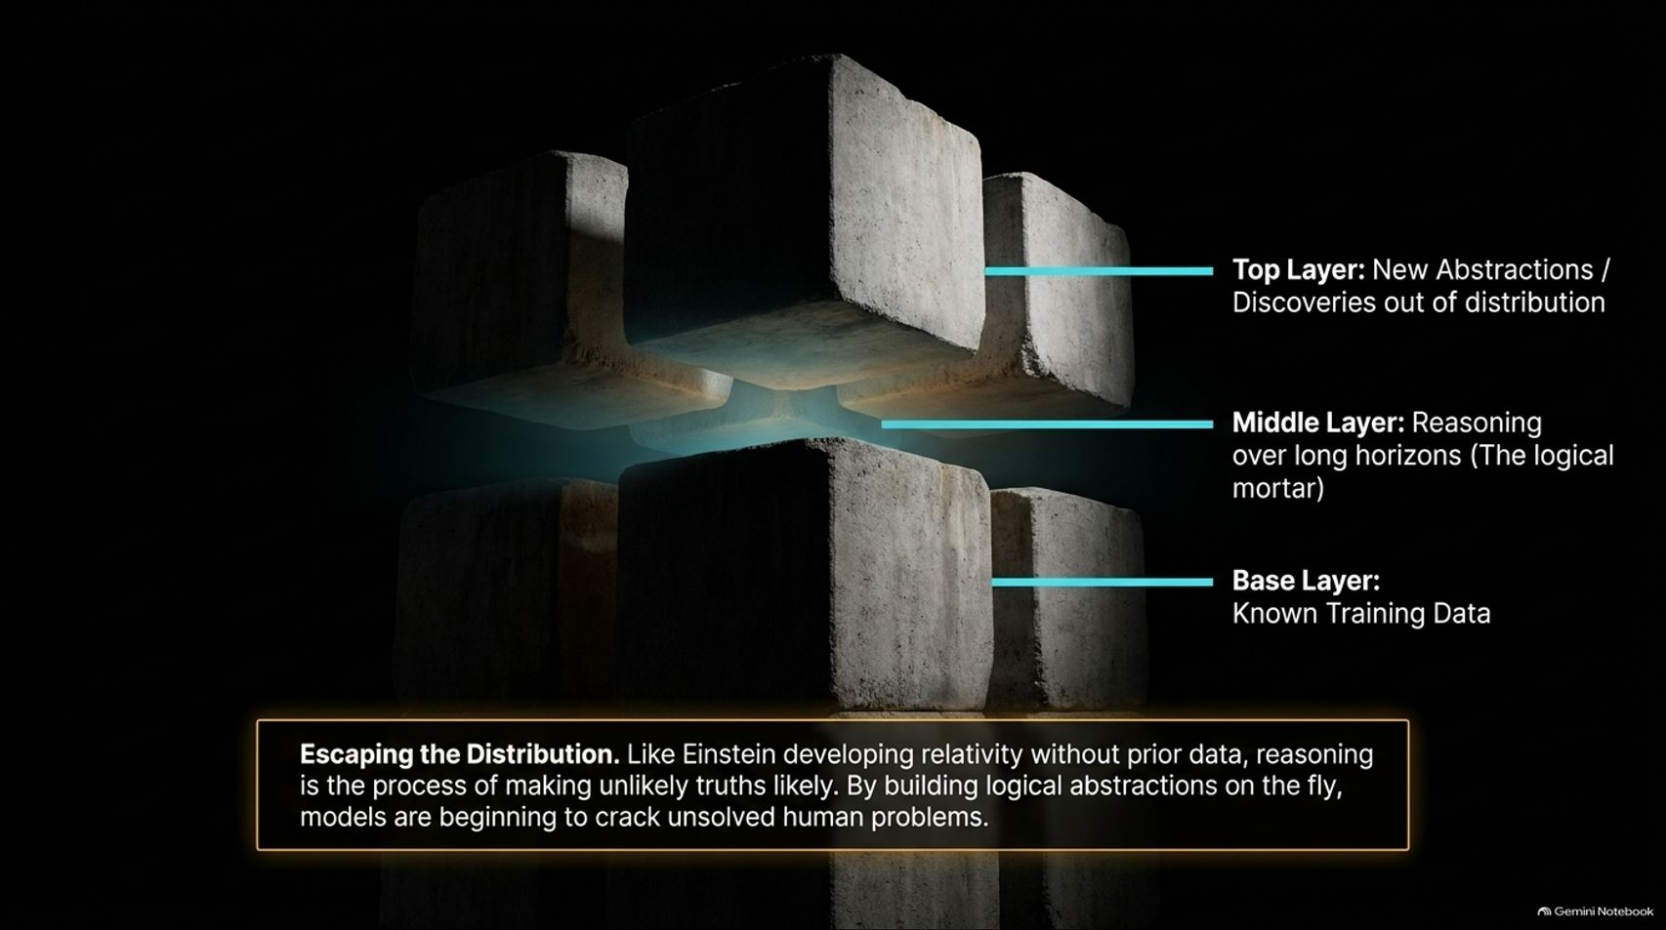
Notes:
Estimated Time: 3.5 – 4.5 minutes
Slide Focus: Base Layer (known training data), Middle Layer (logical mortar), and Top Layer (new abstractions and discoveries out of distribution).
Speaker Notes: A common critique of AI is: "Models are just trained on existing human data; by definition, they can't discover anything truly new." But as Jeremy Berman highlights, reasoning models are beginning to break past this barrier.
Think of this conceptual cube:
Base Layer: The known training data ingested during pre-training.
Middle Layer: Reasoning over long horizons—acting as the "logical mortar" that connects facts.
Top Layer: New abstractions and discoveries that exist entirely out of distribution.
Think of Albert Einstein developing general relativity. The final equations were not an obvious interpolation of existing 19th-century physics data; they required building entirely new mental abstractions through rigorous internal deduction. By mastering long-horizon reasoning and trial-and-error verification, modern AI models are beginning to make unlikely truths likely—opening the door to cracking previously unsolved human problems in math and science.

Slide 15
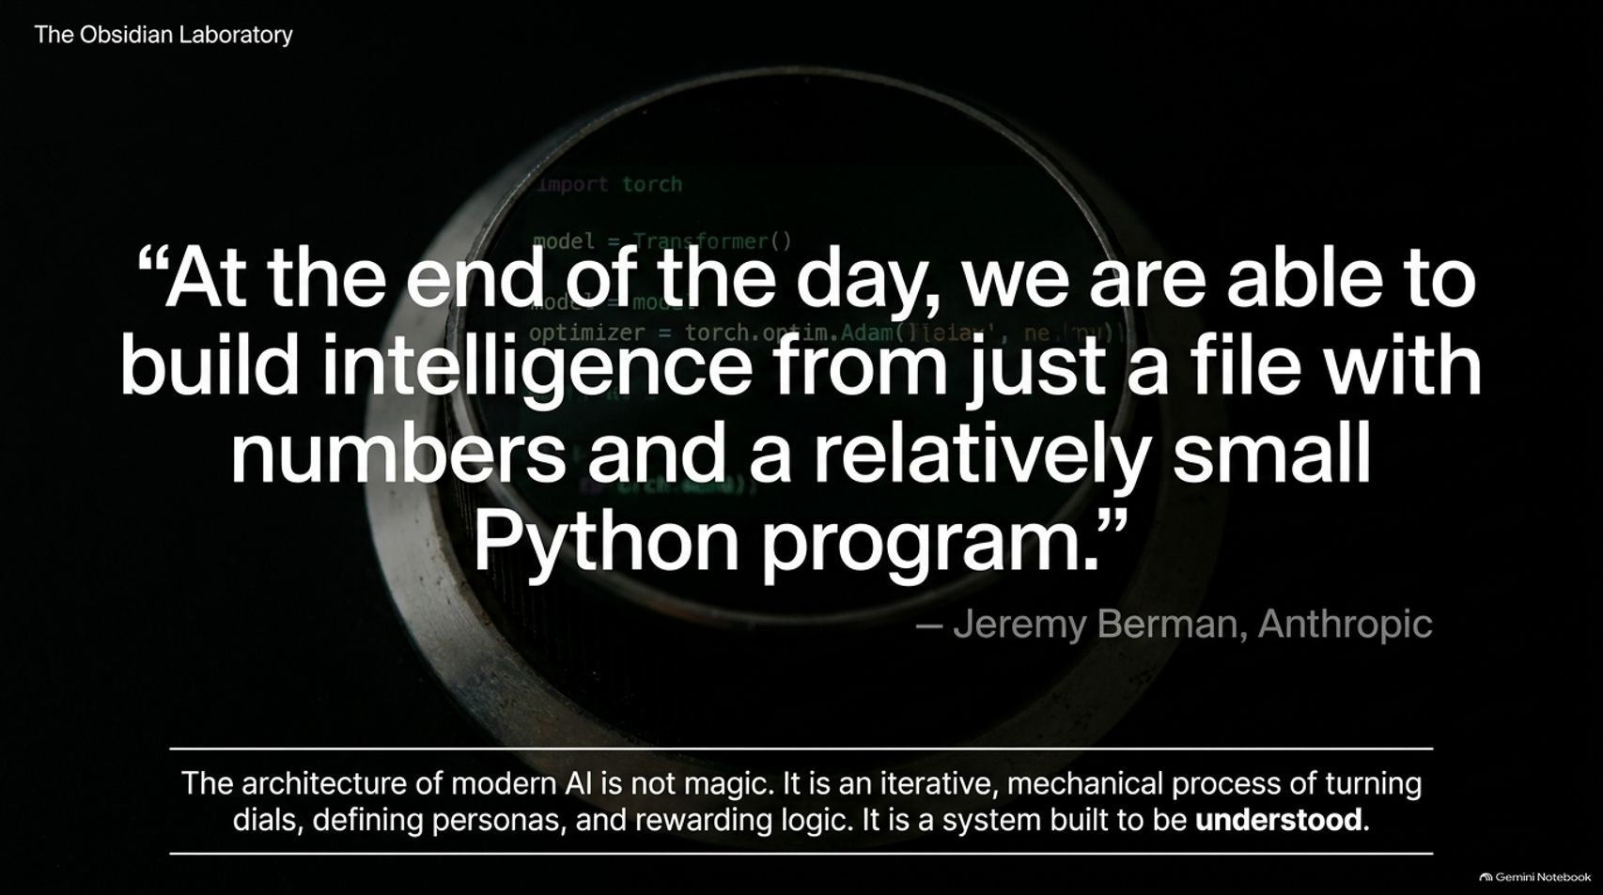
Notes:
Estimated Time: 2.5 – 3 minutes
Slide Focus: Jeremy Berman’s quote: "At the end of the day, we are able to build intelligence from just a file with numbers and a relatively small Python program."
Speaker Notes: As we bring this presentation to a close, let's reflect on this powerful quote from Jeremy Berman at Anthropic:
"At the end of the day, we are able to build intelligence from just a file with numbers and a relatively small Python program."
The architecture of modern AI is not an impenetrable mystery or supernatural entity. It is an iterative, mechanical process of turning numerical dials, defining conversational personas, and rewarding internal logic. It is a system built entirely to be understood.
For anyone looking to enter this field, the barrier to entry has never been lower. With open-weights models, free cloud execution environments like Google Collab, and AI tools available to explain every line of code, you don't need a PhD to start experimenting and learning. You just need curiosity and a willingness to follow your intuition down the rabbit hole.

Slide 16
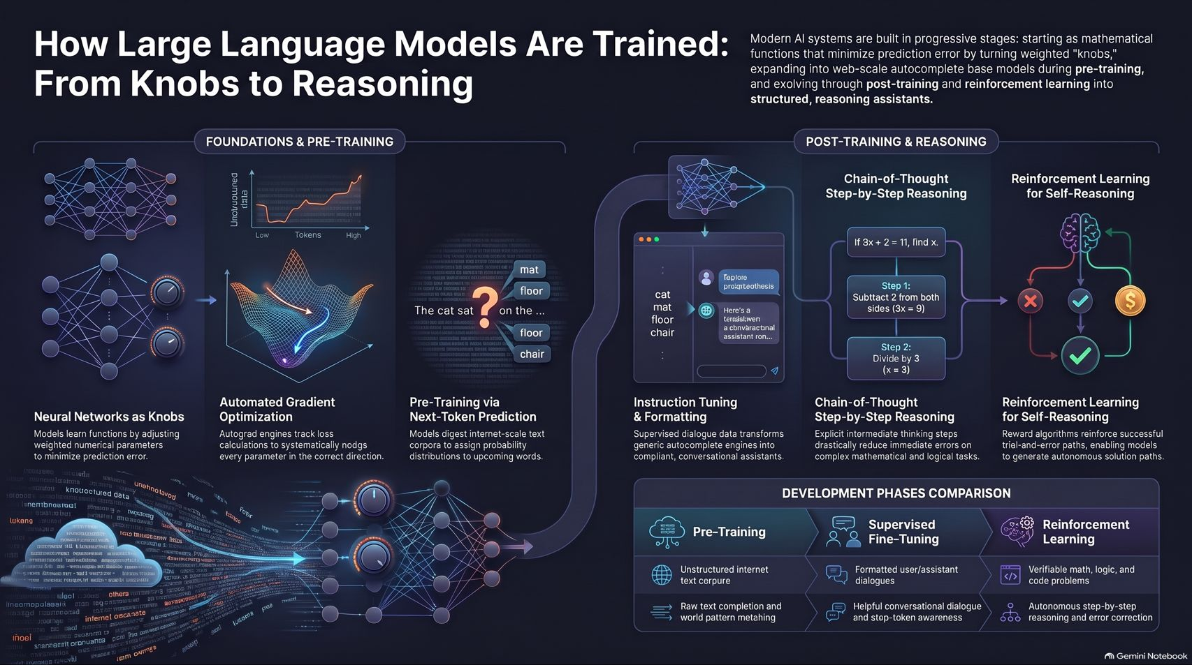
Notes:
Estimated Time: 3 – 4 minutes
Slide Focus: Final recap infographic integrating Foundations & Pre-training, Post-Training & Reasoning, and Development Phases Comparison.
Speaker Notes: This final summary infographic captures the complete journey of AI development we've explored today.
On the left, under Foundations & Pre-training, we see neural networks functioning as weighted knobs, optimized via automated gradient descent on unstructured internet text to create base completion models.
In the center and right, under Post-Training & Reasoning, we see the transformation: instruction tuning adds conversational structure and stop tokens, chain-of-thought prompting unlocks step-by-step logic, and reinforcement learning via GRPO enables autonomous self-correction through trial and error.
Whether looking at the raw data phase, the supervised dialogue formatting phase, or the reinforcement learning reasoning phase, modern AI is a progressive stack of elegant mathematical techniques. Thank you for your time—I'd love to open the floor for any questions you might have.

