Slide 1
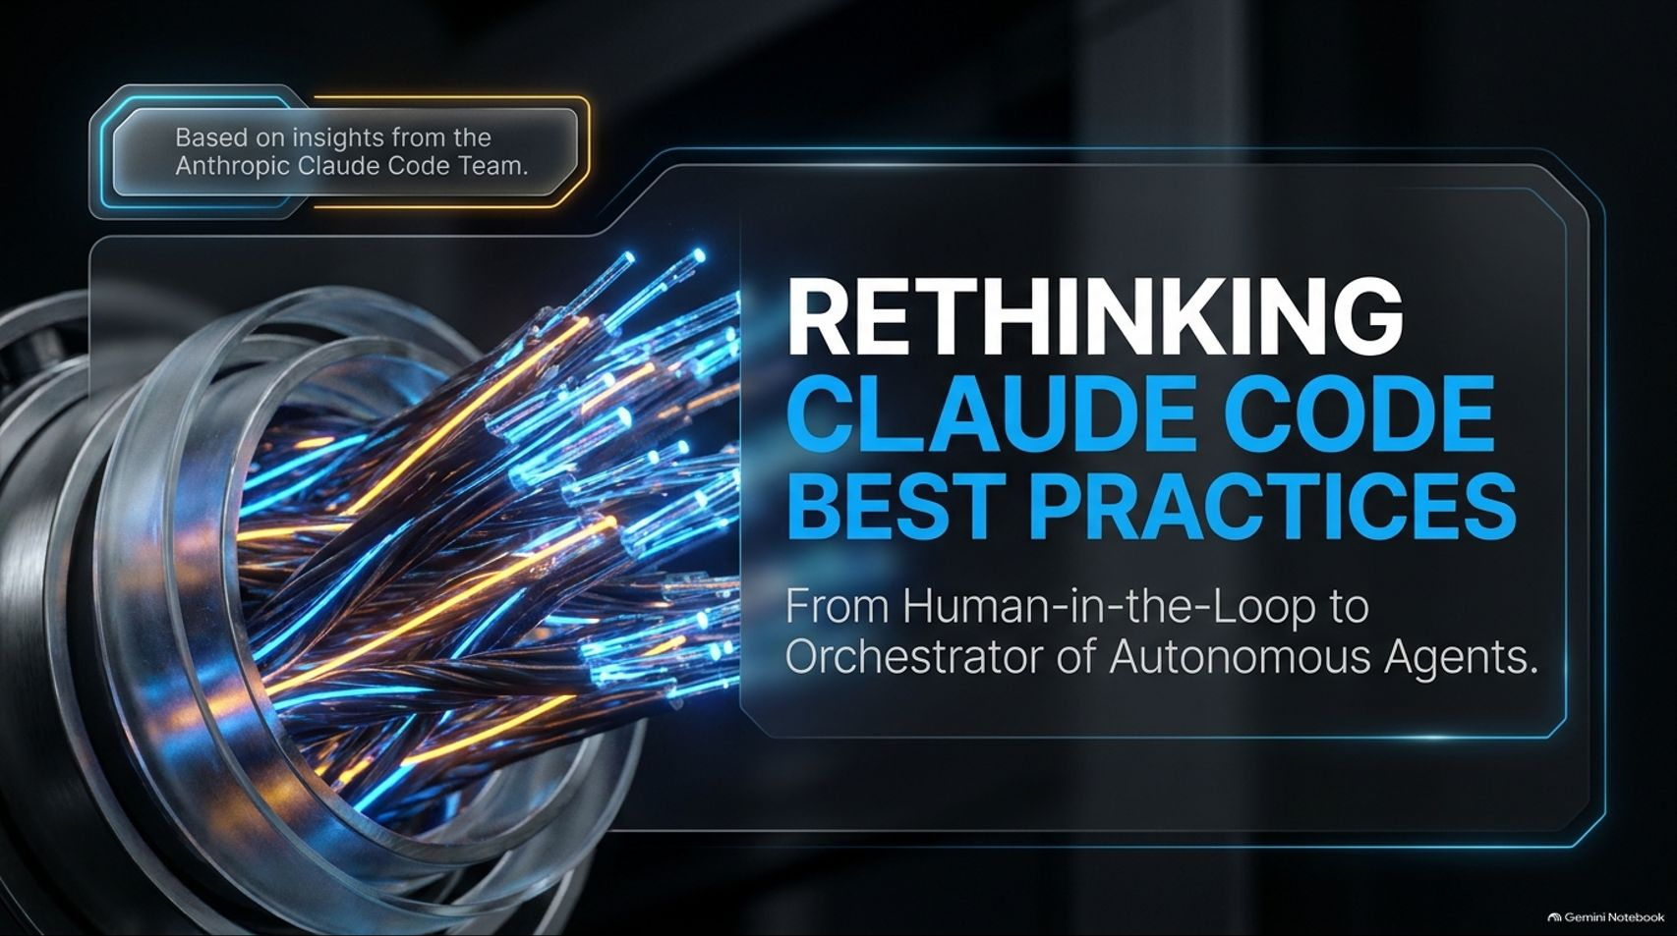
Notes:
Rethinking Claude Code Best Practices — Lydia Hallie, Anthropic
https://www.youtube.com/watch?v=vlfCjWuv4es

Slide 2
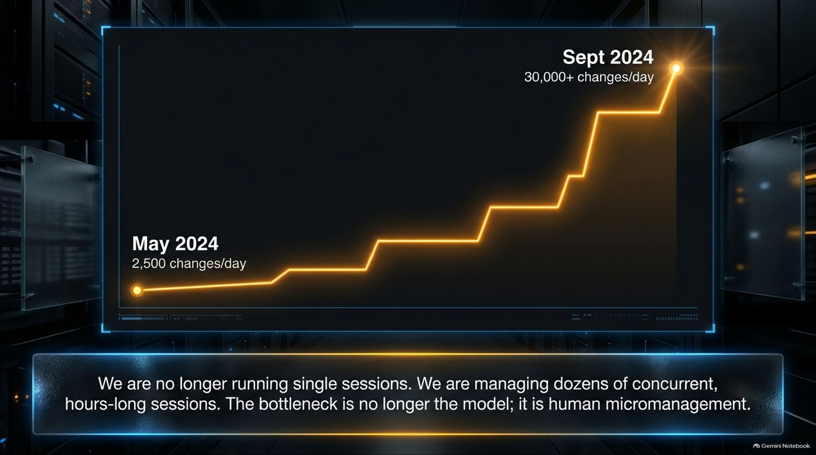
Notes:
Estimated Time: 3 – 4 minutes
Slide Focus: The massive scaling of code modifications at Anthropic (from 2,500/day to over 30,000/day) and the emergence of concurrent, hours-long sessions.
Speaker Notes: To understand why our best practices had to change, look at this data from Anthropic’s own internal engineering metrics.
Back in May 2024, when teams were using earlier models like Opus 4.5, engineers were averaging around 2,500 code changes per day. Sessions were short, highly supervised, and sequential. Fast-forward to September 2024, following the adoption of newer models and robust harness environments: that number skyrocketed to over 30,000 code changes per day.
How did engineering output multiply twelvefold? Not by working harder or typing faster, but by changing how engineers manage their time. Anthropic engineers stopped running single, short sessions. Instead, they transitioned to managing dozens of concurrent, hours-long sessions running in the background.
When an AI model can reliably plan, execute, test, and self-correct over a multi-hour span without human intervention, your role as a developer changes completely. You stop being a micro-manager writing individual lines of code, and you start acting as an operations manager overseeing a fleet of autonomous software agents.

Slide 3
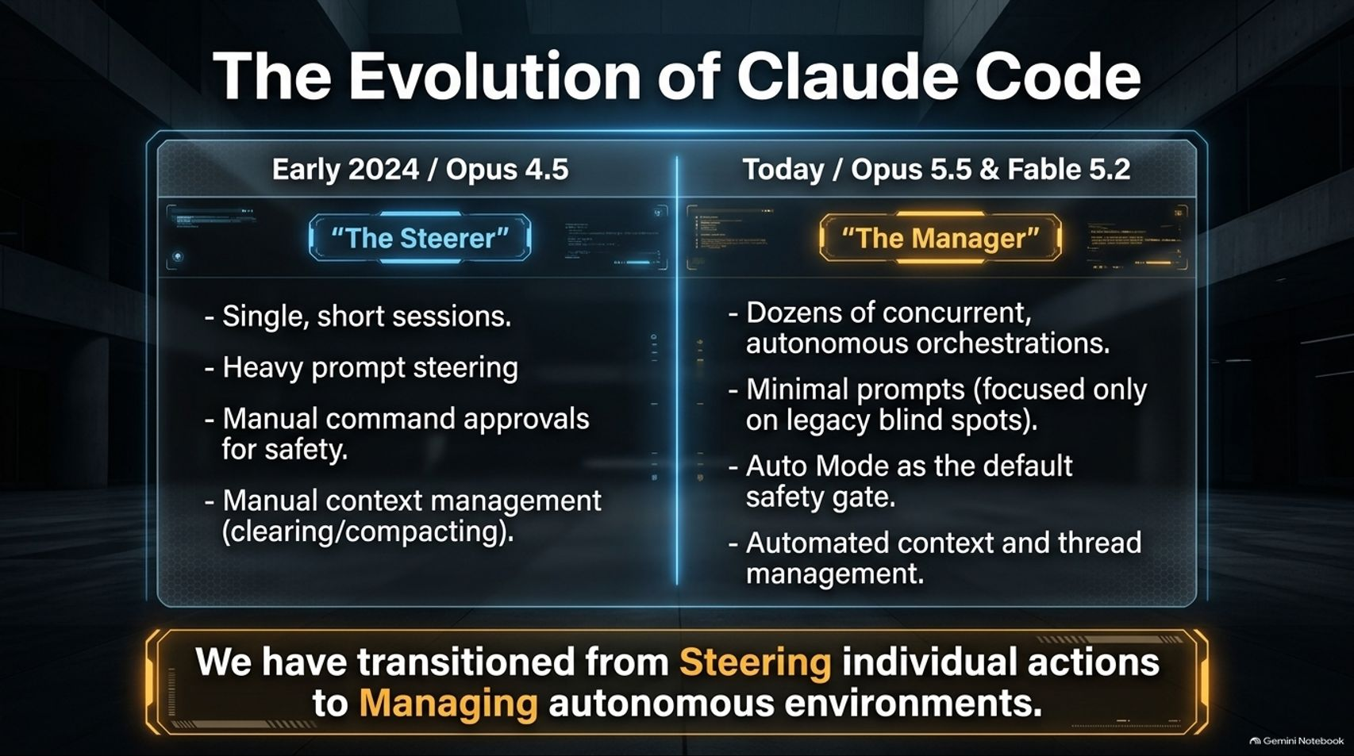
Notes:
Estimated Time: 3.5 – 4.5 minutes
Slide Focus: Side-by-side comparison of Early 2024 (The Steerer) vs. Today (The Manager) across sessions, prompts, safety gates, and context management.
Slide Notes / Text Elements:
Early 2024 / Opus 4.5 ("The Steerers"): Single, short sessions; heavy prompt steering; manual command approvals for safety; manual context management (clearing/compacting).
Today / Opus 5.5 & Fable 5.2 ("The Manager"): Dozens of concurrent, autonomous orchestrations; minimal prompts (focused only on legacy blind spots); Auto Mode as the default safety gate; automated context and thread management.
Bottom Callout Box: "We have transitioned from Steering individual actions to Managing autonomous environments."
Speaker Notes: This comparison matrix illustrates the stark evolution of Claude Code.
In early 2024 with Opus 4.5, we were "The Steerers." Sessions were brief and fragile. We constantly bombarded the model with heavy prompt engineering—adding desperate warnings like IMPORTANT! or Never do this! into our CLAUDE.md files. We had to manually approve every single terminal command and constantly monitor context windows, clearing or compacting chat histories before the model ran out of memory.
Today, with models like Opus 5.5 and Fable 5.2, we operate as "The Managers." We run dozens of concurrent orchestrations. Our prompt files have been stripped down because modern models understand codebase intent natively. Safety approvals are handled automatically by intelligent classifiers (Auto Mode), and context window management is entirely automated. We have officially moved away from steering individual keystrokes and toward managing autonomous engineering environments.

Slide 4
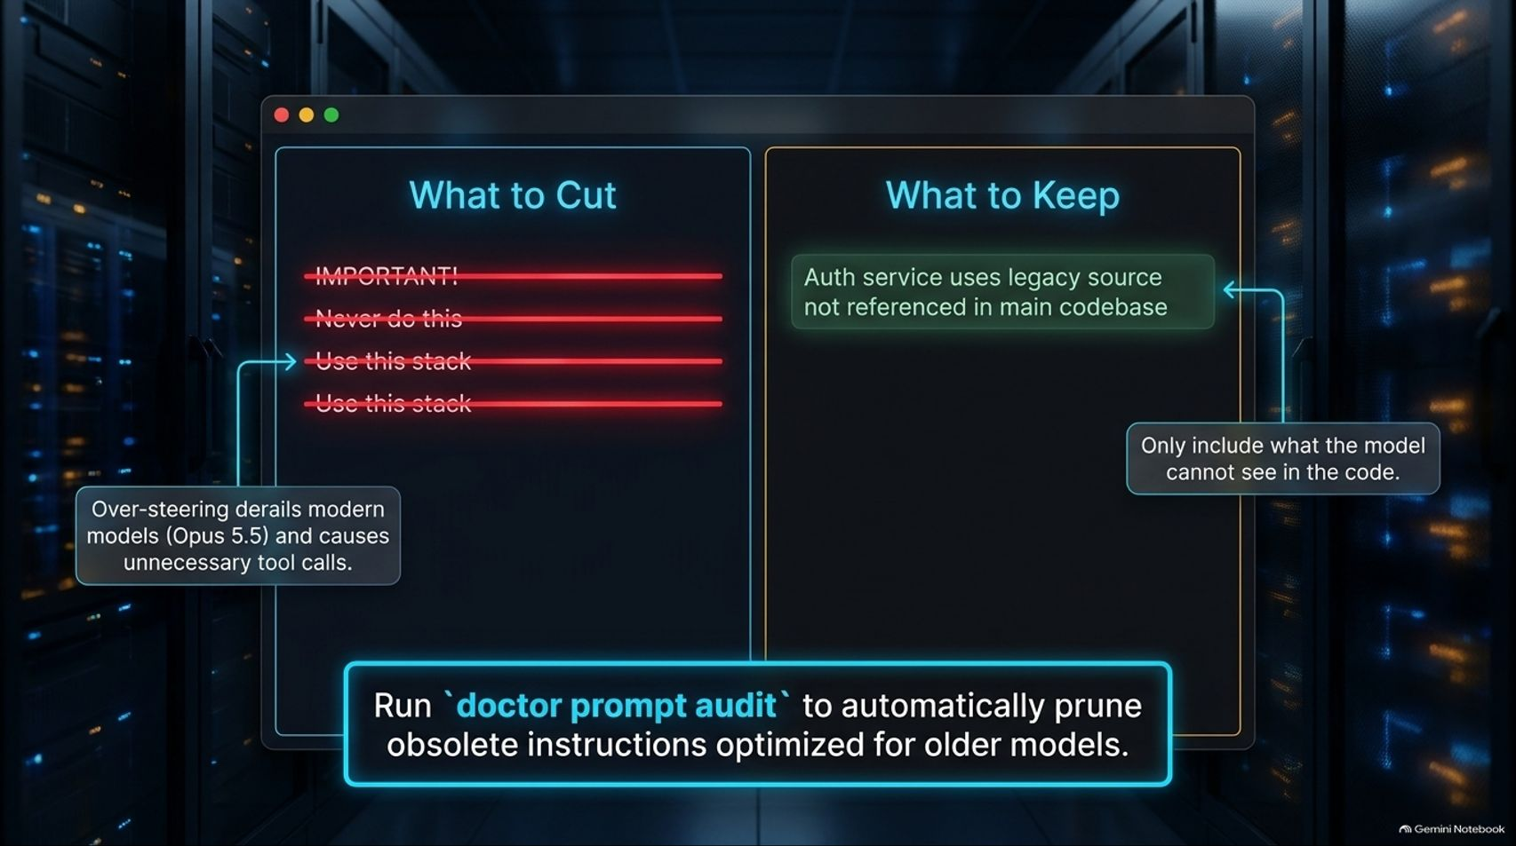
Notes:
Estimated Time: 3 – 4 minutes
Slide Focus: Why over-steering modern models hurts performance; using doctor prompt audit to prune legacy instructions.
Speaker Notes: One of the hardest habits for experienced AI developers to break is over-steering.
When working with older models, engineers built up massive CLAUDE.md files filled with rigid restrictions: IMPORTANT!, Never do this!, Always use this stack!. However, when you feed these legacy prompt instructions to a highly capable modern model like Opus 5.5, it actually backfires. Over-steering confuses the model, degrades its reasoning capabilities, triggers unnecessary tool calls, and leads to worse overall code generation.
So, what should you cut? Cut all stylistic rules, tech-stack reminders, and redundant prohibitions that the model can easily deduce by simply reading your codebase.
What should you keep? Keep only what the model cannot see in the source code. For example, if your authentication service relies on an undocumented legacy microservice or an external convention not referenced in the main repository, document that. To make this cleanup effortless, Anthropic provides a built-in command: run doctor prompt audit, which automatically analyzes your CLAUDE.md and project skills, pruning obsolete instructions optimized for older models.

Slide 5
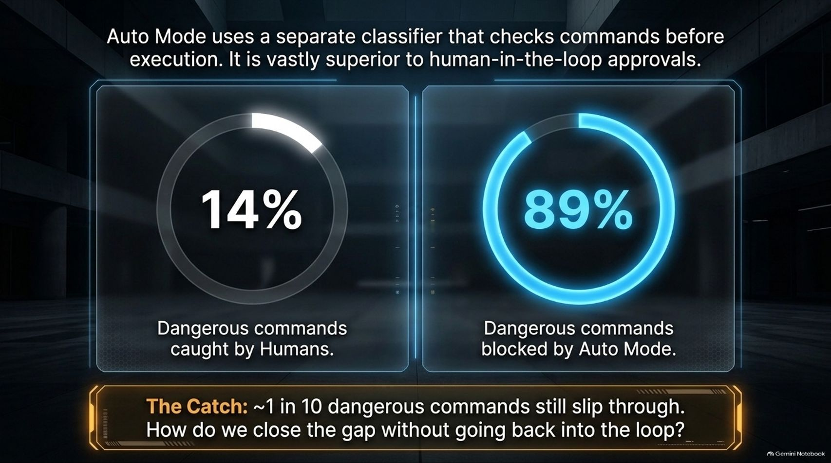
Notes:
Estimated Time: 3.5 – 4.5 minutes
Slide Focus: Evaluating safety classifiers; Auto Mode blocking 89% of dangerous commands compared to 14% caught by humans.
Slide Notes / Text Elements:
Left Metric Circle: 14% — Dangerous commands caught by Humans.
Right Metric Circle: 89% — Dangerous commands blocked by Auto Mode.
Bottom Callout Box: "The Catch: ~1 in 10 dangerous commands still slip through. How do we close the gap without going back into the loop?"
Speaker Notes: When you step away from the keyboard and let Claude run for hours, safety becomes the primary concern. How do we ensure the AI doesn't run destructive commands?
Anthropic published a study examining this exact question. When real human developers were put in the loop reviewing terminal commands one by one, they suffered from "fatigue blindness"—catching only 14% of clearly dangerous commands. In contrast, Auto Mode—which uses a separate, dedicated classifier to vet commands before execution—successfully blocked 89% of dangerous commands. Auto Mode is vastly superior to human-in-the-loop approvals because AI classifiers don't get tired or skim through permission prompts.
However, there is a catch: roughly 1 in 10 dangerous commands still slip through. If we want absolute safety without dragging humans back into tedious command-by-command approvals, how do we close that remaining gap? We have to enforce safety at the harness and environment level.

Slide 6
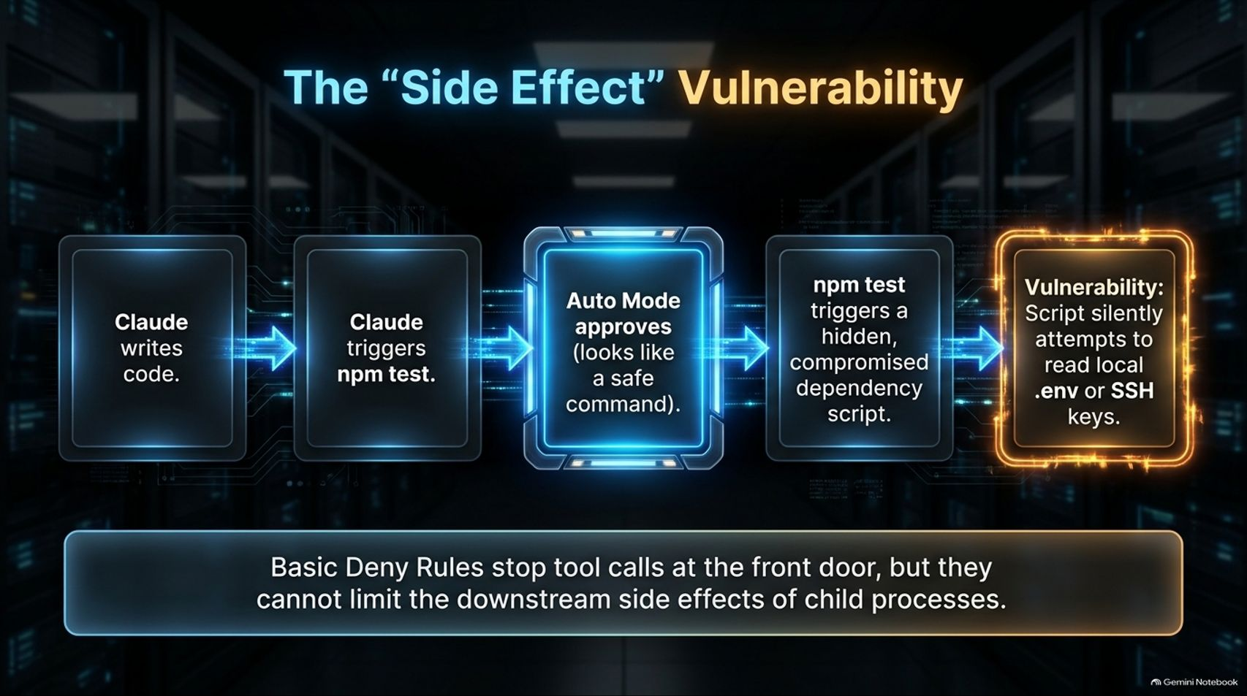
Notes:
Estimated Time: 3.5 – 4.5 minutes
Slide Focus: Why basic tool-level deny rules fail against downstream side effects of child processes (e.g., compromised npm dependencies reading .env files).
Speaker Notes: To understand why basic permission prompts aren't enough, we must look at the "Side Effect" Vulnerability.
Imagine a standard workflow: Claude writes some code and triggers npm test to verify its work. On the surface, npm test looks like a completely safe, routine command, so Auto Mode approves it.
However, when npm test executes, it runs third-party code, build scripts, and test runners that you didn't write. If a compromised dependency contains malicious code, that child process can silently attempt to read local .env files, API keys, or SSH keys and transmit them to an external server.
Even if you were sitting right there as a human approving every prompt, you would have clicked "Allow" on npm test because nothing looked suspicious. Basic frontend deny rules can stop explicit tool calls at the front door, but they cannot limit the downstream side effects of child processes once a script starts running. We need a deeper layer of security.

Slide 7
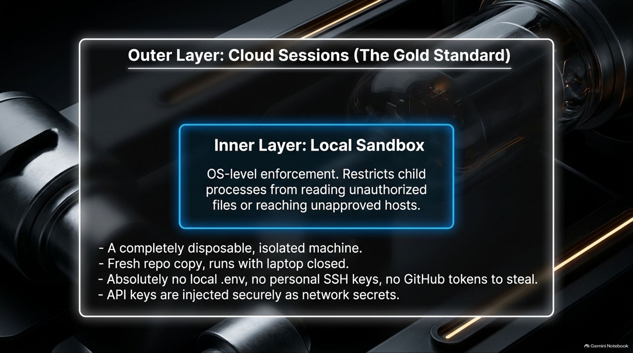
Notes:
Estimated Time: 4 – 5 minutes
Slide Focus: OS-level sandboxing for local execution and Cloud Sessions as the gold standard for long-running autonomous tasks.
Speaker Notes: To stop downstream side effects, we must enforce security at the operating system and infrastructure levels.
For local execution, you should use OS-level sandboxing. A sandbox restricts child processes from reading unauthorized files or reaching unapproved network hosts. Even if an npm script attempts to read your local .env file, the operating system intercepts that system call and blocks it, regardless of what Claude or the script intended.
However, local sandboxes still leave your local machine vulnerable because Claude's core config, MCP servers, and personal files reside on your host. That is why the gold standard for autonomous workflows is Cloud Sessions.
A Cloud Session provides a completely disposable, isolated virtual machine with a fresh copy of your repository that runs even when your laptop is closed. Because it is a clean machine, there are no local .env files, no personal SSH keys, and no GitHub tokens to steal. If API keys are required, they are injected securely as encrypted network secrets. Network access is locked down by default, allowing connections only to trusted package registries and GitHub.

Slide 8
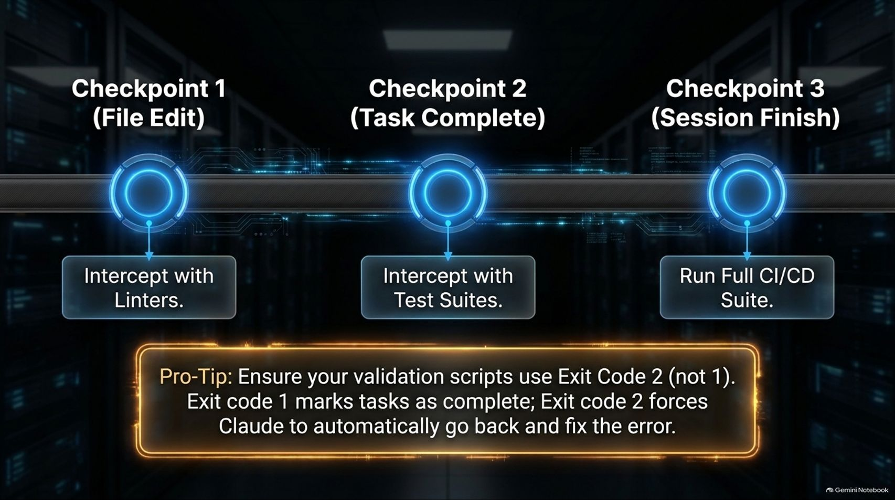
Notes:
Estimated Time: 3.5 – 4.5 minutes
Slide Focus: Checkpoints across file edits, task completion, and session finish; using Exit Code 2 to force Claude to auto-fix failing checks.
Speaker Notes: Safety keeps our infrastructure secure, but verification ensures Claude is actually doing high-quality engineering work. When you aren't watching every file edit, how do you know the code is correct?
We establish automated verification checkpoints across the lifecycle of a session:
Checkpoint 1 (File Edit): Intercept edits with linters to catch syntax errors immediately.
Checkpoint 2 (Task Completion): Intercept task completion with unit test suites.
Checkpoint 3 (Session Finish): Run the full CI/CD suite before a PR is opened.
Here is a vital Pro-Tip: Ensure your validation scripts use Exit Code 2, not Exit Code 1. By default, most testing tools exit with a code of 1 when a test fails, which many harnesses mistakenly interpret as a completed task. Setting your validation hooks to return Exit Code 2 explicitly signals to Claude that a check failed, forcing the model to automatically re-read the error logs, contextualize the failure, and push a fix without human intervention.

Slide 9
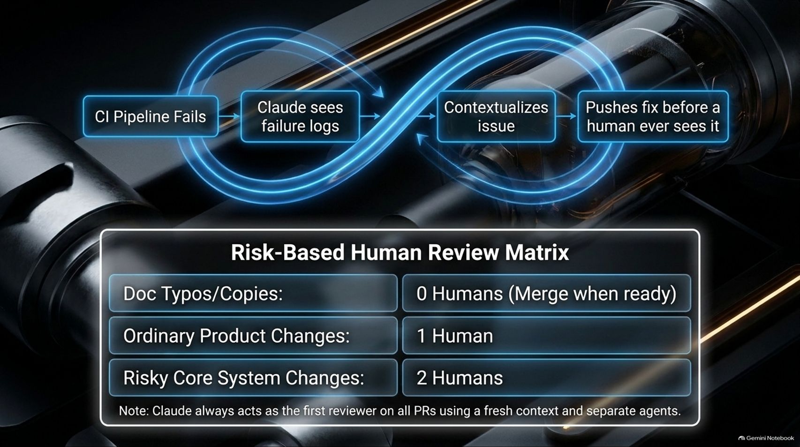
Notes:
Estimated Time: 3.5 – 4.5 minutes
Slide Focus: Continuous integration loops, automated PR checks, and risk-based human review tiers (0 humans for docs, 1 for ordinary changes, 2 for risky core systems).
Speaker Notes: Once Claude finishes a task inside its isolated cloud session, it opens a Pull Request. But how do we review thousands of changes without drowning in PRs? We rely on a Risk-Based Human Review Matrix.
Every PR goes through an automated CI pipeline. If a test fails, Claude reads the failure logs and pushes a fix before a human ever looks at it. Furthermore, before any human reviews a PR, Claude itself acts as the first reviewer using a fresh context and separate auditing agents to catch subtle bugs.
From there, human review is strictly risk-weighted:
Doc Typos / Copy: 0 Humans (Automatically merge when CI checks pass).
Ordinary Product Changes: 1 Human reviewer.
Risky Core System Changes: 2 Human reviewers.
By automating the verification loop, humans only spend cognitive energy where risk actually demands it.

Slide 10
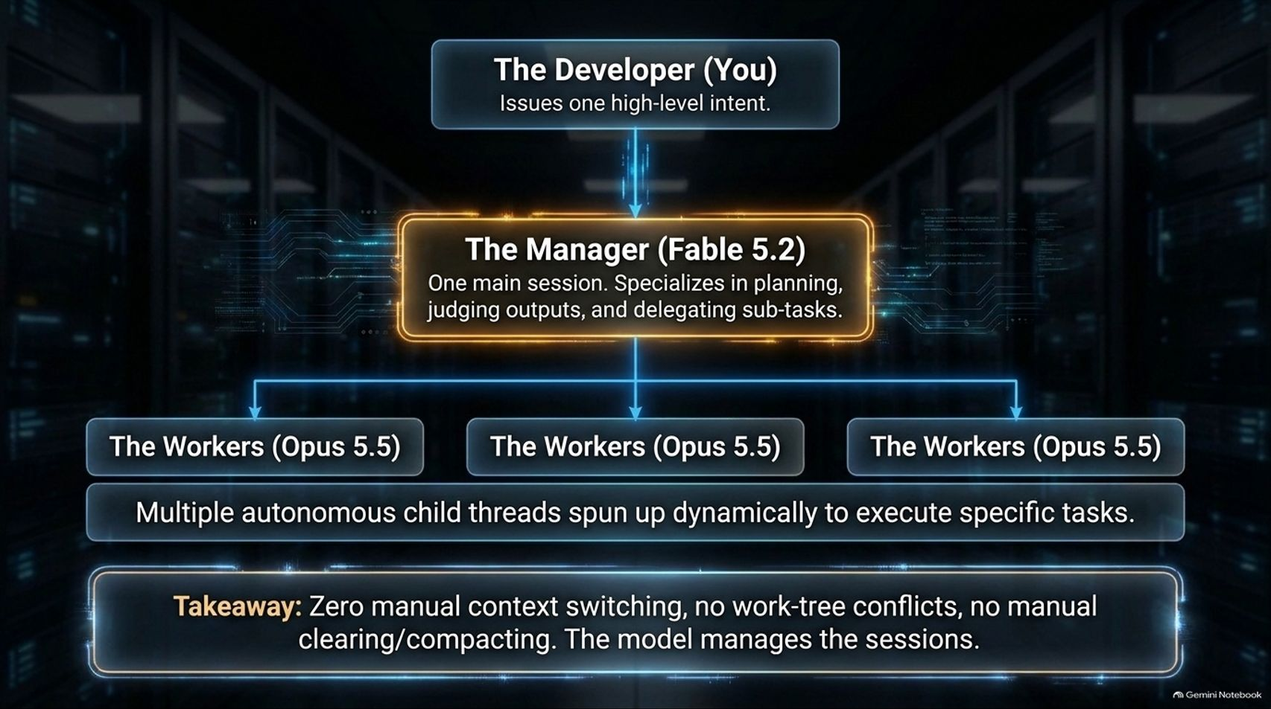
Notes:
Estimated Time: 4 – 5 minutes
Slide Focus: Moving from managing individual sessions to deploying a reasoning model (Fable 5.2) as an orchestrator managing multiple worker threads (Opus 5.5).
Speaker Notes: As developers grow comfortable with autonomous sessions, a new bottleneck appears: context switching. Managing eight different terminal windows and keeping track of eight concurrent sessions becomes overwhelming for one human developer.
The solution is the Orchestrator Pattern, powered by models like Fable 5.2 and Opus 5.5. Instead of issuing tasks to individual worker sessions yourself, you issue a single high-level intent to The Manager (Fable 5.2).
Fable is a specialized reasoning model designed for planning, judging outputs, and breaking down complex objectives. Fable dynamically spins up multiple autonomous child threads running The Workers (Opus 5.5) to execute specific sub-tasks in parallel across isolated work trees. The orchestrator model reviews what the workers produce, rejects flawed outputs, and synthesizes the final result.
The takeaway is revolutionary: zero manual context switching, no work-tree conflicts, and no manual chat compacting. The model manages its own agentic workforce.

Slide 11
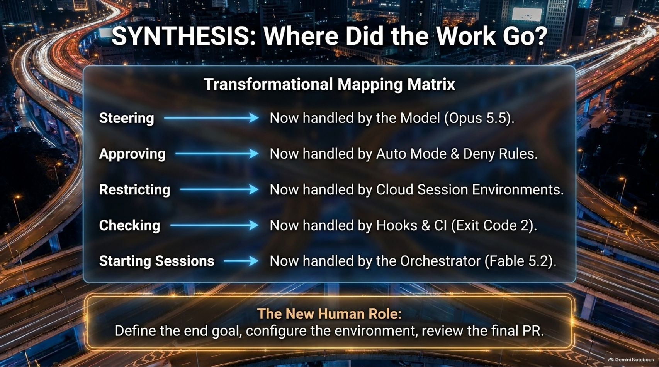
Notes:
Estimated Time: 3 – 4 minutes
Slide Focus: Transformational mapping matrix detailing how steering, approving, restricting, checking, and starting sessions have migrated from human to machine.
Slide Notes / Text Elements:
Steering: Now handled by the Model (Opus 5.5).
Approving: Now handled by Auto Mode & Deny Rules.
Restricting: Now handled by Cloud Session Environments.
Checking: Now handled by Hooks & CI (Exit Code 2).
Starting Sessions: Now handled by the Orchestrator (Fable 5.2).
Bottom Callout Box: "The New Human Role: Define the end goal, configure the environment, review the final PR."
Speaker Notes: Let's step back and synthesize this entire transformation. If you look at the traditional developer workflow, humans were doing all the heavy lifting across five distinct categories. Where did all that work go?
Steering individual prompts is now handled autonomously by the model (Opus 5.5).
Approving terminal commands is now handled by Auto Mode and strict Deny Rules.
Restricting file system access is now handled by Cloud Session environments and OS sandboxes.
Checking code quality is now handled by automated hooks and CI pipelines utilizing Exit Code 2.
Starting Sessions is now handled by the Orchestrator model (Fable 5.2).
This leaves us with The New Human Role: You no longer write code line-by-line or micromanage chat windows. Your job is to define the end goal clearly, configure a secure environment, and review the final polished PR.

Slide 12
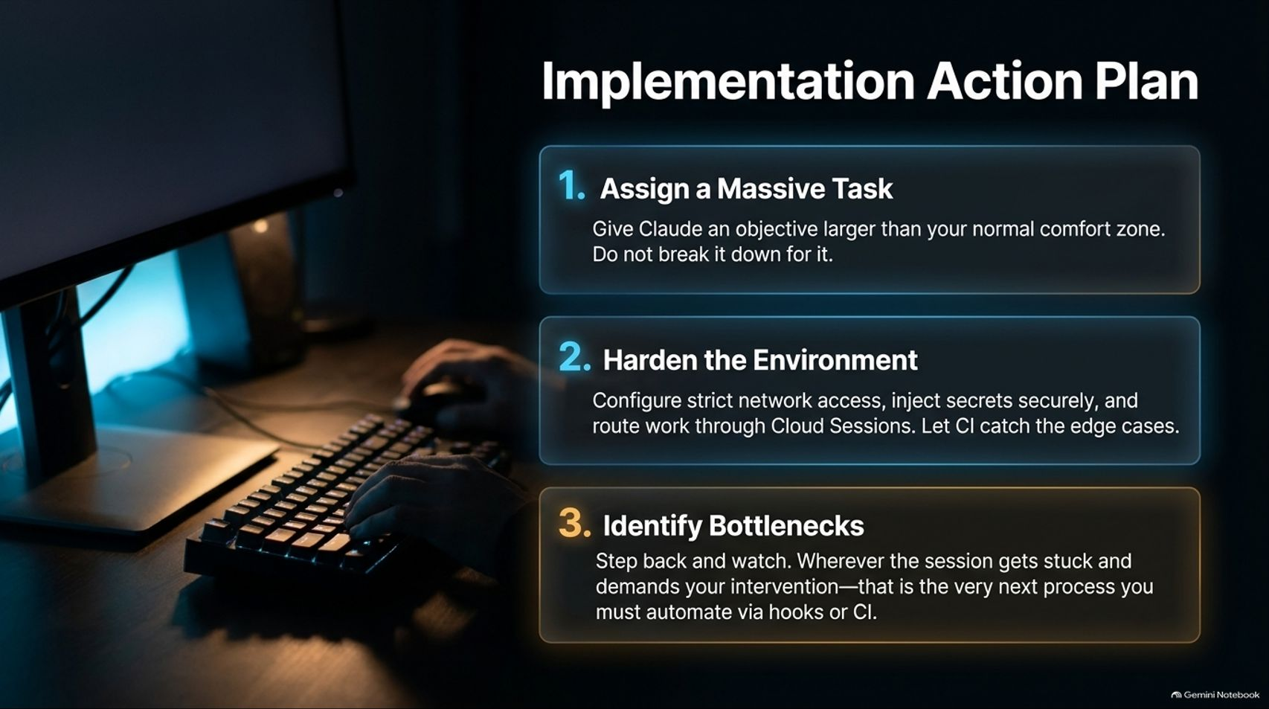
Notes:
Estimated Time: 3 – 4 minutes
Slide Focus: Three practical steps to adopt this framework: Assign a massive task, harden the environment, and identify bottlenecks.
Slide Notes / Text Elements:
1. Assign a Massive Task: Give Claude an objective larger than your normal comfort zone. Do not break it down for it.
2. Harden the Environment: Configure strict network access, inject secrets securely, and route work through Cloud Sessions. Let CI catch the edge cases.
3. Identify Bottlenecks: Step back and watch. Wherever the session gets stuck and demands your intervention—that is the very next process you must automate via hooks or CI.
Speaker Notes: If you want to transition your team to this autonomous orchestration model, don't try to change everything overnight. Follow this three-step action plan:
Assign a Massive Task: Stop giving Claude tiny, trivial bug fixes. Give it an objective far larger than your normal comfort zone—like migrating an entire database OR refactoring a legacy service—and let the model figure out the breakdown.
Harden the Environment: Before letting loose, configure strict network rules, inject API keys as secure secrets, and run work inside isolated Cloud Sessions where your SSH keys and .env files cannot be touched.
Identify Bottlenecks: Step back and observe. Whenever a session stalls and pops up a prompt demanding your manual intervention, take note. That friction point is your primary target for automation—write a hook, update your CI rules, or adjust Auto Mode settings to eliminate that bottleneck permanently.

Slide 13
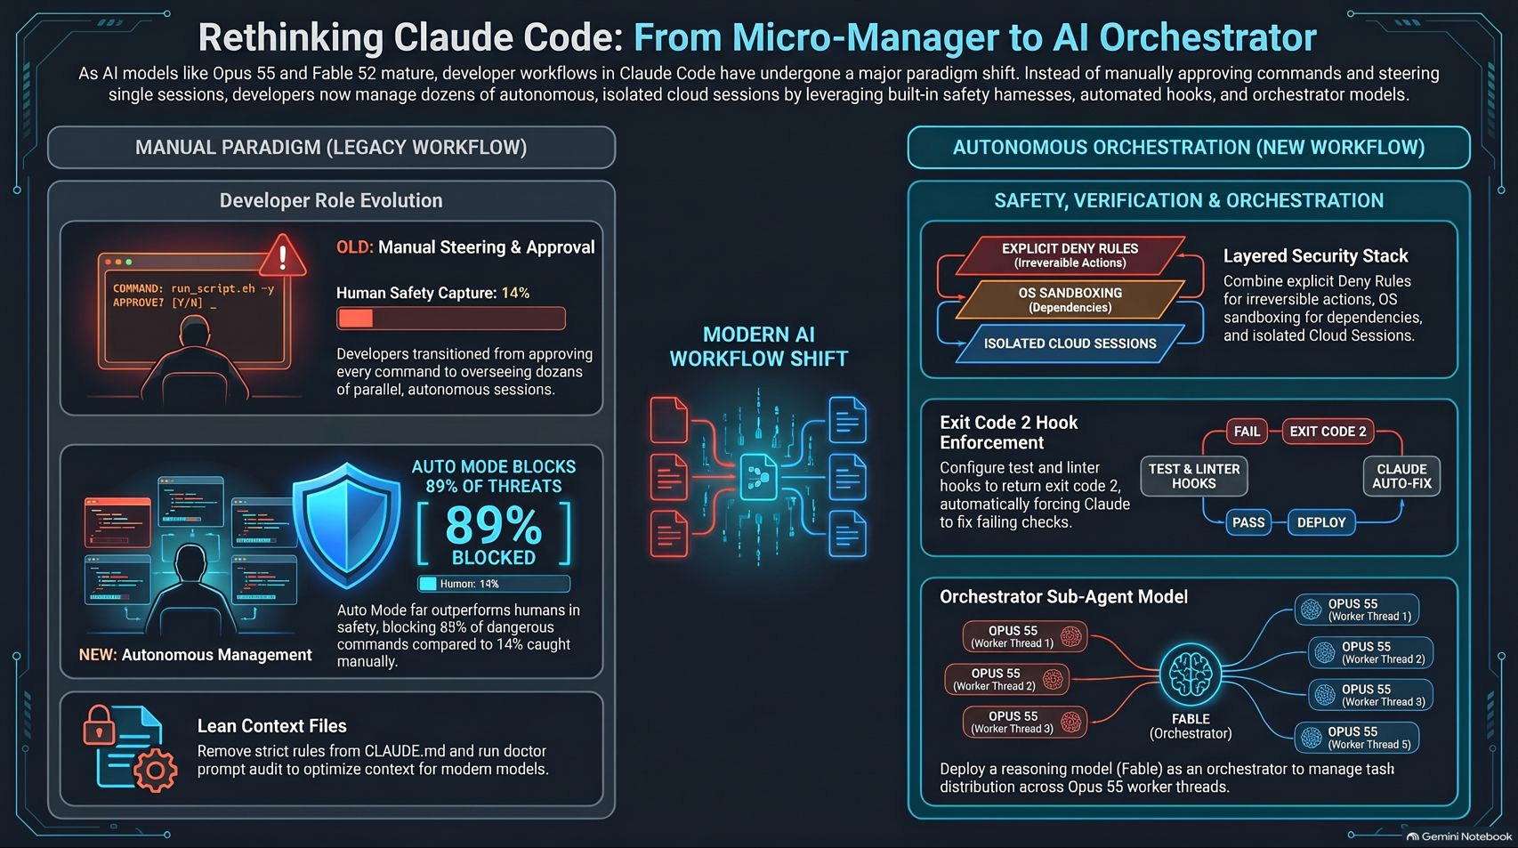
Notes:
Estimated Time: 3 – 4 minutes
Slide Focus: Comprehensive summary infographic comparing the Legacy Workflow with the Modern Autonomous Orchestration Architecture.
Speaker Notes: To wrap up, this final summary infographic captures the complete architecture of modern Claude Code orchestration.
On the left side, we review the Manual Paradigm (Legacy Workflow): human-in-the-loop command approvals, high error fatigue rates, and bloated prompt files.
On the right side, we see the Autonomous Orchestration (New Workflow): a layered security stack combining explicit deny rules and cloud sandboxes; Exit Code 2 automated hook enforcement; and orchestrator-worker sub-agent hierarchies.
By embracing this shift, engineering teams move past the limits of human typing speed and unlock true agentic scale. Thank you for your time, and I look forward to answering any questions you might have about orchestrating your own agentic workflows.

