Slide 1
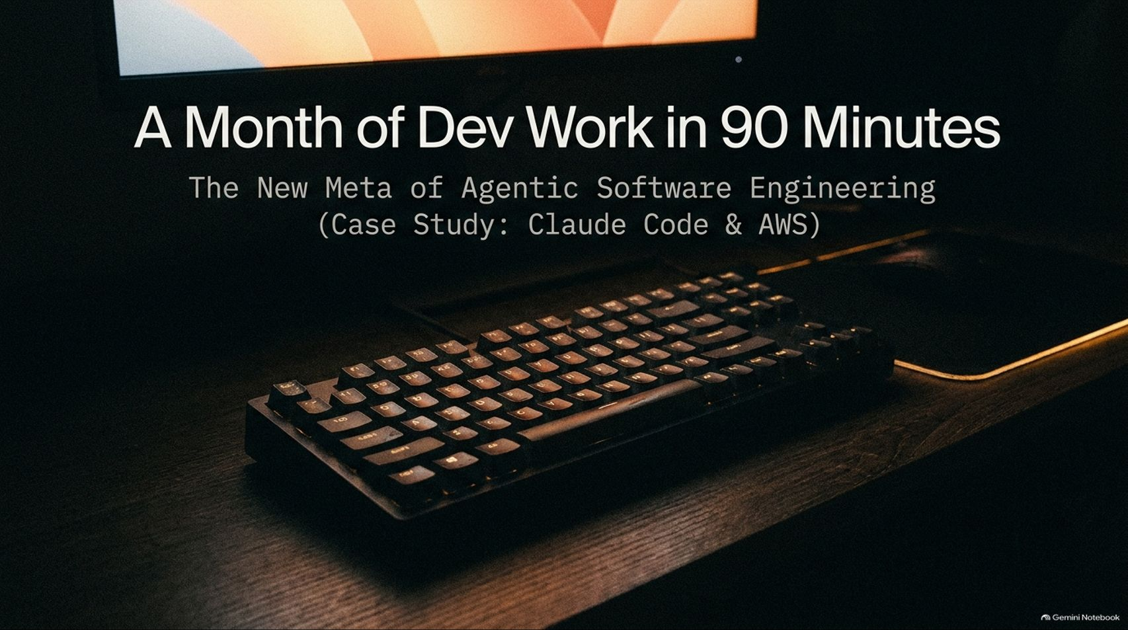
Notes:
Estimated Time: 2.5 – 3 minutes
Slide Focus: Title slide introducing the core thesis: compressing a multi-week enterprise software engineering lifecycle into 90 minutes using Claude Code and AWS.
Speaker Notes: Welcome everyone. Today we are going to examine what happens when you take senior engineering intuition and pair it with modern autonomous coding agents. This deck breaks down a live case study featuring Steve Huynh—a former Amazon Principal Engineer—and Arjay McCandless, where they compressed roughly a month of traditional enterprise software development into a single 90-minute terminal session.
We aren't talking about generating a toy to-do list app or scaffolding a landing page on localhost. We are talking about designing, provisioning, deploying, live-migrating a database, setting up observability dashboards, and running synthetic load tests on a production-grade, full-stack serverless AWS application—all without ever opening a traditional code editor.
Over the next 16 slides, we will trace the exact technical workflow they executed, examine the architectural decisions they made, and step back to look at the profound cultural, economic, and career implications this "new meta" creates for software engineers and enterprise organizations.
A Month of Dev Work in 90 Minutes With Arjay McCandless
https://www.youtube.com/watch?v=hOYzvUQKq8s

Slide 2
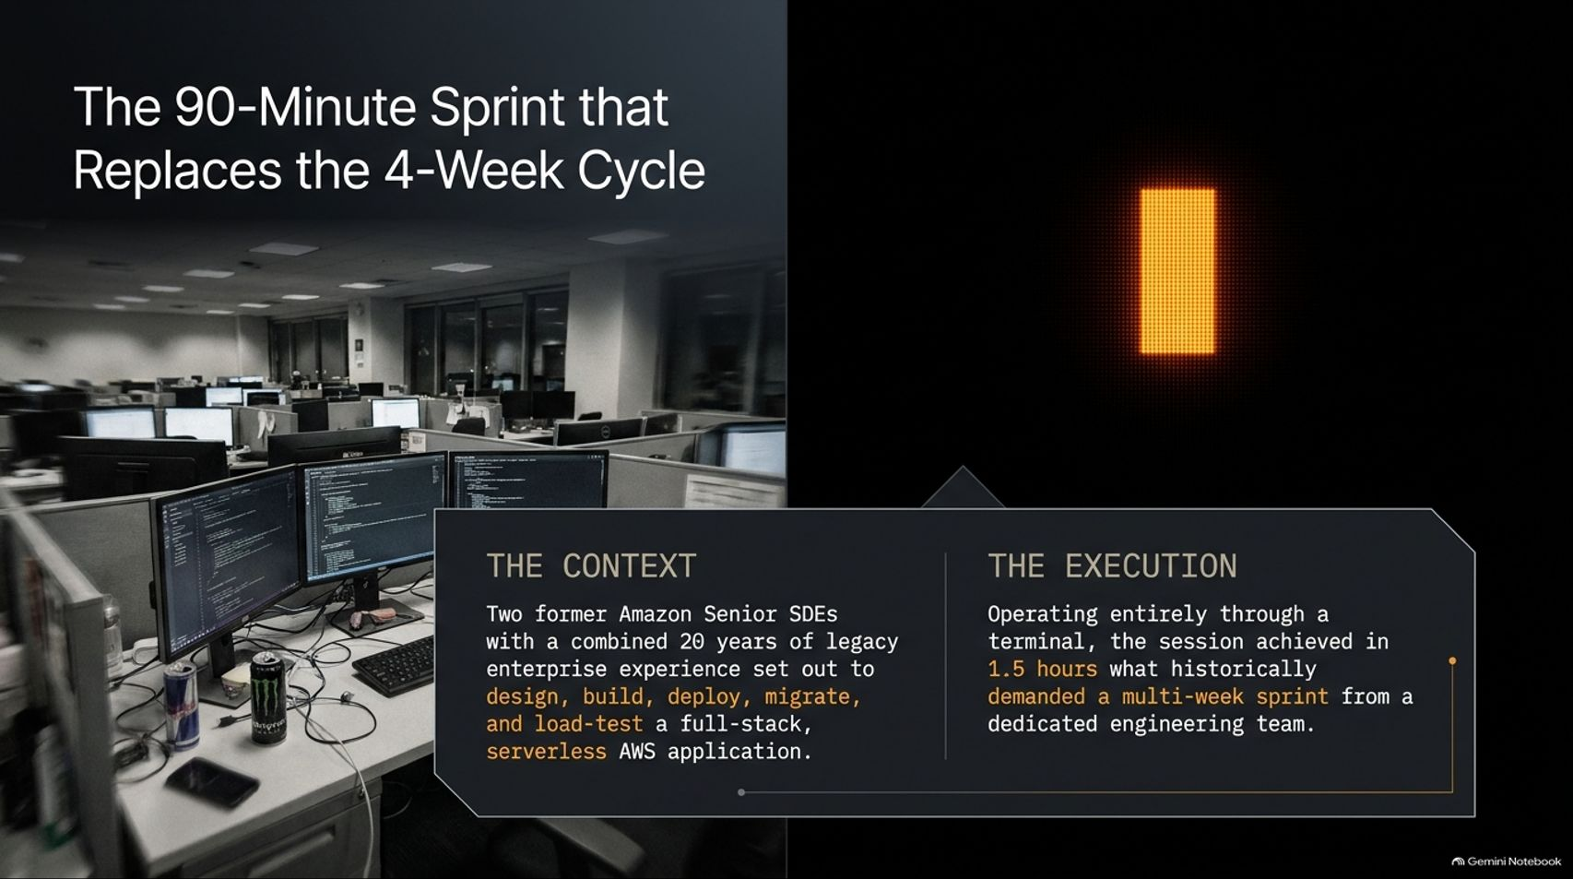
Notes:
Estimated Time: 3 – 4 minutes
Slide Focus: Framing the baseline challenge: two former Amazon Senior SDEs building and load-testing a full-stack serverless AWS app in 1.5 hours versus a multi-week team sprint.
Slide Elements:
The Context: Two former Amazon Senior SDEs with a combined 20 years of legacy enterprise experience set out to design, build, deploy, migrate, and load-test a full-stack, serverless AWS application.
The Execution: Operating entirely through a terminal, the session achieved in 1.5 hours what historically demanded a multi-week sprint from a dedicated engineering team.
Speaker Notes: Let's look at the pedigree and the baseline for this experiment. Both Steve and Arjay are former Amazon Senior Software Development Engineers with a combined two decades of experience building massive-scale enterprise cloud infrastructure. Anyone who has worked inside a large tech organization like Amazon knows what the standard operating procedure looks like for launching a new full-stack service from scratch.
Normally, this requires a dedicated engineering team and at least a four-week sprint: a week of architecture reviews and whiteboarding, another week writing CloudFormation or CDK templates and fighting IAM permissions, a week wiring up frontend and backend integration, and another week dedicated to QA, monitoring, and load testing.
In this case study, Arjay set out to execute that entire lifecycle—from an empty directory to a live, load-tested production stack on AWS—operating exclusively inside a command-line terminal with Claude Code. By the 35-minute mark, the initial full-stack application was already live on the public internet. By minute 90, they had executed a zero-downtime database migration and stress-tested the live cluster. This isn't an incremental 20% productivity boost; it is an order-of-magnitude compression of the software delivery lifecycle.

Slide 3
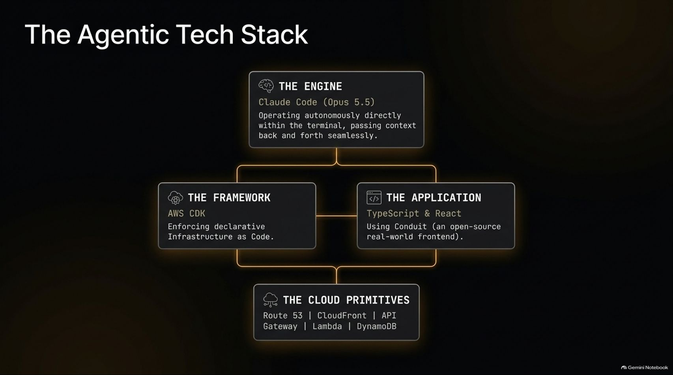
Notes:
Estimated Time: 3 – 4 minutes
Slide Focus: Architectural breakdown of the four layers powering the session: The Engine (Claude Code / Opus 5.5), The Framework (AWS CDK), The Application (TypeScript/React Conduit), and The Cloud Primitives.
Slide Elements:
The Engine: Claude Code (Opus 5.5) — Operating autonomously directly within the terminal, passing context back and forth seamlessly.
The Framework: AWS CDK — Enforcing declarative Infrastructure as Code.
The Application: TypeScript & React — Using Conduit (an open-source real-world frontend).
The Cloud Primitives: Route 53 | CloudFront | API Gateway | Lambda | DynamoDB.
Speaker Notes: Why did this stack work so seamlessly with an autonomous agent? Look closely at the four architectural choices on this slide, because every single one was chosen to minimize friction and maximize feedback loops for the LLM.
First, The Engine: Claude Code running Opus 5.5 directly inside the terminal. Unlike browser-based chatbots where you copy-paste snippets back and forth, a CLI-native agent has direct access to your shell, compiler errors, AWS CLI outputs, and file tree. Context flows seamlessly from command execution right back into the model's reasoning loop.
Second, The Framework: AWS CDK (Cloud Development Kit). Declarative Infrastructure as Code written in TypeScript is a superpower for LLMs. Because the infrastructure and the application share the exact same programming language, the model doesn't suffer from context-switching penalties between YAML/JSON templates and application logic.
Third, The Application: To prove this wasn't a contrived "Hello World" demo, they used Conduit—the open-source "RealWorld" Medium-clone specification. It includes real-world complexity: JWT authentication, user profiles, CRUD operations for articles, comments, tags, and pagination.
Finally, The Cloud Primitives: Route 53 for DNS, CloudFront for CDN delivery, API Gateway for routing, AWS Lambda for stateless compute, and DynamoDB for persistence. Everything is serverless, API-driven, and provisioned programmatically.

Slide 4
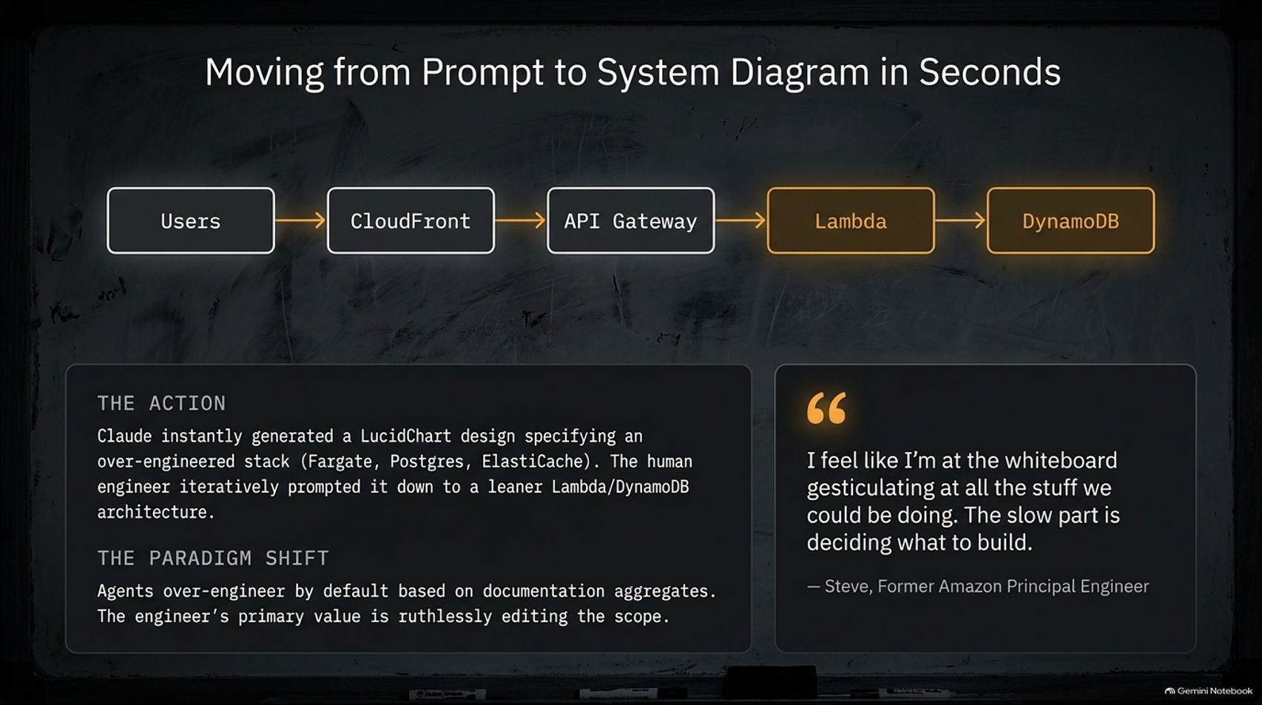

Slide 5
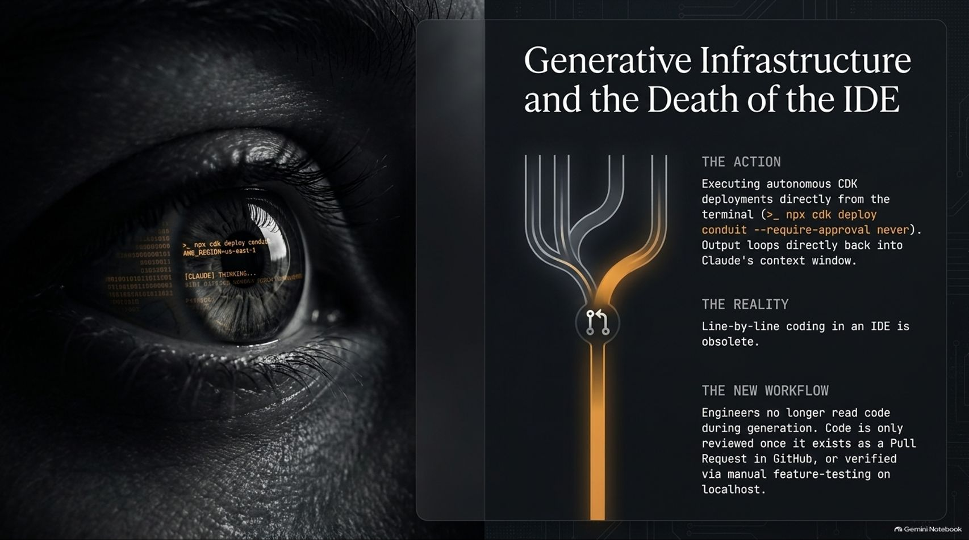
Notes:
Estimated Time: 3.5 – 4.5 minutes
Slide Focus: Executing autonomous cdk deploy loops directly from the CLI, why line-by-line coding in an IDE is becoming obsolete, and shifting human review to GitHub PRs and feature testing.
Slide Elements:
The Action: Executing autonomous CDK deployments directly from the terminal (>_ npx cdk deploy conduit --require-approval never). Output loops directly back into Claude's context window.
The Reality: Line-by-line coding in an IDE is obsolete.
The New Workflow: Engineers no longer read code during generation. Code is only reviewed once it exists as a Pull Request in GitHub, or verified via manual feature-testing on localhost.
Speaker Notes: During the entire 90-minute build, Arjay never once opened VS Code, Cursor, or any traditional Integrated Development Environment to manually edit a file.
Look at how the feedback loop actually works when you operate in the terminal: Claude writes the CDK infrastructure code, executes npx cdk deploy conduit --require-approval never, and watches the CloudFormation deployment stream directly in stdout. When an IAM role lacks a permission or a TypeScript compilation error occurs, the stack trace feeds straight back into Claude's context window. The agent diagnoses the error, patches the code, and redeploys automatically.
This leads to a provocative but accurate conclusion: line-by-line coding in an IDE is rapidly becoming obsolete. When an agent generates thousands of lines of boilerplate, infrastructure definitions, and glue code across dozens of files, reading code during generation is a waste of human cognitive bandwidth.
In the new workflow, the engineer steps up a level of abstraction. You don't micromanage syntax in an editor; you verify functional behavior via live endpoint testing, and you reserve deep code inspection for formal GitHub Pull Requests once the agent has verified that the build and tests pass.

Slide 6
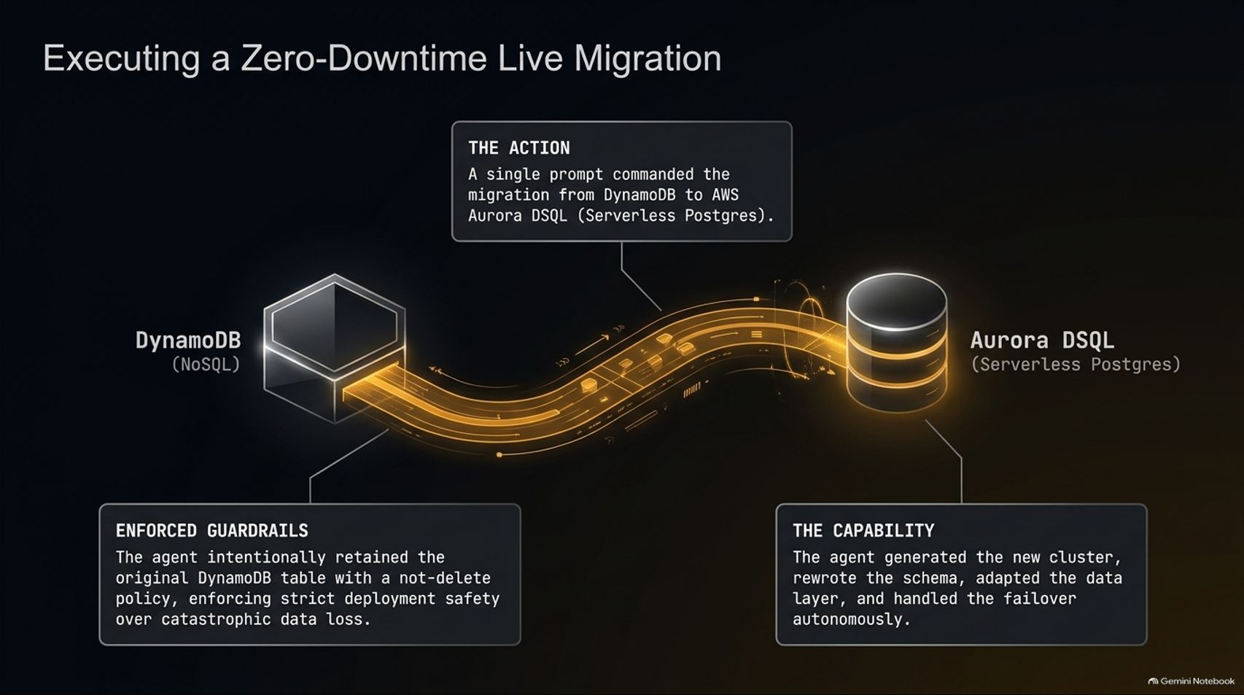
Notes:
Estimated Time: 4 – 5 minutes
Slide Focus: Commanding a single-prompt migration from DynamoDB (NoSQL) to AWS Aurora DSQL (Serverless Postgres), and the critical safety guardrails protecting production data.
Slide Elements:
The Action: A single prompt commanded the migration from DynamoDB to AWS Aurora DSQL (Serverless Postgres).
Enforced Guardrails: The agent intentionally retained the original DynamoDB table with a not-delete policy, enforcing strict deployment safety over catastrophic data loss.
The Capability: The agent generated the new cluster, rewrote the schema, adapted the data layer, and handled the failover autonomously.
Speaker Notes: Once the Conduit app was running live on DynamoDB, Steve and Arjay threw a classic enterprise curveball at the agent: "We realized relational queries are getting messy. Migrate the entire application database from NoSQL DynamoDB to AWS Aurora DSQL (Serverless Postgres) with zero downtime."
In a traditional enterprise environment, migrating from a NoSQL key-value store to a distributed relational SQL database is a terrifying, multi-week project fraught with schema translation bugs and downtime risks.
With a single high-level directive, Claude Code spun up the new Aurora DSQL cluster via CDK, designed the relational SQL schema, rewrote the backend data access layer, migrated existing records, and cut over traffic—all within minutes.
Equally impressive was the safety guardrail enforced during the migration. When updating the CDK stack, the agent explicitly configured a retention policy (RemovalPolicy.RETAIN) on the legacy DynamoDB table rather than deleting it. As Arjay emphasizes in the talk, you never blindly YOLO a destructive database migration. Keeping the old table intact ensures that if anything goes wrong post-cutover, you have an instant rollback path with zero catastrophic data loss.

Slide 7
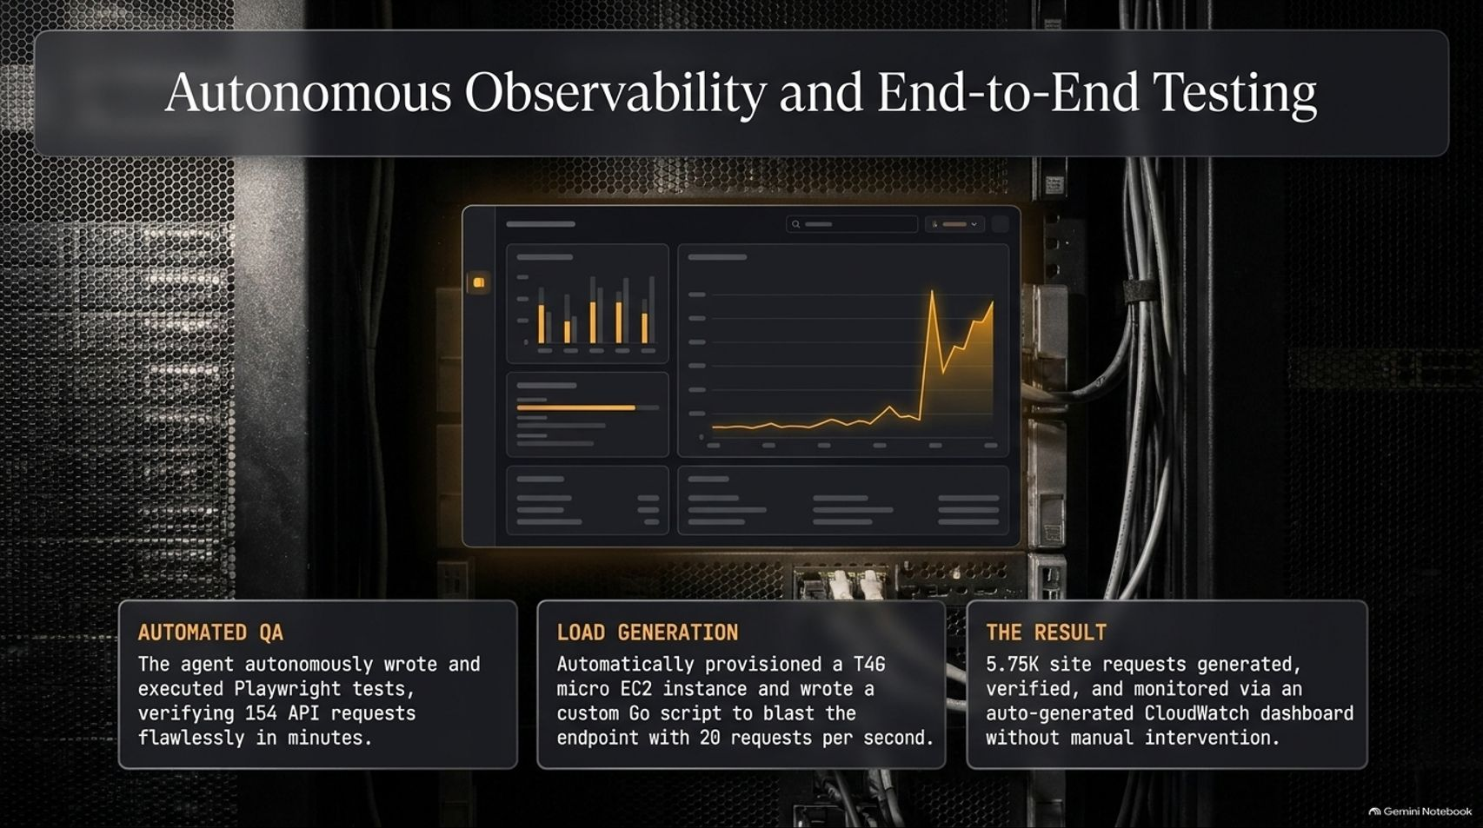
Notes:
Estimated Time: 3.5 – 4.5 minutes
Slide Focus: How Claude wrote Playwright E2E tests (154 API requests), provisioned a t4g.micro EC2 load generator with a custom Go script, and built a CloudWatch telemetry dashboard.
Slide Elements:
Automated QA: The agent autonomously wrote and executed Playwright tests, verifying 154 API requests flawlessly in minutes.
Load Generation: Automatically provisioned a T4G micro EC2 instance and wrote a custom Go script to blast the endpoint with 20 requests per second.
The Result: 5.75K site requests generated, verified, and monitored via an auto-generated CloudWatch dashboard without manual intervention.
Speaker Notes: Building and deploying an app is only half the battle; proving it works under load is what separates a prototype from production engineering.
Rather than manually clicking around the UI, Arjay instructed Claude to verify the live deployment end-to-end. First, the agent autonomously wrote and ran a full suite of Playwright browser tests, simulating real user sign-ups, logins, article creation, and commenting—verifying 154 distinct API requests without a single manual click.
Next, they wanted real telemetry. Instead of asking Arjay to configure complex load-testing SaaS tools, Claude automatically provisioned an inexpensive t4g.micro EC2 instance in AWS, wrote a lightweight, high-concurrency Go load-testing script, and blasted the live API Gateway endpoint at 20 requests per second.
Simultaneously, Claude generated a custom AWS CloudWatch dashboard tracking API request volume, Lambda cold starts, 4xx/5xx error rates, and Aurora DSQL capacity utilization. Within minutes, they watched 5,750 live requests flow through the system on real-time telemetry charts—all orchestrated from a single terminal session.

Slide 8
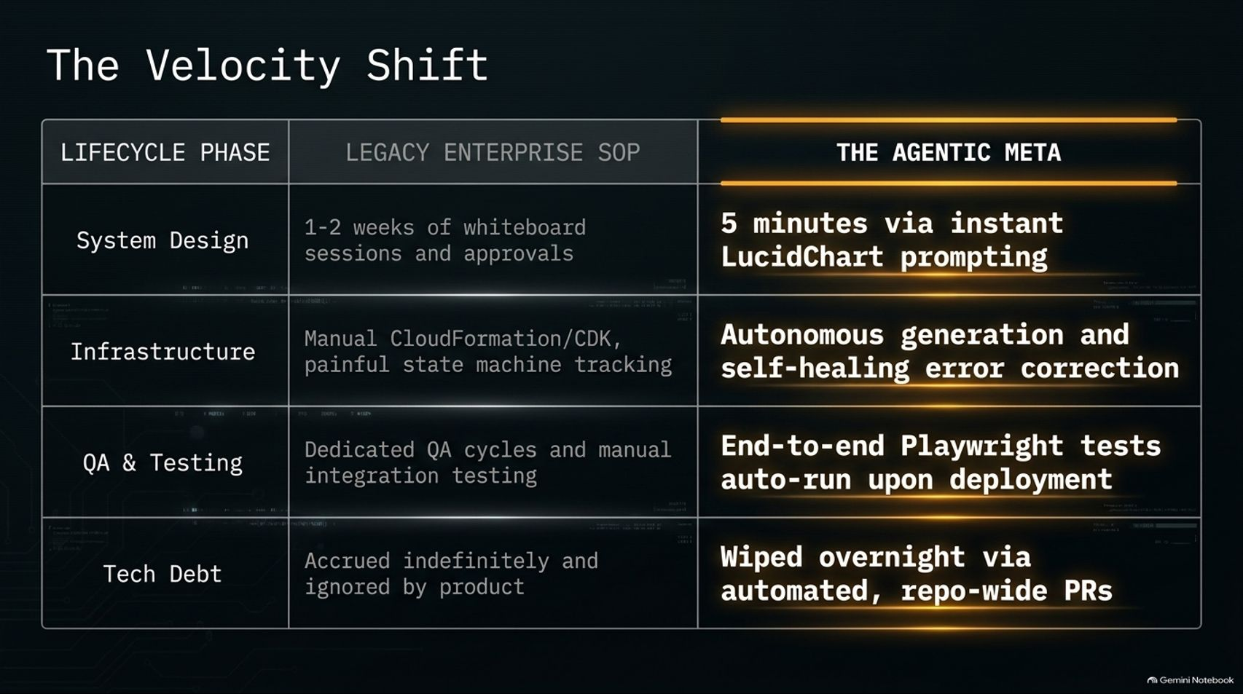
Notes:
Estimated Time: 3 – 4 minutes
Slide Focus: Side-by-side comparison table contrasting Legacy Enterprise SOP against The Agentic Meta across System Design, Infrastructure, QA & Testing, and Tech Debt.
Slide Elements:
System Design: 1–2 weeks of whiteboard sessions and approvals → 5 minutes via instant LucidChart prompting.
Infrastructure: Manual CloudFormation/CDK, painful state machine tracking → Autonomous generation and self-healing error correction.
QA & Testing: Dedicated QA cycles and manual integration testing → End-to-end Playwright tests auto-run upon deployment.
Tech Debt: Accrued indefinitely and ignored by product → Wiped overnight via automated, repo-wide PRs.
Speaker Notes: This table summarizes the structural compression across all four phases of the software engineering lifecycle.
In System Design, what used to consume one to two weeks of architecture review boards and diagramming tools now happens in five minutes of iterative prompting.
In Infrastructure, engineers used to spend days wrestling with CloudFormation drift, state machine failures, and cryptic IAM errors. Now, the agent writes the CDK code, watches deployment logs, and self-heals errors in real time.
In QA & Testing, instead of tossing code over the wall to a separate QA team for manual regression cycles, end-to-end Playwright suites and synthetic load generators are written and executed automatically upon deployment.
Finally, look at Tech Debt. Historically, tech debt accrued indefinitely because product managers rarely prioritized refactoring sprints over new features. Today, repo-wide migrations—like swapping databases or upgrading deprecated frameworks—can be executed overnight via automated Pull Requests.

Slide 9
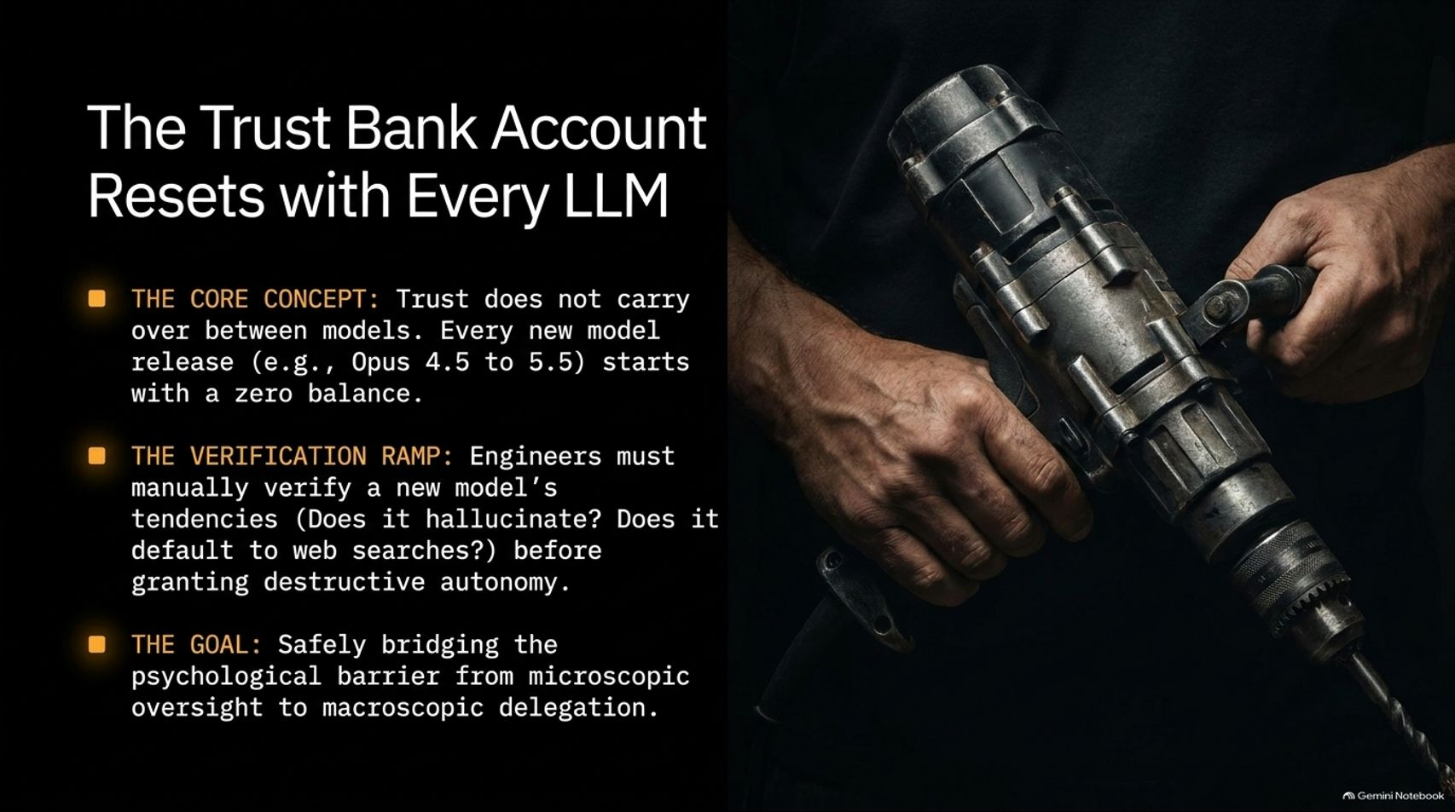

Slide 10
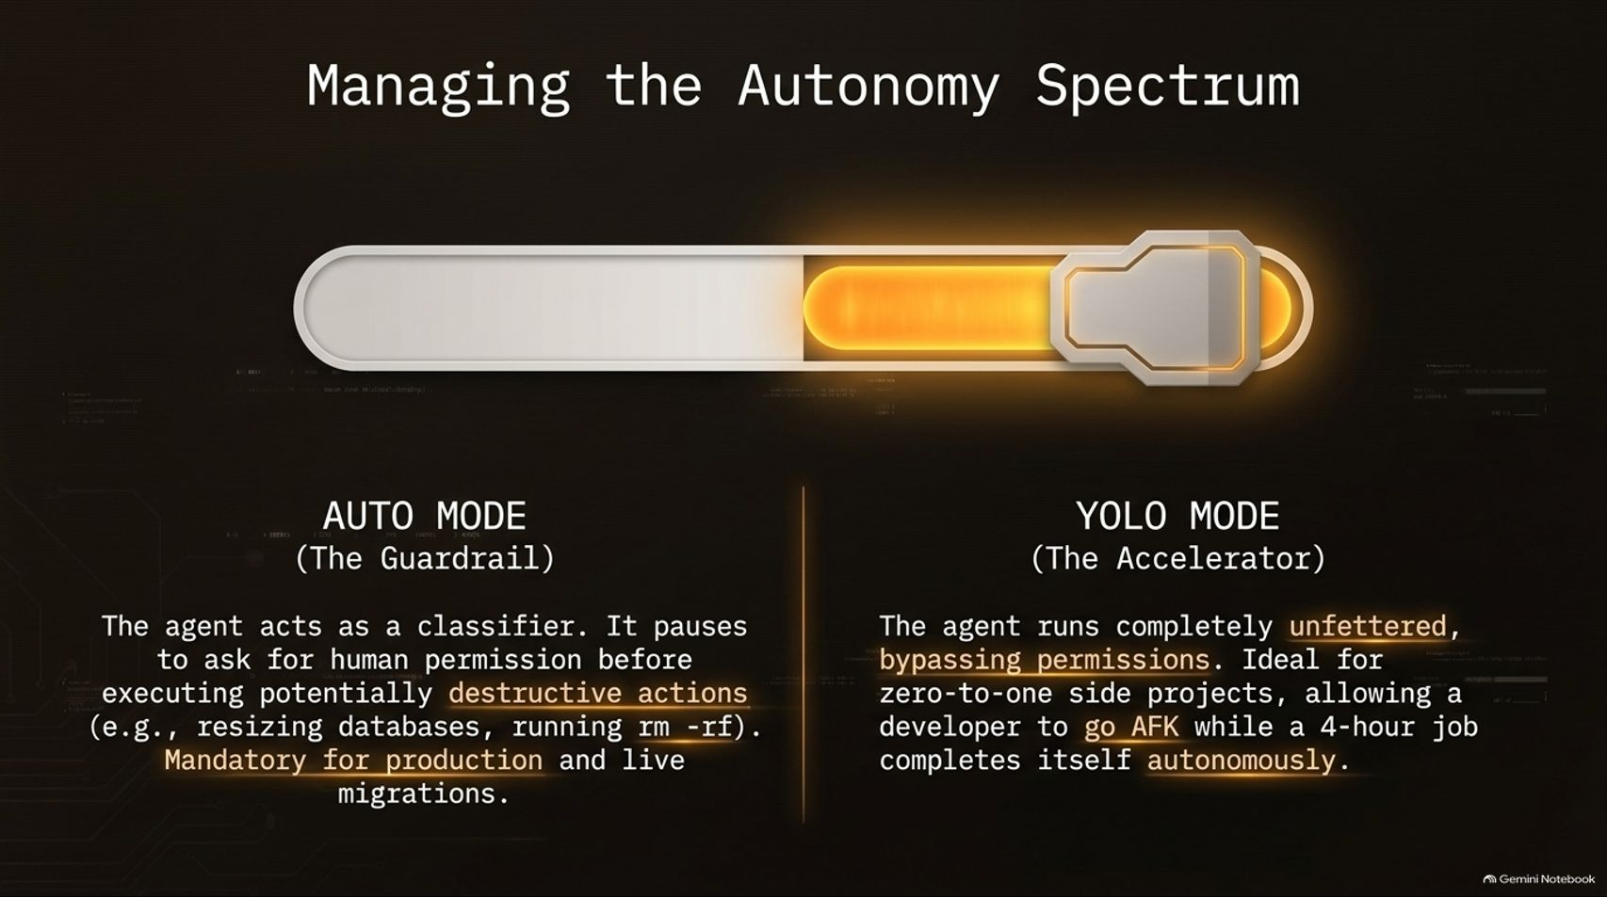
Notes:
Estimated Time: 3.5 – 4.5 minutes
Slide Focus: Contrasting Auto Mode (the classifier guardrail for production) with YOLO Mode (unfettered permission bypass for zero-to-one side projects).
Slide Elements:
Auto Mode (The Guardrail): The agent acts as a classifier. It pauses to ask for human permission before executing potentially destructive actions (e.g., resizing databases, running rm -rf). Mandatory for production and live migrations.
YOLO Mode (The Accelerator): The agent runs completely unfettered, bypassing permissions. Ideal for zero-to-one side projects, allowing a developer to go AFK while a 4-hour job completes itself autonomously.
Speaker Notes: Effective agentic engineering isn't binary—you don't just turn autonomy "on" or "off." You actively manage an Autonomy Spectrum depending on the blast radius of your environment.
On the left side of the spectrum is Auto Mode, which acts as an intelligent guardrail. In Auto Mode, a safety classifier evaluates every shell command before execution. Safe, routine operations like running unit tests or reading files proceed automatically, while potentially destructive actions—like dropping a database table, modifying production IAM policies, or running rm -rf—pause and demand explicit human sign-off. Auto Mode is mandatory whenever you touch production infrastructure or live customer data.
On the right side of the spectrum is YOLO Mode (running with permission checks bypassed). In an isolated sandbox or a greenfield zero-to-one side project where there is zero production blast radius, YOLO Mode is a massive accelerator. It lets you kick off a complex four-hour build, walk away from your keyboard to grab dinner, and return to a fully compiled, tested application. Knowing which mode fits the risk profile of your environment is a core skill for modern engineers.

Slide 11
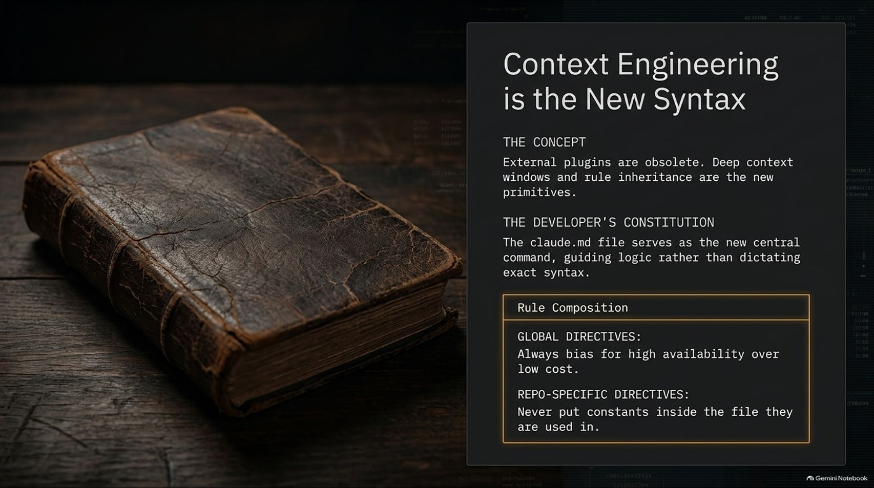
Notes:
Estimated Time: 4 – 5 minutes
Slide Focus: Replacing heavy external plugins with clean CLAUDE.md rule inheritance—treating CLAUDE.md as a developer constitution divided into global and repo-specific directives.
Slide Elements:
The Concept: External plugins are obsolete. Deep context windows and rule inheritance are the new primitives.
The Developer's Constitution: The claude.md file serves as the new central command, guiding logic rather than dictating exact syntax.
Rule Composition: Global Directives ("Always bias for high availability over low cost") vs. Repo-Specific Directives ("Never put constants inside the file they are used in").
Speaker Notes: In traditional software development, we obsessed over syntax, IDE extensions, and linter plugins. In the agentic era, Context Engineering is the new syntax.
As models have grown smarter and context windows deeper, heavy third-party prompt wrappers and bloated plugin ecosystems have become largely unnecessary—and as Arjay notes in the video, overloading a frontier model with too many rigid "skills" can actually hold it back. Instead, clean markdown rule inheritance—specifically your CLAUDE.md file—acts as the Developer's Constitution.
Rather than micromanaging low-level code formatting, you use CLAUDE.md to encode architectural values and invariant rules across two tiers:
Global Directives (stored in your user home directory) define your personal engineering philosophy across all projects—for example: "Always bias for high availability and data safety over minimizing cloud costs."
Repo-Specific Directives (checked into the repository root) capture local domain rules that aren't obvious from reading a single file—such as: "Never hardcode configuration constants inside the module where they are consumed; centralize them in config.ts."
When your context hierarchy is clean, the agent writes code that naturally aligns with your team's architectural standards on the first pass.

Slide 12
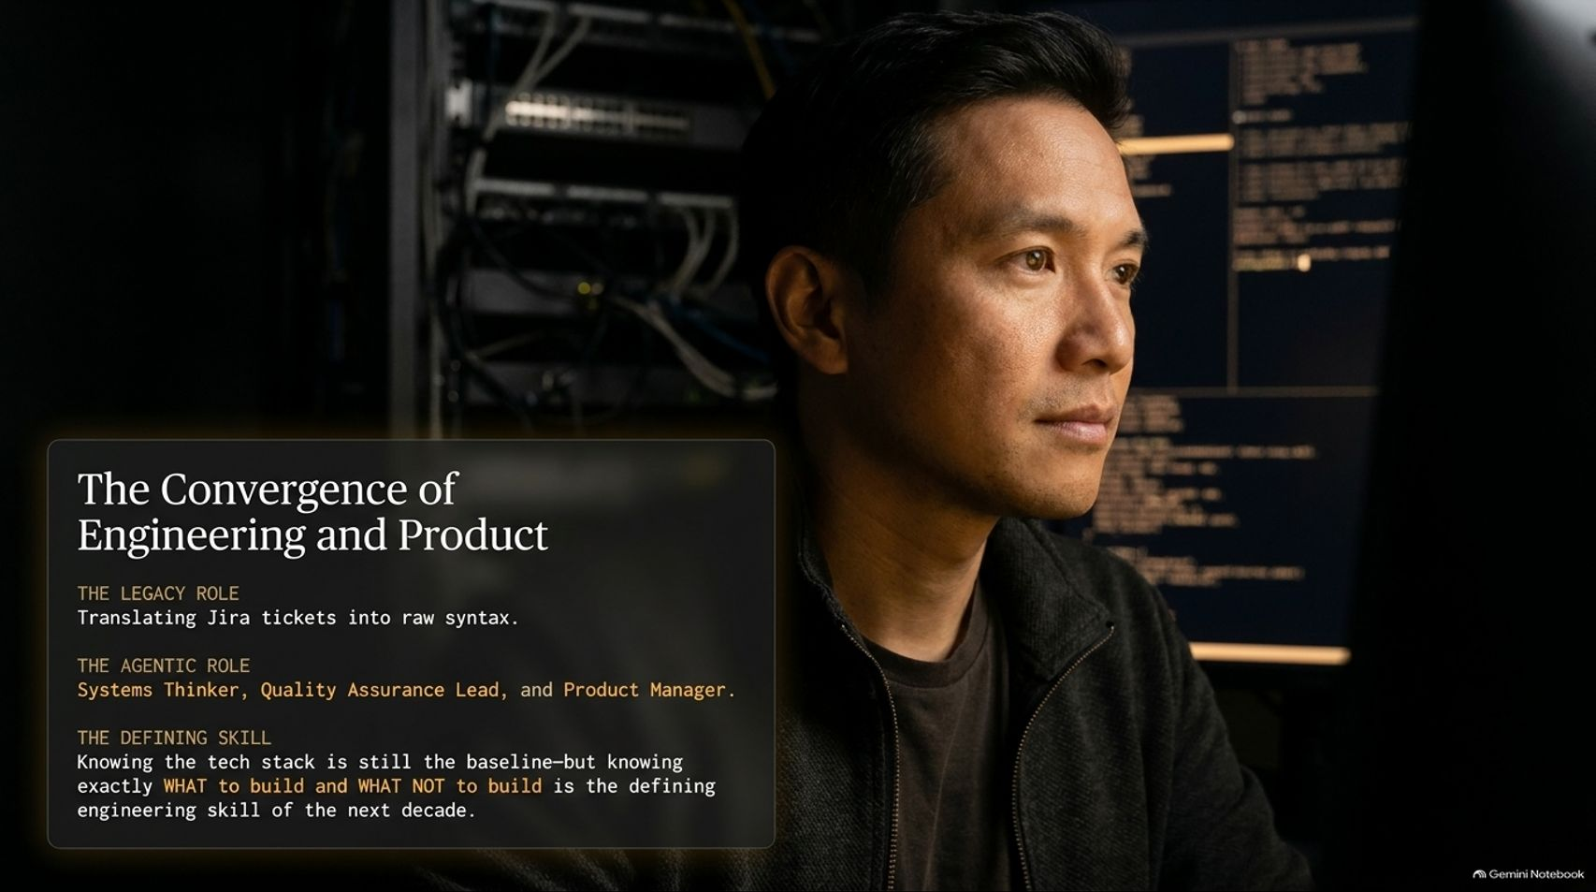
Notes:
Estimated Time: 3.5 – 4.5 minutes
Slide Focus: How the developer's role shifts from translating Jira tickets into syntax to acting as a Systems Thinker, QA Lead, and Product Manager.
Slide Elements:
The Legacy Role: Translating Jira tickets into raw syntax.
The Agentic Role: Systems Thinker, Quality Assurance Lead, and Product Manager.
The Defining Skill: Knowing the tech stack is still the baseline—but knowing exactly WHAT to build and WHAT NOT to build is the defining engineering skill of the next decade.
Speaker Notes: When AI agents can write TypeScript, provision AWS infrastructure, and generate Playwright tests in minutes, what happens to the identity of a software engineer?
For decades, software engineering was largely defined by translation: taking a product requirement or a Jira ticket and manually translating it into syntactically correct code. That translation layer is rapidly commoditizing.
As a result, we are witnessing the convergence of Engineering and Product. Today's high-leverage engineer operates simultaneously as a Systems Thinker (designing clean boundaries and resilient cloud architectures), a Quality Assurance Lead (building automated verification harnesses and edge-case tests), and a Product Manager (evaluating user value and cutting unnecessary features).
Deep technical knowledge of your stack remains the essential baseline—you need it to audit the agent's architecture and catch subtle bugs. However, knowing what to build—and more importantly, what NOT to build—is the defining engineering skill of the next decade.

Slide 13
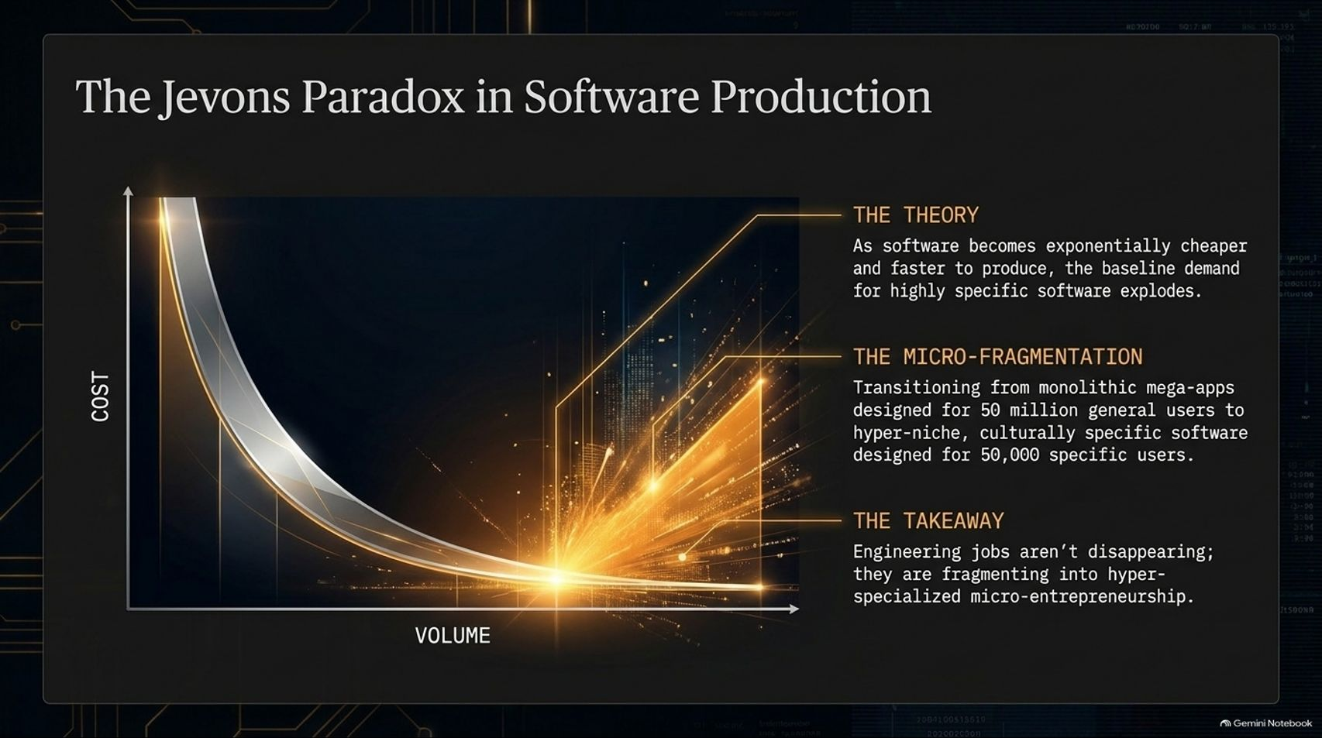
Notes:
Estimated Time: 3.5 – 4.5 minutes
Slide Focus: Applying Jevons Paradox to software economics: cheaper, faster software creation triggers an explosion in demand for hyper-niche, bespoke applications rather than eliminating engineering jobs.
Slide Elements:
The Theory: As software becomes exponentially cheaper and faster to produce, the baseline demand for highly specific software explodes.
The Micro-Fragmentation: Transitioning from monolithic mega-apps designed for 50 million general users to hyper-niche, culturally specific software designed for 50,000 specific users.
The Takeaway: Engineering jobs aren't disappearing; they are fragmenting into hyper-specialized micro-entrepreneurship.
Speaker Notes: Whenever a technological leap makes production dramatically faster, people naturally ask: "Are software developer jobs cooked?"
To answer that, we have to look at Jevons Paradox—the economic principle observed during the Industrial Revolution when steam engines became dramatically more efficient at burning coal. Rather than reducing total coal consumption, making energy cheaper caused coal demand to skyrocket because whole new industries suddenly became economically viable.
The exact same dynamic is playing out in software right now. Historically, building and maintaining a full-stack cloud application required millions of dollars in engineering salaries. Because the fixed cost was so high, software companies were forced to build generic, monolithic "mega-apps" aimed at 50 million broad users just to recoup their R&D costs.
When one engineer can spin up a custom, production-grade cloud service in 90 minutes, the economics invert. We are entering an era of micro-fragmentation—building hyper-niche, culturally or workflow-specific software tailored for 50,000, 5,000, or even 500 specialized users. Engineering jobs aren't vanishing; they are exploding outward into hyper-specialized micro-entrepreneurship and bespoke internal tooling.

Slide 14
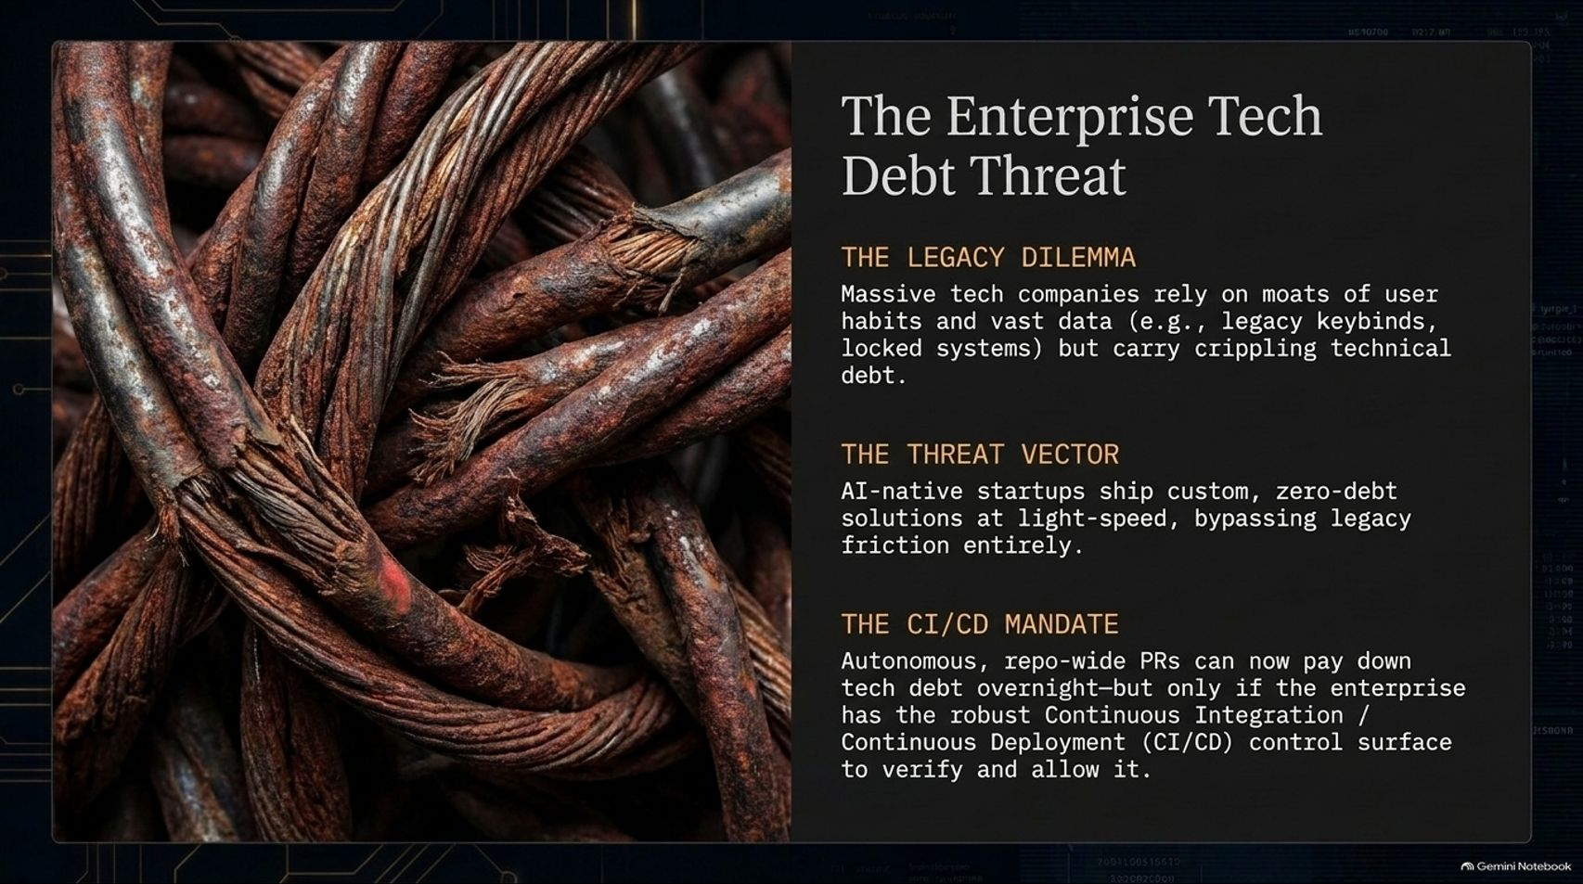
Notes:
Estimated Time: 4 – 5 minutes
Slide Focus: Why incumbent enterprises face an existential threat from zero-debt AI-native startups, and why robust CI/CD pipelines are mandatory to unlock overnight agentic refactoring.
Slide Elements:
The Legacy Dilemma: Massive tech companies rely on moats of user habits and vast data (e.g., legacy keybinds, locked systems) but carry crippling technical debt.
The Threat Vector: AI-native startups ship custom, zero-debt solutions at light-speed, bypassing legacy friction entirely.
The CI/CD Mandate: Autonomous, repo-wide PRs can now pay down tech debt overnight—but only if the enterprise has the robust Continuous Integration / Continuous Deployment (CI/CD) control surface to verify and allow it.
Speaker Notes: While solo builders and small teams are thriving in this new paradigm, large incumbent enterprises face a serious strategic threat.
Established tech companies often rely on defensive moats built around user habits, proprietary data, and high switching costs. However, beneath the surface, many carry decades of crippling technical debt—monolithic codebases, brittle deployment scripts, and undocumented dependencies. Meanwhile, lean, AI-native startups are shipping modern, zero-debt alternatives at breakneck speed.
Here is the good news for enterprises: AI agents are the ultimate weapon for paying down technical debt. You can now unleash autonomous agents to execute massive, repo-wide migrations—upgrading ancient language runtimes, decoupling monoliths, or standardizing APIs—overnight via automated Pull Requests.
However, there is a strict prerequisite: The CI/CD Mandate. An autonomous agent can only refactor a massive enterprise codebase safely if the organization possesses a rock-solid, automated Continuous Integration and Continuous Deployment (CI/CD) control surface. Without comprehensive automated tests, staging environments, and rollback pipelines to verify the agent's PRs, enterprise red tape and fear of outages will paralyze the organization while faster competitors race ahead.

Slide 15
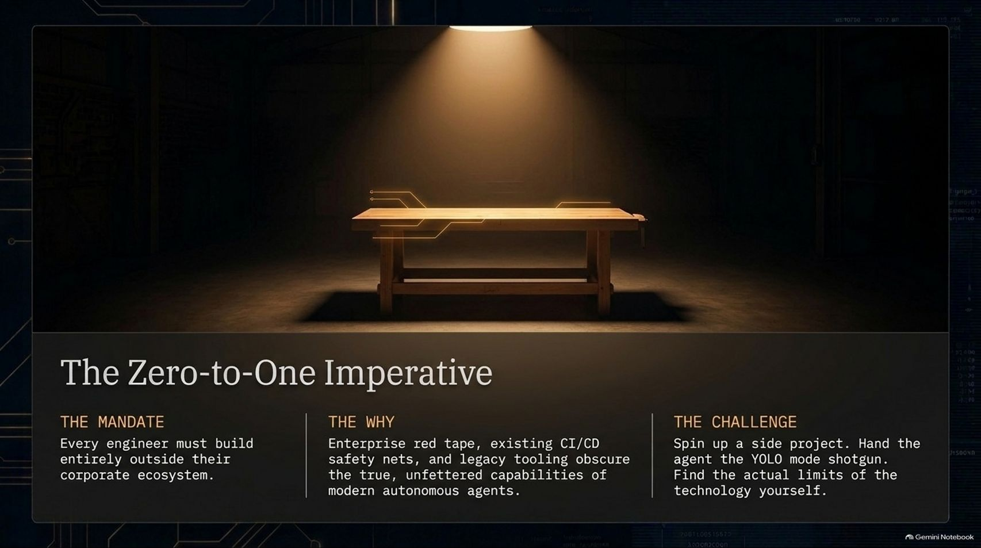
Notes:
Estimated Time: 3 – 4 minutes
Slide Focus: A call to action for every engineer: build a greenfield side project outside corporate red tape to experience the true, unfettered ceiling of autonomous agents.
Slide Elements:
The Mandate: Every engineer must build entirely outside their corporate ecosystem.
The Why: Enterprise red tape, existing CI/CD safety nets, and legacy tooling obscure the true, unfettered capabilities of modern autonomous agents.
The Challenge: Spin up a side project. Hand the agent the YOLO mode shotgun. Find the actual limits of the technology yourself.
Speaker Notes: If you take only one practical action item away from today's presentation, let it be this: The Zero-to-One Imperative.
If your only exposure to AI coding tools is inside a heavily locked-down corporate repository—surrounded by legacy monoliths, strict compliance proxies, and slow build pipelines—you have a distorted view of what modern models can actually do. Corporate friction obscures the true ceiling of agentic software engineering.
To calibrate your intuition, every engineer needs to build something from zero to one completely outside their corporate ecosystem. Spin up a personal side project over a weekend. Start from an empty directory, hand Claude Code the keys in YOLO Mode, and push the agent until it breaks.
Discover firsthand where the model shines, where it hallucinates, and how fast you can ship when all organizational friction is stripped away. Once you experience that velocity firsthand, you can bring those patterns back into your day job and advocate for modernizing your team's engineering harness.

Slide 16
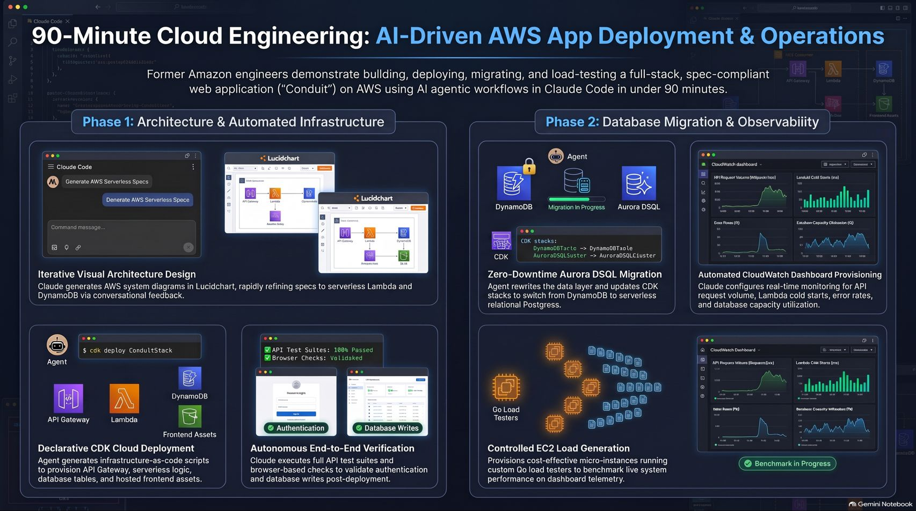
Notes:
Estimated Time: 3 – 4 minutes
Slide Focus: Visual end-to-end recap of Phase 1 (Architecture & Automated Infrastructure) and Phase 2 (Database Migration & Observability).
Speaker Notes: To close, this final visual summary brings together the entire 90-minute arc we just walked through, divided into two cohesive phases.
In Phase 1: Architecture & Automated Infrastructure, we started with conversational system design—generating LucidChart diagrams and refining an over-engineered blueprint down to a lean serverless stack. From there, Claude Code generated declarative AWS CDK scripts, deployed API Gateway, Lambda, DynamoDB, and CloudFront assets directly from the terminal, and validated the live deployment using automated Playwright browser and API test suites.
In Phase 2: Database Migration & Observability, we pushed the agent into live operational engineering—executing a zero-downtime migration from DynamoDB to serverless relational Aurora DSQL while enforcing retention guardrails. Finally, the agent provisioned real-time CloudWatch dashboards and spun up an EC2 instance running custom Go load testers to benchmark 5,750 live requests.
This is the new meta of software engineering: humans setting architectural direction, defining safety guardrails, and auditing outcomes—while autonomous agents handle the heavy lifting of execution. Thank you all for your time, and I'd love to open the floor for questions.

