Slide 1
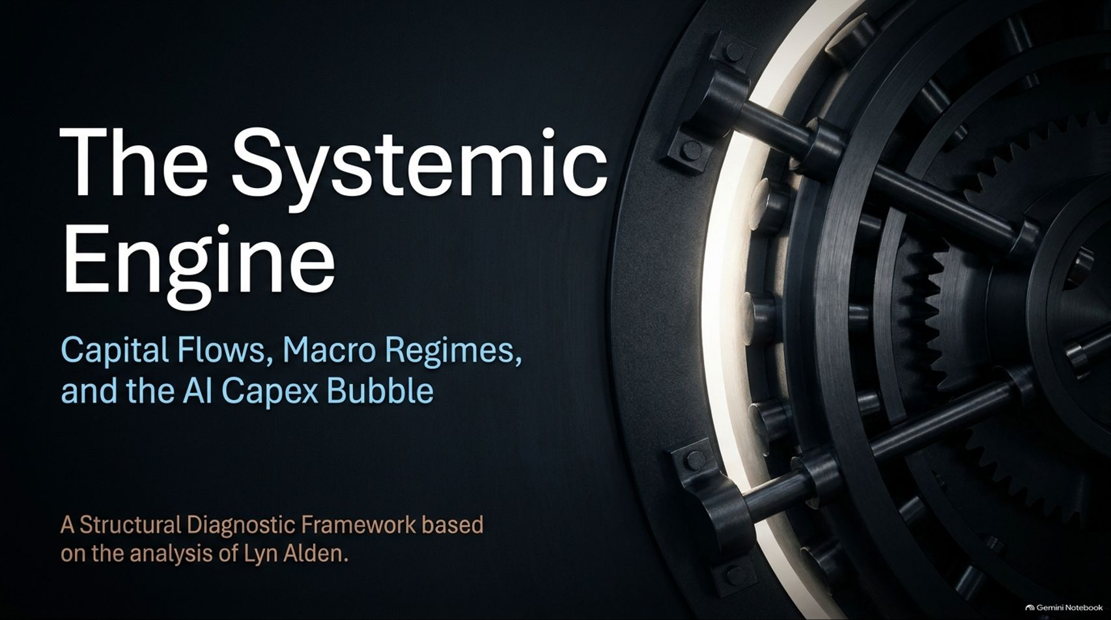
Notes:
Title: The Systemic Engine: Capital Flows, Macro Regimes, and the AI Capex Bubble
Target Duration: 2–3 minutes
Speaker Notes:
"Welcome, everyone. Today we are unpacking a comprehensive diagnostic framework that connects macro liquidity regimes to the monumental capital shifts happening across the artificial intelligence landscape.
Based on the structural analysis of macro strategist Lyn Alden, we aren't just looking at tech headlines or daily market noise; we are looking at the underlying plumbing of the global financial system.
Over the course of this presentation, we’ll explore how structural 7% GDP deficits, over-$1-trillion interest expense floors, and an inverted AI CapEx pyramid are creating a unique two-speed economic reality.
We will examine why the frontier model layer resembles an unstable Jenga block, why the semiconductor trade behaves rationally compared to consumer staples, and how investors can position themselves for the inevitable transition from infrastructure overbuild to real-world productivity winners. Let’s dive into the core mechanics."
Anthropic IPO Could Pop The Bubble...And Much More (w/Lyn Alden)
https://www.youtube.com/watch?v=7UopY9pKCsA

Slide 2
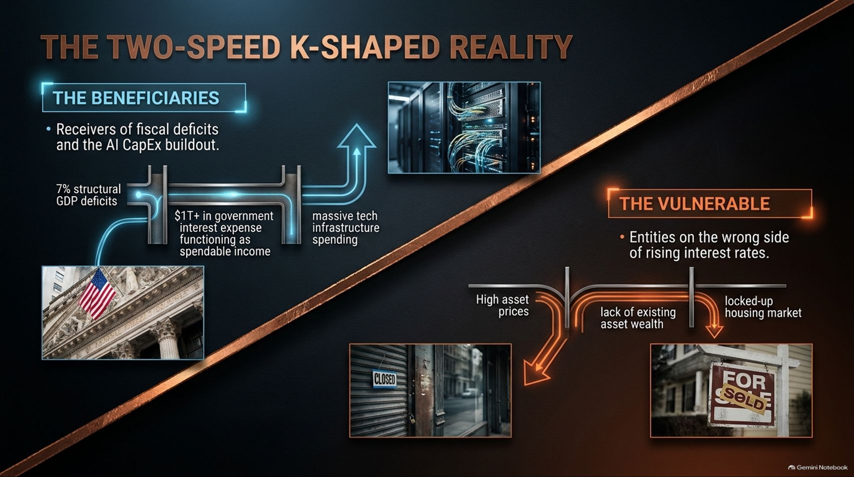
Notes:
Title: The Two-Speed K-Shaped Reality
Target Duration: 3–4 minutes
Speaker Notes:
"To understand where capital is flowing today, we first have to recognize that the modern economy is operating on a two-speed, K-shaped trajectory.
On the top arm of the K, we find the beneficiaries: those directly receiving the tailwinds of structural government deficits and massive tech infrastructure spending. With over $1 trillion in annual government interest expense functioning as spendable income, cash is actively being pumped into specific sectors.
Conversely, on the bottom arm, we see the vulnerable entities trapped on the wrong side of high interest rates. Younger families locked out of an illiquid housing market and consumers lacking asset wealth face a grindy, high-cost environment.
This divergence is not an accident; it is the direct outcome of fiscal injections interacting unevenly with restricted private credit and elevated borrowing costs."

Slide 3
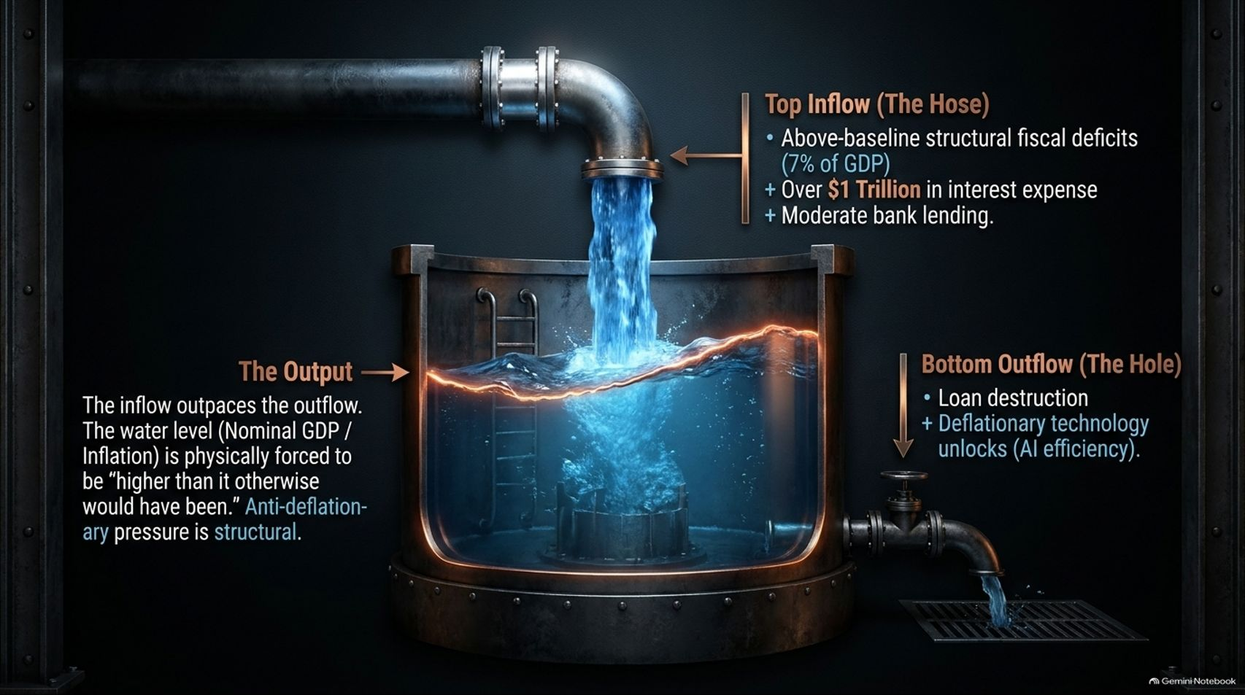
Notes:
Title: The Macro Plumbing: Inflows, Outflows, and the Net Water Level
Target Duration: 3–5 minutes
Speaker Notes:
"Let's visualize this macroeconomic engine as a giant industrial tank. At the top, we have the primary inflow—the hose—driven by above-baseline structural fiscal deficits running at roughly 7% of GDP, augmented by over a trillion dollars in government interest payments and moderate bank lending.
On the right side, the bottom outflow or hole consists of two main forces: private sector loan destruction and deflationary technology unlocks, particularly AI-driven efficiencies.
The net result? The inflow consistently outpaces the outflow. Consequently, the water level—representing nominal GDP and inflation—is physically forced to stay higher than it otherwise would have been.
As Lyn Alden emphasizes, this environment isn't a hyper-inflationary disaster like 2020, but it is structurally anti-deflationary, creating a resilient economic floor that catches the broader market before it can crash into a deep recession. "

Slide 4
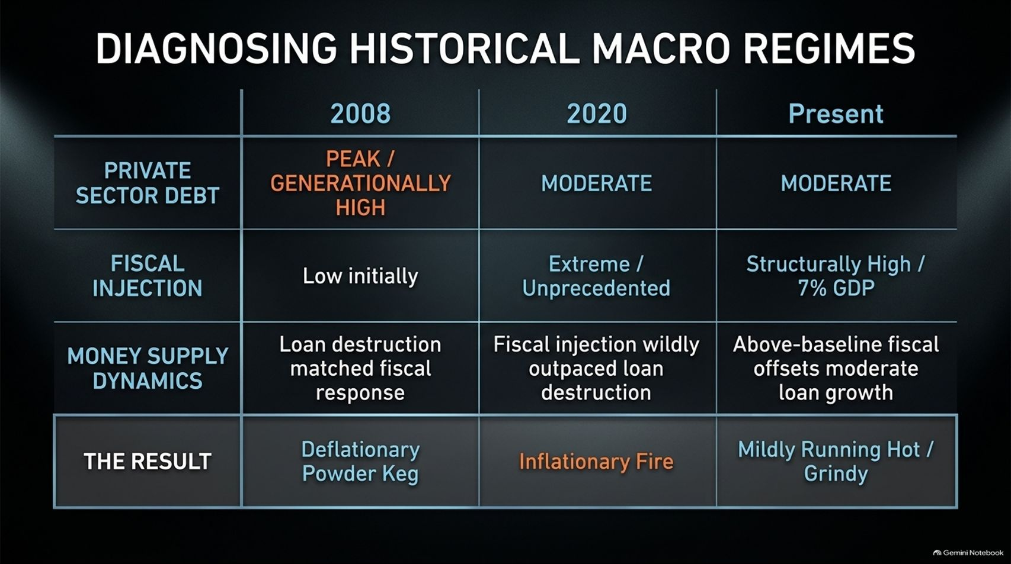
Notes:
Title: Diagnosing Historical Macro Regimes
Target Duration: 4–6 minutes
Speaker Notes:
"To appreciate why the present macro setup behaves the way it does, we must run a diagnostic comparison across three distinct eras: 2008, 2020, and the Present.
In 2008, private sector debt was at a generationally high peak. When the housing bubble burst, massive loan destruction matched a sluggish initial fiscal response, turning the economy into a deflationary powder keg.
In 2020, private sector debt was moderate, but the fiscal injection was extreme and unprecedented—wildly outpacing loan destruction and igniting an inflationary fire.
Today, in the Present, private sector debt is moderate, but we have a structurally high 7% fiscal deficit serving as a permanent baseline. Above-baseline fiscal spending offsets moderate loan growth, resulting in an economy that is mildly running hot, or 'grindy'. Understanding this framework prevents us from misapplying 2008 deflationary panic or 2020 hyper-stimulus assumptions to our current market reality."

Slide 5
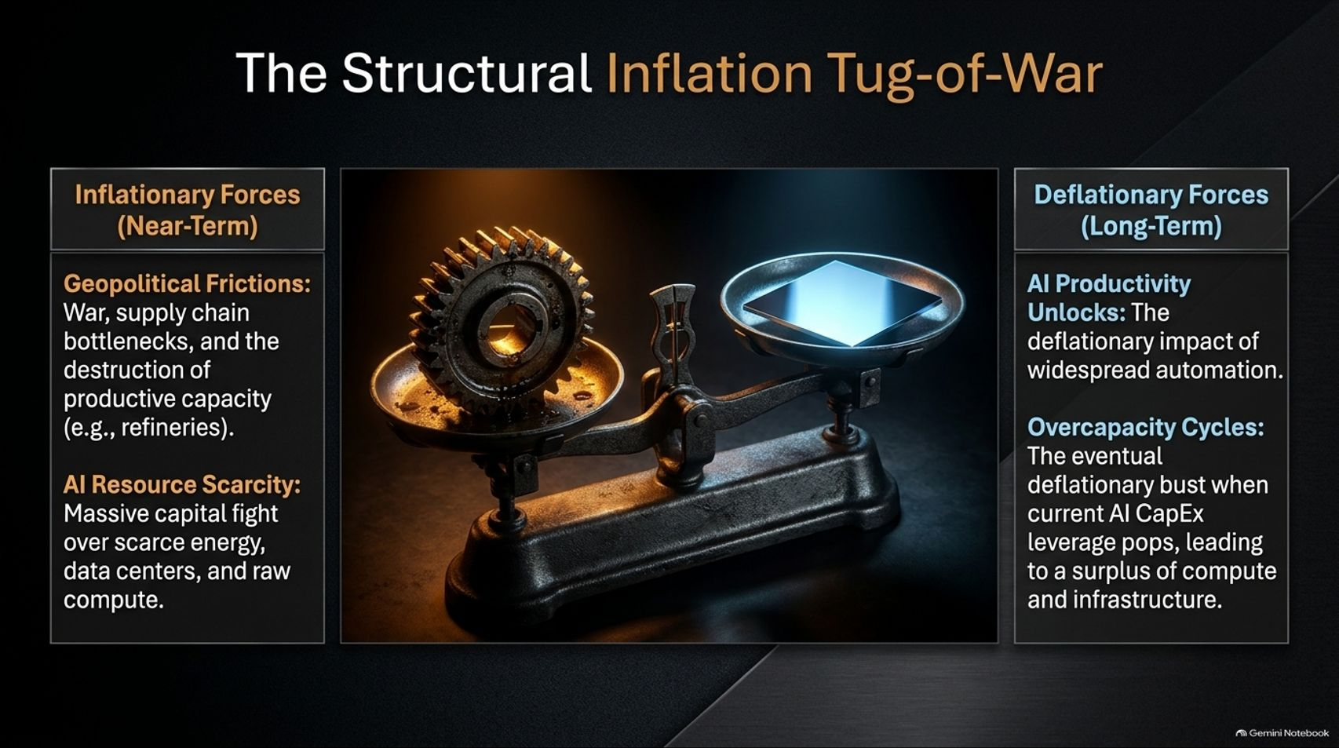
Notes:
Title: The Structural Inflation Tug-of-War
Target Duration: 3–5 minutes
Speaker Notes:
"Inflation today is locked in a fierce structural tug-of-war between near-term inflationary pressures and long-term deflationary forces.
On the left side of the scale, near-term inflationary forces are dominated by geopolitical frictions—such as conflicts, supply chain bottlenecks, and the physical destruction of productive capacity like oil refineries—alongside massive AI resource scarcity. Tech giants are currently fighting a capital war over scarce energy grids, data center land, and raw compute.
On the right side, long-term deflationary forces loom on the horizon. These include AI productivity unlocks, where widespread automation drives down operational costs, and inevitable overcapacity cycles. Once the current AI CapEx leverage pops, a surplus of compute and infrastructure will flood the market, unlocking massive deflationary pressure."

Slide 6
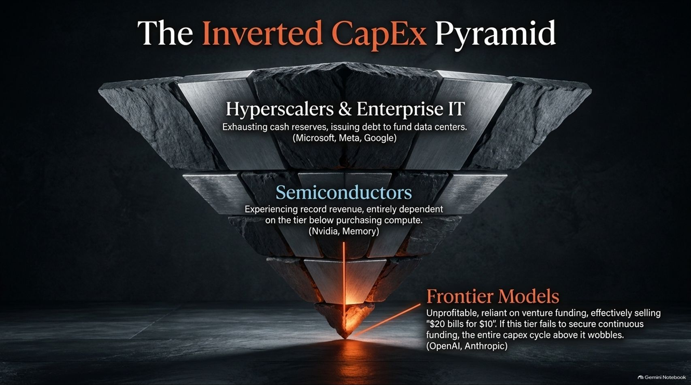
Notes:
Title: The Inverted CapEx Pyramid
Target Duration: 4–6 minutes
Speaker Notes:
"When we look at the architecture of the AI boom, it resembles a fragile, inverted Jenga puzzle—an Inverted CapEx Pyramid.
At the broad base sitting on top are the Hyperscalers and Enterprise IT (Microsoft, Meta, Google, Alphabet). They are exhausting cash reserves and issuing debt to fund multi-billion-dollar data centers.
In the middle layer are Semiconductors (Nvidia, memory producers), experiencing record revenues, yet entirely dependent on the tier below purchasing compute.
At the tiny, precarious point at the very bottom are the Frontier Models (OpenAI, Anthropic). These entities are deeply unprofitable, reliant on continuous venture funding, and effectively selling '$20 bills for $10'. If this bottom apex fails to secure continuous funding or stumbles during an IPO, the entire multi-trillion-dollar CapEx structure above it wobbles."

Slide 7
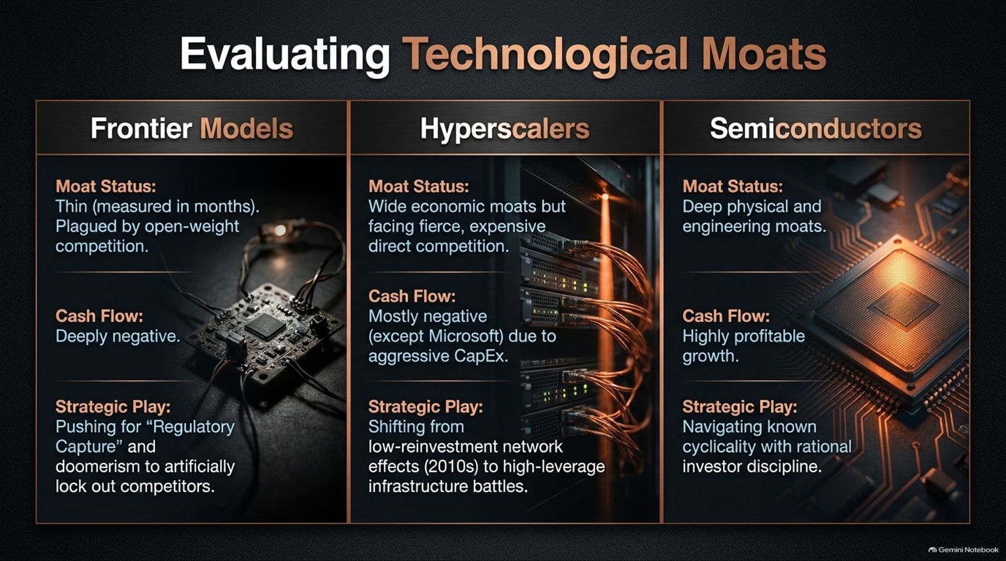
Notes:
Title: Evaluating Technological Moats
Target Duration: 4–6 minutes
Speaker Notes:
"Let’s break down the three layers of the AI ecosystem by evaluating their actual economic moats, cash flows, and strategic plays.
First, Frontier Models possess razor-thin moats measurable in months, plagued by open-weight competition and deeply negative cash flows. Their strategic play? Pushing for regulatory capture and artificial doomerism to lock out competitors.
Second, Hyperscalers have wide economic moats built on legacy businesses, but nearly all of them except Microsoft are currently free cash flow negative due to aggressive CapEx. They are shifting from the low-reinvestment network effects of the 2010s into brutal, high-leverage infrastructure battles.
Third, Semiconductors feature deep physical and engineering moats, highly profitable growth, and a strategic leadership that navigates industry cyclicality with disciplined realism."

Slide 8
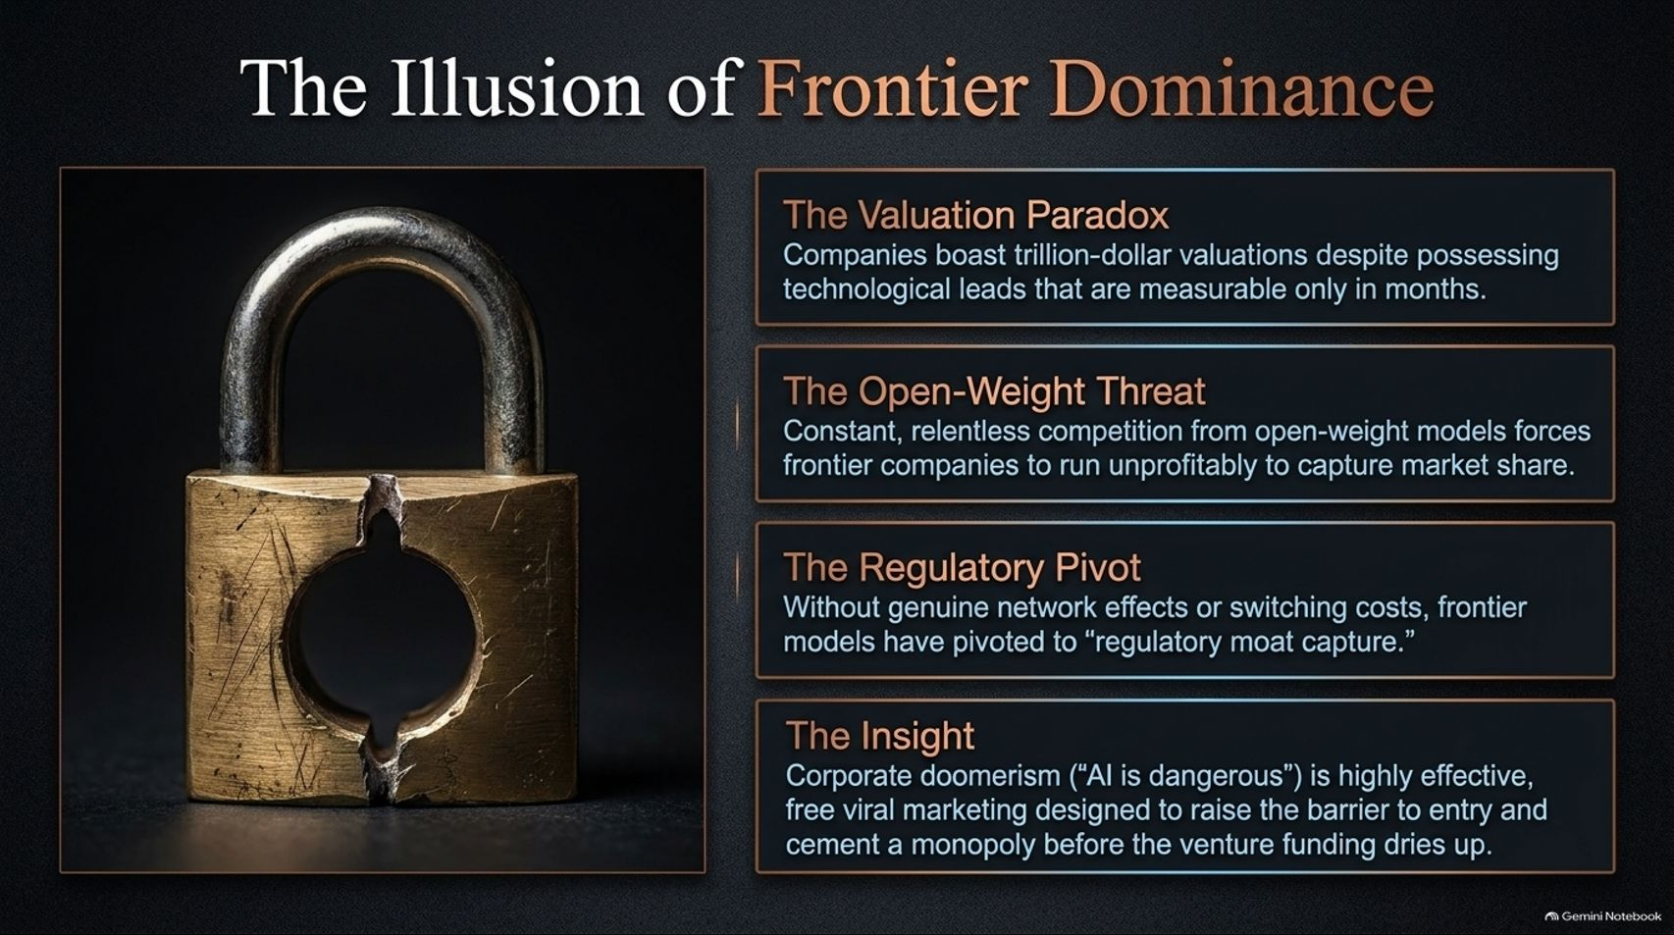
Notes:
Title: The Illusion of Frontier Dominance
Target Duration: 3–5 minutes
Speaker Notes:
"Why do frontier model companies command trillion-dollar valuations when their technological lead is so precarious? This brings us to the Illusion of Frontier Dominance.
It is a Valuation Paradox: commanding massive market caps despite possessing technological leads that evaporate within months.
The Open-Weight Threat is constant; relentless open-source competition forces frontier companies to operate unprofitably just to defend market share.
Lacking genuine network effects or switching costs, these companies have executed a Regulatory Pivot—turning to 'regulatory moat capture'.
Corporate doomerism ('AI is dangerous') functions as brilliant, free viral marketing designed to raise compliance barriers, cementing monopolies before venture funding dries up."

Slide 9
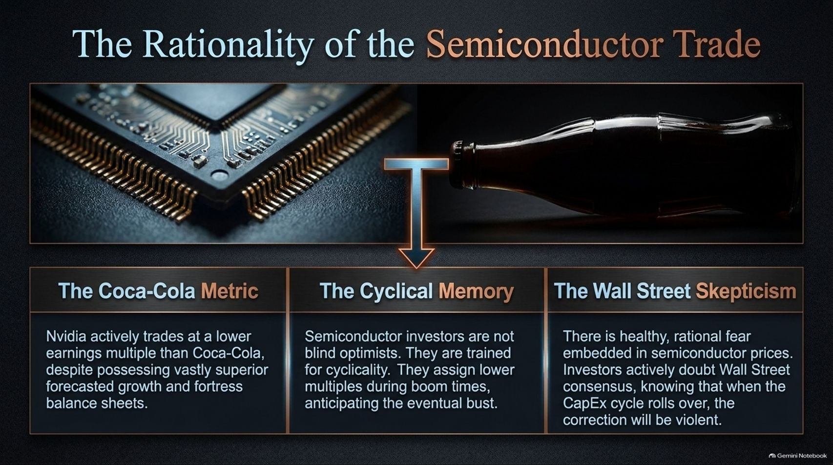
Notes:
Title: The Rationality of the Semiconductor Trade
Target Duration: 3–5 minutes
Speaker Notes:
"Many retail investors view semiconductor stocks as a dangerous bubble, but looking at the underlying metrics reveals a different story: The Rationality of the Semiconductor Trade.
Consider the Coca-Cola Metric: Nvidia has frequently traded at a lower earnings multiple than Coca-Cola, despite possessing vastly superior forecasted growth and a fortress balance sheet.
Furthermore, Cyclical Memory investors are not blind optimists; they are conditioned by decades of cyclicality, assigning lower multiples during boom times precisely because they anticipate the eventual bust.
There is healthy, rational fear embedded in semiconductor prices. Investors actively doubt Wall Street consensus, knowing that when the CapEx cycle rolls over, the correction will be sharp."

Slide 10
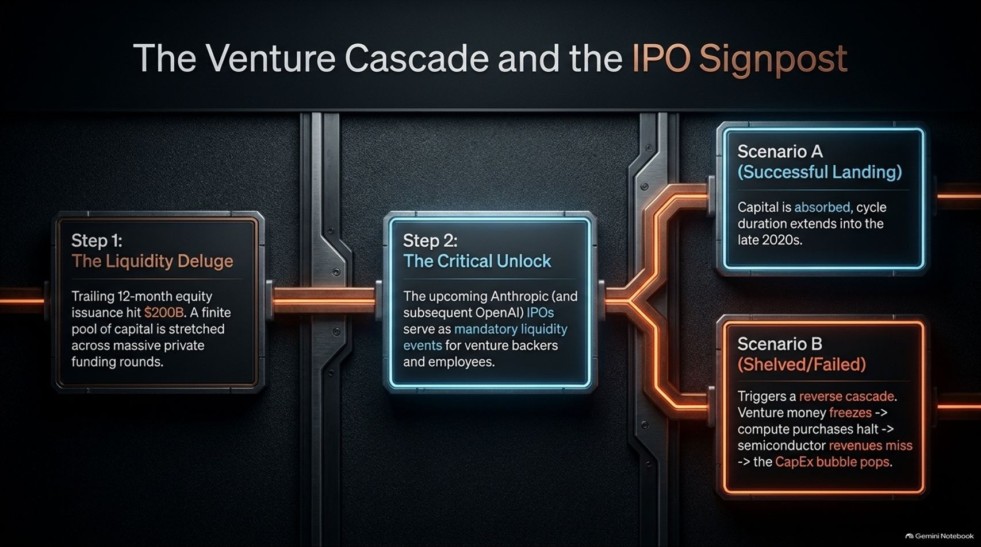
Notes:
Title: The Venture Cascade and the IPO Signpost
Target Duration: 4–6 minutes
Speaker Notes:
"How does this cycle ultimately resolve? We are tracking a clear Venture Cascade and IPO Signpost.
Step 1 (The Liquidity Deluge): Trailing 12-month equity issuance hit $200 billion against a finite pool of private capital.
Step 2 (The Critical Unlock): Upcoming high-profile IPOs—such as Anthropic and OpenAI—serve as mandatory liquidity events for venture backers and employees.
This brings us to a fork in the road: Scenario A (Successful Landing), where capital is absorbed smoothly and the cycle extends into the late 2020s; or Scenario B (Shelved/Failed IPOs), which triggers a reverse cascade: venture money freezes, compute purchases halt, semiconductor revenues miss, and the entire AI CapEx bubble pops."

Slide 11
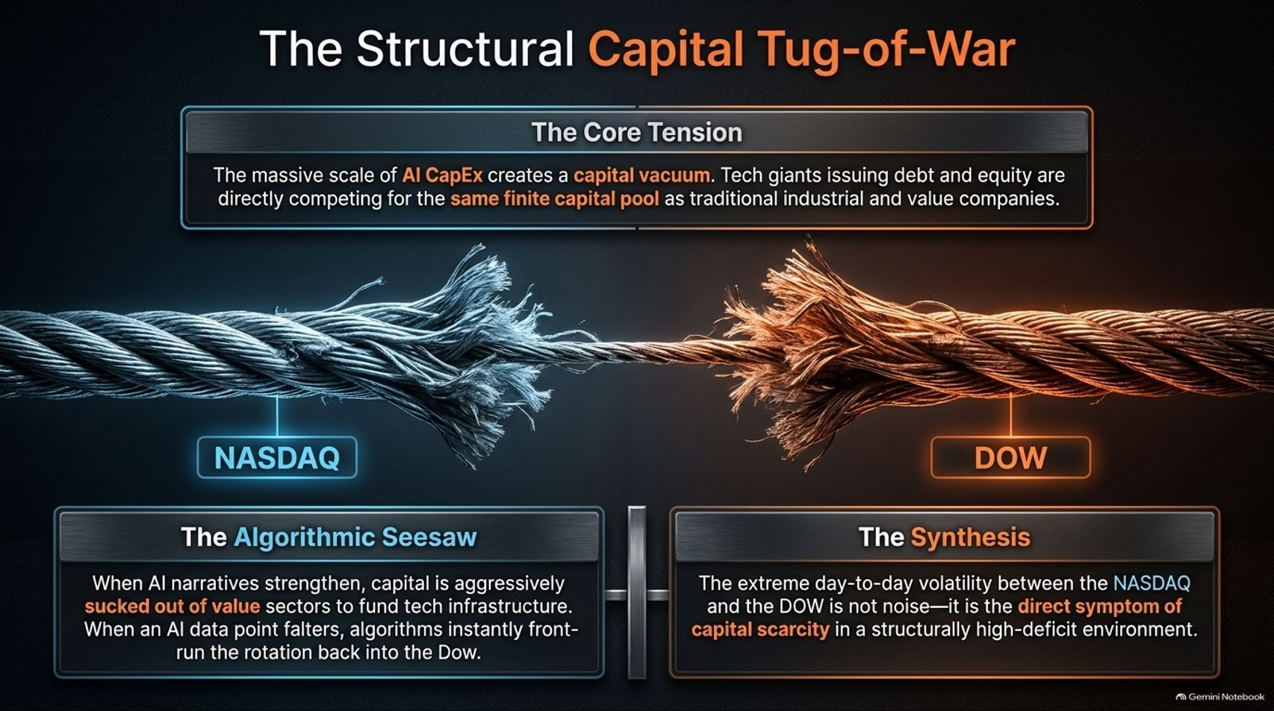
Notes:
Title: The Structural Capital Tug-of-War
Target Duration: 3–5 minutes
Speaker Notes:
"Zooming out to the broader market, we witness a Structural Capital Tug-of-War between the tech-heavy NASDAQ and the value-heavy DOW.
The core tension stems from the massive scale of AI CapEx creating a financial vacuum. Tech giants issuing debt and equity directly compete for the exact same finite capital pool as traditional industrial and value companies.
Through the Algorithmic Seesaw, when AI narratives surge, capital is aggressively sucked out of value sectors to fund tech infrastructure. When an AI data point falters, algorithms instantly rotate capital back into the Dow.
This extreme day-to-day market volatility is not random noise; it is the direct symptom of capital scarcity in a structurally high-deficit environment."

Slide 12
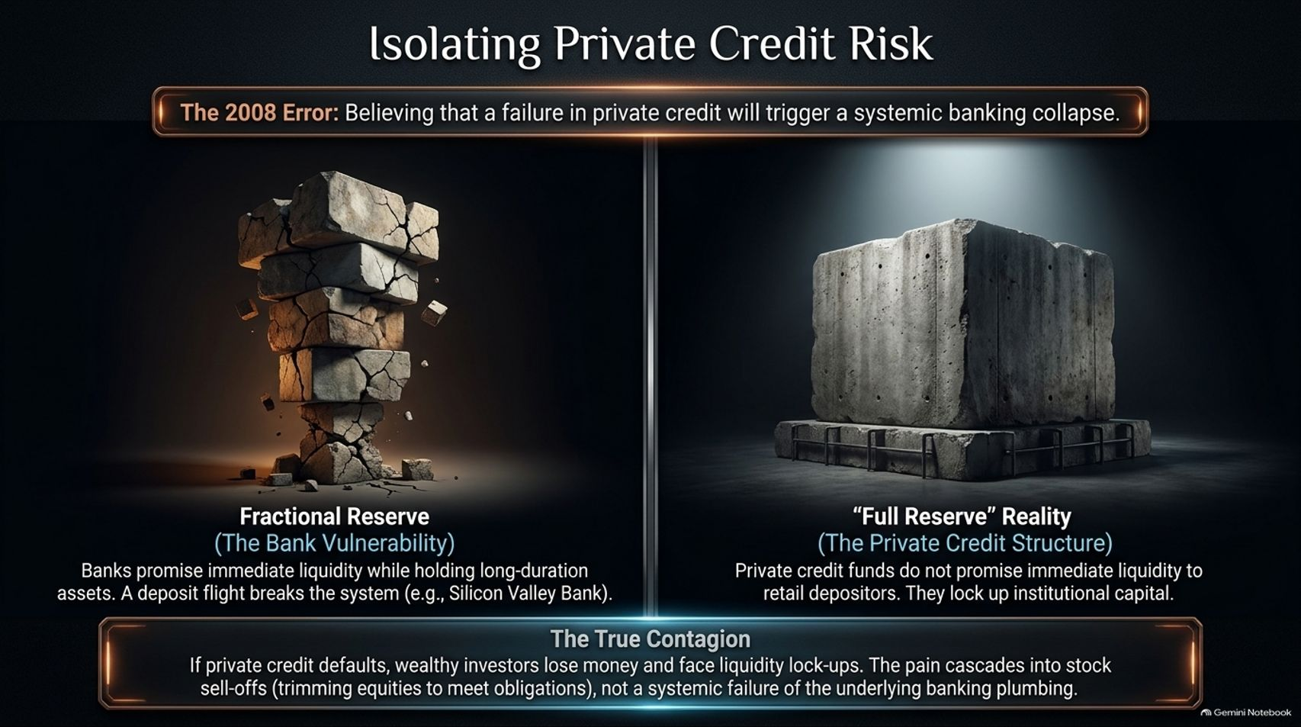
Notes:
Title: Isolating Private Credit Risk
Target Duration: 4–6 minutes
Speaker Notes:
"A major anxiety in modern macro commentary is whether private credit will trigger a systemic banking collapse like 2008. Lyn Alden argues that this fear is largely misplaced.
Traditional banks operate on Fractional Reserve mechanics—promising immediate liquidity to depositors while holding long-duration, illiquid assets, creating extreme vulnerability to deposit flight (e.g., Silicon Valley Bank).
In contrast, Private Credit Structures operate closer to a 'Full Reserve' reality. Private credit funds do not promise immediate daily liquidity to retail depositors; they lock up institutional capital over multi-year periods.
Therefore, The True Contagion is isolated: if private credit funds suffer defaults, wealthy institutional investors take losses and face liquidity lock-ups. This may cause localized stock sell-offs as investors trim equities to meet cash obligations, but it does not rupture the underlying plumbing of the commercial banking system."

Slide 13
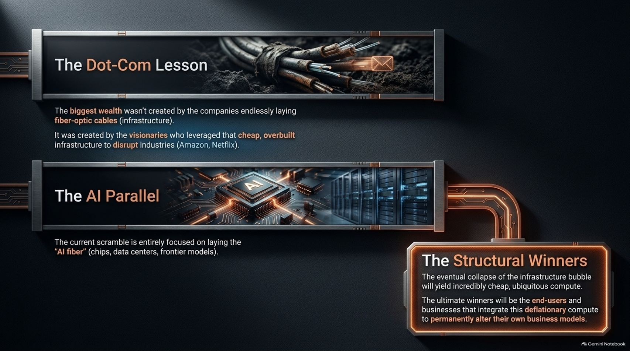
Notes:
Title: The Dot-Com Lesson and the AI Parallel
Target Duration: 3–5 minutes
Speaker Notes:
"History offers a vital blueprint through The Dot-Com Lesson. During the late 1990s, the greatest generational wealth wasn't created by the companies endlessly laying fiber-optic cables—the infrastructure builders.
Instead, wealth was created by visionaries who later leveraged that cheap, overbuilt infrastructure to disrupt entirely new industries—such as Amazon and Netflix.
We see an exact AI Parallel today. The current corporate scramble is entirely focused on laying 'AI fiber'—chips, data centers, and frontier models.
The eventual collapse of this infrastructure bubble will yield incredibly cheap, ubiquitous compute. The Structural Winners will ultimately be the end-users and businesses that integrate this deflationary compute to permanently alter their own business models."

Slide 14
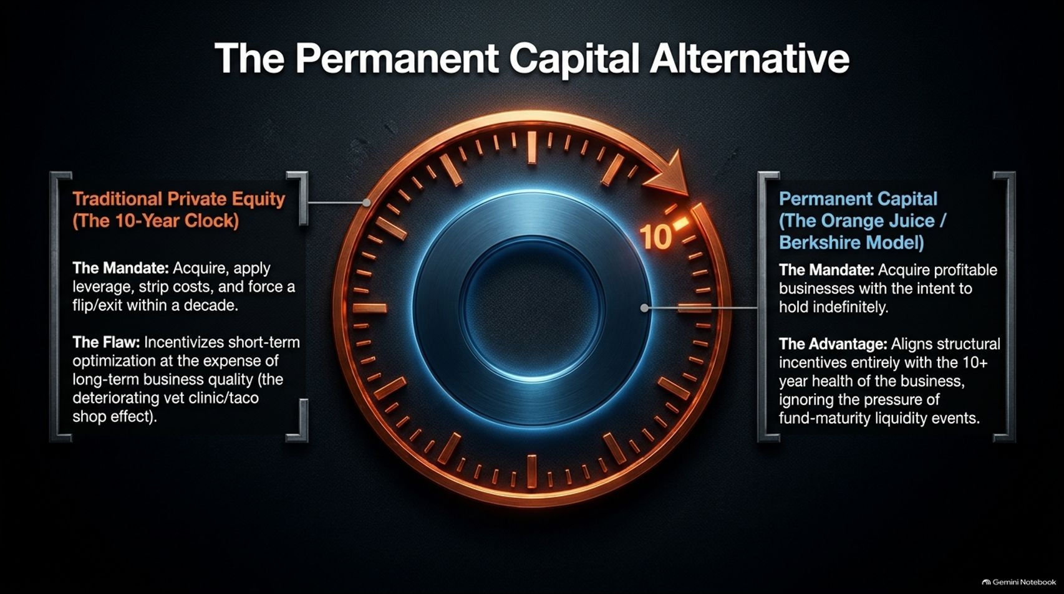
Notes:
Title: The Permanent Capital Alternative
Target Duration: 3–5 minutes
Speaker Notes:
"Shifting from public markets to private business ownership, we examine The Permanent Capital Alternative versus Traditional Private Equity.
Traditional Private Equity operates on a 10-Year Clock. Its mandate is to acquire companies using heavy leverage, strip costs, and force a flip or exit within a decade. The structural flaw is that it incentivizes short-term financial optimization at the expense of long-term business quality—often called the deteriorating local business effect.
Conversely, Permanent Capital—following the Berkshire Hathaway model—acquires profitable businesses with the explicit intent to hold indefinitely.
This model aligns structural incentives entirely with the 10-plus-year health of the enterprise, eliminating the destructive pressure of fund-maturity liquidity events."

Slide 15
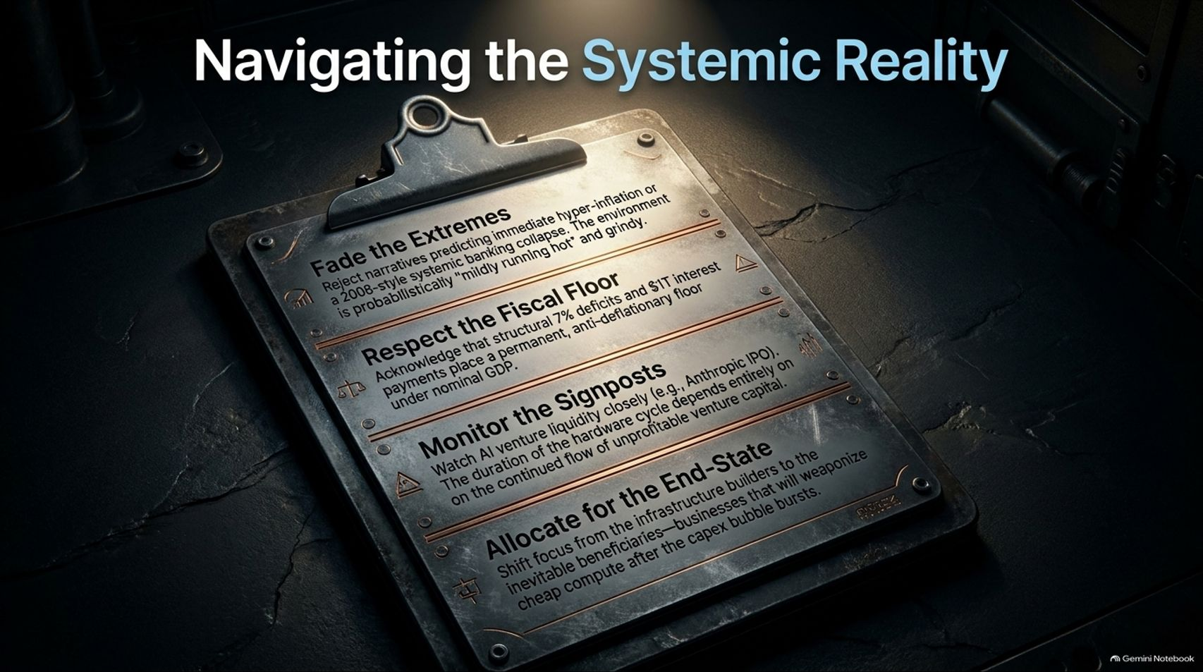
Notes:
Title: Navigating the Systemic Reality
Target Duration: 3–4 minutes
Speaker Notes:
"To synthesize our framework into actionable strategy, we must follow four core rules for Navigating the Systemic Reality:
Fade the Extremes: Reject sensationalist narratives predicting immediate hyper-inflation or a 2008-style systemic banking collapse. The macro environment is probabilistic, grindy, and mildly running hot.
Respect the Fiscal Floor: Acknowledge that structural 7% deficits and $1 trillion in interest payments place a permanent anti-deflationary floor under nominal GDP.
Monitor the Signposts: Watch AI venture liquidity closely, including major IPOs like Anthropic. The duration of the hardware cycle depends entirely on continued capital flows into unprofitable ventures.
Allocate for the End-State: Shift focus away from infrastructure builders and toward the inevitable downstream businesses that will weaponize cheap compute after the CapEx bubble bursts."

Slide 16


