Slide 1

Notes:
Automate Everything: The Most Valuable Skill You Can Learn Before 2027
https://www.youtube.com/watch?v=zNf4dTjI-NM

Slide 2
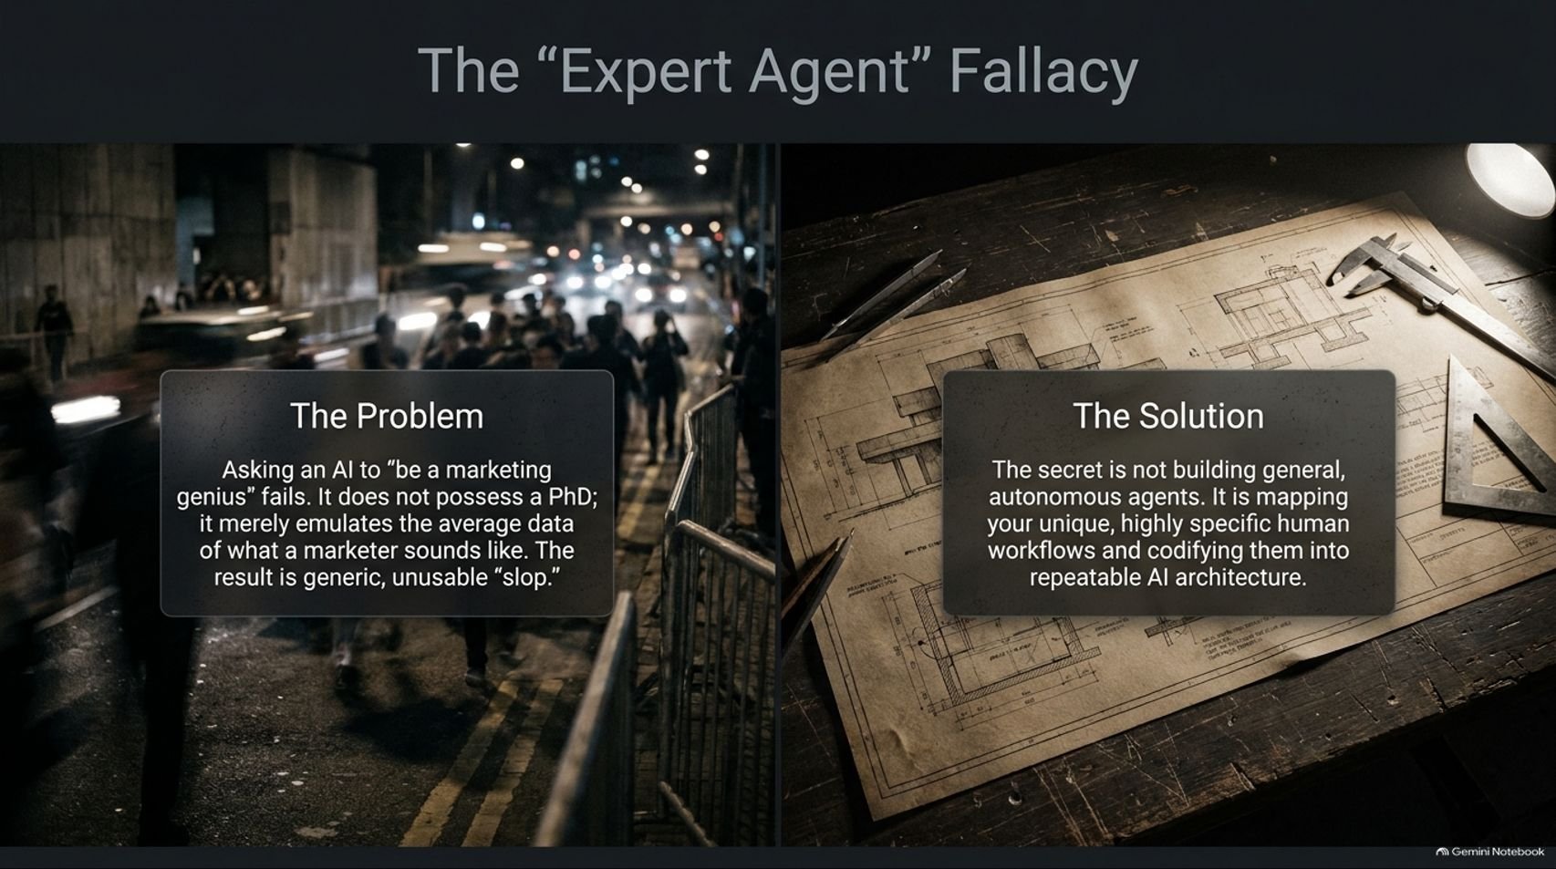
Notes:
Title: The "Expert Agent" Fallacy
Target Duration: 3–4 minutes
Speaker Notes:
"Let's start by addressing The Problem: the classic trap of asking an AI to 'be a marketing genius' or a 'senior accountant.'
When you type a prompt like that, the AI doesn't suddenly acquire a PhD; it merely emulates the average statistical data of what a marketer or accountant sounds like. The result is generic, surface-level output that lacks real business context.
The Solution is not building vague, autonomous agents that wander around guessing what you want. The secret is mapping your unique, highly specific human workflows and codifying them into repeatable AI architecture.
Instead of treating the model like an all-knowing expert, we need to treat it like an eager intern that requires exact boundaries, clear context, and structured Standard Operating Procedures."

Slide 3
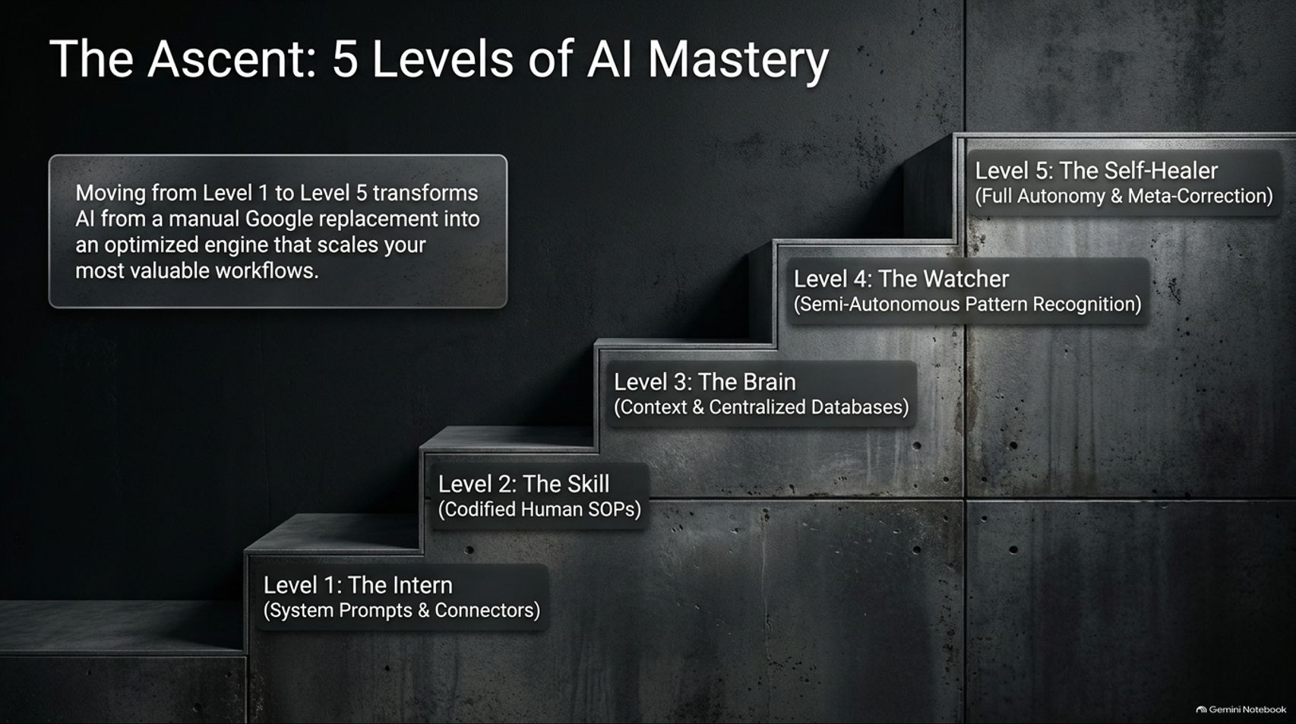
Notes:
Title: The Ascent: 5 Levels of AI Mastery
Target Duration: 3–5 minutes
Speaker Notes:
"To successfully integrate AI into your professional life or enterprise, you need a roadmap. We call this The Ascent: 5 Levels of AI Mastery.
Moving from Level 1 to Level 5 transforms AI from a manual Google replacement into an optimized engine that scales your most valuable workflows.
Level 1 is The Intern: basic system prompts and simple tool connectors.
Level 2 is The Skill: capturing codified human SOPs.
Level 3 is The Brain: moving to centralized, context-optimized databases.
Level 4 is The Watcher: semi-autonomous pattern recognition and automated monitoring.
And finally, Level 5 achieves full autonomy via self-healing systems. Let's walk through each level step-by-step."

Slide 4
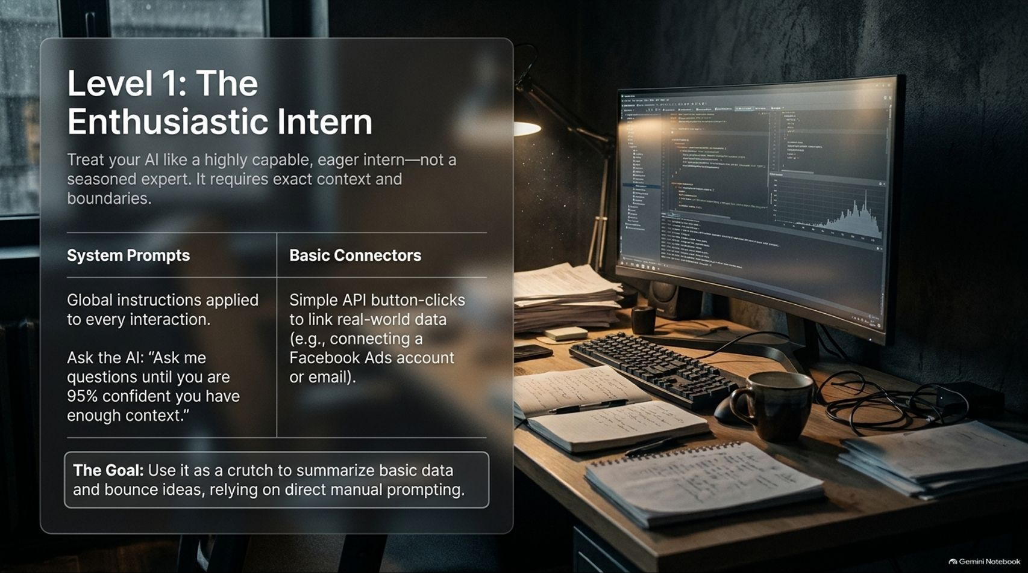
Notes:
Title: Level 1: The Enthusiastic Intern
Target Duration: 3–4 minutes
Speaker Notes:
"At Level 1, you treat your AI like a highly capable, eager intern—not a seasoned expert. It requires exact context and strict boundaries.
This level relies on System Prompts (global custom instructions applied to every interaction) and Basic Connectors (simple API button-clicks to link real-world data like email or ad accounts).
A fantastic tactical trick at this level is to prompt the AI: 'Ask me questions until you are 95% confident you have enough context.' This trains you in giving proper context.
The Goal: Use it as a crutch to summarize basic data, brainstorm ideas, and bounce concepts around, relying on direct manual prompting."

Slide 5
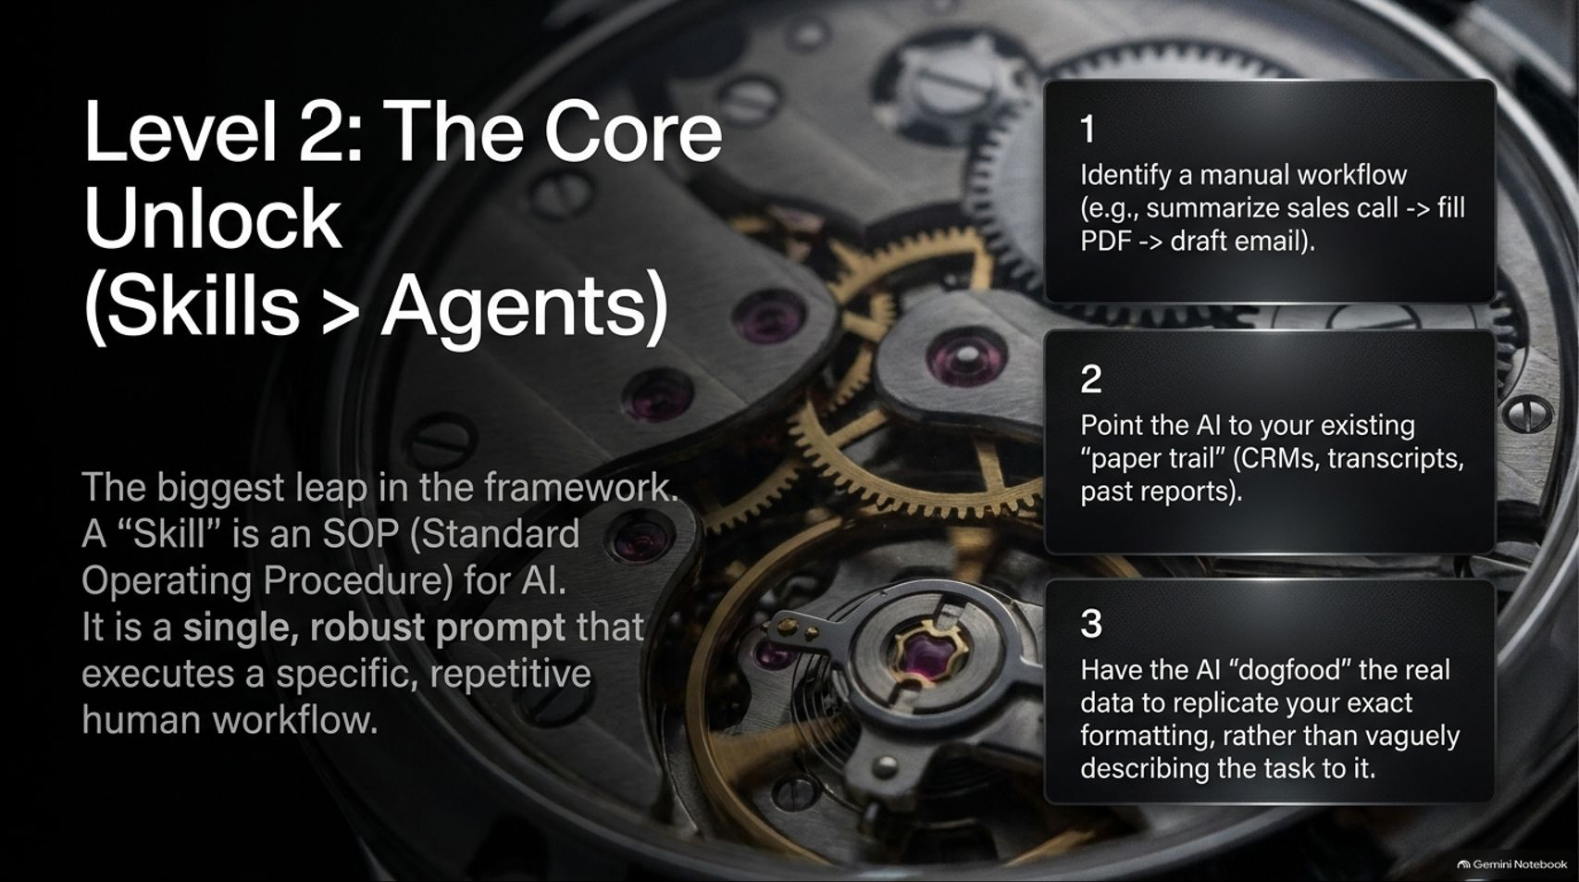
Notes:
Title: Level 2: The Core Unlock (Skills > Agents)
Target Duration: 4–5 minutes
Speaker Notes:
"If there is one single unlock that will give you the highest return on investment in your business, it is Level 2.
The biggest mistake people make is building vague agents. Instead, you must build Skills. A Skill is an SOP (Standard Operating Procedure) for AI—a single, robust prompt that executes a specific, repetitive human workflow.
To build one: 1. Identify a manual workflow, like summarizing a sales call, filling out a PDF, and drafting a follow-up email. 2. Point the AI to your existing paper trail—CRMs, transcripts, past reports. 3. Have the AI 'dogfood' your real data to replicate your exact formatting and tone, rather than vaguely describing the task to it.
Codifying your SOPs turns messy chat sessions into precise, repeatable tools."

Slide 6
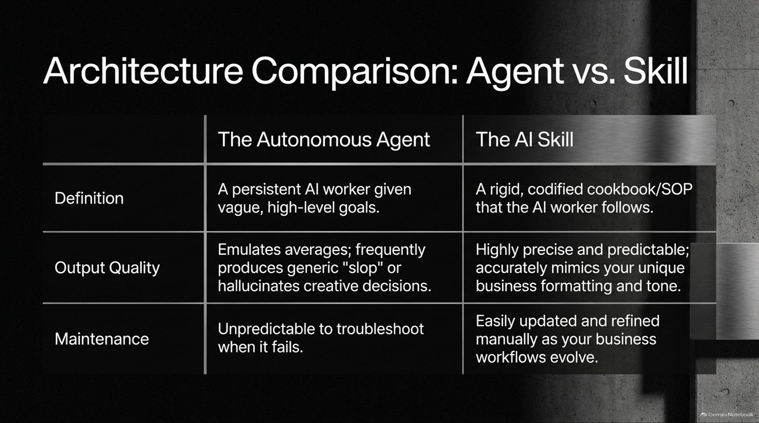
Notes:
Title: Architecture Comparison: Agent vs. Skill
Target Duration: 3–5 minutes
Speaker Notes:
"To clearly see why Level 2 represents such a massive leap, let's look at the architectural differences between an Autonomous Agent and an AI Skill.
An Autonomous Agent is a persistent worker given vague, high-level goals. It frequently produces generic 'slop' or hallucinates creative decisions, and it is unpredictable to troubleshoot when it fails.
An AI Skill, on the other hand, is a rigid, codified cookbook or SOP that the AI worker follows. It produces highly precise and predictable output that accurately mimics your unique business formatting and tone, and it can be easily updated and refined manually as your business evolves.
Stop relying on open-ended agents; build structured skills."

Slide 7
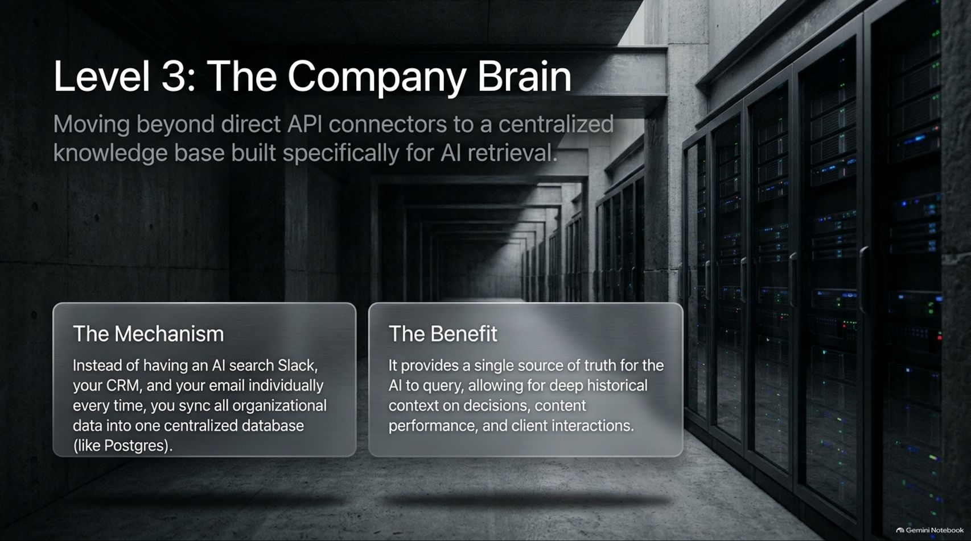
Notes:
Title: Level 3: The Company Brain
Target Duration: 4–6 minutes
Speaker Notes:
"Once you have standardized your skills, you hit Level 3: The Company Brain. This is about moving beyond direct, messy API connectors to a centralized knowledge base built specifically for AI retrieval.
The Mechanism: Instead of having an AI individually search Slack, your CRM, and your email every single time you prompt it, you sync all organizational data into one centralized database—such as a PostgreSQL instance hosted on platforms like Railway.
The Benefit: It provides a single source of truth for the AI to query, allowing for deep historical context on past decisions, content performance, and client interactions without fragmenting your data."

Slide 8
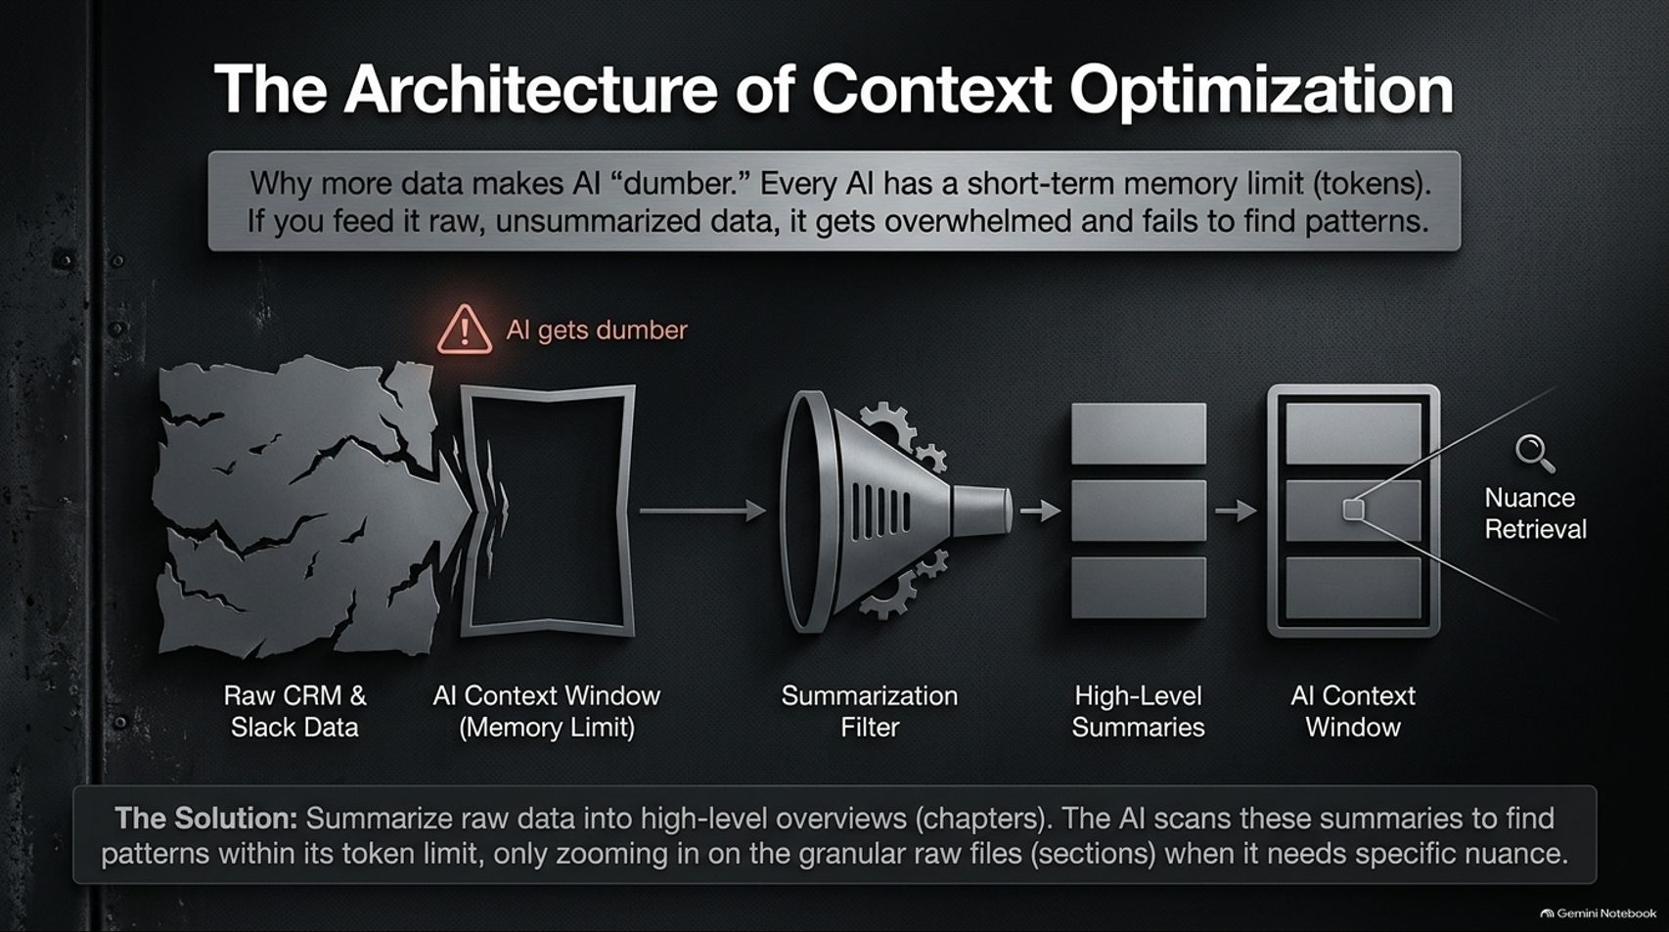
Notes:
Title: The Architecture of Context Optimization
Target Duration: 4–6 minutes
Speaker Notes:
"Why is a Company Brain so crucial? Because of Context Optimization. There is a common myth that 'more data makes AI smarter.' In reality, every AI has a short-term memory limit measured in tokens.
If you feed an AI raw, unsummarized CRM and Slack data, it gets overwhelmed, gets 'dumber,' and fails to find patterns.
The Solution: Use a summarization filter. Raw data is processed into high-level summaries or chapters.
The AI scans these high-level overviews to find patterns within its token limit, only zooming in on the granular raw files (the sections) when it needs specific nuance. This keeps your AI fast, accurate, and cost-efficient."

Slide 9
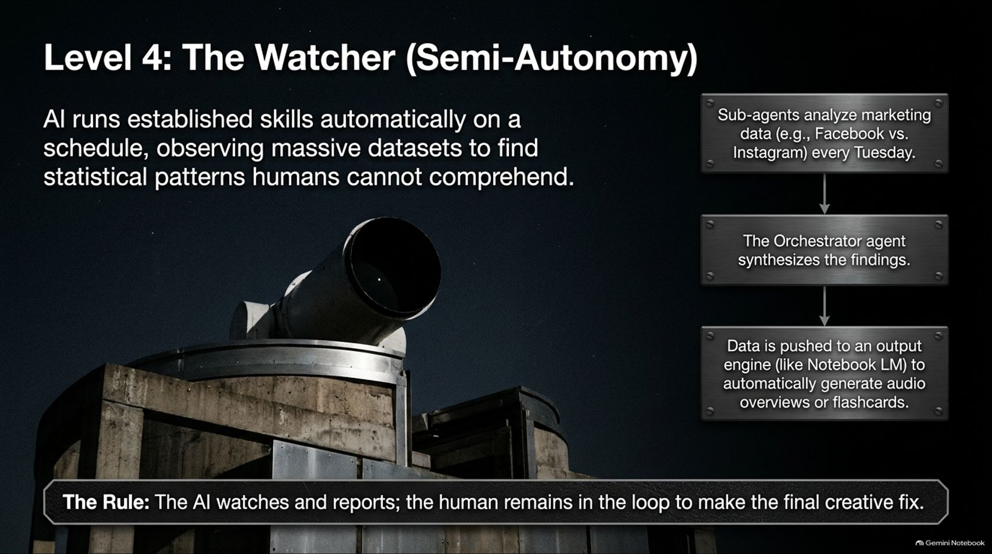
Notes:
Title: Level 4: The Watcher (Semi-Autonomy)
Target Duration: 3–5 minutes
Speaker Notes:
"At Level 4, we enter the realm of semi-autonomy: The Watcher.
Here, the AI runs established skills automatically on a schedule, observing massive datasets to find statistical patterns that humans simply cannot comprehend.
For example, sub-agents might analyze marketing data across Facebook and Instagram every Tuesday. An orchestrator agent synthesizes those findings, and the resulting insights are pushed to an output engine—such as NotebookLM—to automatically generate audio overviews, flashcards, or executive reports.
The Golden Rule here: The AI watches and reports; the human remains firmly in the loop to make the final creative fix or strategic decision."

Slide 10
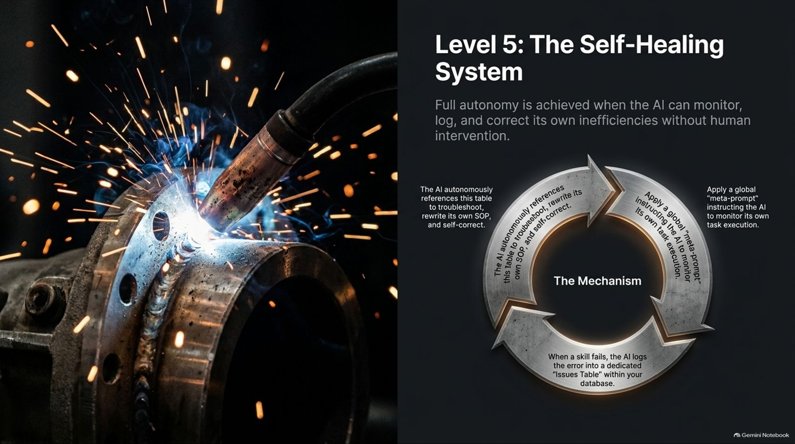
Notes:
Title: Level 5: The Self-Healing System
Target Duration: 4–6 minutes
Speaker Notes:
"At the pinnacle of the framework is Level 5: The Self-Healing System. Full autonomy is achieved when the AI can monitor, log, and correct its own inefficiencies without human intervention.
The Mechanism operates in a continuous loop:
1. Apply a global 'meta-prompt' instructing the AI to monitor its own task execution.
2. When a skill fails or encounters an error, the AI logs the error into a dedicated 'Issues Table' within your database.
3. The AI autonomously references this table to troubleshoot, rewrite its own SOP, and self-correct before running the task again.
This closes the loop, turning your automation into a self-improving, autonomous asset."

Slide 11
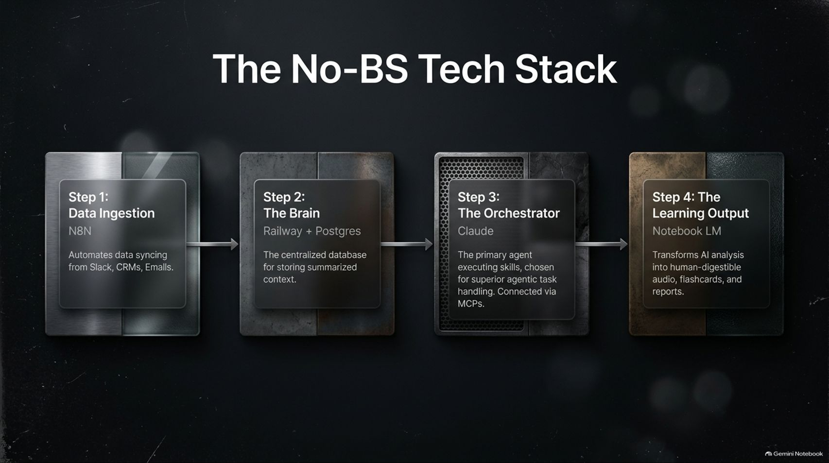
Notes:
Title: The No-BS Tech Stack
Target Duration: 3–5 minutes
Speaker Notes:
"If you are wondering what tools to actually use to build this out, here is The No-BS Tech Stack recommended for modern operators:
Step 1: Data Ingestion (N8N)—Automates data syncing from Slack, CRMs, and email securely.
Step 2: The Brain (Railway + Postgres)—The centralized database for storing structured, summarized context.
Step 3: The Orchestrator (Claude)—The primary agent executing skills, chosen for superior agentic task handling and connected via MCPs (Model Context Protocols).
Step 4: The Learning Output (NotebookLM)—Transforms AI analysis into human-digestible audio overviews, flashcards, and reports."

Slide 12
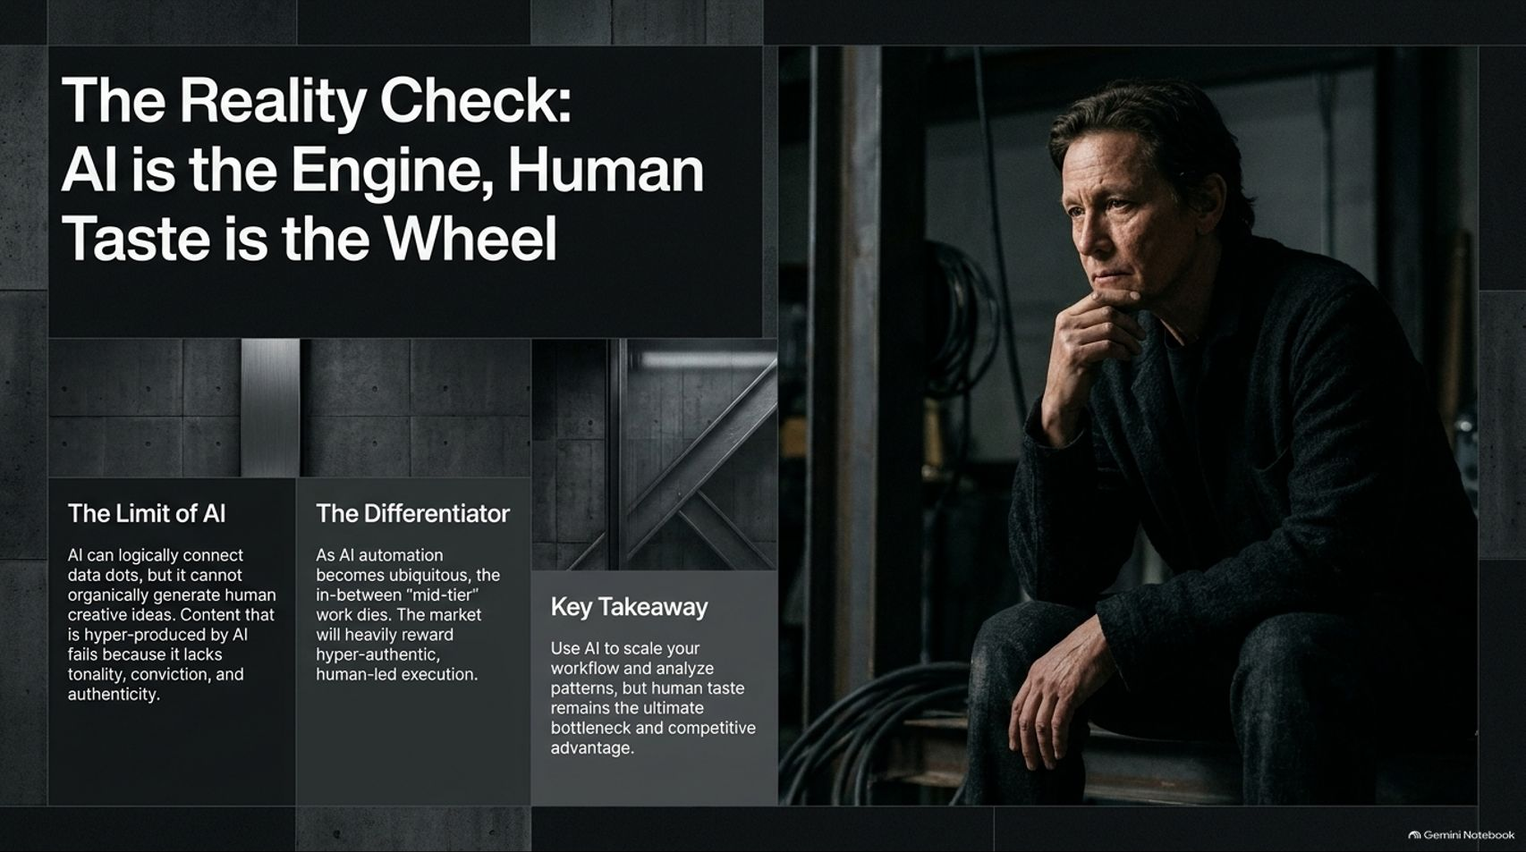
Notes:
Title: The Reality Check: AI is the Engine, Human Taste is the Wheel
Target Duration: 3–5 minutes
Speaker Notes:
"Before rushing off to automate everything, we need a reality check: AI is the Engine, Human Taste is the Wheel.
The Limit of AI: AI can logically connect data dots, but it cannot organically generate true human creative ideas. Content or work that is hyper-produced by AI fails because it lacks tonality, conviction, and authenticity.
The Differentiator: As AI automation becomes ubiquitous, generic mid-tier work dies. The market heavily rewards hyper-authentic, human-led execution.
Key Takeaway: Use AI to scale your workflows and analyze patterns, but remember that your unique human taste remains the ultimate bottleneck and competitive advantage."

Slide 13
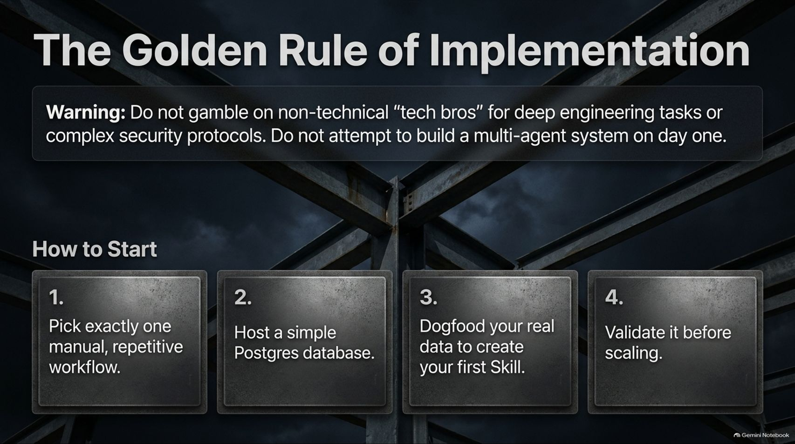
Notes:
Title: The Golden Rule of Implementation
Target Duration: 3–4 minutes
Speaker Notes:
"A vital Warning: Do not gamble on non-technical 'tech bros' for deep engineering tasks or complex security protocols, and never attempt to build a multi-agent system on day one.
If you want to start right now, follow these four steps:
1. Pick exactly one manual, repetitive workflow.
2. Host a simple PostgreSQL database.
3. Dogfood your real data to create your very first Skill.
4. Validate it thoroughly before attempting to scale.
Keep it simple, start small, and build secure foundations."

Slide 14
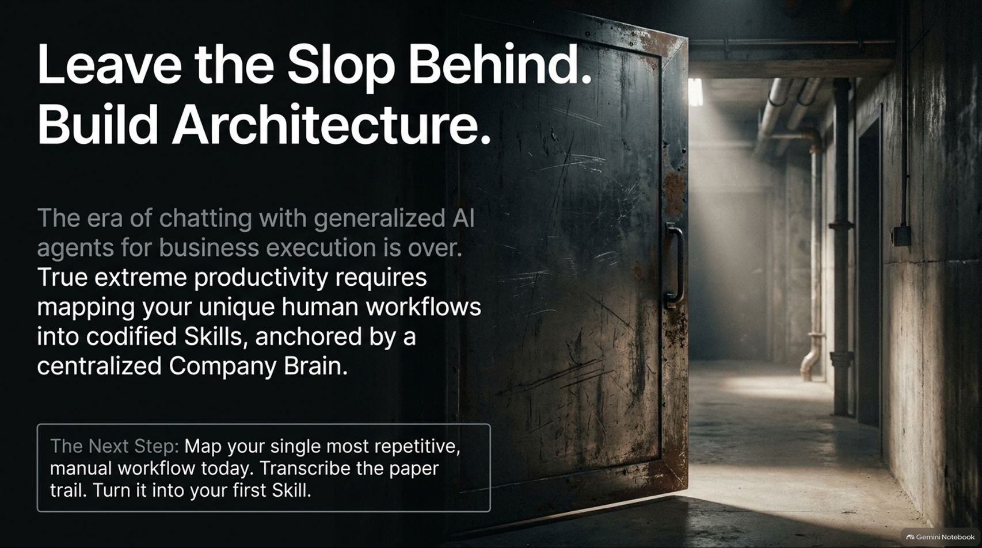
Notes:
Title: Leave the Slop Behind. Build Architecture.
Target Duration: 3–4 minutes
Speaker Notes:
"As we draw to a close, remember: the era of casually chatting with generalized AI agents for business execution is over.
True, extreme productivity does not come from magic prompts; it comes from mapping your unique human workflows into codified Skills, anchored securely by a centralized Company Brain.
The Next Step: Map your single most repetitive, manual workflow today. Transcribe your paper trail, gather your operational data, and turn it into your very first AI Skill."

Slide 15
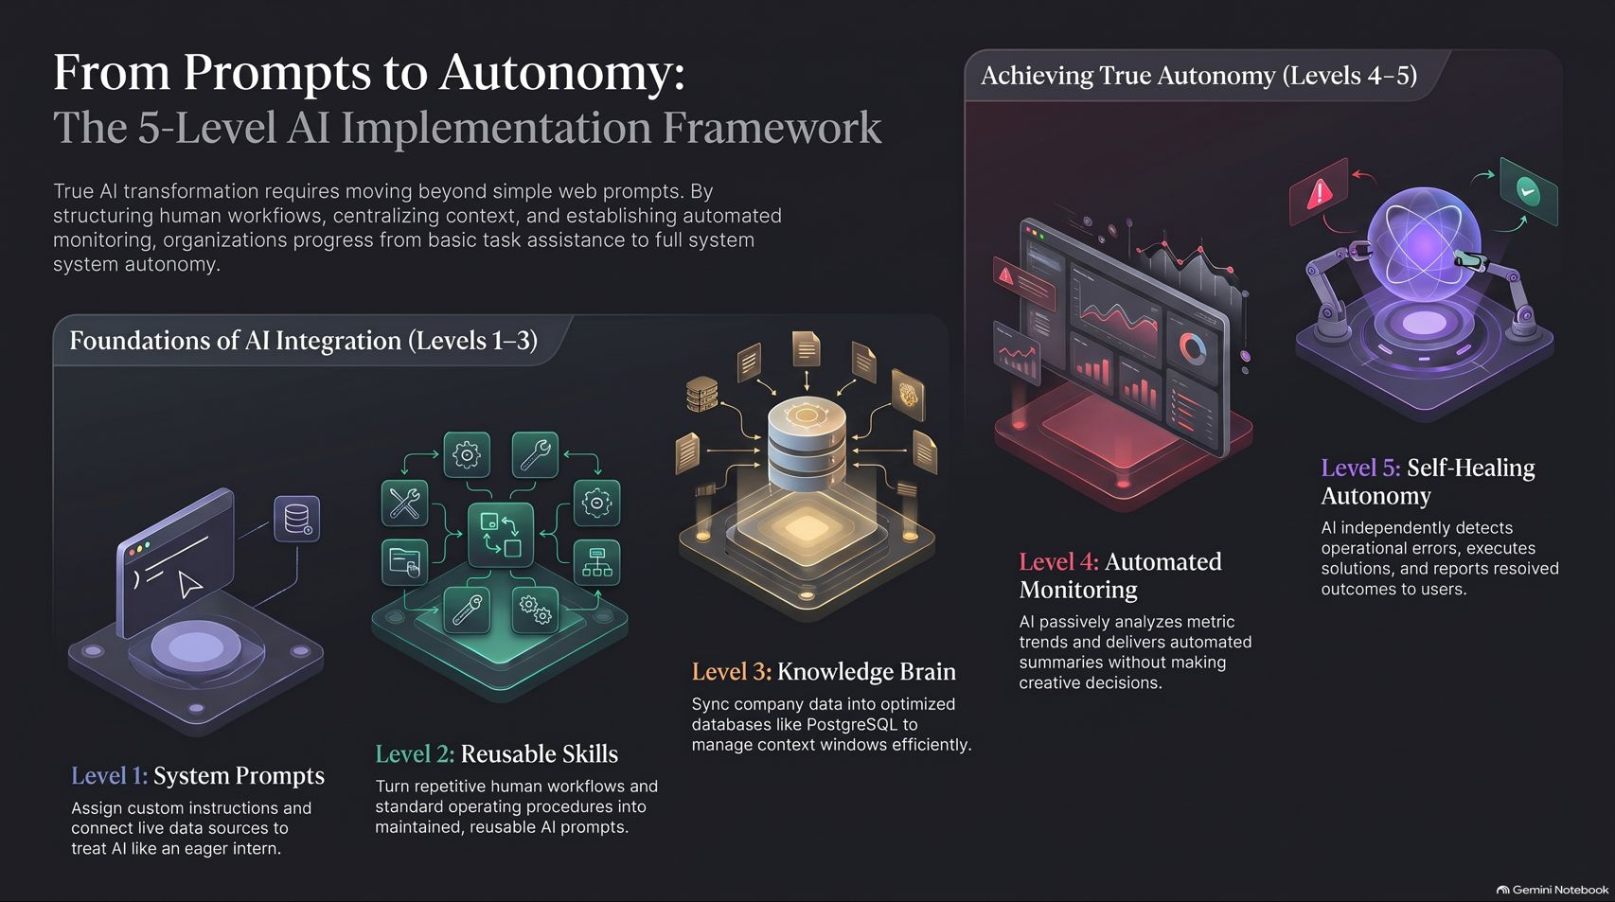
Notes:
Title: From Prompts to Autonomy: The 5-Level AI Implementation Framework
Target Duration: 3–5 minutes
Speaker Notes:
"Our concluding slide provides the master overview of our entire journey: From Prompts to Autonomy.
True AI transformation requires moving beyond simple web prompts. By structuring human workflows (Levels 1 and 2), centralizing organizational context (Level 3), and establishing automated monitoring and self-healing systems (Levels 4 and 5), organizations progress from basic task assistance to full system autonomy.
Leave the AI slop behind, build robust architecture, and let your systems scale your business while you focus on high-level human strategy. Thank you."

