Slide 1

Notes:
Title: The Detective and the Disconnect: Navigating Market Chaos with 100-Year Thinking
Target Duration: 2–3 minutes
Speaker Notes:
"Welcome everyone. Today we are addressing a vital question for any serious, long-term investor: How do you maintain psychological equilibrium and analytical clarity when the market descends into short-term chaos?
Based on the insights of long-term thinkers like Robert Hagstrom and Chris Mayer, we are exploring The Dispassionate Investor framework.
Right now, the market is suffering from a massive perceptual disconnect. While high-return technology and infrastructure leaders are being heavily flushed out by short-term algorithmic trading, defensive consumer staples are trading at luxury, speculative multiples.
Over the course of this presentation, we’ll learn how to suppress the panic, adopt the lens of a dispassionate detective, and focus on the fundamental weighing machine of free cash flow rather than the voting machine of daily price action."
Tech Is the Cheapest Since 2022. Walmart Is 46 Times Earnings. Where Is the Bubble?
https://www.youtube.com/watch?v=G32zyl-aaoo

Slide 2
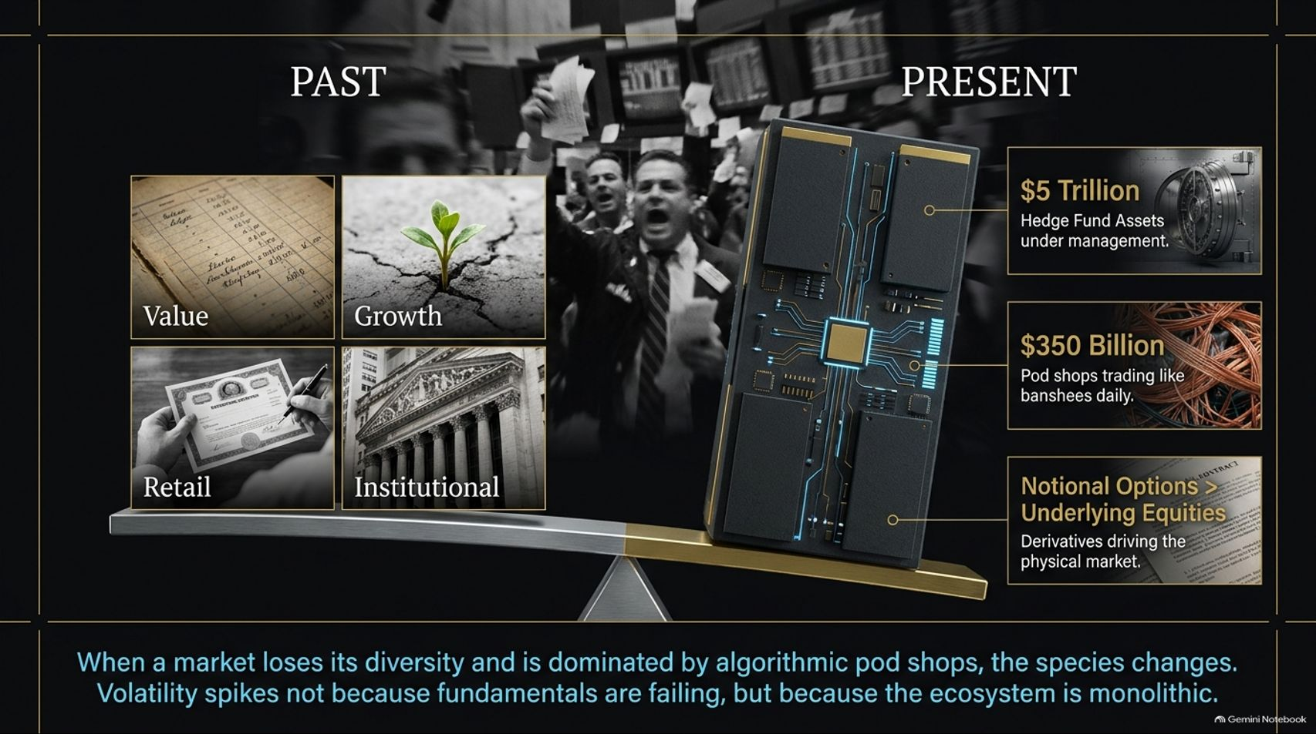
Notes:
Title: The Evolving Species of Market Participants
Target Duration: 3–5 minutes
Speaker Notes:
"To understand why markets feel so radically unstable today, we have to look at how the market participants have structurally changed over time.
In the Past, the market was a diverse ecosystem featuring value investors, growth pickers, retail participants, and long-term institutional investors.
In the Present, the species has fundamentally mutated. We are managing a marketplace dominated by $5 trillion in hedge fund assets under management, $350 billion in pod shops trading like banshees on a daily basis, and notional options trading volumes that vastly exceed the underlying physical stock market.
When a market loses its diversity and is dominated by monolithic algorithmic players, volatility spikes not because business fundamentals are failing, but because the ecosystem itself has become uniform and hyper-reactive."

Slide 3
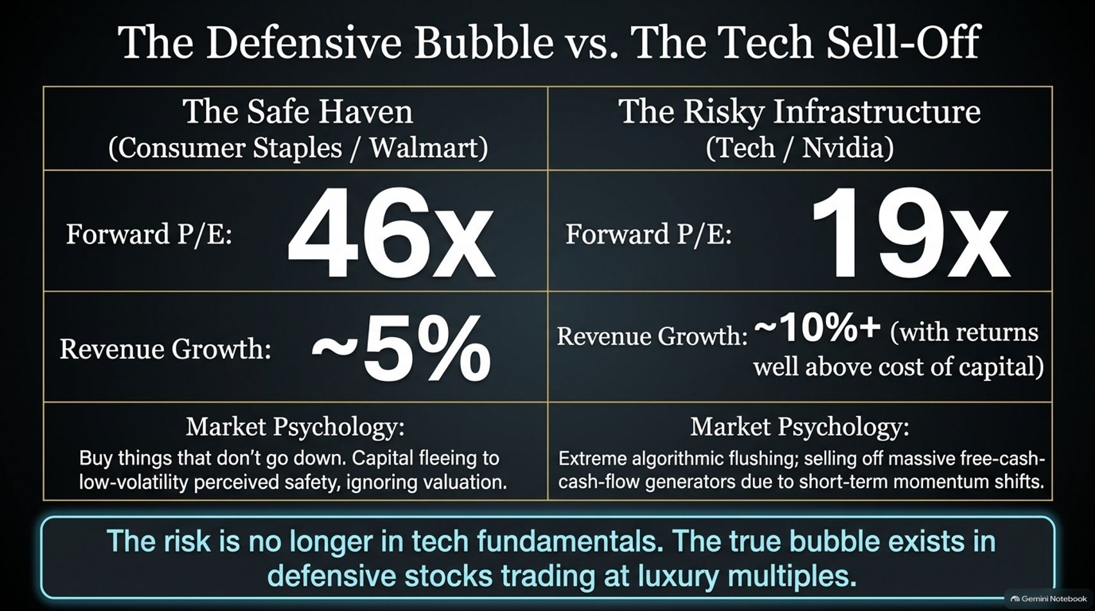
Notes:
Title: The Defensive Bubble vs. The Tech Sell-Off
Target Duration: 4–6 minutes
Speaker Notes:
"Let's examine the heart of the current market disconnect: The Defensive Bubble vs. The Tech Sell-Off.
Look at the valuation paradox on your screen. Safe Haven consumer staples like Walmart are trading at a staggering 46x forward P/E on sluggish revenue growth of roughly 5%. Investors are fleeing to perceived safety, ignoring fundamental overpricing.
On the flip side, Risky Infrastructure leaders like Nvidia are trading at just 19x forward P/E, despite generating robust revenue growth of 10%+ with returns well above their cost of capital.
Market Psychology is currently flipped on its head: algorithmic flushing is selling off massive free-cash-flow generators based on short-term momentum shifts. The true bubble today is not in tech fundamentals; it exists in defensive stocks trading at luxury multiples."

Slide 4
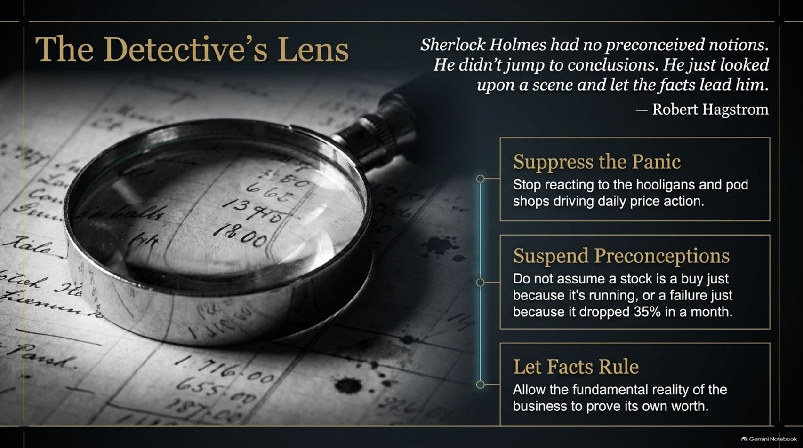
Notes:
Title: The Detective's Lens
Target Duration: 3–5 minutes
Speaker Notes:
"To cut through this noise, we must adopt The Detective's Lens. As Robert Hagstrom notes, referencing Robert Hagstrom’s adaptation of literary greats, Sherlock Holmes had no preconceived notions; he didn't jump to conclusions—he simply looked upon a scene and let the facts lead him.
Applying this to investing requires three strict rules:
1. Suppress the Panic: Stop reacting to the hooligans and pod shops driving daily price action.
2. Suspend Preconceptions: Do not assume a stock is a buy just because it's running, or a broken business just because it dropped 35% in a single month.
3. Let Facts Rule: Allow the fundamental reality and cash-generating power of the business to prove its own worth."

Slide 5
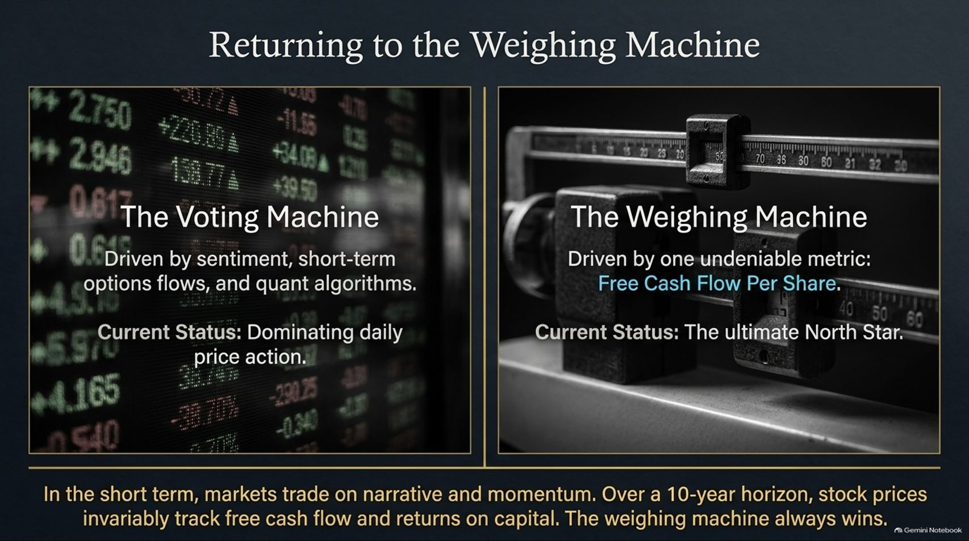
Notes:
Title: Returning to the Weighing Machine
Target Duration: 3–5 minutes
Speaker Notes:
"We must constantly remind ourselves of Benjamin Graham's timeless metaphor: the market is a voting machine in the short term, but a weighing machine in the long run.
The Voting Machine is driven by sentiment, short-term options flows, and quant momentum algorithms, dominating daily price action.
The Weighing Machine is driven by one undeniable North Star: Free Cash Flow Per Share.
In the short term, markets trade on narrative and momentum. But over a 10-year horizon, stock prices invariably track free cash flow and returns on capital. The weighing machine always wins."

Slide 6
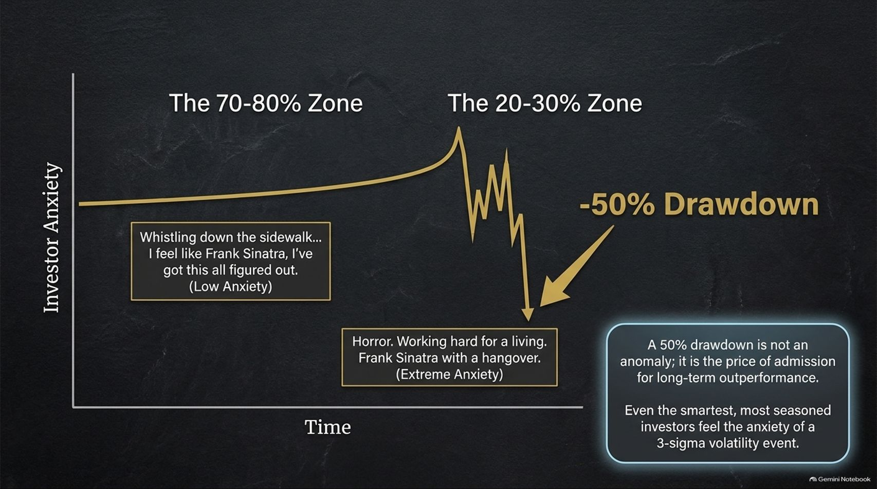
Notes:
Title: The Psychology of Drawdowns: Navigating Investor Anxiety
Target Duration: 4–6 minutes
Speaker Notes:
"Investing over a career requires psychological endurance. Think of it through the lens of Chip Mason’s wisdom: 70 to 80% of the time, managing money feels like whistling down the sidewalk feeling like Frank Sinatra—low anxiety and high confidence.
But 20 to 30% of the time, it's pure horror—working hard for a living like Frank Sinatra with a hangover.
When a -50% drawdown hits a portfolio, it feels like an existential crisis. However, a major drawdown is not a market anomaly; it is the mandatory price of admission for long-term outperformance. Even the smartest, most seasoned investors must weather 3-sigma volatility events without breaking."

Slide 7
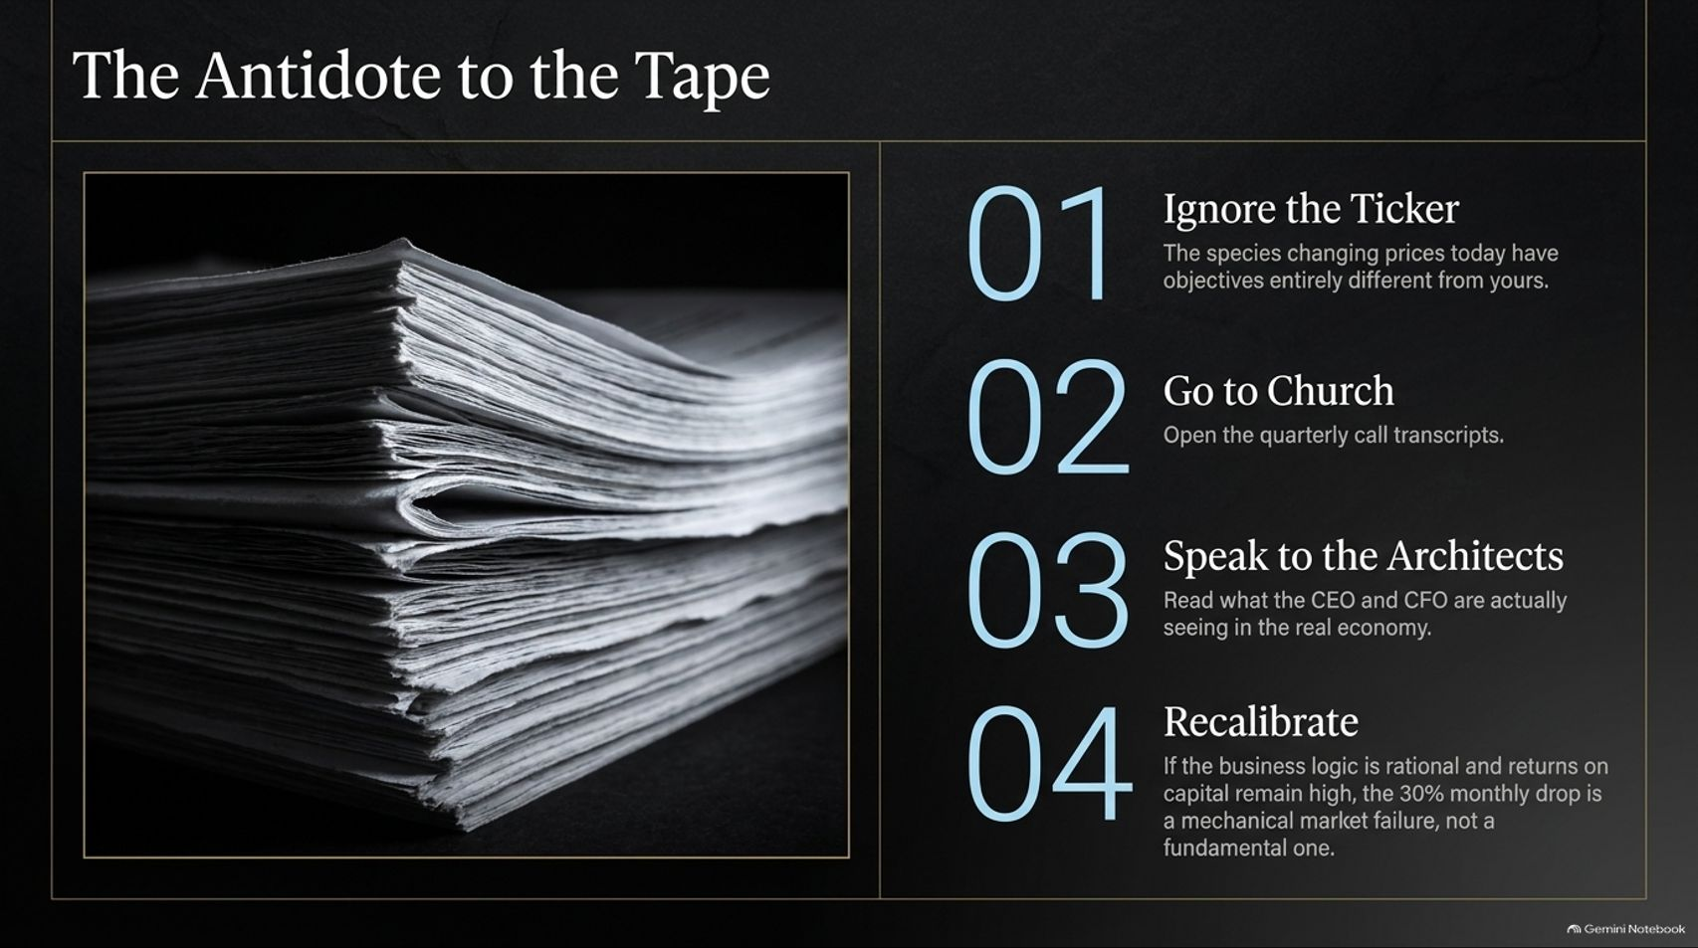
Notes:
Title: The Antidote to the Tape
Target Duration: 3–5 minutes
Speaker Notes:
"When daily price action becomes deafening, how do we protect our mindset? Here is The Antidote to the Tape:
01. Ignore the Ticker: The species changing prices today have objectives entirely different from yours.
02. Go to Church: Open and read the quarterly call transcripts.
03. Speak to the Architects: Read what CEOs and CFOs are actually seeing in the real economy, bypassing media hype.
04. Recalibrate: If the business logic remains rational and returns on capital remain high, a 30% monthly price drop is a mechanical market failure, not a fundamental one."

Slide 8

Notes:
Title: The Guarantee of Average vs. Evolution
Target Duration: 3–5 minutes
Speaker Notes:
"Why do long-term investors reject pure indexing? This brings us to The Guarantee of Average vs. Evolution.
If you had $1 million to invest in a local town, would you blindly buy a fraction of every gas station, dress shop, and failing restaurant? Indexing guarantees you own the decay alongside the growth.
Capitalism works by creating new moats and destroying old ones. The evolutionary investor seeks out only the rare businesses generating highly sustainable economic returns. As Warren Buffett famously noted: why wouldn't you pick the best businesses that are priced attractively, rather than owning 500 average companies?"

Slide 9
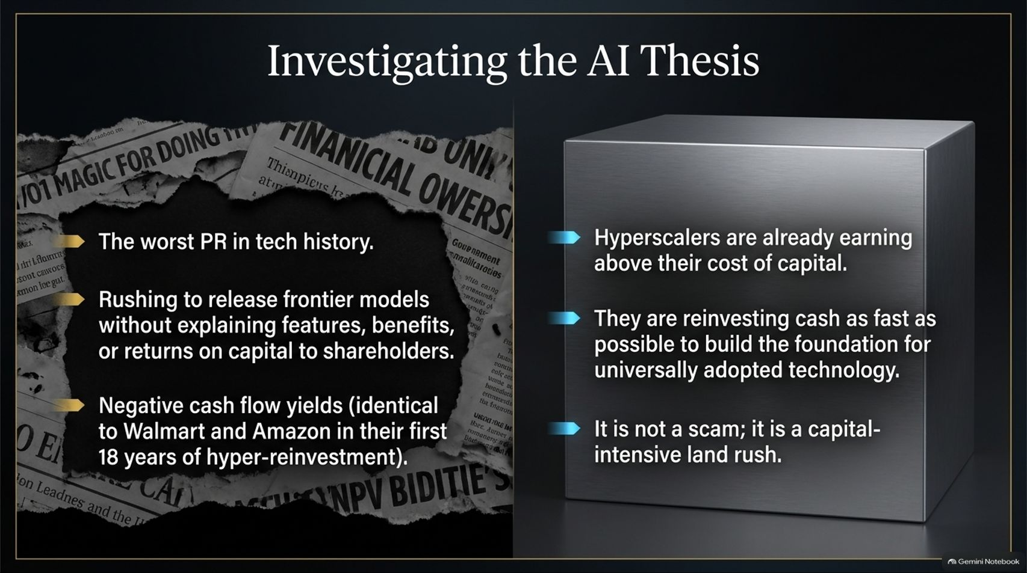
Notes:
Title: Investigating the AI Thesis: Land Rush or Scam?
Target Duration: 4–6 minutes
Speaker Notes:
"Let's investigate the most controversial topic in modern markets: The AI Thesis.
Critics argue AI suffers from the worst PR in tech history—rushing to release frontier models without clearly explaining features, benefits, or immediate returns on capital to shareholders, resulting in negative cash flow yields. Skeptics call it a scam.
But let's look at historical parallels. Walmart and Amazon experienced negative free cash flow for their first 18 years of hyper-reinvestment.
Today, hyperscalers are already earning above their cost of capital and are reinvesting cash as fast as possible to build the foundation for universally adopted technology. It is not a scam; it is a capital-intensive land rush."

Slide 10
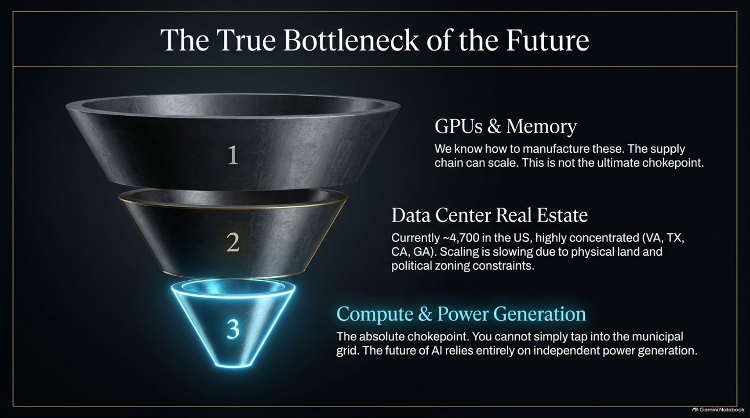
Notes:
Title: The True Bottleneck of the Future: Power and Compute
Target Duration: 3–5 minutes
Speaker Notes:
"Where is the true chokepoint in the AI revolution? Let's break down the funnel:
1. GPUs & Memory: We know how to manufacture these; supply chains can scale. This is not the ultimate chokepoint.
2. Data Center Real Estate: There are roughly 4,700 data centers in the US, highly concentrated in states like Virginia, Texas, California, and Georgia. Scaling is slowing due to physical land and zoning constraints.
3. Compute & Power Generation: This is the absolute chokepoint. You cannot simply tap into the municipal grid without triggering local backlash; the future of AI relies entirely on independent power generation."

Slide 11

Notes:
Title: The Power Reality: Electrification and Infrastructure
Target Duration: 3–5 minutes
Speaker Notes:
"Diving deeper into The Power Reality, the primary reason data centers face construction delays is a severe lack of electrification.
Municipal grids cannot handle the load, and taxpayers will not subsidize industrial data center power bills.
The Solution: Independent power packs. Companies are building dedicated power plants globally specifically to feed localized data centers.
Core Insight: Excess returns are generated at the point of severe supply-demand imbalance. In the AI revolution, that imbalance is not in software—it is in heavy electrical infrastructure."

Slide 12
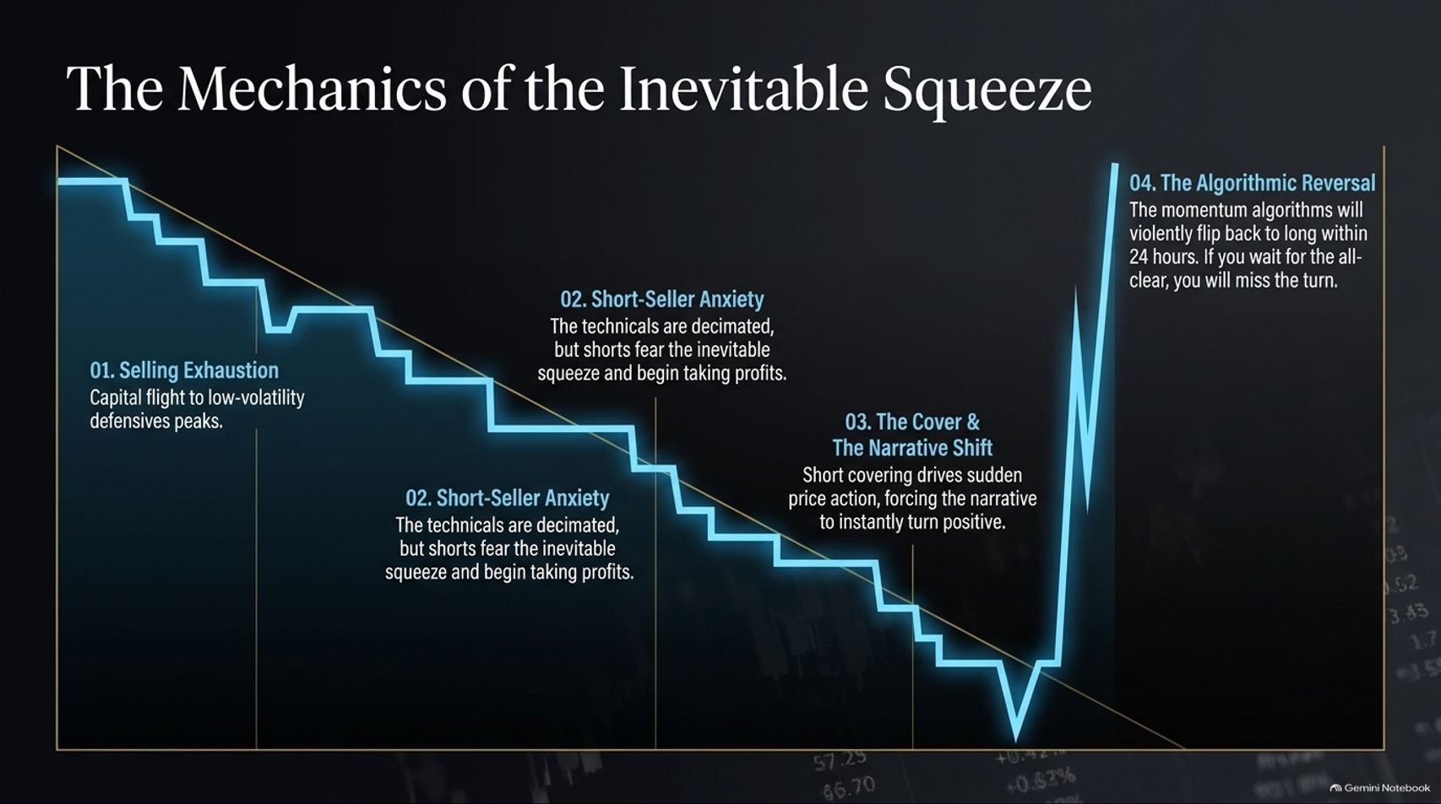
Notes:
Title: The Mechanics of the Inevitable Squeeze
Target Duration: 3–5 minutes
Speaker Notes:
"When tech stocks experience brutal liquidations, how does the cycle reverse? Let's trace The Mechanics of the Inevitable Squeeze:
01. Selling Exhaustion: Capital flees to low-volatility defensive peaks.
02. Short-Seller Anxiety: Technicals are decimated, but short sellers fear the inevitable squeeze and begin taking profits.
03. The Cover & Narrative Shift: Short covering drives sudden price action, forcing the market narrative to instantly turn positive.
04. The Algorithmic Reversal: Momentum algorithms violently flip back to long within 24 hours. If you wait for the all-clear sign, you will miss the turn entirely."

Slide 13
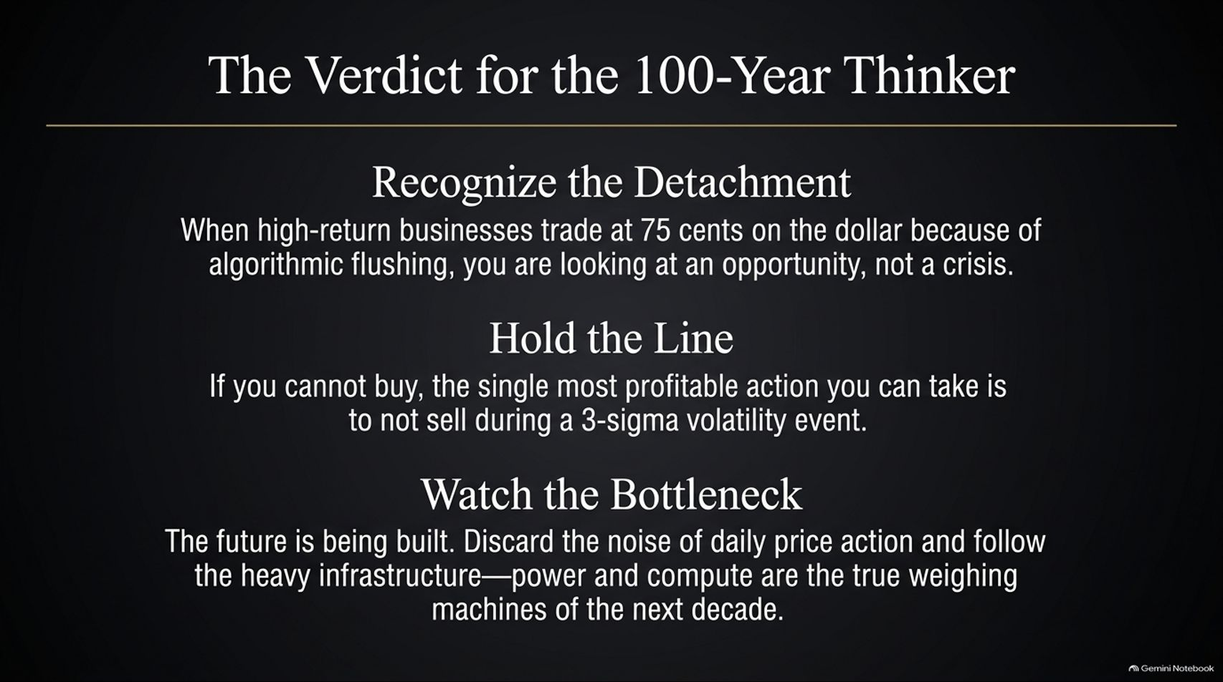
Notes:
Title: The Verdict for the 100-Year Thinker
Target Duration: 3–5 minutes
Speaker Notes:
"What is our final verdict as 100-year thinkers navigating this environment?
Recognize the Detachment: When high-return businesses trade at 75 cents on the dollar because of algorithmic flushing, you are looking at an opportunity, not a crisis.
Hold the Line: If you cannot buy, the single most profitable action you can take is to not sell during a 3-sigma volatility event.
Watch the Bottleneck: Discard the daily noise of price action and follow the heavy infrastructure—power and compute are the true weighing machines of the next decade."

Slide 14
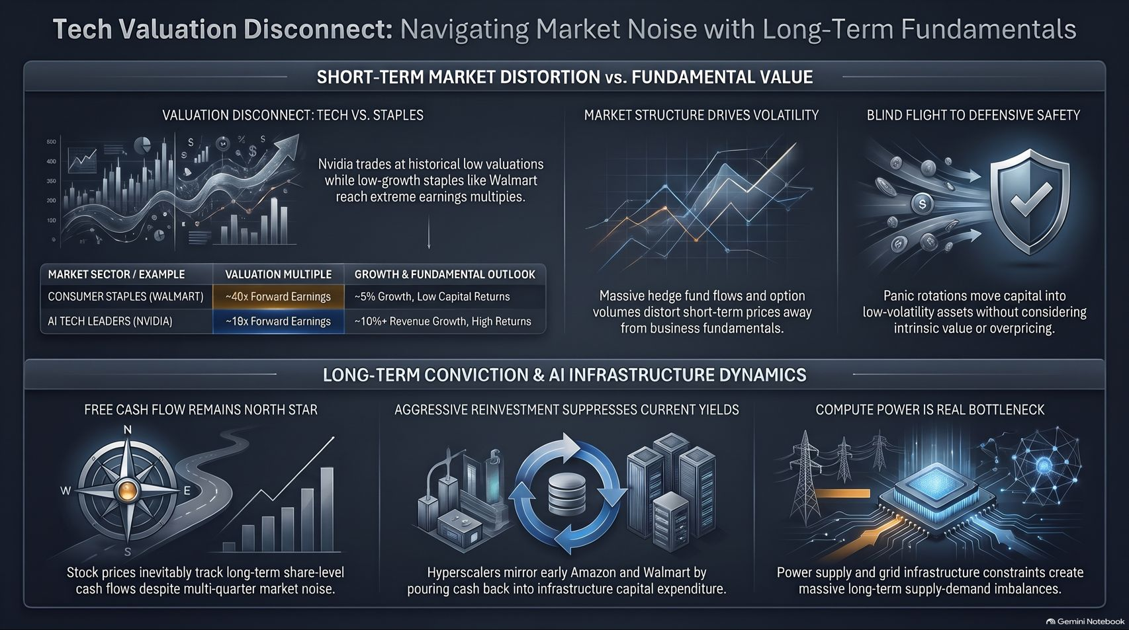
Notes:
Title: Tech Valuation Disconnect: Navigating Market Noise with Long-Term Fundamentals
Target Duration: 4–6 minutes
Speaker Notes:
"As our master summary slide, this visual map captures everything we have discussed.
Across the top, we see the Short-Term Market Distortion vs. Fundamental Value: contrasting Walmart's 40x+ forward multiple against Nvidia's reasonable 19x multiple, driven by blind flight to defensive safety and algorithmic fund flows.
Across the bottom, we ground ourselves in Long-Term Conviction & AI Infrastructure Dynamics: free cash flow remaining our North Star, aggressive reinvestment suppressing current yields just like early Walmart, and compute power serving as the ultimate physical bottleneck.
By ignoring the tape, focusing on cash generation, and thinking in 100-year horizons, we turn market chaos into our greatest advantage. Thank you."

