Slide 1
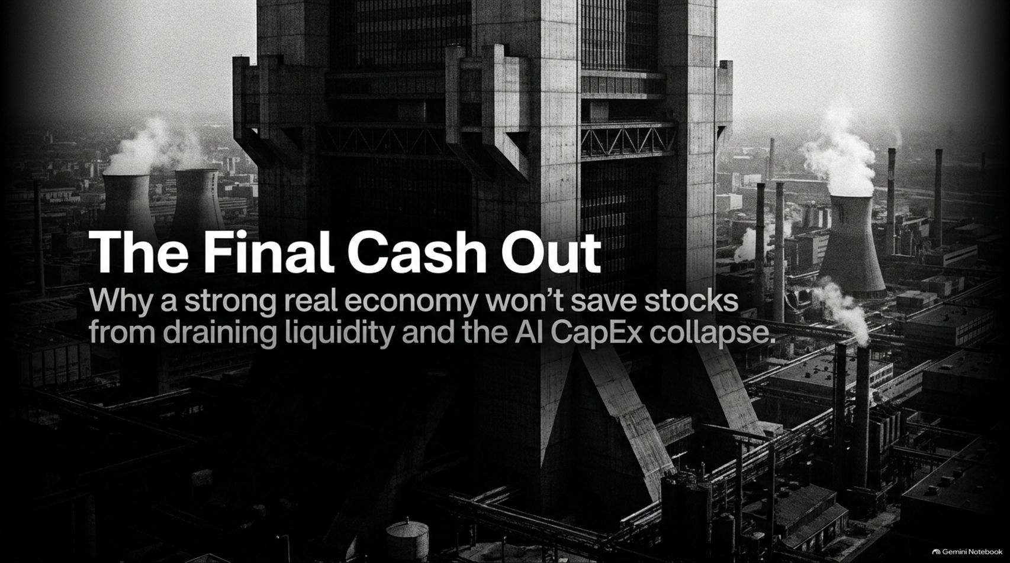
Notes:
Title: The Final Cash Out: Why a strong real economy won't save stocks from draining liquidity and the AI CapEx collapse
Target Duration: 2–3 minutes
Speaker Notes:
"Welcome, everyone. Today we are addressing a vital and deeply contrarian premise: Why a strong real economy is not going to save the stock market.
In fact, as financial expert Michael Howell and our panel have highlighted, the strength of the real economy is actively cannibalizing financial markets by absorbing all available liquidity.
Combined with a speculative AI buildout operating on phantom backlogs, extreme off-balance-sheet debt, and intense local regulatory pushback, we are entering the final cash-out phase of this cycle.
Over the next 16 slides, we will dissect the three pillars of market headwinds and provide an actionable playbook for navigating the turbulent transition ahead."
Even a Strong Economy Won’t Save Stocks | Michael Howell, Jack Gamble & George Noble
https://www.youtube.com/watch?v=jKP_Ay6tqXE

Slide 2

Notes:
Title: The Convergence of Three Market Headwinds
Target Duration: 3–5 minutes
Speaker Notes:
"To understand our current vulnerability, we must look at the convergence of three distinct structural headwinds:
Pillar 1 (Macro — The Liquidity Drain): A resilient real economy and massive government deficits are absorbing all available capital, flattening global yield curves, and starving financial asset markets.
Pillar 2 (Micro — The AI IOU Economy): The AI CapEx bubble is operating on phantom backlogs and hundreds of billions in off-balance-sheet debt, serving as a pure exit liquidity event for early private equity.
Pillar 3 (Physical — The Infrastructure Wall): Real-world power constraints and severe local regulatory pushback are halting the 'infinite scale' narrative.
These forces are colliding simultaneously, creating a multi-front risk environment for equities."

Slide 3


Slide 4
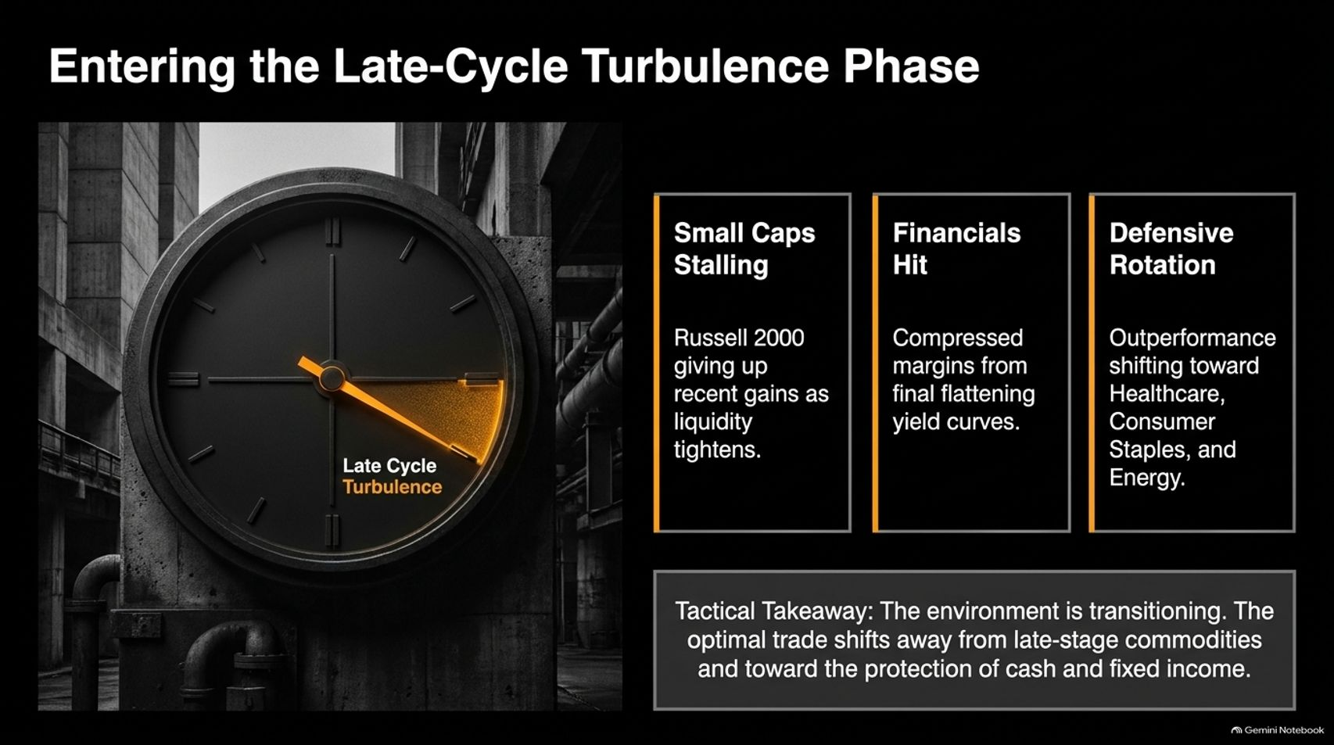
Notes:
Title: Entering the Late-Cycle Turbulence Phase
Target Duration: 3–5 minutes
Speaker Notes:
"As liquidity drains, market internals shift from expansion to late-cycle turbulence:
Small Caps Stalling: The Russell 2000 has given up recent gains as liquidity tightens.
Financials Hit: Compressed margins resulting from flattening yield curves are punishing banking sector profitability.
Defensive Rotation: Leadership is actively rotating out of growth and into healthcare, consumer staples, and energy.
Tactical Takeaway: The environment has transitioned. The optimal trade shifts away from late-stage commodities and toward the protection of cash and fixed income."

Slide 5
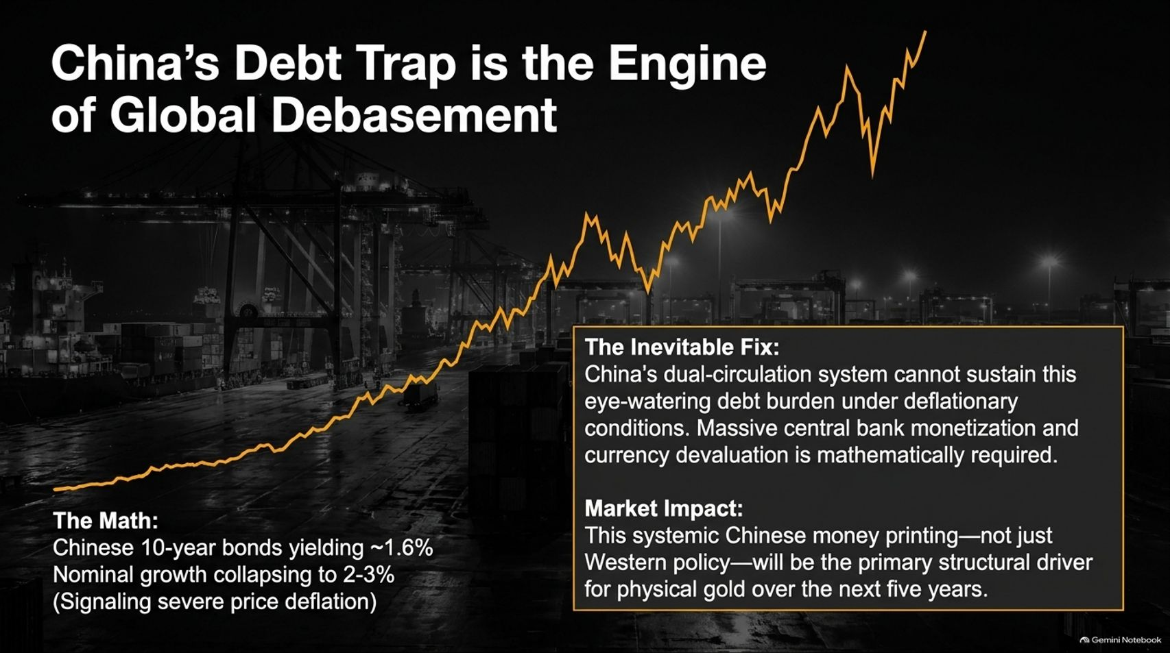
Notes:
Title: China’s Debt Trap is the Engine of Global Debasement
Target Duration: 4–6 minutes
Speaker Notes:
"Looking internationally, China’s structural situation is the primary engine of global currency debasement.
The Math: Chinese 10-year bonds are yielding roughly 1.6%, with nominal growth collapsing to 2–3%, signaling severe price deflation under an eye-watering debt burden.
The Inevitable Fix: China’s dual-circulation system cannot sustain this condition. Massive central bank monetization and currency devaluation are mathematically required.
Market Impact: This systemic Chinese money printing—far more than Western policy—will be the primary structural driver for physical gold over the next five years."

Slide 6
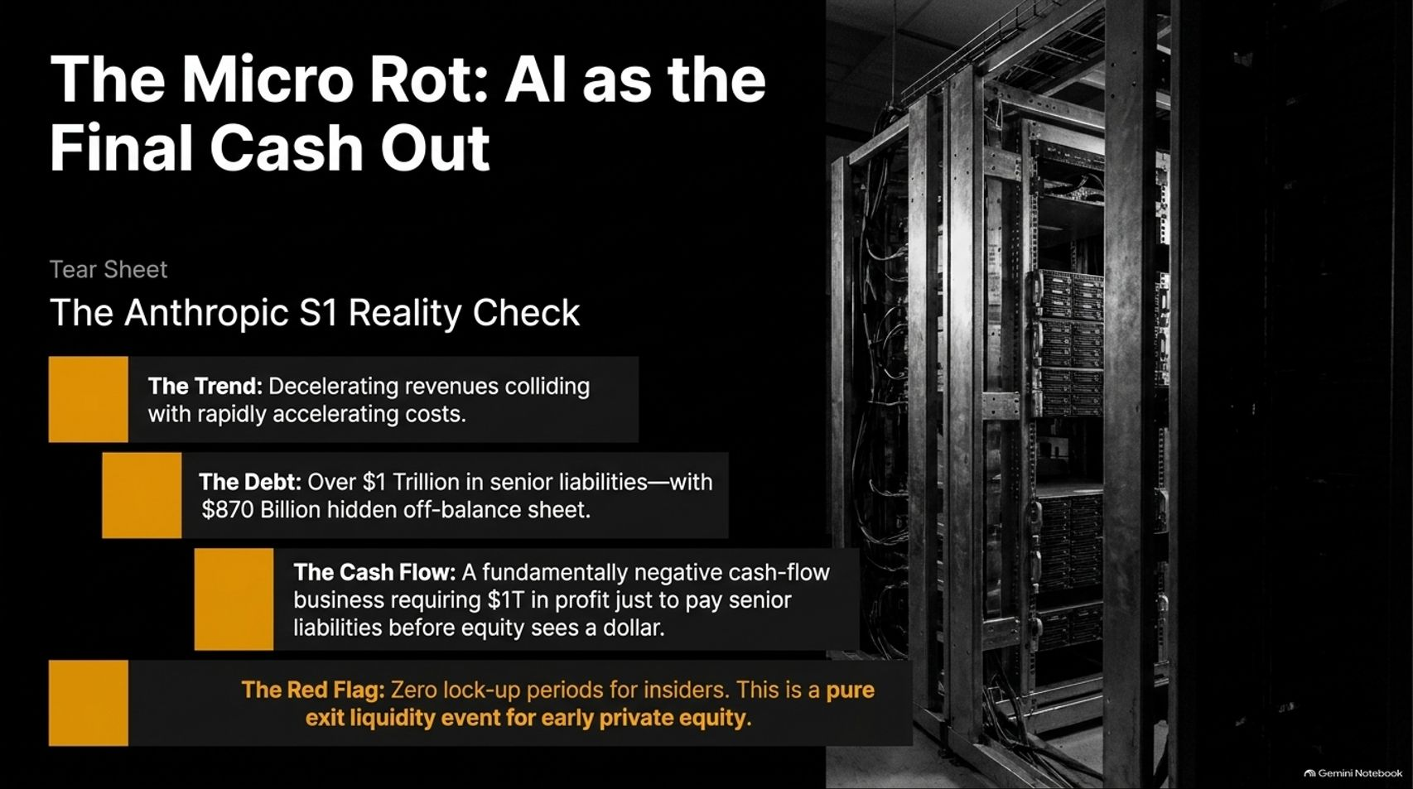
Notes:
Title: The Micro Rot: AI as the Final Cash Out (Anthropic S1 Reality Check)
Target Duration: 4–6 minutes
Speaker Notes:
"Turning to Pillar 2, we examine the micro rot in the AI sector, using the Anthropic S1 filing analysis by David Trainer as our blueprint.
The Trend: Decelerating revenues colliding with rapidly accelerating operating costs.
The Debt: Over $1 trillion in senior liabilities, with a staggering $870 billion hidden off-balance sheet.
The Cash Flow: A fundamentally negative cash-flow business requiring $1 trillion in profit just to pay senior liabilities before equity holders see a single dollar.
The Red Flag: Zero lock-up periods for insiders. This is a textbook, pure exit liquidity event for early private equity investors looking to cash out before the music stops."

Slide 7
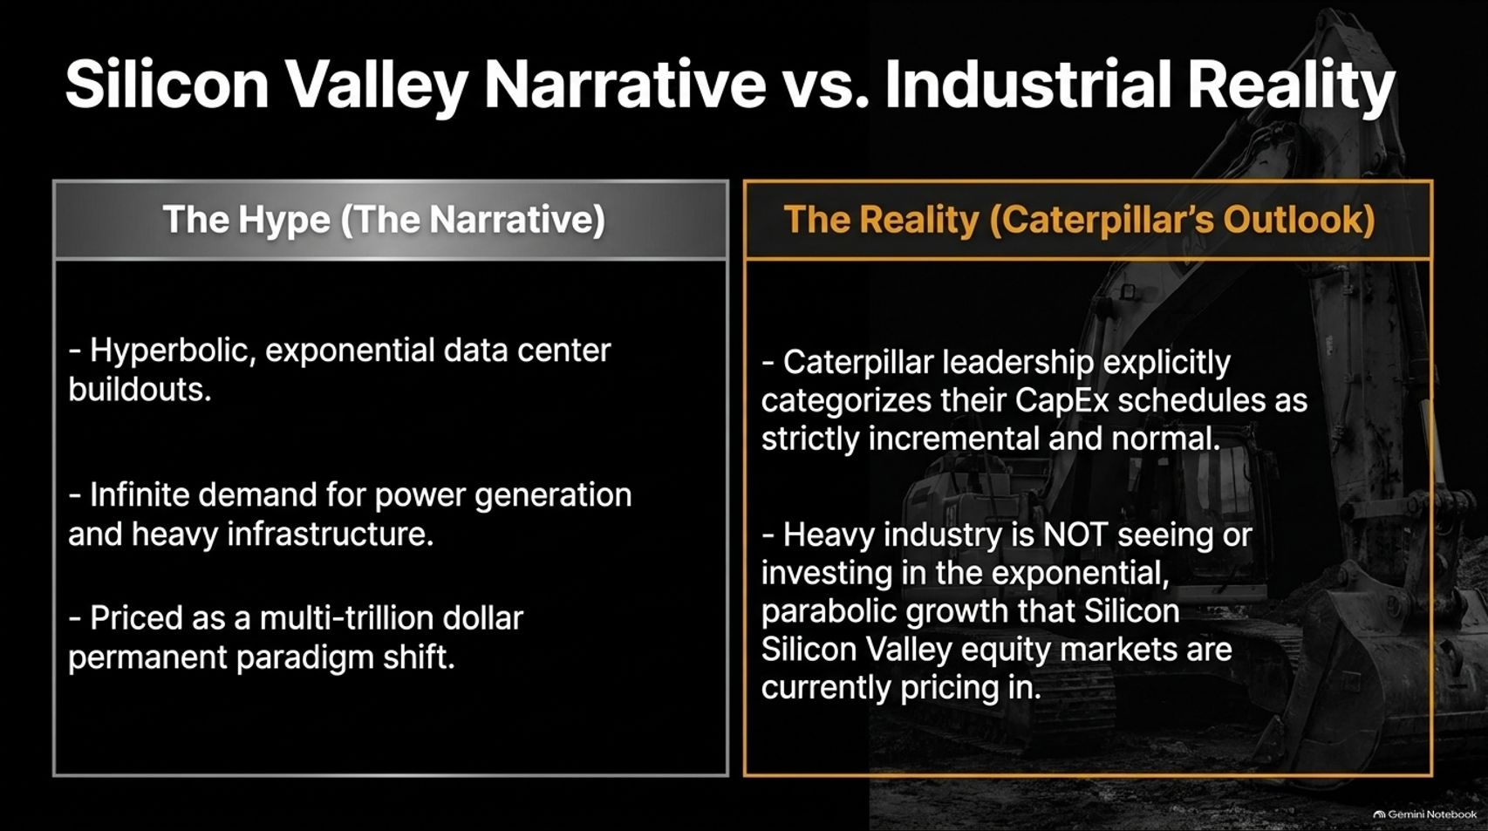
Notes:
Title: Silicon Valley Narrative vs. Industrial Reality
Target Duration: 3–5 minutes
Speaker Notes:
"There is a massive chasm between Silicon Valley's narrative and heavy industrial reality.
The Hype: Media and venture narratives push hyperbolic, exponential data center buildouts, infinite demand for power generation, and a multi-trillion-dollar permanent paradigm shift.
The Reality (Caterpillar’s Outlook): Ground-level channel checks—such as Caterpillar leadership commentary shared by industry insiders—categorize CapEx schedules as strictly incremental and normal.
Heavy industry is not seeing or investing in the parabolic growth that Silicon Valley equity markets are currently pricing in."

Slide 8
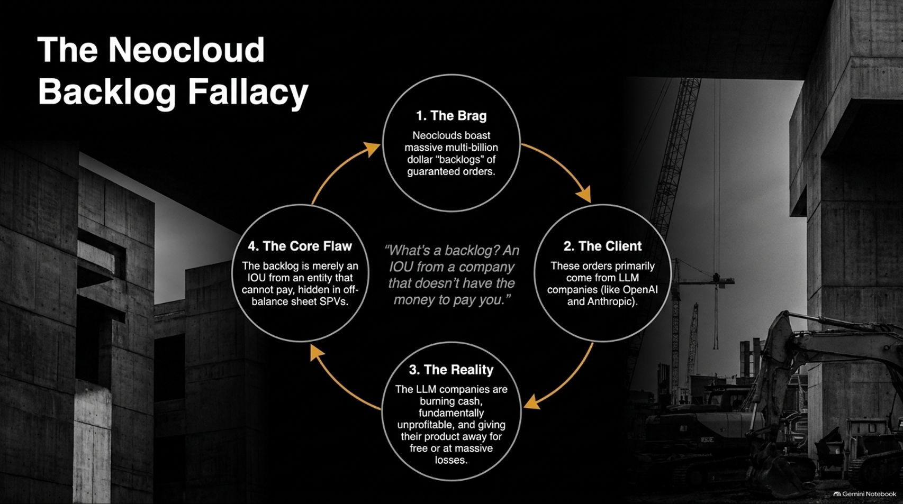
Notes:
Title: The Neocloud Backlog Fallacy
Target Duration: 3–5 minutes
Speaker Notes:
"Let's break down the illusion of Neocloud backlogs through a four-part cycle:
1. The Brag: Neoclouds boast massive multi-billion-dollar backlogs of guaranteed orders.
2. The Client: These orders primarily come from foundational LLM companies like OpenAI and Anthropic.
3. The Reality: These LLM companies are burning cash, remaining fundamentally unprofitable, and giving their product away for free or at massive losses.
4. The Core Flaw: What is a backlog? It is simply an IOU from an entity that cannot pay, hidden away in off-balance-sheet Special Purpose Vehicles (SPVs)."

Slide 9
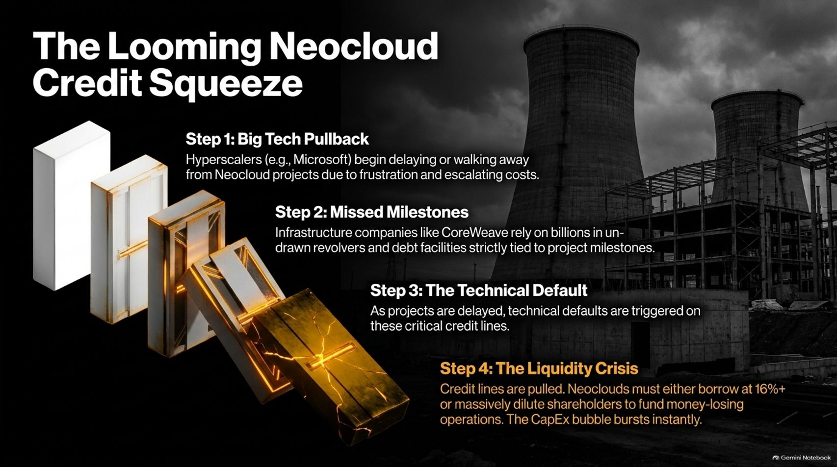
Notes:
Title: The Looming Neocloud Credit Squeeze
Target Duration: 4–6 minutes
Speaker Notes:
"The vulnerability of the Neocloud ecosystem creates a domino-effect credit squeeze:
Step 1 (Big Tech Pullback): Hyperscalers like Microsoft begin delaying or walking away from Neocloud projects due to frustration and escalating costs.
Step 2 (Missed Milestones): Infrastructure firms like CoreWeave rely heavily on billions in undrawn revolvers and debt facilities strictly tied to project milestones.
Step 3 (Technical Default): As projects stall, technical defaults are triggered on these critical credit lines.
Step 4 (Liquidity Crisis): Credit lines are pulled. Neoclouds are forced to either borrow at 16%+ interest or massively dilute shareholders to fund money-losing operations, bursting the CapEx bubble instantly."

Slide 10
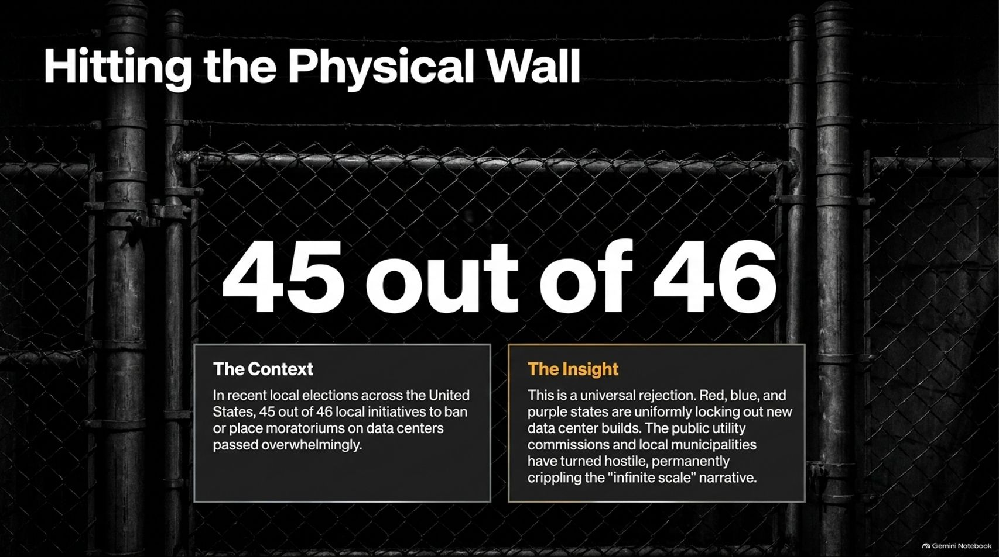
Notes:
Title: Hitting the Physical Wall
Target Duration: 3–5 minutes
Speaker Notes:
"Pillar 3 represents the physical and regulatory wall halting the data center narrative.
The Context: In recent local elections across the United States, 45 out of 46 local initiatives to ban or place moratoriums on data centers passed overwhelmingly.
The Insight: This is a universal pushback spanning red, blue, and purple states. Public utility commissions and local municipalities have turned hostile.
When local communities reject the noise, water usage, and grid strain of data centers, the 'infinite scale' narrative is permanently crippled."

Slide 11
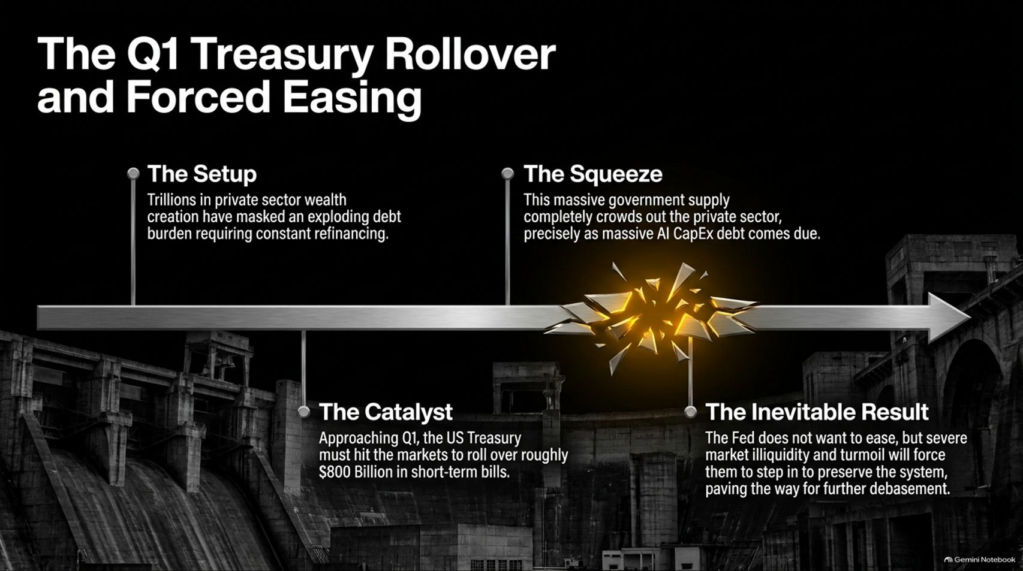
Notes:
Title: The Q1 Treasury Rollover and Forced Easing
Target Duration: 4–6 minutes
Speaker Notes:
"Looking ahead to the macroeconomic calendar, we face a major liquidity crunch in Q1:
The Setup: Trillions in private sector wealth creation have masked an exploding debt burden requiring constant refinancing.
The Catalyst: Approaching Q1, the US Treasury must hit the markets to roll over roughly $800 billion in short-term bills.
The Squeeze: This massive government supply completely crowds out the private sector precisely as massive AI CapEx debt comes due.
The Inevitable Result: While the Fed does not want to ease, severe market illiquidity and turmoil will force them to step in to preserve the system, paving the way for further currency debasement."

Slide 12

Notes:
Title: The Structural Case for $10,000 Gold
Target Duration: 3–5 minutes
Speaker Notes:
"With global debasement locked in, the structural case for gold has never been stronger, driven by two forces:
Eastern Monetization: Chinese central banks are mathematically forced to print money to escape a deflationary debt trap.
Western System Preservation: The Federal Reserve will be forced back into liquidity injections to prevent a credit freeze from the Q1 Treasury squeeze.
The Valuation Metric: The historical Gold-to-Oil ratio averages 20:1. With structural constraints on oil supply keeping a floor on crude, gold's upward repricing is a systemic mean-reversion, not a temporary spike."

Slide 13
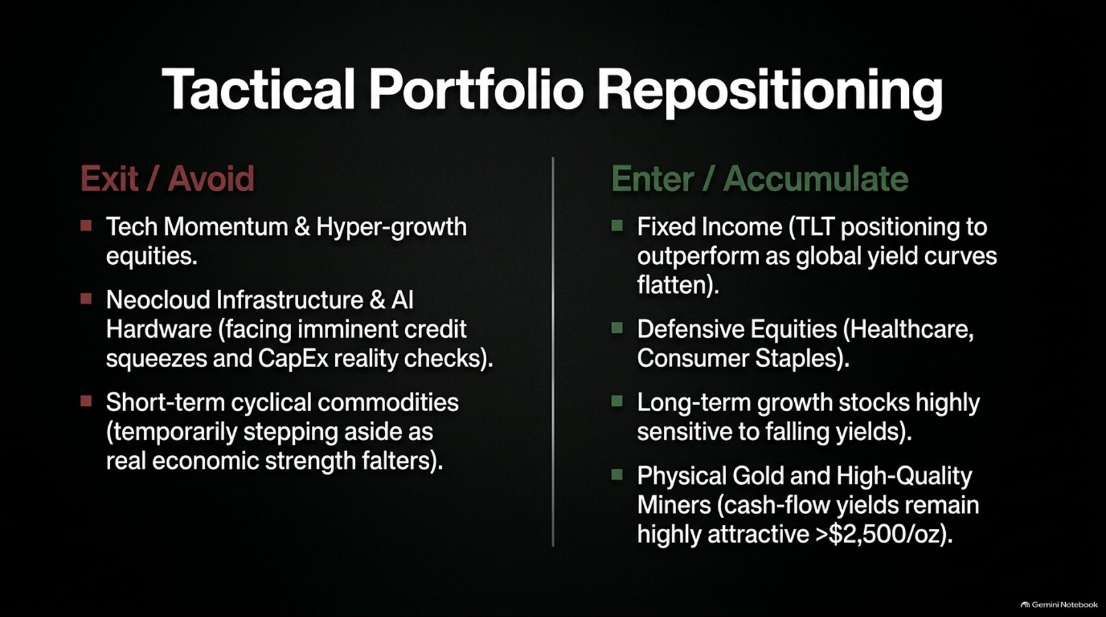
Notes:
Title: Tactical Portfolio Repositioning
Target Duration: 4–6 minutes
Speaker Notes:
"How do we position our portfolios for this environment? Here is the tactical asset allocation shift:
Exit / Avoid:
Tech momentum and hyper-growth equities.
Neocloud infrastructure and AI hardware facing imminent credit squeezes.
Short-term cyclical commodities, temporarily stepping aside as real economic strength falters.
Enter / Accumulate:
Fixed income (TLT positioning to outperform as global yield curves flatten).
Defensive equities (Healthcare, Consumer Staples).
Physical gold and high-quality miners, where cash-flow yields remain highly attractive above $2,500/oz."

Slide 14
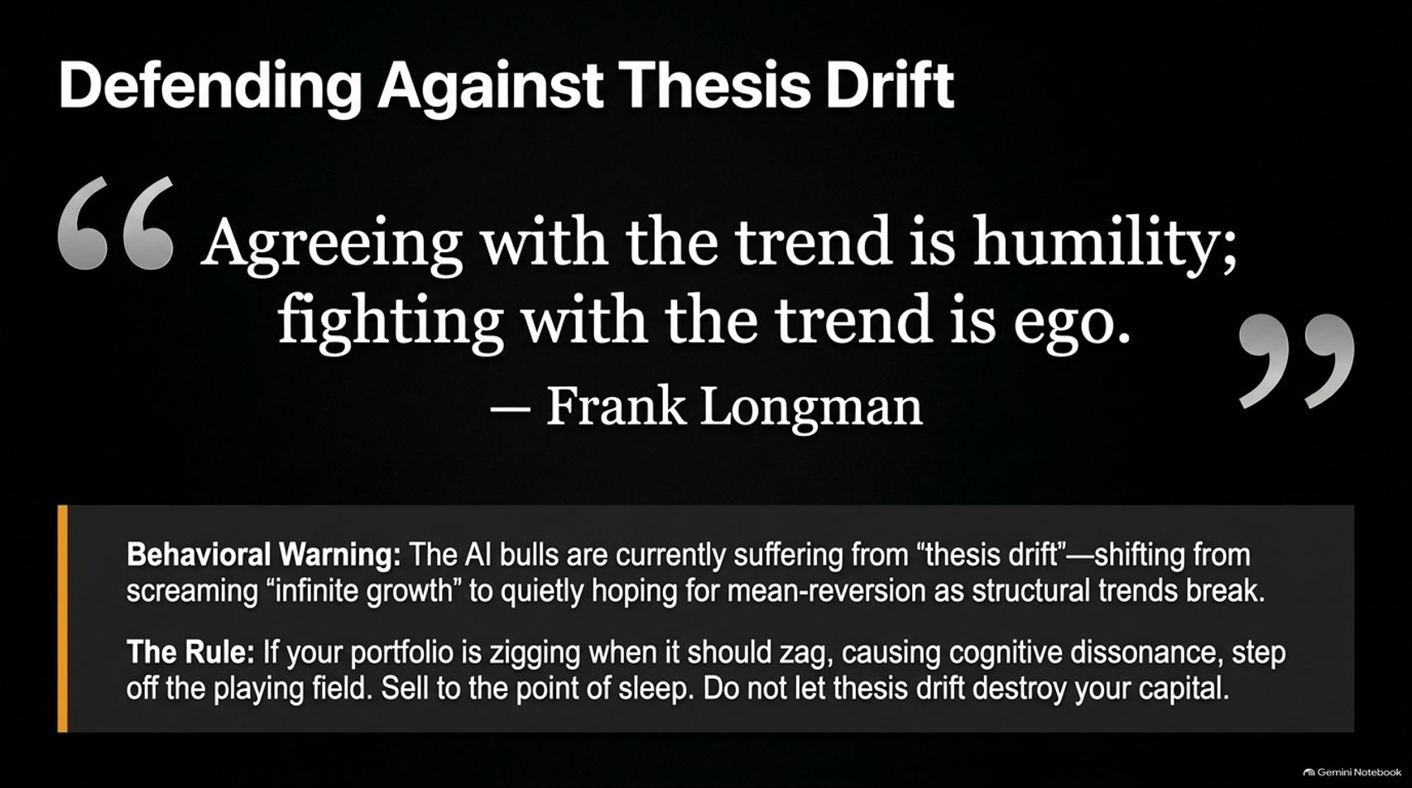
Notes:
Title: Defending Against Thesis Drift
Target Duration: 3–5 minutes
Speaker Notes:
"As Frank Longman noted: 'Agreeing with the trend is humility; fighting with the trend is ego.'
Behavioral Warning: AI bulls are currently suffering from 'thesis drift'—shifting from screaming 'infinite growth' to quietly hoping for mean-reversion as structural trends break.
The Rule: If your portfolio is zigging when it should be zagging, causing severe cognitive dissonance, step off the playing field. Sell to the point of sleep. Do not let thesis drift destroy your capital."

Slide 15

Notes:
Title: The Bottom Line
Target Duration: 3–5 minutes
Speaker Notes:
"In summary, the bottom line is clear:
Markets are aggressively pricing in a technological utopia while entirely ignoring a macroeconomic eclipse.
Capital constraints, physical reality, and tightening global liquidity are reasserting themselves with a vengeance.
Prepare for systemic debasement, prioritize defensive cash flows, and avoid acting as exit liquidity for the final cash out."

Slide 16

Notes:
Title: Tightening Macro Liquidity & The AI CapEx Reckoning
Target Duration: 4–6 minutes
Speaker Notes:
"Our concluding slide provides the master architecture of our thesis.
On the left, Macro Liquidity & Late-Cycle Indicators show the real economy absorbing capital, classic yield curve flattening, and the incoming Q1 refinancing squeeze.
On the right, The AI CapEx & Infrastructure Vulnerabilities highlight flawed monetization of free-tier models, hundreds of billions in unbacked off-balance-sheet liabilities, and nationwide municipal data center bans.
Recognize the convergence of these forces, protect your capital, and stay disciplined as the cycle turns."

