Slide 1
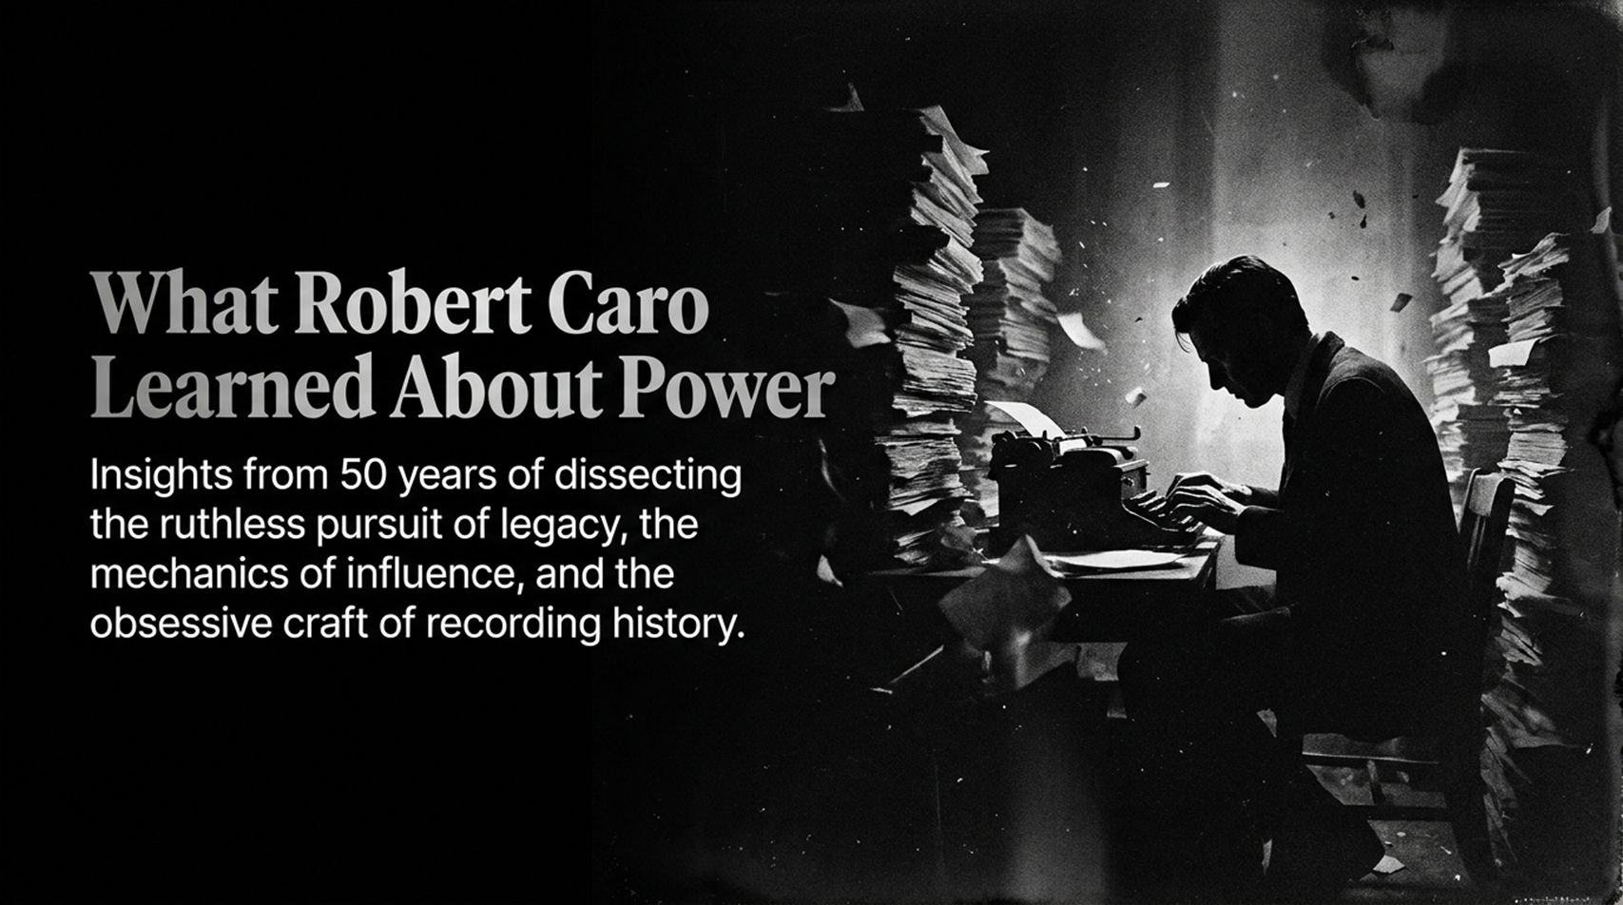
Notes:
Slide Duration: 2 – 3 minutes
Executive Takeaway: Introducing Robert Caro’s 50-year quest to decode how raw power operates, how institutions are manipulated, and what it takes to meticulously record political history.
Verbatim Talk Script:
"Good morning, everyone. Over the last fifty years, Robert Caro has done something extraordinary. While most historians look at power from a distance, Caro lived inside it—moving to the Texas Hill Country to understand the crushing poverty of young Lyndon Johnson, wading into municipal archives three levels down in the Hudson River boat basin, and tracking down everyone from high-powered fixers to campaign chauffeurs. Today, we are going to explore what Caro learned after half a century of dissecting the ruthless pursuit of legacy, the hidden mechanics of political influence, and the obsessive, agonizing craft of recording history. As Caro notes in his recent reflections, understanding power isn't about looking at the shiny surface of politics; it's about diving into the machinery beneath."
Video & Historical Reference: Drawing from the opening remarks of the interview discussing Caro's 50-year commitment, living in the Hill Country, and sifting through municipal archives.
Delivery Prompt: Pause for emphasis on '50 years.' Lean into the microphone slightly to set an intimate, storytelling tone.
What Robert Caro learned about power after studying it for 50 years
https://www.youtube.com/watch?v=f0J_EeW42Lo

Slide 2
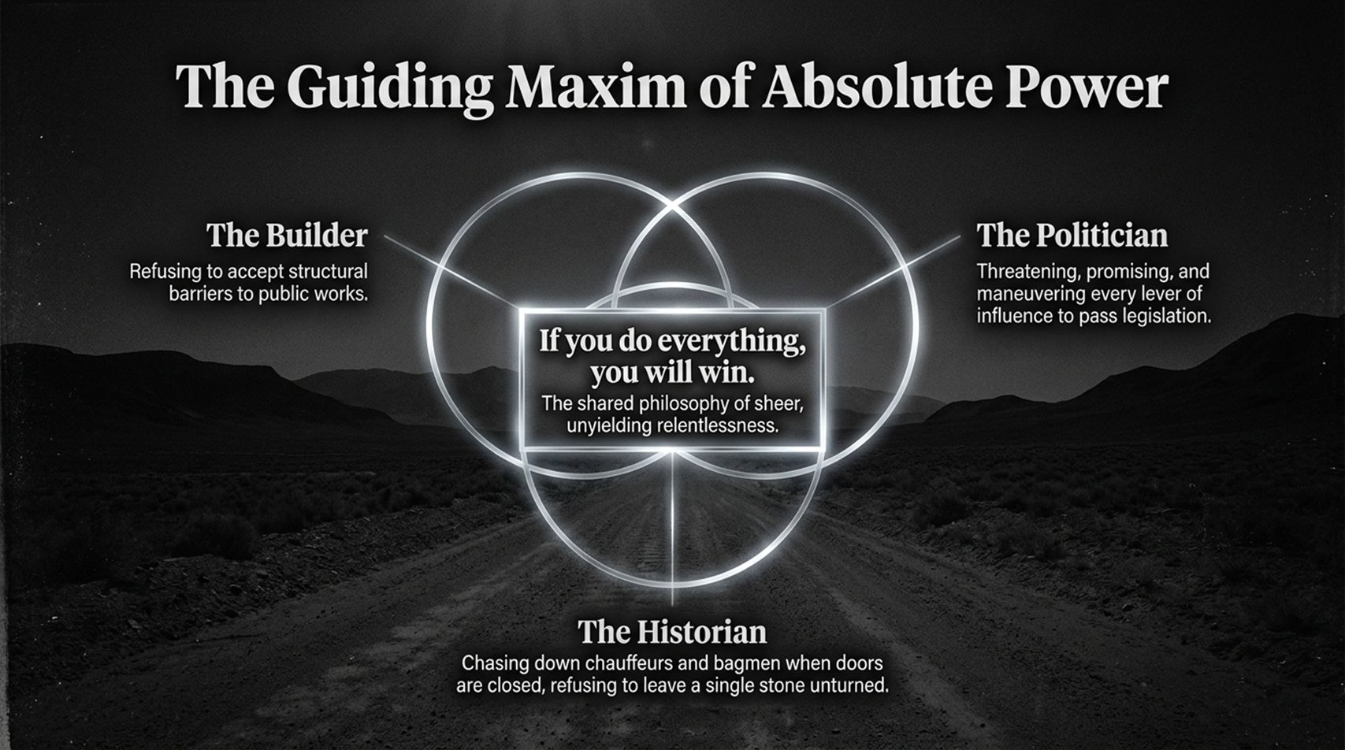
Notes:
Slide Duration: 3 – 4 minutes
Executive Takeaway: The unifying philosophy shared by master builders and master politicians alike: "If you do everything, you will win."
Verbatim Talk Script:
"If you study Robert Caro’s subjects—whether it’s Robert Moses reshaping New York City or Lyndon Johnson navigating the U.S. Senate—you encounter a single, relentless maxim: 'If you do everything, you will win.' What does that mean in practice? It means refusing to accept structural barriers, treating opposition not as a stop sign but as a puzzle to be solved, and chasing down every single lead when doors are slammed in your face. Both Moses and Johnson shared this unyielding relentlessness. They didn't just work hard; they outworked reality. They tracked the bagmen, they courted the chauffeurs, and they mastered every procedural lever until nobody else could compete."
Video & Historical Reference: Reference to the central thesis: "If you do everything, you will win, that is the maxim by which Lyndon Johnson lived his life...".
Delivery Prompt: Trace the Venn diagram visually with your hand from the Builder to the Politician and down to the Historian.

Slide 3
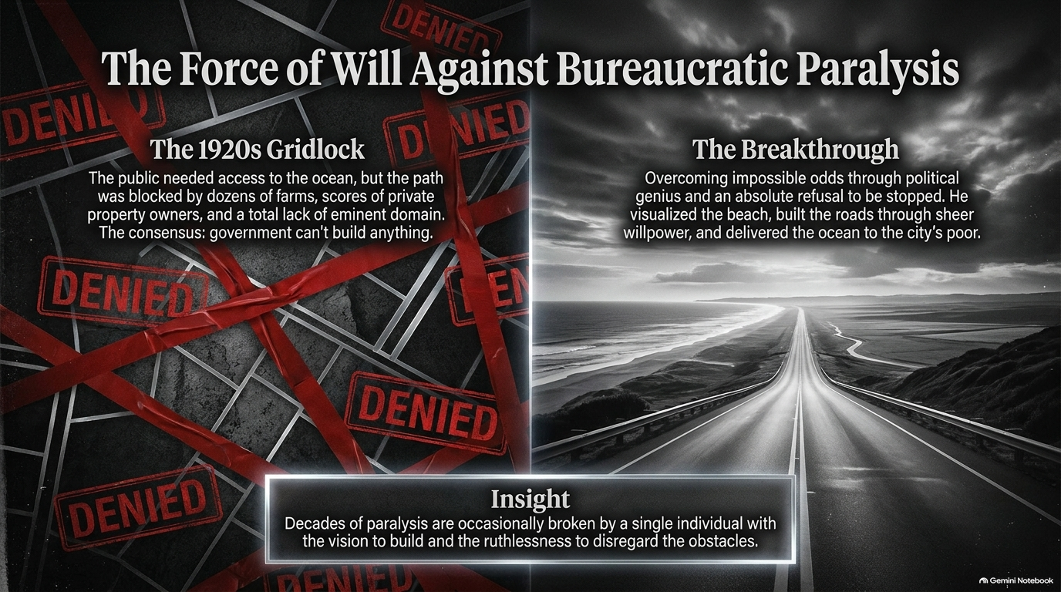
Notes:
Slide Duration: 3 – 5 minutes
Executive Takeaway: How systemic gridlock in the 1920s was shattered not by comfortable consensus, but by an individual's sheer, unyielding force of will.
Verbatim Talk Script:
"We often hear today that government can't build anything anymore—that environmental reviews, land-use boards, and community litigation have paralyzed us. People look at projects like the Second Avenue subway taking 50 years and costing billions, and they wonder if we've lost our capacity to execute. But Caro reminds us: when Robert Moses started in the 1920s, people were saying the exact same thing. They said government couldn't build highways because property owners would block them, farms were in the way, and eminent domain didn't exist. Yet Moses looked at a stretch of beach 27 miles from the city and said, 'I'm going to build a road there.' He didn't wait for permission; he forced reality to bend to his vision. It raises a profound question for modern democracies: How do we balance public safeguards with the sheer willpower required to build?"
Video & Historical Reference: Caro’s discussion on 1920s gridlock, Jones Beach, and public works versus modern infrastructure bottlenecks.
Delivery Prompt: Adopt a reflective tone when posing the democratic dilemma regarding modern infrastructure speed versus bureaucratic gridlock.

Slide 4
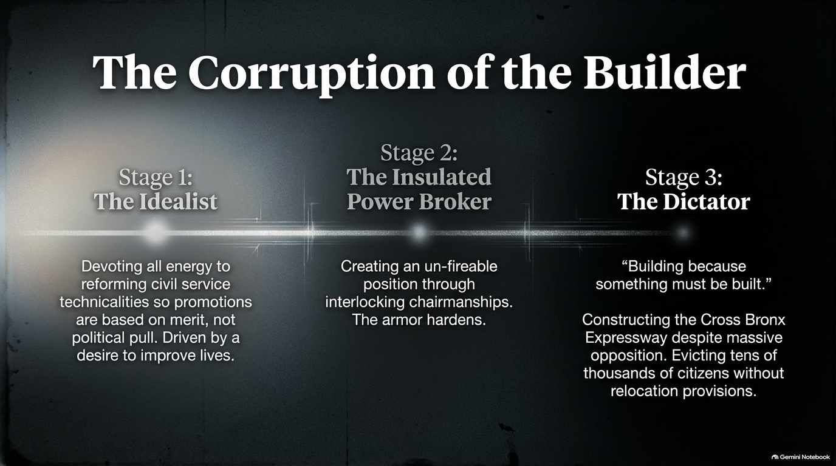
Notes:
Slide Duration: 4 – 5 minutes
Executive Takeaway: Tracing the dangerous evolutionary arc of authority: how a young idealist hardening against opposition transforms into an insulated dictator.
Verbatim Talk Script:
"One of the most tragic lessons in The Power Broker is how absolute authority corrupts not through sudden malice, but through a gradual hardening of the armor. Stage One is the Idealist: a young Robert Moses working tirelessly on civil service reform, fighting so that government promotions are based purely on merit rather than political pull. He wants to make life better for the poor by giving them access to beaches and parks. But as he faces relentless opposition, he enters Stage Two: the Insulated Power Broker, building interlocking chairmanships that make him unfireable. And finally, he reaches Stage Three: the Dictator. A man who builds simply because 'something must be built,' driving the Cross Bronx Expressway through vibrant neighborhoods, evicting tens of thousands of citizens without a shred of relocation planning, and creating the world's longest traffic jam the day it opened. Power doesn't just reveal character; it hardens it against human cost."
Video & Historical Reference: Caro detailing Moses's evolution from a young civil service reformer to the builder of the Cross Bronx Expressway.
Delivery Prompt: Step across the stage as you transition through the three distinct stages to visually mark the progression.

Slide 5
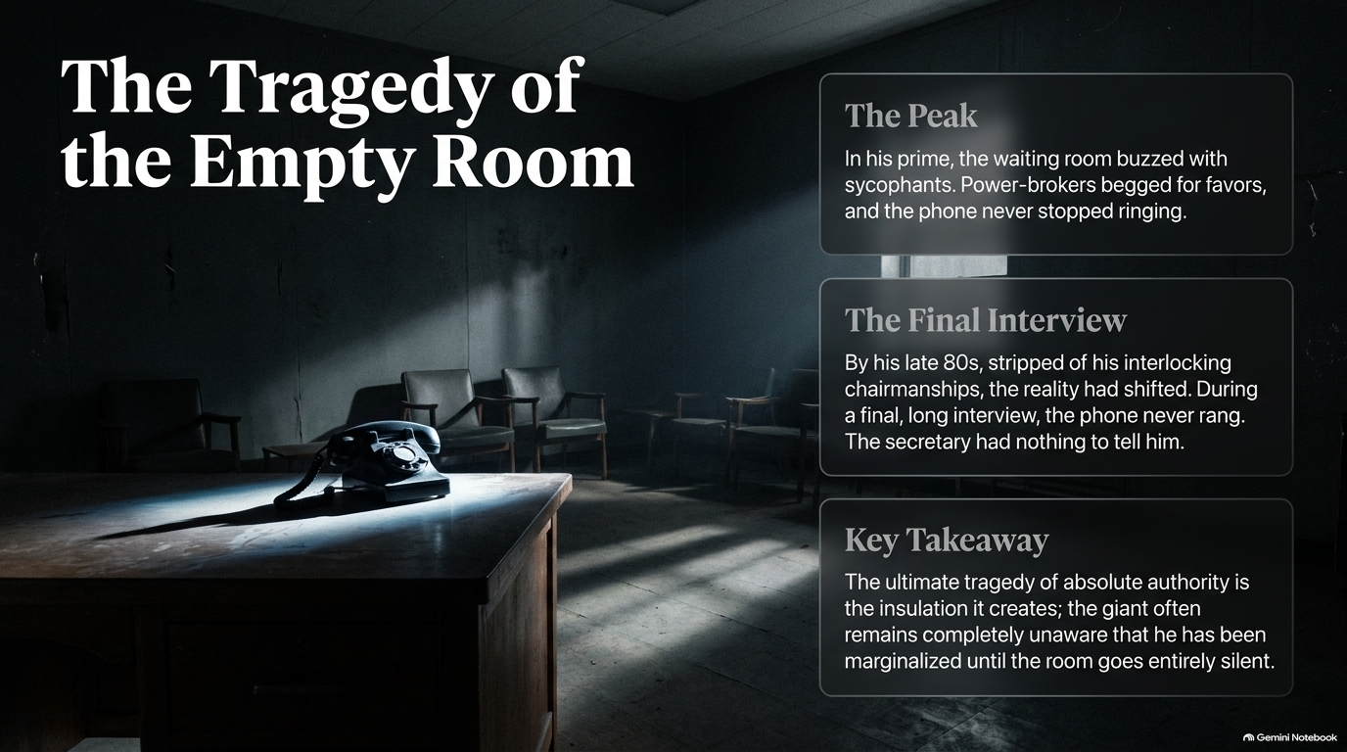
Notes:
Slide Duration: 3 – 4 minutes
Executive Takeaway: The ultimate irony of absolute power is the total isolation it creates, leaving the titan blind to his own marginalization until the phone stops ringing.
Verbatim Talk Script:
"Picture this scene: In his prime, Robert Moses sat in his Triboro Bridge office while the waiting room buzzed with sycophants, power-brokers begged for favors, and the phone never stopped ringing. But fast-forward to his late 80s. Stripped of his interlocking chairmanships by Governor Nelson Rockefeller, Moses sat down for a final, long interview. And something surreal happened: during the entire conversation, the phone never rang. The secretary had nothing to tell him. Caro describes the poignant tragedy of this moment. Moses was so profoundly insulated by his own myth and surrounded by loyalists who still treated him with deference that he never fully realized he had been marginalized. The giant remained trapped in silence, continuing to push for projects in a world that had already moved on."
Video & Historical Reference: The vivid recounting of Caro's final interview with Moses at the Triboro Bridge headquarters.
Delivery Prompt: Lower your voice slightly and pause for two full seconds before delivering the line 'the phone never rang.'

Slide 6
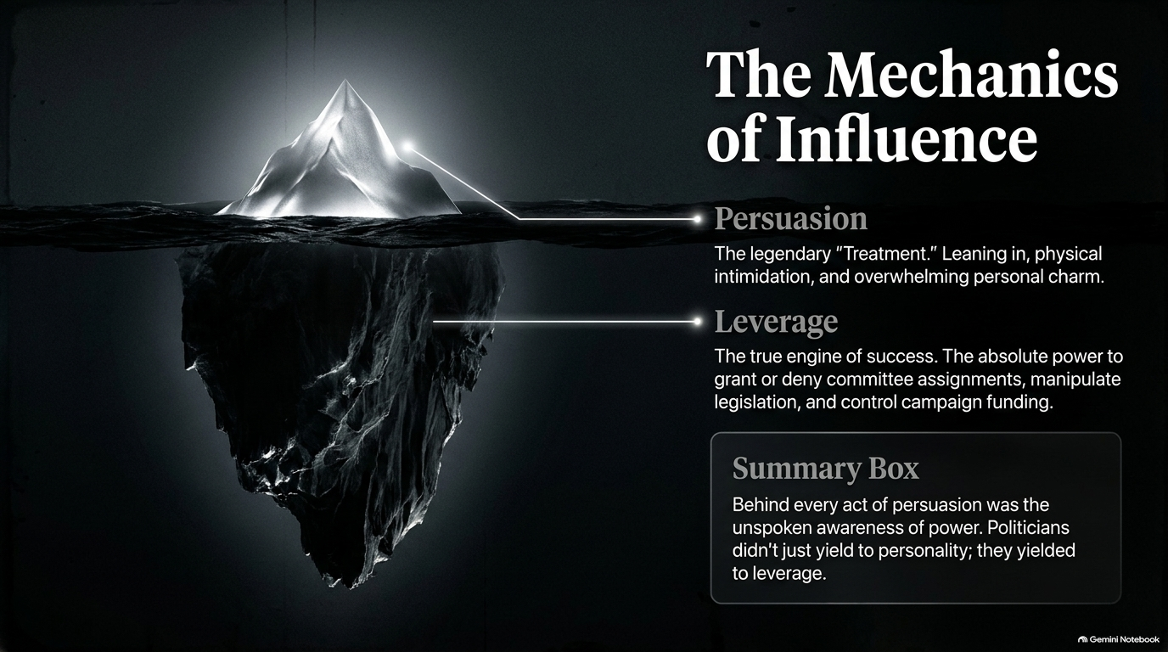
Notes:
Slide Duration: 3 – 5 minutes
Executive Takeaway: True political power does not rest on charm or persuasion alone; it rests on raw institutional leverage—the absolute ability to grant or deny favors.
Verbatim Talk Script:
"When we look at political giants like Lyndon Johnson, we often attribute their success to personal charm—the legendary 'Treatment,' where Johnson would physically lean in, tower over opponents, and use overwhelming personal presence to win them over. But Caro uncovers a deeper truth: persuasion is just the tip of the iceberg. Beneath the surface lies the true engine of success—leverage. When Johnson put his arm around a senator, everyone in the room knew he held the power to grant or deny committee assignments, steer federal projects, or manipulate campaign funding. Politicians didn't just yield to his personality; they yielded to his leverage. If you want to understand influence, look past the charisma and examine who holds the keys to everyone else's survival."
Video & Historical Reference: Caro's analysis of Lyndon Johnson in Master of the Senate, detailing how persuasion is backed by institutional leverage.
Delivery Prompt: Use an iceberg gesture with your hands to separate the visible 'Persuasion' from the submerged 'Leverage.'

Slide 7
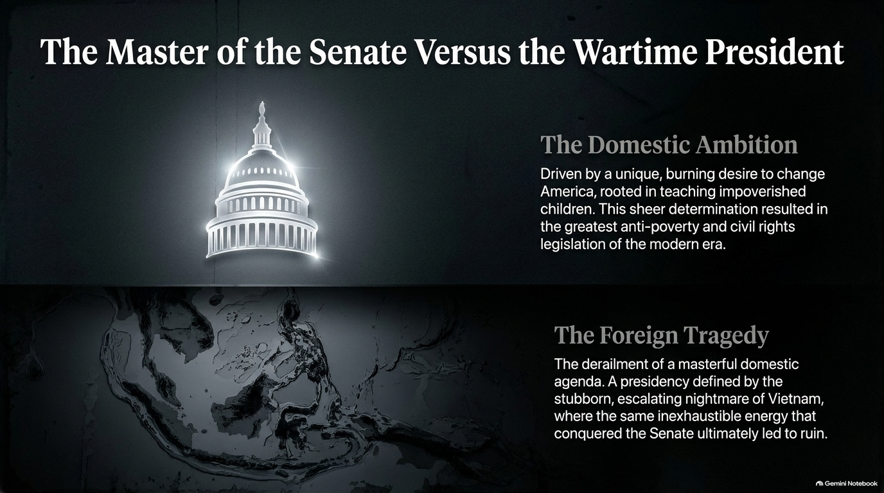
Notes:
Slide Duration: 4 – 6 minutes
Executive Takeaway: The exact same inexhaustible energy and political genius that conquered domestic legislation can lead to catastrophic ruin when applied blindly to foreign quagmires.
Verbatim Talk Script:
"Lyndon Johnson was a man of staggering contradictions. On the domestic front, his ambition was rooted in a profound, burning desire to change America—driven by memories of teaching impoverished children in the Texas Hill Country. That sheer determination made him the Master of the Senate and enabled him to pass the greatest civil rights and anti-poverty legislation of the modern era. Yet, that very same inexhaustible energy and refusal to back down became a foreign tragedy. When applied to the escalating nightmare of Vietnam, Johnson's stubborn refusal to admit defeat or alter course destroyed his presidency. The traits that made him a domestic titan became the very instruments of his undoing. It stands as a timeless warning: the strengths that elevate a leader can become fatal flaws if unchecked by humility."
Video & Historical Reference: The discussion comparing Johnson's domestic legislative triumphs with the tragedy of the Vietnam escalation.
Delivery Prompt: Use contrasting hand movements—one side representing the Capitol dome, the other representing the jungle terrain of Vietnam.

Slide 8
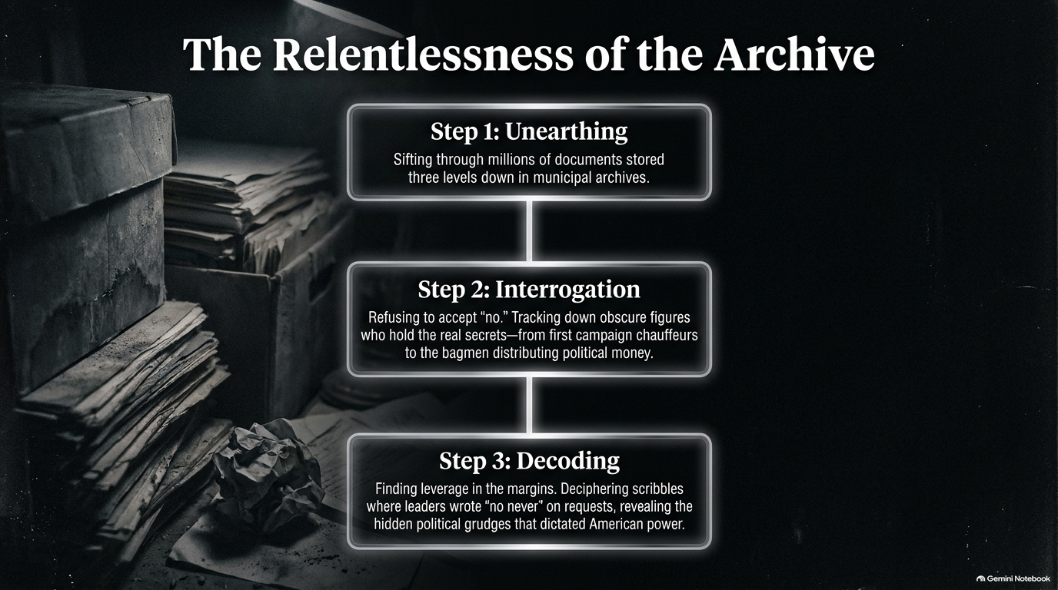
Notes:
Slide Duration: 3 – 4 minutes
Executive Takeaway: True historical research cannot be rushed or digitized away; it requires physical unearthing, ruthless interrogation, and decoding the margins of power.
Verbatim Talk Script:
"How do you uncover how power actually works? Robert Caro’s methodology gives us the blueprint. Step One is Unearthing: sifting through millions of forgotten documents stored three levels down in municipal basements. Step Two is Interrogation: refusing to take 'no' for an answer. When people told Caro they wouldn't grant an interview, he tracked down campaign chauffeurs and bagmen distributing political money because he knew they held the real secrets. And Step Three is Decoding: finding leverage in the margins. Caro found documents where politicians asked Lyndon Johnson for money, and Johnson scrawled cryptic notes like 'No never.' By decoding those grudges, Caro exposed the hidden architecture of American power."
Video & Historical Reference: Caro’s stories of searching the 79th Street boat basin archives and interviewing John Connolly about political cash.
Delivery Prompt: Speak with methodical rhythm, emphasizing the three steps: Unearthing, Interrogation, Decoding.

Slide 9
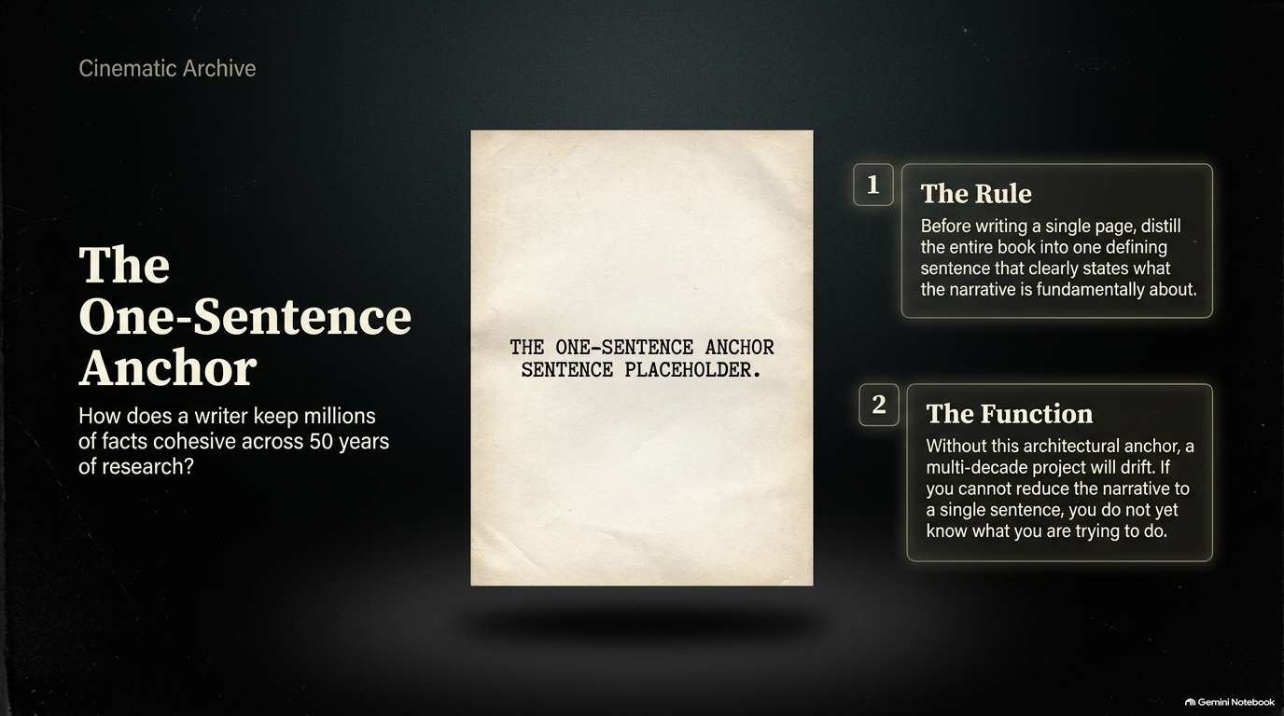
Notes:
Slide Duration: 3 – 4 minutes
Executive Takeaway: To manage millions of facts across decades of research, a writer must distill their entire narrative into a single, unyielding anchor sentence.
Verbatim Talk Script:
"How does a writer keep millions of facts cohesive across 50 years of research without getting lost in the labyrinth of history? Caro learned this lesson the hard way. Before writing a single page of a new book, he forces himself to distill the entire project into one defining sentence that clearly states what the narrative is fundamentally about. Without this architectural anchor, a multi-decade project will inevitably drift. As Caro puts it, if you cannot reduce your core narrative to a single sentence, you do not yet know what you are trying to do. It’s a powerful lesson for any complex undertaking: clarity of purpose must precede execution."
Video & Historical Reference: Caro explaining his method of using a one-sentence anchor before starting a manuscript to avoid narrative drift.
Delivery Prompt: Tap your index finger on the podium to emphasize the necessity of the single guiding sentence.

Slide 10
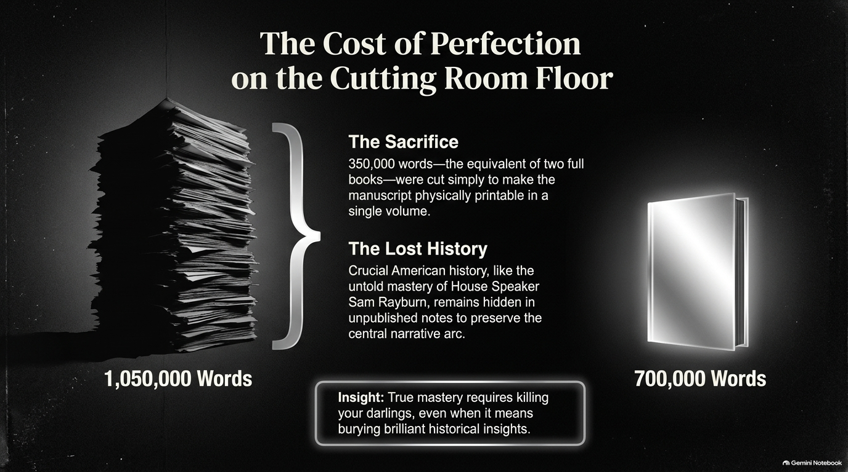
Notes:
Slide Duration: 3 – 5 minutes
Executive Takeaway: True mastery requires 'killing your darlings'—sacrificing hundreds of thousands of words of brilliant research to preserve the central narrative arc.
Verbatim Talk Script:
"Perfection has a brutal price. When Robert Caro handed his manuscript for The Power Broker to his editor, Robert Gottlieb, the draft was 1,050,000 words long. To make the book physically printable in a single volume, they had to cut 350,000 words—the equivalent of two full books. Think about that: brilliant chapters, rich historical portraits like the untold mastery of House Speaker Sam Rayburn, were left out to preserve the central narrative arc. Caro admits it is tragic that much of that history remains hidden in unpublished notes. But true mastery requires killing your darlings, even when it means burying brilliant insights for the sake of the work's structural integrity."
Video & Historical Reference: Caro discussing cutting 350,000 words from The Power Broker manuscript with his editor Robert Gottlieb.
Delivery Prompt: Use visual scale with your hands to contrast the massive stack of words versus the published book.

Slide 11
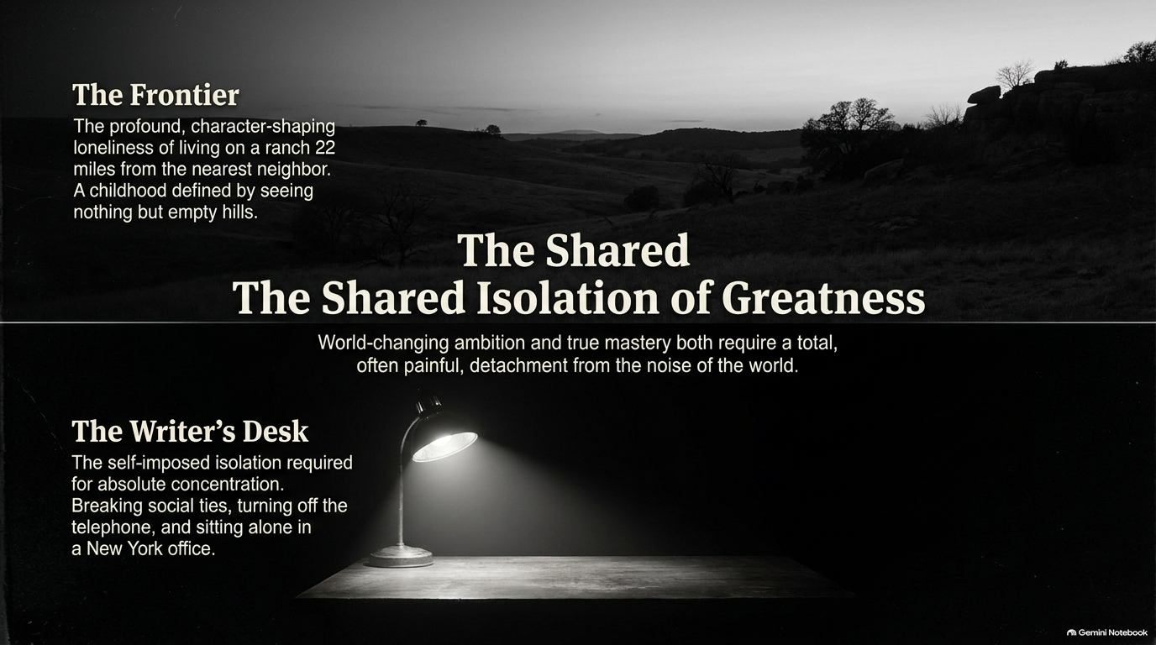
Notes:
Slide Duration: 3 – 4 minutes
Executive Takeaway: World-changing ambition and rigorous scholarship both demand a total, often painful detachment from the noise of the modern world.
Verbatim Talk Script:
"There is a fascinating parallel between the subjects Caro writes about and Caro himself: the shared isolation of greatness. Lyndon Johnson was shaped by the profound, character-defining loneliness of growing up on a Texas ranch 22 miles from the nearest neighbor, where his mother could walk up a hill and see nothing but empty hills. Similarly, Robert Caro imposes strict isolation on himself in his New York office—turning off the phone, cutting off social ties, and refusing to chat so he can achieve absolute concentration. World-changing ambition and true mastery both require a total, often painful detachment from the noise of the world. Greatness is forged in silence."
Video & Historical Reference: Caro reflecting on his daily routine of turning off his phone and comparing it to the frontier loneliness of Lyndon Johnson’s upbringing.
Delivery Prompt: Soften your voice and speak deliberately to capture the introspective, quiet atmosphere of the writer's desk.

Slide 12

Notes:
Slide Duration: 3 – 4 minutes
Executive Takeaway: Prioritizing accessibility and public stewardship over financial gain ensures that raw historical archives continue to educate future generations.
Verbatim Talk Script:
"When it came time to house his life's work, Robert Caro made a monumental decision. He turned down highly lucrative offers from regional institutions to house his archives at the New York Historical Society for significantly less money—an amount that mattered deeply to him. Why? Because of access. Over 700 detailed, typed interview notes capturing voices that can never be interviewed again must remain easily accessible in New York to anyone trying to understand power. While Caro's published books explain the past to us today, his meticulously preserved, unseen archives provide the raw material for generations of future historians to uncover the rest of the story."
Video & Historical Reference: Caro explaining why he donated his archives to the New York Historical Society instead of taking higher bids elsewhere.
Delivery Prompt: Convey a sense of legacy and generosity as you describe the archiving decision.

Slide 13
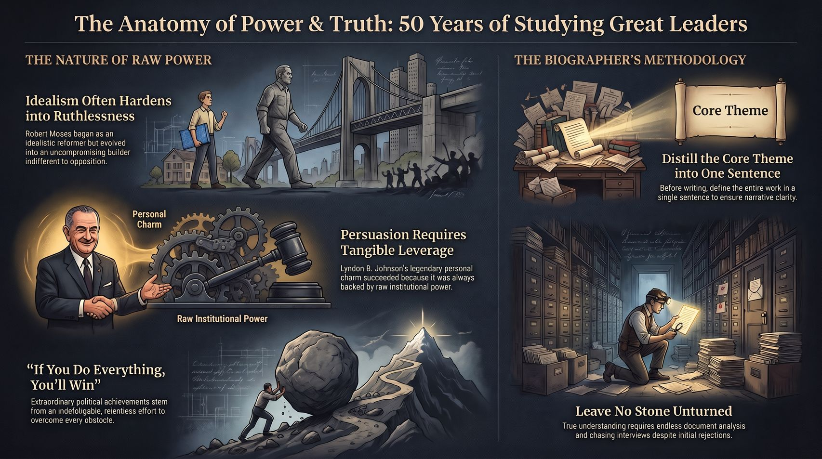
Notes:
Slide Duration: 4 – 6 minutes
Executive Takeaway: Synthesizing fifty years of historical inquiry: idealism hardens into ruthlessness, persuasion requires leverage, and ultimate truth demands relentless persistence.
Verbatim Talk Script:
"As we bring this journey together, we look at the complete anatomy of power and truth that Robert Caro has spent fifty years mapping out. We've seen how idealism hardens into ruthlessness when vision outgrows empathy. We've seen that true persuasion is hollow without the institutional leverage backing it up. We've learned that extraordinary achievements require an indefatigable, relentless effort to overcome every obstacle—encapsulated in that single maxim: 'If you do everything, you will win.' And above all, we have learned the biographer's ultimate methodology: distill your core theme into a single sentence, and leave no stone unturned in pursuit of the truth. Robert Caro didn't just write biographies of powerful men; he gave us a permanent lens through which to examine how power works, how it corrupts, and how it shapes our world. Thank you."
Video & Historical Reference: Comprehensive synthesis of the overarching themes from the interview regarding Robert Moses, Lyndon Johnson, and historical methodology.
Delivery Prompt: Stand tall, make direct eye contact with the audience, and deliver the final thank you with a warm, resolute cadence.

