Slide 1
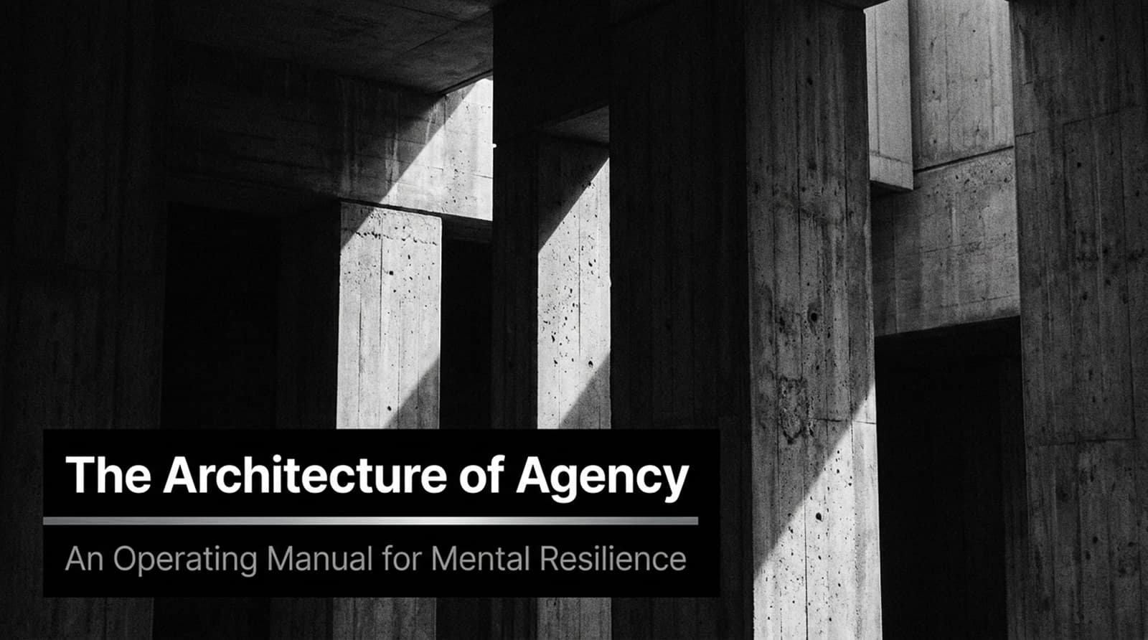
Notes:
Core Topic: Introduction to Mental Resilience as an Operating System
Good morning, everyone, and welcome. Today, we are exploring a vital operating manual for high performance: The Architecture of Agency: An Operating Manual for Mental Resilience.
If you look at the title slide, it establishes our core premise: resilience isn't an innate personality trait you're simply born with; it is an architectural structure. Just as physical buildings require robust pillars and foundations to withstand external loads, human agency requires deliberate mental frameworks to navigate stress, uncertainty, and friction without collapsing. Over the next 16 slides, we are going to dissect the exact mechanics of mental strength, moving from reactive emotional loops to calculated, value-driven execution. Let's begin.
Build an Unbreakable Mindset 💪 | Full Audiobook for Mental Strength, Discipline & Success
https://www.youtube.com/watch?v=TkzBwPVCYGg

Slide 2
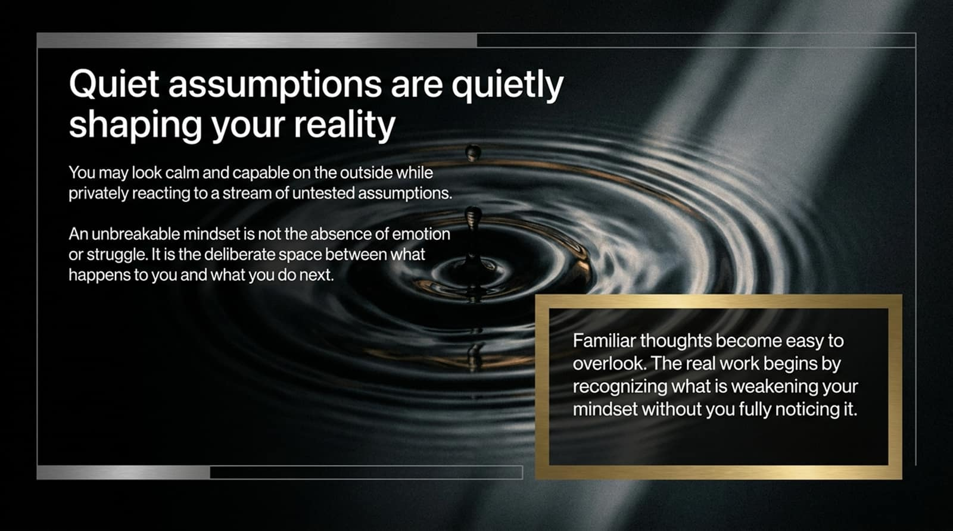
Notes:
Core Topic: Untested Assumptions and the Space Between Stimulus and Action
Let’s start with a foundational truth: Quiet assumptions are quietly shaping your reality.
You may look calm, composed, and capable on the outside while privately reacting to a relentless stream of untested internal assumptions. An unbreakable mindset is never the total absence of emotion or struggle; rather, it is the deliberate, engineered space between what happens to you and what you choose to do next.
As the callout highlights: Familiar thoughts become easy to overlook. The real work begins by recognizing what is weakening your mindset without you fully noticing it. Uncovering these silent scripts is the first step toward true agency.

Slide 3
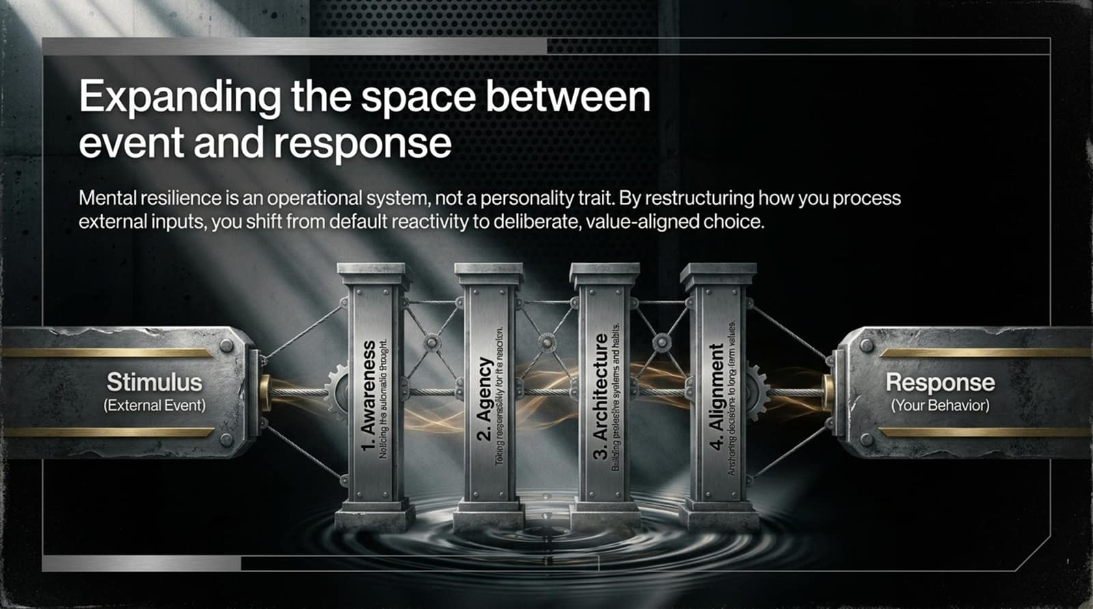
Notes:
Core Topic: The Four Pillars: Awareness, Agency, Architecture, and Alignment
How do we structurally expand that crucial space? Look at the four-pillar architecture illustrated on this slide:
1. Awareness: Noticing the automatic thought before it hijacks your behavior.
2. Agency: Taking full responsibility for the reaction rather than blaming external circumstances.
3. Architecture: Building proactive systems and habits that make good choices the default.
4. Alignment: Anchoring daily decisions to long-term core values.
Mental resilience is an operational system. By restructuring how you process external inputs, you shift permanently from default reactivity to deliberate, value-aligned choice.

Slide 4
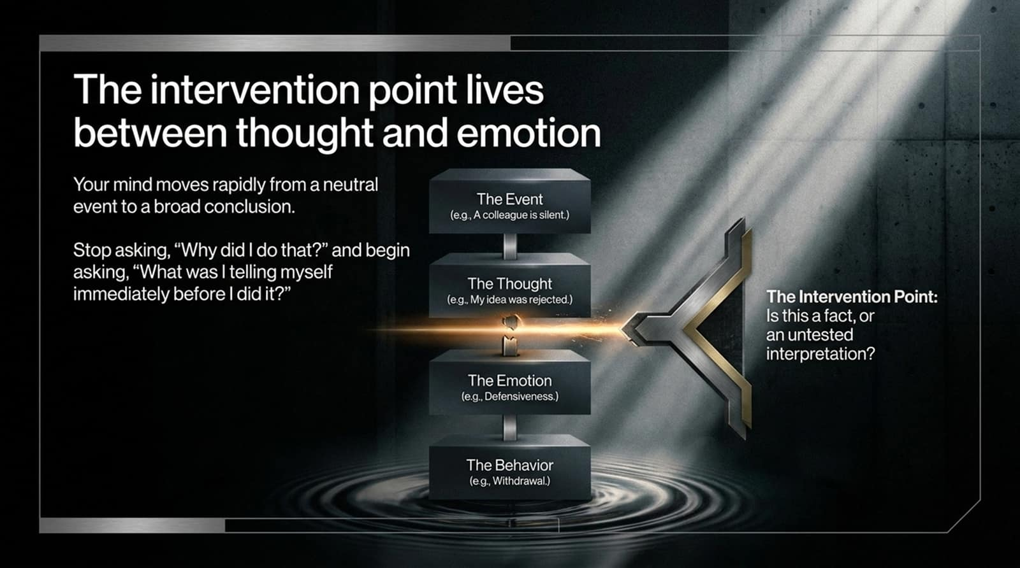
Notes:
Core Topic: The Event-Thought-Emotion-Behavior Chain and Interrogating Interpretations
Your mind moves with terrifying speed from a neutral event straight to a broad emotional conclusion. Look at the vertical chain on this slide:
The Event: (e.g., A colleague remains silent during a pitch).
The Thought: (e.g., 'My idea was completely rejected and they think I'm incompetent').
The Emotion: (Defensiveness, anxiety, or resentment).
The Behavior: (Withdrawal, snapping, or shutting down).
Stop asking, 'Why am I like this?' and begin asking, 'What was I telling myself immediately before I acted?' The Intervention Point is right there between thought and emotion, where you ask: Is this an objective fact, or an untested interpretation?

Slide 5
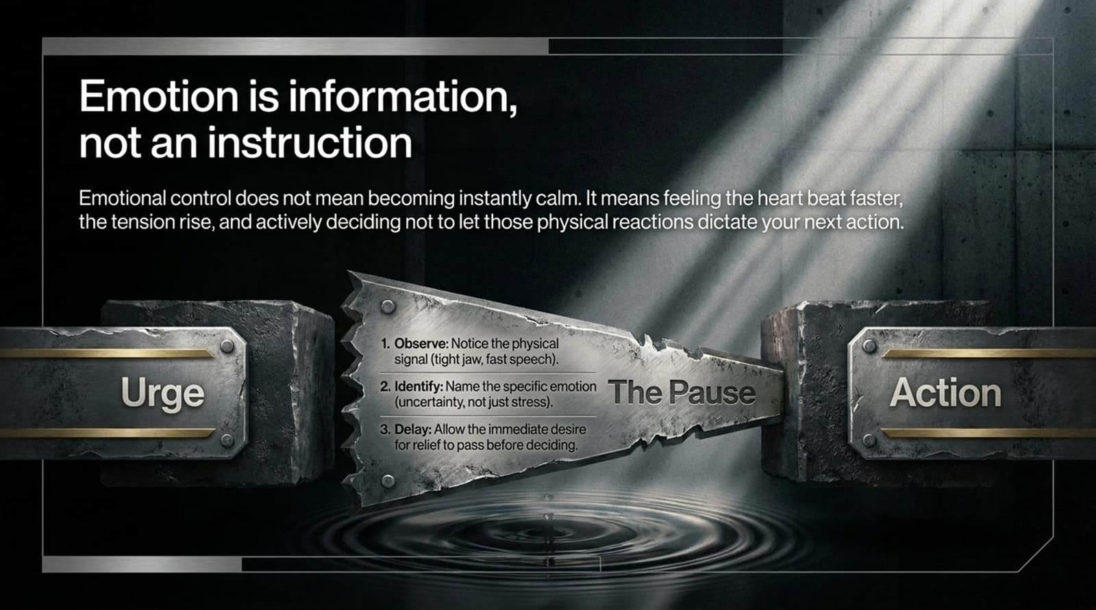
Notes:
Core Topic: Physiological Arousal, The Pause, and Delayed Reaction
A core tenet of mental architecture is recognizing that Emotion is information, not an instruction.
Emotional control does not mean becoming an unfeeling robot or feeling instantly calm. It means feeling your heart beat faster, noticing the physical tension rising, and actively deciding not to let those raw physical reactions dictate your next action.
Follow the three-step pause protocol:
Observe: Notice the physical signal (tight jaw, shallow breathing).
Identify: Name the specific emotion accurately (uncertainty, not general stress).
Delay: Allow the immediate desire for relief to pass before deciding.

Slide 6
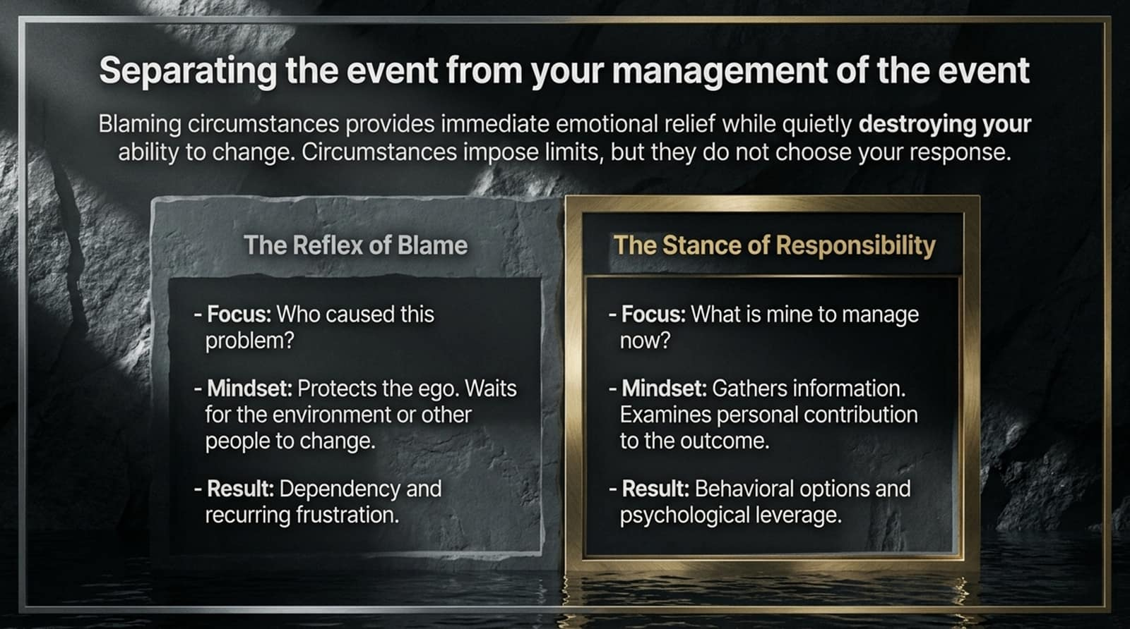
Notes:
Core Topic: The Reflex of Blame vs. The Stance of Responsibility
When setbacks occur, we face a crucial fork in the road: blame the environment or take ownership.
The Reflex of Blame: Focuses on 'Who caused this problem?' It protects the ego short-term while waiting passively for external conditions or other people to change. Result: Chronic dependency and recurring frustration.
The Stance of Responsibility: Focuses on 'What is mine to manage right now?' It gathers objective data and examines personal contribution to the outcome. Result: Behavioral options and immense psychological leverage.
Blaming circumstances provides temporary emotional relief while quietly destroying your power to change your life.

Slide 7
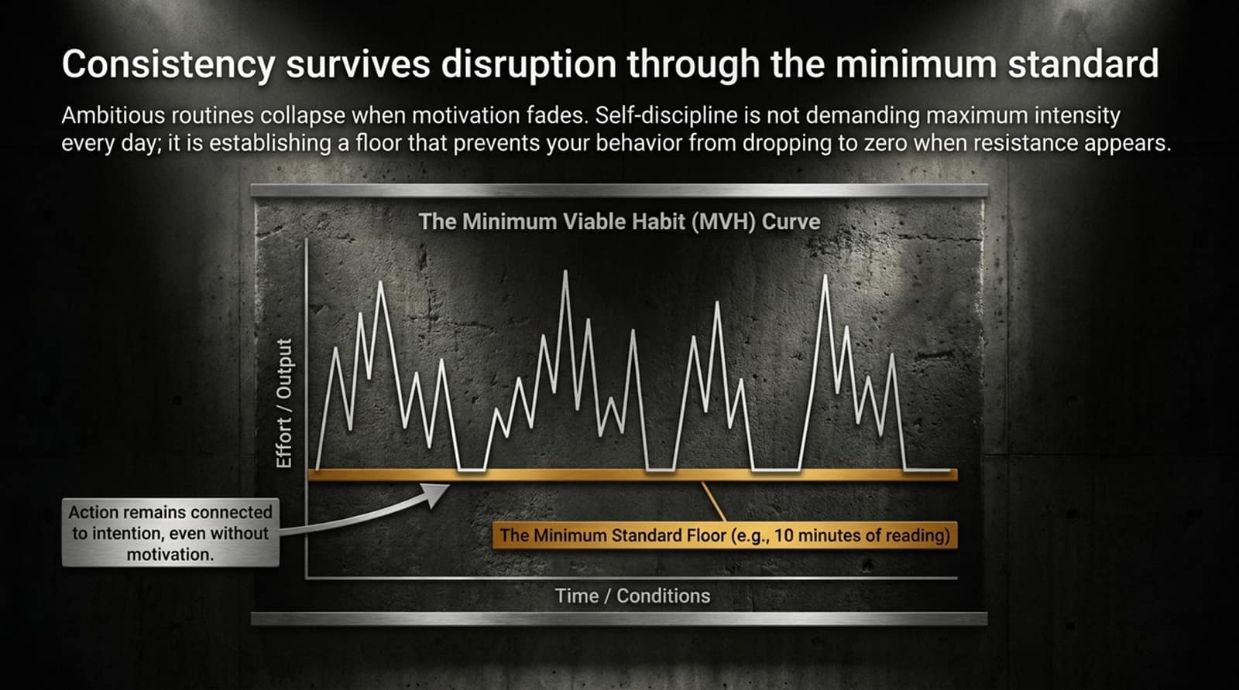
Notes:
Core Topic: The Minimum Viable Habit (MVH) Curve and Avoiding the Zero Floor
Ambitious routines and New Year's resolutions inevitably collapse when motivation fades and life gets chaotic. Look at The Minimum Viable Habit (MVH) Curve on this slide:
Self-discipline is not demanding maximum intensity every single day; it is establishing a floor that prevents your behavior from dropping to zero when resistance appears.
Notice the gold floor line on the chart: even when output fluctuates wildly due to external conditions, maintaining a tiny baseline standard (e.g., 10 pages of reading, 5 minutes of mobility work) ensures your action remains connected to your intention without relying on fleeting motivation.

Slide 8
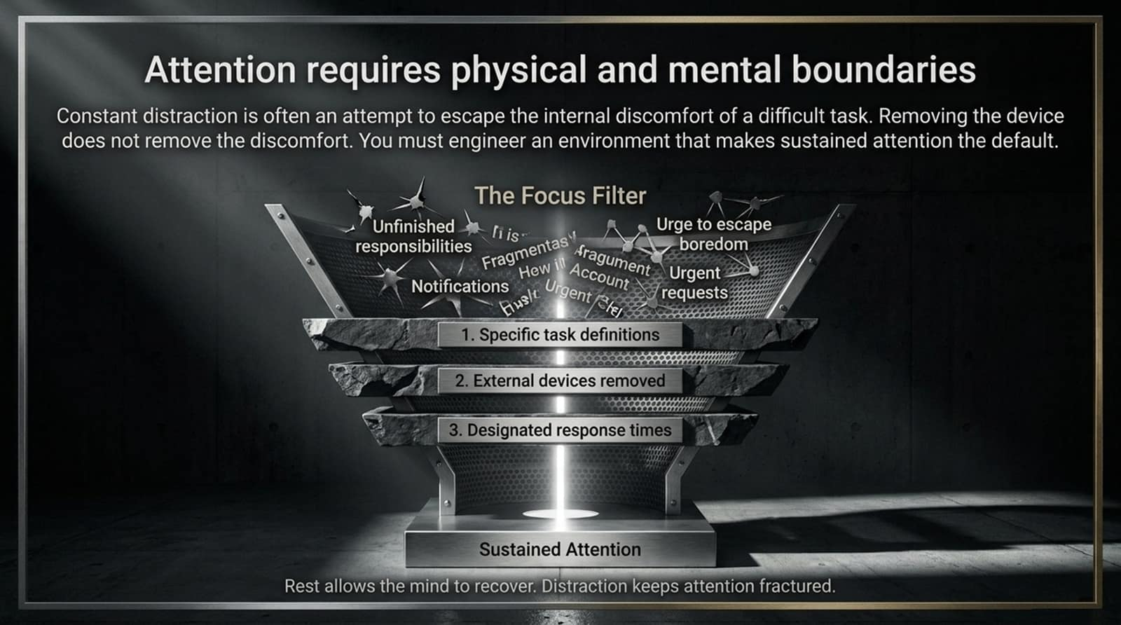
Notes:
Core Topic: The Focus Filter, Environmental Design, and Sustained Attention
Constant distraction is rarely a time-management problem; it is almost always an attempt to escape the internal discomfort of a difficult, cognitively demanding task. Removing your phone from the desk does not remove that internal discomfort.
Look at the Focus Filter funnel on this slide:
Unfinished responsibilities, notifications, and the urge to escape boredom bombard our working memory.
To achieve sustained attention, you must build a 3-tier barrier: (1) Specific task definitions, (2) External devices removed, and (3) Designated response times. Rest allows the mind to recover; constant distraction keeps attention permanently fractured.

Slide 9
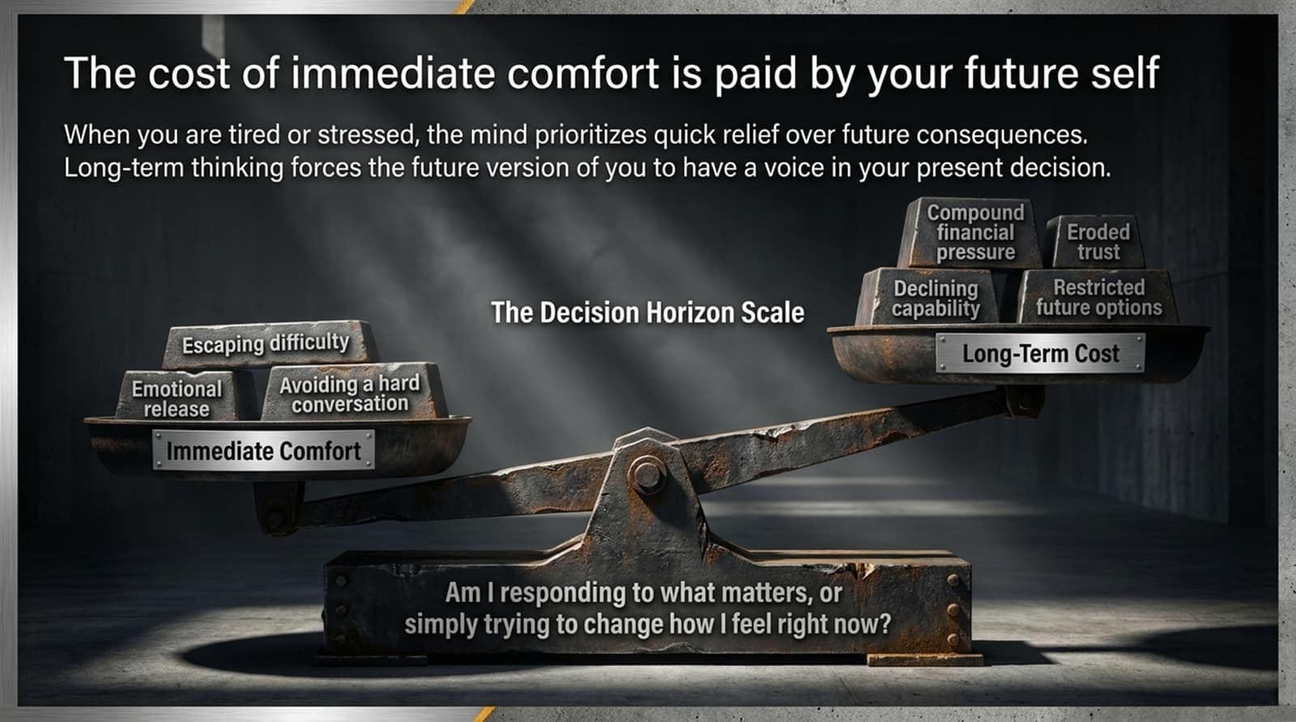
Notes:
Core Topic: Decision Horizon Scale, Short-Term Relief vs. Long-Term Compound Costs
When you are tired, stressed, or overwhelmed, your brain naturally prioritizes quick emotional relief over future consequences. Look at The Decision Horizon Scale on this slide:
On the left pan, we put immediate comfort: escaping difficulty, seeking emotional release, or avoiding a hard conversation. On the right pan sits the long-term cost: compound financial pressure, declining capability, eroded trust, and restricted future options.
Long-term thinking forces the future version of you to have a voice in your present decision. Always ask yourself: Amis responding to what actually matters, or simply trying to change how I feel right now?

Slide 10
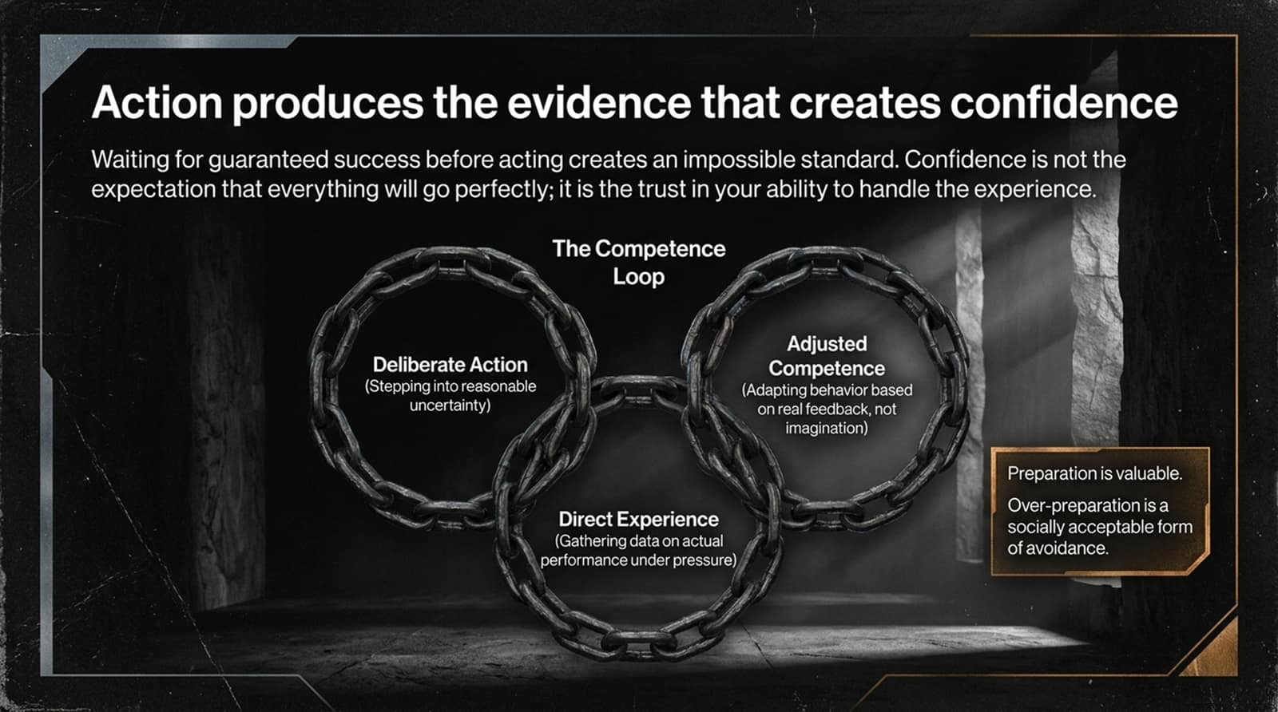
Notes:
Core Topic: The Competence Loop and Over-Preparation as Avoidance
Waiting for guaranteed confidence before taking action creates an impossible, paralyzing standard. Confidence is not the naive expectation that everything will go perfectly; it is trust in your ability to handle the experience.
Look at The Competence Loop interlocking chain on this slide:
Deliberate Action: Stepping into reasonable uncertainty.
Direct Experience: Gathering hard data on actual performance under pressure.
Adjusted Competence: Adapting behavior based on real feedback, not abstract imagination.
Remember: Over-preparation is often just a socially acceptable form of psychological avoidance.

Slide 11
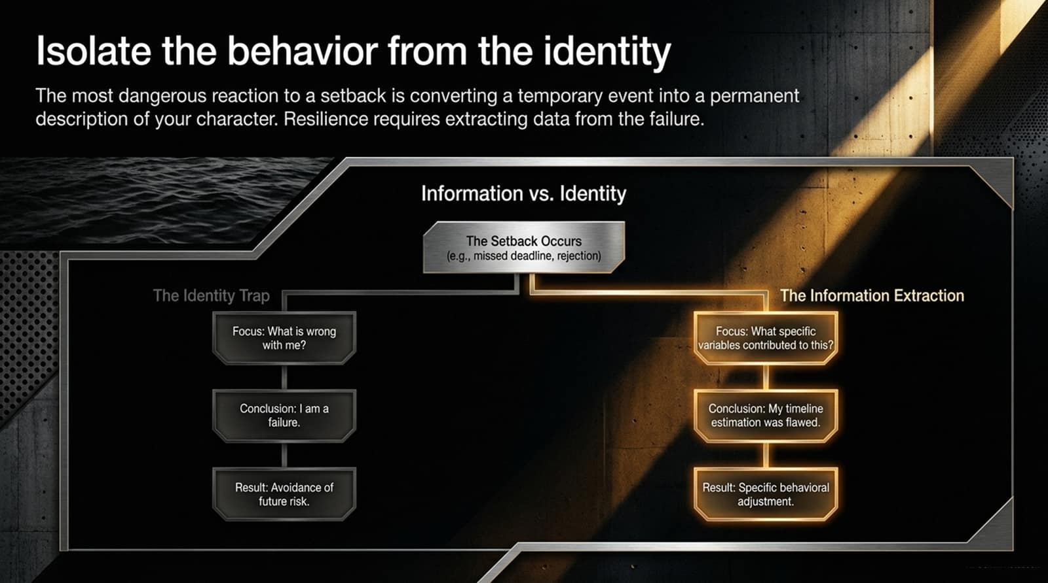
Notes:
Core Topic: The Identity Trap vs. Information Extraction
The most dangerous reaction to a setback—such as a missed deadline, a rejected pitch, or a failed project—is converting a temporary event into a permanent indictment of your character.
The Identity Trap: Asks 'What is wrong with me?' Leads to the conclusion 'I am a failure,' which results in the avoidance of future risk and growth.
The Information Extraction: Asks 'What specific variables contributed to this outcome?' Leads to the conclusion 'My timeline estimation or strategy was flawed,' which results in precise behavioral adjustments.
Resilience requires extracting cold data from failure, not warm emotional suffering.

Slide 12

Notes:
Core Topic: Stated Values vs. Revealed Priorities
Values are not abstract ideals you admire in quiet moments; they are priorities that you are actively willing to practice and protect under pressure. If your schedule continuously absorbs whatever external demands shout the loudest, your life is organized by urgency, not importance.
Stated Values: What you say matters when you are isolated from pressure and friction.
Revealed Priorities: What you actually choose when discomfort, competing demands, and fatigue arrive.
A goal tells you where you want to arrive. A value determines what you are unwilling to become along the way.

Slide 13
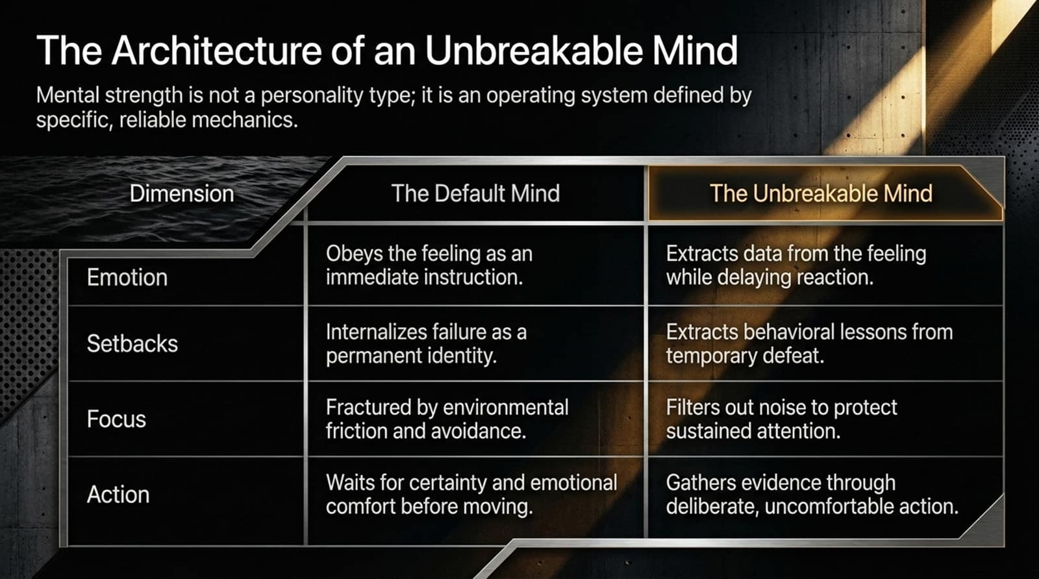
Notes:
Core Topic: Comprehensive Matrix of Default Mind vs. Unbreakable Mind
Let’s review the complete structural contrast summarized in this matrix:
Emotion: The Default Mind obeys feelings as immediate instructions. The Unbreakable Mind extracts data from the feeling while delaying reaction.
Setbacks: The Default Mind internalizes failure as a permanent identity. The Unbreakable Mind extracts behavioral lessons from temporary defeat.
Focus: The Default Mind is fractured by environmental friction and avoidance. The Unbreakable Mind filters out noise to protect sustained attention.
Action: The Default Mind waits for certainty and emotional comfort. The Unbreakable Mind gathers evidence through deliberate, uncomfortable action.

Slide 14
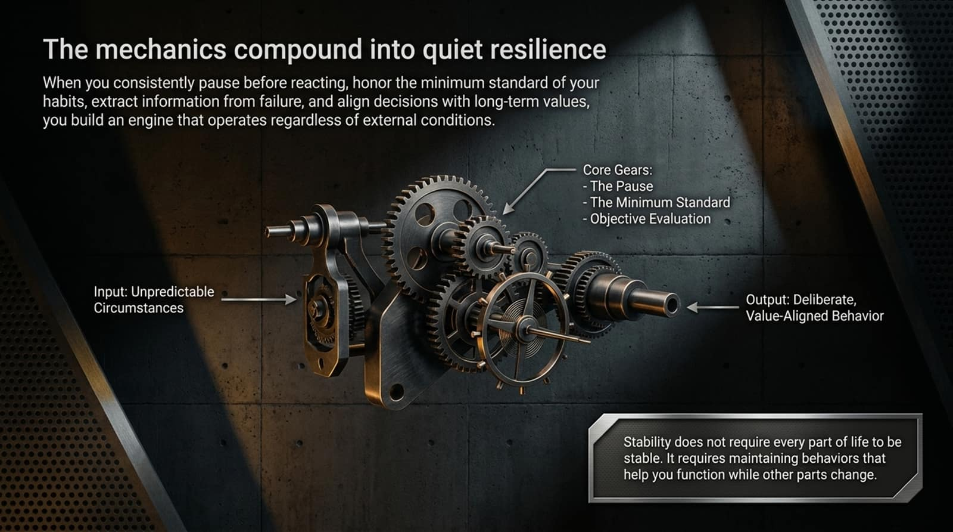
Notes:
Core Topic: The Gear System: Pause, Minimum Standard, and Objective Evaluation
When you assemble these individual mechanics, they compound into an unstoppable engine of quiet resilience. Look at the clockwork gear mechanism illustrated on this slide:
Input: Unpredictable, chaotic external circumstances.
Core Gears: The Pause, The Minimum Standard, and Objective Evaluation.
Output: Deliberate, value-aligned behavior.
Stability does not require every part of your life to be calm or predictable at once. True stability requires maintaining internal behavioral standards that help you function effectively while external conditions change.

Slide 15
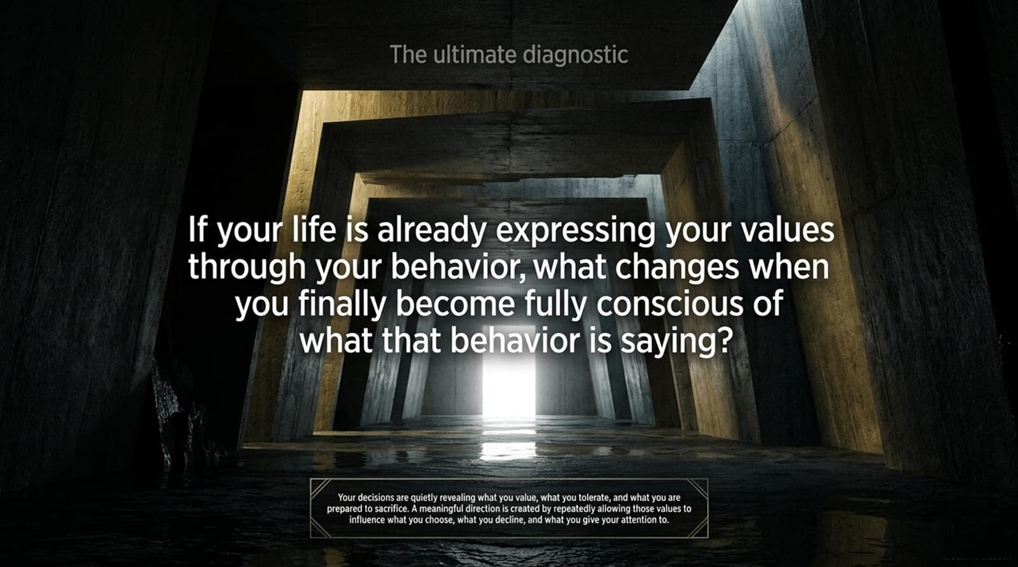
Notes:
Core Topic: Conscious Behavior and the Ultimate Reflective Question
As we look down this corridor toward the light on this slide, consider the ultimate diagnostic question:
If your life is already expressing your values through your daily behavior, what changes when you finally become fully conscious of what that behavior is saying?
Your decisions are quietly revealing what you value, what you tolerate, and what you are prepared to sacrifice. Meaningful direction is created by repeatedly allowing those core values to influence what you choose, what you decline, and where you invest your attention.

Slide 16
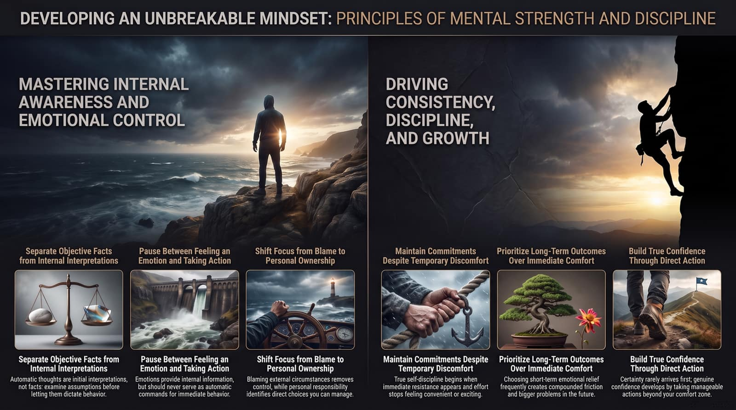
Notes:
Core Topic: Summary of Internal Awareness, Emotional Control, and Discipline
To wrap up our operating manual, this summary dashboard encapsulates our journey:
Master internal awareness by separating objective facts from emotional interpretations.
Drive consistency through minimum standards, prioritizing long-term horizons over immediate comfort.
Build bulletproof confidence through direct action.
Thank you for your time today. Go build your architecture of agency.

