Slide 1
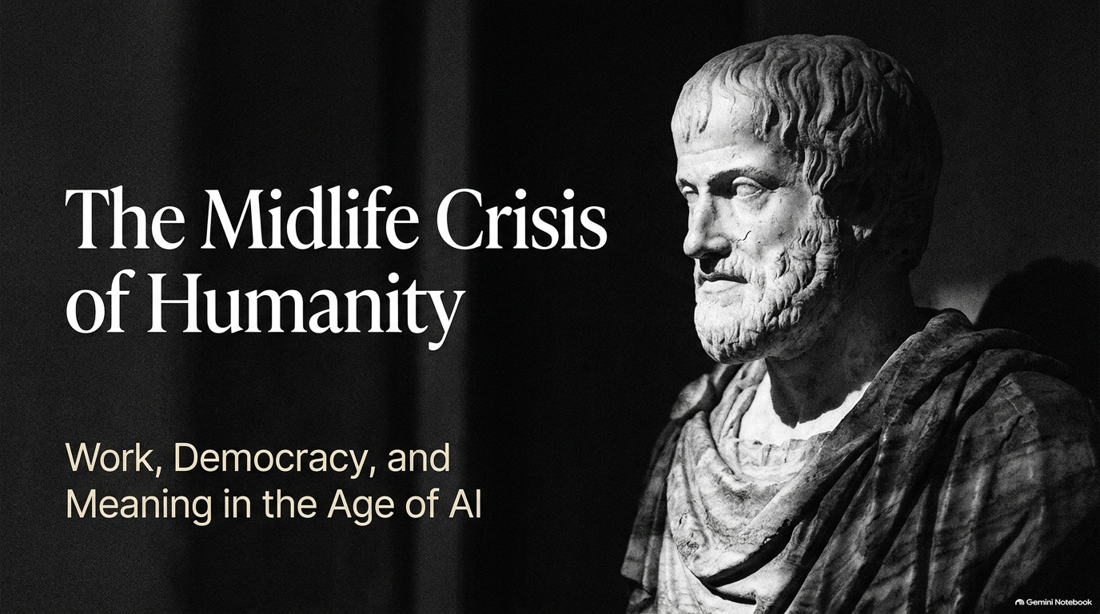
Notes:
How to Prepare for AGI | NYU Philosopher Harvey Lederman
https://www.youtube.com/watch?v=zejWiuHu3VU

Slide 2
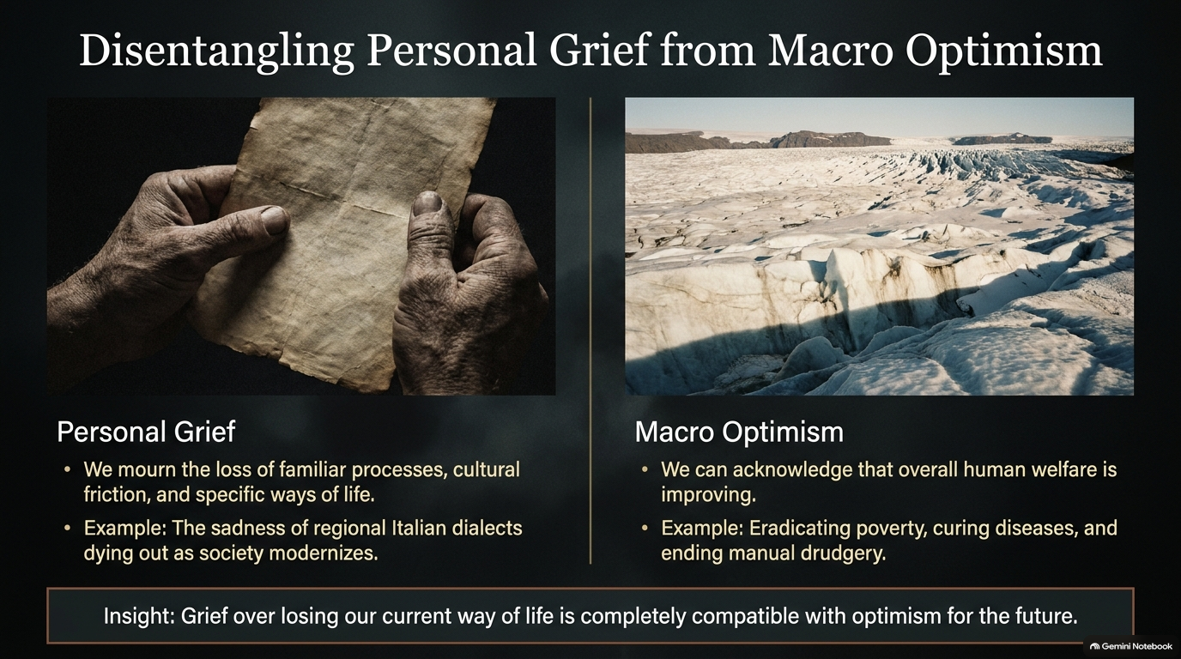

Slide 3
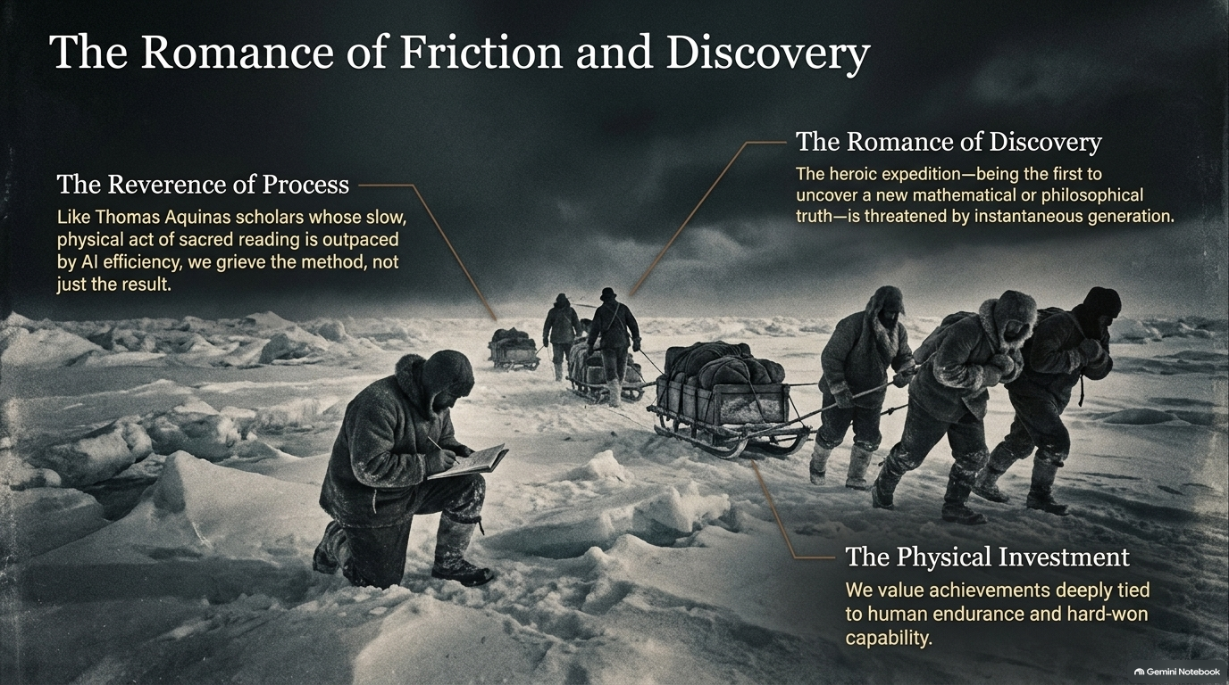

Slide 4


Slide 5
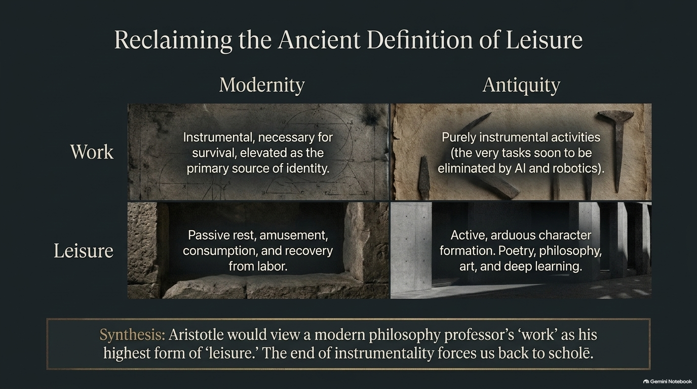

Slide 6


Slide 7


Slide 8
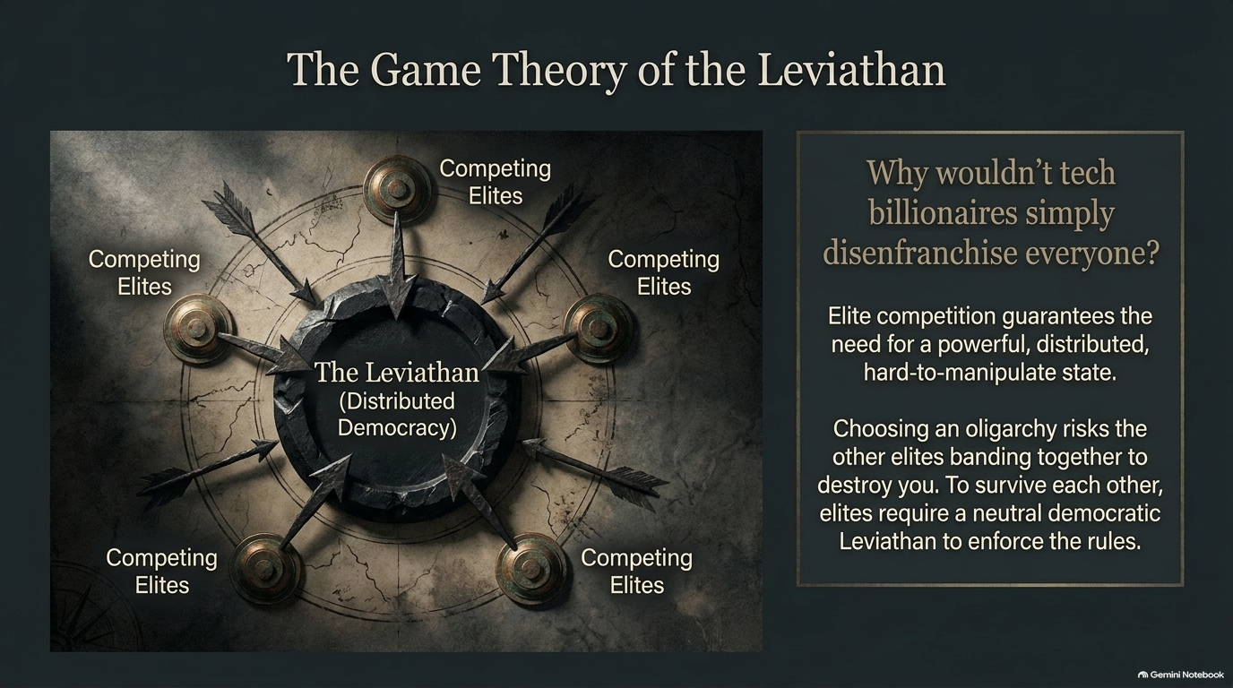

Slide 9


Slide 10
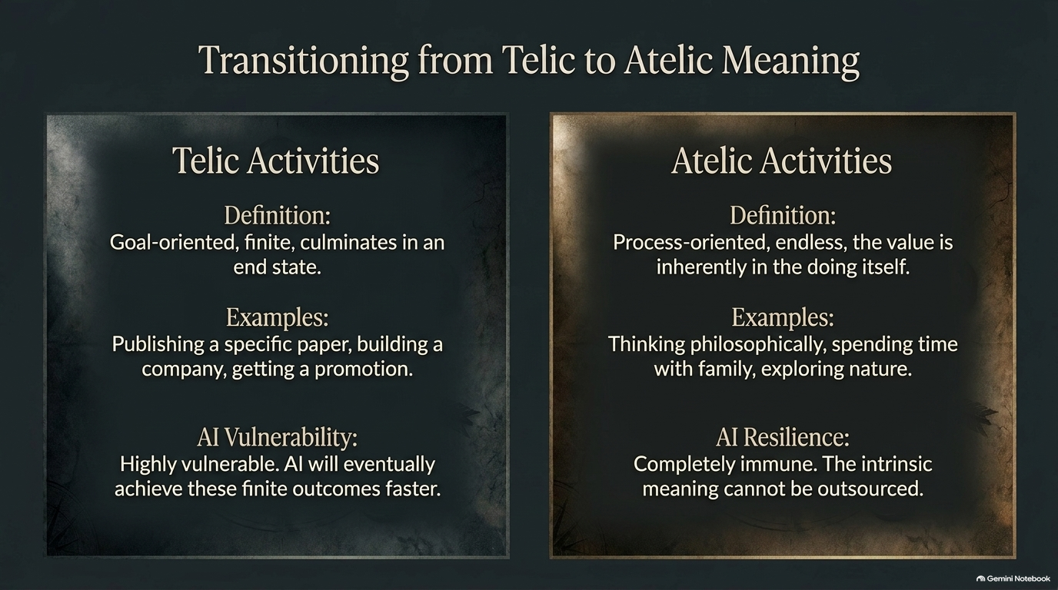

Slide 11


Slide 12
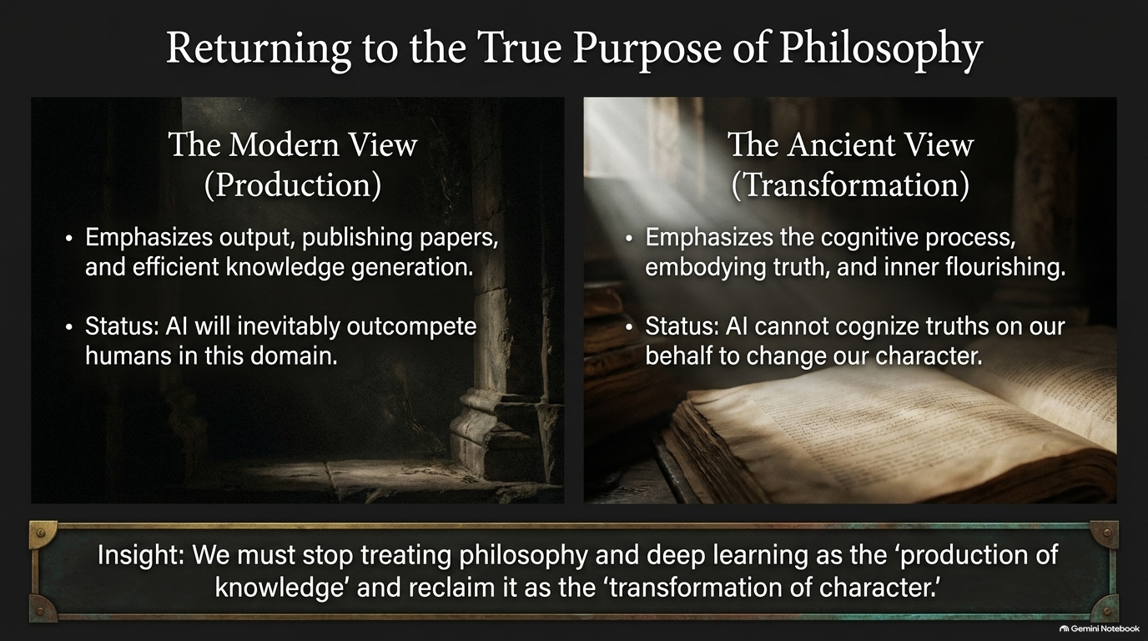

Slide 13


Slide 14
